Slide 1
Upper & Lower Bounds
Upper & Lower Bounds
SAM
2H Q18
June 2017
2H Q7
June 2018
2H Q21
Spec 1
2H Q22
June 2017
3H Q17
Nov 2018
2H Q9
Spec 1
3H Q2
Nov 2017
1H Q13
Nov 2018
2H Q18
Spec 2
2H Q17
Nov 2017
3H Q5
June 2019
2H Q6
Spec 2
3H Q4
Nov 2017
3H Q16
June 2019
3H Q19

Slide 2
Upper & Lower Bounds
SAM 2H Q18

Slide 3
Upper & Lower Bounds
SAM 2H Q18
A

Slide 4
Upper & Lower Bounds
Specimen Set 1 2H Q22

Slide 5
Upper & Lower Bounds
Specimen Set 1 2H Q22
A

Slide 6
Upper & Lower Bounds
Specimen Set 1 3H Q2

Slide 7
Upper & Lower Bounds
Specimen Set 1 3H Q2
A

Slide 8
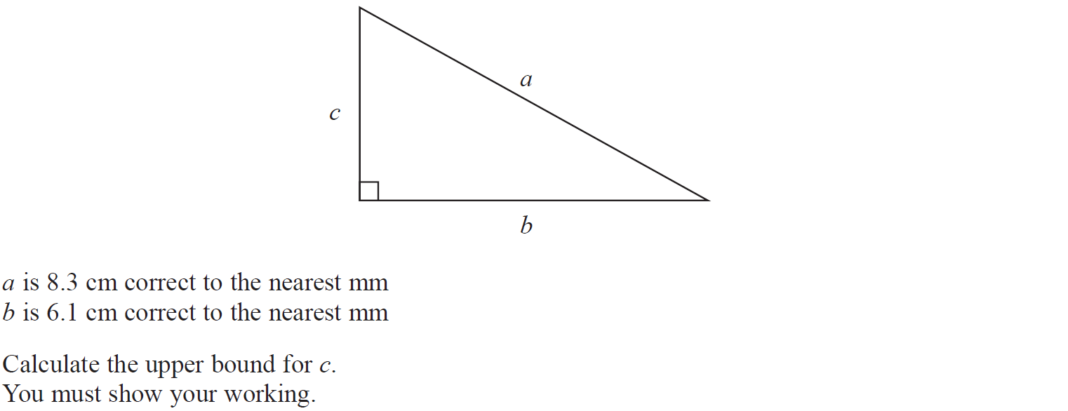
Upper & Lower Bounds
Specimen Set 2 2H Q17

Slide 9
Upper & Lower Bounds
Specimen Set 2 2H Q17
A

Slide 10
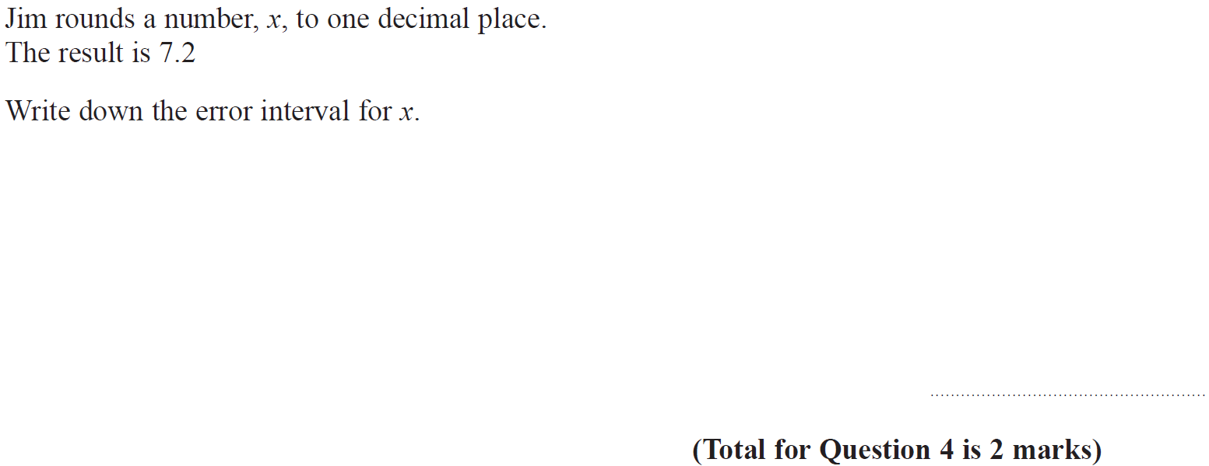
Upper & Lower Bounds
Specimen Set 2 3H Q4

Slide 11
Upper & Lower Bounds
Specimen Set 2 3H Q4
A

Slide 12
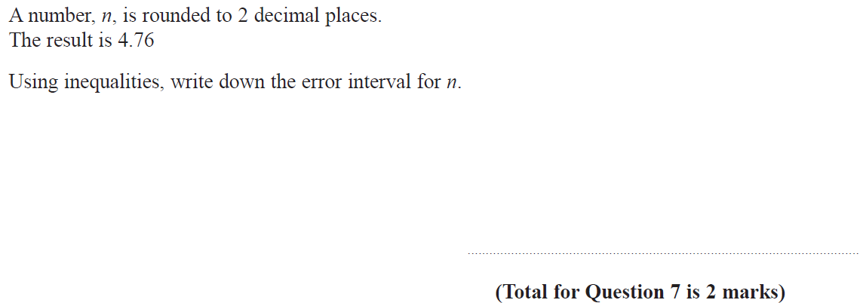
Upper & Lower Bounds
June 2017 2H Q7

Slide 13
Upper & Lower Bounds
June 2017 2H Q7
A

Slide 14
Upper & Lower Bounds
June 2017 3H Q17

Slide 15
Upper & Lower Bounds
June 2017 3H Q17
A
B

Slide 16
Upper & Lower Bounds
Nov 2017 1H Q13

Slide 17
Upper & Lower Bounds
Nov 2017 1H Q13
A

Slide 18
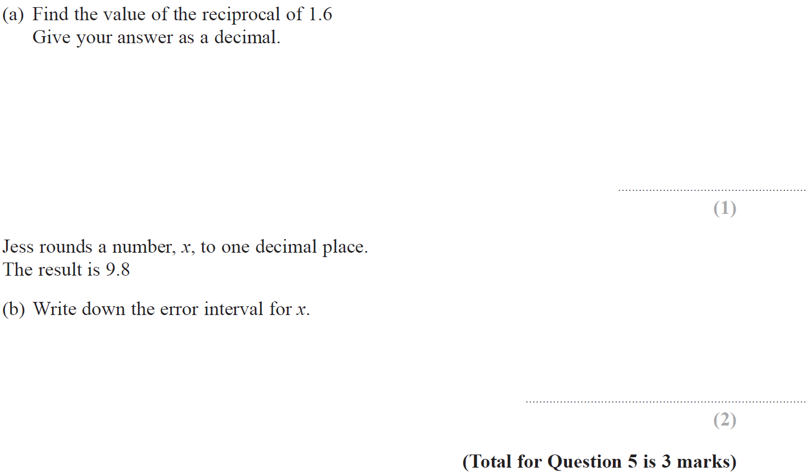
Upper & Lower Bounds
Nov 2017 3H Q5

Slide 19
Upper & Lower Bounds
Nov 2017 3H Q5
A
B

Slide 20
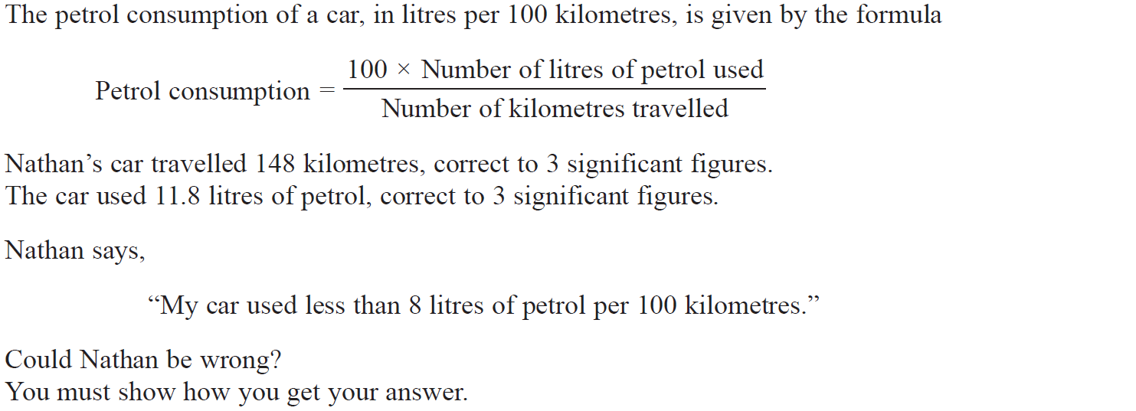
Upper & Lower Bounds
Nov 2017 3H Q16

Slide 21
Upper & Lower Bounds
Nov 2017 3H Q16
A

Slide 22
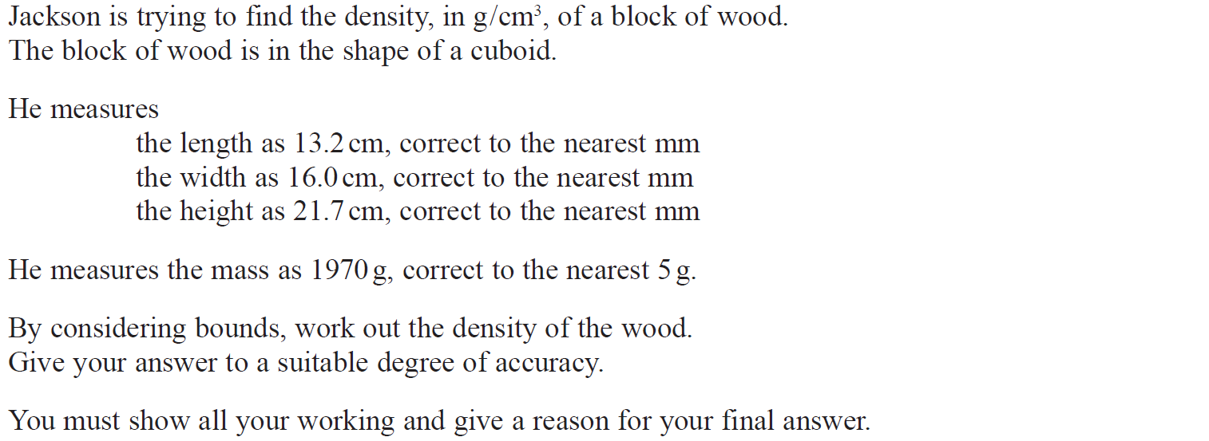
Upper & Lower Bounds
June 2018 2H Q21

Slide 23
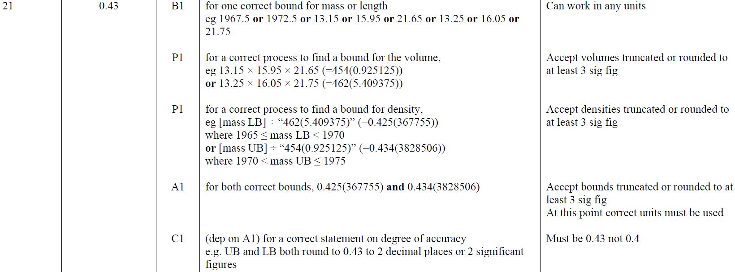
Upper & Lower Bounds
June 2018 2H Q21
A

Slide 24
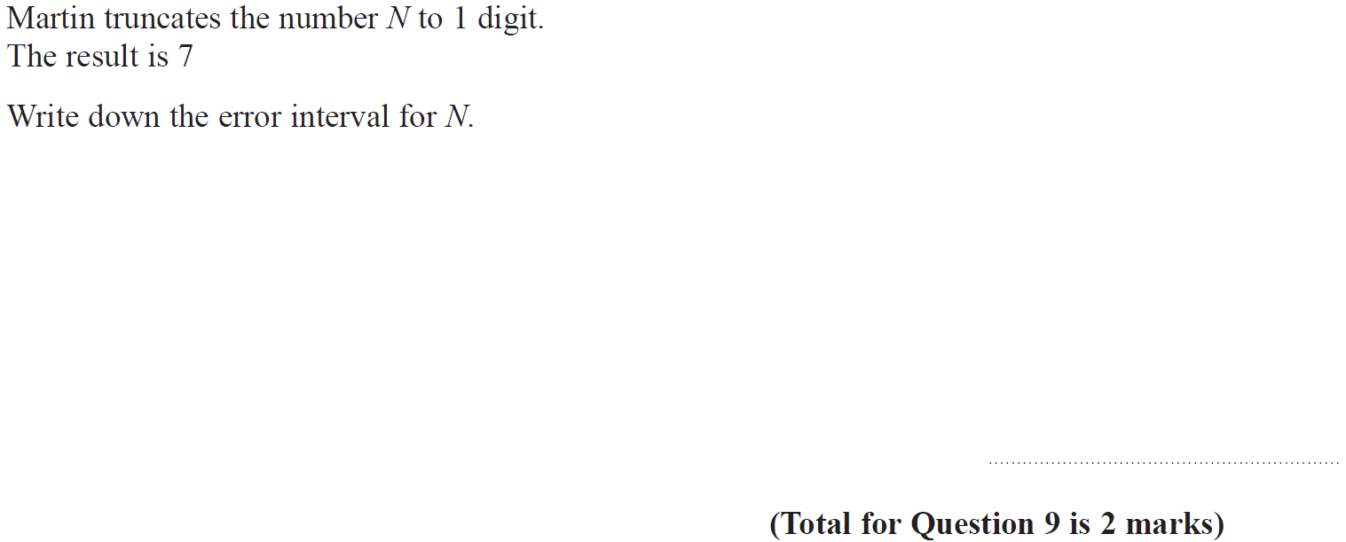
Upper & Lower Bounds
Nov 2018 2H Q9

Slide 25
Upper & Lower Bounds
Nov 2018 2H Q9
A

Slide 26
Upper & Lower Bounds
Nov 2018 3H Q18

Slide 27
Upper & Lower Bounds
Nov 2018 3H Q18
A

Slide 28
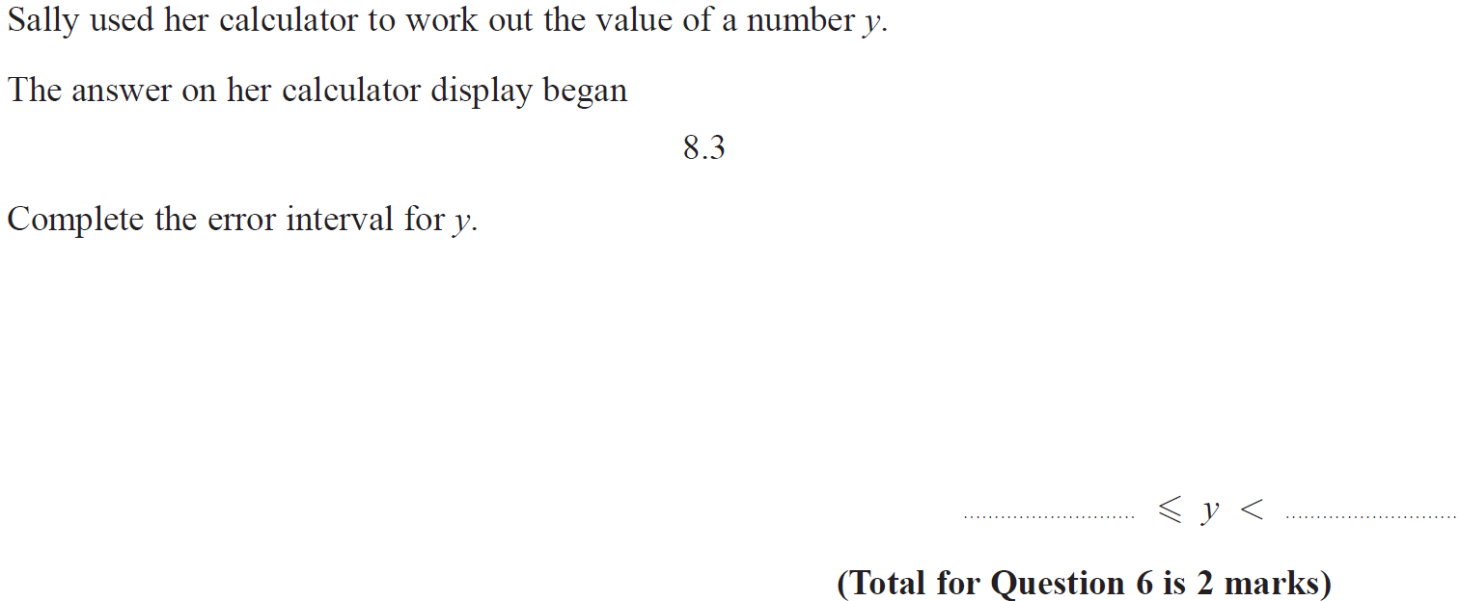
Upper & Lower Bounds
June 2019 2H Q6

Slide 29
Upper & Lower Bounds
June 2019 2H Q6
A
A SF

Slide 30
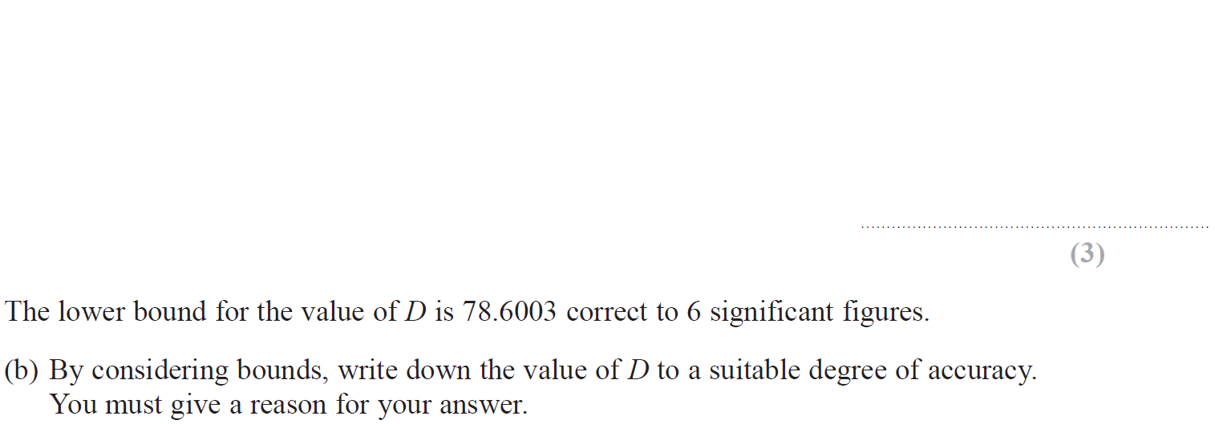
Upper & Lower Bounds
June 2019 3H Q19

Slide 31
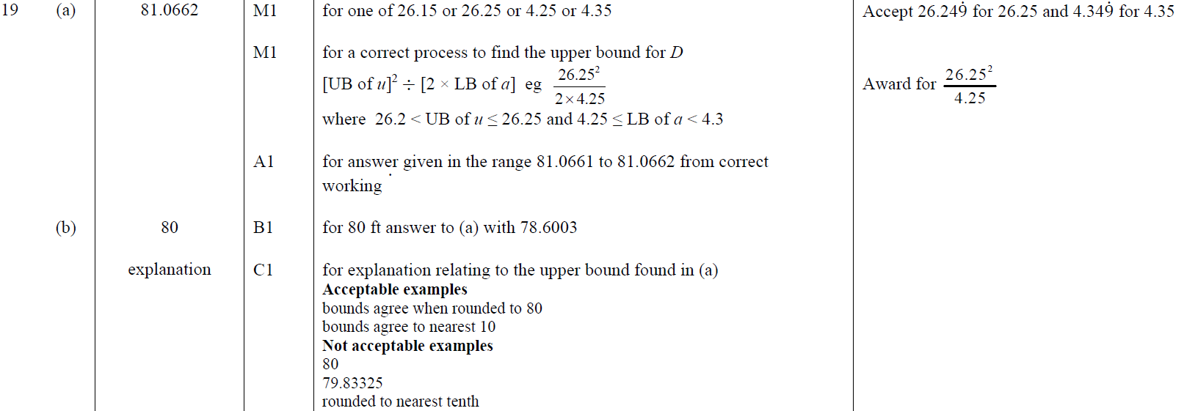
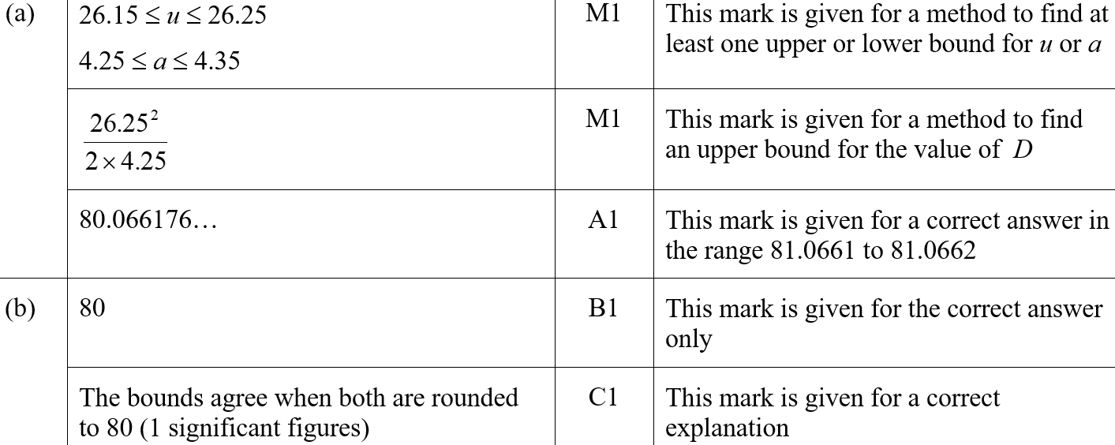
Upper & Lower Bounds
June 2019 3H Q19
A
B
A SF
B SF

