Slide 1
Upper & Lower Bounds
Upper & Lower Bounds
May 2017
1H Q2
June 2018
3H Q14
SAM
2H Q8
June 2017
3H Q11
Nov 2018
3H Q4
Practice
1H Q1
Nov 2017
1H Q12
Nov 2018
3H Q16

Slide 2
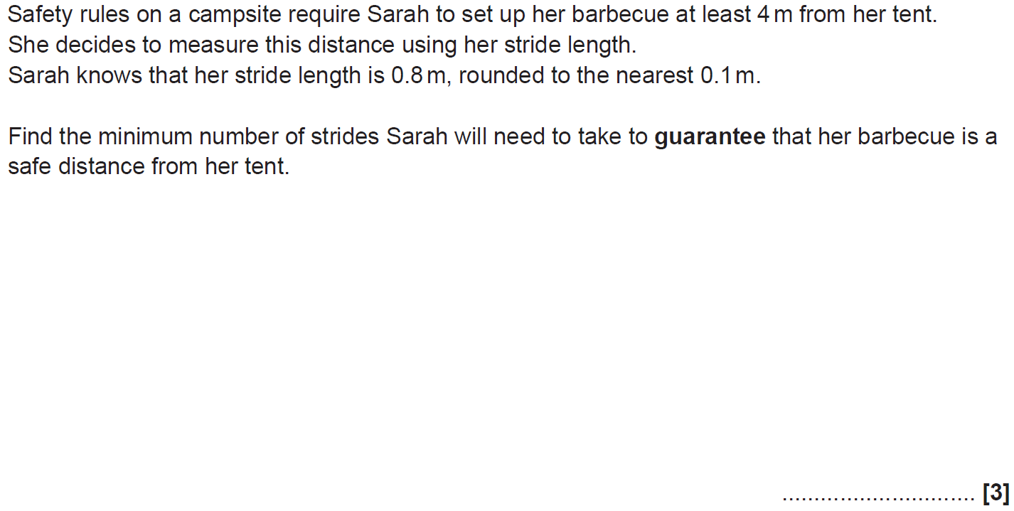
Upper & Lower Bounds
SAM 2H Q8

Slide 3
Upper & Lower Bounds
SAM 2H Q8
A

Slide 4
Upper & Lower Bounds
Practice 1H Q1

Slide 5
Upper & Lower Bounds
Practice 1H Q1
A (i)
A (ii)
B

Slide 6
Upper & Lower Bounds
May 2017 1H Q2

Slide 7
Upper & Lower Bounds
May 2017 1H Q2
A

Slide 8
Upper & Lower Bounds
June 2017 3H Q11

Slide 9
Upper & Lower Bounds
June 2017 3H Q11
A

Slide 10
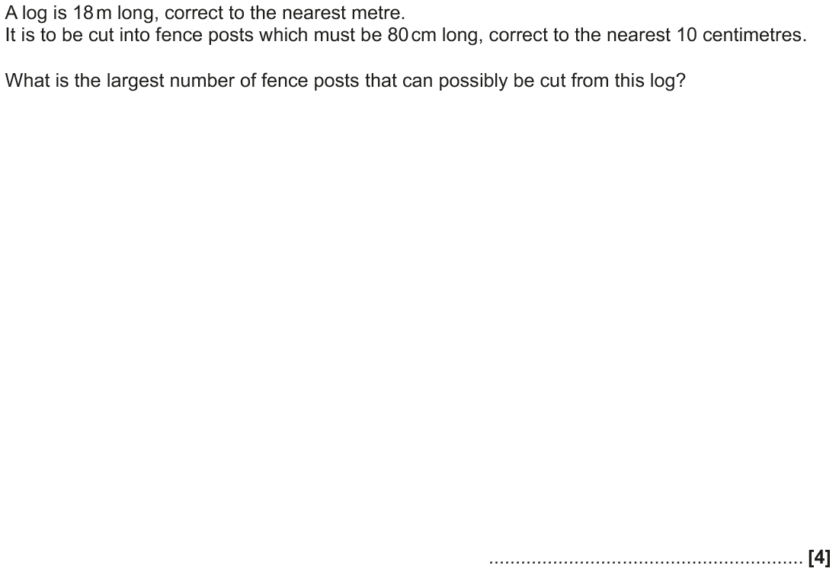
Upper & Lower Bounds
Nov 2017 1H Q12

Slide 11
Upper & Lower Bounds
Nov 2017 1H Q12
A

Slide 12
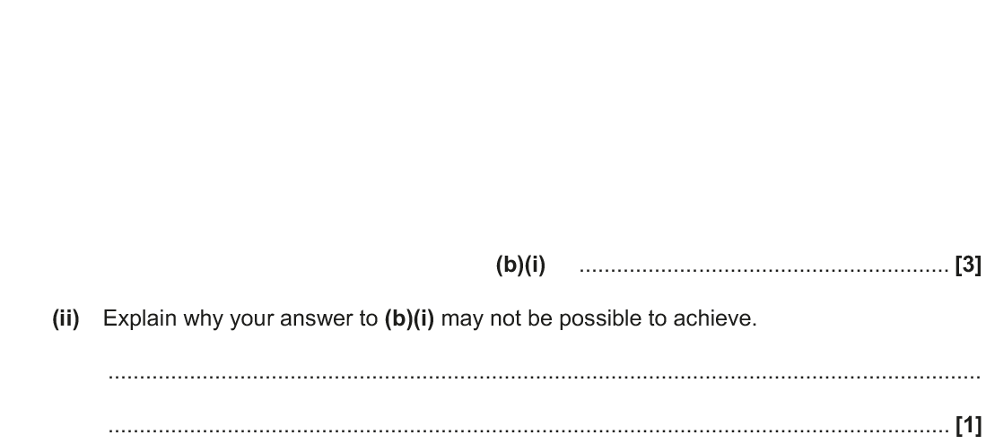
Upper & Lower Bounds
June 2018 3H Q14

Slide 13
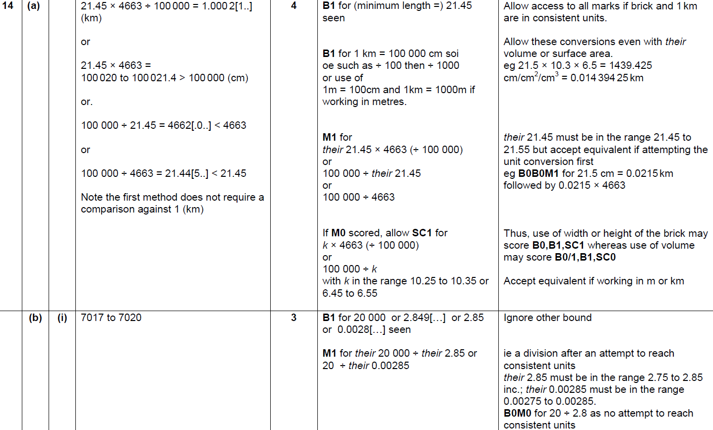
Upper & Lower Bounds
June 2018 3H Q14
A
B (i)
B (ii)

Slide 14
Upper & Lower Bounds
Nov 2018 3H Q4

Slide 15
Upper & Lower Bounds
Nov 2018 3H Q4
A

Slide 16
Upper & Lower Bounds
Nov 2018 3H Q16

Slide 17
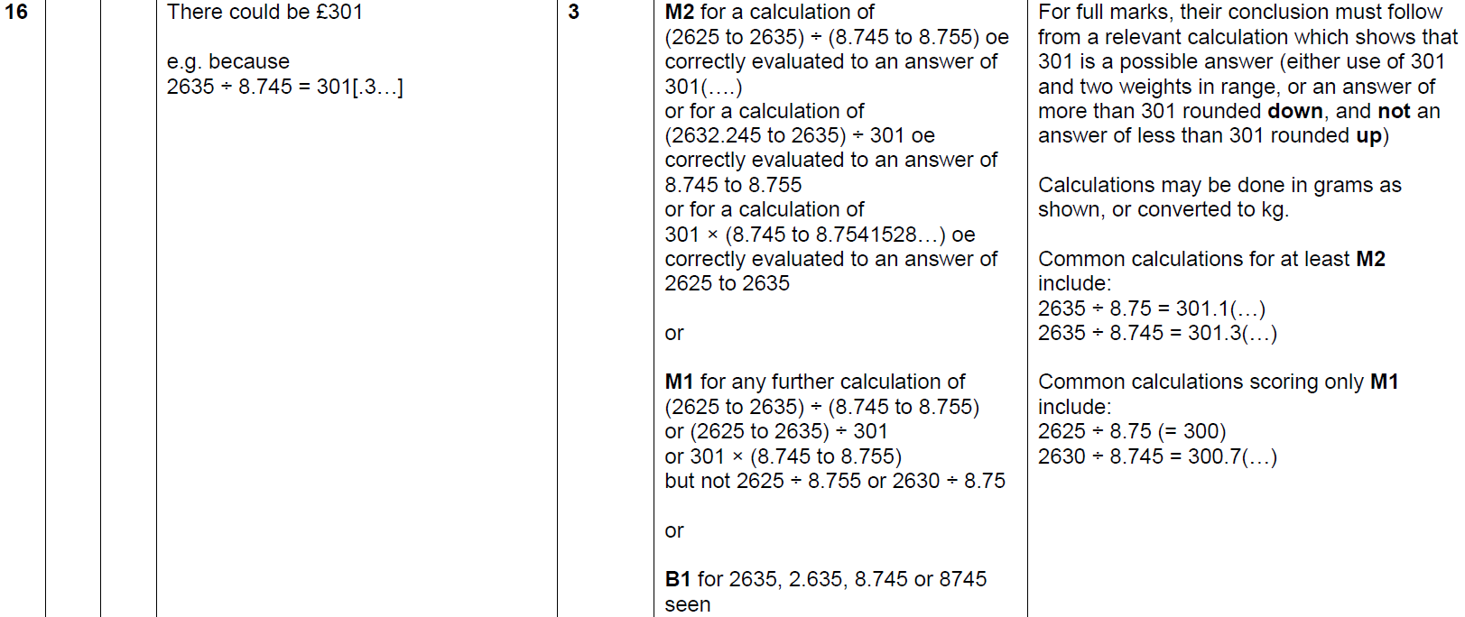
Upper & Lower Bounds
Nov 2018 3H Q16
A

