Slide 1
Trig Exact Values & Graphs
Trig Exact Values & Graphs
Nov 2017
1H Q20
Nov 2018
1H Q8
Spec 1
1H Q7
Nov 2018
3H Q11
Spec 2
2H Q19
May 2019
1H Q14
June 2019
3H Q21
Graphs

Slide 2
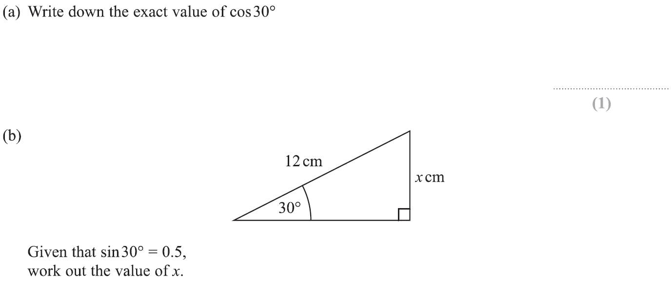
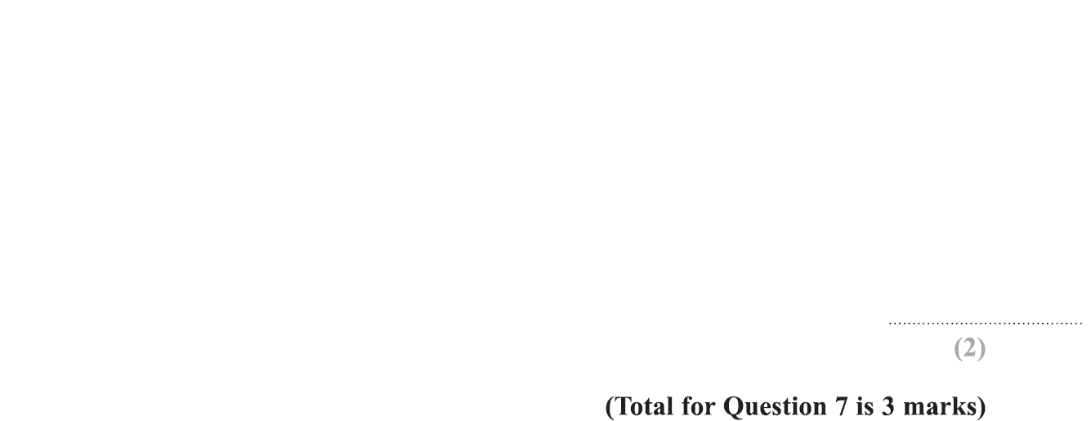
Trig Exact Values & Graphs
Specimen Set 1 1H Q7

Slide 3
Trig Exact Values & Graphs
Specimen Set 1 1H Q7
A
B

Slide 4
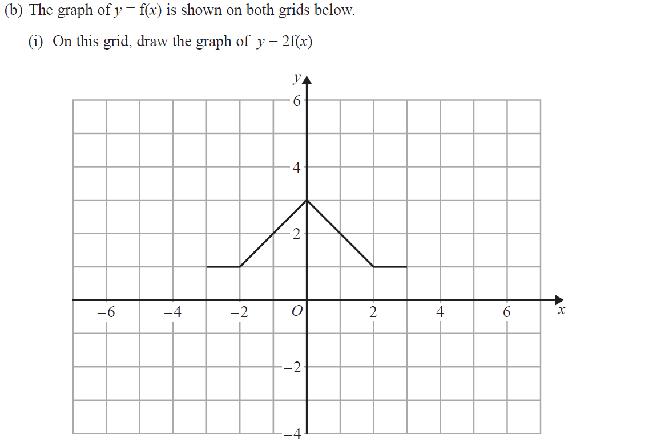
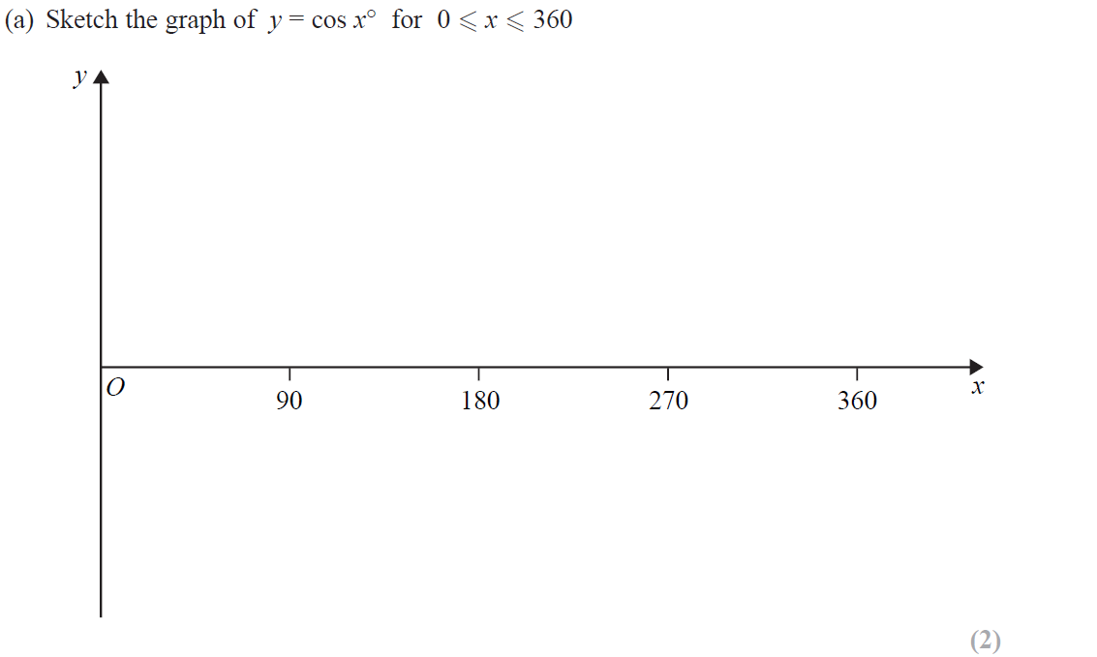
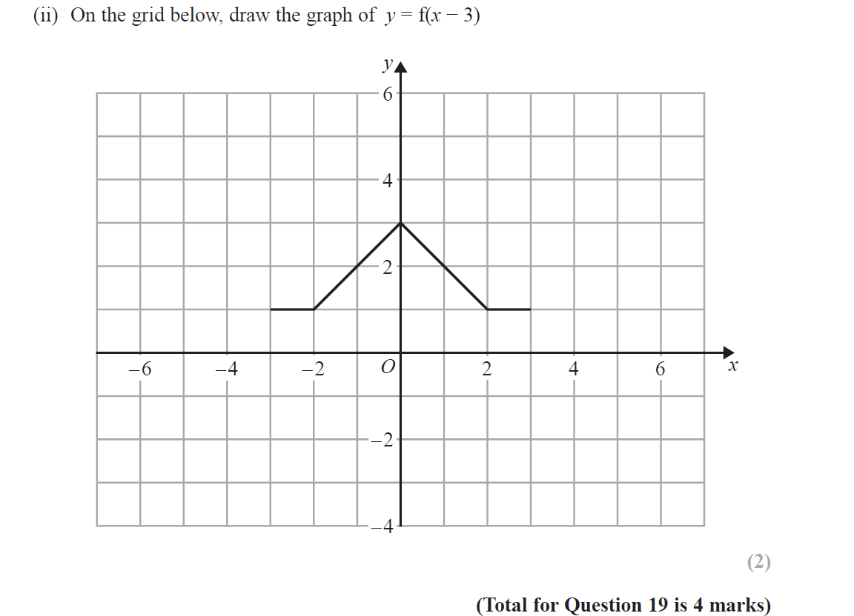
Trig Exact Values & Graphs
Specimen Set 2 2H Q19
Reveal Graph (i)
Reveal Graph (ii)

Slide 5
Trig Exact Values & Graphs
Specimen Set 2 2H Q19
A
B

Slide 6
Trig Exact Values & Graphs
Nov 2017 1H Q20

Slide 7
Trig Exact Values & Graphs
Nov 2017 1H Q20
A

Slide 8
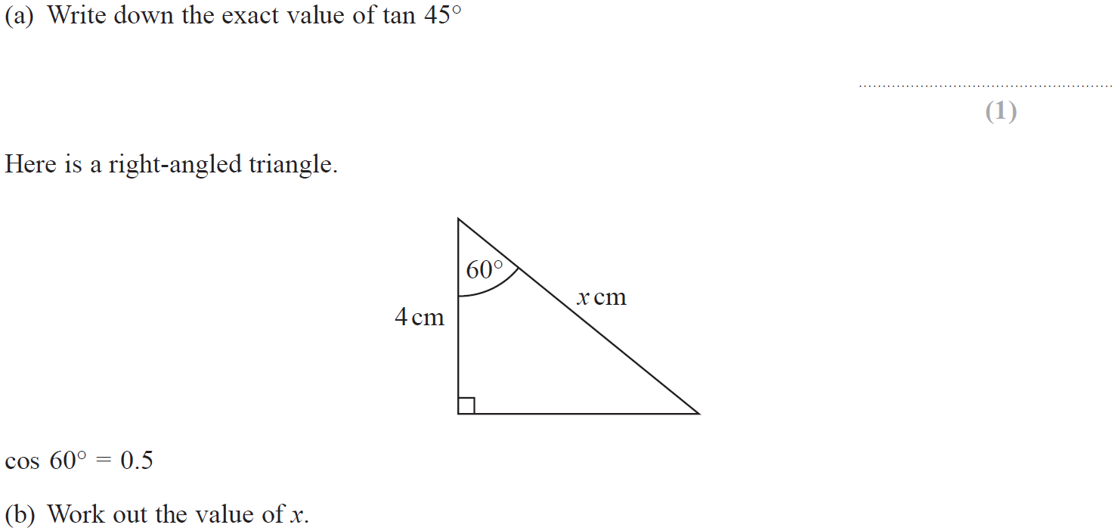
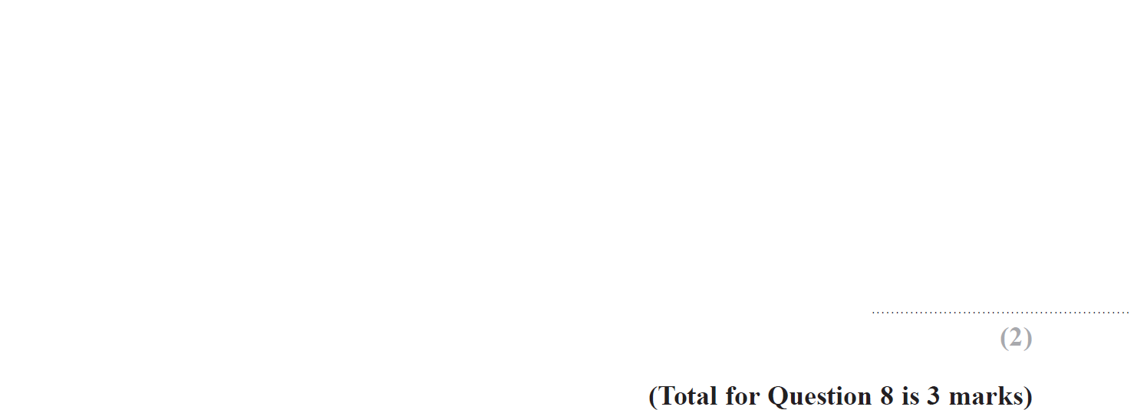
Trig Exact Values & Graphs
Nov 2018 1H Q8

Slide 9
Trig Exact Values & Graphs
Nov 2018 1H Q8
A
B

Slide 10
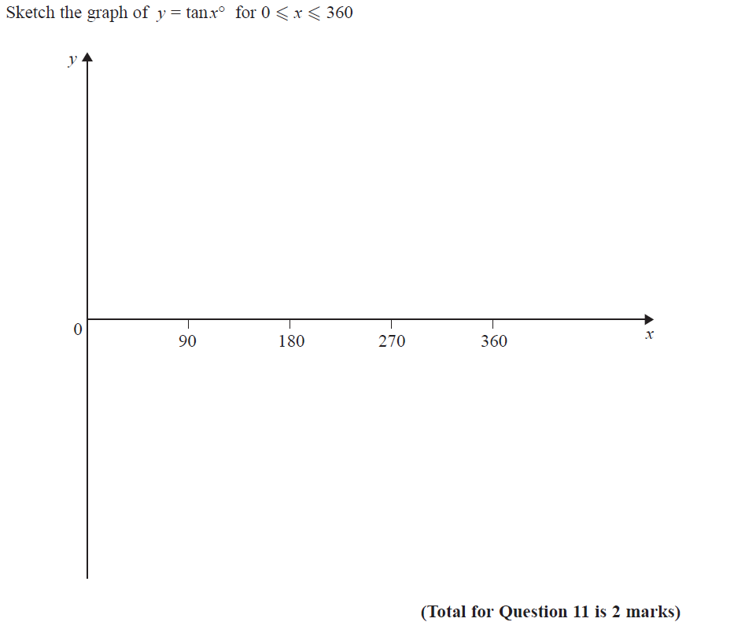
Trig Exact Values & Graphs
Nov 2018 3H Q11

Slide 11
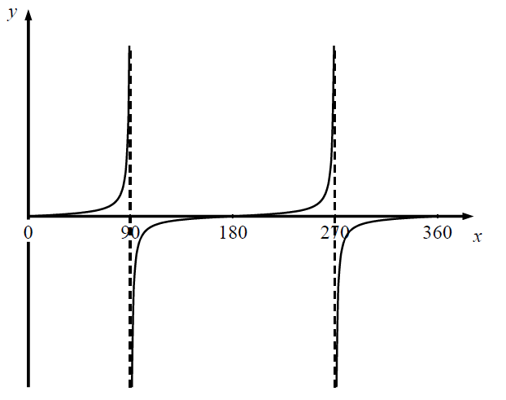
Trig Exact Values & Graphs
Nov 2018 3H Q11
A

Slide 12
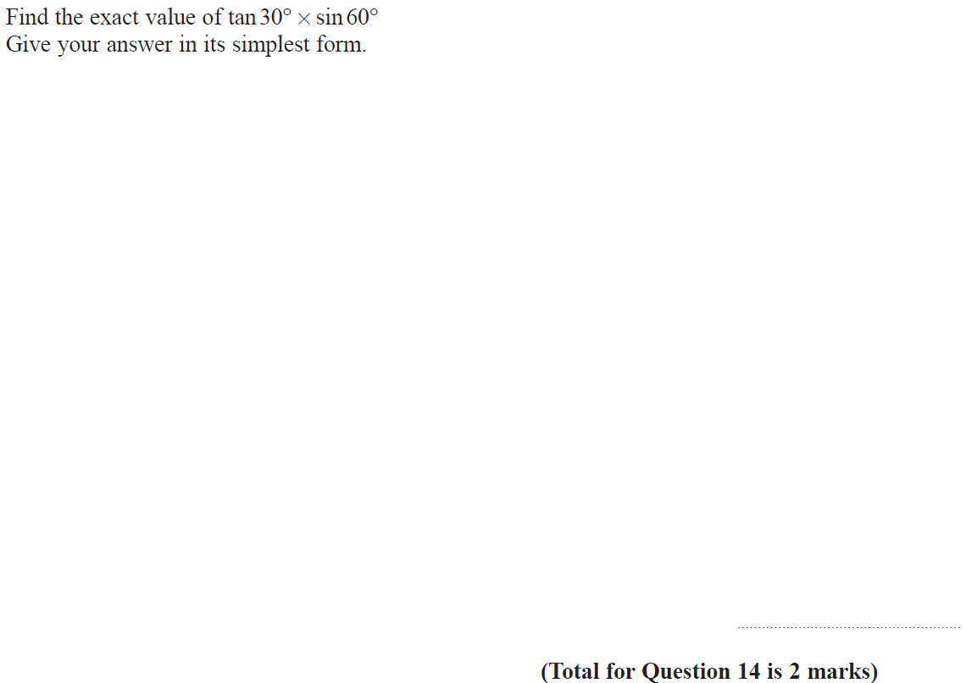
Trig Exact Values & Graphs
May 2019 1H Q14

Slide 13
Trig Exact Values & Graphs
May 2019 1H Q14
A
A SF

Slide 14
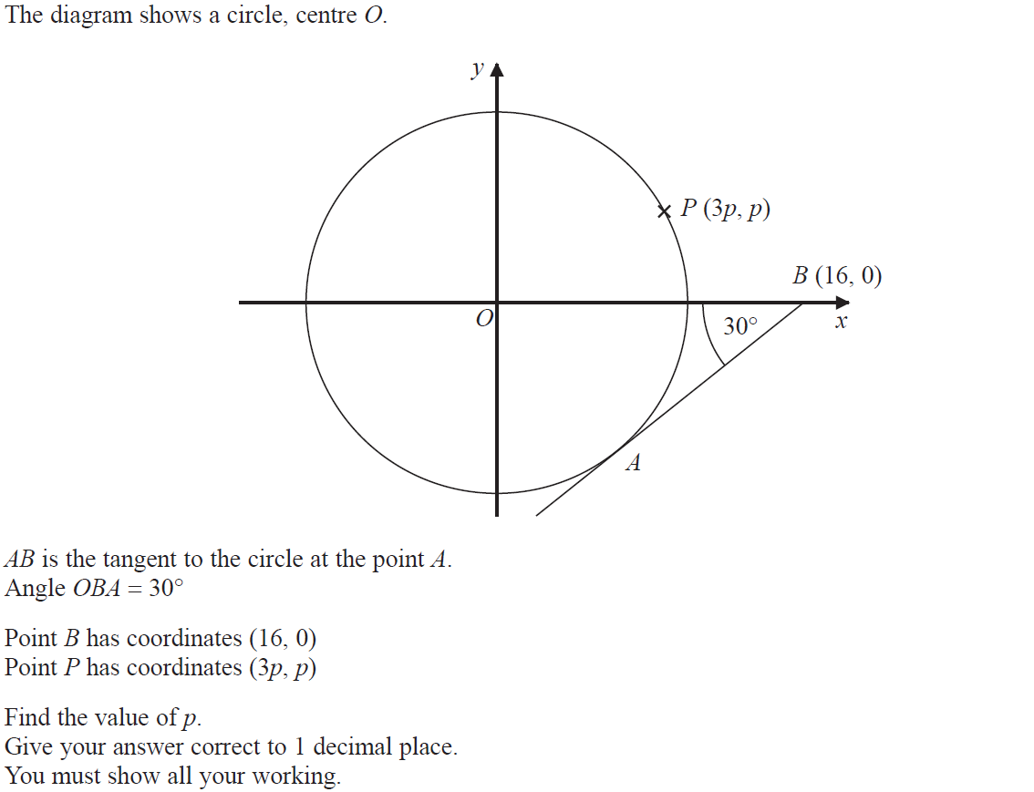
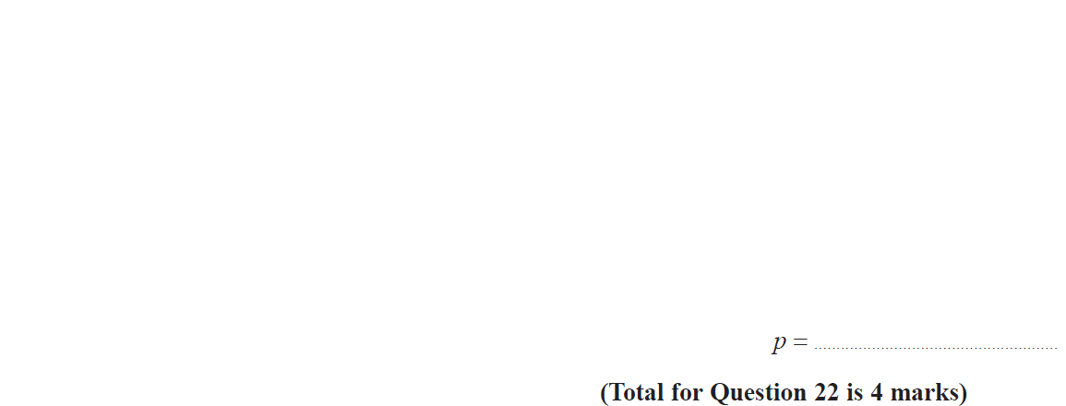
Trig Exact Values & Graphs
June 2019 3H Q21

Slide 15
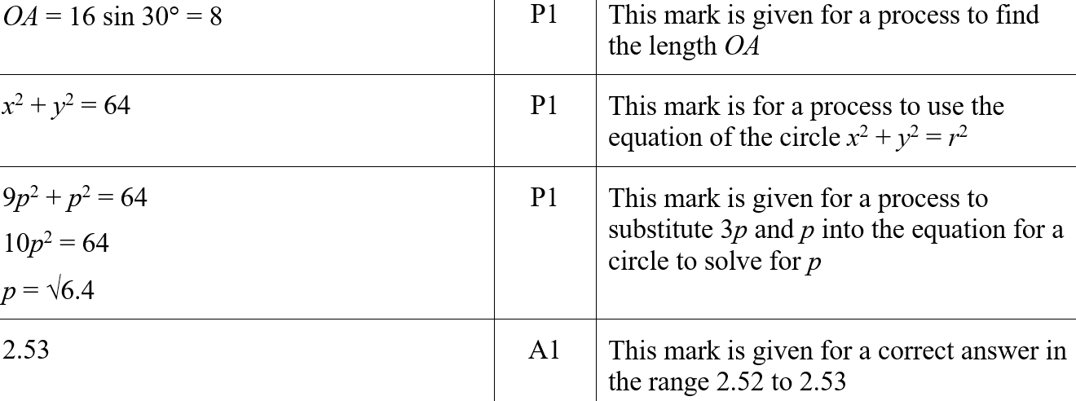
Trig Exact Values & Graphs
June 2019 3H Q21
A
A SF

