Slide 1
Tree Diagrams
Tree Diagrams
June 2017 2H Q12
Edexcel
Nov 2017 3H Q12
SAM
2H Q12
AQA
June 2018 2H Q15
Spec 1
2H Q11
OCR
June 2018 3H Q4
June 2019 2H Q10
See also:
Multiple Events

Slide 2
Tree Diagrams
Tree Diagrams
Edexcel
May 2017
1H Q16
AQA
SAM
1H Q20
Nov 2017
3H Q11
1 Marker
OCR
June 2018
2H Q11
Frequency Tree
See also:
Multiple Events

Slide 3
Tree Diagrams
Tree Diagrams
Edexcel
May 2017 1H Q13
AQA
Nov 2017 3H Q11
OCR
Nov 2018 3H Q7
See also:
Multiple Events

Slide 4
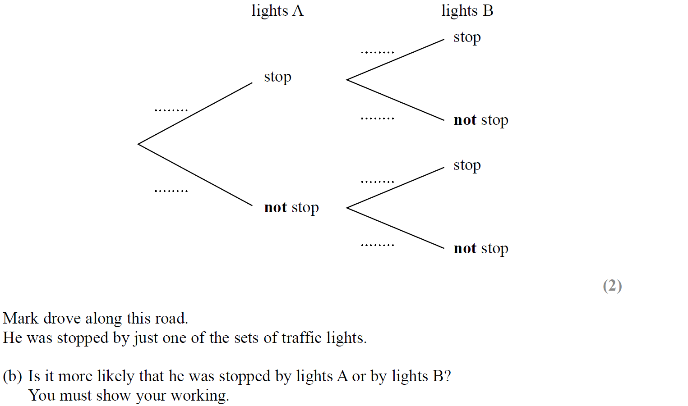
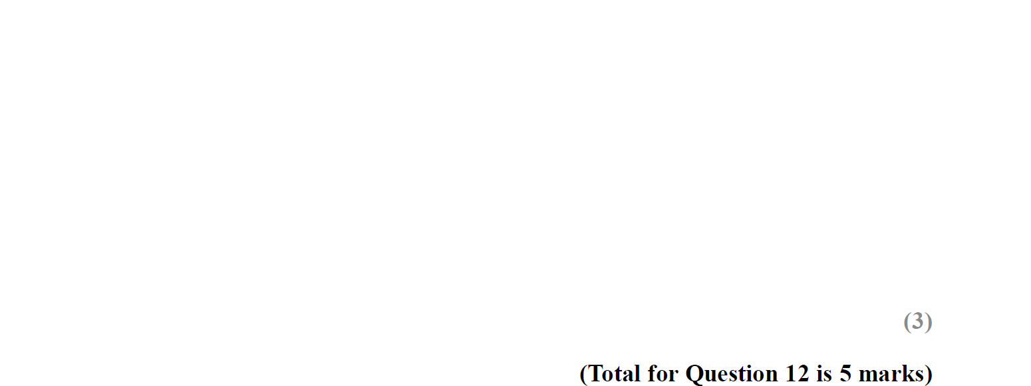
Tree Diagrams
SAM 2H Q12
$$0.3$$
Reveal tree diagram
$$0.4$$
$$0.7$$
$$0.6$$
$$0.8$$
Hide tree diagram
$$0.2$$

Slide 5
Tree Diagrams
SAM 2H Q12
A
B

Slide 6
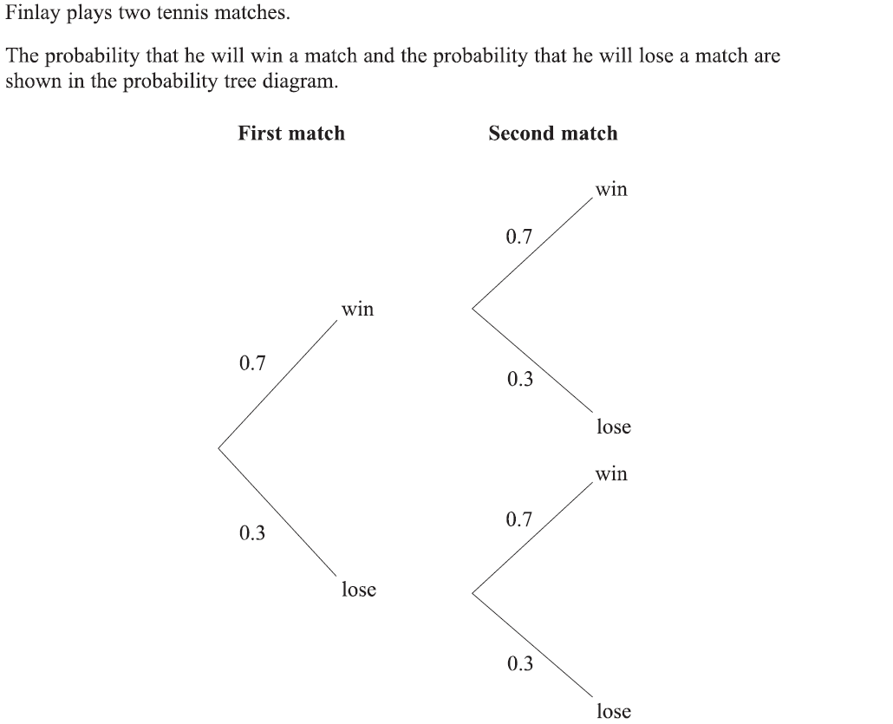
Tree Diagrams
Specimen Set 1 2H Q11

Slide 7
Tree Diagrams
Specimen Set 1 2H Q11
A
B

Slide 8
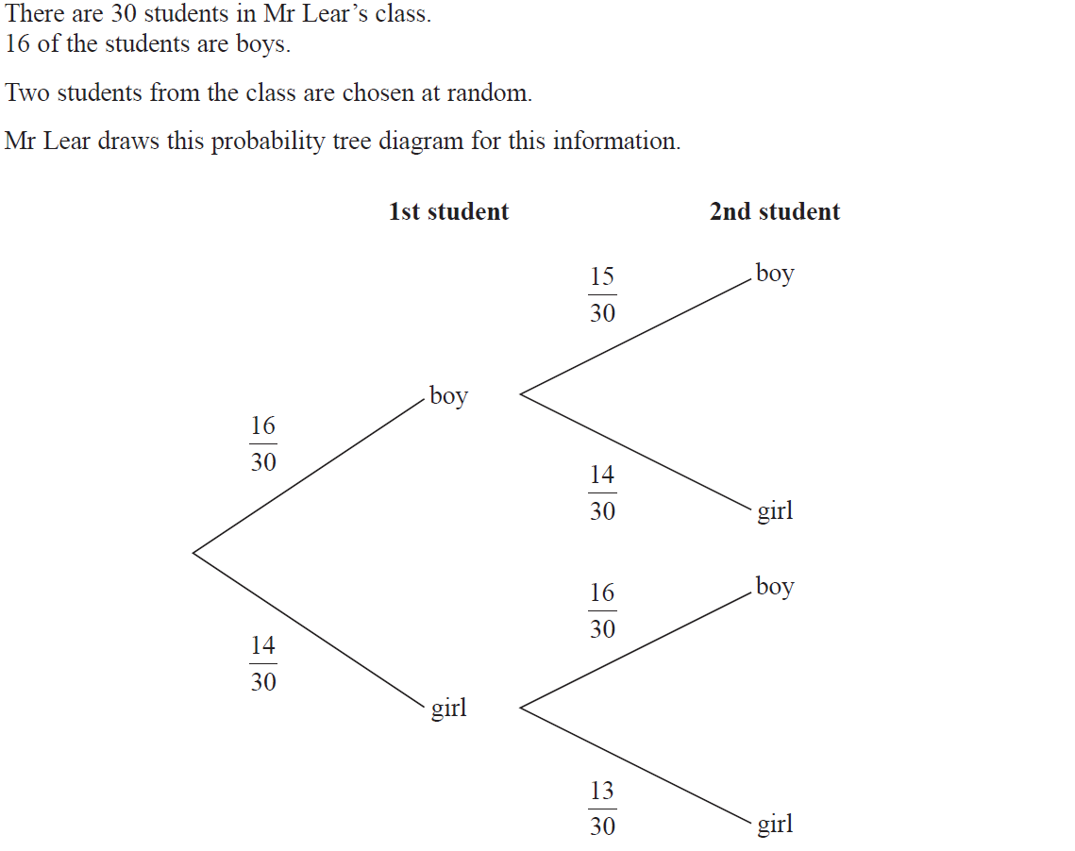
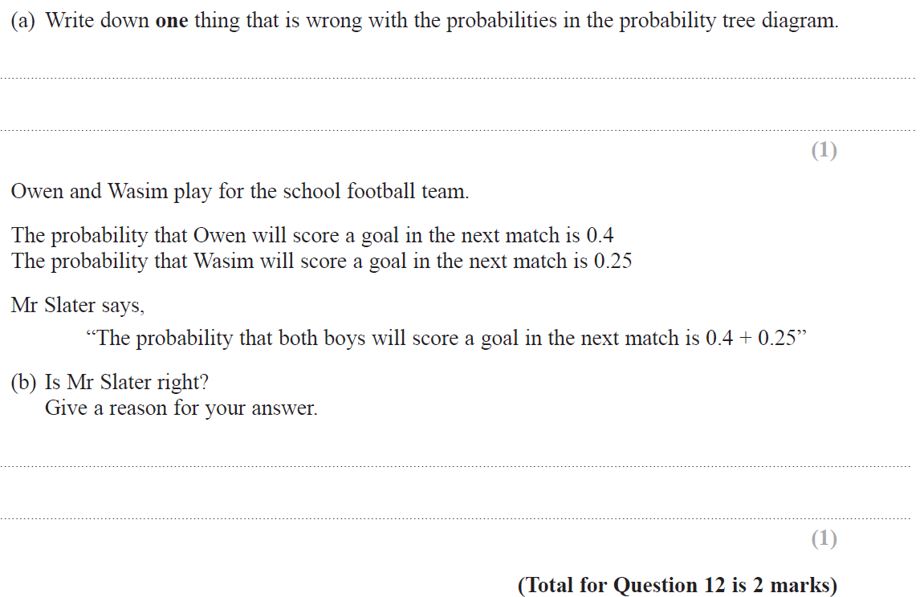
Tree Diagrams
June 2017 2H Q12

Slide 9
Tree Diagrams
June 2017 2H Q12
A
B

Slide 10
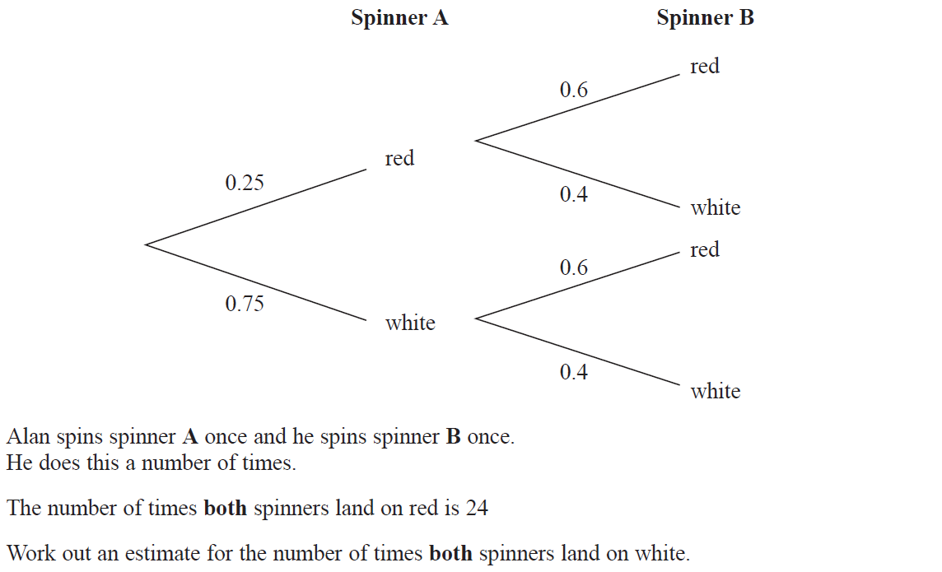
Tree Diagrams
Nov 2017 3H Q12

Slide 11
Tree Diagrams
Nov 2017 3H Q12
A

Slide 12
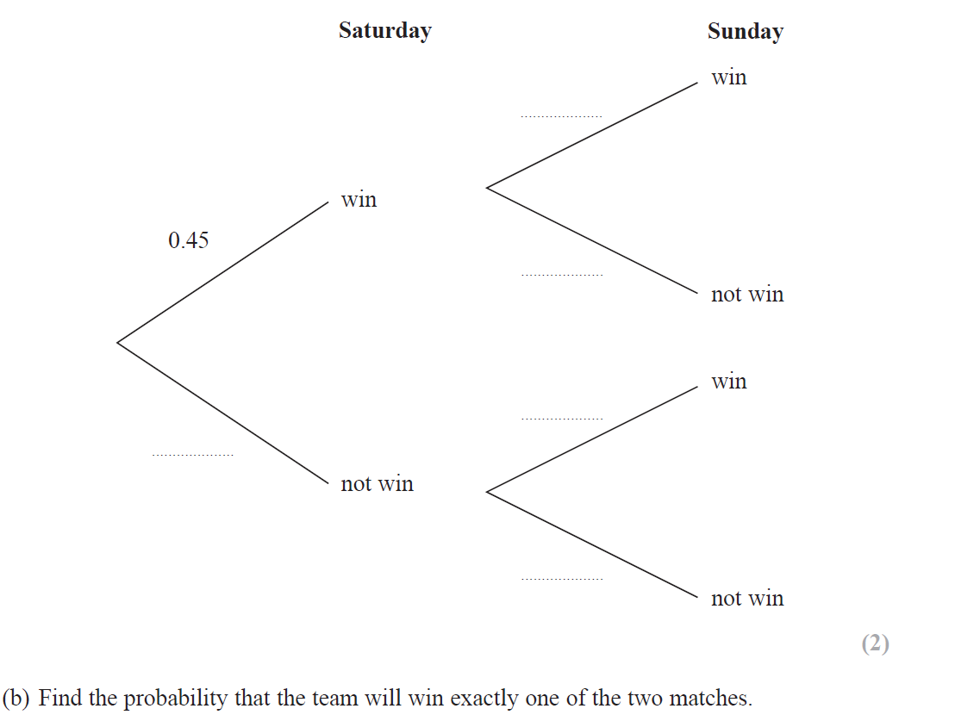
Tree Diagrams
June 2018 2H Q15
$$0.67$$
Reveal tree diagram
$$0.33$$
$$0.35$$
Hide tree diagram
$$0.55$$
$$0.65$$

Slide 13
Tree Diagrams
June 2018 2H Q15
A
B

Slide 14
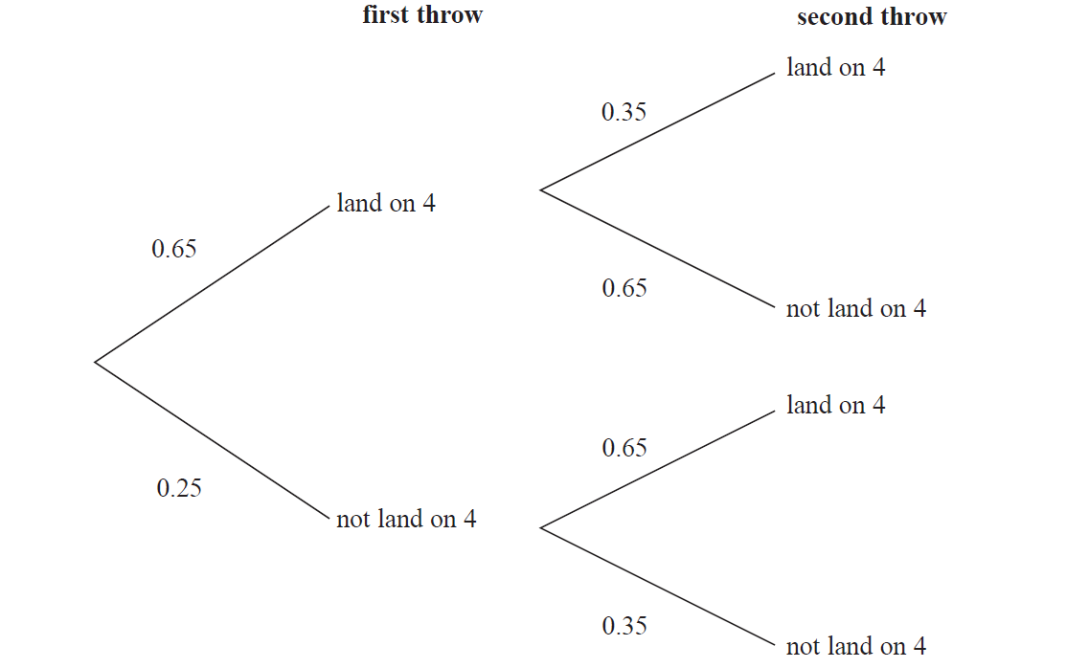
Tree Diagrams
June 2018 3H Q4

Slide 15
Tree Diagrams
June 2018 3H Q4
A

Slide 16
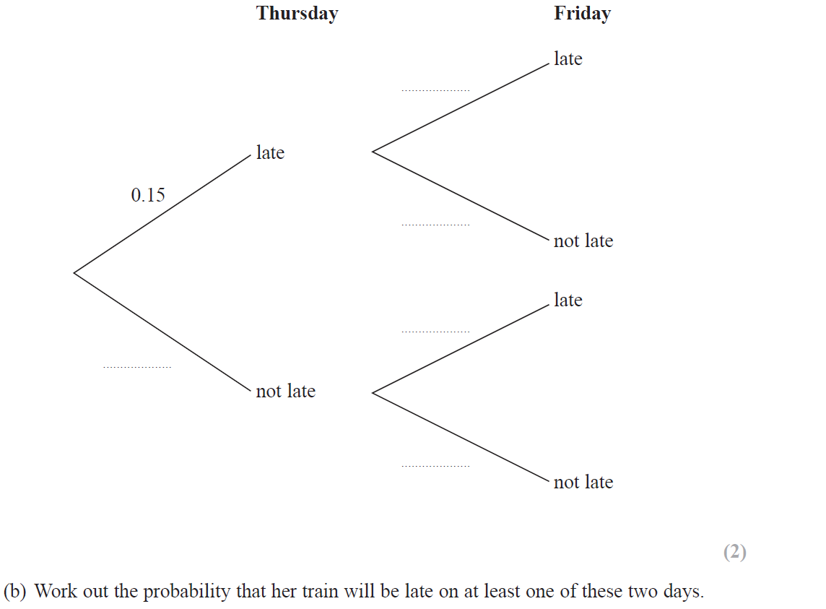
Tree Diagrams
June 2019 2H Q10

Slide 17
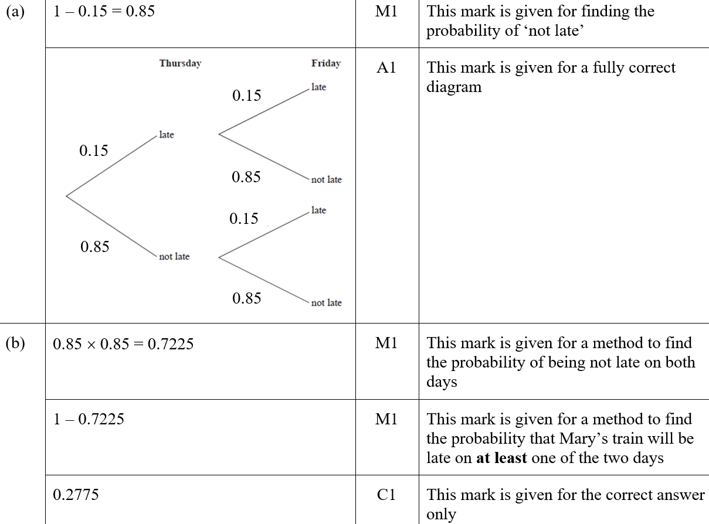
Tree Diagrams
June 2019 2H Q10
A
B
ASF
B SF

Slide 18
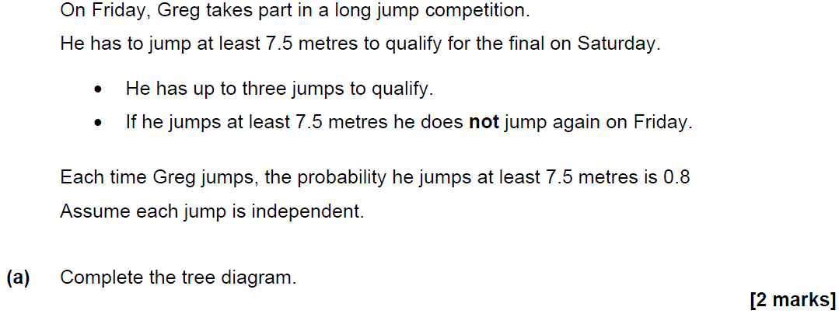
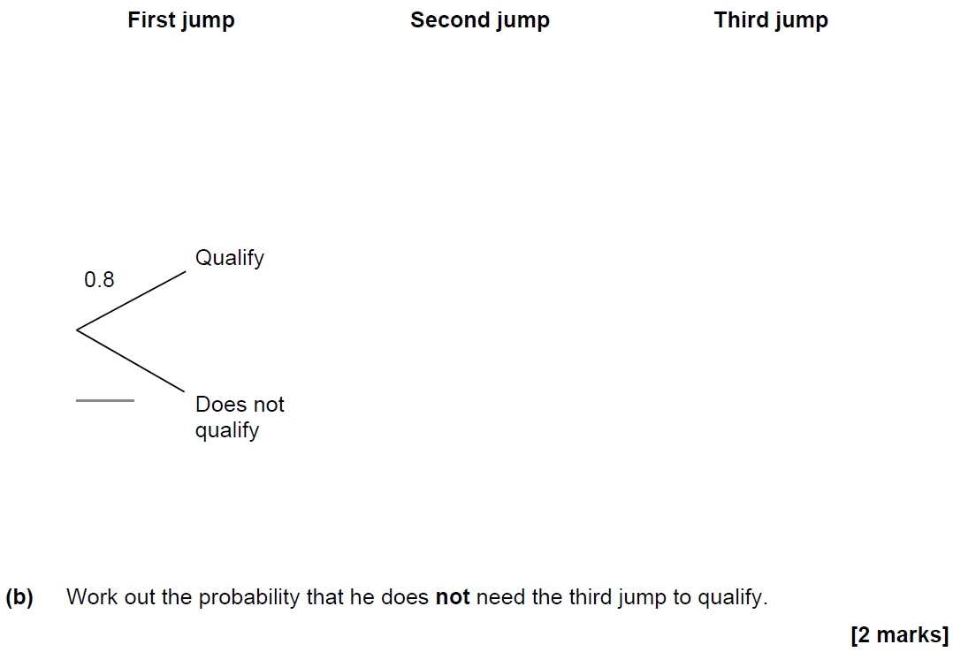
Tree Diagrams
SAM 1H Q20

Slide 19
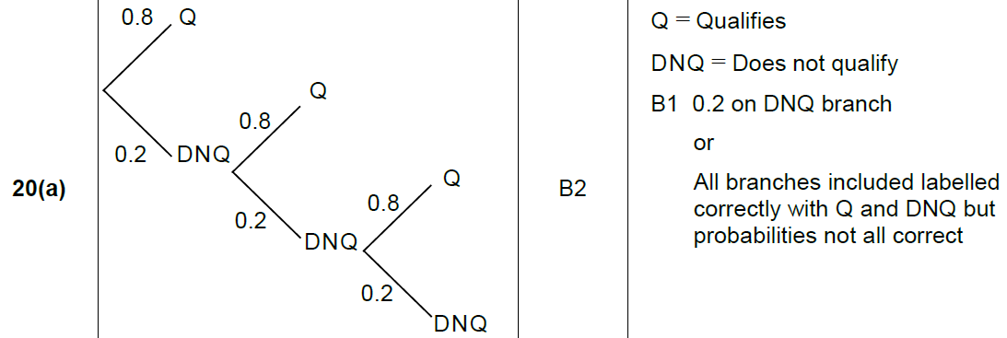
Tree Diagrams
SAM 1H Q20
A
B

Slide 20
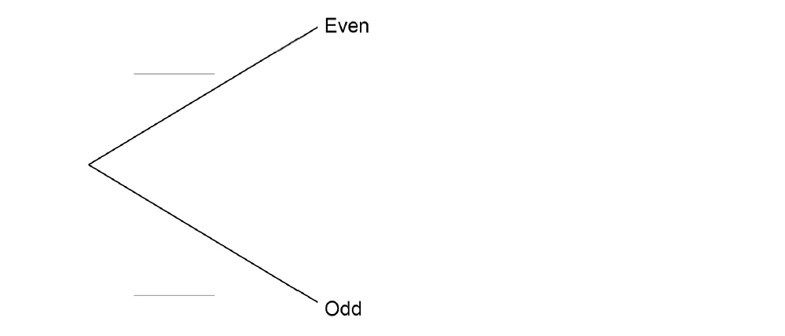
Tree Diagrams
May 2017 1H Q16

Slide 21
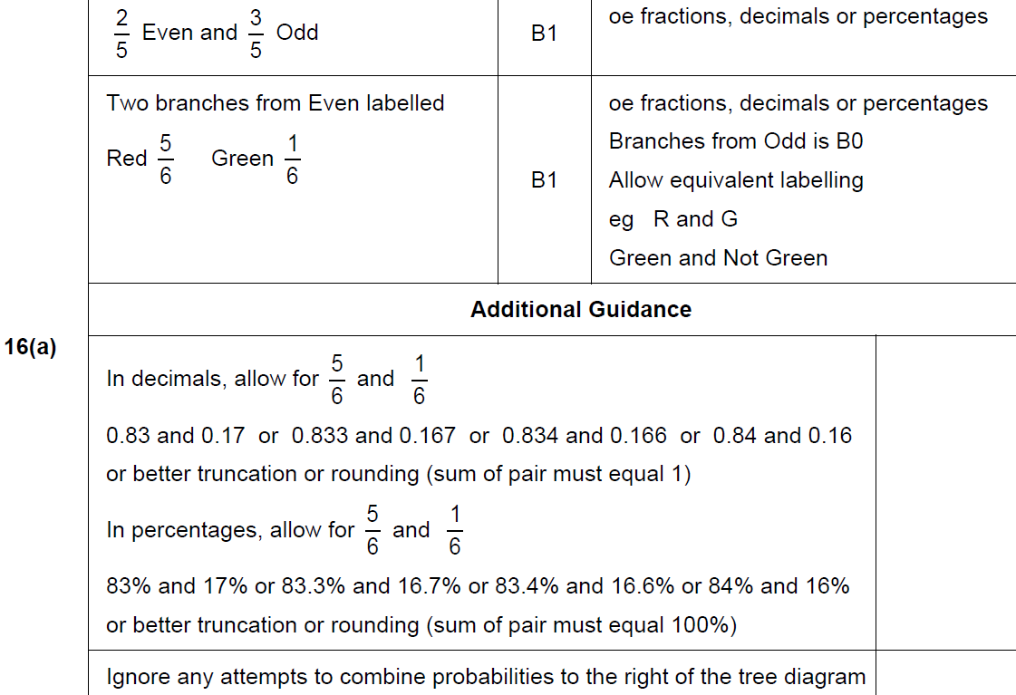
Tree Diagrams
May 2017 1H Q16
A

Slide 22
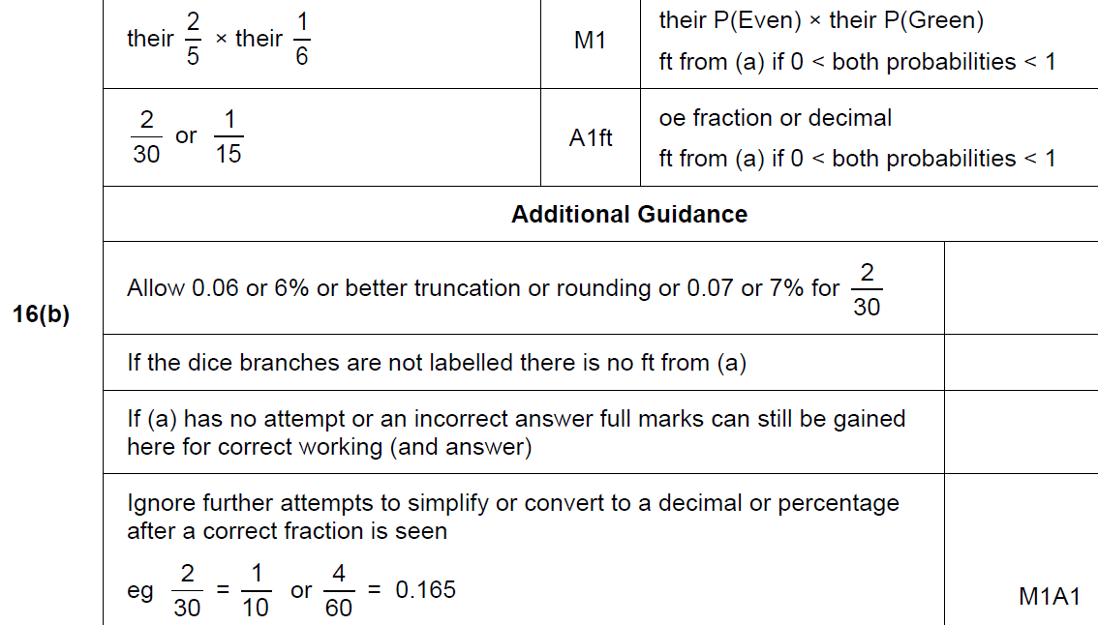
Tree Diagrams
May 2017 1H Q16
B

Slide 23
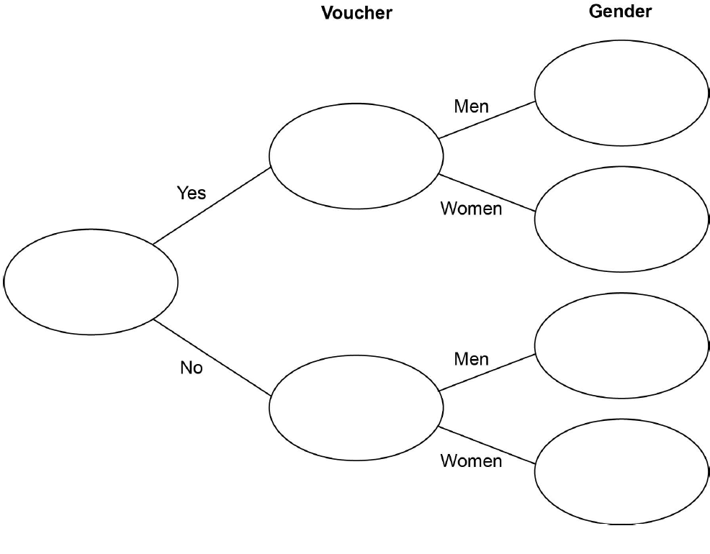
Tree Diagrams
Nov 2017 3H Q11

Slide 24
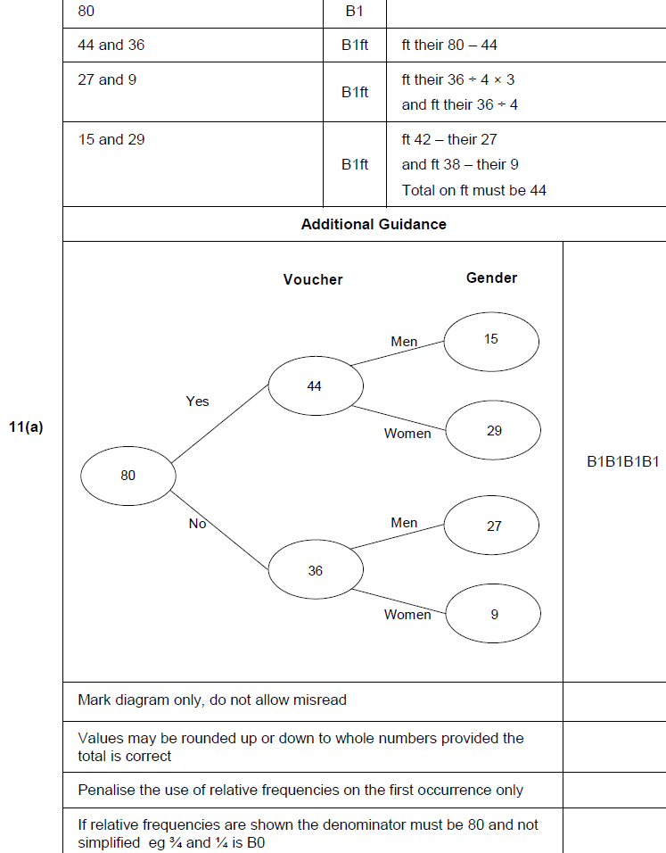
Tree Diagrams
Nov 2017 3H Q11
A

Slide 25
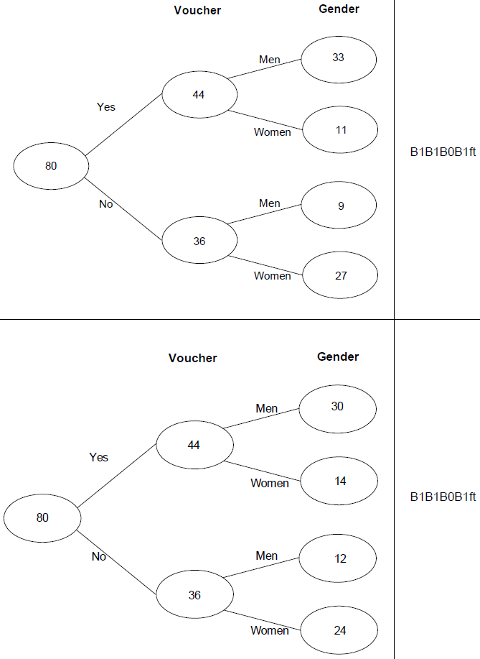
Tree Diagrams
Nov 2017 3H Q11
A notes

Slide 26
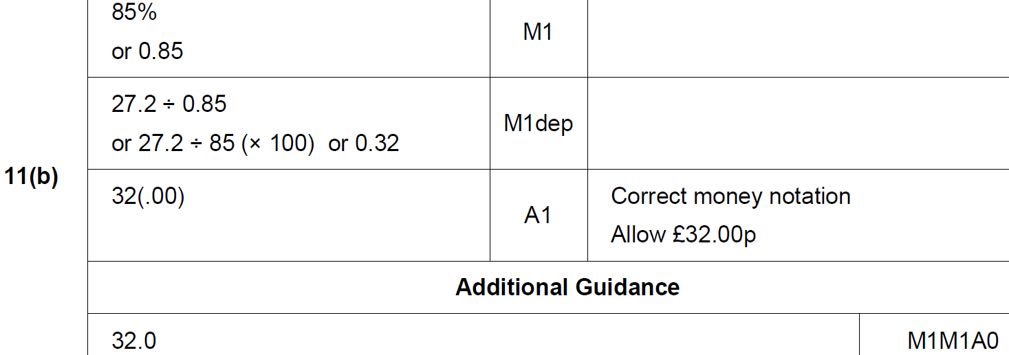
Tree Diagrams
Nov 2017 3H Q11
B

Slide 27
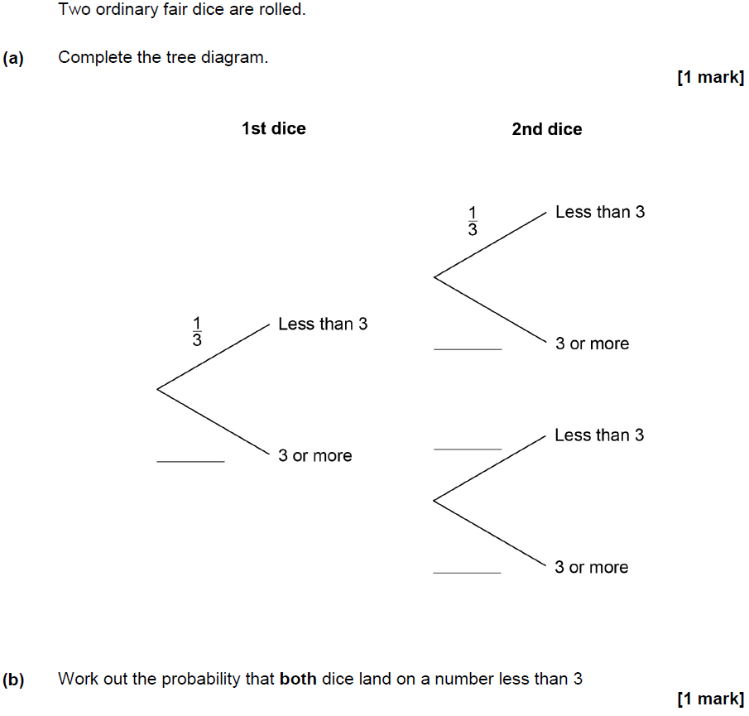
Tree Diagrams
June 2018 2H Q11

Slide 28
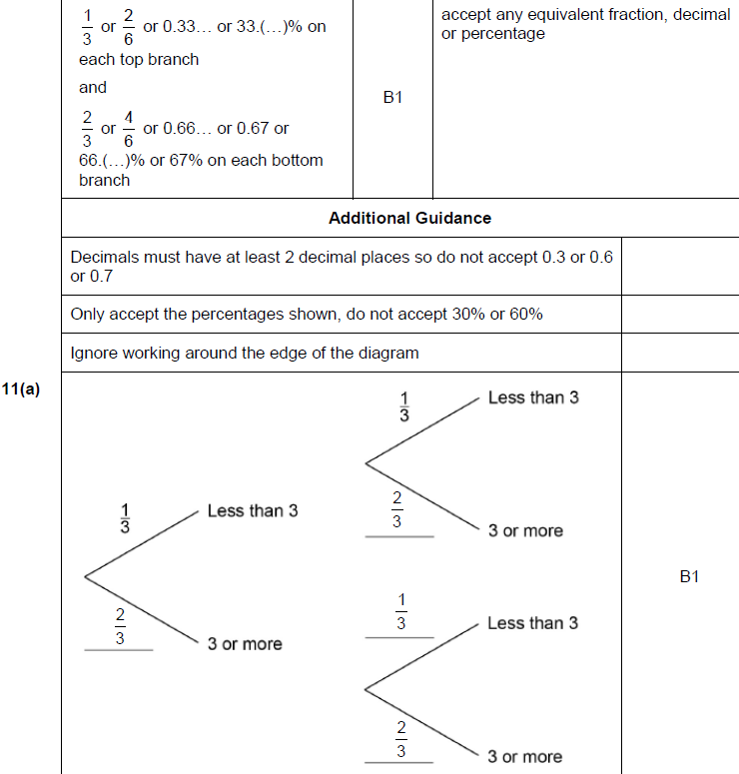
Tree Diagrams
June 2018 2H Q11
A

Slide 29
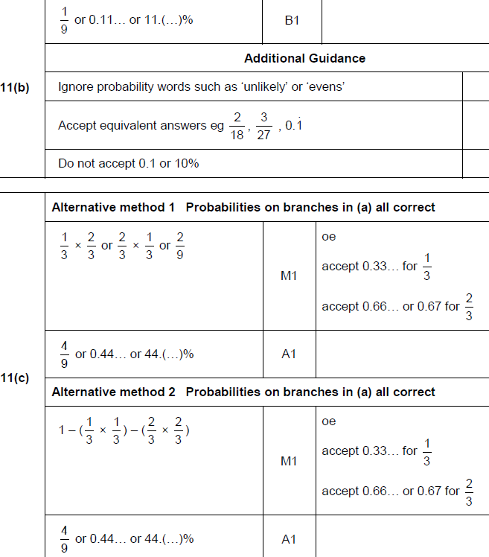
Tree Diagrams
June 2018 2H Q11
B
C

Slide 30
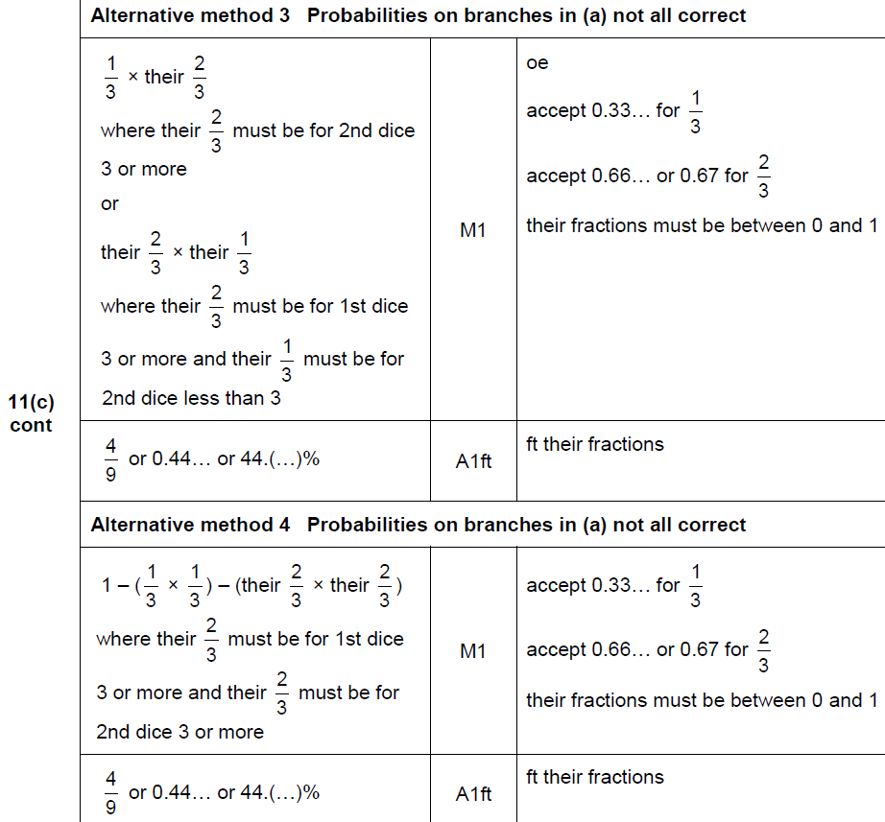
Tree Diagrams
June 2018 2H Q11
C Alternative 2 & 3

Slide 31
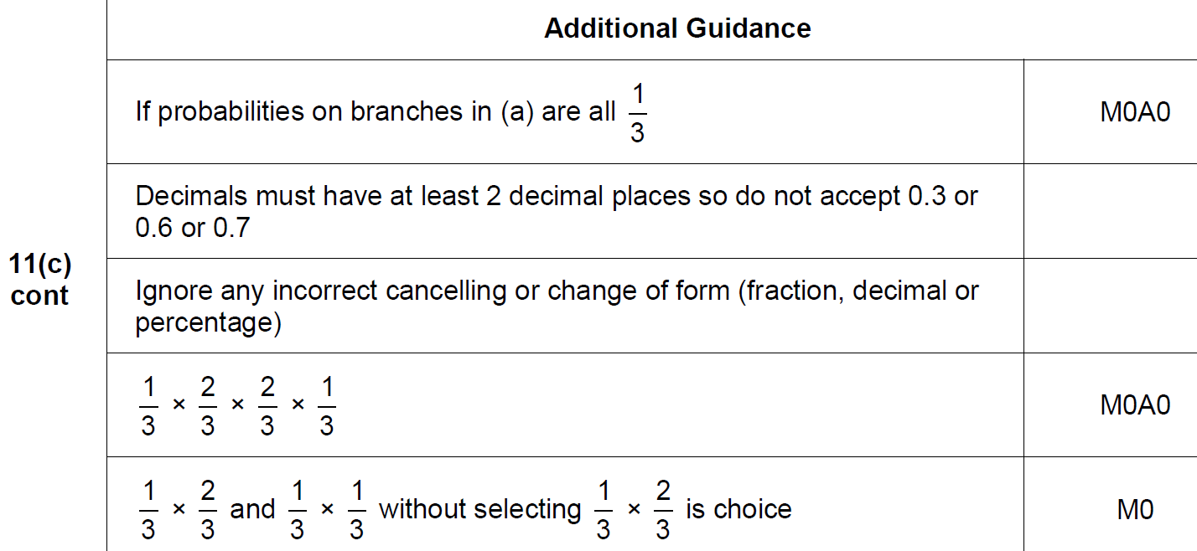
Tree Diagrams
June 2018 2H Q11
C notes

Slide 32
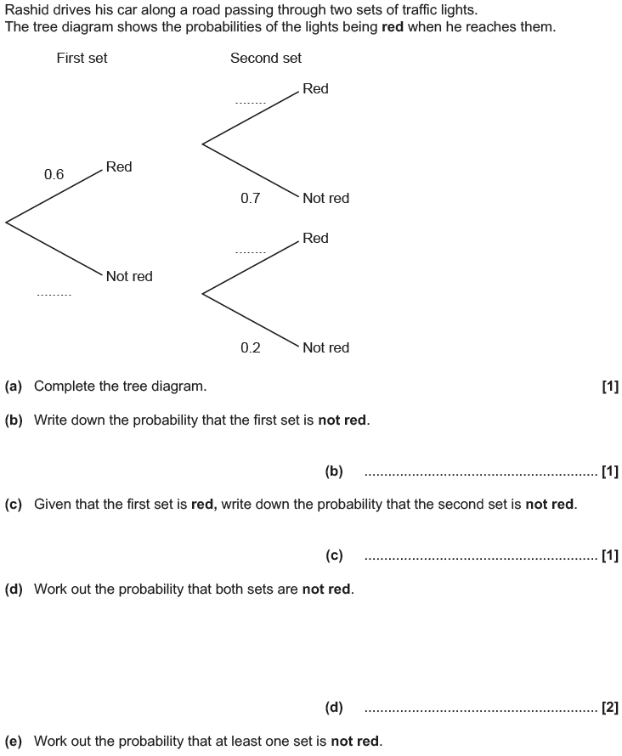
Tree Diagrams
May 2017 1H Q13
$$0.3$$
Reveal tree diagram
$$0.8$$
$$0.4$$
Hide tree diagram

Slide 33
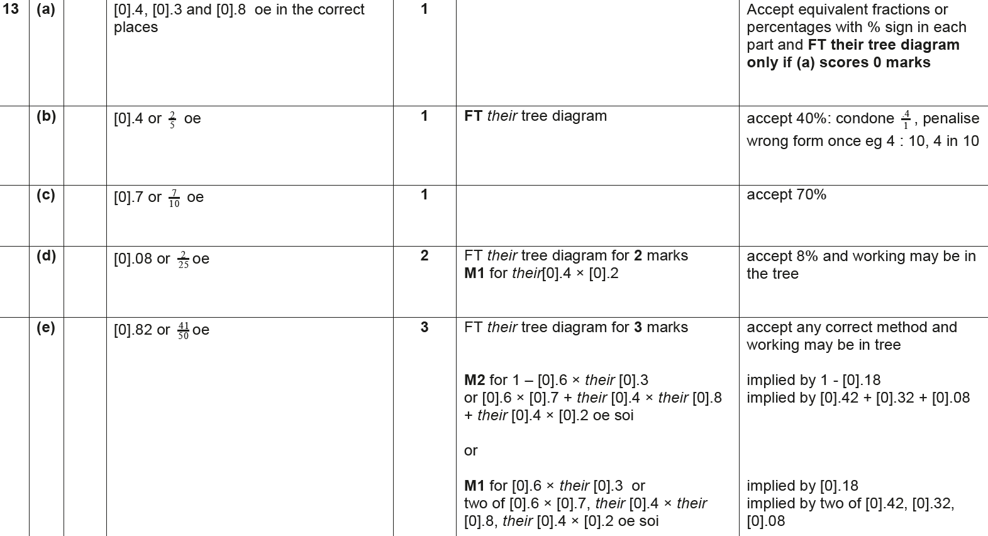
Tree Diagrams
May 2017 1H Q13
A
B
C
D
E

Slide 34
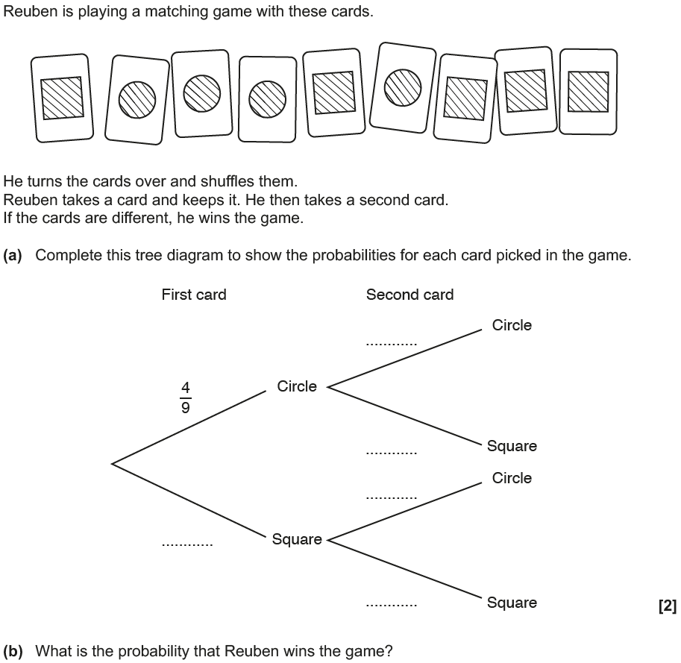
Tree Diagrams
Nov 2017 3H Q11

Slide 35
Tree Diagrams
Nov 2017 3H Q11
A
B

Slide 36
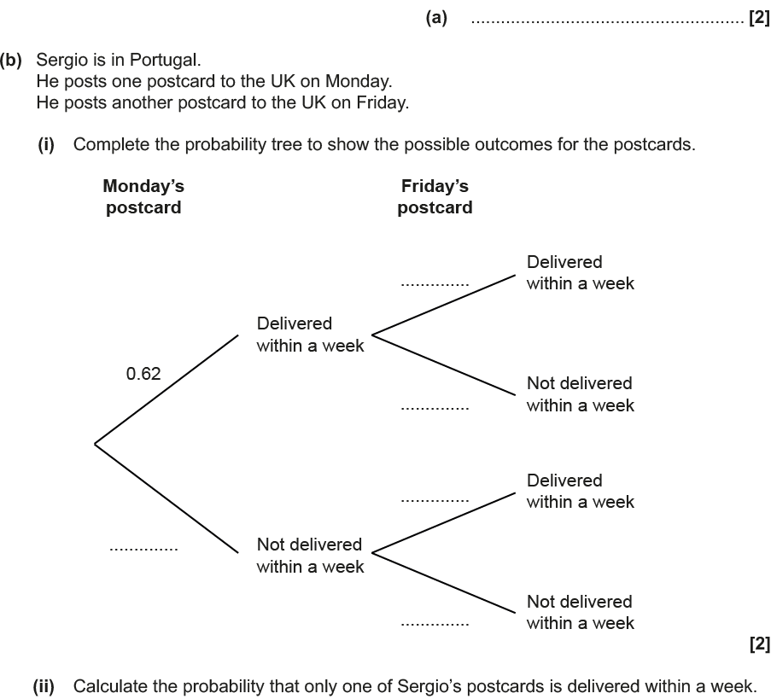
Tree Diagrams
Nov 2018 3H Q7

Slide 37
Tree Diagrams
Nov 2018 3H Q7
A
B (i)
B (ii)

