Slide 1
Tree Diagrams
Tree Diagrams
June 2017 2H Q12
Nov 2017 3H Q12
SAM
2H Q12
June 2018 2H Q15
Spec 1
2H Q11
June 2018 3H Q4
June 2019 2H Q10

Slide 2
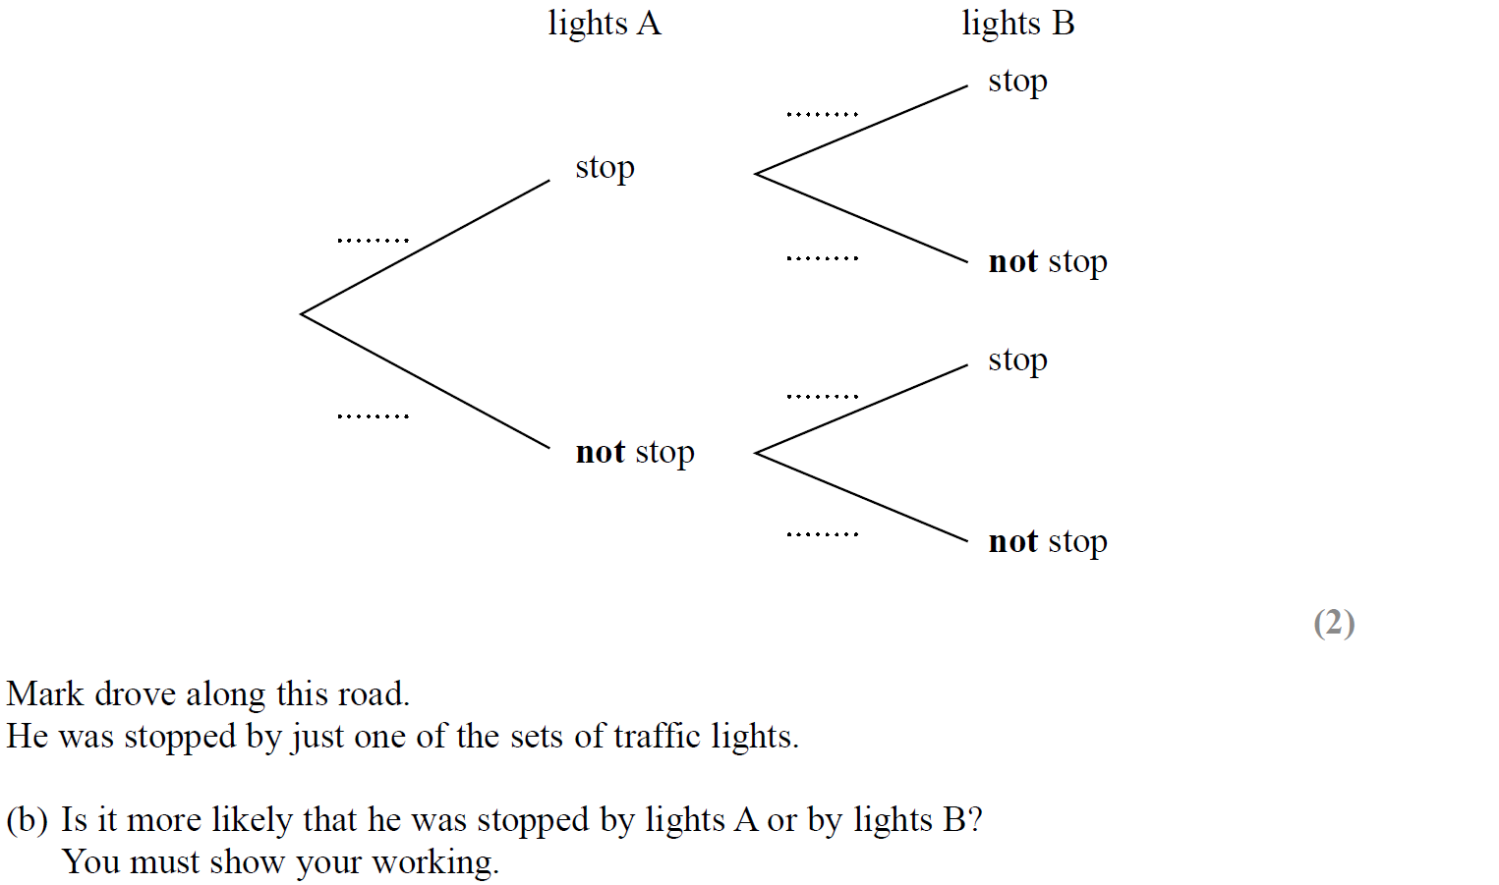
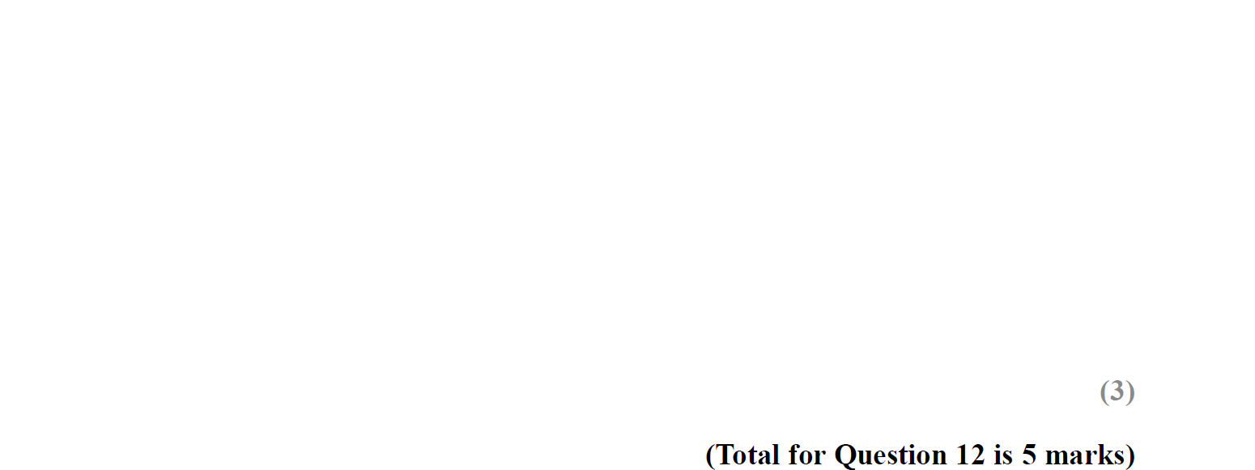
Tree Diagrams
SAM 2H Q12
$$0.3$$
Reveal tree diagram
$$0.4$$
$$0.7$$
$$0.6$$
$$0.8$$
Hide tree diagram
$$0.2$$

Slide 3
Tree Diagrams
SAM 2H Q12
A
B

Slide 4
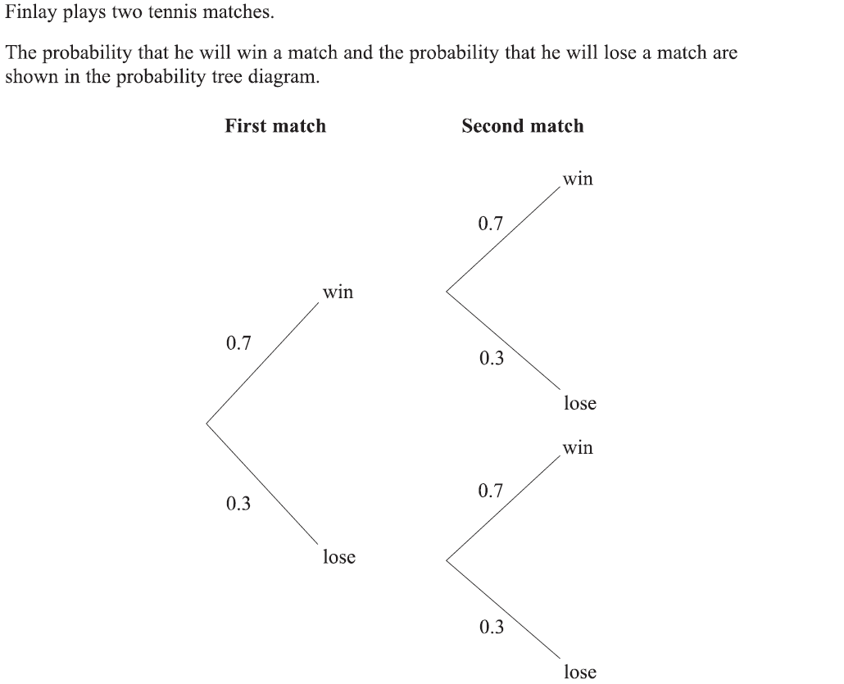
Tree Diagrams
Specimen Set 1 2H Q11

Slide 5
Tree Diagrams
Specimen Set 1 2H Q11
A
B

Slide 6
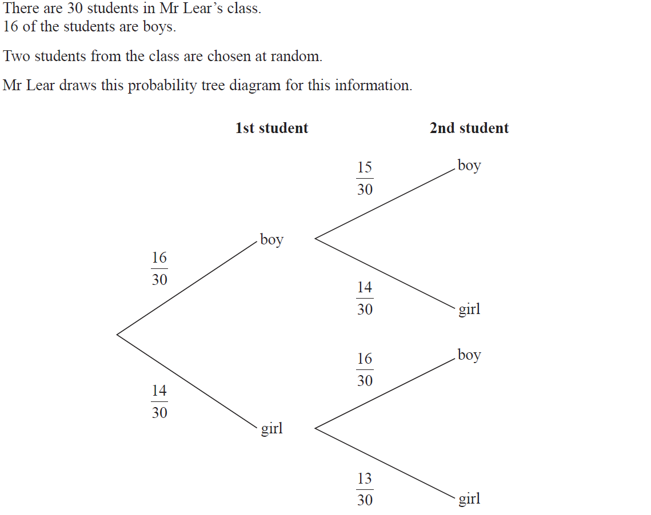
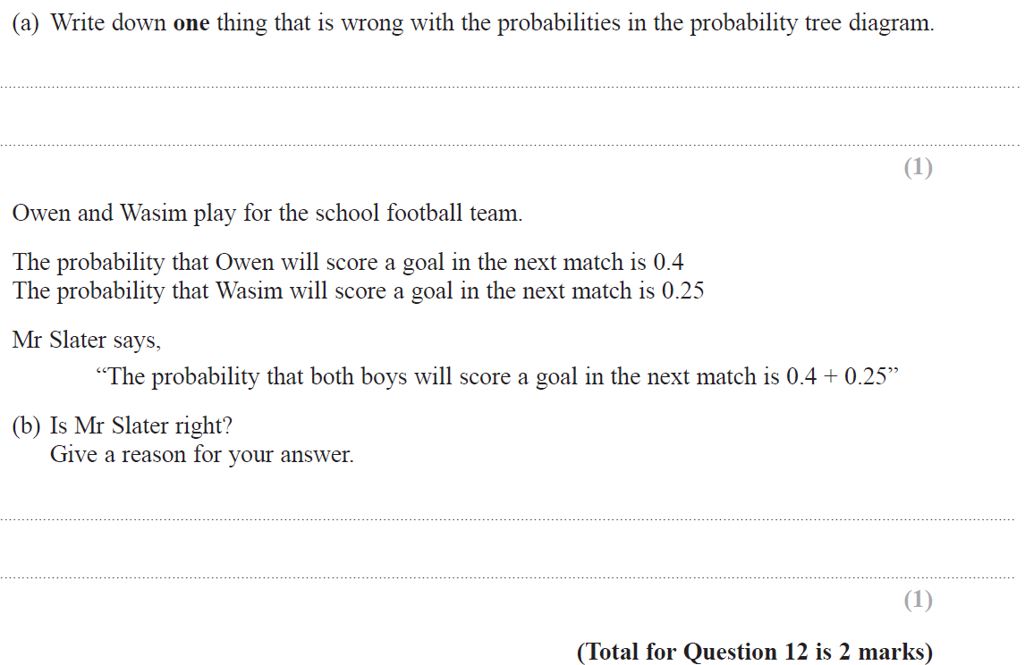
Tree Diagrams
June 2017 2H Q12

Slide 7
Tree Diagrams
June 2017 2H Q12
A
B

Slide 8
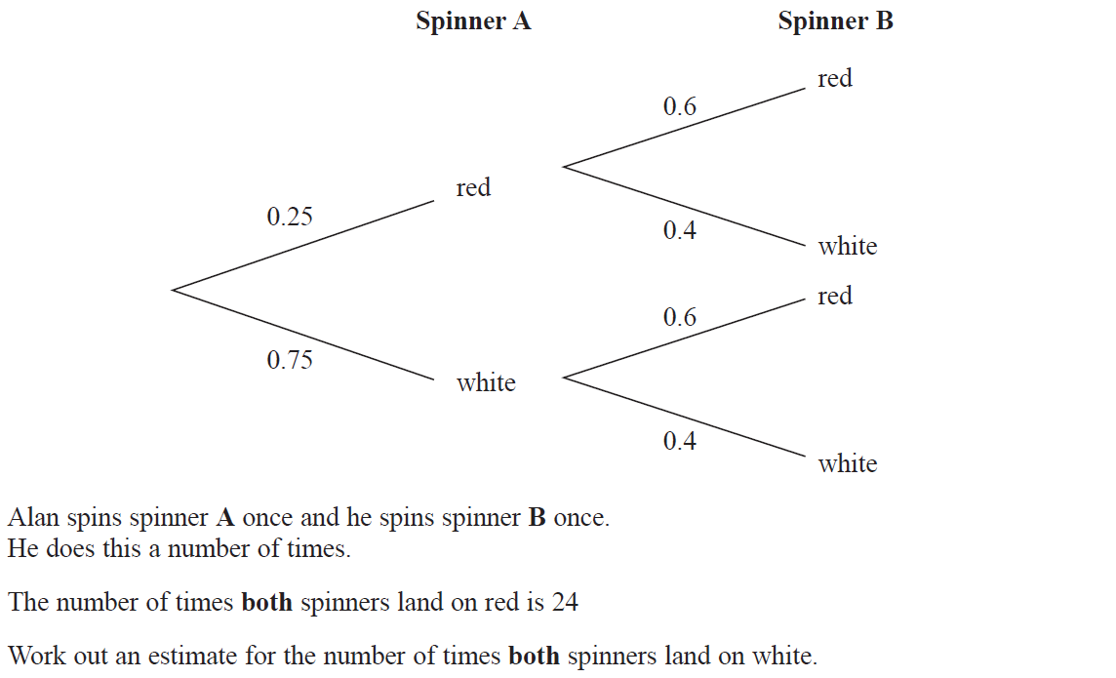
Tree Diagrams
Nov 2017 3H Q12

Slide 9
Tree Diagrams
Nov 2017 3H Q12
A

Slide 10
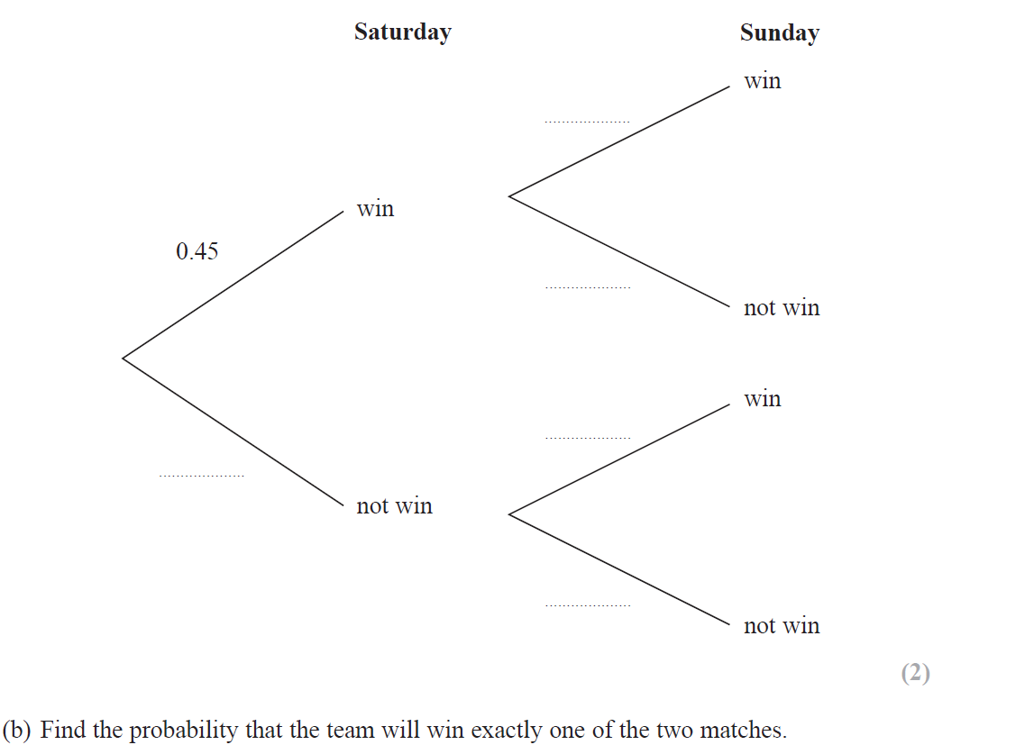
Tree Diagrams
June 2018 2H Q15
$$0.67$$
Reveal tree diagram
$$0.33$$
$$0.35$$
Hide tree diagram
$$0.55$$
$$0.65$$

Slide 11
Tree Diagrams
June 2018 2H Q15
A
B

Slide 12
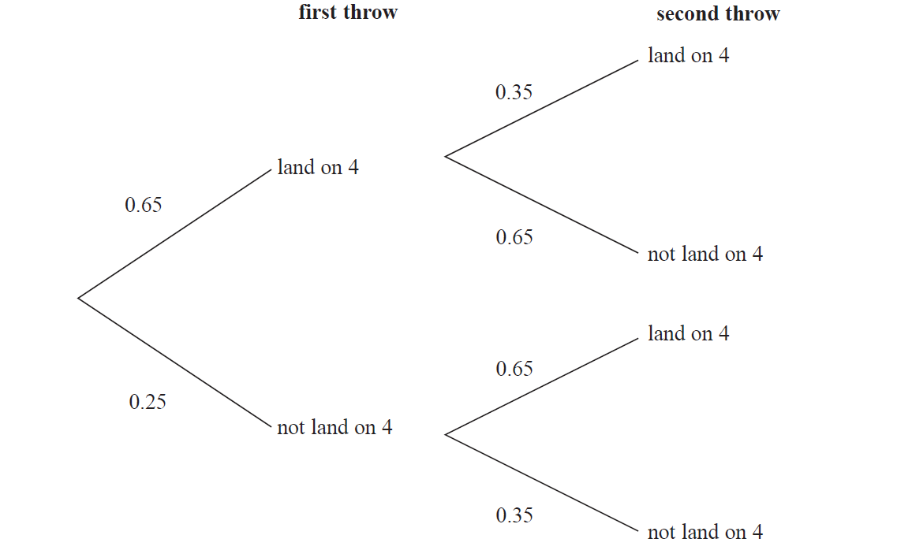
Tree Diagrams
June 2018 3H Q4

Slide 13
Tree Diagrams
June 2018 3H Q4
A

Slide 14
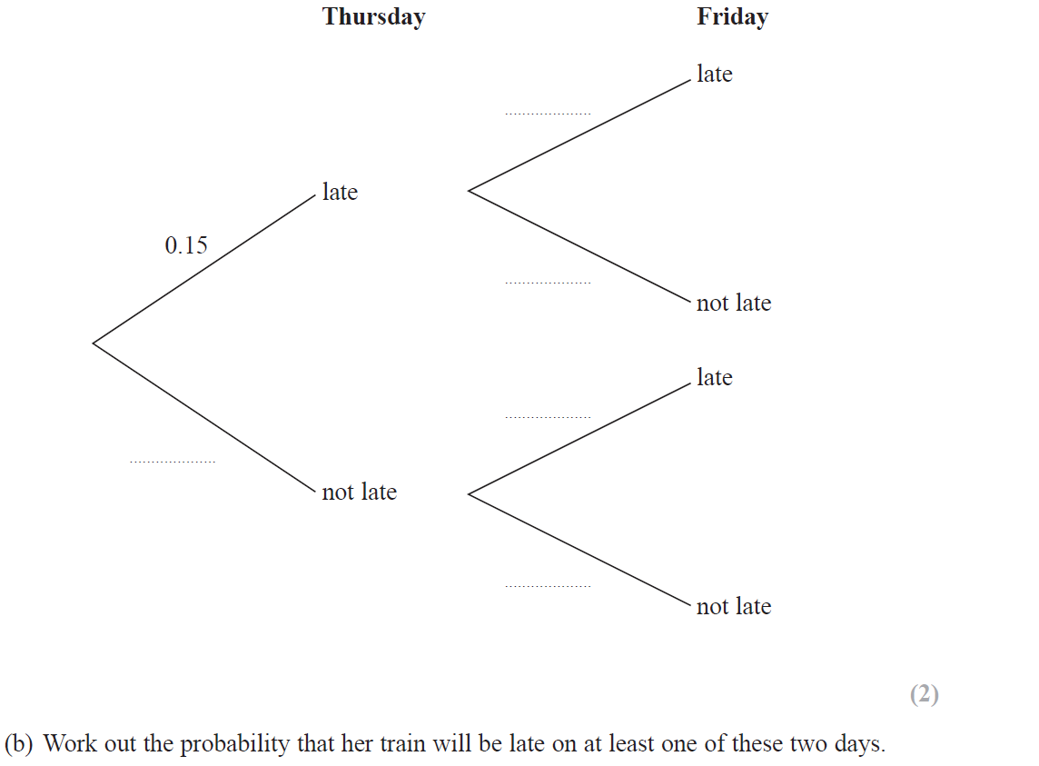
Tree Diagrams
June 2019 2H Q10

Slide 15
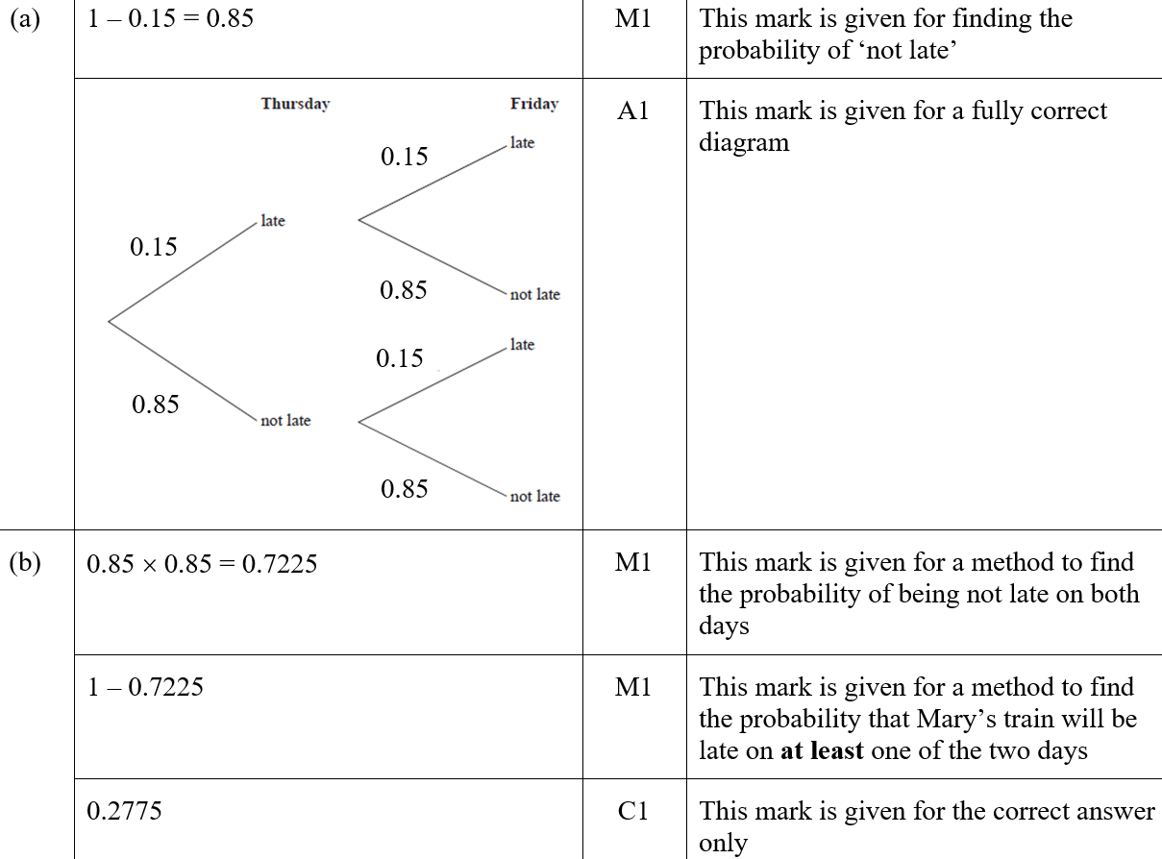
Tree Diagrams
June 2019 2H Q10
A
B
ASF
B SF

