Slide 1
Transformations of Shapes
Transformations of Shapes
May 2017
1H Q21
May 2018
1H Q21
May 2017
1H Q21
SAM
1H Q23
Nov 2018
3H Q1
1 Marker
Nov 2017
2H Q7
Nov 2018
3H Q25
May 2018
1H Q2
Invariant Points & Lines

Slide 2
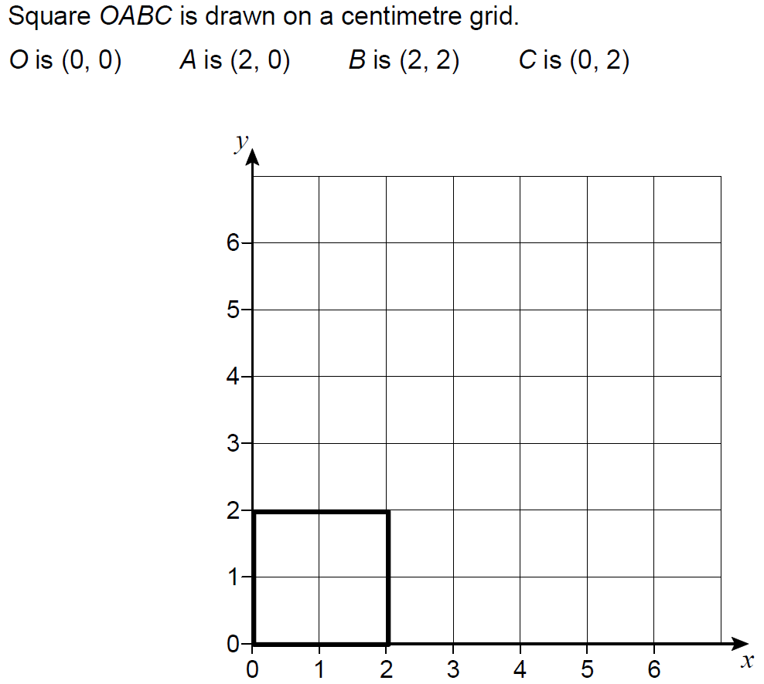
Transformations of Shapes
SAM 1H Q23

Slide 3
Transformations of Shapes
SAM 1H Q23
A
B
C

Slide 4
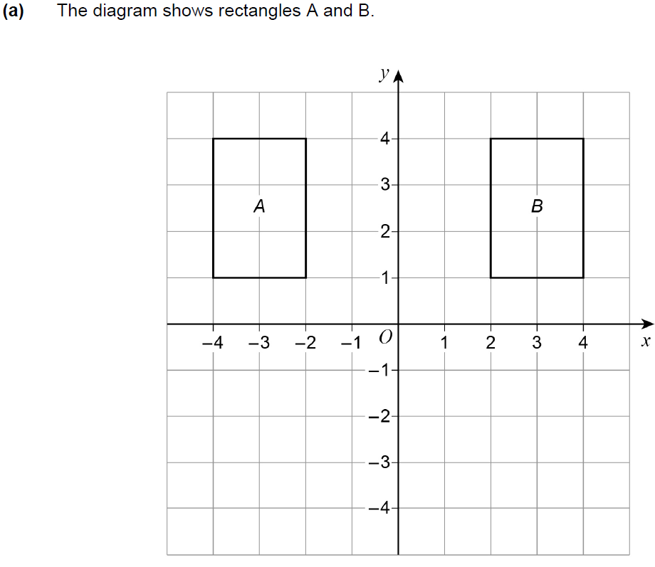
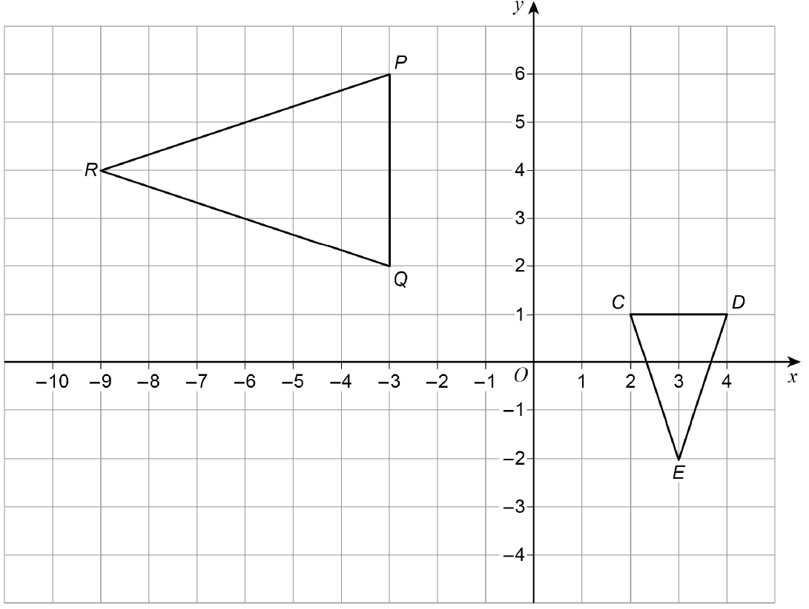
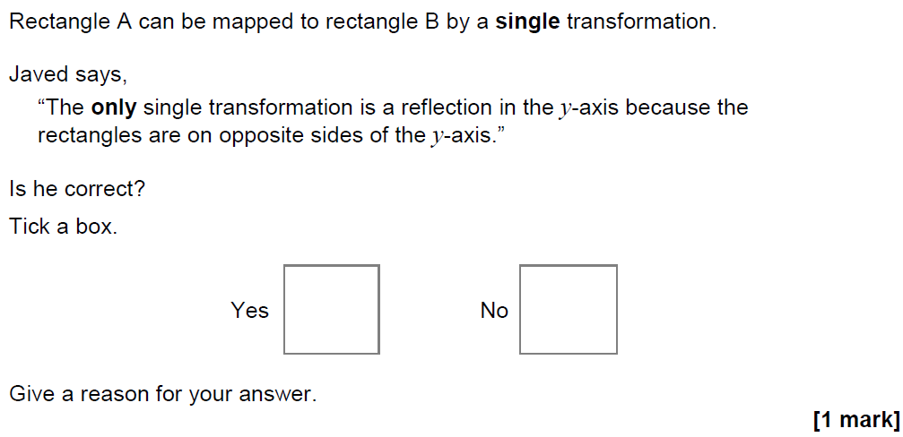
Transformations of Shapes
May 2017 1H Q21

Slide 5
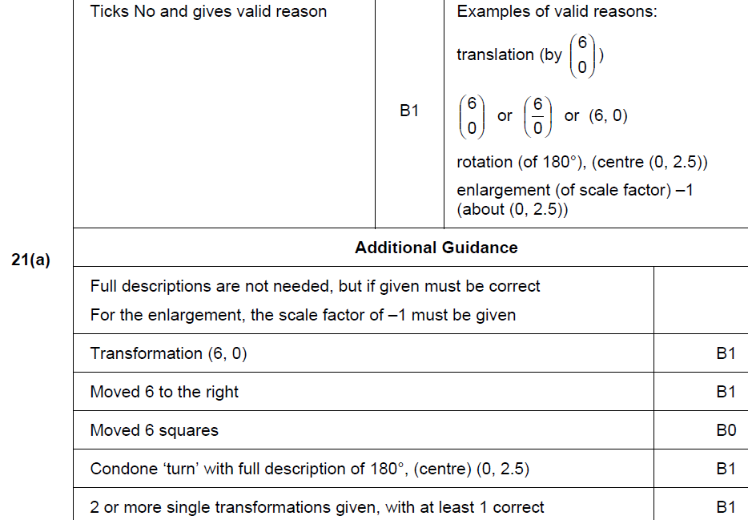
Transformations of Shapes
May 2017 1H Q21
A

Slide 6
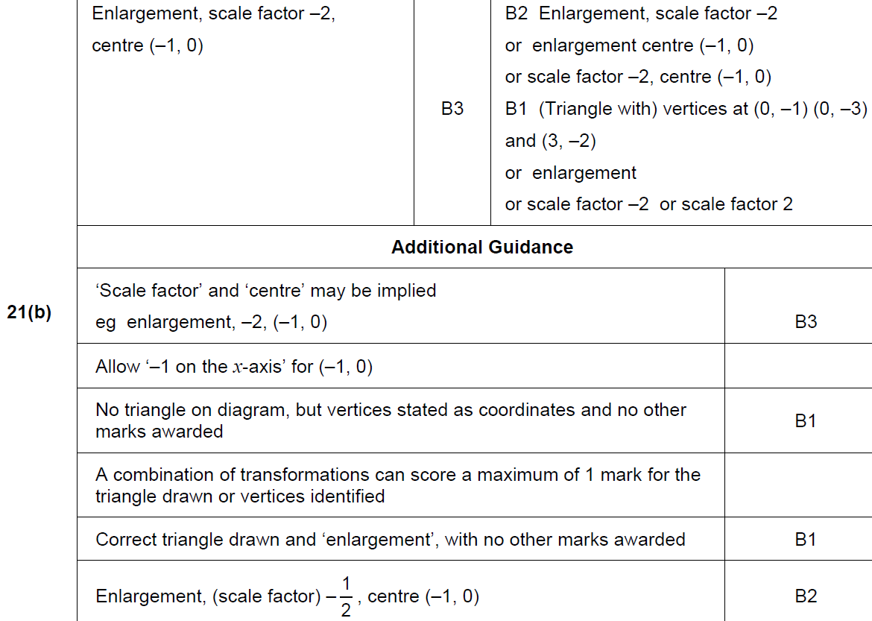
Transformations of Shapes
May 2017 1H Q21
B

Slide 7
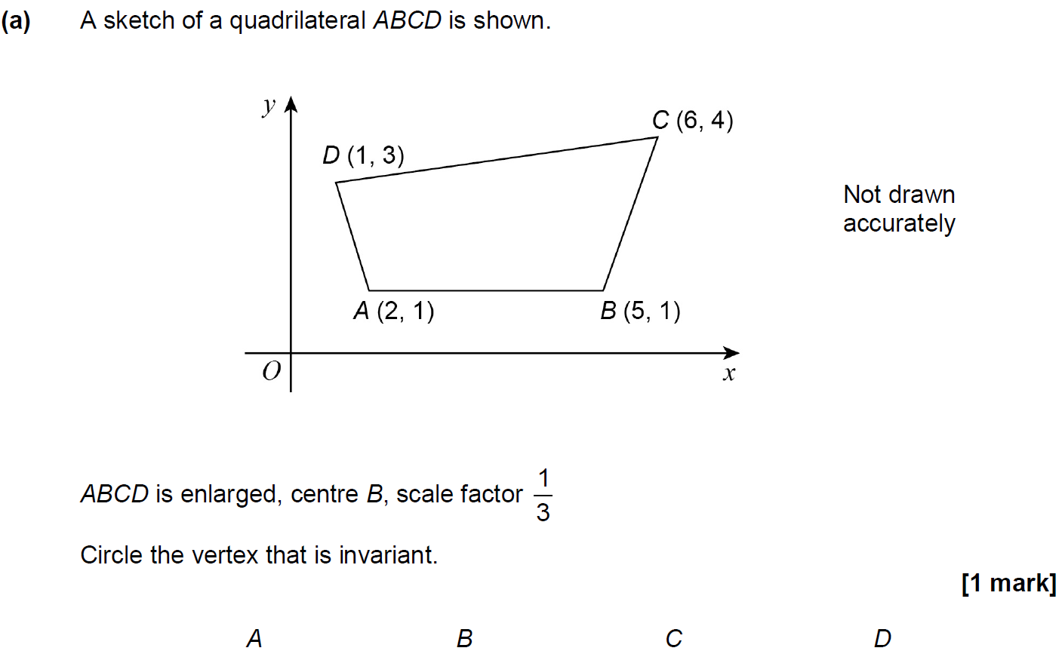
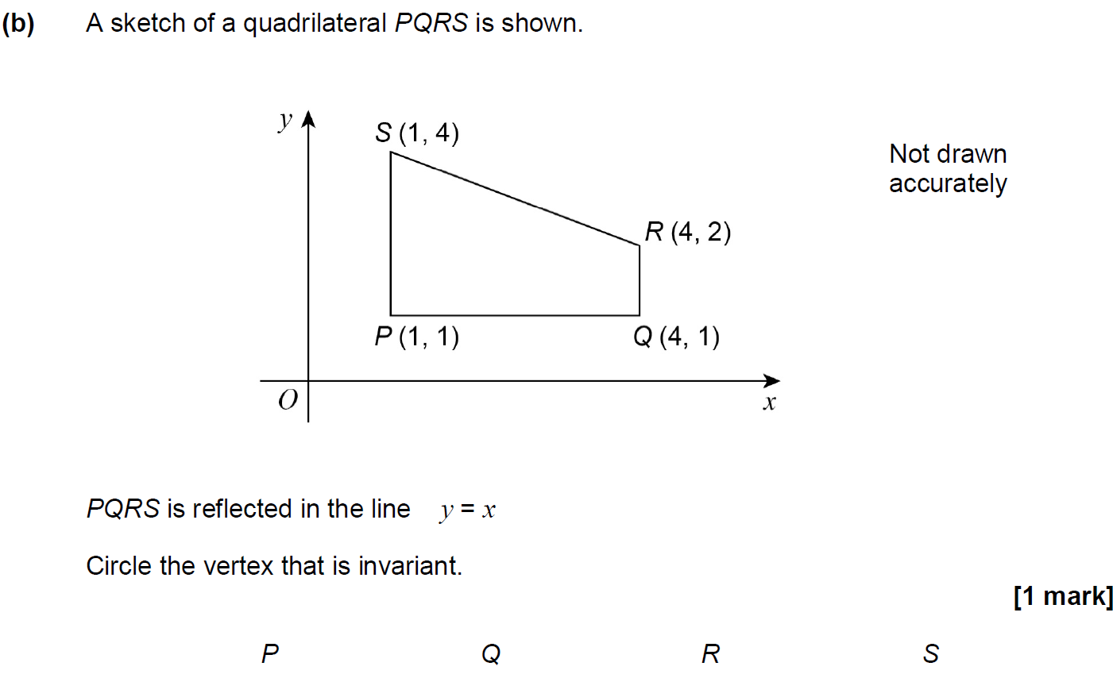
Transformations of Shapes
June 2017 2H Q26

Slide 8
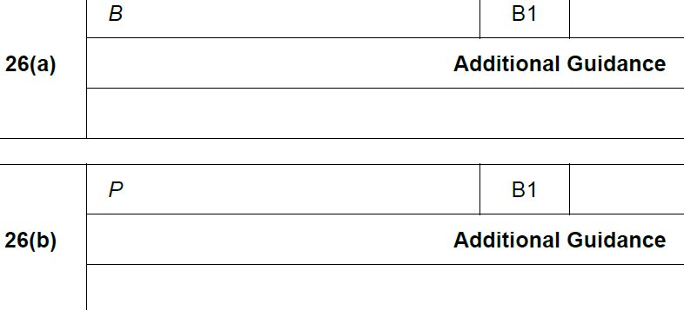
Transformations of Shapes
June 2017 2H Q26
A
B

Slide 9
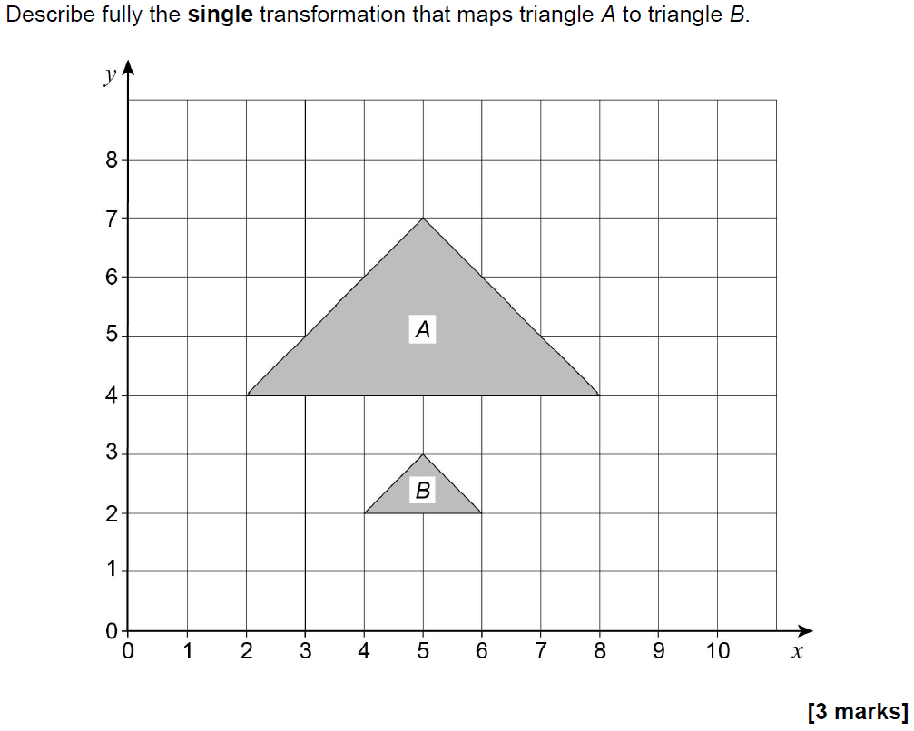
Transformations of Shapes
Nov 2017 2H Q7

Slide 10
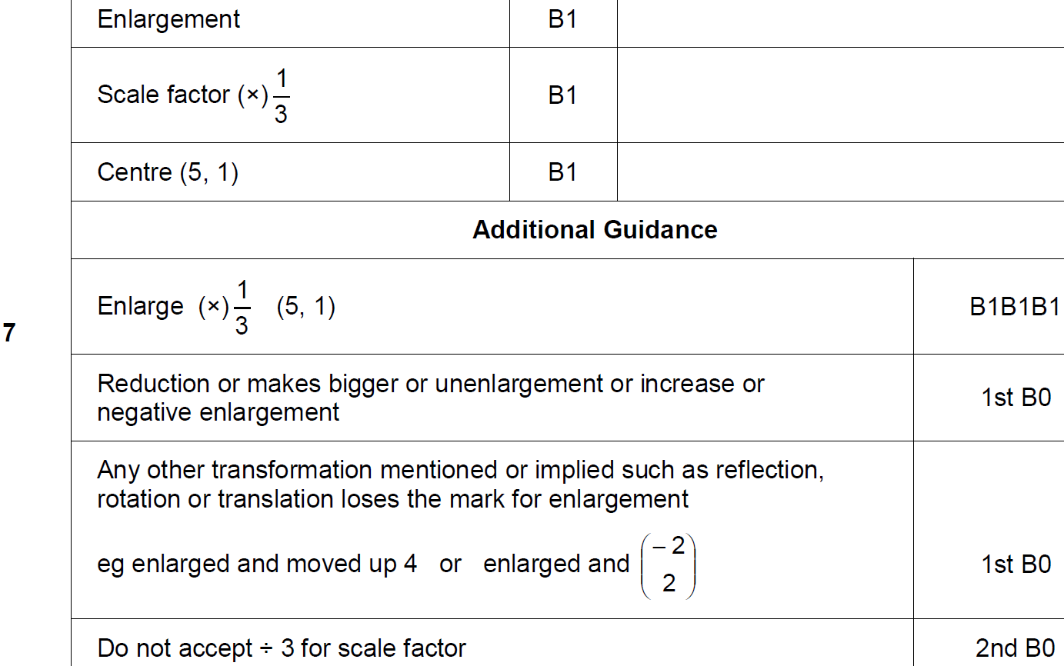
Transformations of Shapes
Nov 2017 2H Q7
A

Slide 11
Transformations of Shapes
May 2018 1H Q2

Slide 12
Transformations of Shapes
May 2018 1H Q2
A

Slide 13
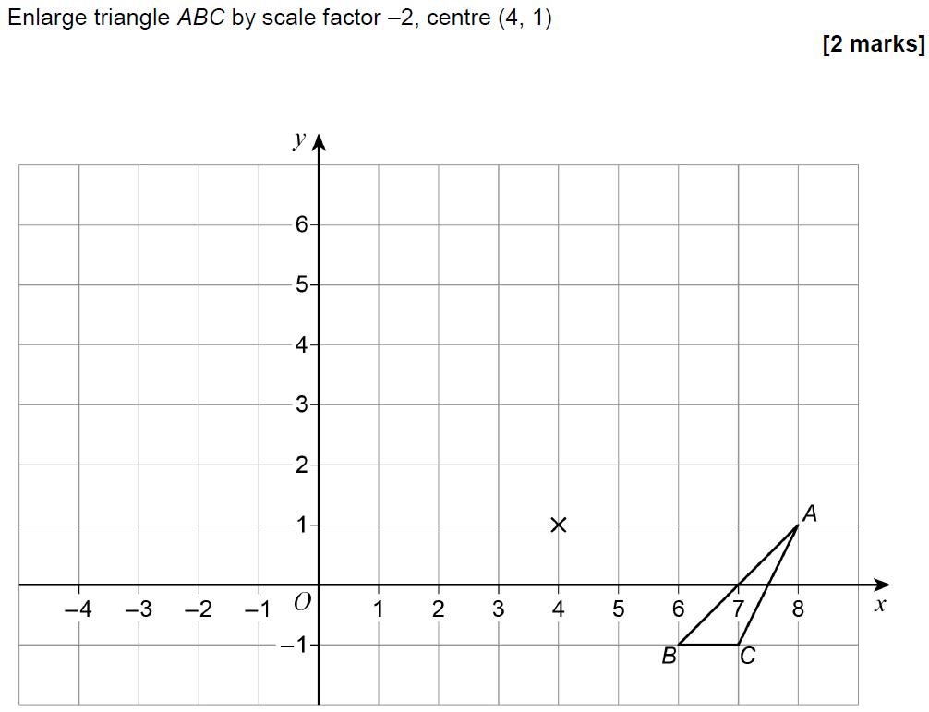
Transformations of Shapes
May 2018 1H Q21

Slide 14
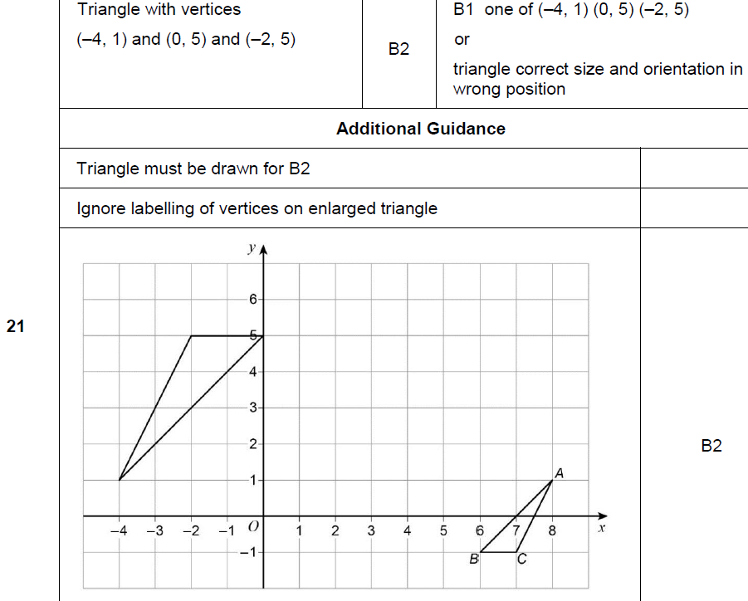
Transformations of Shapes
May 2018 1H Q21
A

Slide 15
Transformations of Shapes
Nov 2018 3H Q1

Slide 16
Transformations of Shapes
Nov 2018 3H Q1
A

Slide 17
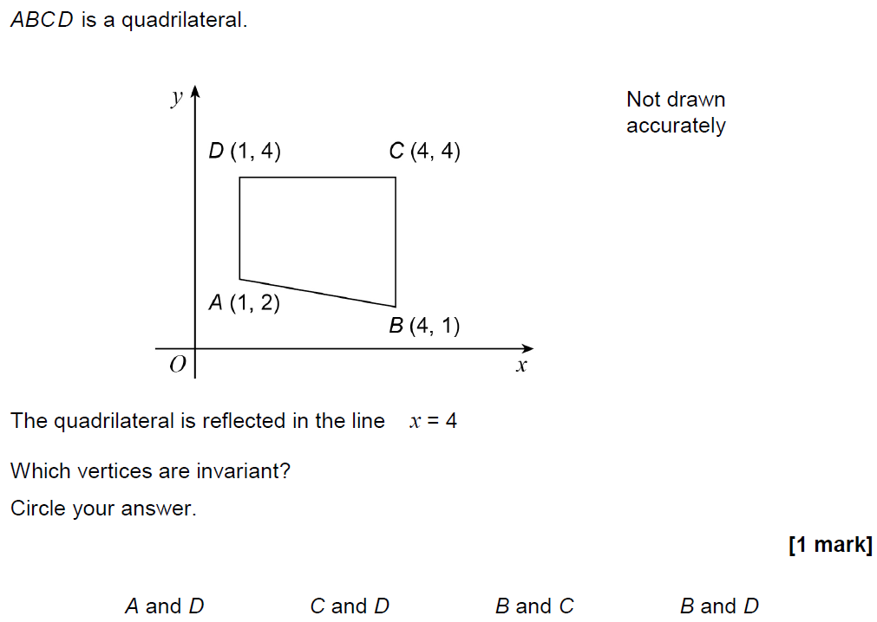
Transformations of Shapes
Nov 2018 3H Q25

Slide 18
Transformations of Shapes
Nov 2018 3H Q25
A

