Slide 1
Transformations of Shapes
Transformations of Shapes
Old Spec Q’s
SAM
2H Q6
May 2018
1HR Q3
Jan 2019
1H Q2

Slide 2
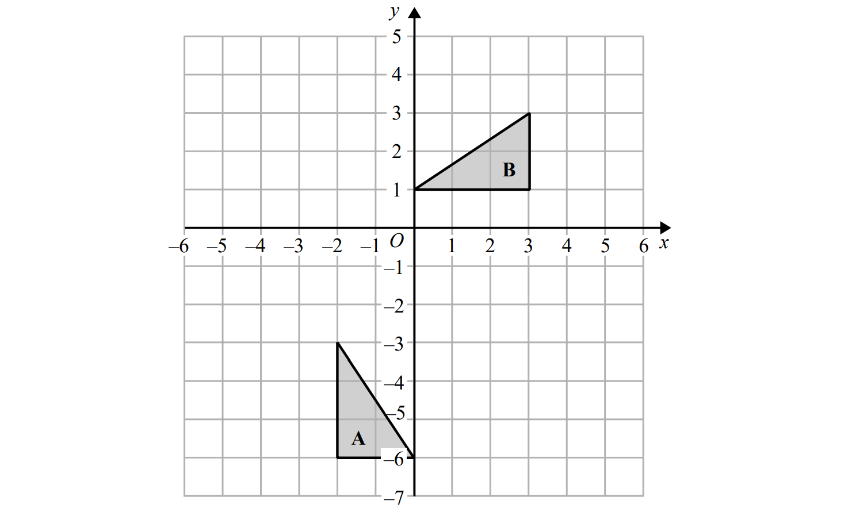
Transformations of Shapes
SAM 2H Q6
Reveal Shape (a)
A’ .

Slide 3
Transformations of Shapes
SAM 2H Q6
A
B

Slide 4
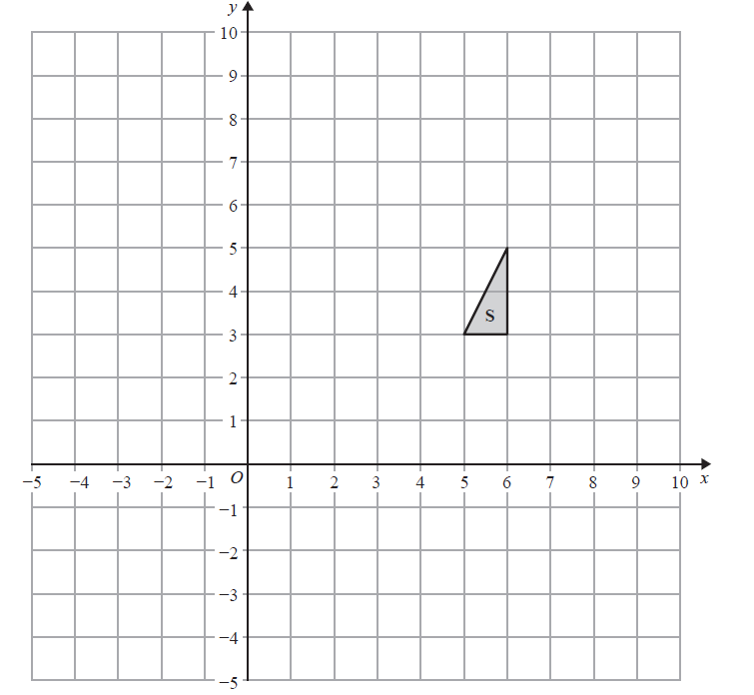
Transformations of Shapes
May 2018 1HR Q3
Reveal Shape (a)
R .
Reveal Shape (b)
T

Slide 5
Transformations of Shapes
May 2018 1HR Q3
A
B

Slide 6
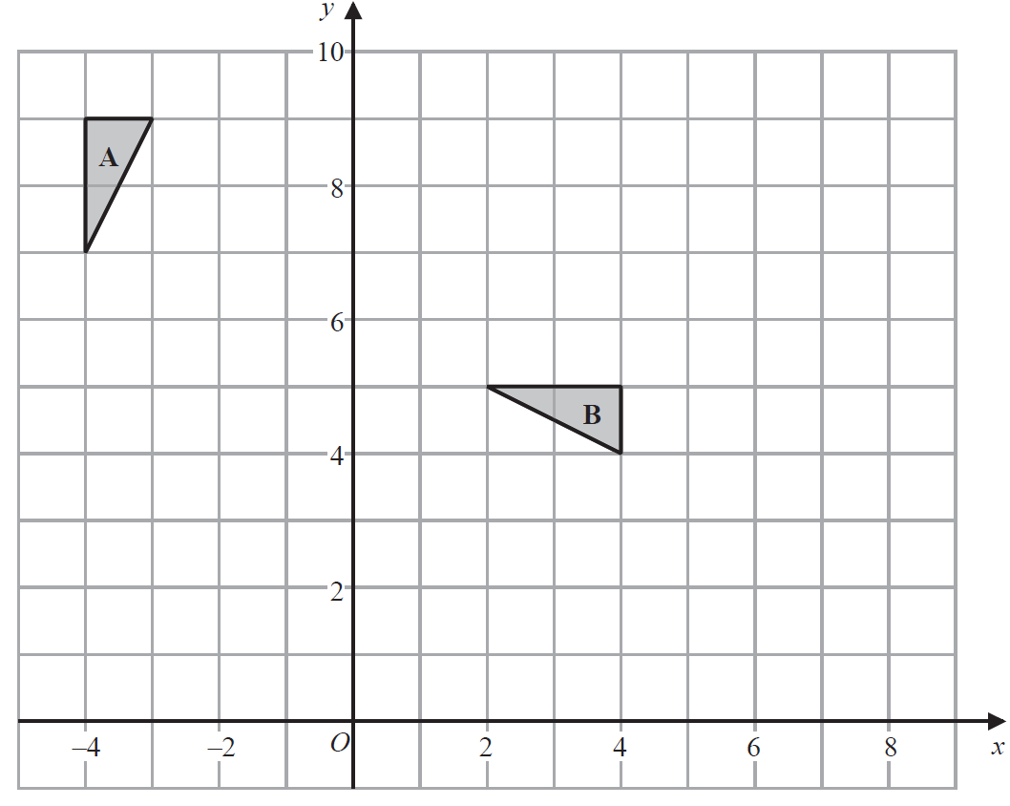
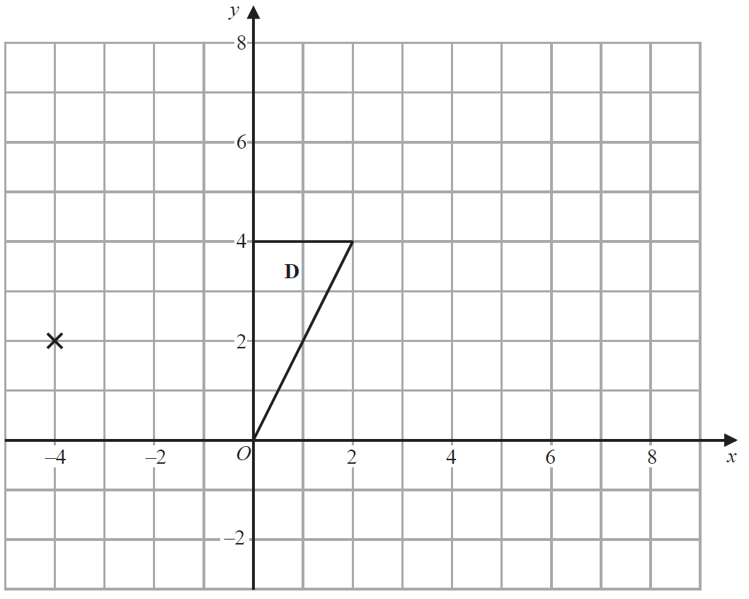
Transformations of Shapes
Jan 2019 1H Q2
D’ .
C .
Reveal Shape (c)
Reveal Shape (b)

Slide 7
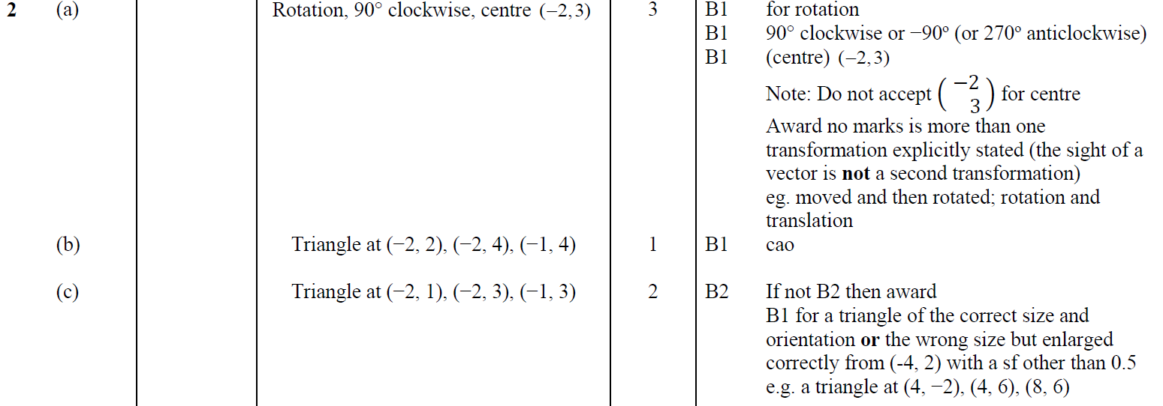
Transformations of Shapes
Jan 2019 1H Q2
A
B
B

Slide 8
Transformations of Shapes
Transformations of Shapes
New Spec Q’s
May 2004
4H Q6
Nov 2007
4H Q4
Jan 2012 4H Q12
May 2014 3H Q3
June 2016 4HR Q1
May 2005
3H Q4
May 2008
3H Q3
May 2012 4H Q4
May 2014 4HR Q4
Jan 2017 4H Q11
Nov 2005
3H Q9
Nov 2008
3H Q4
Jan 2013 3H Q4
Jan 2015 4H Q5
Jan 2017 3HR Q6
Nov 2005
4H Q6
May 2009
3H Q3
May 2013 4H Q4
Jan 2015 3HR Q7
Jan 2017 3H Q2
Nov 2005
4H Q20
June 2009
4H Q7
May 2013 3HR Q6
June 2015 4H Q5
May 2017 3HR Q8
May 2006
3H Q3
Nov 2009
4H Q6
May 2013 4HR Q2
May 2015 3HR Q5
Jan 2018 4H Q6
Nov 2006
3H Q10
June 2010
3H Q9
Jan 2014 3H Q9
Jan 2016 3HR Q3
Jan 2018 4HR Q5
Nov 2006
4H Q11
Nov 2010
4H Q7
Jan 2014 4H Q5
June 2016 4H Q8
May 2018 3H Q4
May 2007
3H Q4
June 2011 3H Q6
Jan 2014 4HR Q7
May 2016 3HR Q8
June 2018 4HR Q5

Slide 9
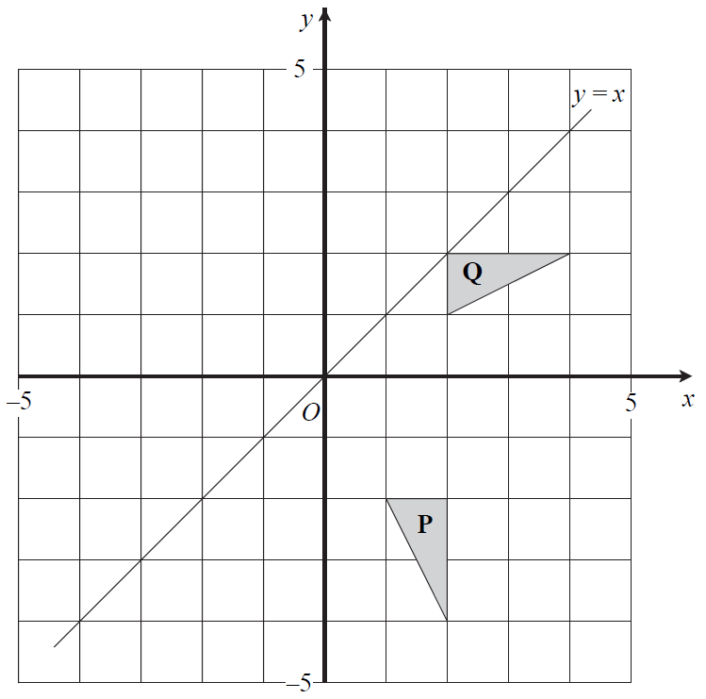
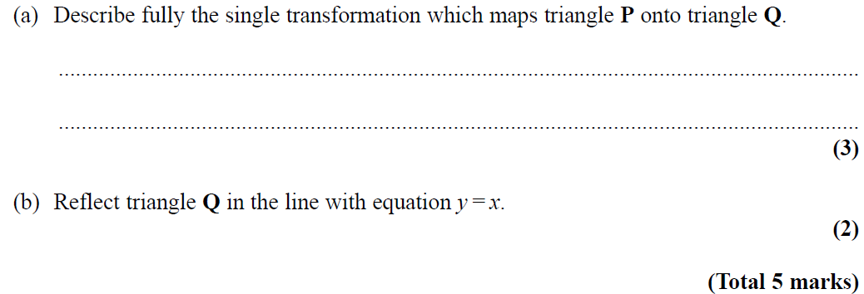
Transformations of Shapes
May 2004 4H Q6
Reveal Shape (b)

Slide 10
Transformations of Shapes
May 2004 4H Q6
A
B

Slide 11
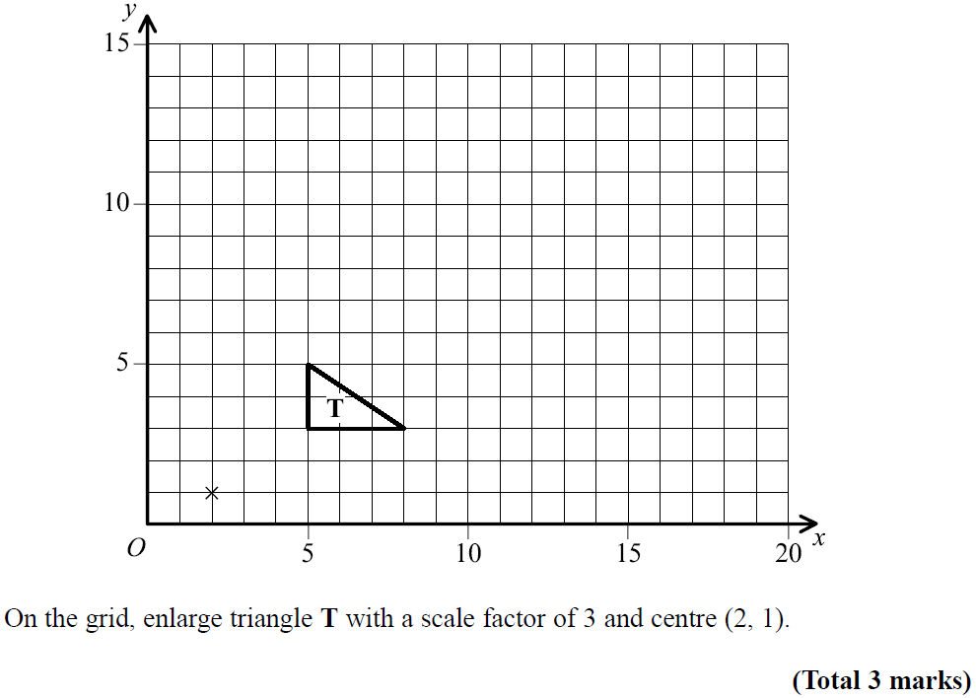
Transformations of Shapes
May 2005 3H Q4
Reveal Shape (b)

Slide 12
Transformations of Shapes
May 2005 3H Q4
A

Slide 13
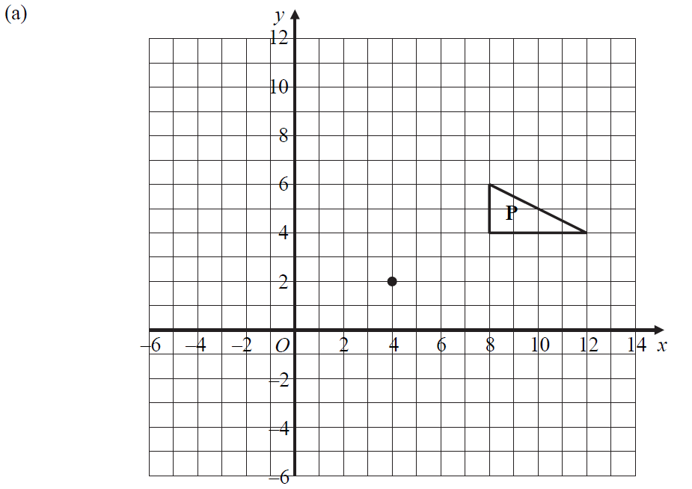
Transformations of Shapes
Nov 2005 3H Q9
a
Reveal Shape (a)
b
Reveal Shape (b)

Slide 14
Transformations of Shapes
Nov 2005 3H Q9
A
B

Slide 15
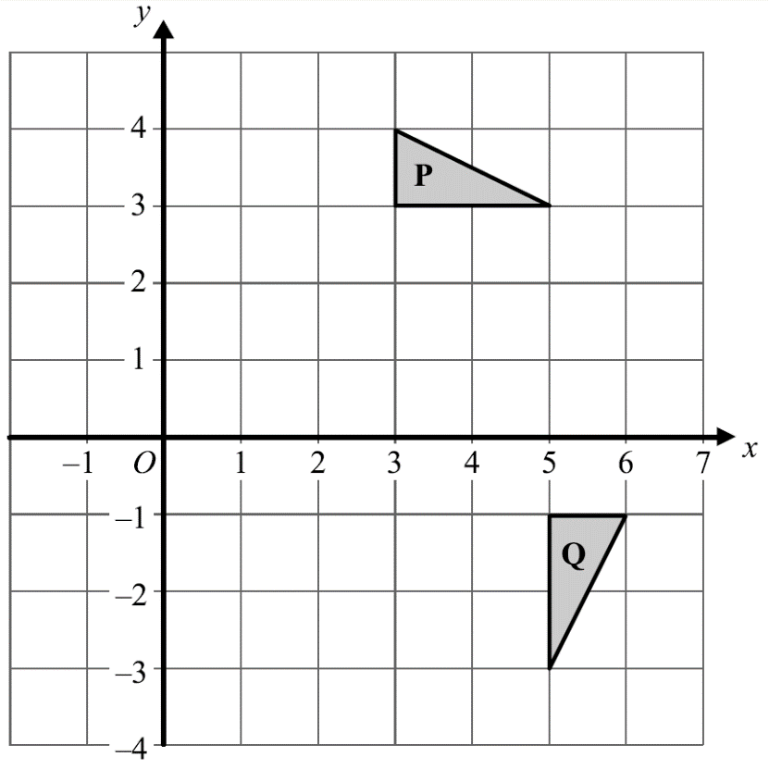
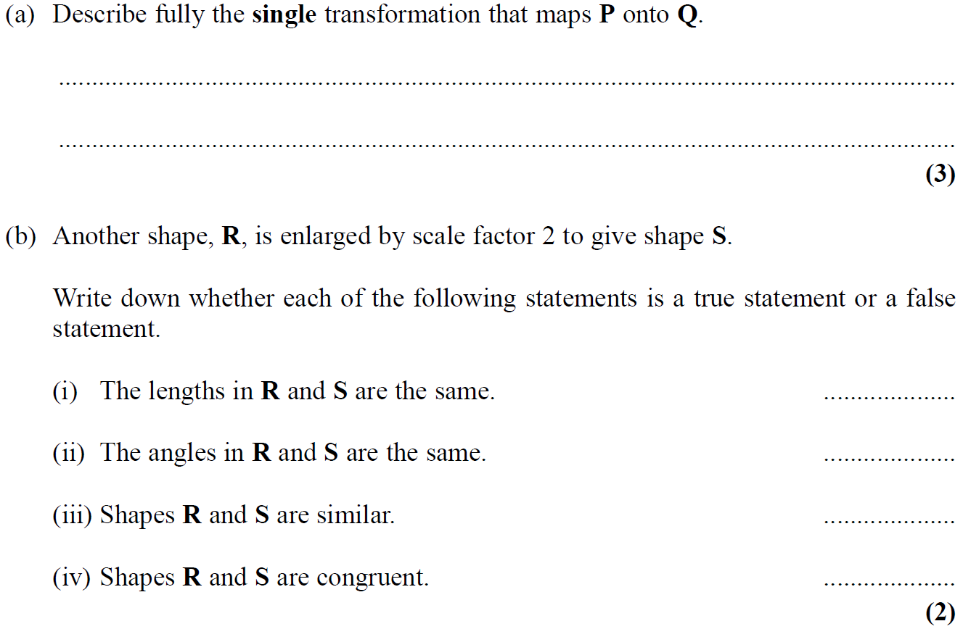
Transformations of Shapes
Nov 2005 4H Q6

Slide 16
Transformations of Shapes
Nov 2005 4H Q6
A
B

Slide 17
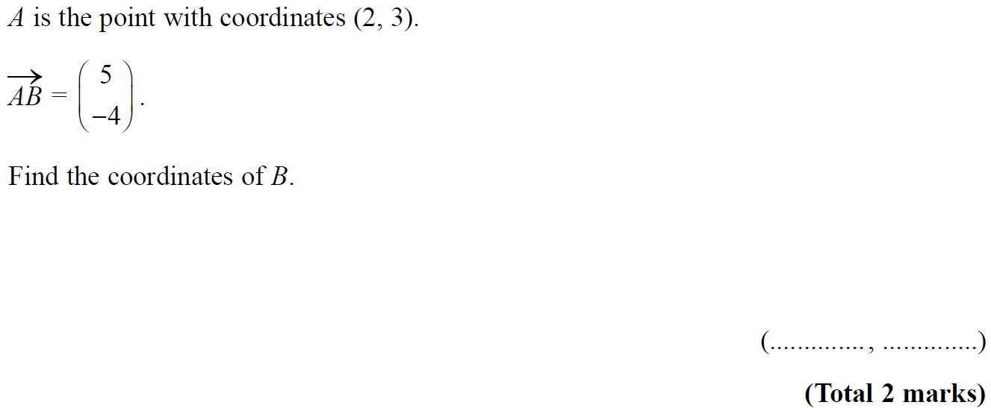
Transformations of Shapes
Nov 2005 4H Q20

Slide 18
Transformations of Shapes
Nov 2005 4H Q20
A

Slide 19
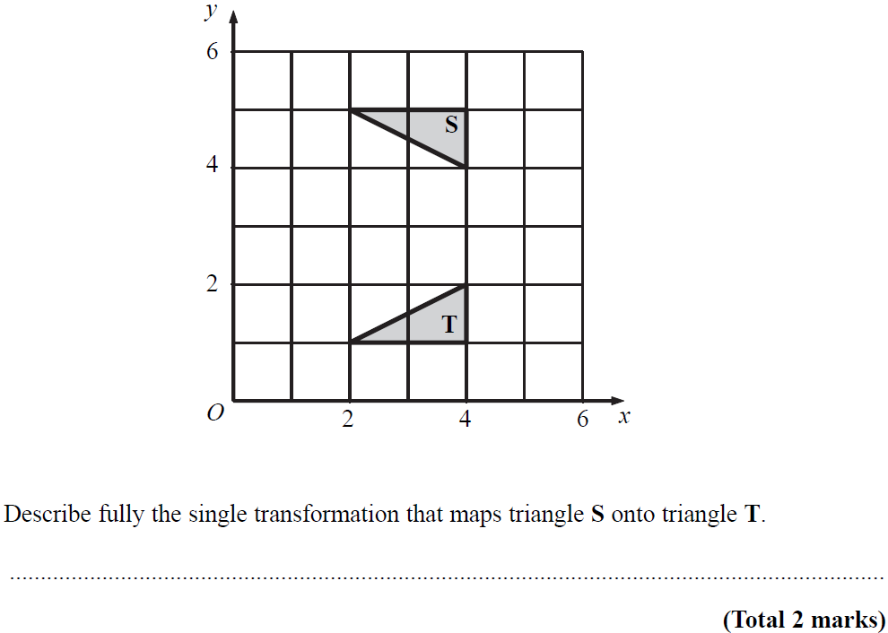
Transformations of Shapes
May 2006 3H Q3

Slide 20
Transformations of Shapes
May 2006 3H Q3
A

Slide 21
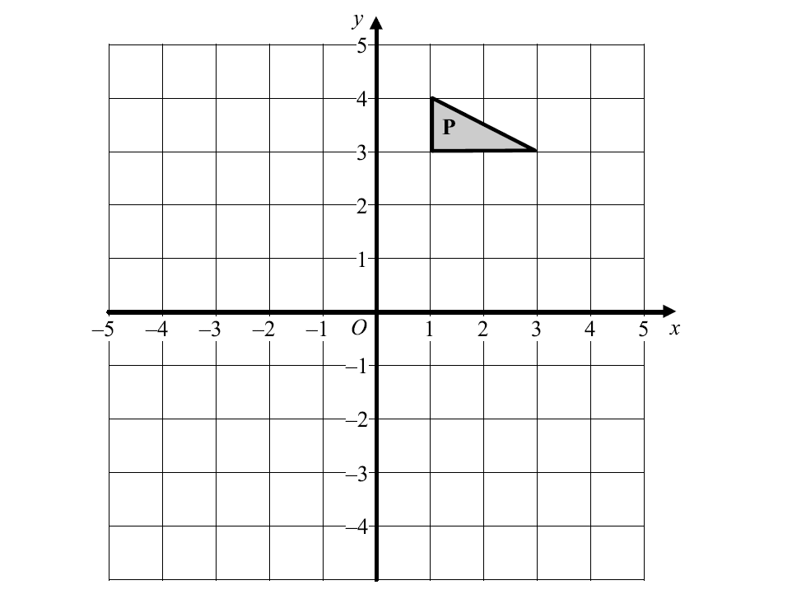
Transformations of Shapes
Nov 2006 3H Q10
Q
Reveal Shape after reflection
R
Reveal Shape after rotation

Slide 22
Transformations of Shapes
Nov 2006 3H Q10
A

Slide 23
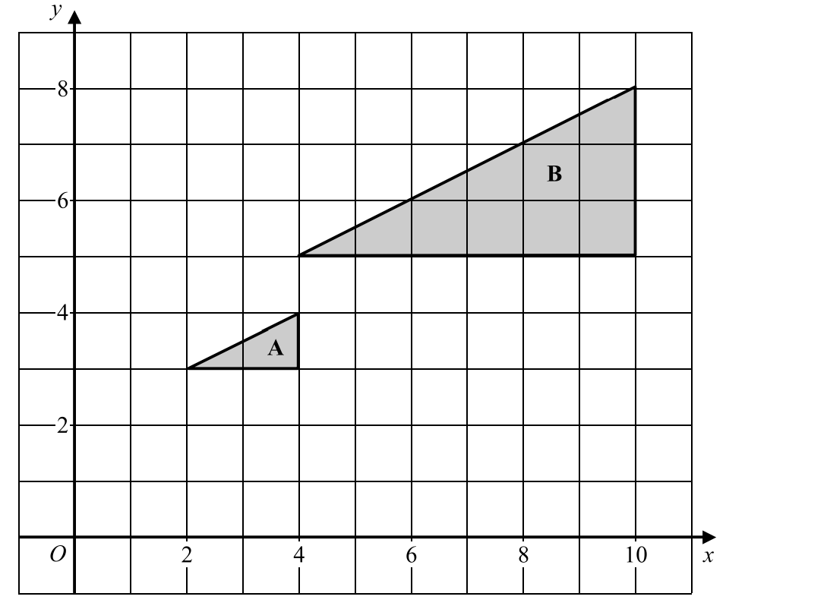
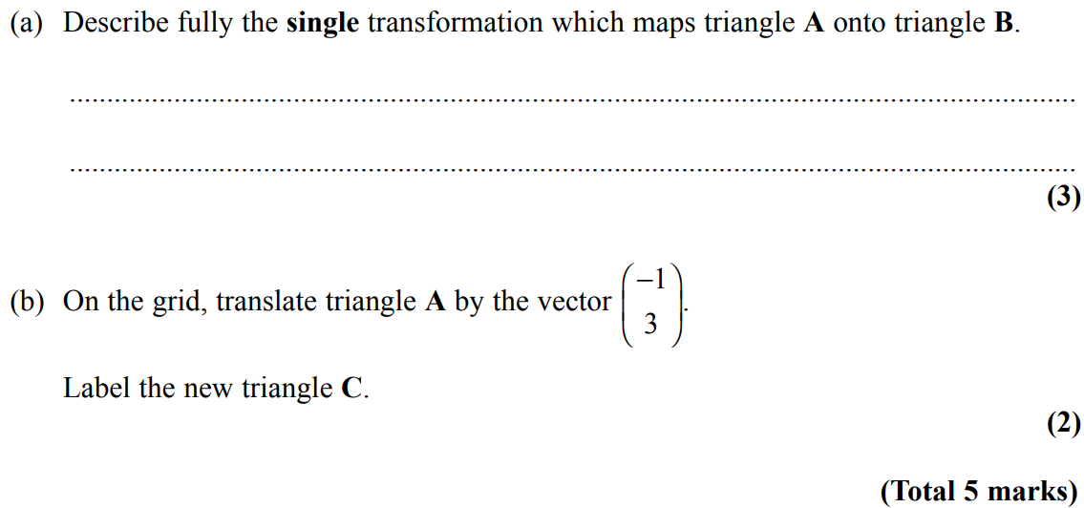
Transformations of Shapes
Nov 2006 4H Q11
C
Reveal Shape (b)

Slide 24
Transformations of Shapes
Nov 2006 4H Q11
A
B

Slide 25
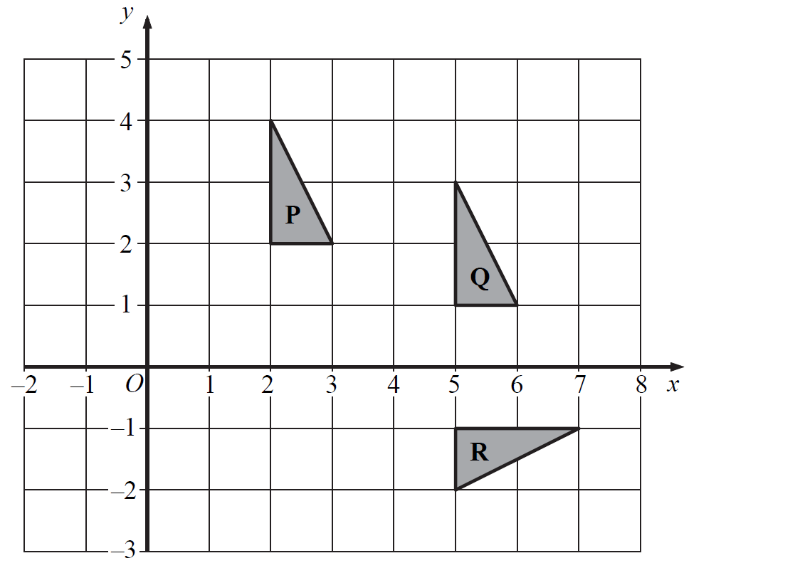
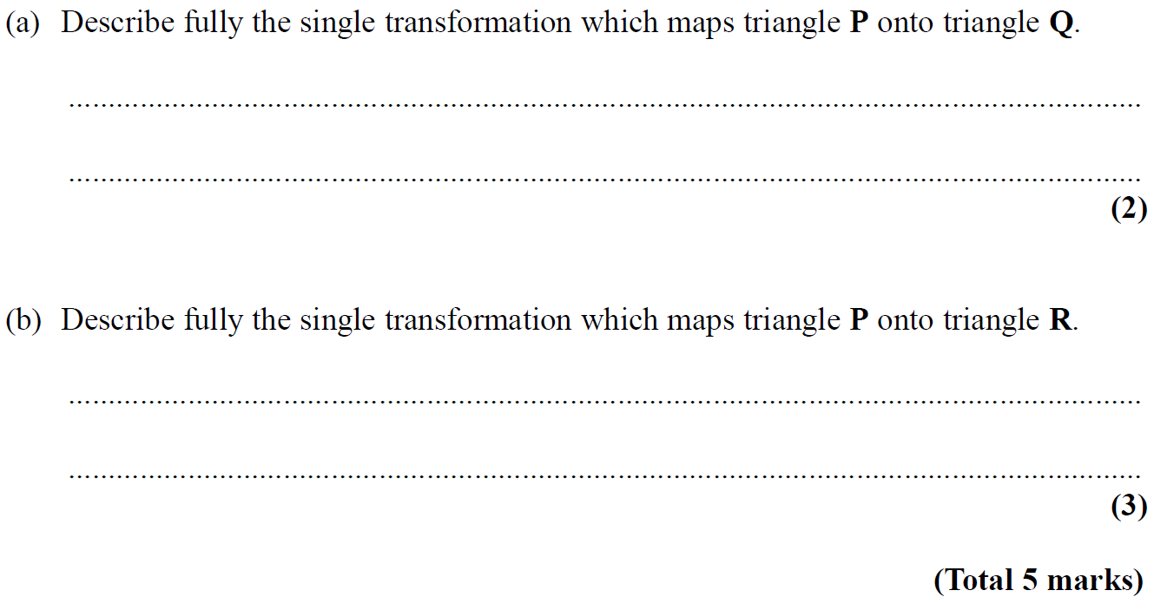
Transformations of Shapes
May 2007 3H Q4

Slide 26
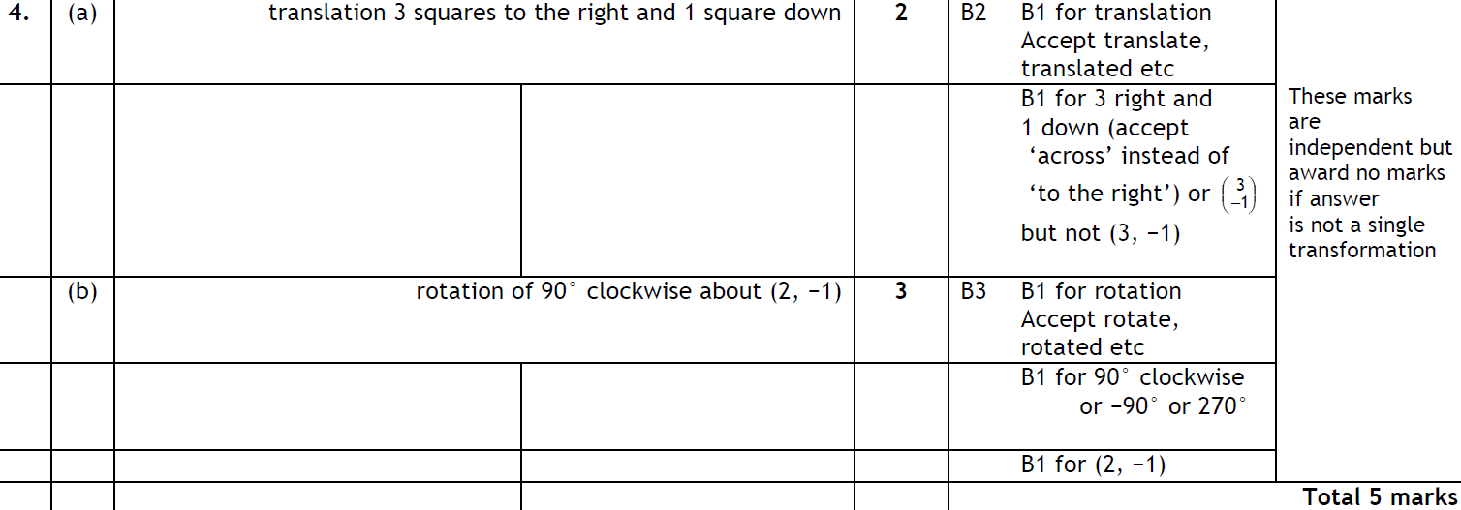
Transformations of Shapes
May 2007 3H Q4
A
B

Slide 27
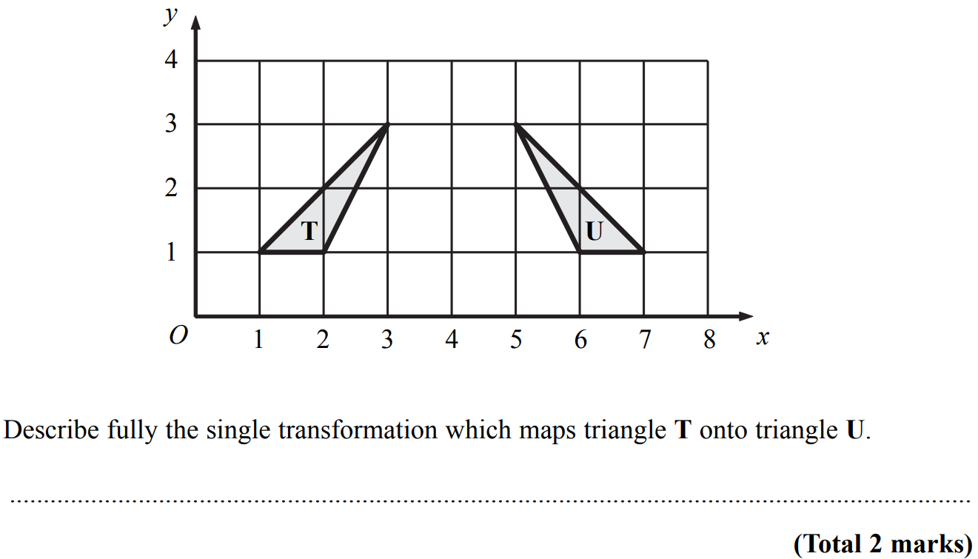
Transformations of Shapes
Nov 2007 4H Q4

Slide 28
Transformations of Shapes
Nov 2007 4H Q4
A

Slide 29
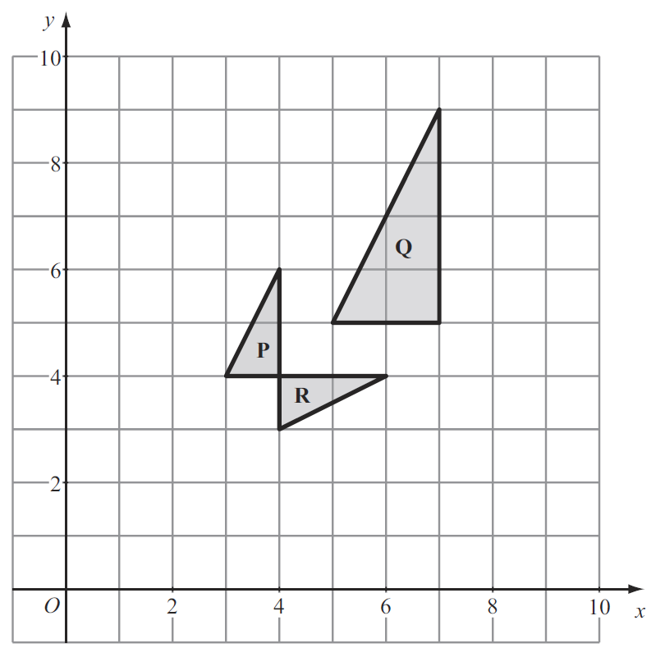
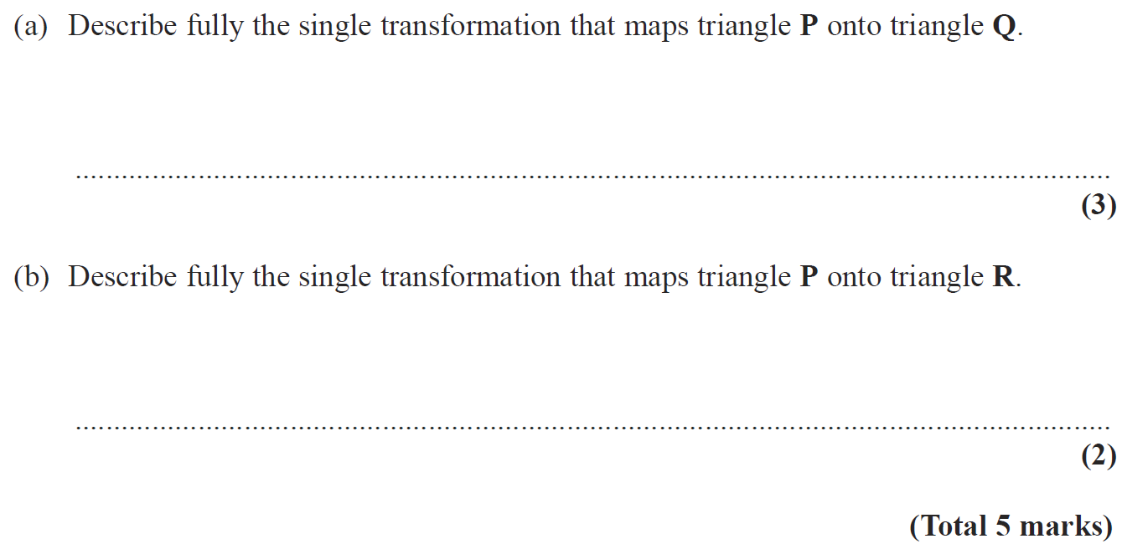
Transformations of Shapes
May 2008 3H Q3

Slide 30
Transformations of Shapes
May 2008 3H Q3
A
notes
B

Slide 31
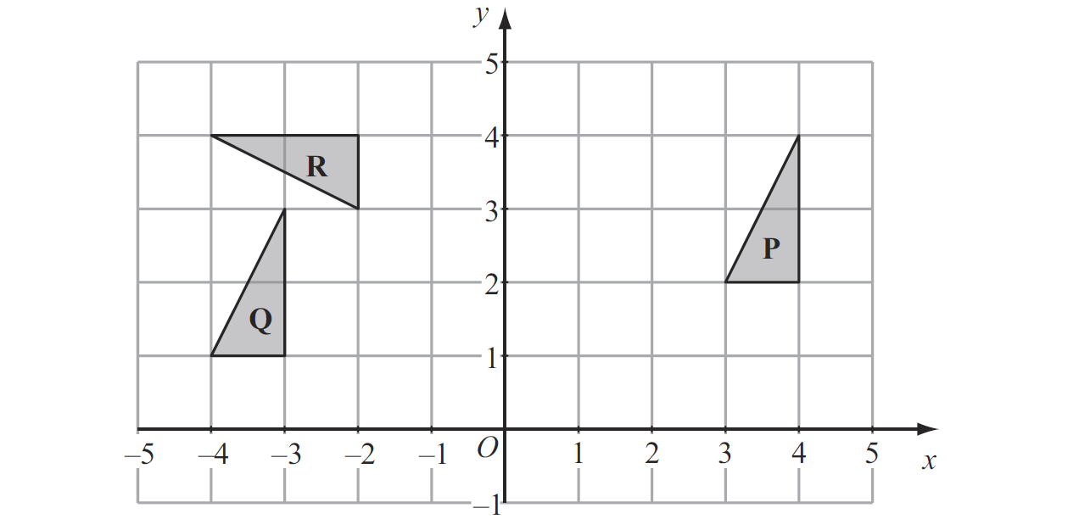
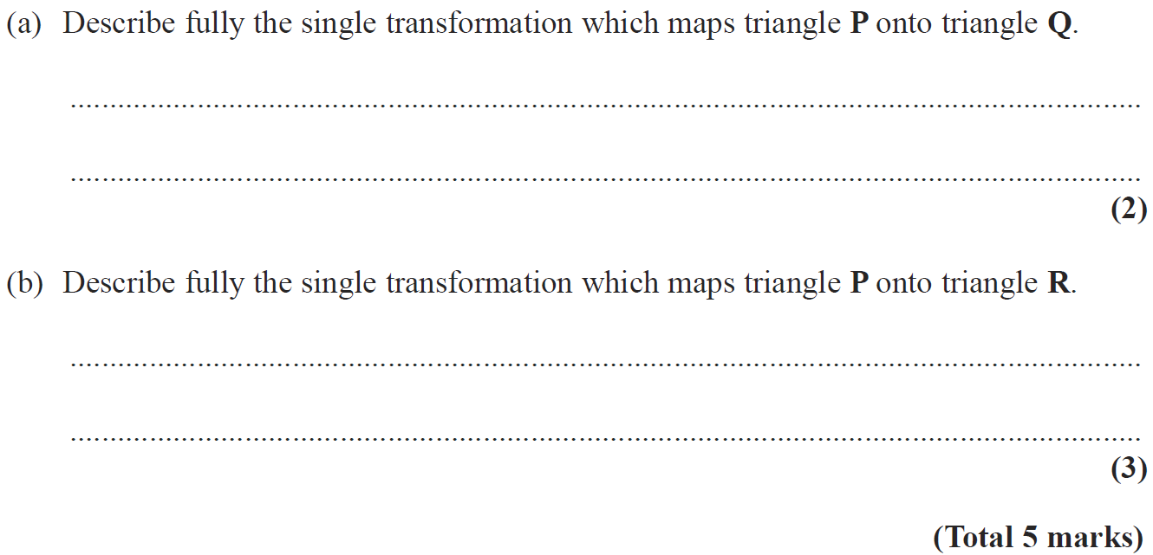
Transformations of Shapes
Nov 2008 3H Q4

Slide 32
Transformations of Shapes
Nov 2008 3H Q4
A
notes
B

Slide 33
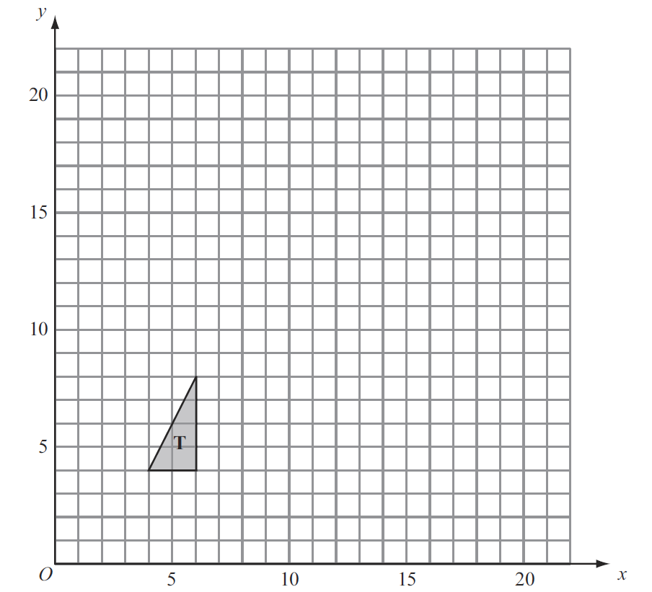
Transformations of Shapes
May 2009 3H Q3
Reveal Shape

Slide 34
Transformations of Shapes
May 2009 3H Q3
A

Slide 35
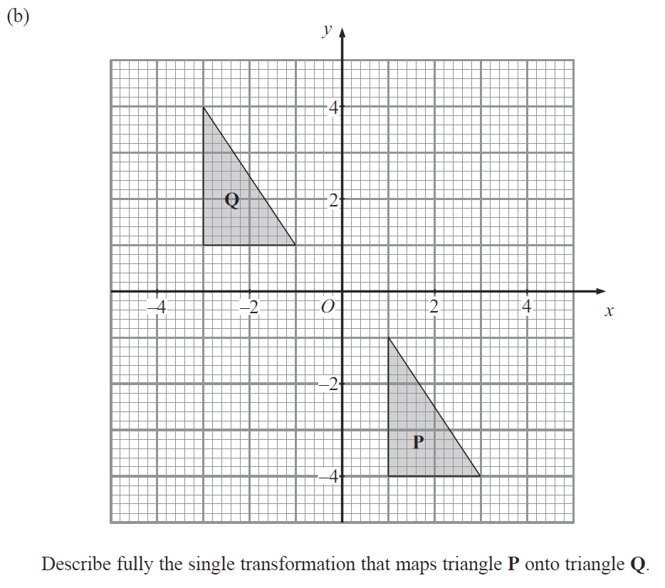
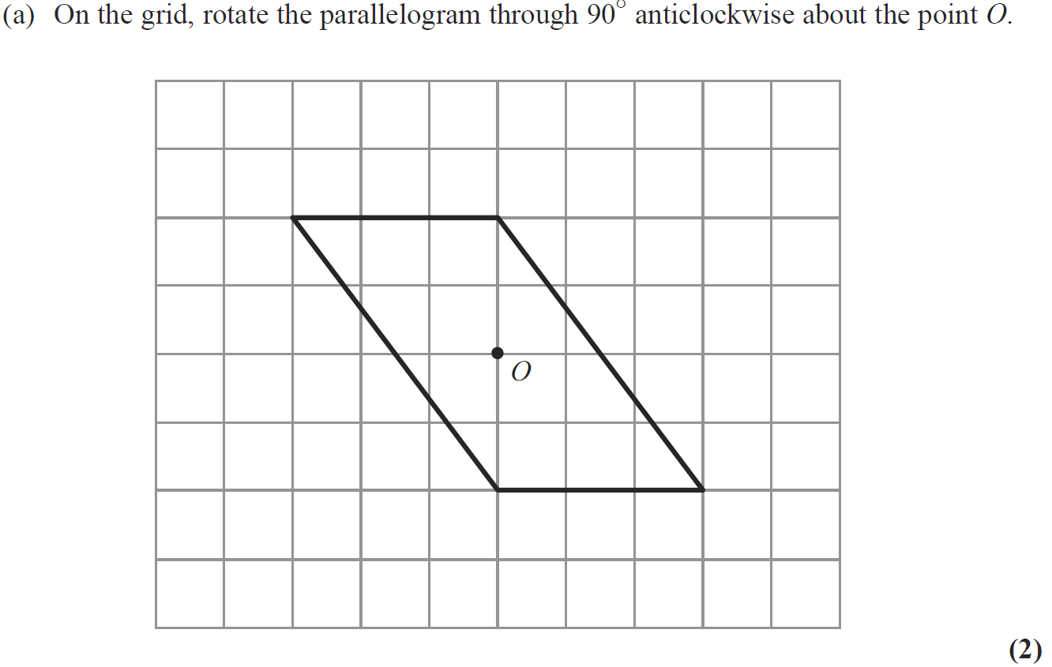
Transformations of Shapes
June 2009 4H Q7
Reveal Shape

Slide 36
Transformations of Shapes
June 2009 4H Q7
A
B

Slide 37
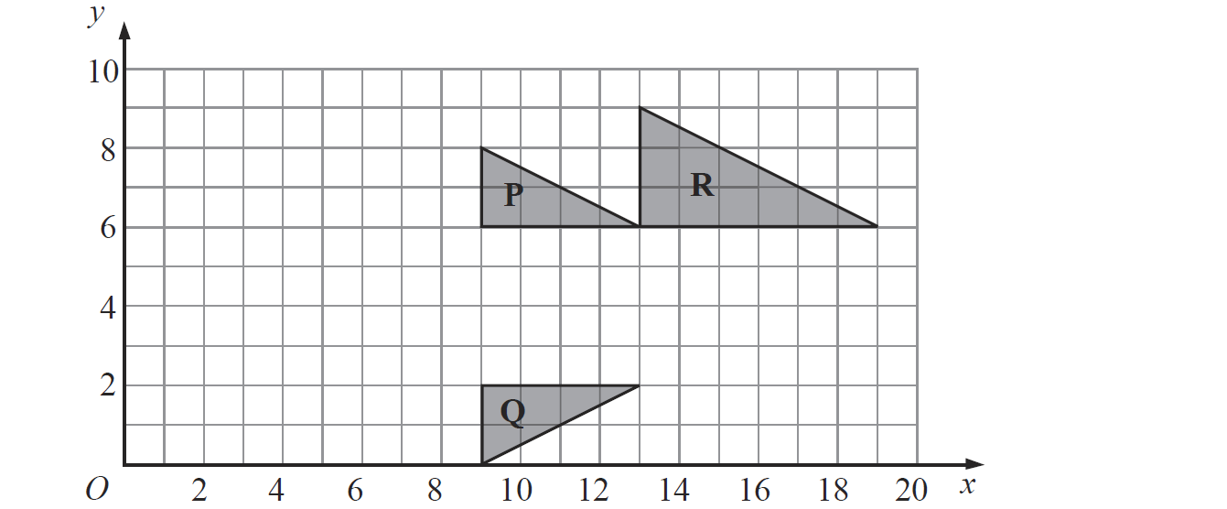
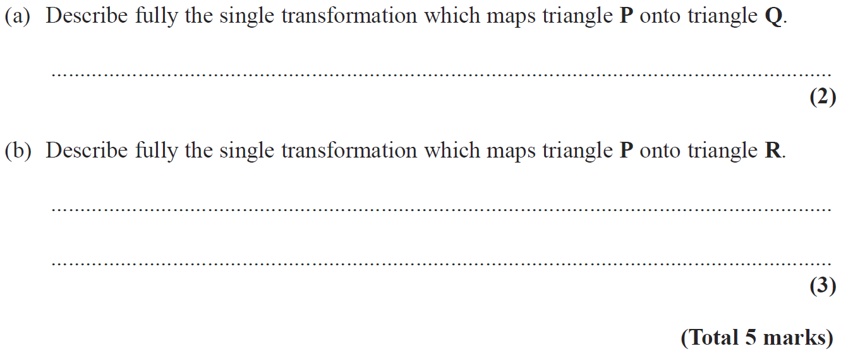
Transformations of Shapes
Nov 2009 4H Q6

Slide 38
Transformations of Shapes
Nov 2009 4H Q6
A
B

Slide 39
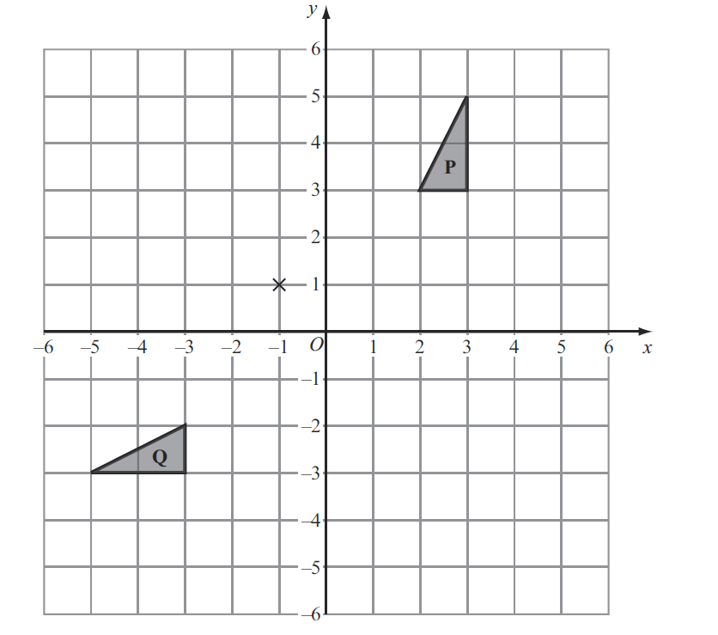
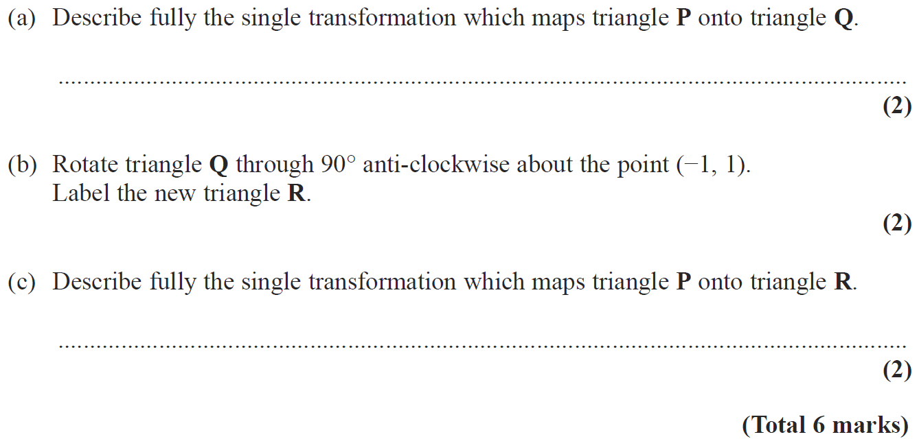
Transformations of Shapes
June 2010 3H Q9
Reveal Shape (b)

Slide 40
Transformations of Shapes
June 2010 3H Q9
A
B
C

Slide 41
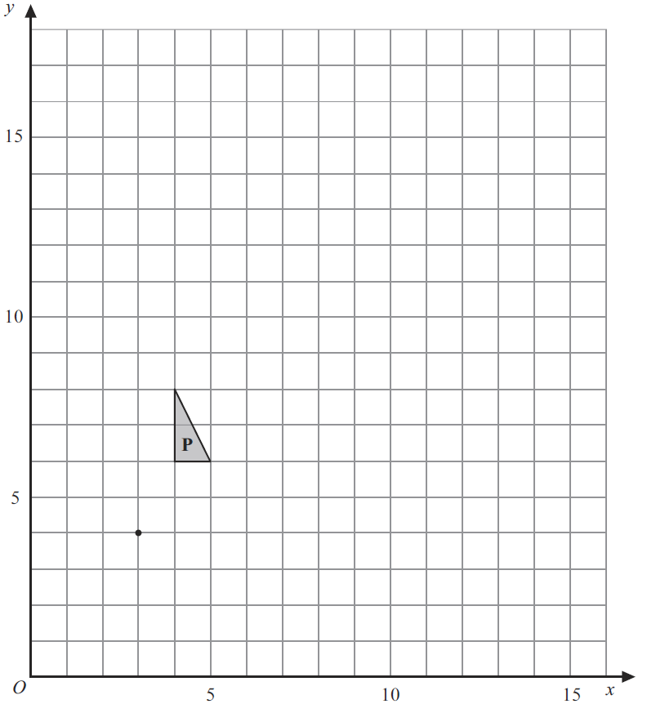
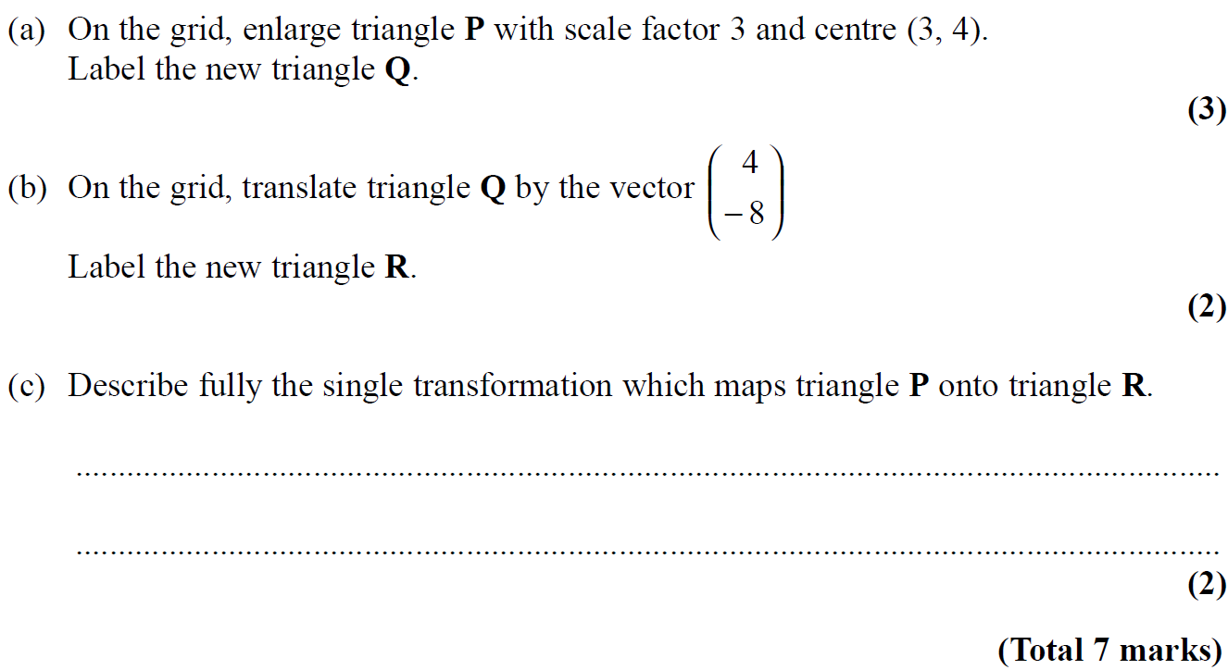
Transformations of Shapes
Nov 2010 4H Q7
Q
R
Reveal Shape (a)
Reveal Shape (b)

Slide 42
Transformations of Shapes
Nov 2010 4H Q7
A
B
C

Slide 43
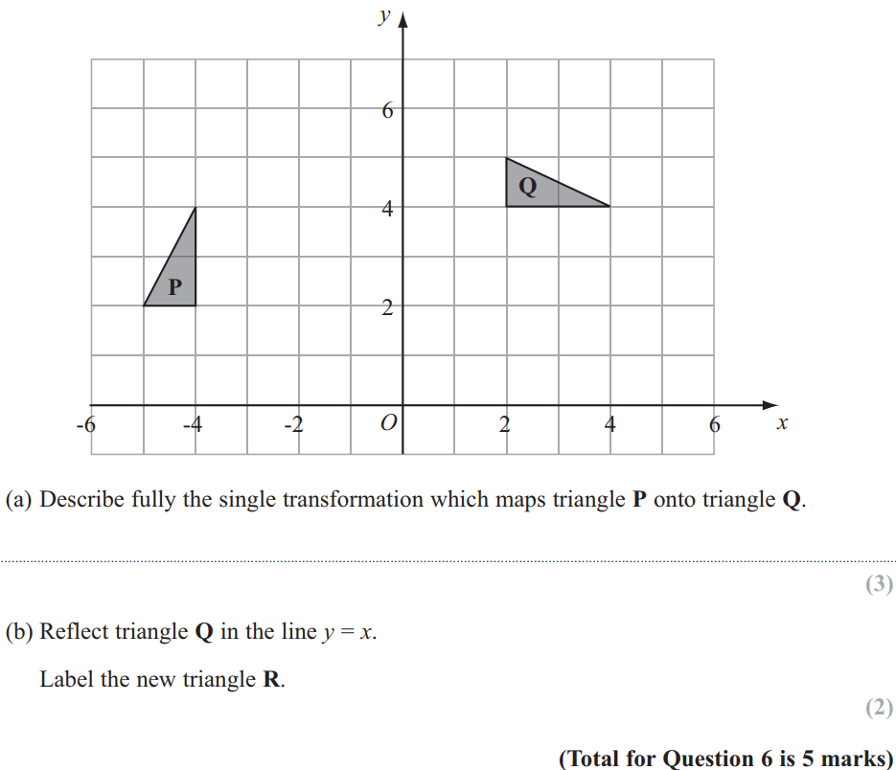
Transformations of Shapes
June 2011 3H Q6
Reveal Shape (b)

Slide 44
Transformations of Shapes
June 2011 3H Q6
A
B

Slide 45
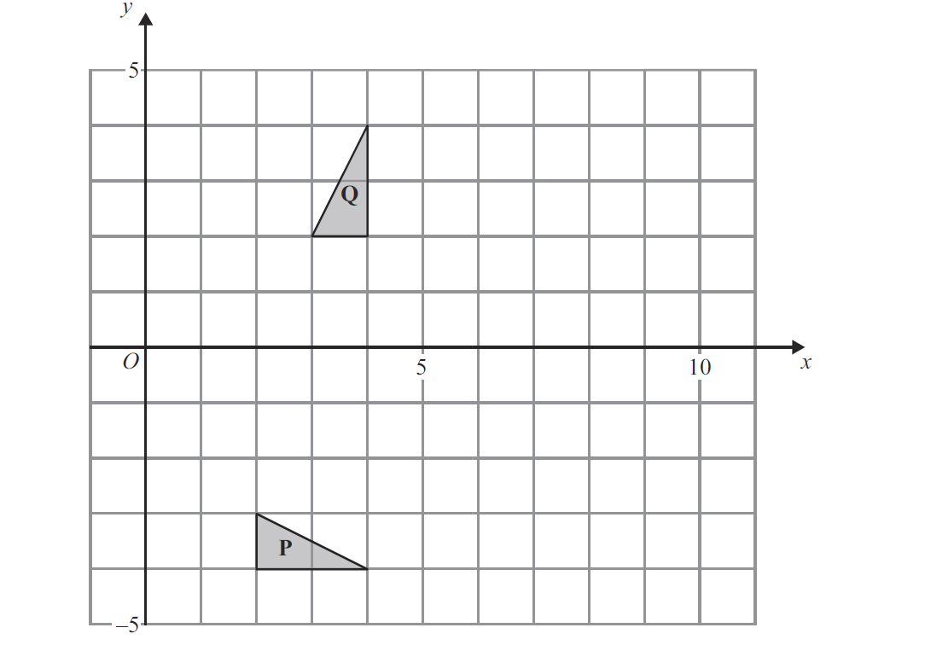
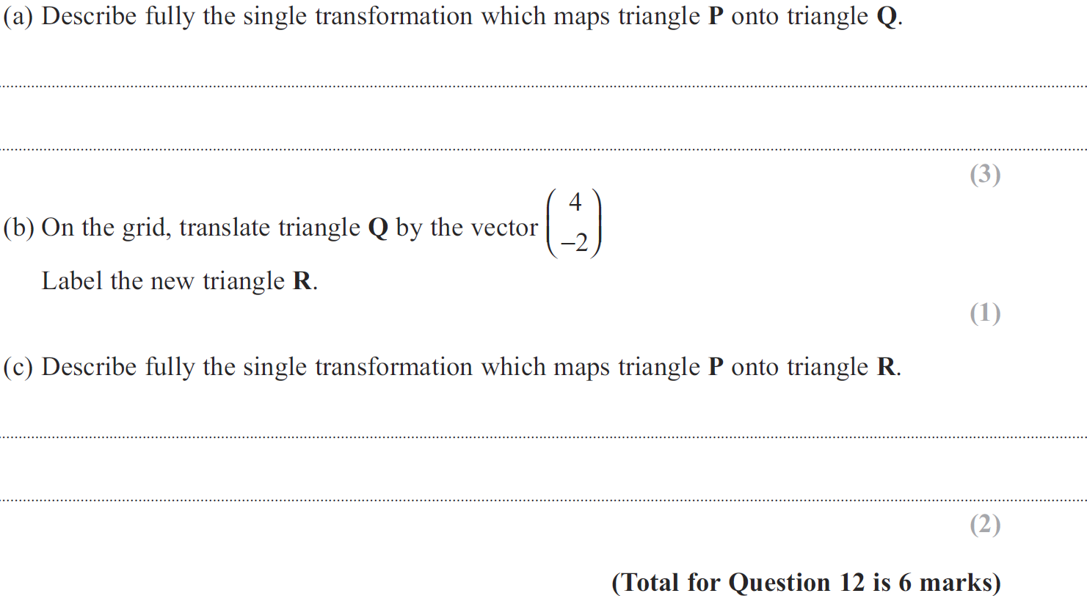
Transformations of Shapes
Jan 2012 4H Q12
Reveal Shape (b)
R

Slide 46
Transformations of Shapes
Jan 2012 4H Q12
A
B
C

Slide 47
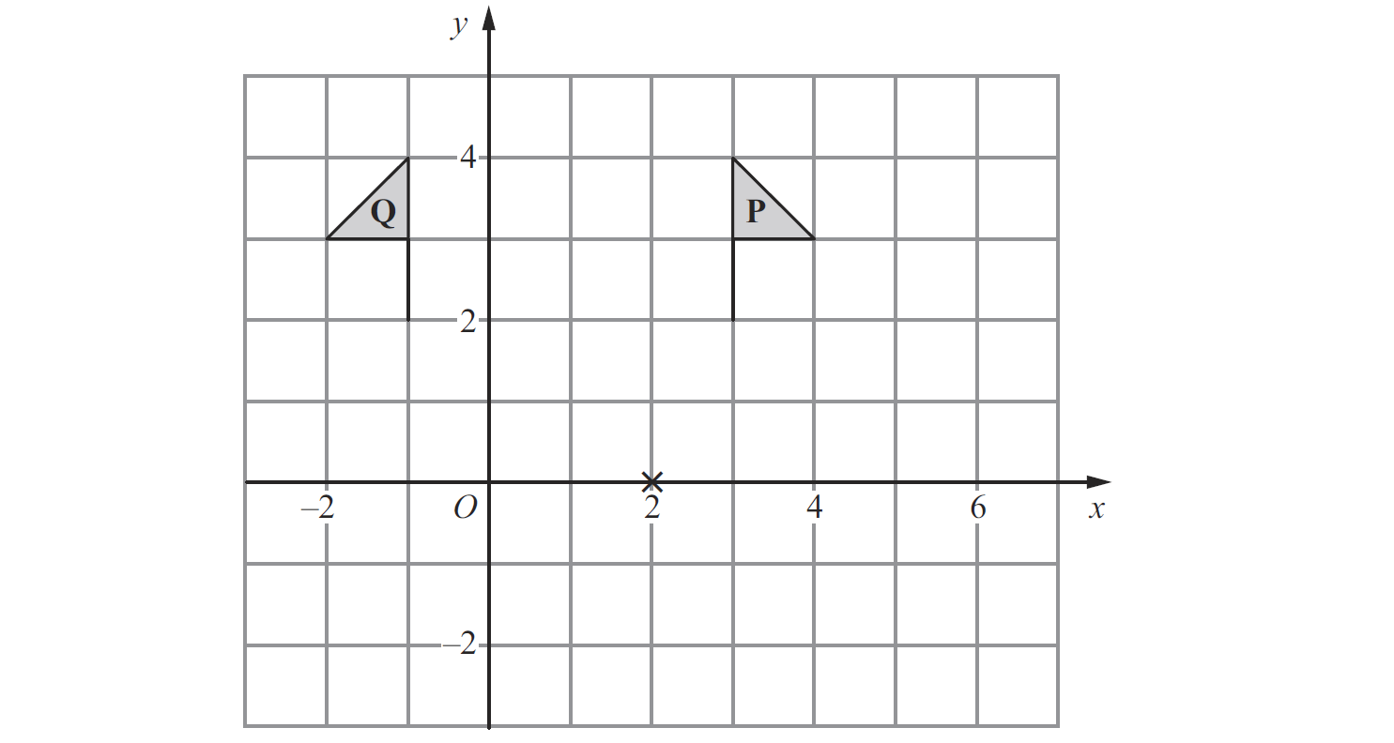
Transformations of Shapes
May 2012 4H Q4
Reveal Shape (b)
R

Slide 48
Transformations of Shapes
May 2012 4H Q4
A
B

Slide 49
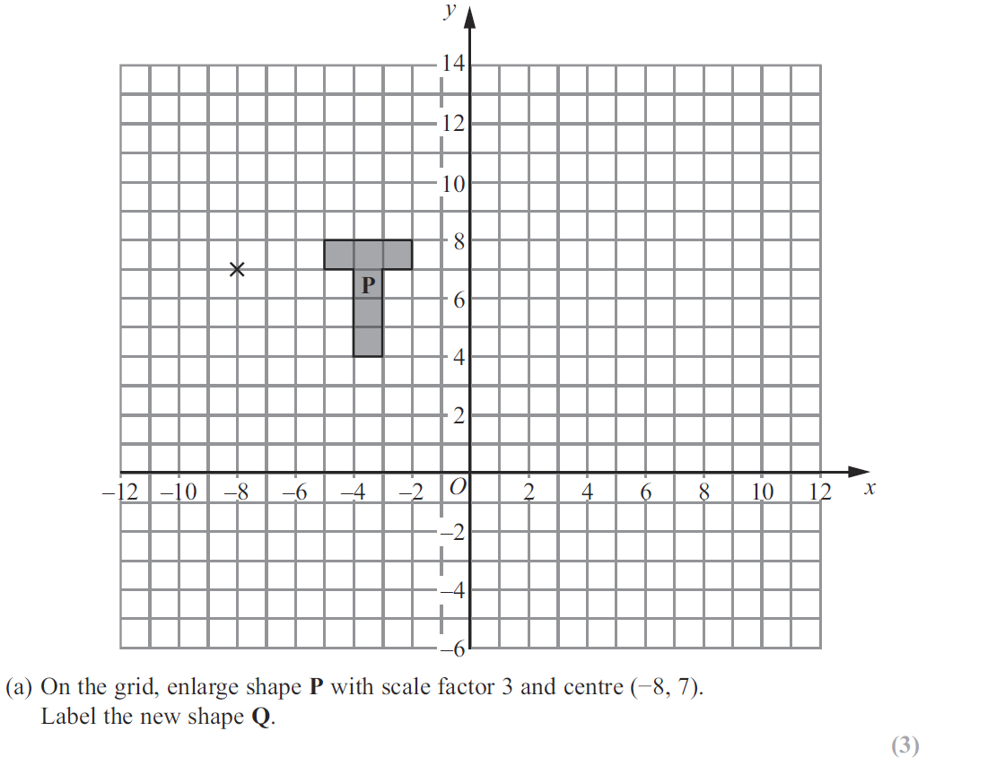
Transformations of Shapes
Jan 2013 3H Q4
Reveal Shape (a)
Q
Reveal Shape (b)
R

Slide 50
Transformations of Shapes
Jan 2013 3H Q4
A
B

Slide 51
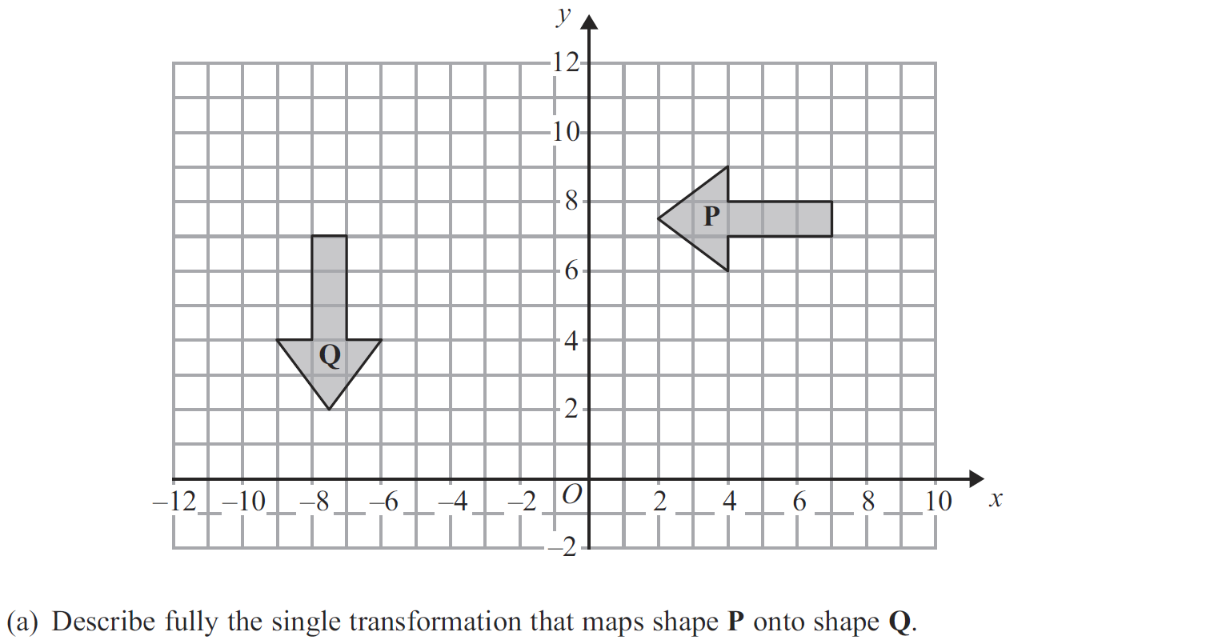
Transformations of Shapes
May 2013 4H Q4
R
Reveal Shape (b)

Slide 52
Transformations of Shapes
May 2013 4H Q4
A
B

Slide 53
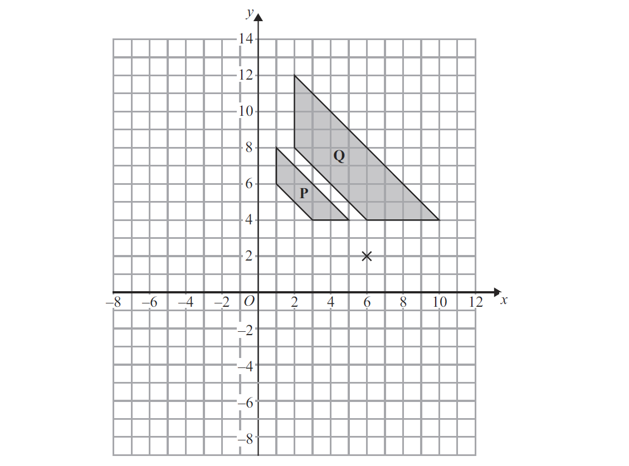
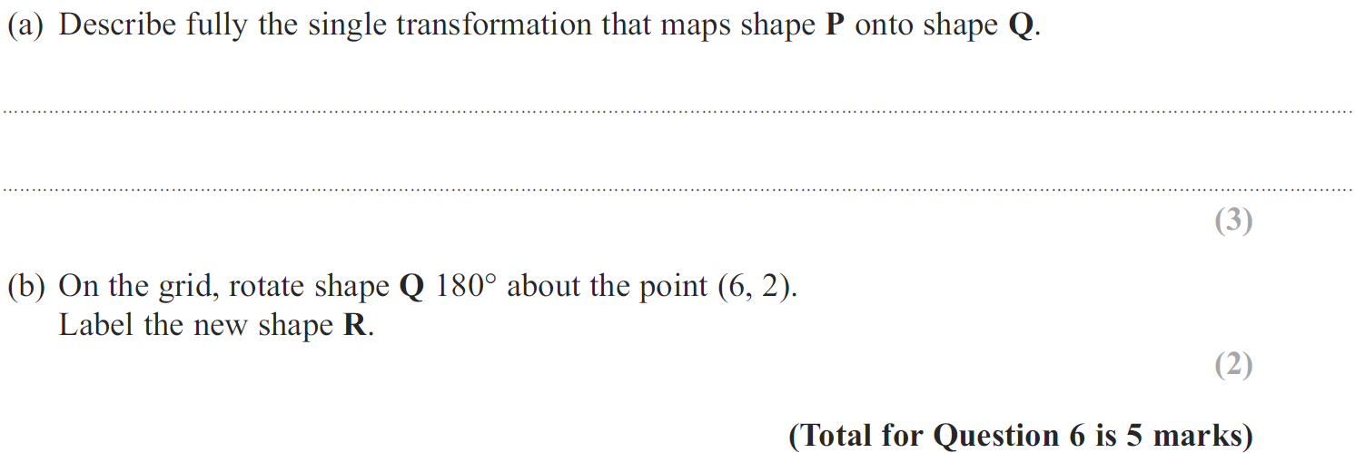
Transformations of Shapes
May 2013 3HR Q6
Reveal Shape (b)
R

Slide 54
Transformations of Shapes
May 2013 3HR Q6
A
B

Slide 55
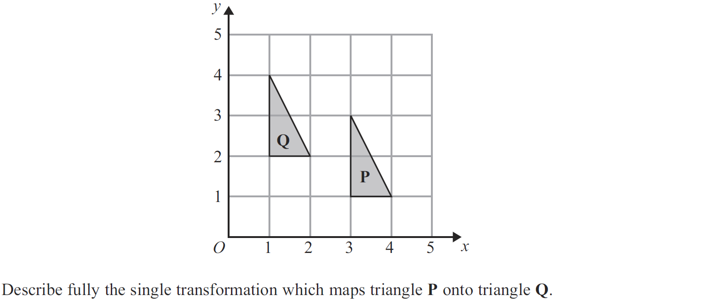
Transformations of Shapes
May 2013 4HR Q2

Slide 56
Transformations of Shapes
May 2013 4HR Q2
A

Slide 57
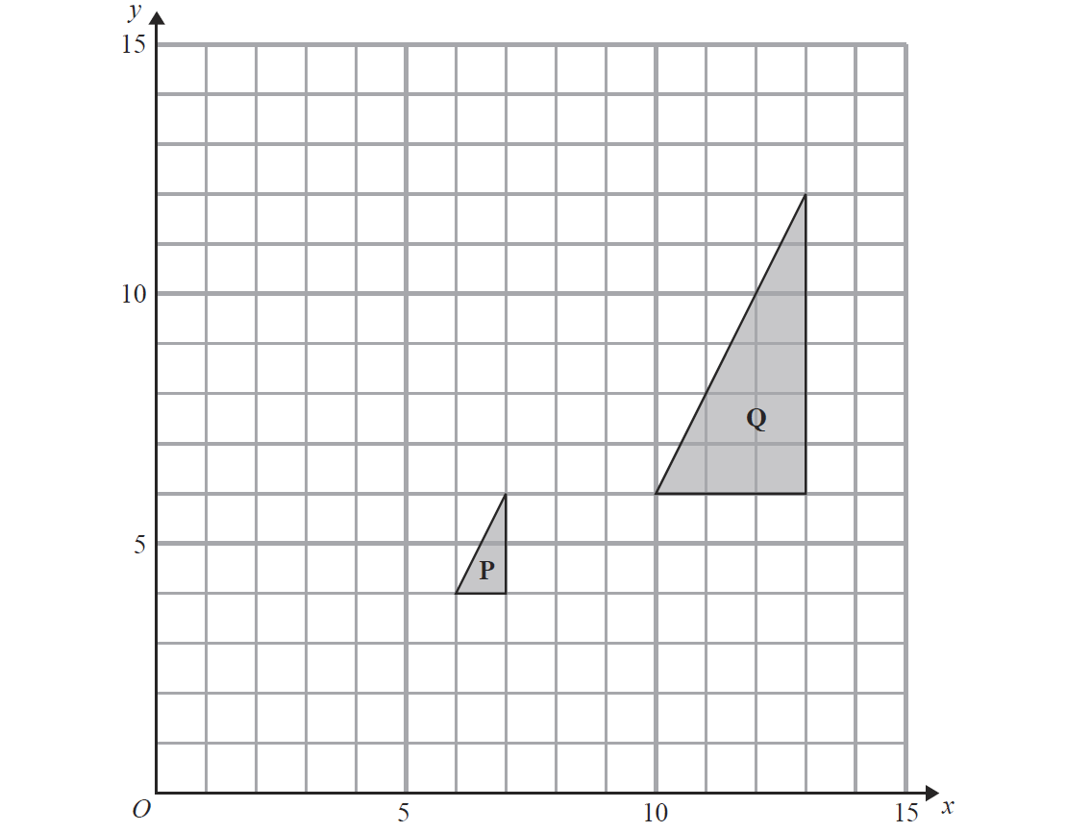
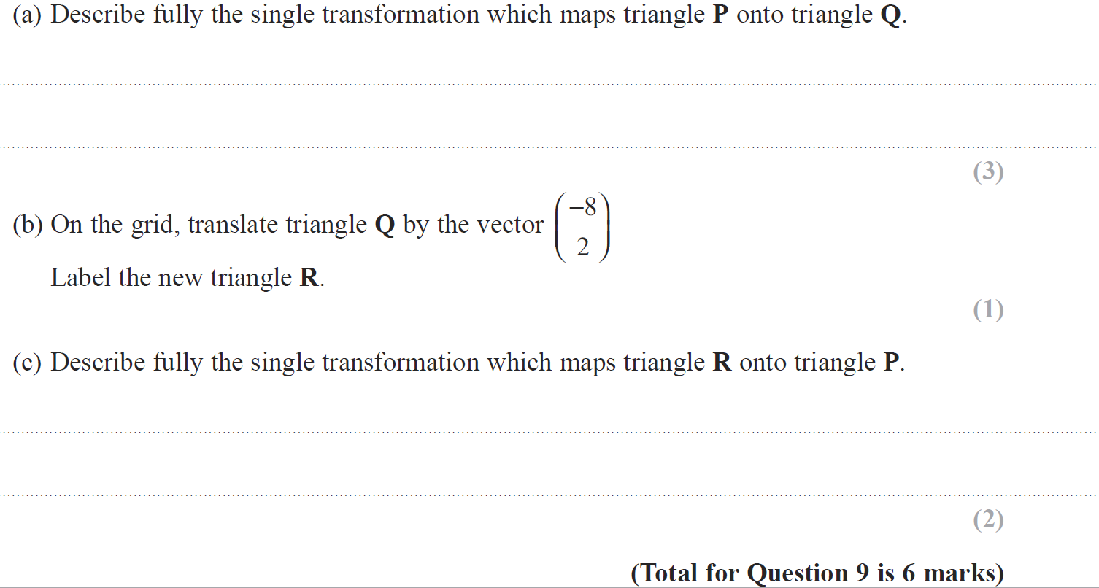
Transformations of Shapes
Jan 2014 3H Q9
R
Reveal Shape (b)

Slide 58
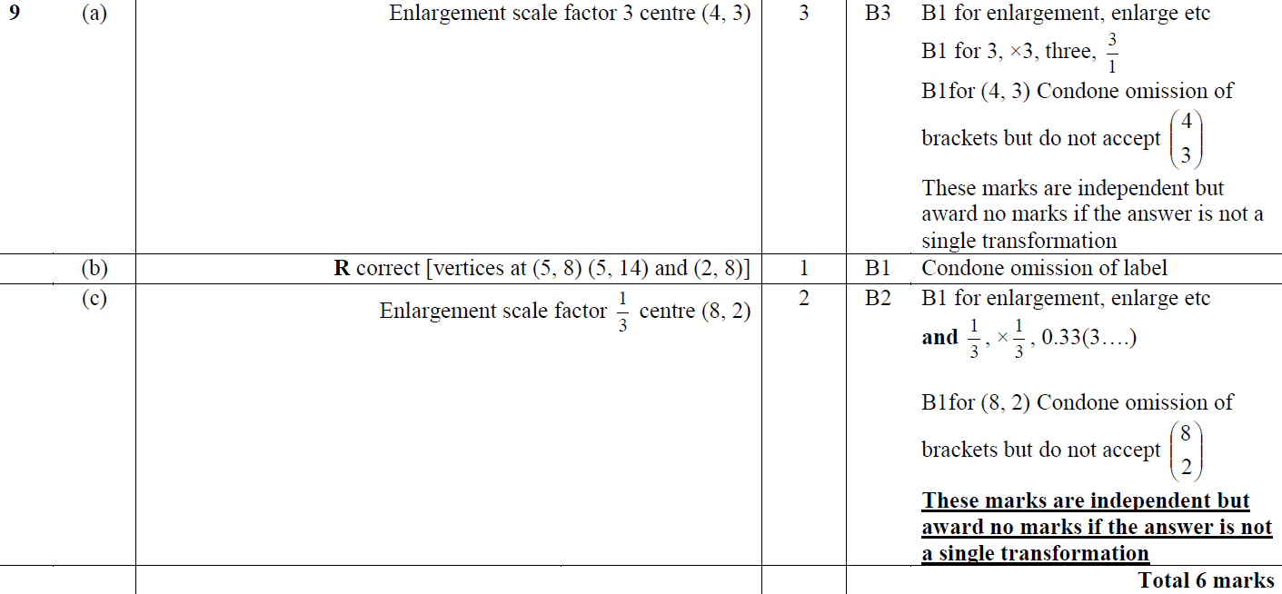
Transformations of Shapes
Jan 2014 3H Q9
A
B
C

Slide 59
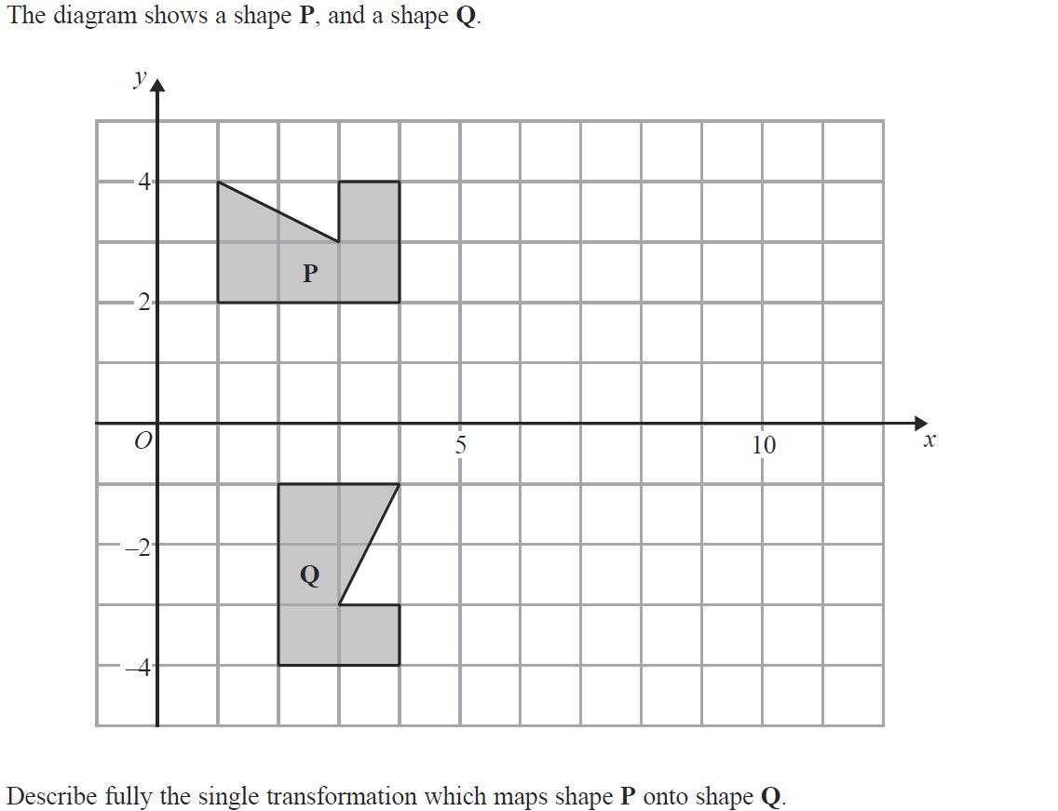
Transformations of Shapes
Jan 2014 4H Q5

Slide 60
Transformations of Shapes
Jan 2014 4H Q5
A

Slide 61
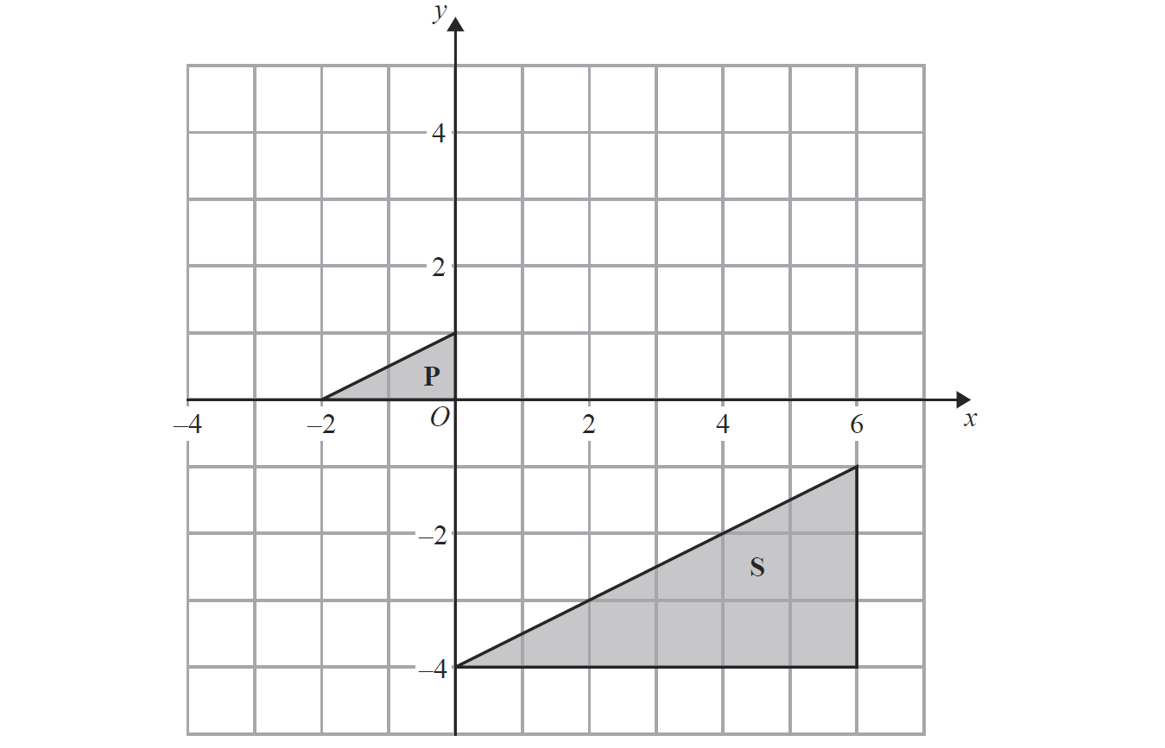
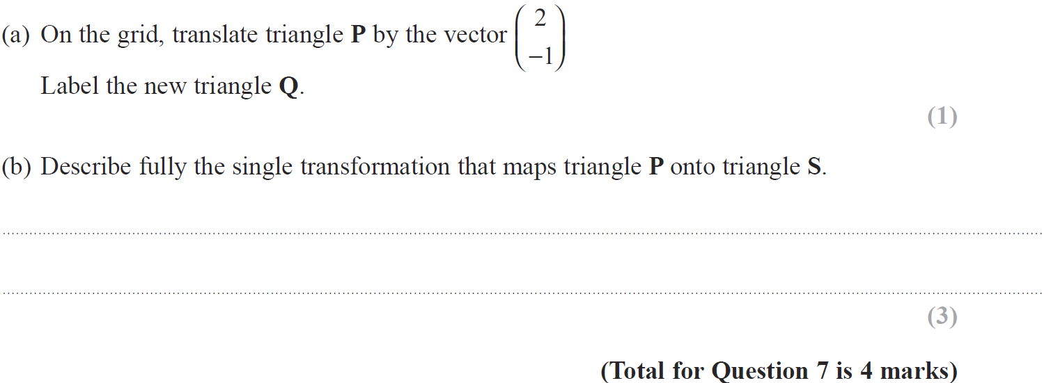
Transformations of Shapes
Jan 2014 4HR Q7
Reveal Shape (a)
Q

Slide 62
Transformations of Shapes
Jan 2014 4HR Q7
A
B

Slide 63
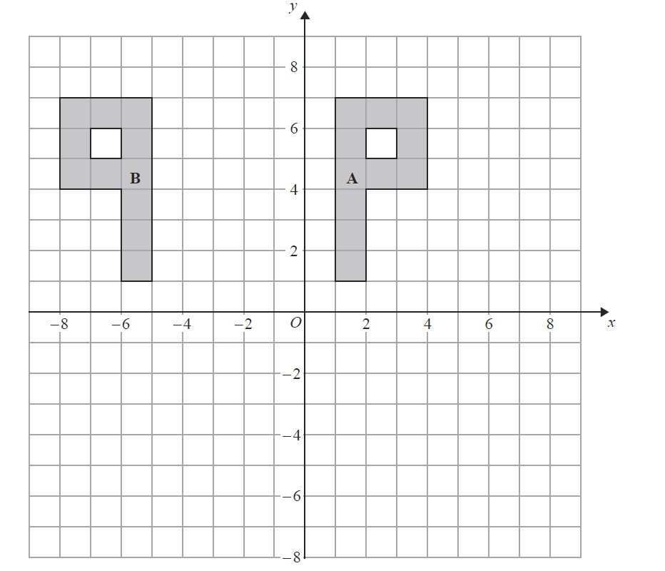
Transformations of Shapes
May 2014 3H Q3
Reveal Shape (b)
C

Slide 64
Transformations of Shapes
May 2014 3H Q3
A
B

Slide 65
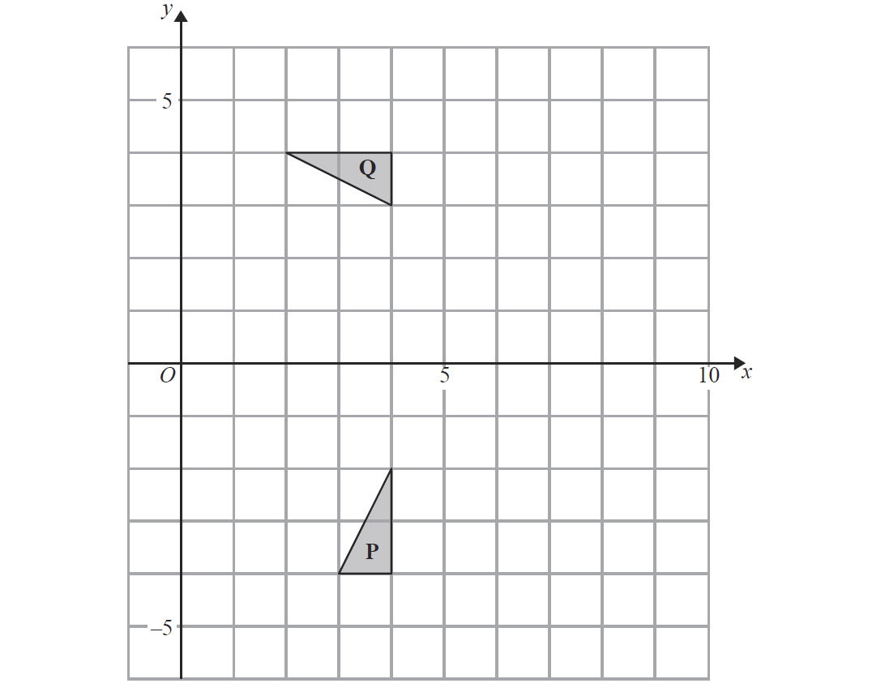
Transformations of Shapes
May 2014 4HR Q4
R
Reveal Shape (b)

Slide 66
Transformations of Shapes
May 2014 4HR Q4
A
B

Slide 67
Transformations of Shapes
Jan 2015 4H Q5
Reveal Shape (b)

Slide 68
Transformations of Shapes
Jan 2015 4H Q5
A
B

Slide 69
Transformations of Shapes
Jan 2015 3HR Q7

Slide 70
Transformations of Shapes
Jan 2015 3HR Q7
A

Slide 71
Transformations of Shapes
May 2015 3HR Q5
R
Reveal Shape (c)
Reveal Shape (b)

Slide 72
Transformations of Shapes
May 2015 3HR Q5
A
B
C

Slide 73
Transformations of Shapes
June 2015 4H Q5
Reveal Shape (a)

Slide 74
Transformations of Shapes
June 2015 4H Q5
A
B

Slide 75
Transformations of Shapes
Jan 2016 3HR Q3
Reveal Shape (c)
Reveal Shape (b)

Slide 76
Transformations of Shapes
Jan 2016 3HR Q3
A
B
C

Slide 77
Transformations of Shapes
June 2016 4H Q8
C .
Reveal Shape (b)
Reveal Shape (c)

Slide 78
Transformations of Shapes
June 2016 4H Q8
A
B
C

Slide 79
Transformations of Shapes
May 2016 3HR Q8
R
Reveal Shape (b)

Slide 80
Transformations of Shapes
May 2016 3HR Q8
A
B

Slide 81
Transformations of Shapes
June 2016 4HR Q1
T
Reveal Shape (a)

Slide 82
Transformations of Shapes
June 2016 4HR Q1
A
B

Slide 83
Transformations of Shapes
Jan 2017 4H Q11
S .
R .
Reveal Shape (a)
Reveal Shape (b)

Slide 84
Transformations of Shapes
Jan 2017 4H Q11
A
B

Slide 85
Transformations of Shapes
Jan 2017 3HR Q6
C
Reveal Shape (b)

Slide 86
Transformations of Shapes
Jan 2017 3HR Q6
A
B

Slide 87
Transformations of Shapes
May 2017 3H Q2
Q .
Reveal Shape (a)
R
Reveal Shape (b)

Slide 88
Transformations of Shapes
May 2017 3H Q2
A
B

Slide 89
Transformations of Shapes
May 2017 3HR Q8
Reveal Shape (a)
Reveal Shape (b)

Slide 90
Transformations of Shapes
May 2017 3HR Q8
A
B

Slide 91
Transformations of Shapes
Jan 2018 4H Q6
Reveal Shape

Slide 92
Transformations of Shapes
Jan 2018 4H Q6
A

Slide 93
Transformations of Shapes
Jan 2018 4HR Q5
Reveal Shape (b)

Slide 94
Transformations of Shapes
Jan 2018 4HR Q5
A
B

Slide 95
Transformations of Shapes
May 2018 3H Q4
Reveal Shape (b)

Slide 96
Transformations of Shapes
May 2018 3H Q4
A
B

Slide 97
Transformations of Shapes
June 2018 4HR Q5
Reveal Shape (a)

Slide 98
Transformations of Shapes
June 2018 4HR Q5
A
B

