Slide 1
Transformations of Shapes
Transformations of Shapes
June 2017
2H Q9
Nov 2018
1H Q13
Edexcel
SAM
1H Q20
Nov 2017
1H Q18
Nov 2018
2H Q8
AQA
Spec 2
2H Q1
Nov 2017
2H Q5
Nov 2018
3H Q20
OCR
Spec 2
3H Q13
May 2018
1H Q7
May 2019
1H Q5
June 2018
2H Q7
June 2019
3H Q8
Invariant Points & Lines

Slide 2
Transformations of Shapes
Transformations of Shapes
May 2017
1H Q21
Edexcel
May 2018
1H Q21
May 2017
1H Q21
AQA
SAM
1H Q23
Nov 2018
3H Q1
1 Marker
Nov 2017
2H Q7
OCR
Nov 2018
3H Q25
May 2018
1H Q2
Invariant Points & Lines

Slide 3
Transformations of Shapes
Transformations of Shapes
May 2017
1H Q11
Edexcel
June 2017
3H Q9
SAM
2H Q1
AQA
Nov 2017
2H Q5
Practice
3H Q9
OCR
May 2018
1H Q6
Nov 2018
2H Q10
Invariant Points & Lines

Slide 4
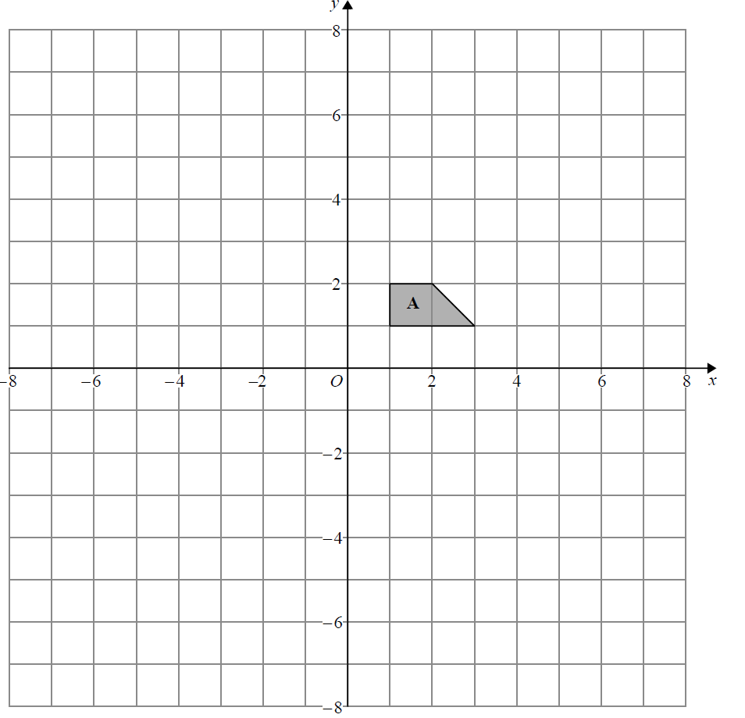
Transformations of Shapes
SAM 1H Q20
Reveal Shape B
B

Slide 5
Transformations of Shapes
SAM 1H Q20
A
B

Slide 6
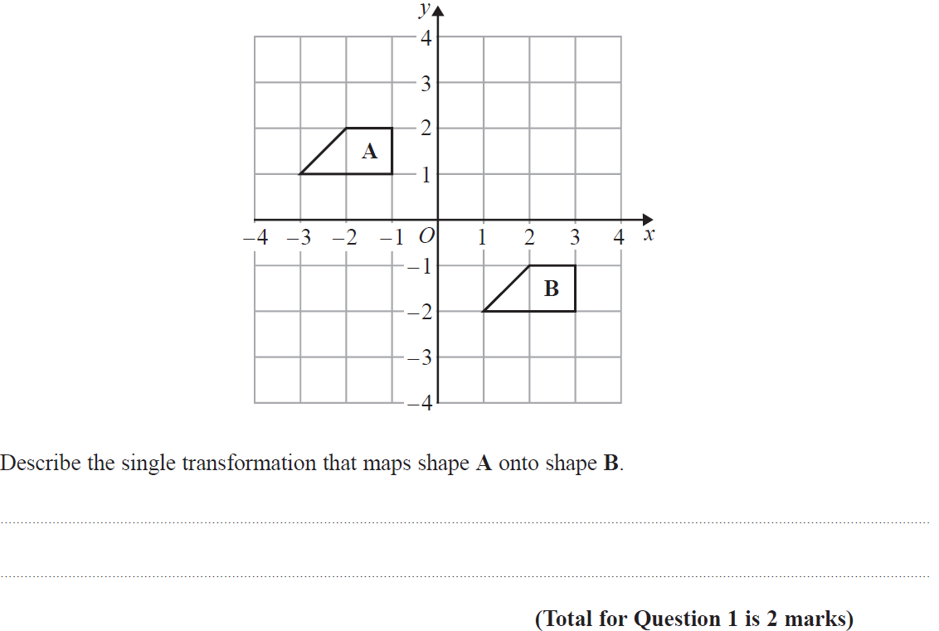
Transformations of Shapes
Specimen Set 2 2H Q1

Slide 7
Transformations of Shapes
Specimen Set 2 2H Q1
A

Slide 8
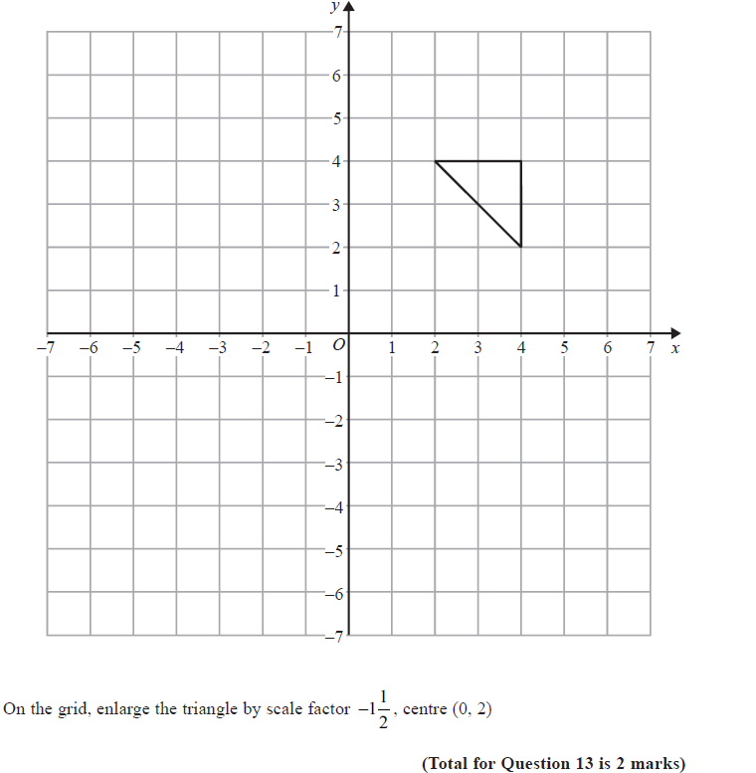
Transformations of Shapes
Specimen Set 2 3H Q13
Reveal Shape

Slide 9
Transformations of Shapes
Specimen Set 2 3H Q13
A

Slide 10
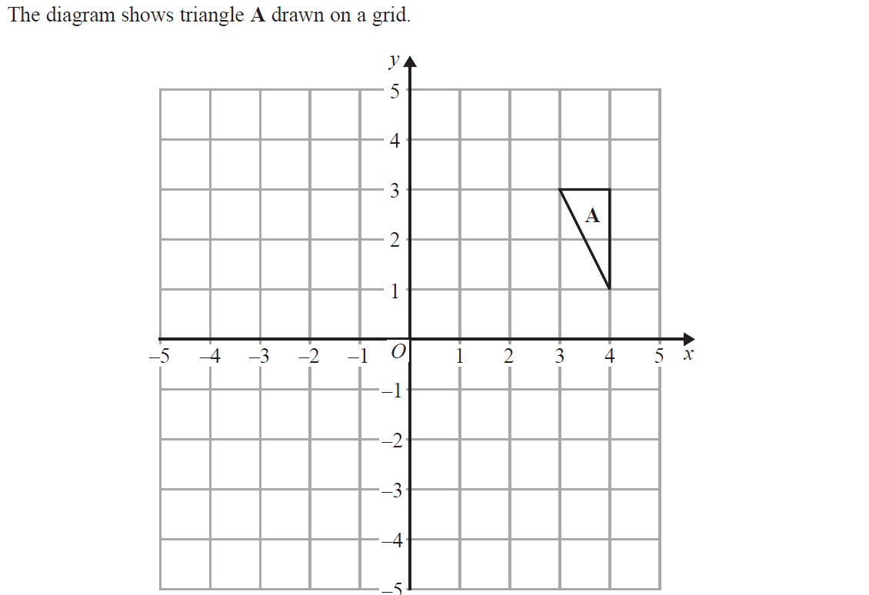
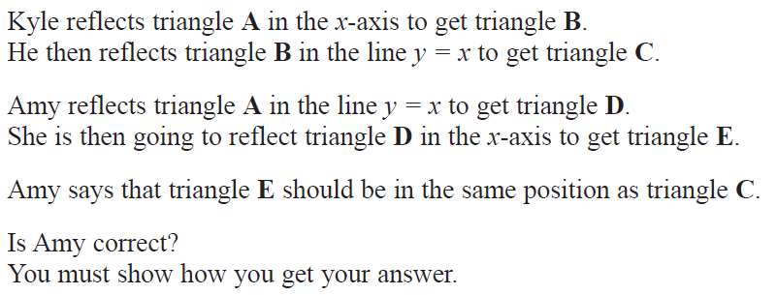
Transformations of Shapes
June 2017 2H Q9
C
D
Reveal Shape B
Reveal Shape C
Reveal Shape D
Reveal Shape E
B
E

Slide 11
Transformations of Shapes
June 2017 2H Q9
A

Slide 12
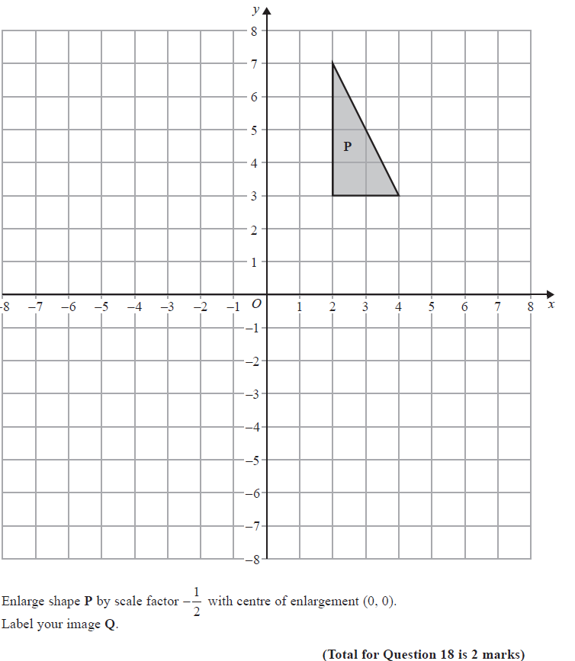
Transformations of Shapes
Nov 2017 1H Q18
Reveal Shape Q
Q

Slide 13
Transformations of Shapes
Nov 2017 1H Q18
A

Slide 14
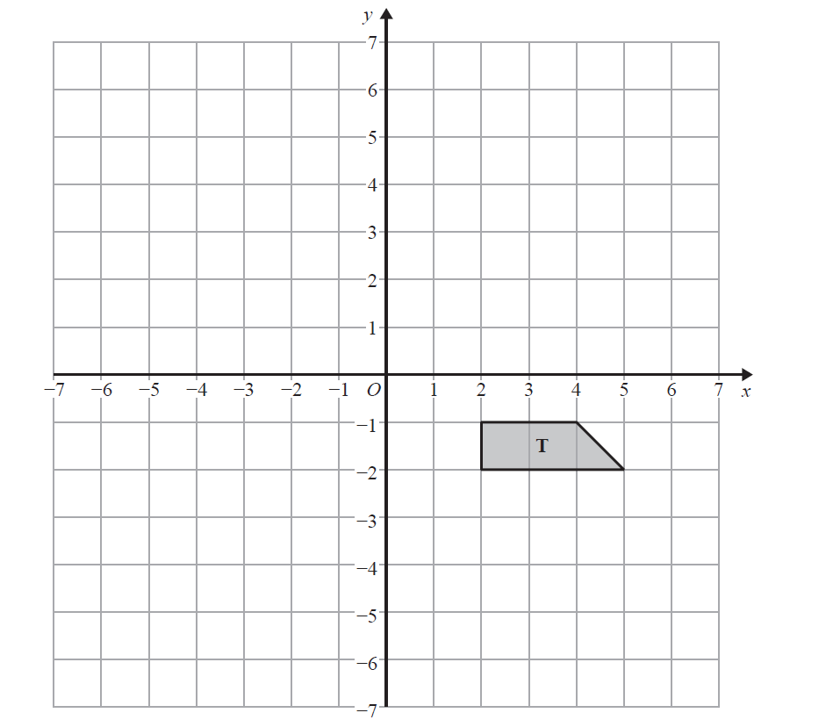
Transformations of Shapes
Nov 2017 2H Q5
Reveal Shape A
A
Reveal Shape B
B

Slide 15
Transformations of Shapes
Nov 2017 2H Q5
A
B

Slide 16
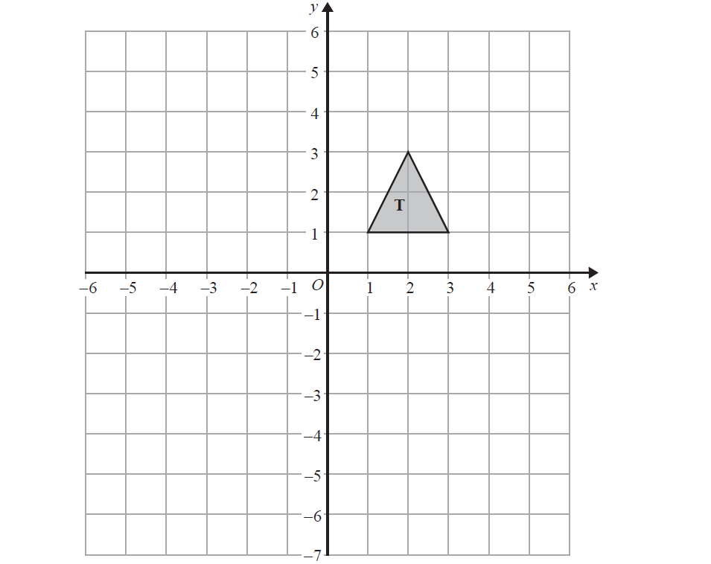
Transformations of Shapes
May 2018 1H Q7
R
Reveal Shape R
Reveal Shape S
S

Slide 17
Transformations of Shapes
May 2018 1H Q7
A

Slide 18
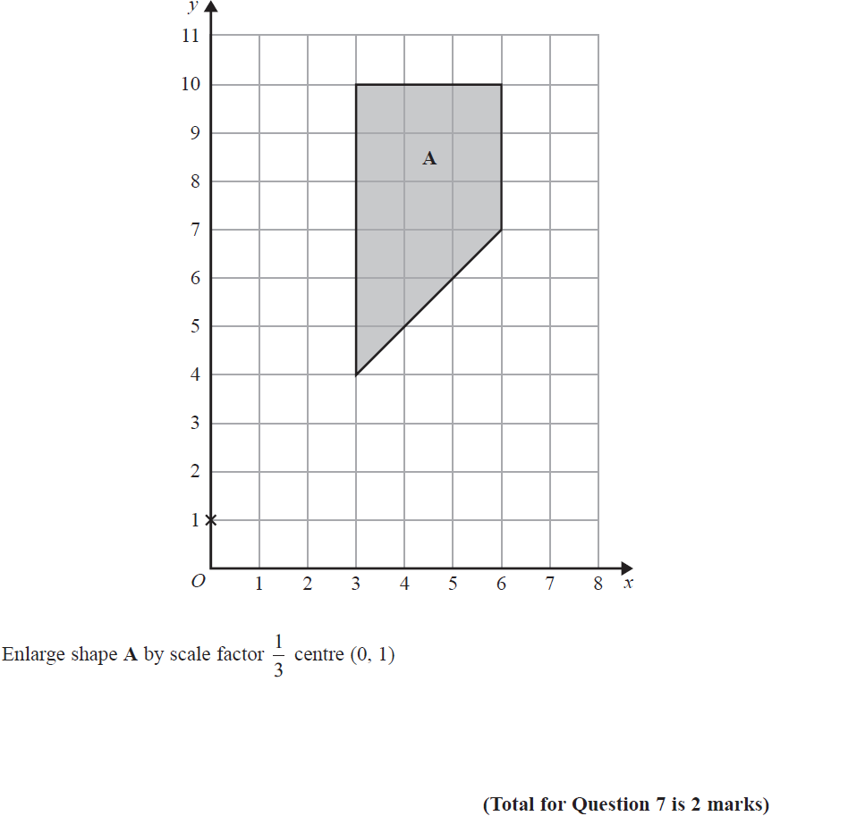
Transformations of Shapes
June 2018 2H Q7
Reveal Shape A’
A’

Slide 19
Transformations of Shapes
June 2018 2H Q7
A

Slide 20
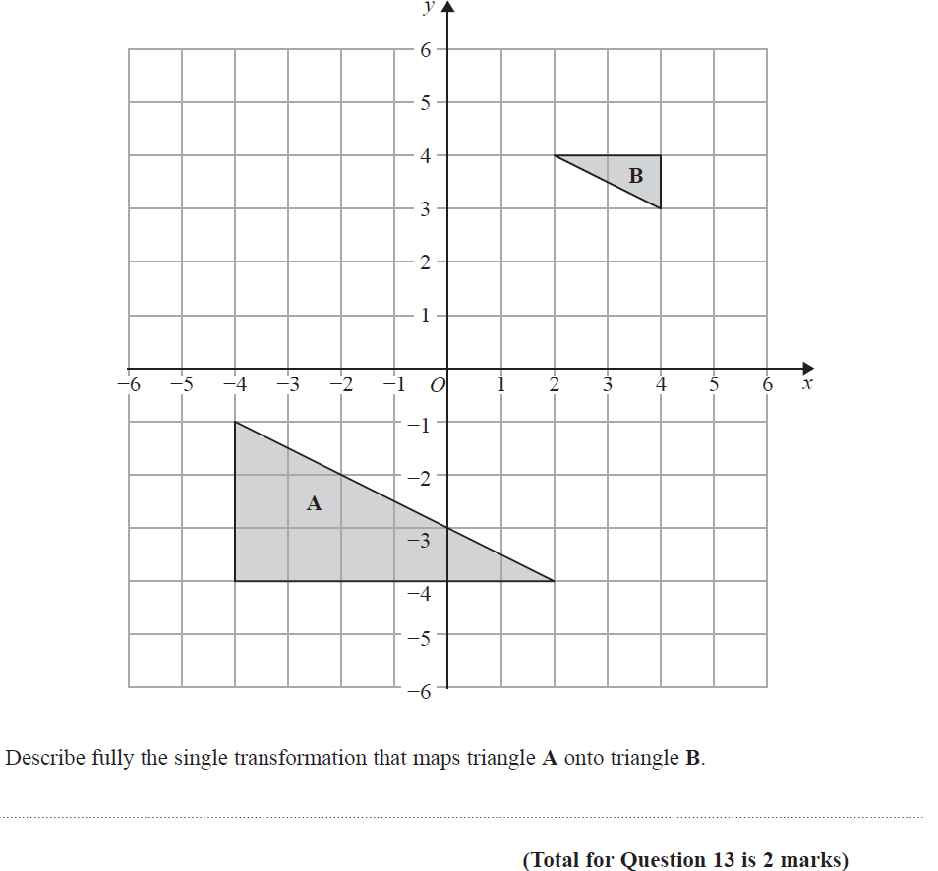
Transformations of Shapes
Nov 2018 1H Q13

Slide 21
Transformations of Shapes
Nov 2018 1H Q13
A

Slide 22
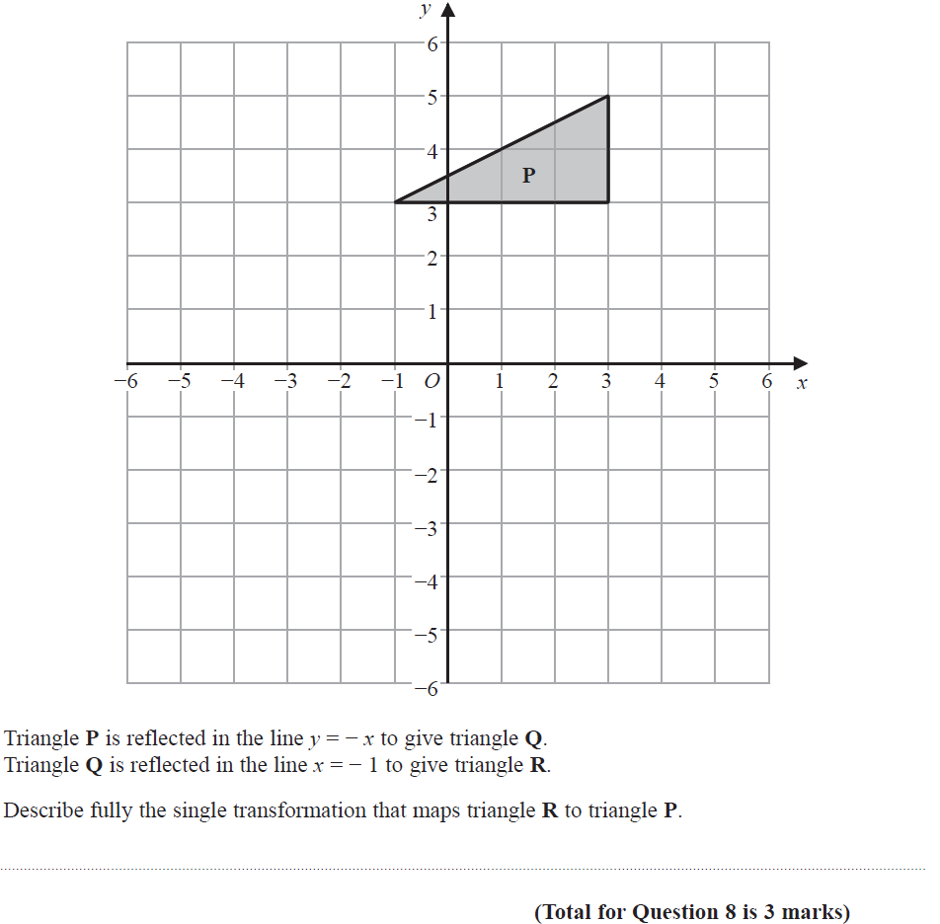
Transformations of Shapes
Nov 2018 2H Q8
Reveal Shape Q
Reveal Shape R
Q
R

Slide 23
Transformations of Shapes
Nov 2018 2H Q8
A

Slide 24
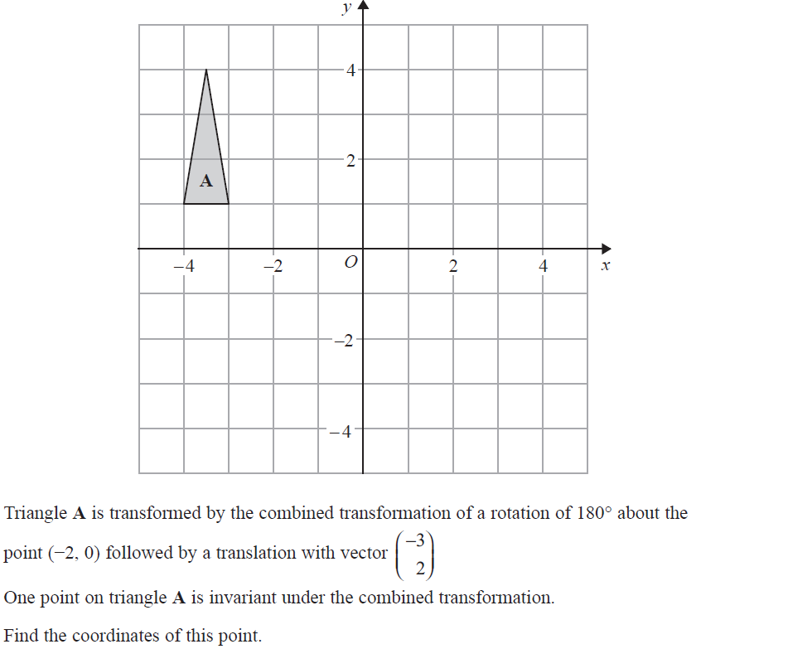
Transformations of Shapes
Nov 2018 3H Q20
Reveal Shape A’
A’’
Reveal Shape A’’
A’

Slide 25
Transformations of Shapes
Nov 2018 3H Q20
A

Slide 26
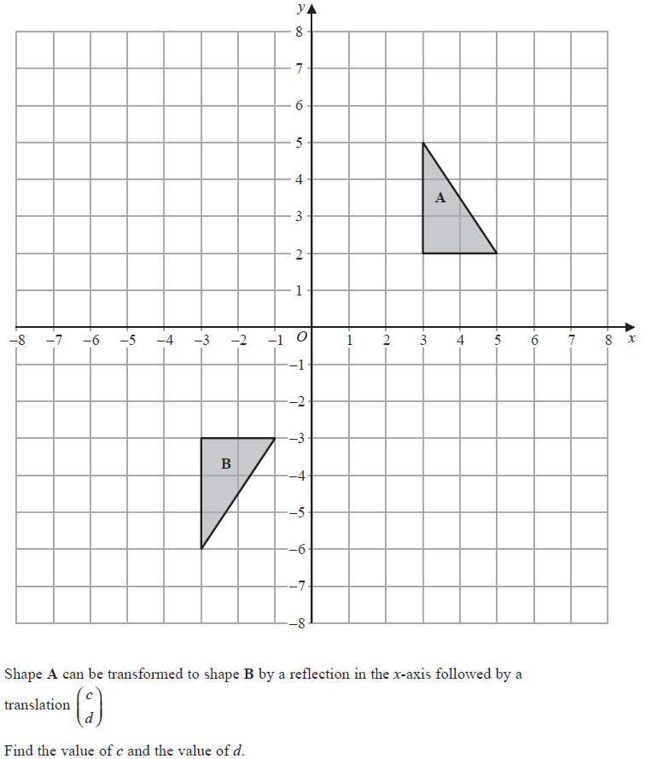
Transformations of Shapes
May 2019 1H Q5

Slide 27
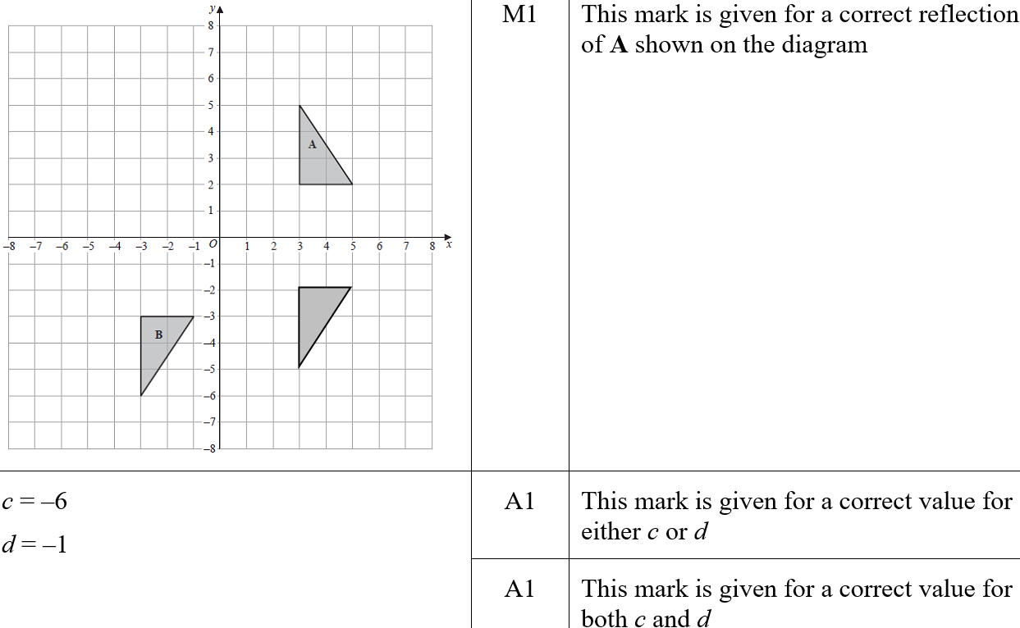
Transformations of Shapes
May 2019 1H Q5
A
A SF

Slide 28
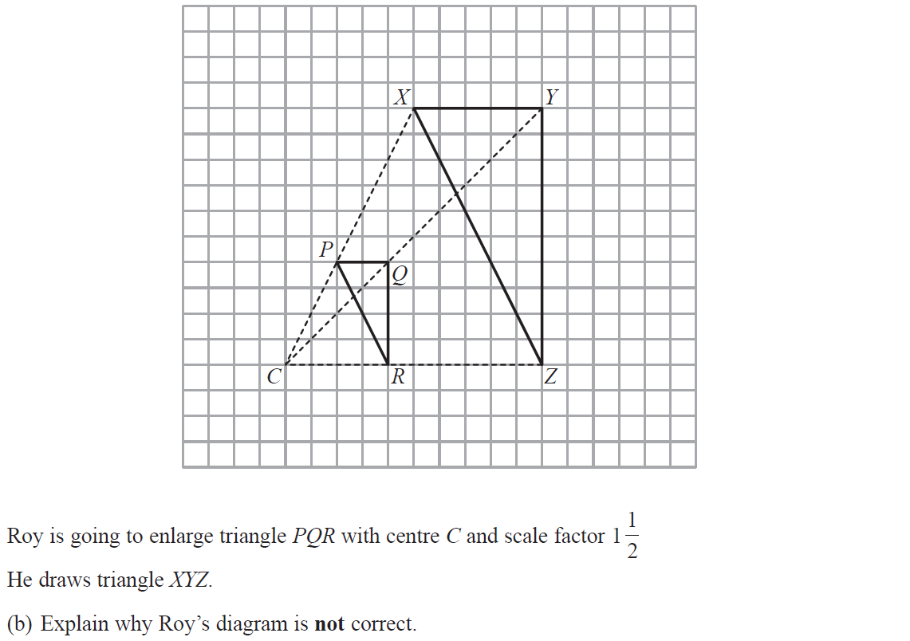
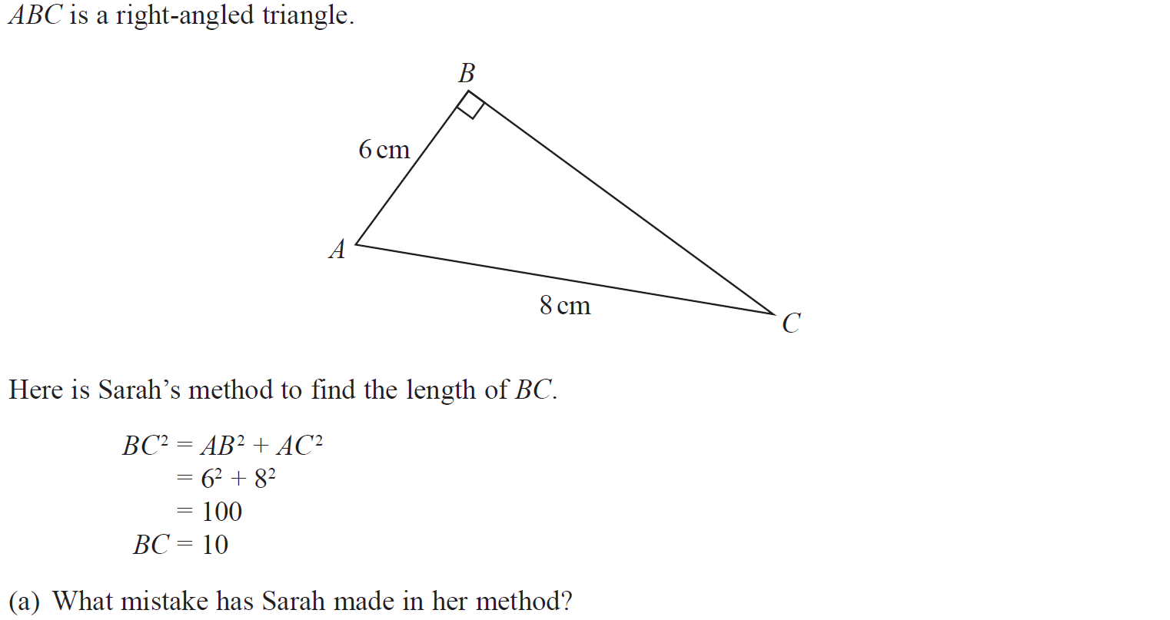
Transformations of Shapes
June 2019 3H Q8

Slide 29
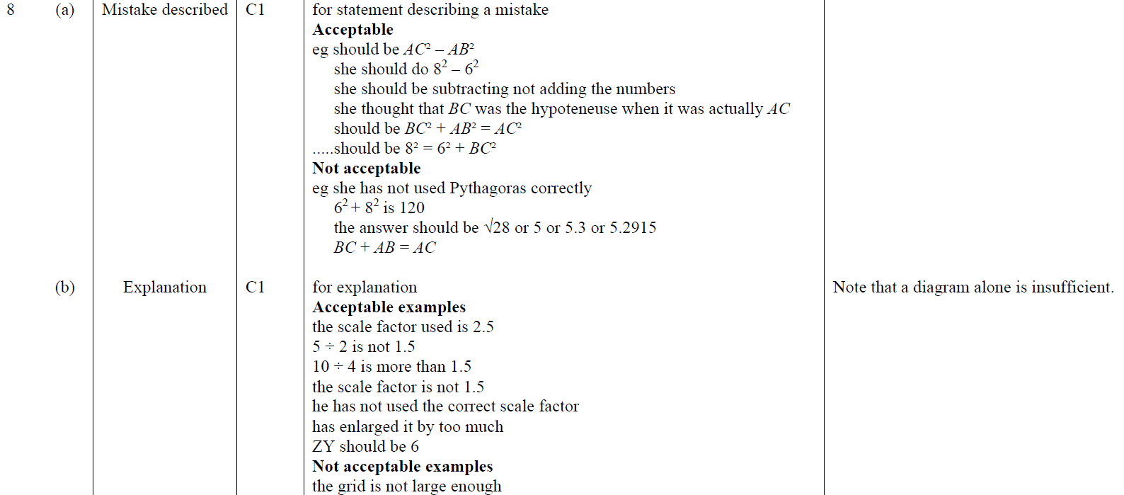
Transformations of Shapes
June 2019 3H Q8
A
B
A SF
B SF

Slide 30
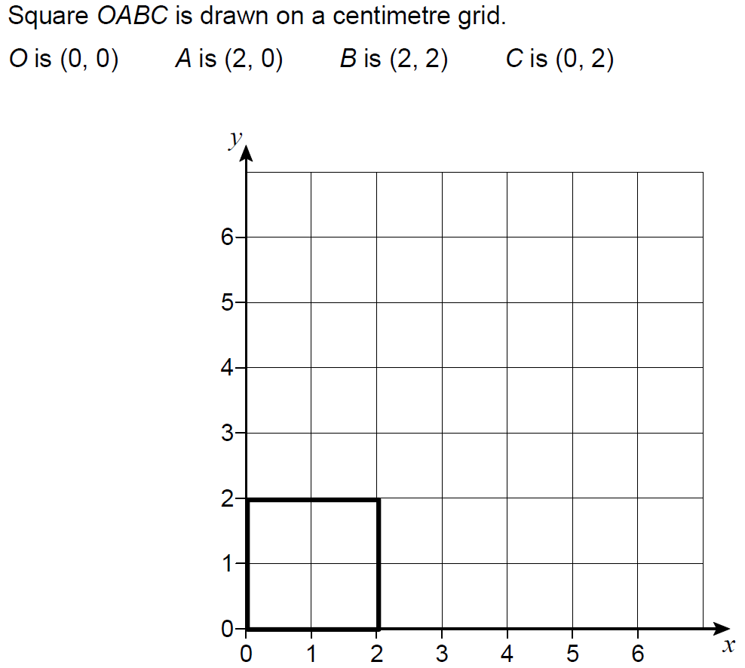
Transformations of Shapes
SAM 1H Q23

Slide 31
Transformations of Shapes
SAM 1H Q23
A
B
C

Slide 32
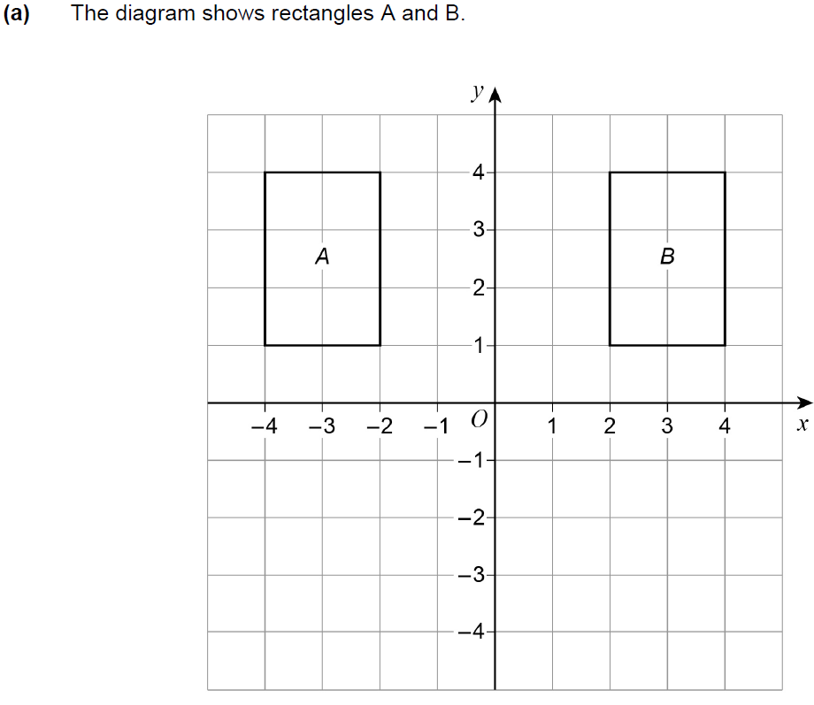
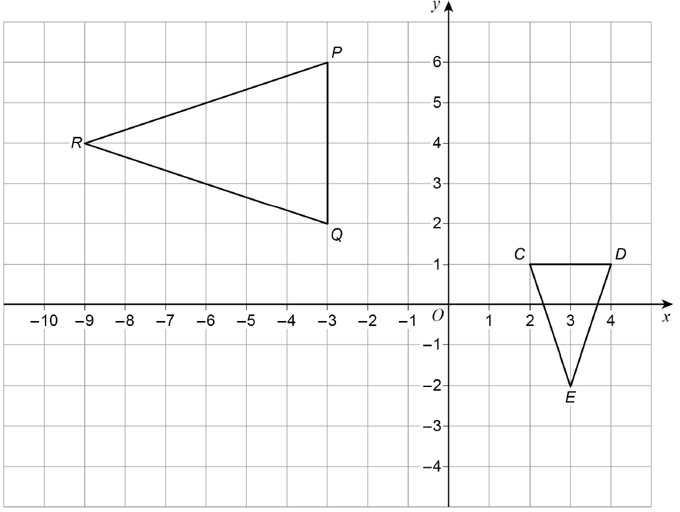
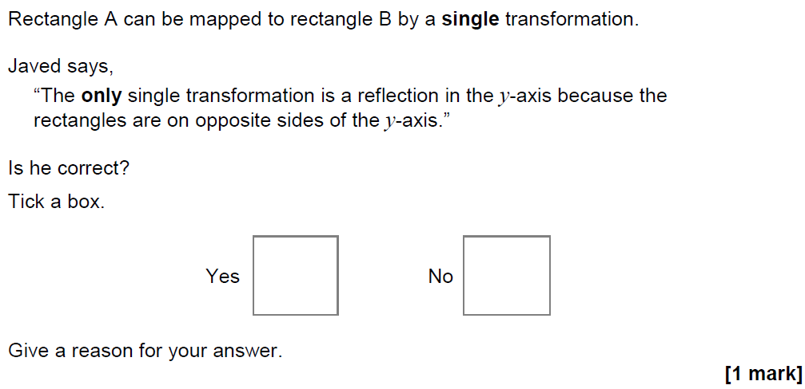
Transformations of Shapes
May 2017 1H Q21

Slide 33
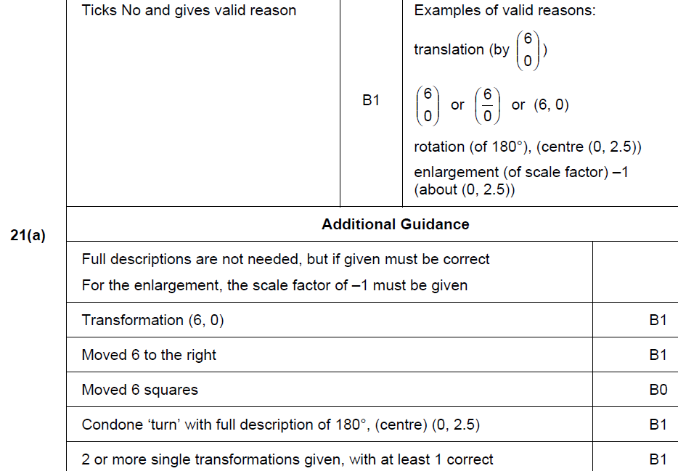
Transformations of Shapes
May 2017 1H Q21
A

Slide 34
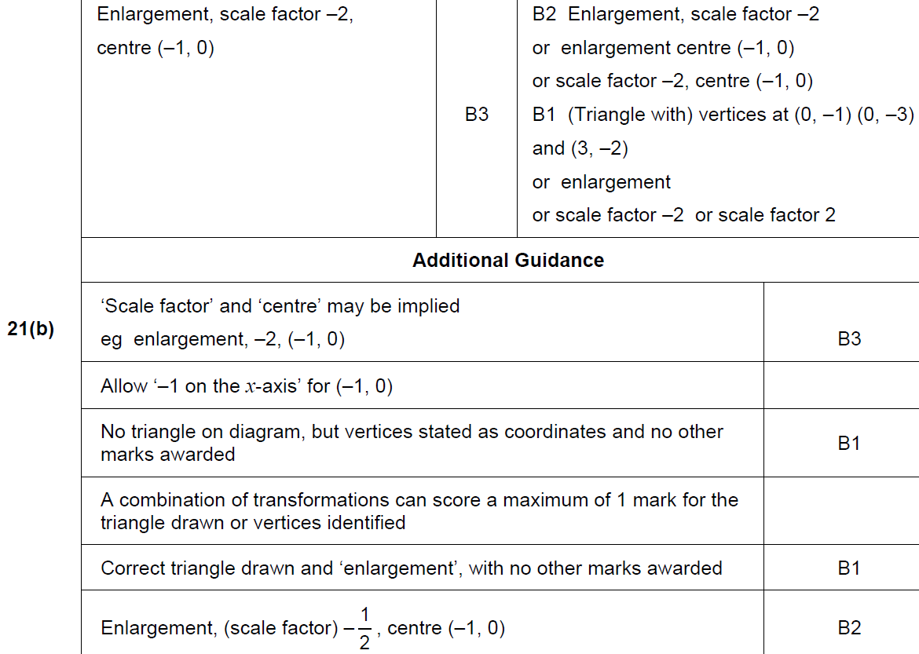
Transformations of Shapes
May 2017 1H Q21
B

Slide 35
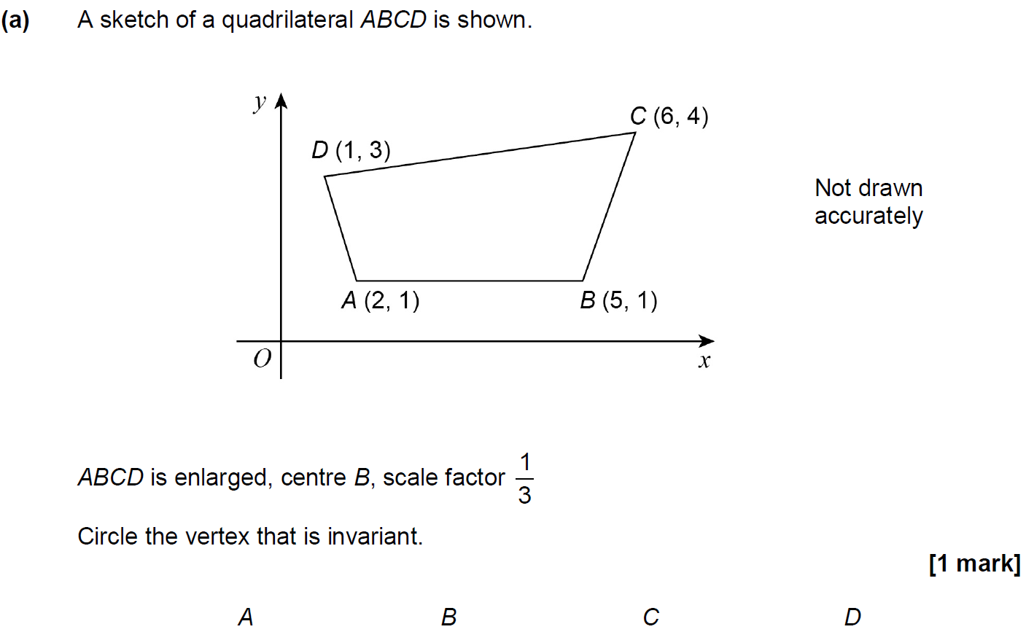
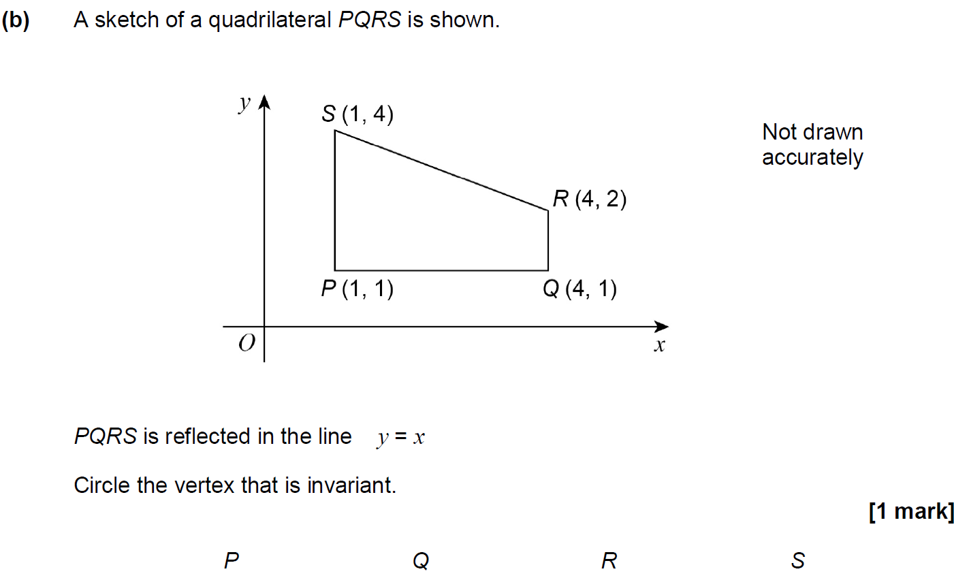
Transformations of Shapes
June 2017 2H Q26

Slide 36
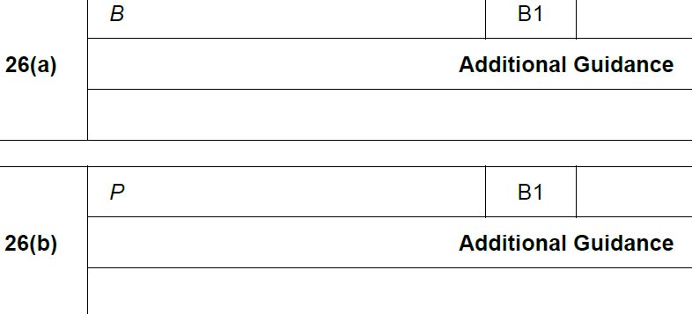
Transformations of Shapes
June 2017 2H Q26
A
B

Slide 37
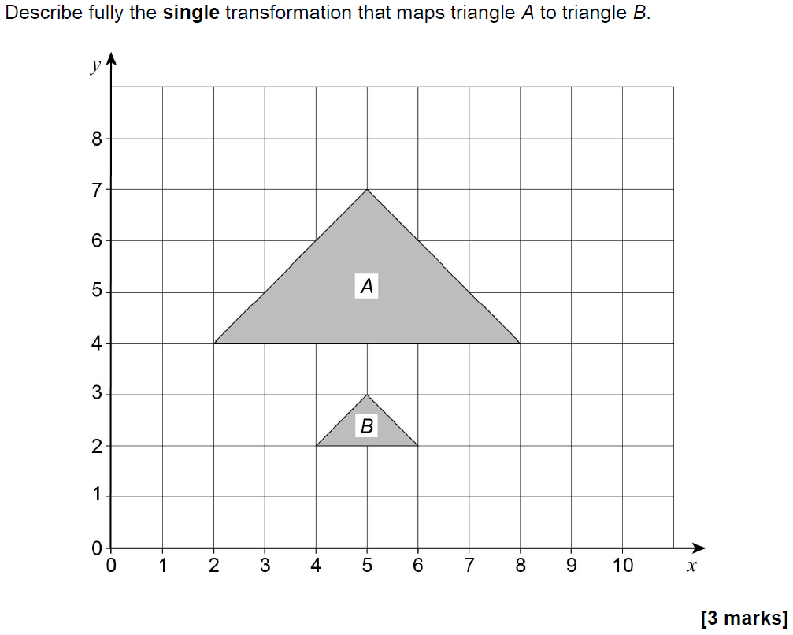
Transformations of Shapes
Nov 2017 2H Q7

Slide 38
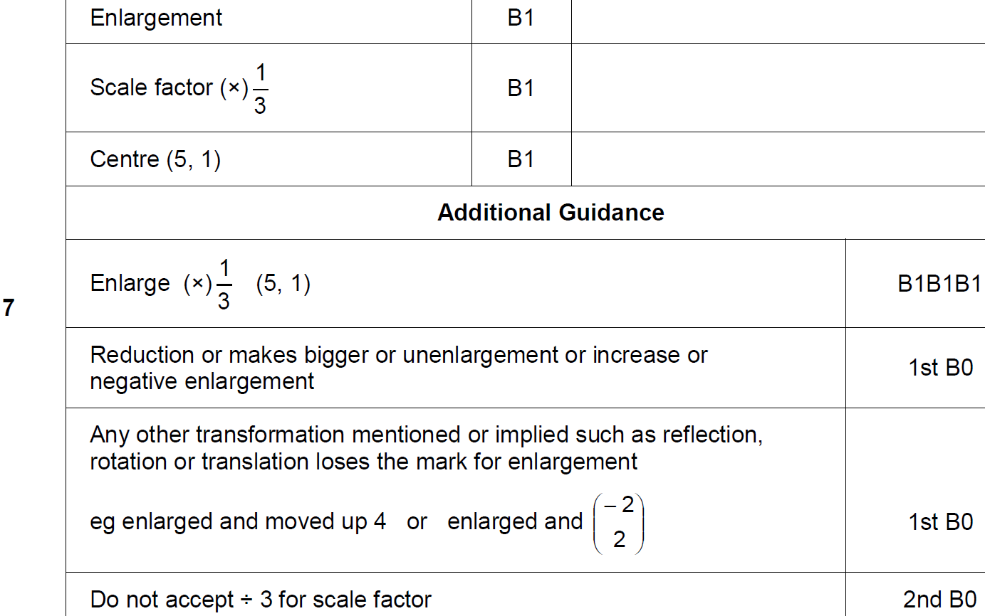
Transformations of Shapes
Nov 2017 2H Q7
A

Slide 39
Transformations of Shapes
May 2018 1H Q2

Slide 40
Transformations of Shapes
May 2018 1H Q2
A

Slide 41
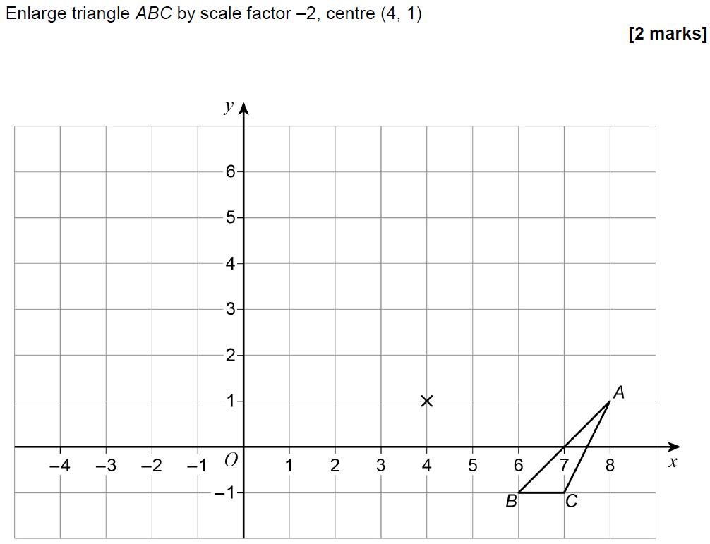
Transformations of Shapes
May 2018 1H Q21

Slide 42
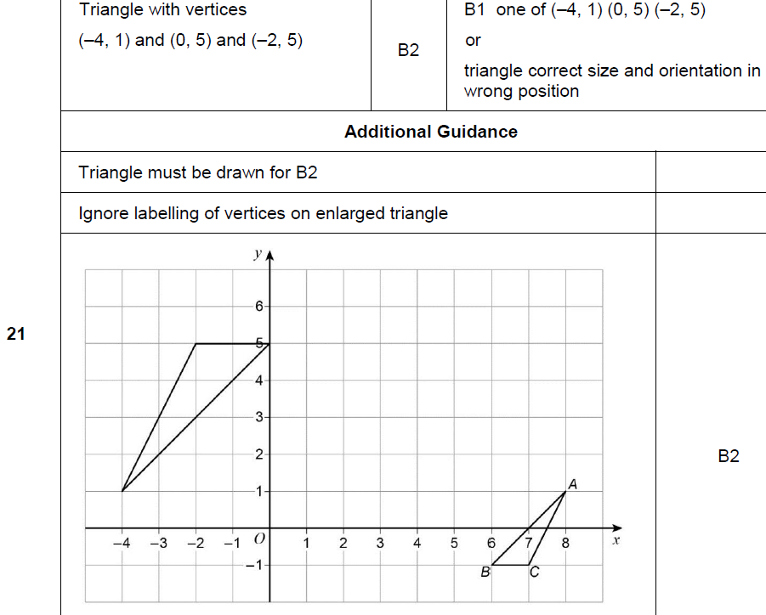
Transformations of Shapes
May 2018 1H Q21
A

Slide 43
Transformations of Shapes
Nov 2018 3H Q1

Slide 44
Transformations of Shapes
Nov 2018 3H Q1
A

Slide 45
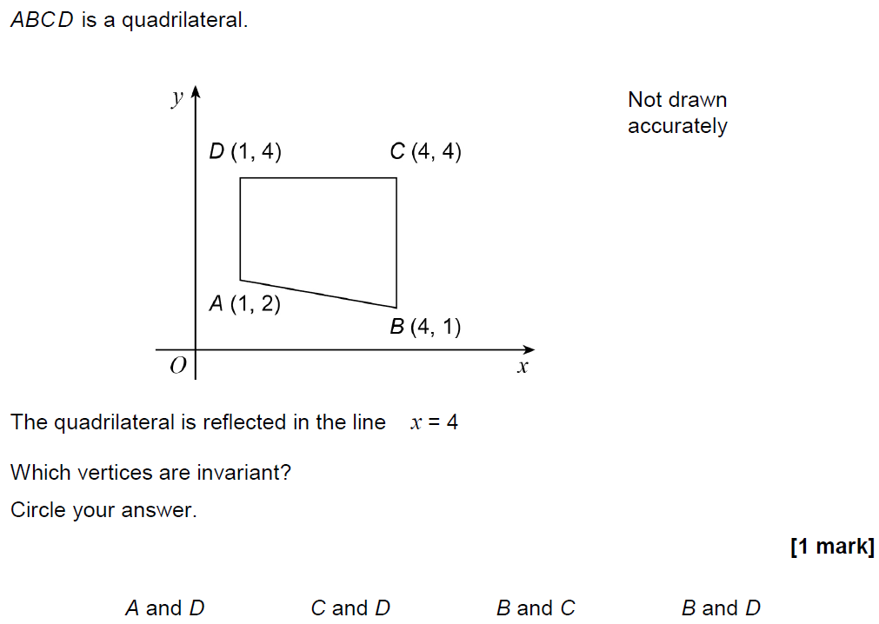
Transformations of Shapes
Nov 2018 3H Q25

Slide 46
Transformations of Shapes
Nov 2018 3H Q25
A

Slide 47
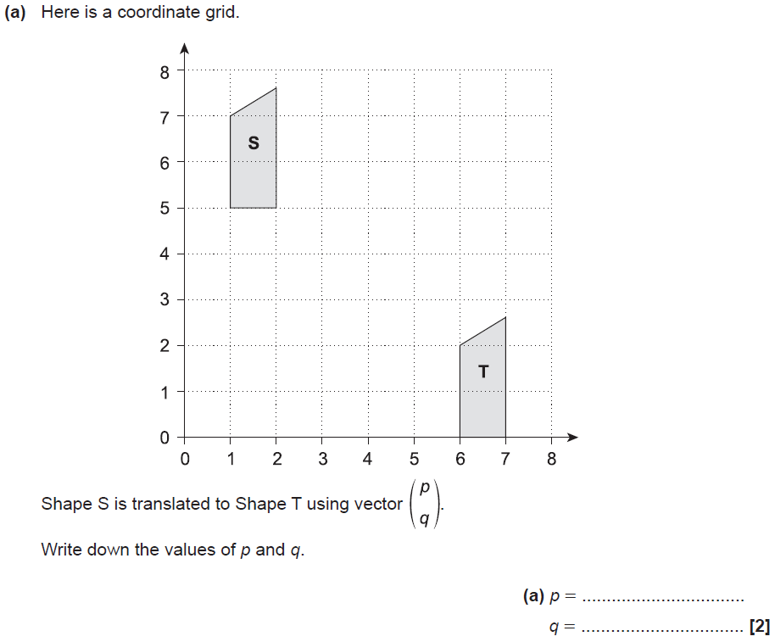
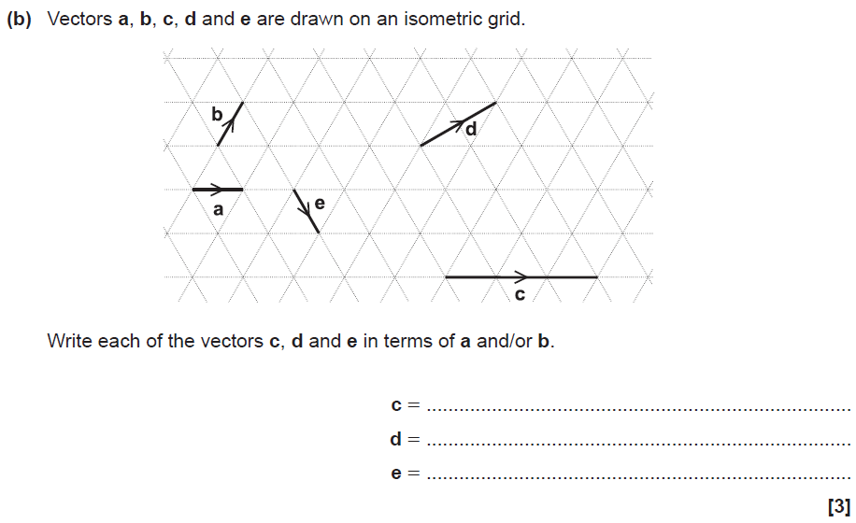
Transformations of Shapes
SAM 2H Q1

Slide 48
Transformations of Shapes
SAM 2H Q1
A
B

Slide 49
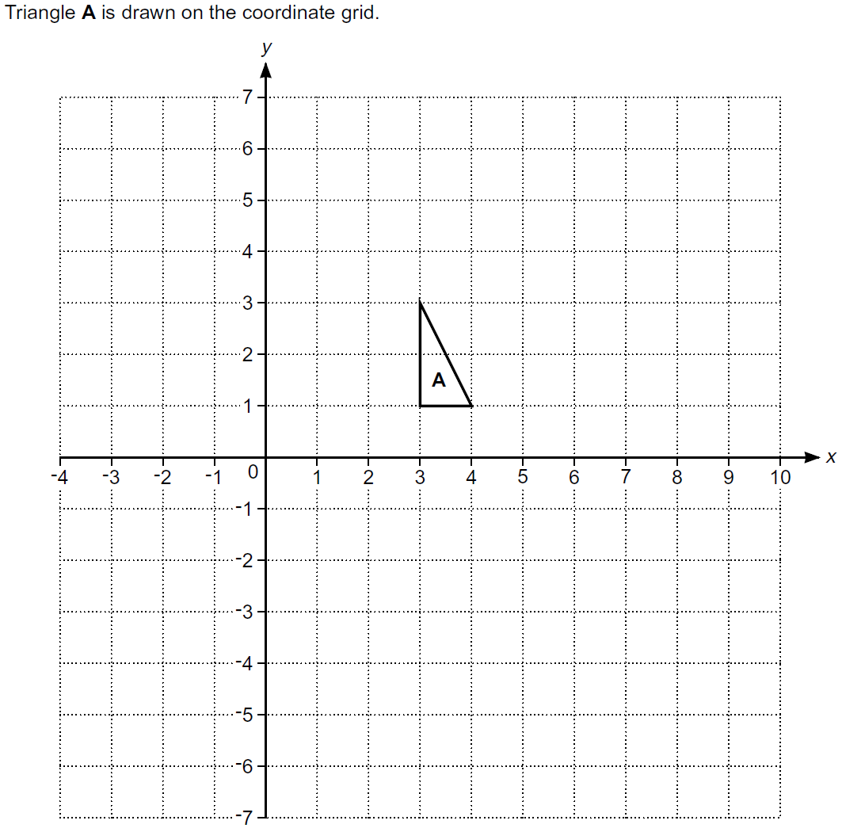
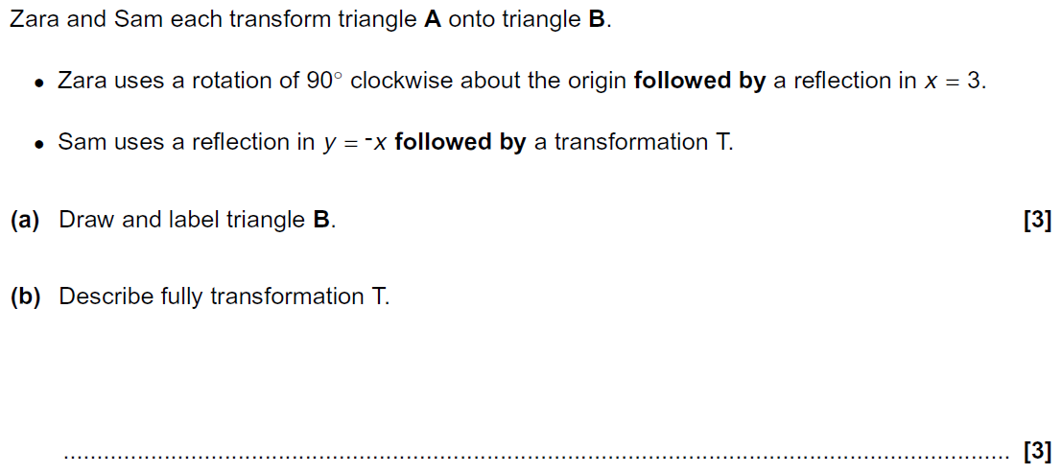
Transformations of Shapes
Practice 3H Q9
Reveal Shape B
B

Slide 50
Transformations of Shapes
Practice 3H Q9
A
B

Slide 51
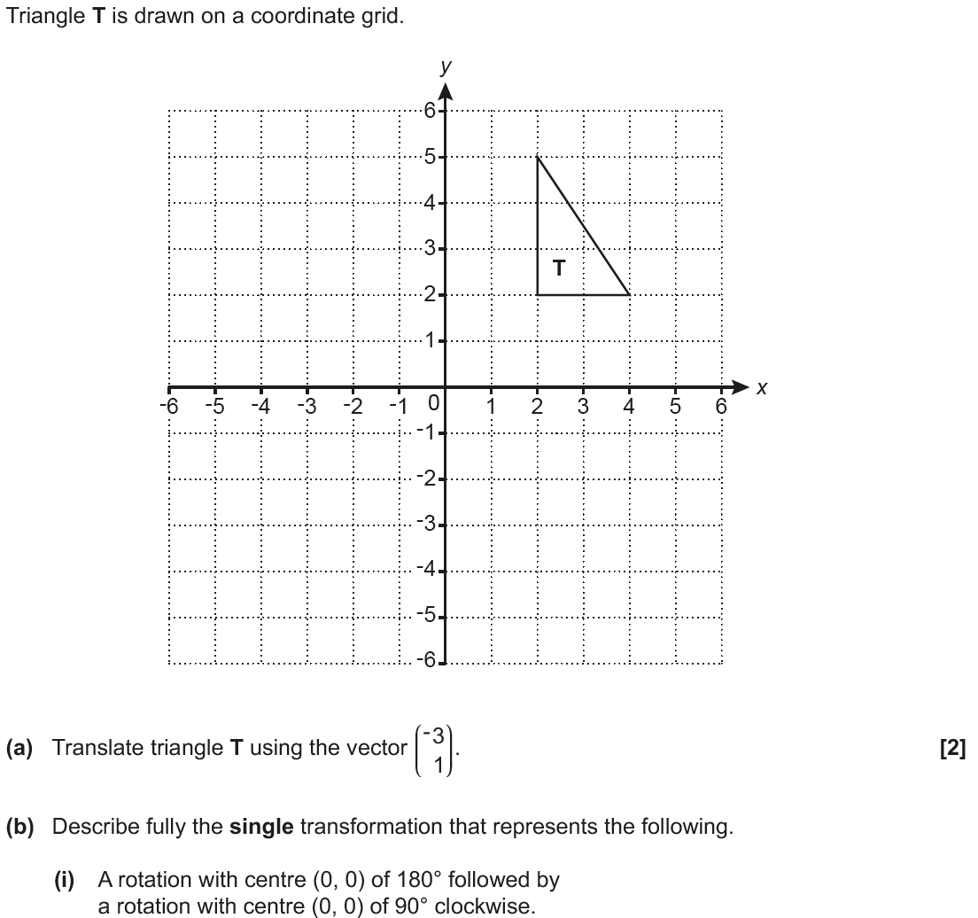
Transformations of Shapes
May 2017 1H Q11
T₁ .
T₃
T₂
T_{4 .}
.
T₅
Reveal Shape T₁ (a)
Hide T₁
Reveal Shape T₂
Hide T₂
Reveal Shape T₃
Hide T₃
Reveal Shape T₄
Hide T₄
Reveal Shape T₅
Hide T₅

Slide 52
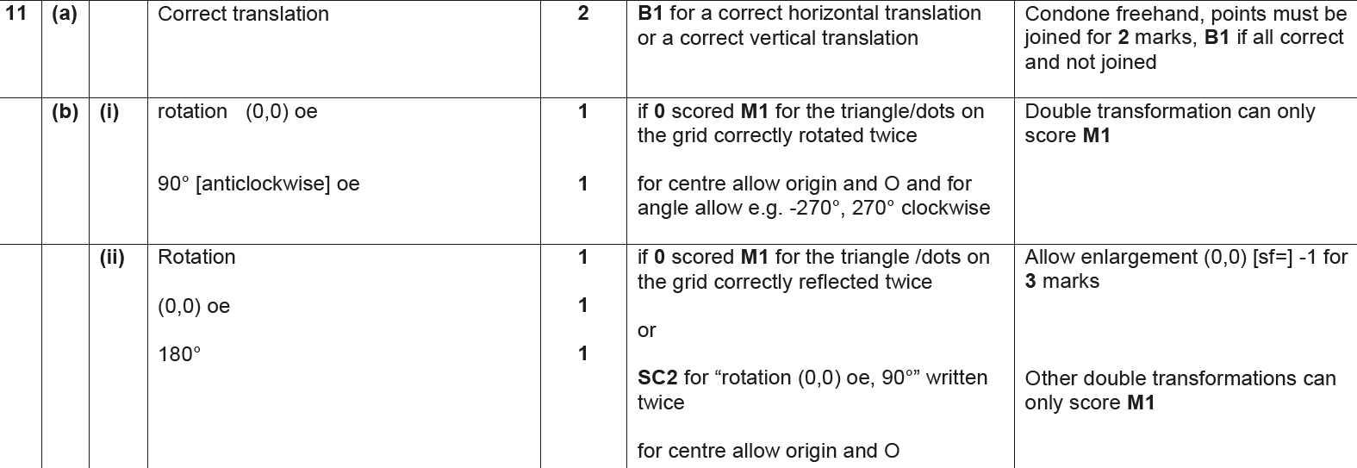
Transformations of Shapes
May 2017 1H Q11
A
B (i)
B (ii)

Slide 53
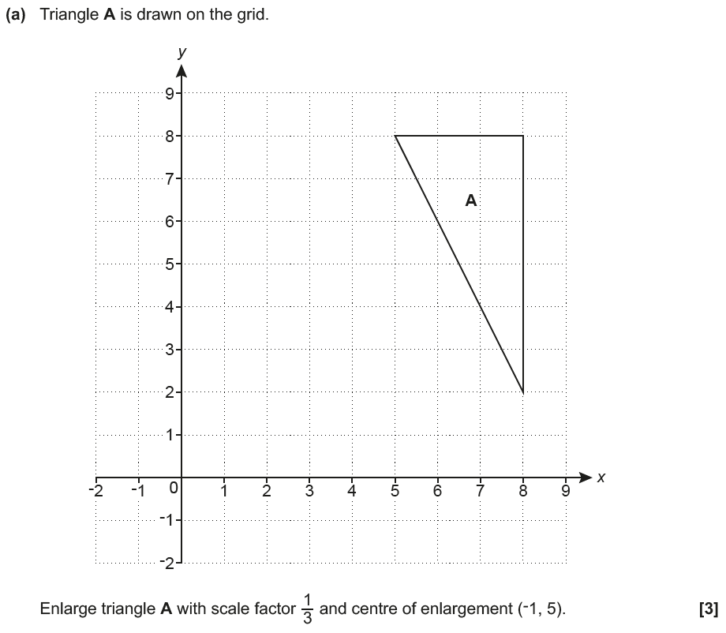
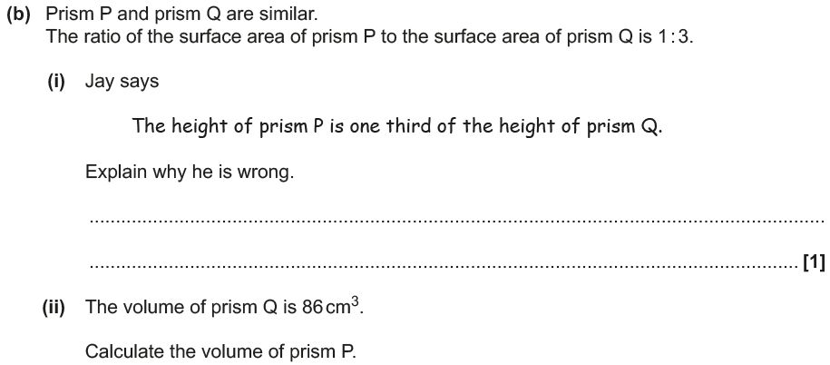
Transformations of Shapes
June 2017 3H Q9
A₁
Reveal Shape A₁ (a)
Hide A₁

Slide 54
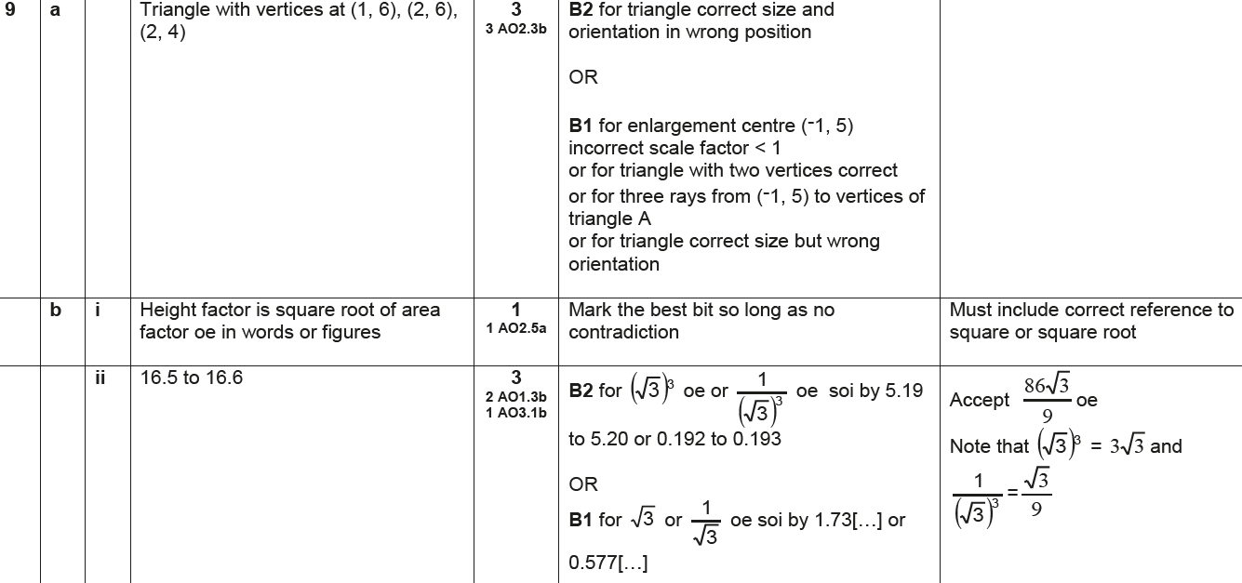
Transformations of Shapes
June 2017 3H Q9
A
B (i)
B (ii)

Slide 55
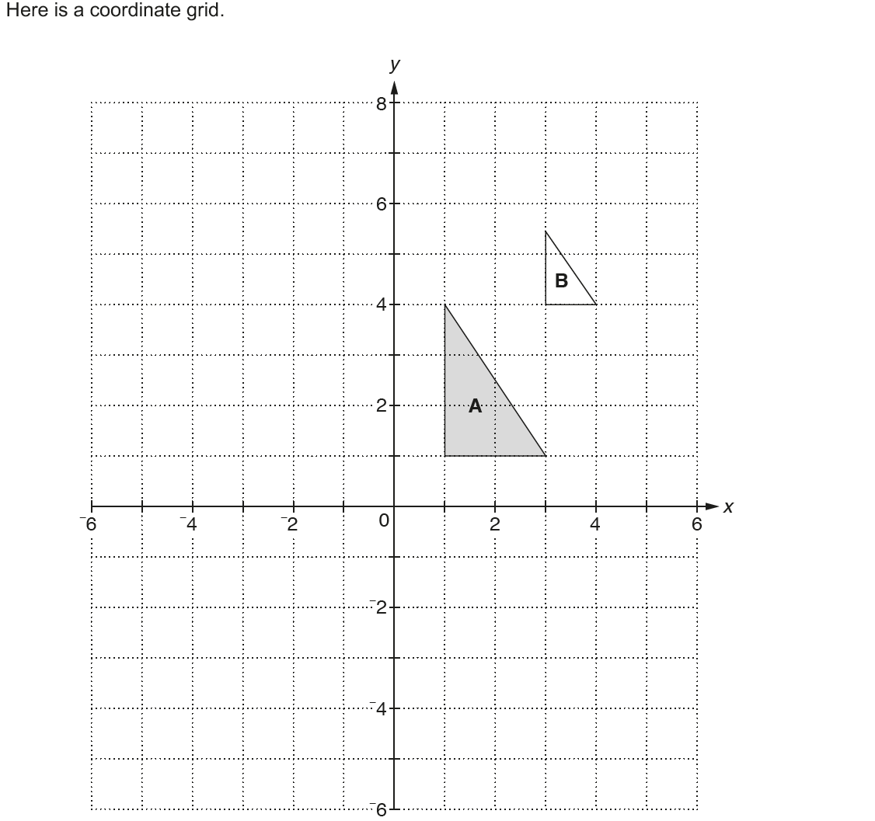
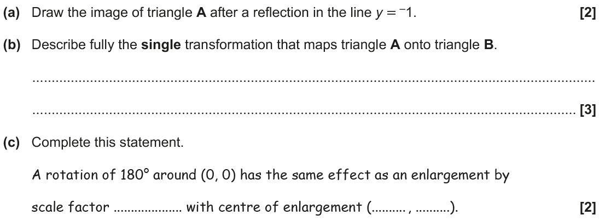
Transformations of Shapes
Nov 2017 2H Q5
A₁
Reveal Shape A₁ (a)
Hide A₁

Slide 56
Transformations of Shapes
Nov 2017 2H Q5
A
B
C

Slide 57
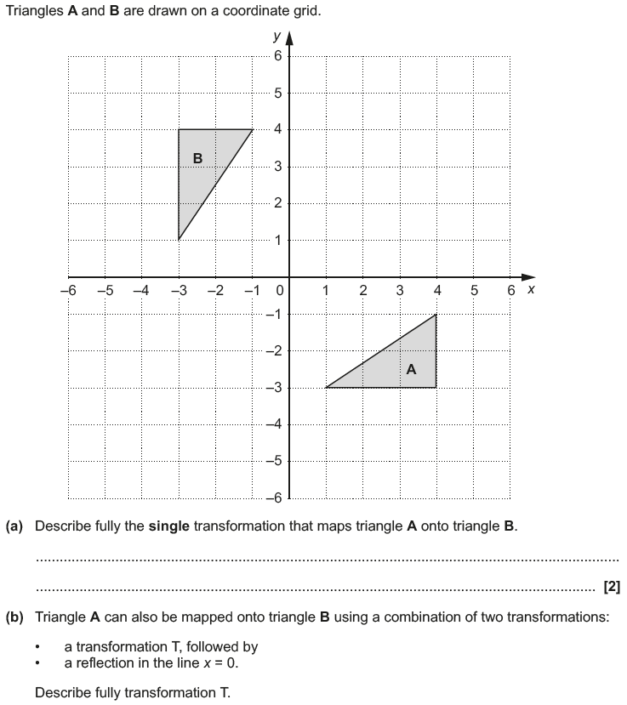
Transformations of Shapes
May 2018 1H Q6

Slide 58
Transformations of Shapes
May 2018 1H Q6
A
B

Slide 59
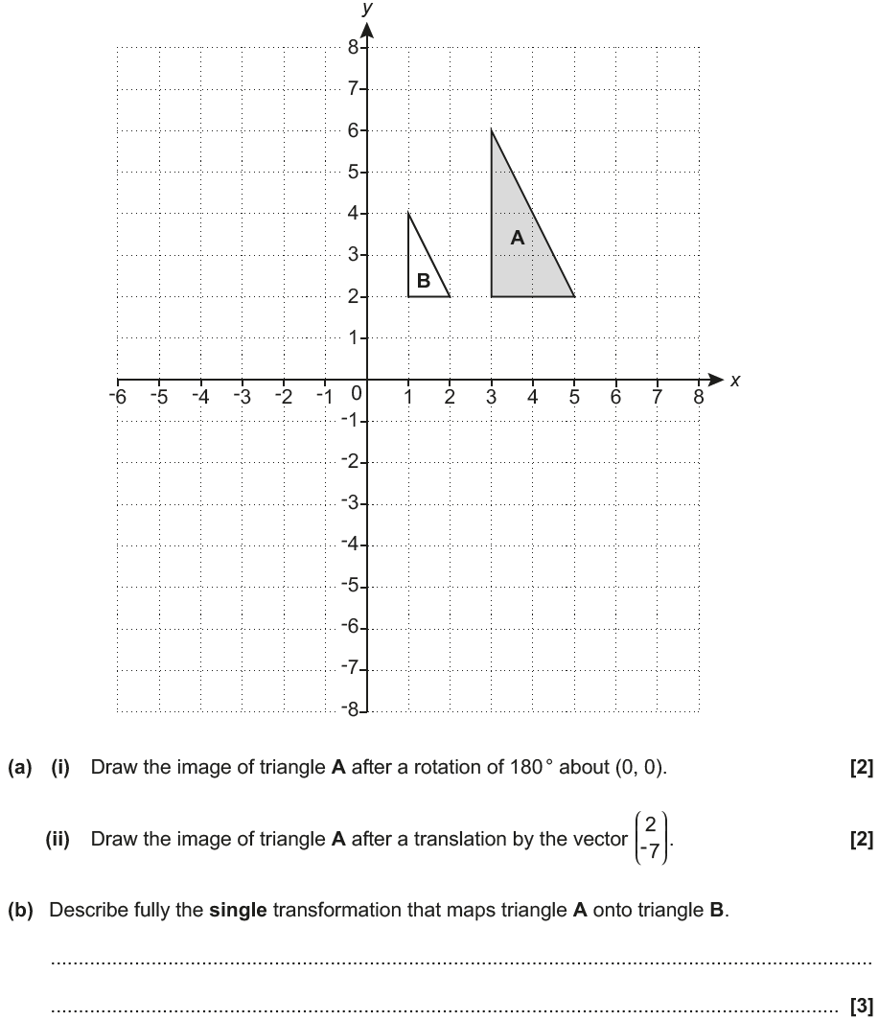
Transformations of Shapes
Nov 2018 2H Q10
A₂
A₁
Reveal Shape A₁ (i)
Hide A₁
Reveal Shape A₂ (ii)
Hide A₂

Slide 60
Transformations of Shapes
Nov 2018 2H Q10
A (i)
A (ii)
B

