Slide 1
Transformations of Shapes
Transformations of Shapes
May 2017
1H Q11
June 2017
3H Q9
SAM
2H Q1
Nov 2017
2H Q5
Practice
3H Q9
May 2018
1H Q6
Nov 2018
2H Q10
Invariant Points & Lines

Slide 2
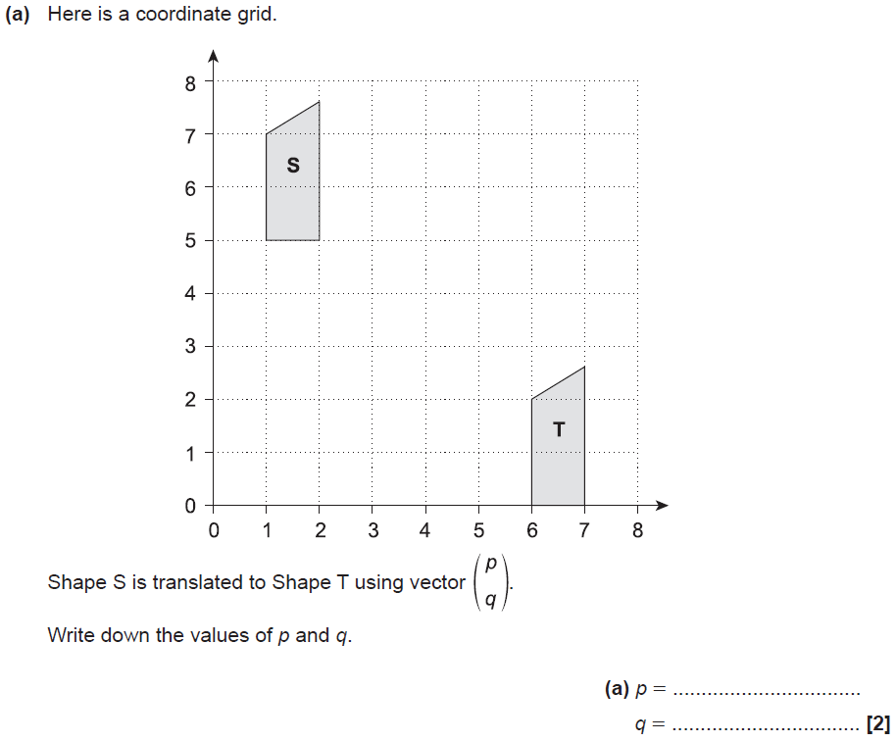
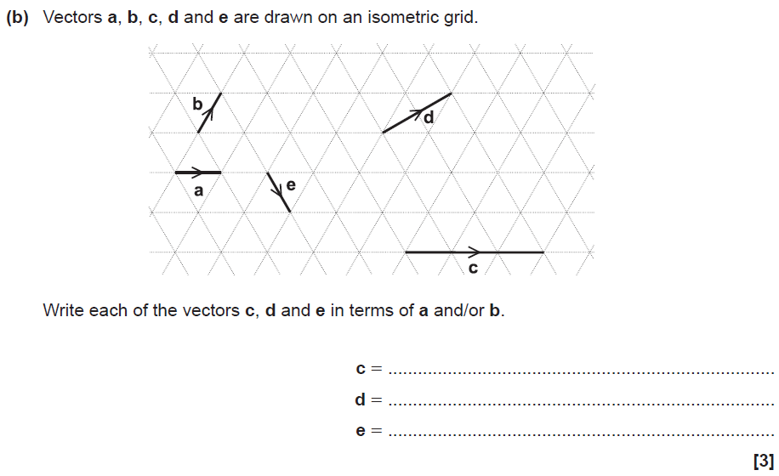
Transformations of Shapes
SAM 2H Q1

Slide 3
Transformations of Shapes
SAM 2H Q1
A
B

Slide 4
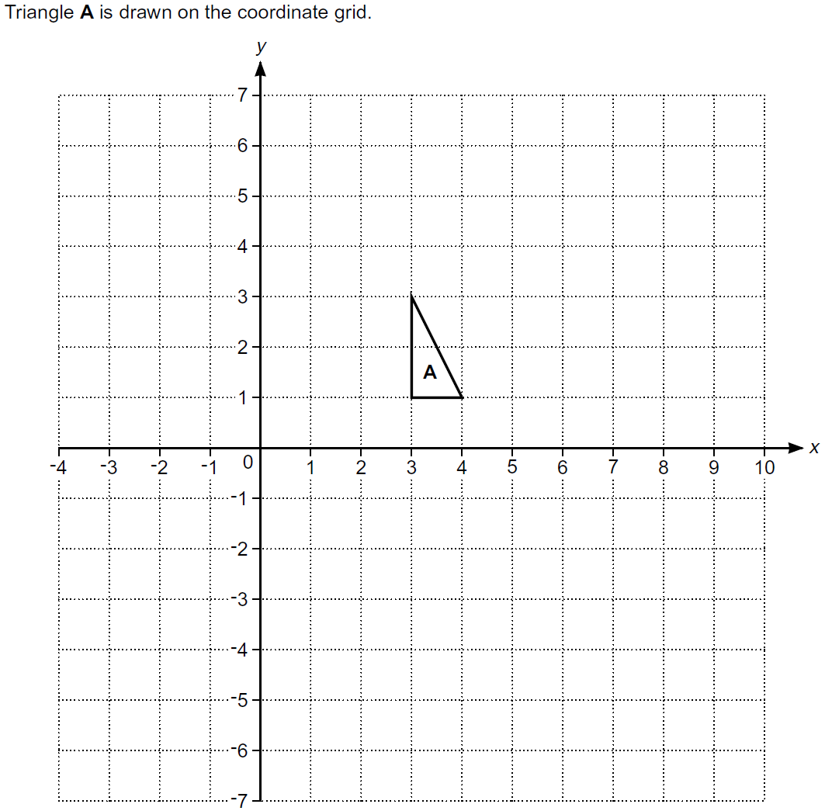
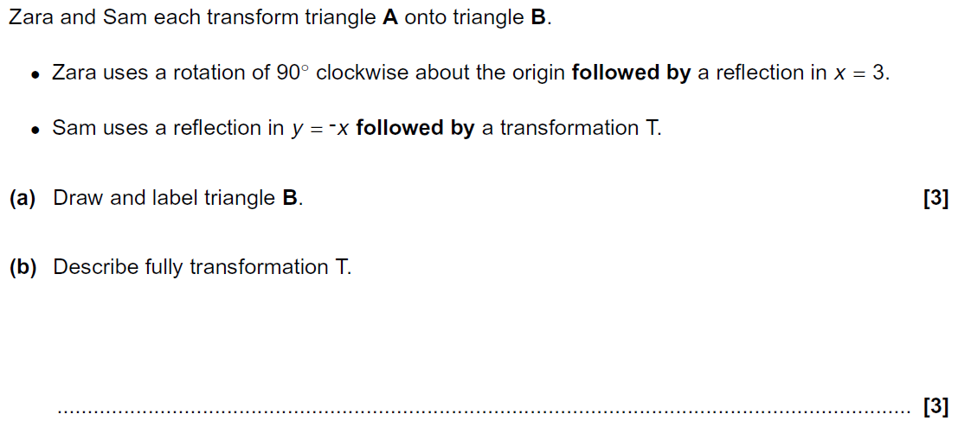
Transformations of Shapes
Practice 3H Q9
Reveal Shape B
B

Slide 5
Transformations of Shapes
Practice 3H Q9
A
B

Slide 6
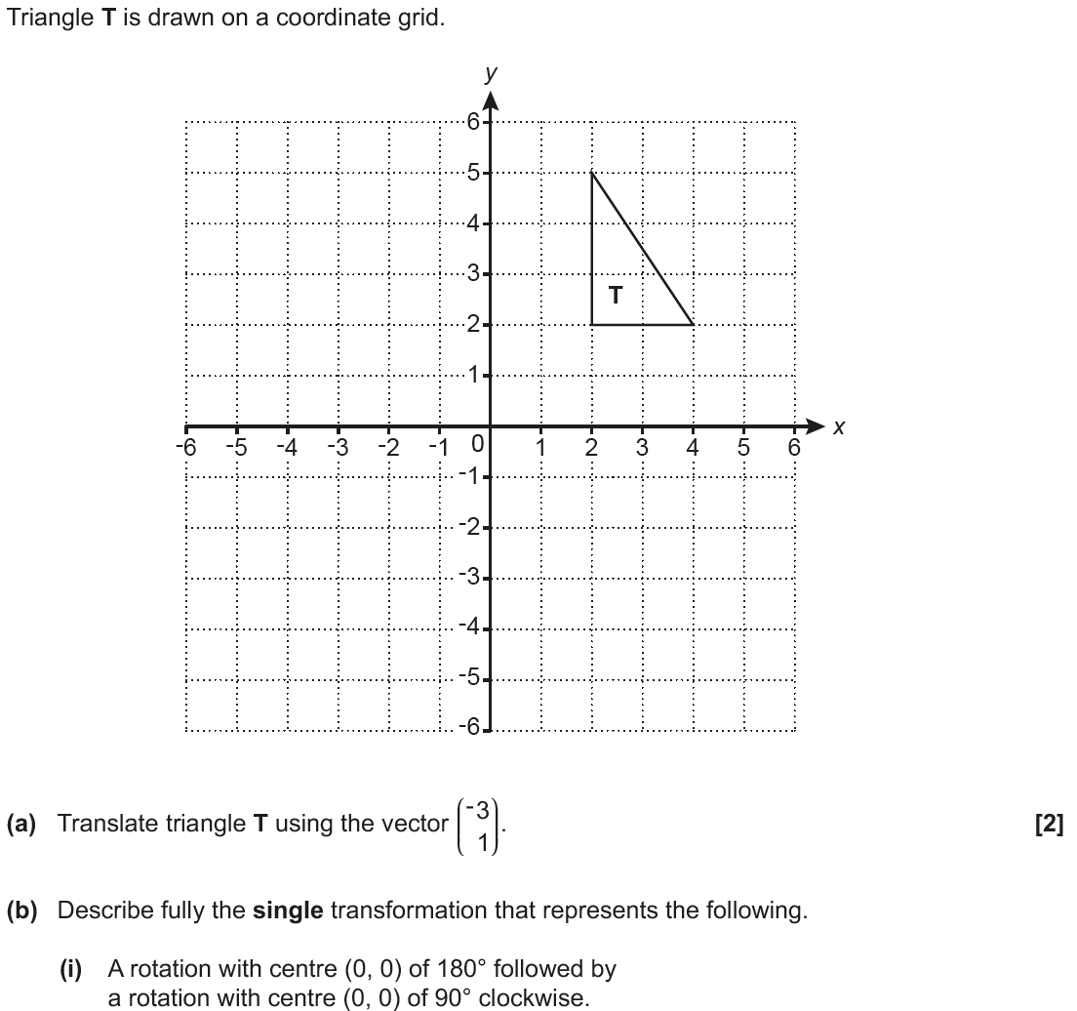
Transformations of Shapes
May 2017 1H Q11
T₁ .
T₃
T₂
T_{4 .}
.
T₅
Reveal Shape T₁ (a)
Hide T₁
Reveal Shape T₂
Hide T₂
Reveal Shape T₃
Hide T₃
Reveal Shape T₄
Hide T₄
Reveal Shape T₅
Hide T₅

Slide 7
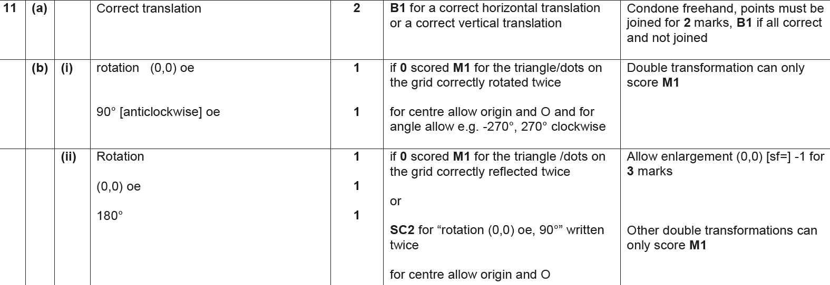
Transformations of Shapes
May 2017 1H Q11
A
B (i)
B (ii)

Slide 8
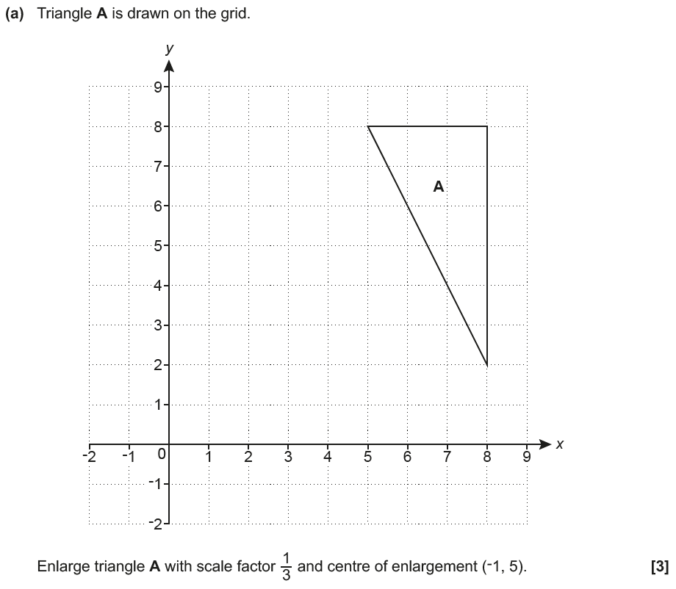
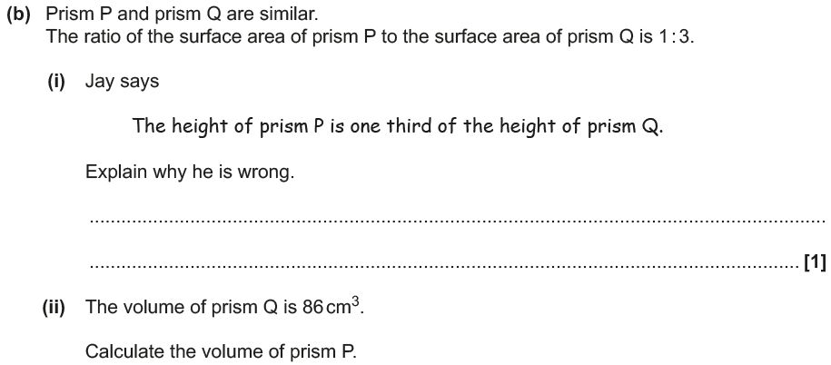
Transformations of Shapes
June 2017 3H Q9
A₁
Reveal Shape A₁ (a)
Hide A₁

Slide 9
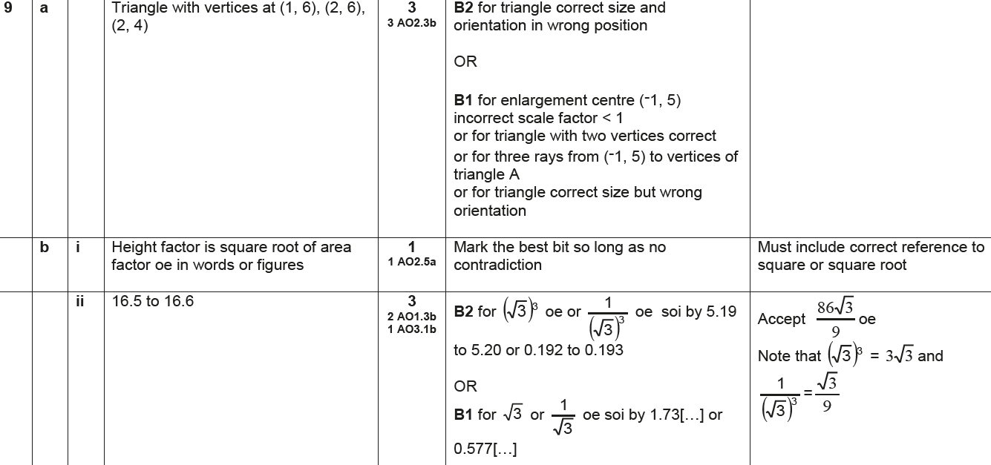
Transformations of Shapes
June 2017 3H Q9
A
B (i)
B (ii)

Slide 10
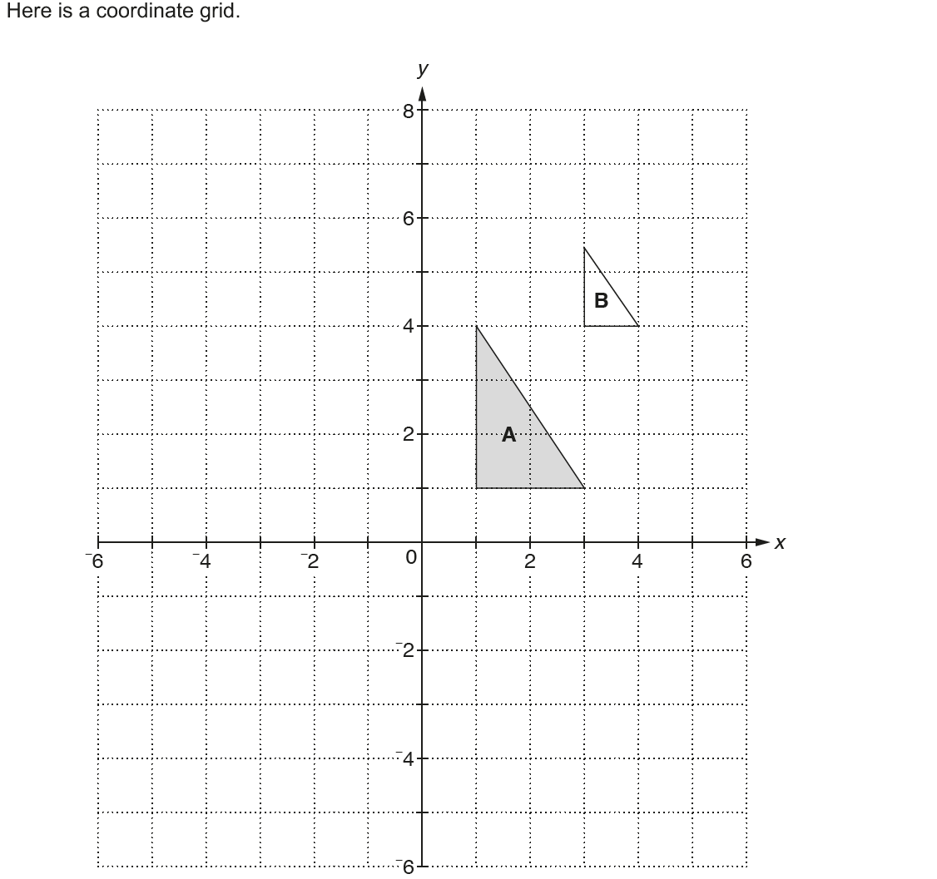
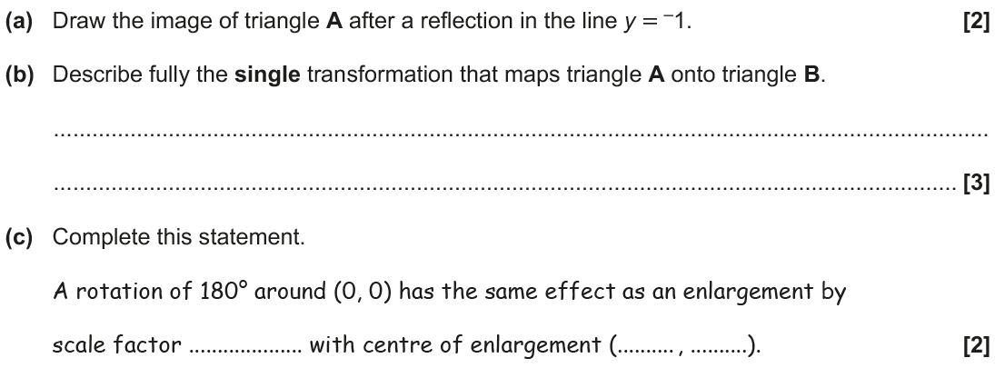
Transformations of Shapes
Nov 2017 2H Q5
A₁
Reveal Shape A₁ (a)
Hide A₁

Slide 11
Transformations of Shapes
Nov 2017 2H Q5
A
B
C

Slide 12
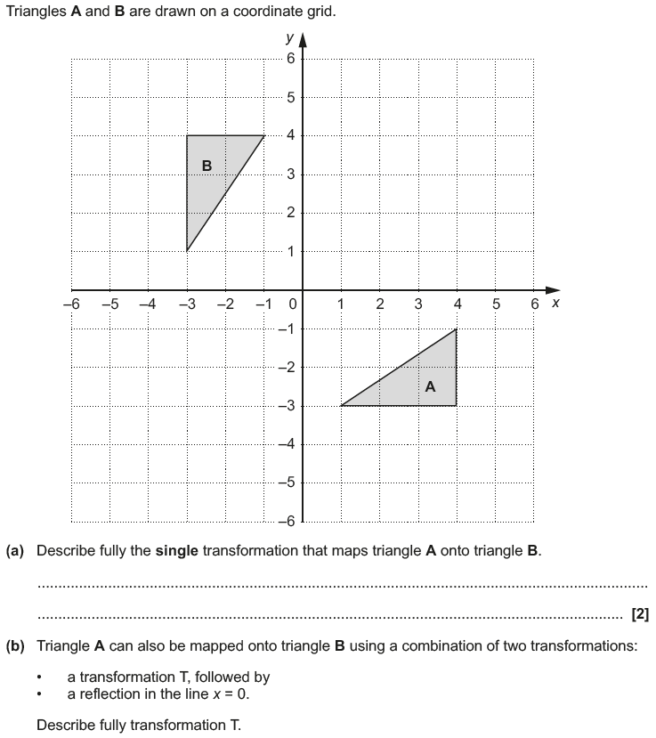
Transformations of Shapes
May 2018 1H Q6

Slide 13
Transformations of Shapes
May 2018 1H Q6
A
B

Slide 14
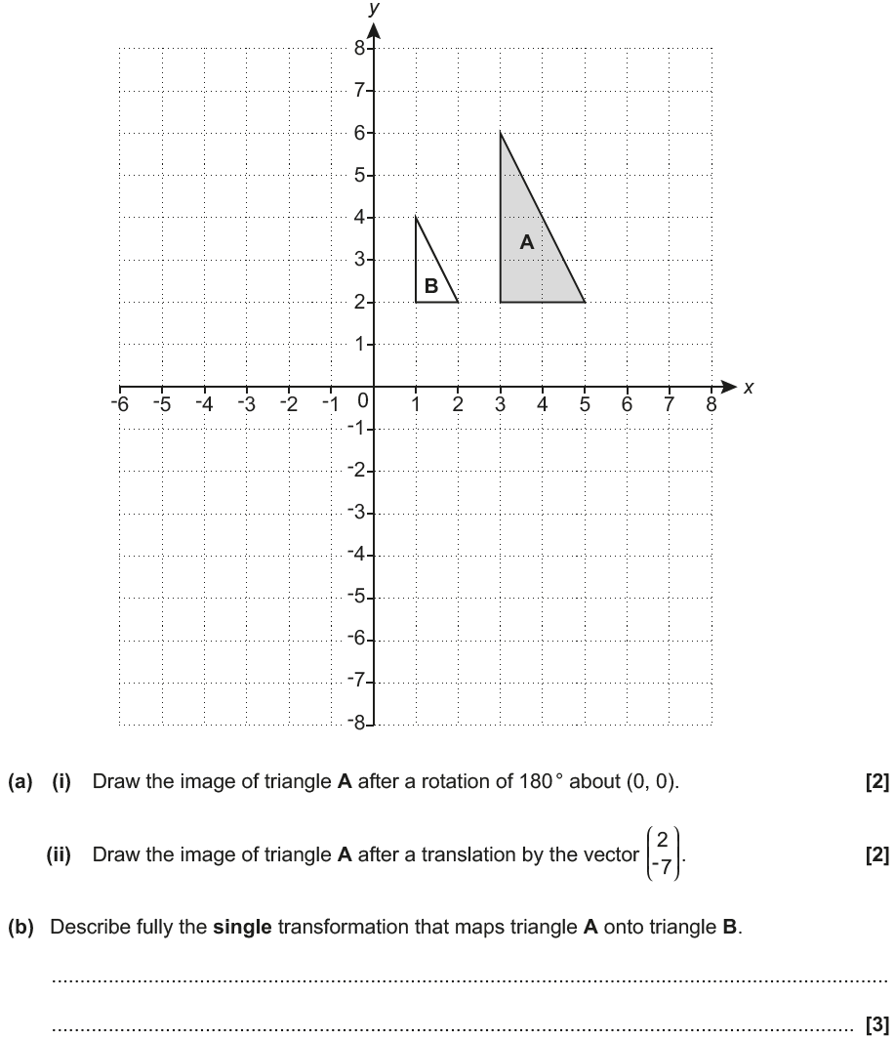
Transformations of Shapes
Nov 2018 2H Q10
A₂
A₁
Reveal Shape A₁ (i)
Hide A₁
Reveal Shape A₂ (ii)
Hide A₂

Slide 15
Transformations of Shapes
Nov 2018 2H Q10
A (i)
A (ii)
B

