Slide 1
Transformations of Shapes
Transformations of Shapes
June 2017
2H Q9
Nov 2018
1H Q13
SAM
1H Q20
Nov 2017
1H Q18
Nov 2018
2H Q8
Spec 2
2H Q1
Nov 2017
2H Q5
Nov 2018
3H Q20
Spec 2
3H Q13
May 2018
1H Q7
May 2019
1H Q5
June 2018
2H Q7
June 2019
3H Q8
Invariant Points & Lines

Slide 2
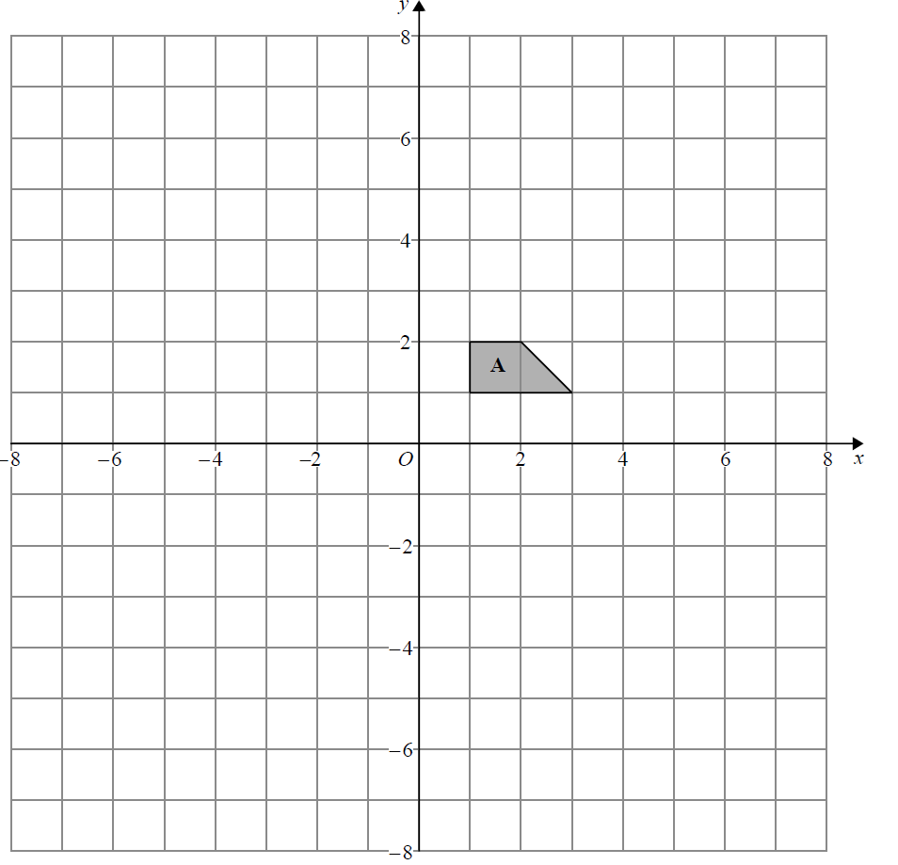
Transformations of Shapes
SAM 1H Q20
Reveal Shape B
B

Slide 3
Transformations of Shapes
SAM 1H Q20
A
B

Slide 4
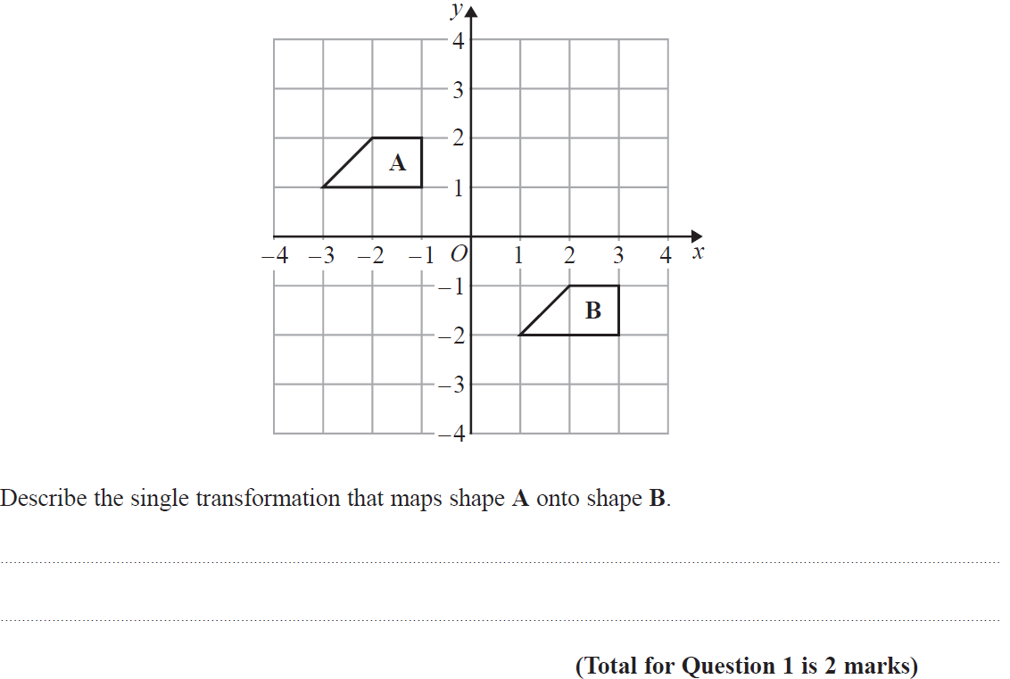
Transformations of Shapes
Specimen Set 2 2H Q1

Slide 5
Transformations of Shapes
Specimen Set 2 2H Q1
A

Slide 6
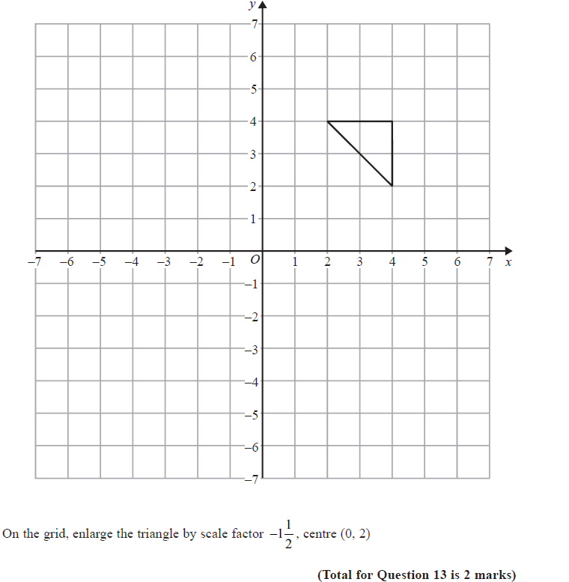
Transformations of Shapes
Specimen Set 2 3H Q13
Reveal Shape

Slide 7
Transformations of Shapes
Specimen Set 2 3H Q13
A

Slide 8
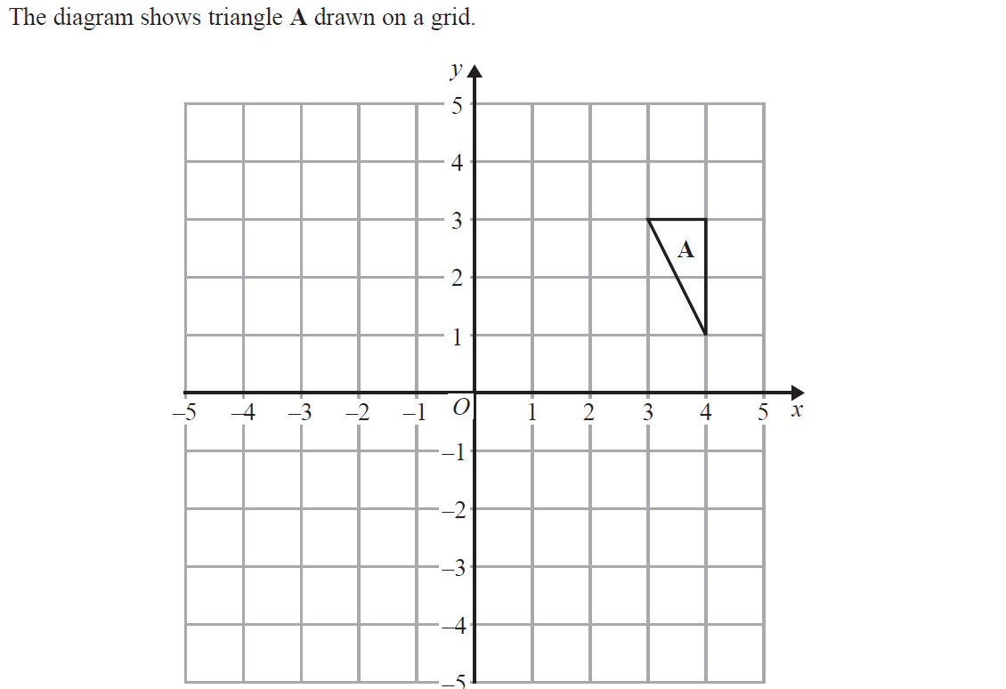
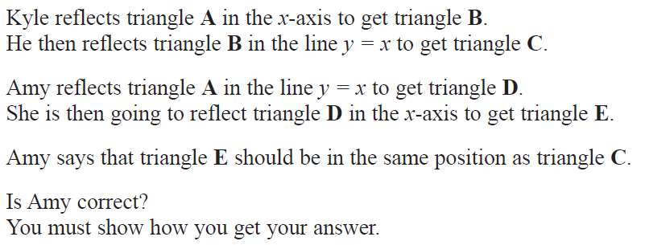
Transformations of Shapes
June 2017 2H Q9
C
D
Reveal Shape B
Reveal Shape C
Reveal Shape D
Reveal Shape E
B
E

Slide 9
Transformations of Shapes
June 2017 2H Q9
A

Slide 10
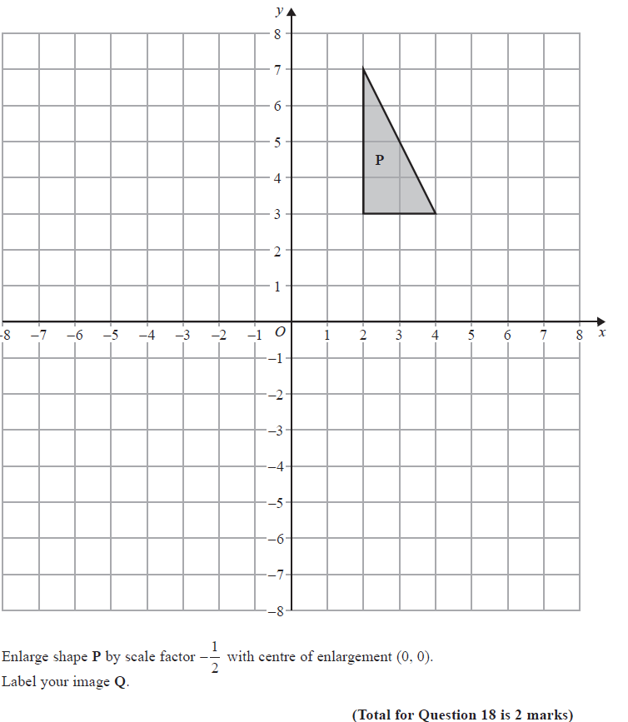
Transformations of Shapes
Nov 2017 1H Q18
Reveal Shape Q
Q

Slide 11
Transformations of Shapes
Nov 2017 1H Q18
A

Slide 12
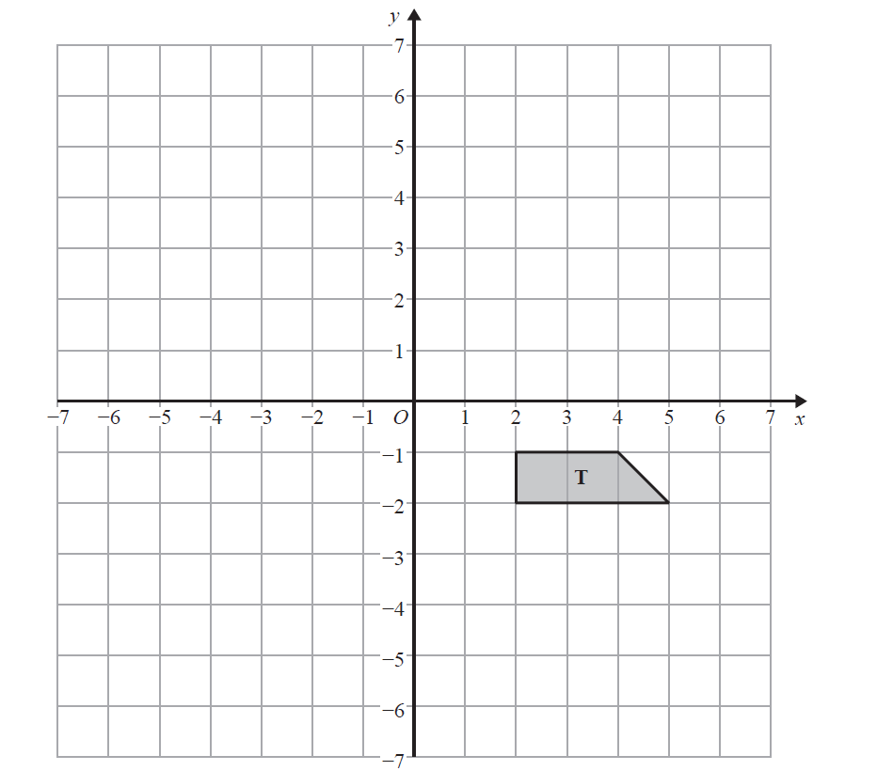
Transformations of Shapes
Nov 2017 2H Q5
Reveal Shape A
A
Reveal Shape B
B

Slide 13
Transformations of Shapes
Nov 2017 2H Q5
A
B

Slide 14
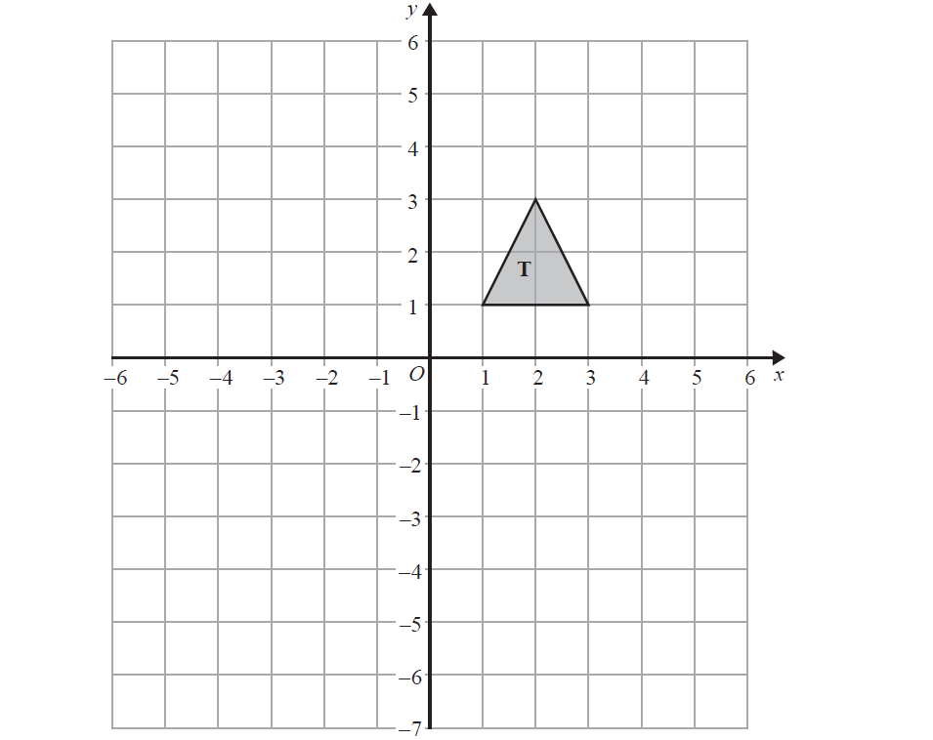
Transformations of Shapes
May 2018 1H Q7
R
Reveal Shape R
Reveal Shape S
S

Slide 15
Transformations of Shapes
May 2018 1H Q7
A

Slide 16
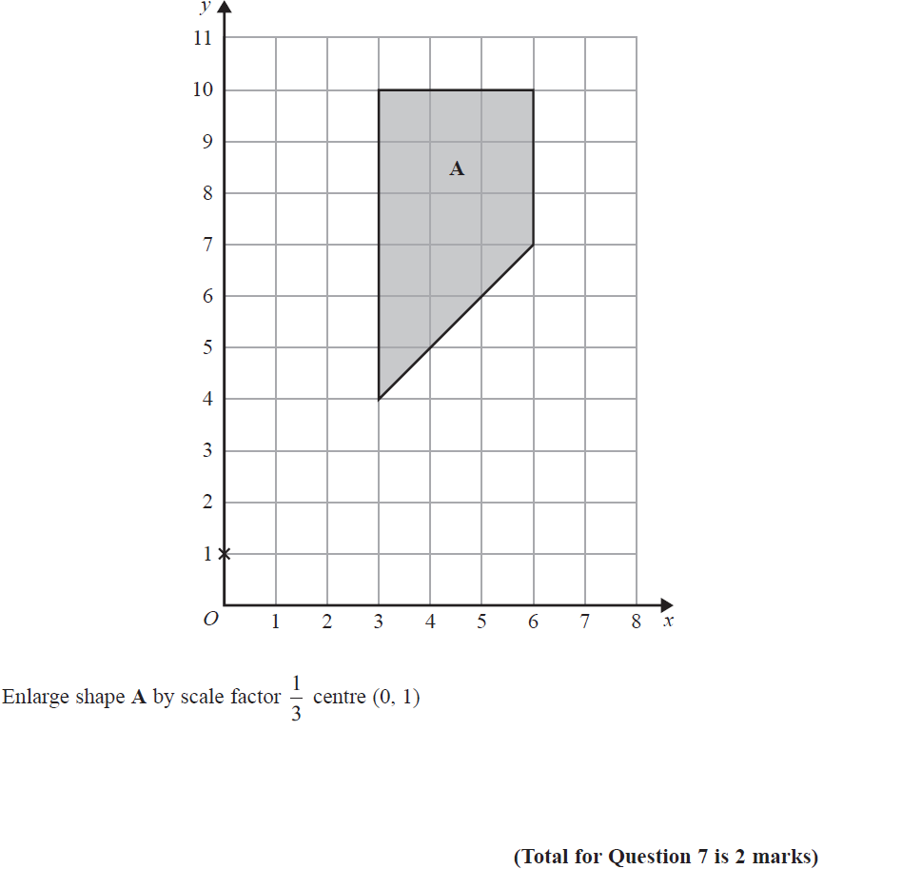
Transformations of Shapes
June 2018 2H Q7
Reveal Shape A’
A’

Slide 17
Transformations of Shapes
June 2018 2H Q7
A

Slide 18
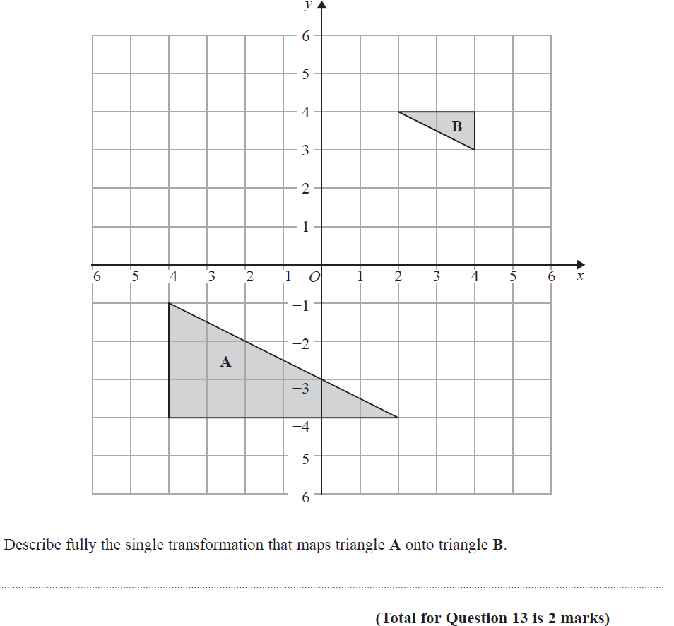
Transformations of Shapes
Nov 2018 1H Q13

Slide 19
Transformations of Shapes
Nov 2018 1H Q13
A

Slide 20
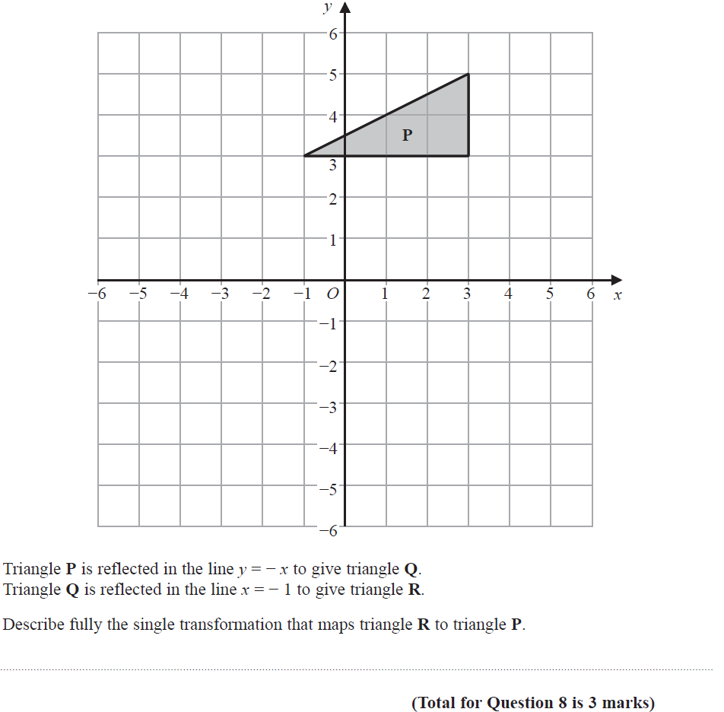
Transformations of Shapes
Nov 2018 2H Q8
Reveal Shape Q
Reveal Shape R
Q
R

Slide 21
Transformations of Shapes
Nov 2018 2H Q8
A

Slide 22
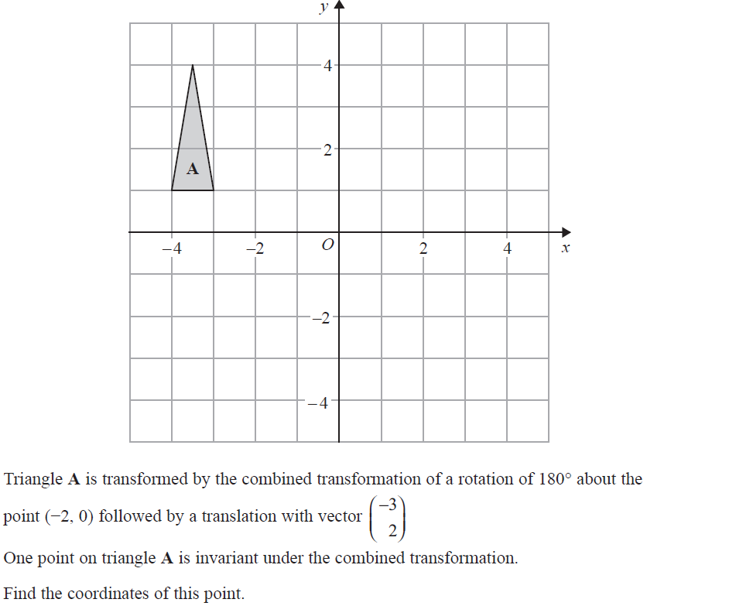
Transformations of Shapes
Nov 2018 3H Q20
Reveal Shape A’
A’’
Reveal Shape A’’
A’

Slide 23
Transformations of Shapes
Nov 2018 3H Q20
A

Slide 24
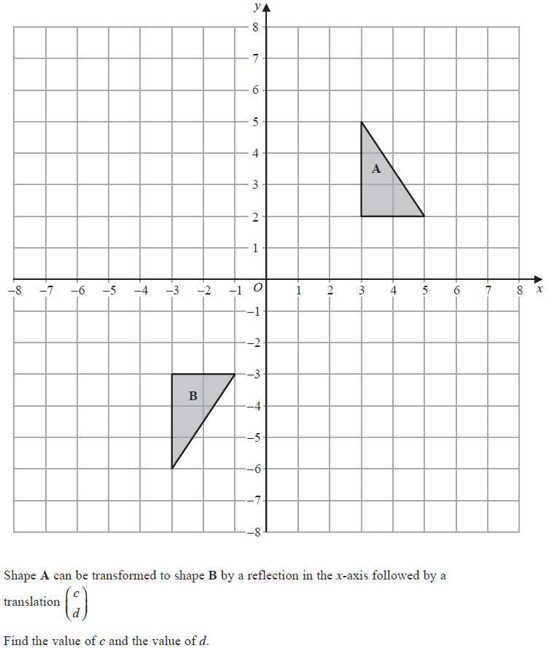
Transformations of Shapes
May 2019 1H Q5

Slide 25
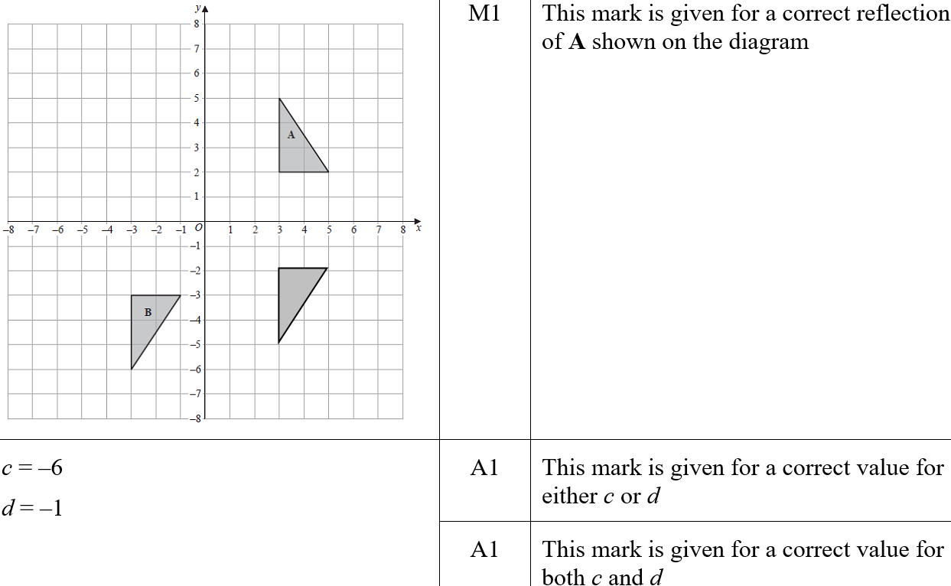
Transformations of Shapes
May 2019 1H Q5
A
A SF

Slide 26
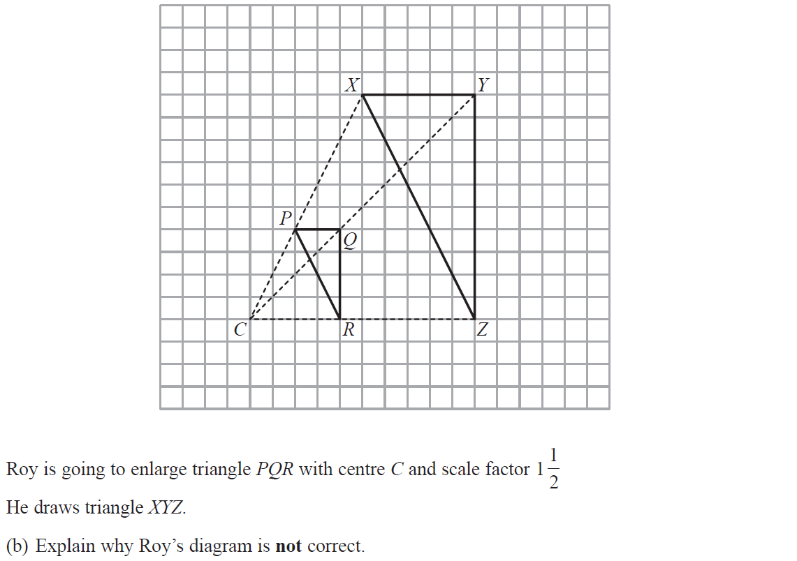
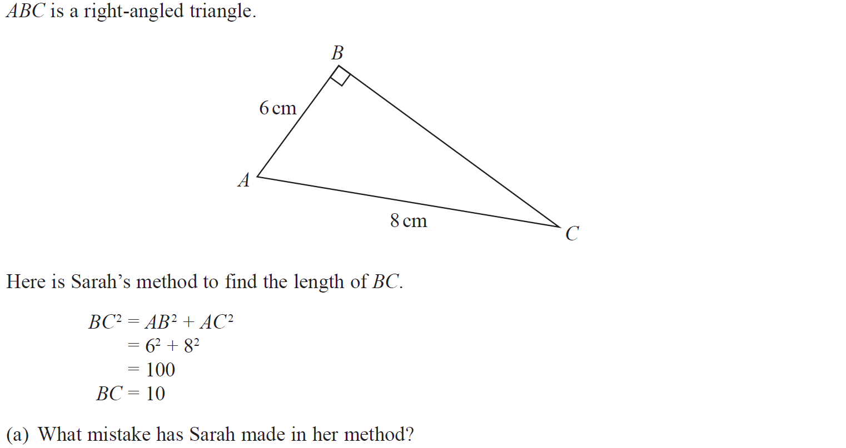
Transformations of Shapes
June 2019 3H Q8

Slide 27
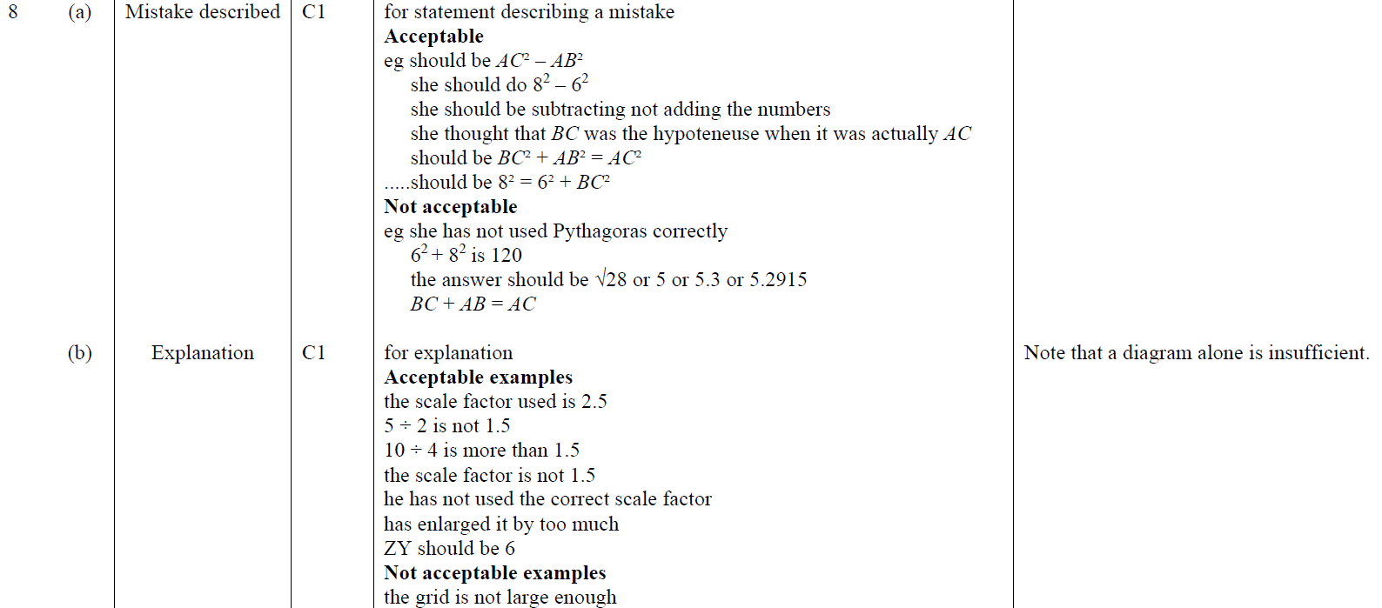
Transformations of Shapes
June 2019 3H Q8
A
B
A SF
B SF

