Slide 1
Time-Series
Time-Series
SAM
1H Q21
Spec 1
2H Q20
Nov 2017 2H Q10
Edexcel
June 2018 3H Q15
Spec 1
2H Q3
Spec 2
2H Q2
Nov 2017 3H Q18
AQA
June 2019 2H Q14
Spec 1
2H Q5
Spec 2
2H Q15
June 2018 2H Q14
OCR
June 2019 3H Q4
Spec 1
2H Q10
Spec 2
3H Q18
June 2018 3H Q12
Tangents/ Gradients
Trapeziums
See also:
Frequency Polygons

Slide 2
Time-Series
Time-Series
May 2017
1H Q23
Nov 2017
3H Q25
June 2017
2H Q8
Edexcel
SAM
1H Q24
June 2018
2H Q17
June 2017
3H Q15
AQA
SAM
3H Q23
June 2018
3H Q24
1 Marker
June 2017
3H Q24
OCR
SAM
3H Q24
Nov 2018
1H Q6
Nov 2017
1H Q16
Nov 2018
2H Q28
Nov 2017
2H Q24
Tangents/ Gradients
Trapeziums
See also:
Frequency Polygons

Slide 3
Time-Series
Time-Series
May 2017
1H Q15
Edexcel
SAM
2H Q11
Nov 2017
3H Q10
May 2017
1H Q20
AQA
SAM
3H Q10
June 2018
3H Q8
June 2017
2H Q2
OCR
Practice
3H Q13
Nov 2018
3H Q8
Nov 2017
2H Q13
Tangents/ Gradients
Trapeziums
See also:
Frequency Polygons

Slide 4

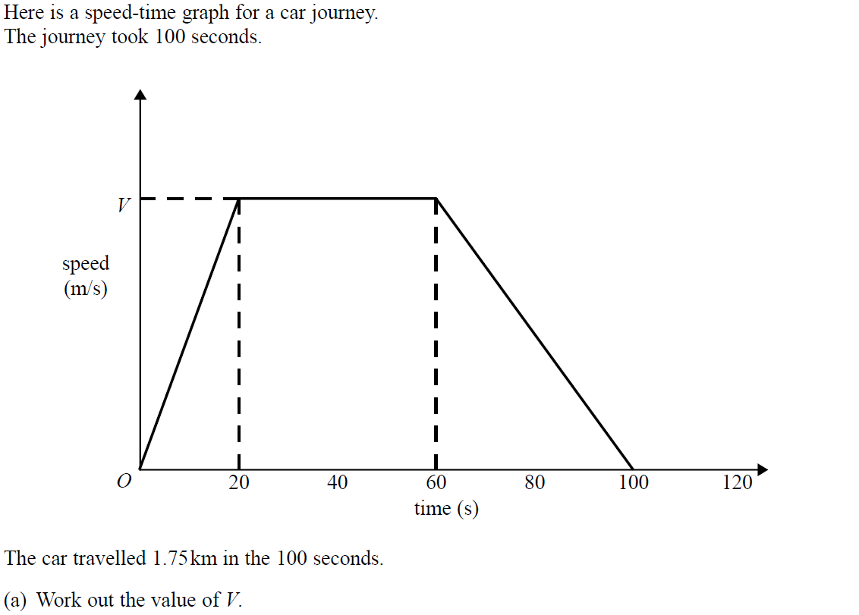
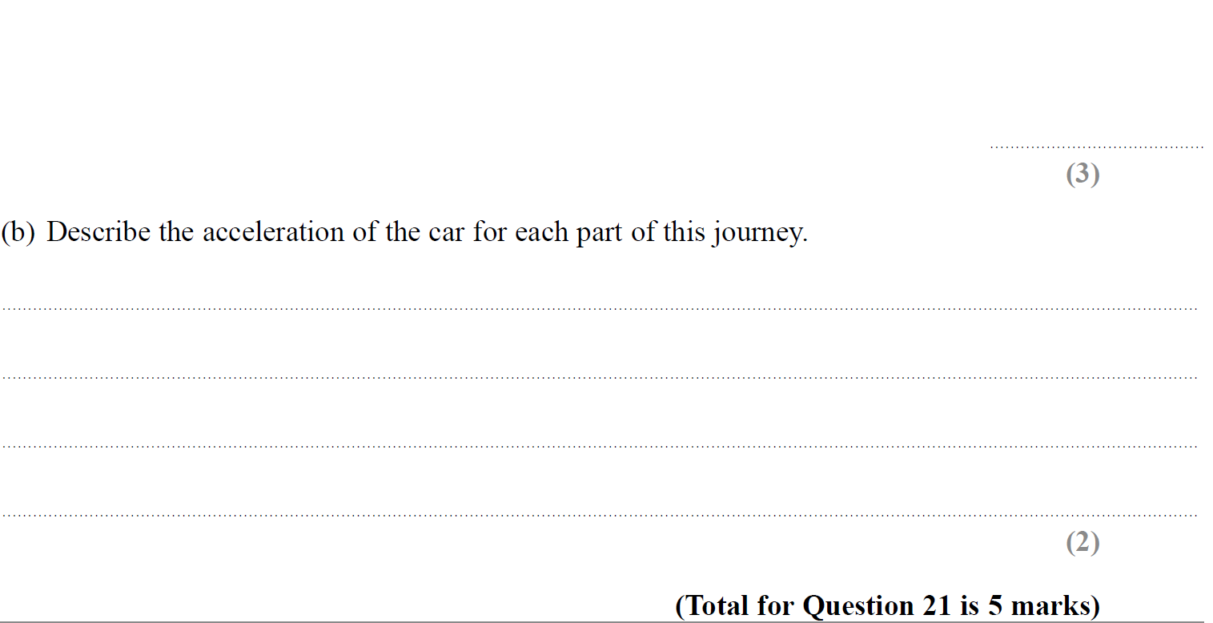

Time-Series
SAM 1H Q21

Slide 5
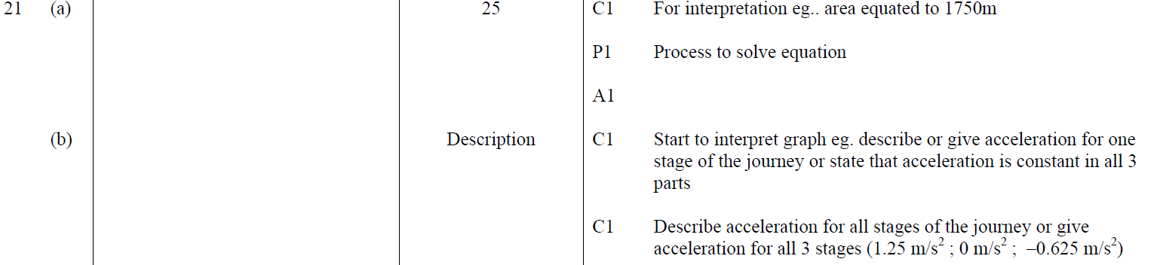

Time-Series
SAM 1H Q21
A
B

Slide 6
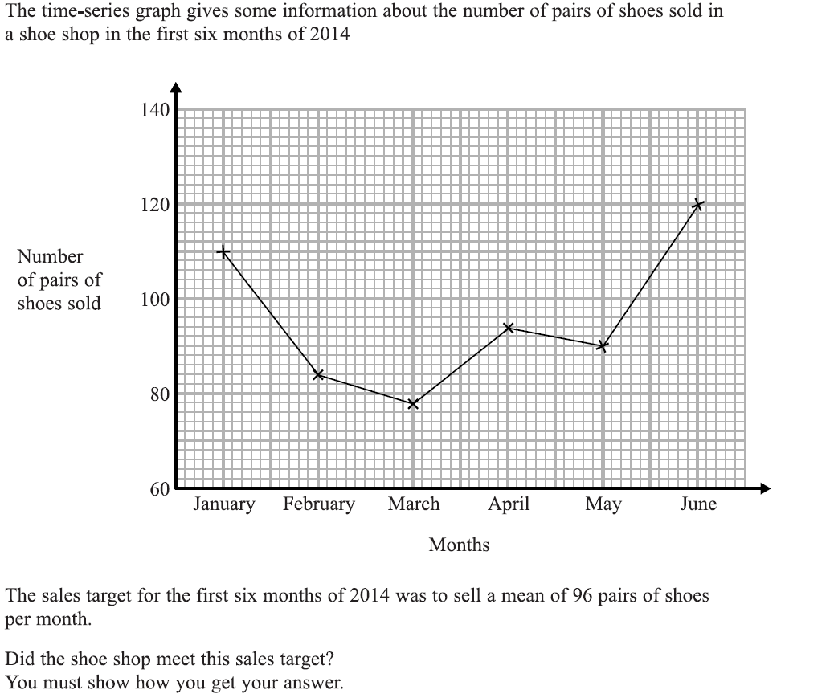

Time-Series
Specimen Set 1 2H Q3

Slide 7
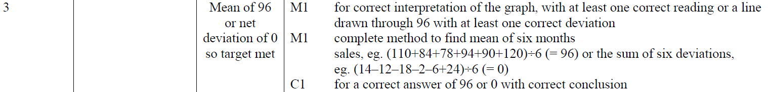
Time-Series
Specimen Set 1 2H Q3
A

Slide 8
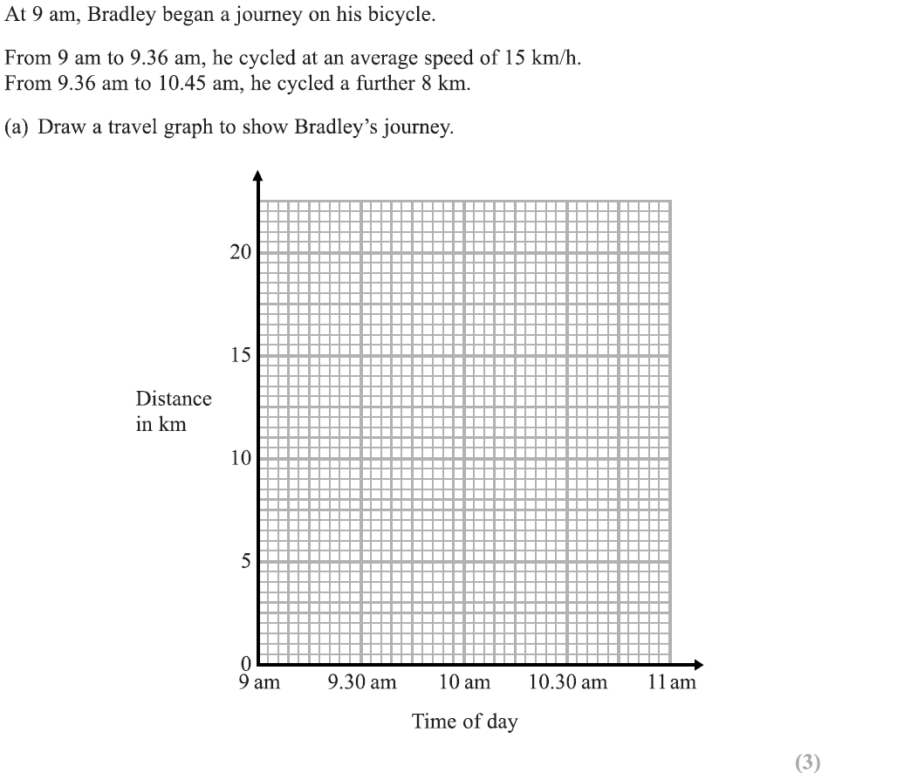
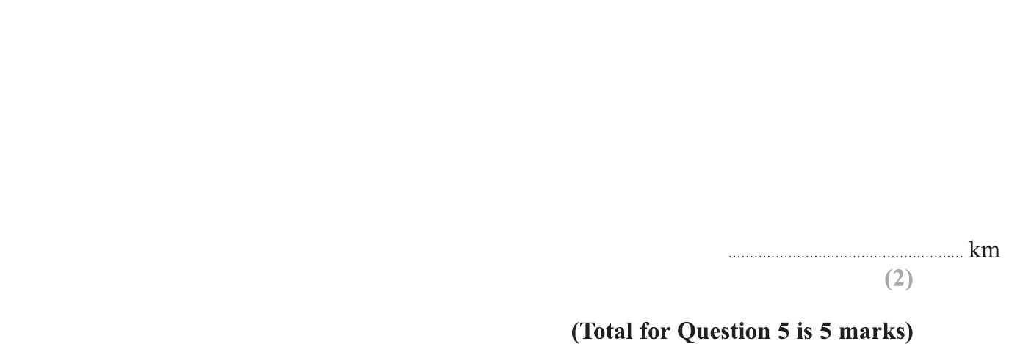
Time-Series
Specimen Set 1 2H Q5
Reveal Graph

Slide 9
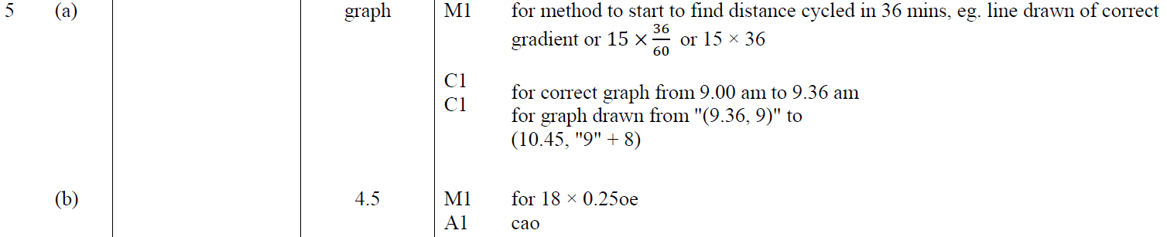
Time-Series
Specimen Set 1 2H Q5
A
B

Slide 10
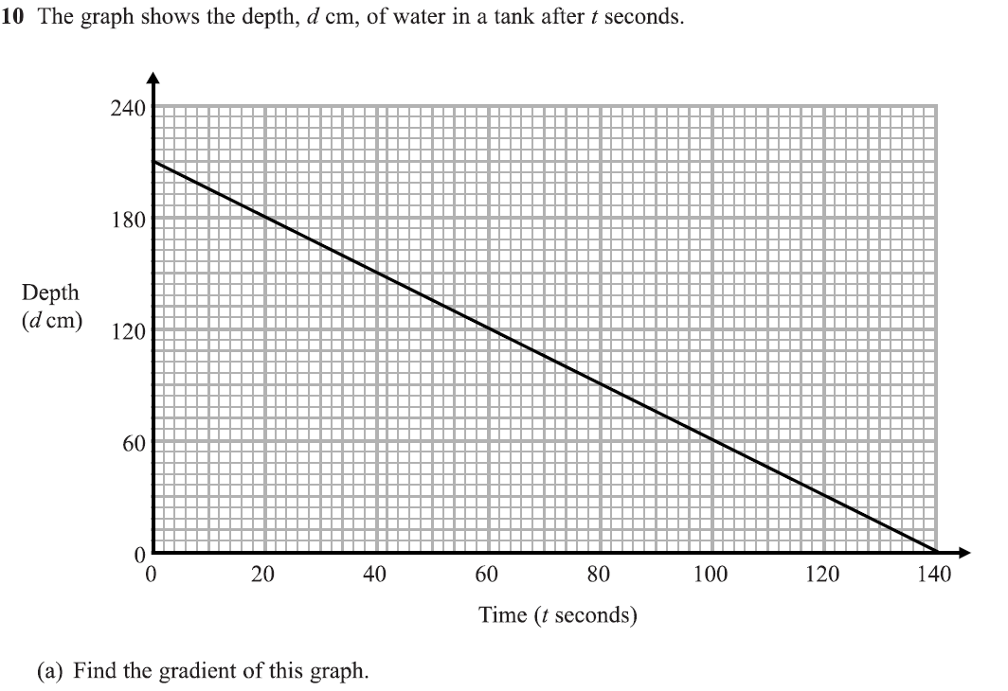
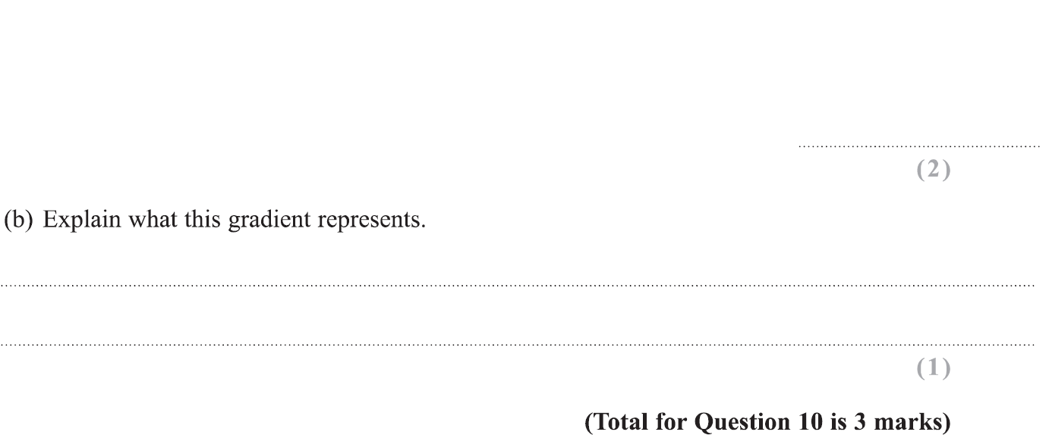
Time-Series
Specimen Set 1 2H Q10

Slide 11
Time-Series
Specimen Set 1 2H Q10
A
B

Slide 12
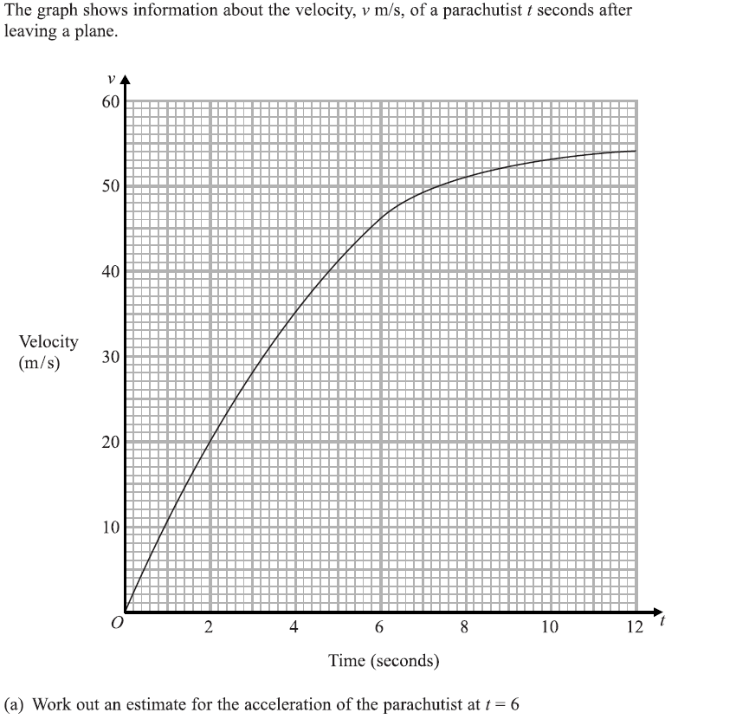
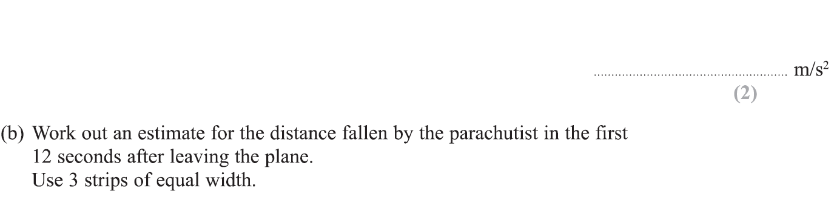
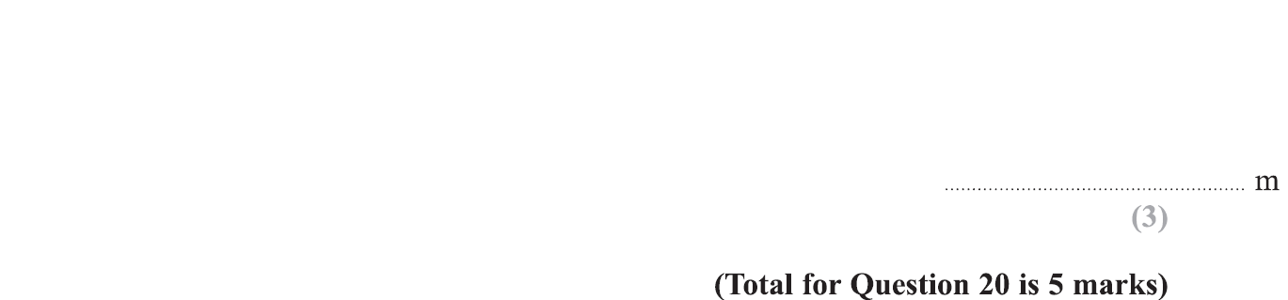
Time-Series
Specimen Set 1 2H Q20

Slide 13
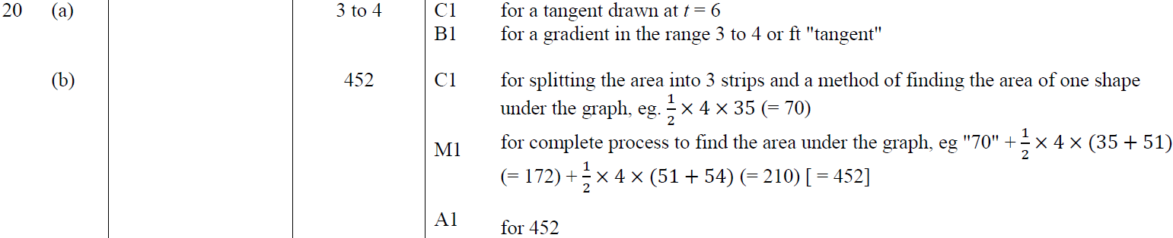
Time-Series
Specimen Set 1 2H Q20
A
B

Slide 14
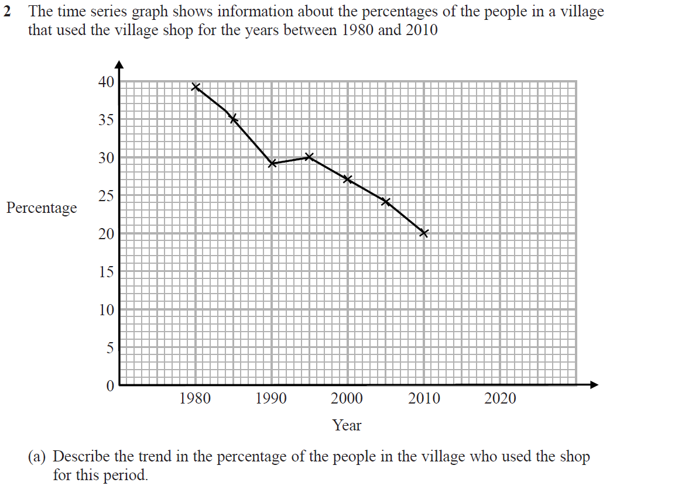
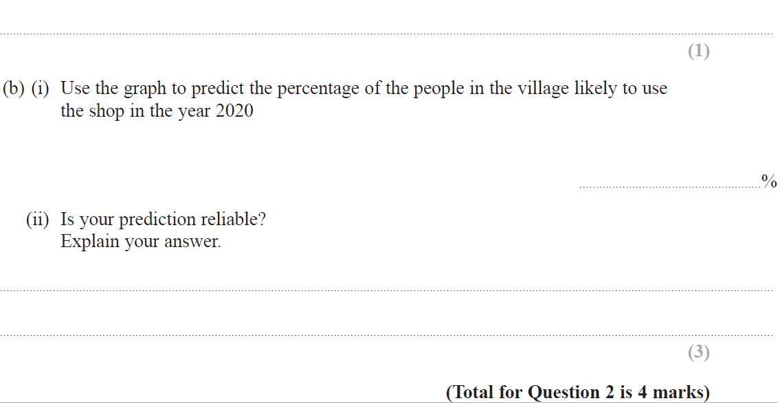
Time-Series
Specimen Set 2 2H Q2

Slide 15
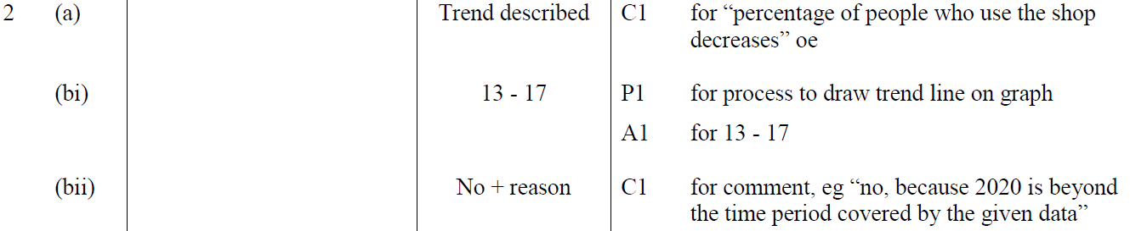
Time-Series
Specimen Set 2 2H Q2
A
B (i)
B (i)

Slide 16
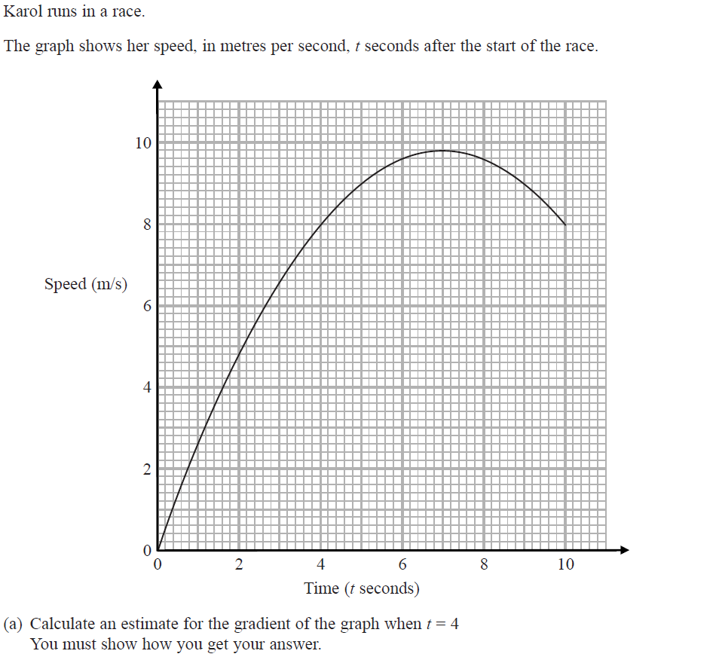
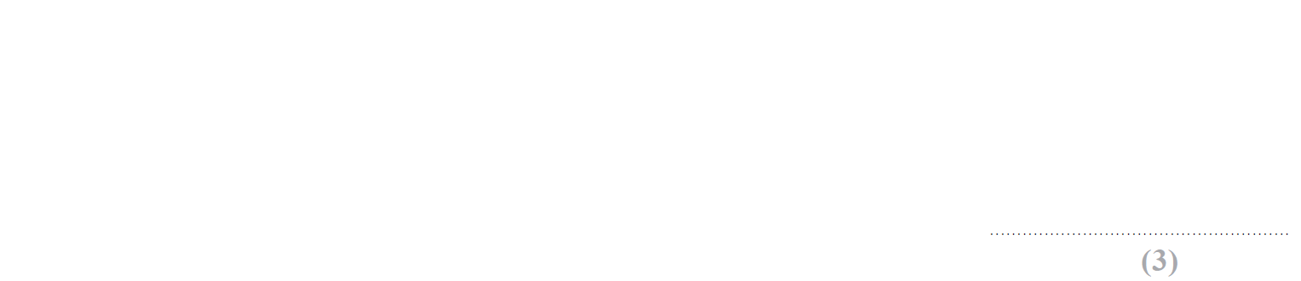
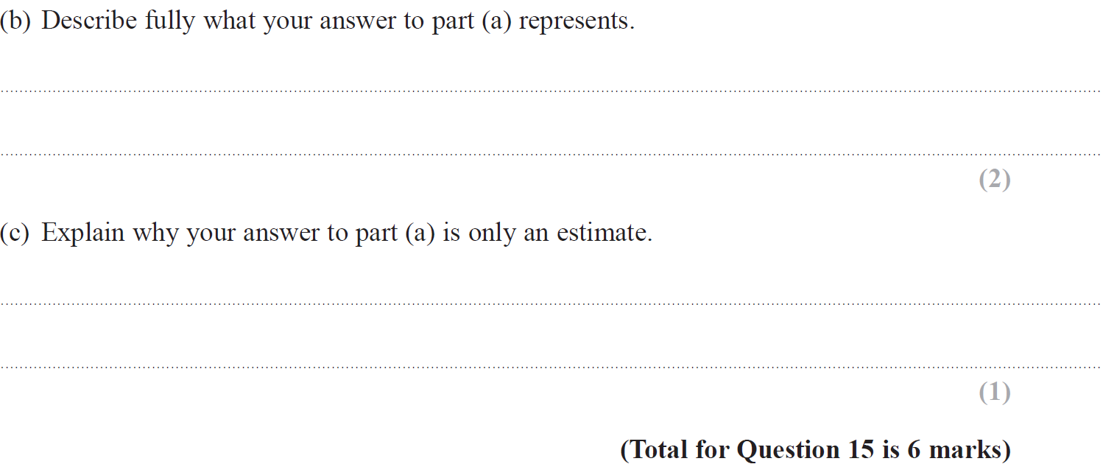
Time-Series
Specimen Set 2 2H Q15

Slide 17
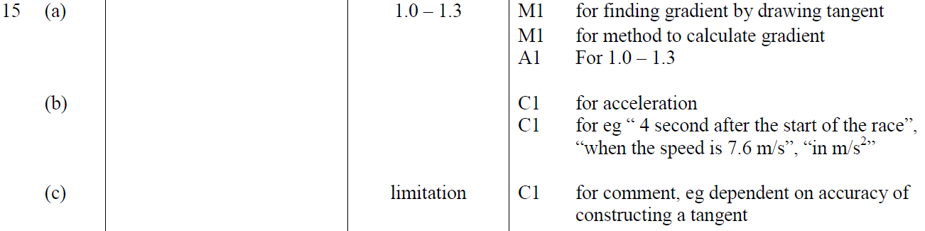
Time-Series
Specimen Set 2 2H Q15
A
B
C

Slide 18
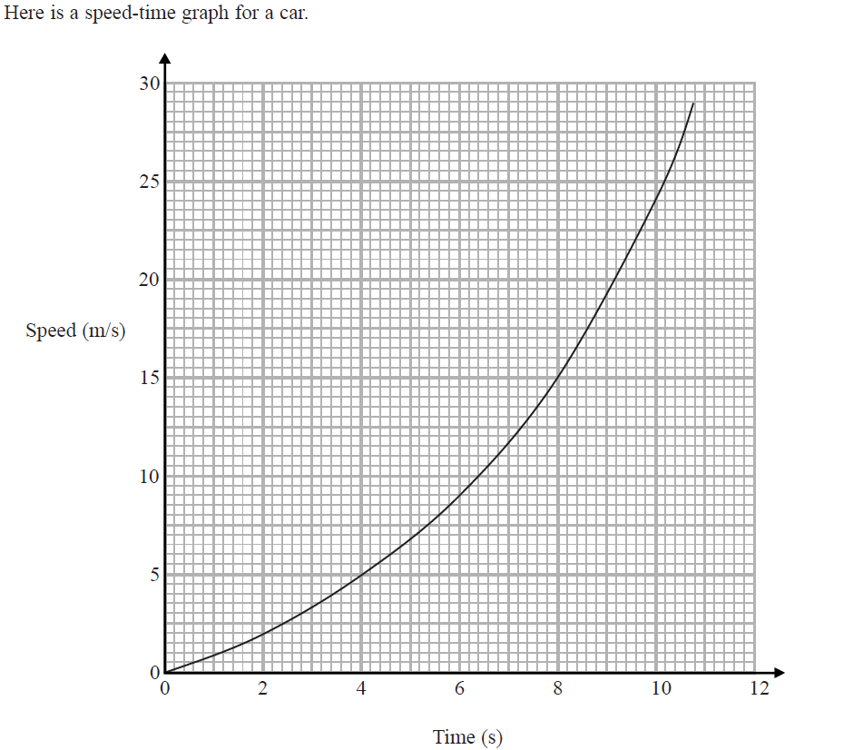
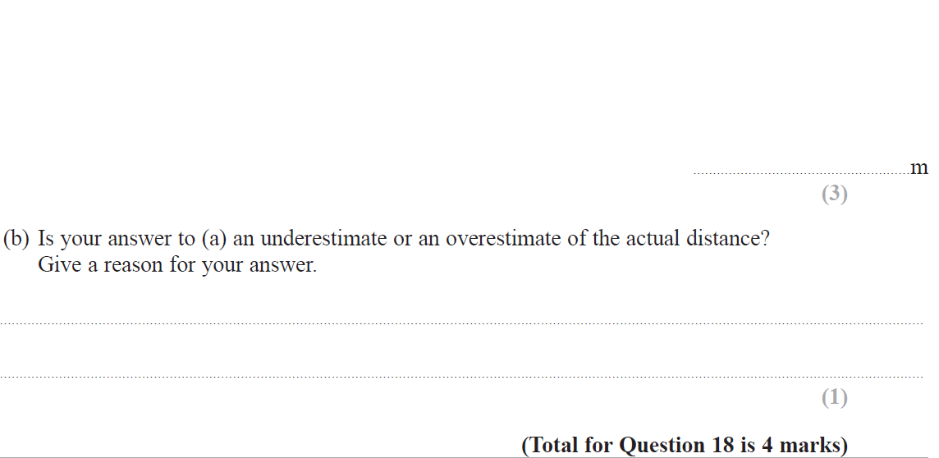
Time-Series
Specimen Set 2 3H Q18

Slide 19
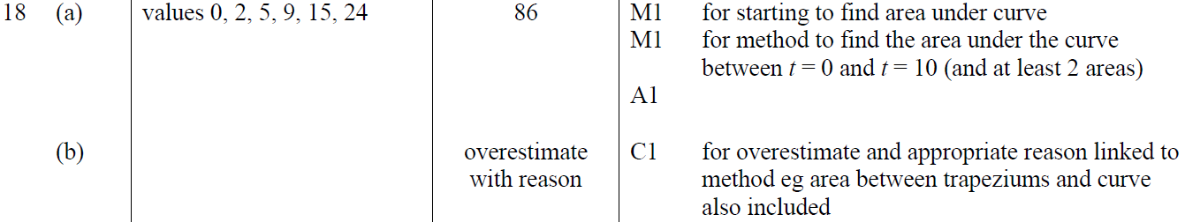
Time-Series
Specimen Set 2 3H Q18
A
B

Slide 20
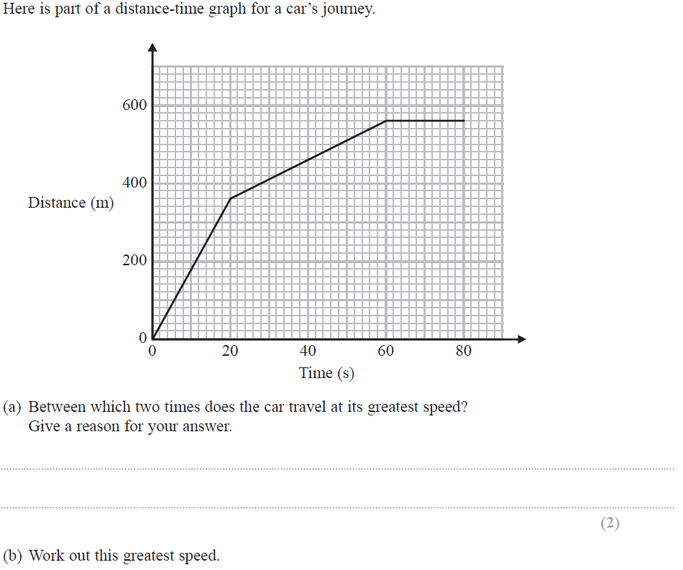
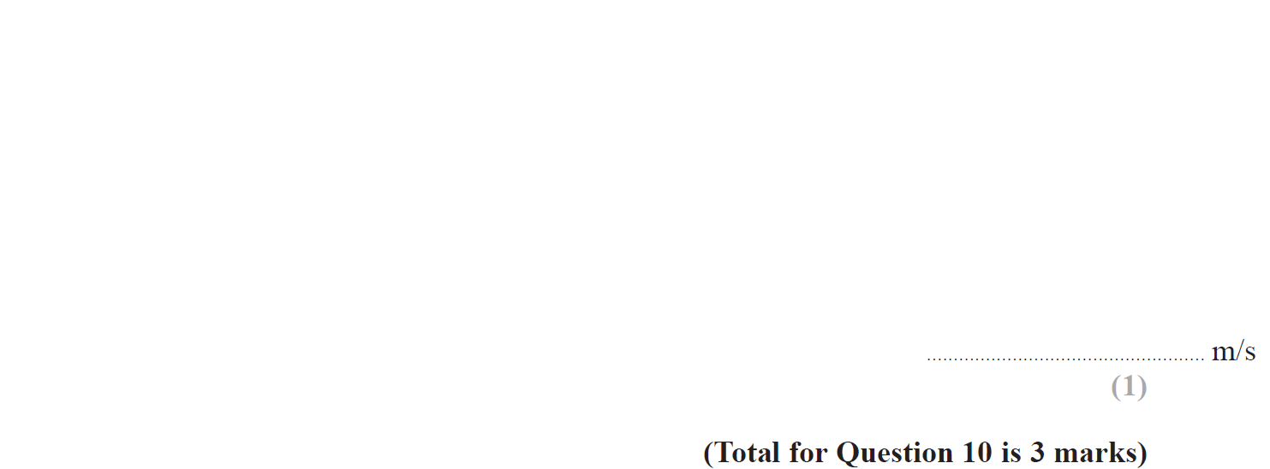
Time-Series
Nov 2017 2H Q10

Slide 21
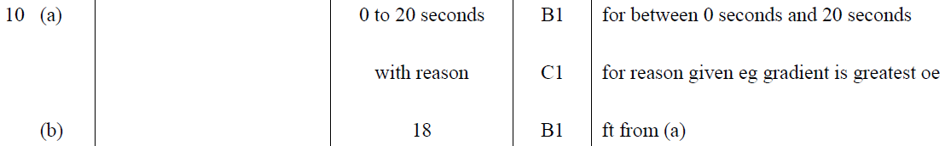
Time-Series
Nov 2017 2H Q10
A
B

Slide 22
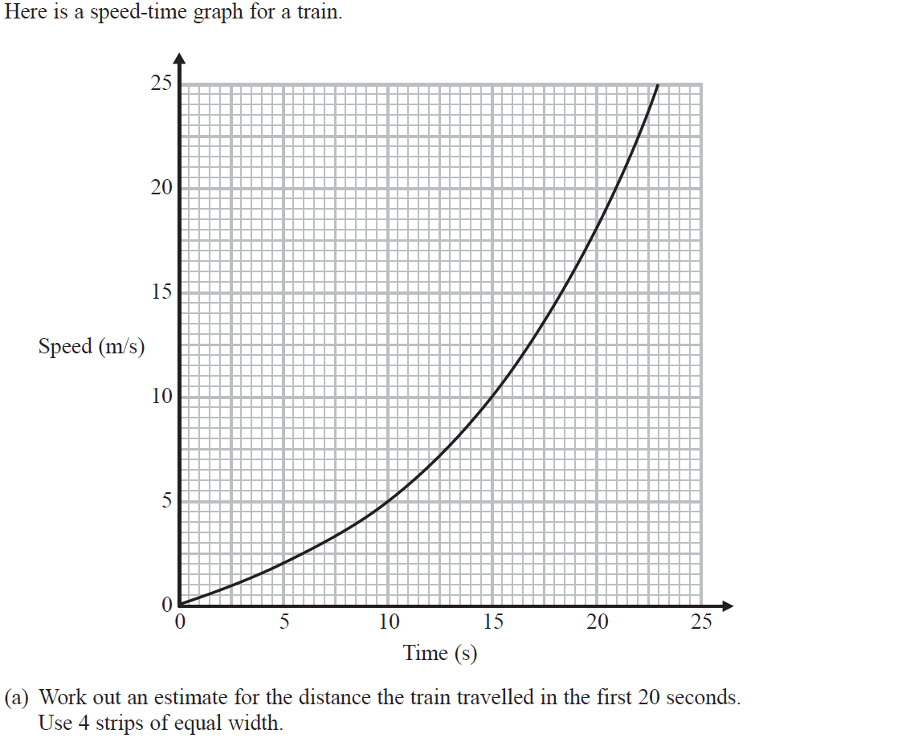
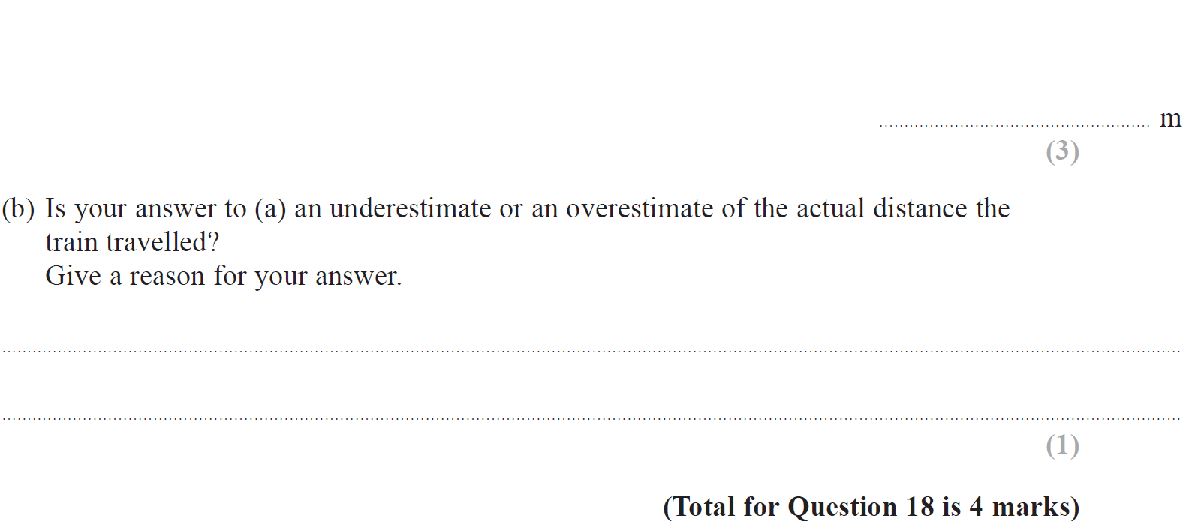
Time-Series
Nov 2017 3H Q18

Slide 23
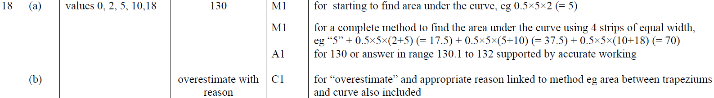
Time-Series
Nov 2017 3H Q18
A
B

Slide 24
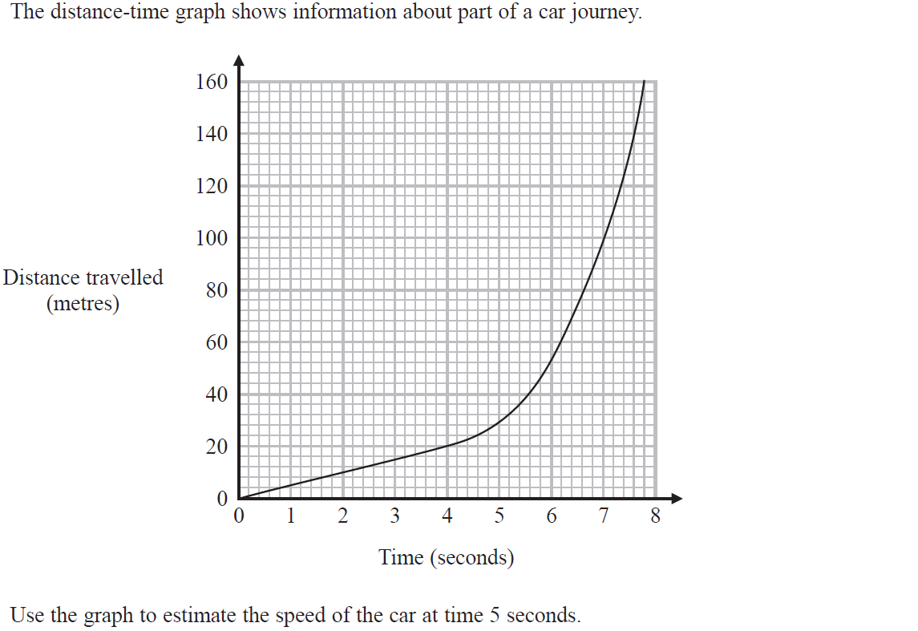
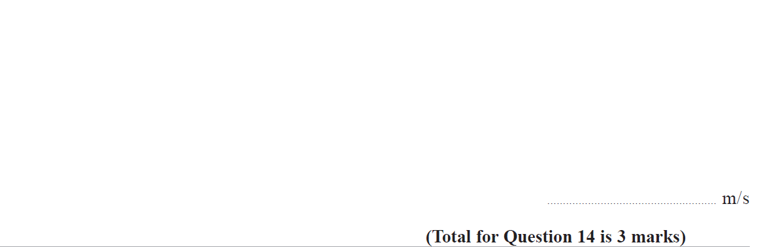
Time-Series
June 2018 2H Q14

Slide 25
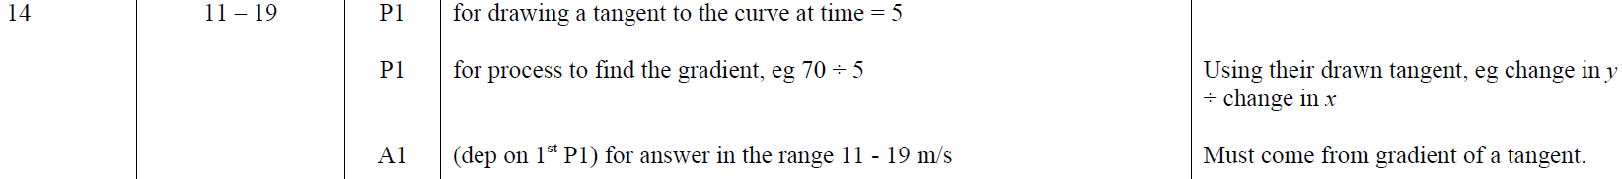
Time-Series
June 2018 2H Q14
A

Slide 26
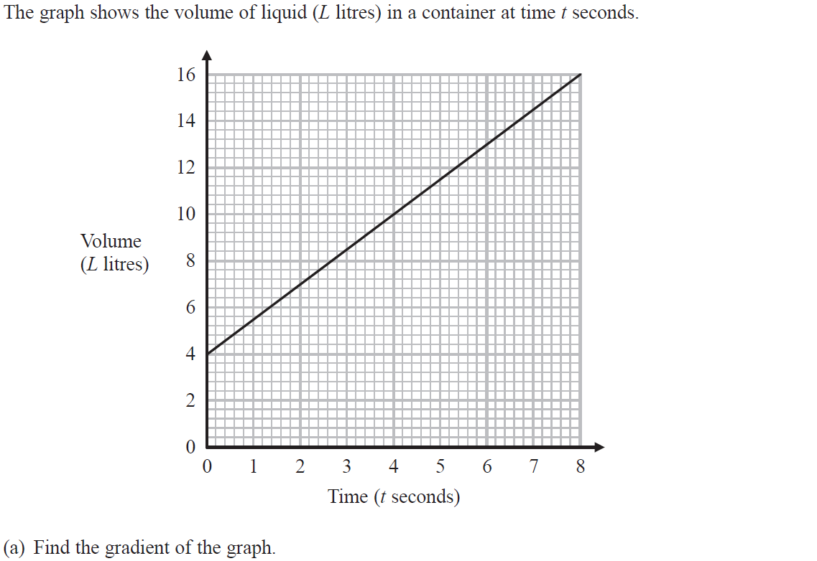
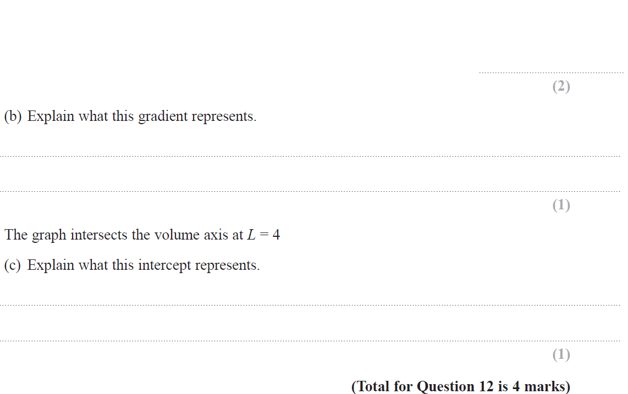
Time-Series
June 2018 3H Q12

Slide 27
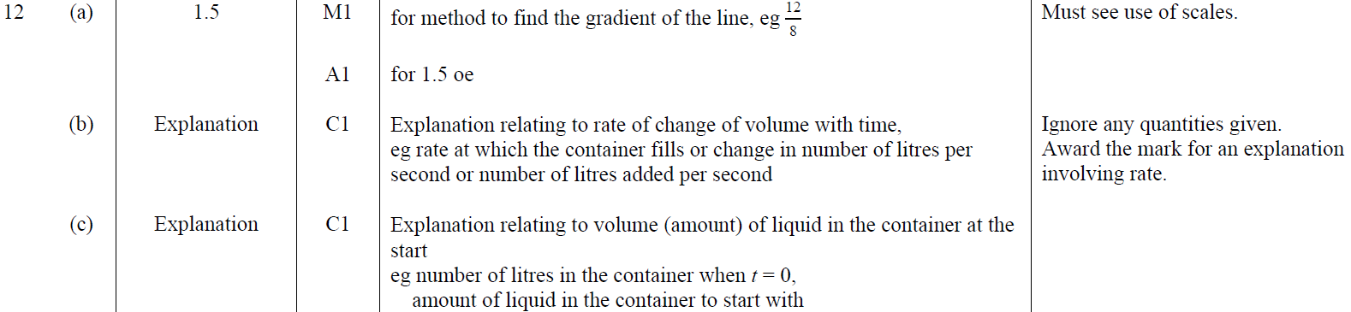
Time-Series
June 2018 3H Q12
A
B
C

Slide 28
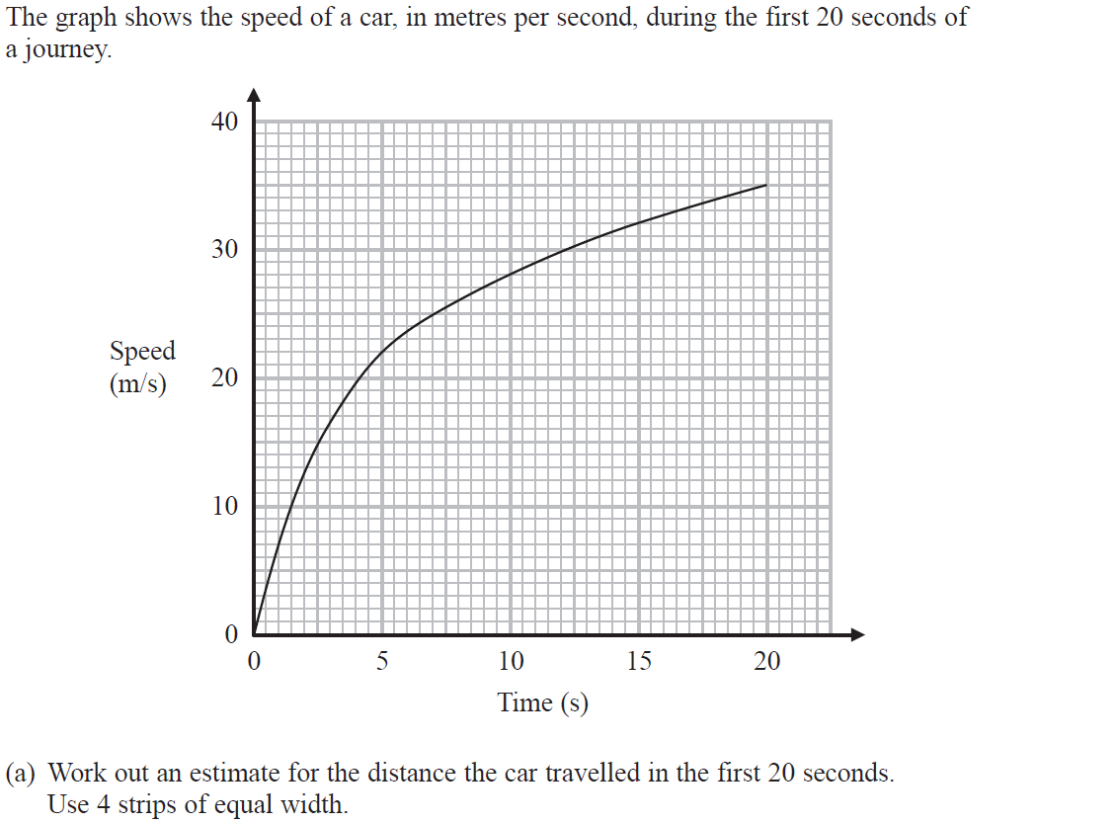
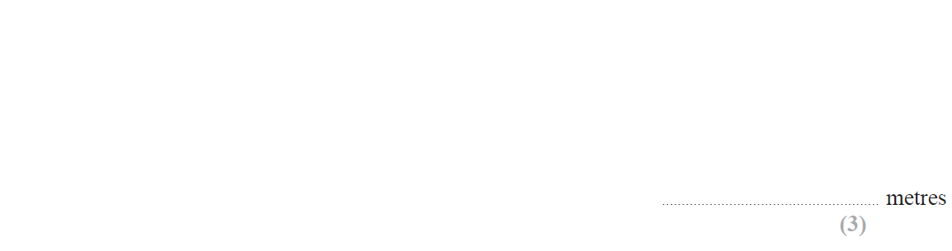
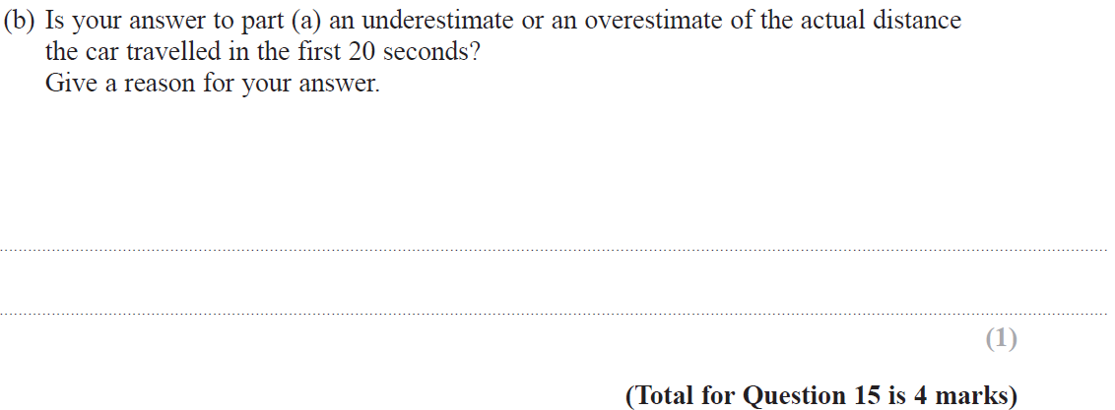
Time-Series
June 2018 3H Q15

Slide 29
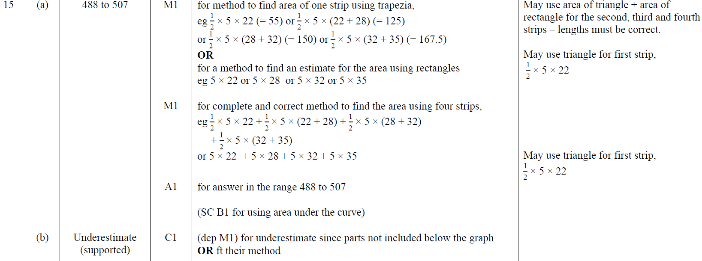
Time-Series
June 2018 3H Q15
A
B

Slide 30
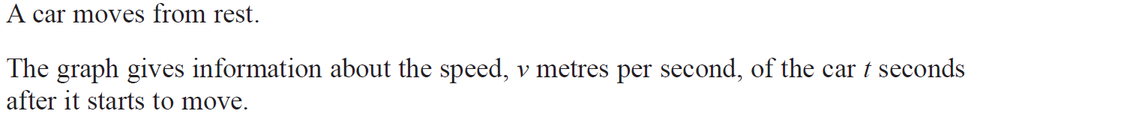
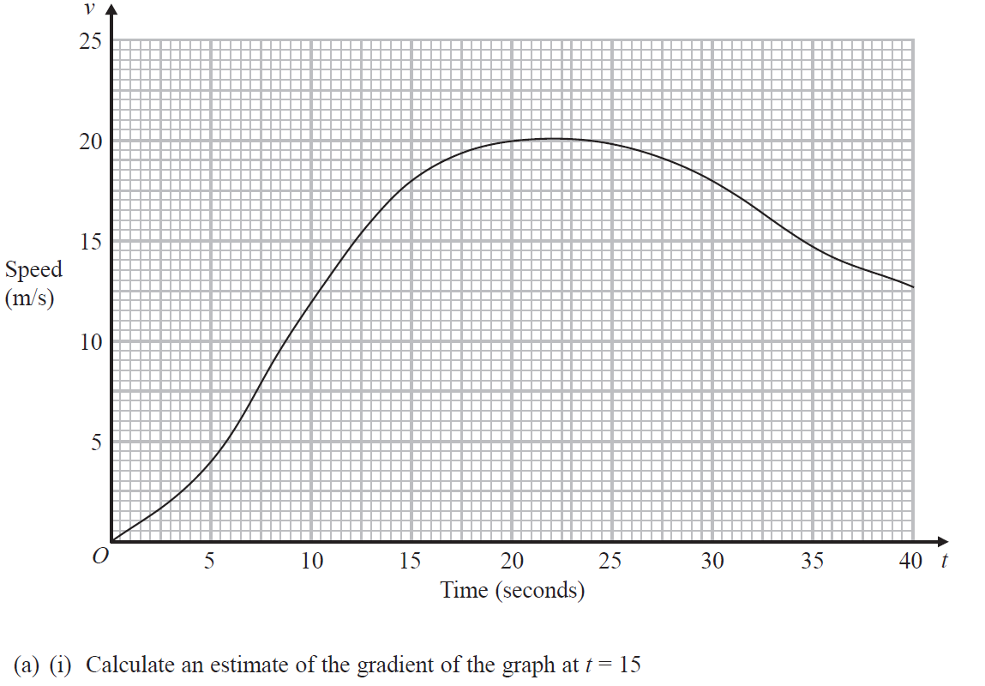
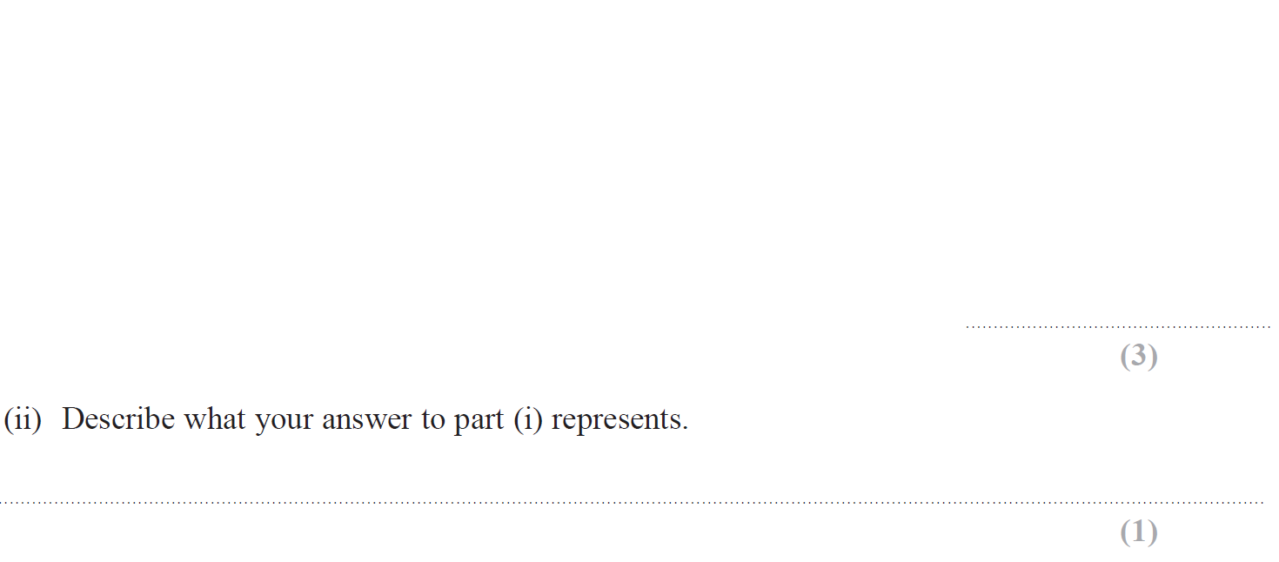
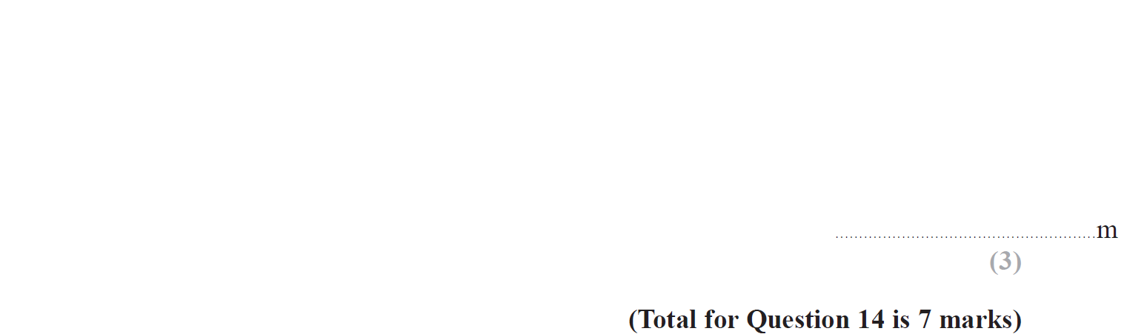
Time-Series
June 2019 2H Q14

Slide 31
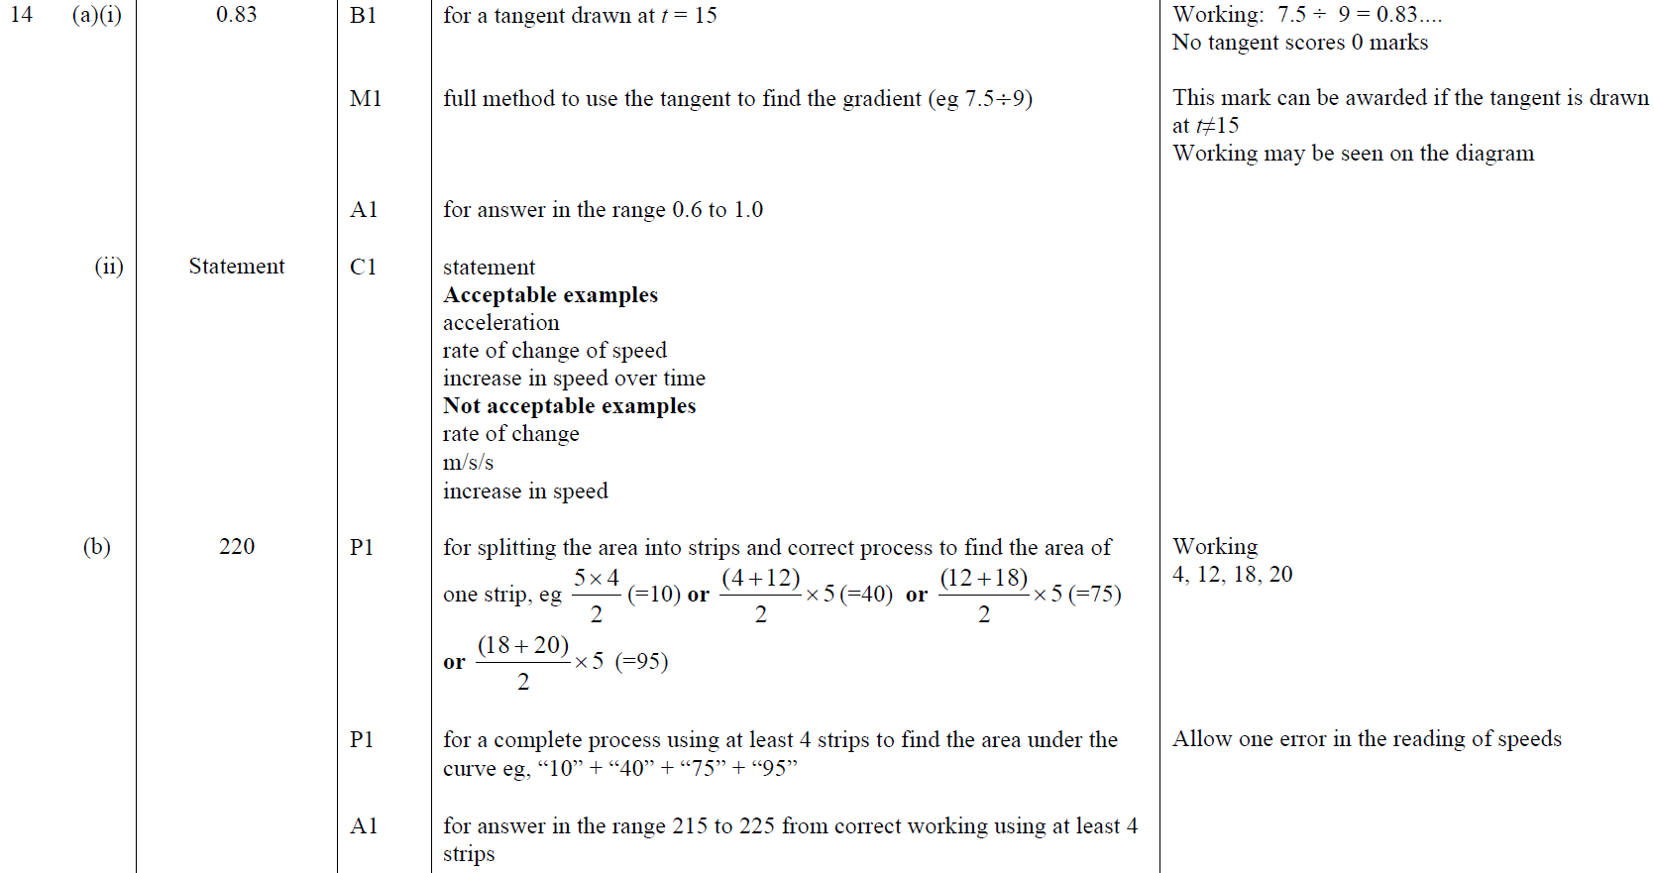
Time-Series
June 2019 2H Q14
A (i)
A (ii)
B

Slide 32
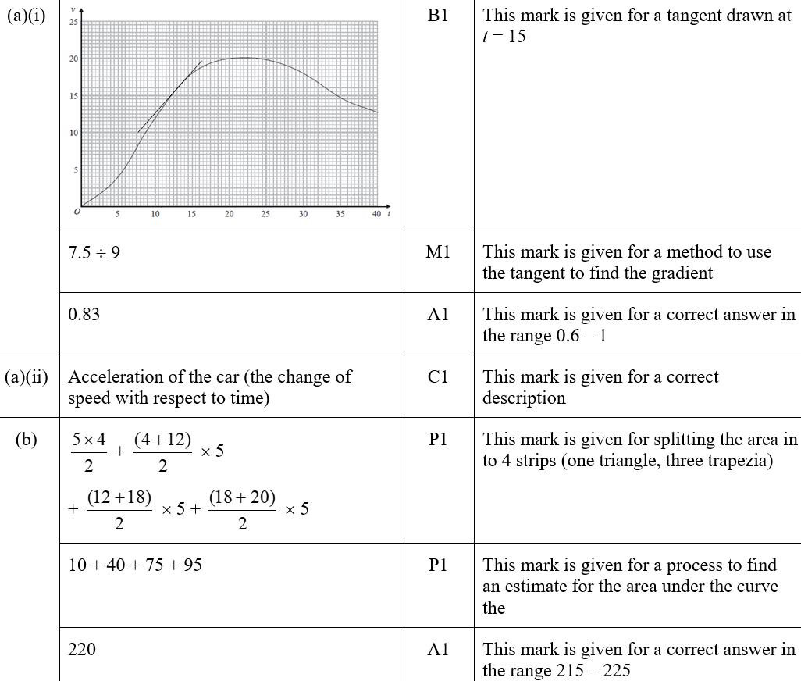
Time-Series
June 2019 2H Q14
A (i)
A (ii)
B

Slide 33
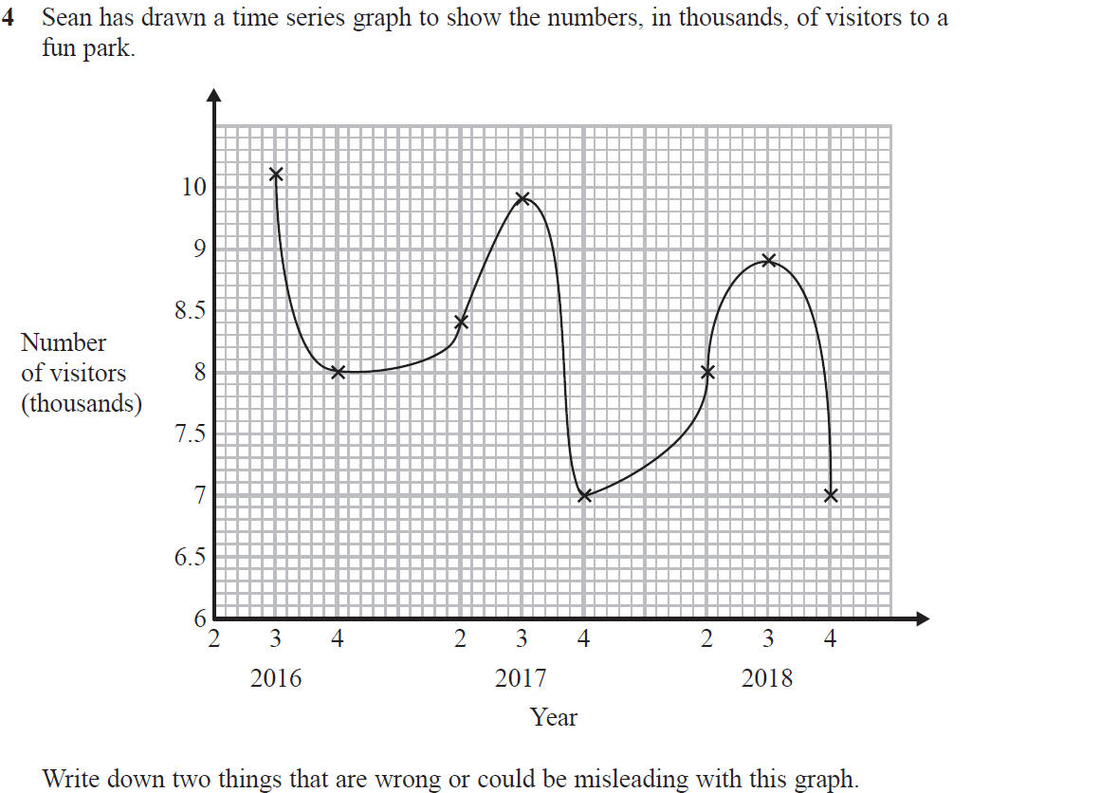
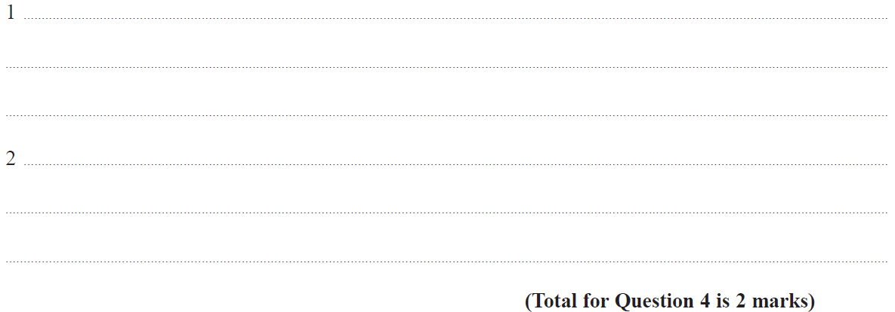
Time-Series
June 2019 3H Q4

Slide 34
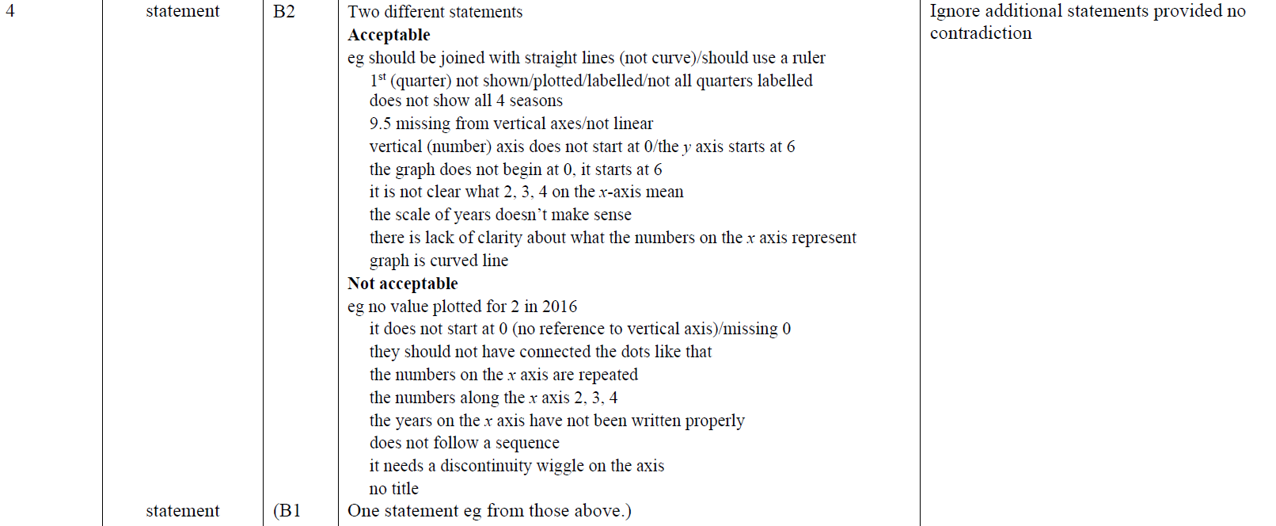
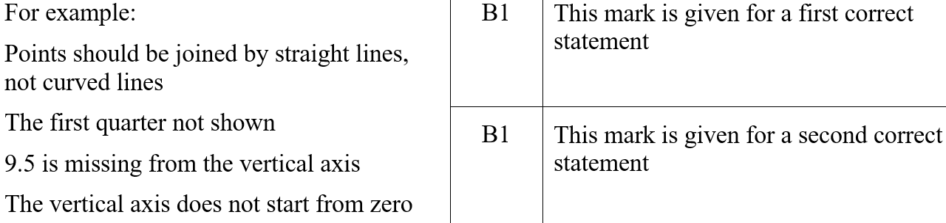
Time-Series
June 2019 3H Q4
A
A SF

Slide 35



Time-Series
SAM 1H Q24

Slide 36

Time-Series
SAM 1H Q24
A
B

Slide 37



Time-Series
SAM 3H Q23

Slide 38

Time-Series
SAM 3H Q23
A
B

Slide 39


Time-Series
SAM 3H Q24

Slide 40

Time-Series
SAM 3H Q24
A

Slide 41

Time-Series
May 2017 1H Q23

Slide 42

Time-Series
May 2017 1H Q23
A
B

Slide 43


Time-Series
June 2017 2H Q8

Slide 44



Time-Series
June 2017 2H Q8
A

Slide 45

Time-Series
June 2017 2H Q8
A

Slide 46

Time-Series
June 2017 3H Q15

Slide 47

Time-Series
June 2017 3H Q15
A
B

Slide 48

Time-Series
June 2017 3H Q24

Slide 49

Time-Series
June 2017 3H Q24
A

Slide 50

Time-Series
Nov 2017 1H Q16

Slide 51
Time-Series
Nov 2017 1H Q16
A

Slide 52

Time-Series
Nov 2017 2H Q24

Slide 53

Time-Series
Nov 2017 2H Q24
A

Slide 54

Time-Series
Nov 2017 3H Q25

Slide 55

Time-Series
Nov 2017 3H Q25
A

Slide 56
Time-Series
June 2018 2H Q17
A ball is thrown vertically upwards.
The graph shows the height of the ball above the ground after it is thrown.
(a) For how many seconds is the ball at a height of more than 2 metres?
[1 mark]
(b) After how many seconds is the ball at instantaneous rest when it is in the air?
[1 mark]
(c) Work out the average speed of the ball when it is moving downwards.
[2 marks]

Slide 57

Time-Series
June 2018 2H Q17
A
B
C

Slide 58


Time-Series
June 2018 3H Q24

Slide 59

Time-Series
June 2018 3H Q24
A

Slide 60


Time-Series
June 2018 3H Q24
A notes
B

Slide 61

Time-Series
Nov 2018 1H Q6

Slide 62

Time-Series
Nov 2018 1H Q6
A

Slide 63


Time-Series
Nov 2018 2H Q28

Slide 64

Time-Series
Nov 2018 2H Q28
A
B

Slide 65

Time-Series
Nov 2018 2H Q28
B

Slide 66


Time-Series
SAM 2H Q11

Slide 67

Time-Series
SAM 2H Q11
A
B

Slide 68




Time-Series
SAM 3H Q10

Slide 69

Time-Series
SAM 3H Q10
A
B

Slide 70





Time-Series
Practice 3H Q13

Slide 71

Time-Series
Practice 3H Q13
A (i)
A (ii)
B
C

Slide 72


Time-Series
May 2017 1H Q15

Slide 73

Time-Series
May 2017 1H Q15
A
B
C
D
E

Slide 74


Time-Series
May 2017 1H Q20

Slide 75

Time-Series
May 2017 1H Q20
A

Slide 76


Time-Series
June 2017 2H Q2

Slide 77

Time-Series
June 2017 2H Q2
A

Slide 78




Time-Series
Nov 2017 2H Q13

Slide 79

Time-Series
Nov 2017 2H Q13
A
B
C (i)
C (ii)

Slide 80


Time-Series
Nov 2017 3H Q10

Slide 81

Time-Series
Nov 2017 3H Q10
A

Slide 82




Time-Series
June 2018 3H Q8

Slide 83


Time-Series
June 2018 3H Q8
A
B
C

Slide 84



Time-Series
Nov 2018 3H Q8

Slide 85

Time-Series
Nov 2018 3H Q8
A (i)
A (ii)
B

