Slide 1
Time-Series
Time-Series
May 2017
1H Q15
SAM
2H Q11
Nov 2017
3H Q10
May 2017
1H Q20
SAM
3H Q10
June 2018
3H Q8
June 2017
2H Q2
Practice
3H Q13
Nov 2018
3H Q8
Nov 2017
2H Q13
Tangents/ Gradients
Trapeziums

Slide 2
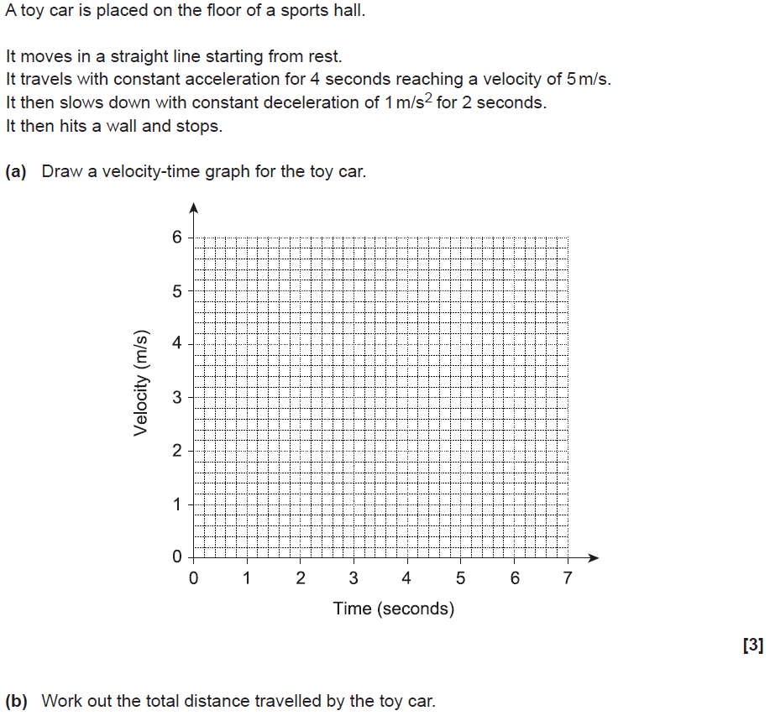
Time-Series
SAM 2H Q11

Slide 3
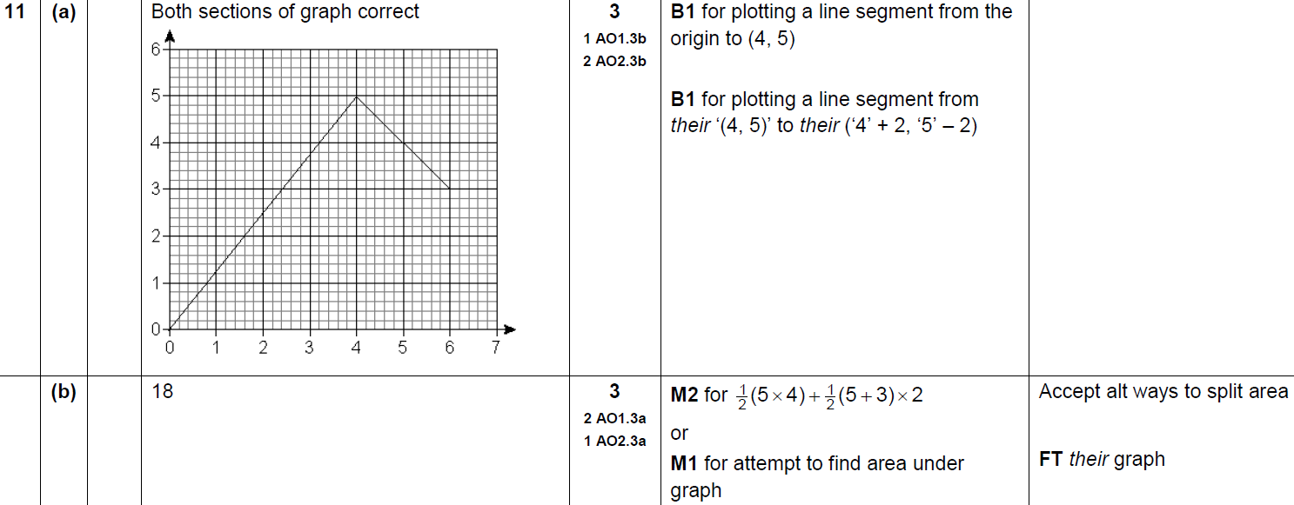
Time-Series
SAM 2H Q11
A
B

Slide 4
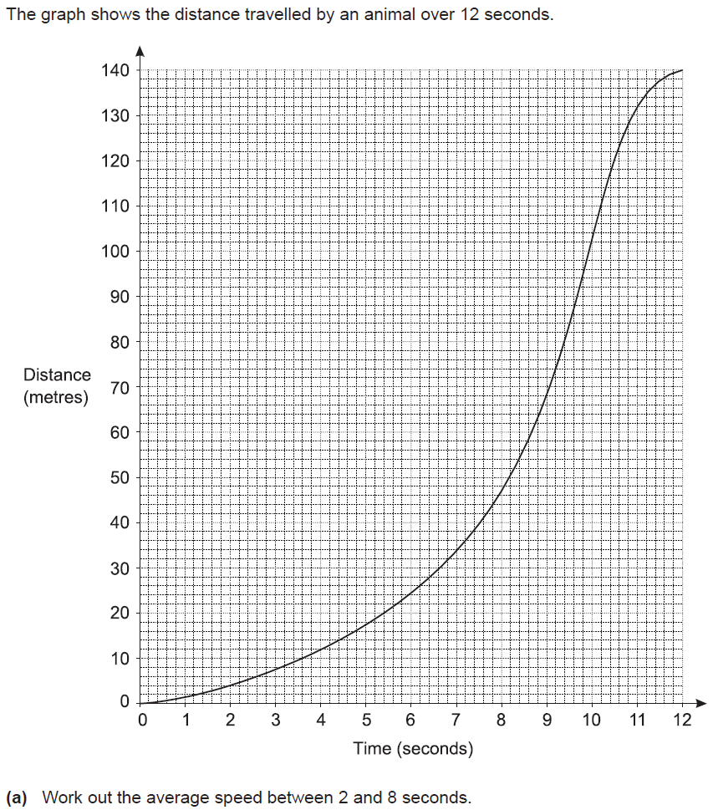
Time-Series
SAM 3H Q10

Slide 5
Time-Series
SAM 3H Q10
A
B

Slide 6
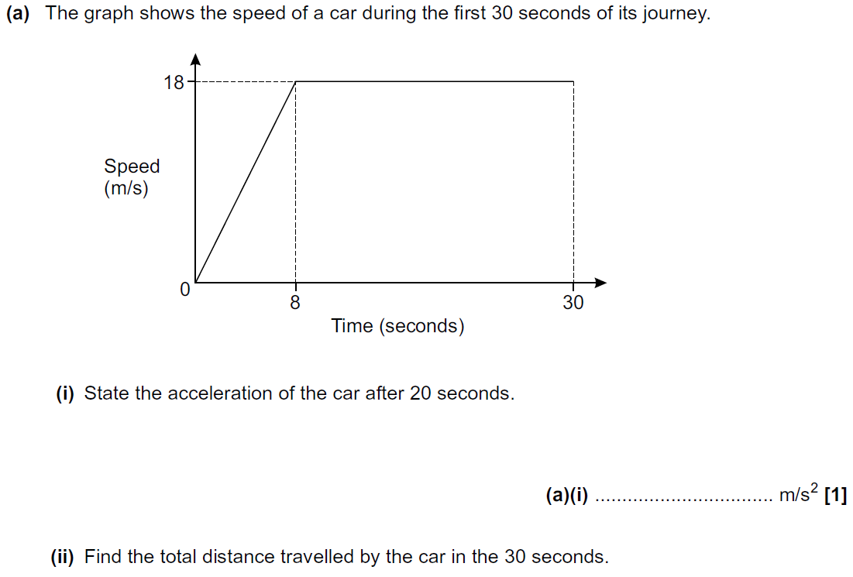
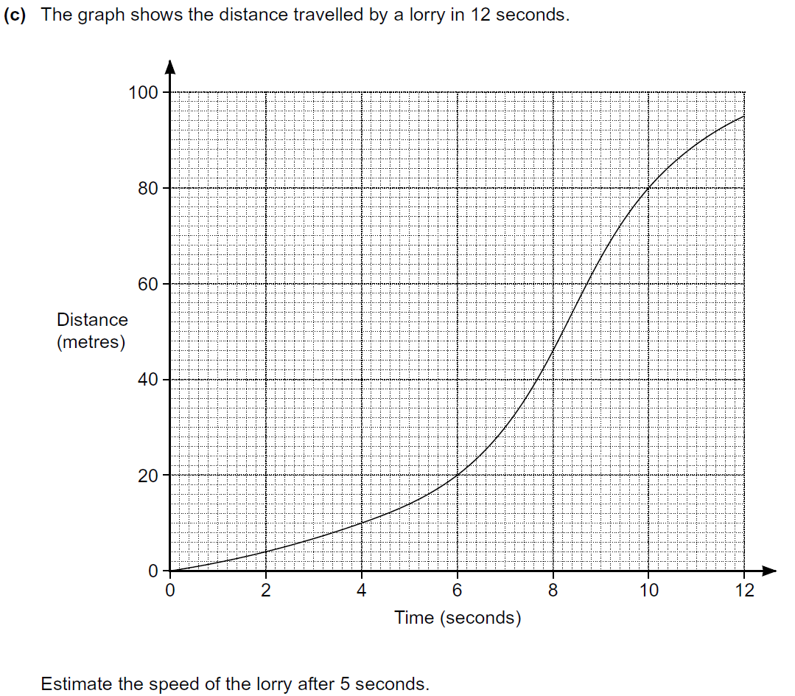
Time-Series
Practice 3H Q13

Slide 7
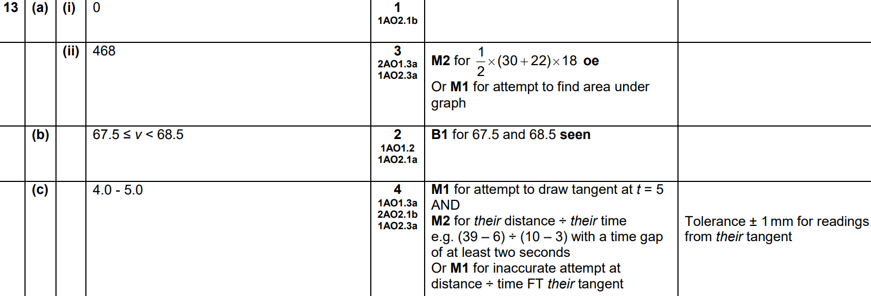
Time-Series
Practice 3H Q13
A (i)
A (ii)
B
C

Slide 8
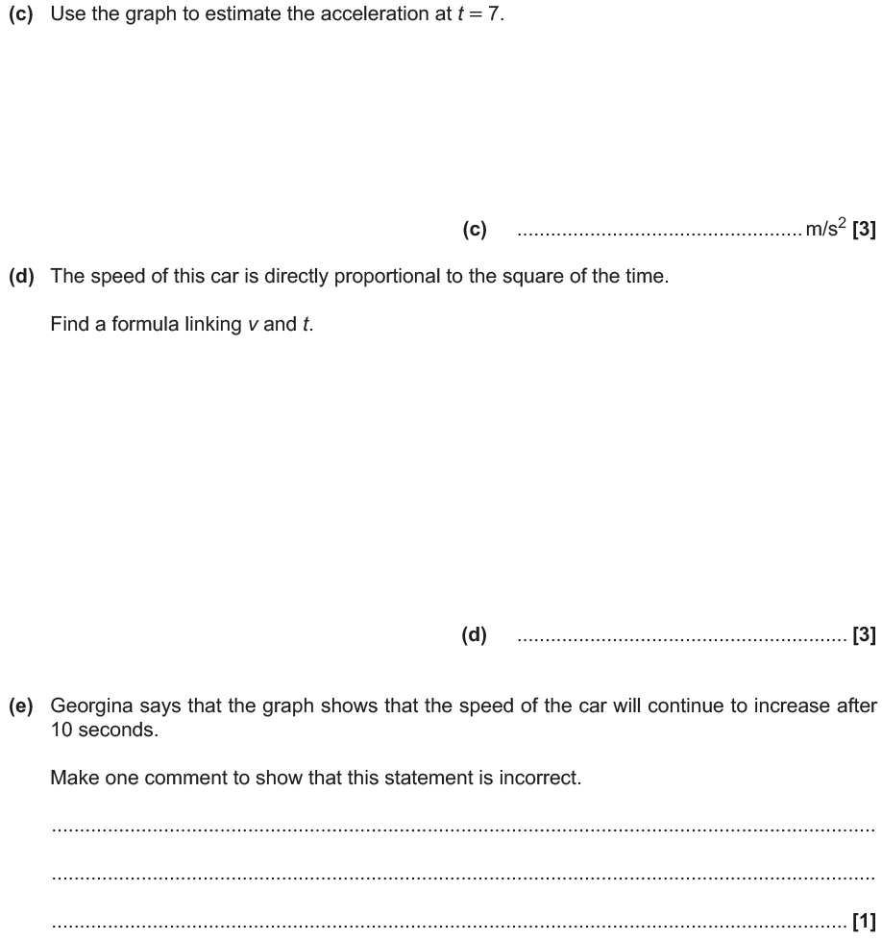
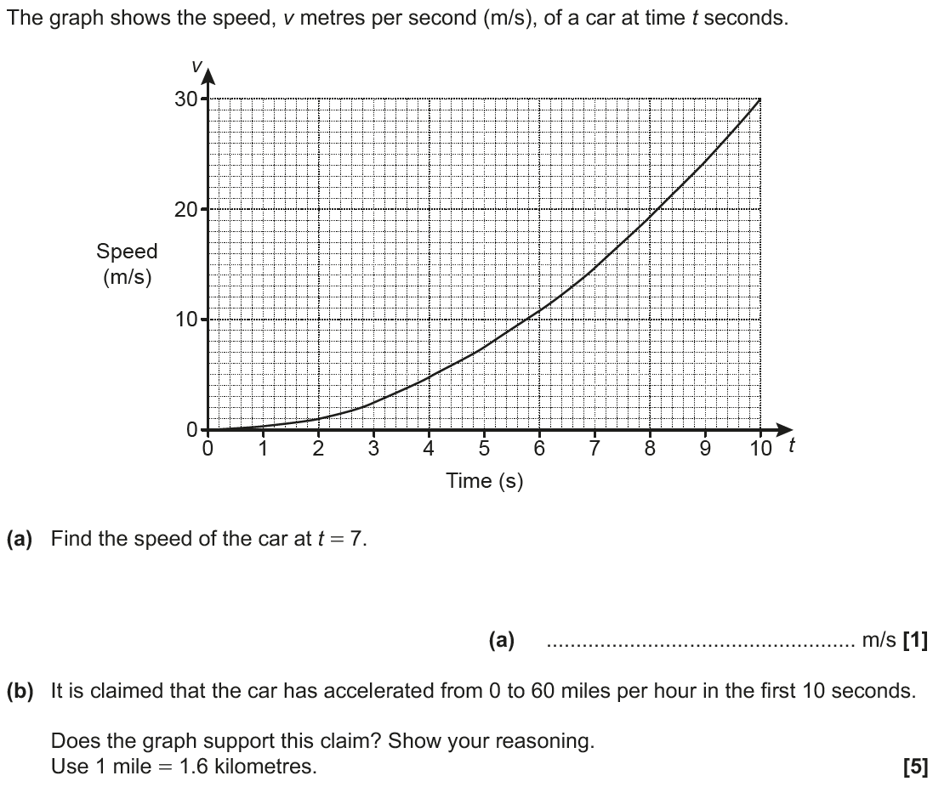
Time-Series
May 2017 1H Q15

Slide 9
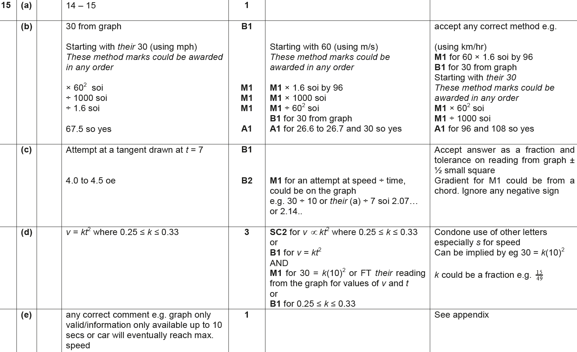
Time-Series
May 2017 1H Q15
A
B
C
D
E

Slide 10
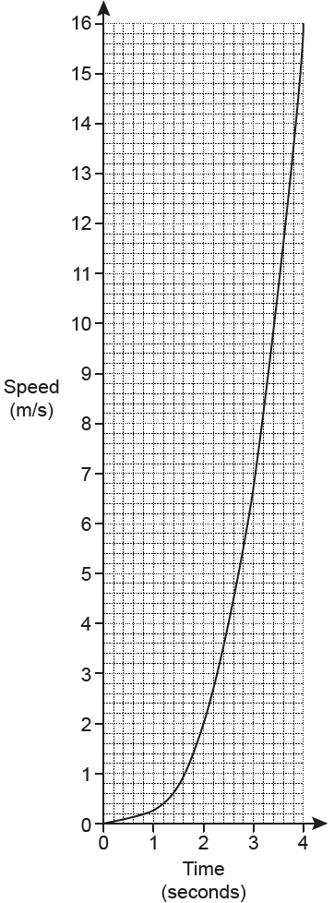
Time-Series
May 2017 1H Q20

Slide 11
Time-Series
May 2017 1H Q20
A

Slide 12
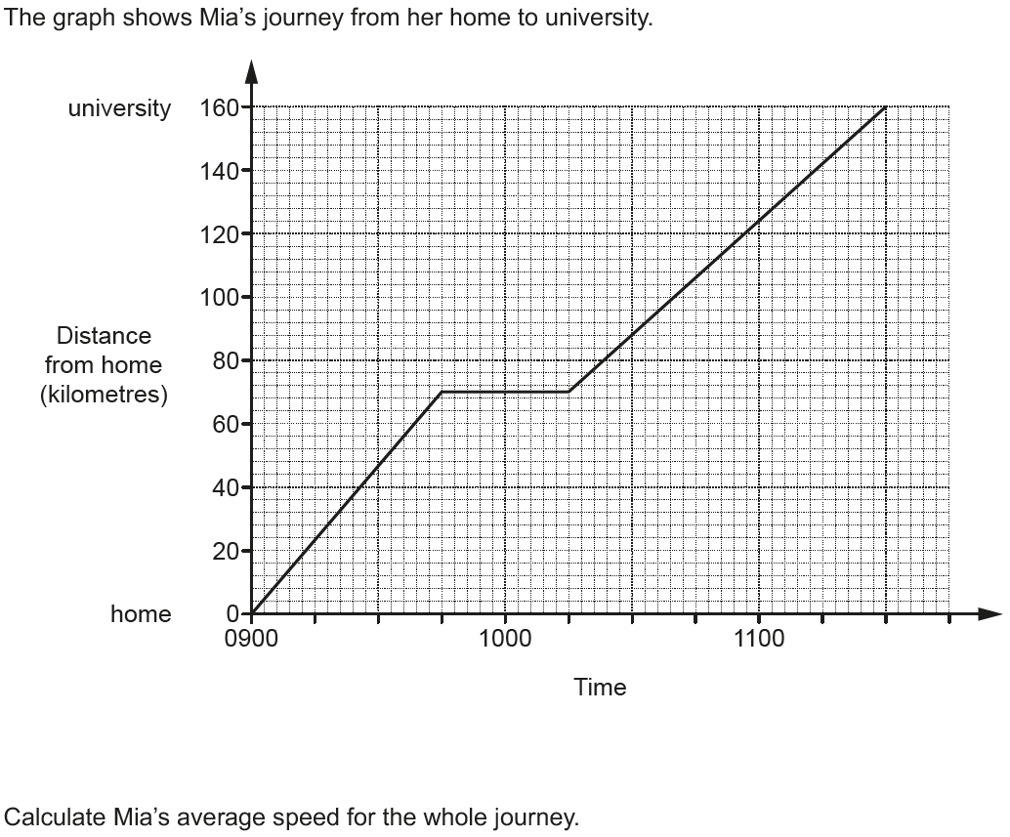
Time-Series
June 2017 2H Q2

Slide 13
Time-Series
June 2017 2H Q2
A

Slide 14
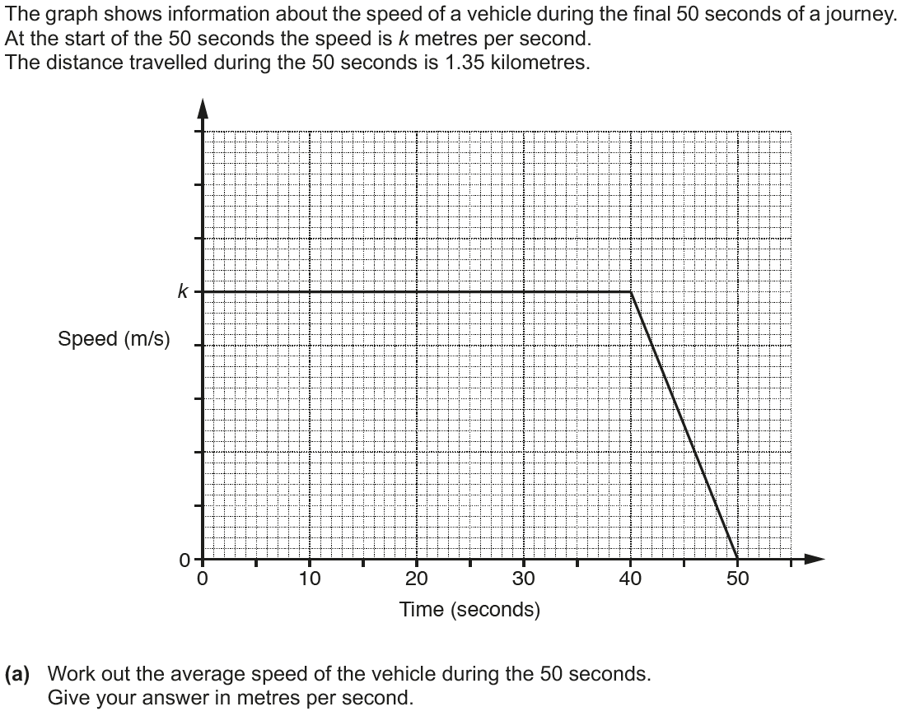
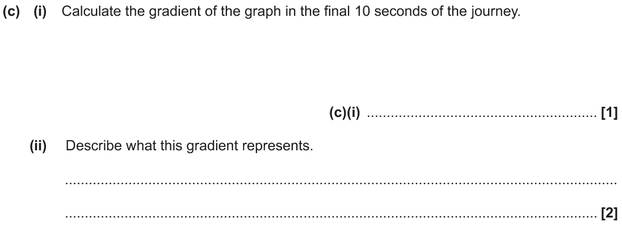
Time-Series
Nov 2017 2H Q13

Slide 15
Time-Series
Nov 2017 2H Q13
A
B
C (i)
C (ii)

Slide 16
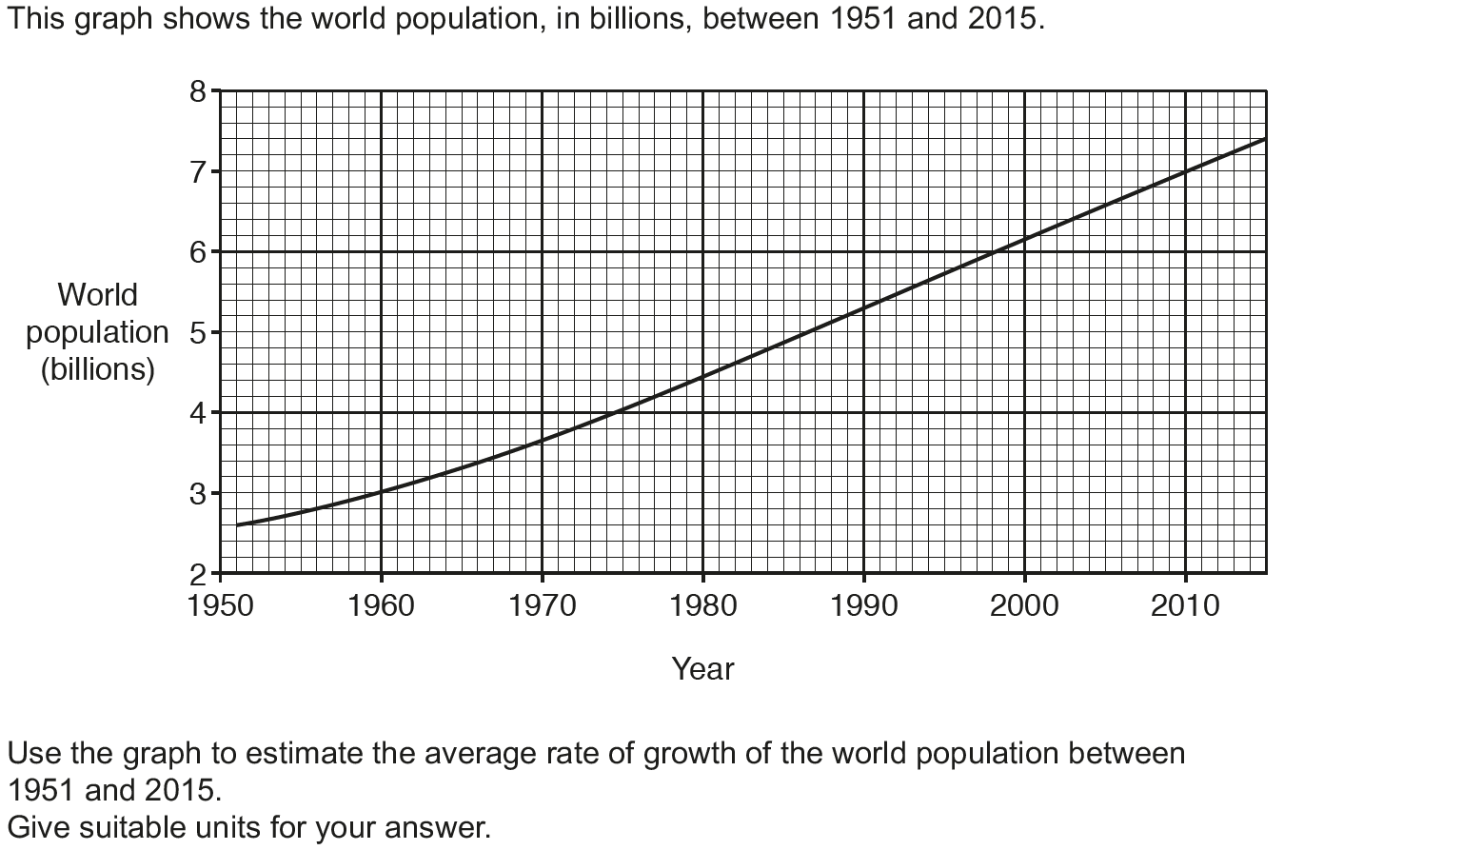
Time-Series
Nov 2017 3H Q10

Slide 17
Time-Series
Nov 2017 3H Q10
A

Slide 18
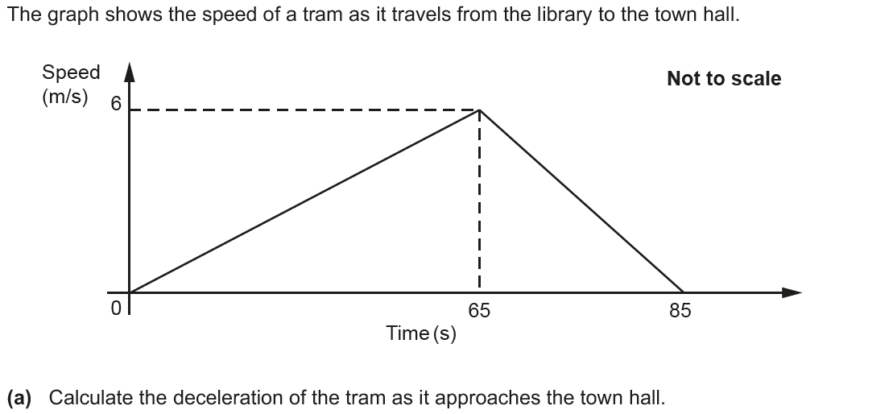
Time-Series
June 2018 3H Q8

Slide 19
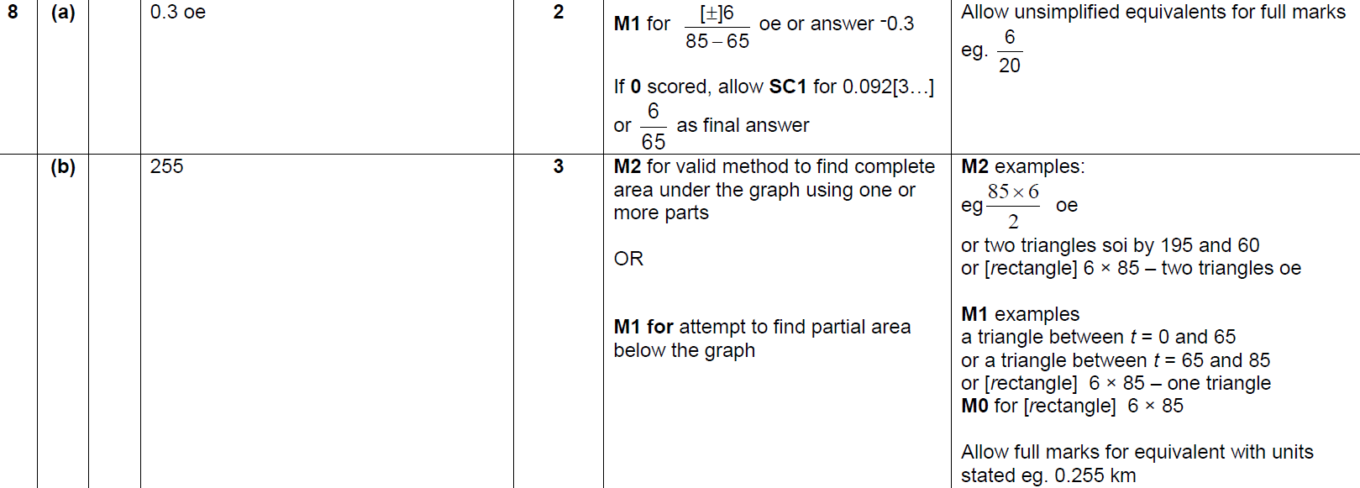
Time-Series
June 2018 3H Q8
A
B
C

Slide 20
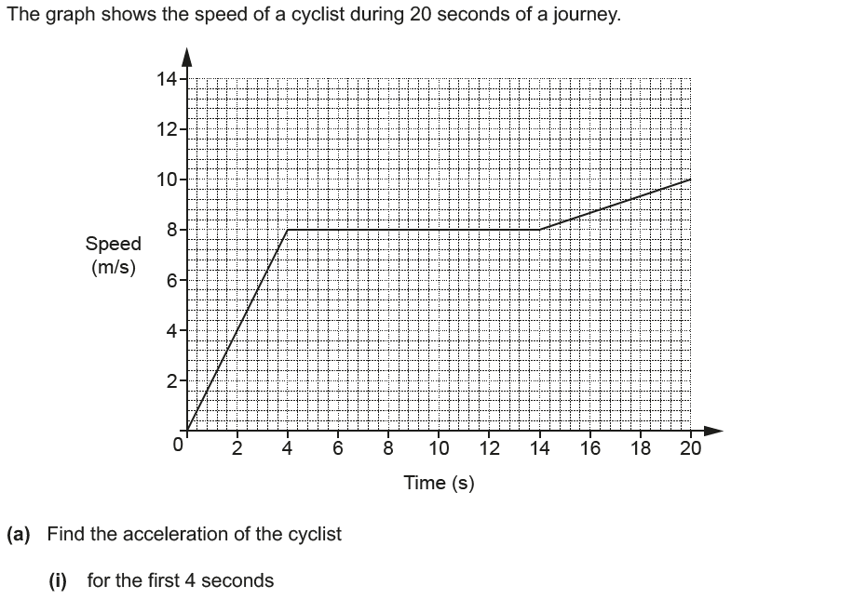
Time-Series
Nov 2018 3H Q8

Slide 21
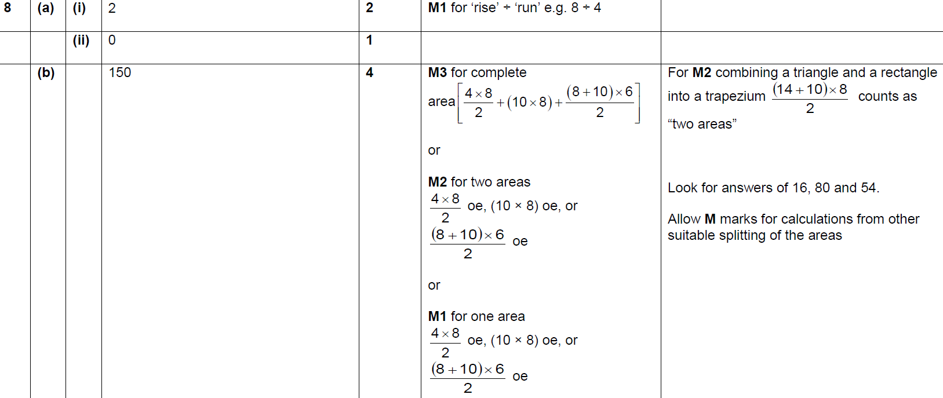
Time-Series
Nov 2018 3H Q8
A (i)
A (ii)
B

