Slide 1
Time-Series
Time-Series
SAM
1H Q21
Spec 1
2H Q20
Nov 2017 2H Q10
June 2018 3H Q15
Spec 1
2H Q3
Spec 2
2H Q2
Nov 2017 3H Q18
June 2019 2H Q14
Spec 1
2H Q5
Spec 2
2H Q15
June 2018 2H Q14
June 2019 3H Q4
Spec 1
2H Q10
Spec 2
3H Q18
June 2018 3H Q12
Tangents/ Gradients
Trapeziums

Slide 2
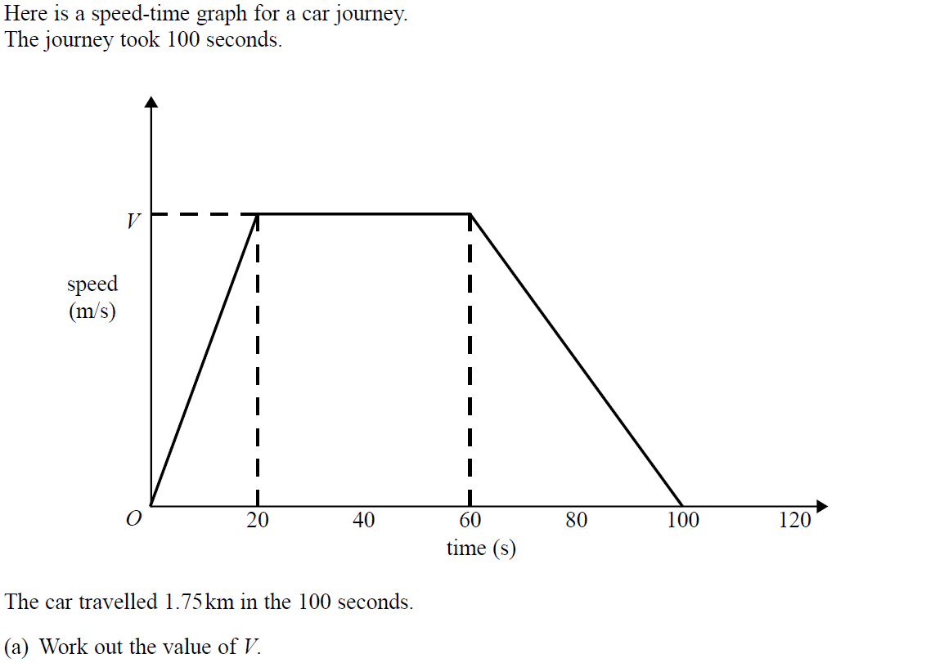
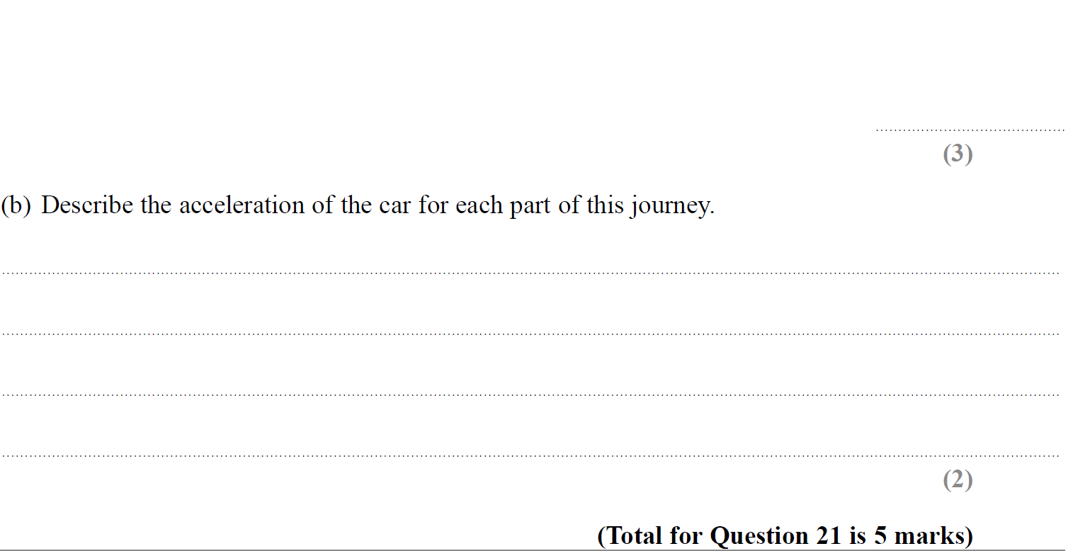
Time-Series
SAM 1H Q21

Slide 3
Time-Series
SAM 1H Q21
A
B

Slide 4
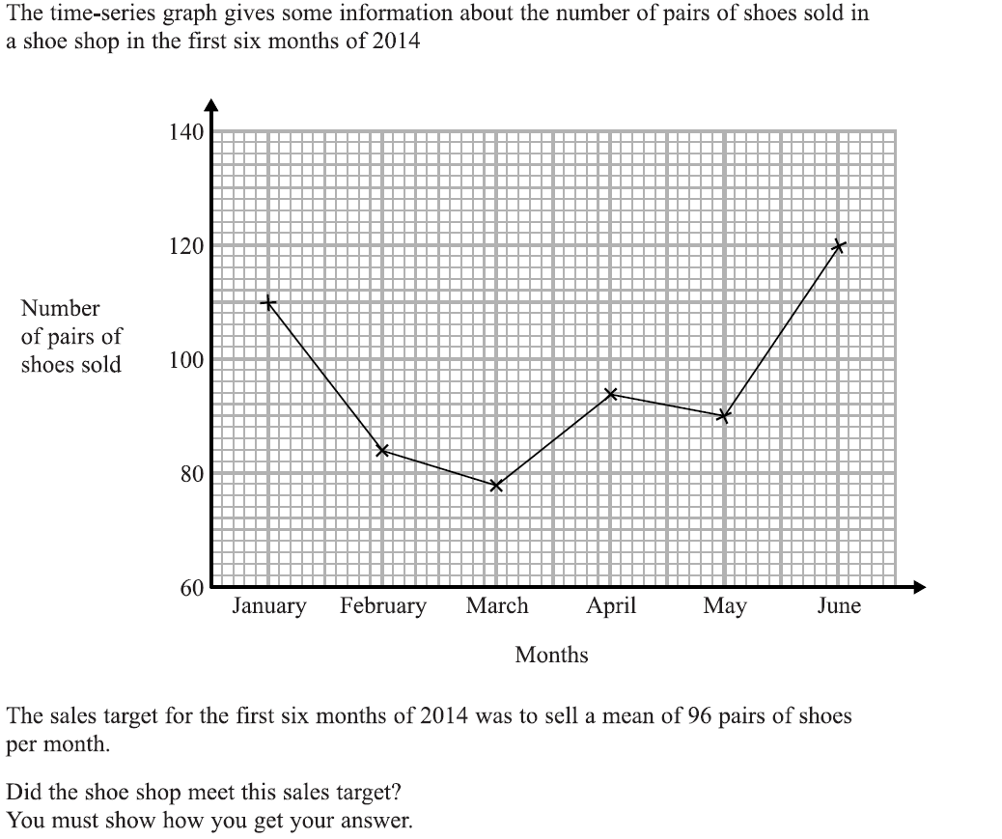
Time-Series
Specimen Set 1 2H Q3

Slide 5
Time-Series
Specimen Set 1 2H Q3
A

Slide 6
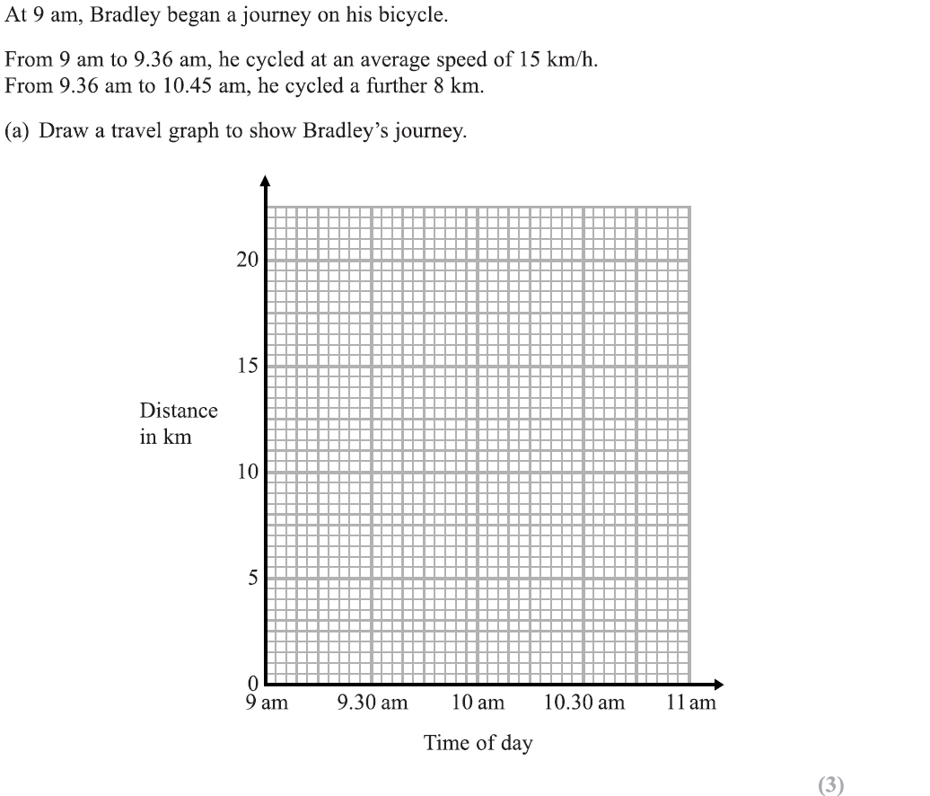
Time-Series
Specimen Set 1 2H Q5
Reveal Graph

Slide 7
Time-Series
Specimen Set 1 2H Q5
A
B

Slide 8
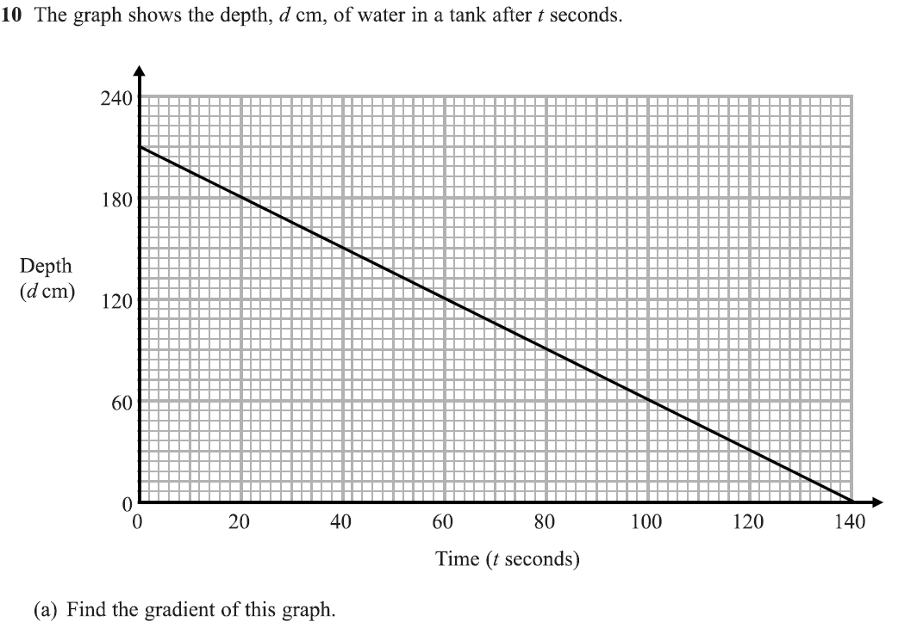
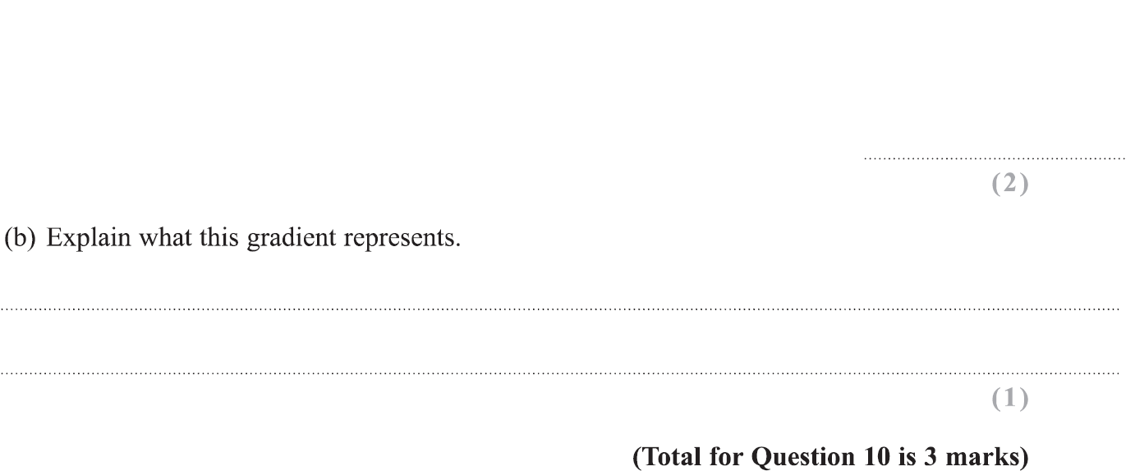
Time-Series
Specimen Set 1 2H Q10

Slide 9
Time-Series
Specimen Set 1 2H Q10
A
B

Slide 10
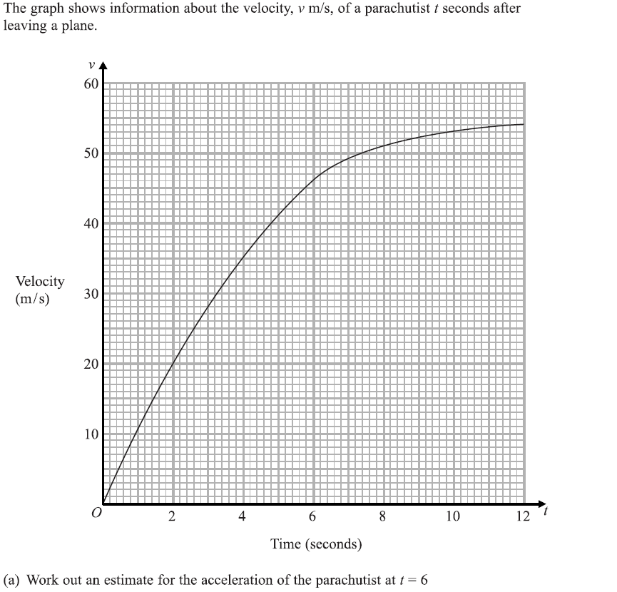
Time-Series
Specimen Set 1 2H Q20

Slide 11
Time-Series
Specimen Set 1 2H Q20
A
B

Slide 12
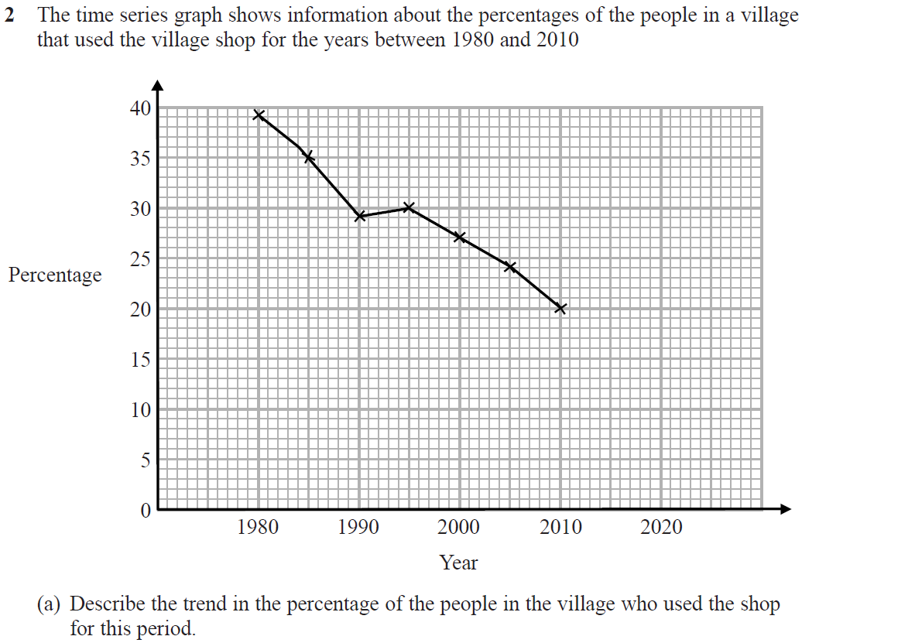
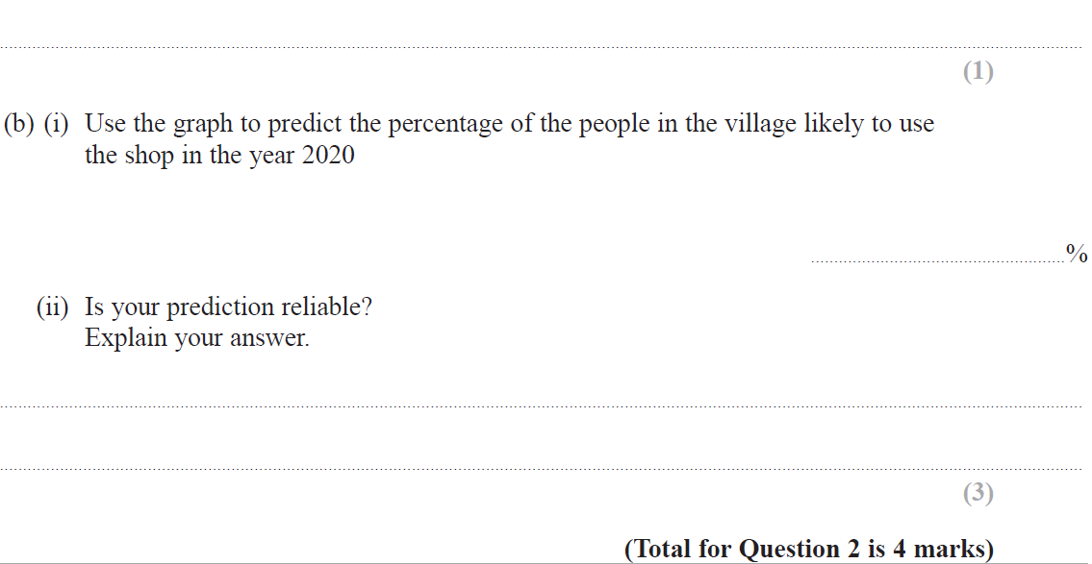
Time-Series
Specimen Set 2 2H Q2

Slide 13
Time-Series
Specimen Set 2 2H Q2
A
B (i)
B (i)

Slide 14
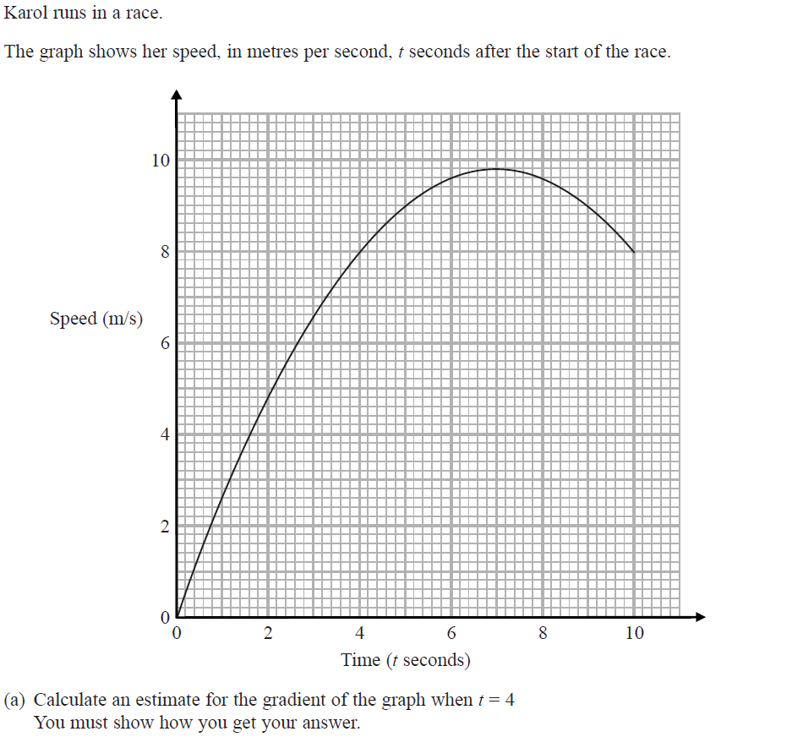
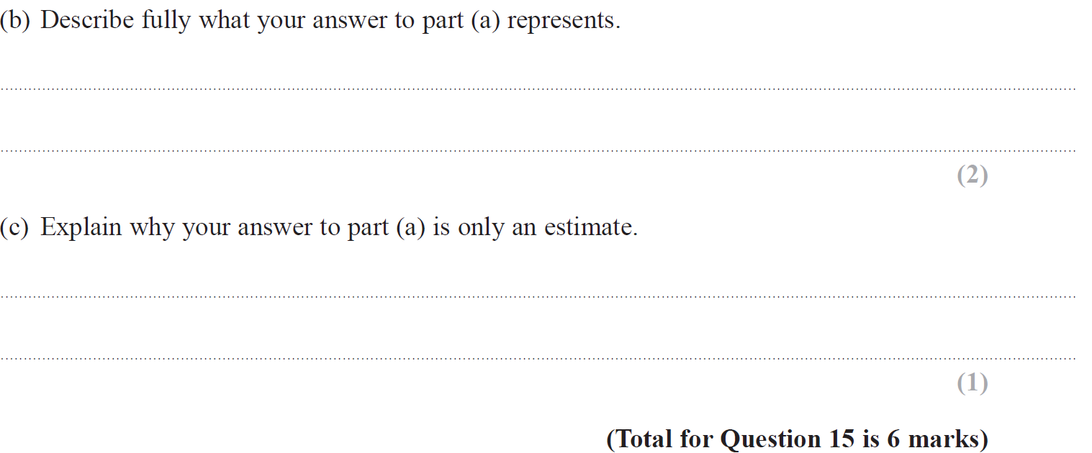
Time-Series
Specimen Set 2 2H Q15

Slide 15
Time-Series
Specimen Set 2 2H Q15
A
B
C

Slide 16
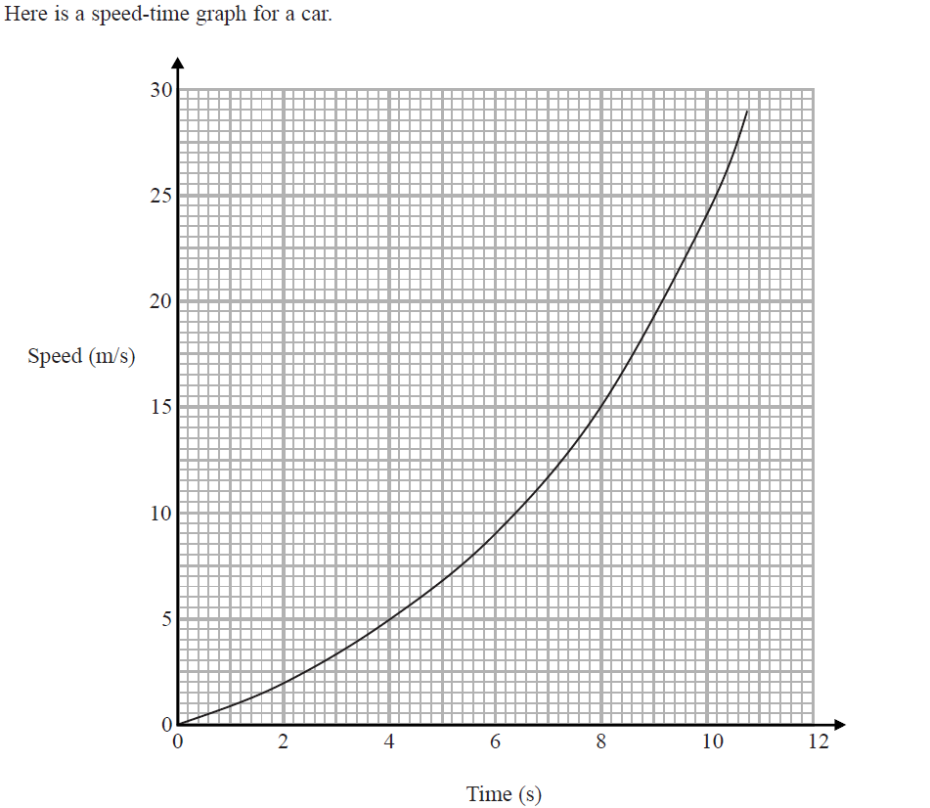
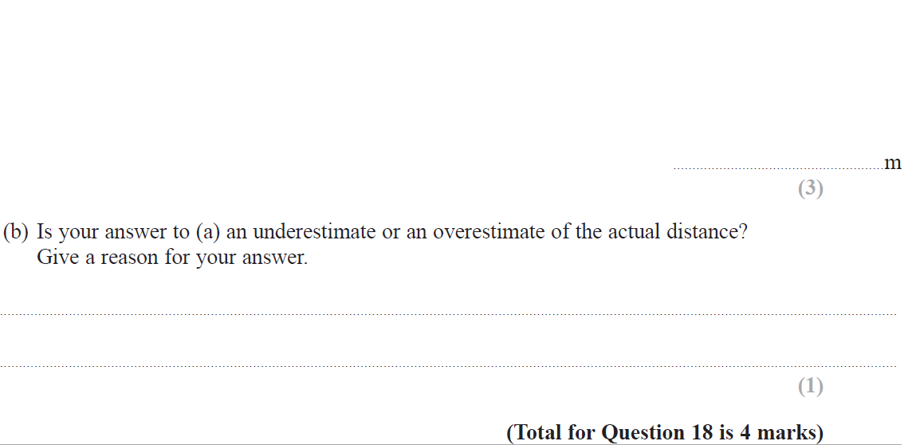
Time-Series
Specimen Set 2 3H Q18

Slide 17
Time-Series
Specimen Set 2 3H Q18
A
B

Slide 18
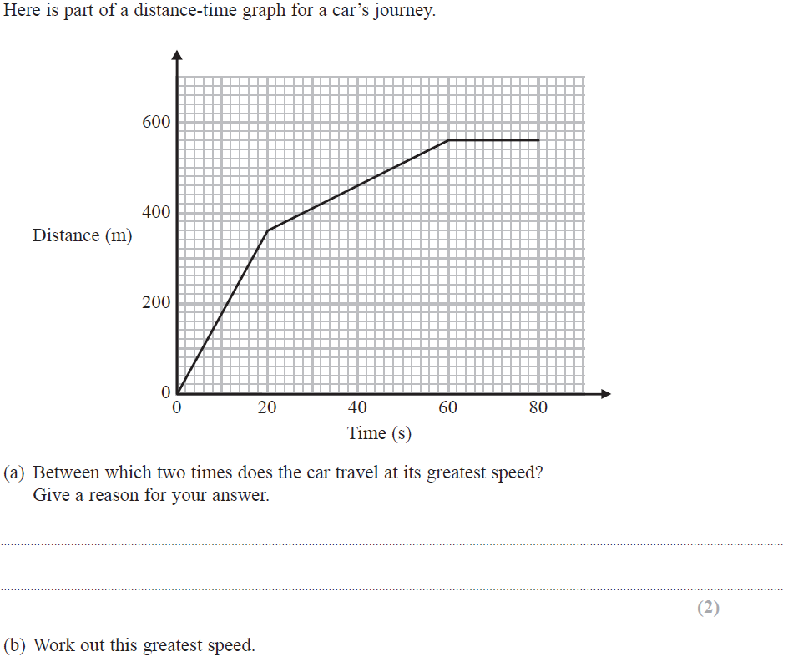
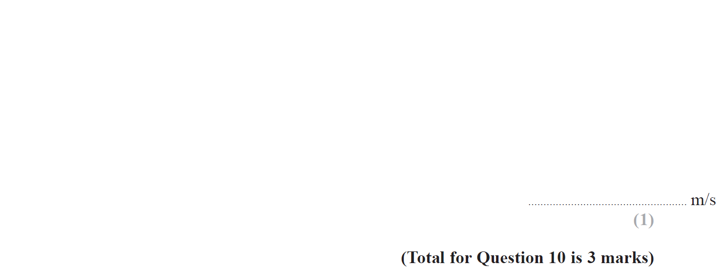
Time-Series
Nov 2017 2H Q10

Slide 19
Time-Series
Nov 2017 2H Q10
A
B

Slide 20
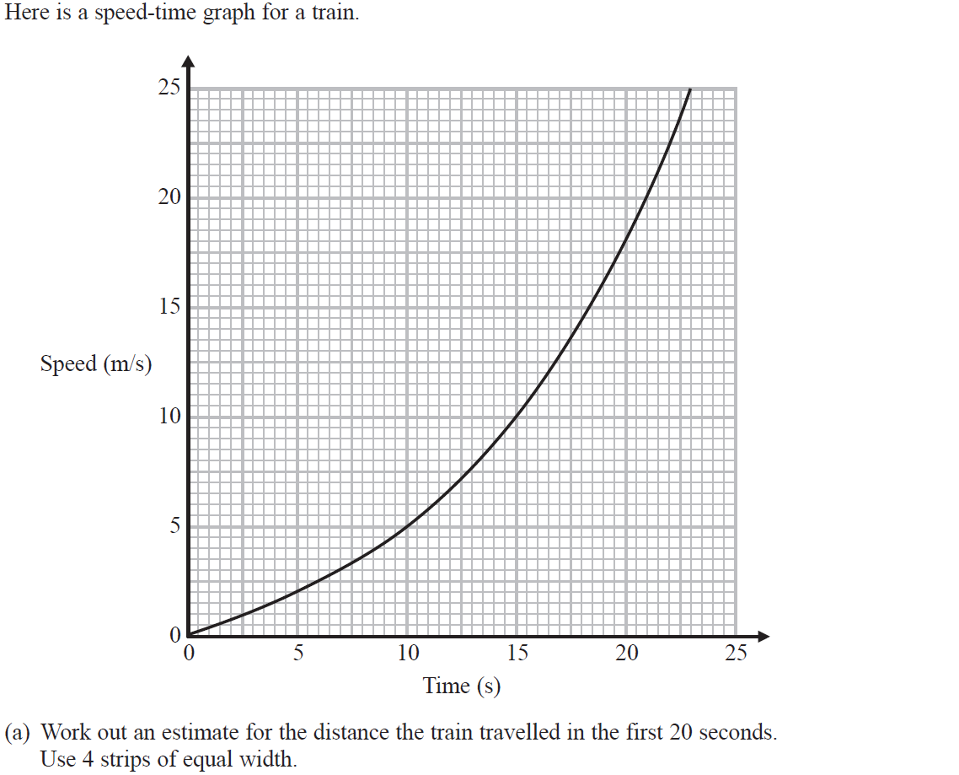
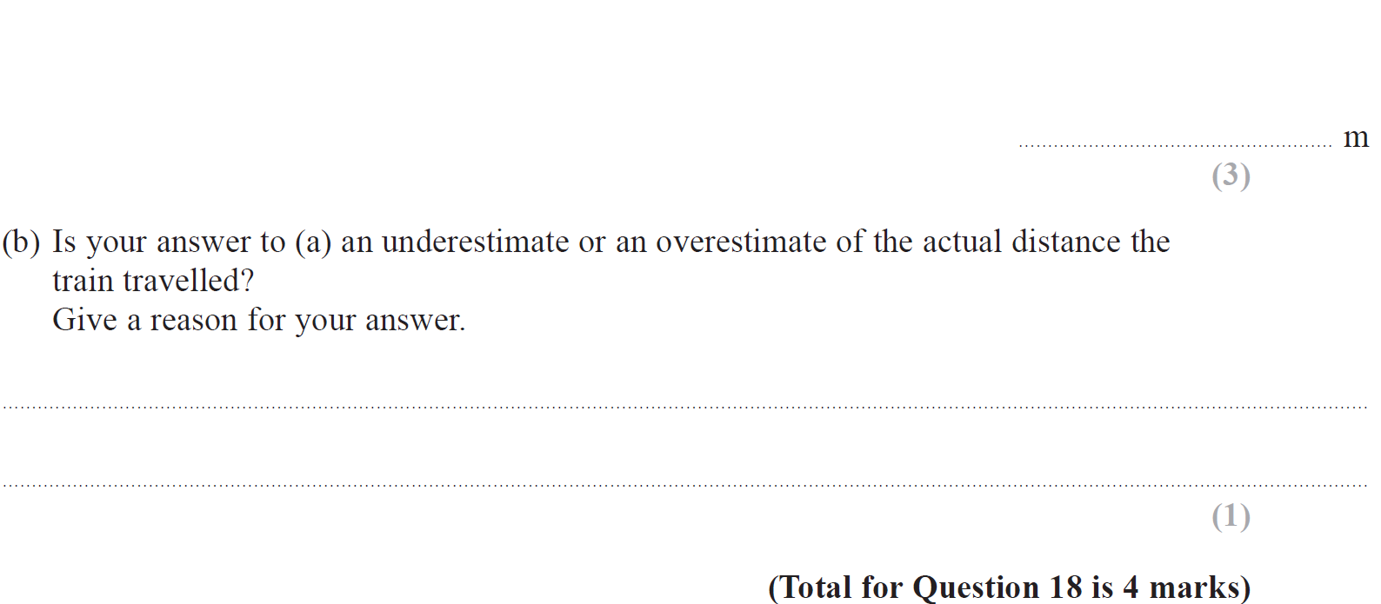
Time-Series
Nov 2017 3H Q18

Slide 21
Time-Series
Nov 2017 3H Q18
A
B

Slide 22
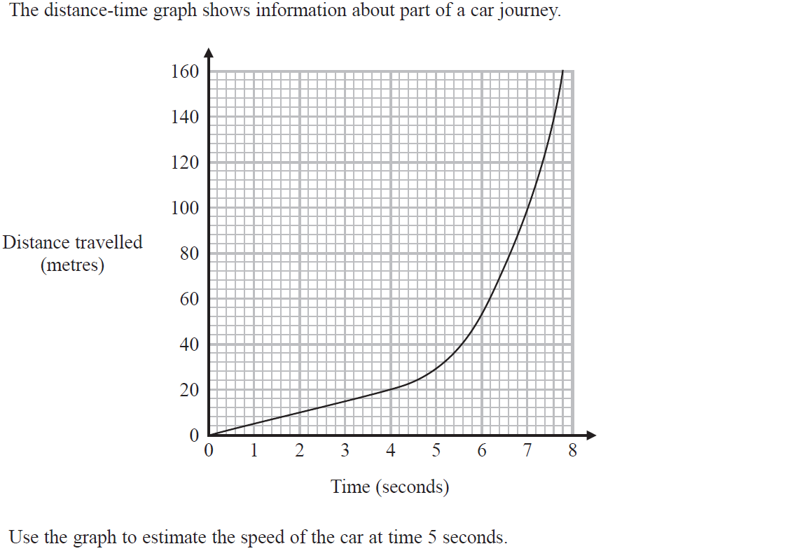
Time-Series
June 2018 2H Q14

Slide 23
Time-Series
June 2018 2H Q14
A

Slide 24
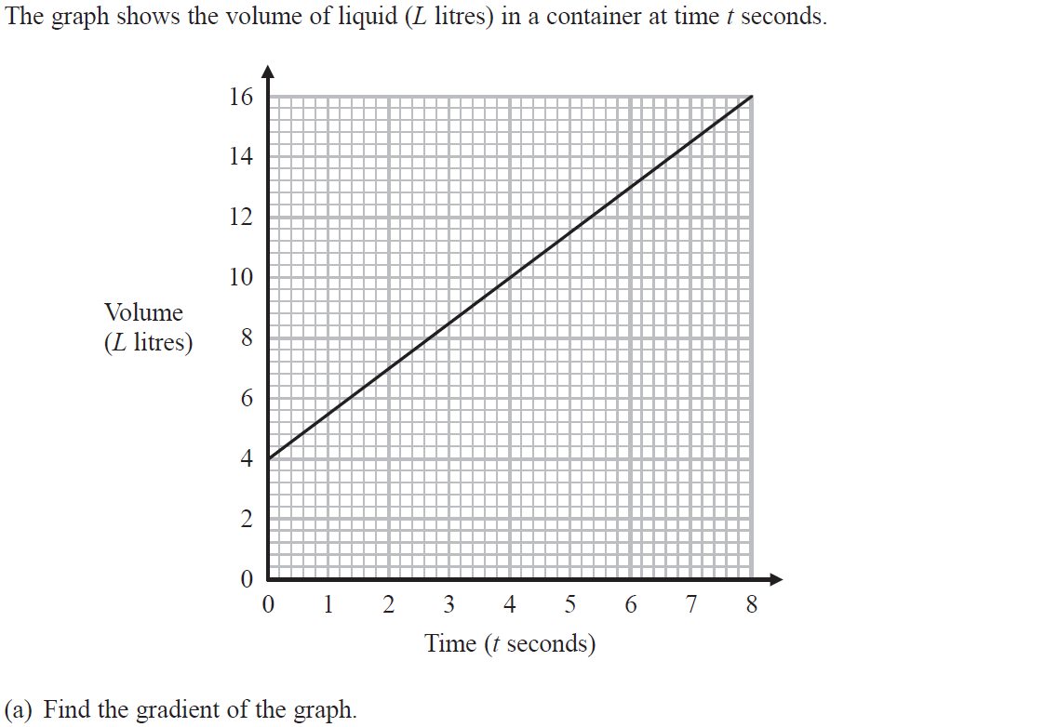
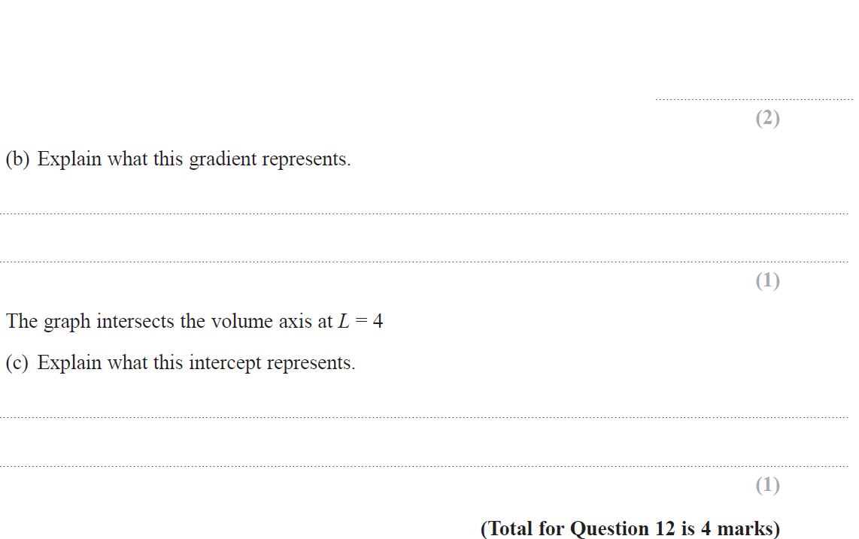
Time-Series
June 2018 3H Q12

Slide 25
Time-Series
June 2018 3H Q12
A
B
C

Slide 26
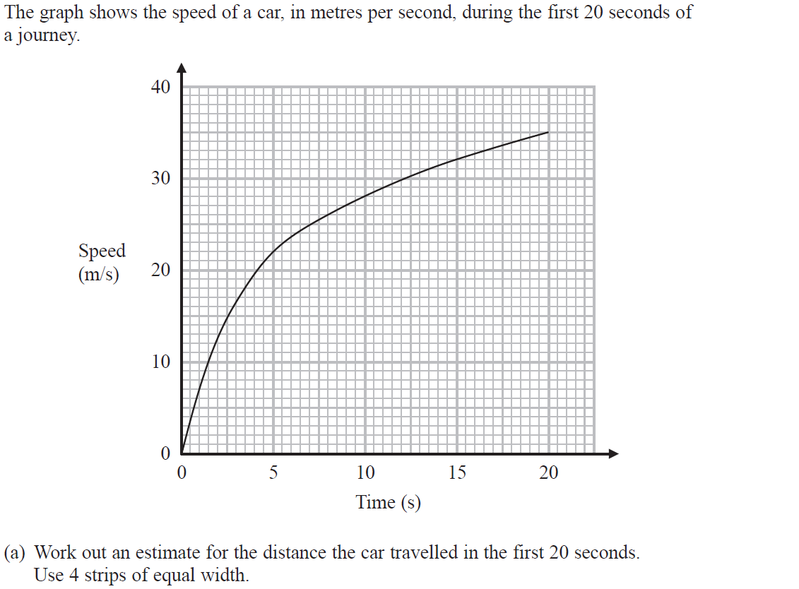
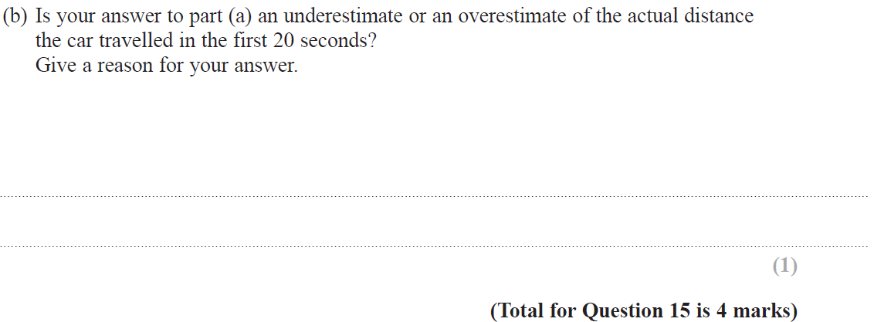
Time-Series
June 2018 3H Q15

Slide 27
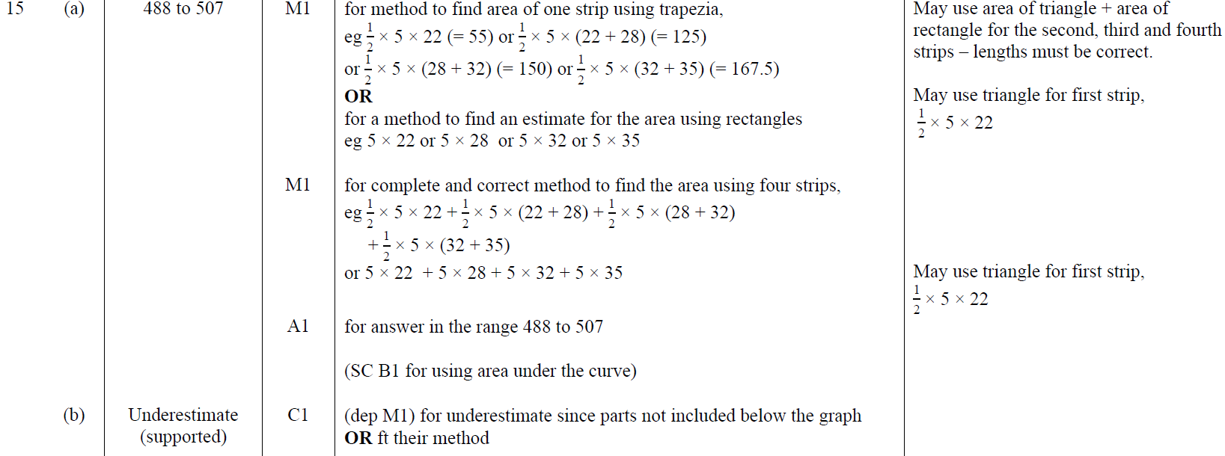
Time-Series
June 2018 3H Q15
A
B

Slide 28
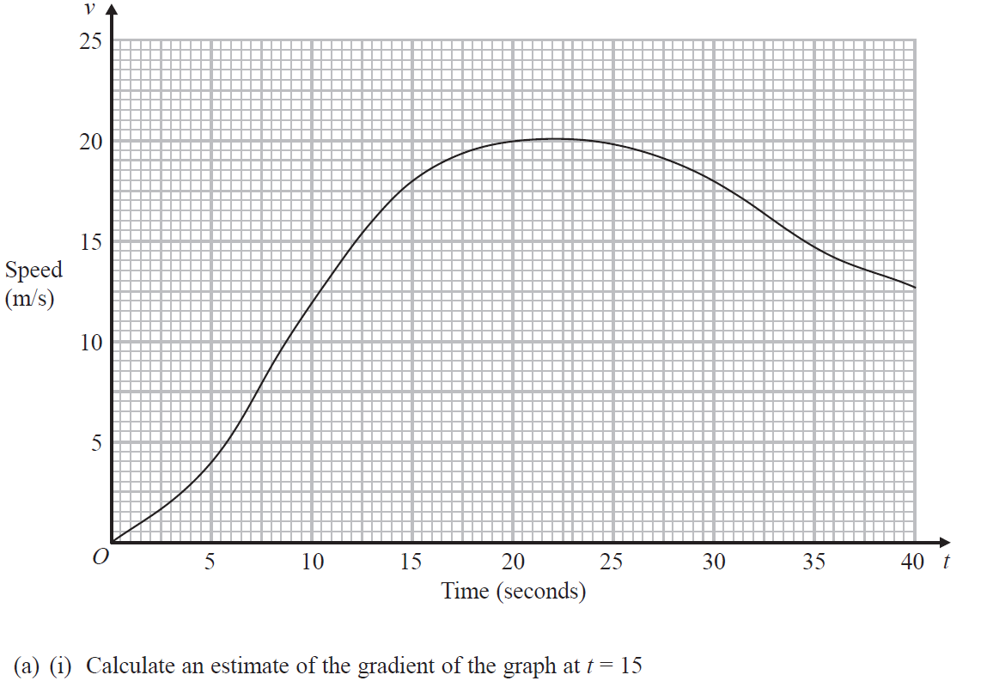
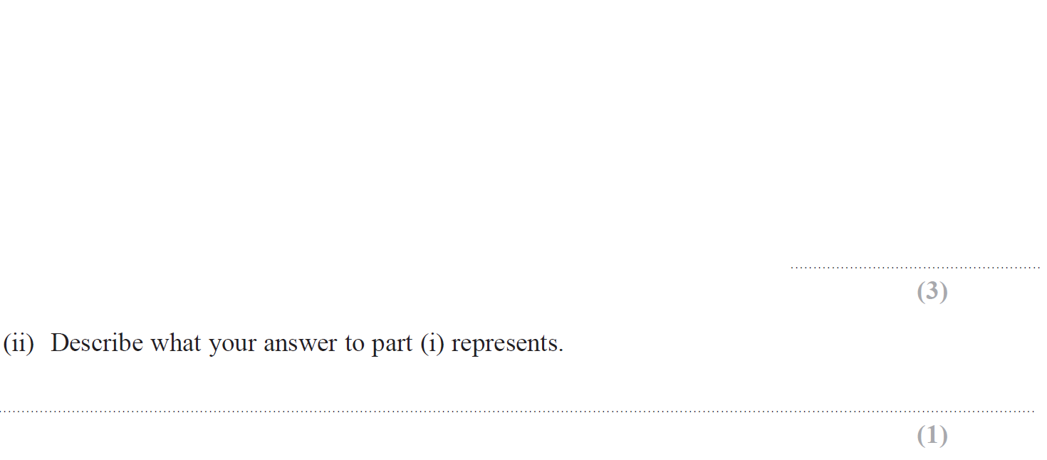
Time-Series
June 2019 2H Q14

Slide 29
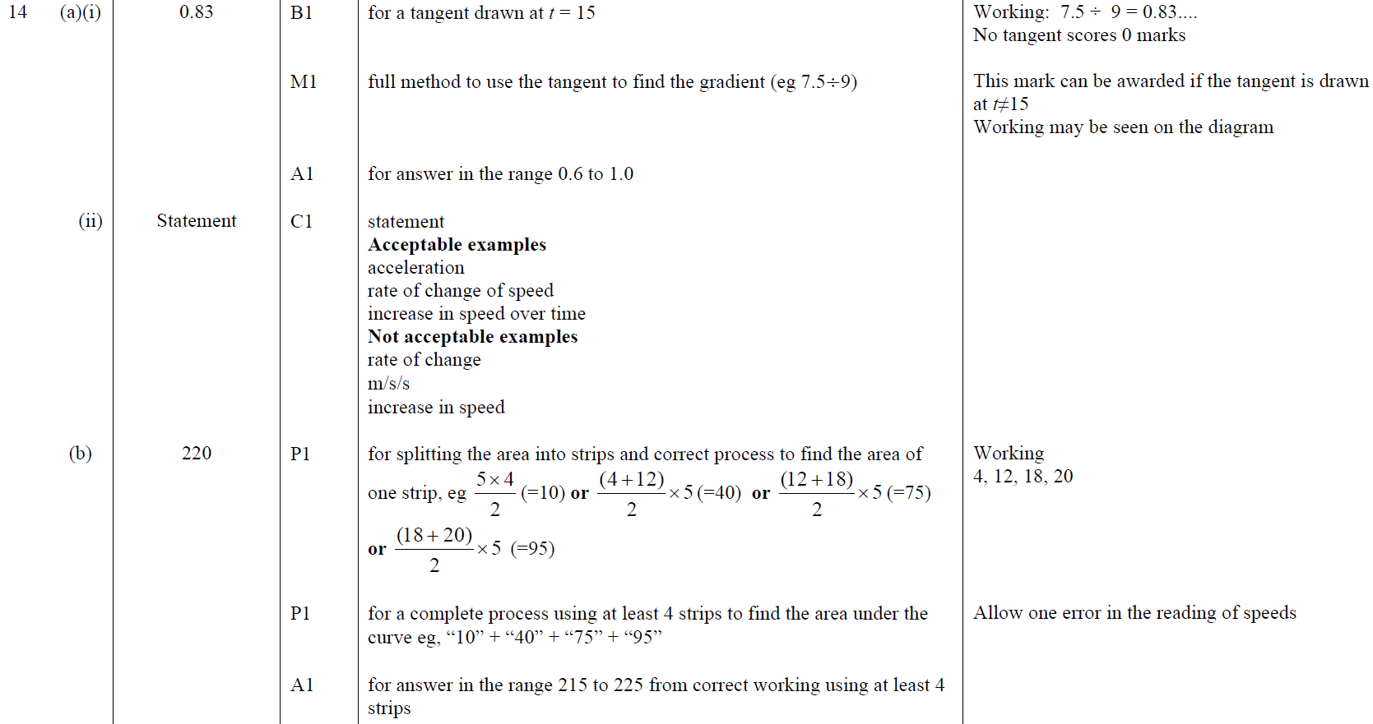
Time-Series
June 2019 2H Q14
A (i)
A (ii)
B

Slide 30
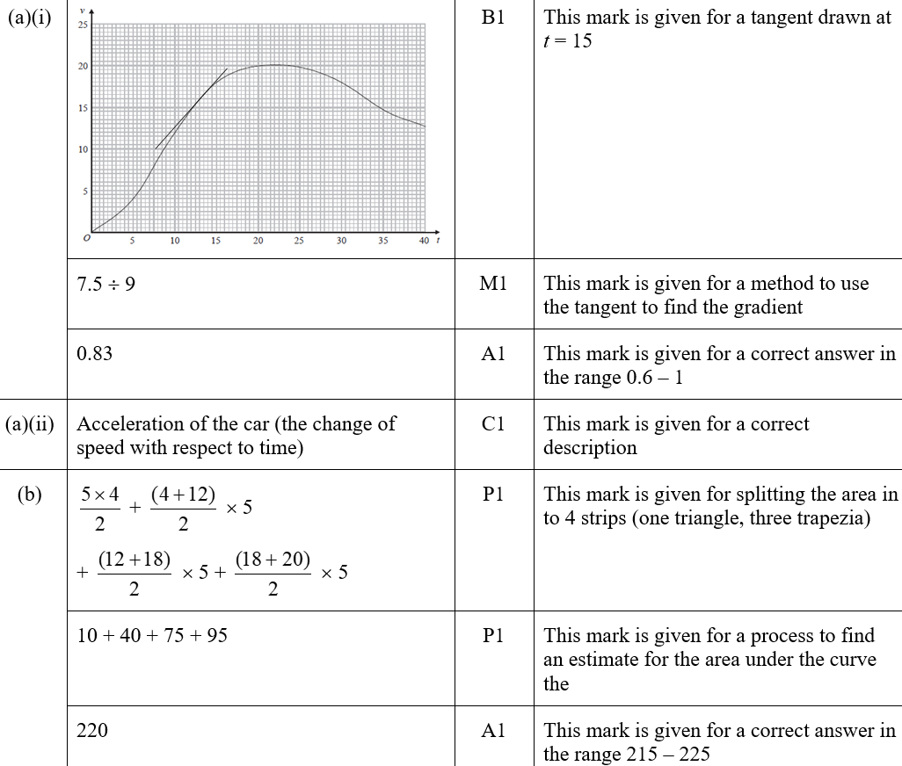
Time-Series
June 2019 2H Q14
A (i)
A (ii)
B

Slide 31
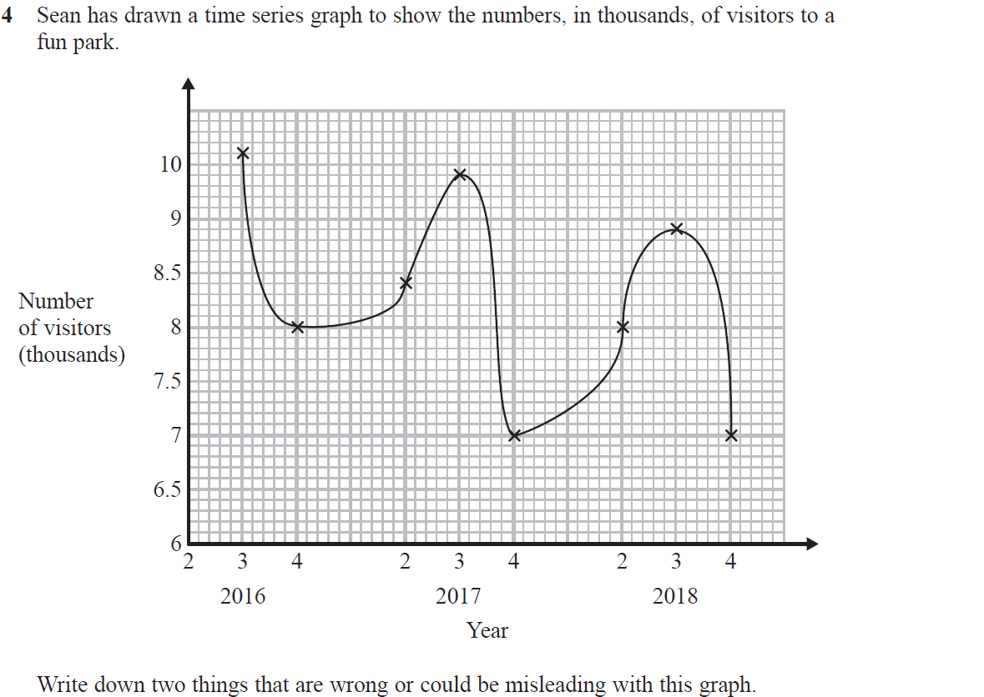
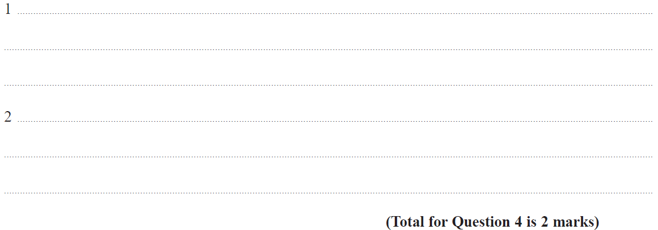
Time-Series
June 2019 3H Q4

Slide 32
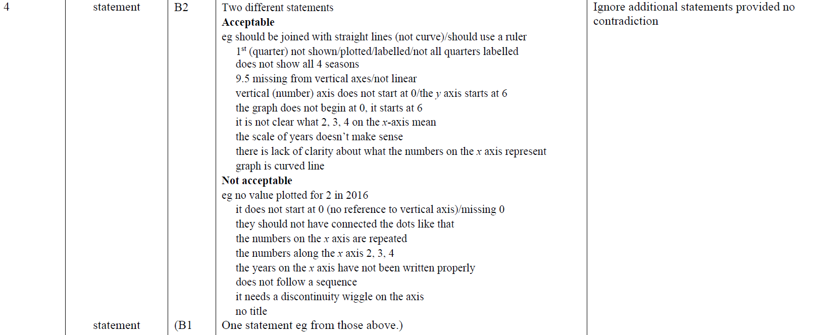
Time-Series
June 2019 3H Q4
A
A SF

