Slide 1
Surds
Surds
Edexcel
May 2018
1H Q28
AQA
SAM
1H Q26
1 Marker
Nov 2018
1H Q24
OCR

Slide 2
Surds
SAM 1H Q26

Slide 3
Surds
SAM 1H Q26
A

Slide 4
Surds
May 2018 1H Q28

Slide 5
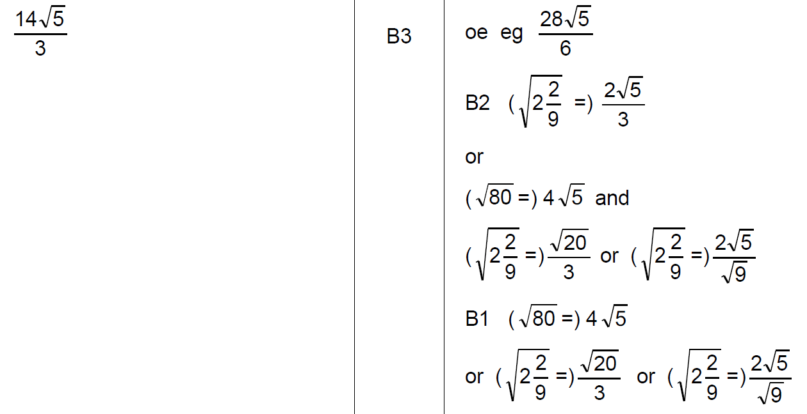
Surds
May 2018 1H Q28
A

Slide 6
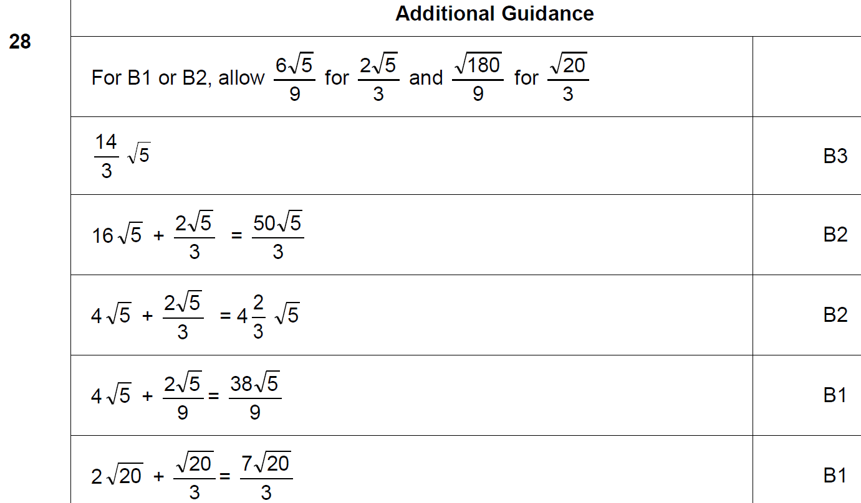
Surds
May 2018 1H Q28
A notes

Slide 7
Surds
Nov 2018 1H Q24

Slide 8
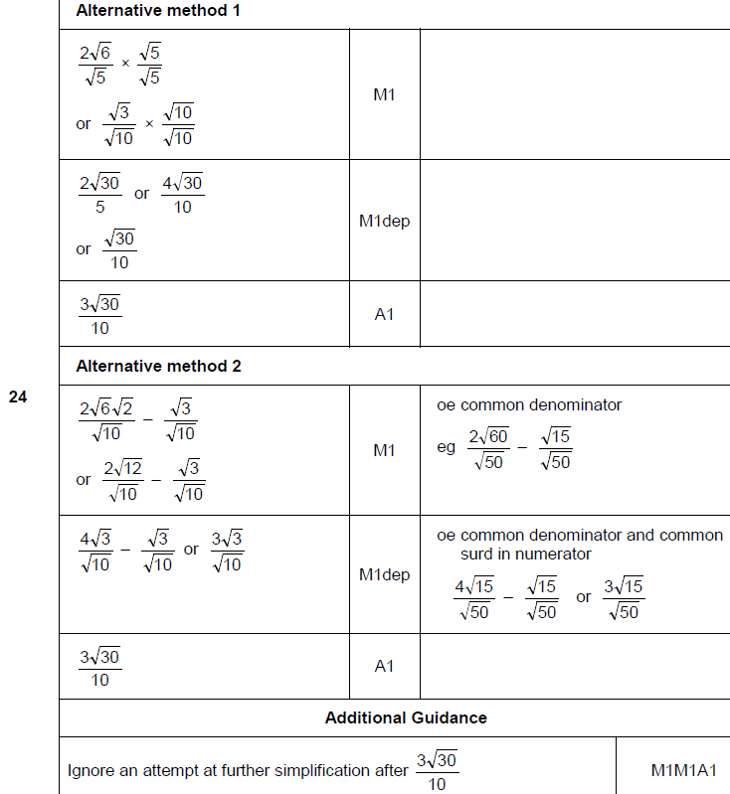
Surds
Nov 2018 1H Q24
A

