Slide 1
Substitution
Substitution
Old Spec Q’s
May 2018 1HR Q5

Slide 2
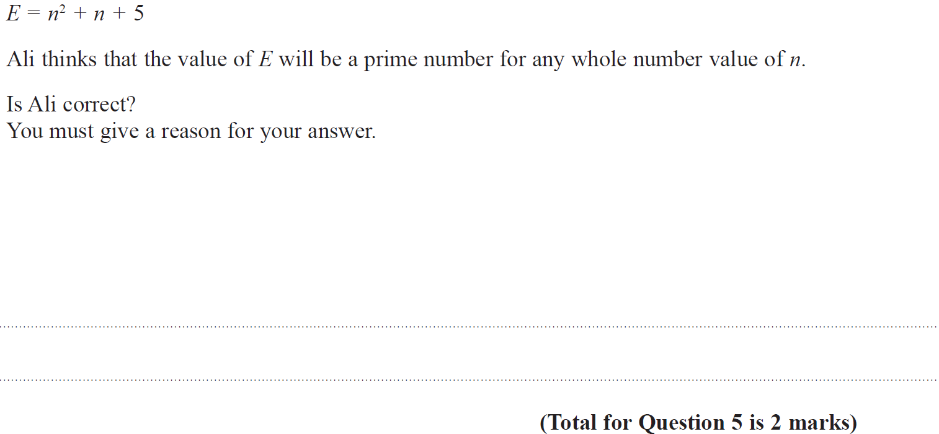
Substitution
May 2018 1HR Q5

Slide 3
Substitution
May 2018 1HR Q5
A

Slide 4
Substitution
Substitution
New Spec Q’s
May 2005 4H Q9
June 2009 4H Q3
May 2013 3HR Q7
Jan 2017 3H Q5
Nov 2005 3H Q6
Nov 2009 4H Q17
Jan 2014 3H Q5
Jan 2017 4HR Q7
May 2006 3H Q4
June 2010 3H Q11
May 2014 3H Q4
May 2017 3H Q1
May 2006 4H Q2
Nov 2010 4H Q6
May 2014 4HR Q1
June 2017 4H Q2
Nov 2006 4H Q8
June 2011 4H Q5
June 2015 4HR Q9
May 2017 3HR Q1
May 2007 3H Q2
Jan 2012 3H Q5
Jan 2016 4H Q2
Jan 2017 3H Q3
May 2008 4H Q4
May 2012 3H Q2
May 2016 3H Q2
Jan 2017 3HR Q4
May 2009 3H Q13
May 2013 3H Q5
May 2016 3HR Q2

Slide 5
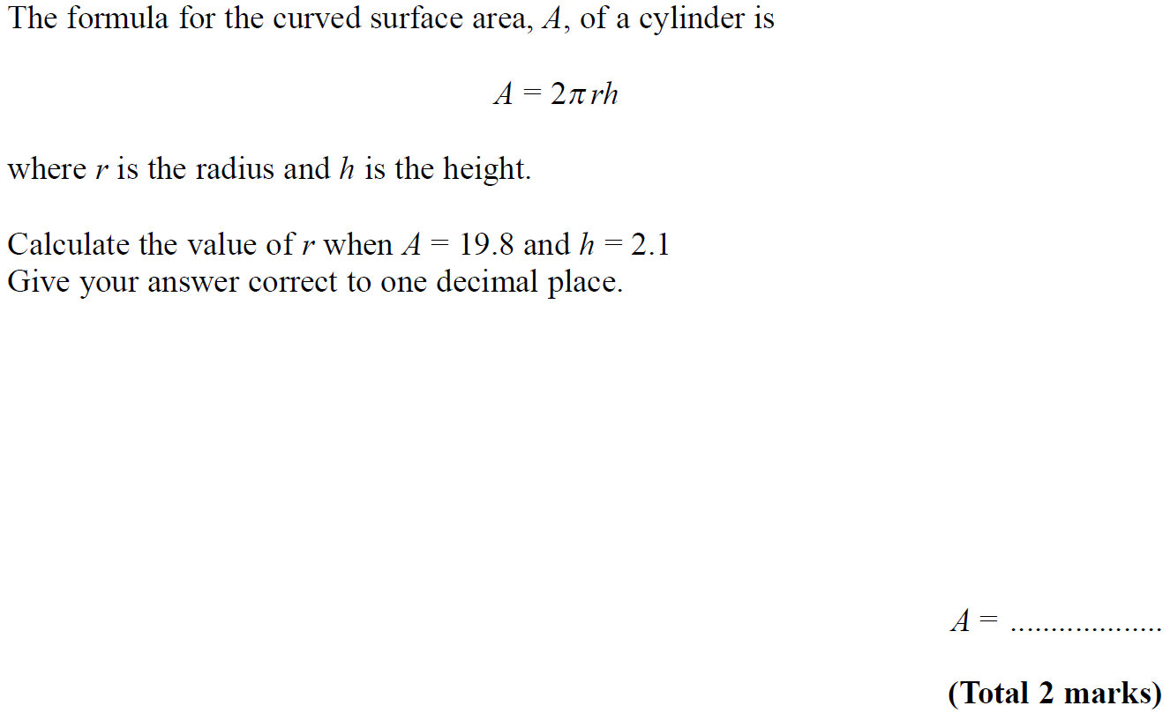
Substitution
May 2005 4H Q9

Slide 6
Substitution
May 2005 4H Q9
A

Slide 7
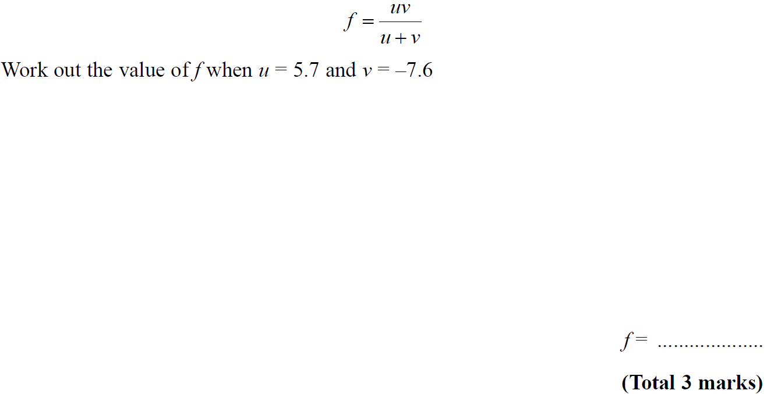
Substitution
Nov 2005 3H Q6

Slide 8
Substitution
Nov 2005 3H Q6
A

Slide 9
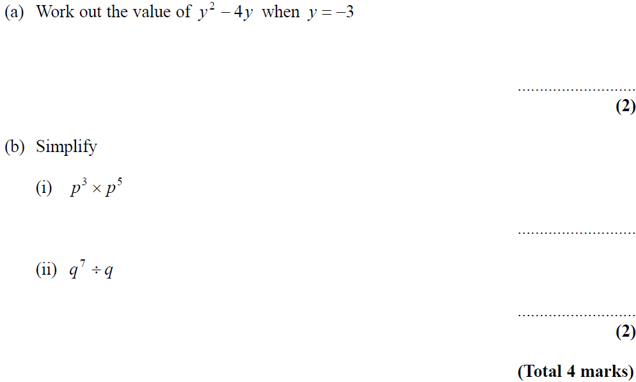
Substitution
May 2006 3H Q4

Slide 10
Substitution
May 2006 3H Q4
A
B (i)
B (ii)

Slide 11
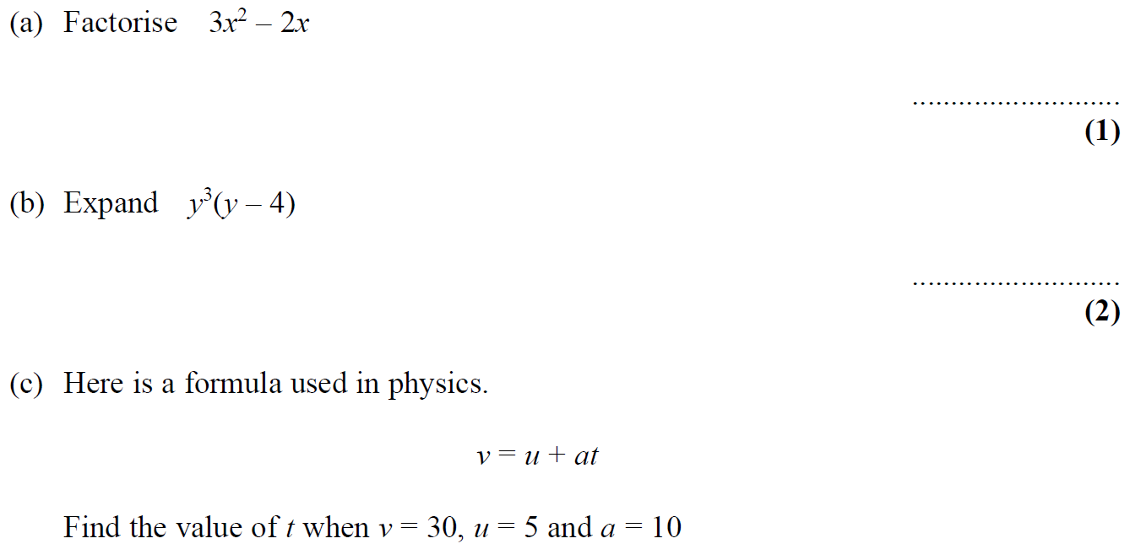
Substitution
May 2006 4H Q2

Slide 12
Substitution
May 2006 4H Q2
A
B
C

Slide 13
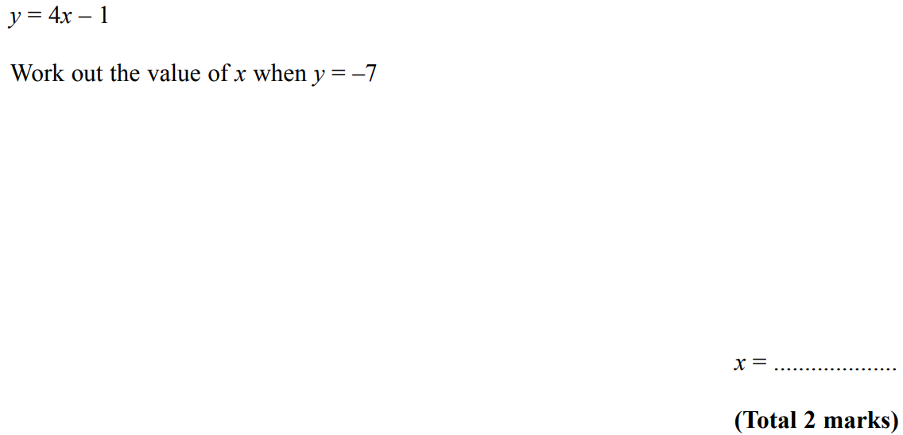
Substitution
Nov 2006 4H Q8

Slide 14
Substitution
Nov 2006 4H Q8
A

Slide 15
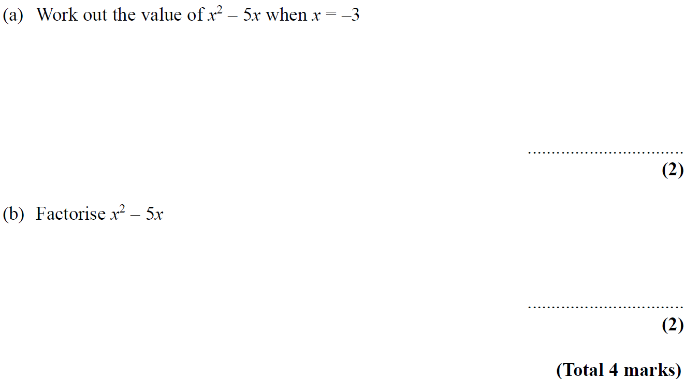
Substitution
May 2007 3H Q2

Slide 16
Substitution
May 2007 3H Q2
A
B

Slide 17
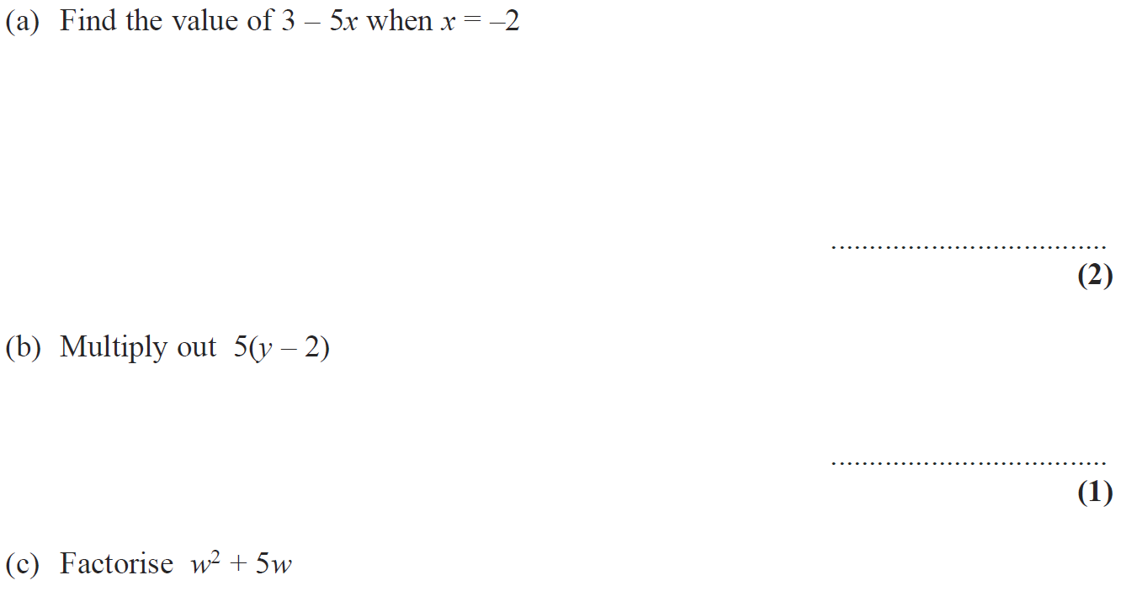
Substitution
May 2008 4H Q4

Slide 18
Substitution
May 2008 4H Q4
A
B
C

Slide 19
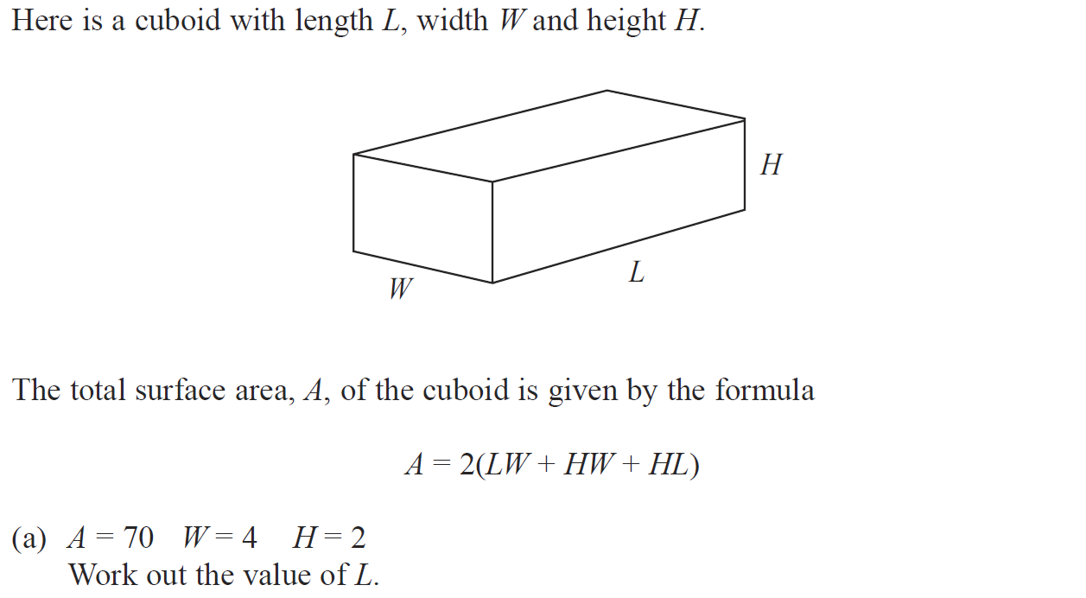
Substitution
May 2009 3H Q13

Slide 20
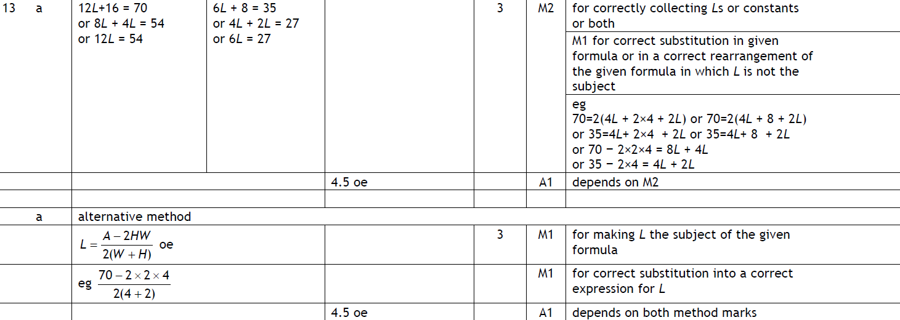
Substitution
May 2009 3H Q13
A
B

Slide 21
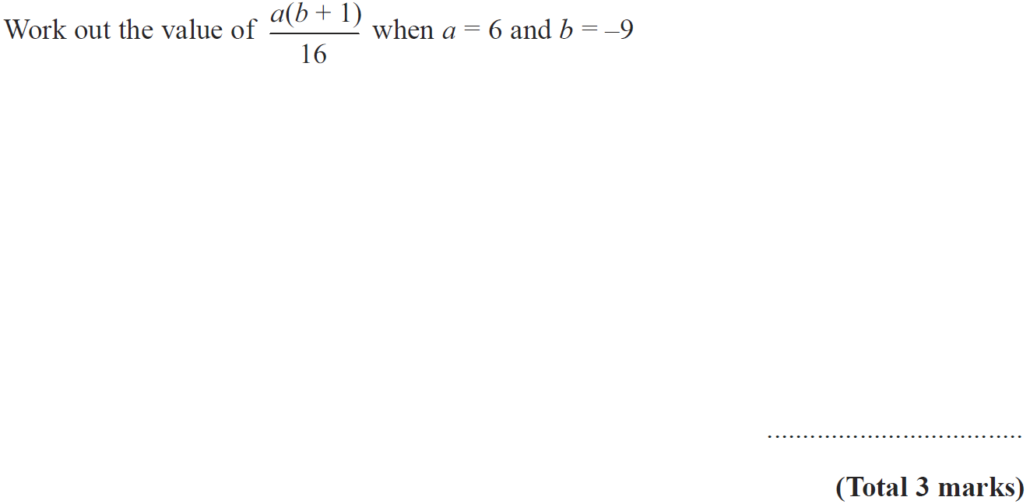
Substitution
June 2009 4H Q3

Slide 22
Substitution
June 2009 4H Q3
A

Slide 23
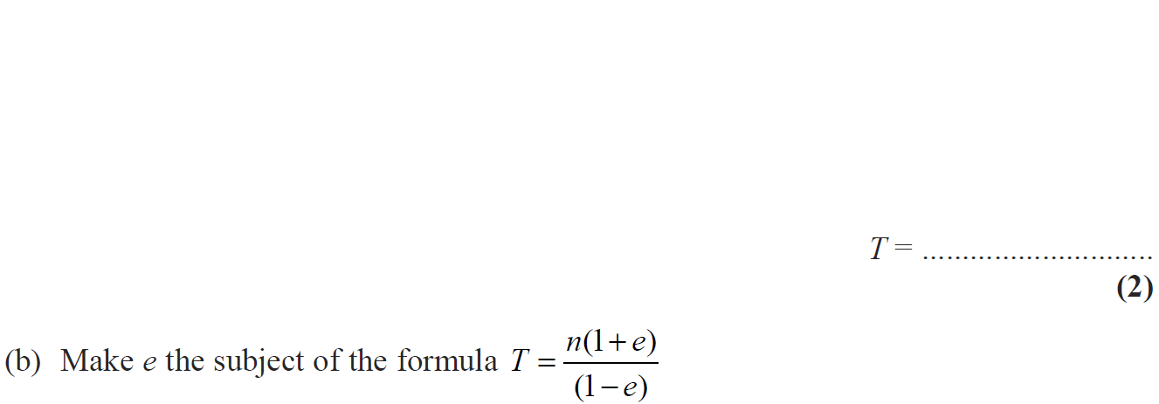
Substitution
Nov 2009 4H Q17

Slide 24
Substitution
Nov 2009 4H Q17
A
B

Slide 25
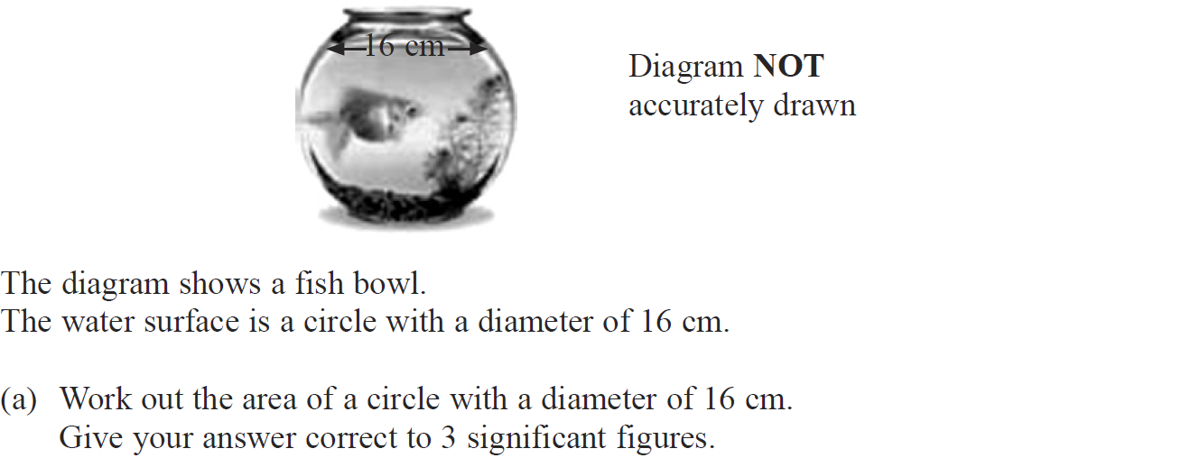
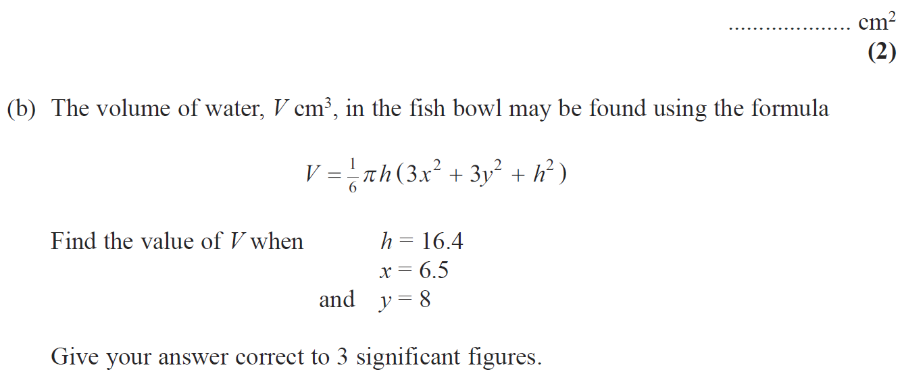
Substitution
June 2010 3H Q11

Slide 26
Substitution
June 2010 3H Q11
A
B

Slide 27
Substitution
Nov 2010 4H Q6

Slide 28
Substitution
Nov 2010 4H Q6
A
B
C

Slide 29
Substitution
June 2011 4H Q5

Slide 30
Substitution
June 2011 4H Q5
A (i)
A (ii)
A (iii)
B
C

Slide 31
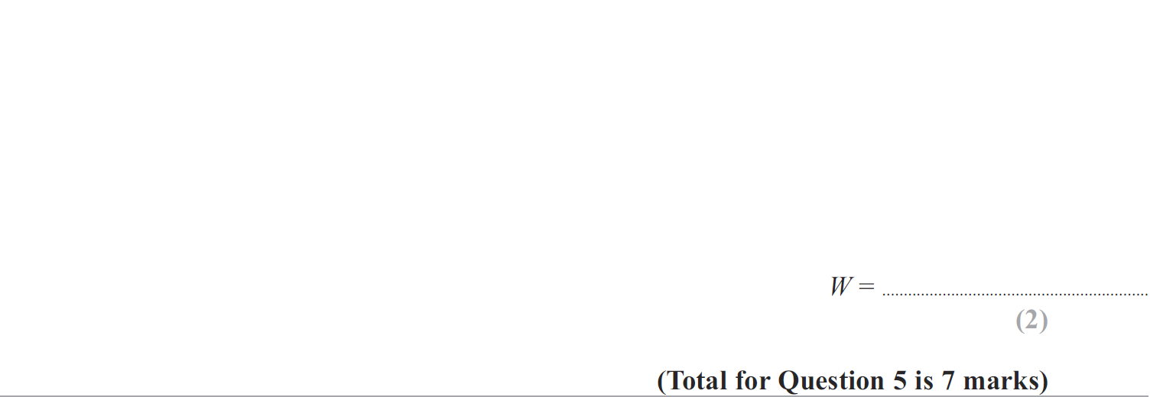
Substitution
Jan 2012 3H Q5

Slide 32
Substitution
Jan 2012 3H Q5
A
B (i)
B (ii)
C

Slide 33
Substitution
May 2012 3H Q2

Slide 34
Substitution
May 2012 3H Q2
A
B

Slide 35
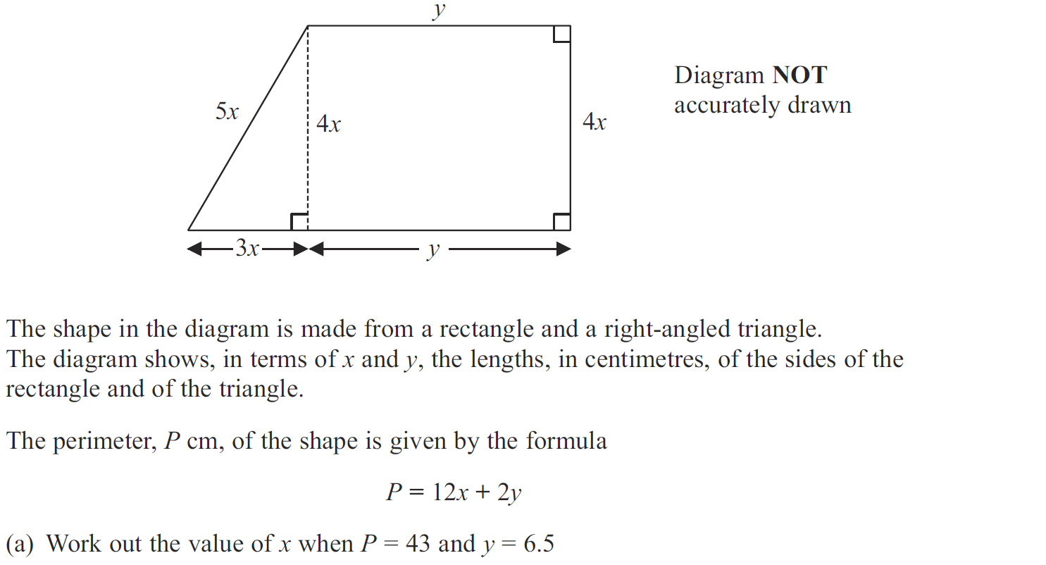
Substitution
May 2013 3H Q5

Slide 36
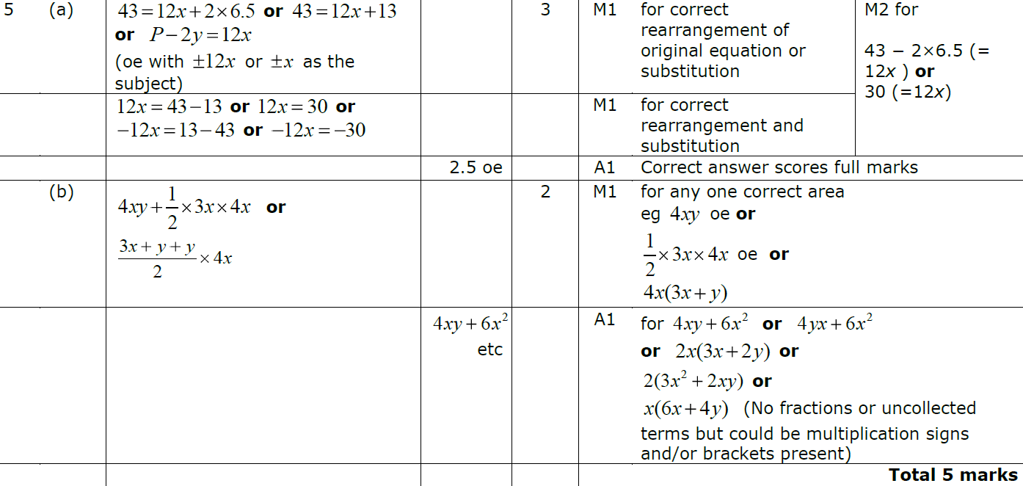
Substitution
May 2013 3H Q5
A
B

Slide 37
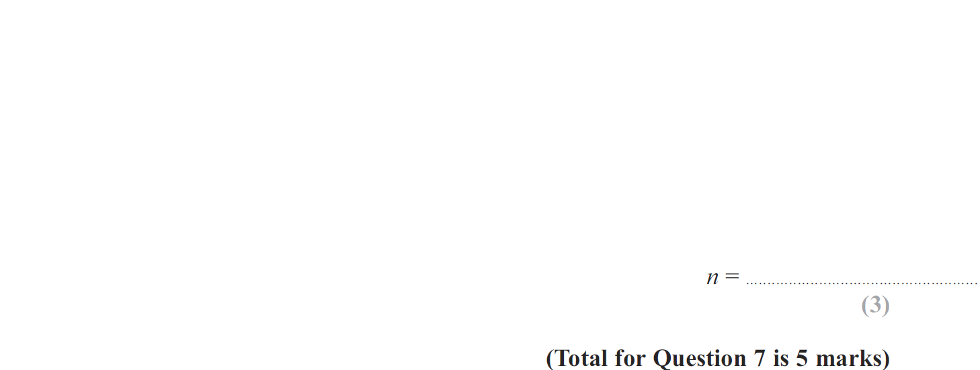
Substitution
May 2013 3HR Q7

Slide 38
Substitution
May 2013 3HR Q7
A
B

Slide 39
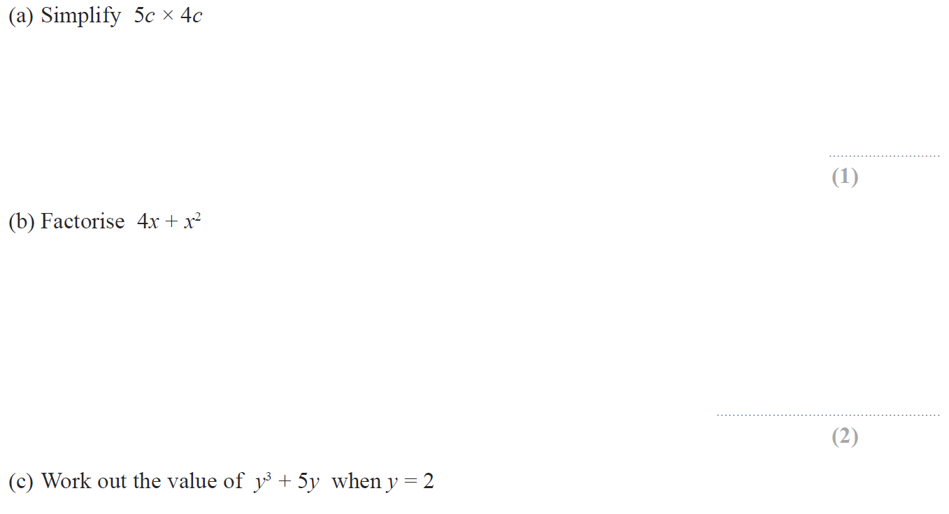
Substitution
Jan 2014 3H Q5

Slide 40
Substitution
Jan 2014 3H Q5
A
B
C

Slide 41
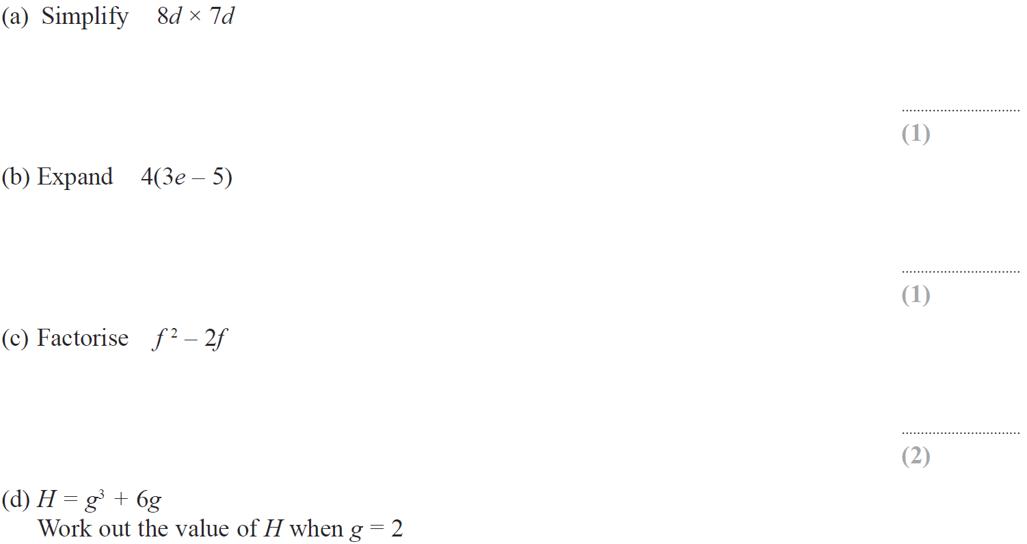
Substitution
May 2014 3H Q4

Slide 42
Substitution
May 2014 3H Q4
A
B
C
D

Slide 43
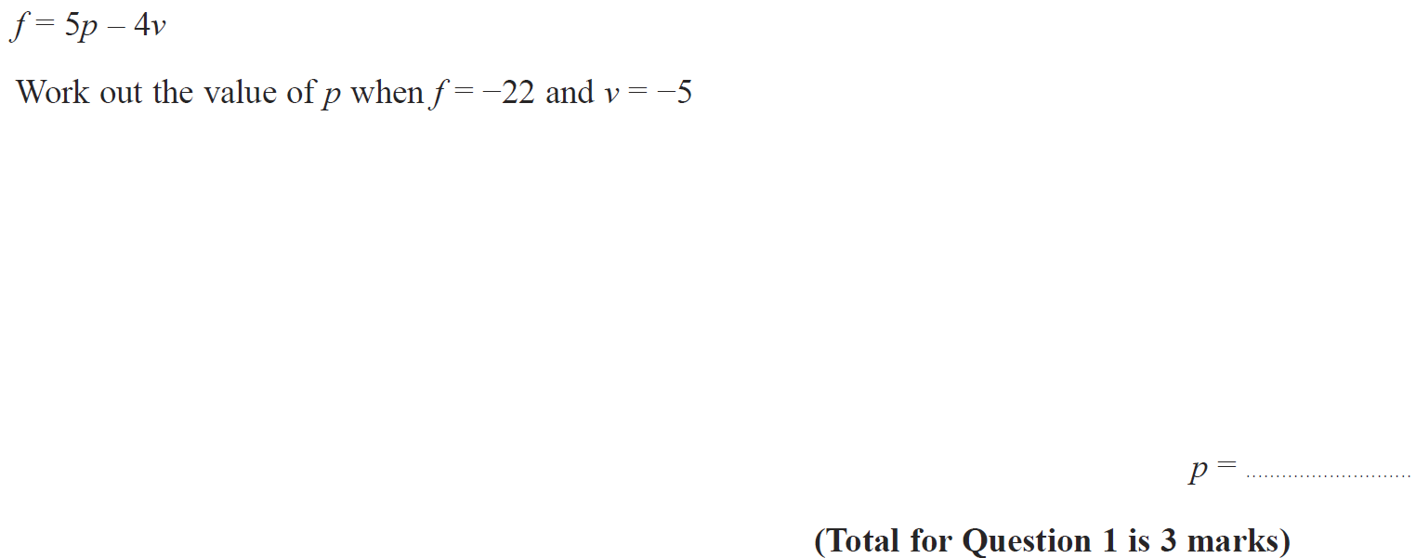
Substitution
May 2014 4HR Q1

Slide 44
Substitution
May 2014 4HR Q1
A

Slide 45
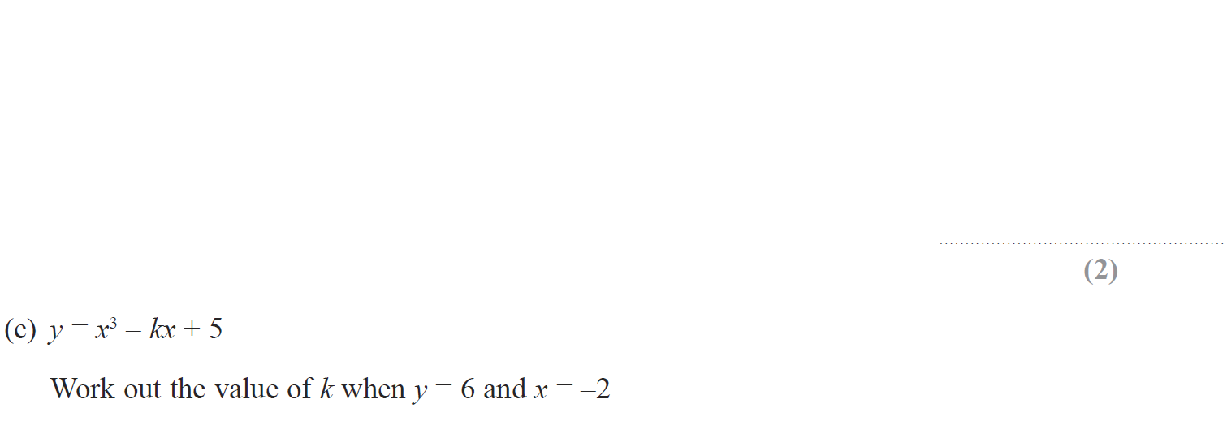
Substitution
June 2015 4HR Q9

Slide 46
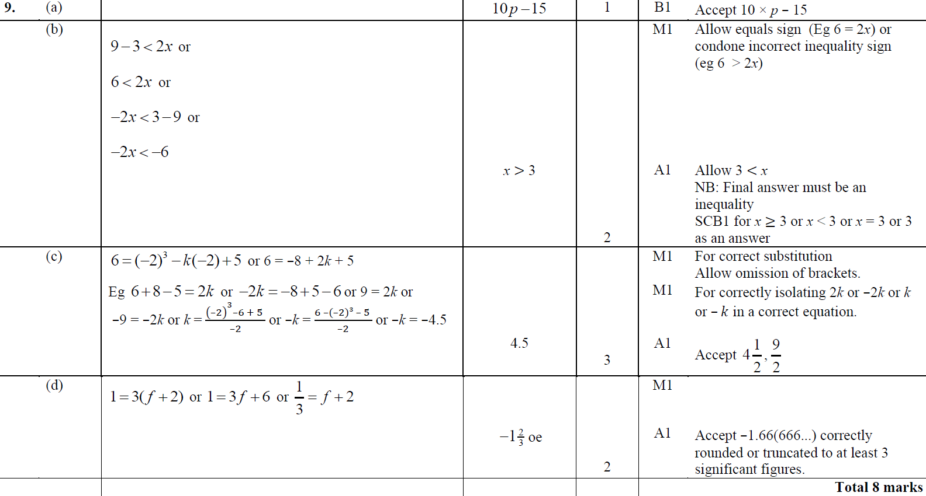
Substitution
June 2015 4HR Q9
A
B
C
D

Slide 47
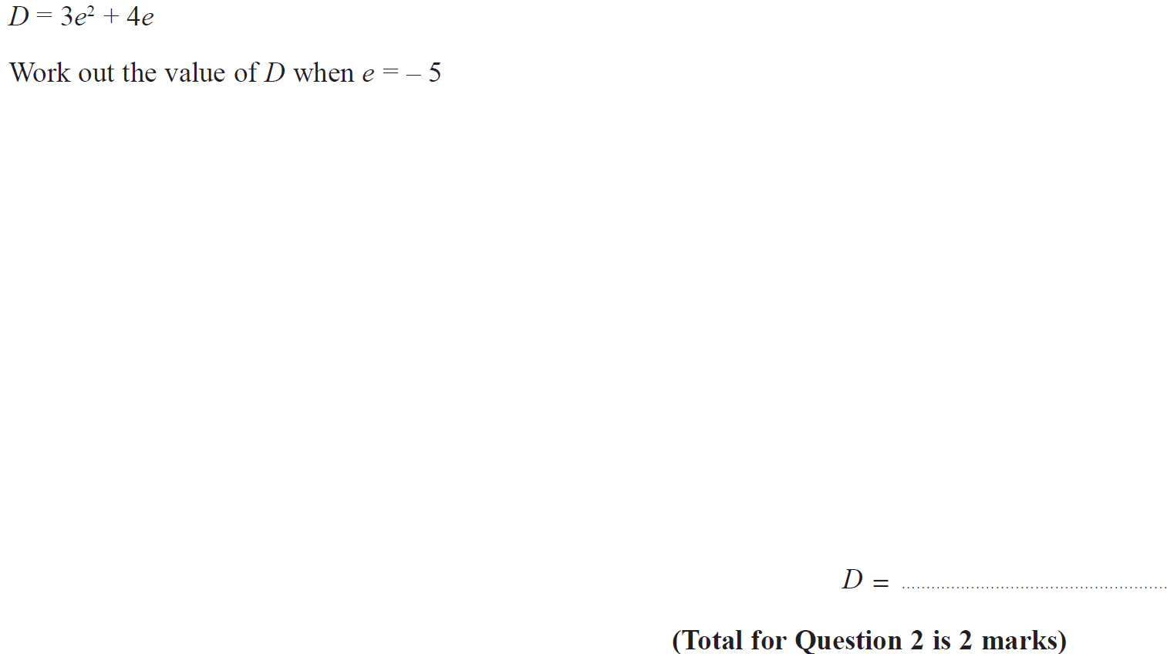
Substitution
Jan 2016 4H Q2

Slide 48
Substitution
Jan 2016 4H Q2
A

Slide 49
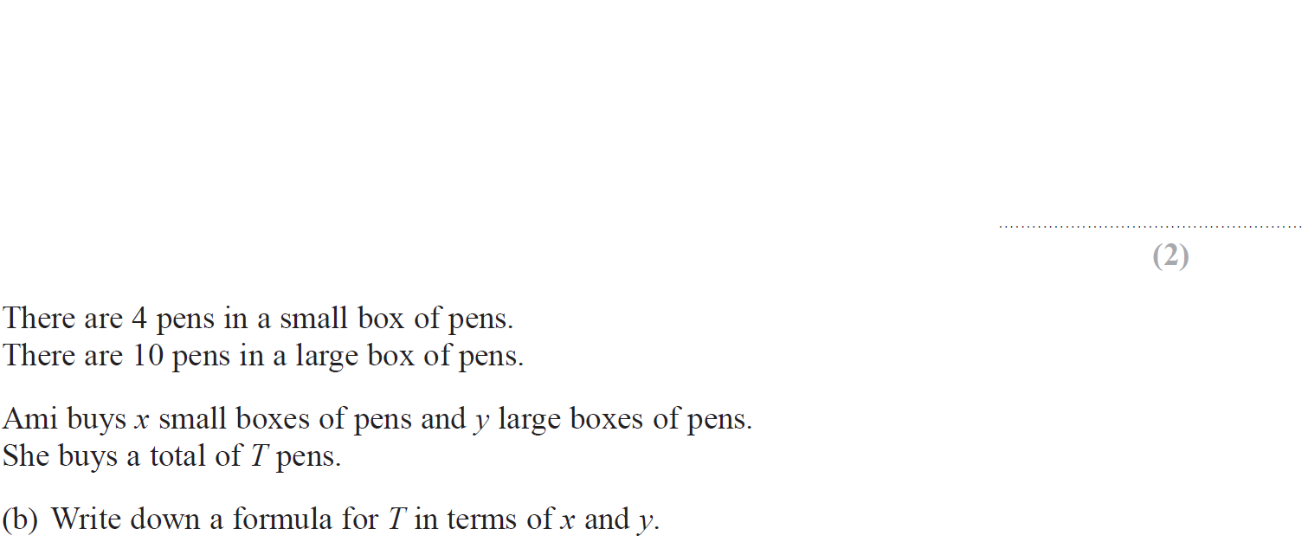
Substitution
May 2016 3H Q2

Slide 50
Substitution
May 2016 3H Q2
A
B

Slide 51
Substitution
May 2016 3HR Q2

Slide 52
Substitution
May 2016 3HR Q2
A
B

Slide 53
Substitution
Jan 2017 3H Q5

Slide 54
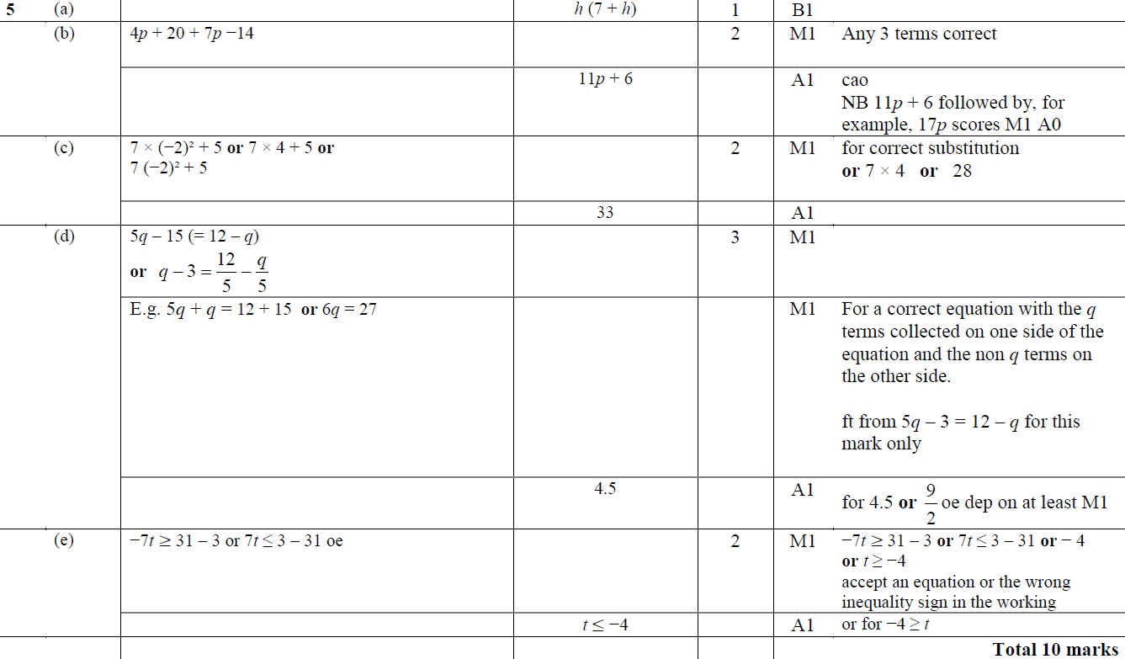
Substitution
Jan 2017 3H Q5
A
B
C
D
E

Slide 55
Substitution
Jan 2017 4HR Q7

Slide 56
Substitution
Jan 2017 4HR Q7
A
B
C
D
E

Slide 57
Substitution
May 2017 3H Q1

Slide 58
Substitution
May 2017 3H Q1
A
B
C
D
E

Slide 59
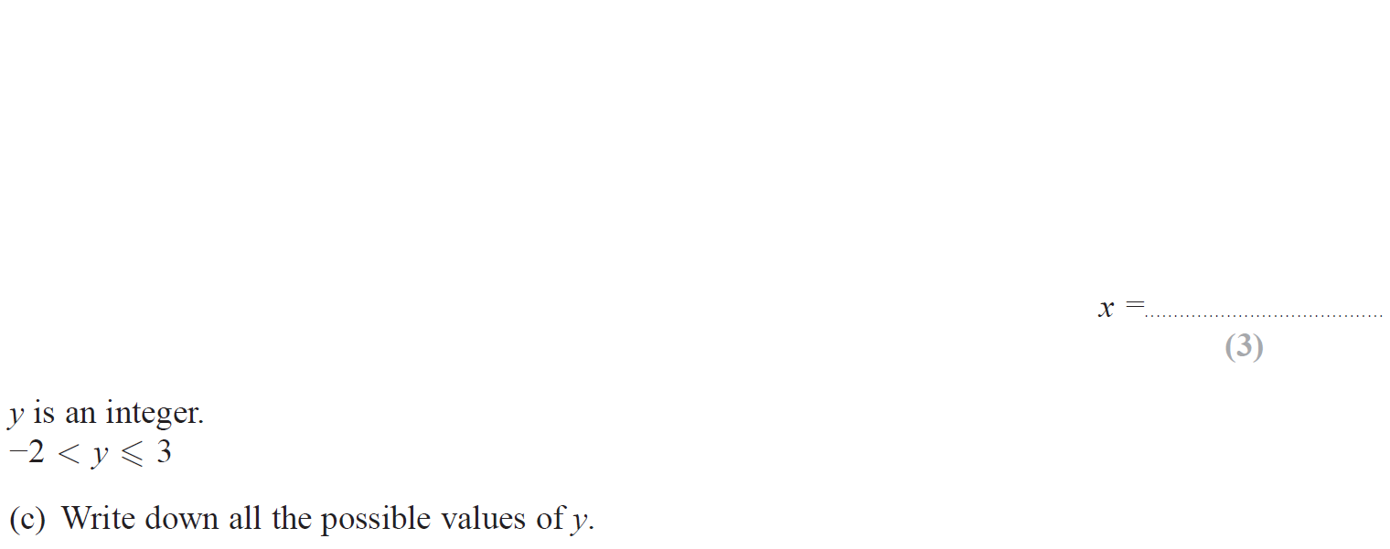
Substitution
June 2017 4H Q2

Slide 60
Substitution
June 2017 4H Q2
A
B
C

Slide 61
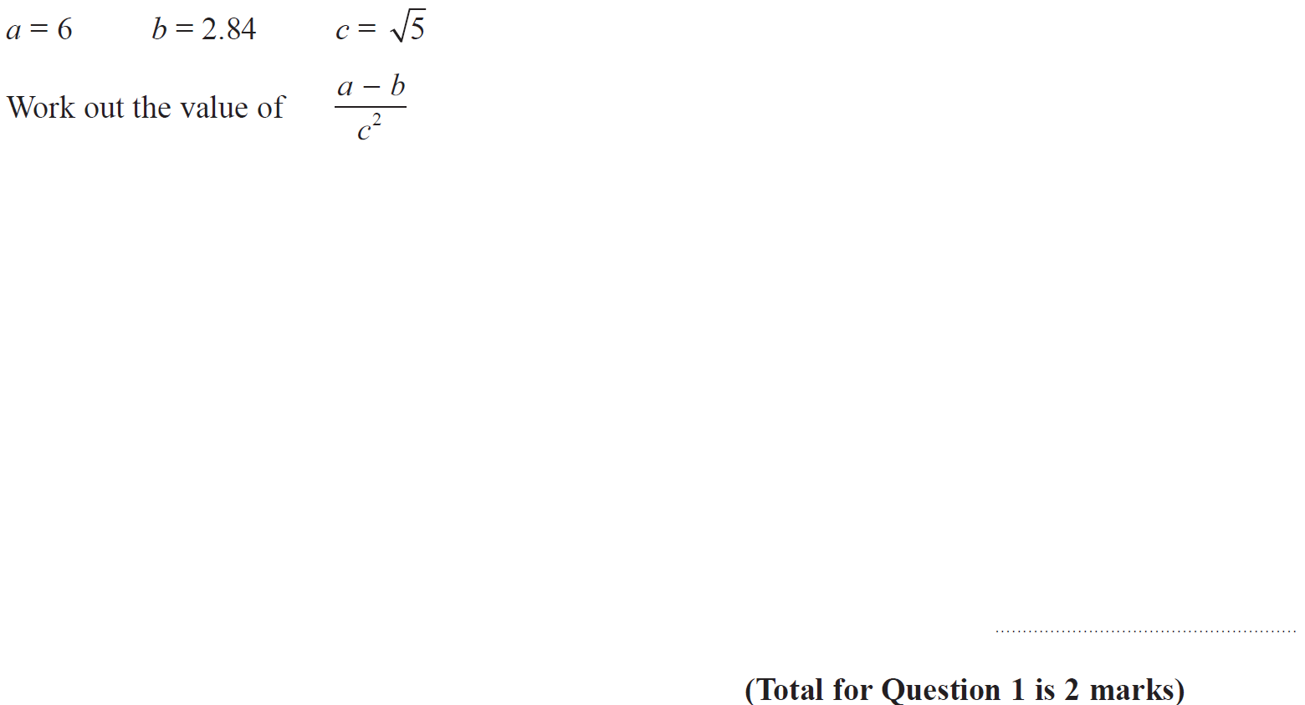
Substitution
May 2017 3HR Q1

Slide 62
Substitution
May 2017 3HR Q1
A

Slide 63
Substitution
Jan 2018 3H Q3

Slide 64
Substitution
Jan 2018 3H Q3
A
B

Slide 65
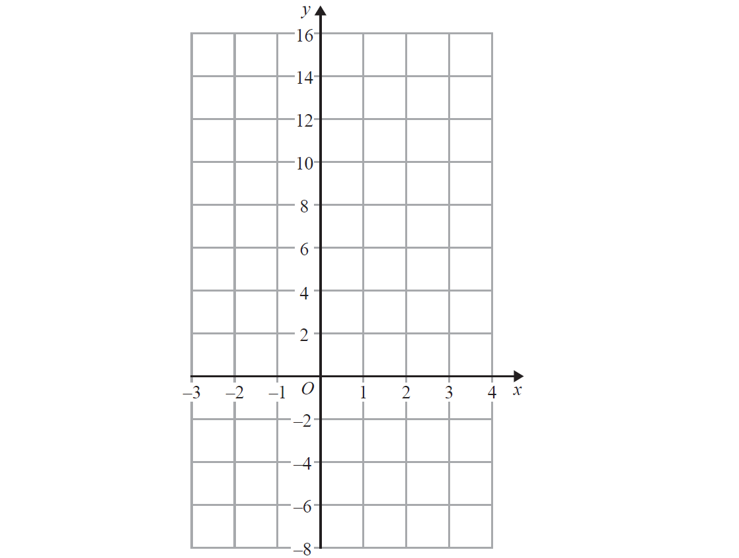
Substitution
Jan 2018 3HR Q4
Show (a)

Slide 66
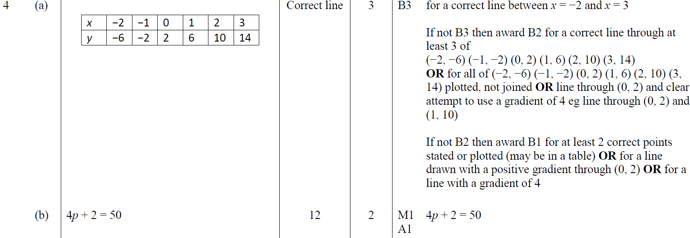
Substitution
Jan 2018 3HR Q4
A
B

