Slide 1
Substitution
Substitution
Nov 2018 1H Q2

Slide 2
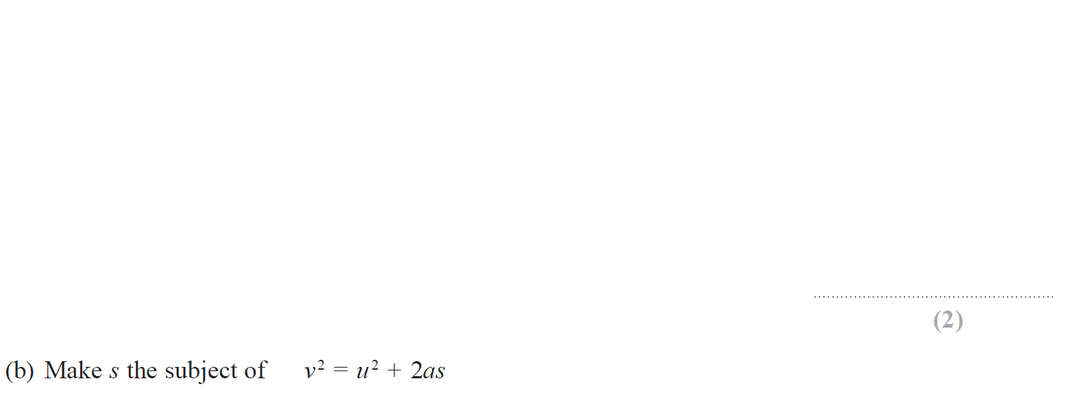
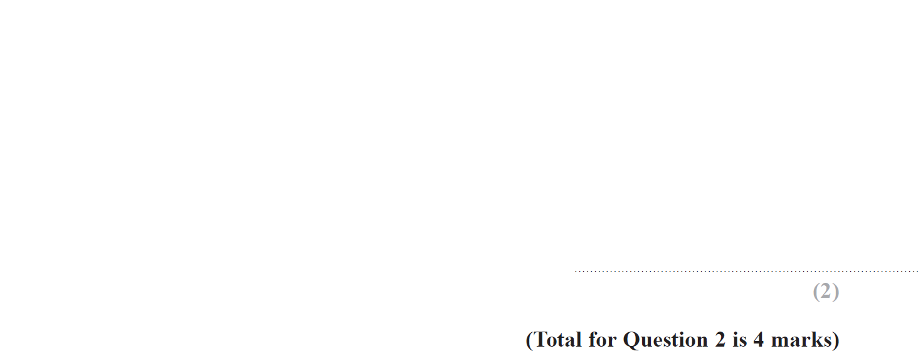
Substitution
Nov 2018 1H Q2

Slide 3
Substitution
Nov 2018 1H Q2
A
B

