Slide 1
Standard Form
Standard Form
May 2017
1H Q13
May 2018
1H Q12
SAM
1H Q15
June 2017
2H Q11
June 2018
2H Q2
1 Marker
SAM
2H Q12
June 2017
3H Q2
Nov 2018
2H Q12
Nov 2017
1H Q2

Slide 2
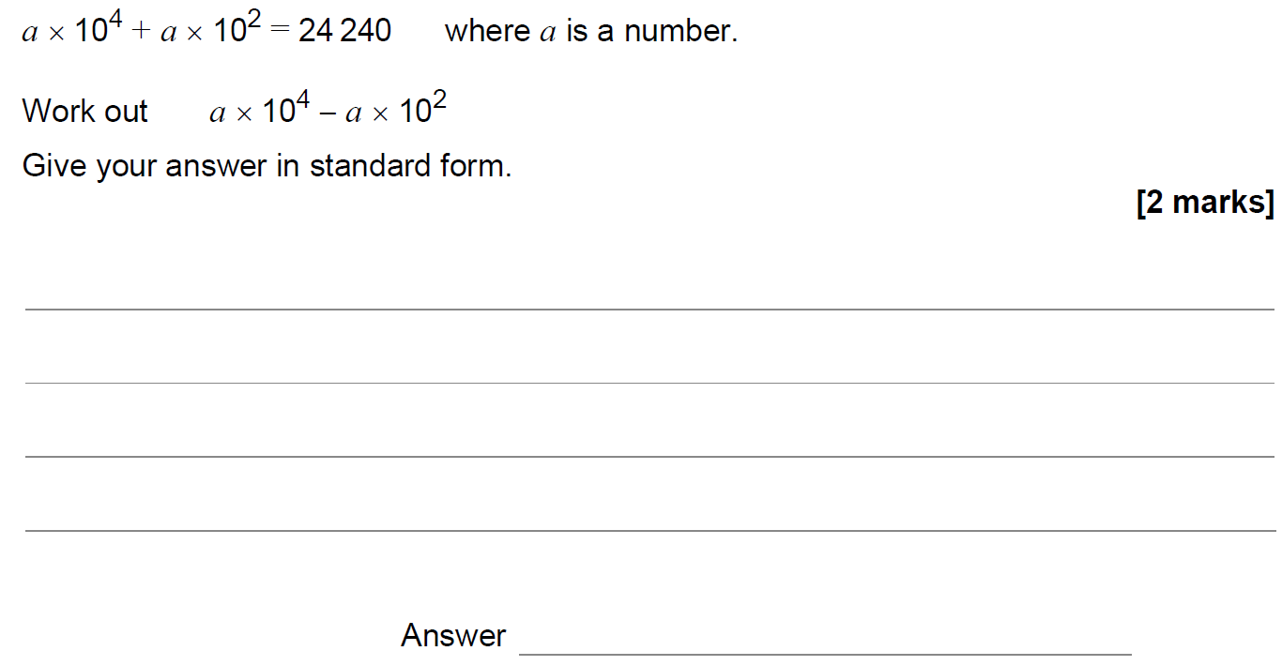
Standard Form
SAM 1H Q15

Slide 3
Standard Form
SAM 1H Q15
A

Slide 4
Standard Form
SAM 2H Q12

Slide 5
Standard Form
SAM 2H Q12
A

Slide 6
Standard Form
May 2017 1H Q13

Slide 7
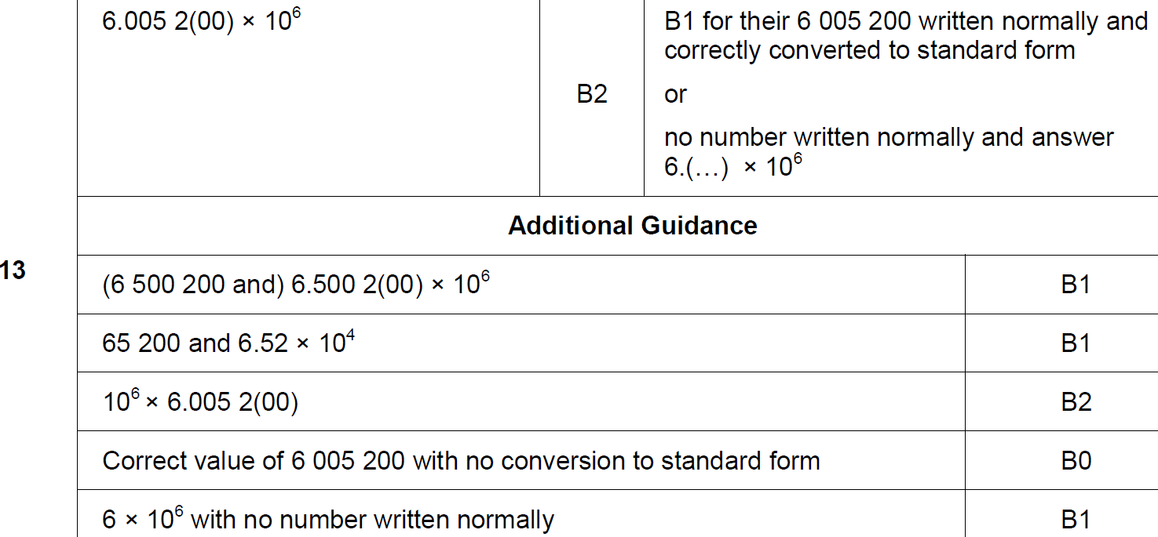
Standard Form
May 2017 1H Q13
A

Slide 8
Standard Form
June 2017 2H Q11

Slide 9
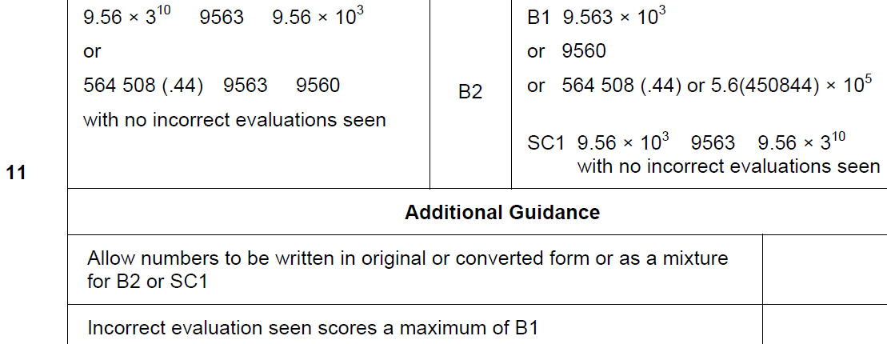
Standard Form
June 2017 2H Q11
A

Slide 10
Standard Form
June 2017 3H Q2

Slide 11
Standard Form
June 2017 3H Q2
A

Slide 12
Standard Form
Nov 2017 1H Q2

Slide 13
Standard Form
Nov 2017 1H Q2
A

Slide 14
Standard Form
May 2018 1H Q12

Slide 15
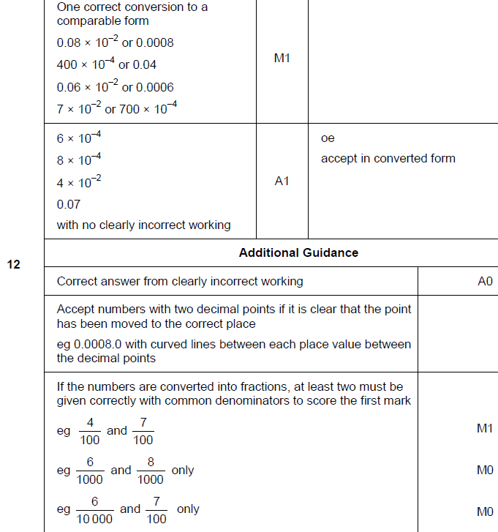
Standard Form
May 2018 1H Q12
A

Slide 16
Standard Form
June 2018 2H Q2

Slide 17
Standard Form
June 2018 2H Q2
A

Slide 18
Standard Form
Nov 2018 2H Q12

Slide 19
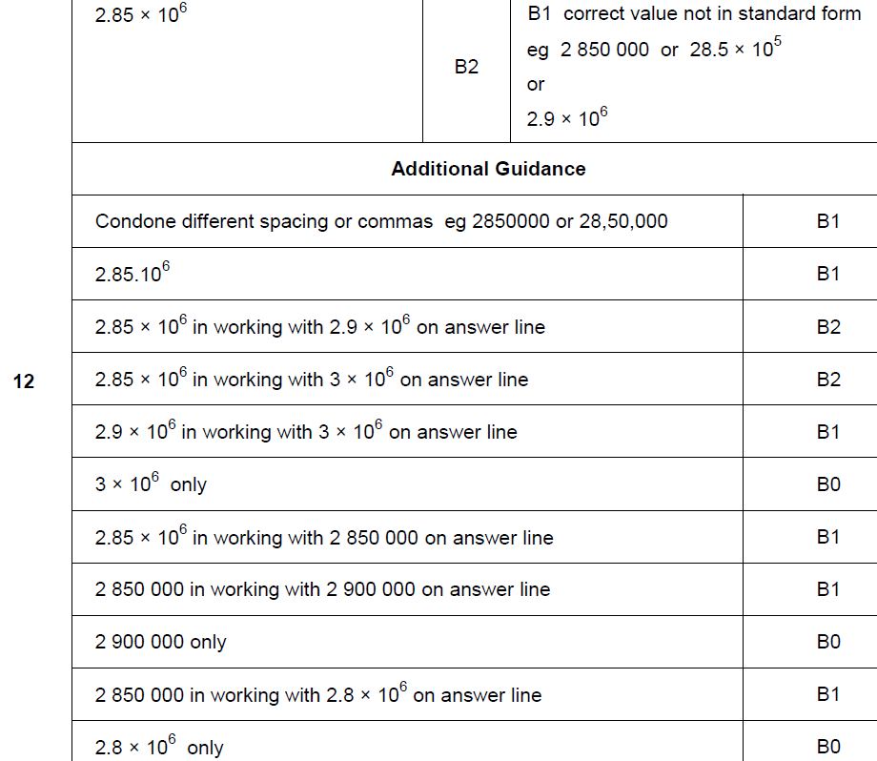
Standard Form
Nov 2018 2H Q12
A

