Slide 1
Standard Form
Standard Form
June 2017
3H Q1
Nov 2017
3H Q5
SAM
1H Q13
June 2018
2H Q1
Practice
3H Q6
Nov 2018
2H Q1
Nov 2018
3H Q3

Slide 2
Standard Form
SAM 1H Q13

Slide 3
Standard Form
SAM 1H Q13
A

Slide 4
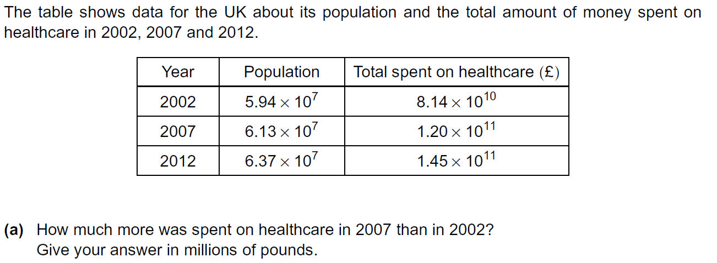
Standard Form
Practice 3H Q6

Slide 5
Standard Form
Practice 3H Q6
A
B

Slide 6
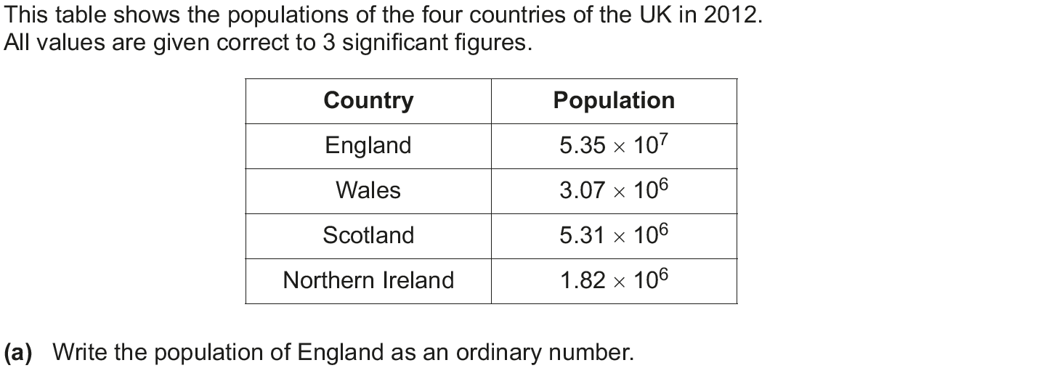
Standard Form
June 2017 3H Q1

Slide 7
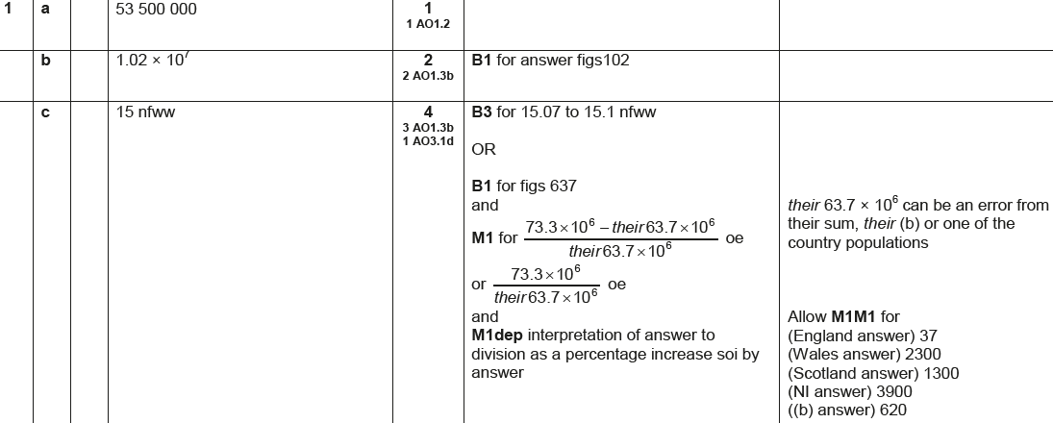
Standard Form
June 2017 3H Q1
A
B
C

Slide 8
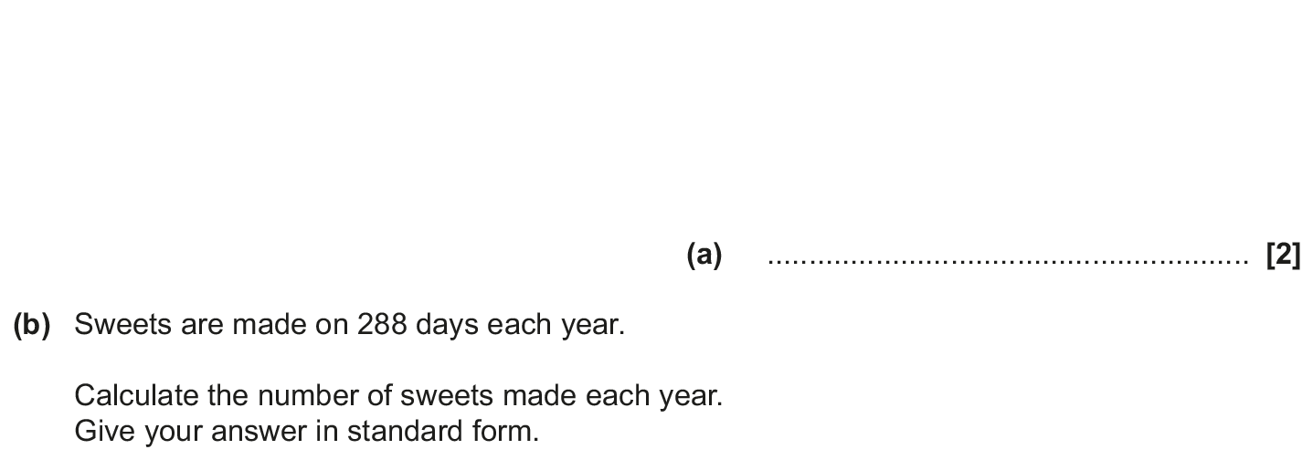
Standard Form
Nov 2017 3H Q5

Slide 9
Standard Form
Nov 2017 3H Q5
A
B
C (i)
C (ii)

Slide 10
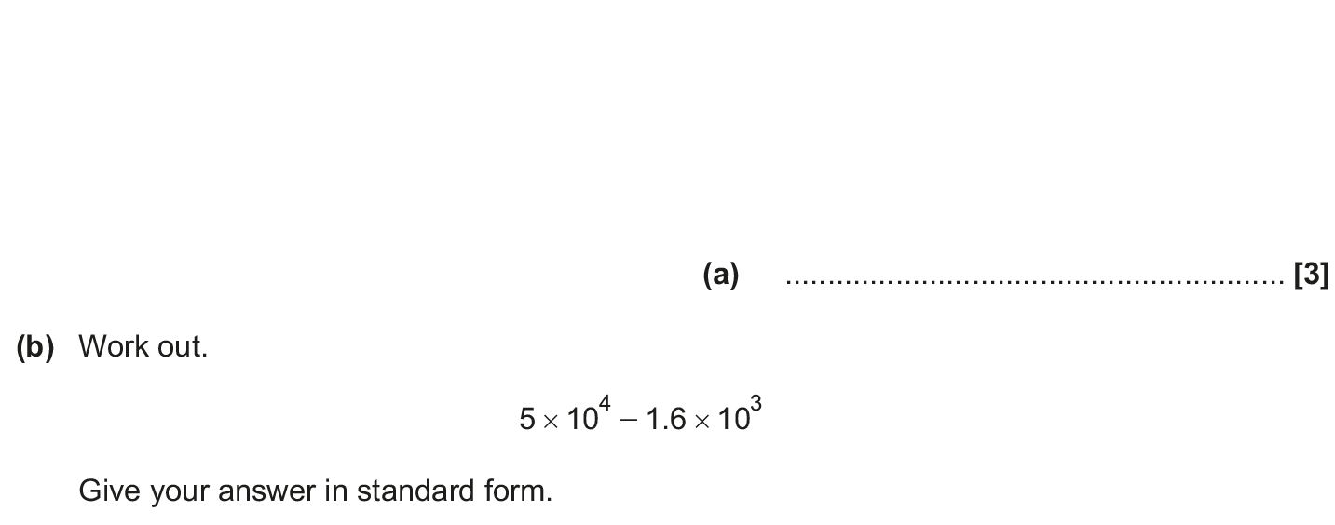
Standard Form
June 2018 2H Q1

Slide 11
Standard Form
June 2018 2H Q1
A
B

Slide 12
Standard Form
Nov 2018 2H Q1

Slide 13
Standard Form
Nov 2018 2H Q1
A
B

Slide 14
Standard Form
Nov 2018 3H Q3

Slide 15
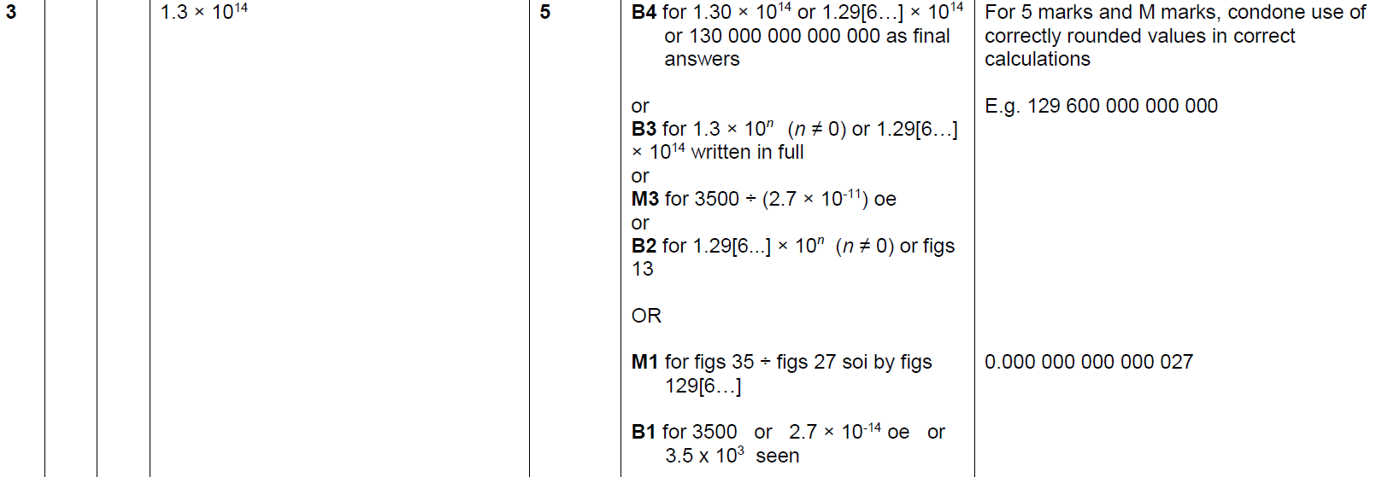
Standard Form
Nov 2018 3H Q3
A

