Slide 1
Standard Form
Standard Form
May 2017
1H Q8
SAM
1H Q9
June 2017
2H Q10
SAM
1H Q11
Nov 2017
3H Q7
SAM
3H Q8
June 2018
3H Q9
Spec 1
1H Q8
Nov 2018
2H Q7
Spec 1
3H Q19
May 2019
1H Q8
Spec 2
3H Q10
June 2019
2H Q8
June 2019
3H Q11

Slide 2
Standard Form
SAM 1H Q9

Slide 3
Standard Form
SAM 1H Q9
A

Slide 4
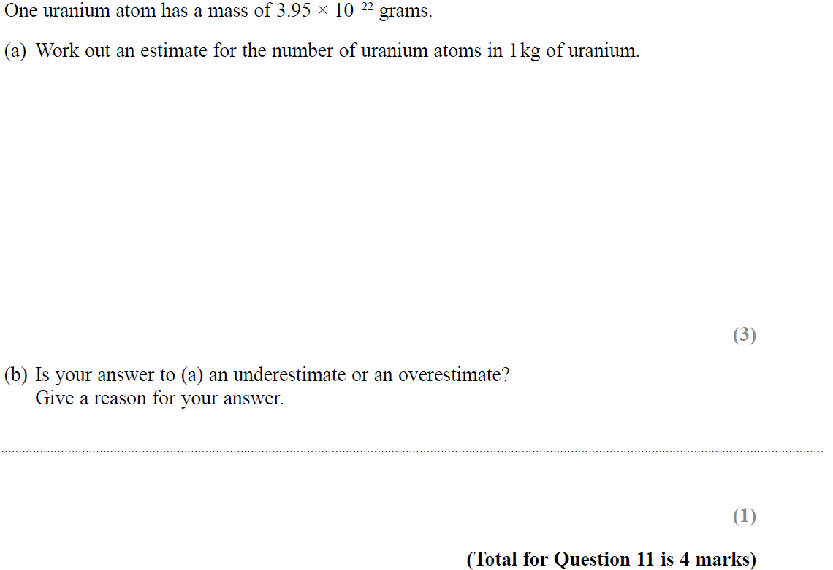
Standard Form
SAM 1H Q11

Slide 5
Standard Form
SAM 1H Q11
A
B

Slide 6
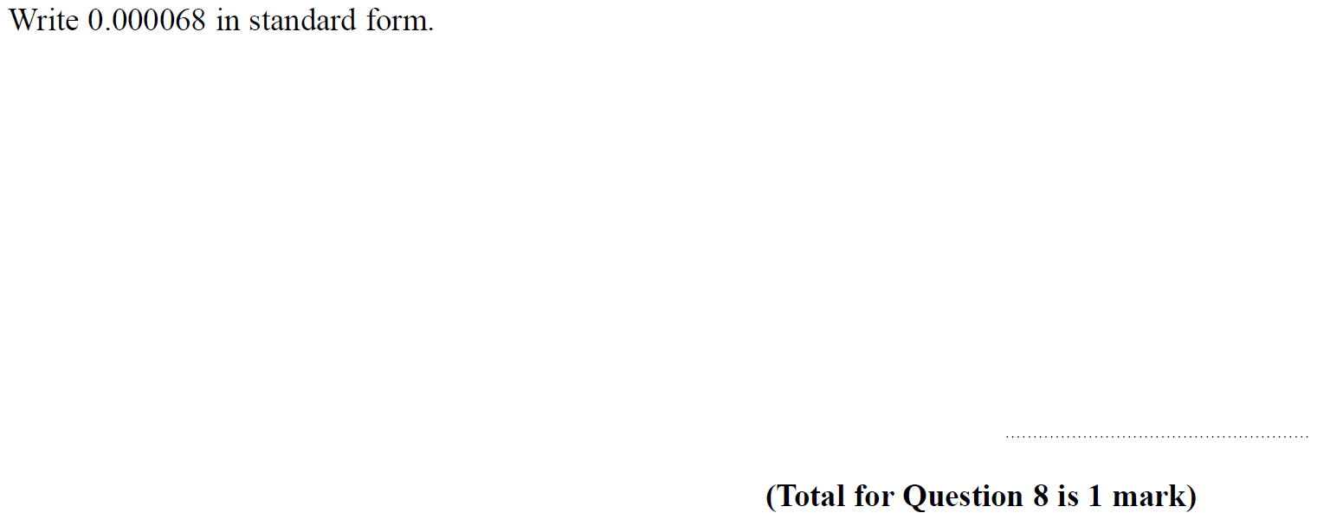
Standard Form
SAM 3H Q8

Slide 7
Standard Form
SAM 3H Q8
A

Slide 8
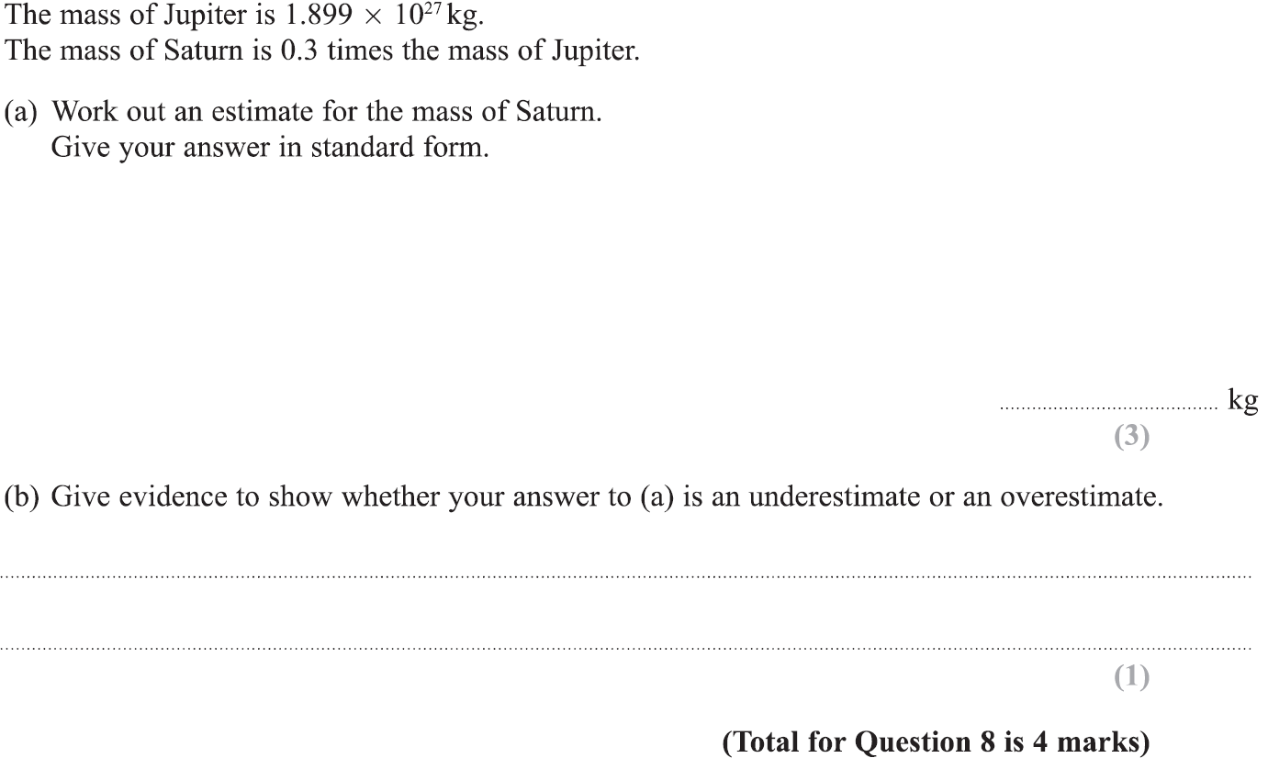
Standard Form
Specimen Set 1 1H Q8

Slide 9
Standard Form
Specimen Set 1 1H Q8
A
B

Slide 10
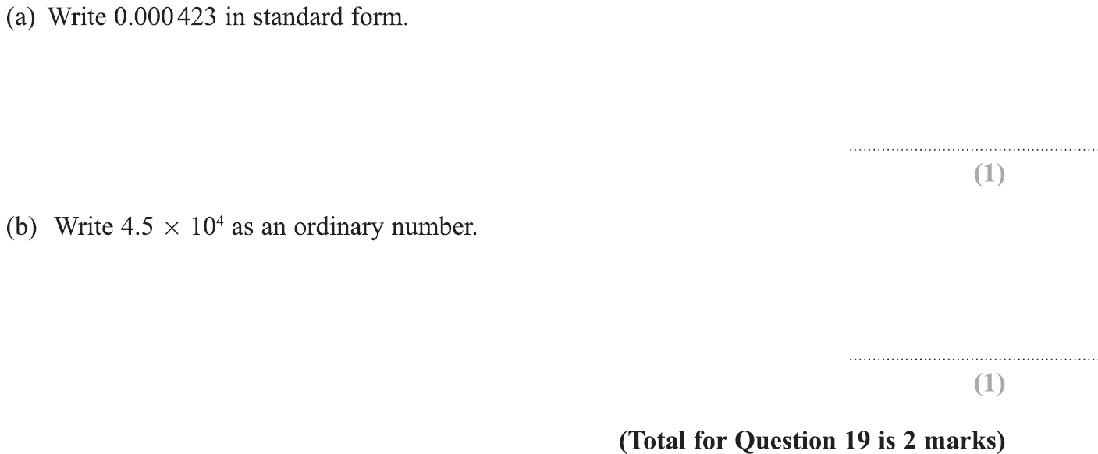
Standard Form
Specimen Set 1 3H Q19

Slide 11
Standard Form
Specimen Set 1 3H Q19
A
B

Slide 12
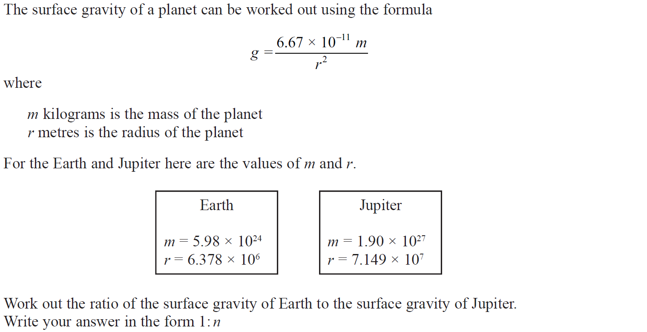
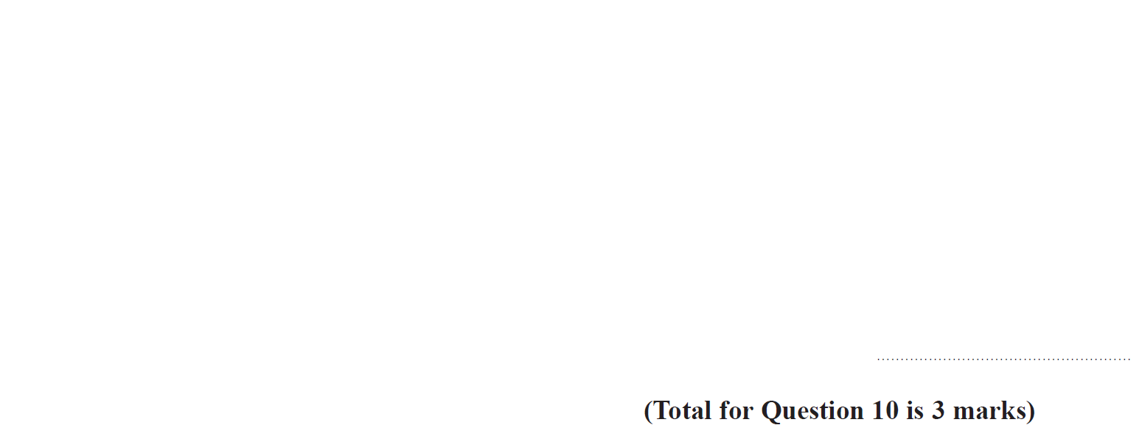
Standard Form
Specimen Set 2 3H Q10

Slide 13
Standard Form
Specimen Set 2 3H Q10
A

Slide 14
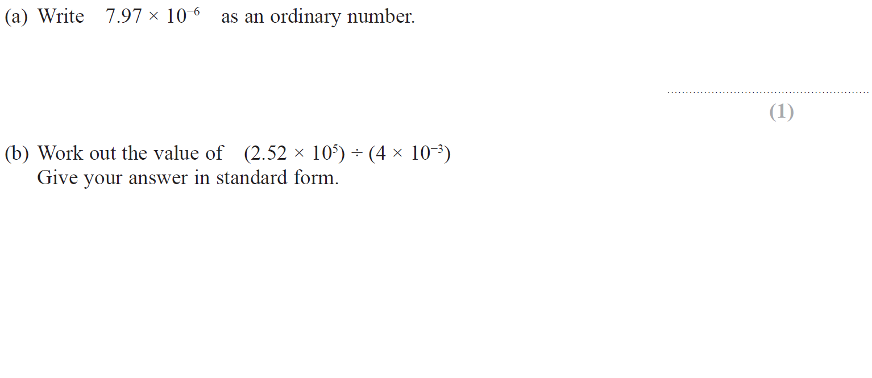
Standard Form
May 2017 1H Q8

Slide 15
Standard Form
June 2017 2H Q10
A
B

Slide 16
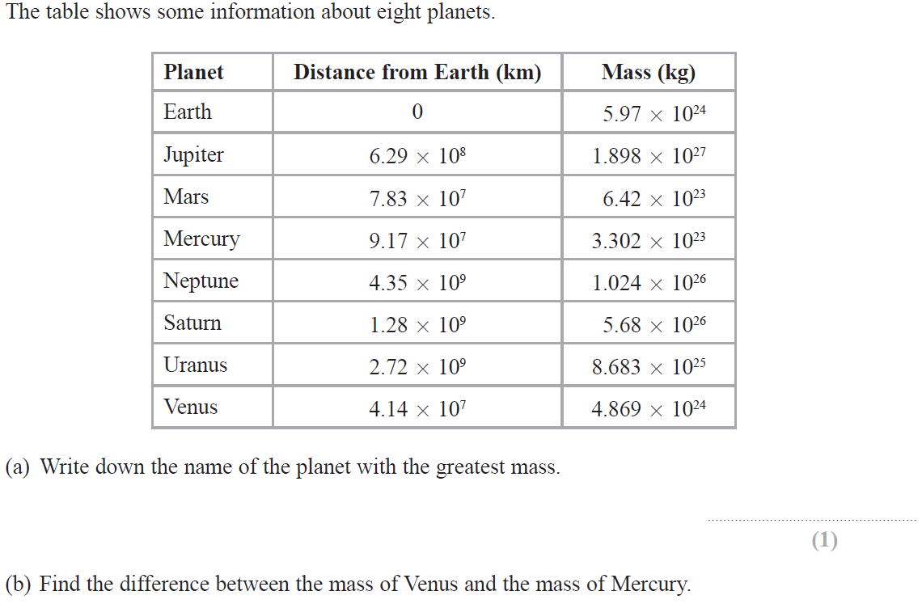
Standard Form
June 2017 2H Q10

Slide 17
Standard Form
June 2017 2H Q10
A
B
C

Slide 18
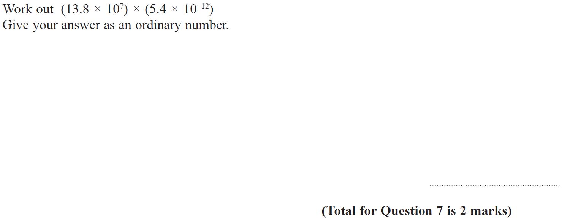
Standard Form
Nov 2017 3H Q7

Slide 19
Standard Form
Nov 2017 3H Q7
A

Slide 20
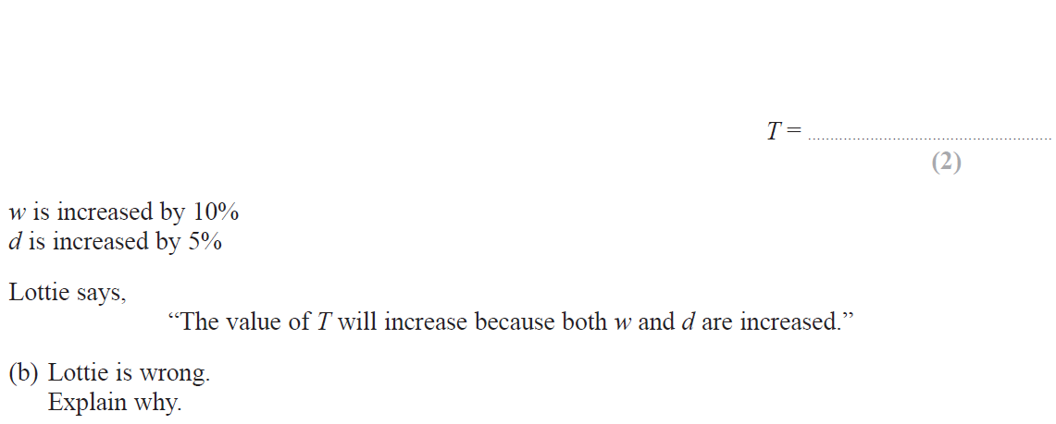
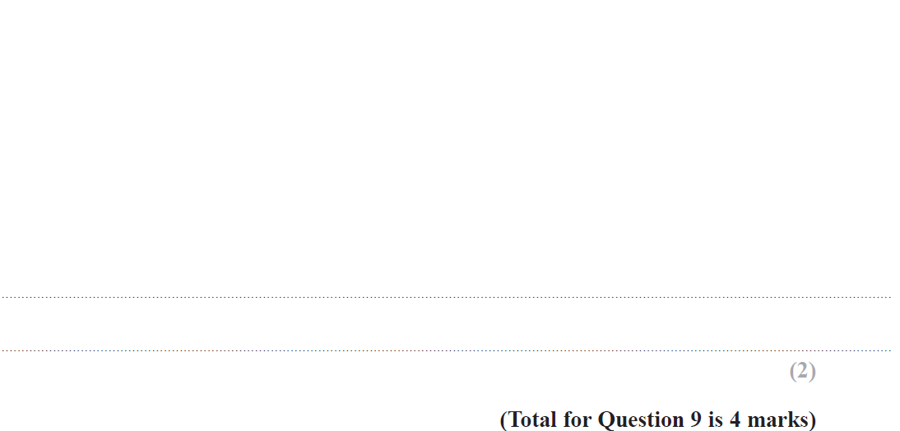
Standard Form
June 2018 3H Q9

Slide 21
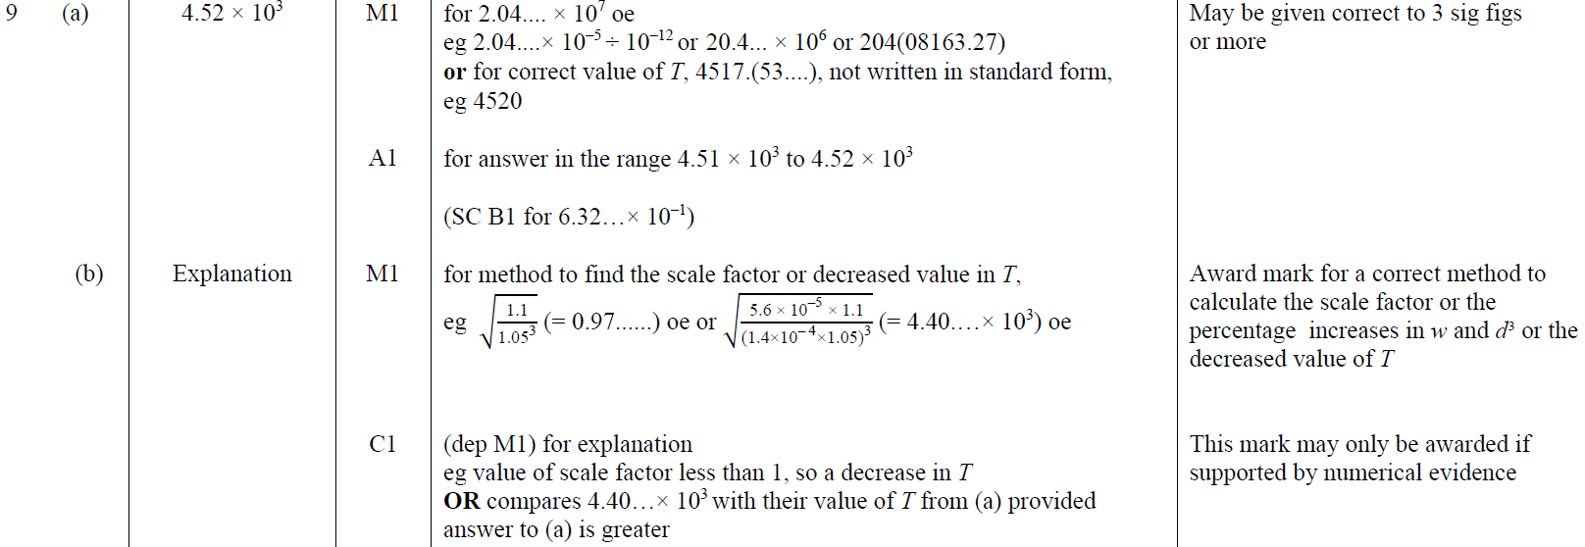
Standard Form
June 2018 3H Q9
A
B

Slide 22
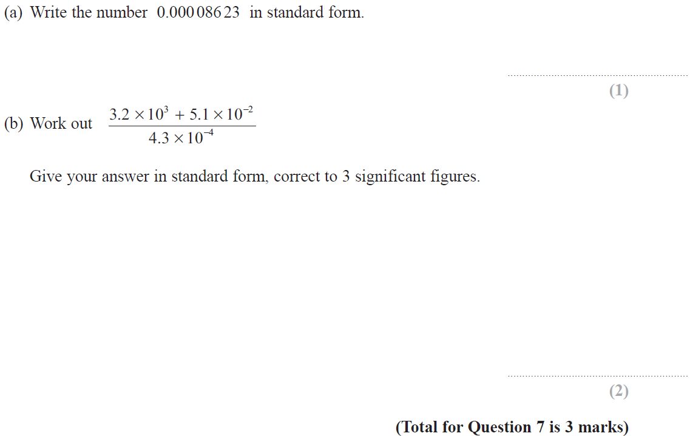
Standard Form
Nov 2018 2H Q7

Slide 23
Standard Form
Nov 2018 2H Q7
A
B

Slide 24
Standard Form
May 2019 1H Q8

Slide 25
Standard Form
May 2019 1H Q8
A
B
C
A SF
B SF
C SF

Slide 26
Standard Form
June 2019 2H Q8

Slide 27
Standard Form
June 2019 2H Q8
A
B
A SF
B SF

Slide 28
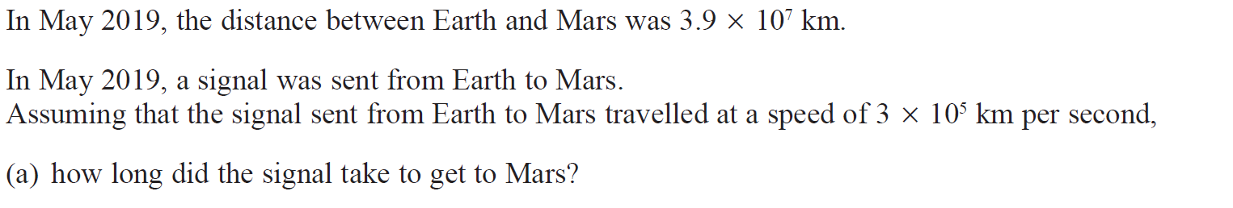
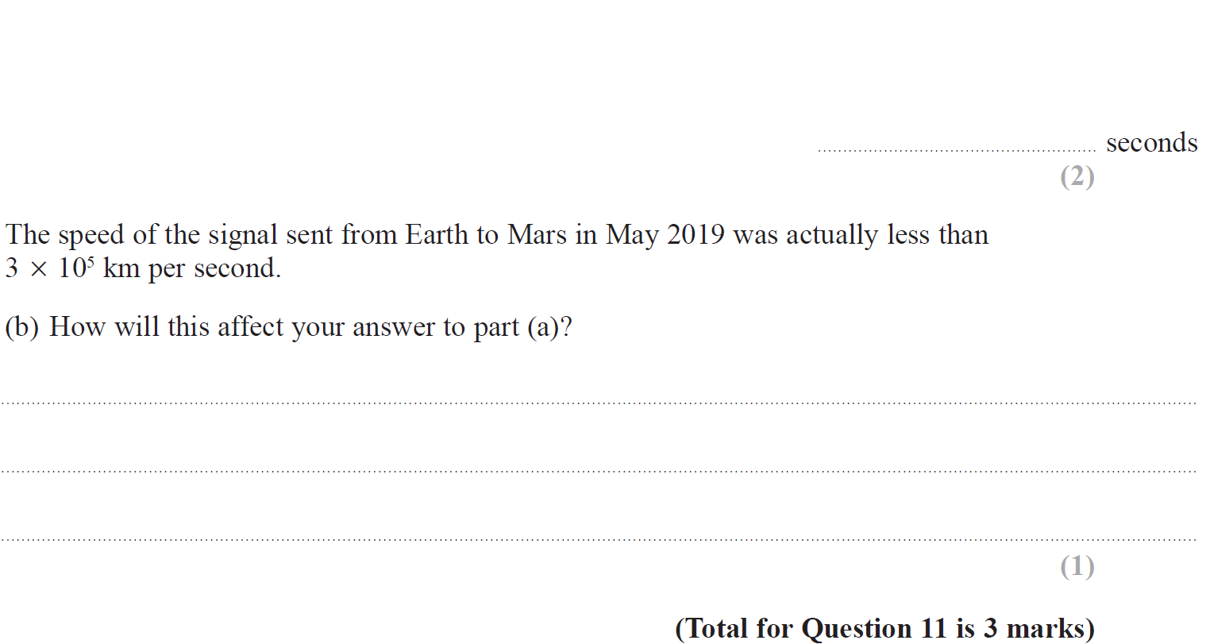
Standard Form
June 2019 3H Q11

Slide 29
Standard Form
June 2019 3H Q11
A
B
A SF
B SF

