Slide 1
Solving Simple Equations
Solving Simple Equations
Nov 2017 2H Q5
1 Marker

Slide 2
Solving Simple Equations
Nov 2017 2H Q5
Solve 4(3x − 2) = 2x − 5
[3 marks]

Slide 3
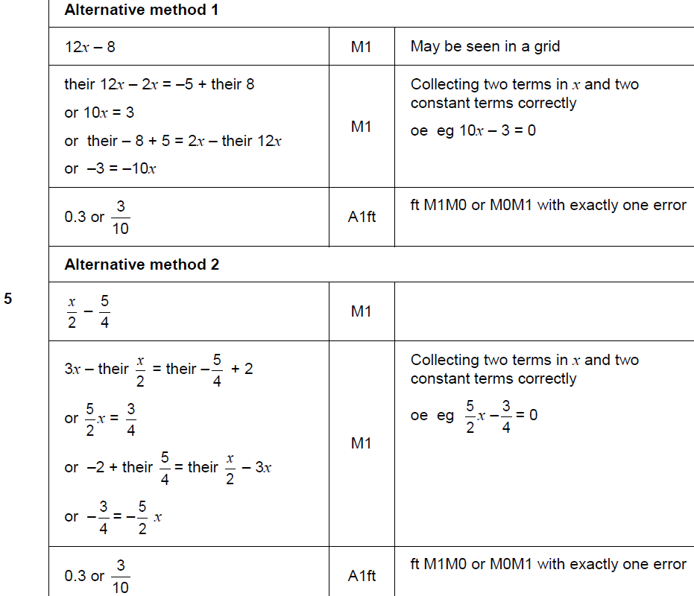
Solving Simple Equations
Nov 2017 2H Q5
A

Slide 4
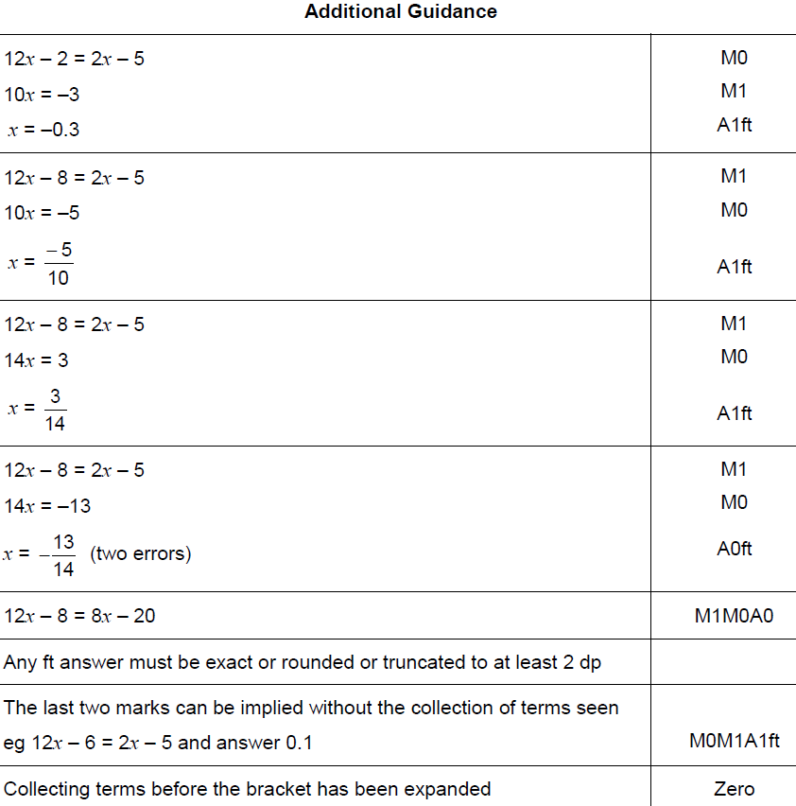
Solving Simple Equations
Nov 2017 2H Q5
A

