Slide 1
Solving Simple Equations
Solving Simple Equations
Old Spec Q’s
SAM
2H Q4
May 2018
1H Q3
June 2018
2HR Q4
Jan 2019
1H Q1
May 2019
1H Q12

Slide 2
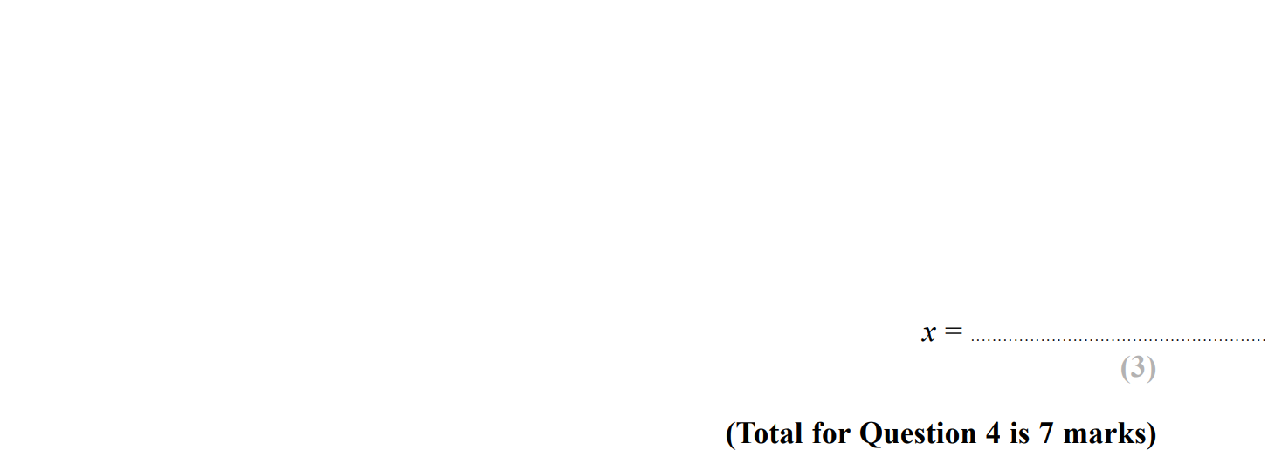
Solving Simple Equations
SAM 2H Q4

Slide 3
Solving Simple Equations
SAM 2H Q4
A
B
C
D
E

Slide 4
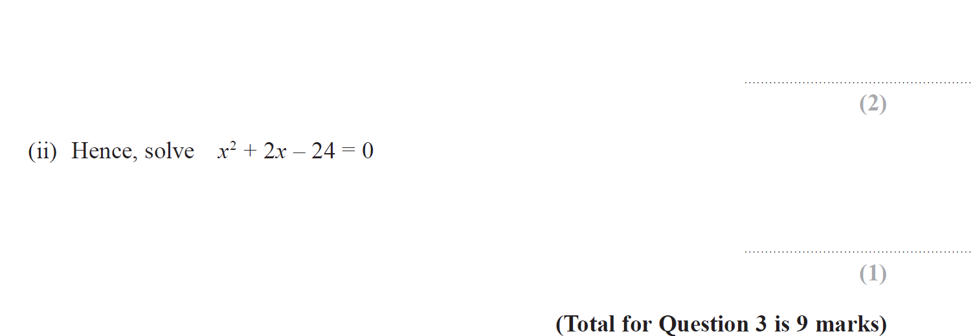
Solving Simple Equations
May 2018 1H Q3

Slide 5
Solving Simple Equations
May 2018 1H Q3
A
B
C
D (i)
D (ii)

Slide 6
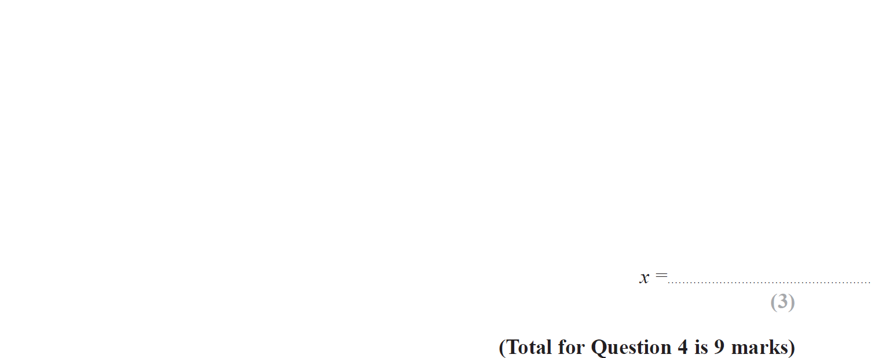
Solving Simple Equations
June 2018 2HR Q4

Slide 7
Solving Simple Equations
June 2018 2HR Q4
A
B
C
D

Slide 8
Solving Simple Equations
Jan 2019 1H Q1

Slide 9
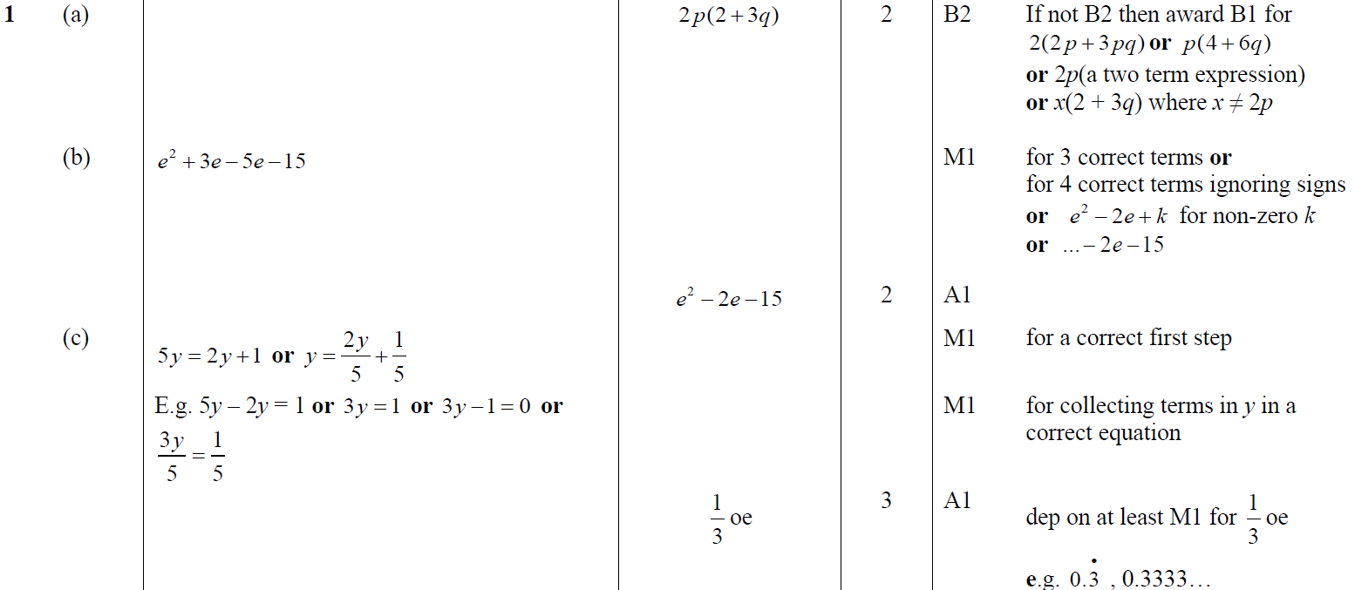
Solving Simple Equations
Jan 2019 1H Q1
A
B
C

Slide 10
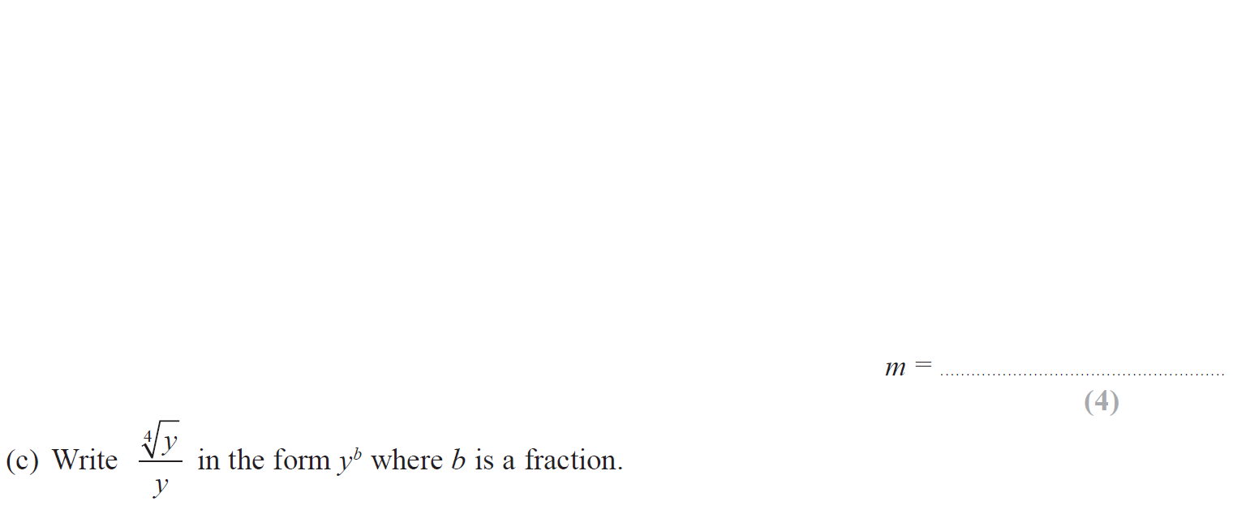
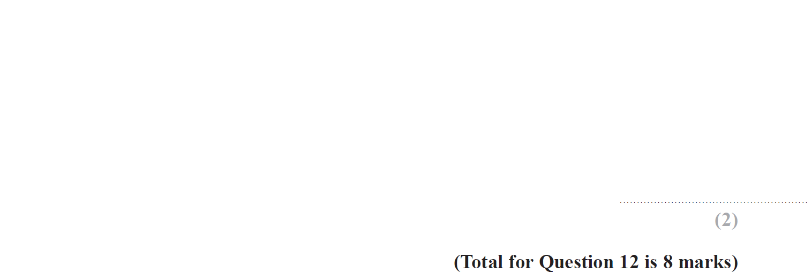
Solving Simple Equations
May 2019 1H Q12

Slide 11
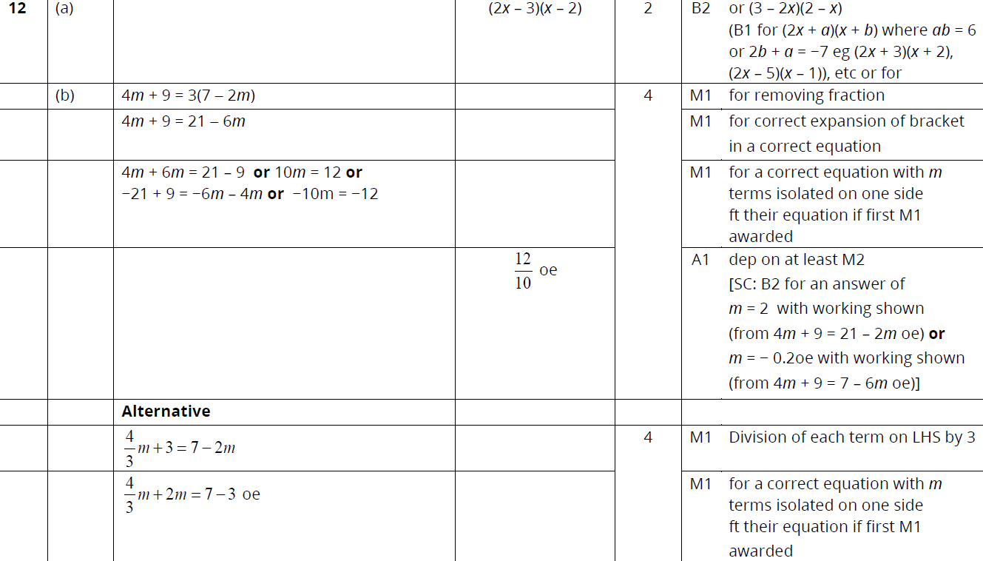
Solving Simple Equations
May 2019 1H Q12
A
B
C

Slide 12
Solving Simple Equations
Solving Simple Equations
New Spec Q’s
May 2004
4H Q11
Nov 2007
3H Q9
Nov 2009
3H Q9
May 2012 3H Q9
Jan 2015 3H Q6
June 2016 4HR Q2
Nov 2004
4H Q2
May 2008
3H Q9
Nov 2009
4H Q2
Jan 2013 4H Q10
Jan 2015 3HR Q4
Jan 2017 3H Q5
May 2005
3H Q2
May 2008
4H Q1
June 2010
3H Q4
May 2013 3H Q3
June 2015 4H Q7
Jan 2017 4HR Q15
May 2005
4H Q1
Nov 2008
3H Q2
June 2010
4H Q1
May 2013 4H Q6
May 2015 3HR Q4
May 2017 3H Q14
Nov 2005
3H Q11
Nov 2008
4H Q6
Nov 2010
3H Q6
May 2013 3HR Q4
June 2015 4HR Q9
June 2017 4H Q2
May 2006
3H Q2
Nov 2008
4H Q13
June 2011 3H Q3
Jan 2014 4H Q3
Jan 2016 3H Q8
May 2017 3HR Q2
May 2006
4H Q8
May 2009
3H Q5
June 2011 4H Q5
Jan 2014 3HR Q4
Jan 2016 4H Q9
June 2017 4HR Q5
May 2007
3H Q9
June 2009
4H Q9
June 2011 4H Q15
May 2014 4H Q9
Jan 2016 4HR Q6
Jan 2018 3H Q5
May 2007
4H Q3
Nov 2009
3H Q2
Jan 2012 4H Q3
May 2014 3HR Q6
June 2016 4H Q2
May 2018 3H Q6

Slide 13
Solving Simple Equations
May 2004 4H Q11

Slide 14
Solving Simple Equations
May 2004 4H Q11
A

Slide 15
Solving Simple Equations
Nov 2004 4H Q2

Slide 16
Solving Simple Equations
Nov 2004 4H Q2
A

Slide 17
Solving Simple Equations
May 2005 3H Q2

Slide 18
Solving Simple Equations
May 2005 3H Q2
A

Slide 19
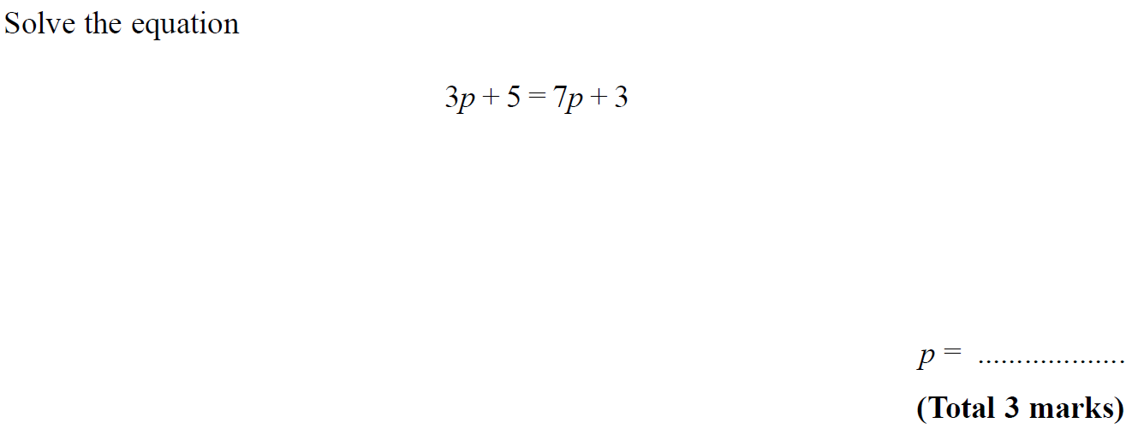
Solving Simple Equations
May 2005 4H Q1

Slide 20
Solving Simple Equations
May 2005 4H Q1
A

Slide 21
Solving Simple Equations
Nov 2005 3H Q11

Slide 22
Solving Simple Equations
Nov 2005 3H Q11
A

Slide 23
Solving Simple Equations
May 2006 3H Q2

Slide 24
Solving Simple Equations
May 2006 3H Q2
A

Slide 25
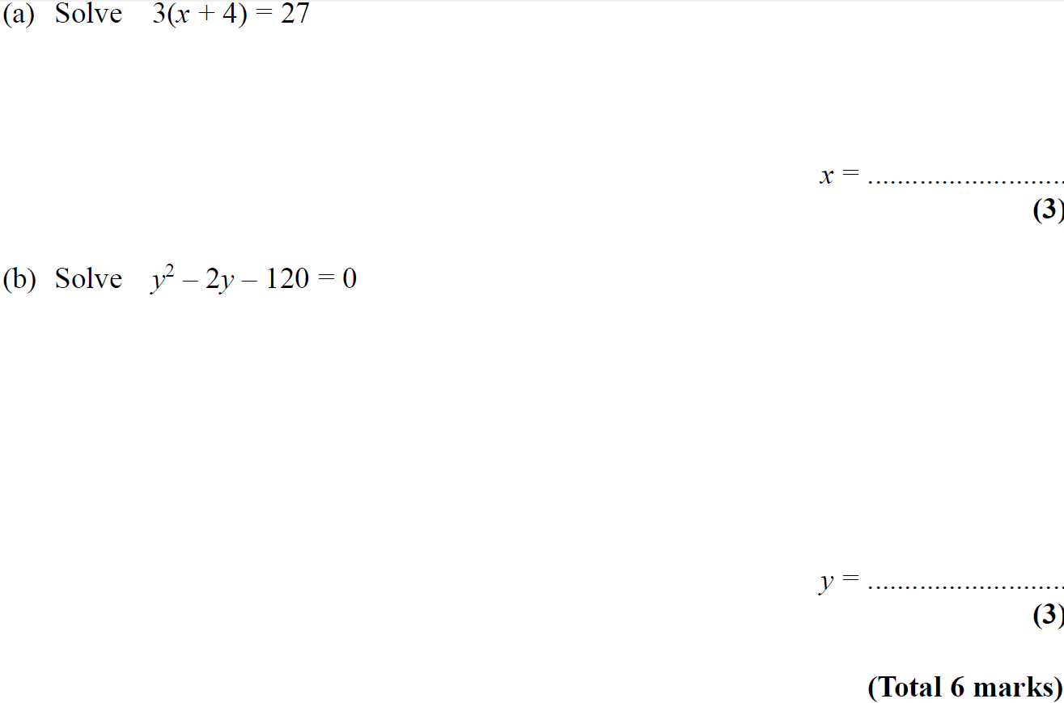
Solving Simple Equations
May 2006 4H Q8

Slide 26
Solving Simple Equations
May 2006 4H Q8
A
B

Slide 27
Solving Simple Equations
May 2007 3H Q9

Slide 28
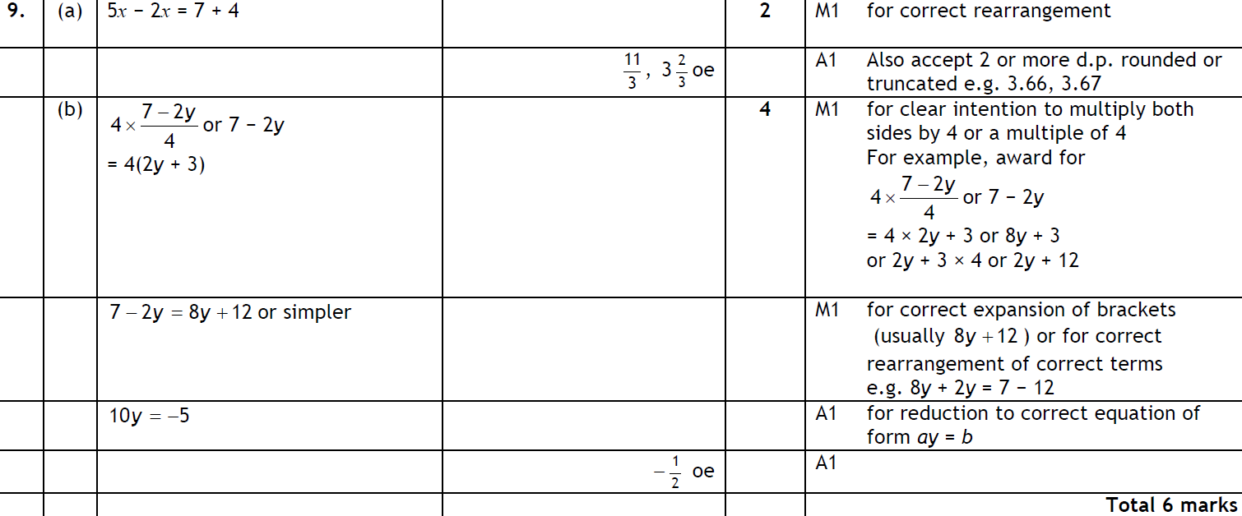
Solving Simple Equations
May 2007 3H Q9
A
B

Slide 29
Solving Simple Equations
May 2007 4H Q3

Slide 30
Solving Simple Equations
May 2007 4H Q3
A

Slide 31
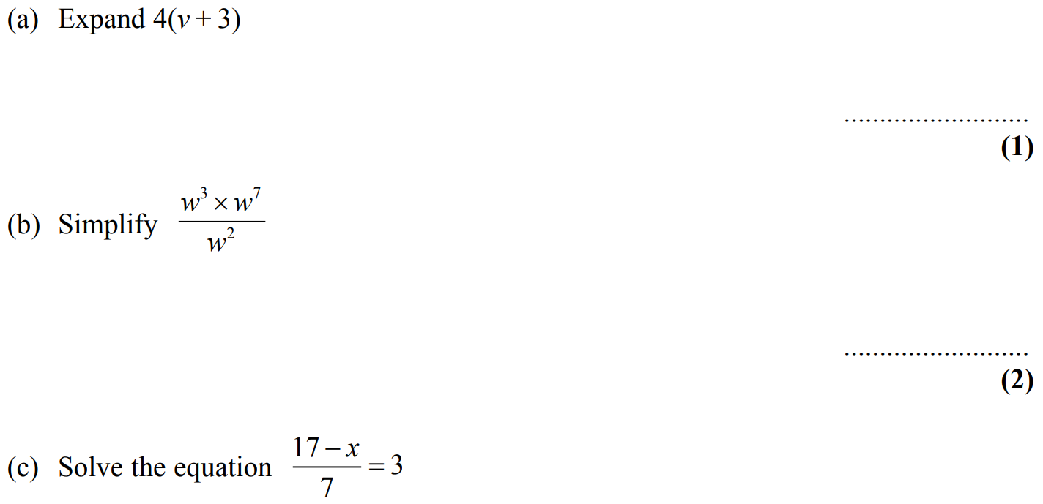
Solving Simple Equations
Nov 2007 3H Q9

Slide 32
Solving Simple Equations
Nov 2007 3H Q9
A
B
C
D

Slide 33
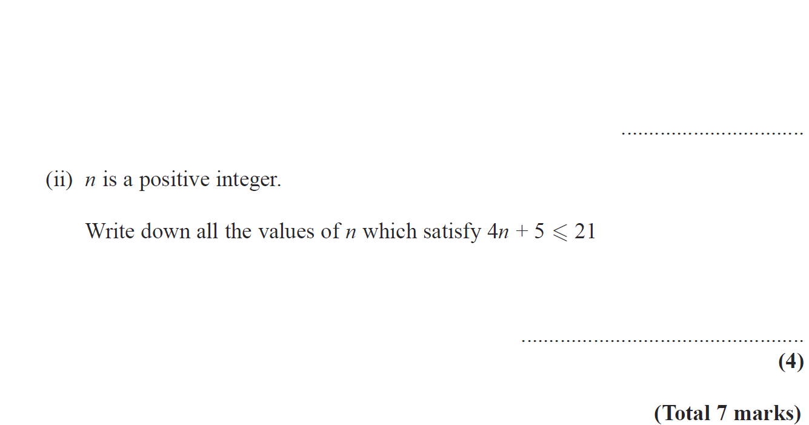
Solving Simple Equations
May 2008 3H Q9

Slide 34
Solving Simple Equations
May 2008 3H Q9
A
B (i)
B (ii)

Slide 35
Solving Simple Equations
May 2008 4H Q1

Slide 36
Solving Simple Equations
May 2008 4H Q1
A
B

Slide 37
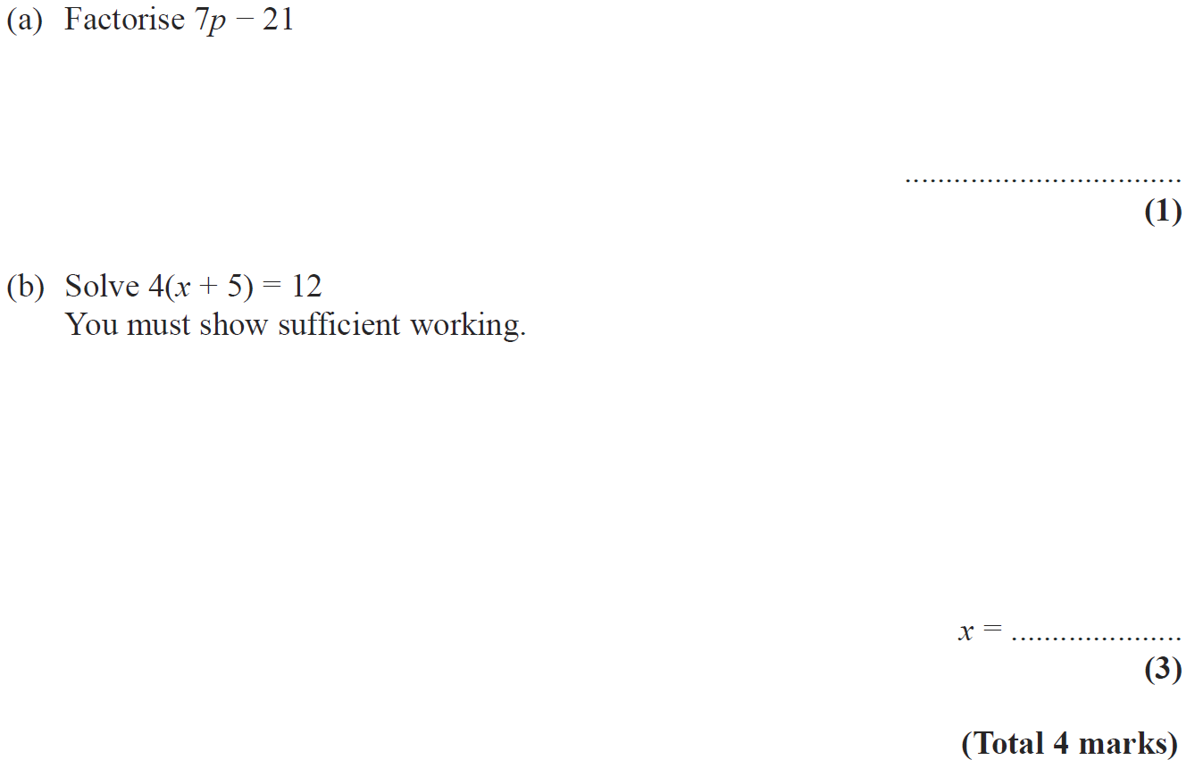
Solving Simple Equations
Nov 2008 3H Q2

Slide 38
Solving Simple Equations
Nov 2008 3H Q2
A
B

Slide 39
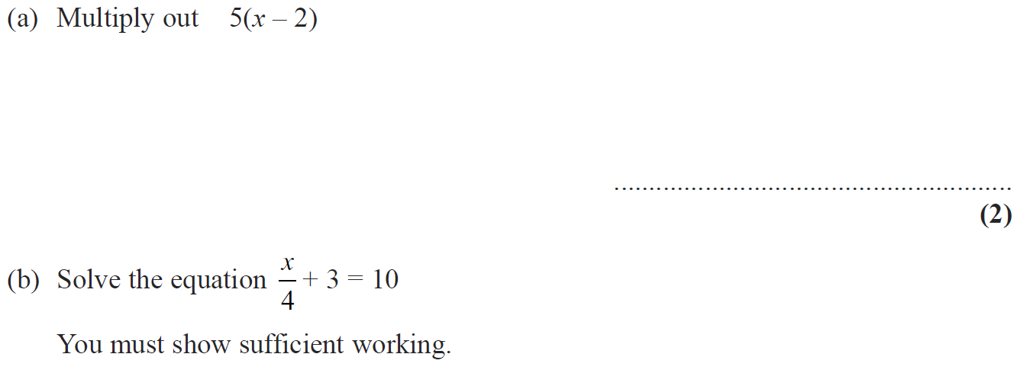
Solving Simple Equations
Nov 2008 4H Q6

Slide 40
Solving Simple Equations
Nov 2008 4H Q6
A
B
C

Slide 41
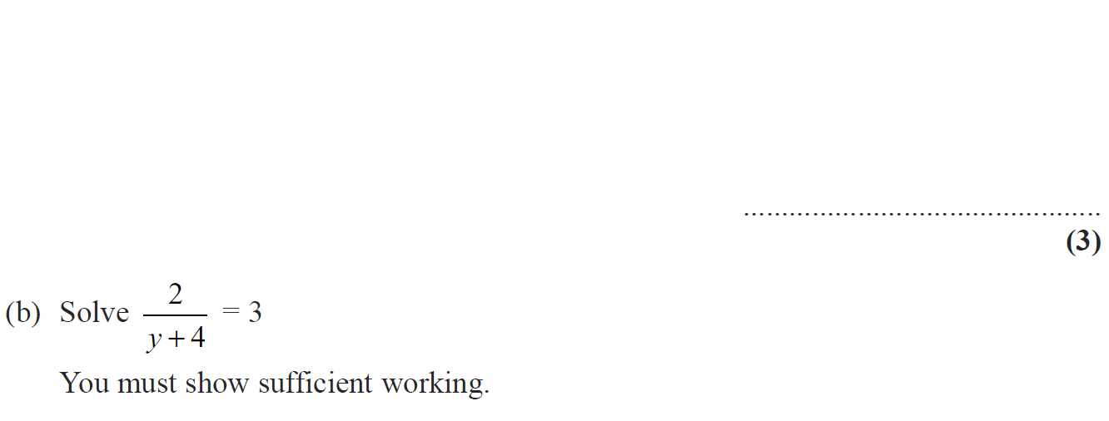
Solving Simple Equations
Nov 2008 4H Q13

Slide 42
Solving Simple Equations
Nov 2008 4H Q13
A
B

Slide 43
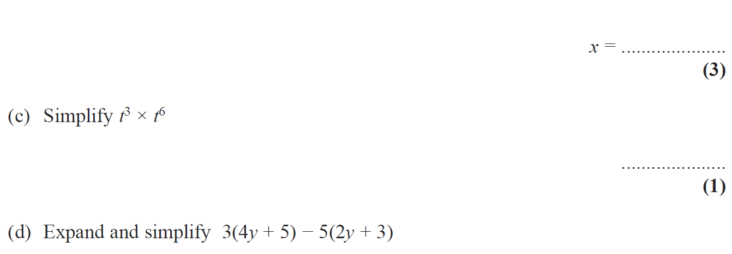
Solving Simple Equations
May 2009 3H Q5

Slide 44
Solving Simple Equations
May 2009 3H Q5
A
B
C
D

Slide 45
Solving Simple Equations
June 2009 4H Q9

Slide 46
Solving Simple Equations
June 2009 4H Q9
A

Slide 47
Solving Simple Equations
Nov 2009 3H Q2

Slide 48
Solving Simple Equations
Nov 2009 3H Q2
A

Slide 49
Solving Simple Equations
Nov 2009 3H Q9

Slide 50
Solving Simple Equations
Nov 2009 3H Q9
A
B
C

Slide 51
Solving Simple Equations
Nov 2009 4H Q2

Slide 52
Solving Simple Equations
Nov 2009 4H Q2
A
B

Slide 53
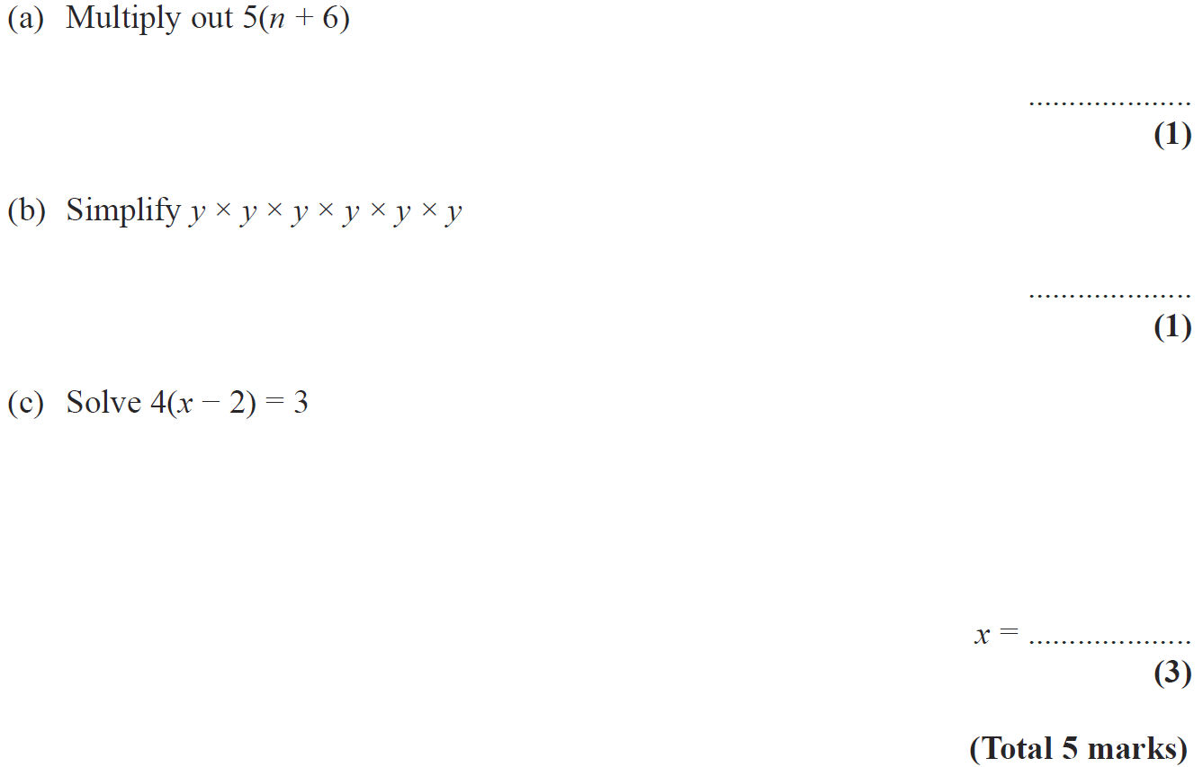
Solving Simple Equations
June 2010 3H Q4

Slide 54
Solving Simple Equations
June 2010 3H Q4
A
B
C

Slide 55
Solving Simple Equations
June 2010 4H Q1

Slide 56
Solving Simple Equations
June 2010 4H Q1
A

Slide 57
Solving Simple Equations
Nov 2010 3H Q6

Slide 58
Solving Simple Equations
Nov 2010 3H Q6
A
B

Slide 59
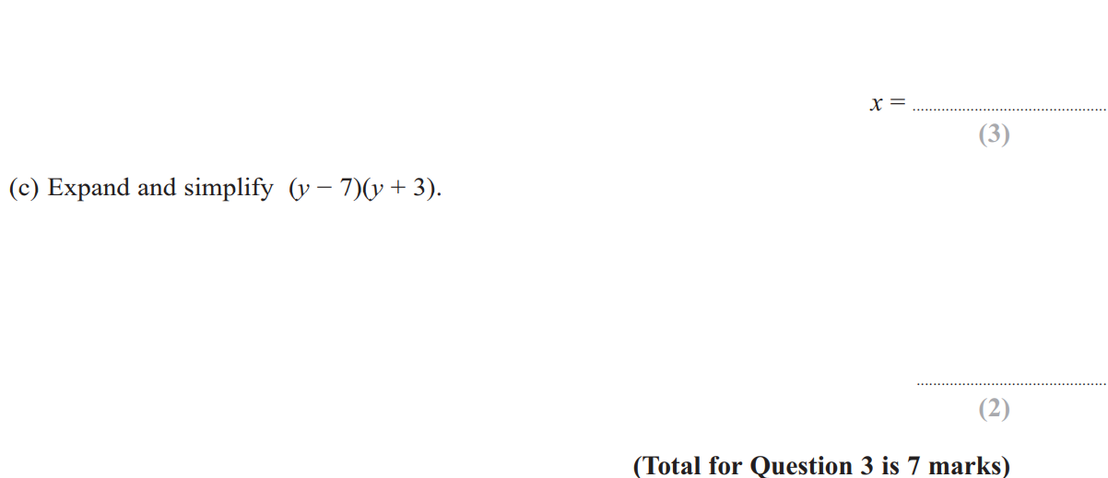
Solving Simple Equations
June 2011 3H Q3

Slide 60
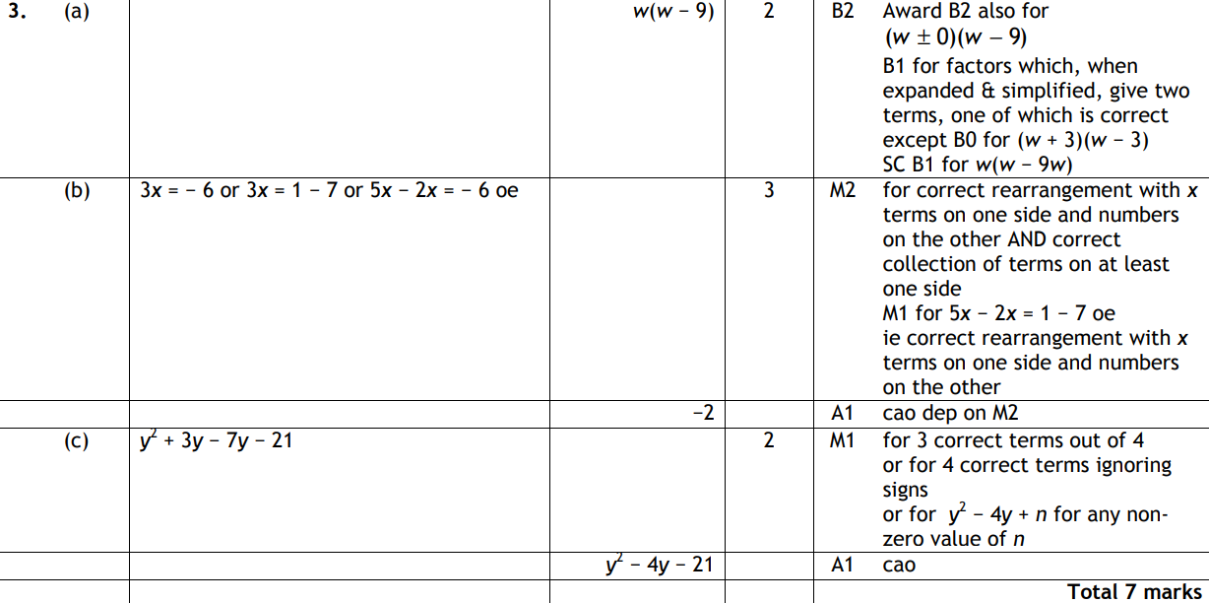
Solving Simple Equations
June 2011 3H Q3
A
B
C

Slide 61
Solving Simple Equations
June 2011 4H Q5

Slide 62
Solving Simple Equations
June 2011 4H Q5
A (i)
A (ii)
A (iii)
B
C

Slide 63
Solving Simple Equations
June 2011 4H Q15

Slide 64
Solving Simple Equations
June 2011 4H Q15
A
B
C
D

Slide 65
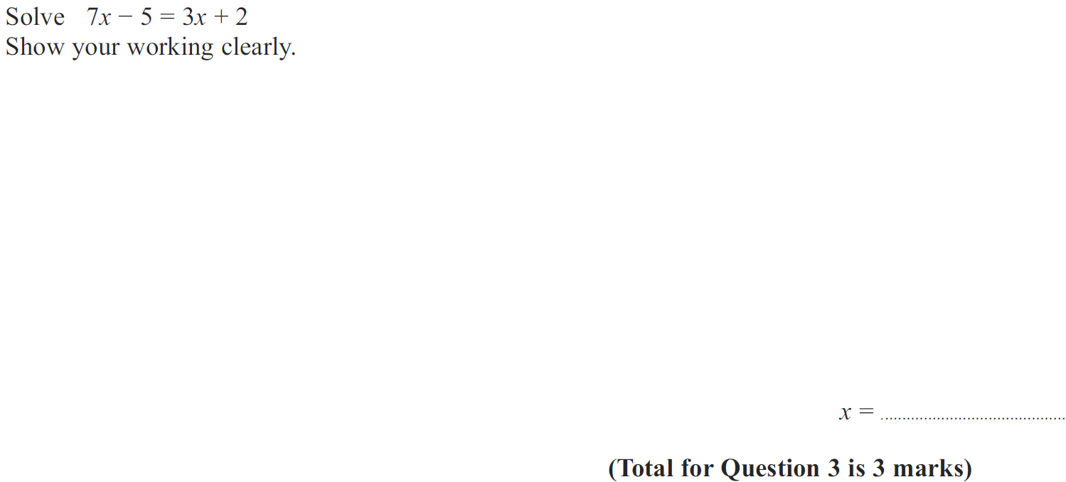
Solving Simple Equations
Jan 2012 4H Q3

Slide 66
Solving Simple Equations
Jan 2012 4H Q3
A

Slide 67
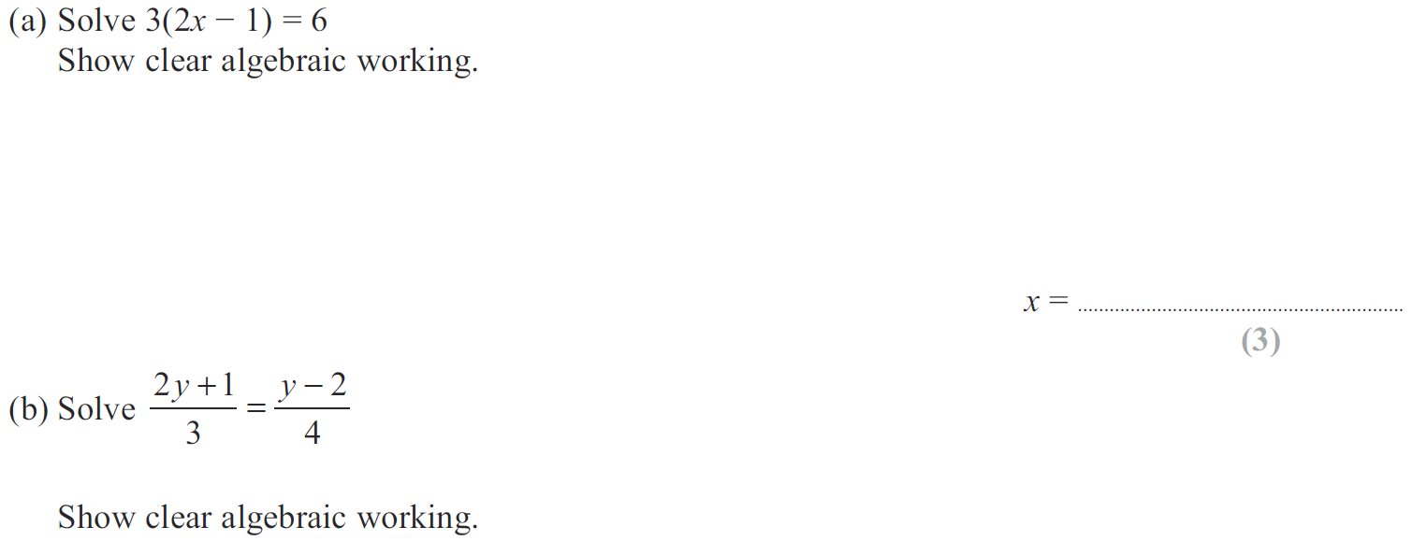
Solving Simple Equations
May 2012 3H Q9

Slide 68
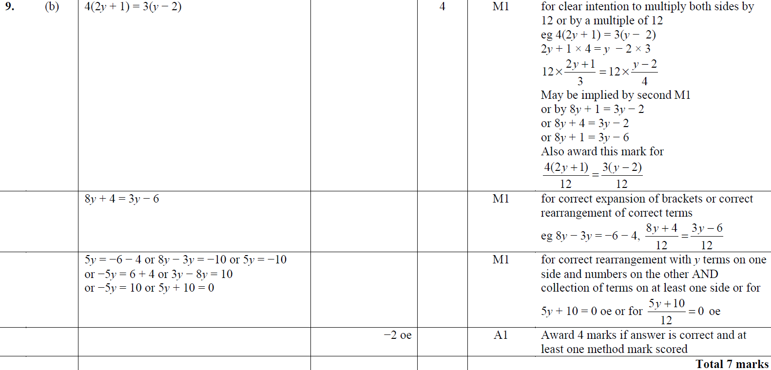
Solving Simple Equations
May 2012 3H Q9
A
B
B Alternative

Slide 69
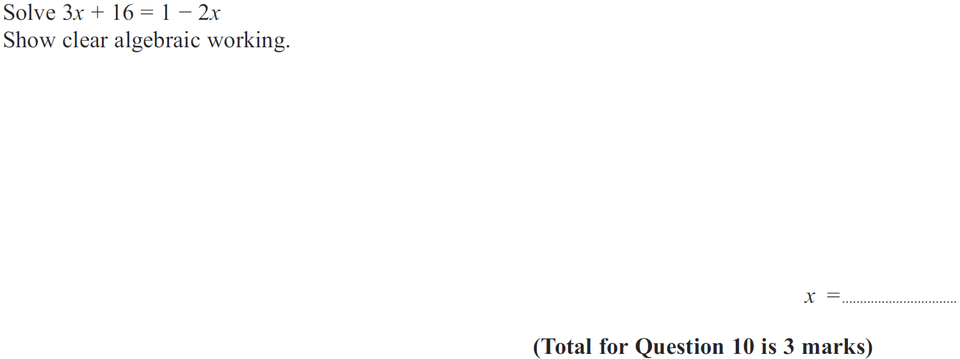
Solving Simple Equations
Jan 2013 4H Q10

Slide 70
Solving Simple Equations
Jan 2013 4H Q10
A

Slide 71
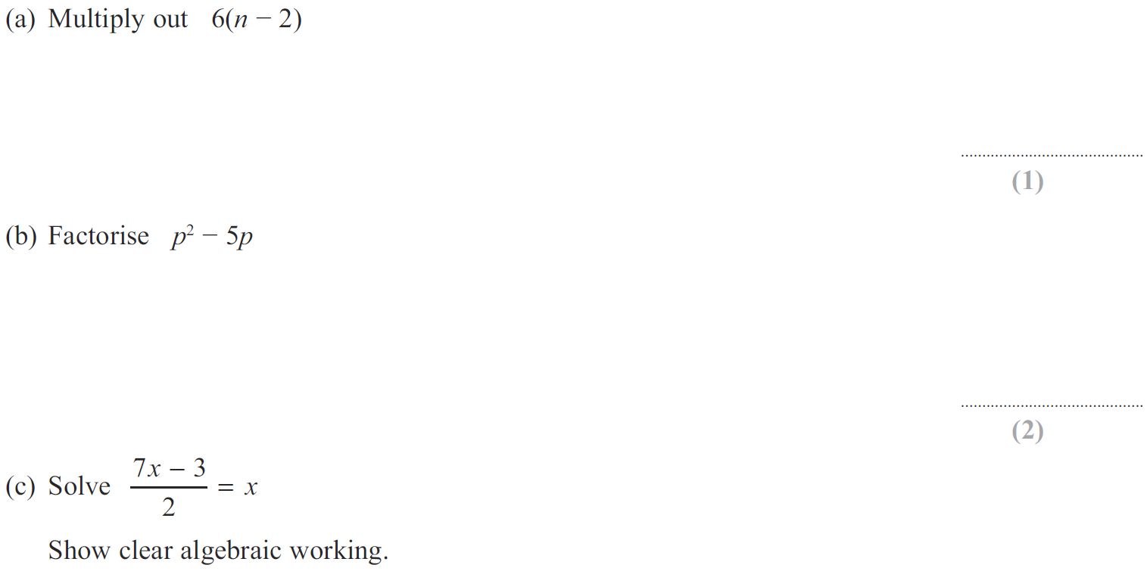
Solving Simple Equations
May 2013 3H Q3

Slide 72
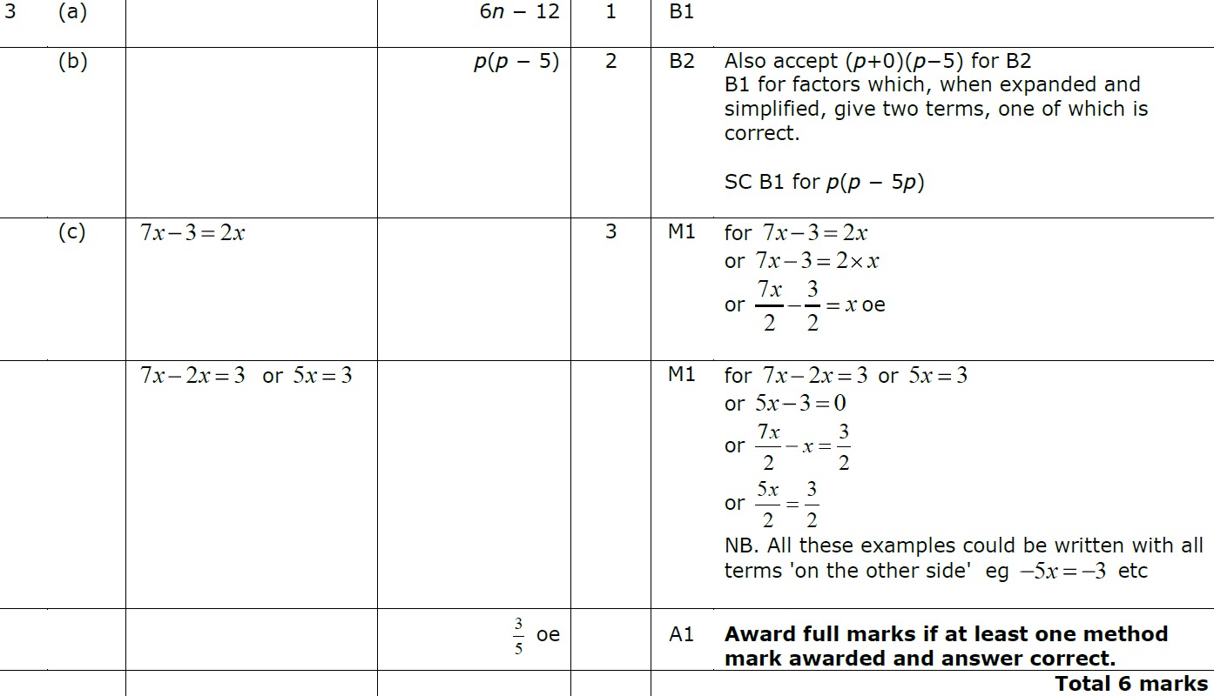
Solving Simple Equations
May 2013 3H Q3
A
B
C

Slide 73
Solving Simple Equations
May 2013 4H Q6

Slide 74
Solving Simple Equations
May 2013 4H Q6
A

Slide 75
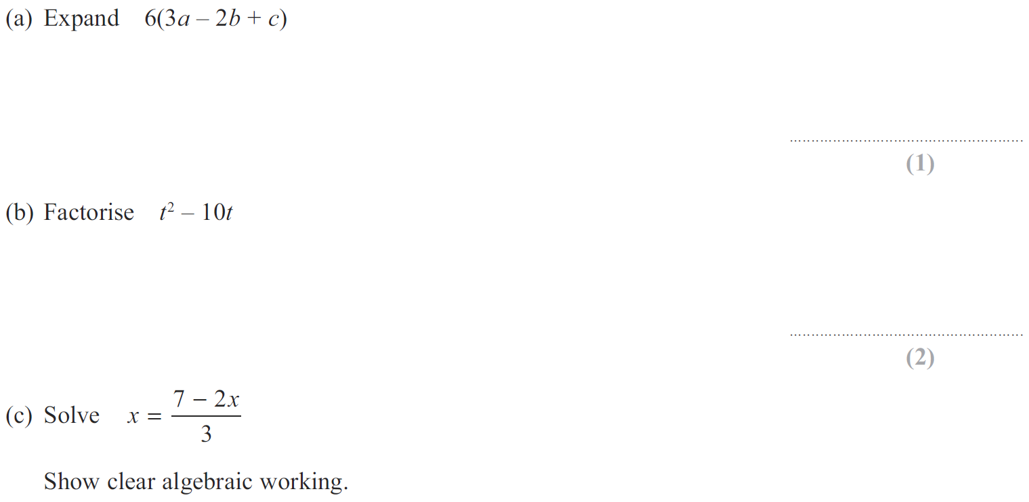
Solving Simple Equations
May 2013 3HR Q4

Slide 76
Solving Simple Equations
May 2013 3HR Q4
A
B
C

Slide 77
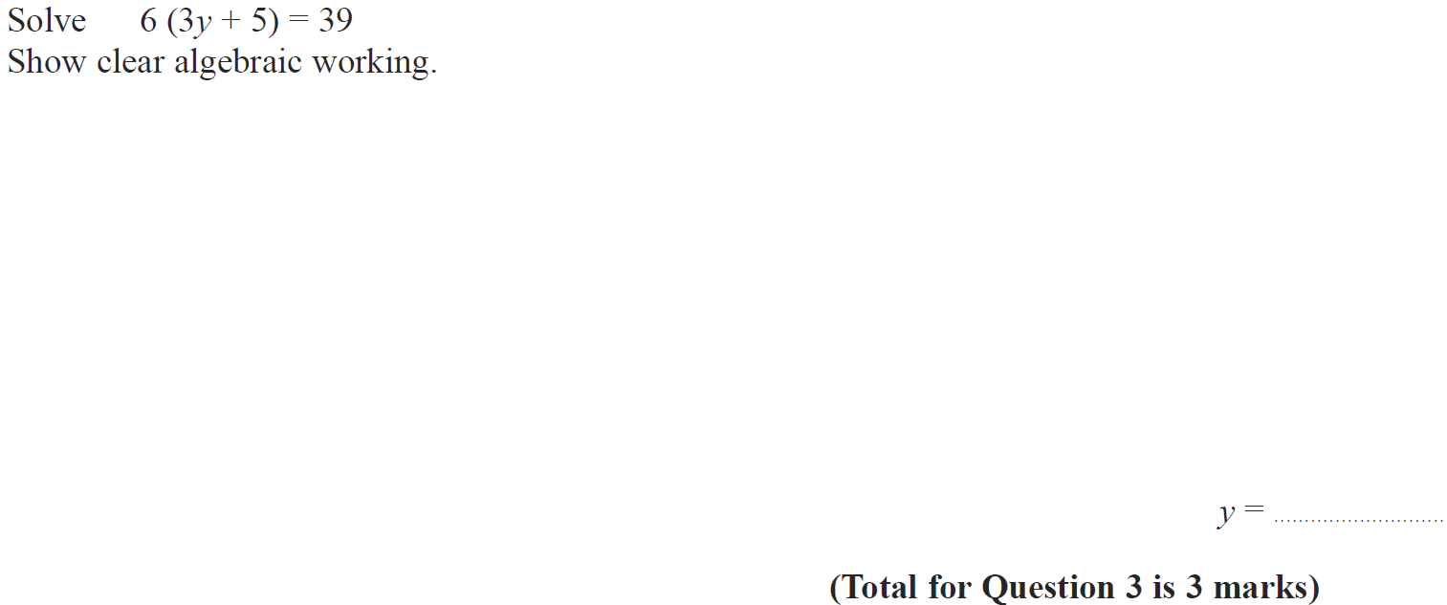
Solving Simple Equations
Jan 2014 4H Q3

Slide 78
Solving Simple Equations
Jan 2014 4H Q3
A

Slide 79
Solving Simple Equations
Jan 2014 3HR Q4

Slide 80
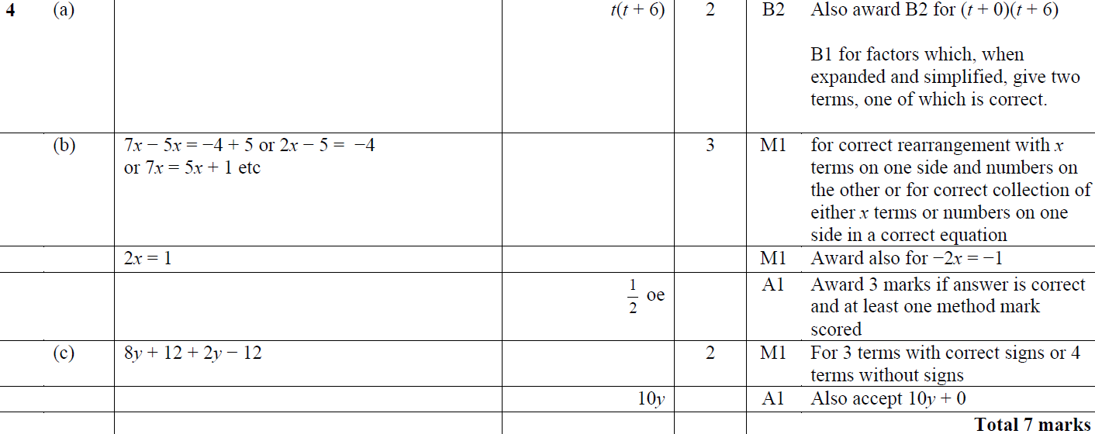
Solving Simple Equations
Jan 2014 3HR Q4
A
B
C

Slide 81
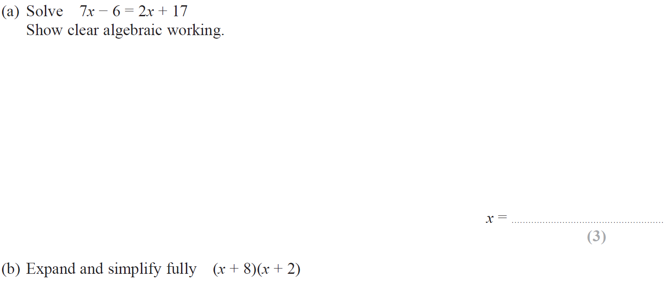
Solving Simple Equations
May 2014 4H Q9

Slide 82
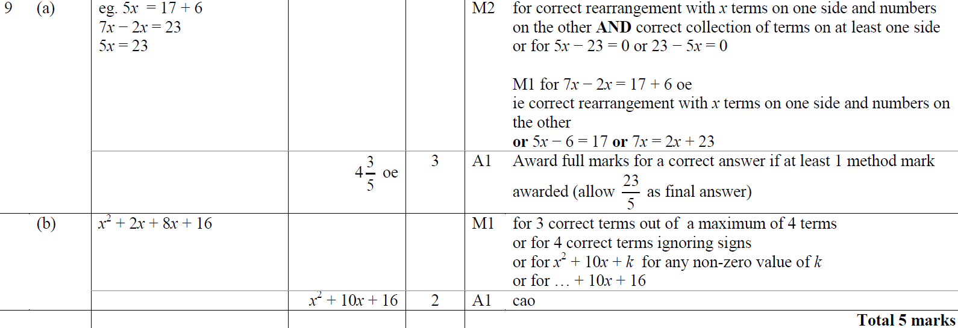
Solving Simple Equations
May 2014 4H Q9
A
B

Slide 83
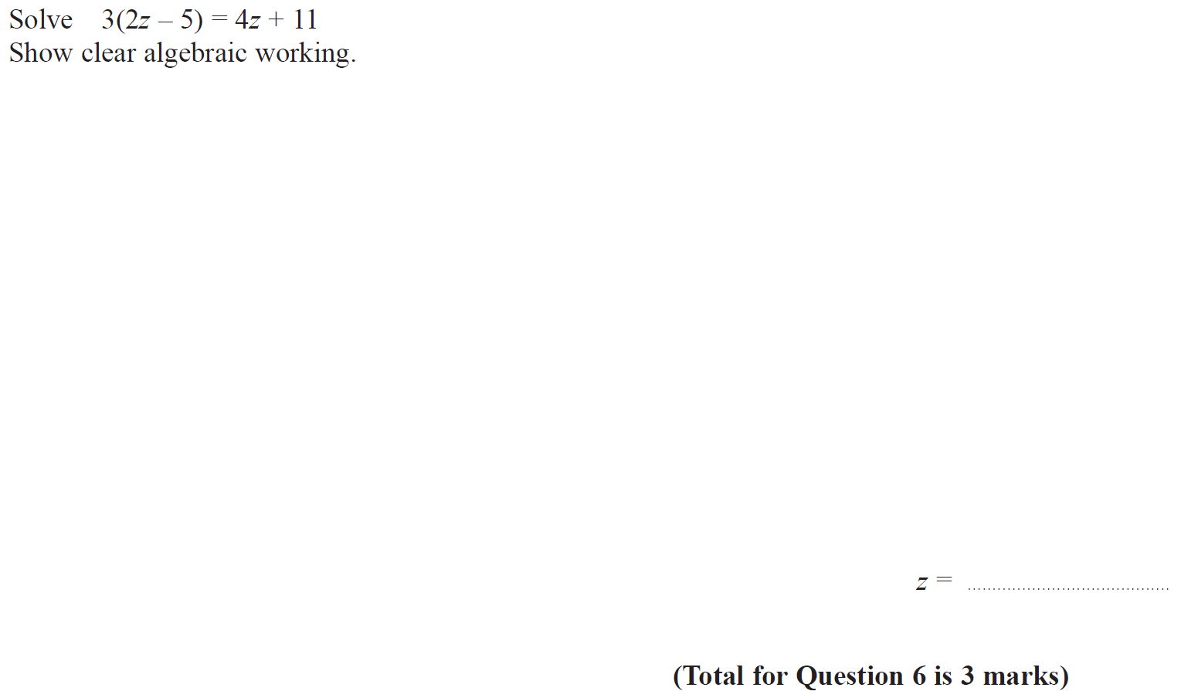
Solving Simple Equations
May 2014 3HR Q6

Slide 84
Solving Simple Equations
May 2014 3HR Q6
A

Slide 85
Solving Simple Equations
Jan 2015 3H Q6

Slide 86
Solving Simple Equations
Jan 2015 3H Q6
A

Slide 87
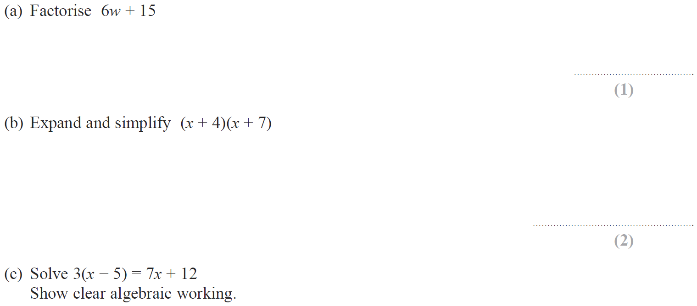
Solving Simple Equations
Jan 2015 3HR Q4

Slide 88
Solving Simple Equations
Jan 2015 3HR Q4
A
B
C

Slide 89
Solving Simple Equations
June 2015 4H Q7

Slide 90
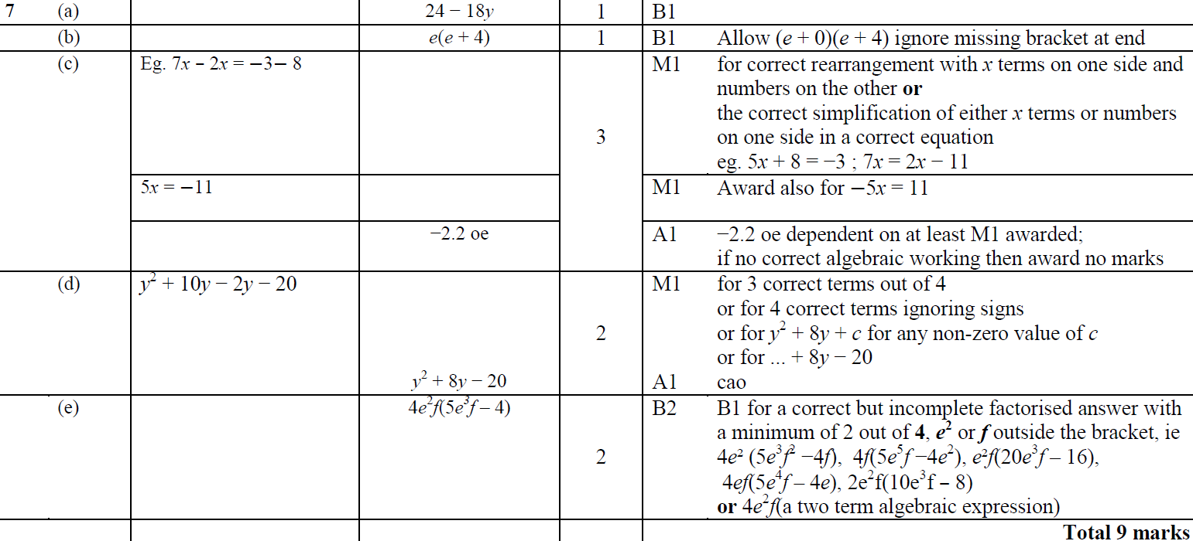
Solving Simple Equations
June 2015 4H Q7
A
B
C
D
E

Slide 91
Solving Simple Equations
May 2015 3HR Q4

Slide 92
Solving Simple Equations
May 2015 3HR Q4
A

Slide 93
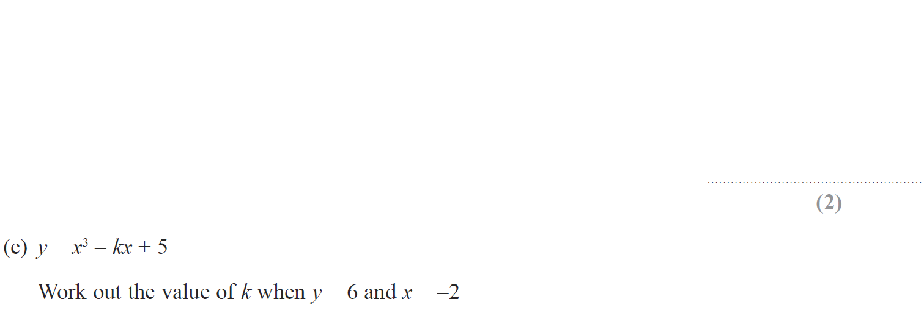
Solving Simple Equations
June 2015 4HR Q9

Slide 94
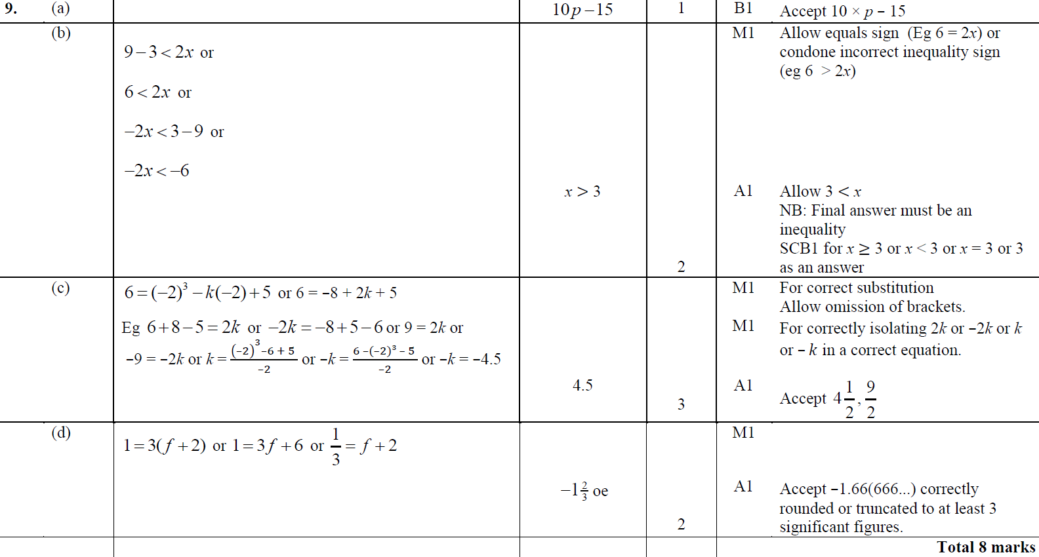
Solving Simple Equations
June 2015 4HR Q9
A
B
C
D

Slide 95
Solving Simple Equations
Jan 2016 3H Q8

Slide 96
Solving Simple Equations
Jan 2016 3H Q8
A

Slide 97
Solving Simple Equations
Jan 2016 4H Q9

Slide 98
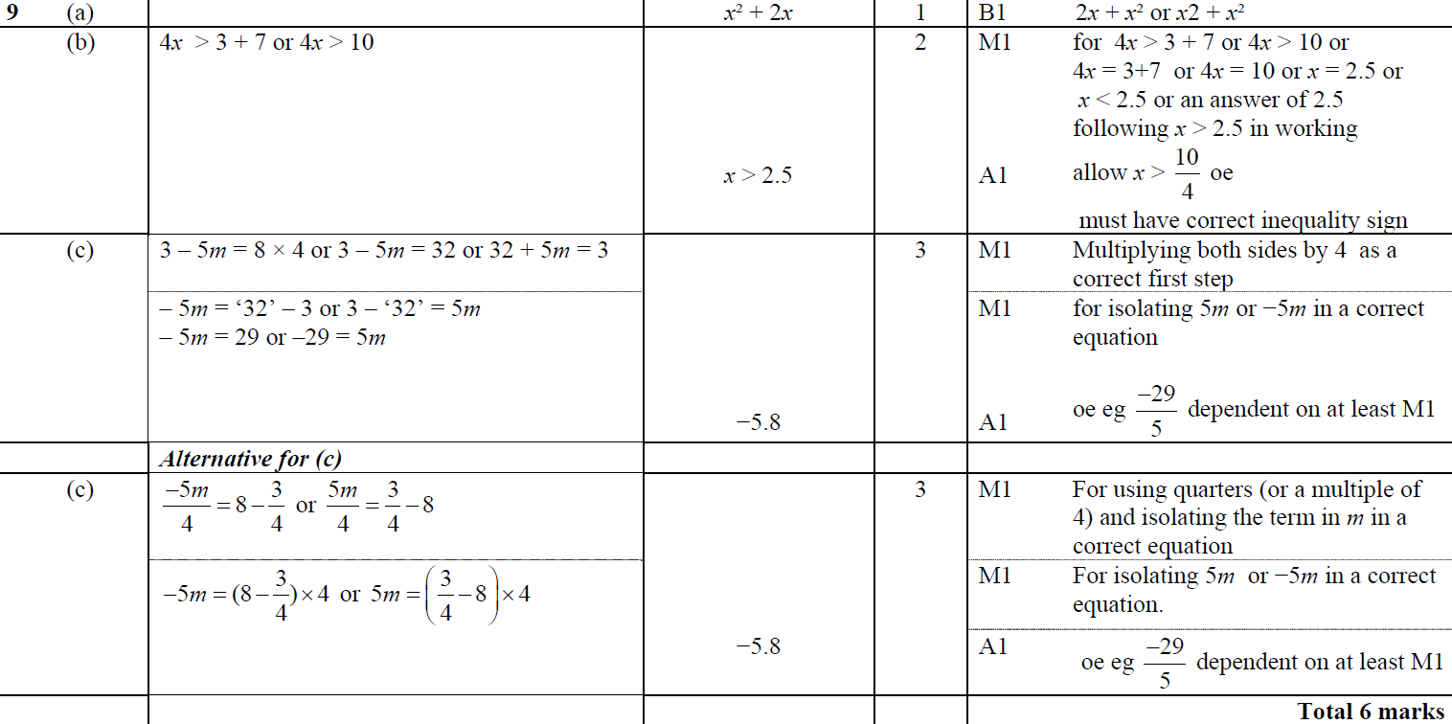
Solving Simple Equations
Jan 2016 4H Q9
A
B
C

Slide 99
Solving Simple Equations
Jan 2016 4HR Q6

Slide 100
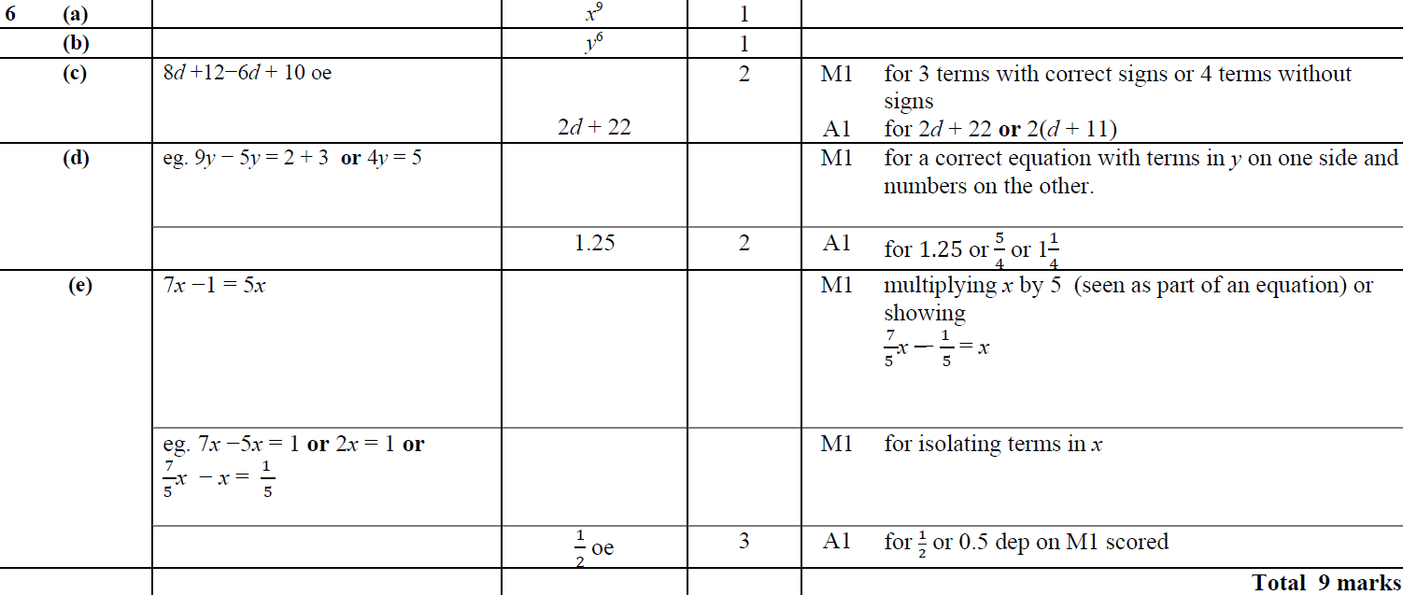
Solving Simple Equations
Jan 2016 4HR Q6
A
B
C
D
E

Slide 101
Solving Simple Equations
June 2016 4H Q2

Slide 102
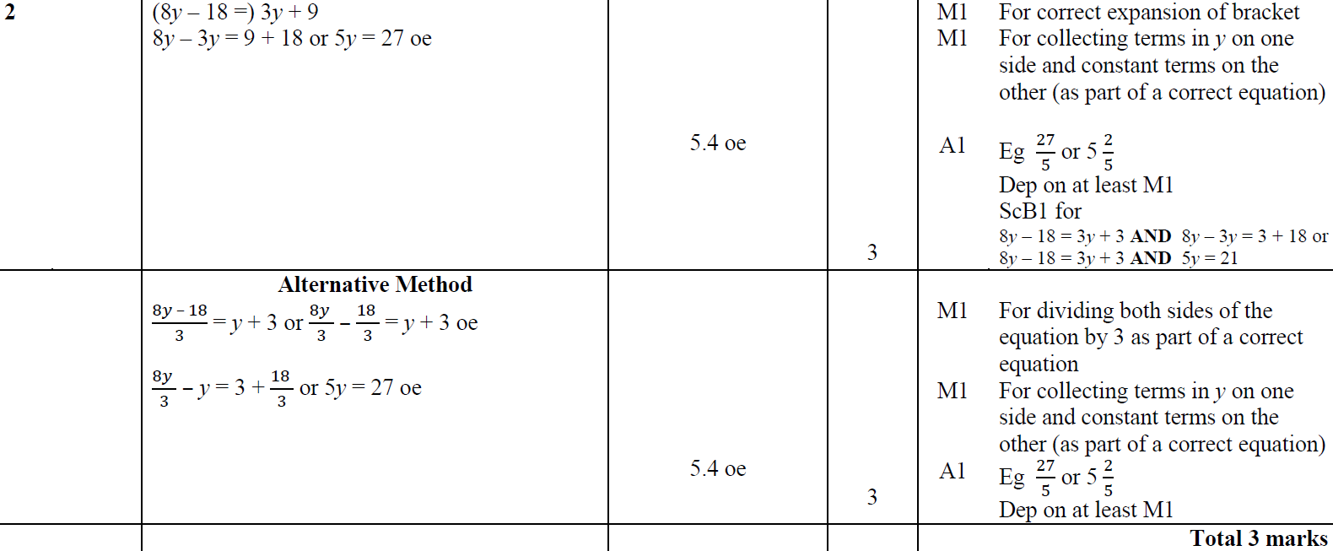
Solving Simple Equations
June 2016 4H Q2
A

Slide 103
Solving Simple Equations
June 2016 4HR Q2

Slide 104
Solving Simple Equations
June 2016 4HR Q2
A
B
C

Slide 105
Solving Simple Equations
Jan 2017 3H Q5

Slide 106
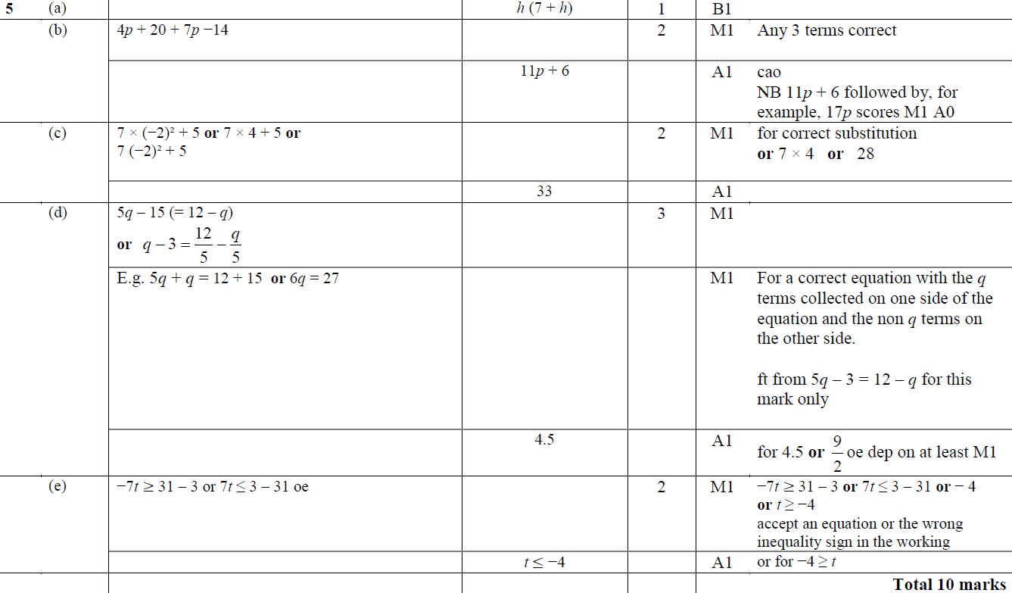
Solving Simple Equations
Jan 2017 3H Q5
A
B
C
D
E

Slide 107
Solving Simple Equations
Jan 2017 4HR Q15

Slide 108
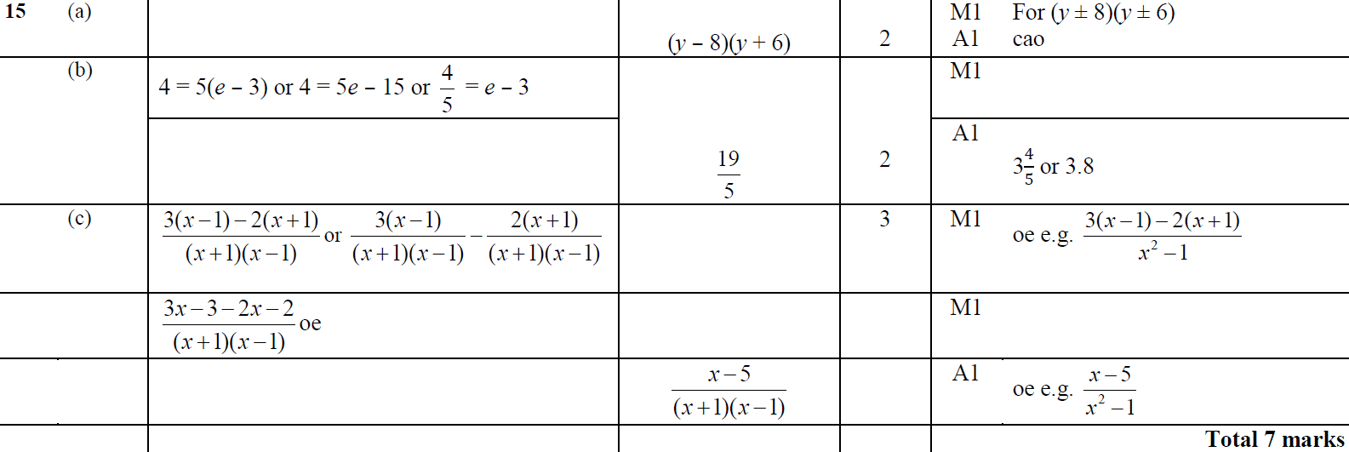
Solving Simple Equations
Jan 2017 4HR Q15
A
B
C

Slide 109
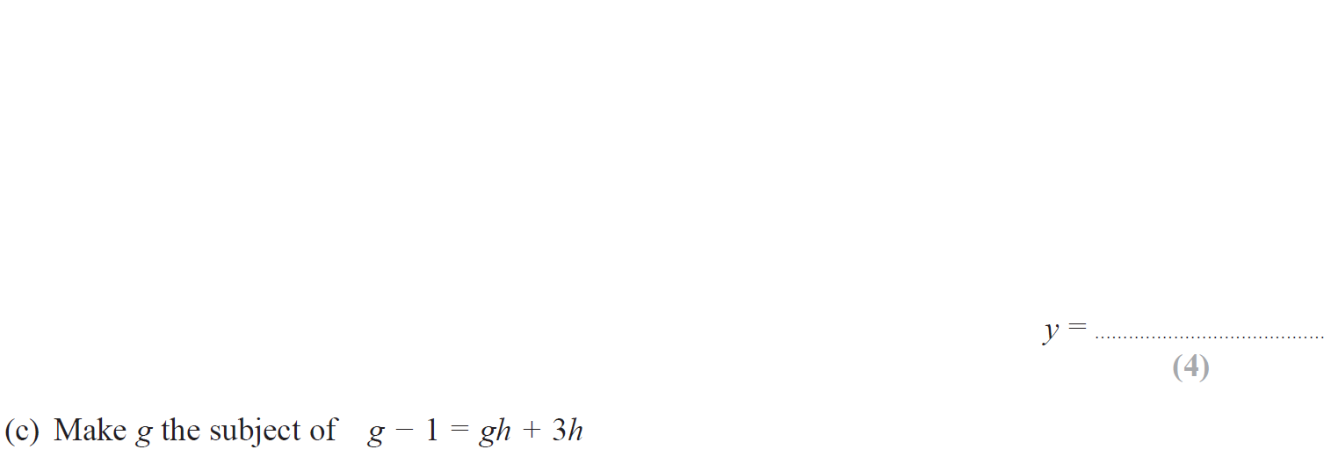
Solving Simple Equations
May 2017 3H Q14

Slide 110
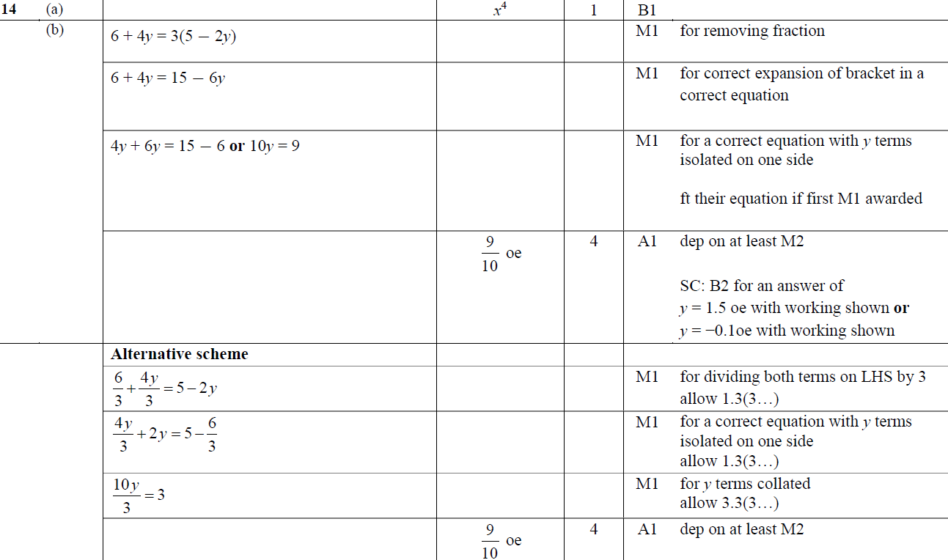
Solving Simple Equations
May 2017 3H Q14
A
B
C

Slide 111
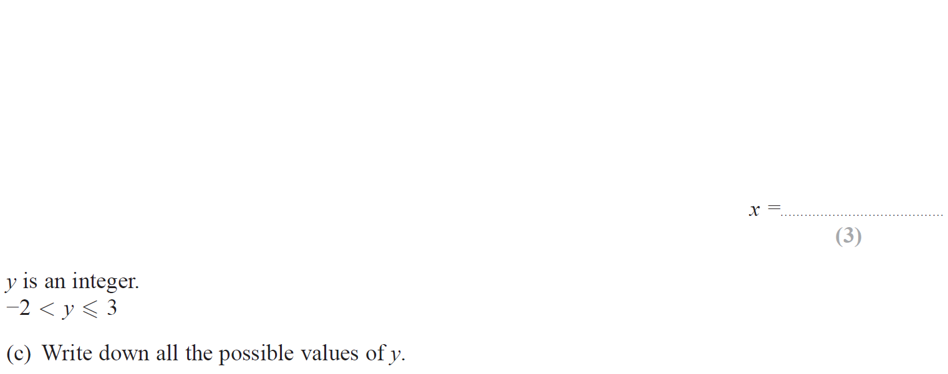
Solving Simple Equations
June 2017 4H Q2

Slide 112
Solving Simple Equations
June 2017 4H Q2
A
B
C

Slide 113
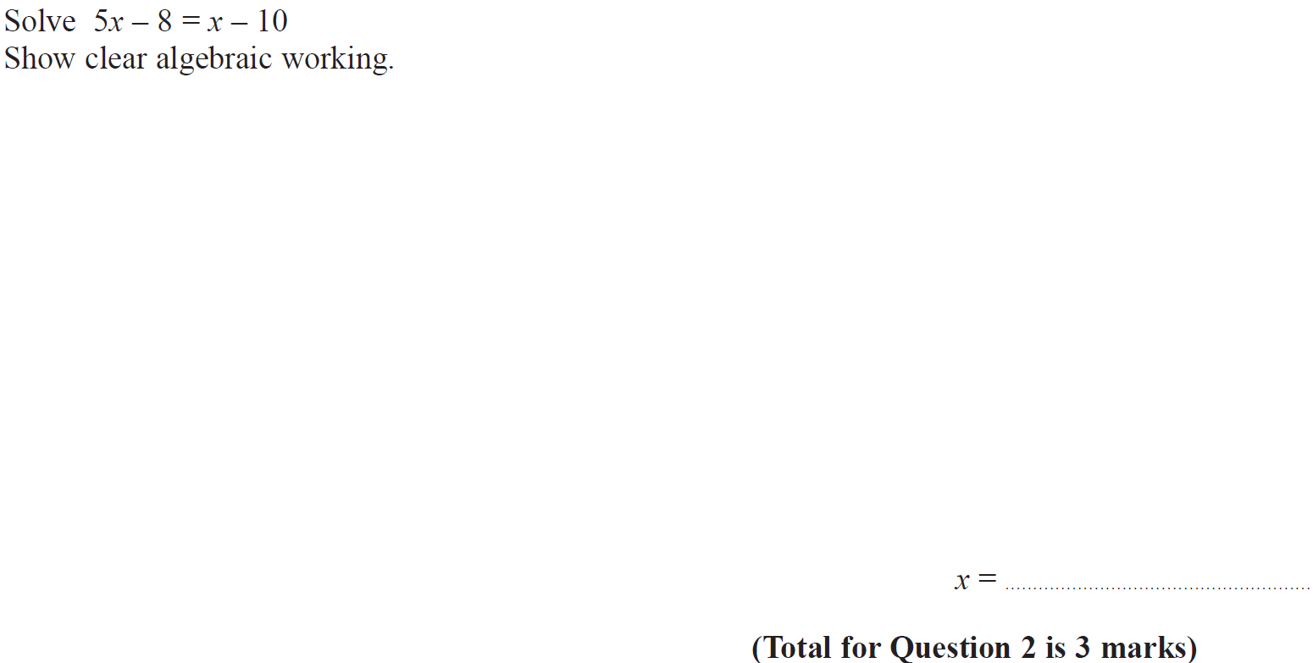
Solving Simple Equations
May 2017 3HR Q2

Slide 114
Solving Simple Equations
May 2017 3HR Q2
A

Slide 115
Solving Simple Equations
June 2017 4HR Q5

Slide 116
Solving Simple Equations
June 2017 4HR Q5
A
B
C
D
E
F
G

Slide 117
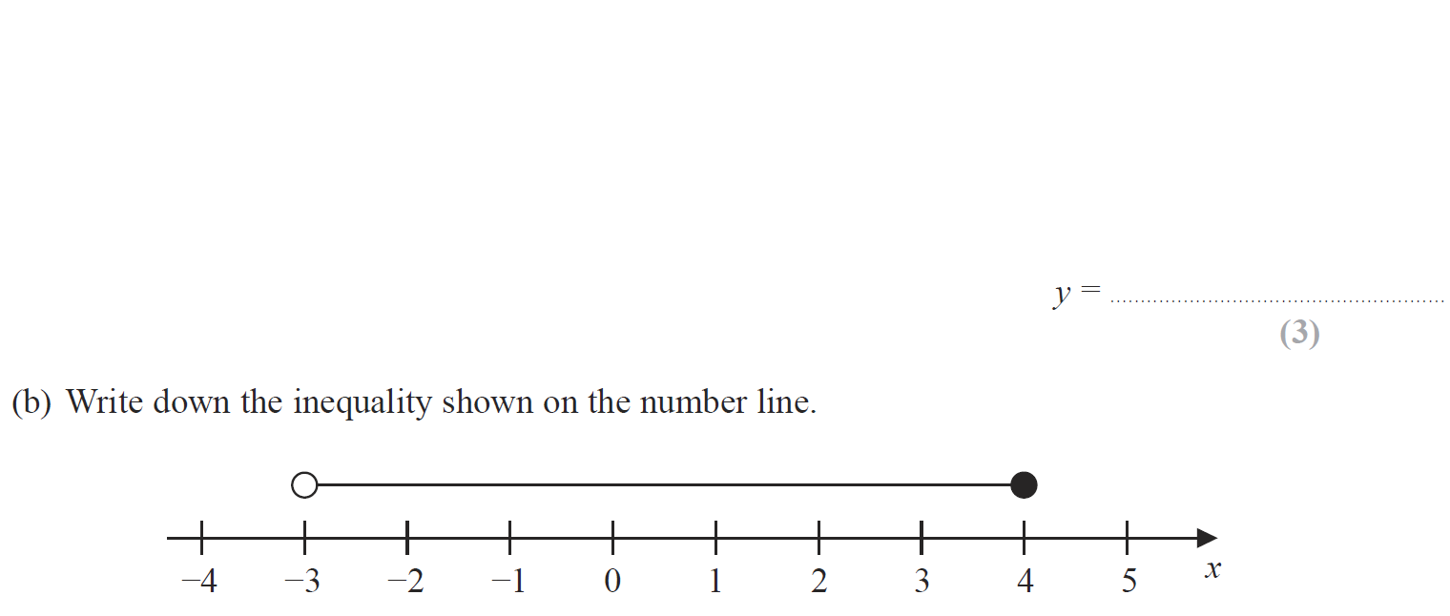
Solving Simple Equations
Jan 2018 3H Q5

Slide 118
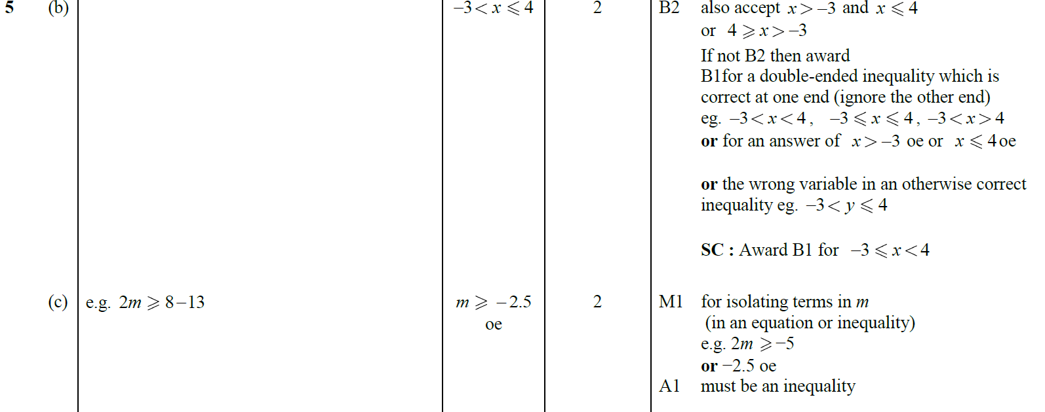
Solving Simple Equations
Jan 2018 3H Q5
A
B
C

Slide 119
Solving Simple Equations
May 2018 3H Q6

Slide 120
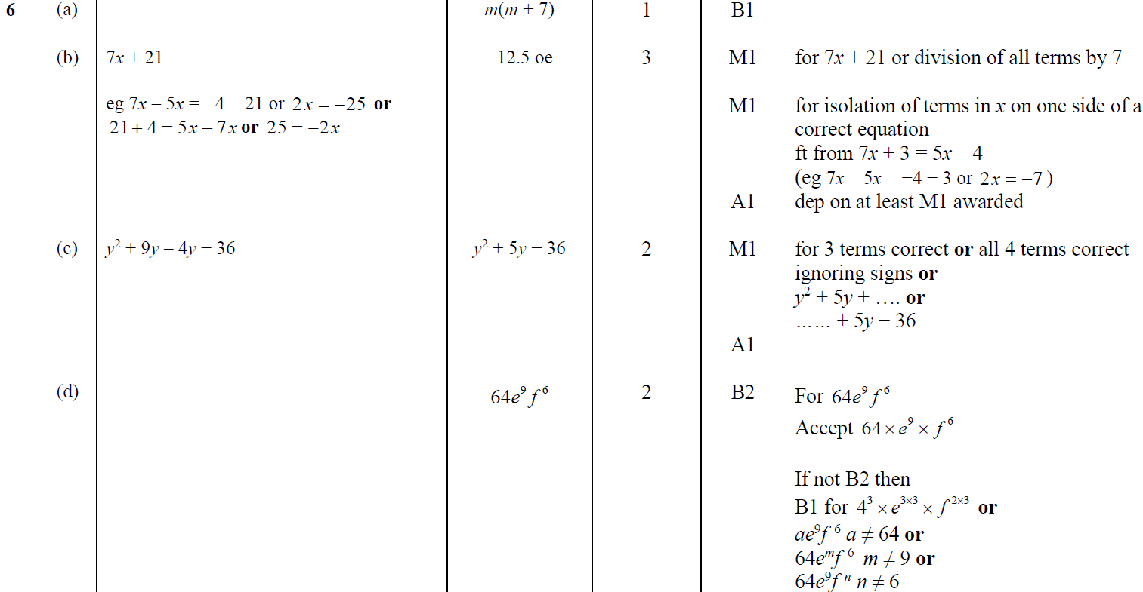
Solving Simple Equations
May 2018 3H Q6
A
B
C
D

