Slide 1
Solving Simple Equations
Solving Simple Equations
Spec 2
2H Q8
Nov 2017 2H Q1
June 2018 3H Q7

Slide 2
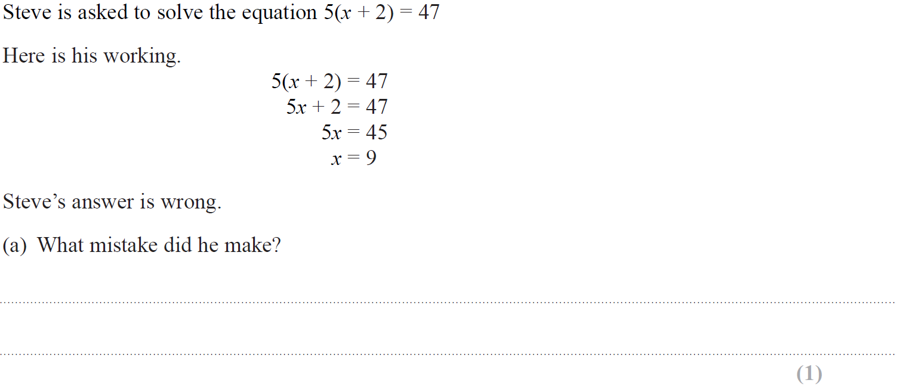
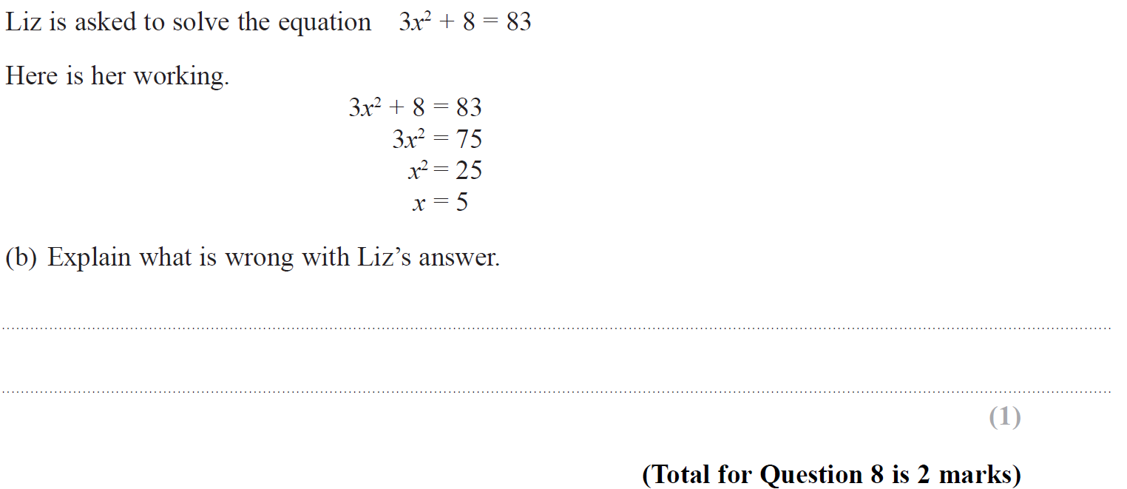
Solving Simple Equations
Specimen Set 2 2H Q8

Slide 3
Solving Simple Equations
Specimen Set 2 2H Q8
A
B

Slide 4
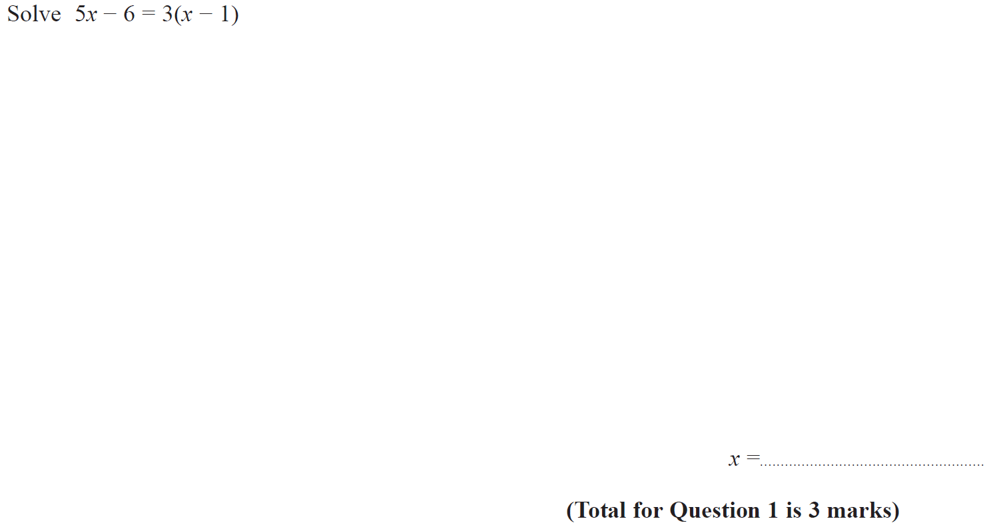
Solving Simple Equations
Nov 2017 2H Q1

Slide 5
Solving Simple Equations
Nov 2017 2H Q1
A

Slide 6
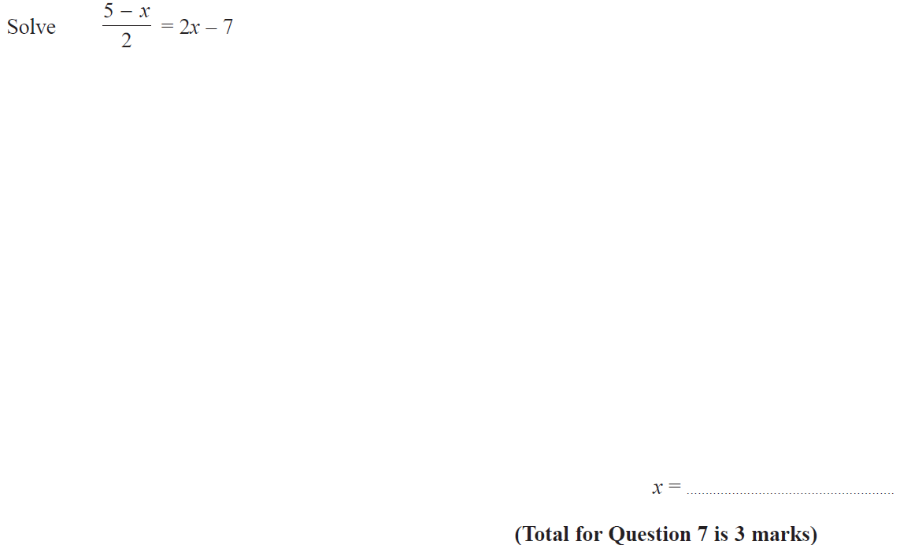
Solving Simple Equations
June 2018 3H Q7

Slide 7
Solving Simple Equations
June 2018 3H Q7
A

