Slide 1
Solving Quadratics
Solving Quadratics
June 2017
2H Q21
Nov 2017
2H Q27
June 2017
3H Q23
May 2018
1H Q27
SAM
2H Q11
1 Marker
June 2017
3H Q26
Nov 2018
1H Q12
Nov 2017
1H Q18
Nov 2018
1H Q25*
*Mainly Graphing

Slide 2
Solving Quadratics
SAM 2H Q11

Slide 3
Solving Quadratics
SAM 2H Q11
A

Slide 4
Solving Quadratics
June 2017 2H Q21

Slide 5
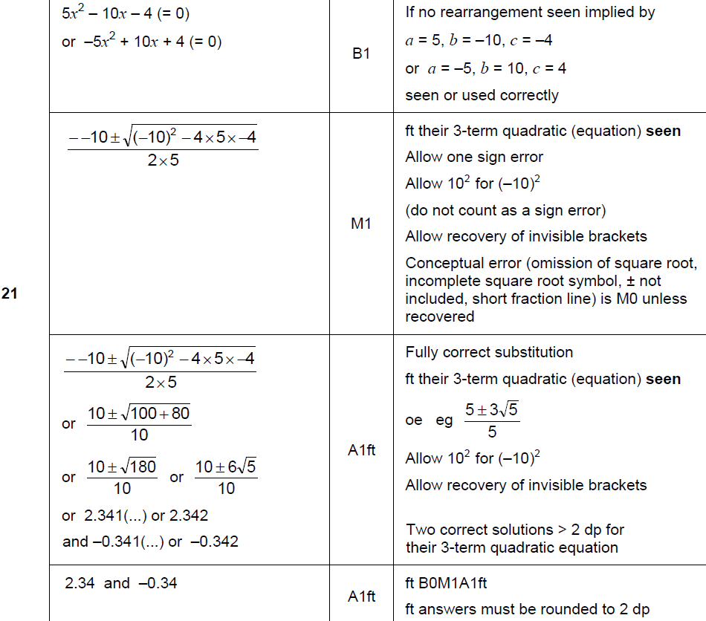
Solving Quadratics
June 2017 2H Q21
A

Slide 6
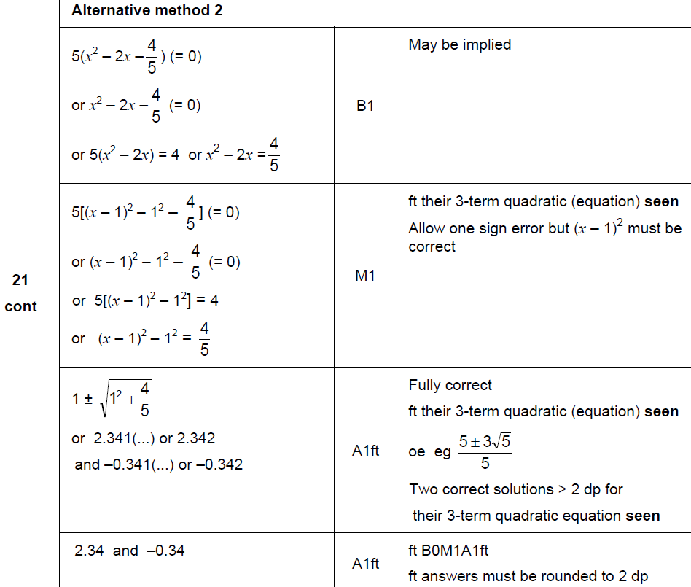
Solving Quadratics
June 2017 2H Q21
A Alternative

Slide 7
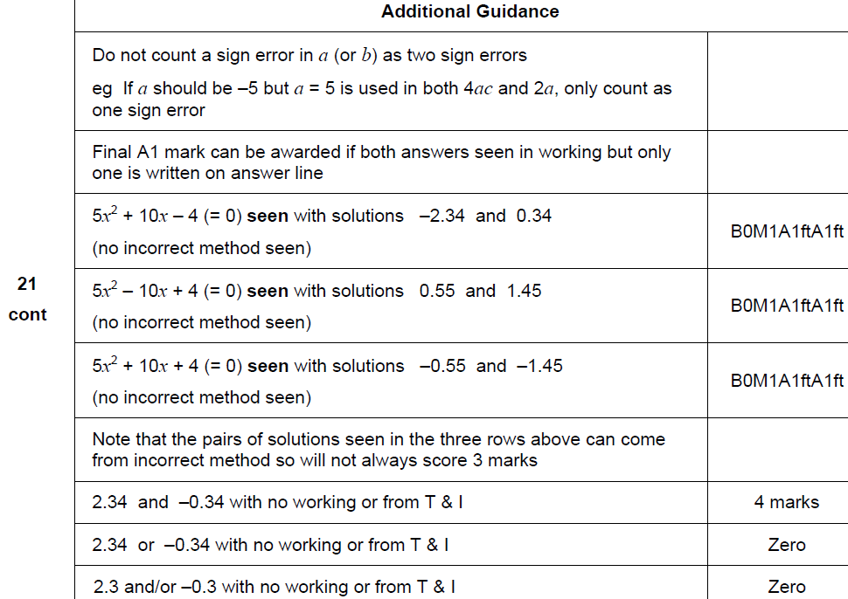
Solving Quadratics
June 2017 2H Q21
A notes

Slide 8
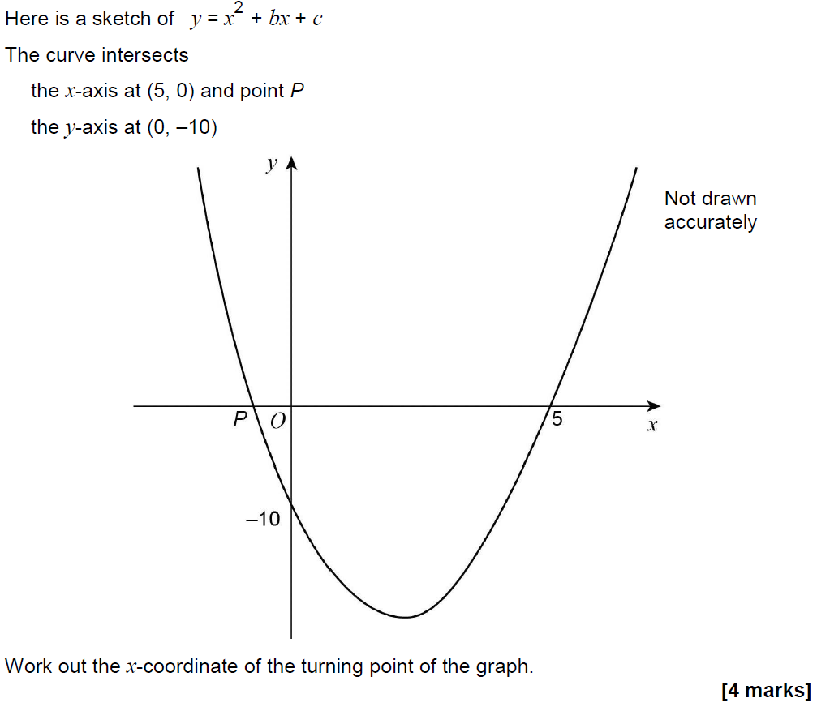
Solving Quadratics
June 2017 3H Q23

Slide 9
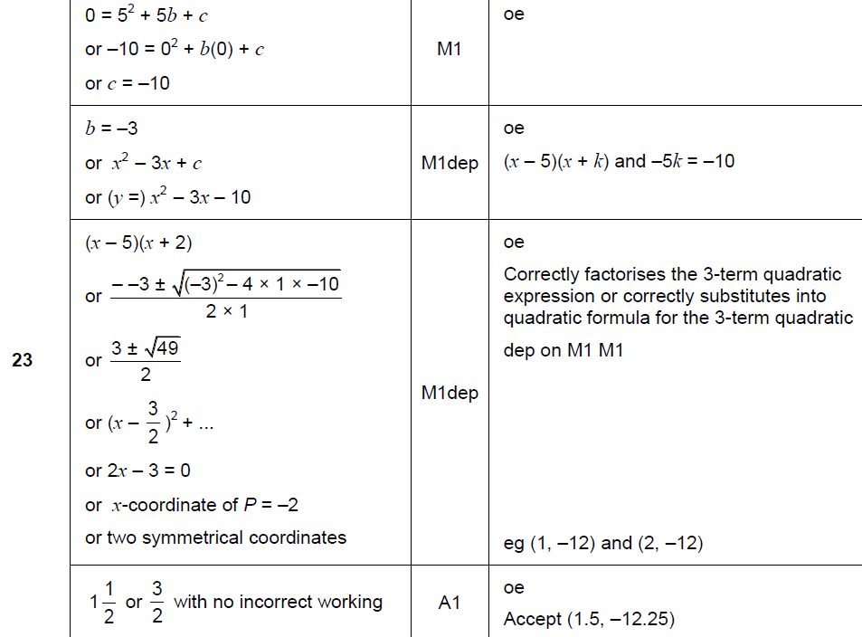
Solving Quadratics
June 2017 3H Q23
A

Slide 10
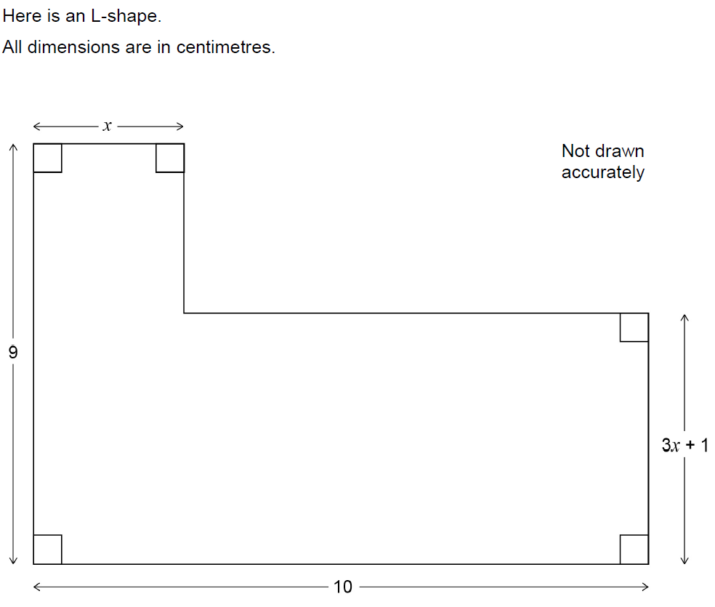
Solving Quadratics
June 2017 3H Q26

Slide 11
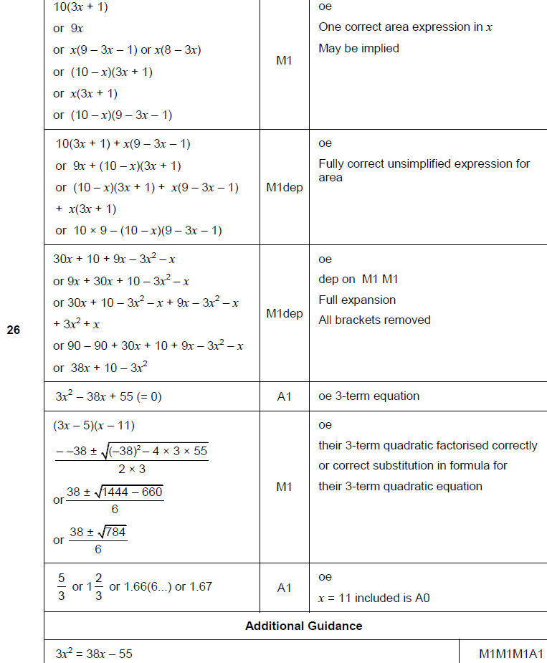
Solving Quadratics
June 2017 3H Q26
A

Slide 12
Solving Quadratics
Nov 2017 1H Q18

Slide 13
Solving Quadratics
Nov 2017 1H Q18
A

Slide 14
Solving Quadratics
Nov 2017 2H Q27

Slide 15
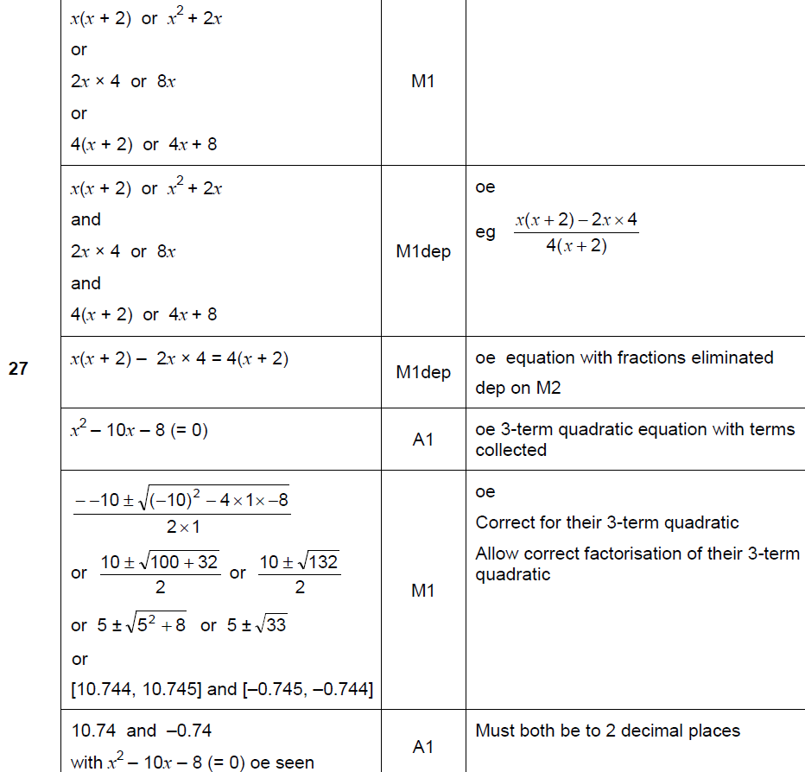
Solving Quadratics
Nov 2017 2H Q27
A

Slide 16
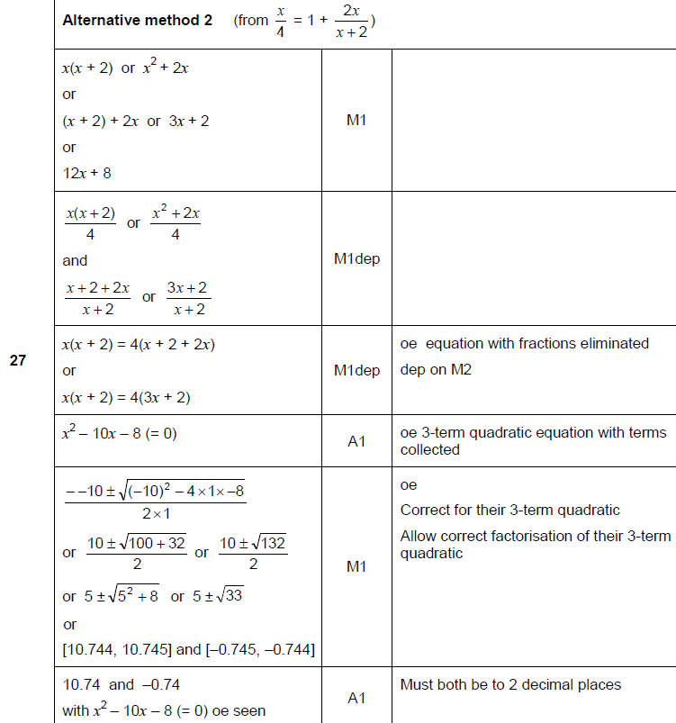
Solving Quadratics
Nov 2017 2H Q27
A Alternative 1

Slide 17
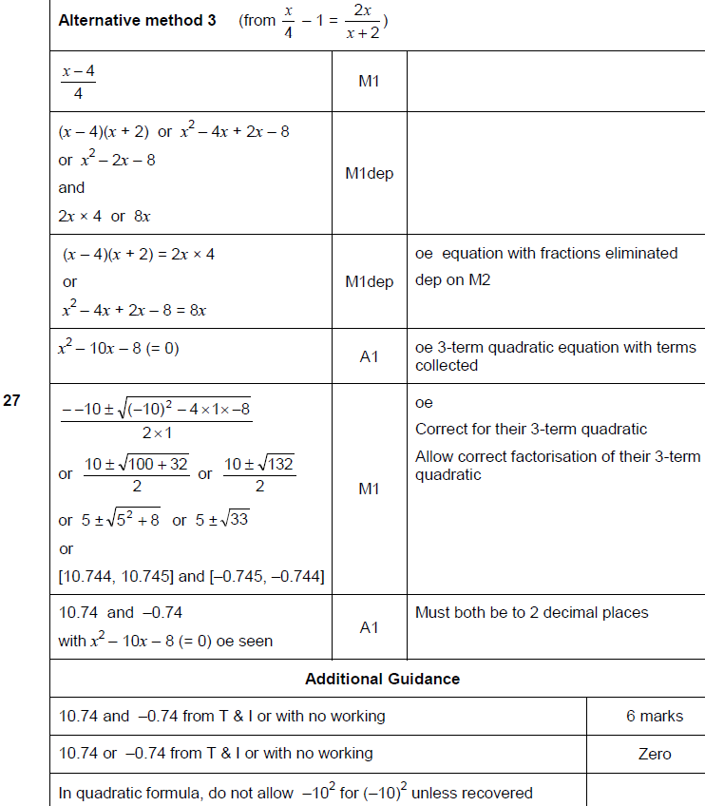
Solving Quadratics
Nov 2017 2H Q27
A Alternative 2 & notes

Slide 18
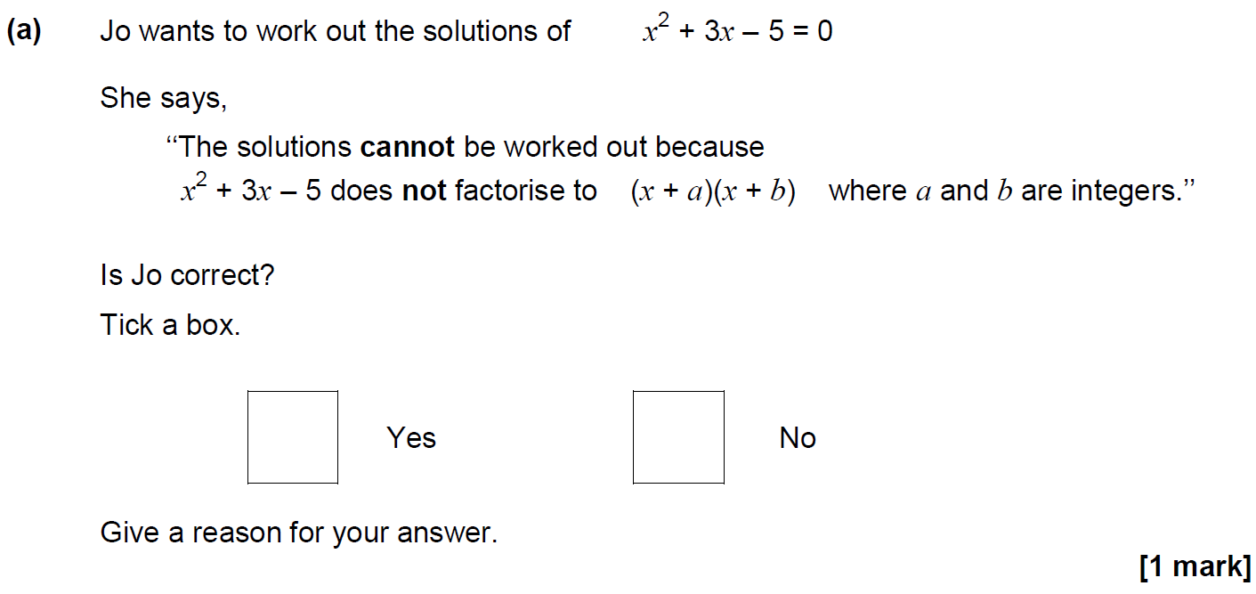
Solving Quadratics
May 2018 1H Q27

Slide 19
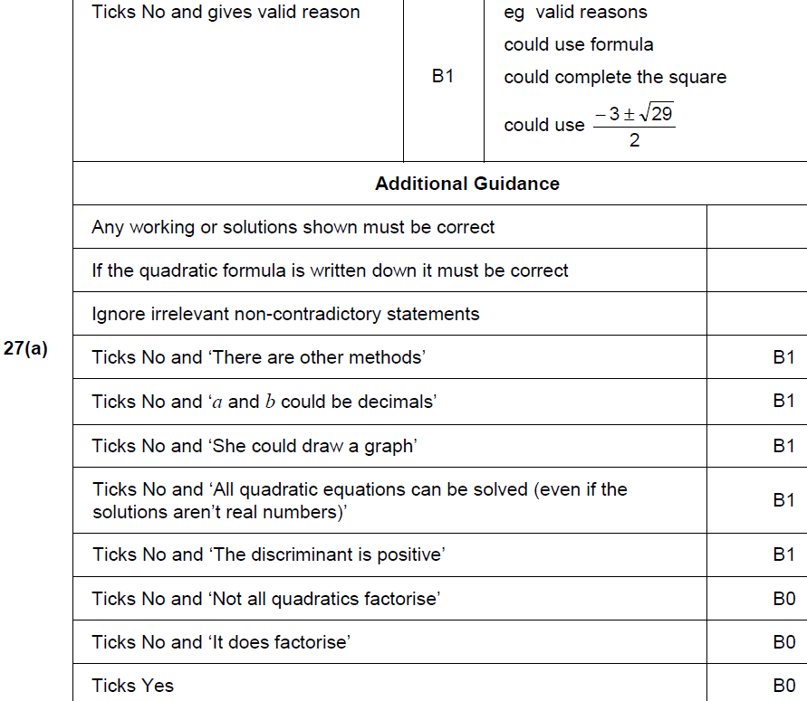
Solving Quadratics
May 2018 1H Q27
A

Slide 20
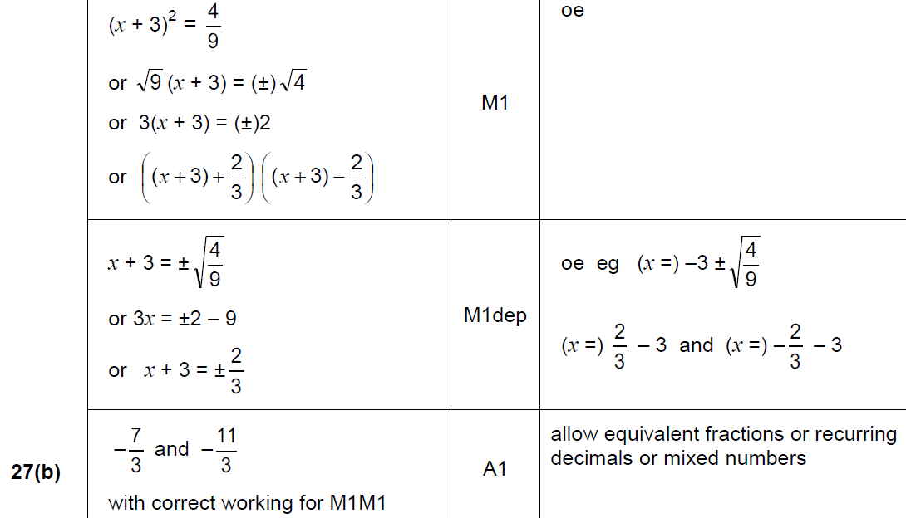
Solving Quadratics
May 2018 1H Q27
B

Slide 21
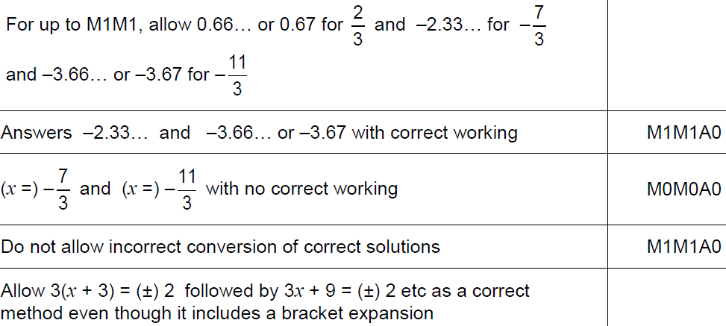
Solving Quadratics
May 2018 1H Q27
B notes

Slide 22
Solving Quadratics
Nov 2018 1H Q12

Slide 23
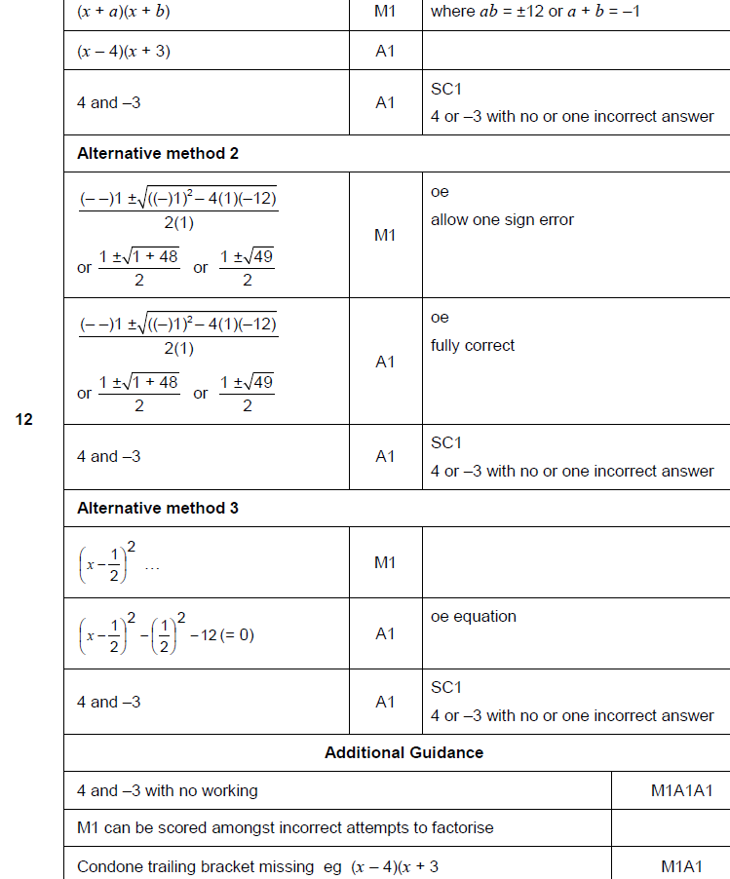
Solving Quadratics
Nov 2018 1H Q12
A

Slide 24
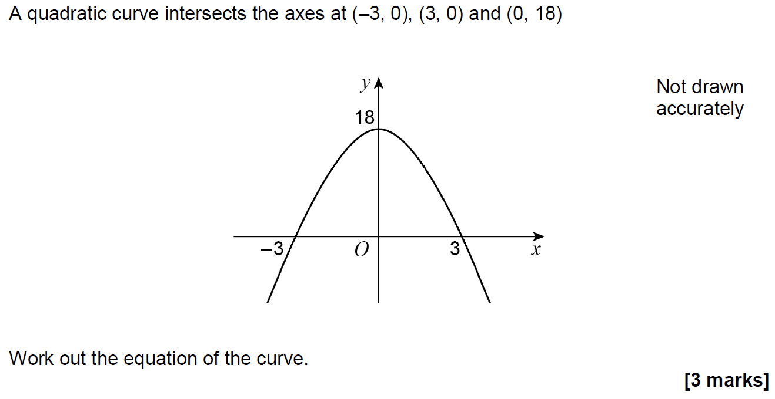
Solving Quadratics
Nov 2018 1H Q25

Slide 25
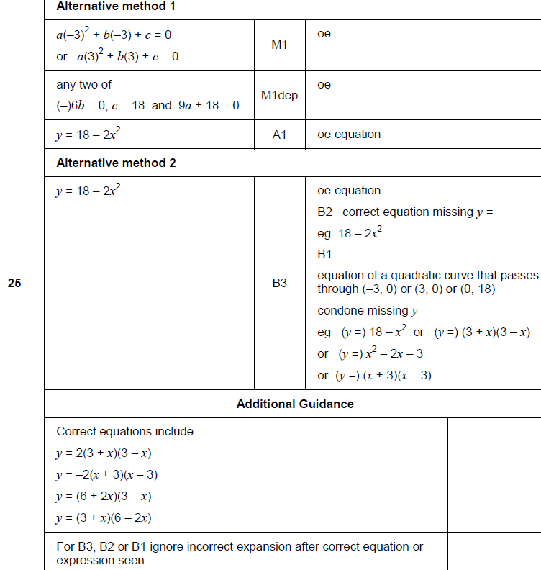
Solving Quadratics
Nov 2018 1H Q25
A

