Slide 1
Solving Quadratics
Solving Quadratics
Nov 2017
2H Q16
SAM
3H Q11
Edexcel
June 2018
3H Q19
Spec 2
1H Q17
AQA
Nov 2018
1H Q22
Spec 2
2H Q21
OCR
Nov 2018
3H Q9
Spec 2
3H Q21
May 2019
1H Q17

Slide 2
Solving Quadratics
Solving Quadratics
June 2017
2H Q21
Nov 2017
2H Q27
Edexcel
June 2017
3H Q23
May 2018
1H Q27
AQA
SAM
2H Q11
1 Marker
June 2017
3H Q26
Nov 2018
1H Q12
OCR
Nov 2017
1H Q18
Nov 2018
1H Q25*
*Mainly Graphing

Slide 3
Solving Quadratics
Solving Quadratics
SAM
3H Q2
May 2017
1H Q18
Edexcel
May 2018
1H Q20
SAM
3H Q17
Nov 2017
1H Q13
AQA
Nov 2018
1H Q16
Practice
2H Q12
Nov 2017
1H Q18
OCR
Nov 2018
3H Q12
Practice
3H Q17
May 2018
1H Q16

Slide 4
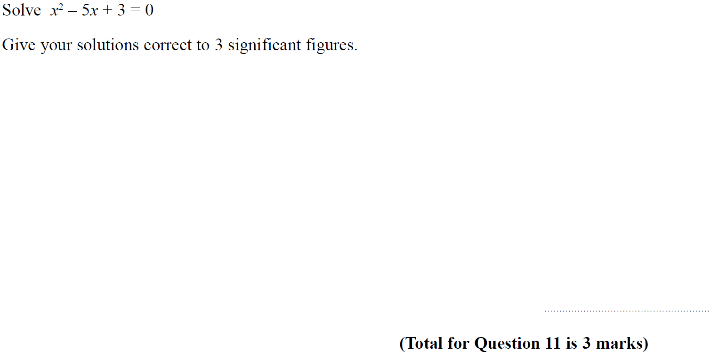
Solving Quadratics
SAM 3H Q11

Slide 5
Solving Quadratics
SAM 3H Q11
A

Slide 6
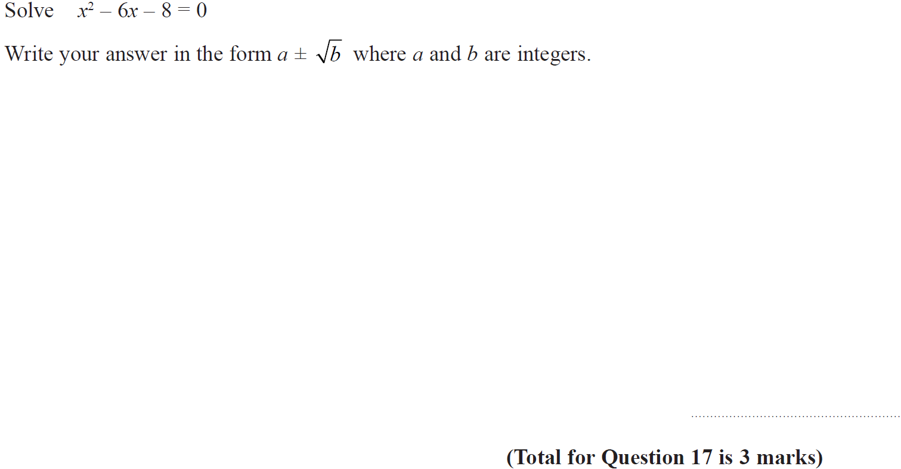
Solving Quadratics
Specimen Set 2 1H Q17

Slide 7
Solving Quadratics
Specimen Set 2 1H Q17
A

Slide 8
Solving Quadratics
Specimen Set 2 2H Q21

Slide 9
Solving Quadratics
Specimen Set 2 2H Q21
A

Slide 10
Solving Quadratics
Specimen Set 2 3H Q21

Slide 11
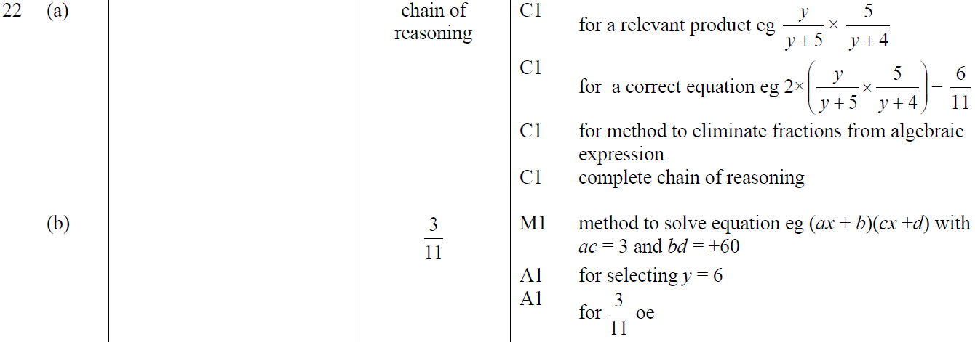
Solving Quadratics
Specimen Set 2 3H Q21
A
B

Slide 12
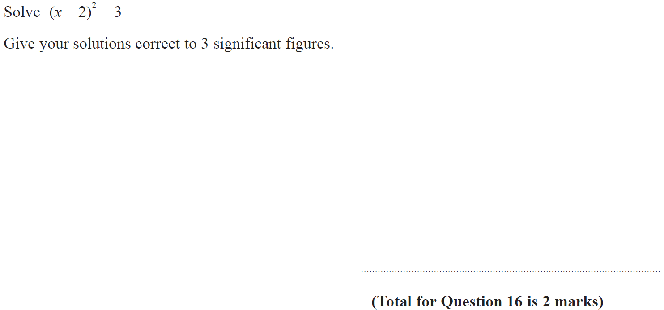
Solving Quadratics
Nov 2017 2H Q16

Slide 13
Solving Quadratics
Nov 2017 2H Q16
A

Slide 14
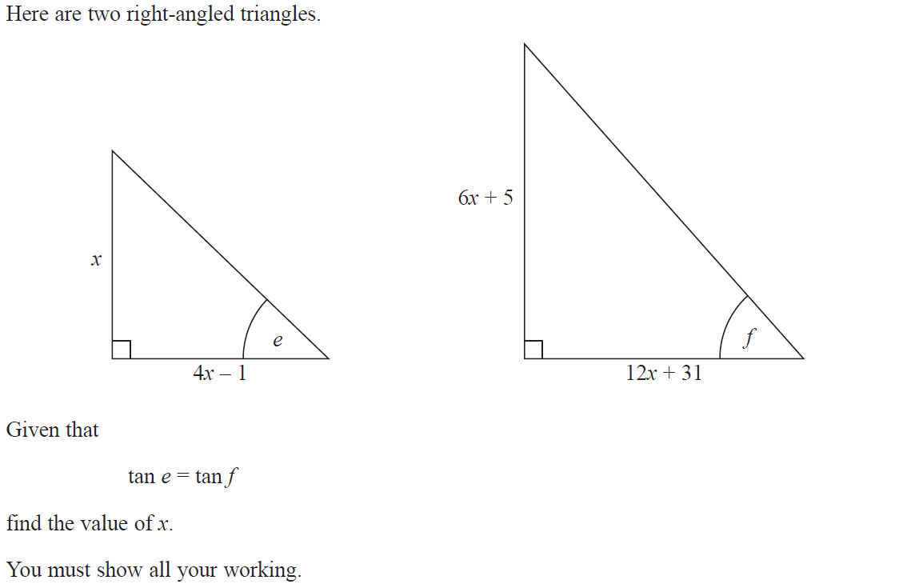
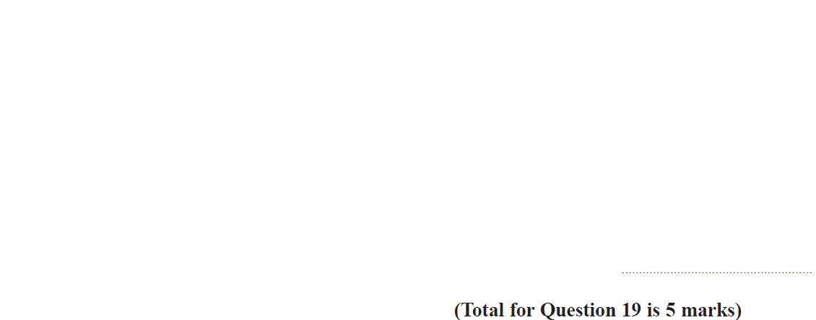
Solving Quadratics
June 2018 3H Q19

Slide 15
Solving Quadratics
June 2018 3H Q19
A

Slide 16
Solving Quadratics
Nov 2018 1H Q22

Slide 17
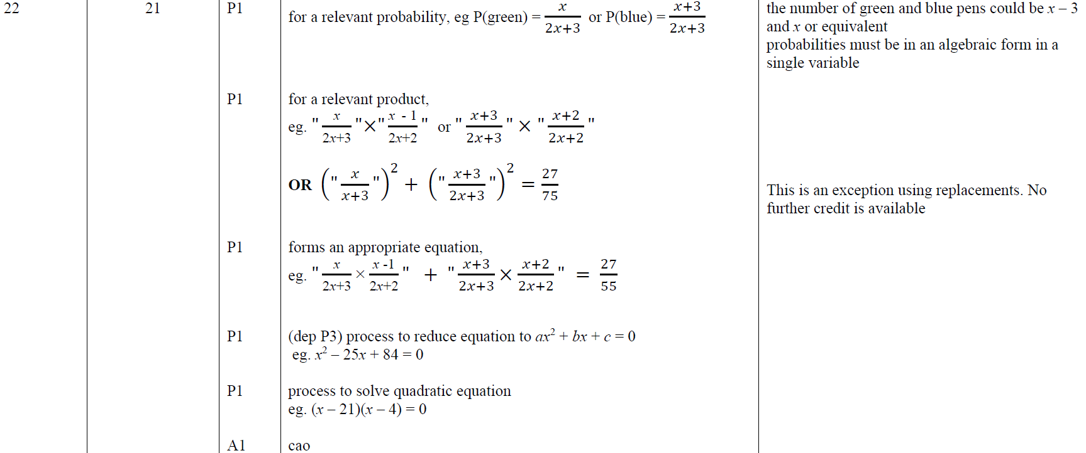
Solving Quadratics
Nov 2018 1H Q22
A

Slide 18
Solving Quadratics
Nov 2018 3H Q9

Slide 19
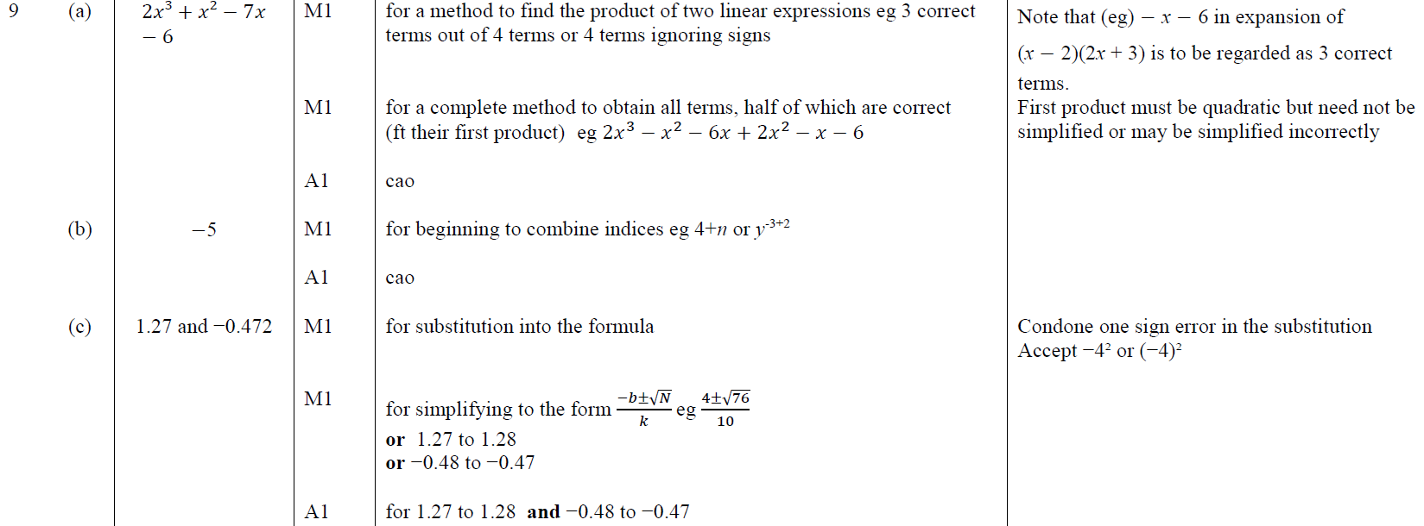
Solving Quadratics
Nov 2018 3H Q9
A
B
C

Slide 20
Solving Quadratics
May 2019 1H Q17

Slide 21
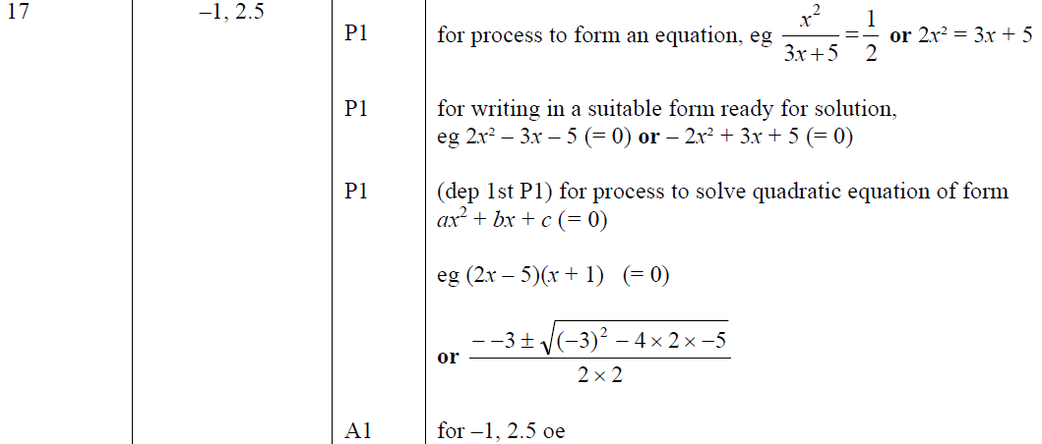
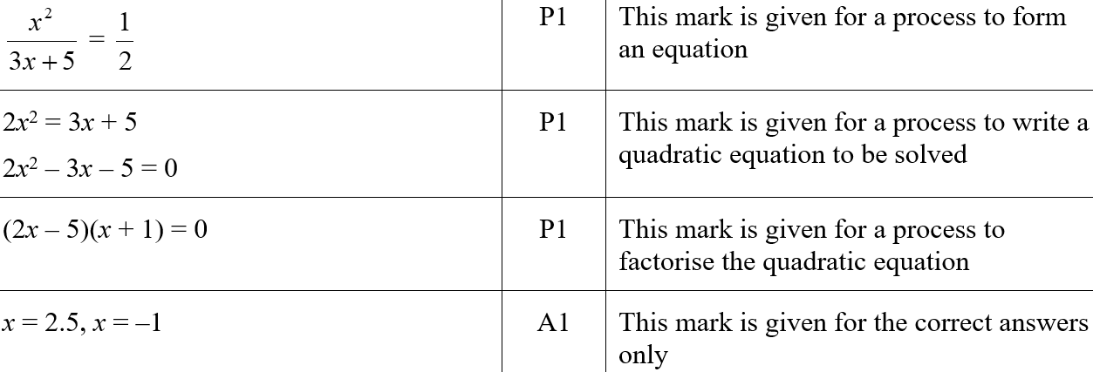
Solving Quadratics
May 2019 1H Q17
A
A SF

Slide 22
Solving Quadratics
SAM 2H Q11

Slide 23
Solving Quadratics
SAM 2H Q11
A

Slide 24
Solving Quadratics
June 2017 2H Q21

Slide 25
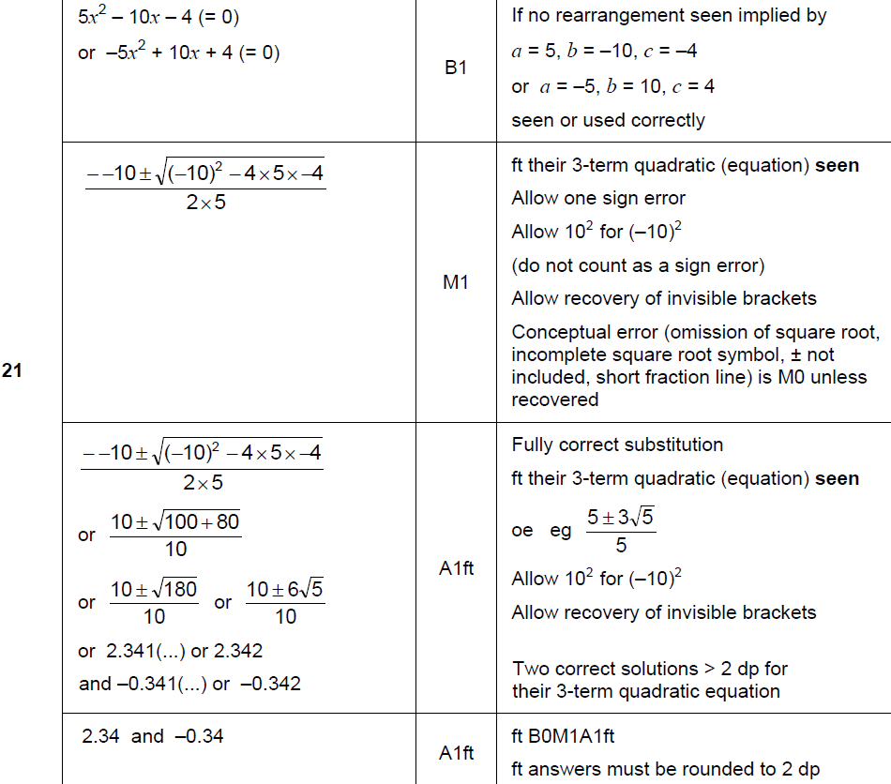
Solving Quadratics
June 2017 2H Q21
A

Slide 26
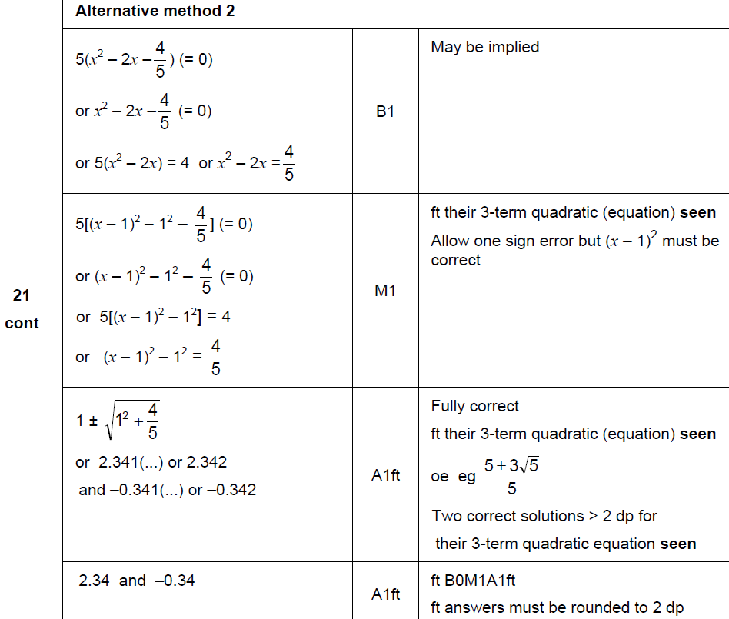
Solving Quadratics
June 2017 2H Q21
A Alternative

Slide 27
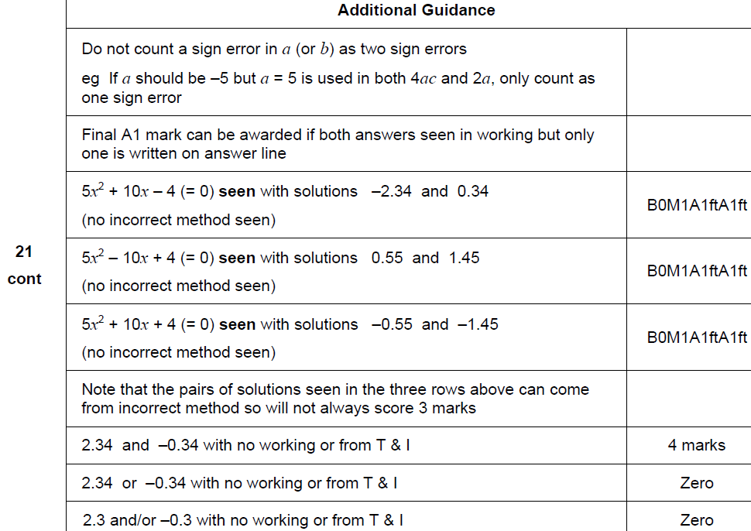
Solving Quadratics
June 2017 2H Q21
A notes

Slide 28
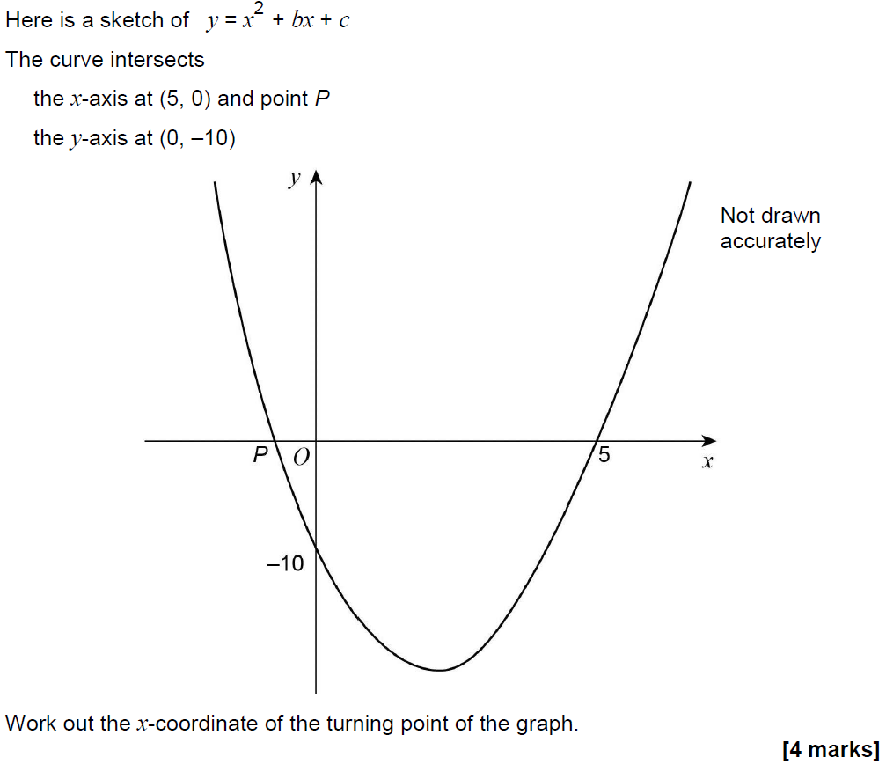
Solving Quadratics
June 2017 3H Q23

Slide 29
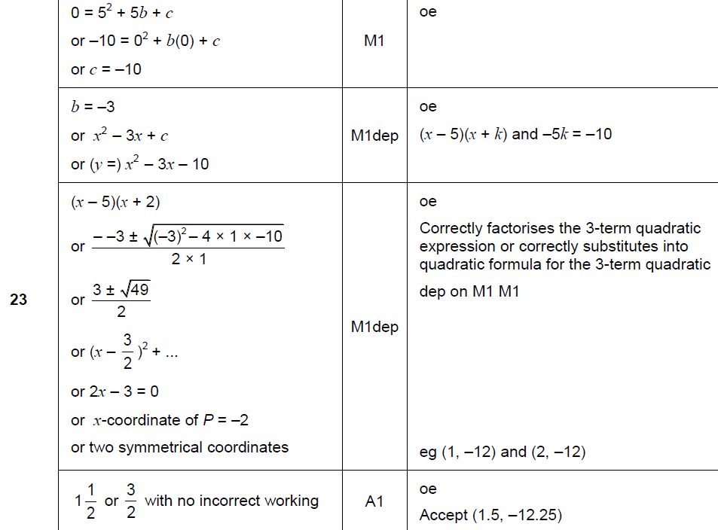
Solving Quadratics
June 2017 3H Q23
A

Slide 30
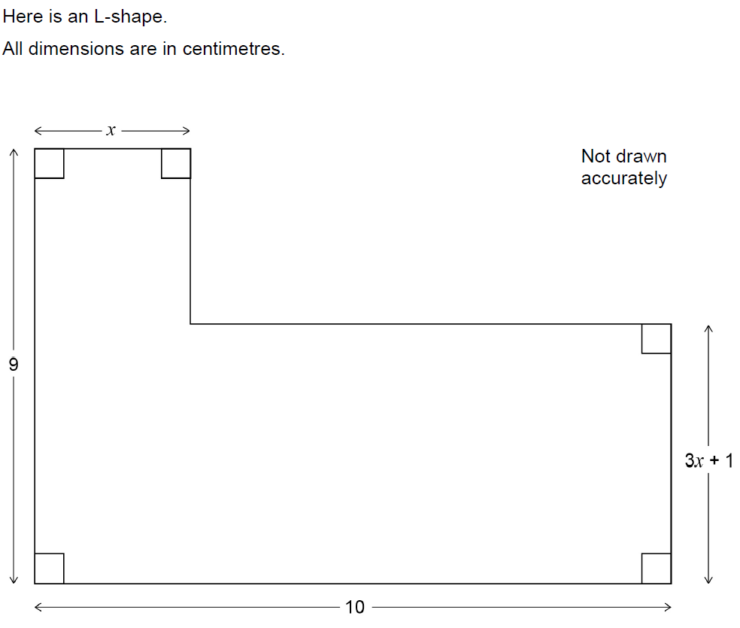
Solving Quadratics
June 2017 3H Q26

Slide 31
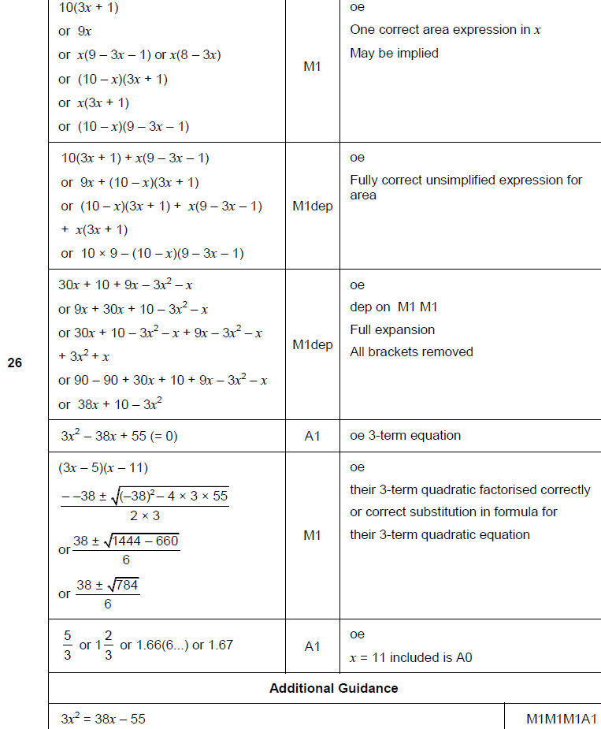
Solving Quadratics
June 2017 3H Q26
A

Slide 32
Solving Quadratics
Nov 2017 1H Q18

Slide 33
Solving Quadratics
Nov 2017 1H Q18
A

Slide 34
Solving Quadratics
Nov 2017 2H Q27

Slide 35
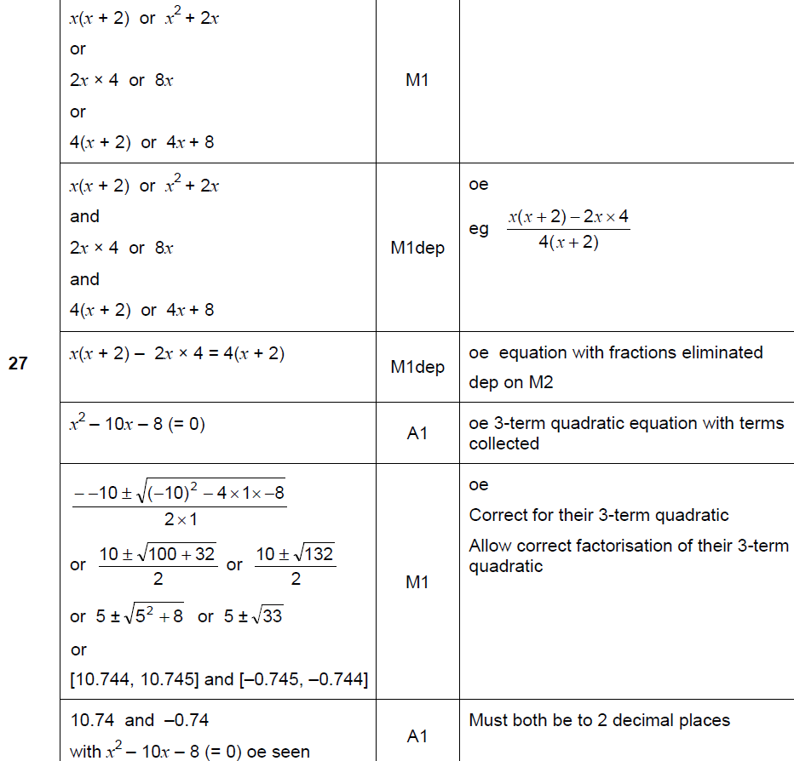
Solving Quadratics
Nov 2017 2H Q27
A

Slide 36
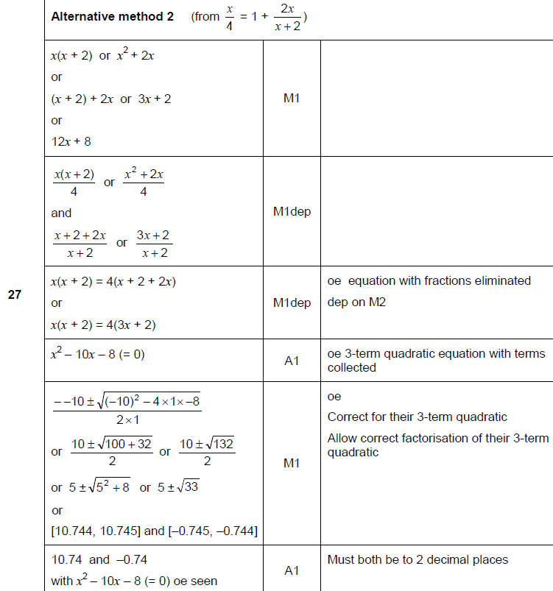
Solving Quadratics
Nov 2017 2H Q27
A Alternative 1

Slide 37
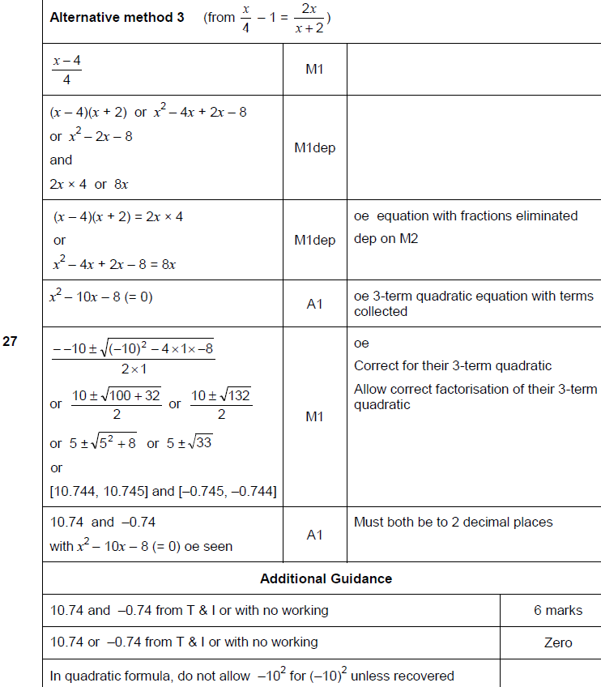
Solving Quadratics
Nov 2017 2H Q27
A Alternative 2 & notes

Slide 38
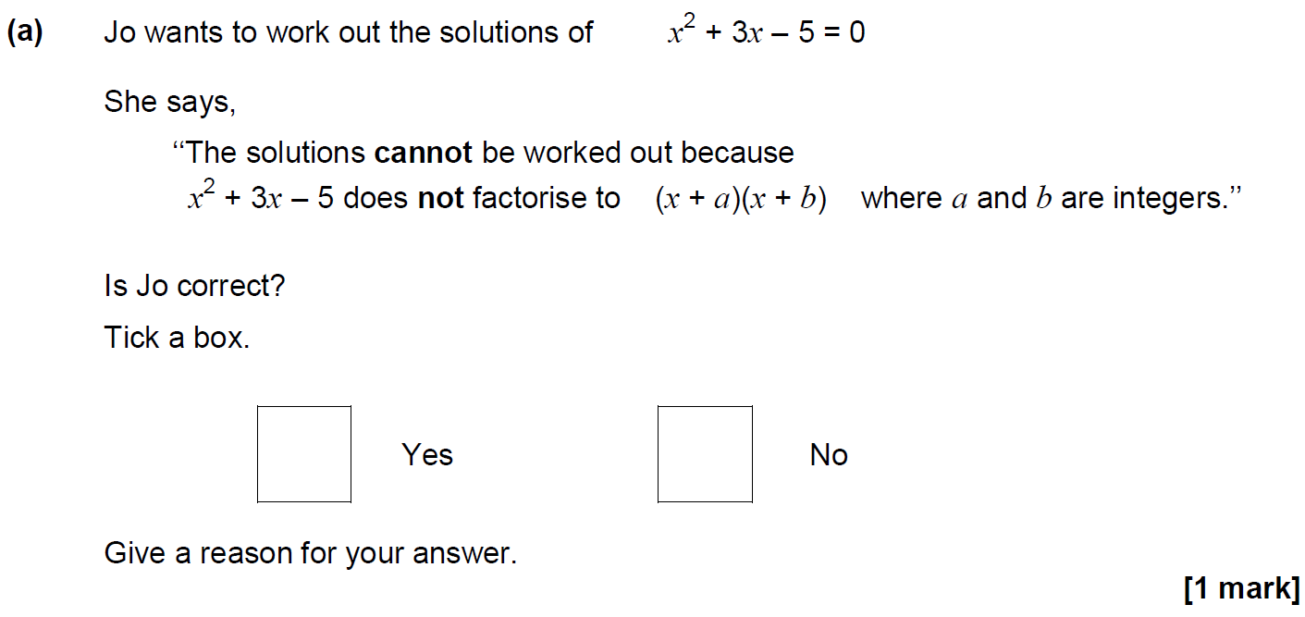
Solving Quadratics
May 2018 1H Q27

Slide 39
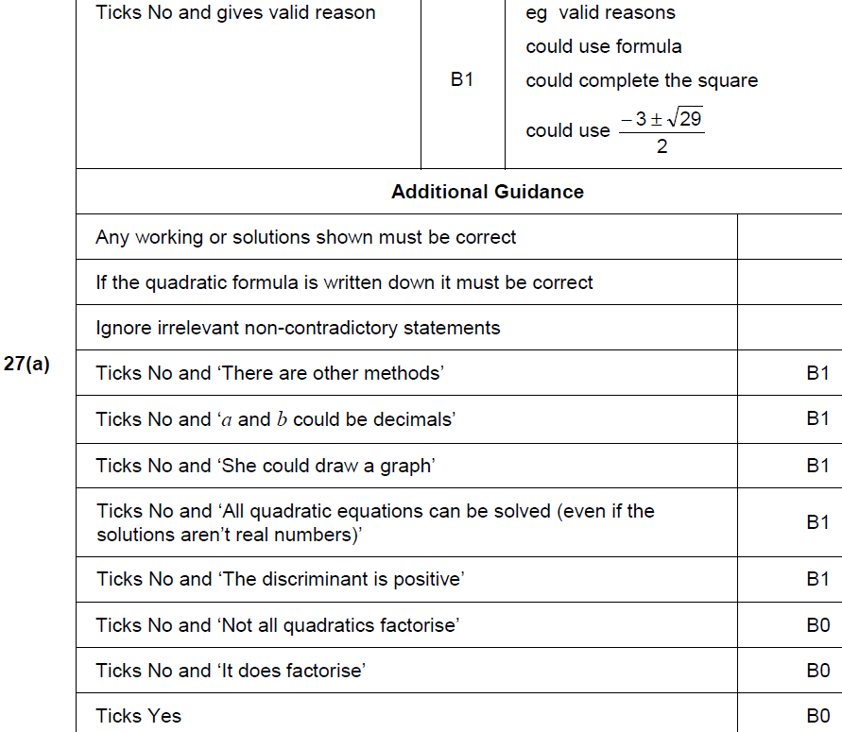
Solving Quadratics
May 2018 1H Q27
A

Slide 40
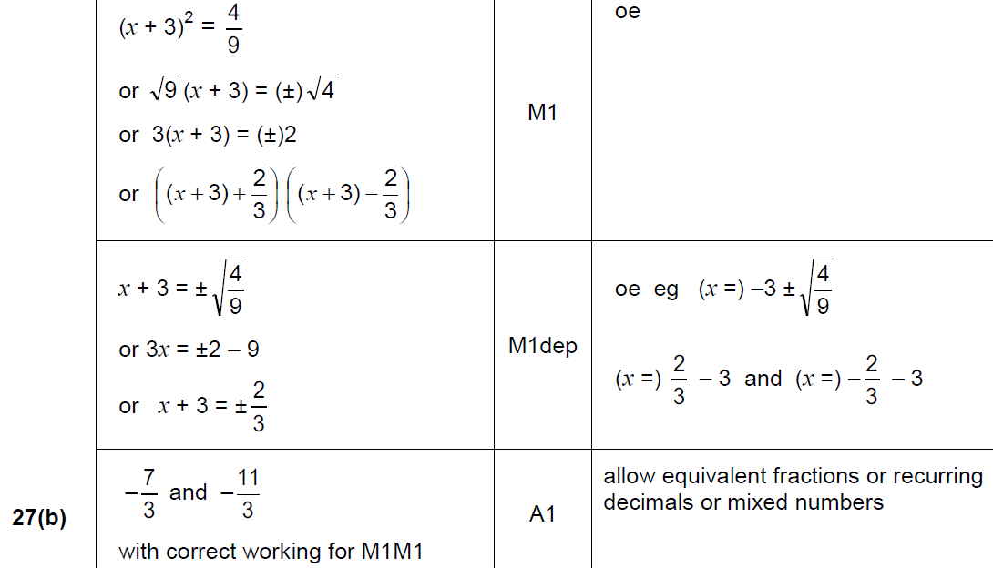
Solving Quadratics
May 2018 1H Q27
B

Slide 41
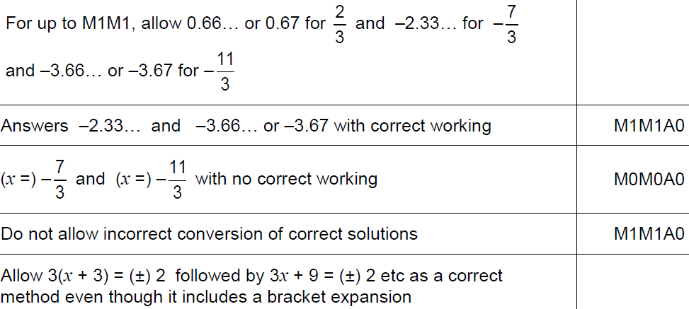
Solving Quadratics
May 2018 1H Q27
B notes

Slide 42
Solving Quadratics
Nov 2018 1H Q12

Slide 43
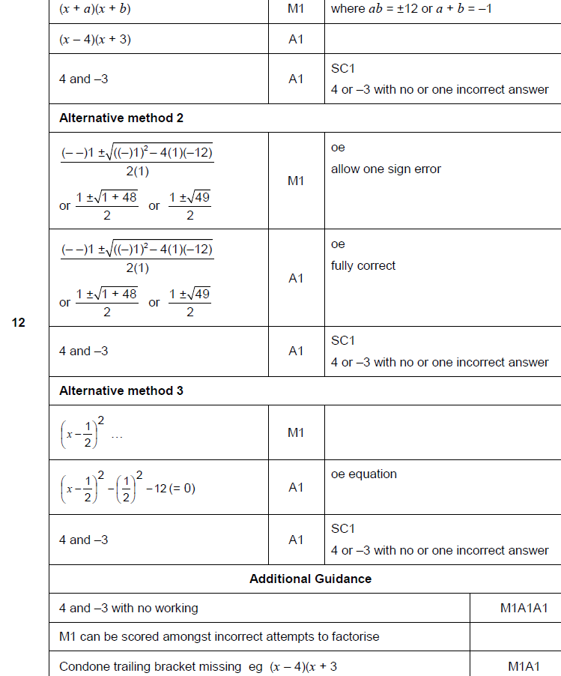
Solving Quadratics
Nov 2018 1H Q12
A

Slide 44
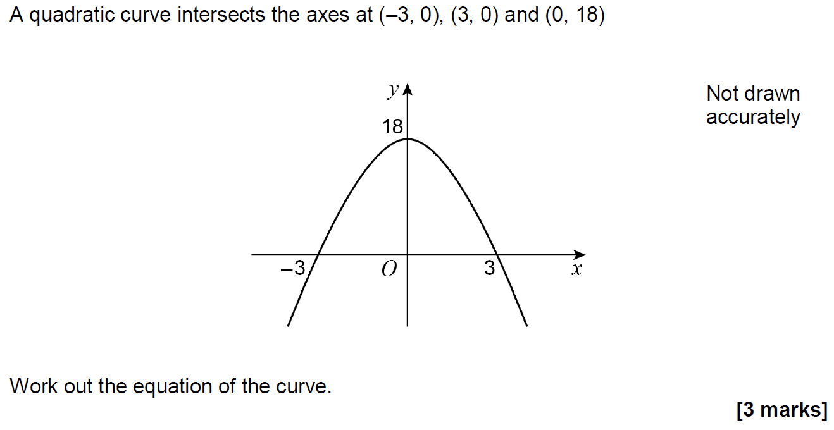
Solving Quadratics
Nov 2018 1H Q25

Slide 45
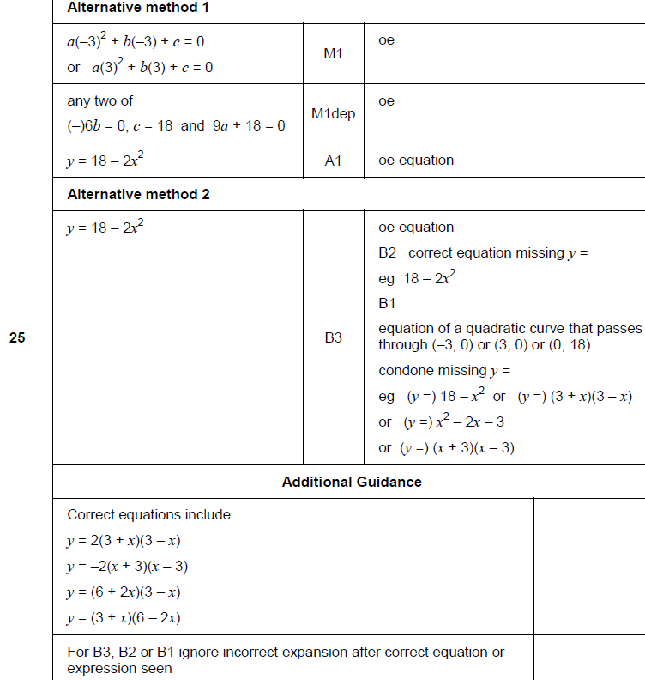
Solving Quadratics
Nov 2018 1H Q25
A

Slide 46
Solving Quadratics
SAM 3H Q2

Slide 47
Solving Quadratics
SAM 3H Q2
A (i)
A (ii)
B
C

Slide 48
Solving Quadratics
SAM 3H Q17

Slide 49
Solving Quadratics
SAM 3H Q17
A

Slide 50
Solving Quadratics
Practice 2H Q12

Slide 51
Solving Quadratics
Practice 2H Q12
A
B
C

Slide 52
Solving Quadratics
Practice 3H Q17

Slide 53
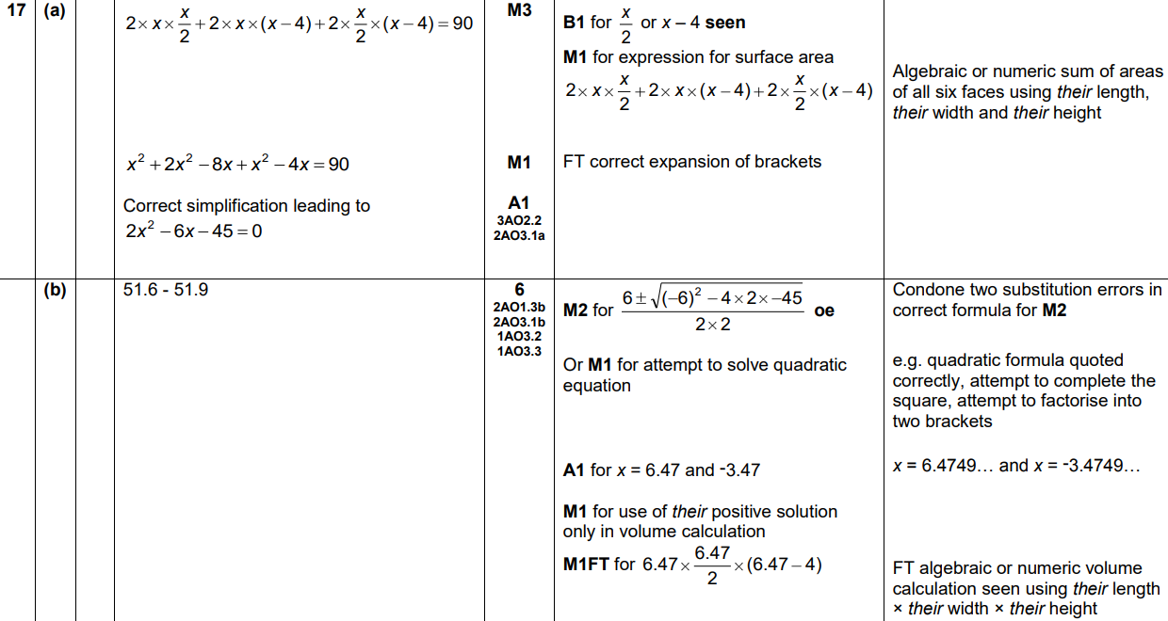
Solving Quadratics
Practice 3H Q17
A
B

Slide 54
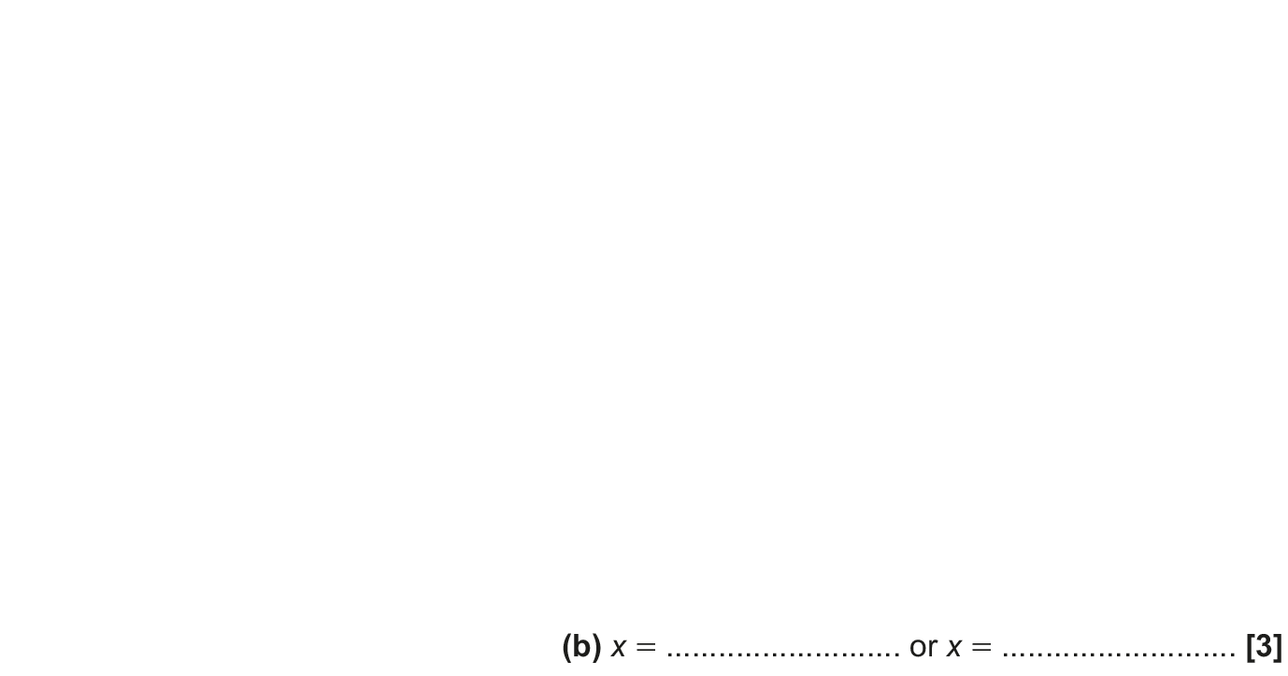
Solving Quadratics
May 2017 1H Q18

Slide 55
Solving Quadratics
May 2017 1H Q18
A
B

Slide 56
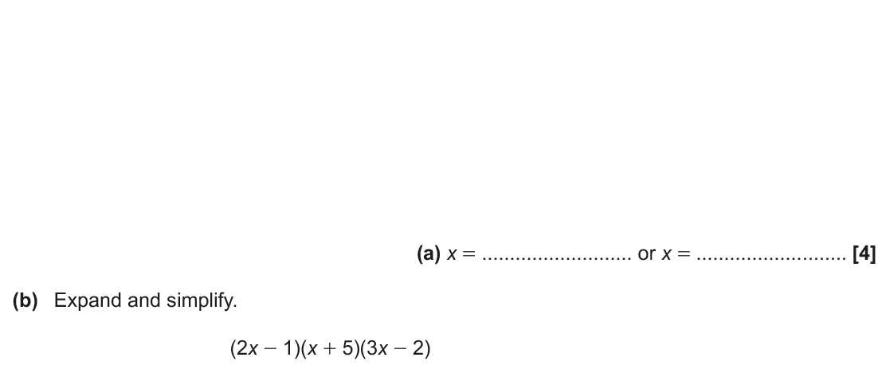
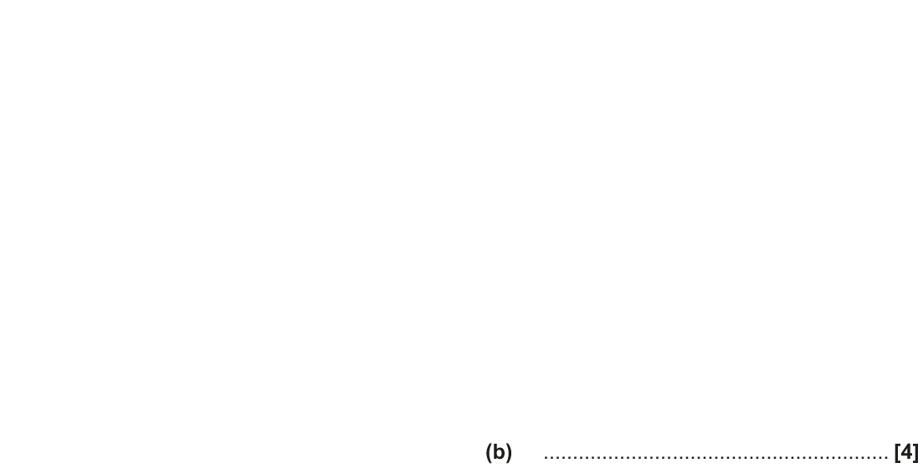
Solving Quadratics
Nov 2017 1H Q13

Slide 57
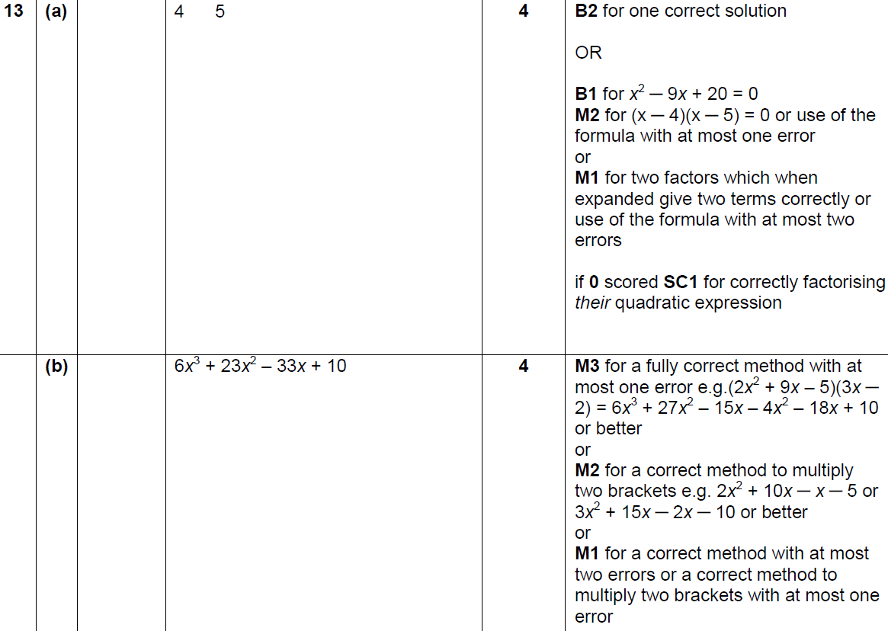
Solving Quadratics
Nov 2017 1H Q13
A
B

Slide 58
Solving Quadratics
Nov 2017 1H Q18

Slide 59
Solving Quadratics
Nov 2017 1H Q18
A

Slide 60
Solving Quadratics
May 2018 1H Q16

Slide 61
Solving Quadratics
May 2018 1H Q16
A

Slide 62
Solving Quadratics
May 2018 1H Q20

Slide 63
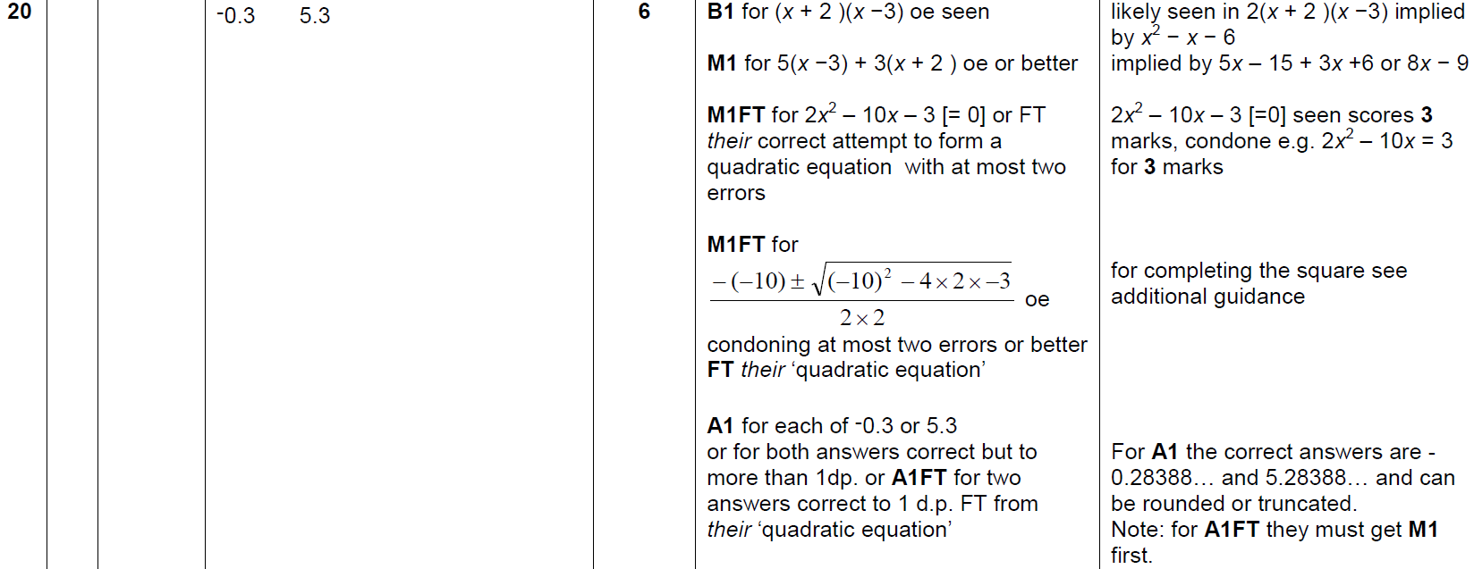
Solving Quadratics
May 2018 1H Q20
A

Slide 64
Solving Quadratics
Nov 2018 1H Q16

Slide 65
Solving Quadratics
Nov 2018 1H Q16
A

Slide 66
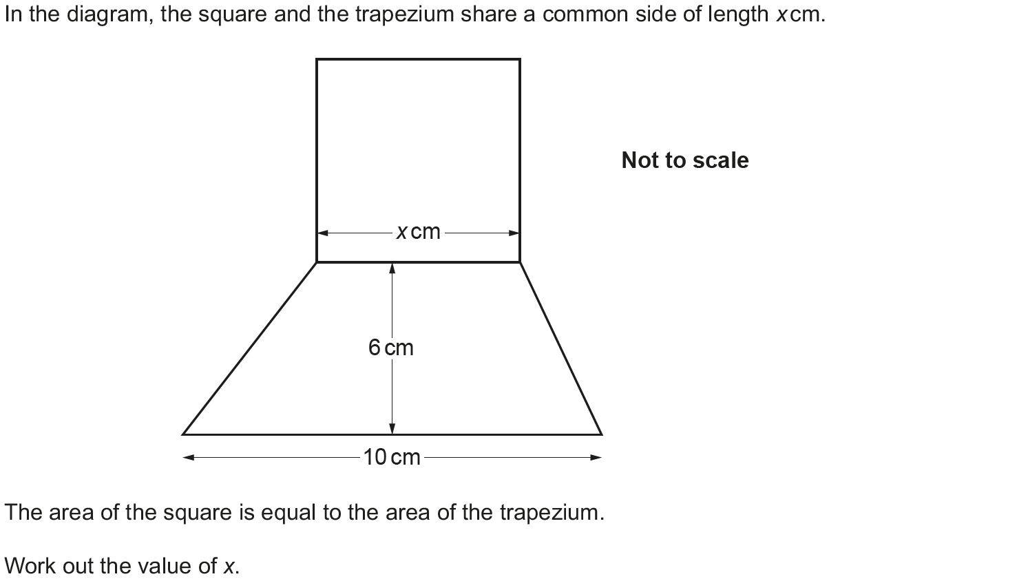
Solving Quadratics
Nov 2018 3H Q12

Slide 67
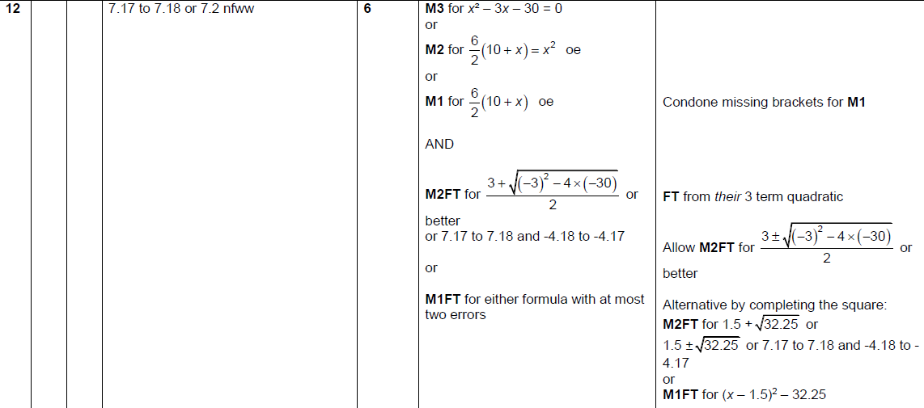
Solving Quadratics
Nov 2018 3H Q12
A

