Slide 1
Solving Quadratics
Solving Quadratics
Old Spec Q’s
SAM
1H Q6
May 2018
1HR Q16
SAM
1H Q15
June 2018
2HR Q20
May 2018
1H Q3
Jan 2019
1H Q12
May 2018
1H Q11
Jan 2019
1H Q20
June 2018
2H Q17
Jan 2019
2H Q15
Jan 2019
1HR Q13

Slide 2
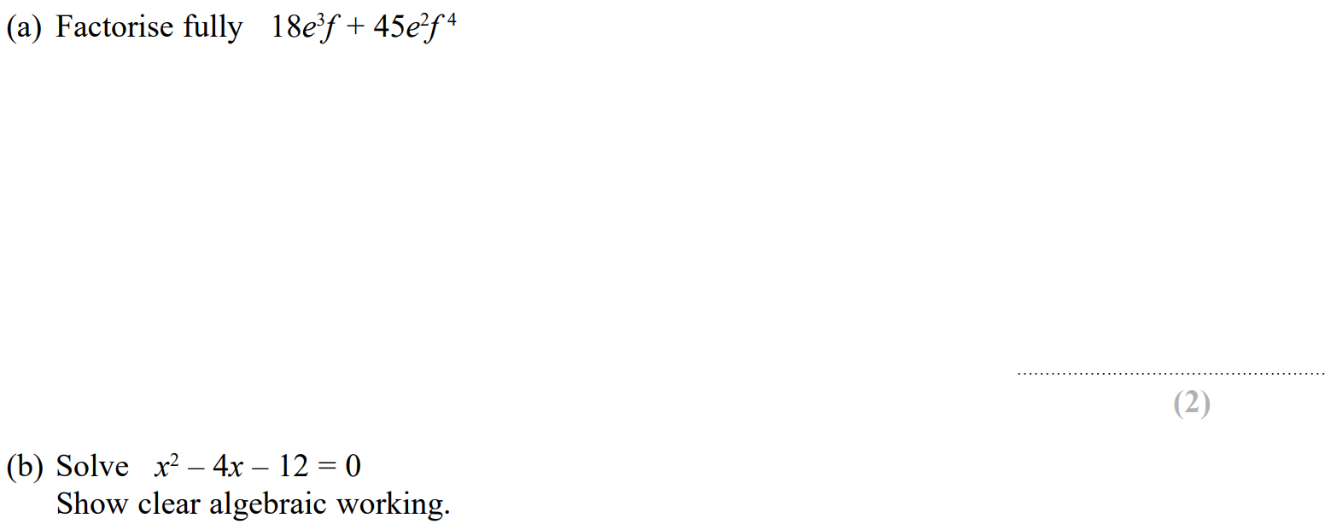
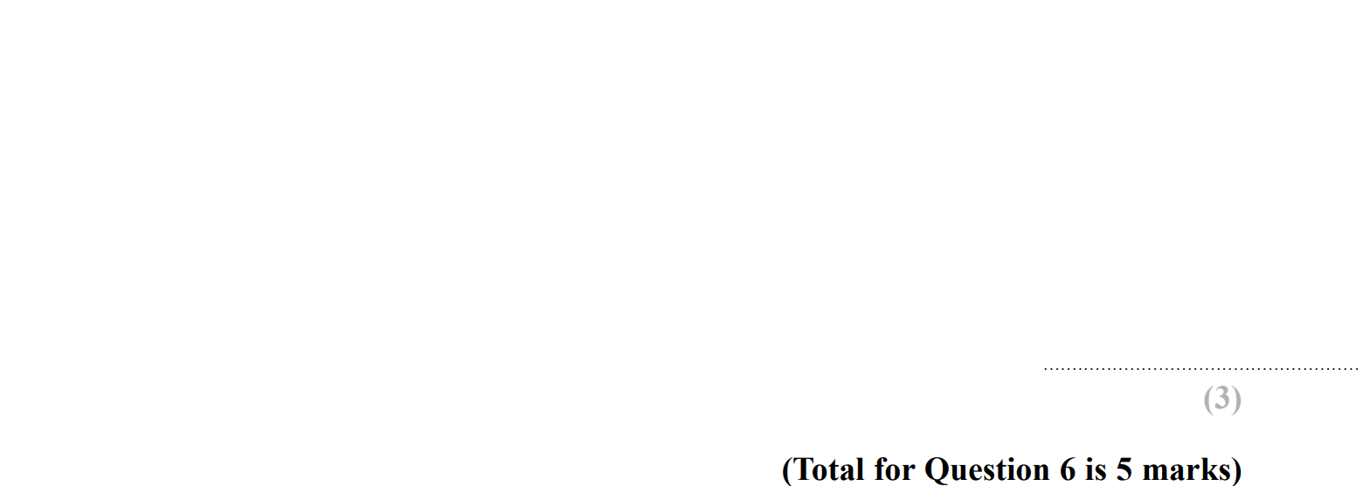
Solving Quadratics
SAM 1H Q6

Slide 3
Solving Quadratics
SAM 1H Q6
A
B

Slide 4
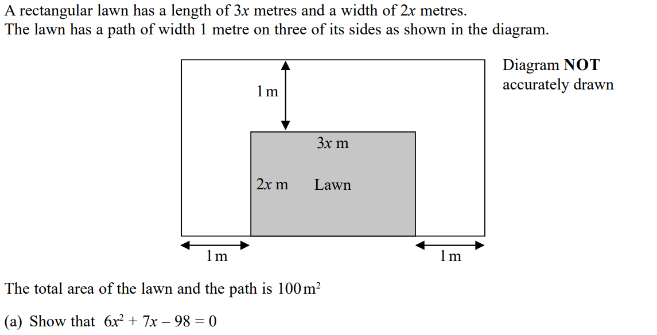
Solving Quadratics
SAM 1H Q15

Slide 5
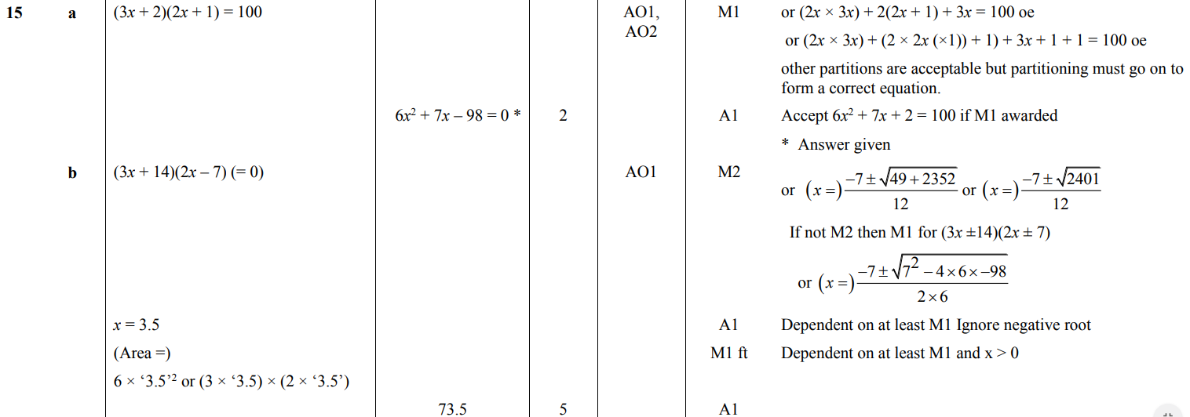
Solving Quadratics
SAM 1H Q15
A
B

Slide 6
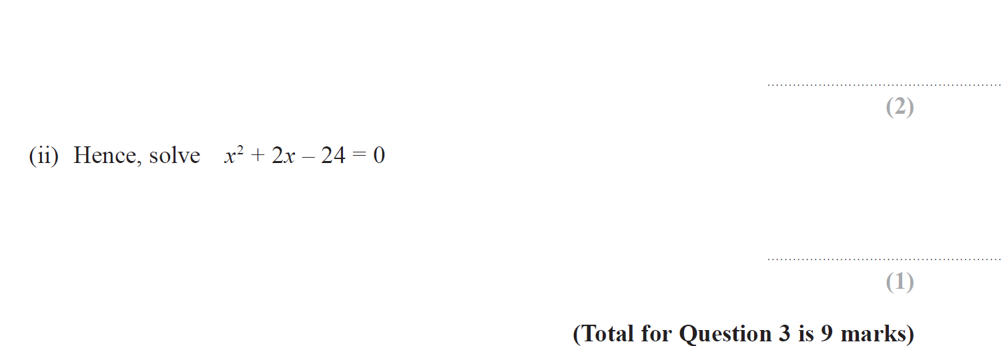
Solving Quadratics
May 2018 1H Q3

Slide 7
Solving Quadratics
May 2018 1H Q3
A
B
C
D (i)
D (ii)

Slide 8
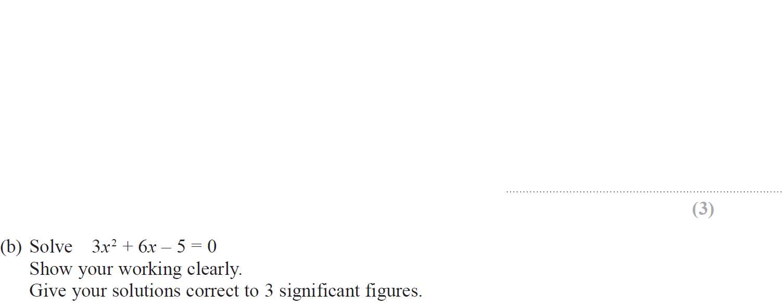
Solving Quadratics
May 2018 1H Q11

Slide 9
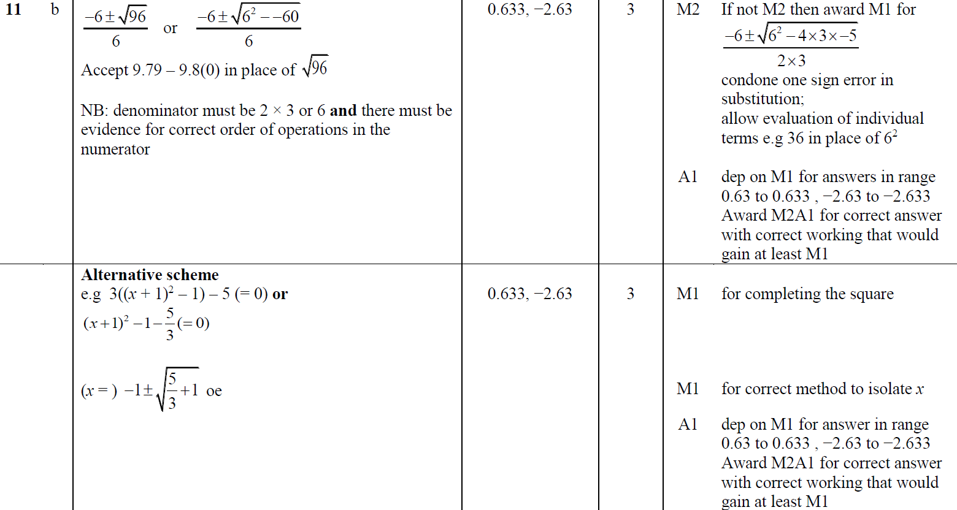
Solving Quadratics
May 2018 1H Q11
A
B

Slide 10
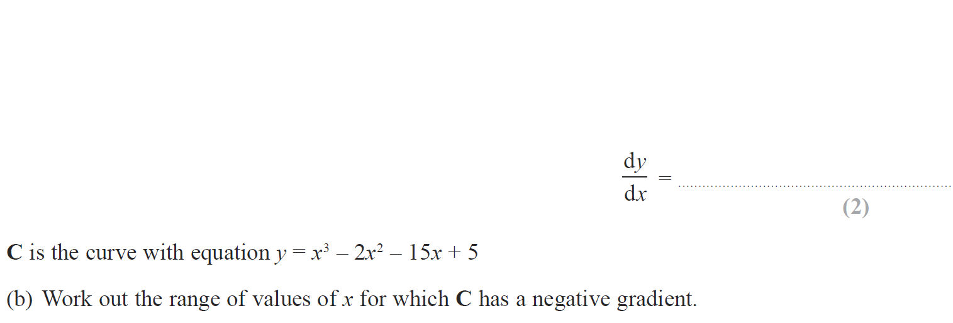
Solving Quadratics
June 2018 2H Q17

Slide 11
Solving Quadratics
June 2018 2H Q17
A
B

Slide 12
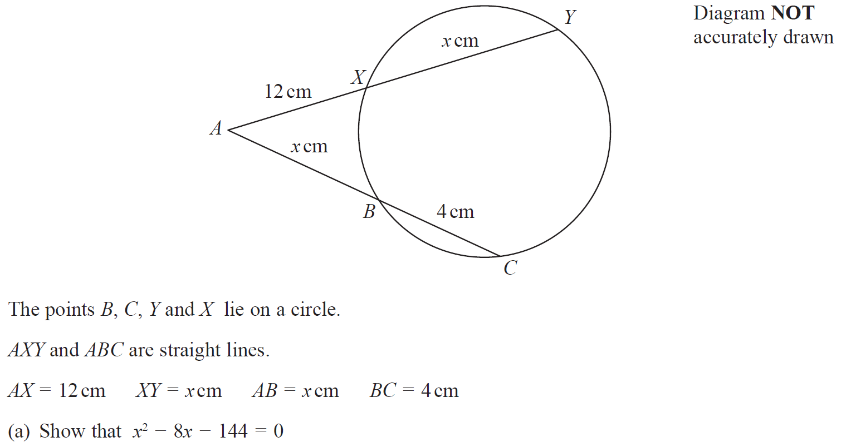
Solving Quadratics
May 2018 1HR Q16

Slide 13
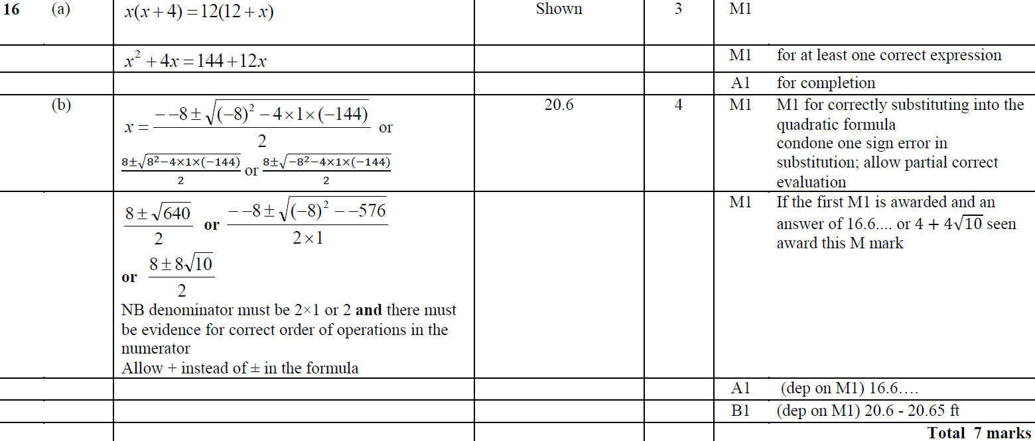
Solving Quadratics
May 2018 1HR Q16
A
B

Slide 14
Solving Quadratics
June 2018 2HR Q20

Slide 15
Solving Quadratics
June 2018 2HR Q20
A

Slide 16
Solving Quadratics
Jan 2019 1H Q12

Slide 17
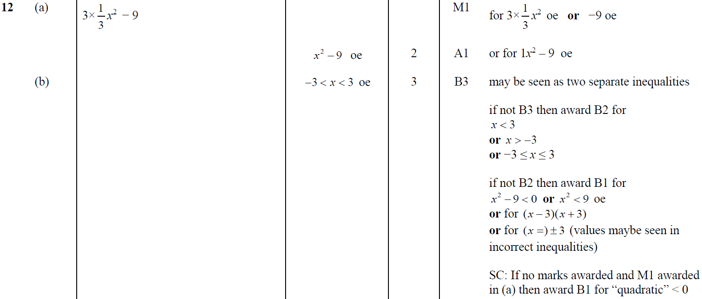
Solving Quadratics
Jan 2019 1H Q12
A
B

Slide 18
Solving Quadratics
Jan 2019 1H Q20

Slide 19
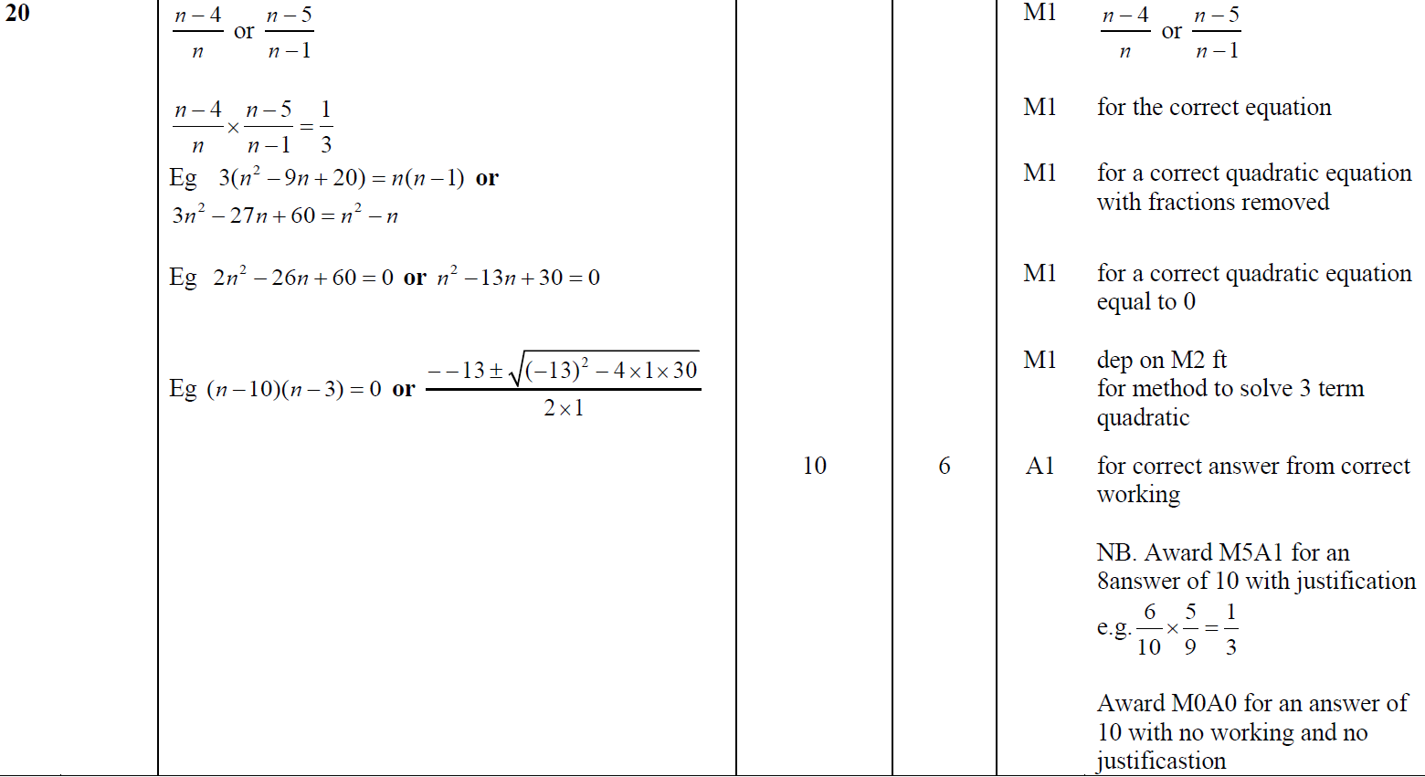
Solving Quadratics
Jan 2019 1H Q20
A

Slide 20
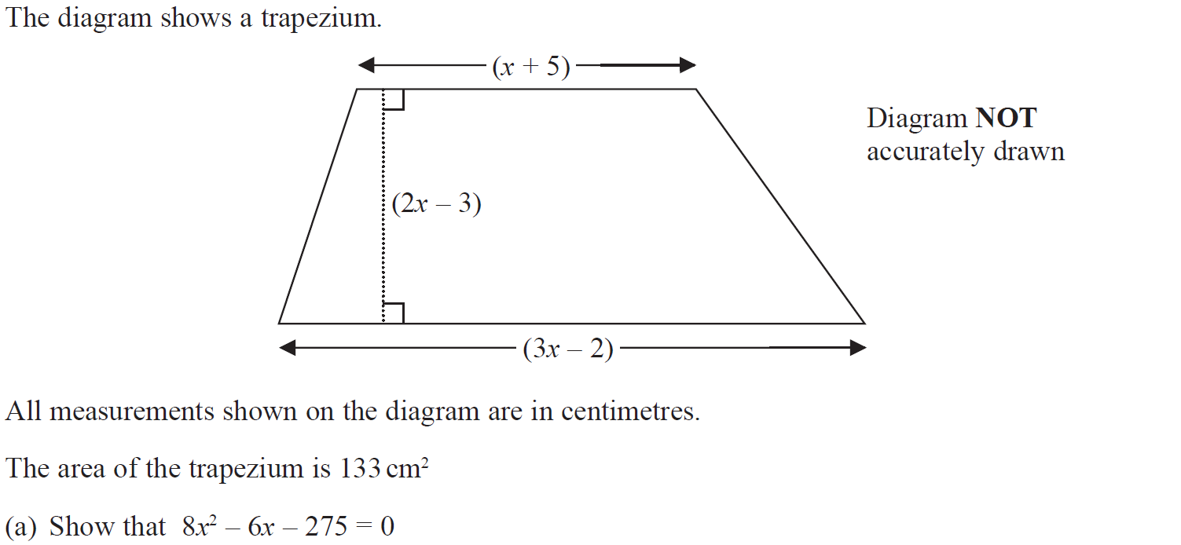
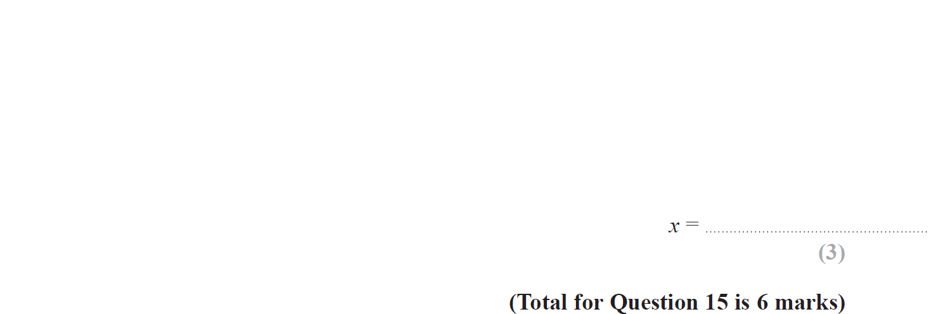
Solving Quadratics
Jan 2019 2H Q15

Slide 21
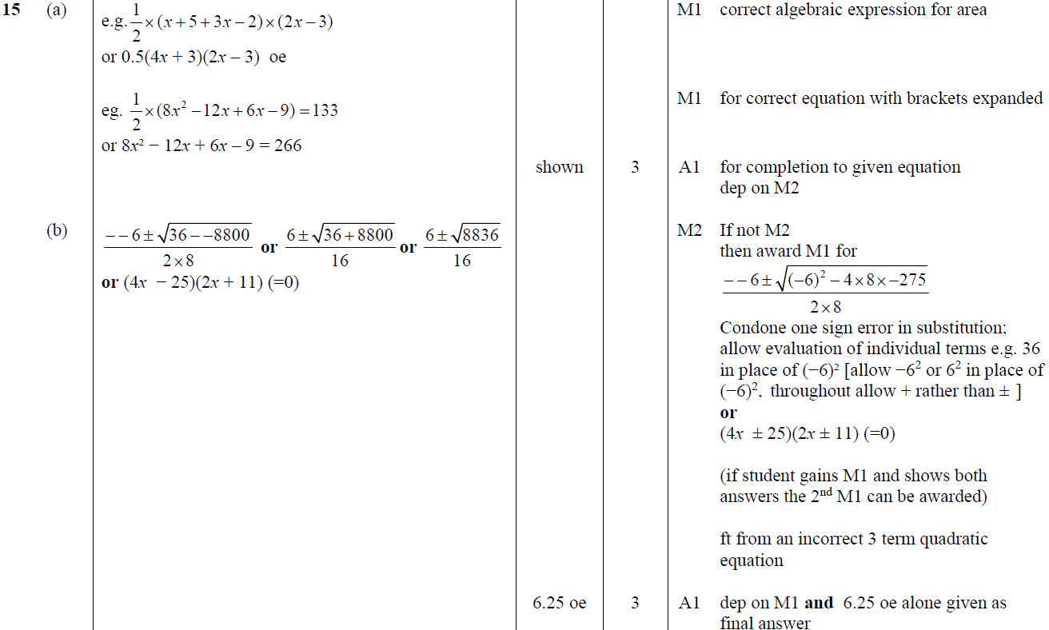
Solving Quadratics
Jan 2019 2H Q15
A
B

Slide 22
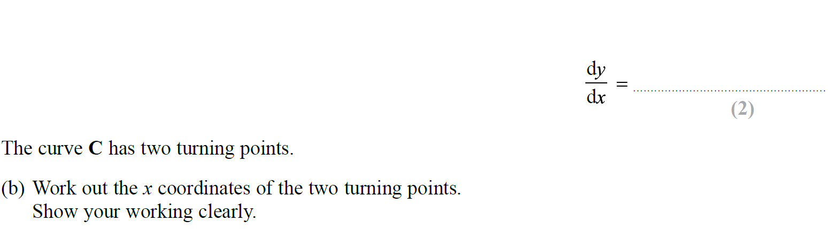
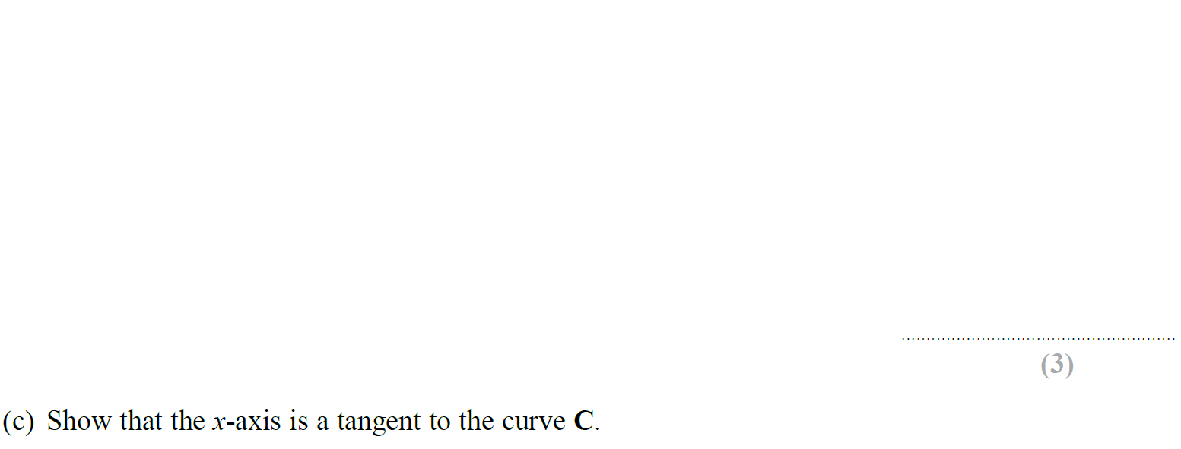
Solving Quadratics
Jan 2019 1HR Q13

Slide 23
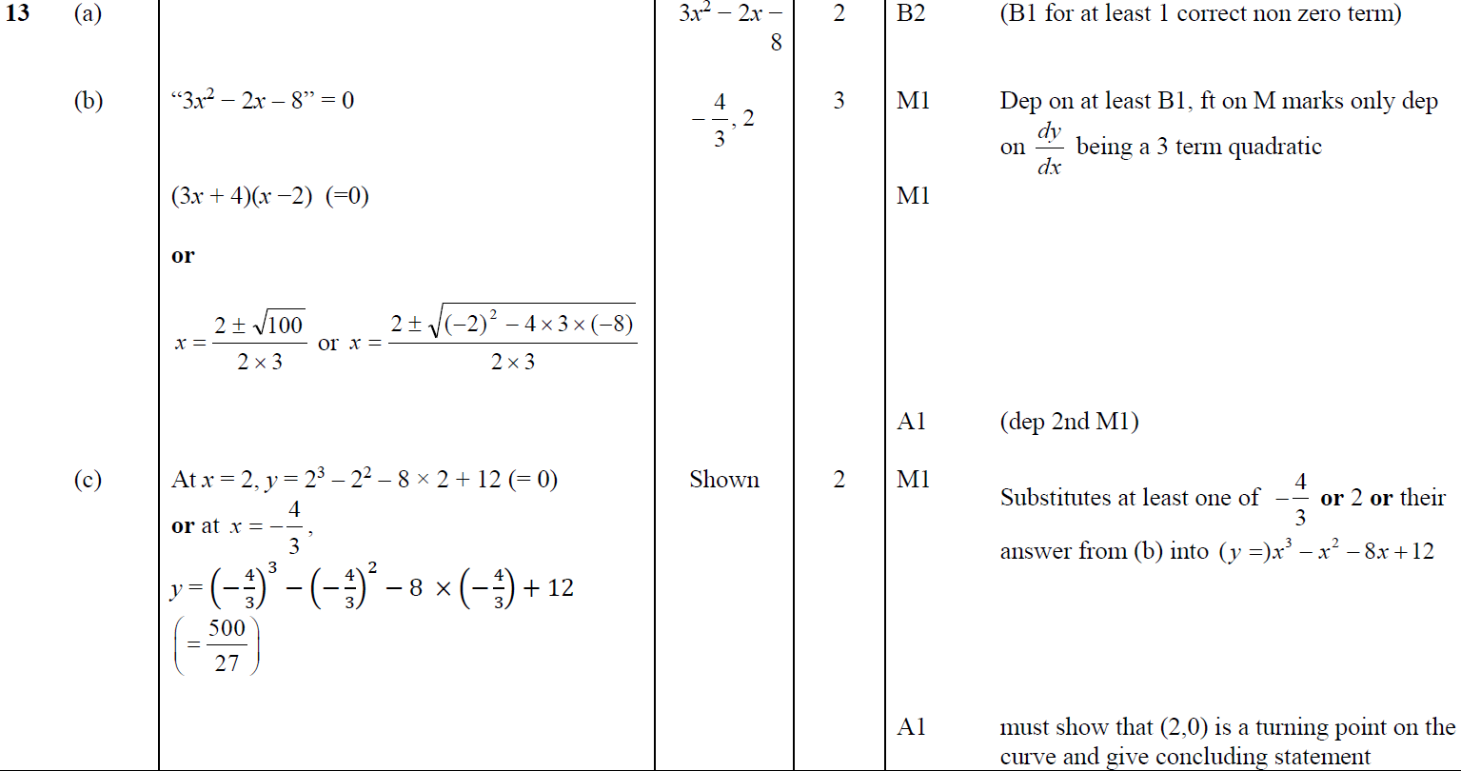
Solving Quadratics
Jan 2019 1HR Q13
A
B
C

Slide 24
Solving Quadratics
Solving Quadratics
New Spec Q’s
Nov 2004
3H Q15
Nov 2007
4H Q25
June 2011 4H Q21
Jan 2014 4H Q18
Jan 2015 4HR Q14
May 2016 3HR Q15
Jan 2018 3HR Q17
Nov 2004
4H Q22
May 2008
3H Q14
Jan 2012 3H Q21
Jan 2014 3HR Q18
Jan 2015 4HR Q20
June 2016 4HR Q16
Jan 2018 4HR Q16
May 2005
3H Q17
May 2008
4H Q16
Jan 2012 4H Q15
Jan 2014 4HR Q15
June 2015 4H Q13
Jan 2017 3H Q17
Jan 2018 4HR Q19
Nov 2005
3H Q15
Nov 2008
4H Q13
Jan 2013 3H Q19
May 2014 3H Q23
June 2015 4H Q21
Jan 2017 4H Q18
May 2018 3H Q13
Nov 2005
4H Q11
June 2009
4H Q16
Jan 2013 4H Q18
May 2014 4H Q18
May 2015 3HR Q19
Jan 2017 3HR Q20
May 2018 3H Q21
May 2006
3H Q23
June 2009
4H Q21
May 2013 3H Q20
May 2014 3HR Q19
Jan 2016 3H Q16
Jan 2017 4HR Q21
May 2018 3HR Q14
May 2006
4H Q8
Nov 2009
3H Q24
May 2013 4H Q23
May 2014 3HR Q20
Jan 2016 4H Q22
June 2017 4H Q15
June 2018 4HR Q19
Nov 2006
4H Q25
June 2010
4H Q13
May 2013 3HR Q21
May 2014 4HR Q16
Jan 2016 3HR Q12
May 2017 3HR Q15
June 2018 4HR Q22
May 2007
4H Q14
Nov 2010
4H Q18
Jan 2014 3H Q20
Jan 2015 4H Q17
May 2016 3H Q17
June 2017 4HR Q17
Inequalities
See also:
Simultaneous Equations

Slide 25
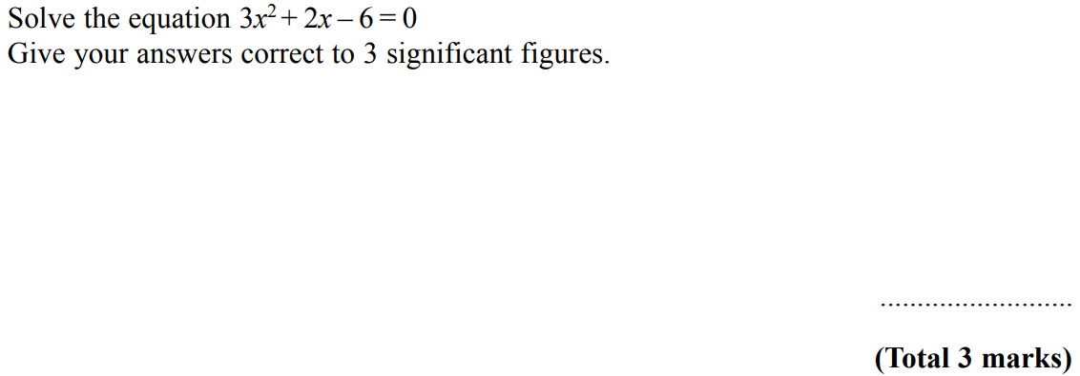
Solving Quadratics
Nov 2004 3H Q15

Slide 26
Solving Quadratics
Nov 2004 3H Q15
A

Slide 27
Solving Quadratics
Nov 2004 4H Q22

Slide 28
Solving Quadratics
Nov 2004 4H Q22
A

Slide 29
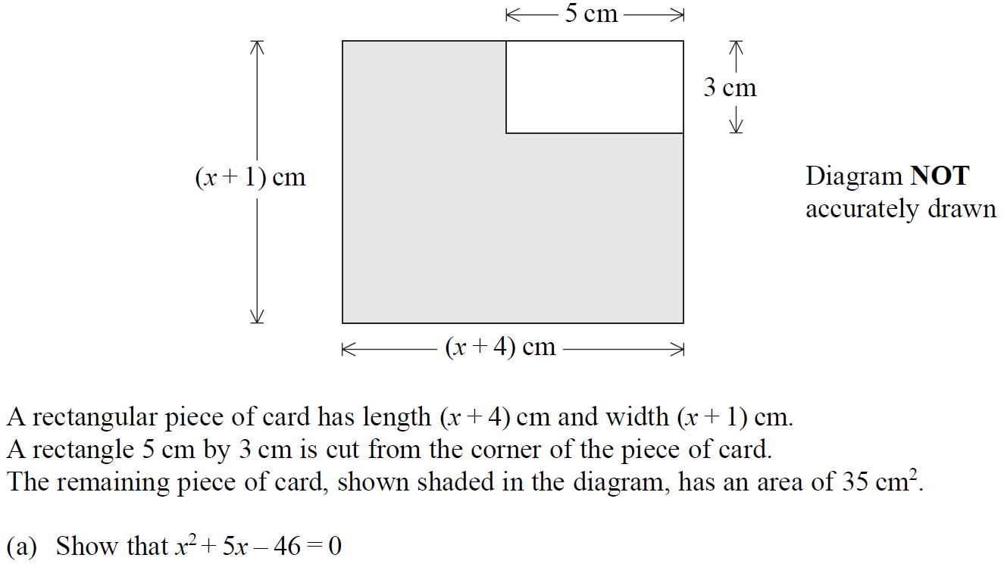
Solving Quadratics
May 2005 3H Q17

Slide 30
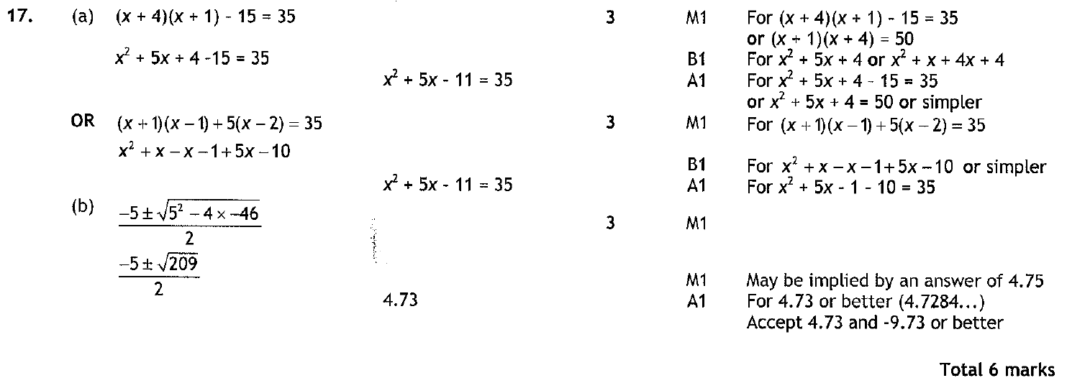
Solving Quadratics
May 2005 3H Q17
A
B

Slide 31
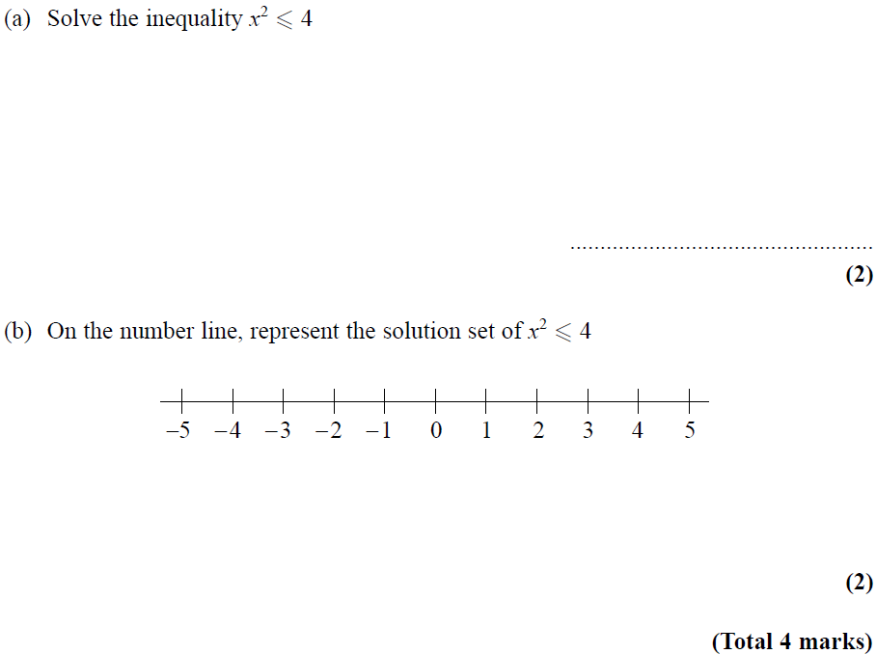
Solving Quadratics
Nov 2005 3H Q15

Slide 32
Solving Quadratics
Nov 2005 3H Q15
A
B

Slide 33
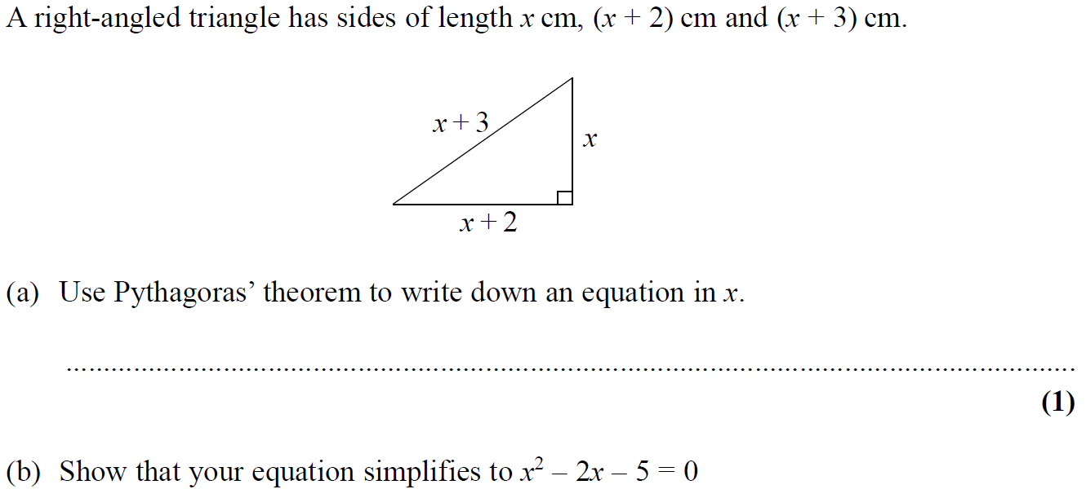
Solving Quadratics
Nov 2005 4H Q11

Slide 34
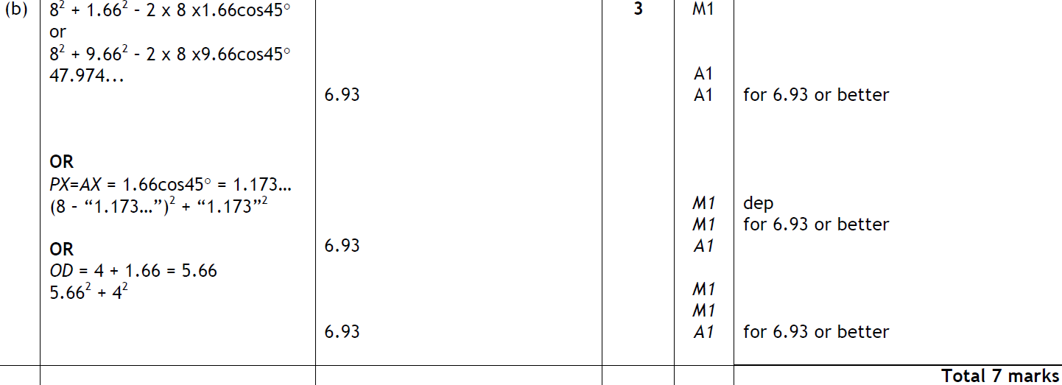
Solving Quadratics
Nov 2005 4H Q11
A
B

Slide 35
Solving Quadratics
May 2006 3H Q23

Slide 36
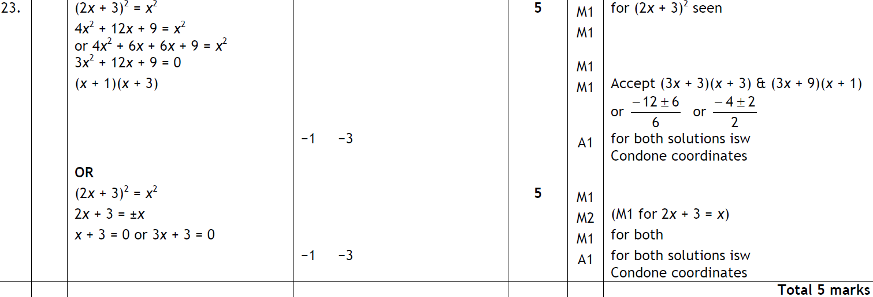
Solving Quadratics
May 2006 3H Q23
A

Slide 37
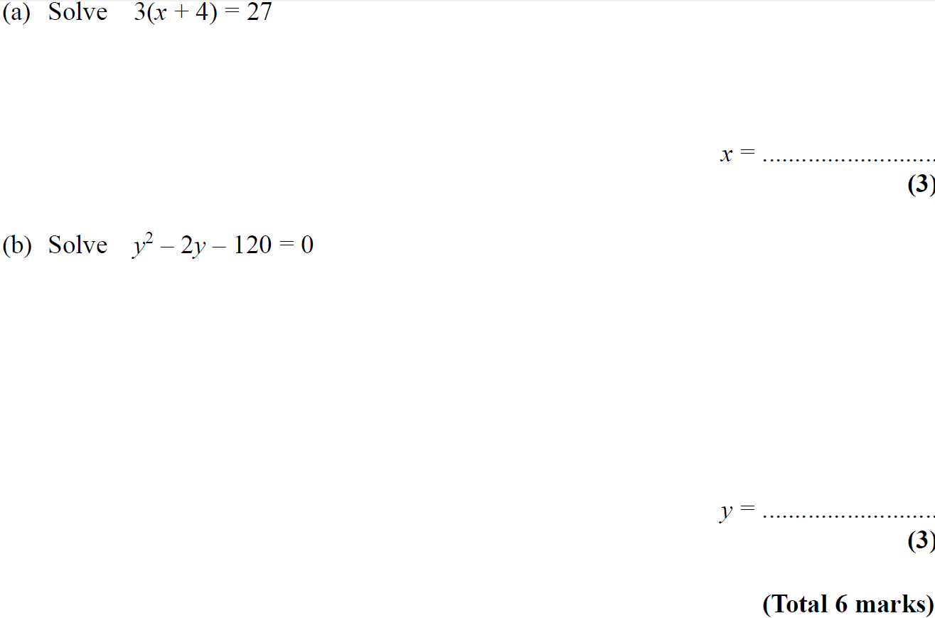
Solving Quadratics
May 2006 4H Q8

Slide 38
Solving Quadratics
May 2006 4H Q8
A
B

Slide 39
Solving Quadratics
Nov 2006 4H Q25

Slide 40
Solving Quadratics
Nov 2006 4H Q25
A
B

Slide 41
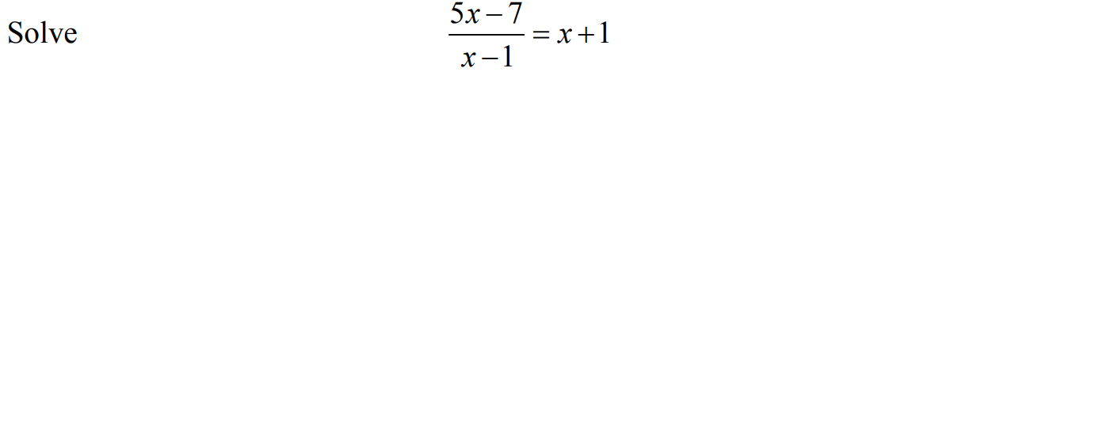
Solving Quadratics
May 2007 4H Q14

Slide 42
Solving Quadratics
May 2007 4H Q14
A

Slide 43
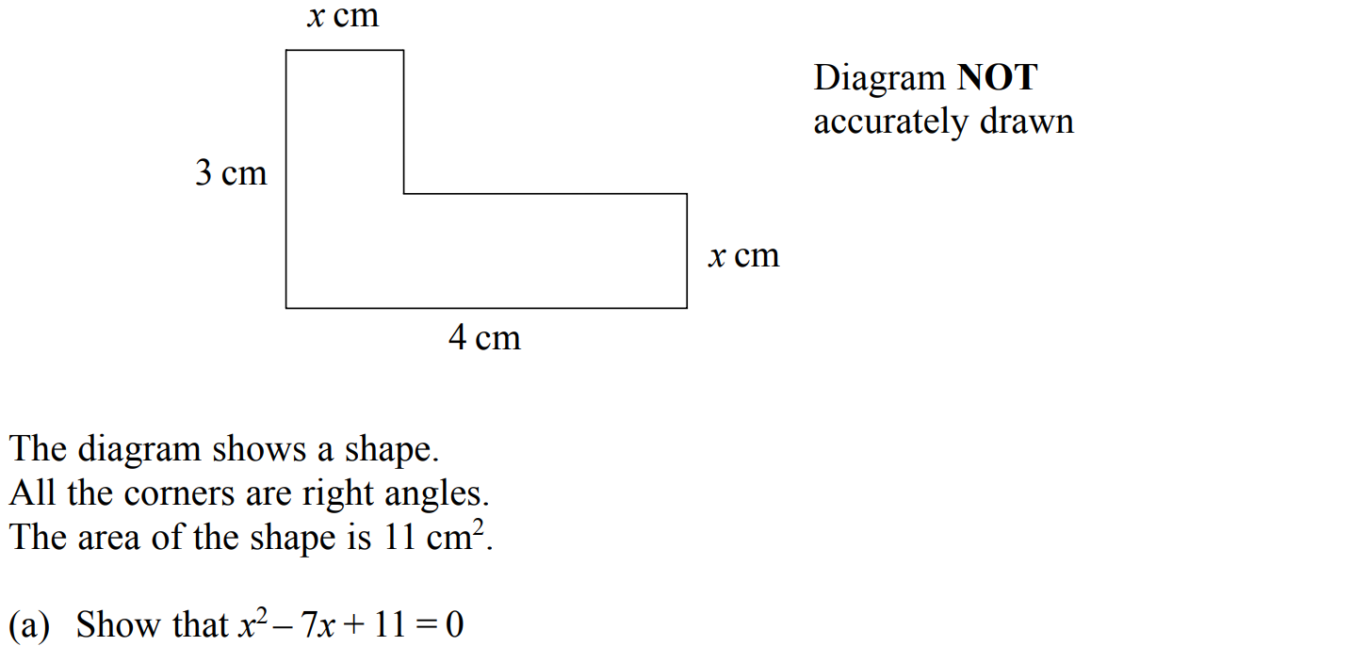
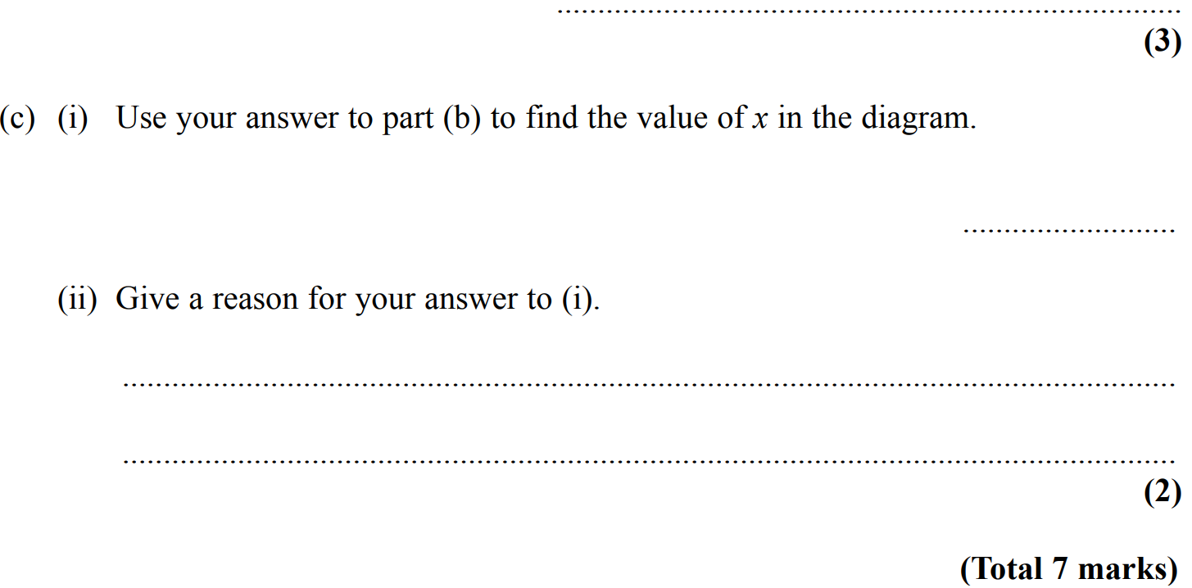
Solving Quadratics
Nov 2007 4H Q25

Slide 44
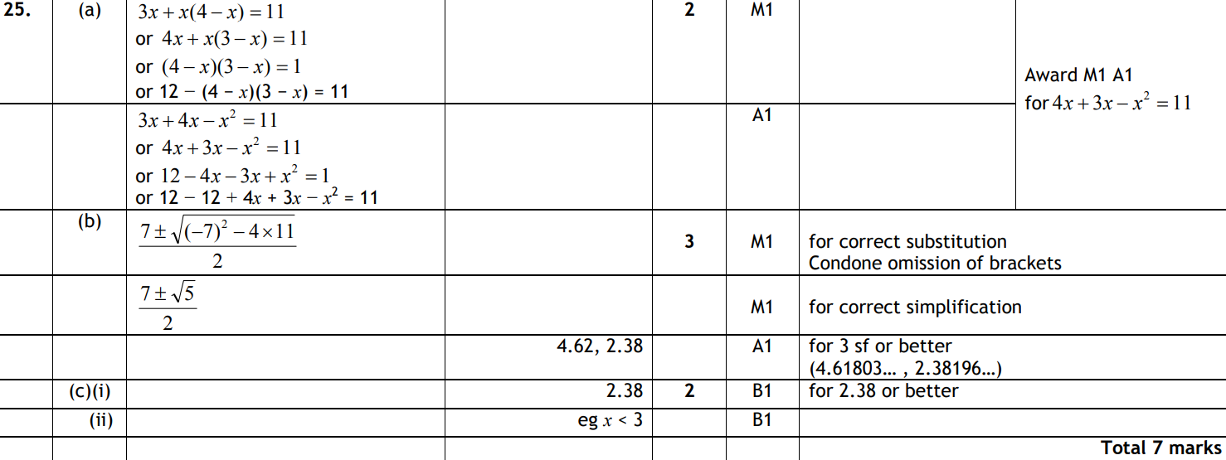
Solving Quadratics
Nov 2007 4H Q25
A
B
C (i)
C (ii)

Slide 45
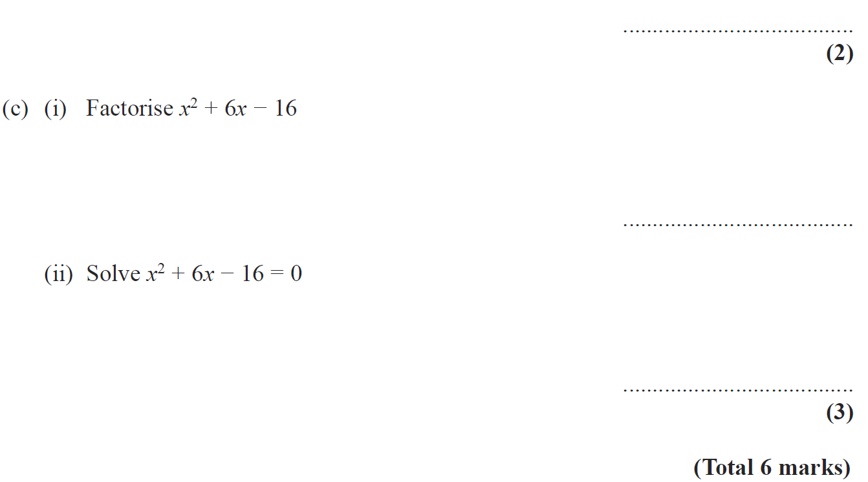
Solving Quadratics
May 2008 3H Q14

Slide 46
Solving Quadratics
May 2008 3H Q14
A
B
C (i)
C (ii)

Slide 47
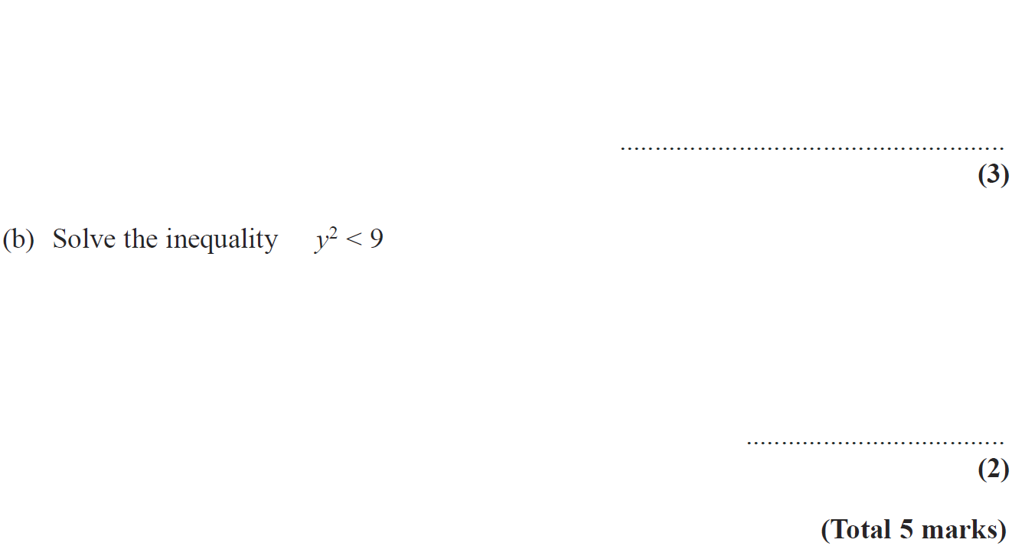
Solving Quadratics
May 2008 4H Q16

Slide 48
Solving Quadratics
May 2008 4H Q16
A
B

Slide 49
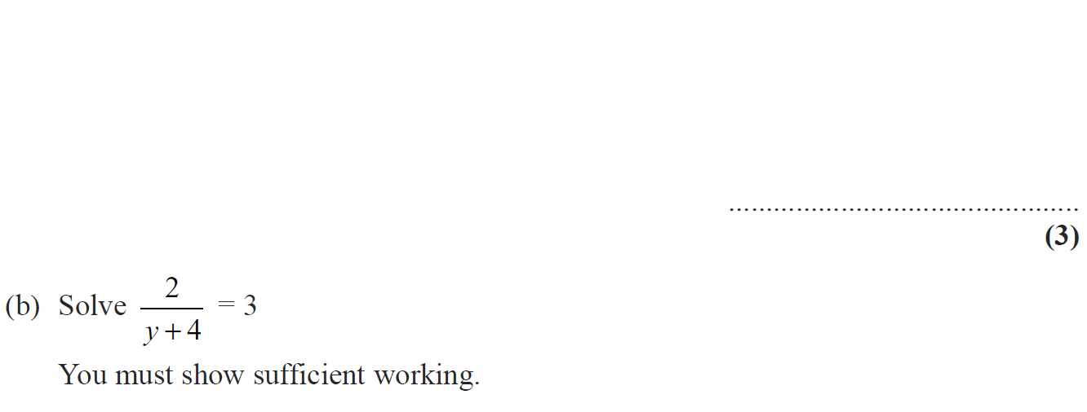
Solving Quadratics
Nov 2008 4H Q13

Slide 50
Solving Quadratics
Nov 2008 4H Q13
A
B

Slide 51
Solving Quadratics
June 2009 4H Q16

Slide 52
Solving Quadratics
June 2009 4H Q16
A
B

Slide 53
Solving Quadratics
June 2009 4H Q21

Slide 54
Solving Quadratics
June 2009 4H Q21
A
B

Slide 55
Solving Quadratics
Nov 2009 3H Q24

Slide 56
Solving Quadratics
Nov 2009 3H Q24
A (i)
A (ii)
B

Slide 57
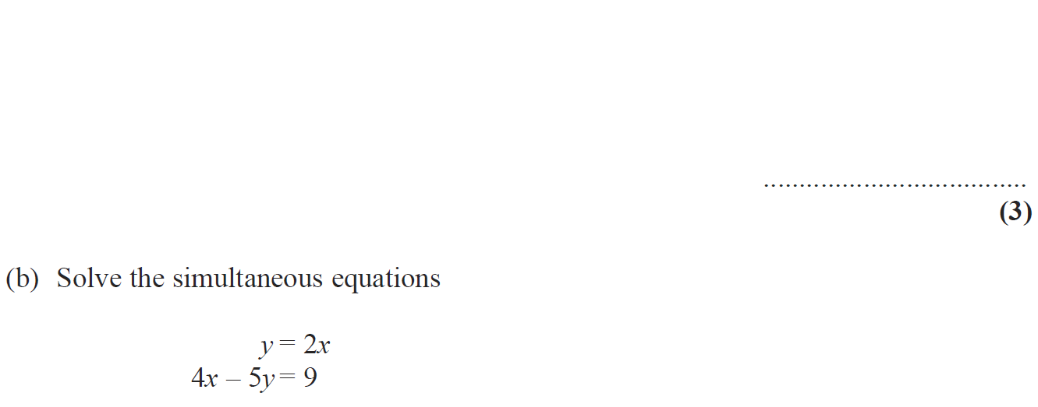
Solving Quadratics
June 2010 4H Q13

Slide 58
Solving Quadratics
June 2010 4H Q13
A
B

Slide 59
Solving Quadratics
Nov 2010 4H Q18

Slide 60
Solving Quadratics
Nov 2010 4H Q18
A

Slide 61
Solving Quadratics
June 2011 4H Q21

Slide 62
Solving Quadratics
June 2011 4H Q21
A
B

Slide 63
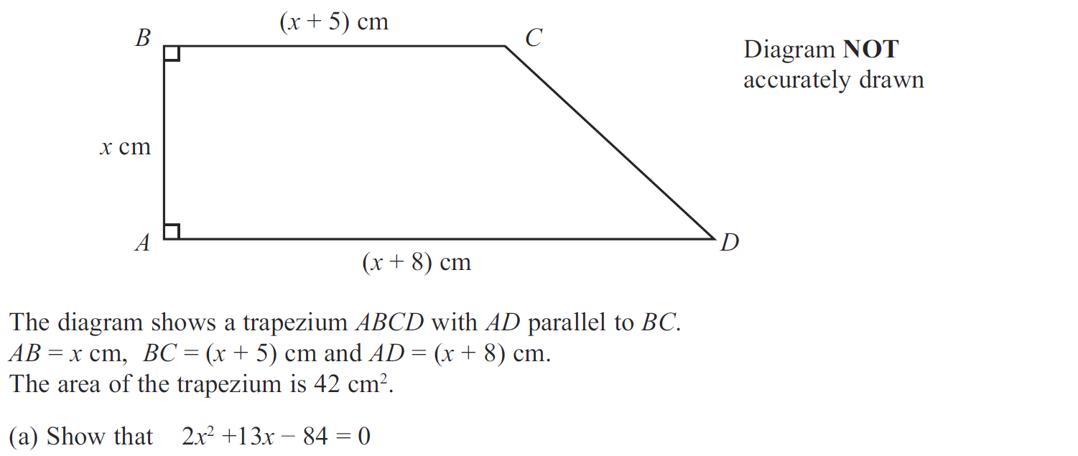
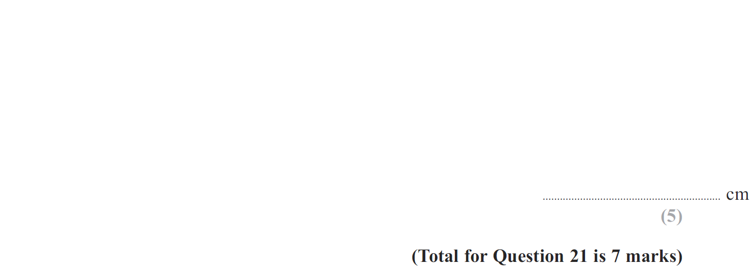
Solving Quadratics
Jan 2012 3H Q21

Slide 64
Solving Quadratics
Jan 2012 3H Q21
A
B

Slide 65
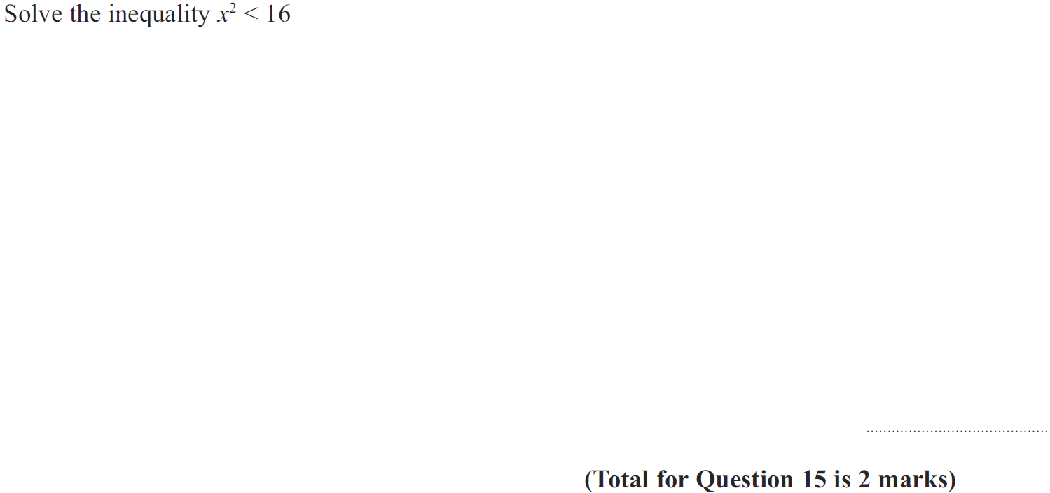
Solving Quadratics
Jan 2012 4H Q15

Slide 66
Solving Quadratics
Jan 2012 4H Q15
A

Slide 67
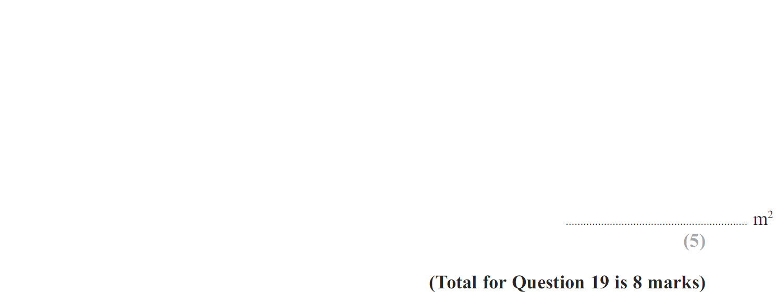
Solving Quadratics
Jan 2013 3H Q19

Slide 68
Solving Quadratics
Jan 2013 3H Q19
A
B

Slide 69
Solving Quadratics
Jan 2013 4H Q18

Slide 70
Solving Quadratics
Jan 2013 4H Q18
A

Slide 71
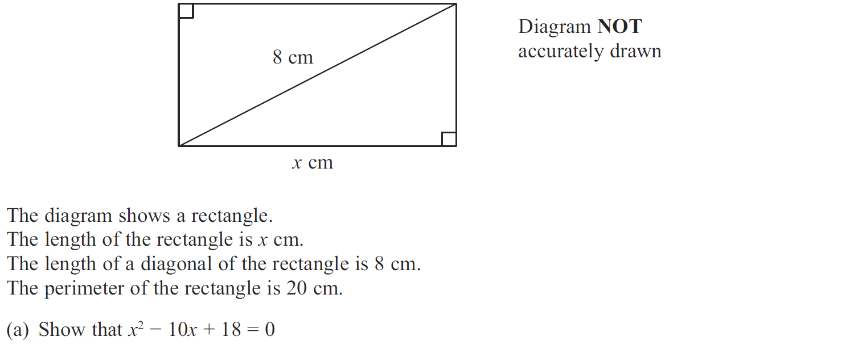
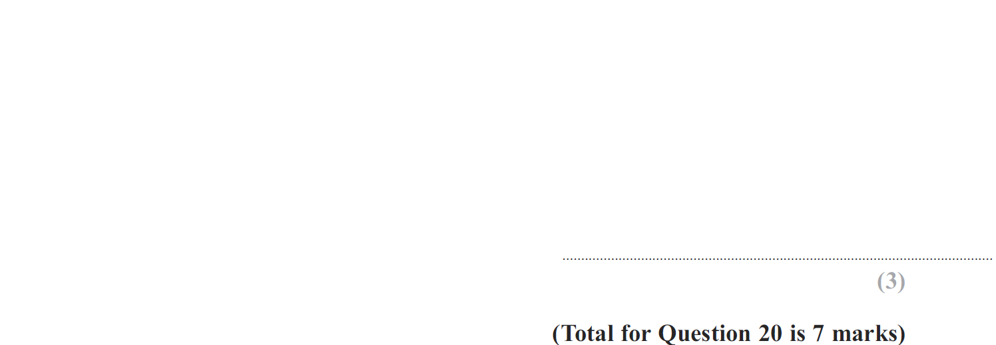
Solving Quadratics
May 2013 3H Q20

Slide 72
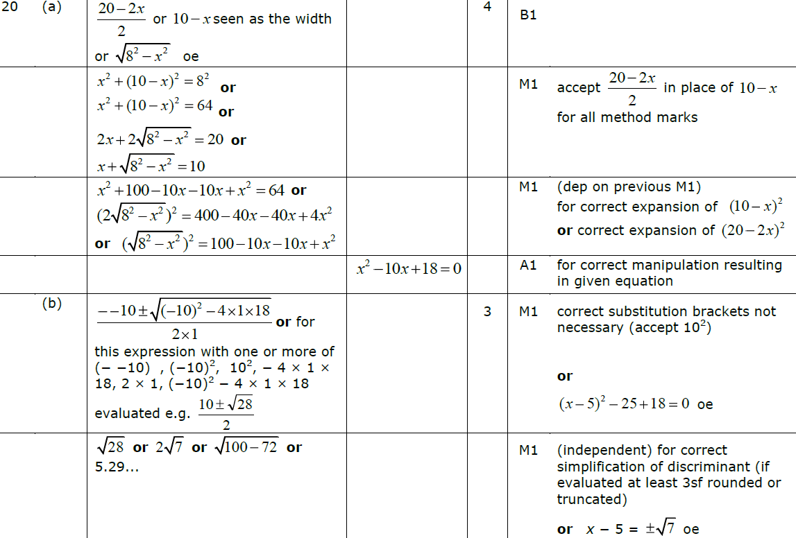
Solving Quadratics
May 2013 3H Q20
A
B

Slide 73
Solving Quadratics
May 2013 4H Q23

Slide 74
Solving Quadratics
May 2013 4H Q23
A

Slide 75
Solving Quadratics
May 2013 3HR Q21

Slide 76
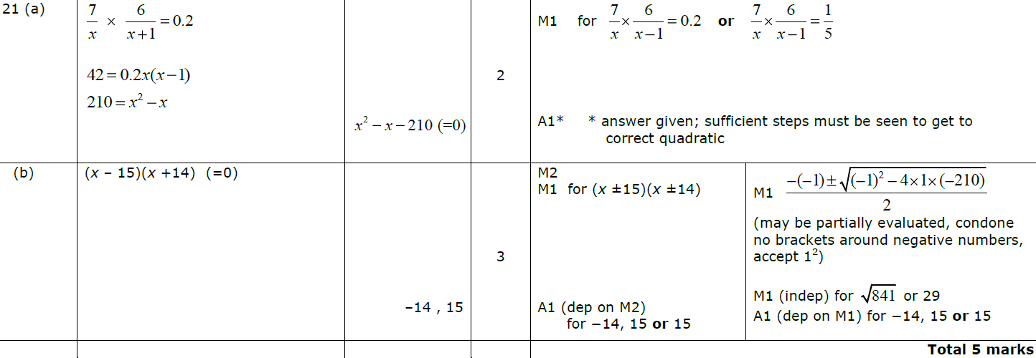
Solving Quadratics
May 2013 3HR Q21
A
B

Slide 77
Solving Quadratics
Jan 2014 3H Q20

Slide 78
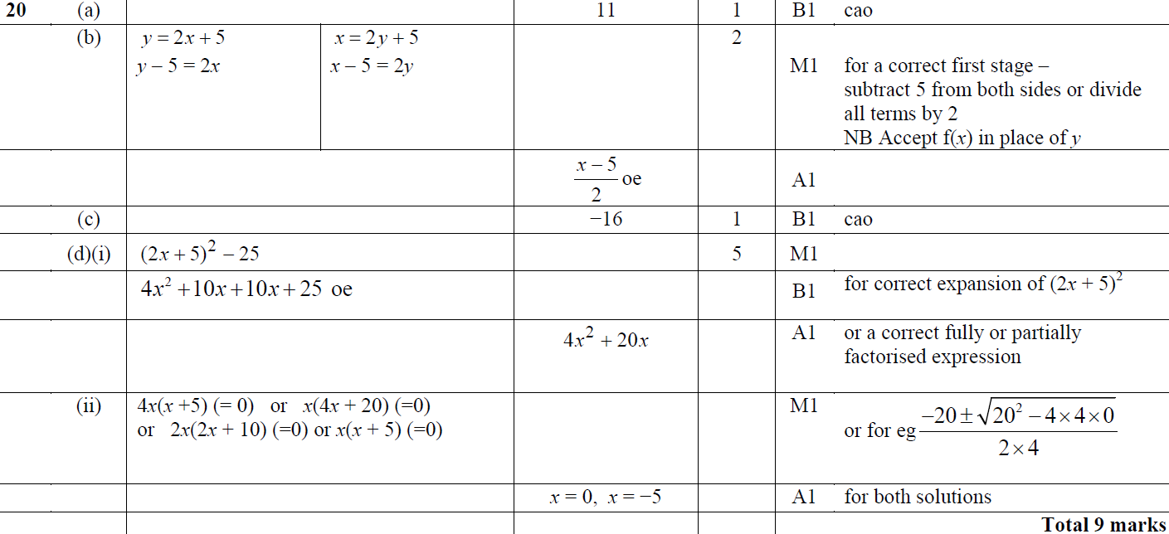
Solving Quadratics
Jan 2014 3H Q20
A
B
C
D (i)
D (ii)

Slide 79
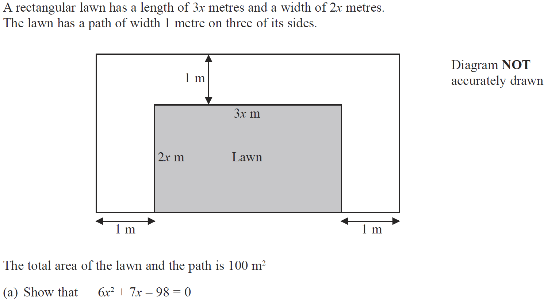
Solving Quadratics
Jan 2014 4H Q18

Slide 80
Solving Quadratics
Jan 2014 4H Q18
A
B

Slide 81
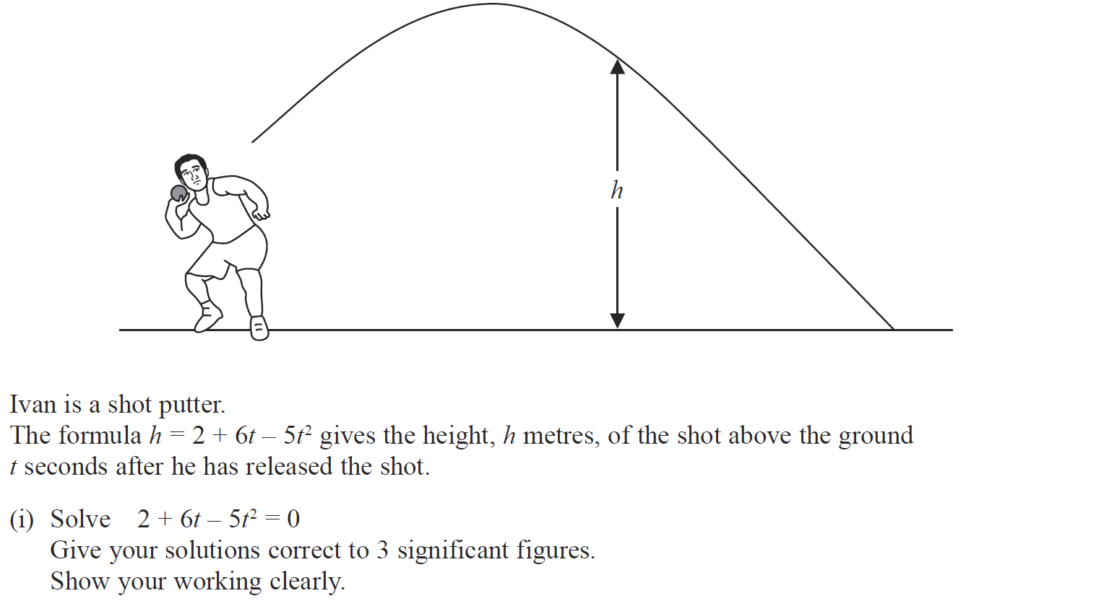
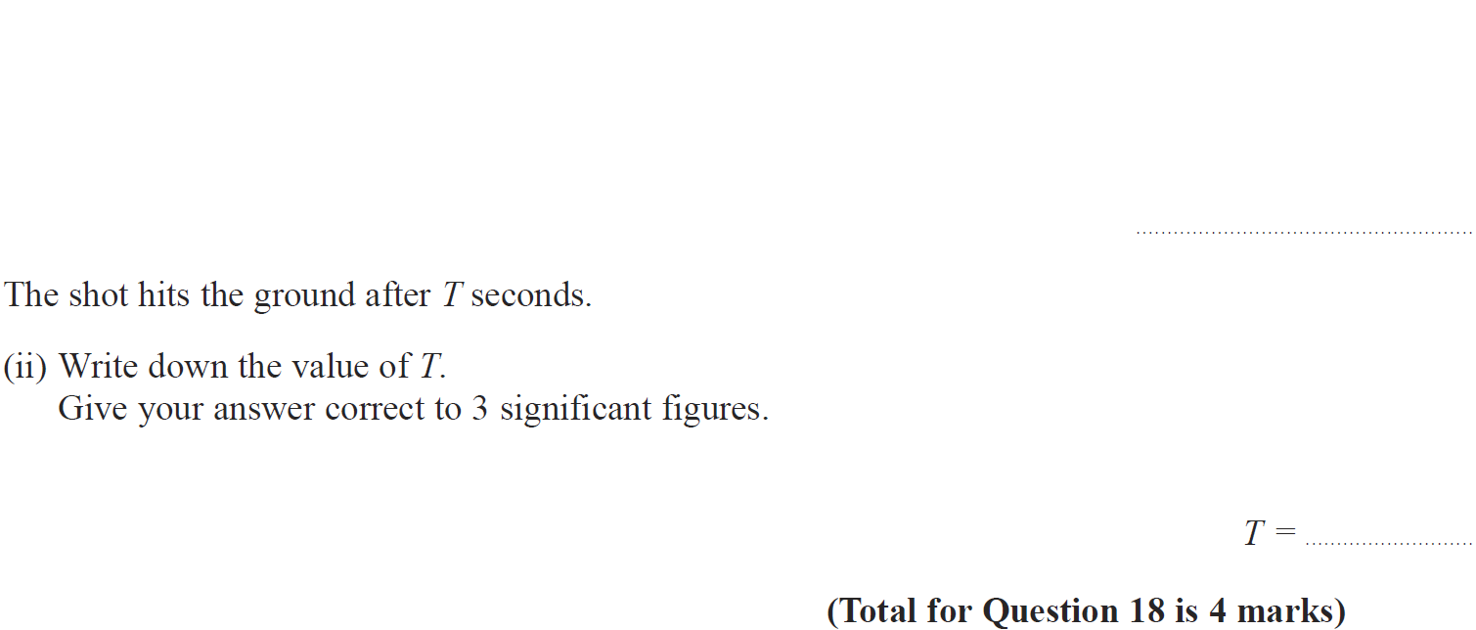
Solving Quadratics
Jan 2014 3HR Q18

Slide 82
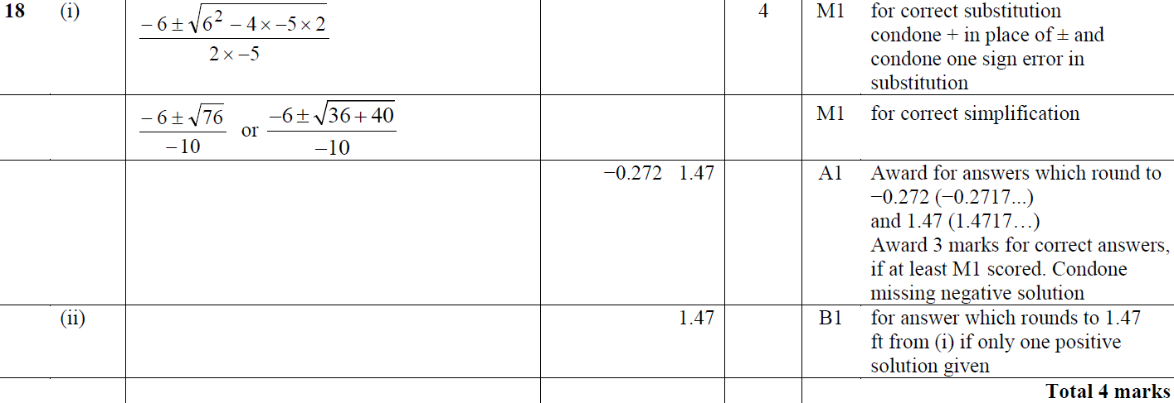
Solving Quadratics
Jan 2014 3HR Q18
A
B

Slide 83
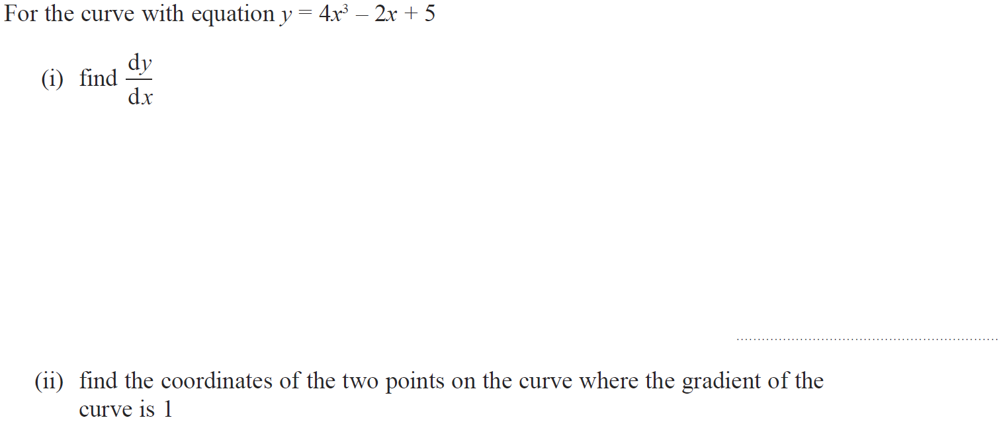
Solving Quadratics
Jan 2014 4HR Q15

Slide 84
Solving Quadratics
Jan 2014 4HR Q15
(i)
(ii)

Slide 85
Solving Quadratics
May 2014 3H Q23

Slide 86
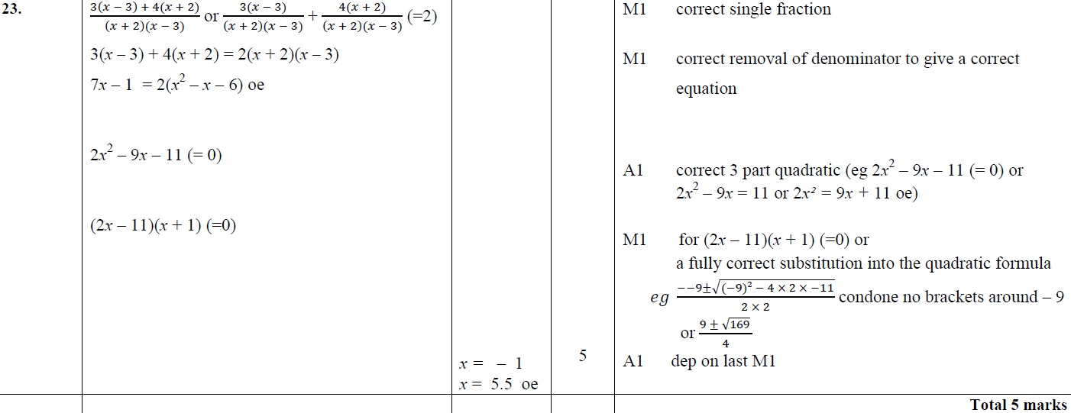
Solving Quadratics
May 2014 3H Q23
A

Slide 87
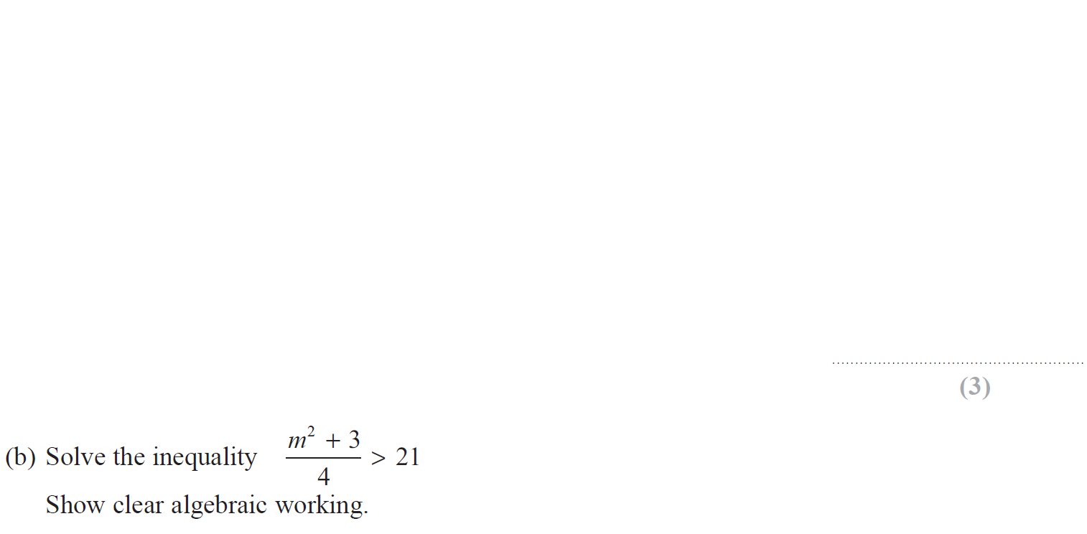
Solving Quadratics
May 2014 4H Q18

Slide 88
Solving Quadratics
May 2014 4H Q18
A
B

Slide 89
Solving Quadratics
May 2014 3HR Q19

Slide 90
Solving Quadratics
May 2014 3HR Q19
A

Slide 91
Solving Quadratics
May 2014 3HR Q20

Slide 92
Solving Quadratics
May 2014 3HR Q20
A

Slide 93
Solving Quadratics
May 2014 4HR Q16

Slide 94
Solving Quadratics
May 2014 4HR Q16
A
B
C
B Alternative

Slide 95
Solving Quadratics
Jan 2015 4H Q17

Slide 96
Solving Quadratics
Jan 2015 4H Q17
A
B

Slide 97
Solving Quadratics
Jan 2015 4HR Q14

Slide 98
Solving Quadratics
Jan 2015 4HR Q14
A
B

Slide 99
Solving Quadratics
Jan 2015 4HR Q20

Slide 100
Solving Quadratics
Jan 2015 4HR Q20
A
B

Slide 101
Solving Quadratics
June 2015 4H Q13

Slide 102
Solving Quadratics
June 2015 4H Q13
A

Slide 103
Solving Quadratics
June 2015 4H Q21

Slide 104
Solving Quadratics
June 2015 4H Q21
A
B

Slide 105
Solving Quadratics
May 2015 3HR Q19

Slide 106
Solving Quadratics
May 2015 3HR Q19
A
B

Slide 107
Solving Quadratics
Jan 2016 3H Q16

Slide 108
Solving Quadratics
Jan 2016 3H Q16
A

Slide 109
Solving Quadratics
Jan 2016 4H Q22

Slide 110
Solving Quadratics
Jan 2016 4H Q22
A

Slide 111
Solving Quadratics
Jan 2016 3HR Q12

Slide 112
Solving Quadratics
Jan 2016 3HR Q12
A

Slide 113
Solving Quadratics
May 2016 3H Q17

Slide 114
Solving Quadratics
May 2016 3H Q17
(i)
(ii)

Slide 115
Solving Quadratics
May 2016 3HR Q15

Slide 116
Solving Quadratics
May 2016 3HR Q15
A
B

Slide 117
Solving Quadratics
June 2016 4HR Q16

Slide 118
Solving Quadratics
June 2016 4HR Q16
A

Slide 119
Solving Quadratics
Jan 2017 3H Q17

Slide 120
Solving Quadratics
Jan 2017 3H Q17
A

Slide 121
Solving Quadratics
Jan 2017 4H Q18

Slide 122
Solving Quadratics
Jan 2017 4H Q18
A
B
C
D

Slide 123
Solving Quadratics
Jan 2017 3HR Q20

Slide 124
Solving Quadratics
Jan 2017 3HR Q20
A
B

Slide 125
Solving Quadratics
Jan 2017 4HR Q21

Slide 126
Solving Quadratics
Jan 2017 4HR Q21
A
B

Slide 127
Solving Quadratics
June 2017 4H Q15

Slide 128
Solving Quadratics
June 2017 4H Q15
A

Slide 129
Solving Quadratics
May 2017 3HR Q15

Slide 130
Solving Quadratics
May 2017 3HR Q15
A
B
C

Slide 131
Solving Quadratics
June 2017 4HR Q17

Slide 132
Solving Quadratics
June 2017 4HR Q17
A

Slide 133
Solving Quadratics
Jan 2018 3HR Q17

Slide 134
Solving Quadratics
Jan 2018 3HR Q17
A
B

Slide 135
Solving Quadratics
Jan 2018 4HR Q16

Slide 136
Solving Quadratics
Jan 2018 4HR Q16
A
B

Slide 137
Solving Quadratics
Jan 2018 4HR Q16

Slide 138
Solving Quadratics
Jan 2018 4HR Q16
A
B

Slide 139
Solving Quadratics
Jan 2018 4HR Q19

Slide 140
Solving Quadratics
Jan 2018 4HR Q19
A

Slide 141
Solving Quadratics
May 2018 3H Q13

Slide 142
Solving Quadratics
May 2018 3H Q13
A

Slide 143
Solving Quadratics
May 2018 3H Q21

Slide 144
Solving Quadratics
May 2018 3H Q21
A
B
C

Slide 145
Solving Quadratics
May 2018 3HR Q14

Slide 146
Solving Quadratics
May 2018 3HR Q14
A
B

Slide 147
Solving Quadratics
June 2018 4HR Q19

Slide 148
Solving Quadratics
June 2018 4HR Q19
A
B

Slide 149
Solving Quadratics
June 2018 4HR Q22

Slide 150
Solving Quadratics
June 2018 4HR Q22
A

