Slide 1
Solving Quadratics
Solving Quadratics
SAM
3H Q2
May 2017
1H Q18
May 2018
1H Q20
SAM
3H Q17
Nov 2017
1H Q13
Nov 2018
1H Q16
Practice
2H Q12
Nov 2017
1H Q18
Nov 2018
3H Q12
Practice
3H Q17
May 2018
1H Q16

Slide 2
Solving Quadratics
SAM 3H Q2

Slide 3
Solving Quadratics
SAM 3H Q2
A (i)
A (ii)
B
C

Slide 4
Solving Quadratics
SAM 3H Q17

Slide 5
Solving Quadratics
SAM 3H Q17
A

Slide 6
Solving Quadratics
Practice 2H Q12

Slide 7
Solving Quadratics
Practice 2H Q12
A
B
C

Slide 8
Solving Quadratics
Practice 3H Q17

Slide 9
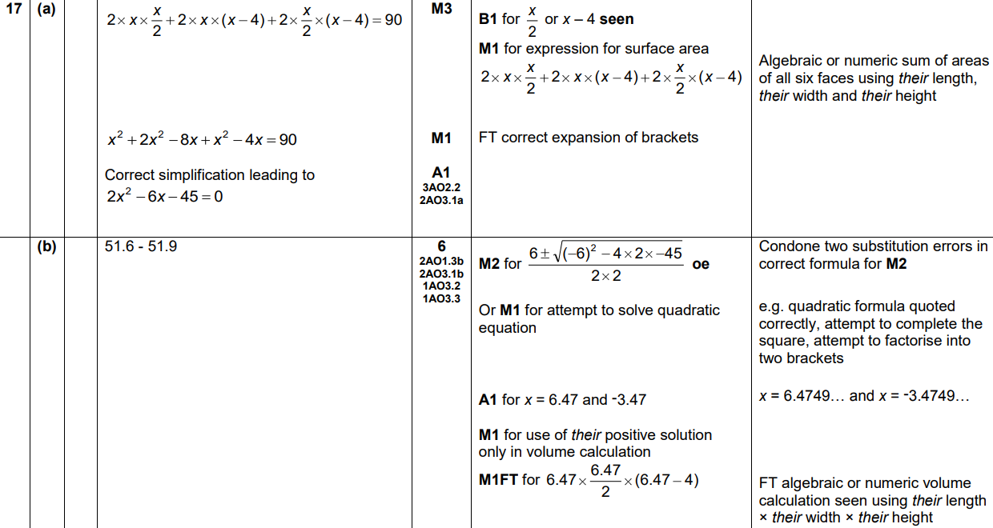
Solving Quadratics
Practice 3H Q17
A
B

Slide 10
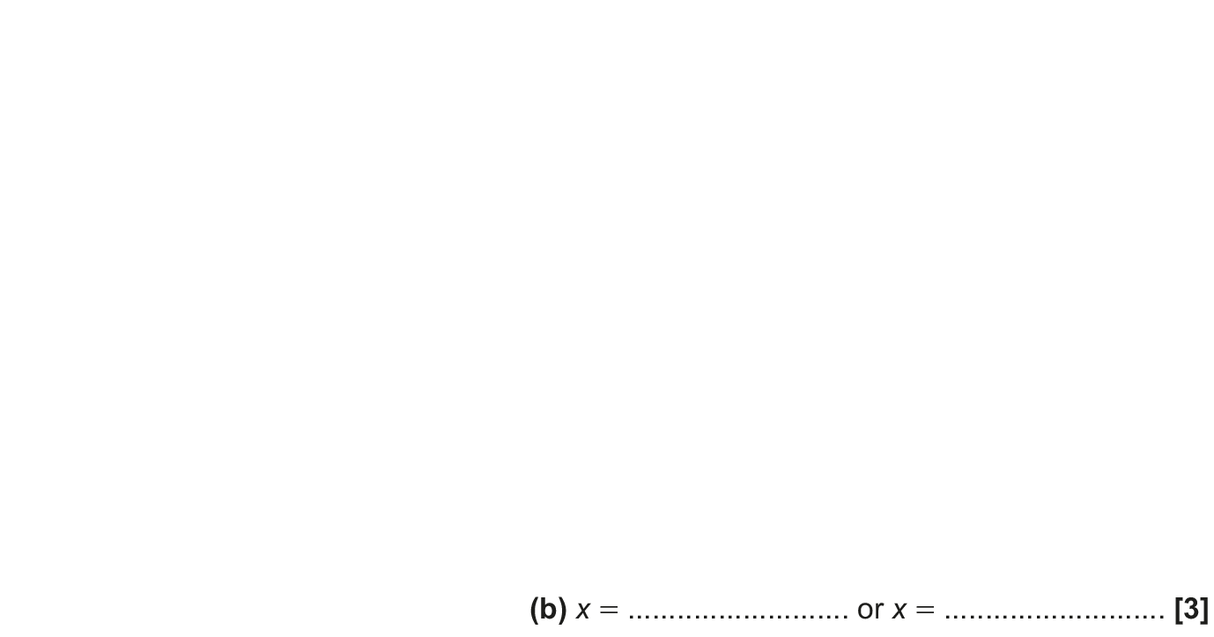
Solving Quadratics
May 2017 1H Q18

Slide 11
Solving Quadratics
May 2017 1H Q18
A
B

Slide 12
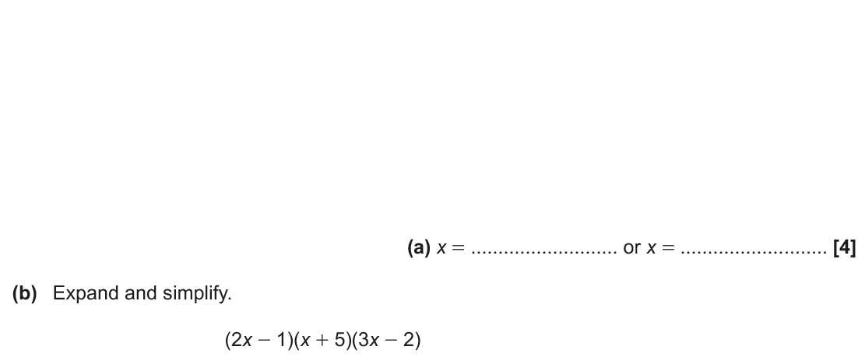
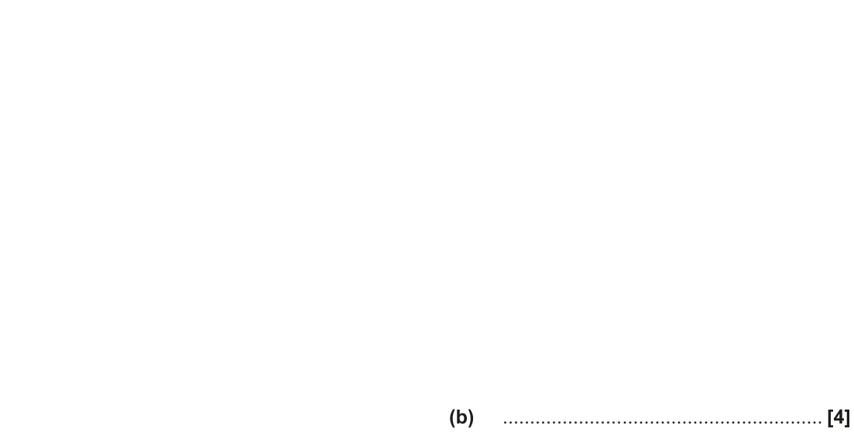
Solving Quadratics
Nov 2017 1H Q13

Slide 13
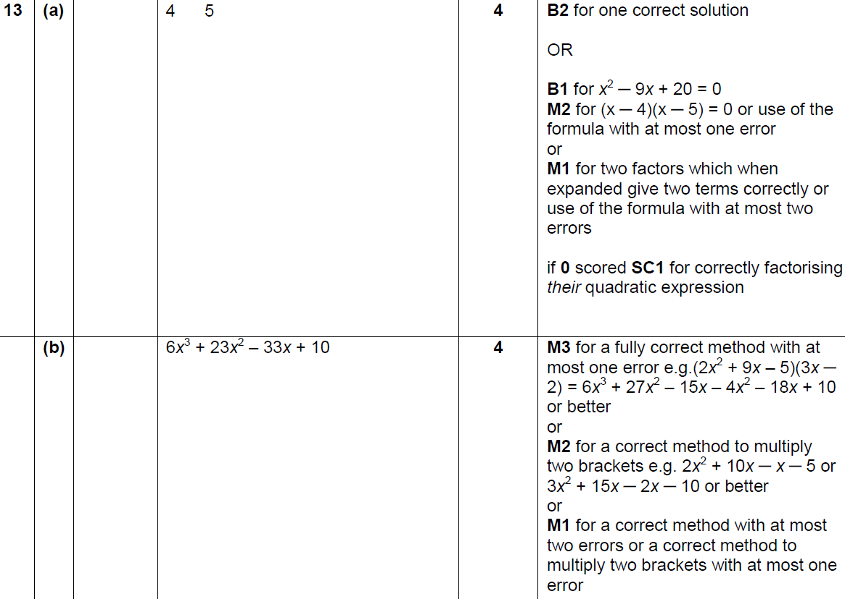
Solving Quadratics
Nov 2017 1H Q13
A
B

Slide 14
Solving Quadratics
Nov 2017 1H Q18

Slide 15
Solving Quadratics
Nov 2017 1H Q18
A

Slide 16
Solving Quadratics
May 2018 1H Q16

Slide 17
Solving Quadratics
May 2018 1H Q16
A

Slide 18
Solving Quadratics
May 2018 1H Q20

Slide 19
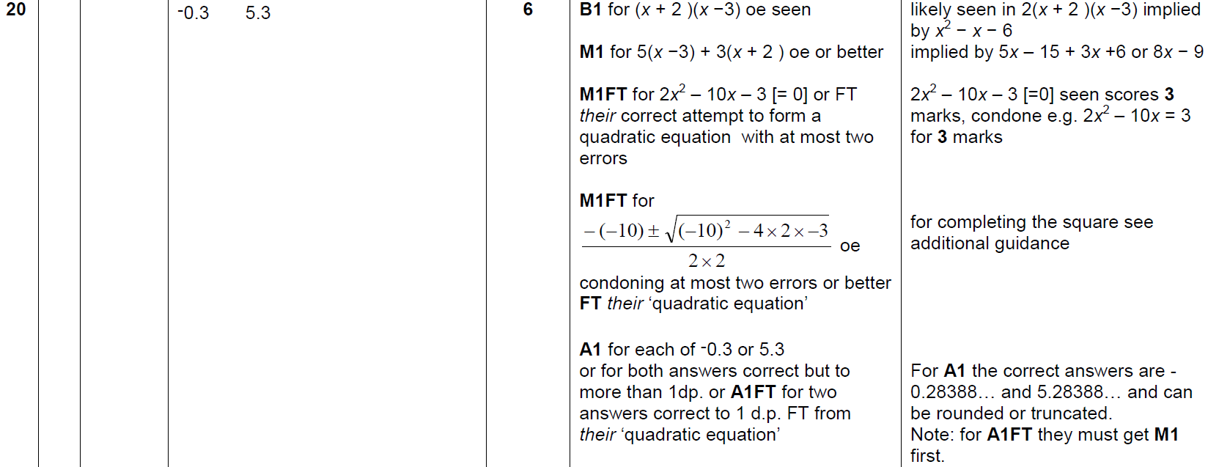
Solving Quadratics
May 2018 1H Q20
A

Slide 20
Solving Quadratics
Nov 2018 1H Q16

Slide 21
Solving Quadratics
Nov 2018 1H Q16
A

Slide 22
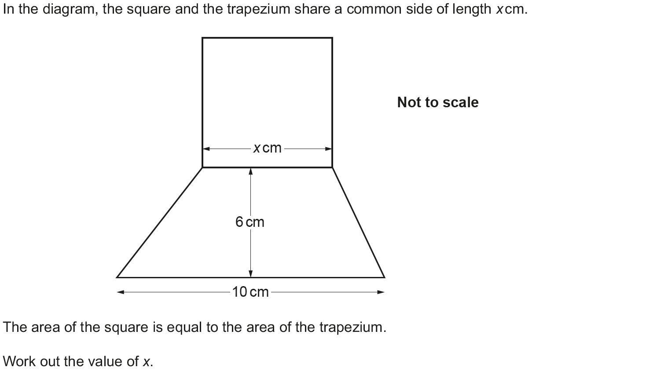
Solving Quadratics
Nov 2018 3H Q12

Slide 23
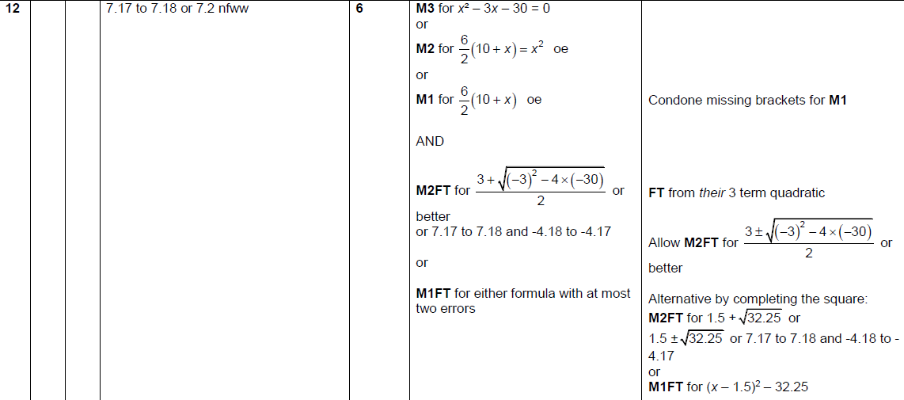
Solving Quadratics
Nov 2018 3H Q12
A

