Slide 1
Solving Quadratics
Solving Quadratics
Nov 2017
2H Q16
SAM
3H Q11
June 2018
3H Q19
Spec 2
1H Q17
Nov 2018
1H Q22
Spec 2
2H Q21
Nov 2018
3H Q9
Spec 2
3H Q21
May 2019
1H Q17

Slide 2
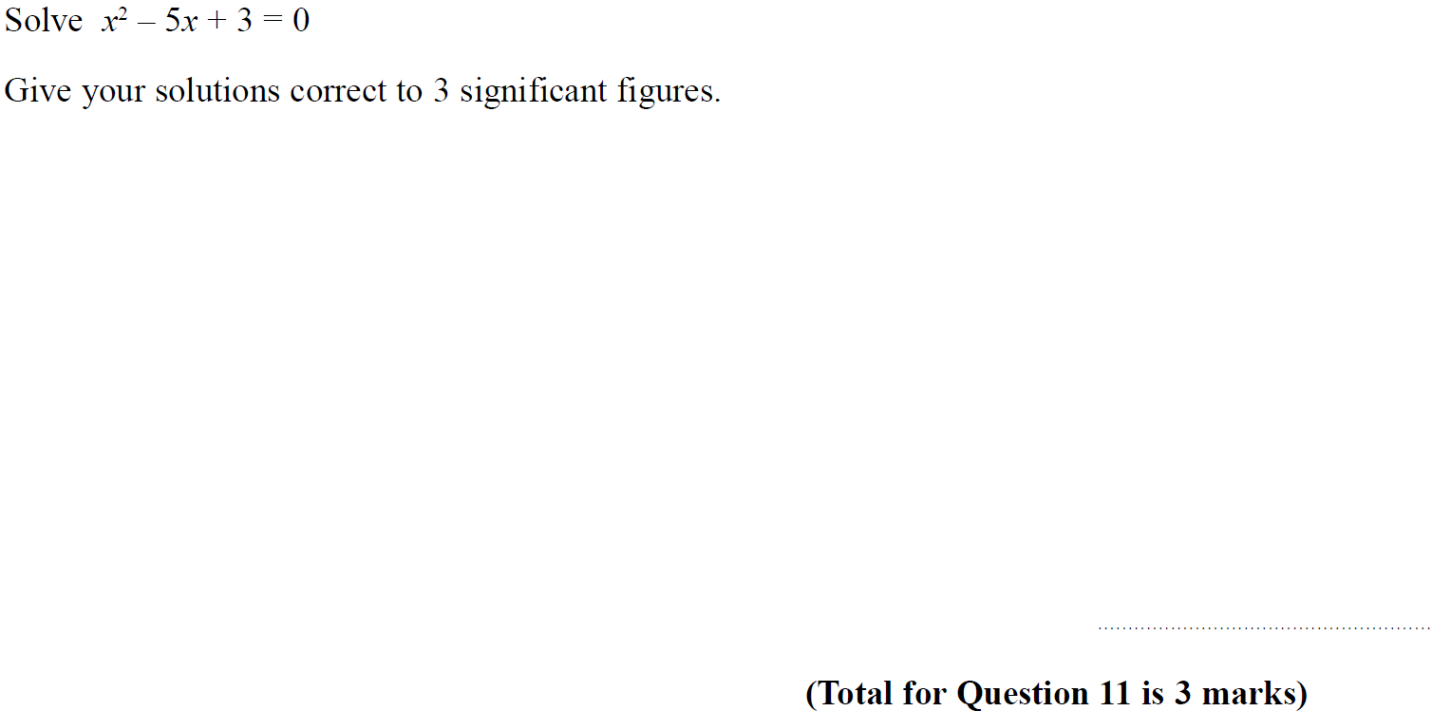
Solving Quadratics
SAM 3H Q11

Slide 3
Solving Quadratics
SAM 3H Q11
A

Slide 4
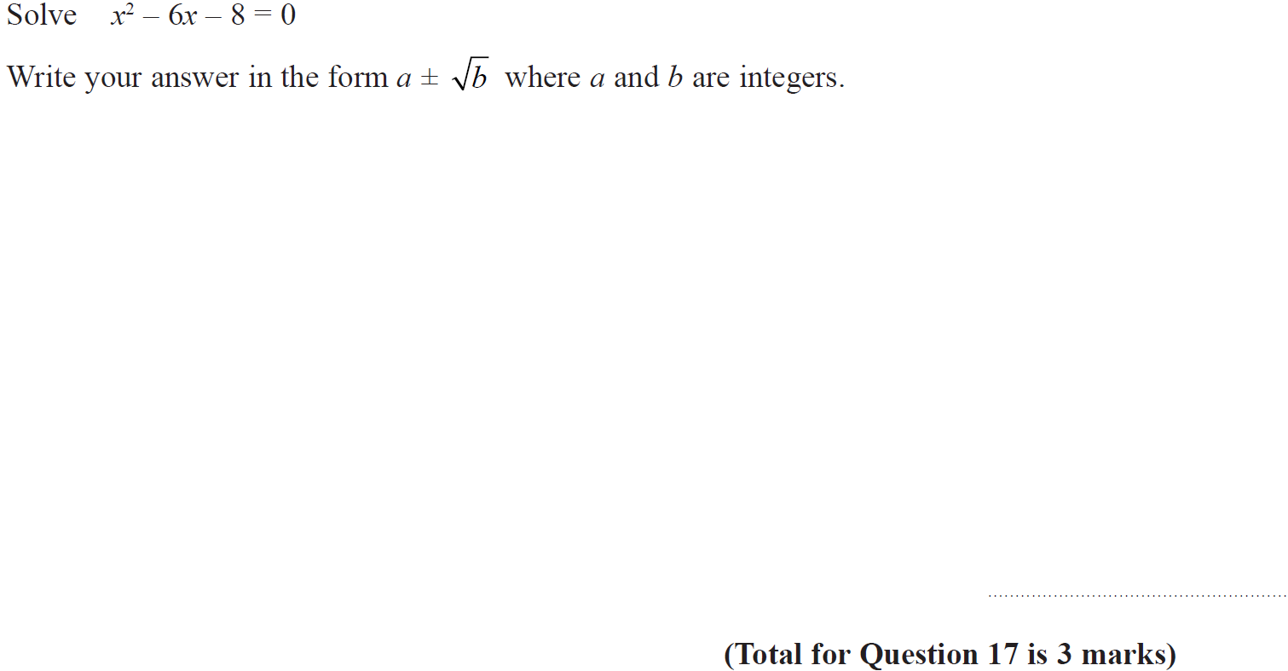
Solving Quadratics
Specimen Set 2 1H Q17

Slide 5
Solving Quadratics
Specimen Set 2 1H Q17
A

Slide 6
Solving Quadratics
Specimen Set 2 2H Q21

Slide 7
Solving Quadratics
Specimen Set 2 2H Q21
A

Slide 8
Solving Quadratics
Specimen Set 2 3H Q21

Slide 9
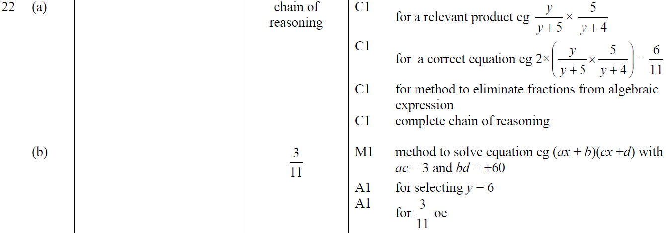
Solving Quadratics
Specimen Set 2 3H Q21
A
B

Slide 10
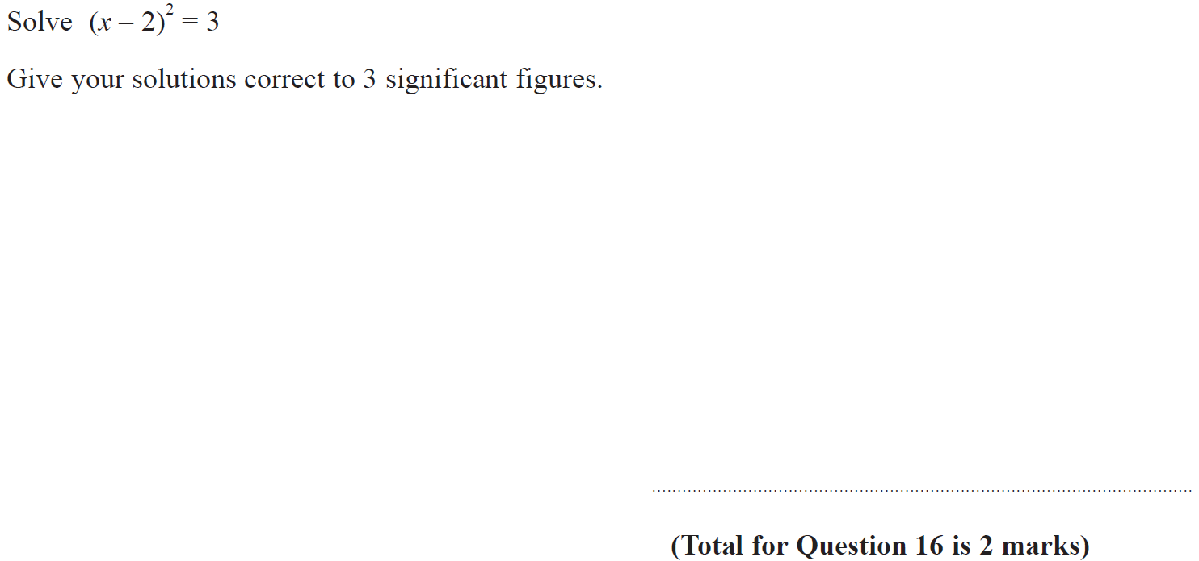
Solving Quadratics
Nov 2017 2H Q16

Slide 11
Solving Quadratics
Nov 2017 2H Q16
A

Slide 12
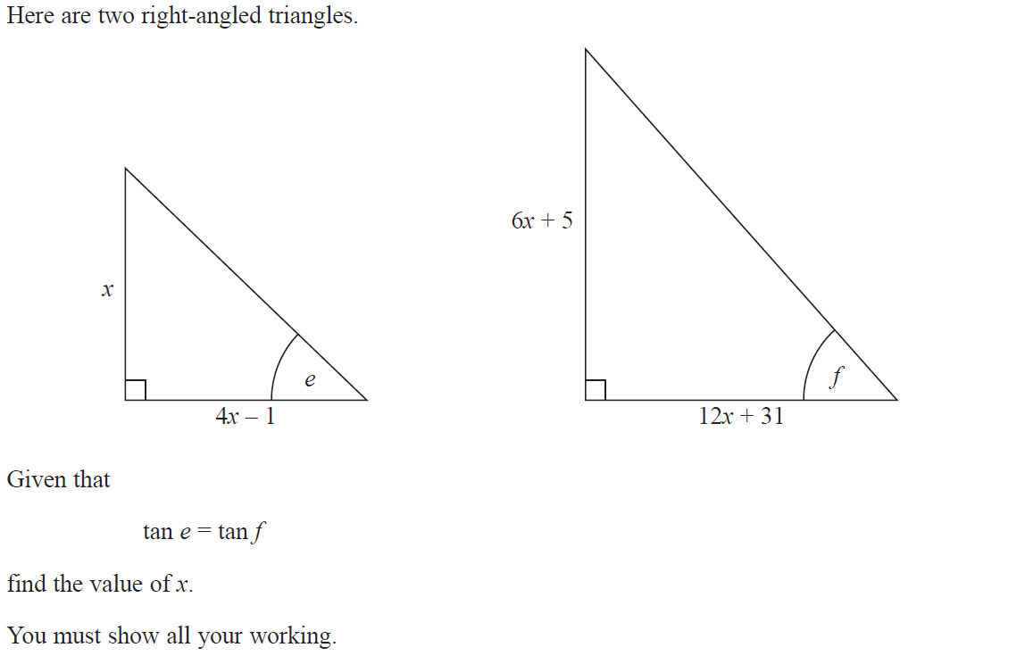
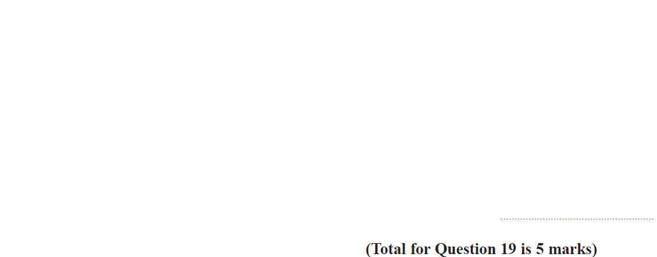
Solving Quadratics
June 2018 3H Q19

Slide 13
Solving Quadratics
June 2018 3H Q19
A

Slide 14
Solving Quadratics
Nov 2018 1H Q22

Slide 15
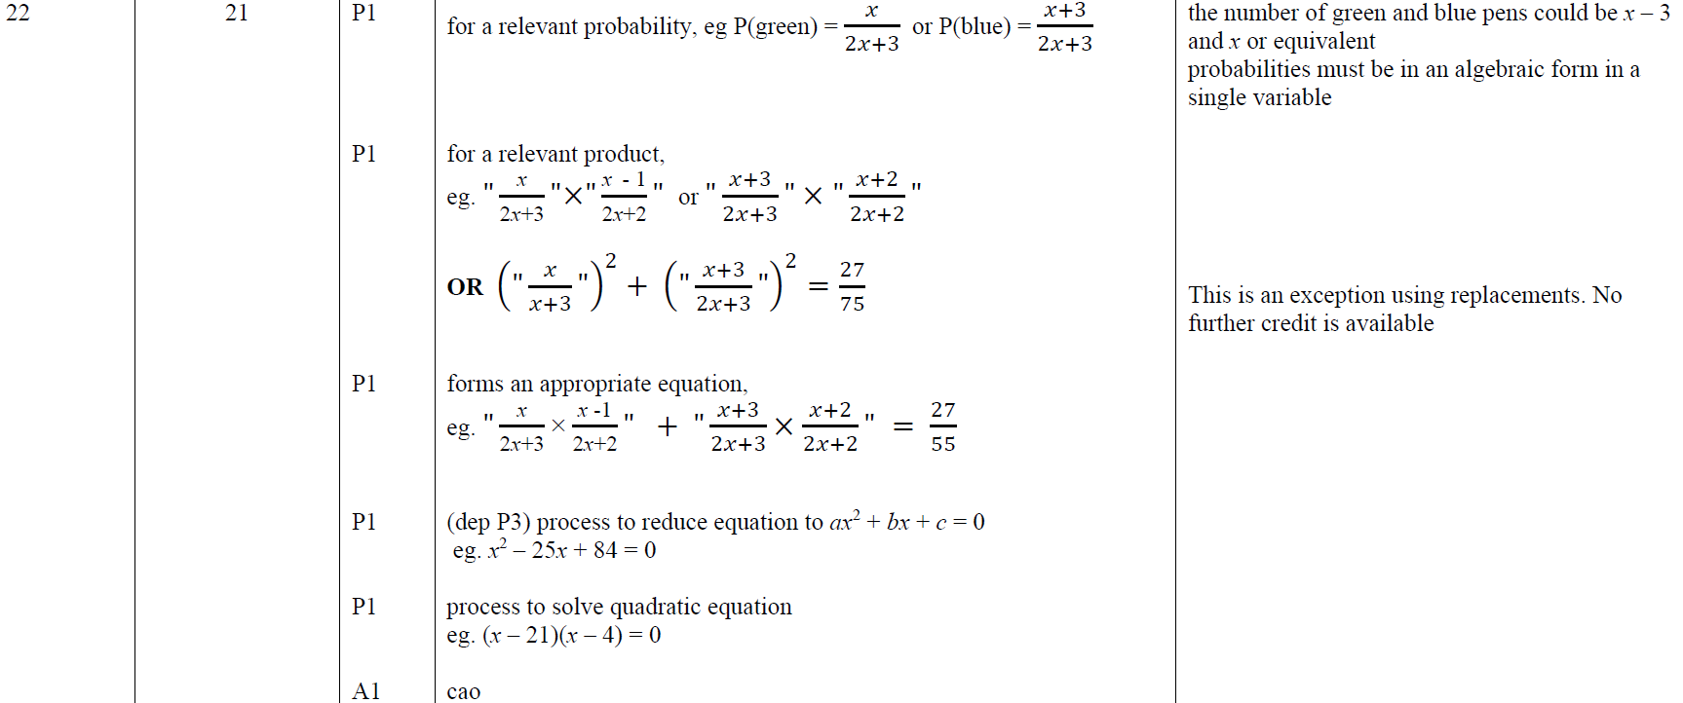
Solving Quadratics
Nov 2018 1H Q22
A

Slide 16
Solving Quadratics
Nov 2018 3H Q9

Slide 17
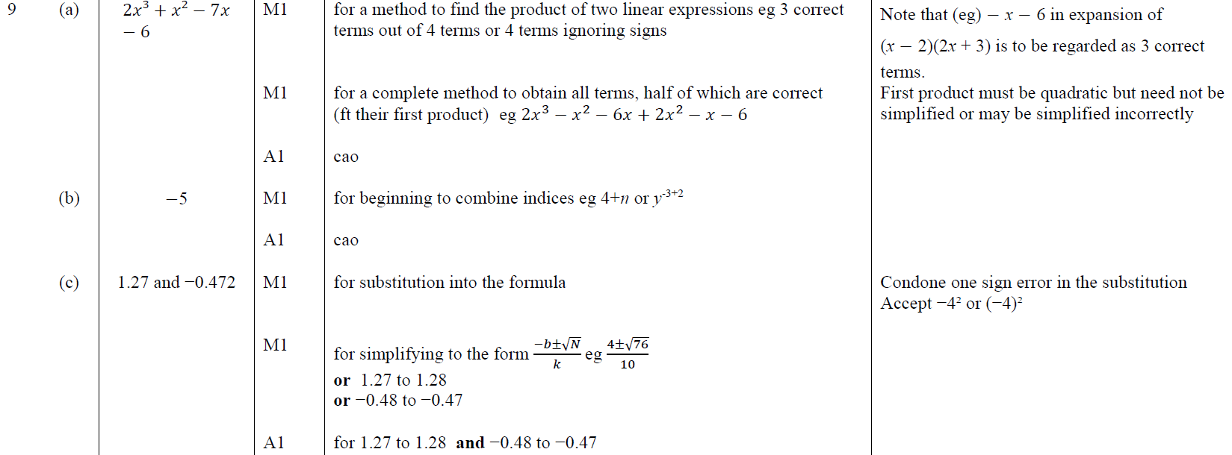
Solving Quadratics
Nov 2018 3H Q9
A
B
C

Slide 18
Solving Quadratics
May 2019 1H Q17

Slide 19
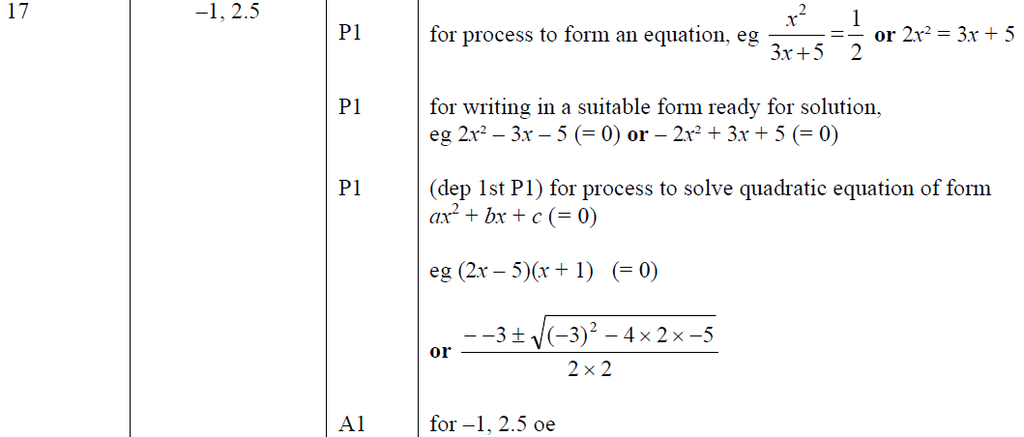
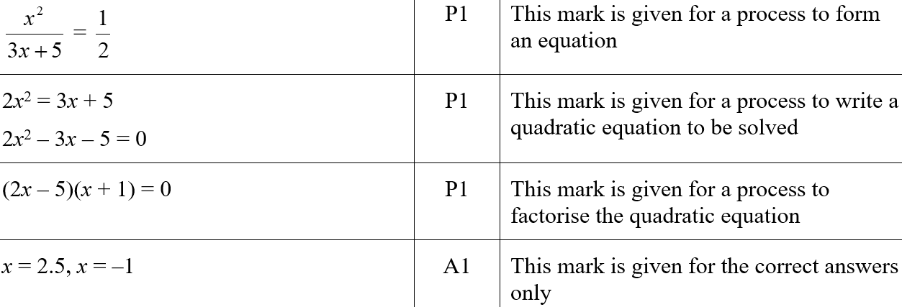
Solving Quadratics
May 2019 1H Q17
A
A SF

