Slide 1
Simultaneous Equations
Simultaneous Equations
May 2017
1H Q10
June 2018
3H Q16
SAM
2H Q8
Nov 2017
2H Q13
Nov 2018
1H Q19
1 Marker
June 2018
2H Q26
Nov 2018
3H Q27
Quadratic
Graphical

Slide 2
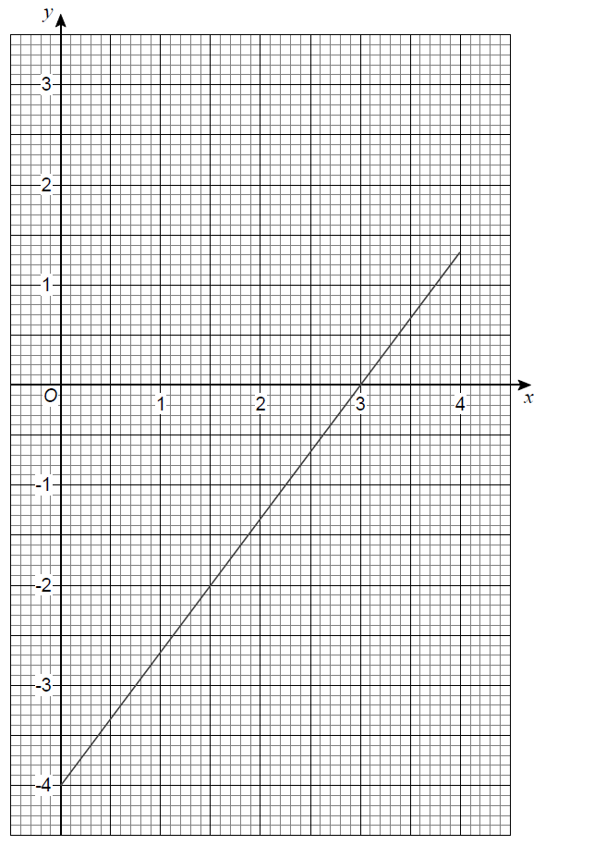
Simultaneous Equations
SAM 2H Q8

Slide 3
Simultaneous Equations
SAM 2H Q8
A

Slide 4
Simultaneous Equations
May 2017 1H Q10

Slide 5
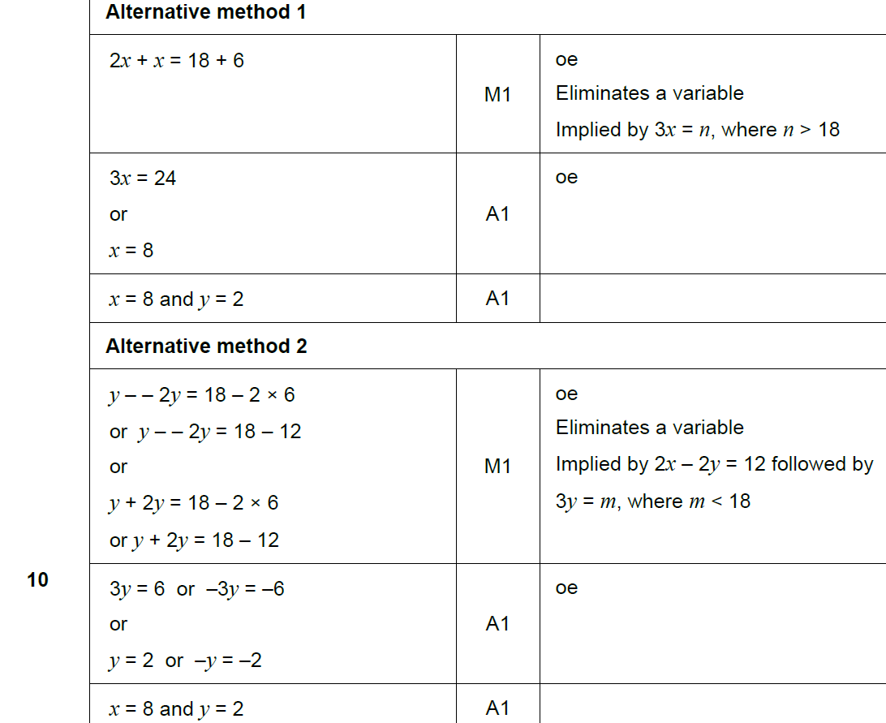
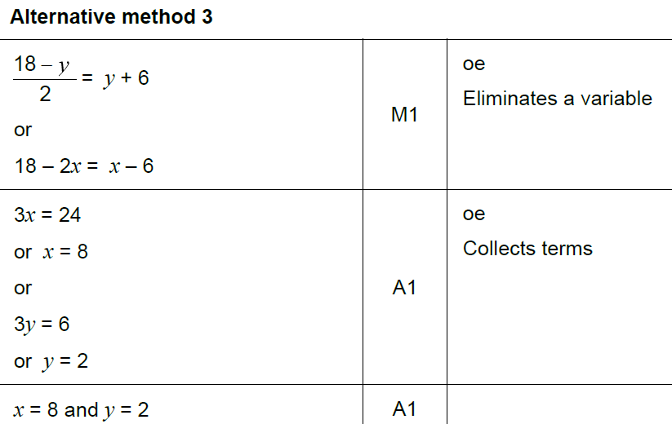
Simultaneous Equations
May 2017 1H Q10
A

Slide 6
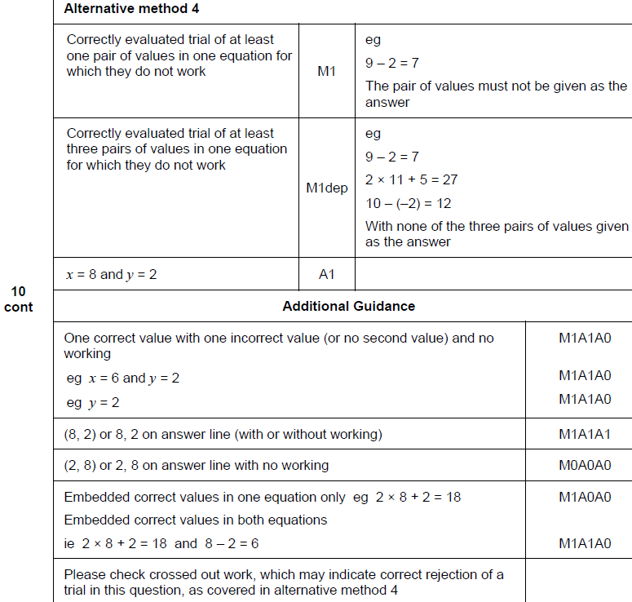
Simultaneous Equations
May 2017 1H Q10
A

Slide 7
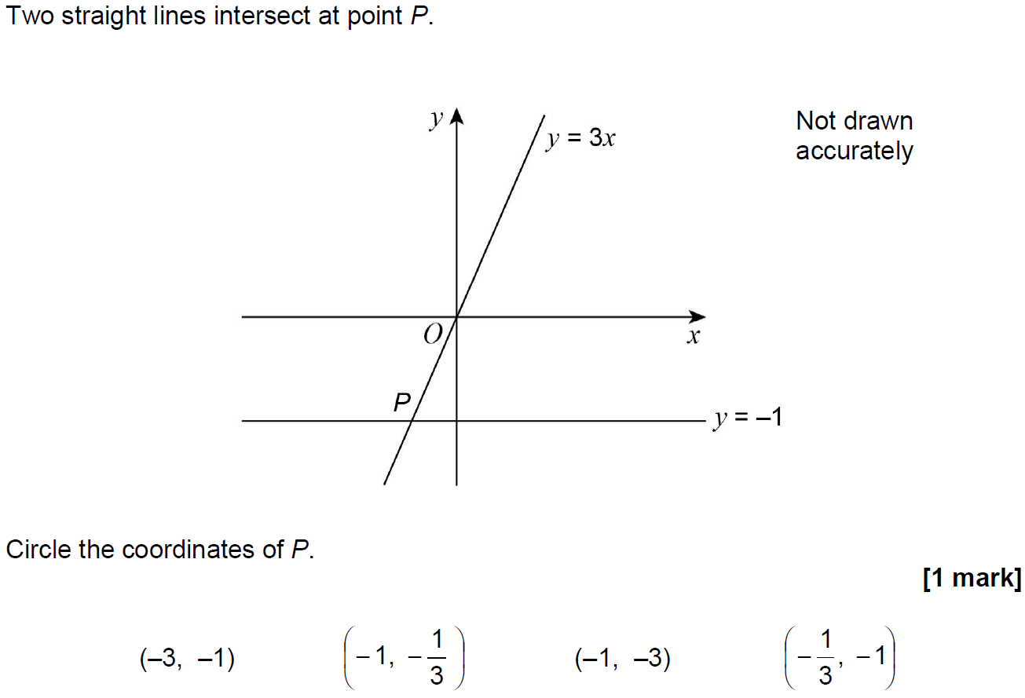
Simultaneous Equations
Nov 2017 2H Q13

Slide 8
Simultaneous Equations
Nov 2017 2H Q13
A

Slide 9
Simultaneous Equations
June 2018 2H Q26

Slide 10
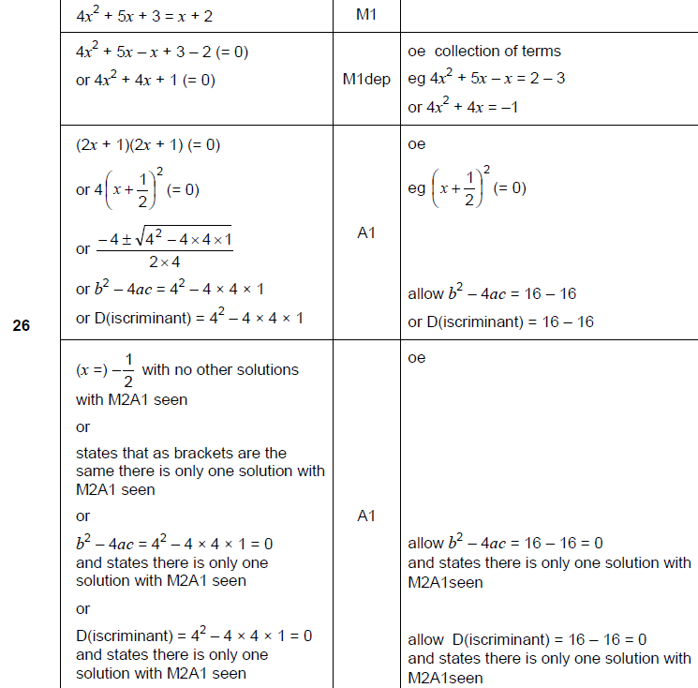
Simultaneous Equations
June 2018 2H Q26
A

Slide 11
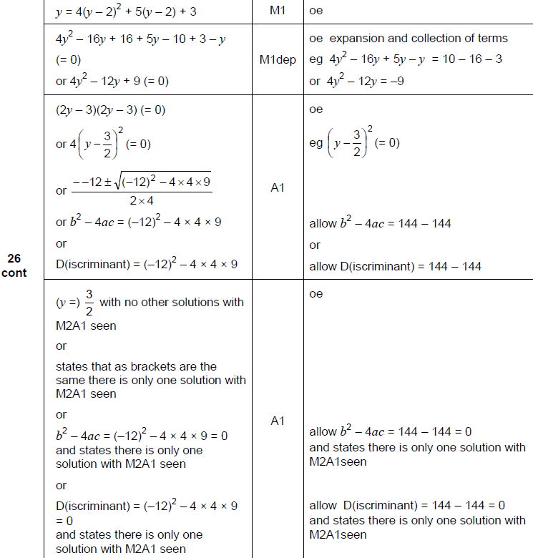
Simultaneous Equations
June 2018 2H Q26
A Alternative

Slide 12
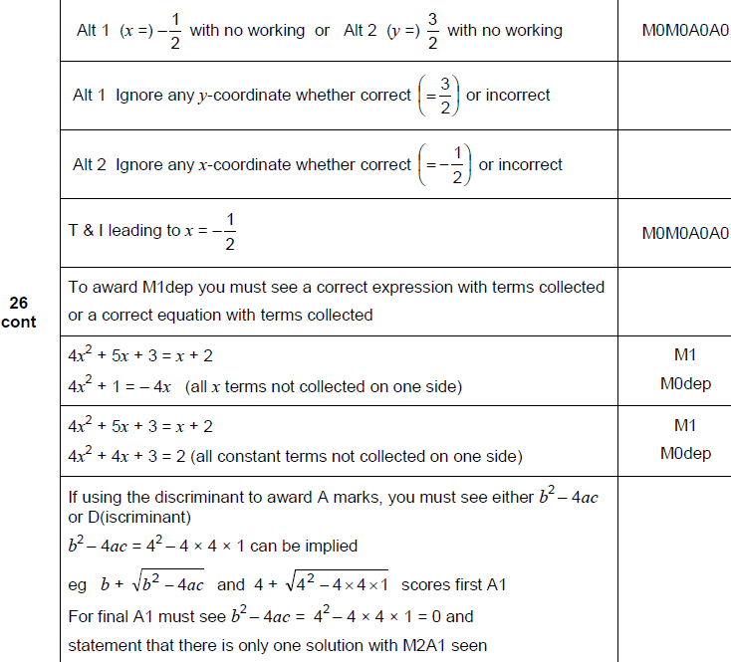
Simultaneous Equations
June 2018 2H Q26
A notes

Slide 13
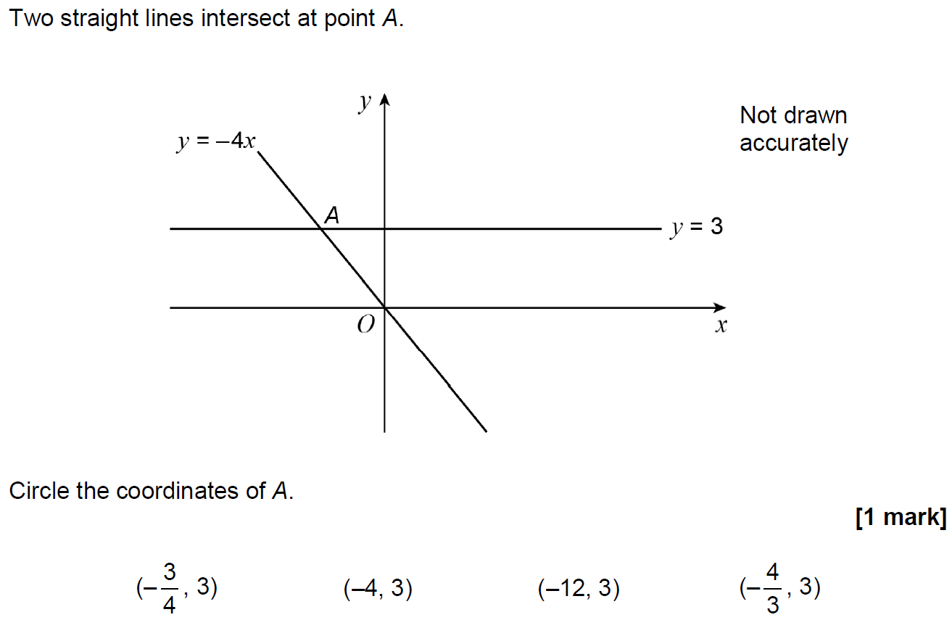
Simultaneous Equations
June 2018 3H Q16

Slide 14
Simultaneous Equations
June 2018 3H Q16
A

Slide 15
Simultaneous Equations
Nov 2018 1H Q19
In a chess club, there are x boys and y girls.
(a) If 5 more boys and 8 more girls join, there would be half as many boys as girls.
Show that y = 2x + 2
[2 marks]
(b) If instead,
10 more boys and 1 more girl join, there would be the same number of boys and girls.
Work out x and y.
[3 marks]

Slide 16
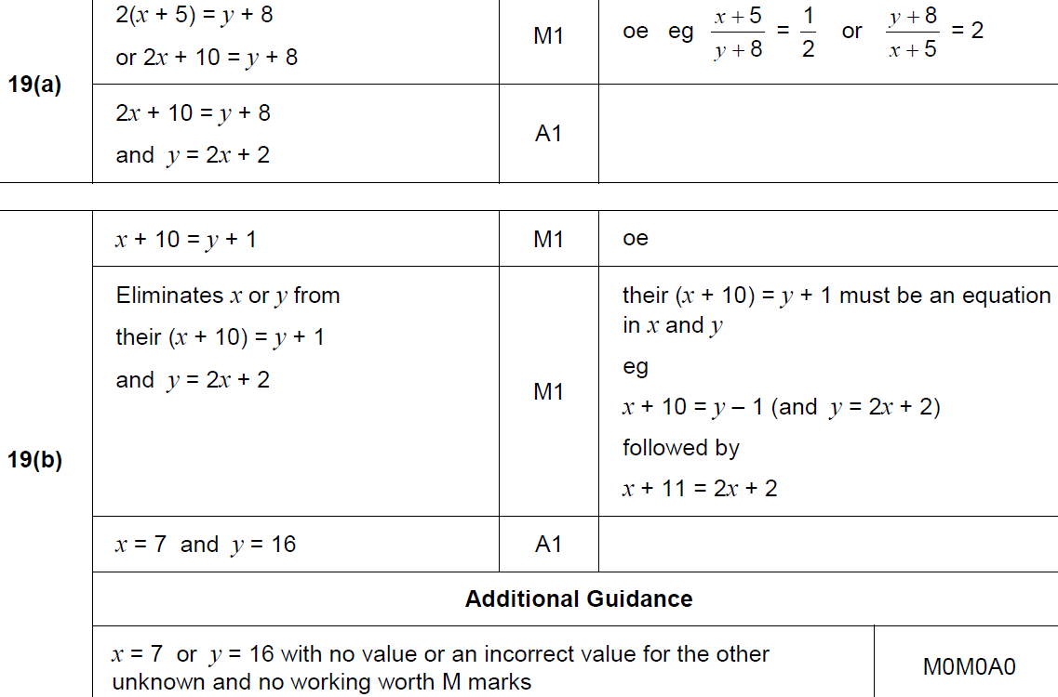
Simultaneous Equations
Nov 2018 1H Q19
A
B

Slide 17
Simultaneous Equations
Nov 2018 3H Q27

Slide 18
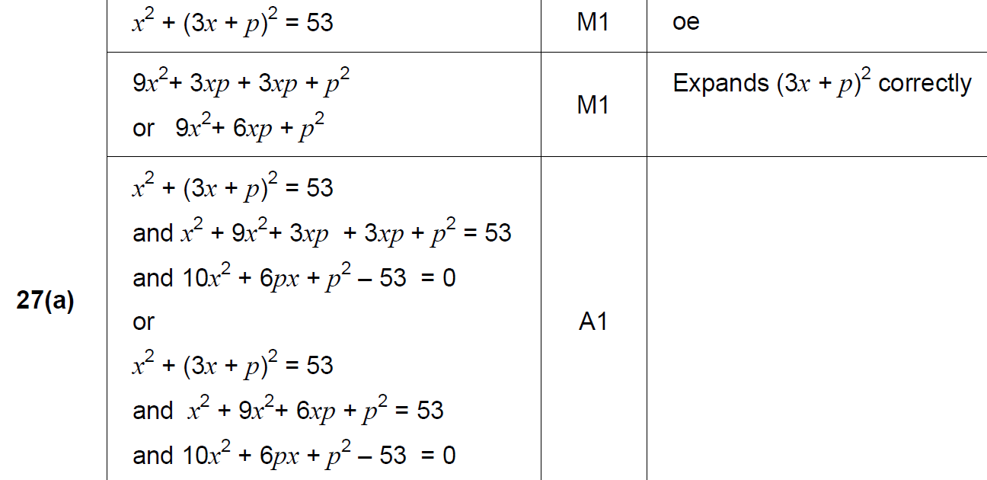
Simultaneous Equations
Nov 2018 3H Q27
A

Slide 19
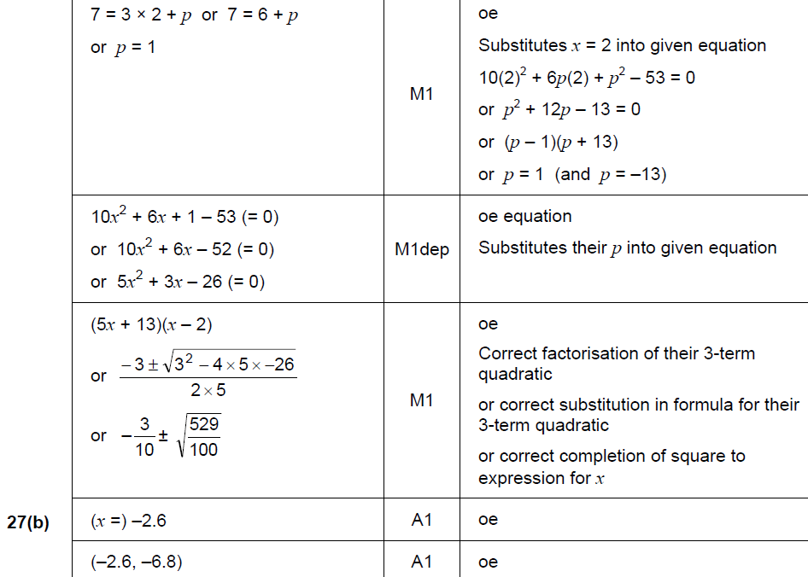
Simultaneous Equations
Nov 2018 3H Q27
B

Slide 20
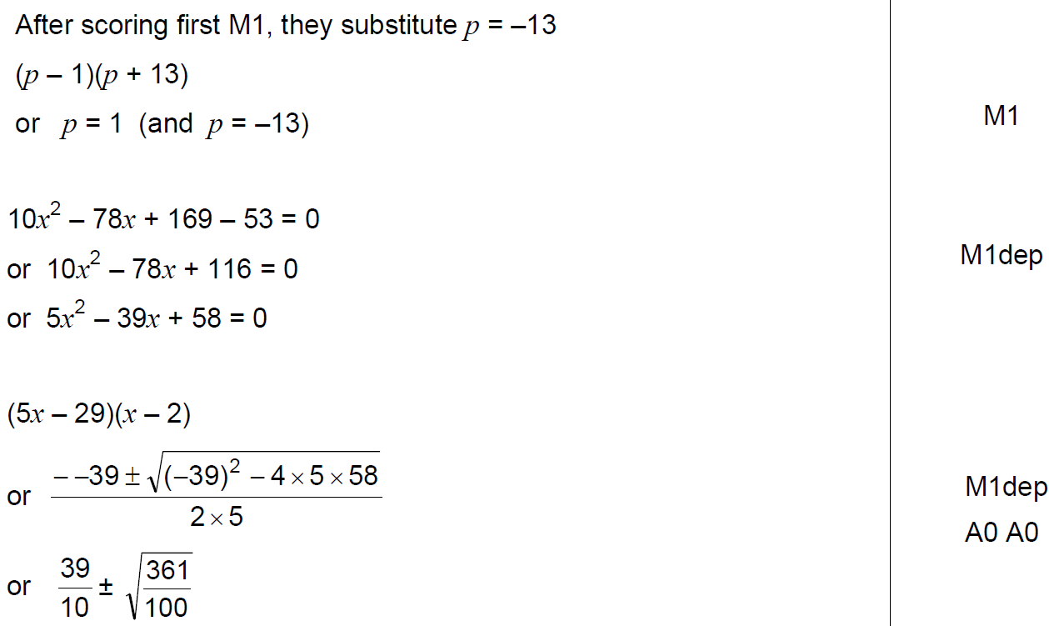
Simultaneous Equations
Nov 2018 3H Q27
B notes

