Slide 1
Simultaneous Equations
Simultaneous Equations
SAM
1H Q8
May 2017
1H Q9
SAM
2H Q6*
Nov 2017
2H Q19
SAM
2H Q19
May 2018
1H Q9
SAM
3H Q2
June 2018
2H Q18
Practice
1H Q8
*not really designed to be sim eq, but can be answered in this way
Nov 2018
3H Q17
Practice
1H Q16
Quadratic
Graphical

Slide 2
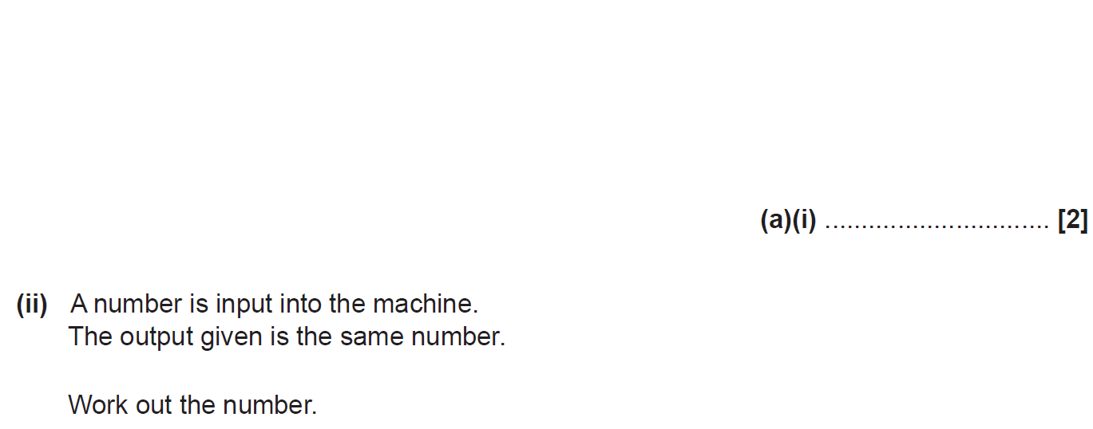
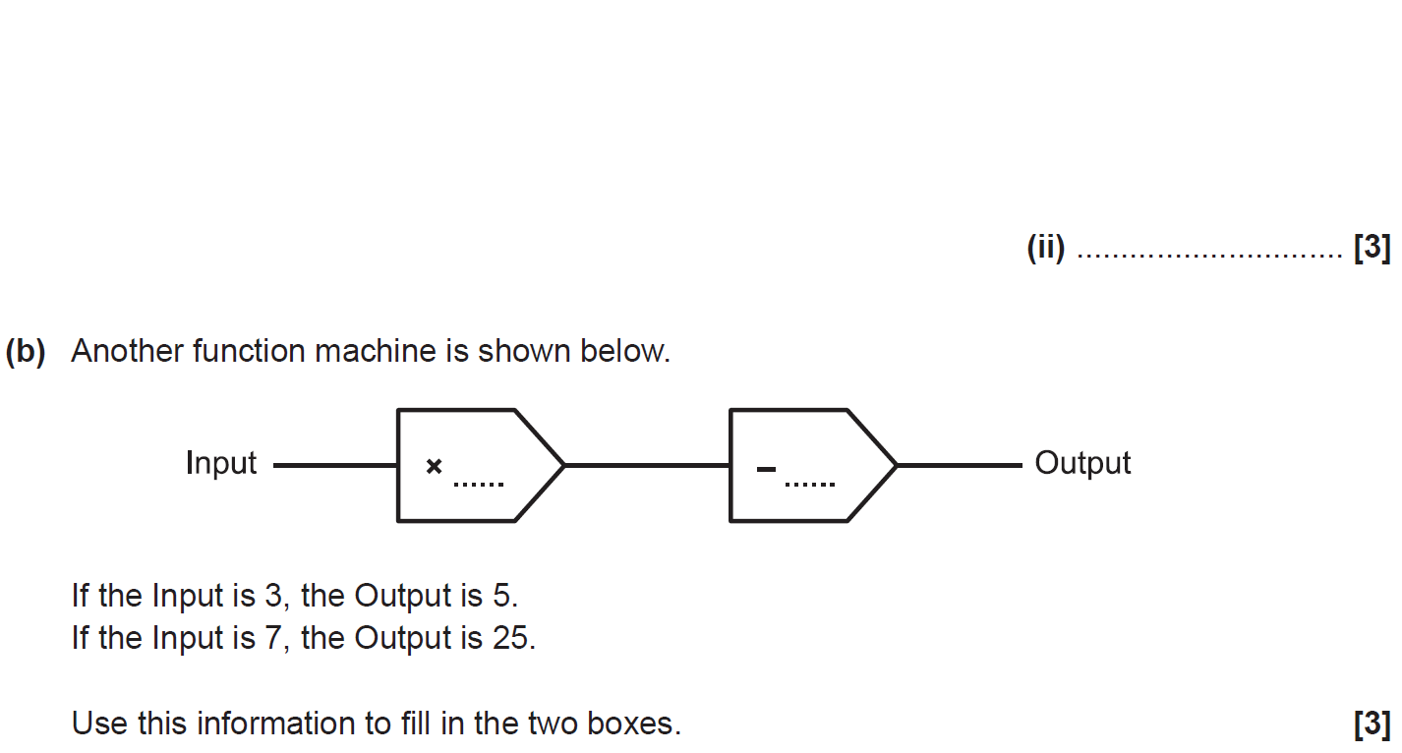
Simultaneous Equations
SAM 1H Q8

Slide 3
Simultaneous Equations
SAM 1H Q8
A (i)
A (ii)
B

Slide 4
Simultaneous Equations
SAM 2H Q6

Slide 5
Simultaneous Equations
SAM 2H Q6
A

Slide 6
Simultaneous Equations
SAM 2H Q19

Slide 7
Simultaneous Equations
SAM 2H Q19
A

Slide 8
Simultaneous Equations
SAM 3H Q2

Slide 9
Simultaneous Equations
SAM 3H Q2
A (i)
A (ii)
B
C

Slide 10
Simultaneous Equations
Practice 1H Q8

Slide 11
Simultaneous Equations
Practice 1H Q8
A

Slide 12
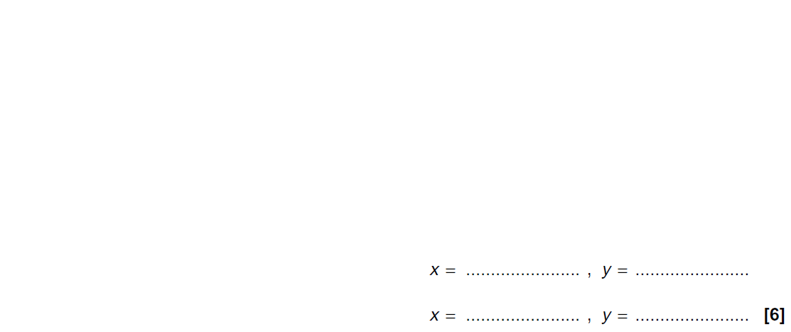
Simultaneous Equations
Practice 1H Q16

Slide 13
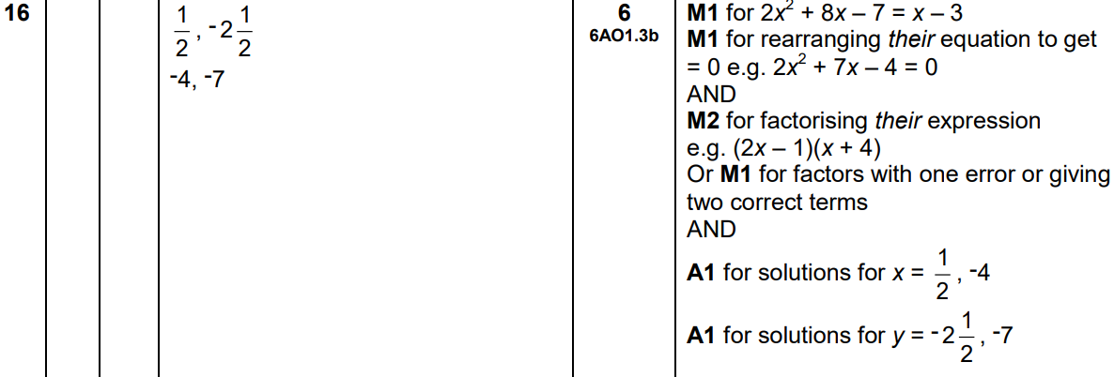
Simultaneous Equations
Practice 1H Q16
A

Slide 14
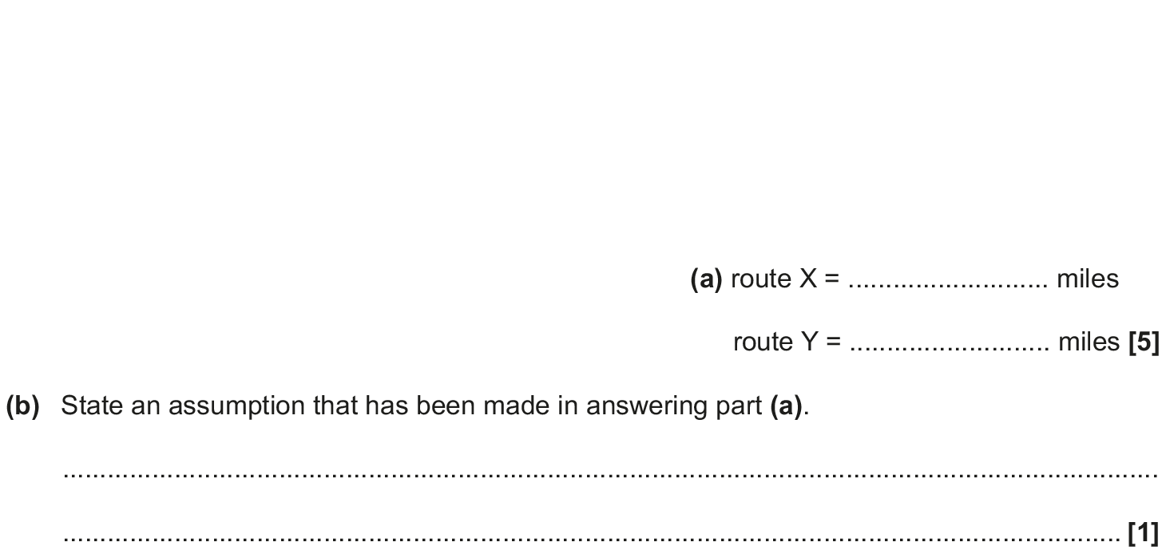
Simultaneous Equations
May 2017 1H Q9

Slide 15
Simultaneous Equations
May 2017 1H Q9
A
B

Slide 16
Simultaneous Equations
Nov 2017 2H Q19

Slide 17
Simultaneous Equations
Nov 2017 2H Q19
A

Slide 18
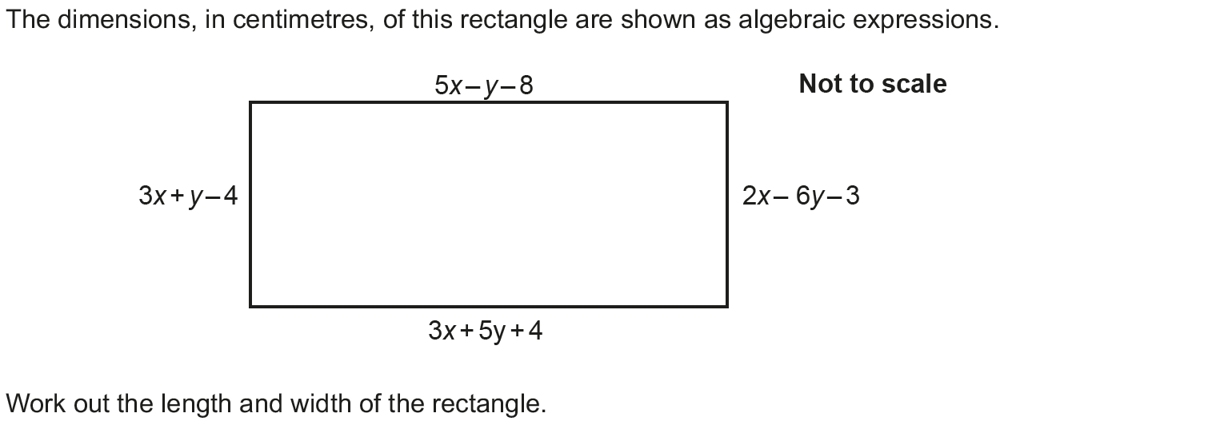
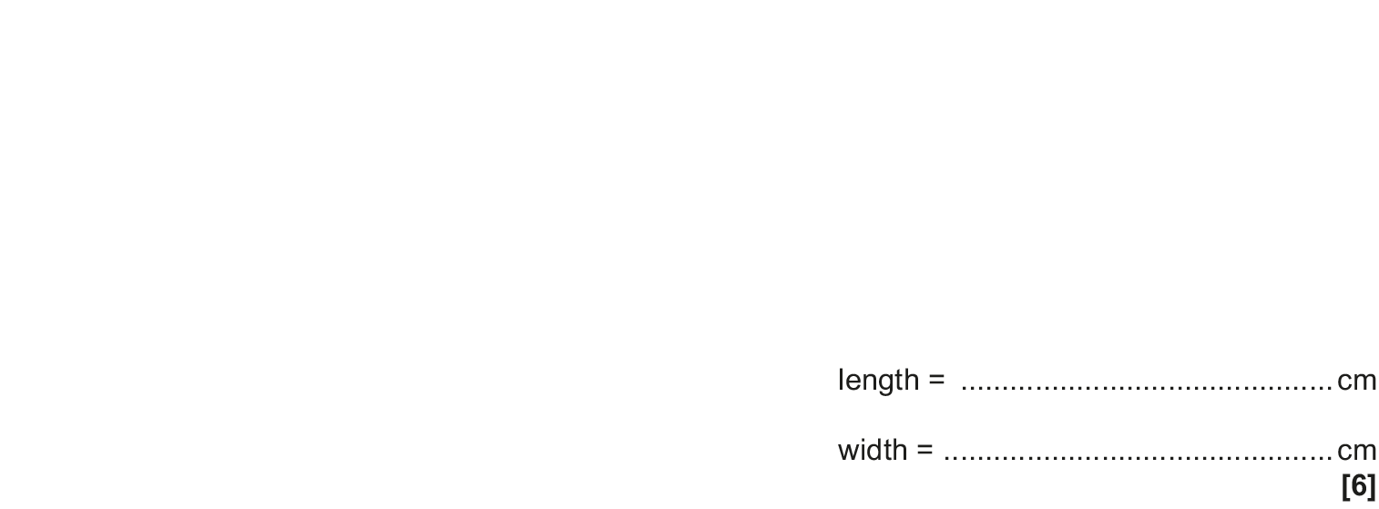
Simultaneous Equations
May 2018 1H Q9

Slide 19
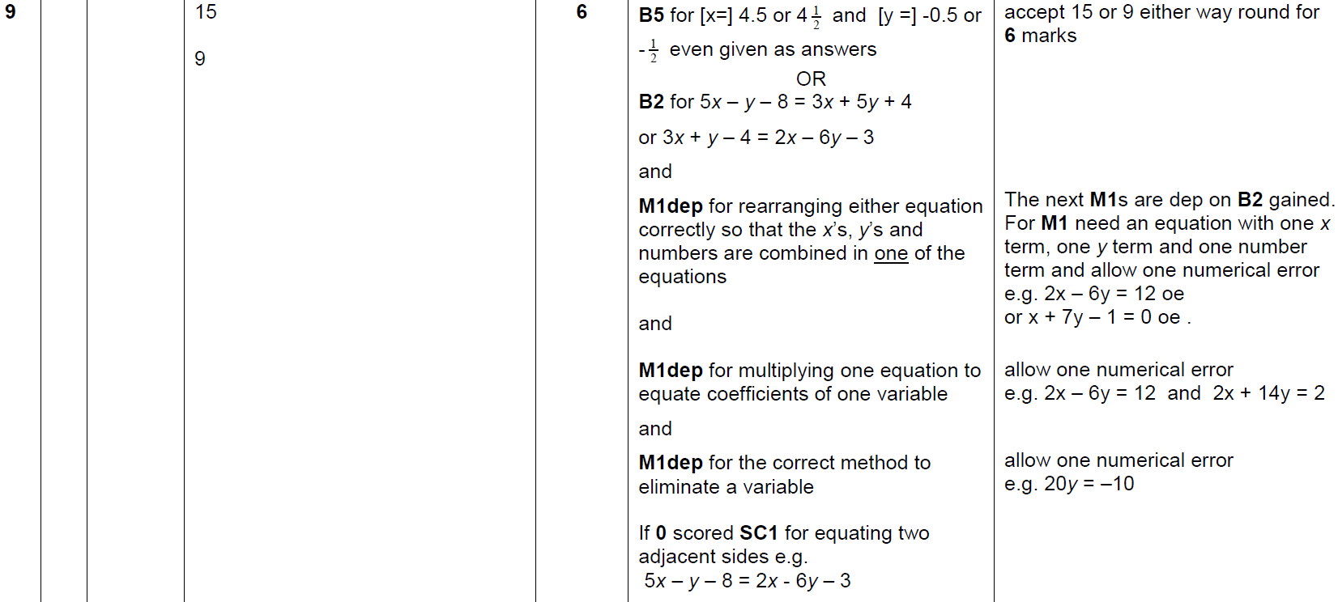
Simultaneous Equations
May 2018 1H Q9
A

Slide 20
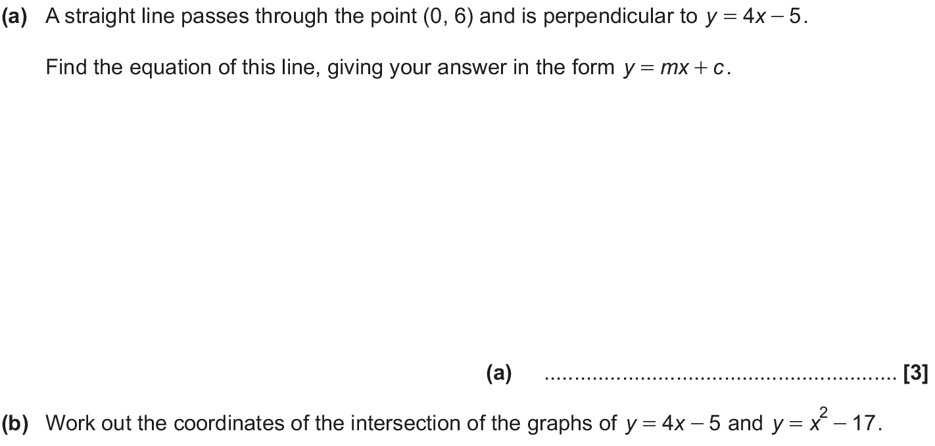
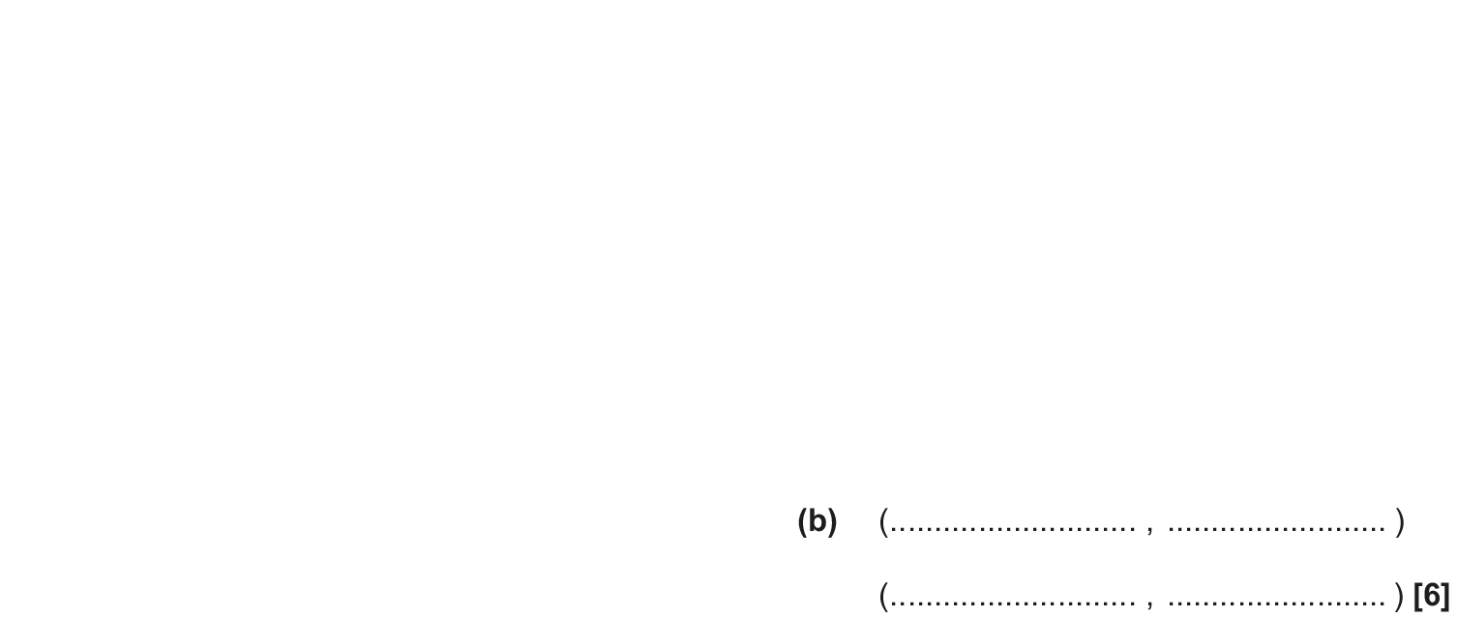
Simultaneous Equations
June 2018 2H Q18

Slide 21
Simultaneous Equations
June 2018 2H Q18
A
B

Slide 22
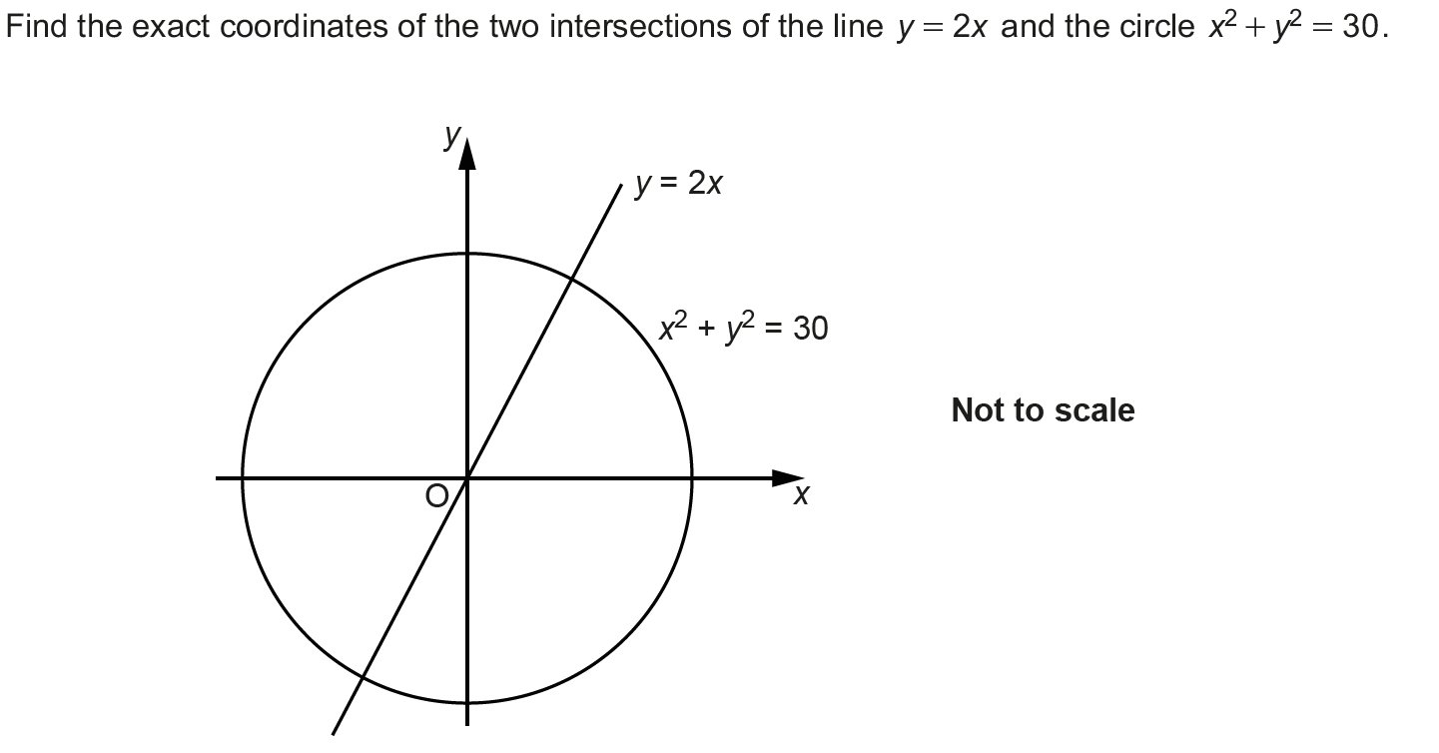
Simultaneous Equations
Nov 2018 3H Q17

Slide 23
Simultaneous Equations
Nov 2018 3H Q17
A

