Slide 1
Simultaneous Equations
Simultaneous Equations
Old Spec Q’s
SAM
2H Q9
Jan 2019
2HR Q21
June 2018
2H Q9
June 2019
2H Q9
May 2018
1HR Q10
June 2019
2H Q20
June 2018
2HR Q18
Jan 2019
2H Q5
Jan 2019
2H Q9
Jan 2019
1HR Q8
Quadratic

Slide 2
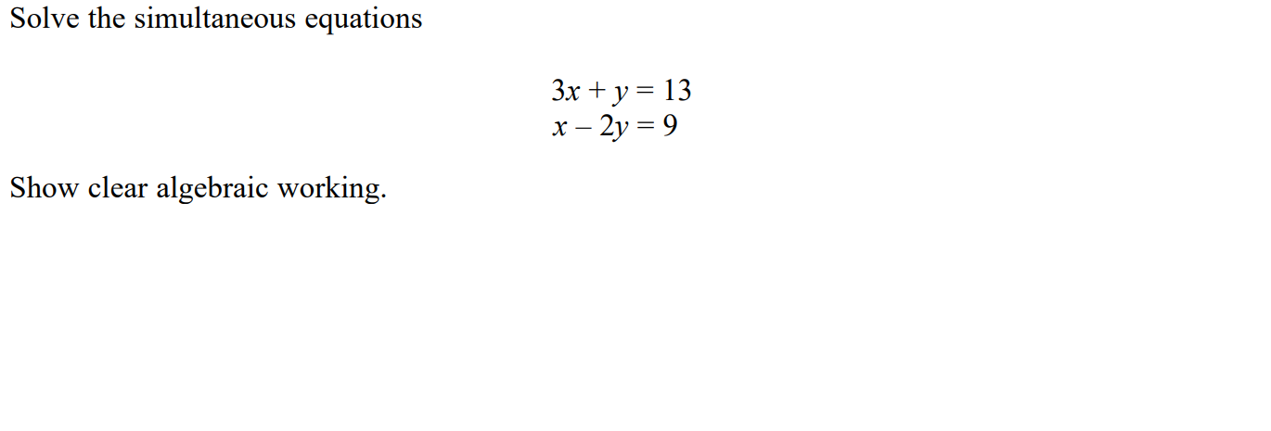
Simultaneous Equations
SAM 2H Q9

Slide 3
Simultaneous Equations
SAM 2H Q9
A

Slide 4
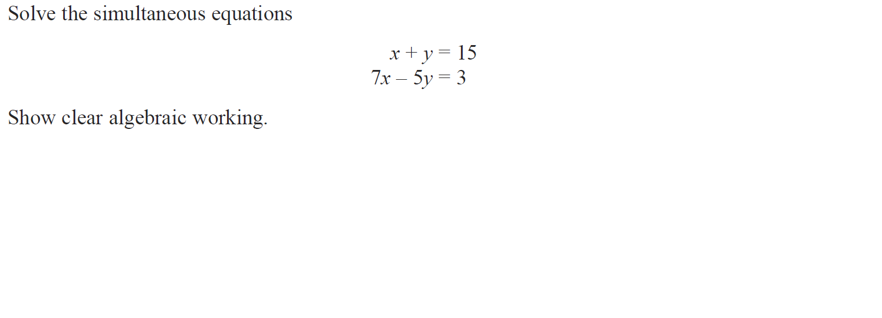
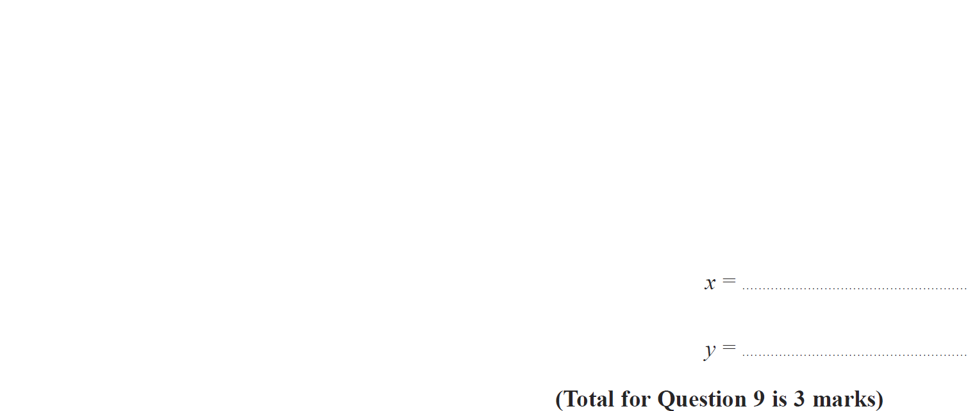
Simultaneous Equations
June 2018 2H Q9

Slide 5
Simultaneous Equations
June 2018 2H Q9
A

Slide 6
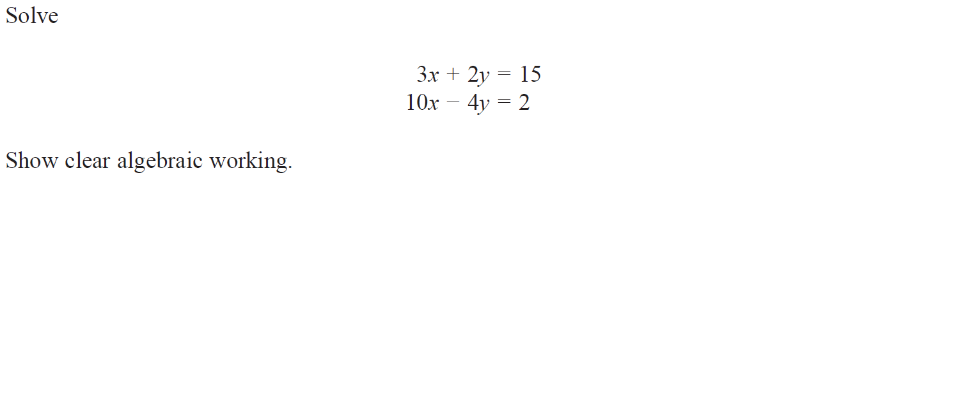
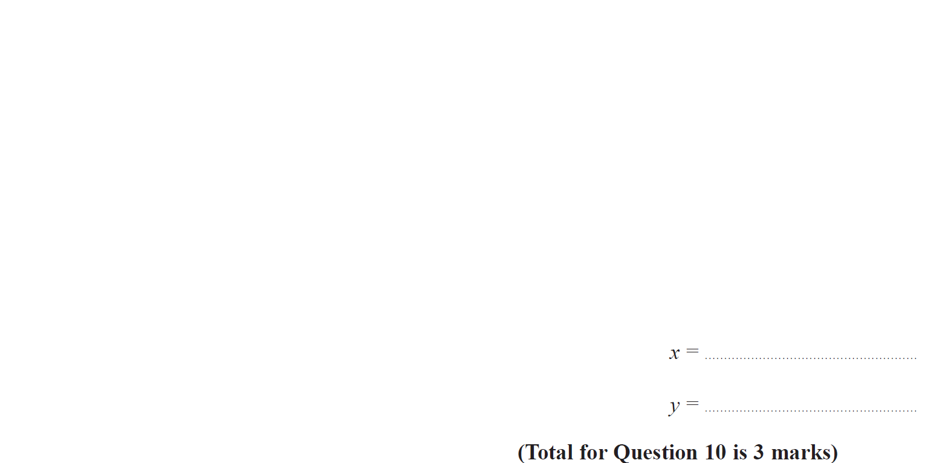
Simultaneous Equations
May 2018 1HR Q10

Slide 7
Simultaneous Equations
May 2018 1HR Q10
A

Slide 8
Simultaneous Equations
June 2018 2HR Q18

Slide 9
Simultaneous Equations
June 2018 2HR Q18
A

Slide 10
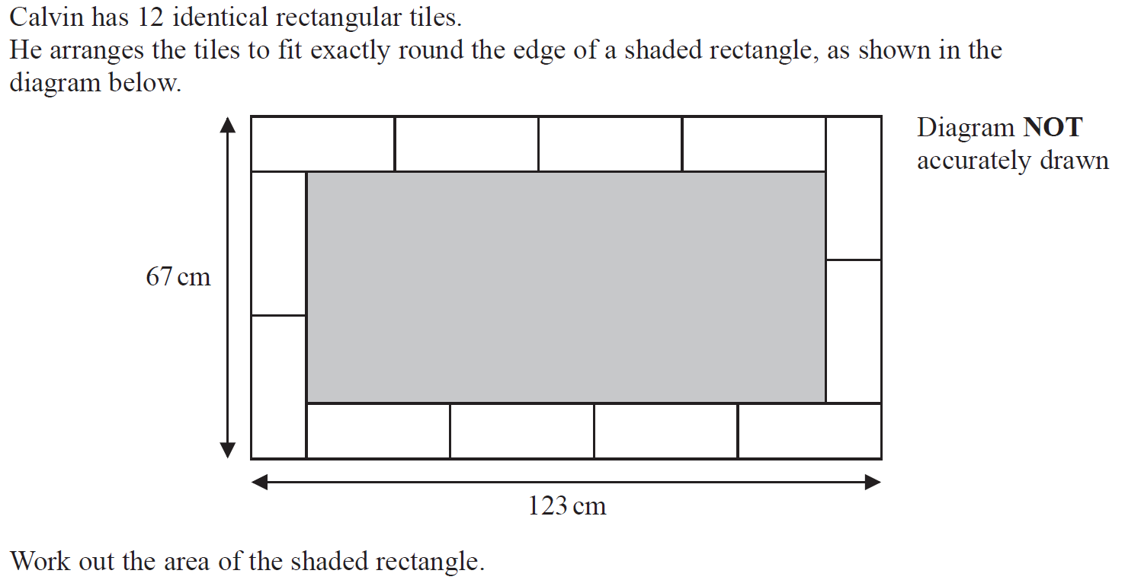
Simultaneous Equations
Jan 2019 2H Q5

Slide 11
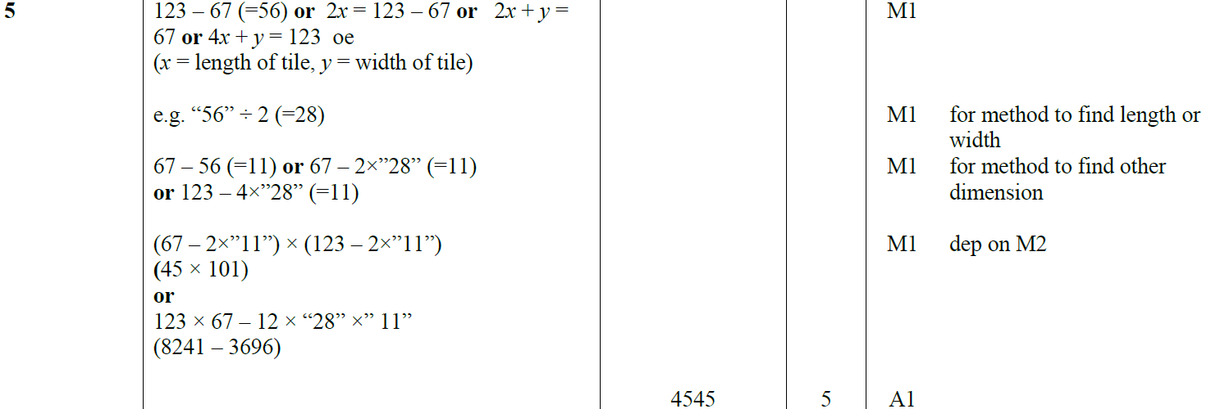
Simultaneous Equations
Jan 2019 2H Q5
A

Slide 12
Simultaneous Equations
Jan 2019 2H Q9

Slide 13
Simultaneous Equations
Jan 2019 2H Q9
A

Slide 14
Simultaneous Equations
Jan 2019 1HR Q8

Slide 15
Simultaneous Equations
Jan 2019 1HR Q8
A

Slide 16
Simultaneous Equations
Jan 2019 2HR Q21

Slide 17
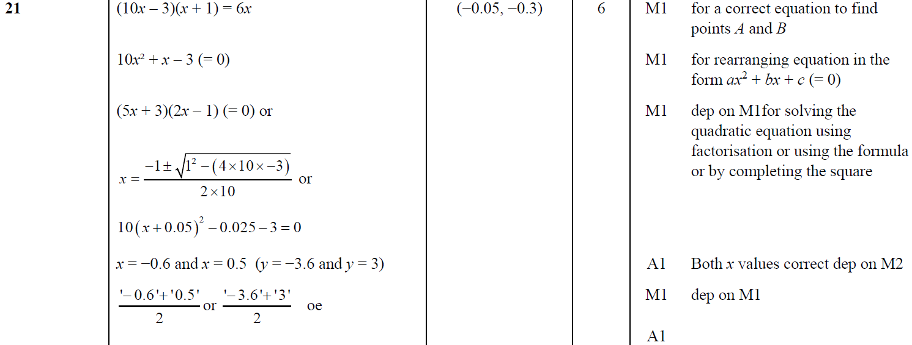
Simultaneous Equations
Jan 2019 2HR Q21
A

Slide 18
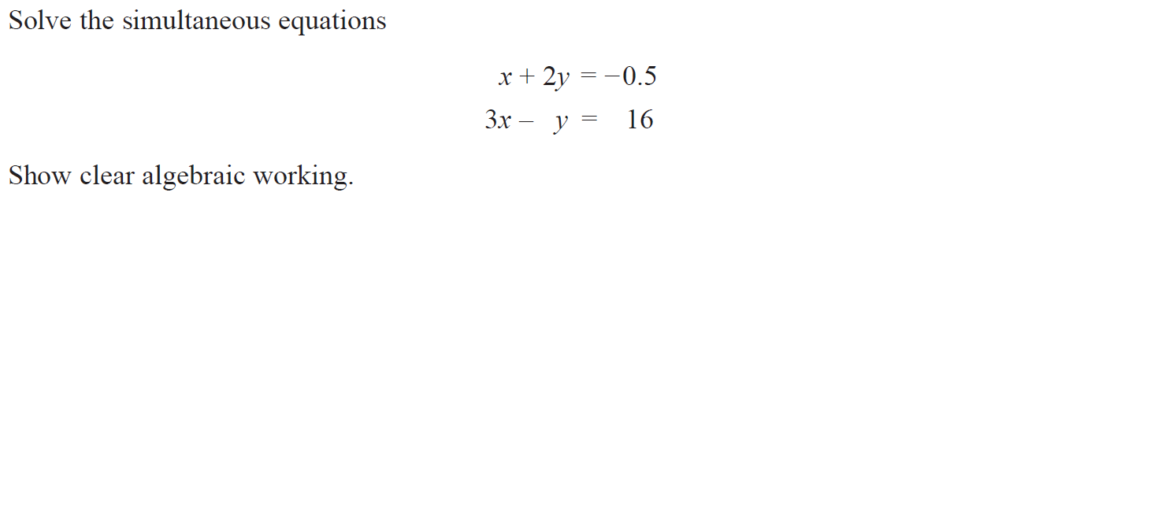
Simultaneous Equations
June 2019 2H Q9

Slide 19
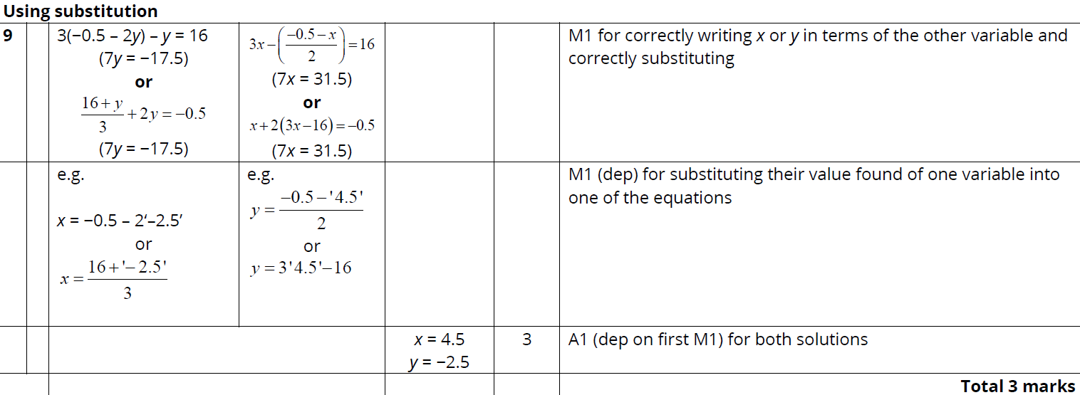
Simultaneous Equations
June 2019 2H Q9
A

Slide 20
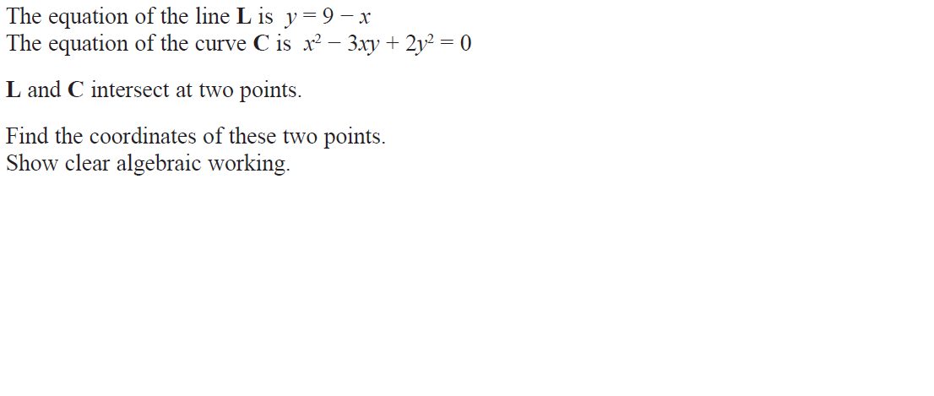
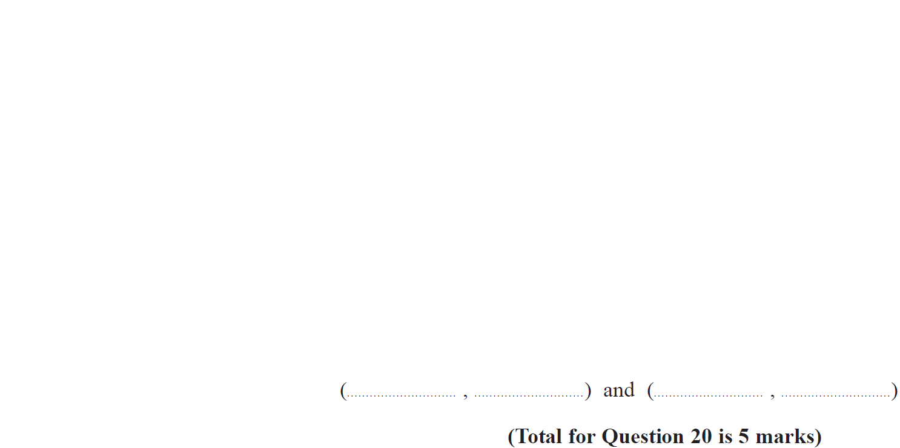
Simultaneous Equations
June 2019 2H Q20

Slide 21
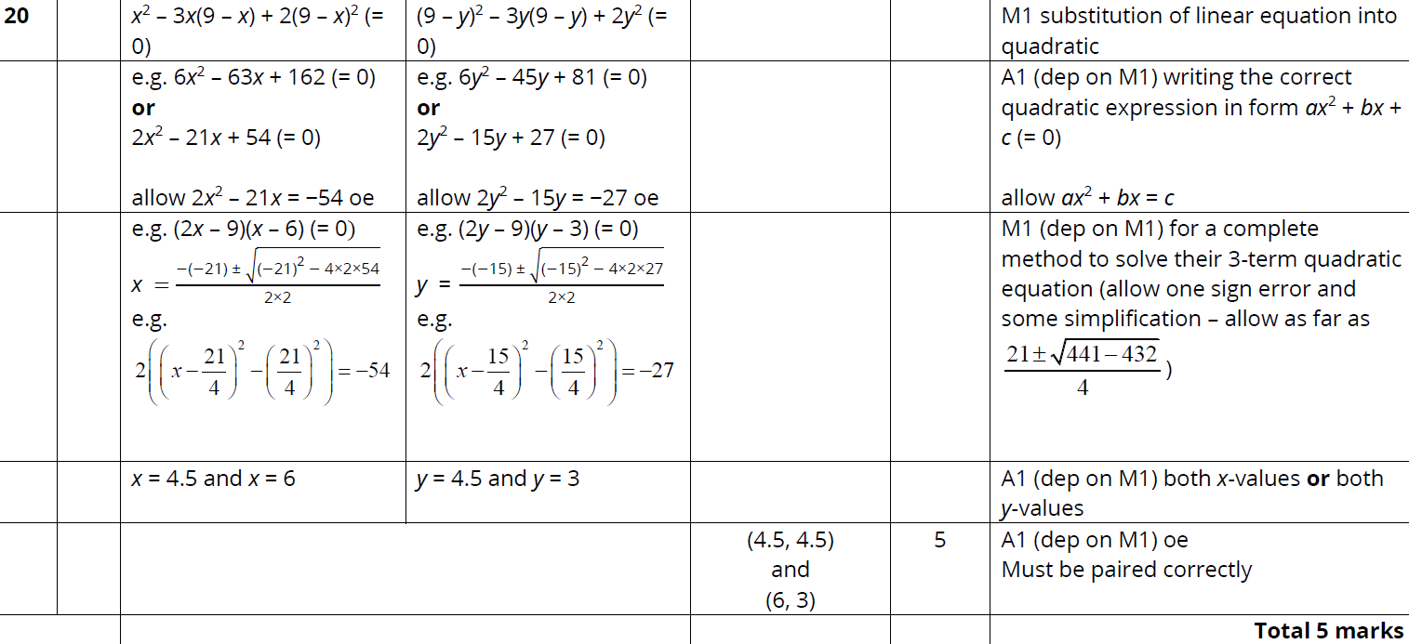
Simultaneous Equations
June 2019 2H Q20
A

Slide 22
Simultaneous Equations
Simultaneous Equations
New Spec Q’s
May 2004
3H Q12
May 2007
4H Q6
Nov 2010
3H Q12
May 2013 4HR Q13
Jan 2015 4HR Q19
June 2016 4HR Q10
Jan 2018 3HR Q15
May 2004
4H Q21
Nov 2007
3H Q14
Nov 2010
4H Q20
Jan 2014 4H Q22
May 2015 3H Q13
June 2016 4HR Q20
May 2018 3H Q11
Nov 2004
4H Q12
May 2008
4H Q9
June 2011 3H Q22
Jan 2014 3HR Q13
June 2015 4H Q23
Jan 2017 3H Q23
May 2018 3HR Q19
May 2005
4H Q11
Nov 2008
4H Q15
Jan 2012 4H Q13
Jan 2014 4HR Q22
May 2015 3HR Q14
Jan 2017 4H Q10
June 2018 4HR Q7
May 2005
3H Q21
May 2009
3H Q11
May 2012 3H Q21
May 2014 4H Q15
Jan 2016 3H Q22
Jan 2017 3HR Q11
May 2006
4H Q17
Nov 2009
3H Q14
May 2012 4H Q7
May 2014 3HR Q13
Jan 2016 4H Q11
May 2017 3H Q10
Nov 2006
3H Q18
Nov 2009
4H Q22
Jan 2013 3H Q5
Jan 2015 3H Q12
Jan 2016 3HR Q11
May 2017 3HR Q18
Nov 2006
4H Q12
June 2010
3H Q21
Jan 2013 4H Q26
Jan 2015 3HR Q24
Jan 2016 4HR Q24
June 2017 4HR Q9
May 2007
3H Q19
June 2010
4H Q13
May 2013 3HR Q25
Jan 2015 4HR Q4
May 2016 3H Q12
Jan 2018 4H Q22
Quadratic

Slide 23
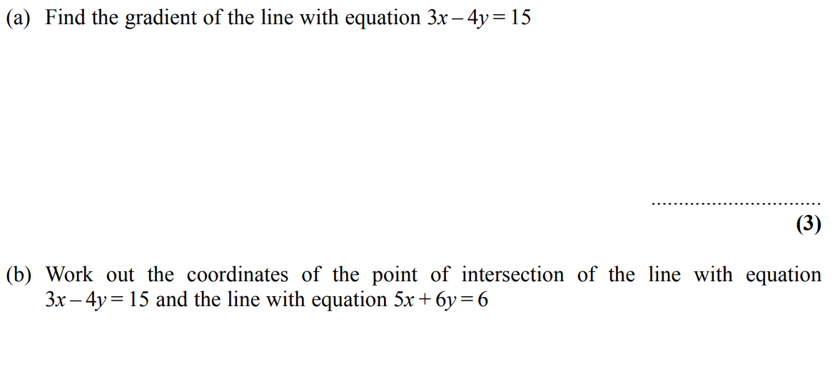
Simultaneous Equations
May 2004 3H Q12

Slide 24
Simultaneous Equations
May 2004 3H Q12
A
B

Slide 25
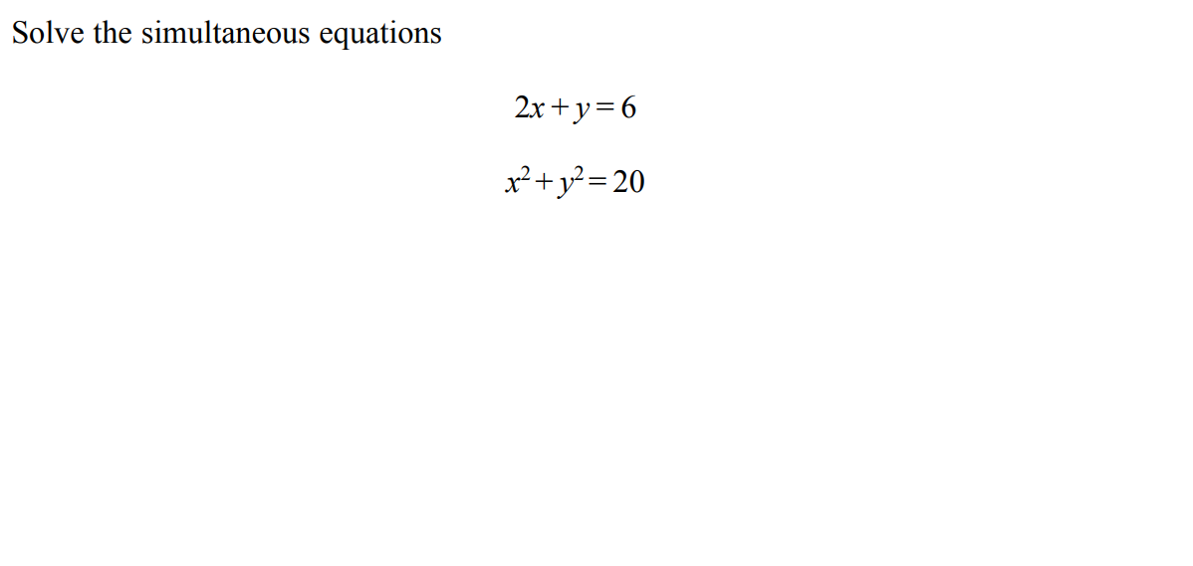
Simultaneous Equations
May 2004 4H Q21

Slide 26
Simultaneous Equations
May 2004 4H Q21
A

Slide 27
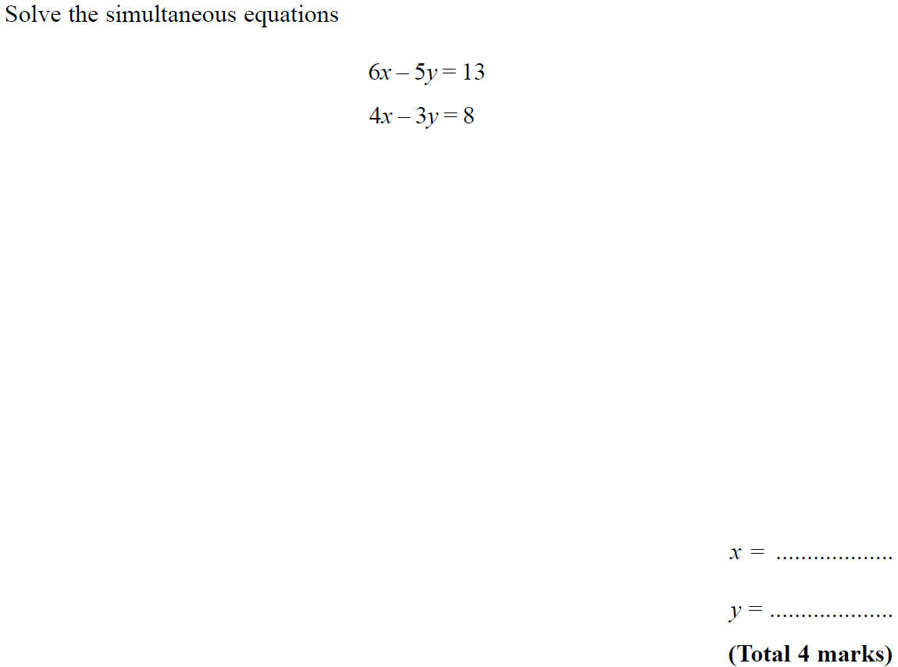
Simultaneous Equations
Nov 2004 4H Q12

Slide 28
Simultaneous Equations
Nov 2004 4H Q12
A

Slide 29
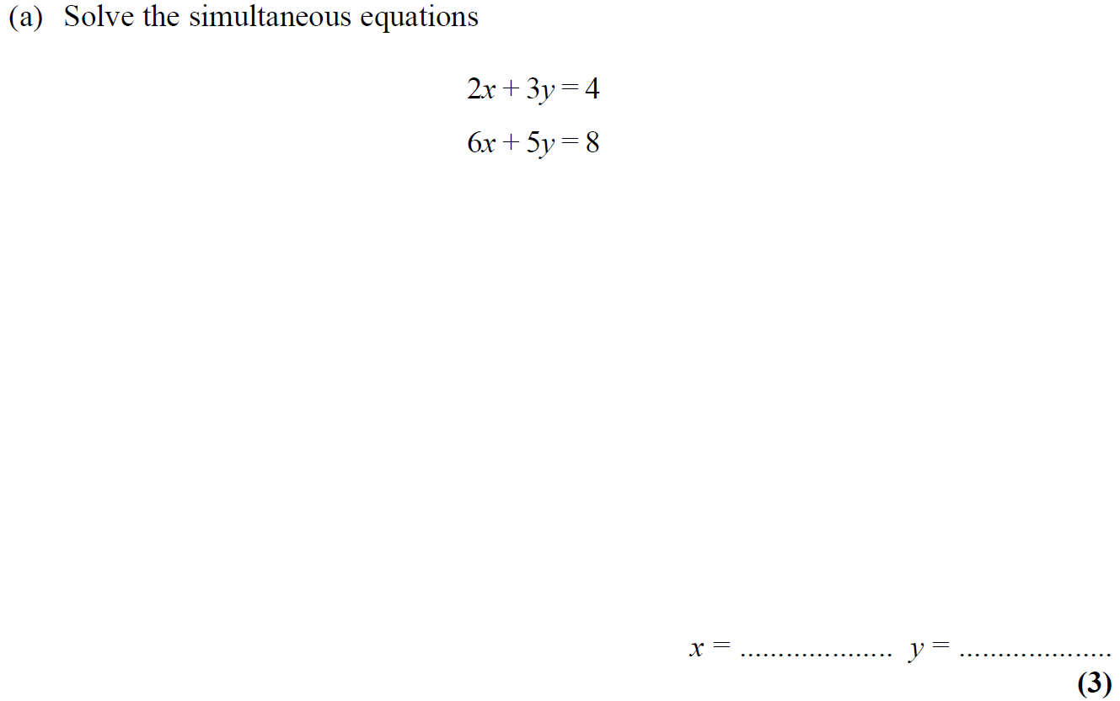
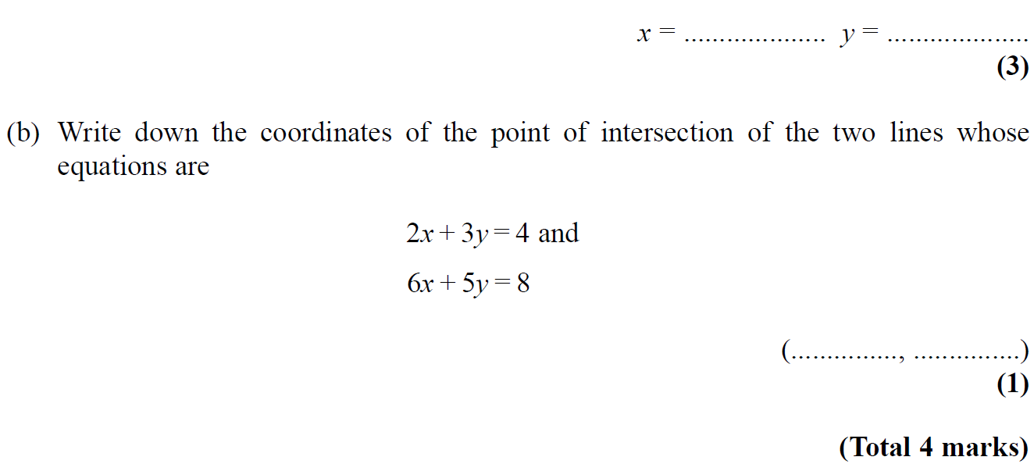
Simultaneous Equations
May 2005 4H Q11

Slide 30
Simultaneous Equations
May 2005 4H Q11
A
B

Slide 31
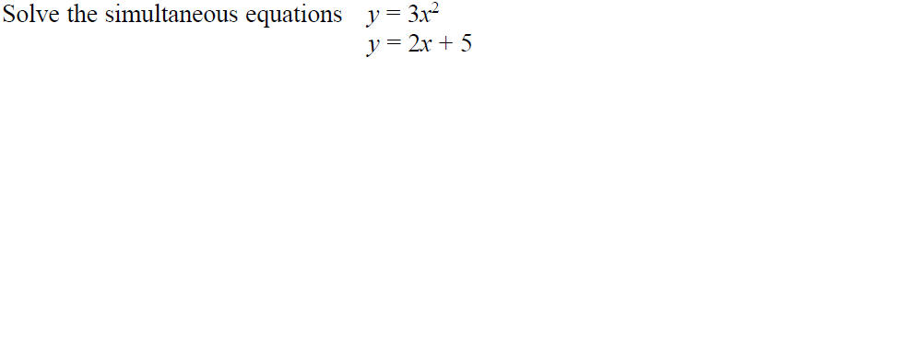
Simultaneous Equations
May 2005 3H Q21

Slide 32
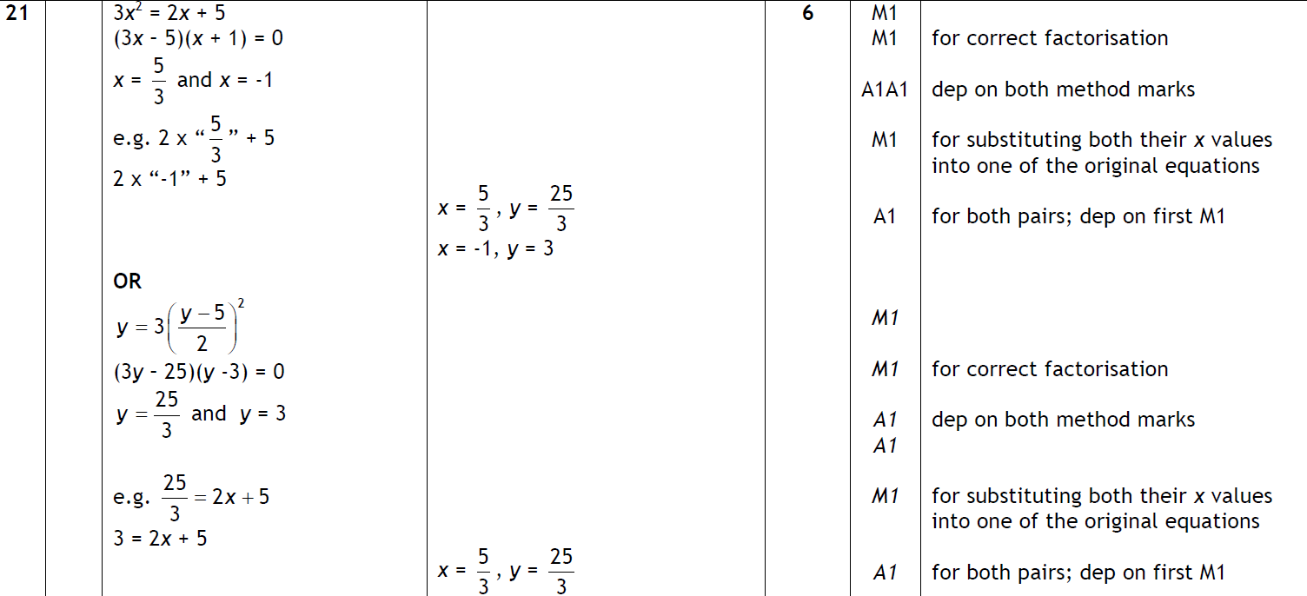
Simultaneous Equations
May 2005 3H Q21
A

Slide 33
Simultaneous Equations
May 2006 4H Q17

Slide 34
Simultaneous Equations
May 2006 4H Q17
A

Slide 35
Simultaneous Equations
Nov 2006 3H Q18

Slide 36
Simultaneous Equations
Nov 2006 3H Q18
A

Slide 37
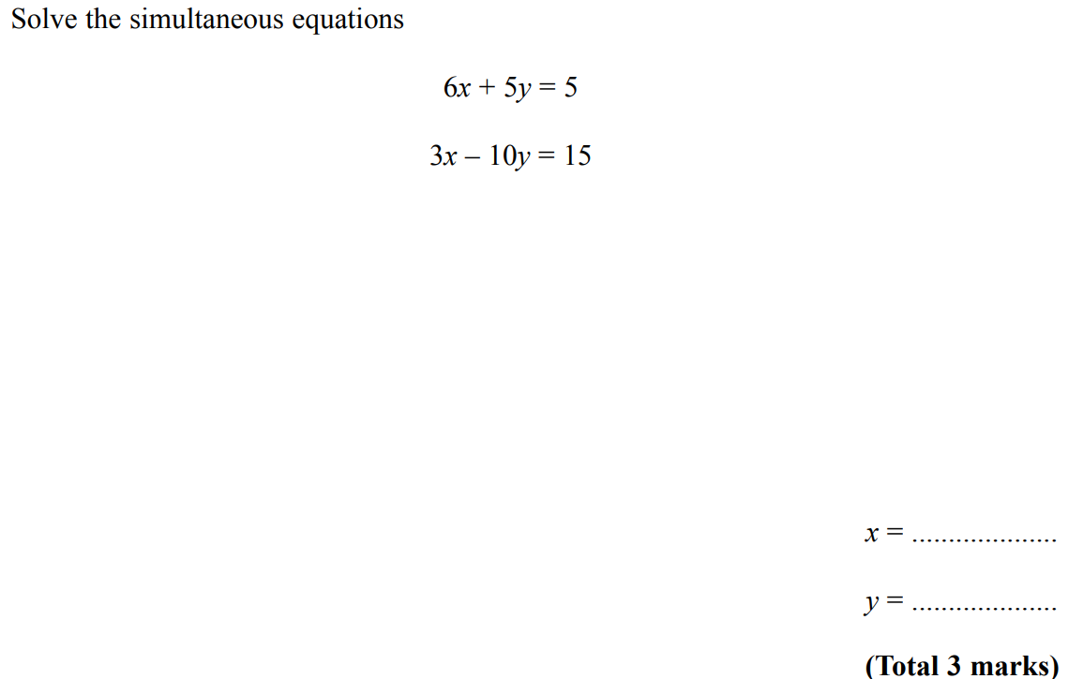
Simultaneous Equations
Nov 2006 4H Q12

Slide 38
Simultaneous Equations
Nov 2006 4H Q12
A

Slide 39
Simultaneous Equations
May 2007 3H Q19

Slide 40
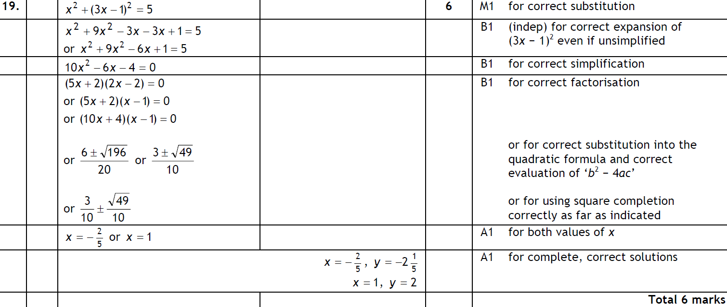
Simultaneous Equations
May 2007 3H Q19
A

Slide 41
Simultaneous Equations
May 2007 4H Q6

Slide 42
Simultaneous Equations
May 2007 4H Q6
A

Slide 43
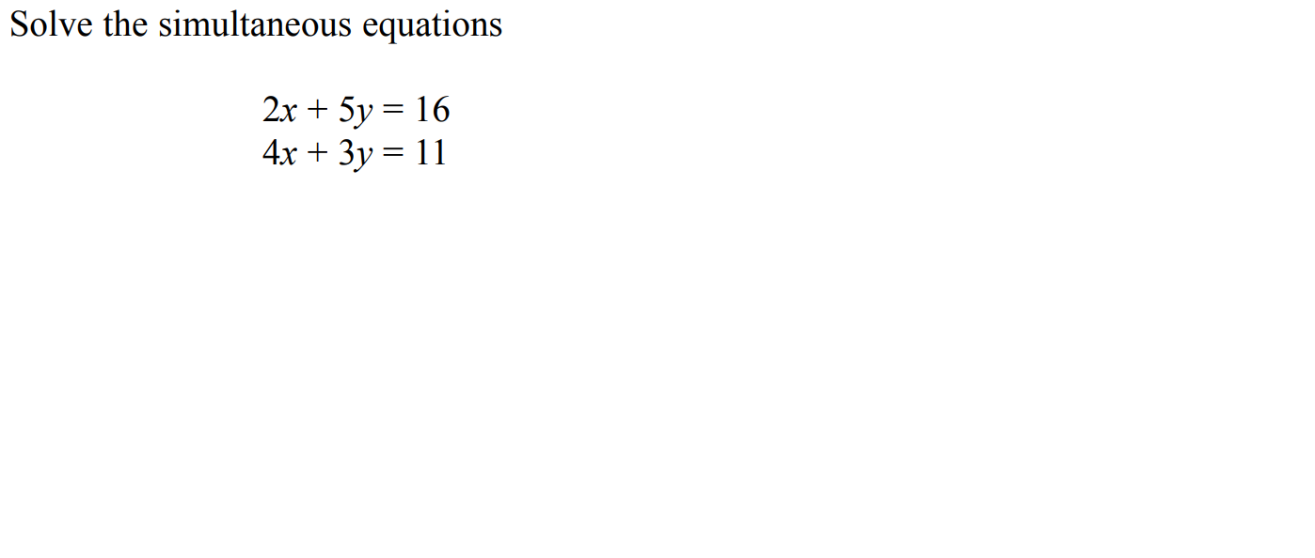
Simultaneous Equations
Nov 2007 3H Q14

Slide 44
Simultaneous Equations
Nov 2007 3H Q14
A

Slide 45
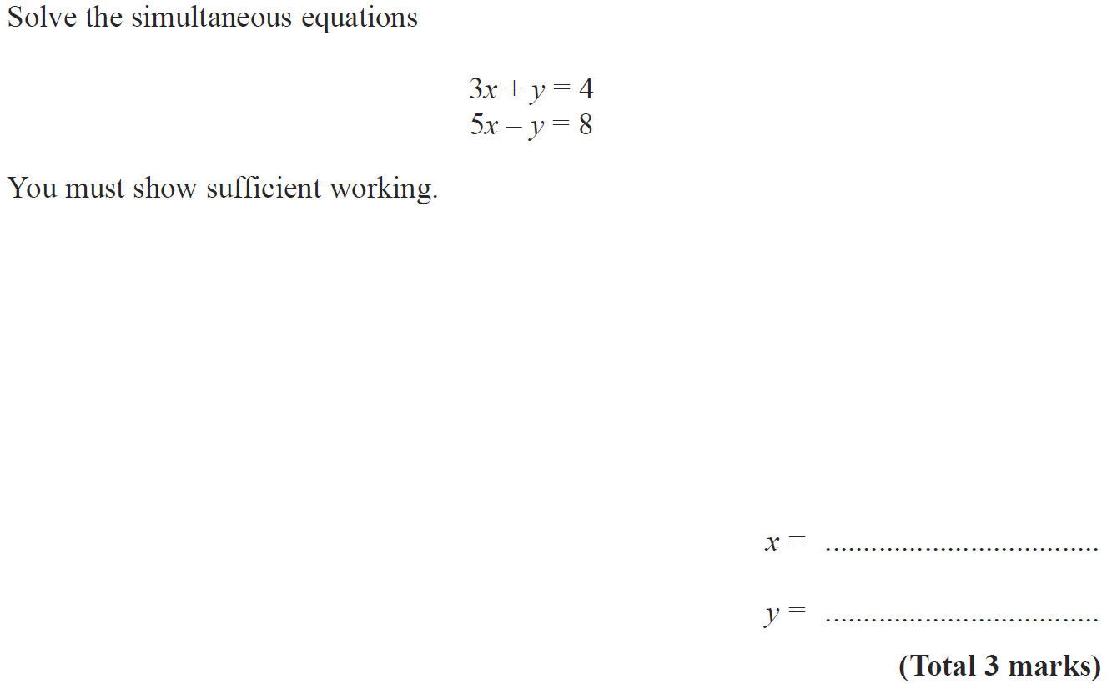
Simultaneous Equations
May 2008 4H Q9

Slide 46
Simultaneous Equations
May 2008 4H Q9
A

Slide 47
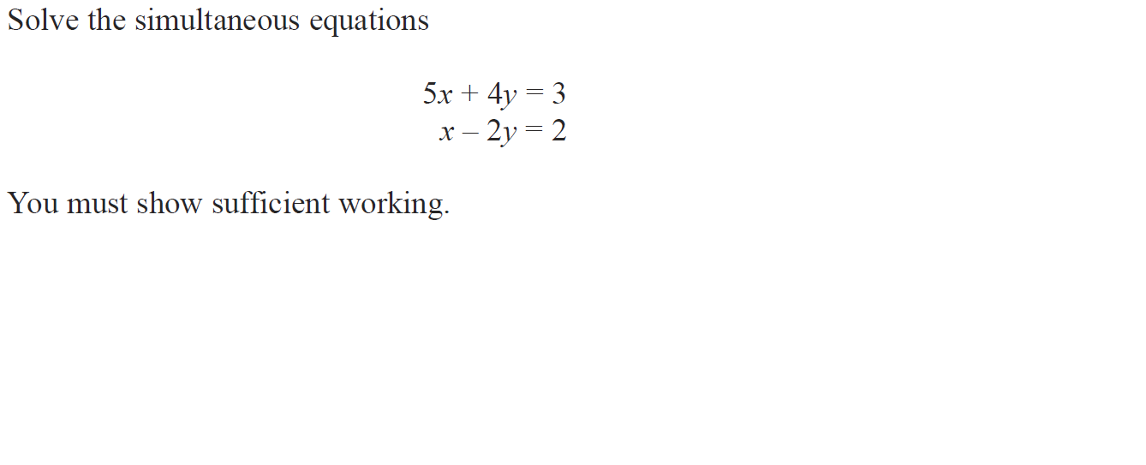
Simultaneous Equations
Nov 2008 4H Q15

Slide 48
Simultaneous Equations
Nov 2008 4H Q15
A

Slide 49
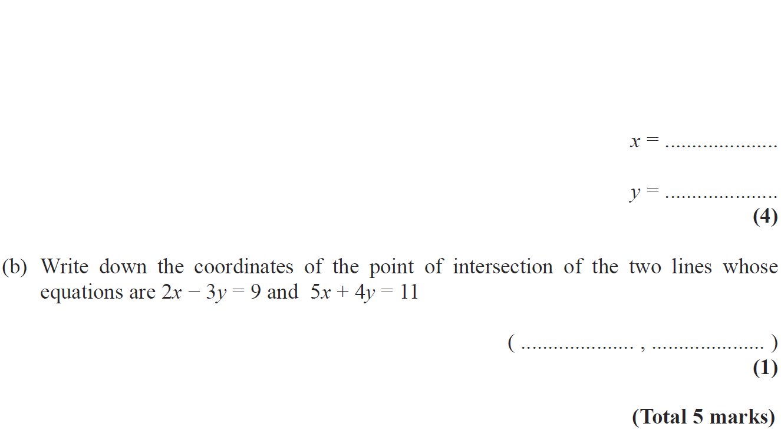
Simultaneous Equations
May 2009 3H Q11

Slide 50
Simultaneous Equations
May 2009 3H Q11
A
B

Slide 51
Simultaneous Equations
Nov 2009 3H Q14

Slide 52
Simultaneous Equations
Nov 2009 3H Q14
A

Slide 53
Simultaneous Equations
Nov 2009 4H Q22

Slide 54
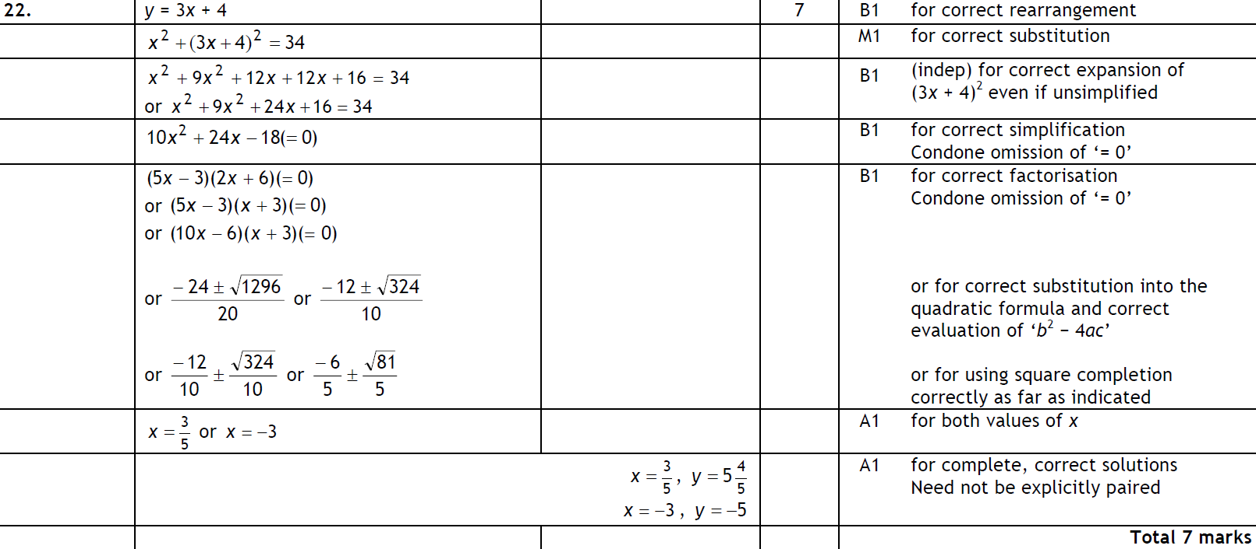
Simultaneous Equations
Nov 2009 4H Q22
A

Slide 55
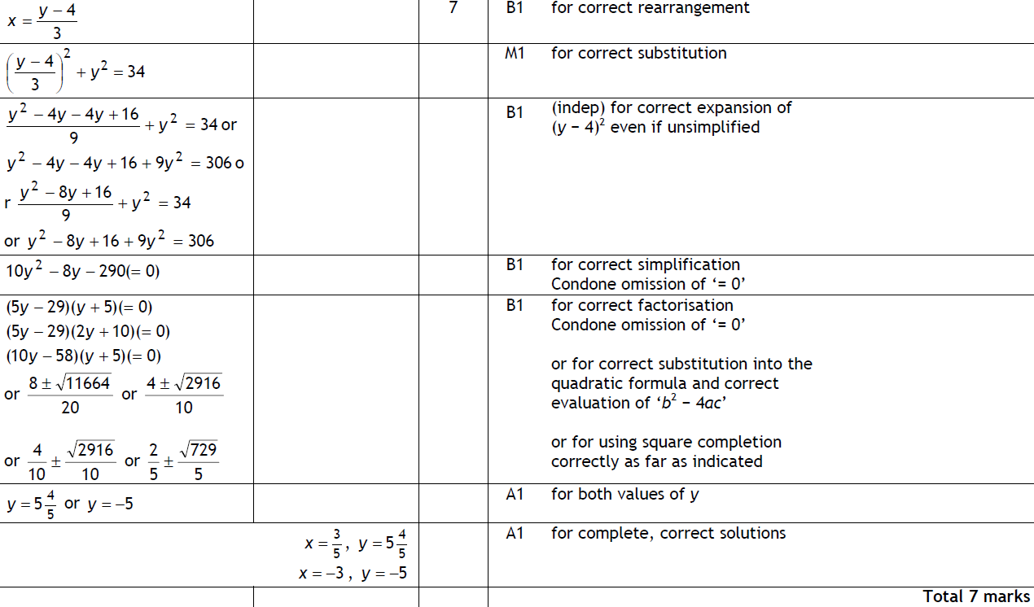
Simultaneous Equations
Nov 2009 4H Q22
Alterative

Slide 56
Simultaneous Equations
June 2010 3H Q21

Slide 57
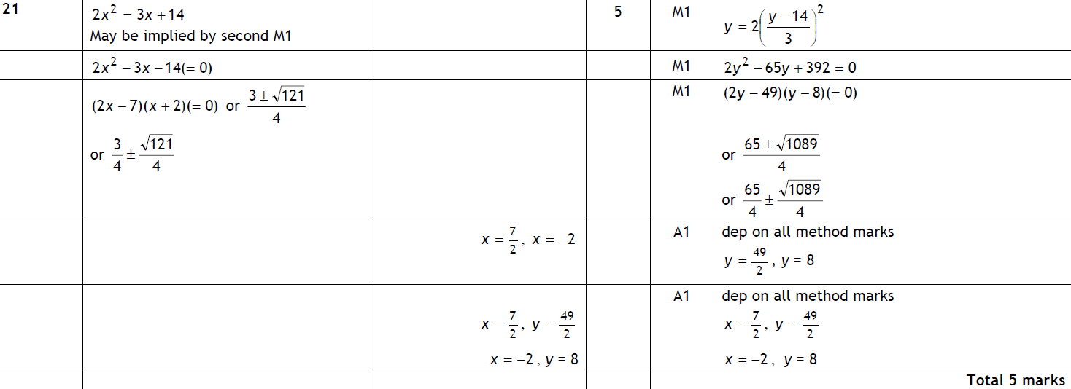
Simultaneous Equations
June 2010 3H Q21
A

Slide 58
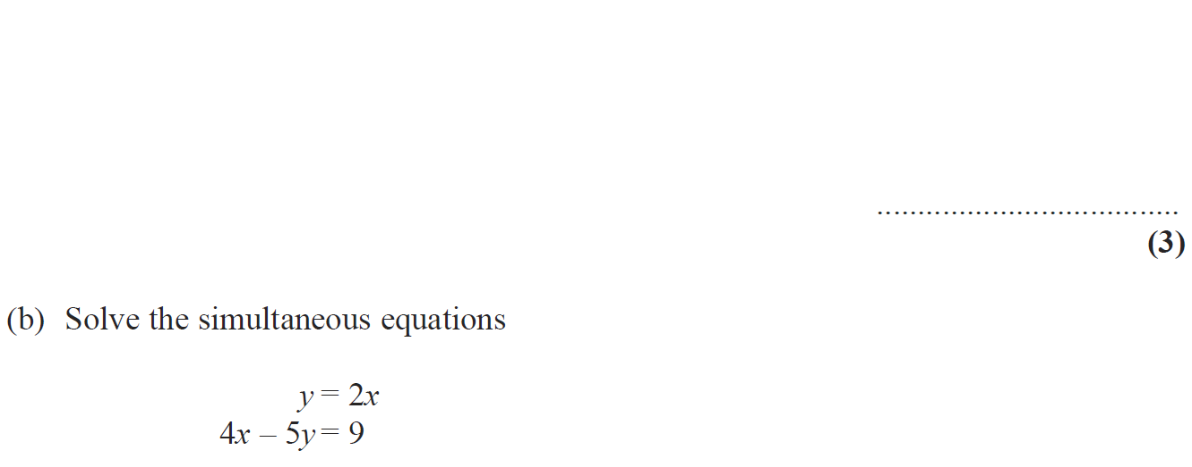
Simultaneous Equations
June 2010 4H Q13

Slide 59
Simultaneous Equations
June 2010 4H Q13
A
B

Slide 60
Simultaneous Equations
Nov 2010 3H Q12

Slide 61
Simultaneous Equations
Nov 2010 3H Q12
A

Slide 62
Simultaneous Equations
Nov 2010 4H Q20

Slide 63
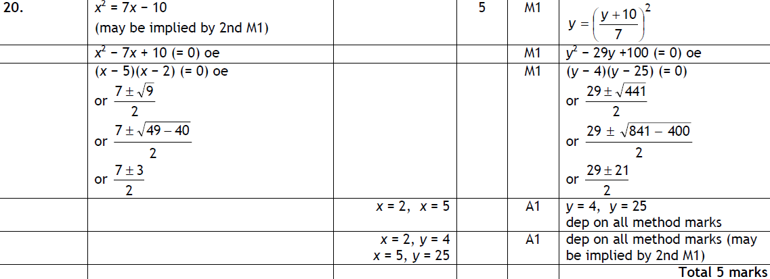
Simultaneous Equations
Nov 2010 4H Q20
A

Slide 64
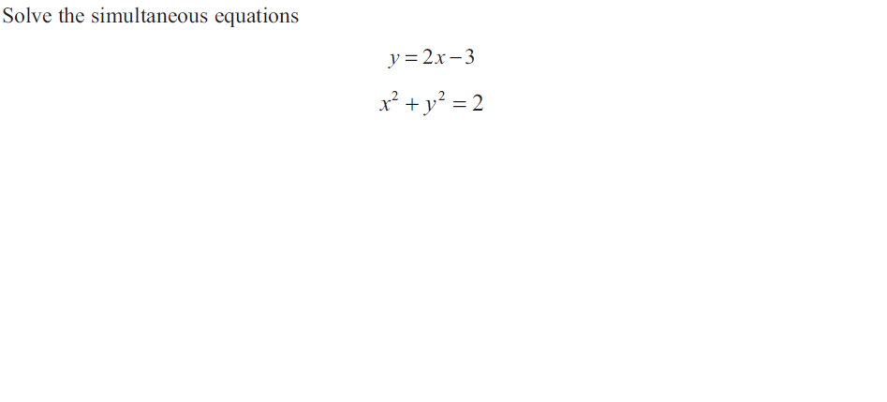
Simultaneous Equations
June 2011 3H Q22

Slide 65
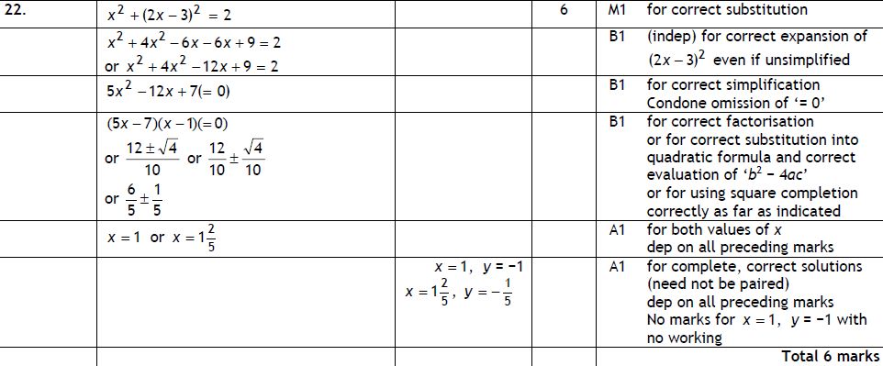
Simultaneous Equations
June 2011 3H Q22
A

Slide 66
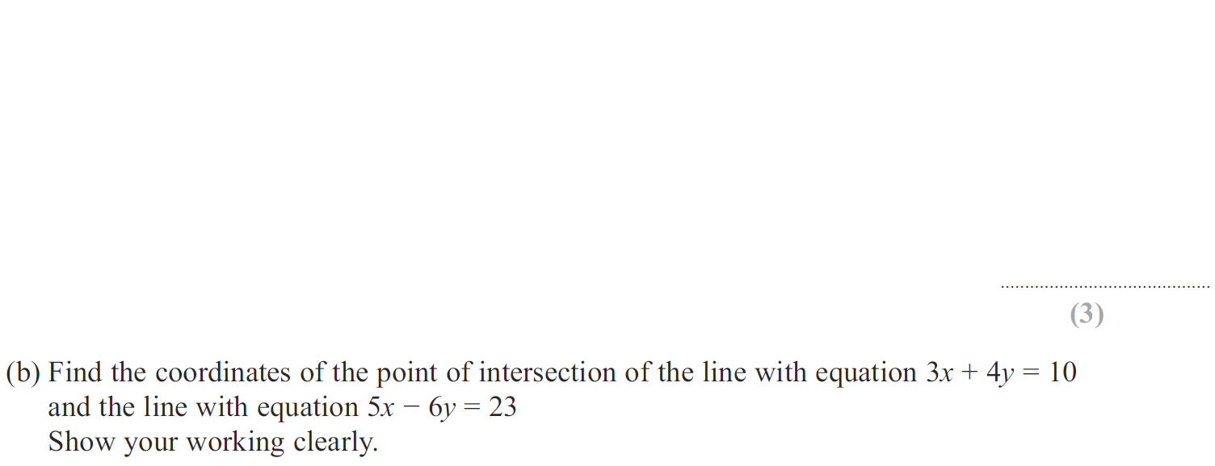
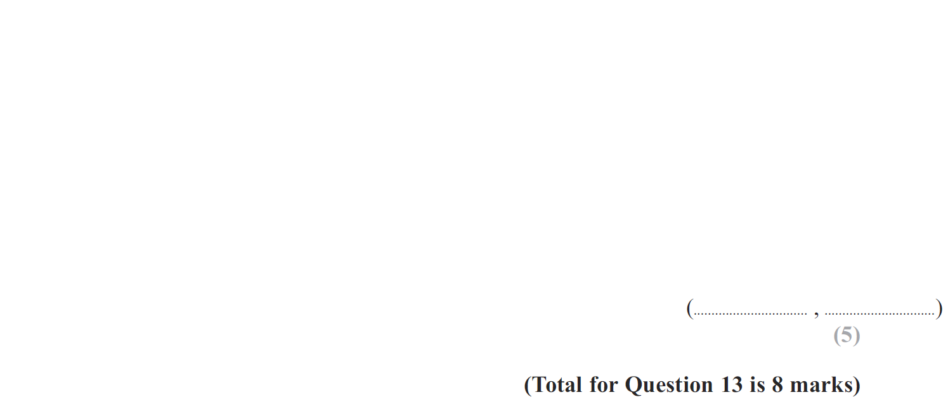
Simultaneous Equations
Jan 2012 4H Q13

Slide 67
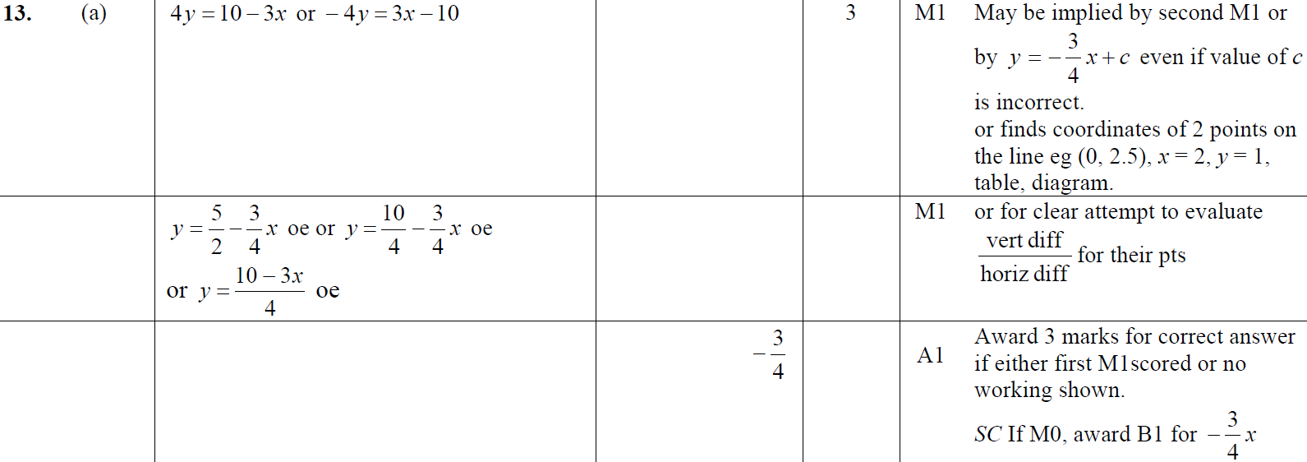
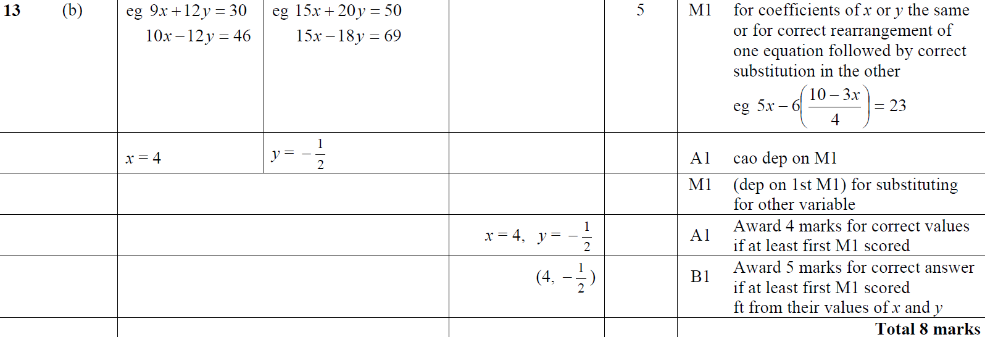
Simultaneous Equations
Jan 2012 4H Q13
A
B

Slide 68
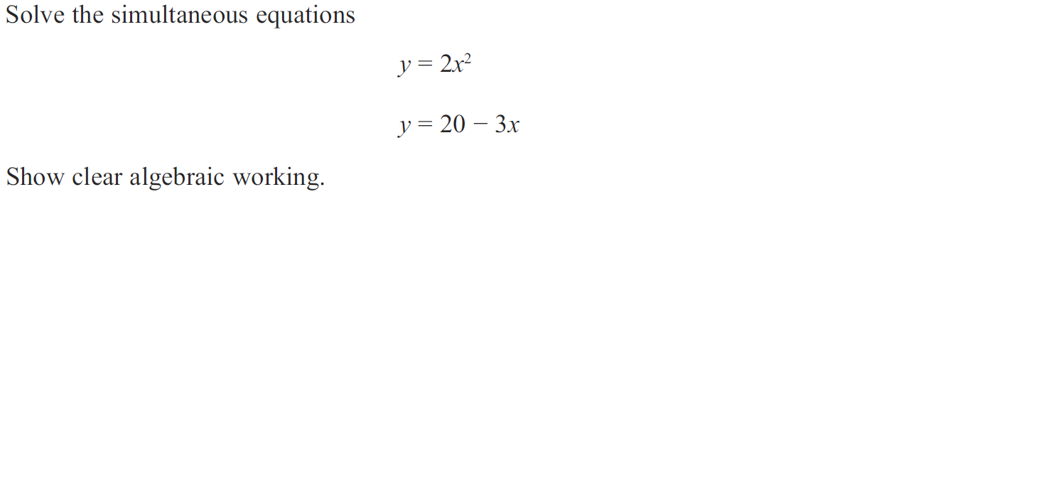
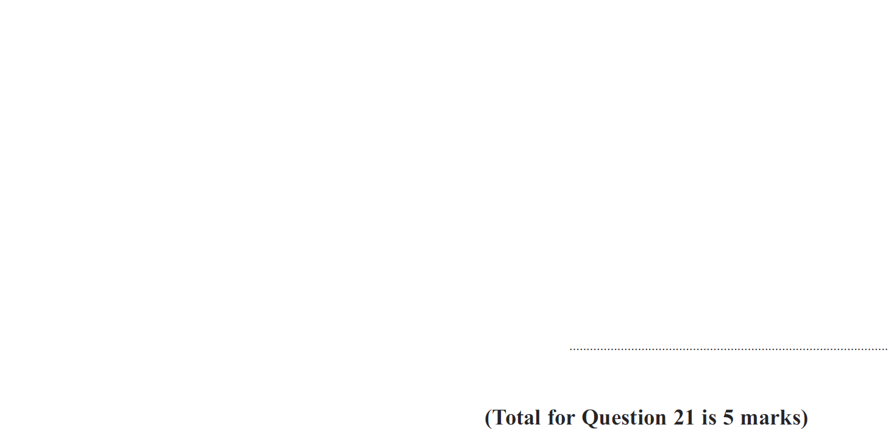
Simultaneous Equations
May 2012 3H Q21

Slide 69
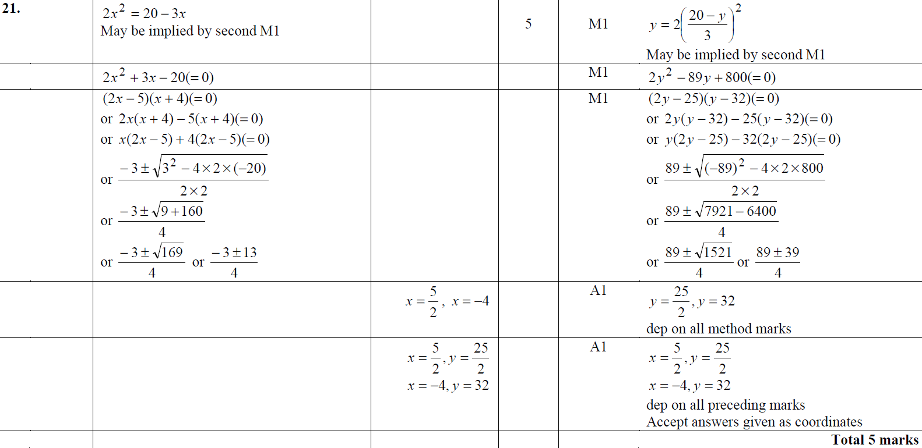
Simultaneous Equations
May 2012 3H Q21
A

Slide 70
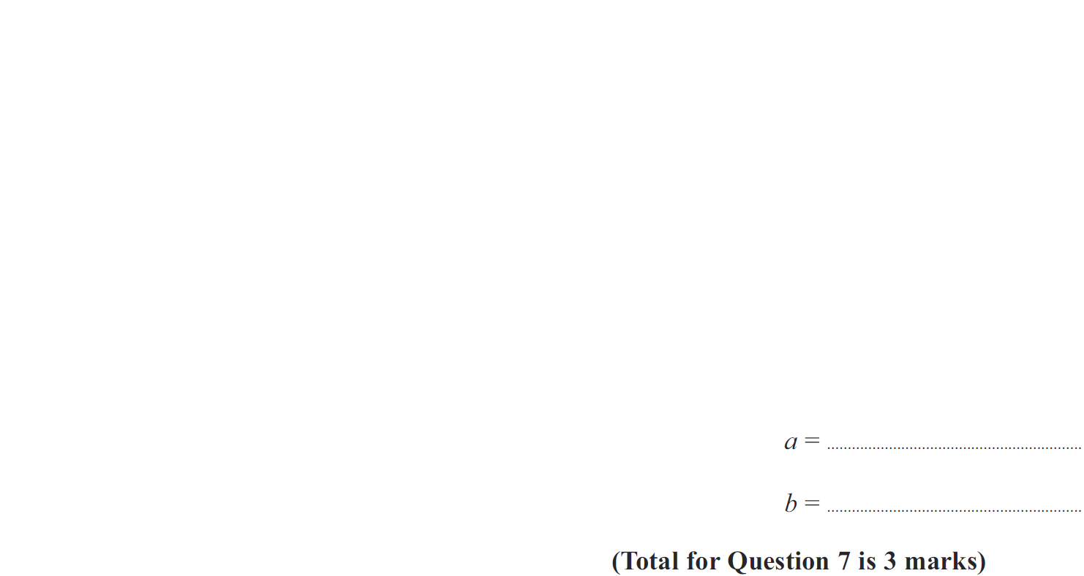
Simultaneous Equations
May 2012 4H Q7

Slide 71
Simultaneous Equations
May 2012 4H Q7
A

Slide 72
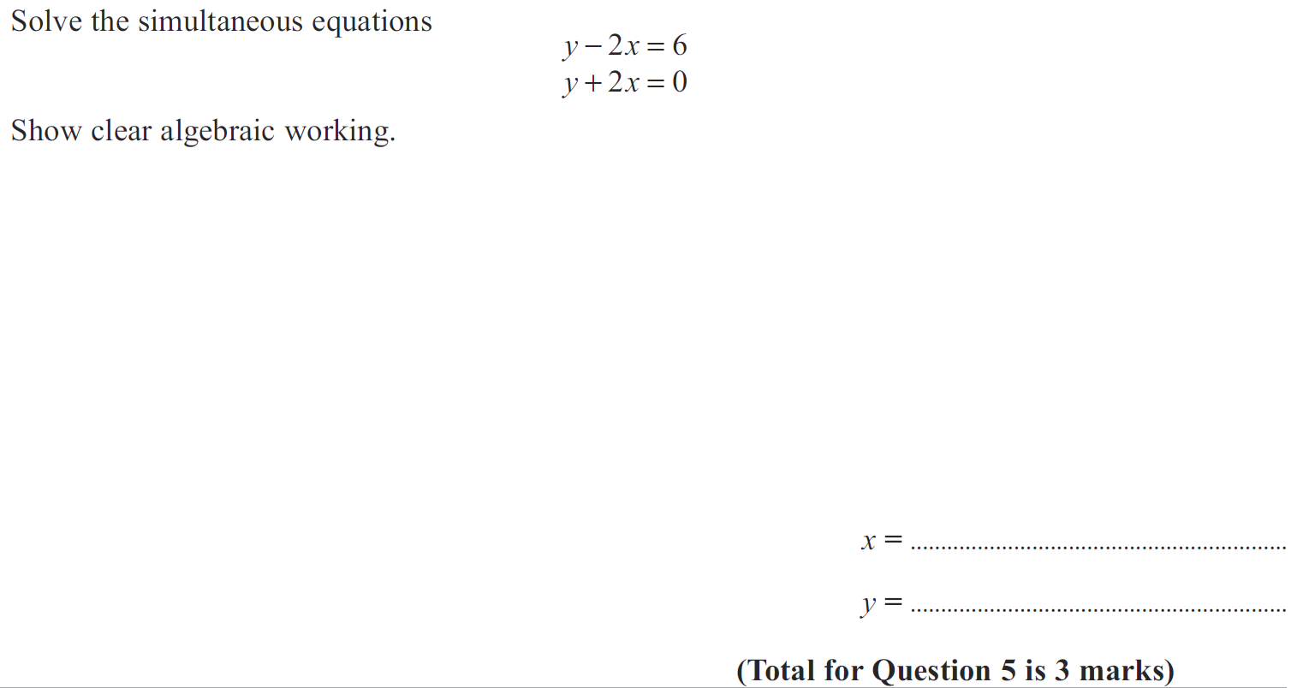
Simultaneous Equations
Jan 2013 3H Q5

Slide 73
Simultaneous Equations
Jan 2013 3H Q5
A

Slide 74
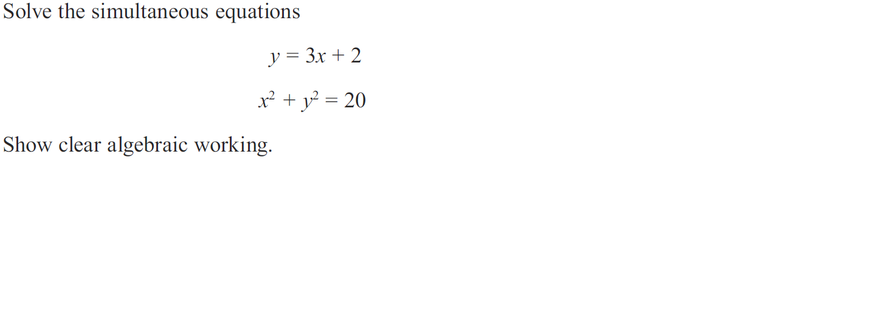
Simultaneous Equations
Jan 2013 4H Q26

Slide 75
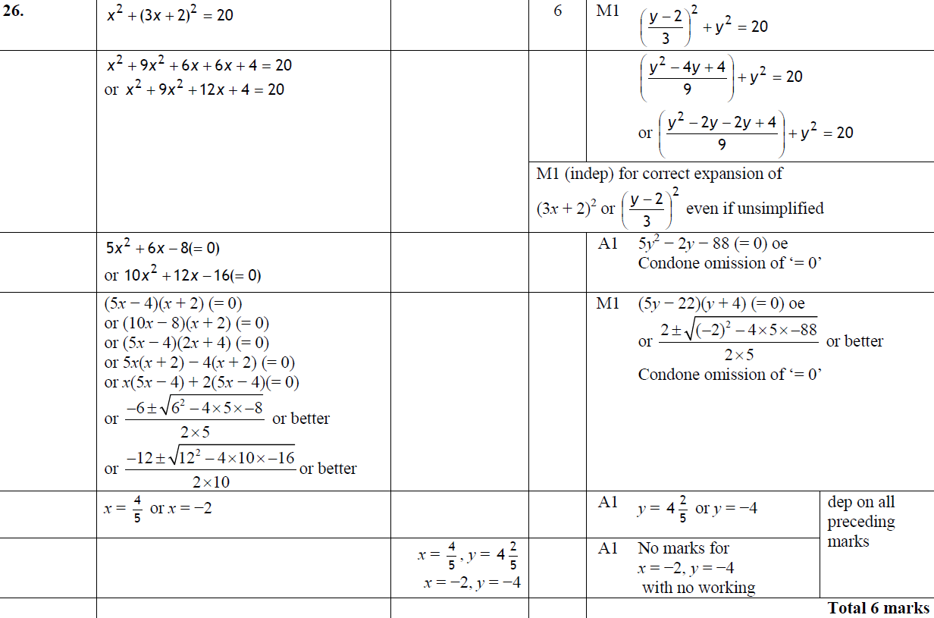
Simultaneous Equations
Jan 2013 4H Q26
A

Slide 76
Simultaneous Equations
May 2013 3HR Q25

Slide 77
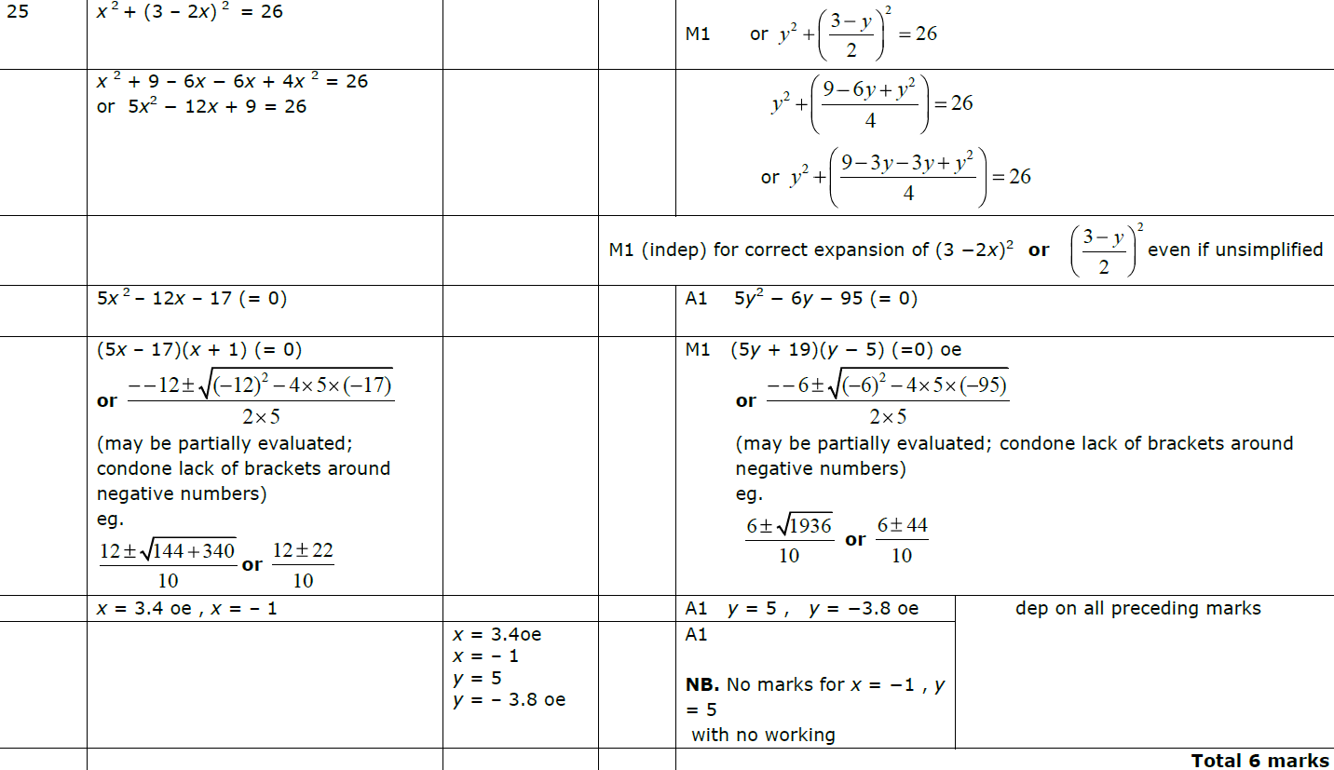
Simultaneous Equations
May 2013 3HR Q25
A

Slide 78
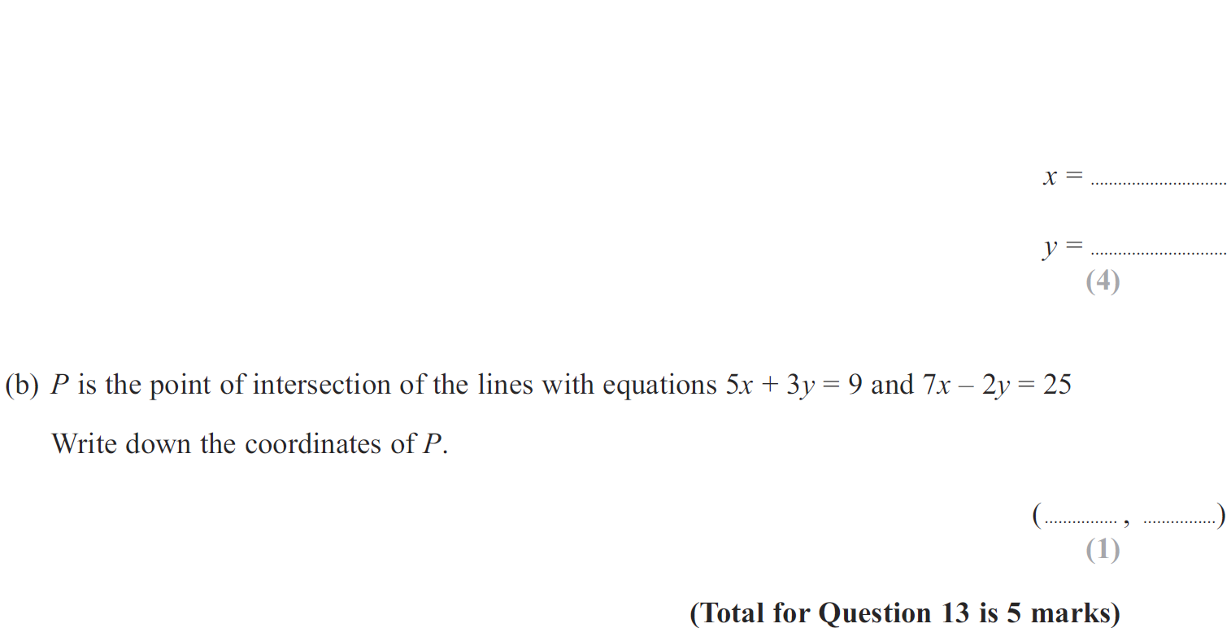
Simultaneous Equations
May 2013 4HR Q13

Slide 79
Simultaneous Equations
May 2013 4HR Q13
A
B

Slide 80
Simultaneous Equations
Jan 2014 4H Q22

Slide 81
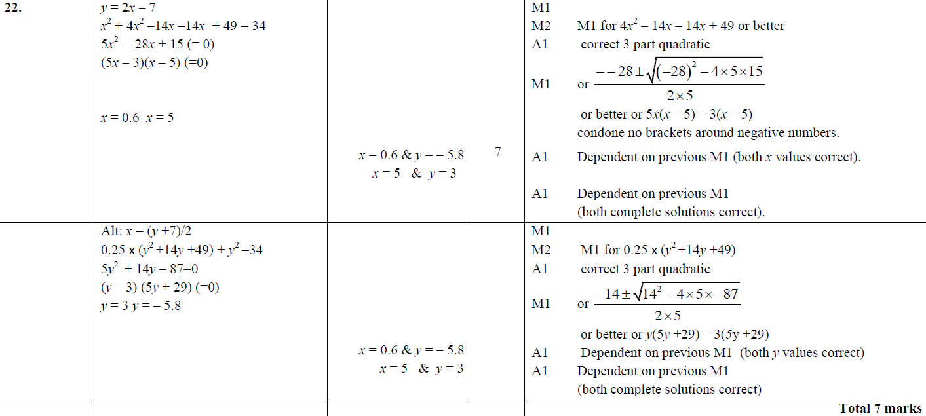
Simultaneous Equations
Jan 2014 4H Q22
A

Slide 82
Simultaneous Equations
Jan 2014 3HR Q13

Slide 83
Simultaneous Equations
Jan 2014 3HR Q13
A
B

Slide 84
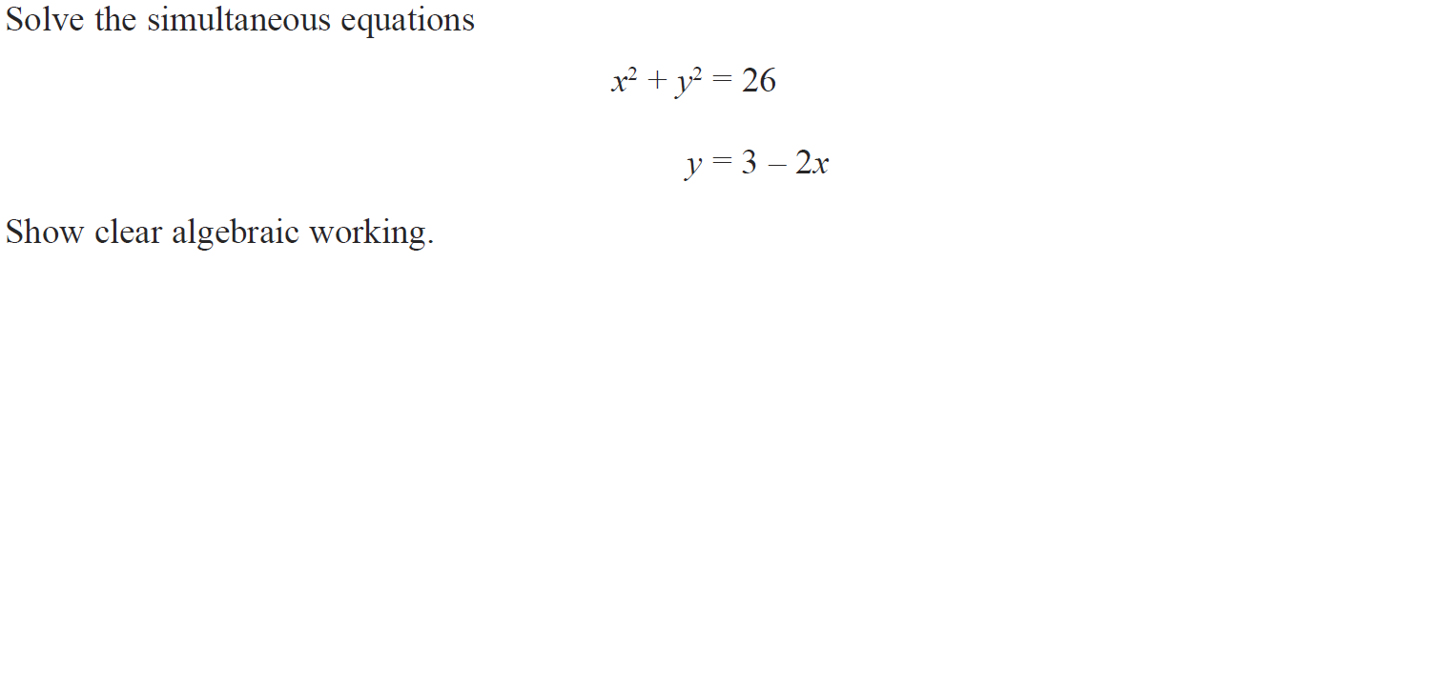
Simultaneous Equations
Jan 2014 4HR Q22

Slide 85
Simultaneous Equations
Jan 2014 4HR Q22
A

Slide 86
Simultaneous Equations
May 2014 4H Q15

Slide 87
Simultaneous Equations
May 2014 4H Q15
A

Slide 88
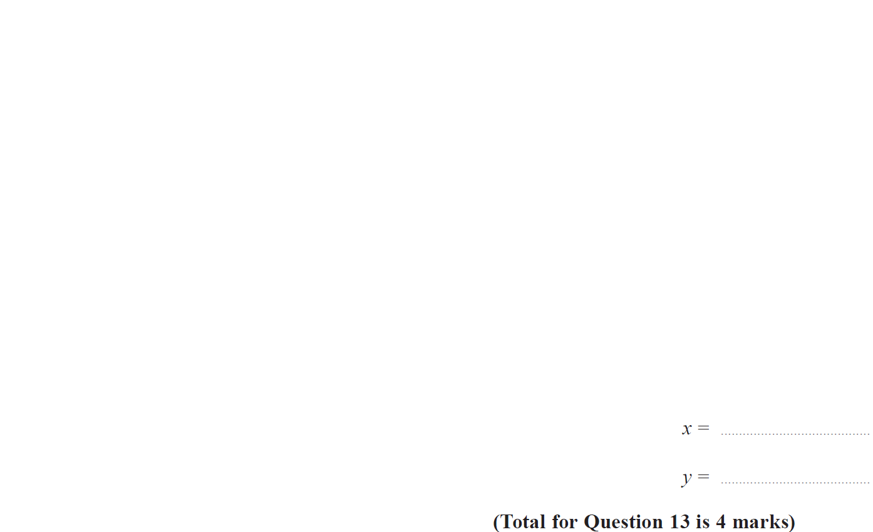
Simultaneous Equations
May 2014 3HR Q13

Slide 89
Simultaneous Equations
May 2014 3HR Q13
A

Slide 90
Simultaneous Equations
Jan 2015 3H Q12

Slide 91
Simultaneous Equations
Jan 2015 3H Q12
A

Slide 92
Simultaneous Equations
Jan 2015 3HR Q24

Slide 93
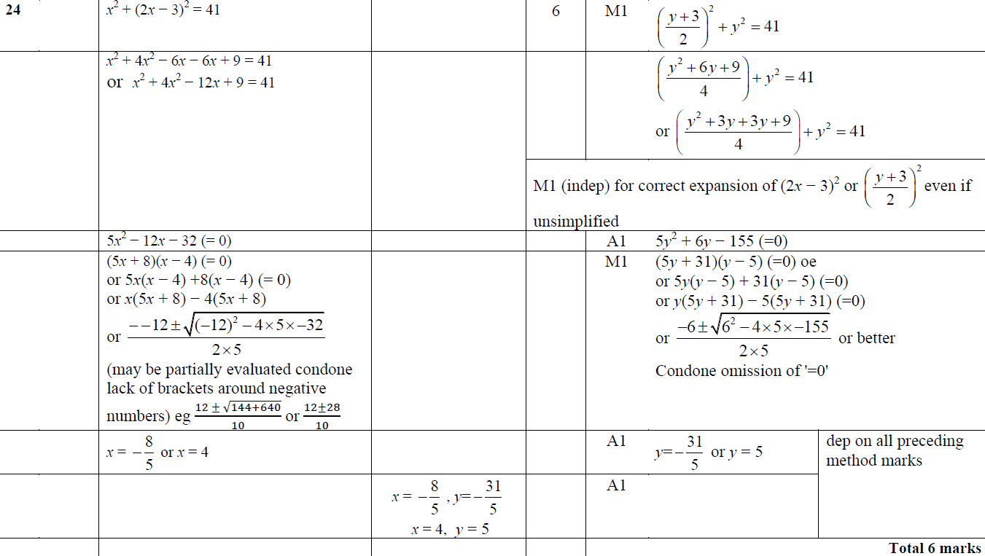
Simultaneous Equations
Jan 2015 3HR Q24
A

Slide 94
Simultaneous Equations
Jan 2015 4HR Q4

Slide 95
Simultaneous Equations
Jan 2015 4HR Q4
A

Slide 96
Simultaneous Equations
Jan 2015 4HR Q19

Slide 97
Simultaneous Equations
Jan 2015 4HR Q19
A
B

Slide 98
Simultaneous Equations
May 2015 3H Q13

Slide 99
Simultaneous Equations
May 2015 3H Q13
A
B

Slide 100
Simultaneous Equations
June 2015 4H Q23

Slide 101
Simultaneous Equations
June 2015 4H Q23
A

Slide 102
Simultaneous Equations
May 2015 3HR Q14

Slide 103
Simultaneous Equations
May 2015 3HR Q14
A

Slide 104
Simultaneous Equations
Jan 2016 3H Q22

Slide 105
Simultaneous Equations
Jan 2016 3H Q22
A

Slide 106
Simultaneous Equations
Jan 2016 4H Q11

Slide 107
Simultaneous Equations
Jan 2016 4H Q11
A

Slide 108
Simultaneous Equations
Jan 2016 3HR Q11

Slide 109
Simultaneous Equations
Jan 2016 3HR Q11
A

Slide 110
Simultaneous Equations
Jan 2016 4HR Q24

Slide 111
Simultaneous Equations
Jan 2016 4HR Q24
A

Slide 112
Simultaneous Equations
May 2016 3H Q12

Slide 113
Simultaneous Equations
May 2016 3H Q12
A

Slide 114
Simultaneous Equations
June 2016 4HR Q10

Slide 115
Simultaneous Equations
June 2016 4HR Q10
A

Slide 116
Simultaneous Equations
June 2016 4HR Q20

Slide 117
Simultaneous Equations
June 2016 4HR Q20
A

Slide 118
Simultaneous Equations
Jan 2017 3H Q23

Slide 119
Simultaneous Equations
Jan 2017 3H Q23
A

Slide 120
Simultaneous Equations
Jan 2017 4H Q10

Slide 121
Simultaneous Equations
Jan 2017 4H Q10
A

Slide 122
Simultaneous Equations
Jan 2017 3HR Q11

Slide 123
Simultaneous Equations
Jan 2017 3HR Q11
A
B
C

Slide 124
Simultaneous Equations
May 2017 3H Q10

Slide 125
Simultaneous Equations
May 2017 3H Q10
A

Slide 126
Simultaneous Equations
May 2017 3HR Q18

Slide 127
Simultaneous Equations
May 2017 3HR Q18
A

Slide 128
Simultaneous Equations
June 2017 4HR Q9

Slide 129
Simultaneous Equations
June 2017 4HR Q9
A

Slide 130
Simultaneous Equations
Jan 2018 4H Q22

Slide 131
Simultaneous Equations
Jan 2018 4H Q22
A

Slide 132
Simultaneous Equations
Jan 2018 3HR Q15

Slide 133
Simultaneous Equations
Jan 2018 3HR Q15
A

Slide 134
Simultaneous Equations
May 2018 3H Q11

Slide 135
Simultaneous Equations
May 2018 3H Q11
A

Slide 136
Simultaneous Equations
May 2018 3HR Q19

Slide 137
Simultaneous Equations
May 2018 3HR Q19
A

Slide 138
Simultaneous Equations
June 2018 4HR Q7

Slide 139
Simultaneous Equations
June 2018 4HR Q7
A

