Slide 1
Simultaneous Equations
Simultaneous Equations
May 2017
1H Q20
Nov 2018
1H Q17
SAM
2H Q20
June 2017
3H Q2
Nov 2018
2H Q18
Spec 1
1H Q4
Nov 2017
1H Q11
Nov 2018
2H Q19
Spec 2
3H Q11
Nov 2017
3H Q19
May 2019
1H Q10
Nov 2018
1H Q6
June 2019
3H Q20
Quadratic
Graphical

Slide 2
Simultaneous Equations
SAM 2H Q20

Slide 3
Simultaneous Equations
SAM 2H Q20
A

Slide 4
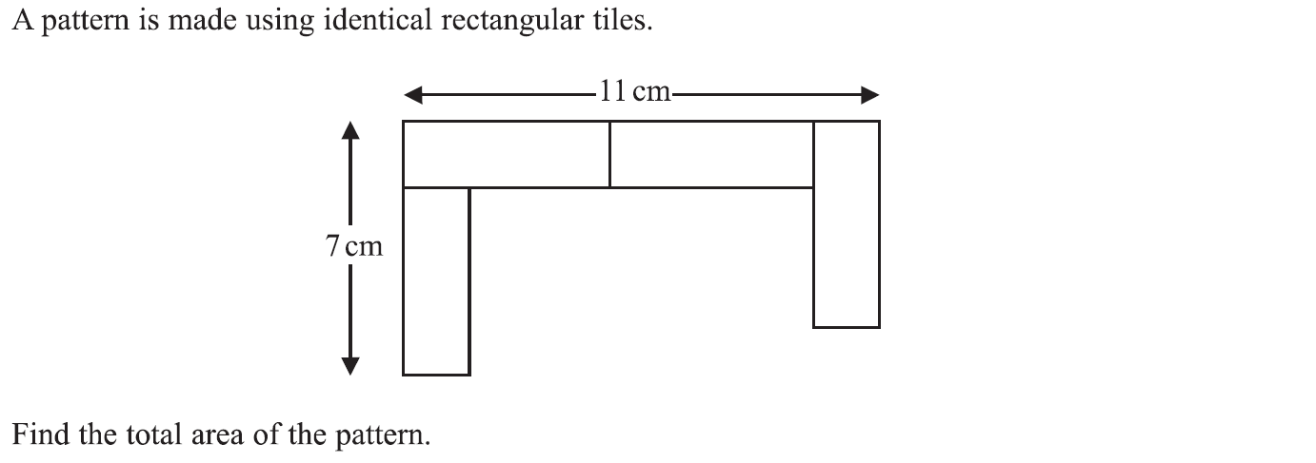
Simultaneous Equations
Specimen Set 1 1H Q4

Slide 5
Simultaneous Equations
Specimen Set 1 1H Q4
A

Slide 6
Simultaneous Equations
Specimen Set 2 3H Q11

Slide 7
Simultaneous Equations
Specimen Set 2 3H Q11
A

Slide 8
Simultaneous Equations
May 2017 1H Q20

Slide 9
Simultaneous Equations
May 2017 1H Q20
A

Slide 10
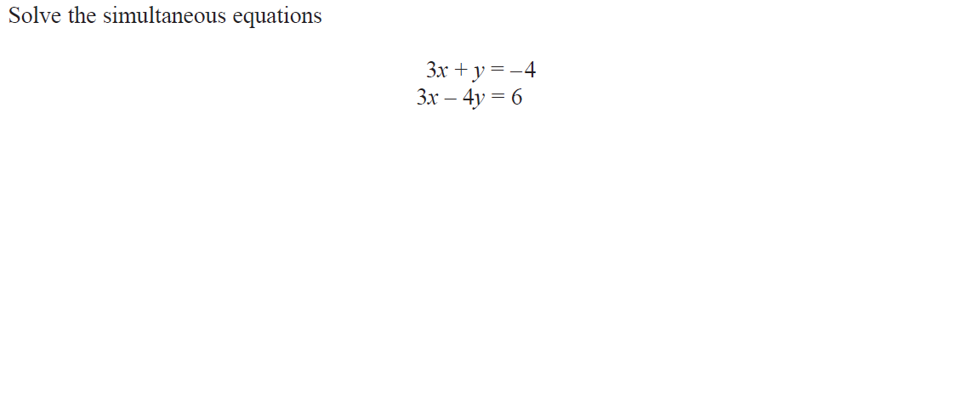
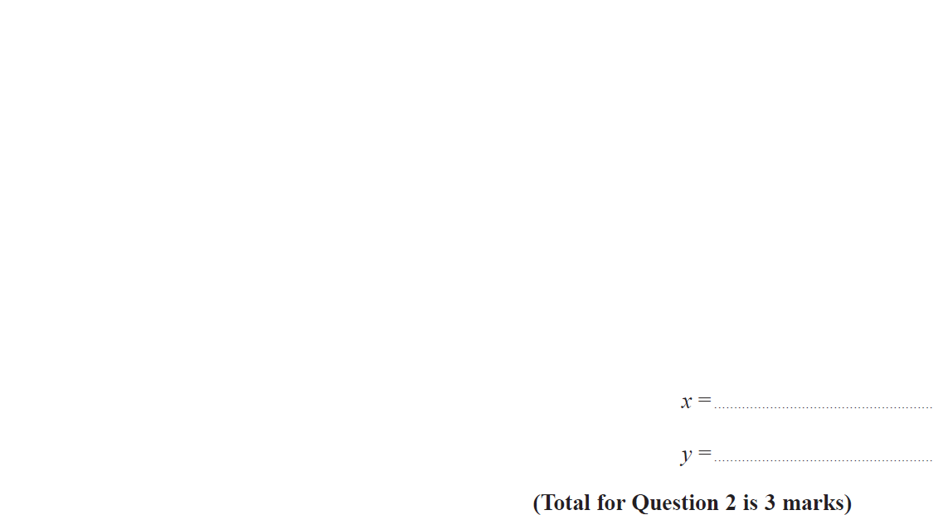
Simultaneous Equations
June 2017 3H Q2

Slide 11
Simultaneous Equations
June 2017 3H Q2
A

Slide 12
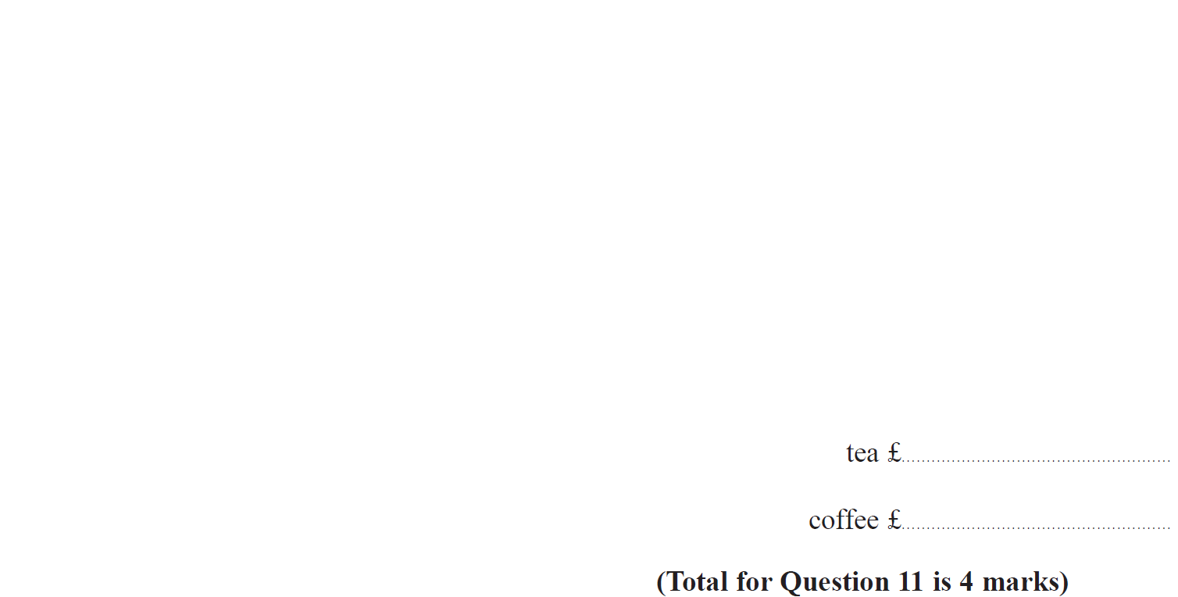
Simultaneous Equations
Nov 2017 1H Q11

Slide 13
Simultaneous Equations
Nov 2017 1H Q11
A

Slide 14
Simultaneous Equations
Nov 2017 3H Q19

Slide 15
Simultaneous Equations
Nov 2017 3H Q19
A

Slide 16
Simultaneous Equations
Nov 2018 1H Q6

Slide 17
Simultaneous Equations
Nov 2018 1H Q6
A

Slide 18
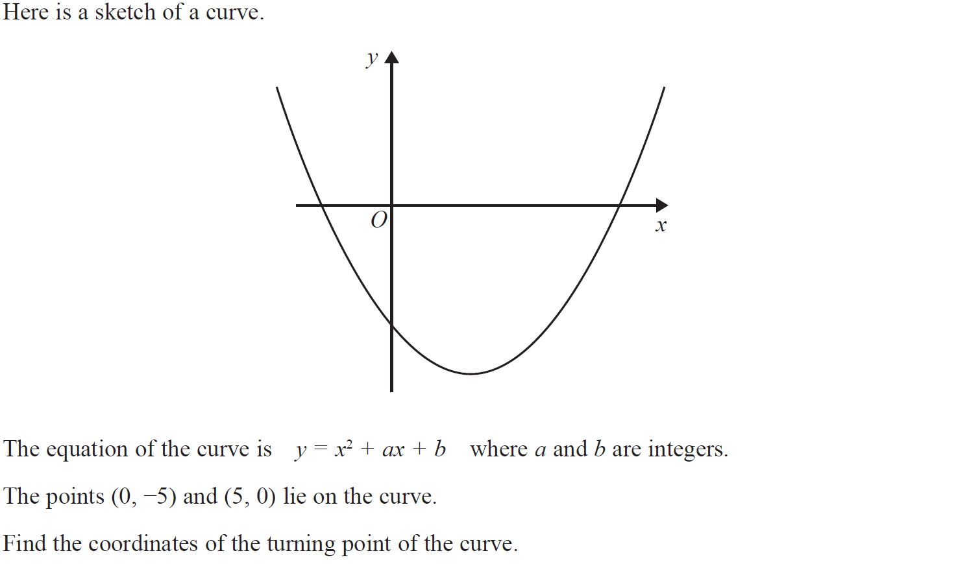
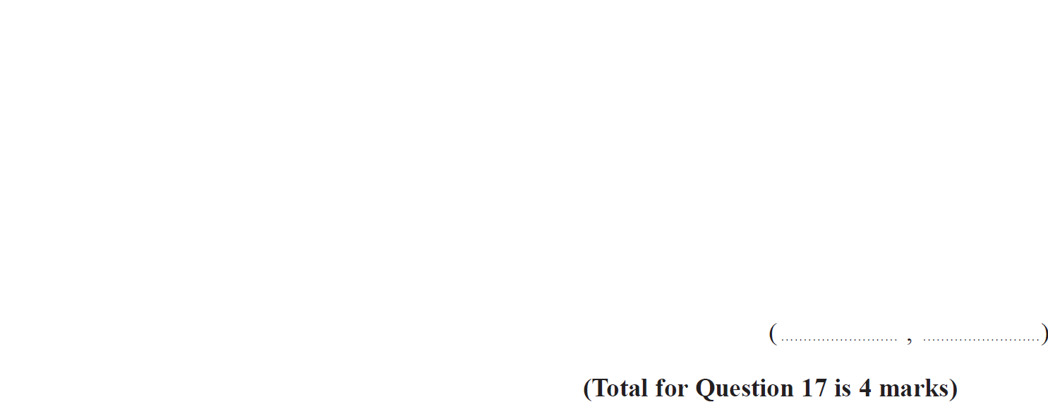
Simultaneous Equations
Nov 2018 1H Q17

Slide 19
Simultaneous Equations
Nov 2018 1H Q17
A

Slide 20
Simultaneous Equations
Nov 2018 2H Q18

Slide 21
Simultaneous Equations
Nov 2018 2H Q18
A

Slide 22
Simultaneous Equations
Nov 2018 3H Q19

Slide 23
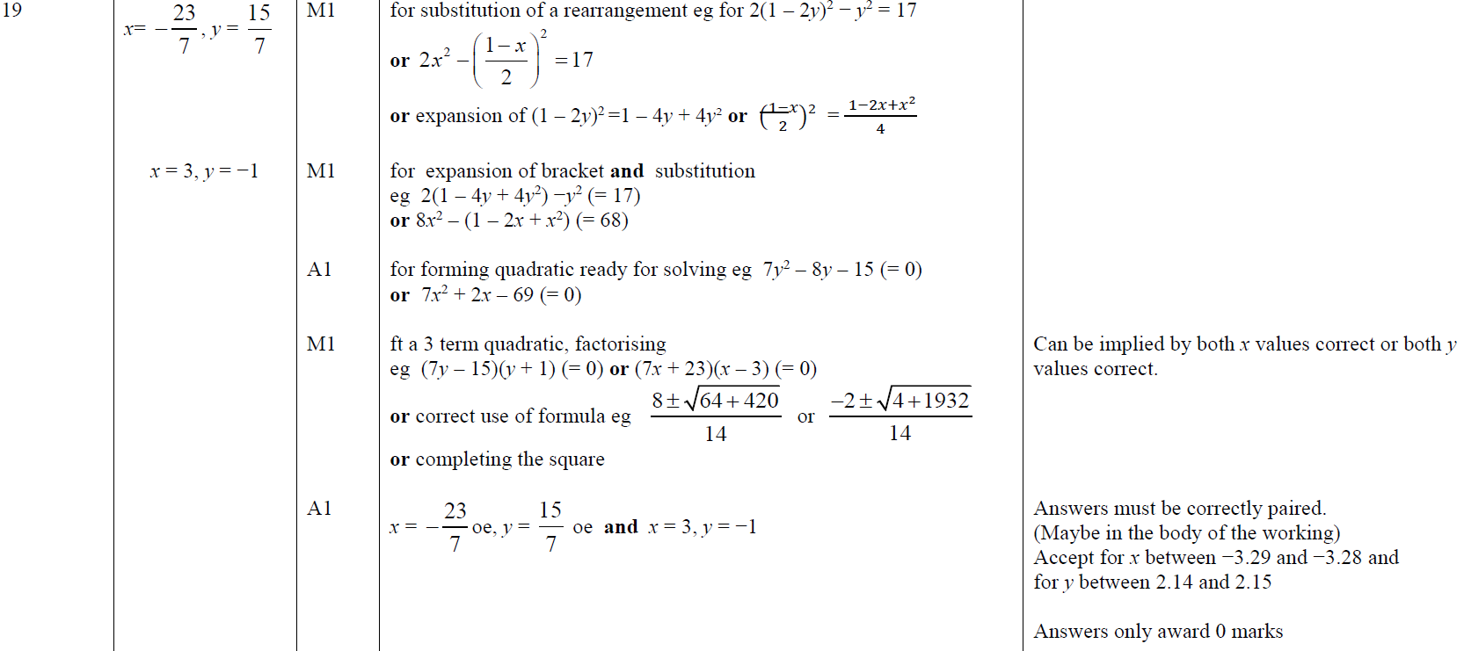
Simultaneous Equations
Nov 2018 3H Q19
A

Slide 24
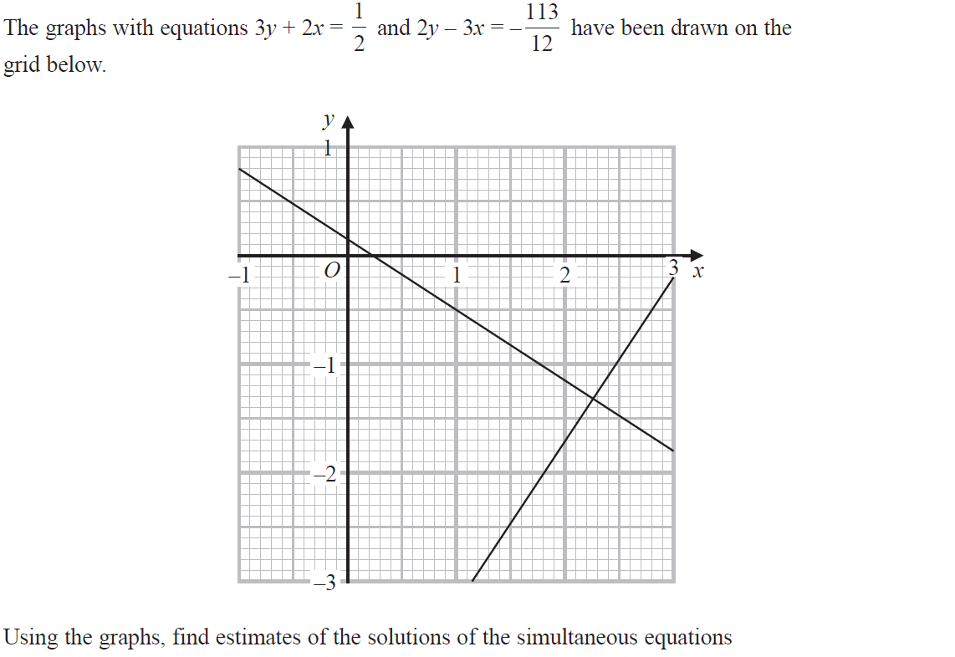
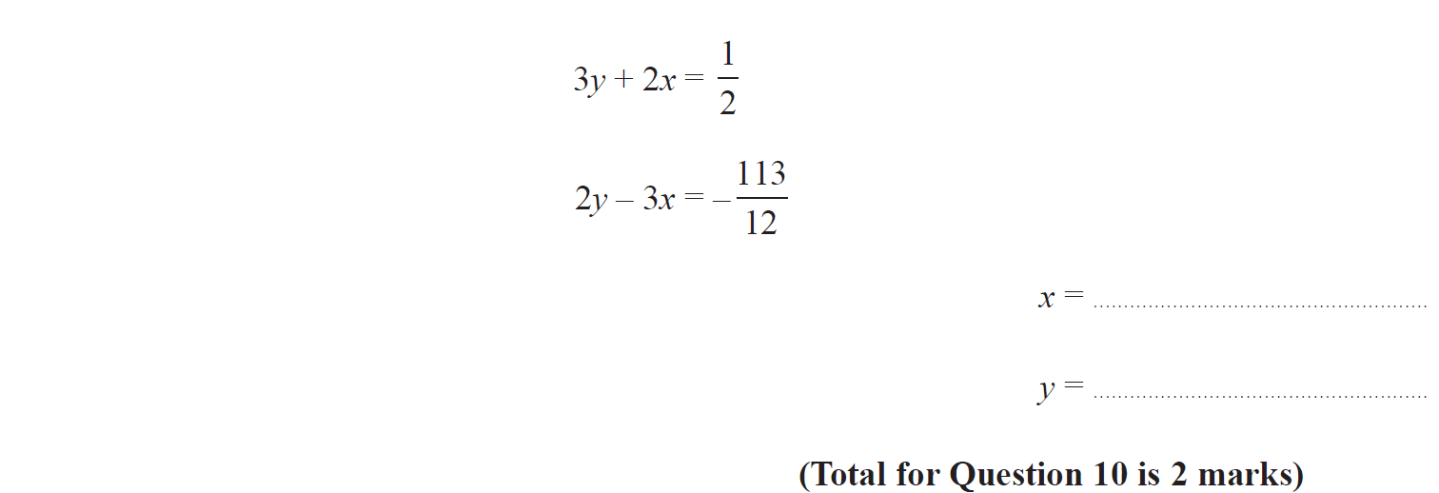
Simultaneous Equations
May 2019 1H Q10

Slide 25
Simultaneous Equations
May 2019 1H Q10
A
A SF

Slide 26
Simultaneous Equations
June 2019 3H Q20

Slide 27
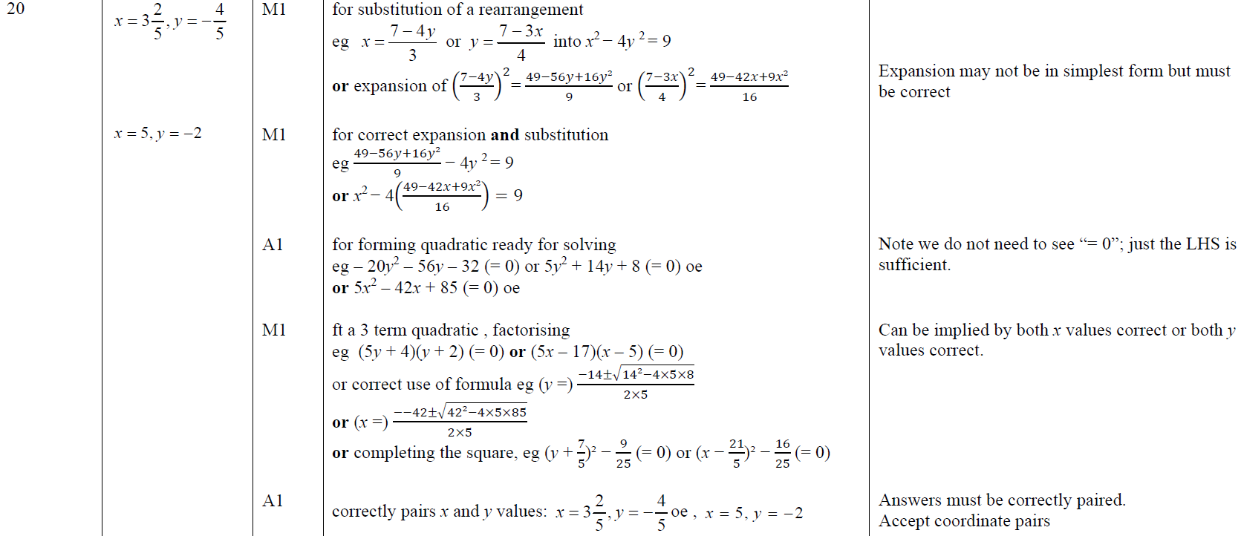
Simultaneous Equations
June 2019 3H Q20
A

Slide 28
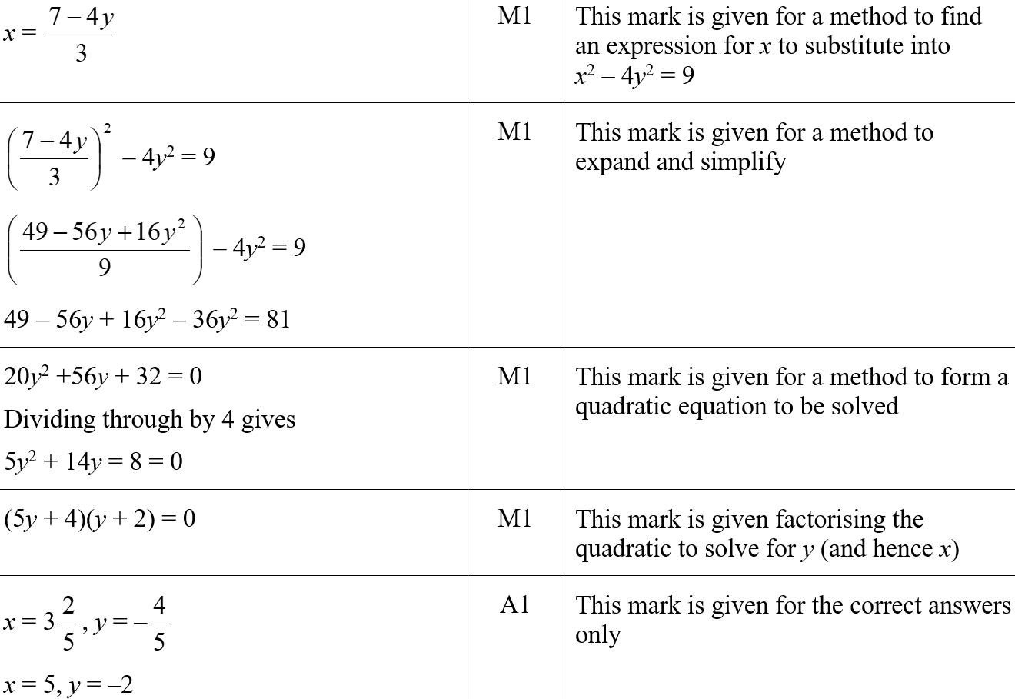
Simultaneous Equations
June 2019 3H Q20
A SF

Slide 29
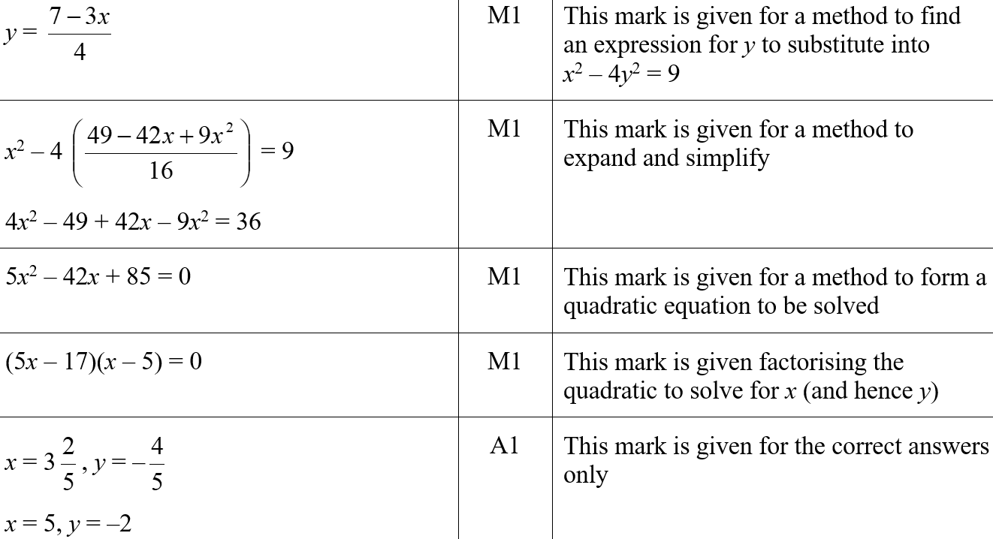
Simultaneous Equations
June 2019 3H Q20
A SF

