Slide 1
Solving Simple Equations
Solving Simple Equations
Practice
3H Q3
June 2017
2H Q10

Slide 2
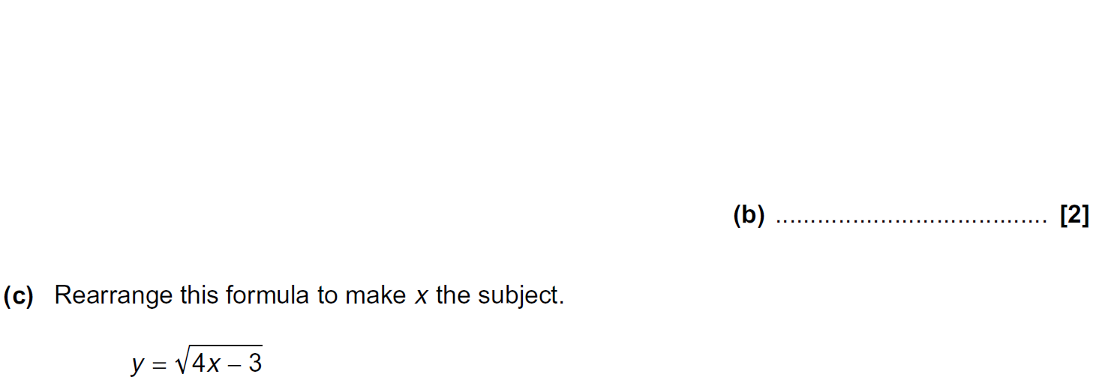
Solving Simple Equations
Practice 3H Q3

Slide 3
Solving Simple Equations
Practice 3H Q3
A
B
C

Slide 4
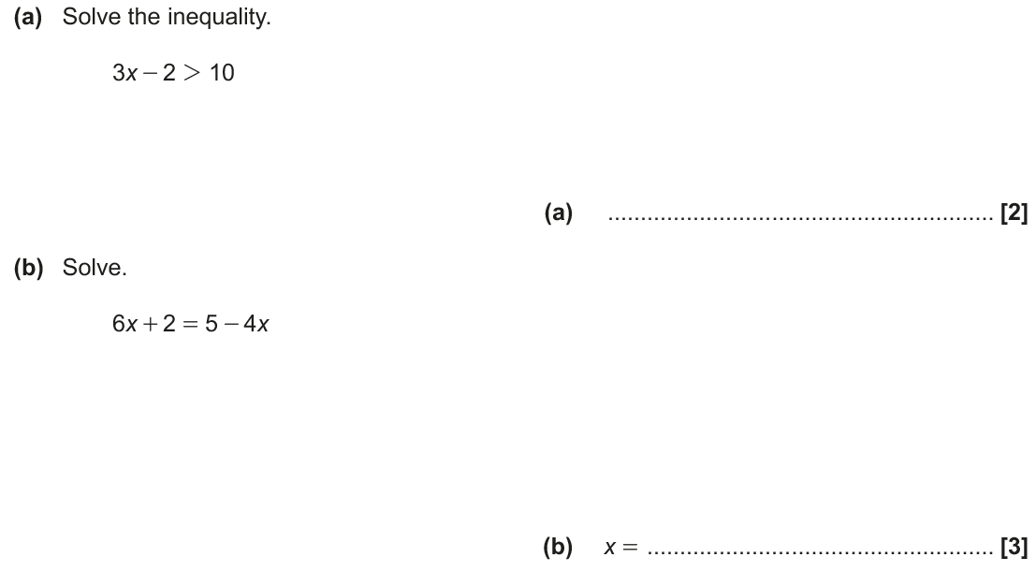
Solving Simple Equations
June 2017 2H Q10

Slide 5
Solving Simple Equations
June 2017 2H Q10
A
B

