Slide 1
Solving Simple Equations
Solving Simple Equations
Edexcel
Spec 2
2H Q8
AQA
Nov 2017 2H Q1
OCR
June 2018 3H Q7

Slide 2
Solving Simple Equations
Solving Simple Equations
Nov 2017 2H Q5
Edexcel
AQA
1 Marker
OCR

Slide 3
Solving Simple Equations
Solving Simple Equations
Edexcel
AQA
Practice
3H Q3
June 2017
2H Q10
OCR

Slide 4
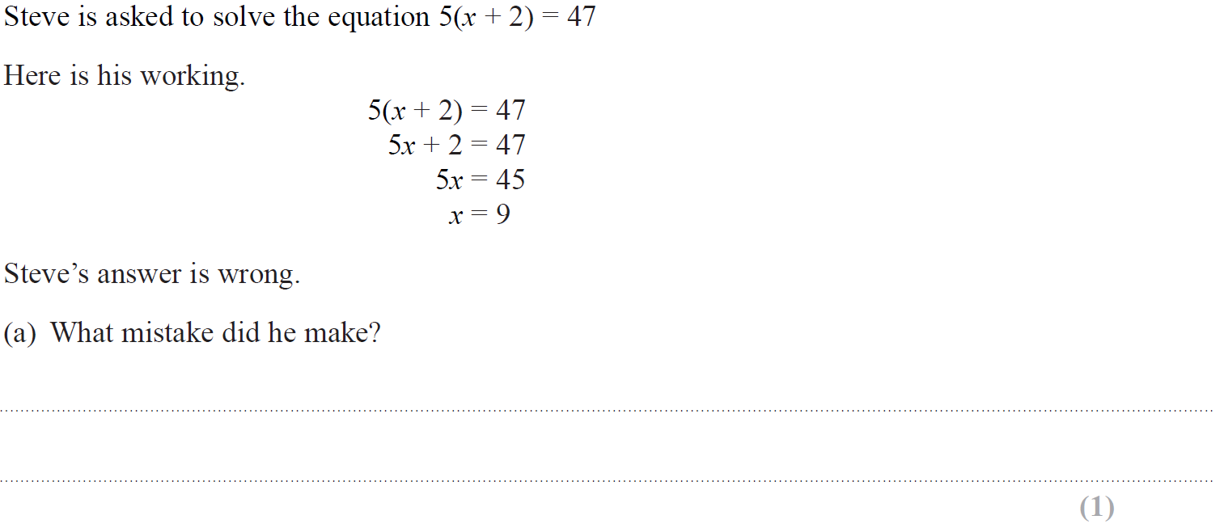
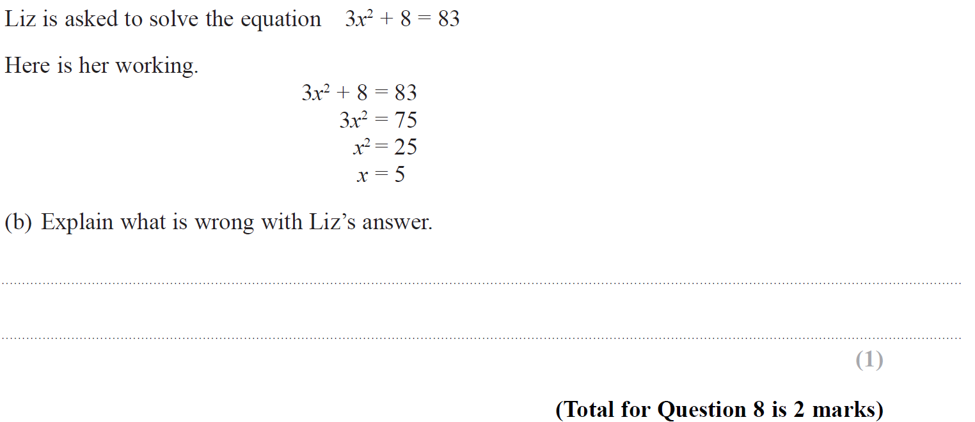
Solving Simple Equations
Specimen Set 2 2H Q8

Slide 5
Solving Simple Equations
Specimen Set 2 2H Q8
A
B

Slide 6
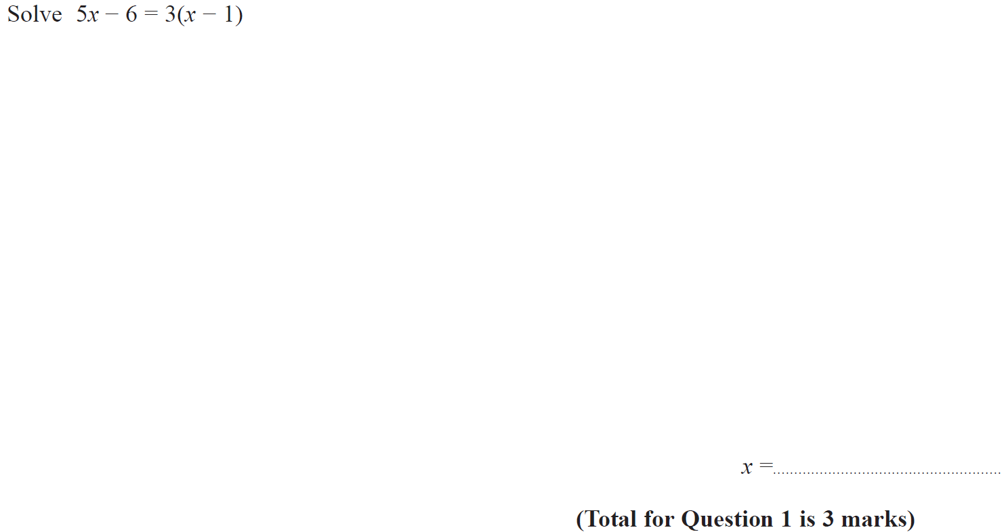
Solving Simple Equations
Nov 2017 2H Q1

Slide 7
Solving Simple Equations
Nov 2017 2H Q1
A

Slide 8
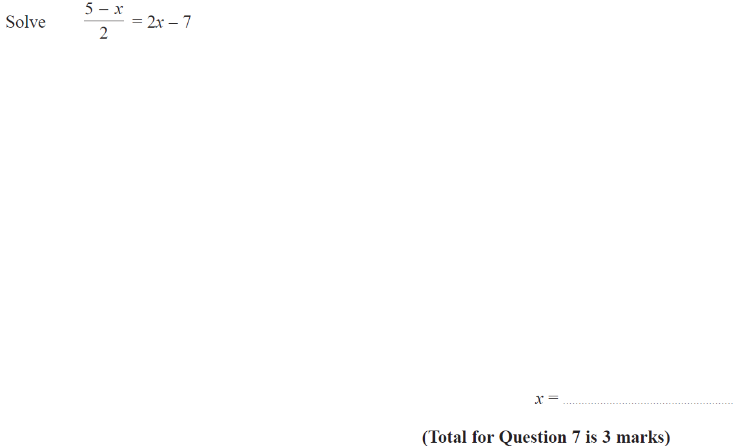
Solving Simple Equations
June 2018 3H Q7

Slide 9
Solving Simple Equations
June 2018 3H Q7
A

Slide 10
Solving Simple Equations
Nov 2017 2H Q5
Solve 4(3x − 2) = 2x − 5
[3 marks]

Slide 11
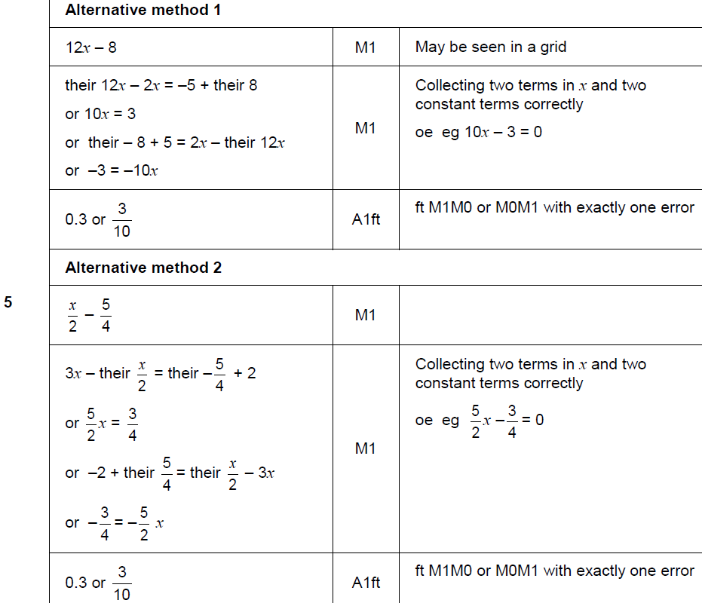
Solving Simple Equations
Nov 2017 2H Q5
A

Slide 12
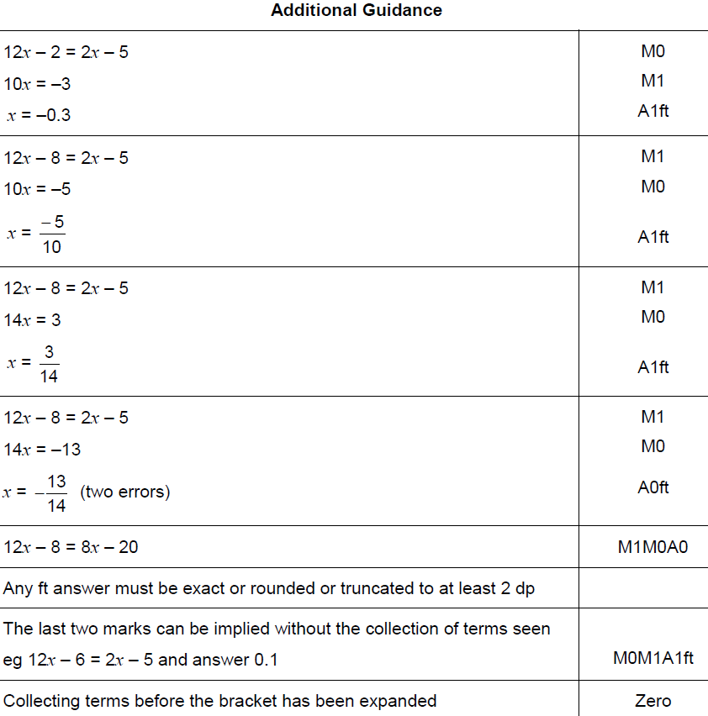
Solving Simple Equations
Nov 2017 2H Q5
A

Slide 13
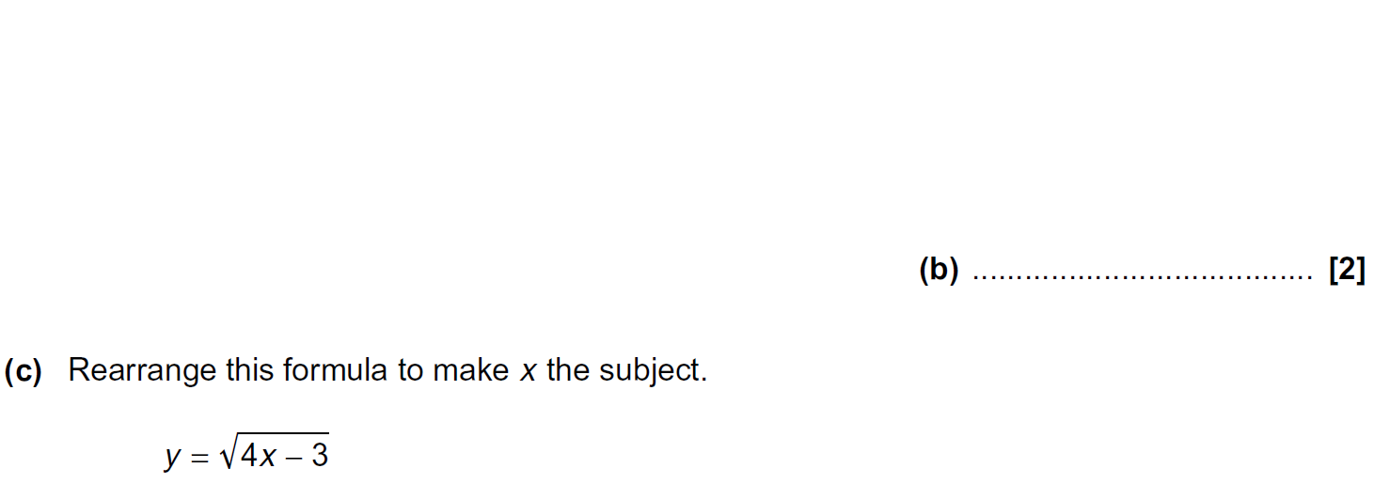
Solving Simple Equations
Practice 3H Q3

Slide 14
Solving Simple Equations
Practice 3H Q3
A
B
C

Slide 15
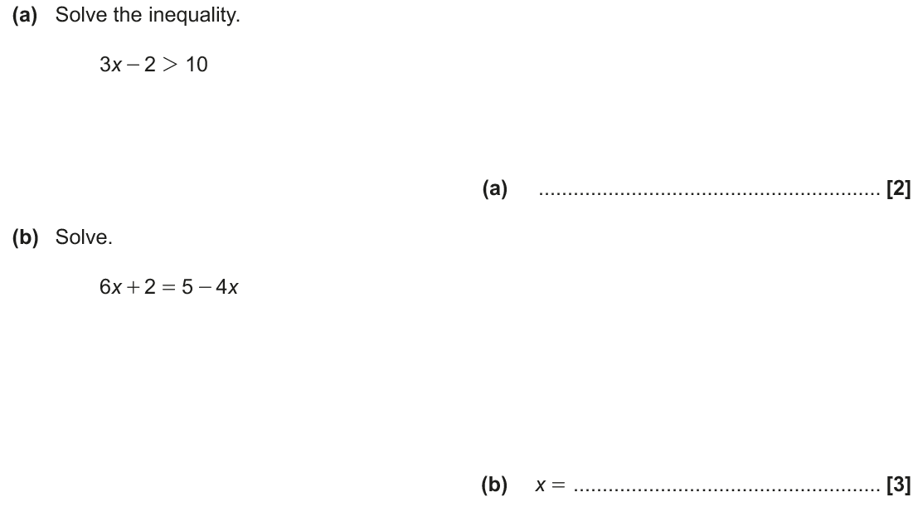
Solving Simple Equations
June 2017 2H Q10

Slide 16
Solving Simple Equations
June 2017 2H Q10
A
B

