Slide 1
Similar Shapes
Similar Shapes
SAM
1H Q3
May 2017
1H Q2
June 2018
2H Q23
SAM
1H Q22*
May 2017
1H Q22
June 2018
3H Q6
SAM
2H Q2
May 2017
1H Q28
Nov 2018
1H Q11
1 Marker
SAM
2H Q13
June 2017
2H Q2
Nov 2018
1H Q23
SAM
2H Q14
Nov 2017
1H Q17
Nov 2018
3H Q23
SAM
2H Q26
May 2018
1H Q13
* Reverse operations
SF in area and volume
Congruent triangles (proof)
Unit Conversions

Slide 2
Similar Shapes
SAM 1H Q3

Slide 3
Similar Shapes
SAM 1H Q3
A

Slide 4
Similar Shapes
SAM 1H Q22

Slide 5
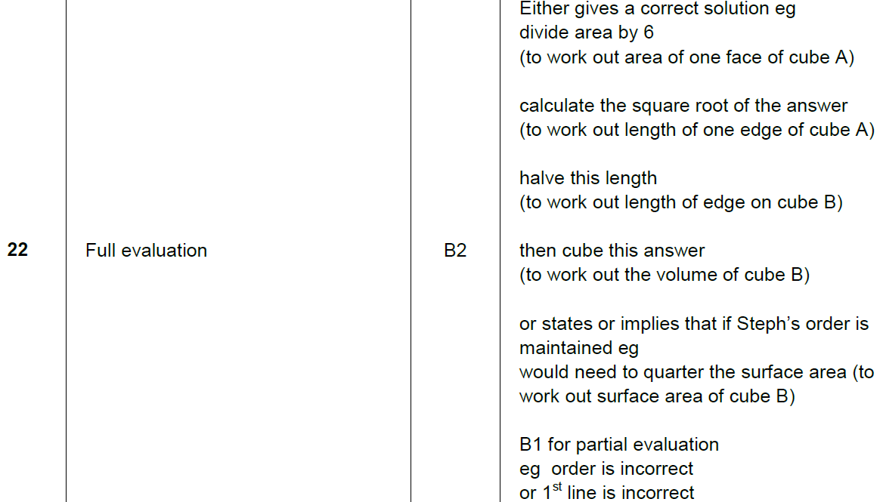
Similar Shapes
SAM 1H Q22
A

Slide 6
Similar Shapes
SAM 2H Q2

Slide 7
Similar Shapes
SAM 2H Q2
A

Slide 8
Similar Shapes
SAM 2H Q13

Slide 9
Similar Shapes
SAM 2H Q13
A

Slide 10
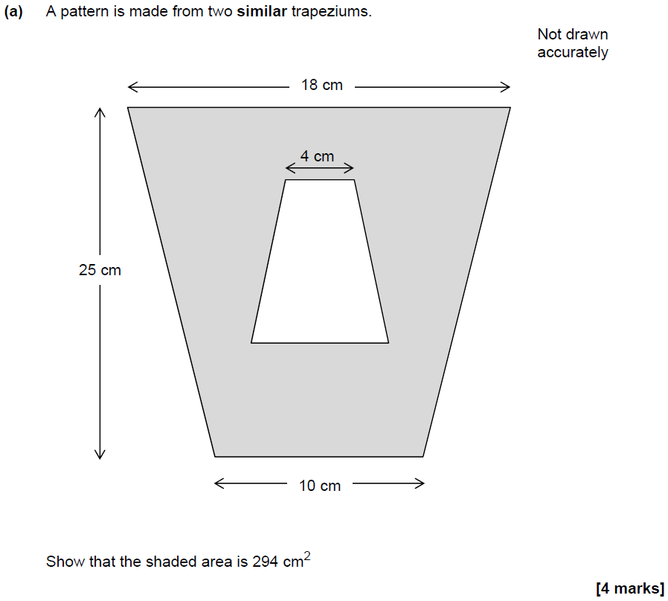
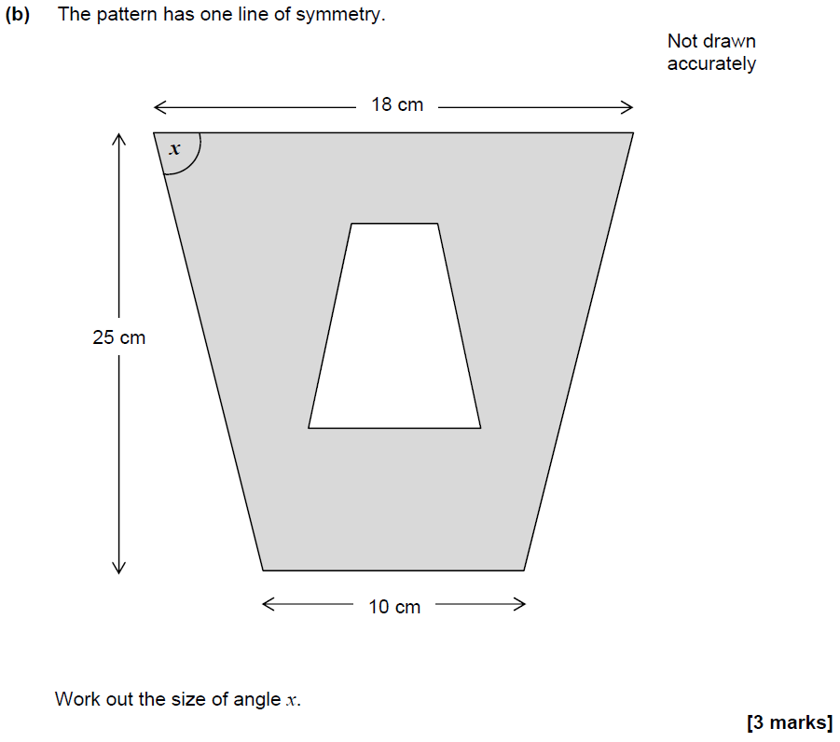
Similar Shapes
SAM 2H Q14

Slide 11
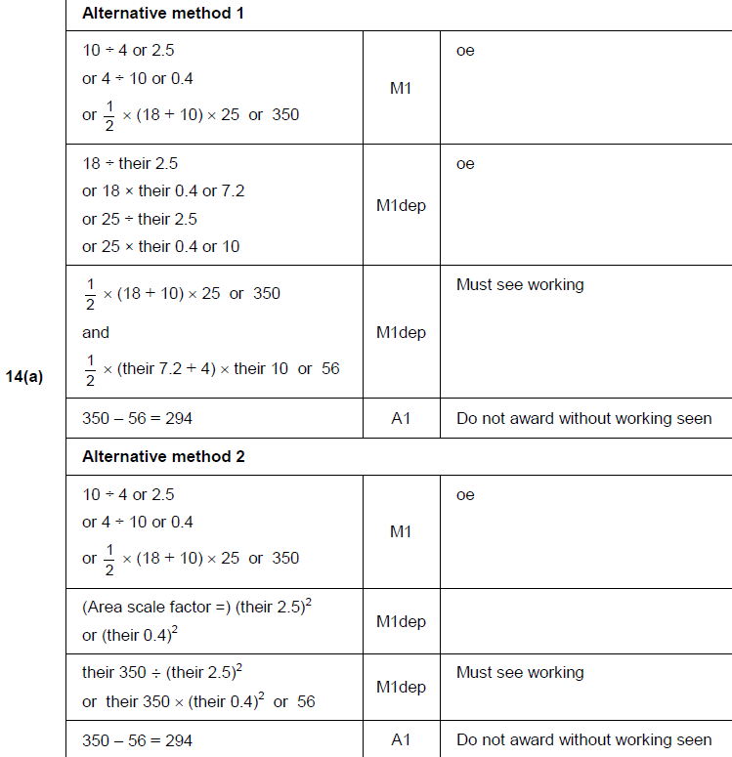
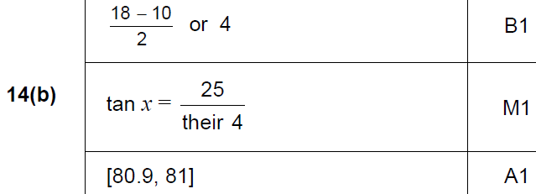
Similar Shapes
SAM 2H Q14
A
B

Slide 12
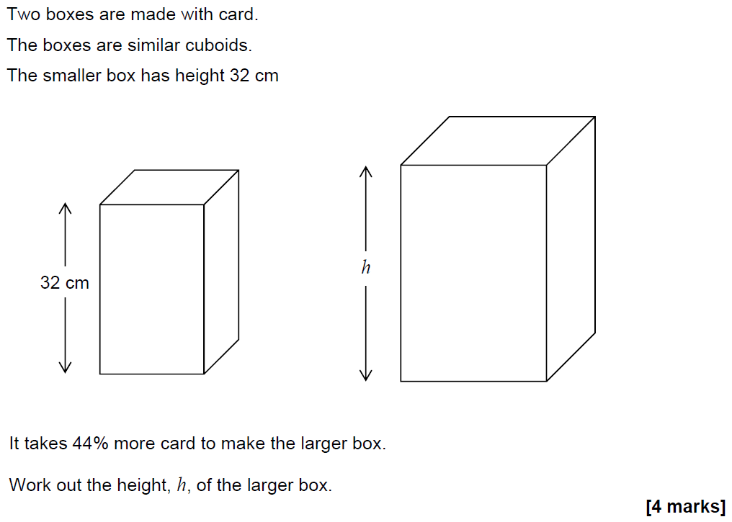
Similar Shapes
SAM 2H Q26

Slide 13
Similar Shapes
SAM 2H Q26
A

Slide 14
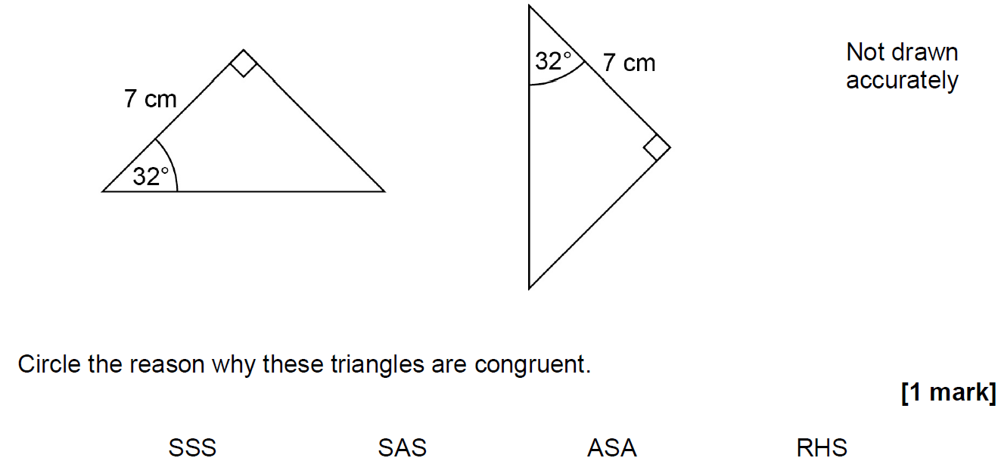
Similar Shapes
May 2017 1H Q2

Slide 15
Similar Shapes
May 2017 1H Q2
A

Slide 16
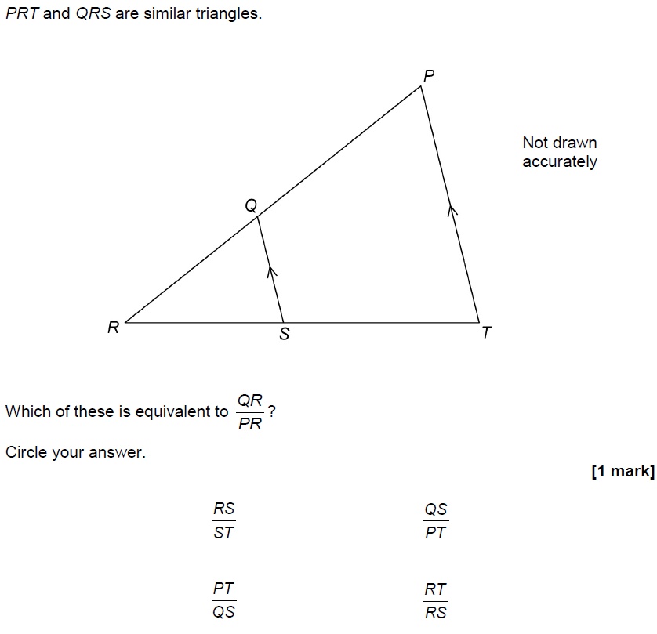
Similar Shapes
May 2017 1H Q22

Slide 17
Similar Shapes
May 2017 1H Q22
A

Slide 18
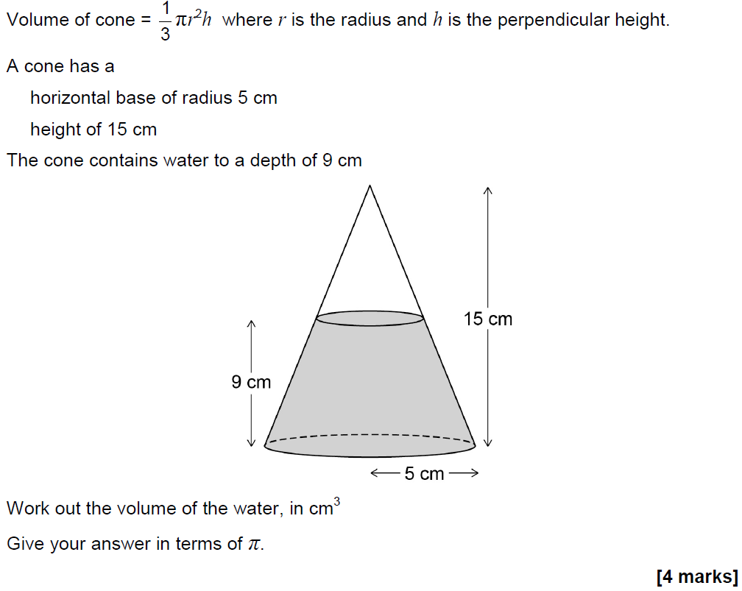
Similar Shapes
May 2017 1H Q28

Slide 19
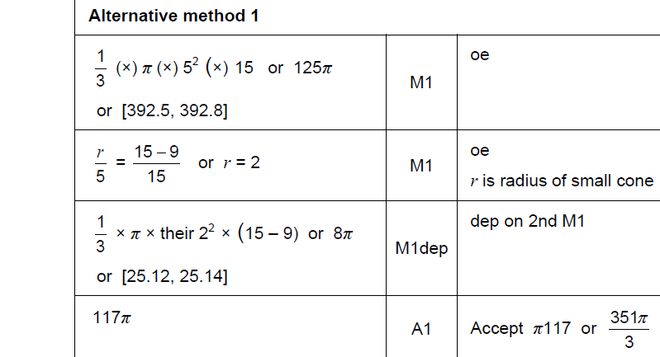
Similar Shapes
May 2017 1H Q28
A

Slide 20
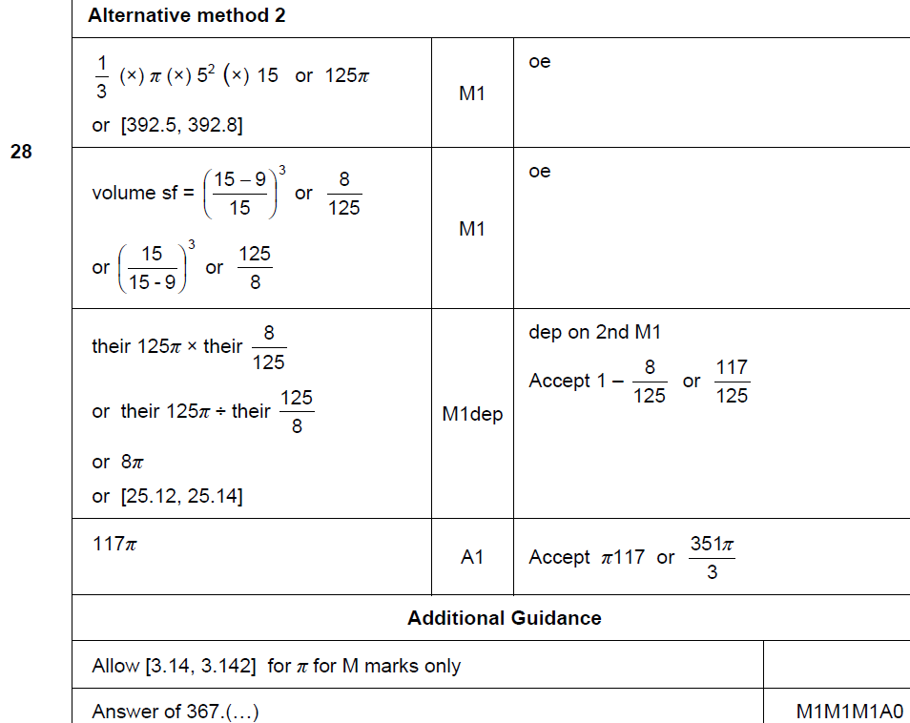
Similar Shapes
May 2017 1H Q28
A Alternative & notes

Slide 21
Similar Shapes
June 2017 2H Q2

Slide 22
Similar Shapes
June 2017 2H Q2
A

Slide 23
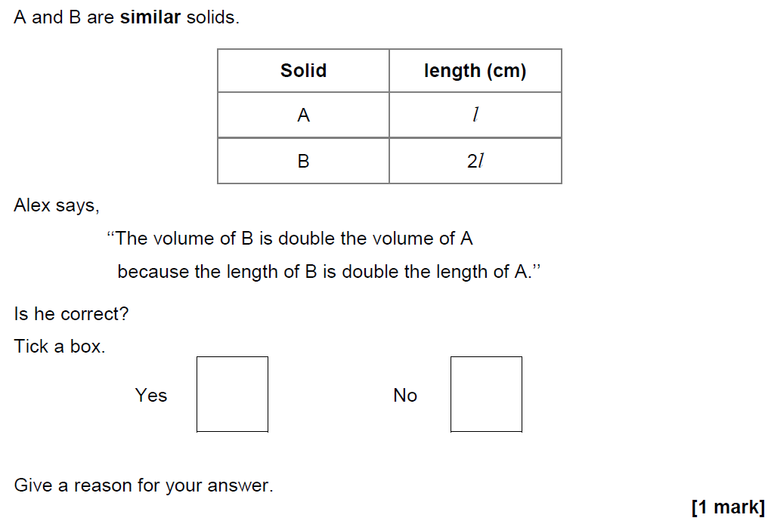
Similar Shapes
Nov 2017 1H Q17

Slide 24
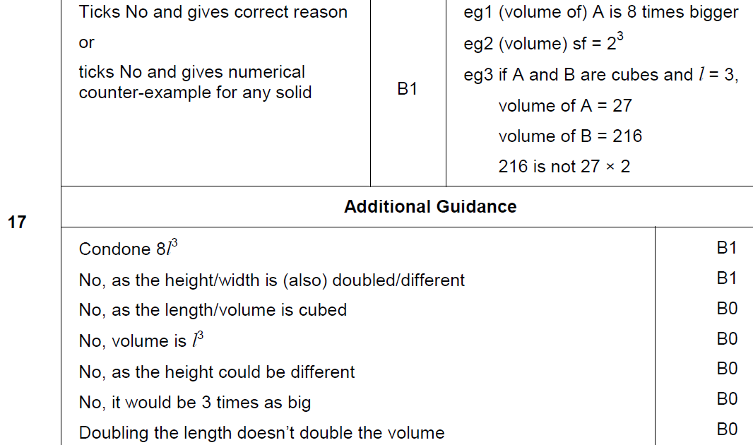
Similar Shapes
Nov 2017 1H Q17
A

Slide 25
Similar Shapes
May 2018 1H Q13

Slide 26
Similar Shapes
May 2018 1H Q13
A

Slide 27
Similar Shapes
June 2018 2H Q23

Slide 28
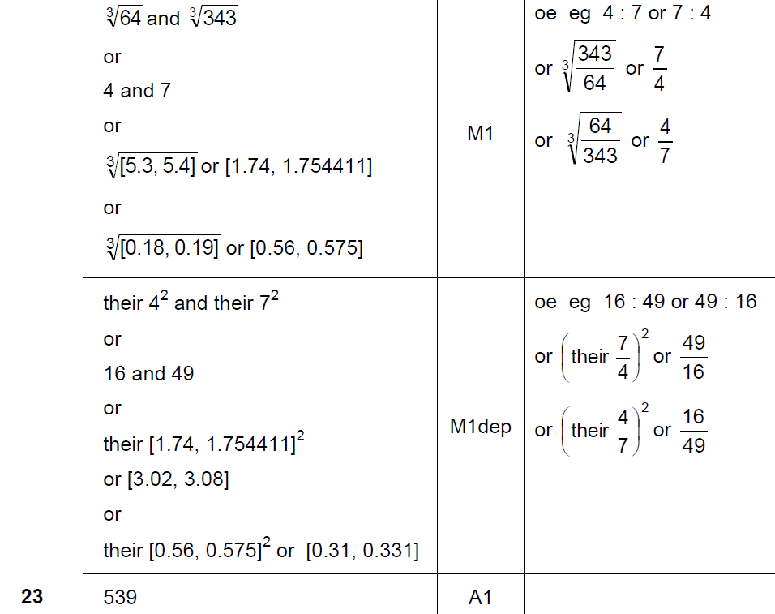
Similar Shapes
June 2018 2H Q23
A

Slide 29
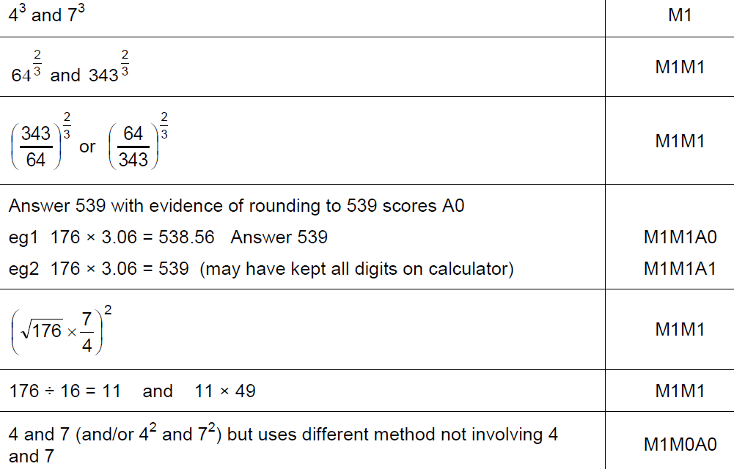
Similar Shapes
June 2018 2H Q23
A notes

Slide 30
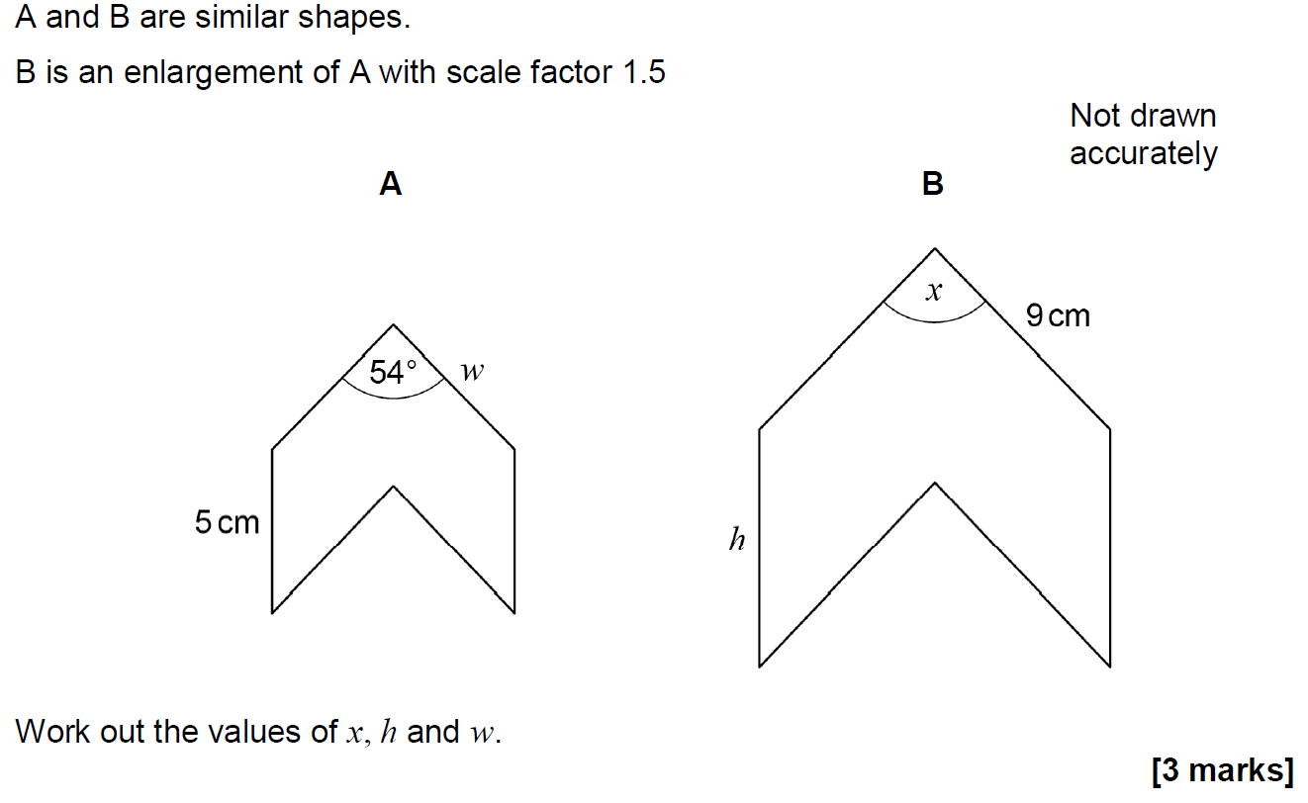
Similar Shapes
June 2018 3H Q6

Slide 31
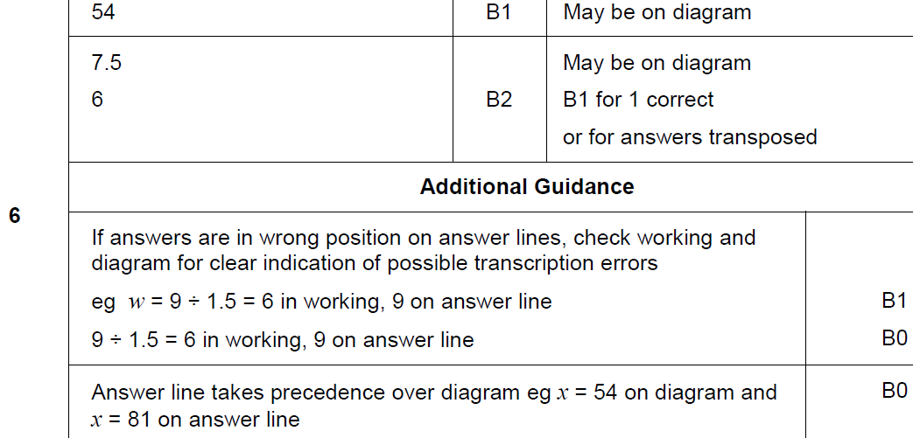
Similar Shapes
June 2018 3H Q6
A

Slide 32
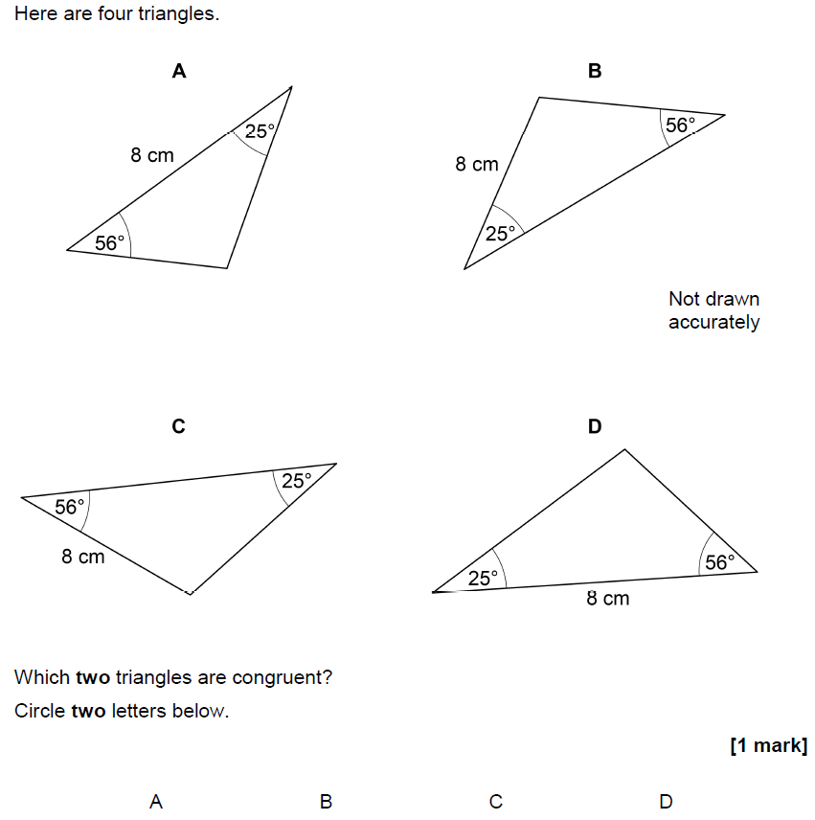
Similar Shapes
Nov 2018 1H Q11

Slide 33
Similar Shapes
Nov 2018 1H Q11
A

Slide 34
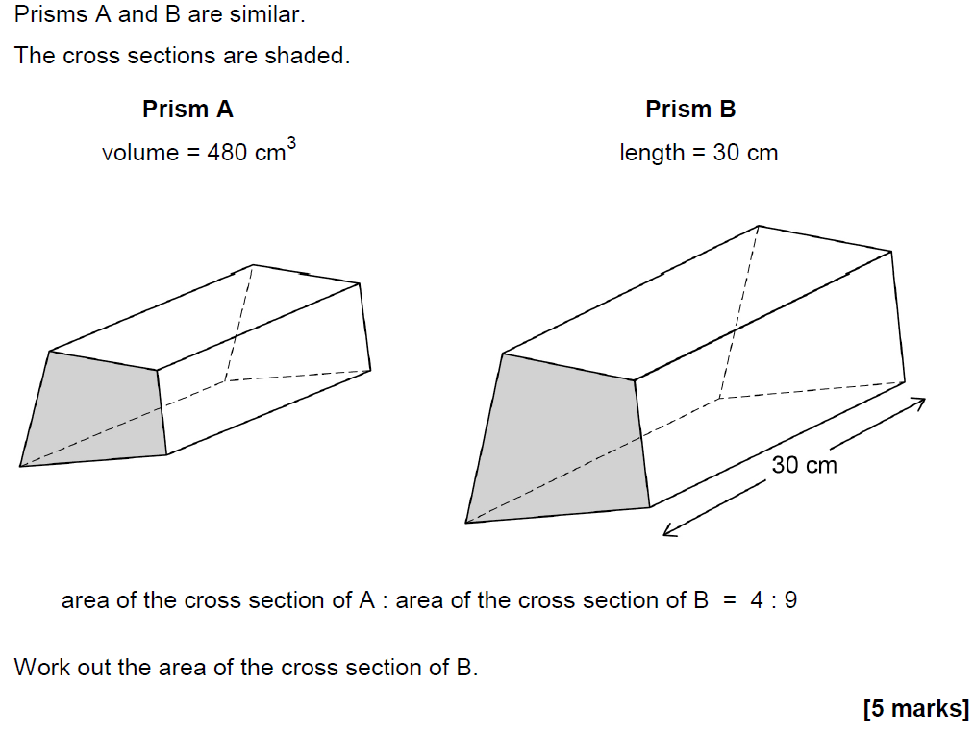
Similar Shapes
Nov 2018 1H Q23

Slide 35
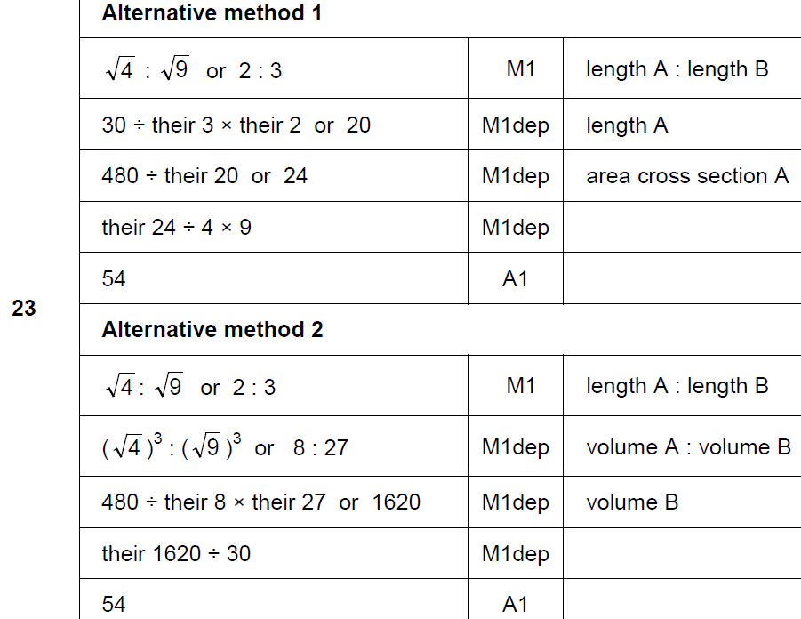
Similar Shapes
Nov 2018 1H Q23
A

Slide 36
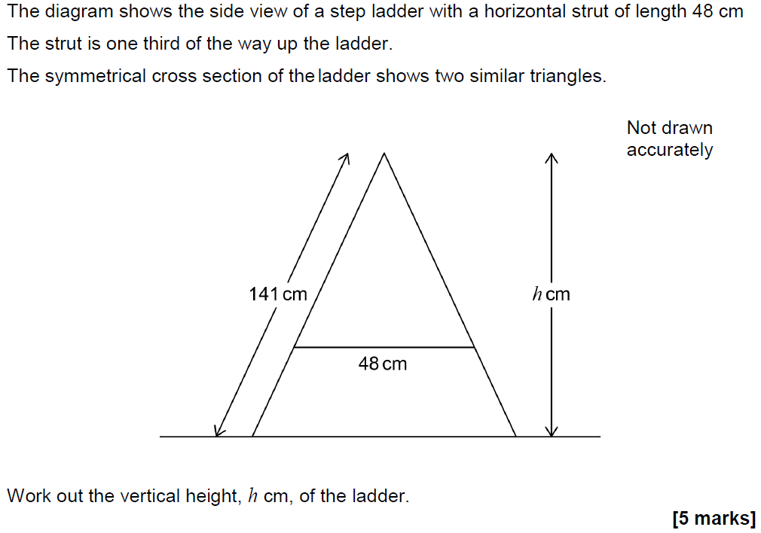
Similar Shapes
Nov 2018 3H Q23

Slide 37
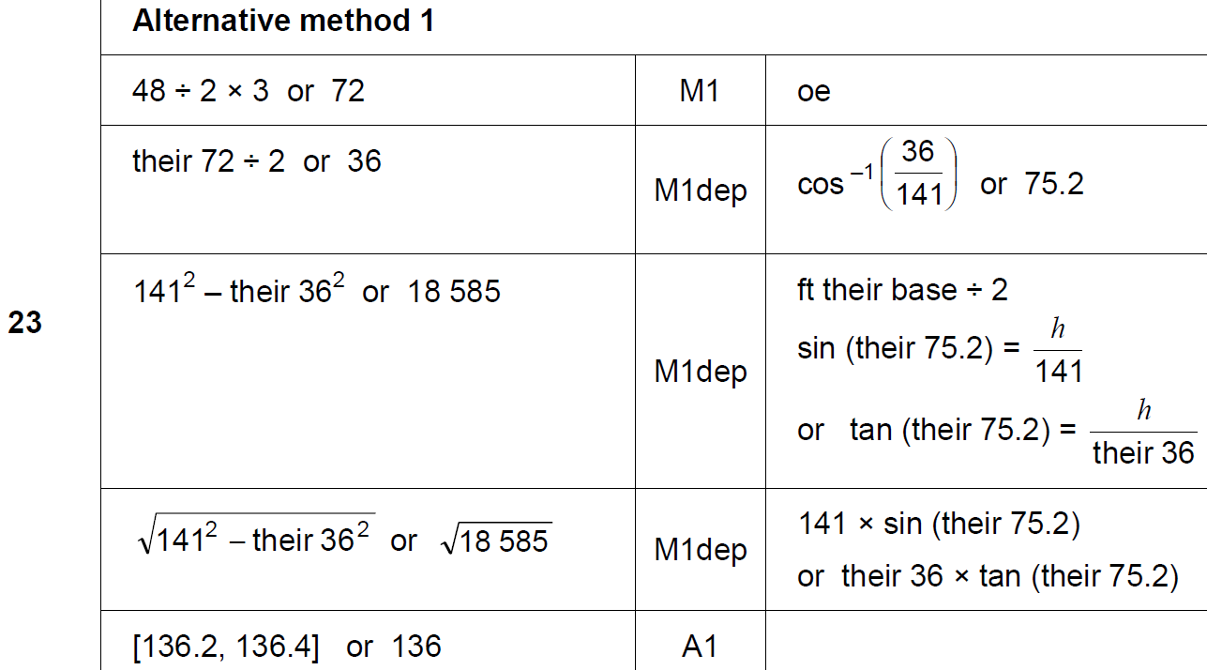
Similar Shapes
Nov 2018 3H Q23
A

Slide 38
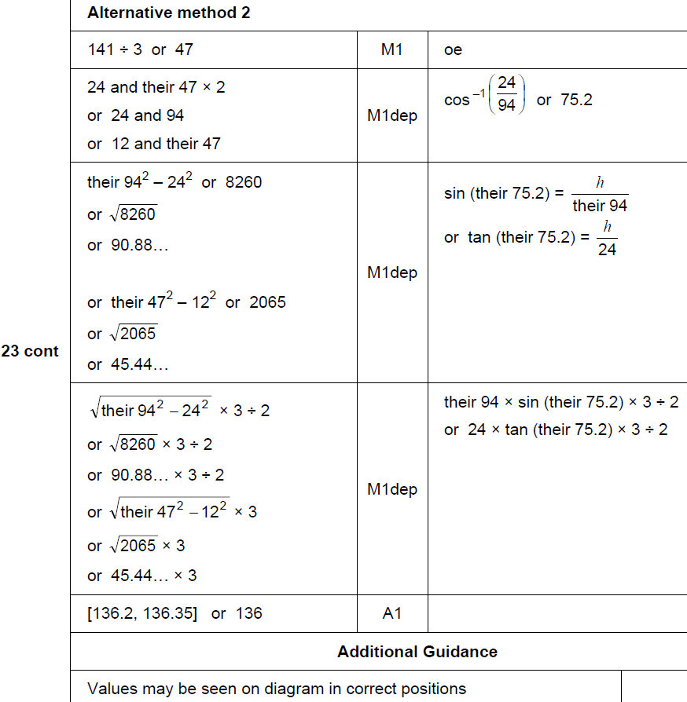
Similar Shapes
Nov 2018 3H Q23
A Alternative & notes

