Slide 1
Similar Shapes
Similar Shapes
SAM
1H Q13
SAM
1H Q18
May 2017
1H Q21
June 2018
3H Q19
Edexcel
SAM
3H Q13
June 2017
2H Q5
June 2018
3H Q21
AQA
Spec 1
1H Q17
Nov 2017
1H Q22
Nov 2018
1H Q15
OCR
Spec 1
2H Q14
Nov 2017
3H Q14
June 2019
2H Q9
Spec 1
3H Q20
June 2018
3H Q13
Spec 2
1H Q12
SF in area and volume
Congruent triangles (proof)

Slide 2
Similar Shapes
Similar Shapes
SAM
1H Q3
May 2017
1H Q2
June 2018
2H Q23
SAM
1H Q22*
May 2017
1H Q22
June 2018
3H Q6
Edexcel
SAM
2H Q2
May 2017
1H Q28
Nov 2018
1H Q11
AQA
1 Marker
SAM
2H Q13
June 2017
2H Q2
Nov 2018
1H Q23
OCR
SAM
2H Q14
Nov 2017
1H Q17
Nov 2018
3H Q23
SAM
2H Q26
May 2018
1H Q13
* Reverse operations
SF in area and volume
Congruent triangles (proof)
Unit Conversions

Slide 3
Similar Shapes
Similar Shapes
June 2017
3H Q9
SAM
1H Q9
June 2018
3H Q12*
Edexcel
SAM
3H Q16
June 2017
3H Q13
SAM
1H Q10
June 2018
3H Q18
AQA
Practice
2H Q10*
Nov 2017
2H Q10
SAM
1H Q13
Nov 2018
1H Q19
OCR
Practice
3H Q12
Nov 2017
3H Q13
SAM
3H Q12
Nov 2018
2H Q17
June 2018
3H Q11
*Similar triangle proof
SF in area and volume
Congruent triangles (proof)

Slide 4
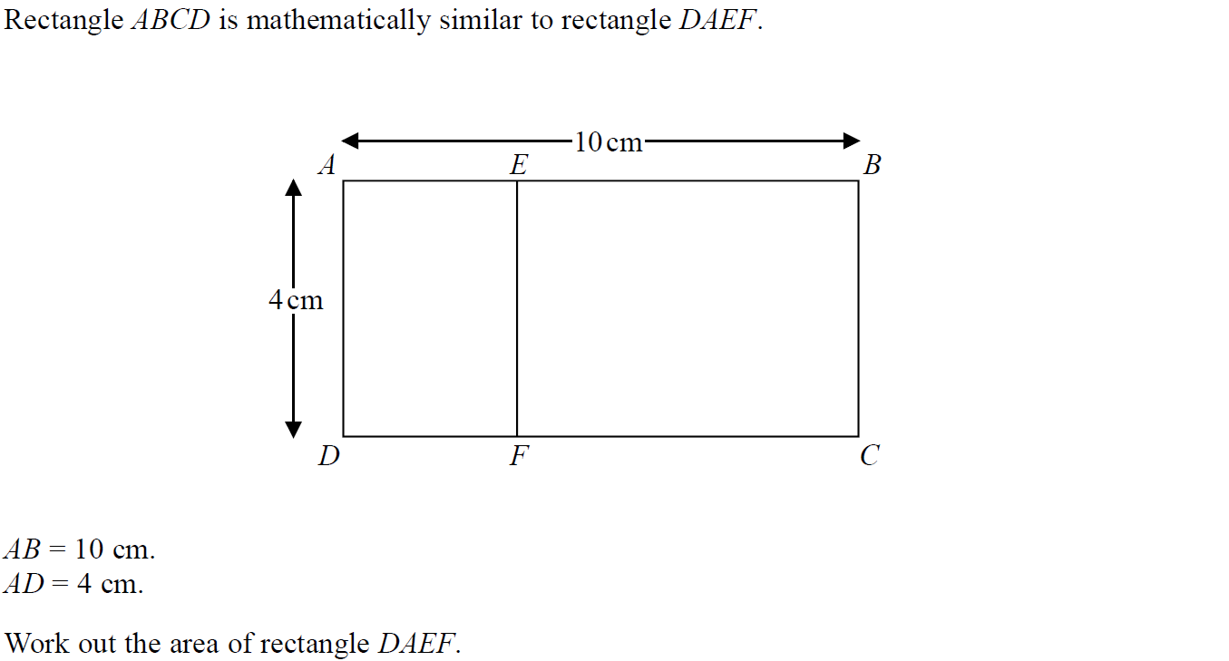
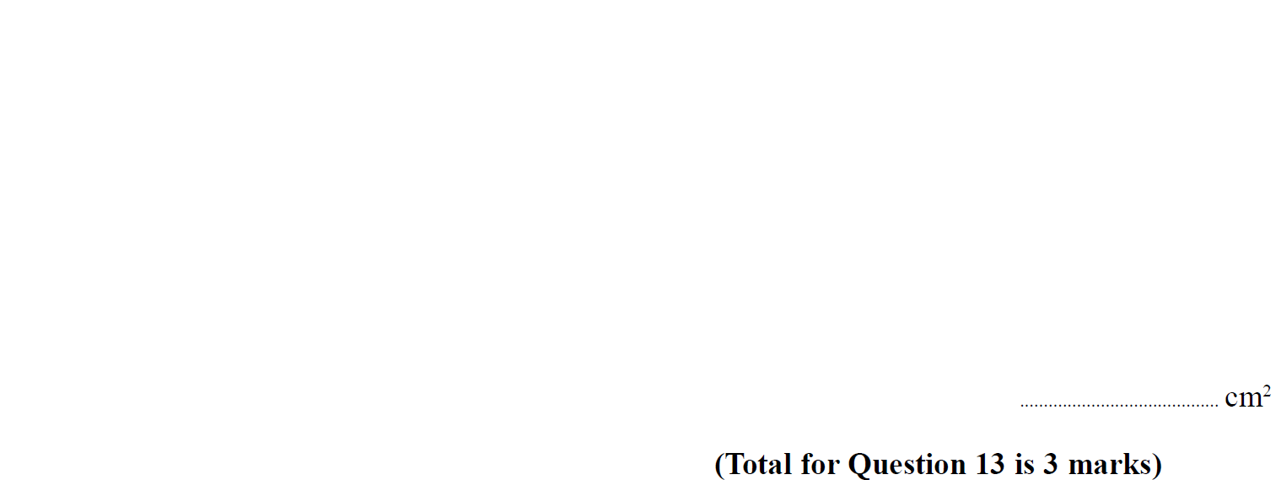
Similar Shapes
SAM 1H Q13

Slide 5
Similar Shapes
SAM 1H Q13
A

Slide 6
Similar Shapes
SAM 1H Q18

Slide 7
Similar Shapes
SAM 1H Q18
A

Slide 8
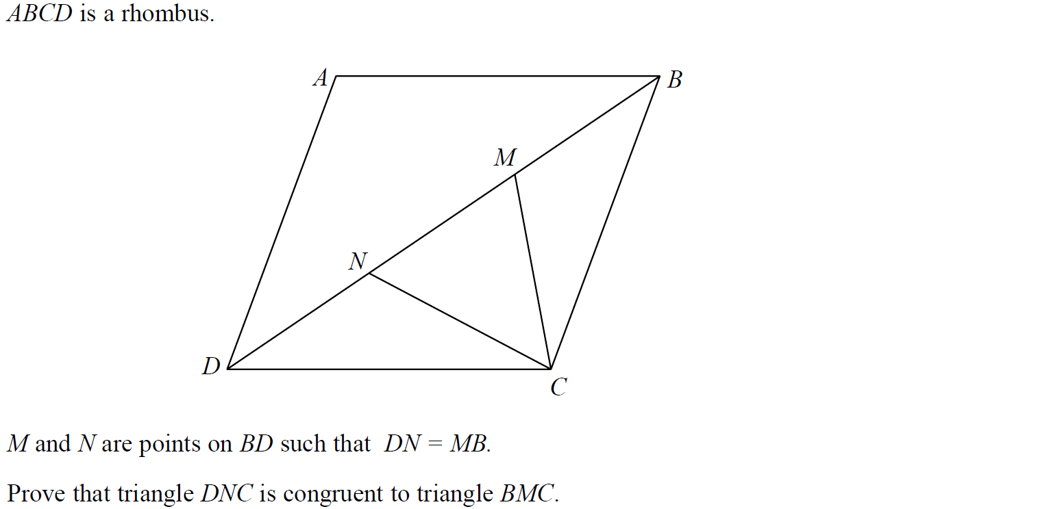
Similar Shapes
SAM 3H Q13

Slide 9
Similar Shapes
SAM 3H Q13
A

Slide 10
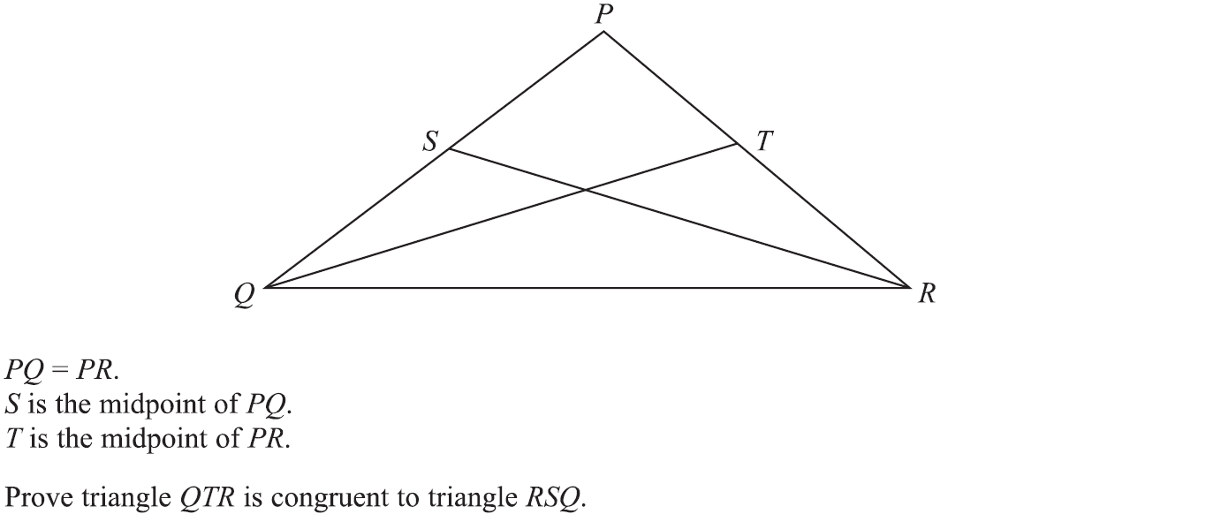
Similar Shapes
Specimen Set 1 1H Q17

Slide 11
Similar Shapes
Specimen Set 1 1H Q17
A

Slide 12
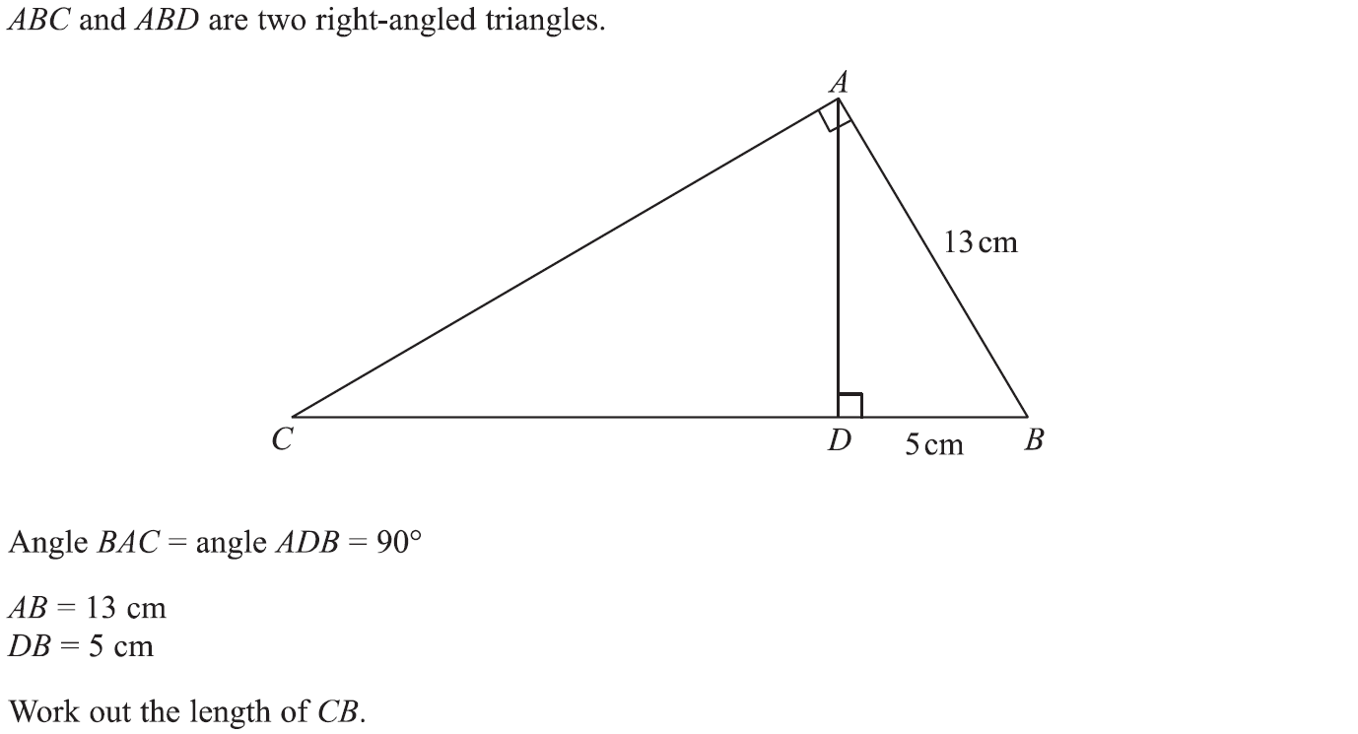
Similar Shapes
Specimen Set 1 2H Q14

Slide 13
Similar Shapes
Specimen Set 1 2H Q14
A

Slide 14
Similar Shapes
Specimen Set 1 3H Q20

Slide 15
Similar Shapes
Specimen Set 1 3H Q20
A

Slide 16
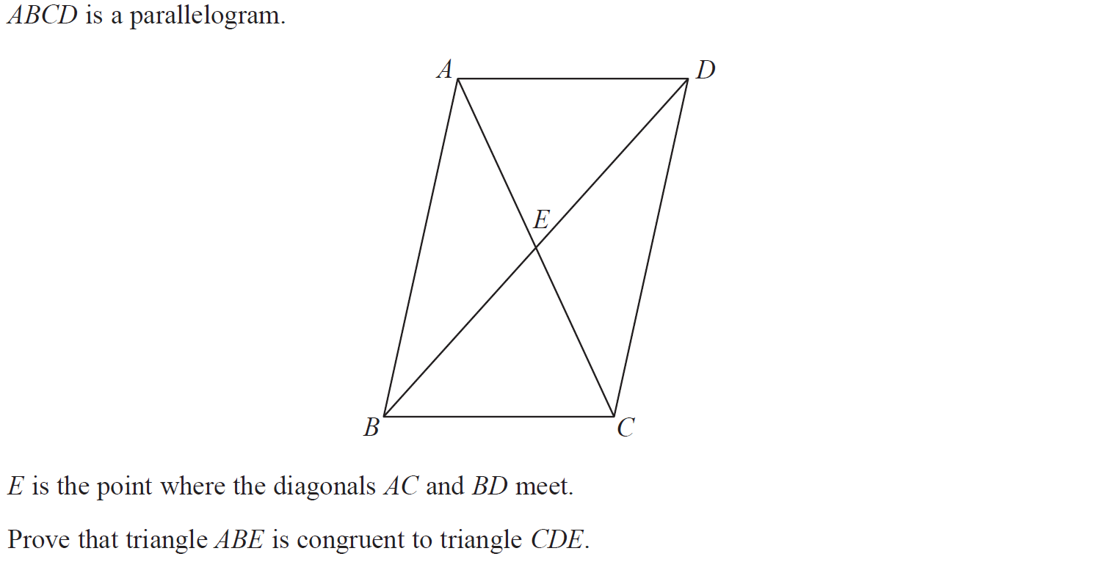
Similar Shapes
Specimen Set 2 1H Q12

Slide 17
Similar Shapes
Specimen Set 2 1H Q12
A

Slide 18
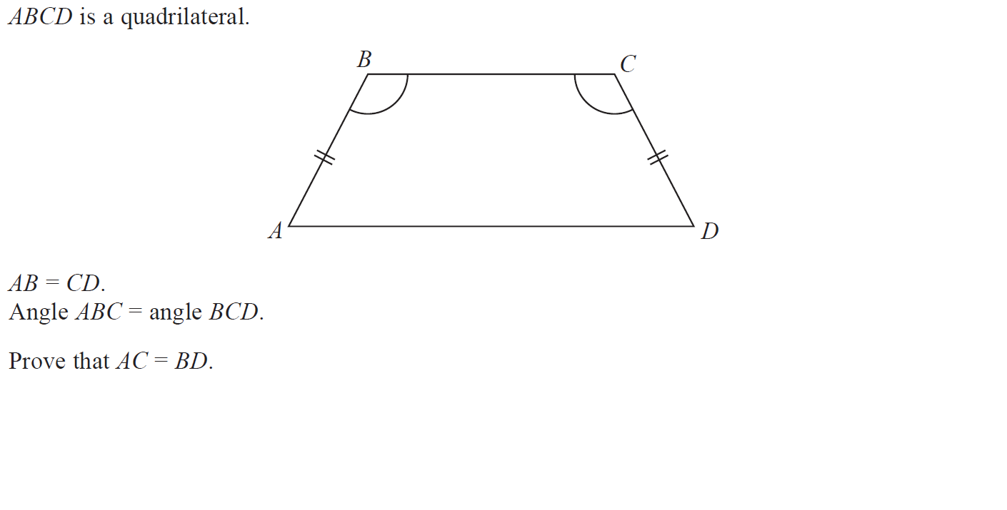
Similar Shapes
May 2017 1H Q21

Slide 19
Similar Shapes
May 2017 1H Q21
A

Slide 20
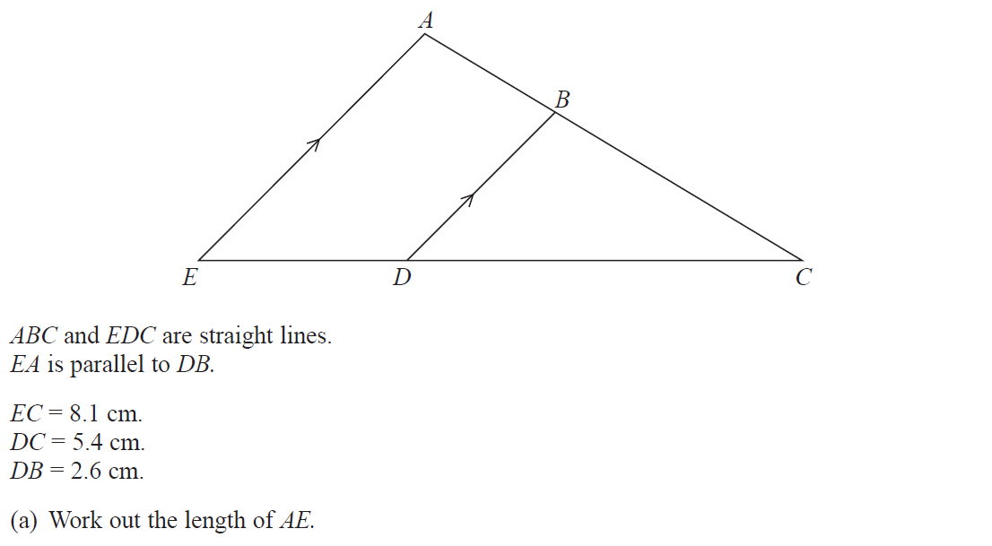
Similar Shapes
June 2017 2H Q5

Slide 21
Similar Shapes
June 2017 2H Q5
A
B

Slide 22
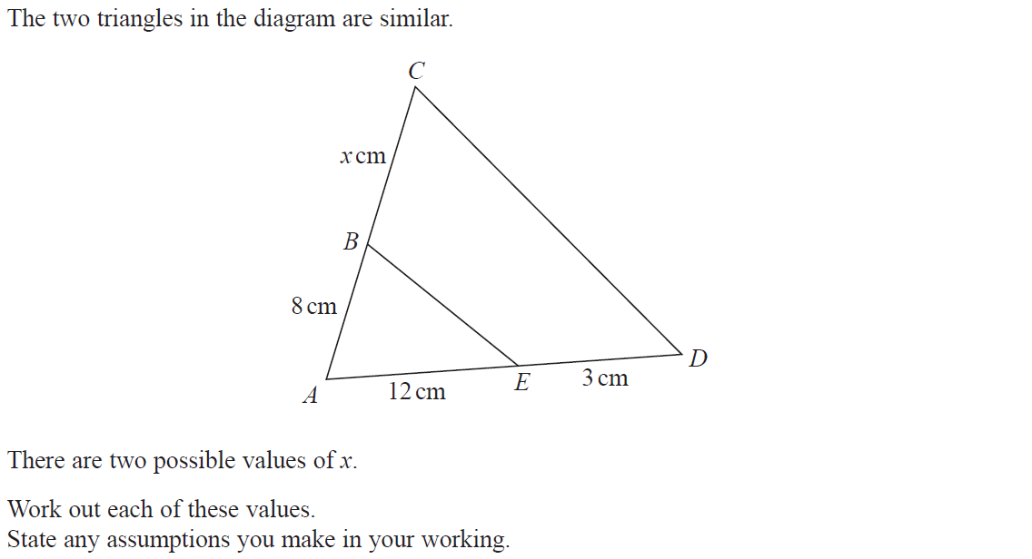
Similar Shapes
Nov 2017 1H Q22

Slide 23
Similar Shapes
Nov 2017 1H Q22
A

Slide 24
Similar Shapes
Nov 2017 3H Q14

Slide 25
Similar Shapes
Nov 2017 3H Q14
A

Slide 26
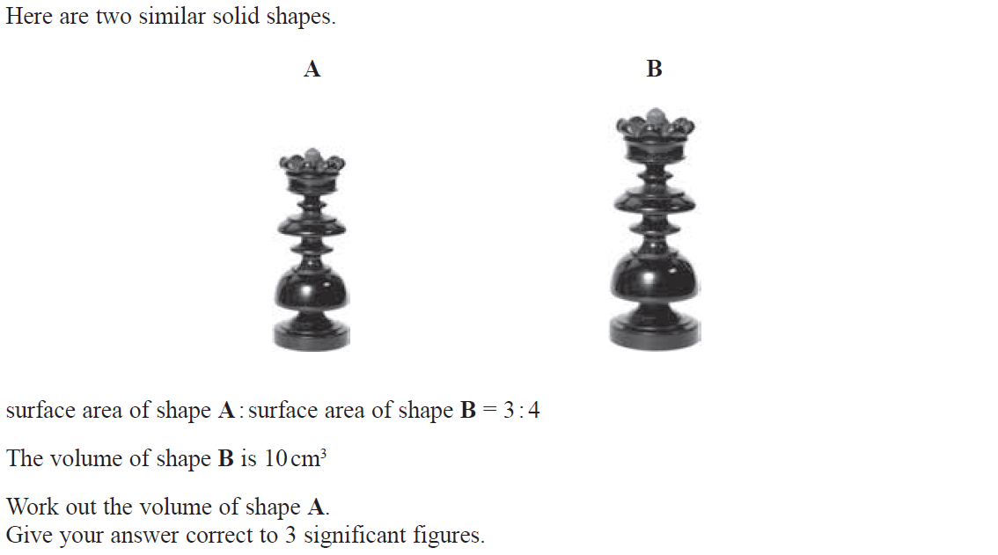
Similar Shapes
June 2018 3H Q13

Slide 27
Similar Shapes
June 2018 3H Q13
A

Slide 28
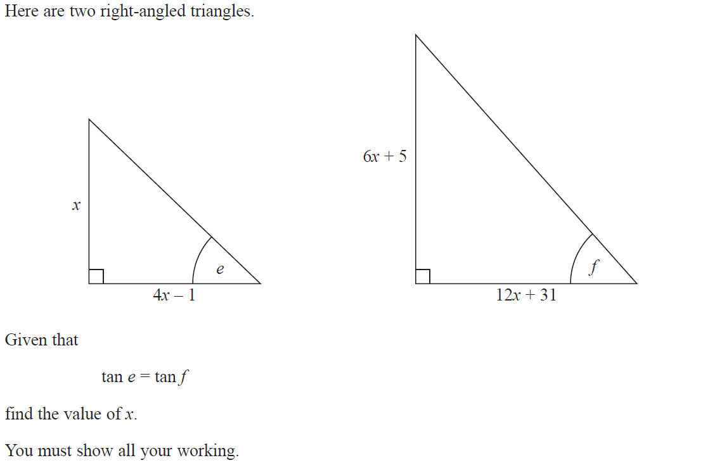
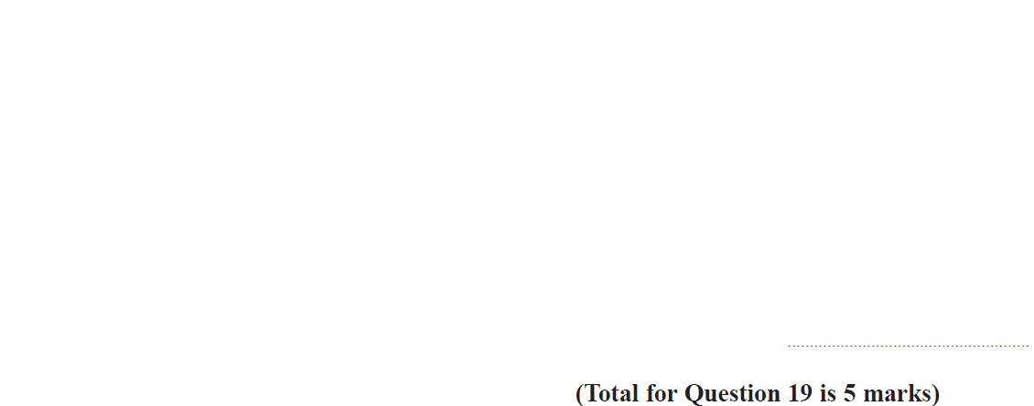
Similar Shapes
June 2018 3H Q19

Slide 29
Similar Shapes
June 2018 3H Q19
A

Slide 30
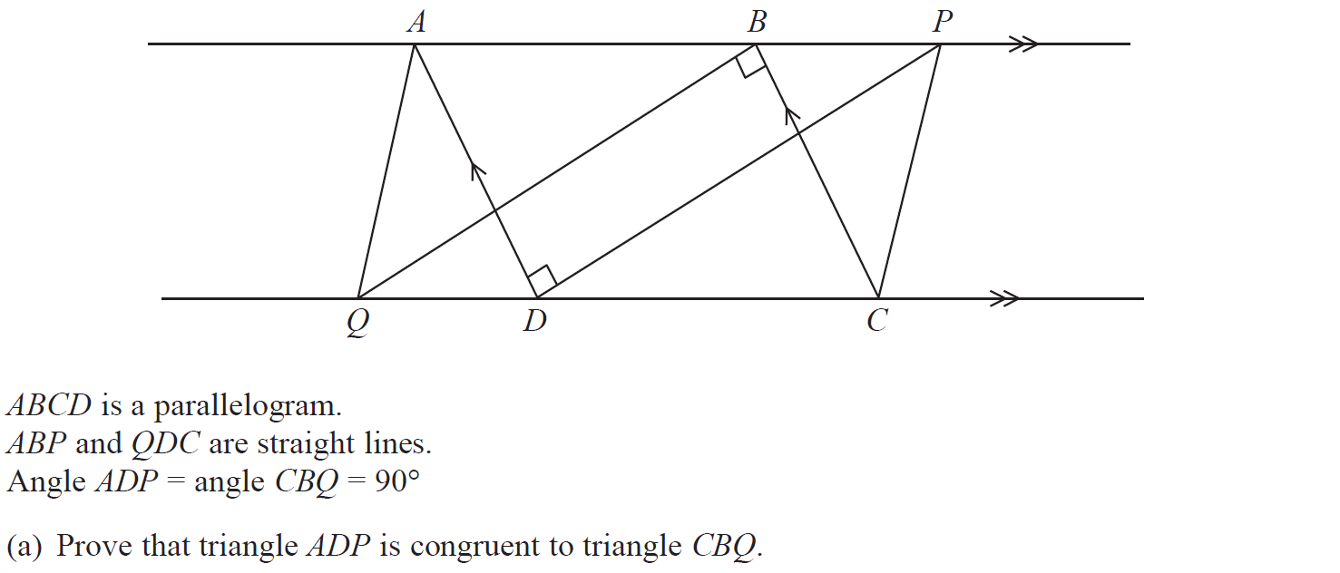
Similar Shapes
June 2018 3H Q21

Slide 31
Similar Shapes
June 2018 3H Q21
A
B

Slide 32
Similar Shapes
Nov 2018 1H Q15

Slide 33
Similar Shapes
Nov 2018 1H Q15
A

Slide 34
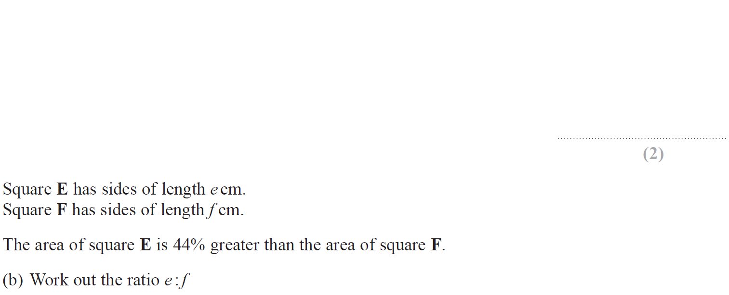
Similar Shapes
June 2019 2H Q9

Slide 35
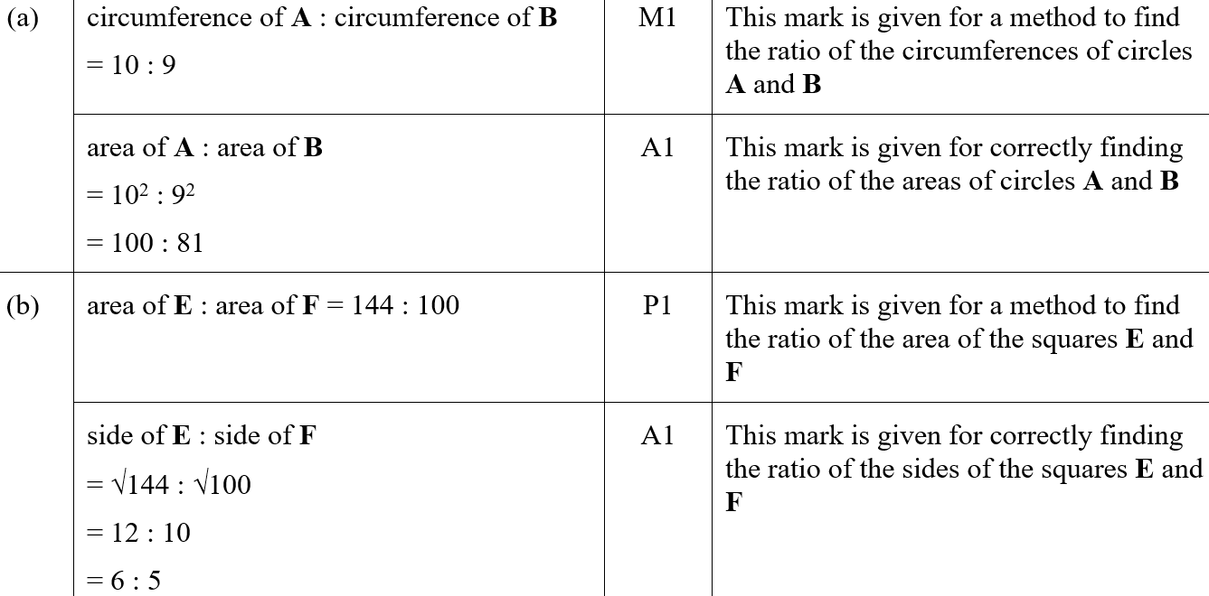
Similar Shapes
June 2019 2H Q9
A
B
A SF
B SF

Slide 36
Similar Shapes
SAM 1H Q3

Slide 37
Similar Shapes
SAM 1H Q3
A

Slide 38
Similar Shapes
SAM 1H Q22

Slide 39
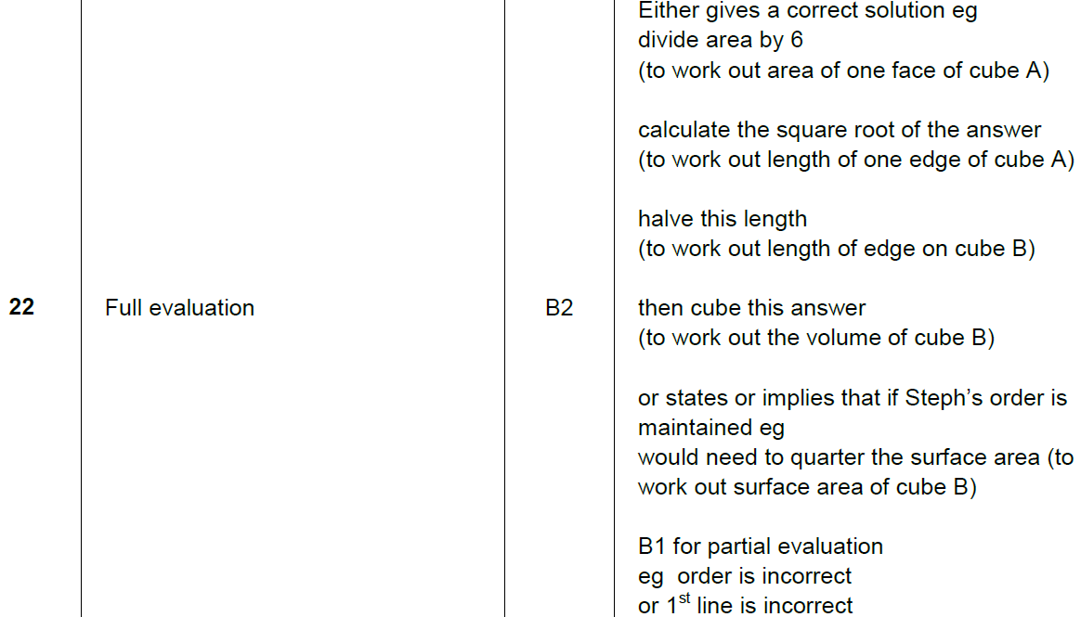
Similar Shapes
SAM 1H Q22
A

Slide 40
Similar Shapes
SAM 2H Q2

Slide 41
Similar Shapes
SAM 2H Q2
A

Slide 42
Similar Shapes
SAM 2H Q13

Slide 43
Similar Shapes
SAM 2H Q13
A

Slide 44
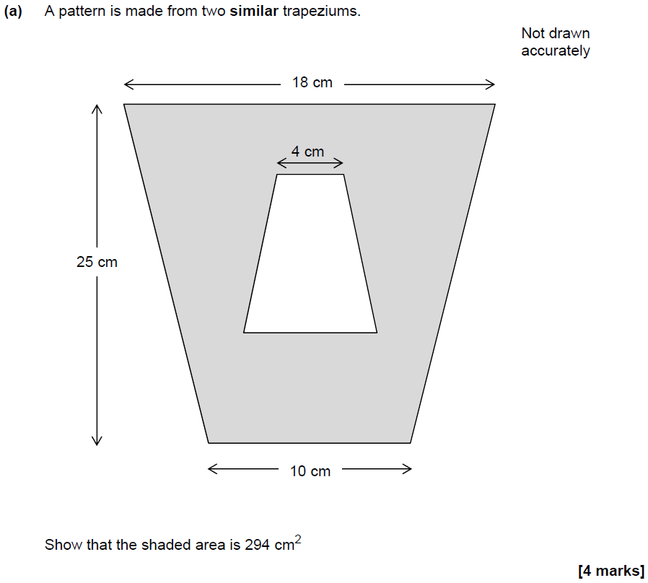
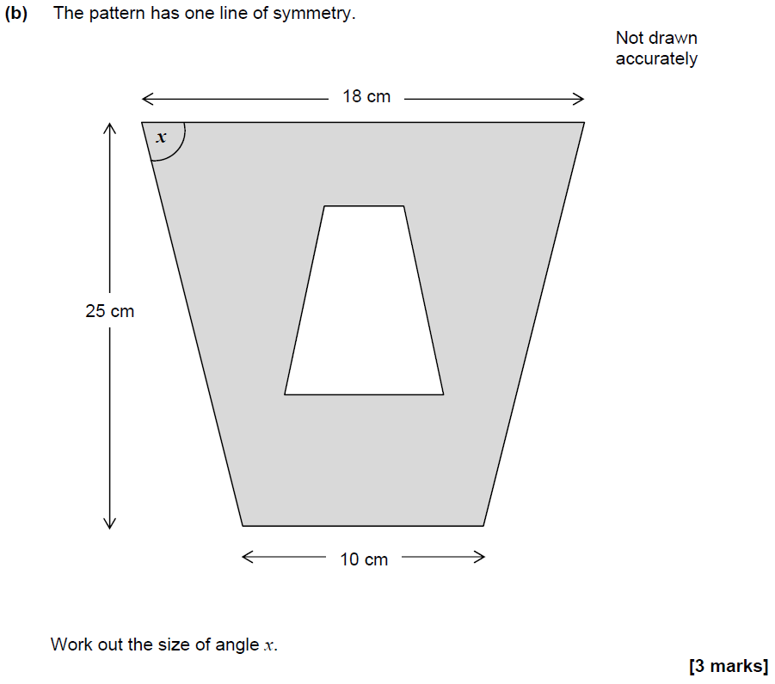
Similar Shapes
SAM 2H Q14

Slide 45
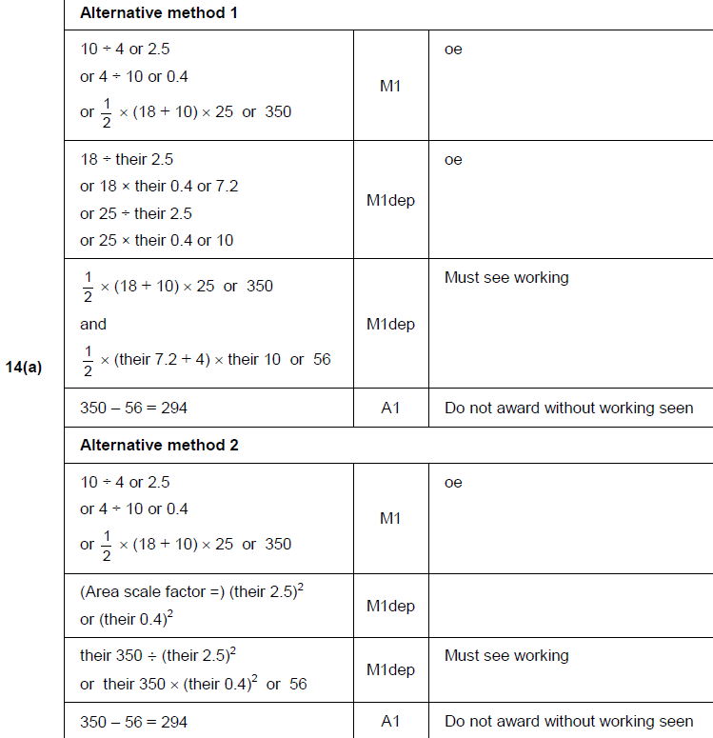
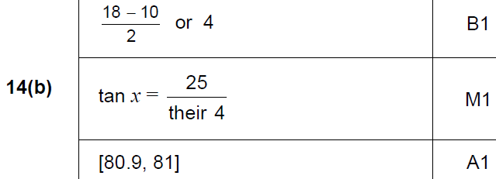
Similar Shapes
SAM 2H Q14
A
B

Slide 46
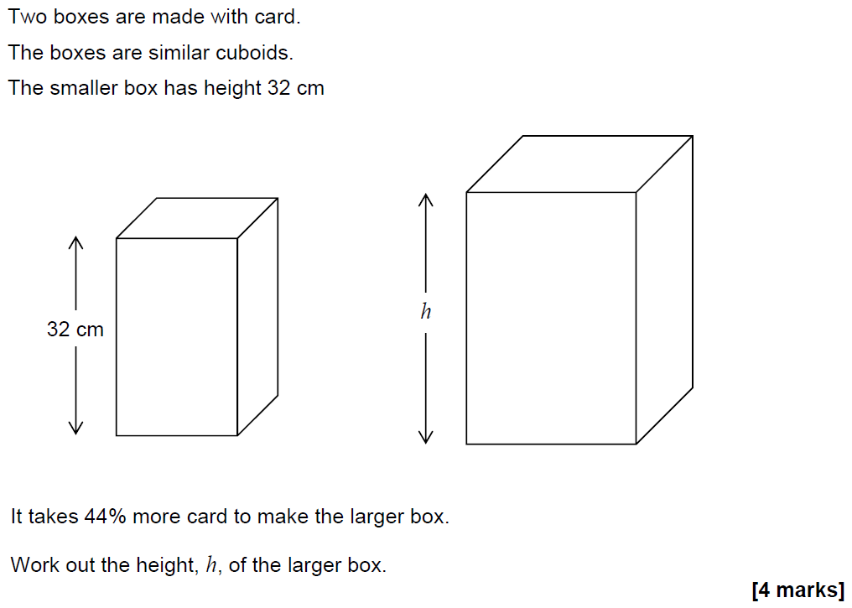
Similar Shapes
SAM 2H Q26

Slide 47
Similar Shapes
SAM 2H Q26
A

Slide 48
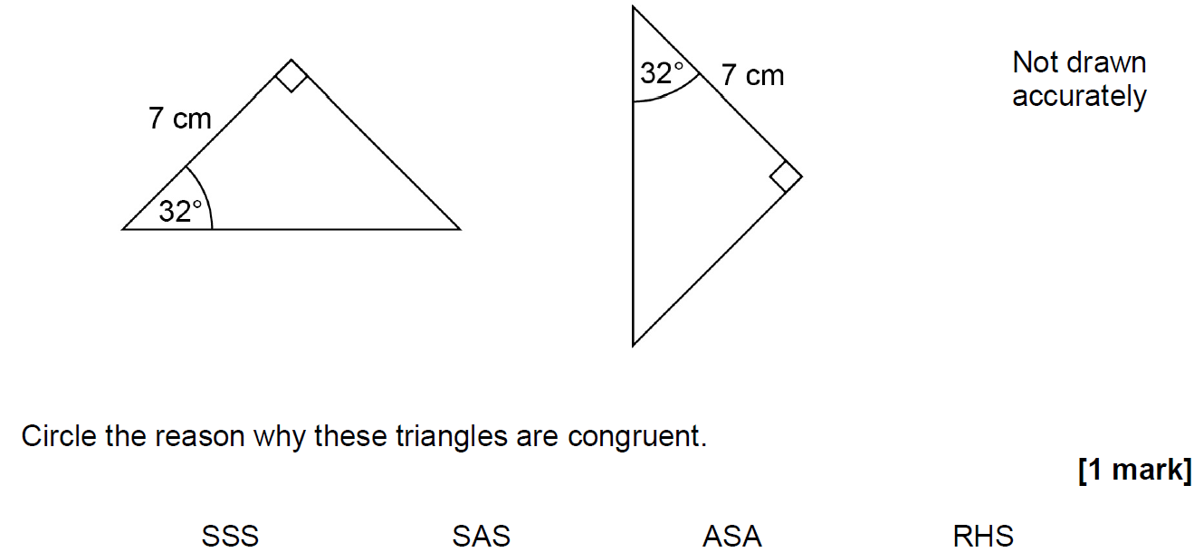
Similar Shapes
May 2017 1H Q2

Slide 49
Similar Shapes
May 2017 1H Q2
A

Slide 50
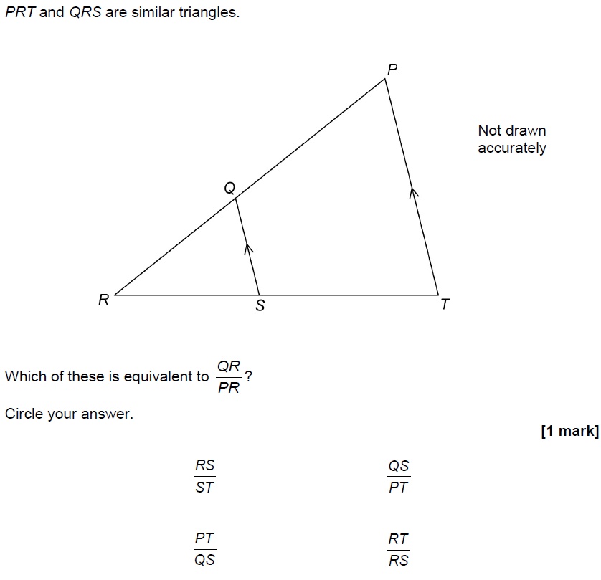
Similar Shapes
May 2017 1H Q22

Slide 51
Similar Shapes
May 2017 1H Q22
A

Slide 52
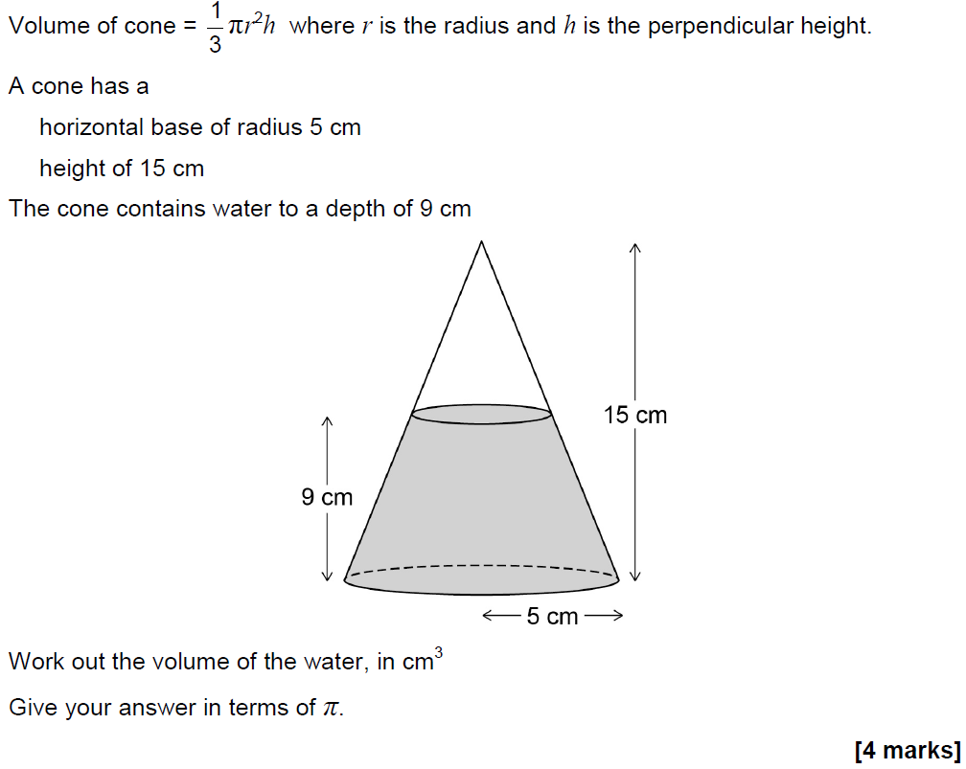
Similar Shapes
May 2017 1H Q28

Slide 53
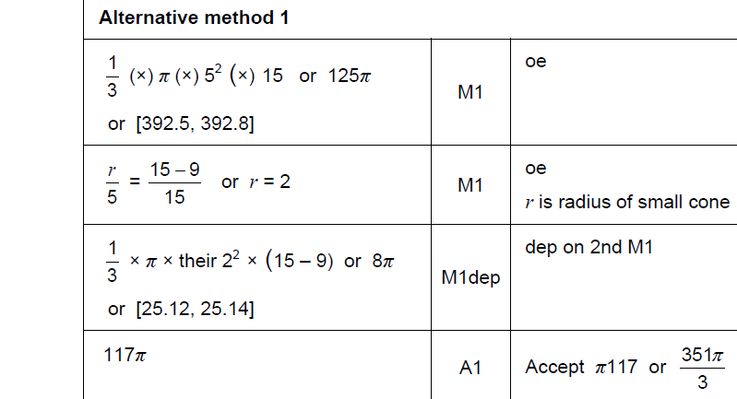
Similar Shapes
May 2017 1H Q28
A

Slide 54
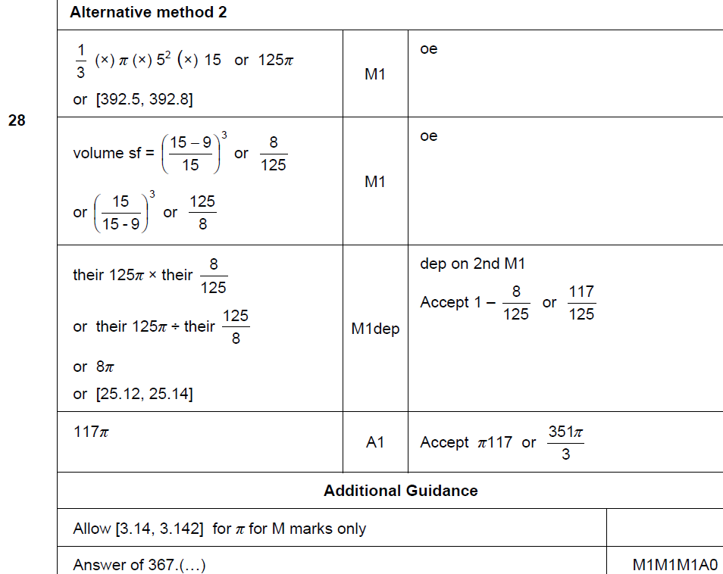
Similar Shapes
May 2017 1H Q28
A Alternative & notes

Slide 55
Similar Shapes
June 2017 2H Q2

Slide 56
Similar Shapes
June 2017 2H Q2
A

Slide 57
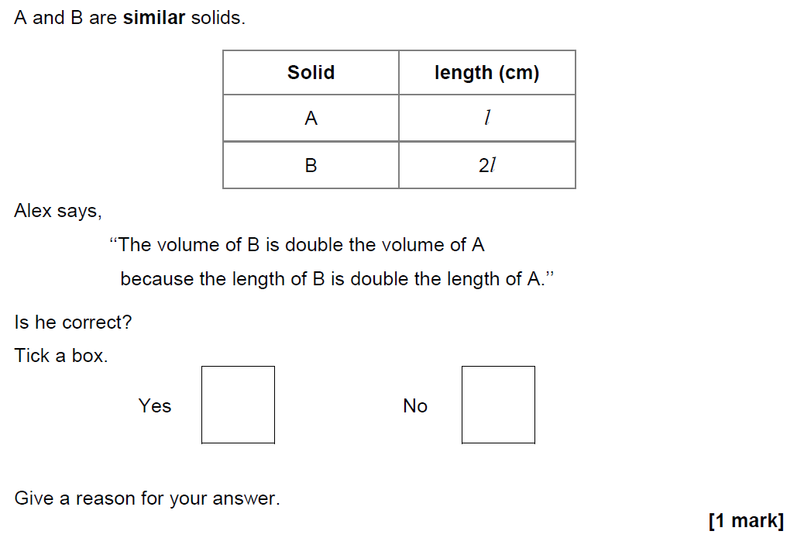
Similar Shapes
Nov 2017 1H Q17

Slide 58
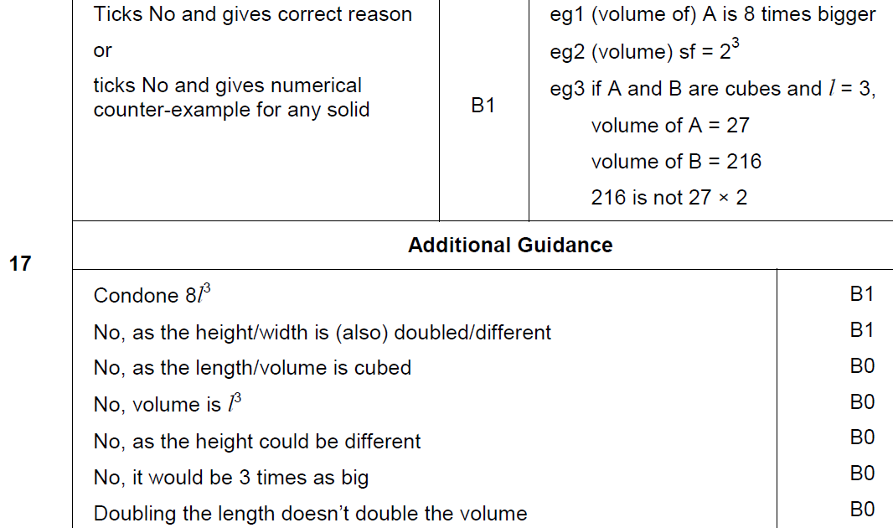
Similar Shapes
Nov 2017 1H Q17
A

Slide 59
Similar Shapes
May 2018 1H Q13

Slide 60
Similar Shapes
May 2018 1H Q13
A

Slide 61
Similar Shapes
June 2018 2H Q23

Slide 62
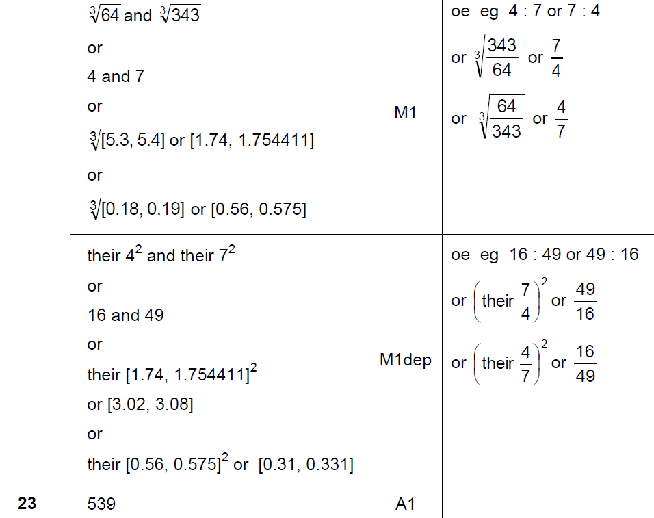
Similar Shapes
June 2018 2H Q23
A

Slide 63
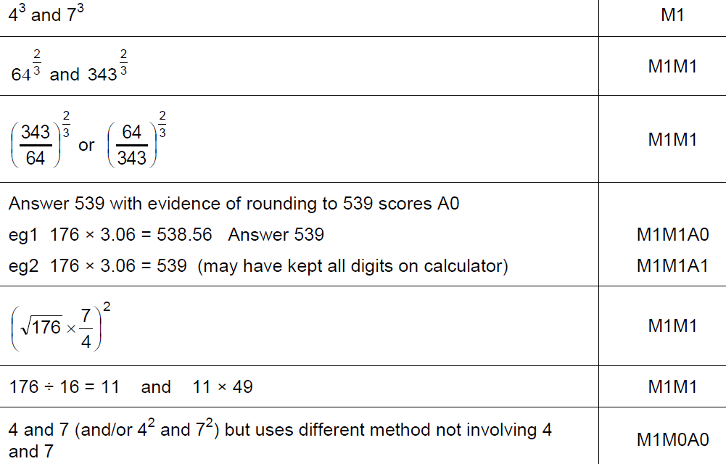
Similar Shapes
June 2018 2H Q23
A notes

Slide 64
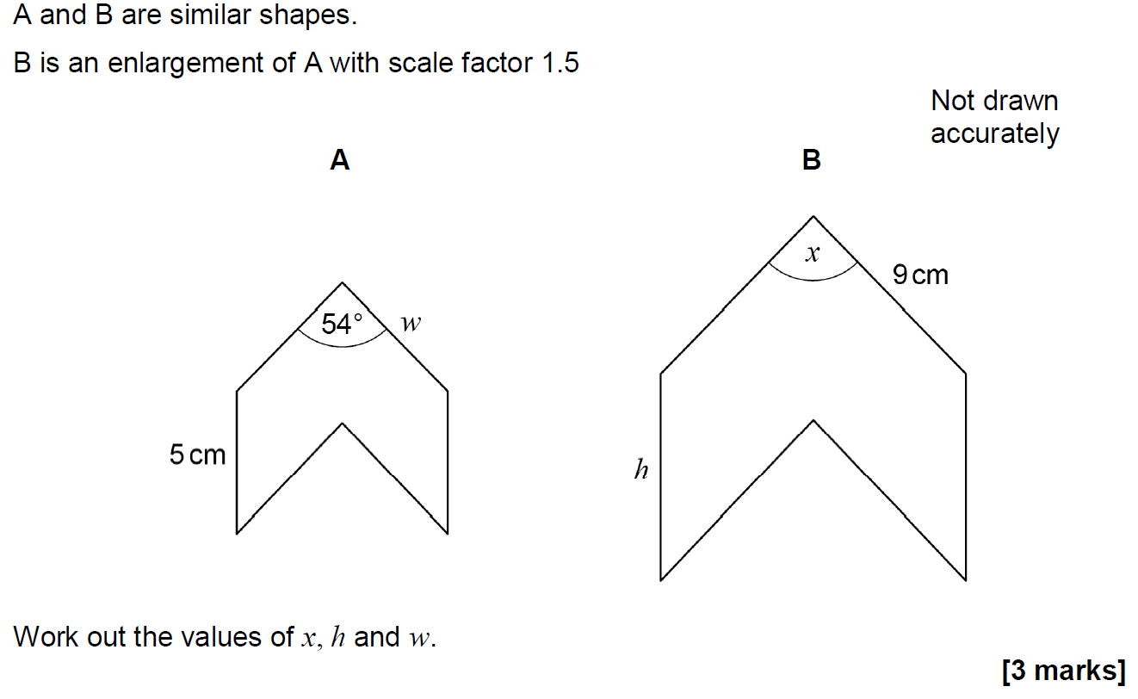
Similar Shapes
June 2018 3H Q6

Slide 65
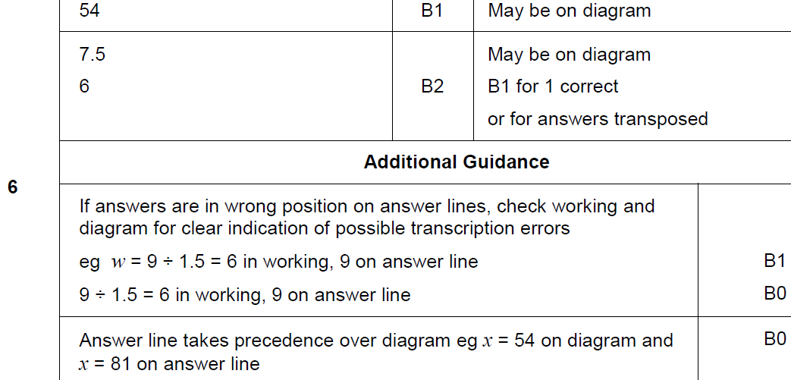
Similar Shapes
June 2018 3H Q6
A

Slide 66
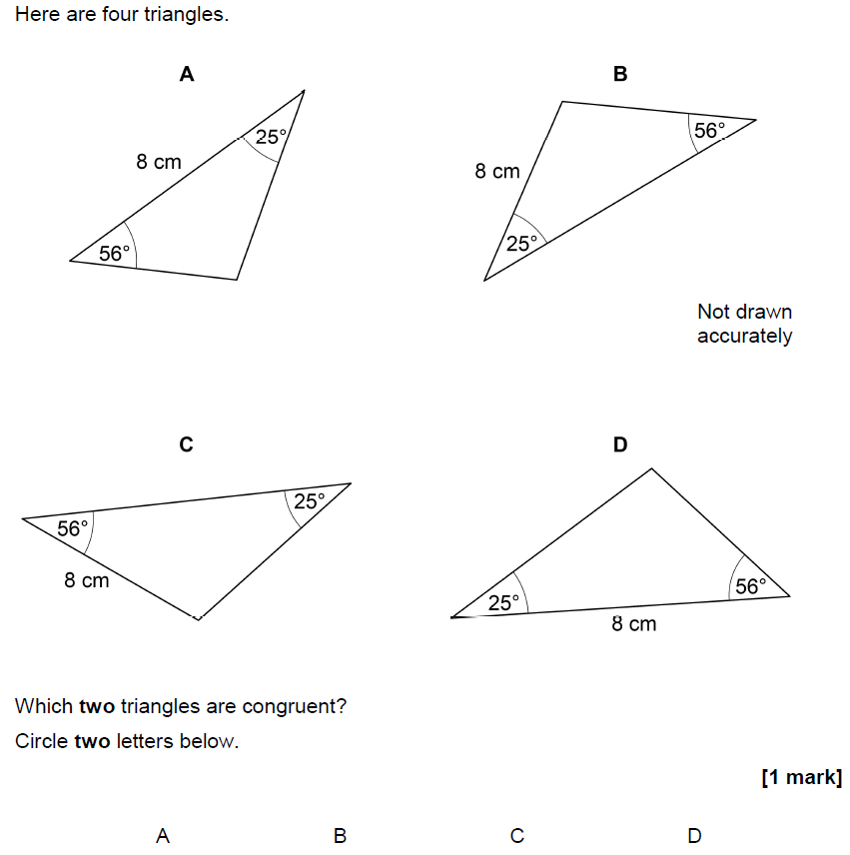
Similar Shapes
Nov 2018 1H Q11

Slide 67
Similar Shapes
Nov 2018 1H Q11
A

Slide 68
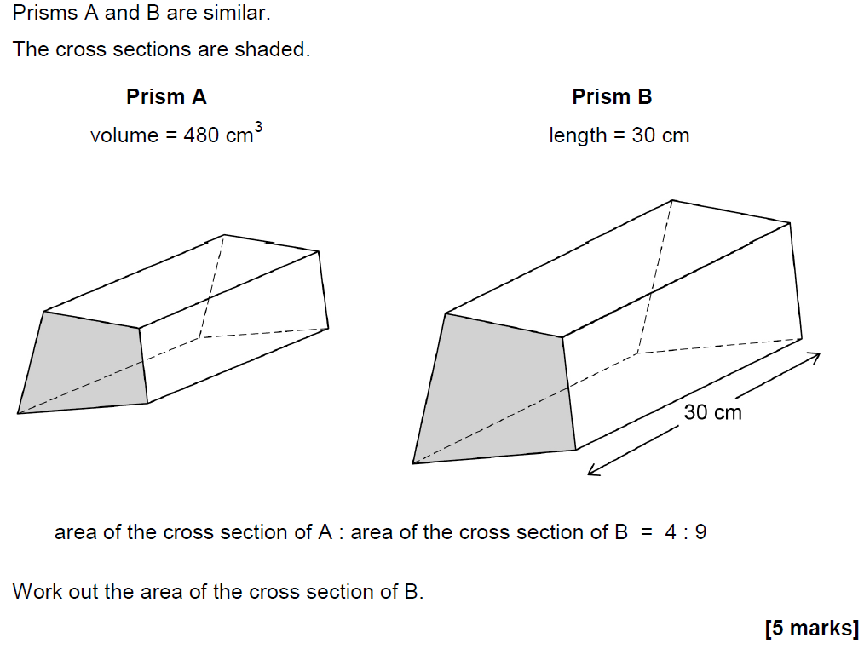
Similar Shapes
Nov 2018 1H Q23

Slide 69
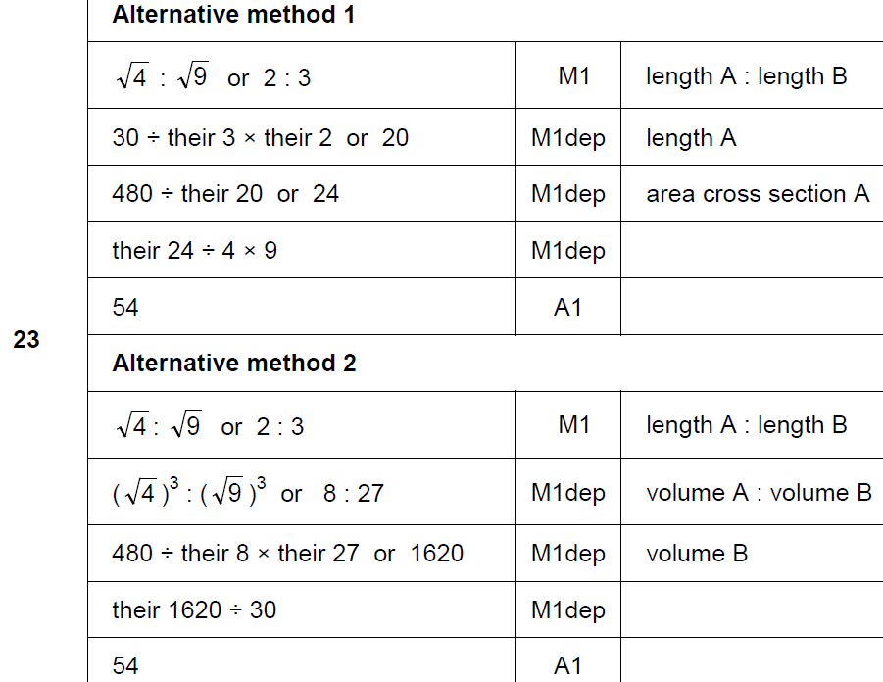
Similar Shapes
Nov 2018 1H Q23
A

Slide 70
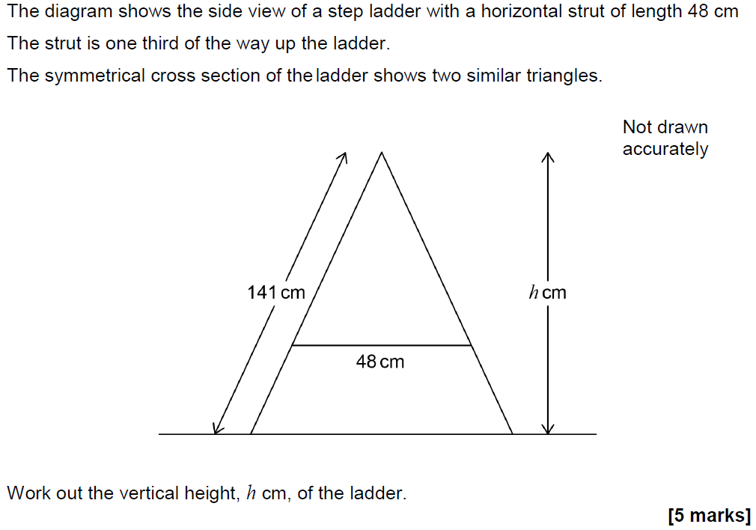
Similar Shapes
Nov 2018 3H Q23

Slide 71
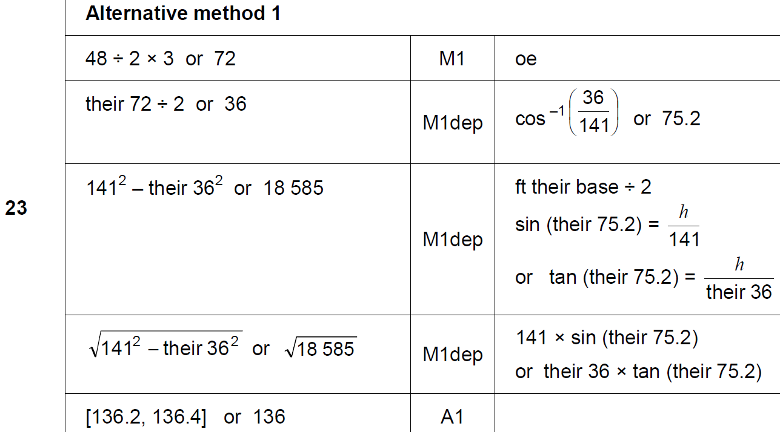
Similar Shapes
Nov 2018 3H Q23
A

Slide 72
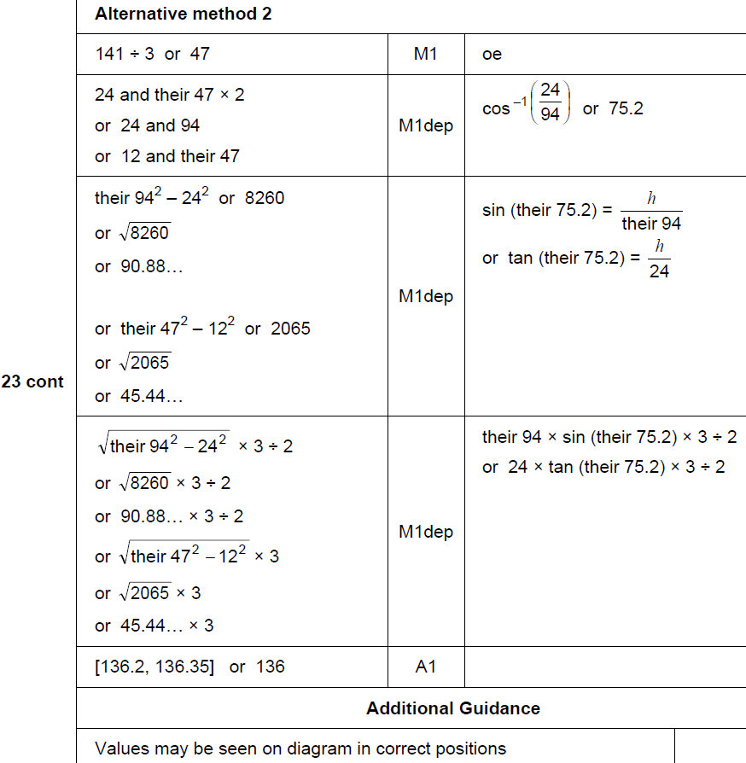
Similar Shapes
Nov 2018 3H Q23
A Alternative & notes

Slide 73
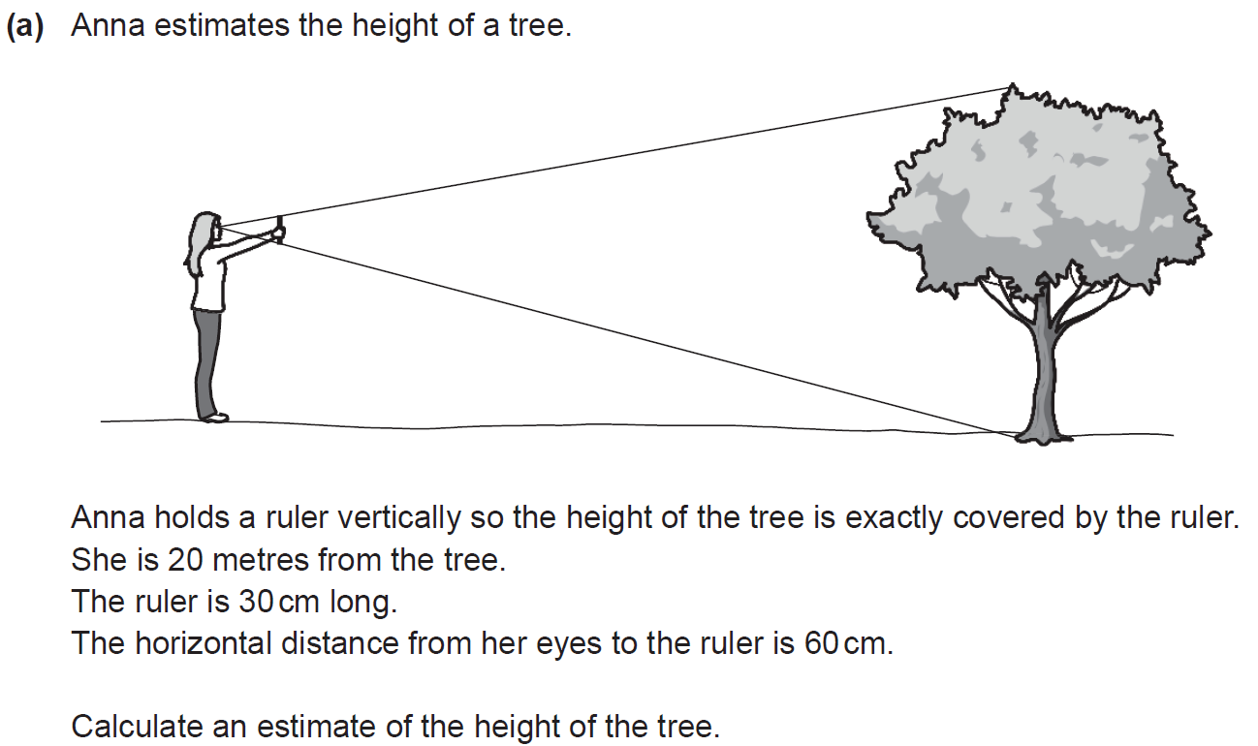
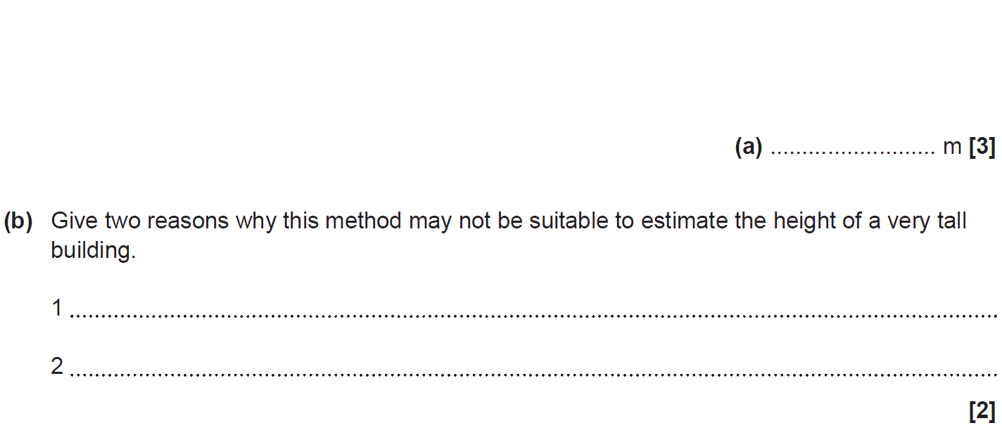
Similar Shapes
SAM 1H Q9

Slide 74
Similar Shapes
SAM 1H Q9
A
B

Slide 75
Similar Shapes
SAM 1H Q10

Slide 76
Similar Shapes
SAM 1H Q10
A

Slide 77
Similar Shapes
SAM 1H Q13

Slide 78
Similar Shapes
SAM 1H Q13
A

Slide 79
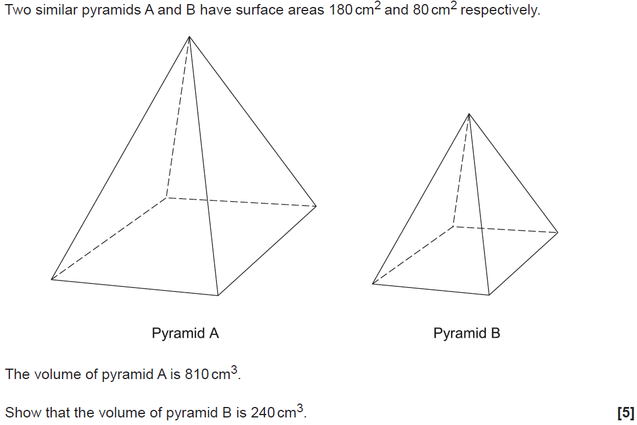
Similar Shapes
SAM 3H Q12

Slide 80
Similar Shapes
SAM 3H Q12
A

Slide 81
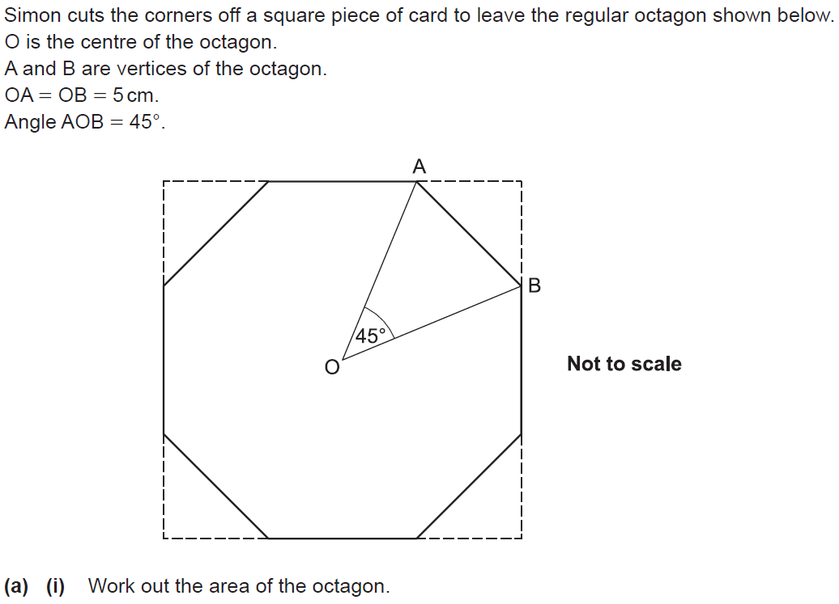
Similar Shapes
SAM 3H Q16

Slide 82
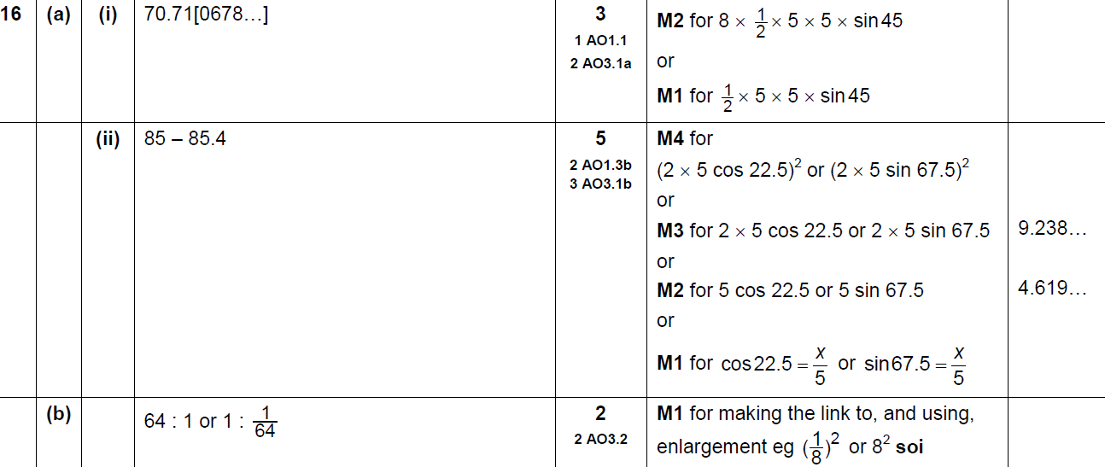
Similar Shapes
SAM 3H Q16
A (i)
A (ii)
B

Slide 83
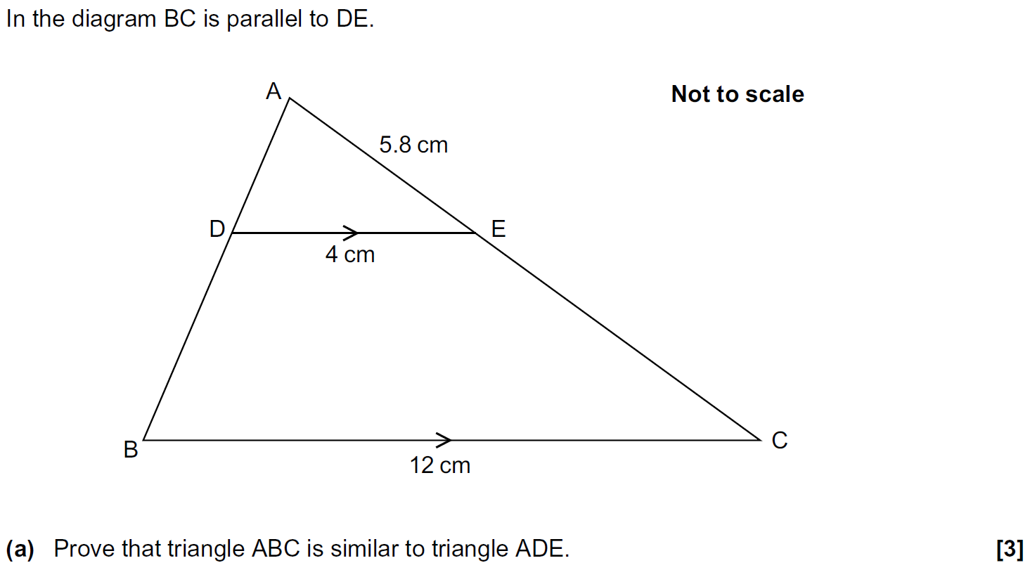
Similar Shapes
Practice 2H Q10

Slide 84
Similar Shapes
Practice 2H Q10
A
B
C

Slide 85
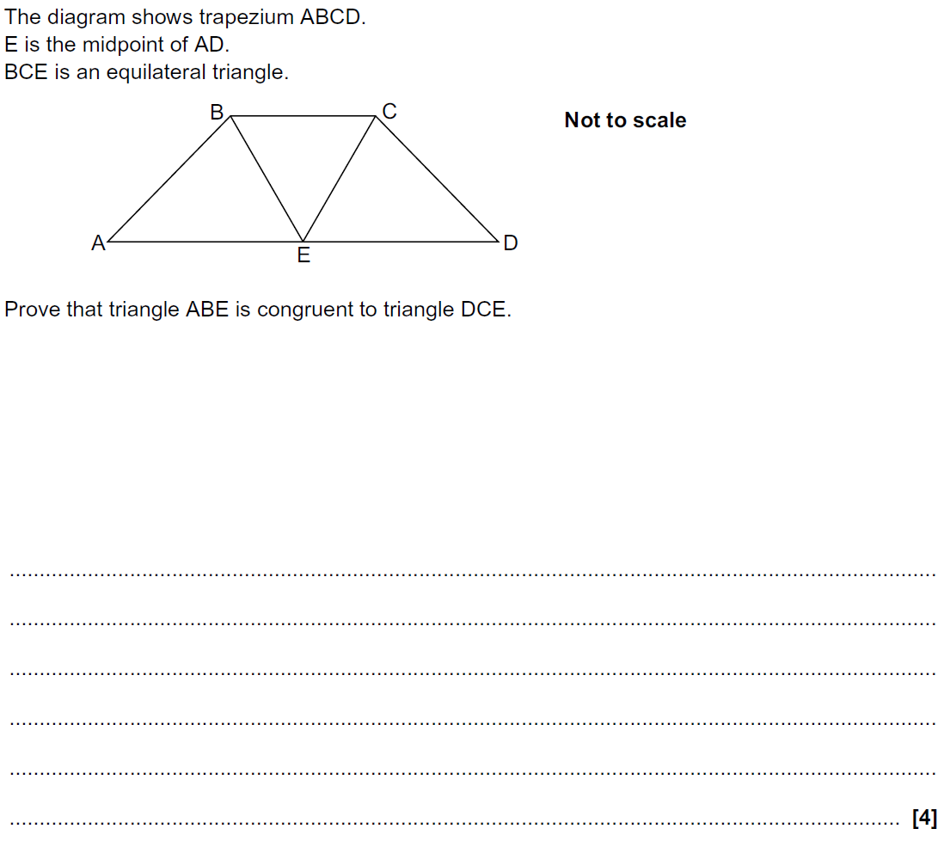
Similar Shapes
Practice 3H Q12

Slide 86
Similar Shapes
Practice 3H Q12
A

Slide 87
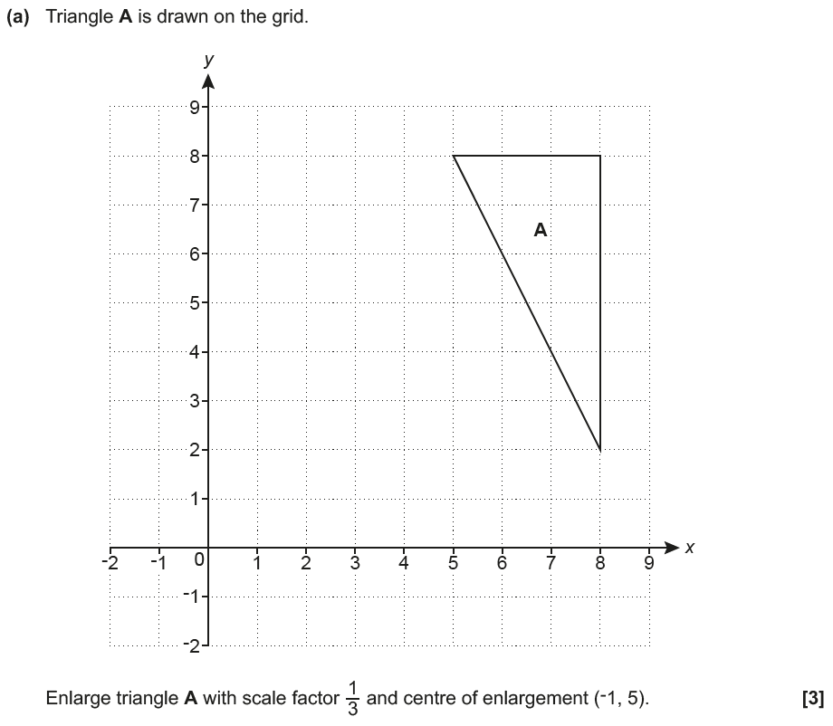
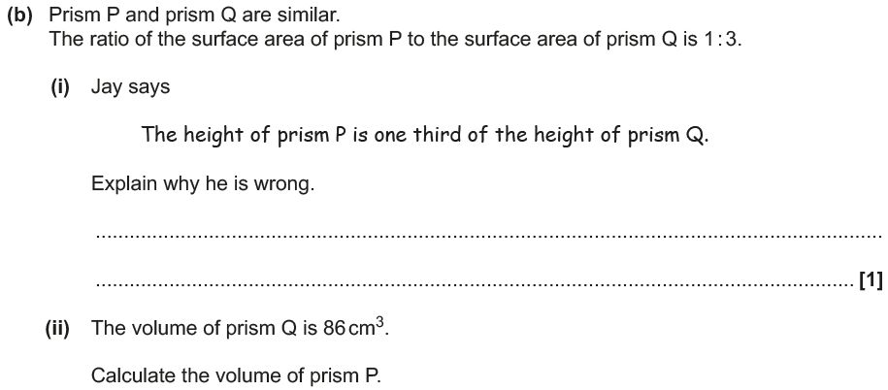
Similar Shapes
June 2017 3H Q9
A₁
Reveal Shape A₁ (a)
Hide A₁

Slide 88
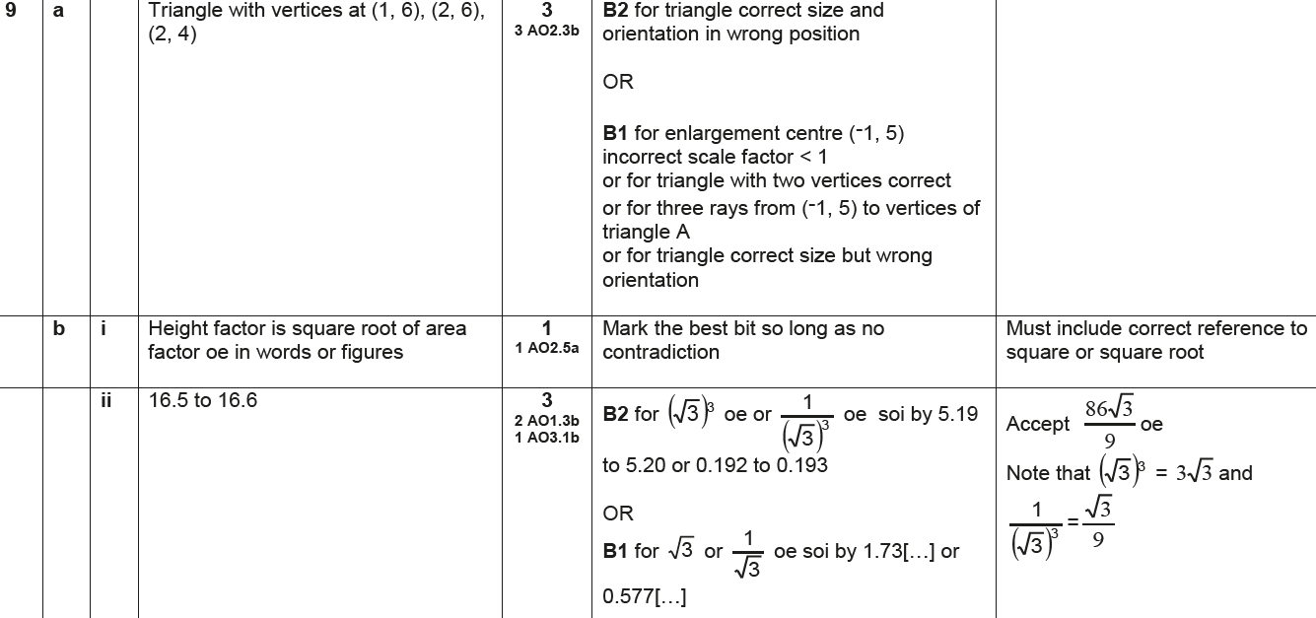
Similar Shapes
June 2017 3H Q9
A
B (i)
B (ii)

Slide 89
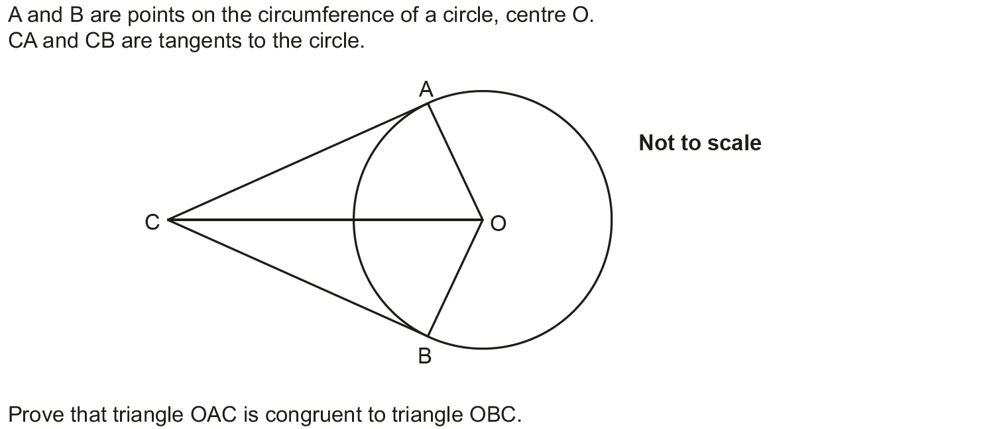
Similar Shapes
June 2017 3H Q13

Slide 90
Similar Shapes
June 2017 3H Q13
A

Slide 91
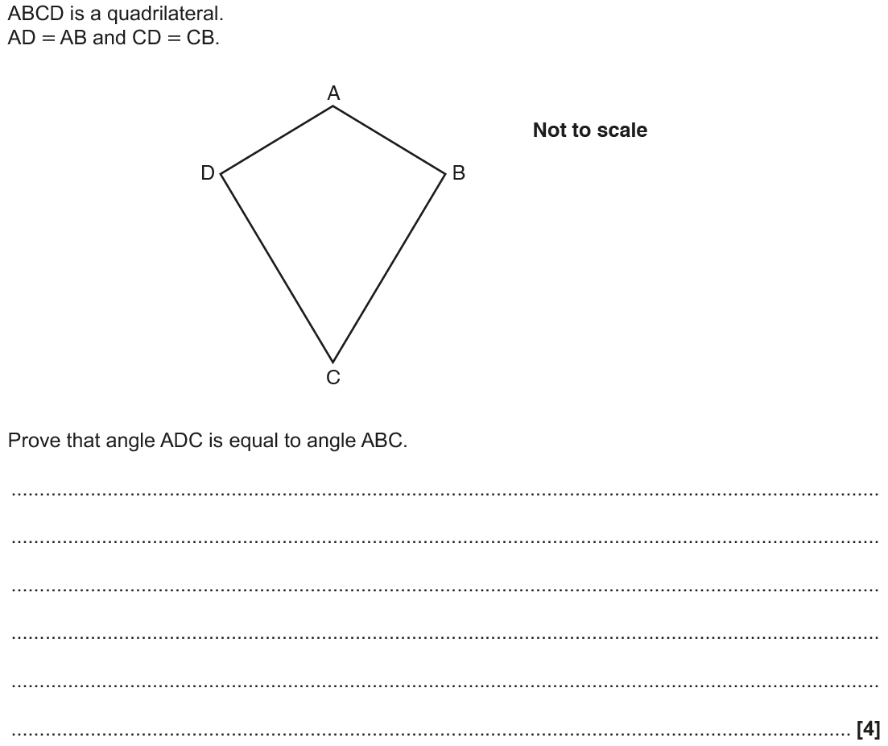
Similar Shapes
Nov 2017 2H Q10

Slide 92
Similar Shapes
Nov 2017 2H Q10
A

Slide 93
Similar Shapes
Nov 2017 3H Q13

Slide 94
Similar Shapes
Nov 2017 3H Q13
A
B

Slide 95
Similar Shapes
June 2018 3H Q11

Slide 96
Similar Shapes
June 2018 3H Q11
A

Slide 97
Similar Shapes
June 2018 3H Q12

Slide 98
Similar Shapes
June 2018 3H Q12
A

Slide 99
Similar Shapes
June 2018 3H Q18

Slide 100
Similar Shapes
June 2018 3H Q18
A
B

Slide 101
Similar Shapes
Nov 2018 1H Q19

Slide 102
Similar Shapes
Nov 2018 1H Q19
A

Slide 103
Similar Shapes
Nov 2018 2H Q17

Slide 104
Similar Shapes
Nov 2018 2H Q17
A

