Slide 1
Similar Shapes
Similar Shapes
Old Spec Q’s
NTSQ
Q7
June 2019
2H Q6
SAM
2H Q18
May 2018
1H Q16
June 2018
2H Q6
Jan 2019
2H Q16
Jan 2019
1HR Q7
May 2019
1H Q17
SF in area and volume

Slide 2
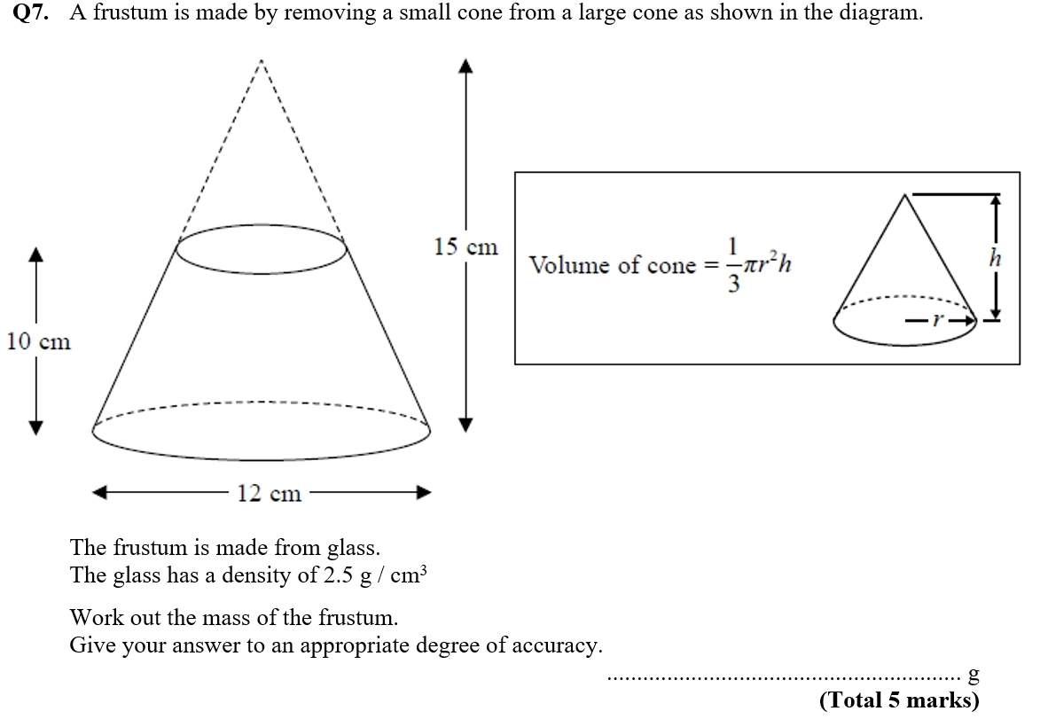
Similar Shapes
NTSQ Q7

Slide 3
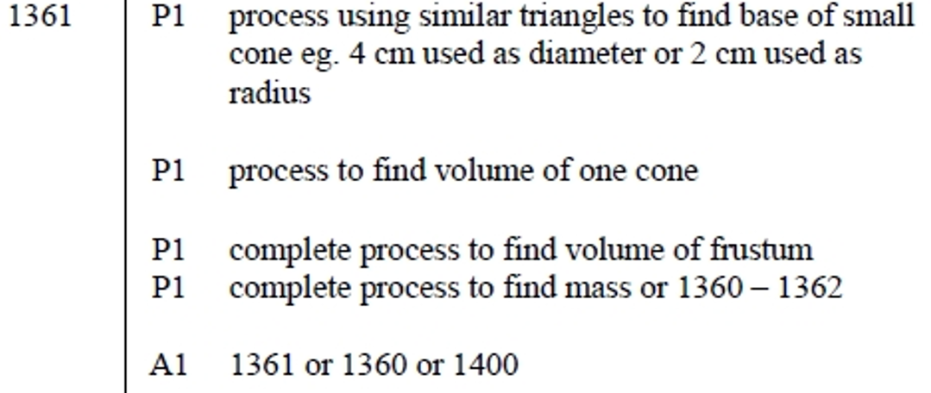
Similar Shapes
NTSQ Q7
A

Slide 4
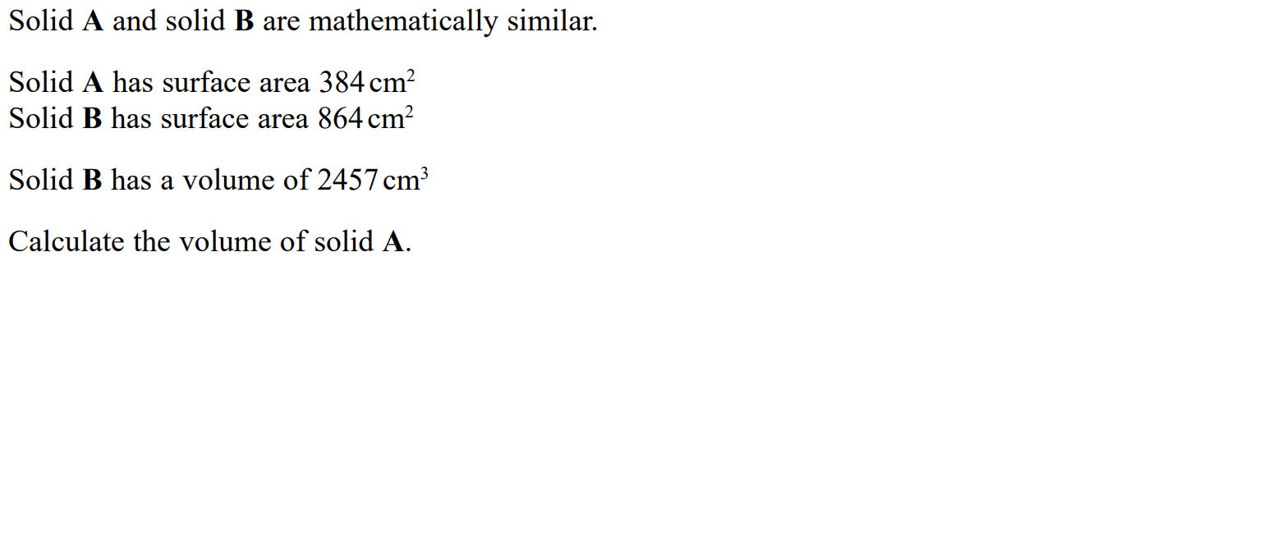
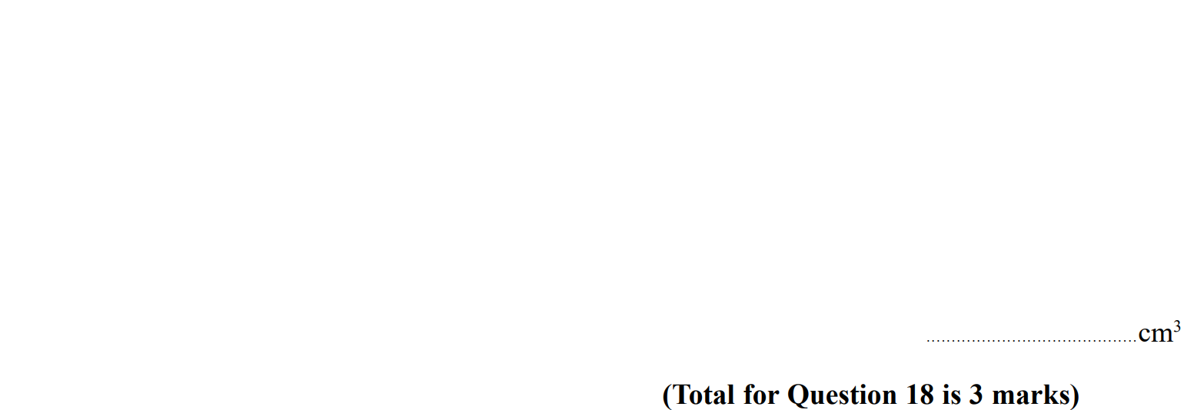
Similar Shapes
SAM 2H Q18

Slide 5
Similar Shapes
SAM 2H Q18
A

Slide 6
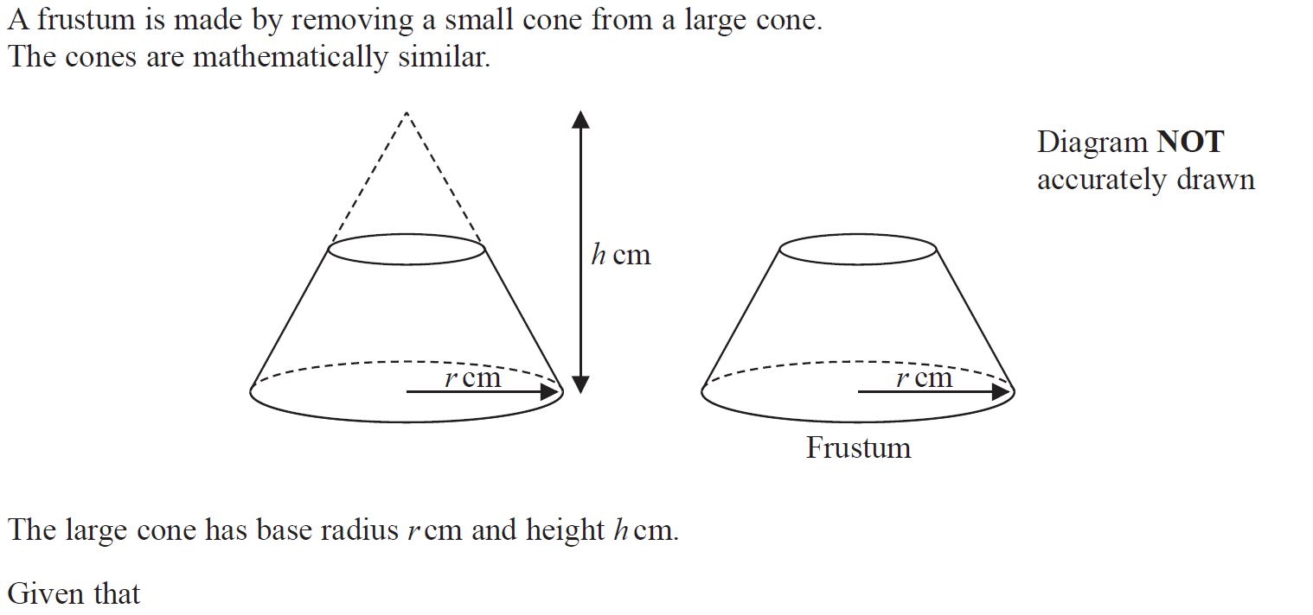
Similar Shapes
May 2018 1H Q16

Slide 7
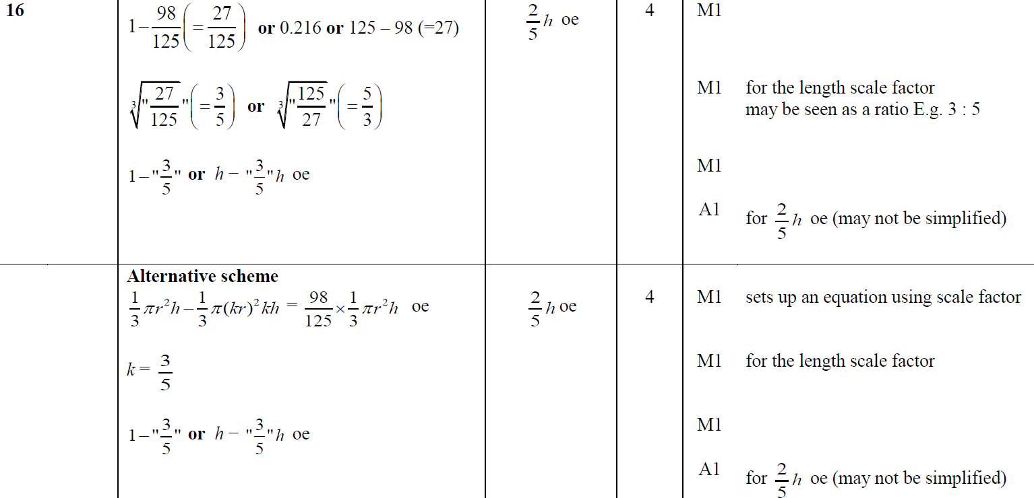
Similar Shapes
May 2018 1H Q16
A

Slide 8
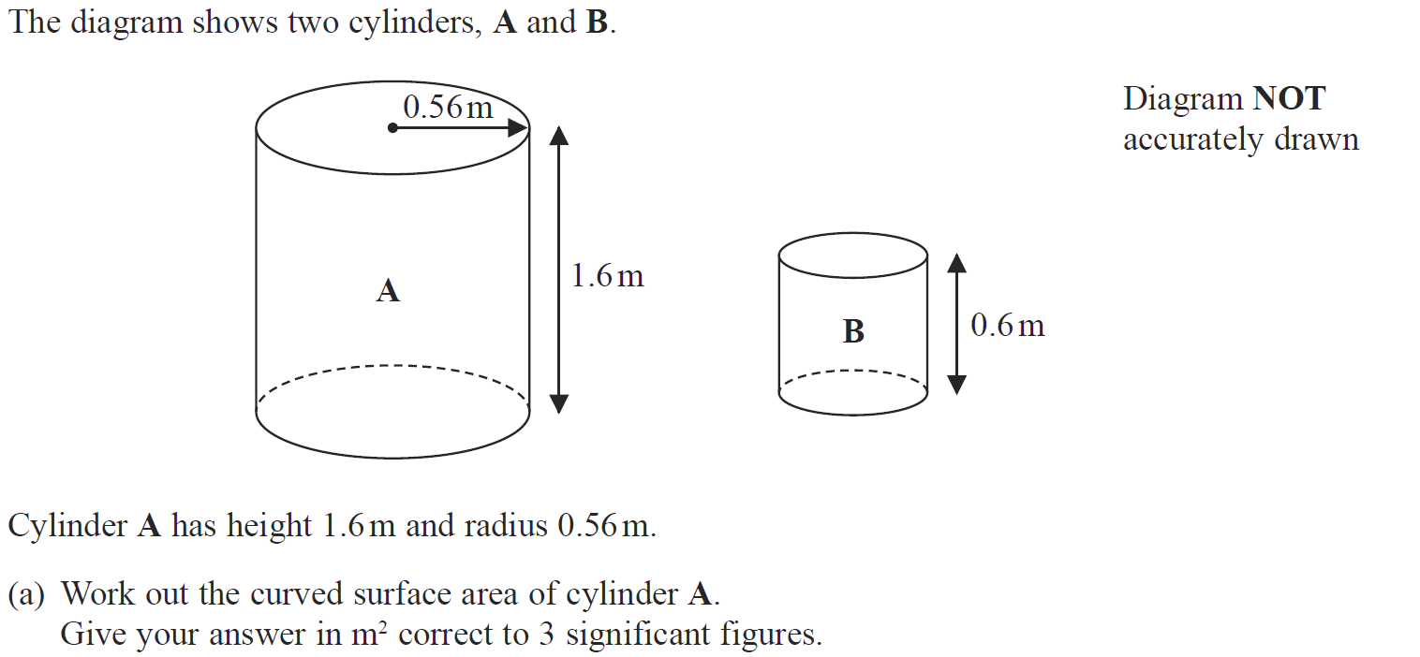
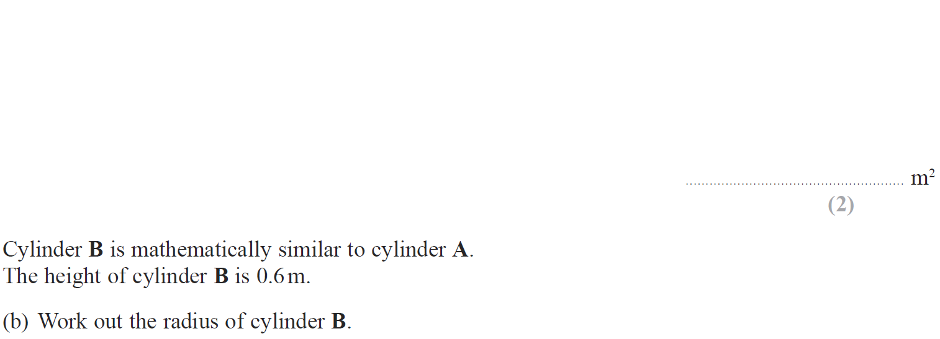
Similar Shapes
June 2018 2H Q6

Slide 9
Similar Shapes
June 2018 2H Q6
A
B

Slide 10
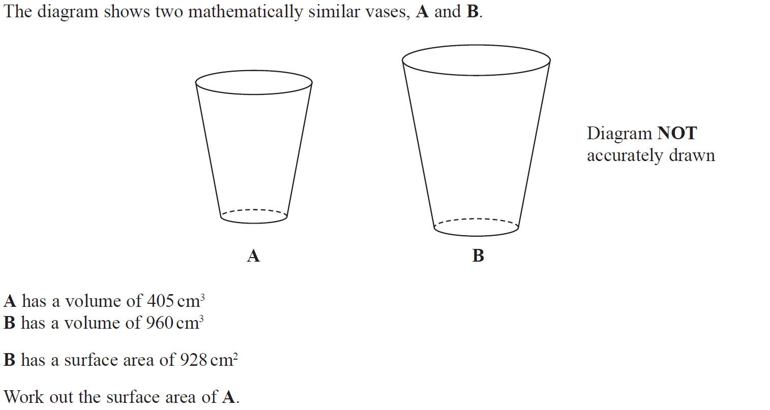
Similar Shapes
Jan 2019 2H Q16

Slide 11
Similar Shapes
Jan 2019 2H Q16
A

Slide 12
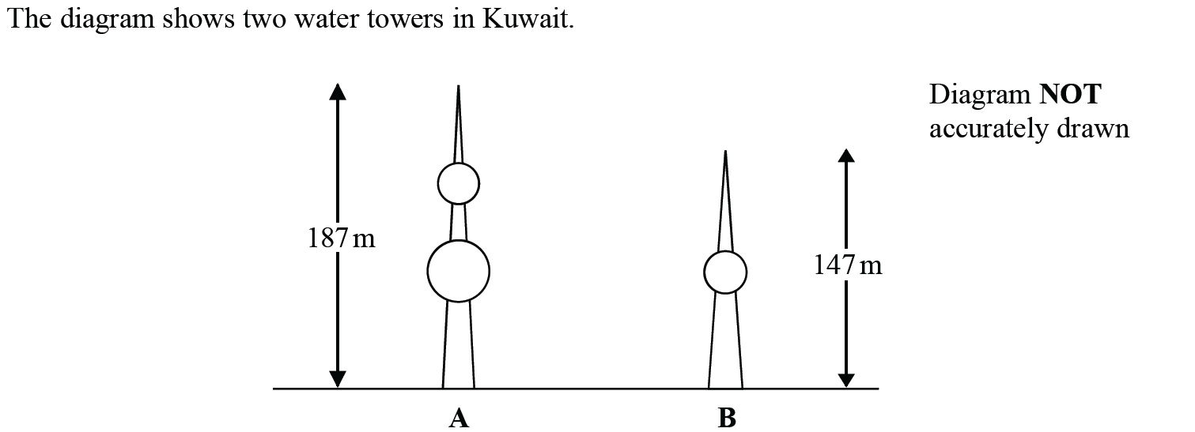
Similar Shapes
Jan 2019 1HR Q7

Slide 13
Similar Shapes
Jan 2019 1HR Q7
A

Slide 14
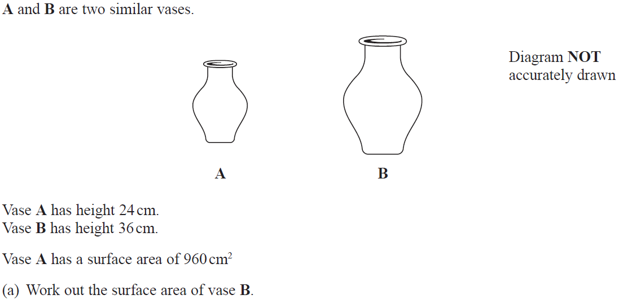
Similar Shapes
May 2019 1H Q17

Slide 15
Similar Shapes
May 2019 1H Q17
A

Slide 16
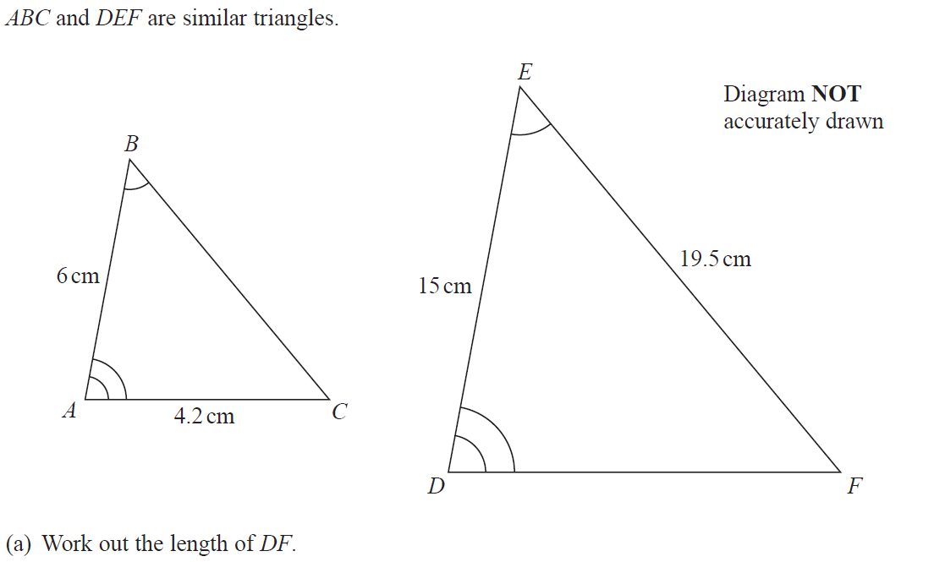
Similar Shapes
June 2019 2H Q6

Slide 17
Similar Shapes
June 2019 2H Q6
A
B

Slide 18
Similar Shapes
Similar Shapes
New Spec Q’s
May 2004
4H Q12
May 2007
3H Q18
Nov 2009
4H Q13
Jan 2013 4H Q17
Jan 2015 3H Q15
May 2016 3HR Q17
May 2018 3HR Q15
Nov 2004
3H Q5
May 2007
4H Q11
June 2010
3H Q17
May 2013 3H Q16
Jan 2015 4HR Q10
Jan 2017 3H Q16
Nov 2004
3H Q12
Nov 2007
4H Q15
June 2010
4H Q10
May 2013 3HR Q14
June 2015 4H Q14
Jan 2017 3HR Q1
Nov 2004
4H Q13
May 2008
3H Q12
Nov 2010
3H Q10
Jan 2014 3HR Q7
June 2015 4HR Q13
Jan 2017 4HR Q14
May 2005
3H Q21
May 2008
4H Q12
June 2011 3H Q12
Jan 2014 3HR Q12
Jan 2016 4H Q14
May 2017 3H Q13
May 2005
4H Q12
Nov 2008
3H Q12
June 2011 4H Q14
May 2014 3H Q15
Jan 2016 4HR Q13
May 2017 3HR Q5
May 2006
3H Q12
May 2009
3H Q16
Jan 2012 3H Q12
May 2014 4H Q12
May 2016 3H Q15
Jan 2018 3H Q18
Nov 2006
3H Q20
June 2009
4H Q13
May 2012 3H Q11
May 2014 3HR Q12
June 2016 4H Q12
Jan 2018 3HR Q12
SF in area and volume

Slide 19
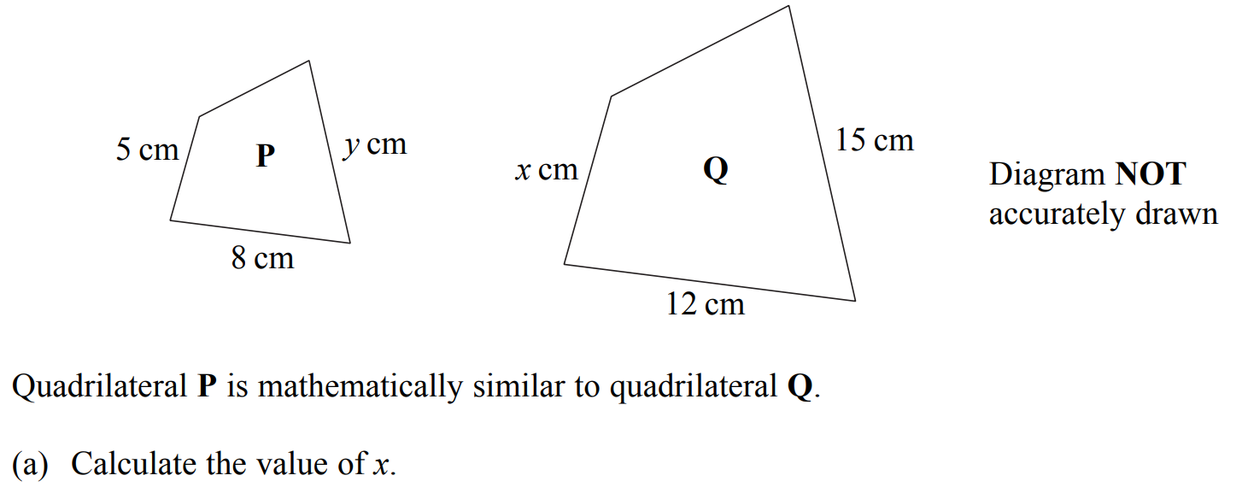
Similar Shapes
May 2004 4H Q12

Slide 20
Similar Shapes
May 2004 4H Q12
A
B
C

Slide 21
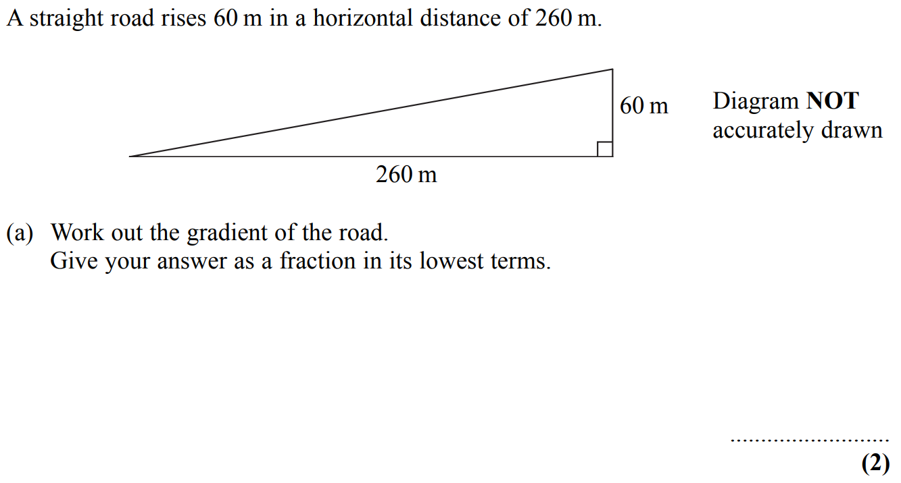
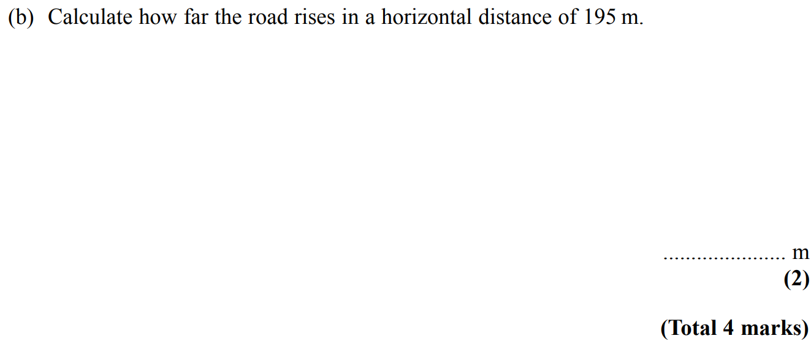
Similar Shapes
Nov 2004 3H Q5

Slide 22
Similar Shapes
Nov 2004 3H Q5
A
B

Slide 23
Similar Shapes
Nov 2004 3H Q14

Slide 24
Similar Shapes
Nov 2004 3H Q14
A
B

Slide 25
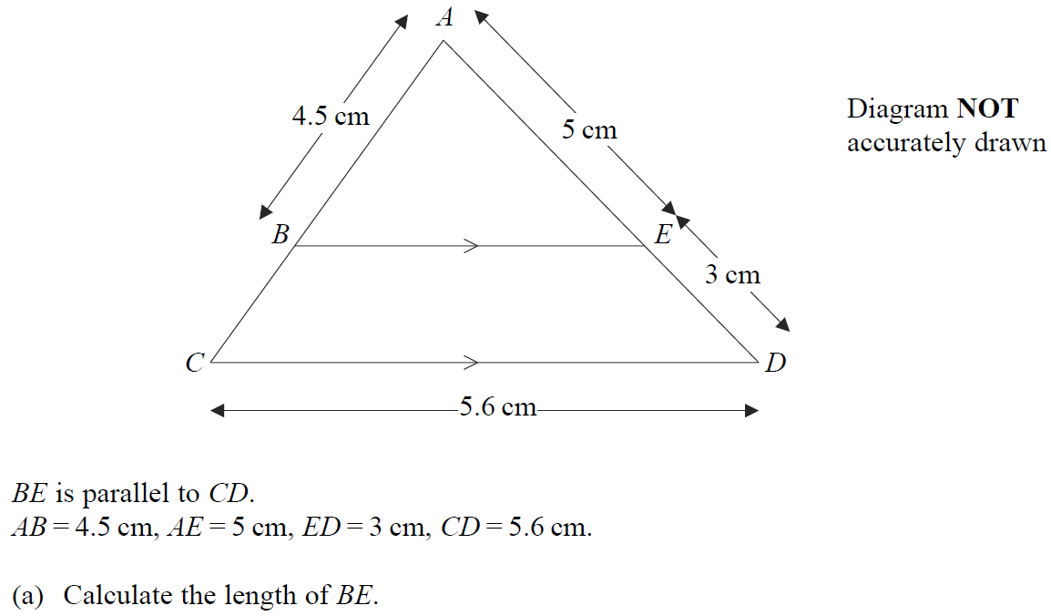
Similar Shapes
Nov 2004 4H Q13

Slide 26
Similar Shapes
Nov 2004 4H Q13
A
B

Slide 27
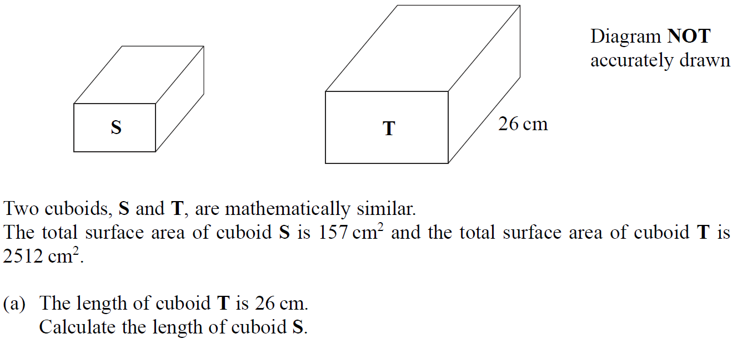
Similar Shapes
May 2005 3H Q21

Slide 28
Similar Shapes
May 2005 3H Q21
A
B

Slide 29
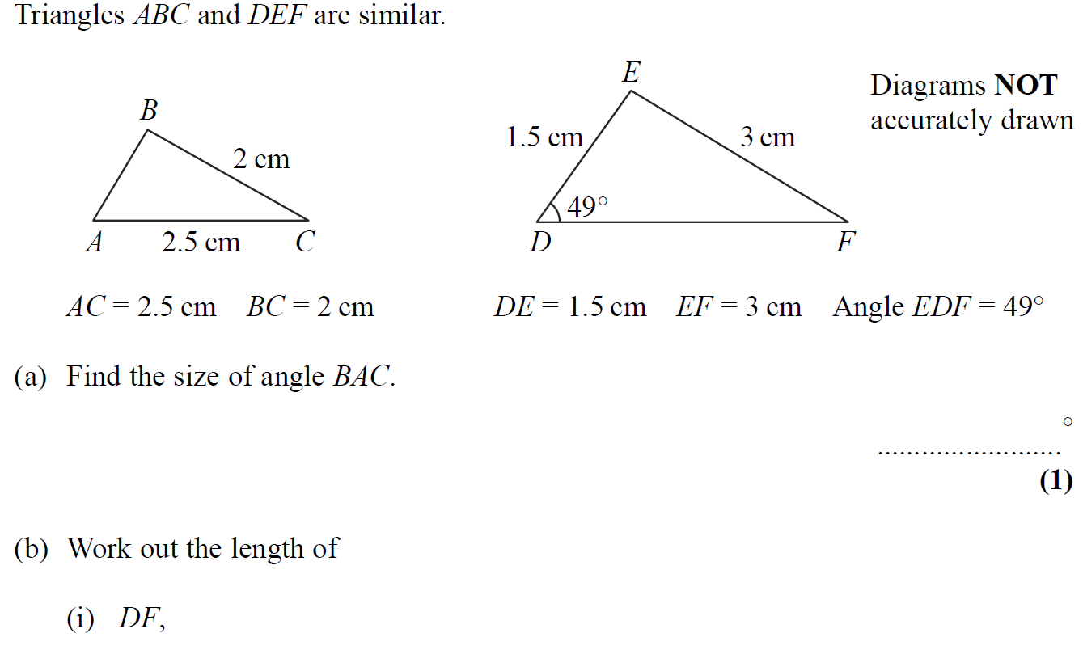
Similar Shapes
May 2005 4H Q12

Slide 30
Similar Shapes
May 2005 4H Q12
A
B (i)
B (ii)

Slide 31
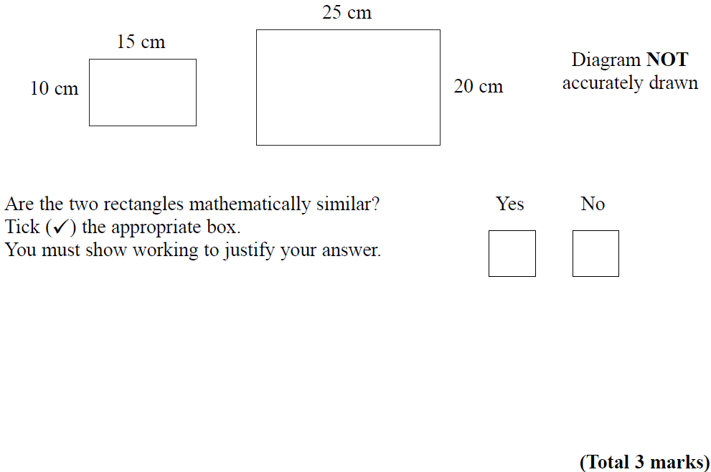
Similar Shapes
May 2006 3H Q12

Slide 32
Similar Shapes
May 2006 3H Q12
A

Slide 33
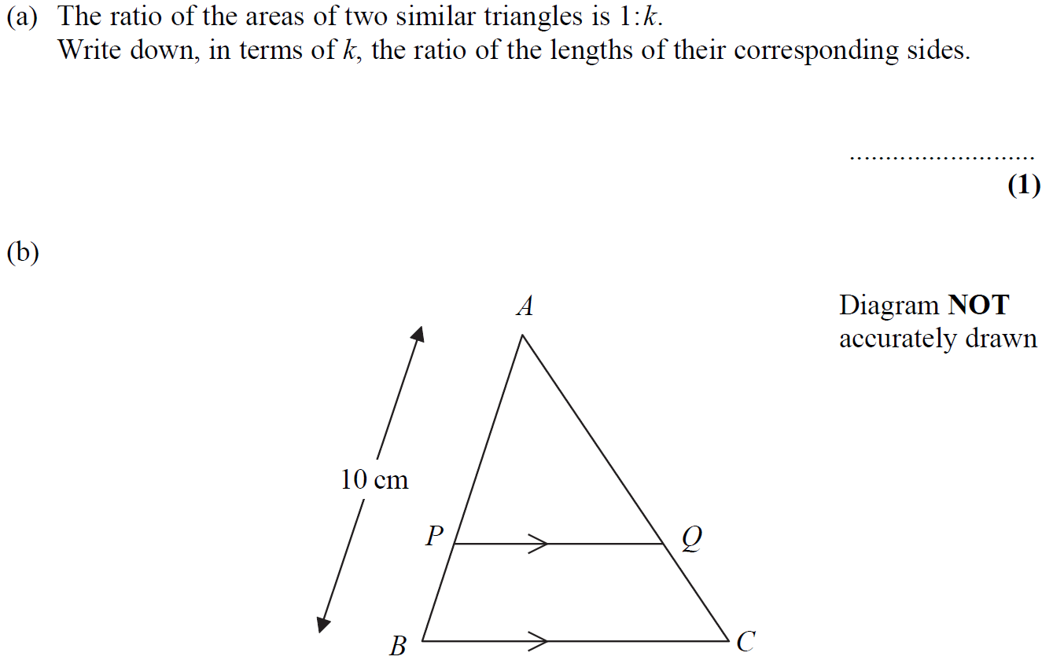
Similar Shapes
Nov 2006 3H Q20

Slide 34
Similar Shapes
Nov 2006 3H Q20
A
B

Slide 35
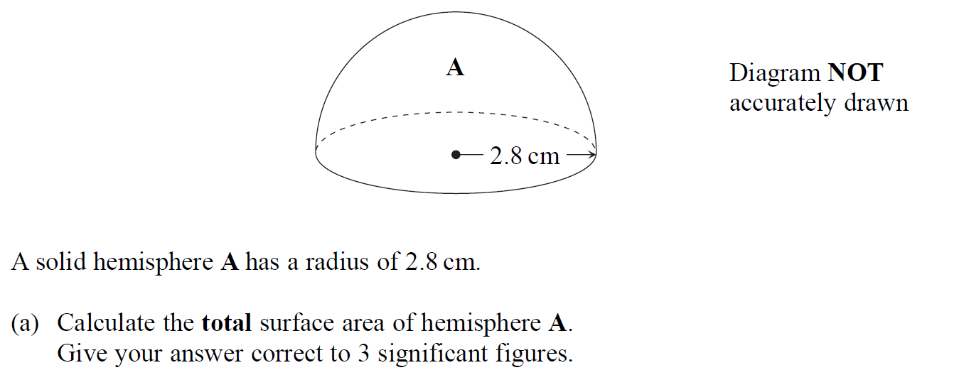
Similar Shapes
May 2007 3H Q18

Slide 36
Similar Shapes
May 2007 3H Q18
A
B

Slide 37
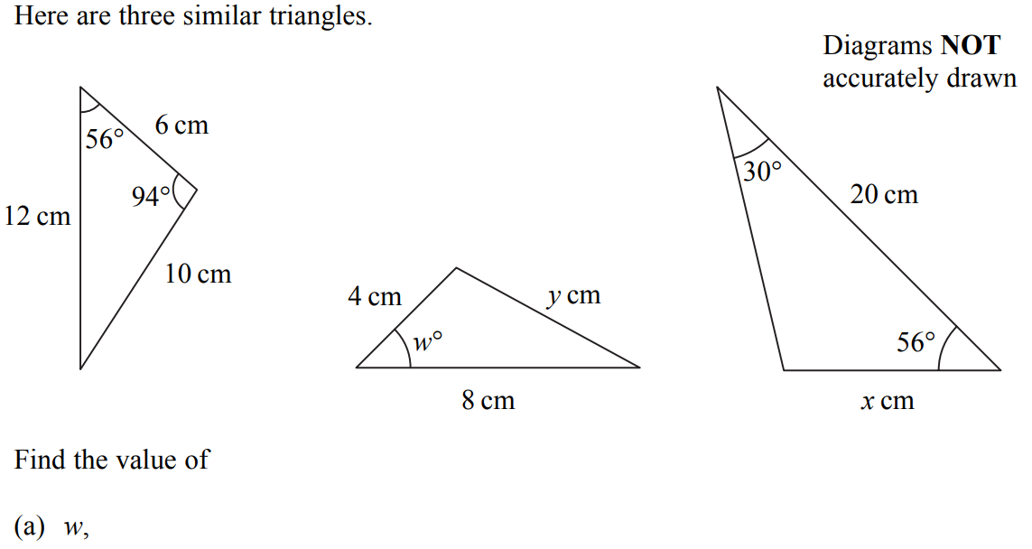
Similar Shapes
May 2007 4H Q11

Slide 38
Similar Shapes
May 2007 4H Q11
A
B
C

Slide 39
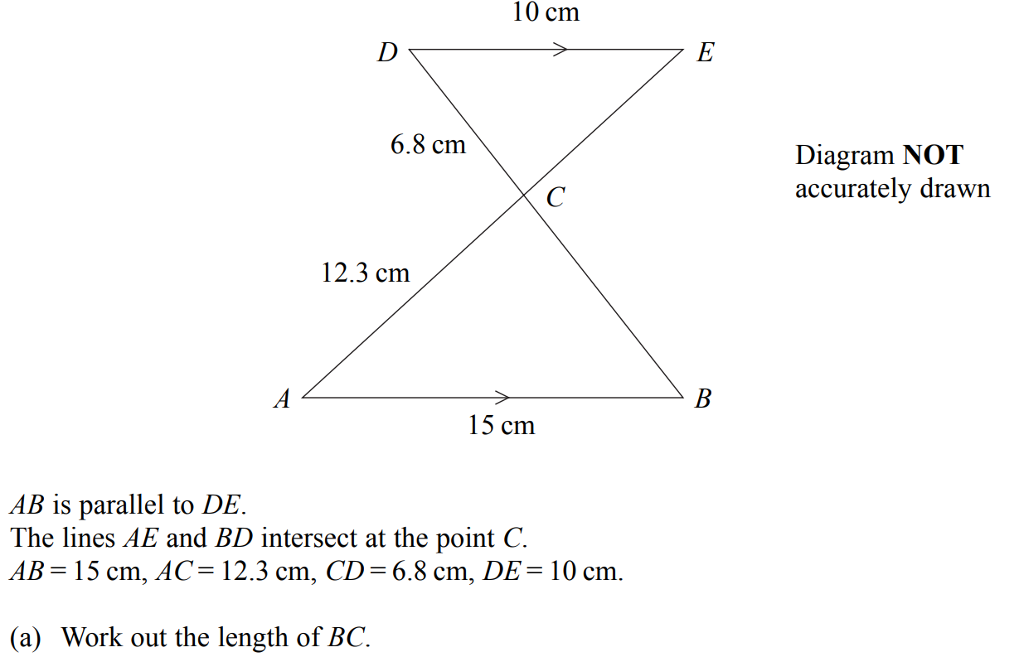
Similar Shapes
Nov 2007 4H Q15

Slide 40
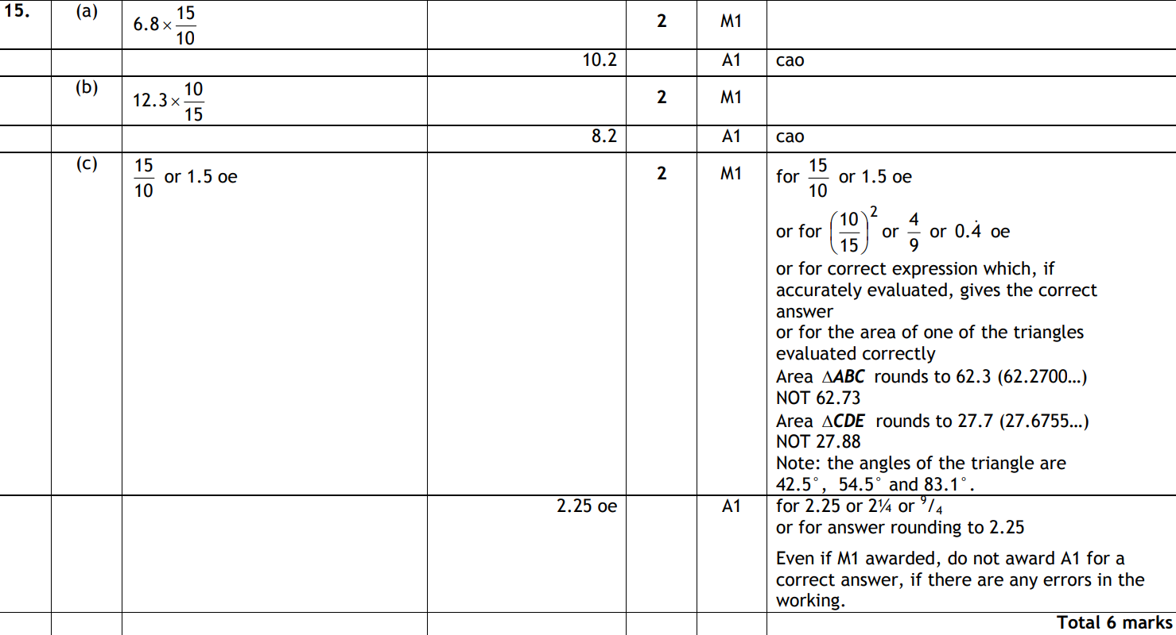
Similar Shapes
Nov 2007 4H Q15
A
B
C

Slide 41
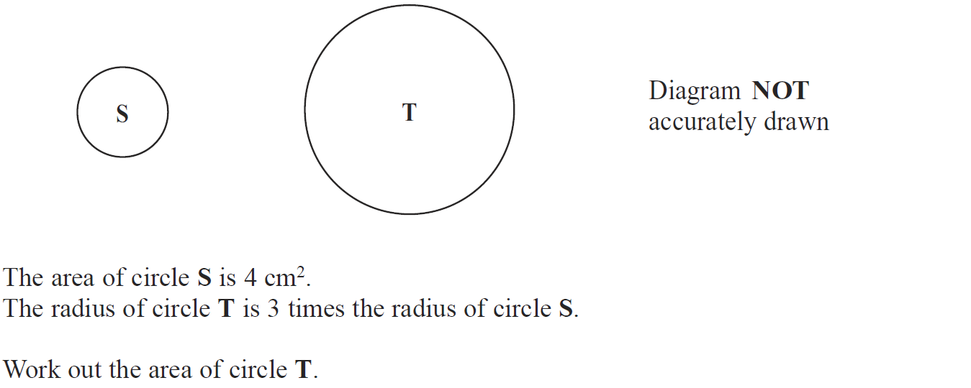
Similar Shapes
May 2008 3H Q12

Slide 42
Similar Shapes
May 2008 3H Q12
A

Slide 43
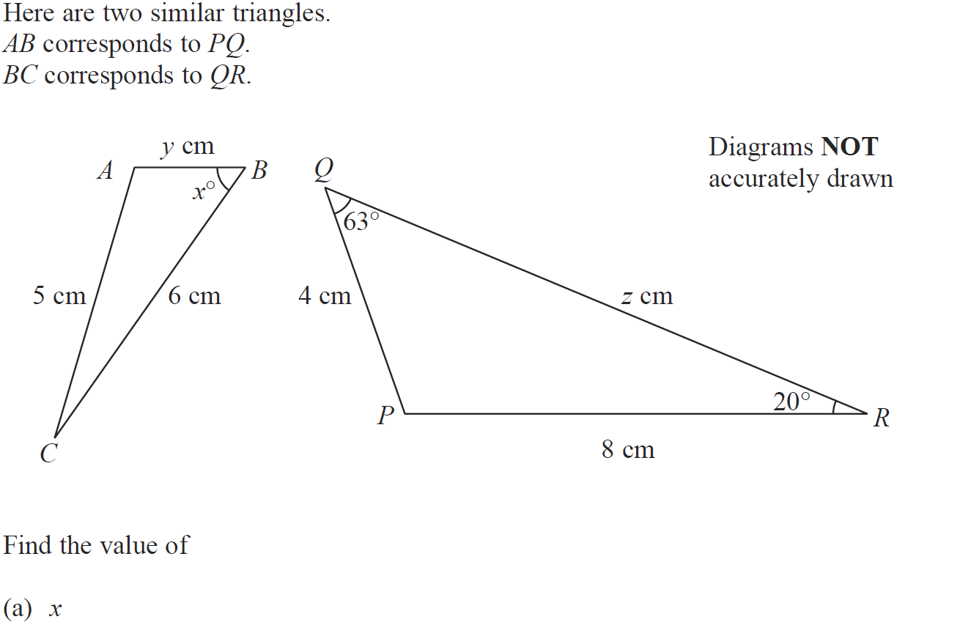
Similar Shapes
May 2008 4H Q12

Slide 44
Similar Shapes
May 2008 4H Q12
A
B
C

Slide 45
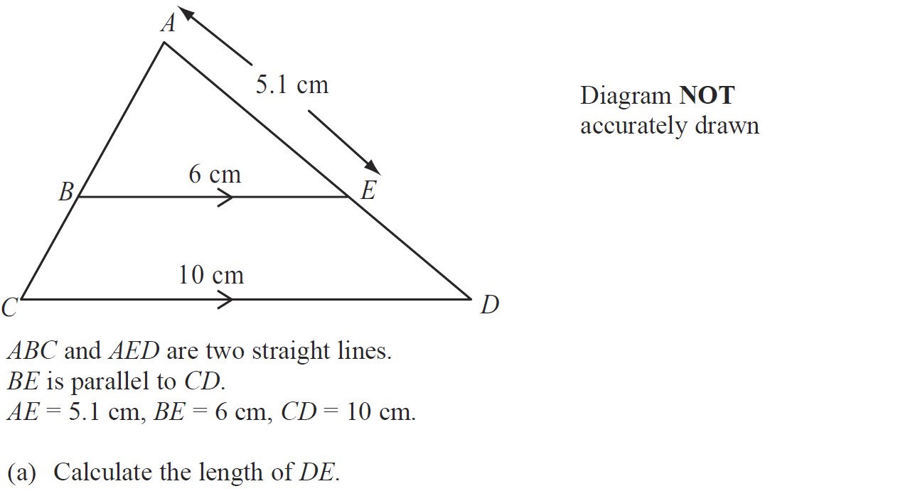
Similar Shapes
Nov 2008 3H Q12

Slide 46
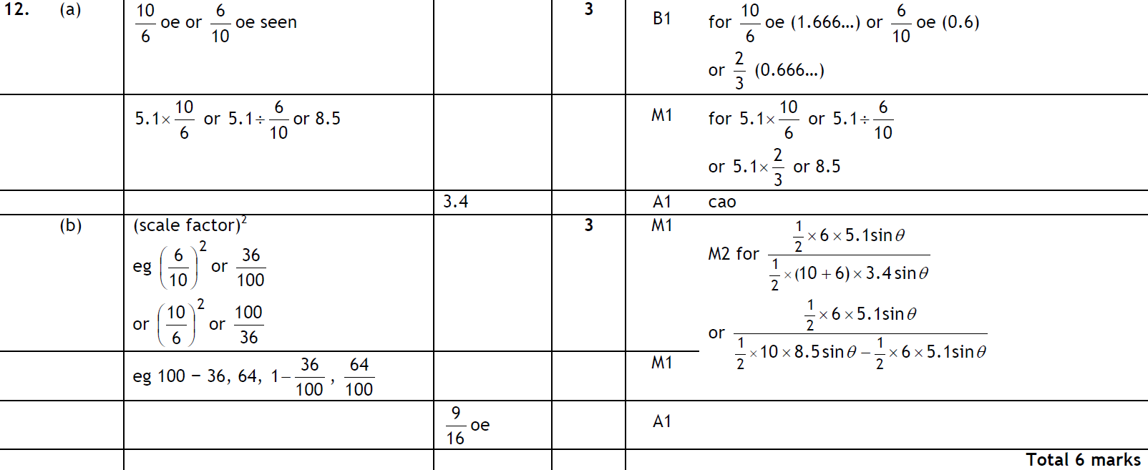
Similar Shapes
Nov 2008 3H Q12
A
B

Slide 47
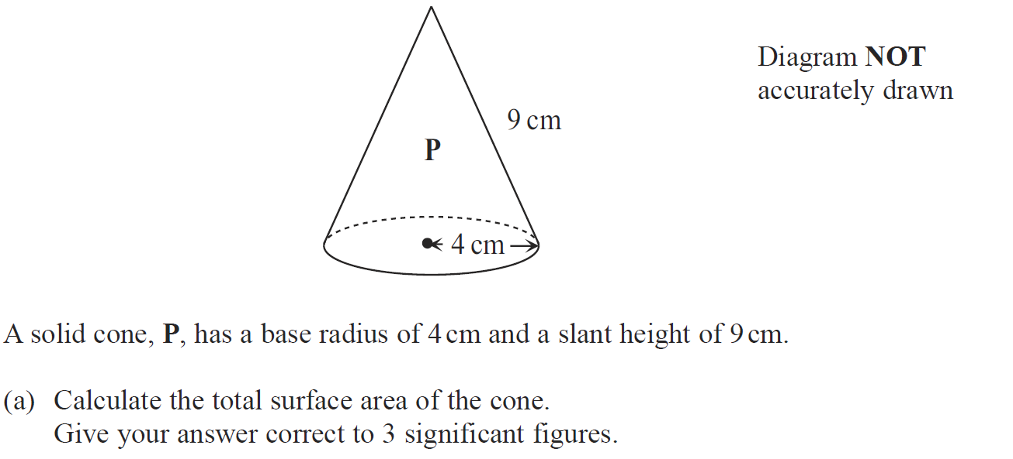
Similar Shapes
May 2009 3H Q16

Slide 48
Similar Shapes
May 2009 3H Q16
A
B

Slide 49
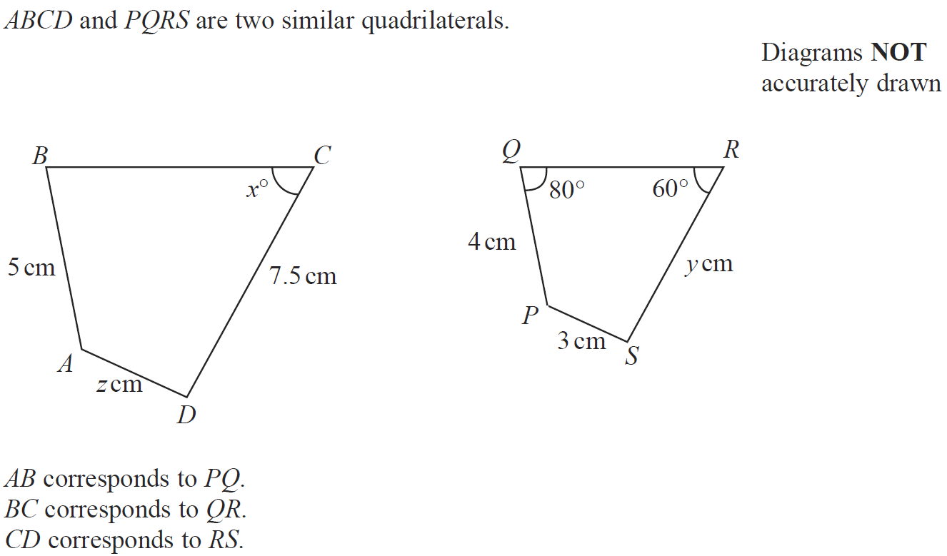
Similar Shapes
June 2009 4H Q13

Slide 50
Similar Shapes
June 2009 4H Q13
A
B
C

Slide 51
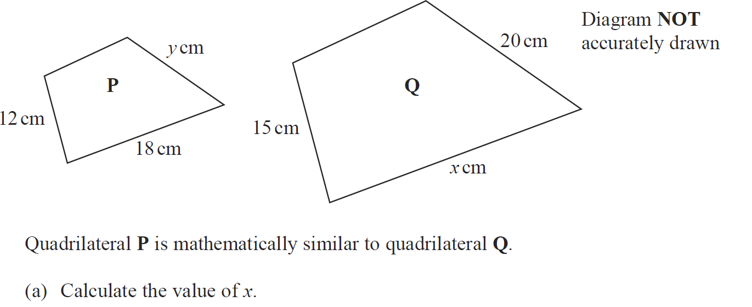
Similar Shapes
Nov 2009 4H Q13

Slide 52
Similar Shapes
Nov 2009 4H Q13
A
B

Slide 53
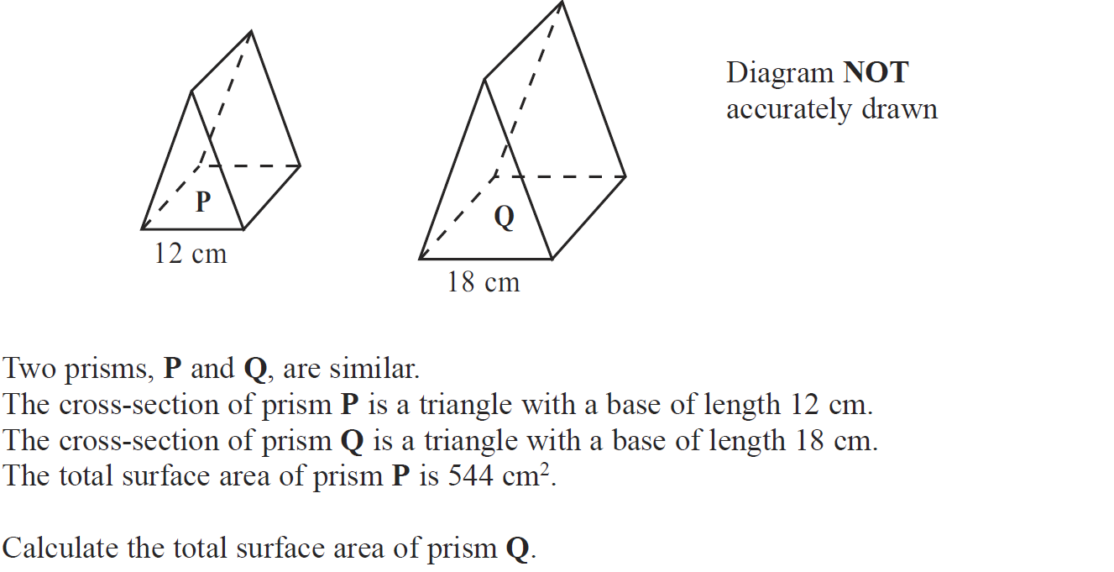
Similar Shapes
June 2010 3H Q17

Slide 54
Similar Shapes
June 2010 3H Q17
A

Slide 55
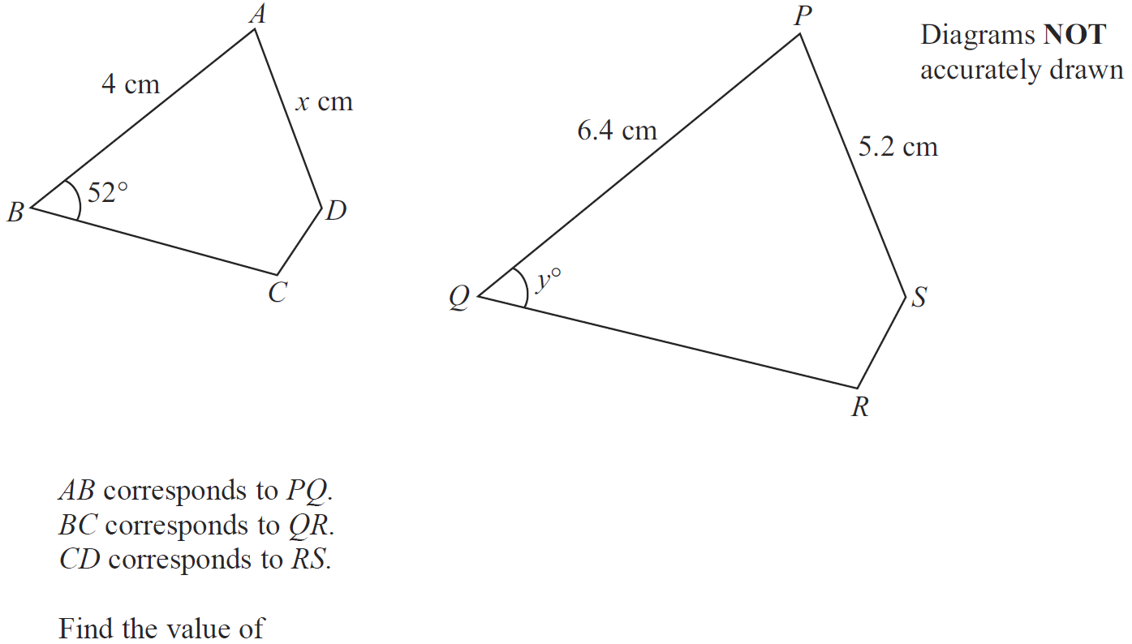
Similar Shapes
June 2010 4H Q10

Slide 56
Similar Shapes
June 2010 4H Q10
A

Slide 57
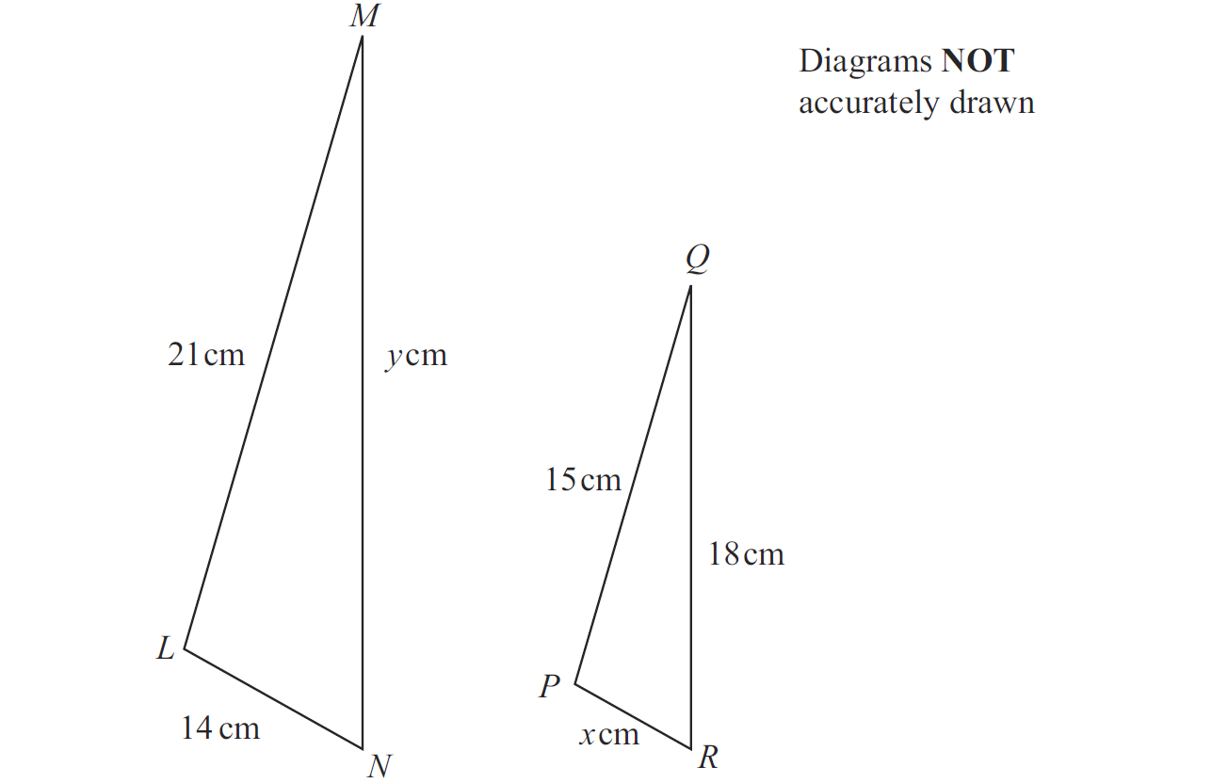
Similar Shapes
Nov 2010 3H Q10

Slide 58
Similar Shapes
Nov 2010 3H Q10
A
B

Slide 59
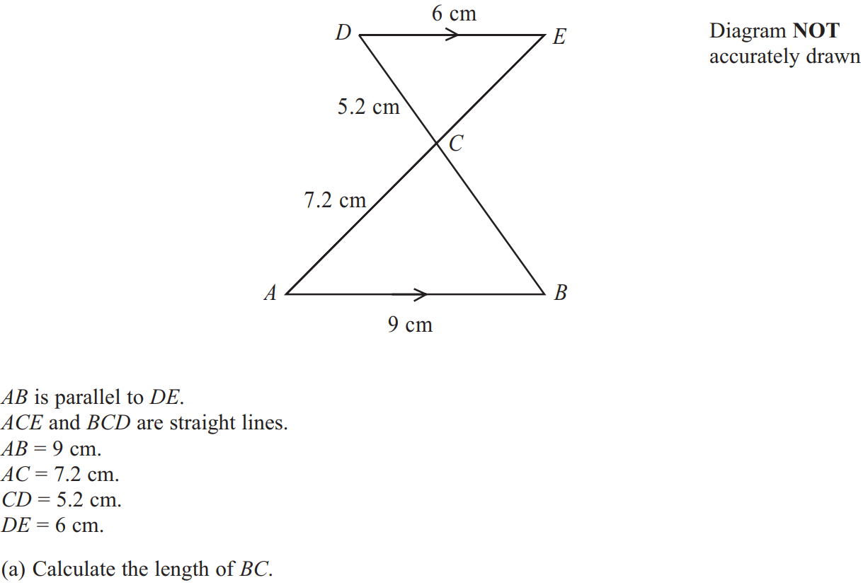
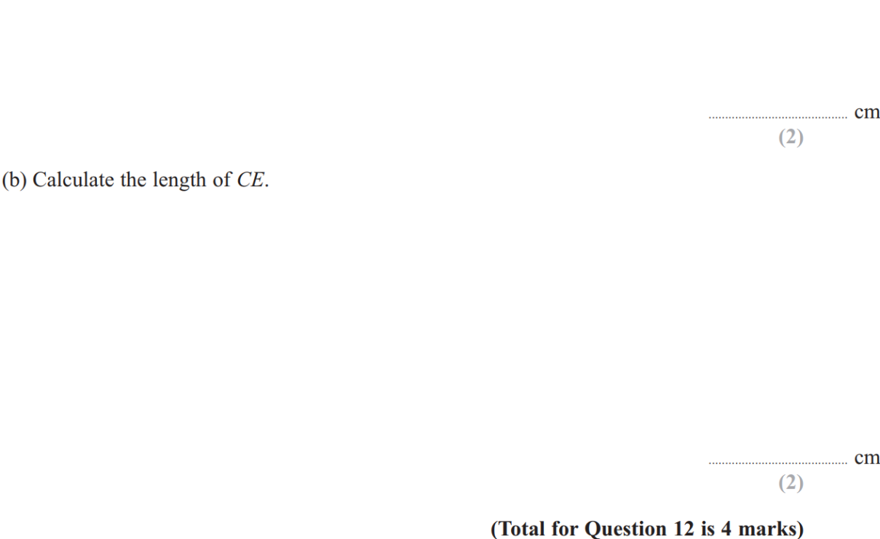
Similar Shapes
June 2011 3H Q12

Slide 60
Similar Shapes
June 2011 3H Q12
A
B

Slide 61
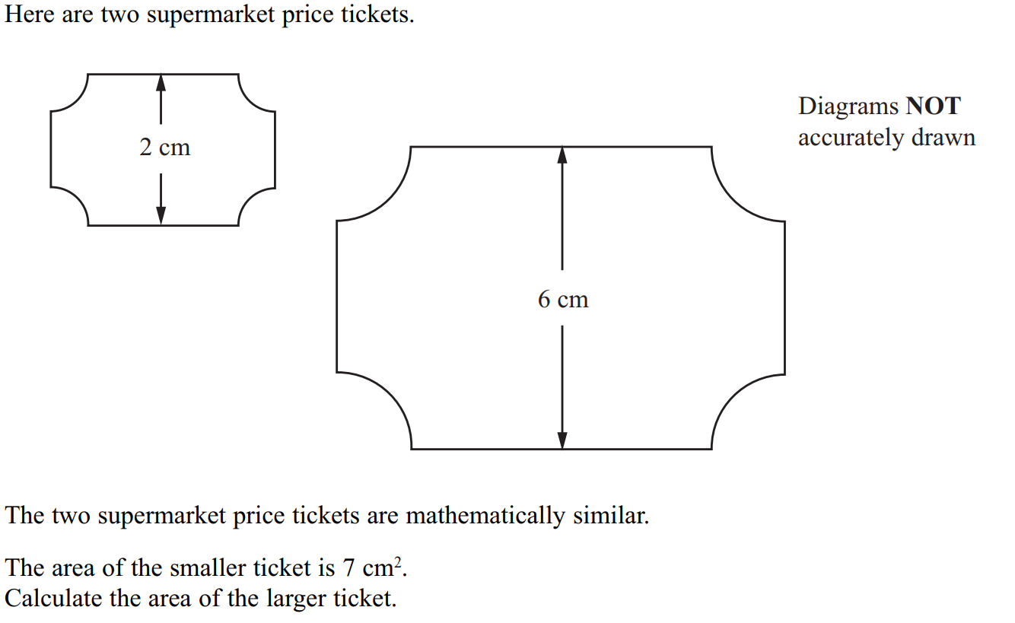
Similar Shapes
June 2011 4H Q14

Slide 62
Similar Shapes
June 2011 4H Q14
A

Slide 63
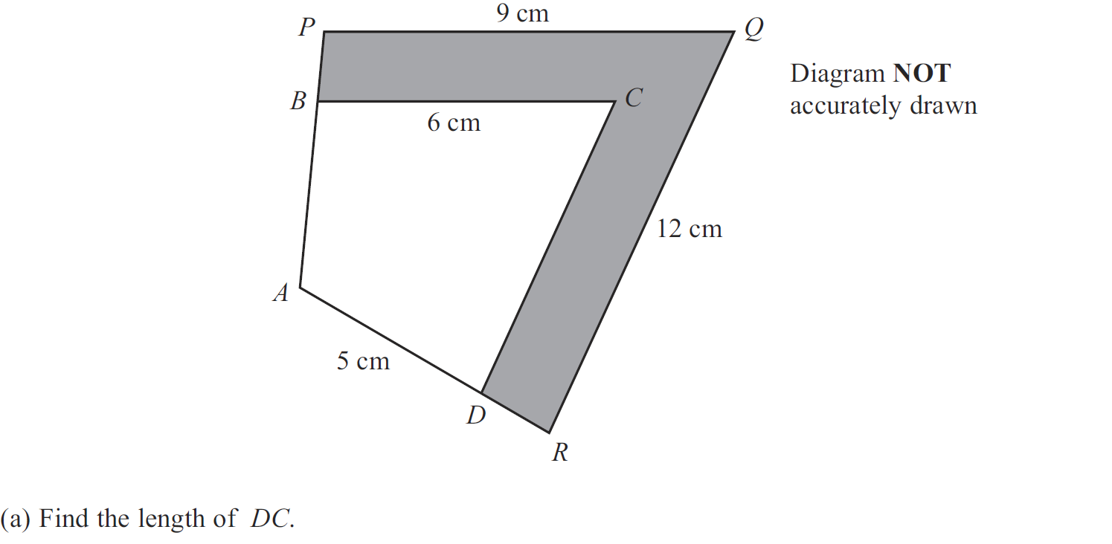
Similar Shapes
Jan 2012 3H Q12

Slide 64
Similar Shapes
Jan 2012 3H Q12
A
B
C

Slide 65
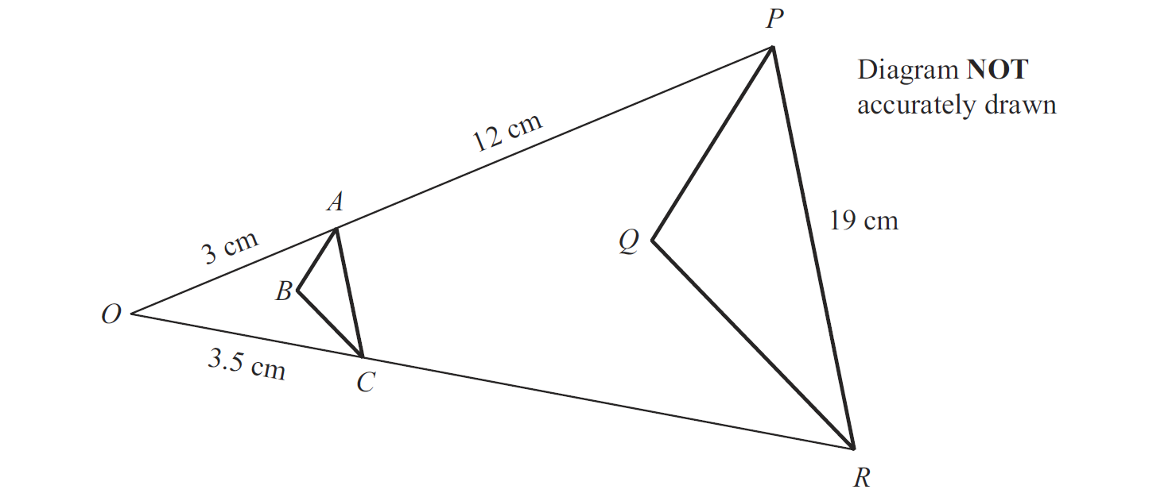
Similar Shapes
May 2012 3H Q11

Slide 66
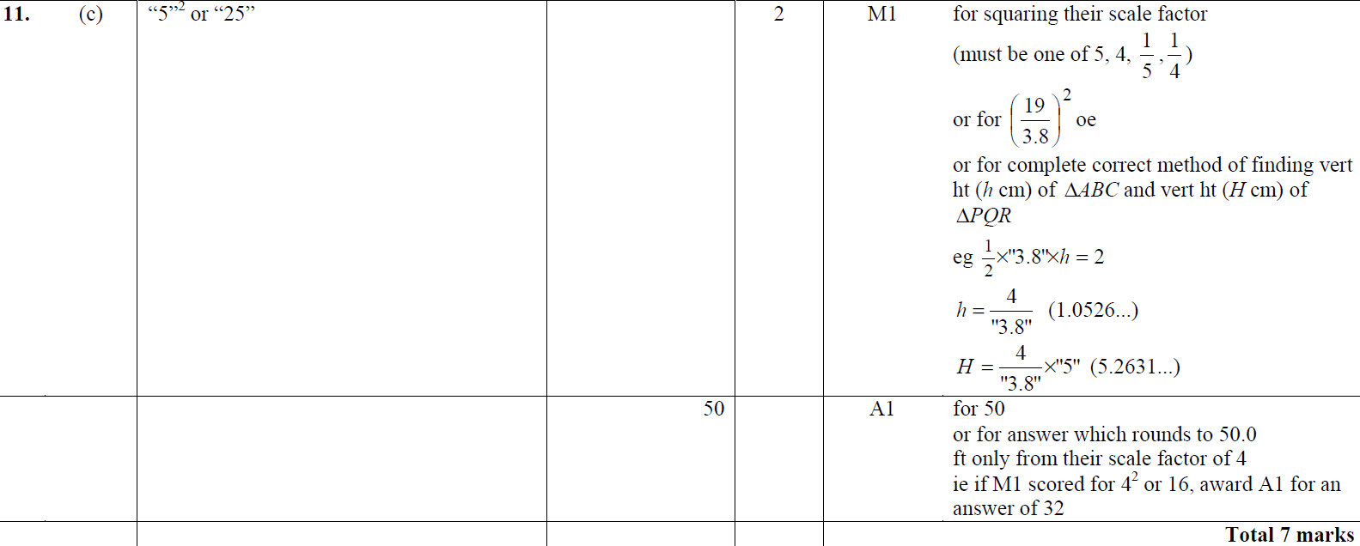
Similar Shapes
May 2012 3H Q11
A
B
C

Slide 67
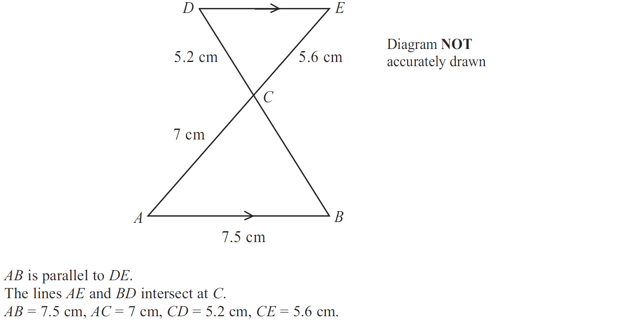
Similar Shapes
Jan 2013 4H Q17

Slide 68
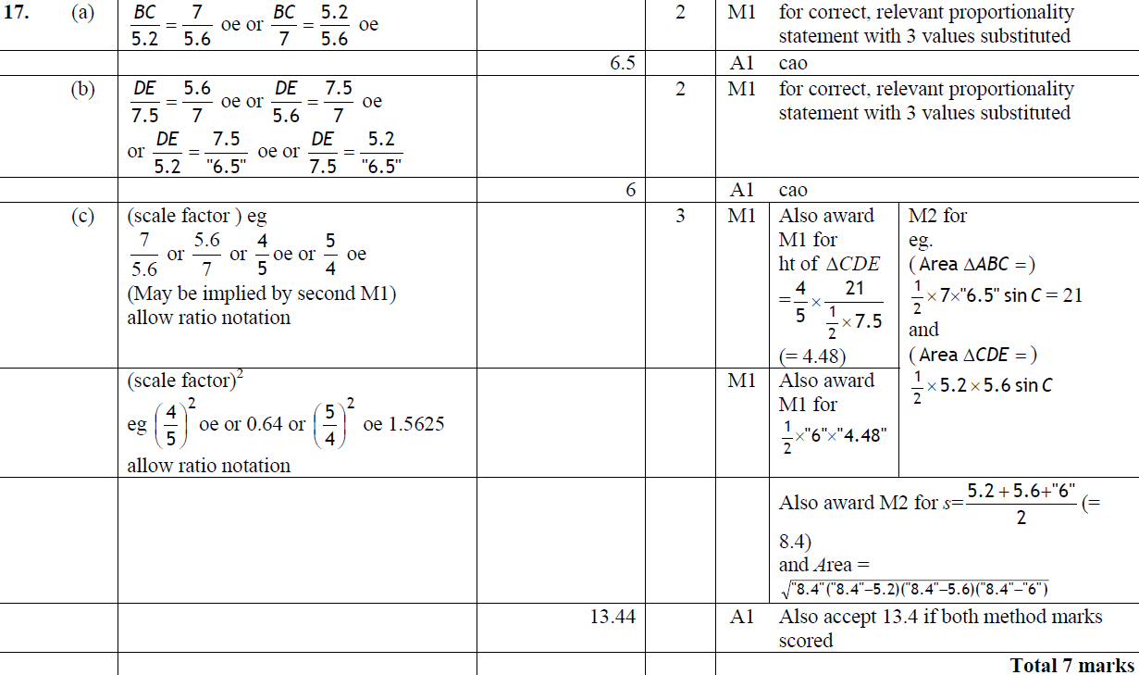
Similar Shapes
Jan 2013 4H Q17
A
B
C

Slide 69
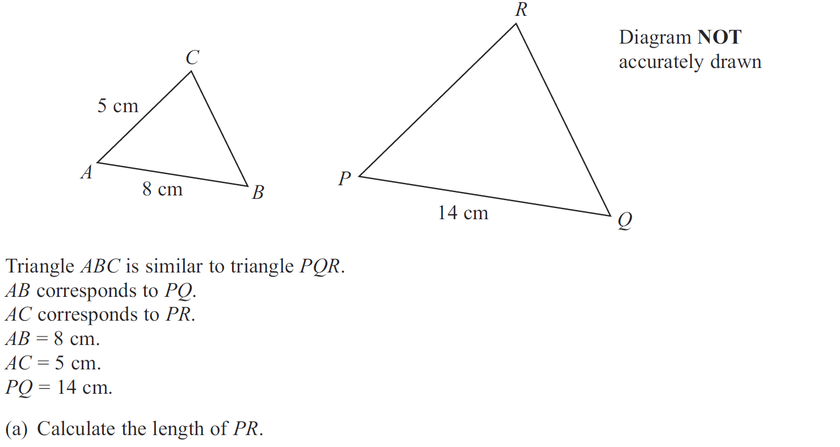
Similar Shapes
May 2013 3H Q16

Slide 70
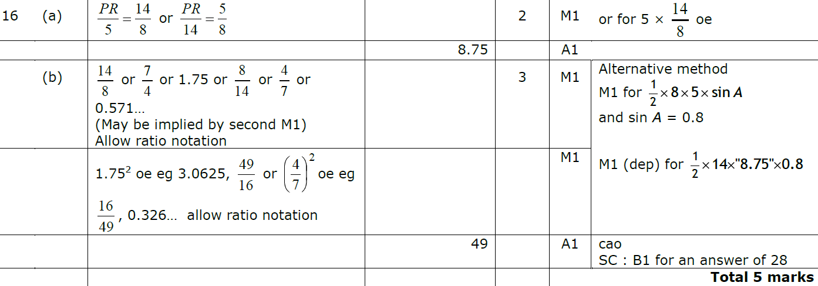
Similar Shapes
May 2013 3H Q16
A
B

Slide 71
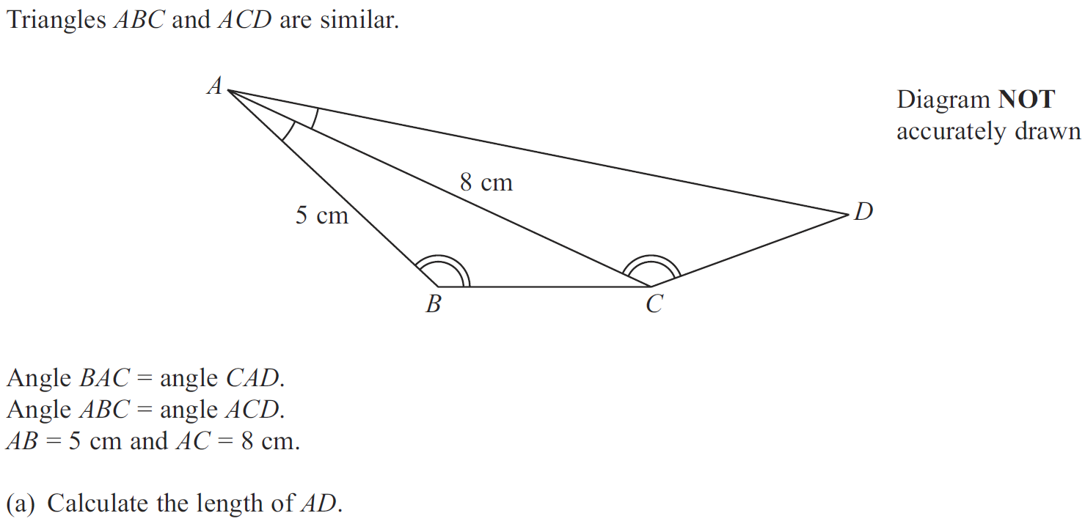
Similar Shapes
May 2013 3HR Q14

Slide 72
Similar Shapes
May 2013 3HR Q14
A
B

Slide 73
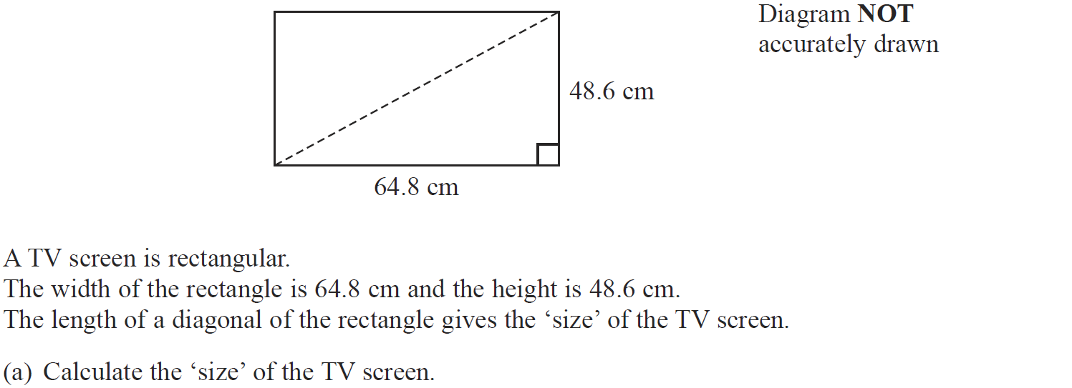
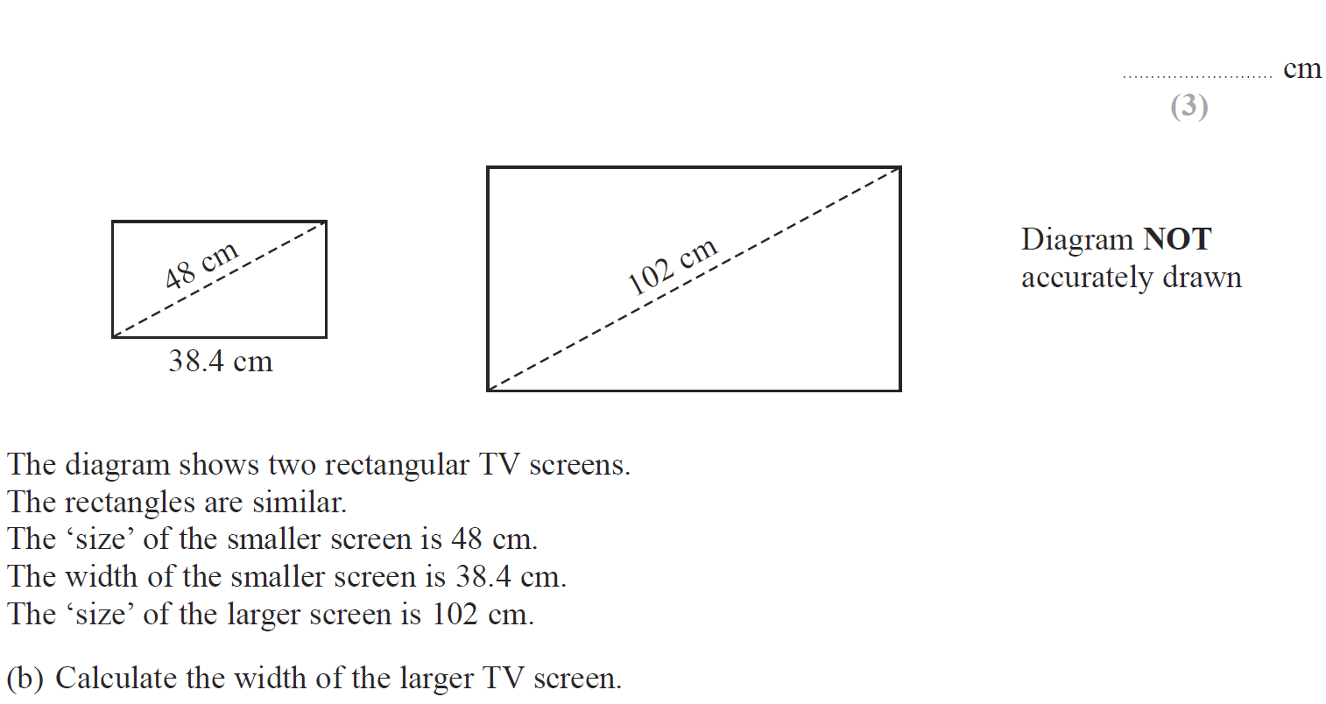
Similar Shapes
Jan 2014 3HR Q7

Slide 74
Similar Shapes
Jan 2014 3HR Q7
A
B

Slide 75
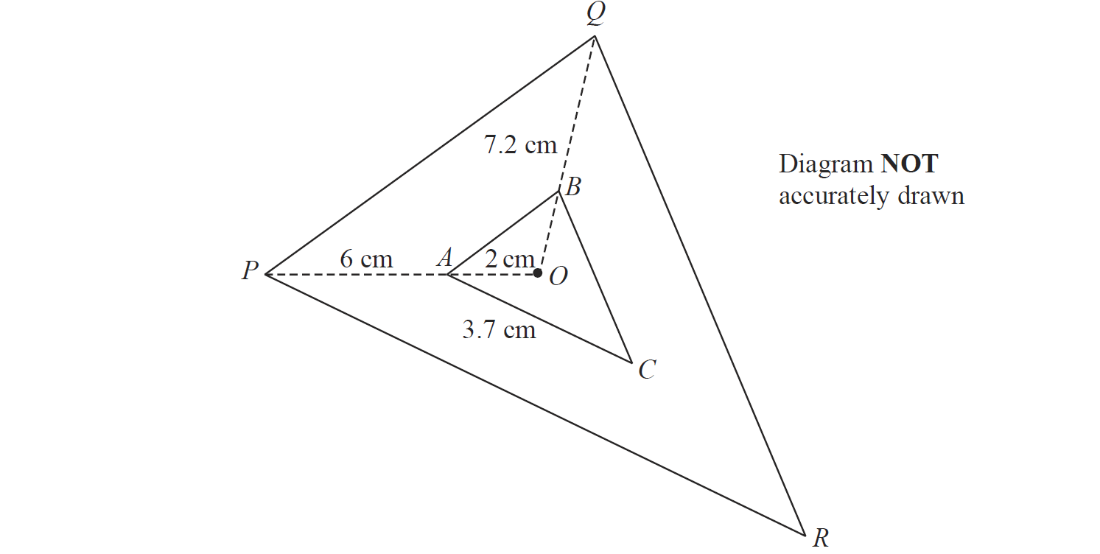
Similar Shapes
Jan 2014 3HR Q12

Slide 76
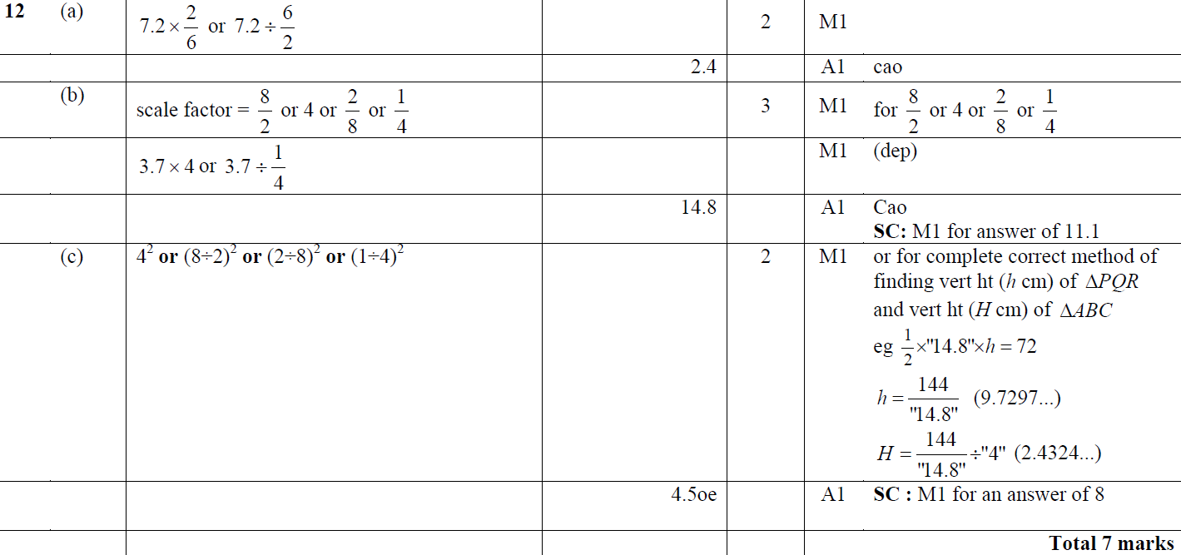
Similar Shapes
Jan 2014 3HR Q12
A
B
C

Slide 77
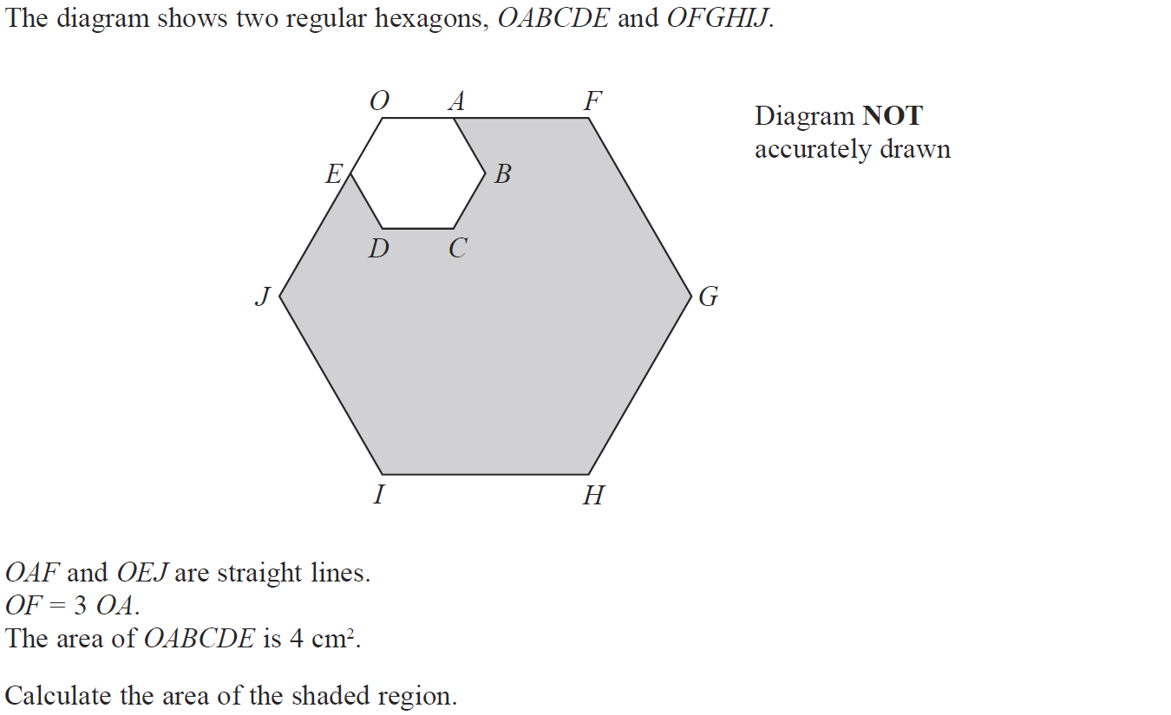
Similar Shapes
May 2014 3H Q15

Slide 78
Similar Shapes
May 2014 3H Q15
A

Slide 79
Similar Shapes
May 2014 4H Q12

Slide 80
Similar Shapes
May 2014 4H Q12
A

Slide 81
Similar Shapes
May 2014 3HR Q12

Slide 82
Similar Shapes
May 2014 3HR Q12
A
B
C
D

Slide 83
Similar Shapes
Jan 2015 3H Q15

Slide 84
Similar Shapes
Jan 2015 3H Q15
A

Slide 85
Similar Shapes
Jan 2015 4HR Q10

Slide 86
Similar Shapes
Jan 2015 4HR Q10
A
B
C

Slide 87
Similar Shapes
June 2015 4H Q14

Slide 88
Similar Shapes
June 2015 4H Q14
A
B

Slide 89
Similar Shapes
June 2015 4HR Q13

Slide 90
Similar Shapes
June 2015 4HR Q13
A
B
C
D

Slide 91
Similar Shapes
Jan 2016 4H Q14

Slide 92
Similar Shapes
Jan 2016 4H Q14
A
B
C

Slide 93
Similar Shapes
Jan 2016 4HR Q13

Slide 94
Similar Shapes
Jan 2016 4HR Q13
A
B

Slide 95
Similar Shapes
May 2016 3H Q15

Slide 96
Similar Shapes
May 2016 3H Q15
A

Slide 97
Similar Shapes
June 2016 4H Q12

Slide 98
Similar Shapes
June 2016 4H Q12
A
B

Slide 99
Similar Shapes
May 2016 3HR Q17

Slide 100
Similar Shapes
May 2016 3HR Q17
A
B
C

Slide 101
Similar Shapes
Jan 2017 3H Q16

Slide 102
Similar Shapes
Jan 2017 3H Q16
A
B

Slide 103
Similar Shapes
Jan 2017 3HR Q1

Slide 104
Similar Shapes
Jan 2017 3HR Q1
A

Slide 105
Similar Shapes
Jan 2017 4HR Q14

Slide 106
Similar Shapes
Jan 2017 4HR Q14
A
B
C

Slide 107
Similar Shapes
May 2017 3H Q13

Slide 108
Similar Shapes
May 2017 3H Q13
A
B
C

Slide 109
Similar Shapes
May 2017 3HR Q5

Slide 110
Similar Shapes
May 2017 3HR Q5
A
B

Slide 111
Similar Shapes
Jan 2018 3H Q18

Slide 112
Similar Shapes
Jan 2018 3H Q18
A
B

Slide 113
Similar Shapes
Jan 2018 3HR Q12

Slide 114
Similar Shapes
Jan 2018 3HR Q12
A
B

Slide 115
Similar Shapes
May 2018 3HR Q15

Slide 116
Similar Shapes
May 2018 3HR Q15
A
B
C

