Slide 1
Similar Shapes
Similar Shapes
June 2017
3H Q9
SAM
1H Q9
June 2018
3H Q12*
SAM
3H Q16
June 2017
3H Q13
SAM
1H Q10
June 2018
3H Q18
Practice
2H Q10*
Nov 2017
2H Q10
SAM
1H Q13
Nov 2018
1H Q19
Practice
3H Q12
Nov 2017
3H Q13
SAM
3H Q12
Nov 2018
2H Q17
June 2018
3H Q11
*Similar triangle proof
SF in area and volume
Congruent triangles (proof)

Slide 2
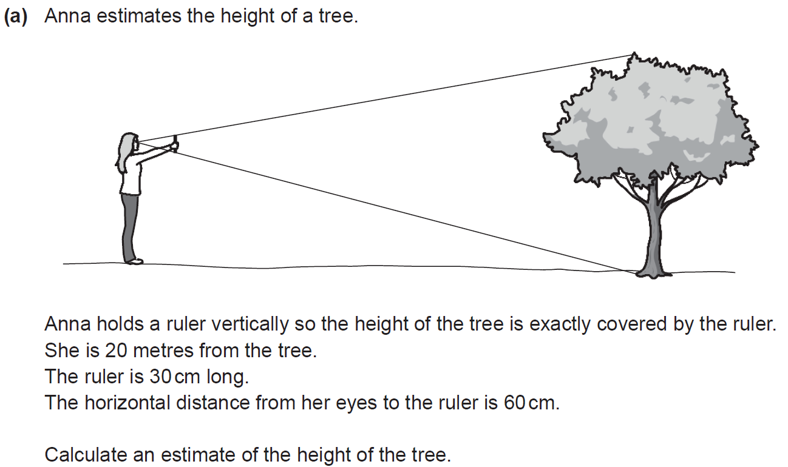
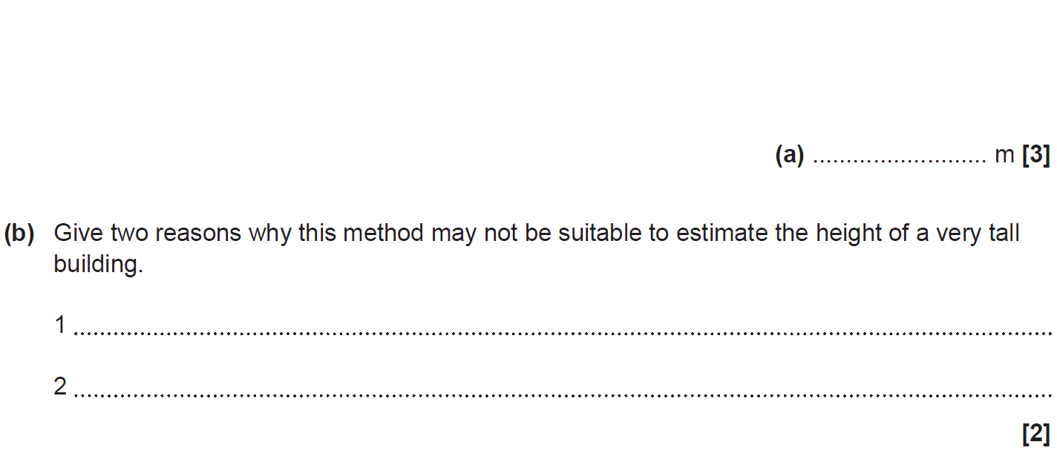
Similar Shapes
SAM 1H Q9

Slide 3
Similar Shapes
SAM 1H Q9
A
B

Slide 4
Similar Shapes
SAM 1H Q10

Slide 5
Similar Shapes
SAM 1H Q10
A

Slide 6
Similar Shapes
SAM 1H Q13

Slide 7
Similar Shapes
SAM 1H Q13
A

Slide 8
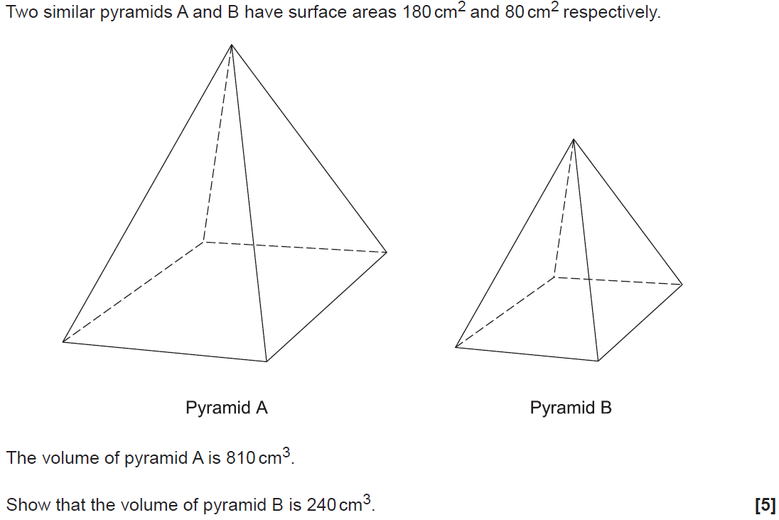
Similar Shapes
SAM 3H Q12

Slide 9
Similar Shapes
SAM 3H Q12
A

Slide 10
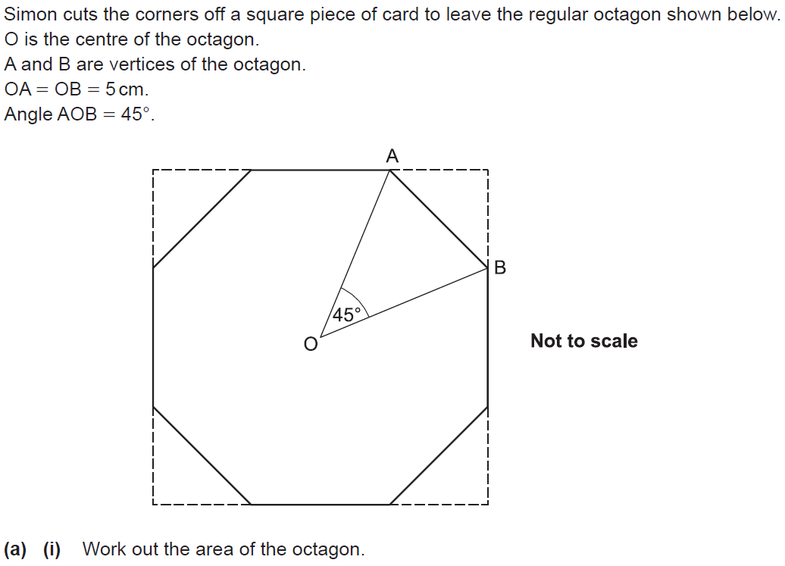
Similar Shapes
SAM 3H Q16

Slide 11
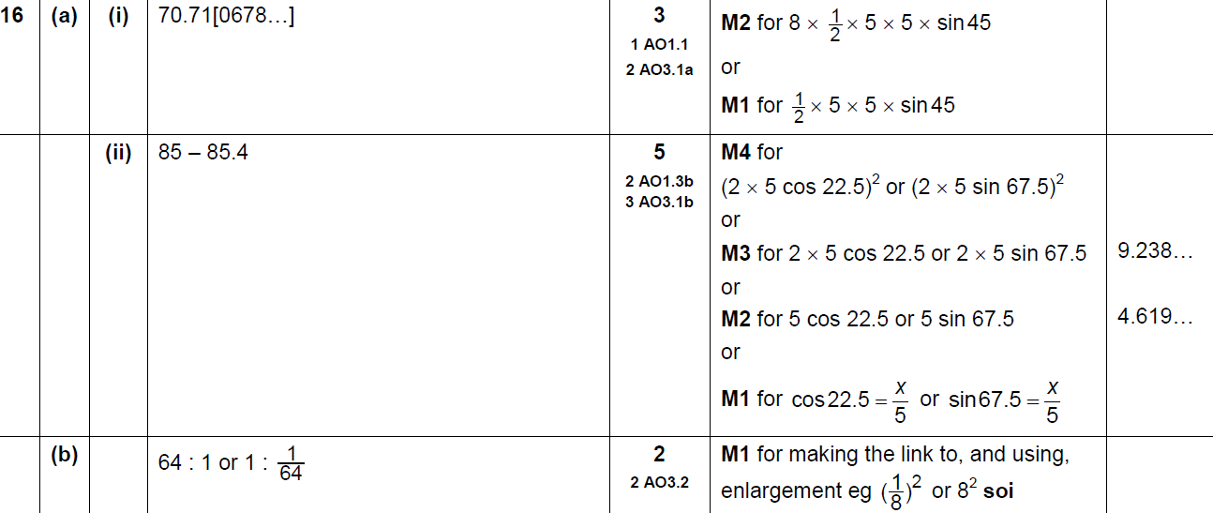
Similar Shapes
SAM 3H Q16
A (i)
A (ii)
B

Slide 12
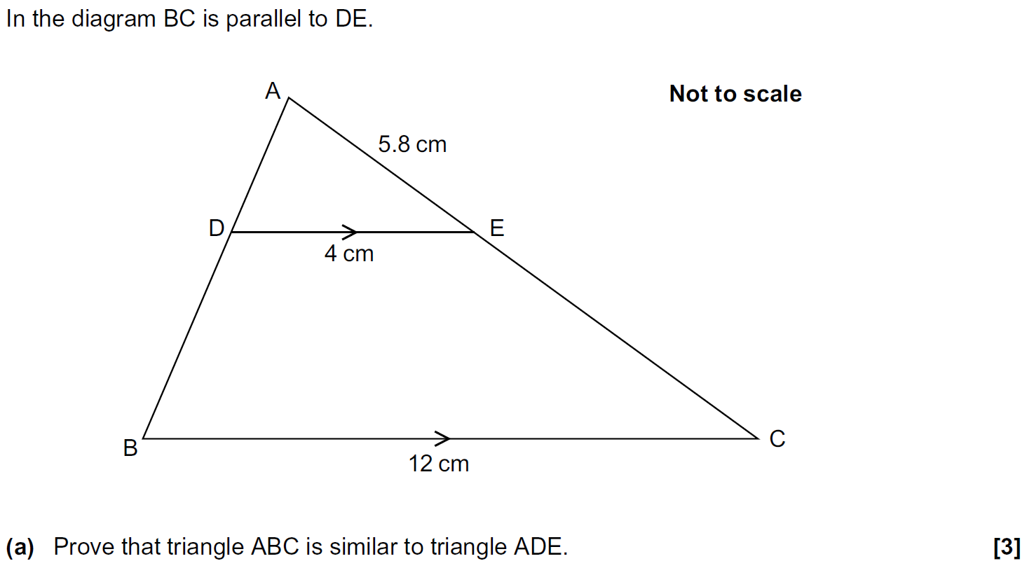
Similar Shapes
Practice 2H Q10

Slide 13
Similar Shapes
Practice 2H Q10
A
B
C

Slide 14
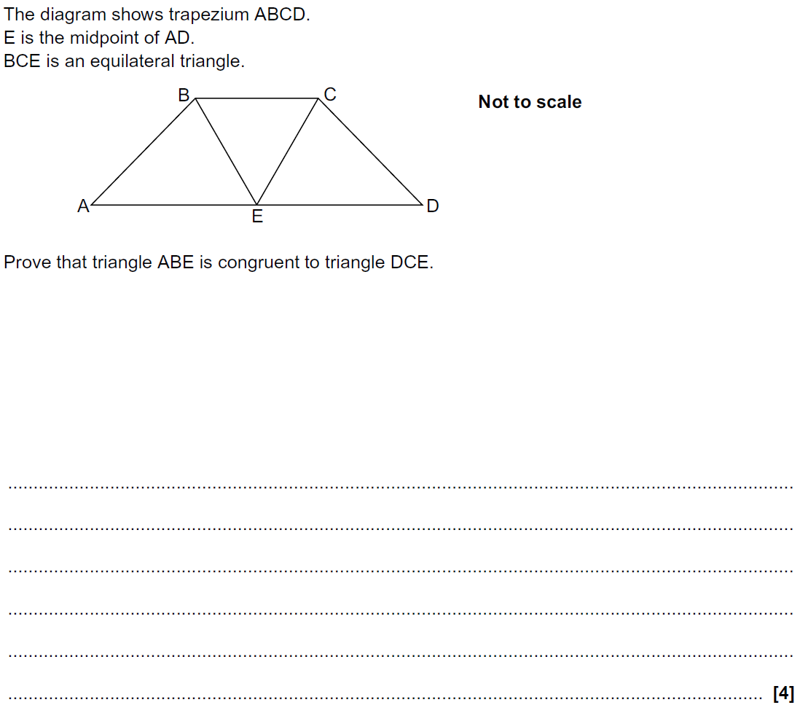
Similar Shapes
Practice 3H Q12

Slide 15
Similar Shapes
Practice 3H Q12
A

Slide 16
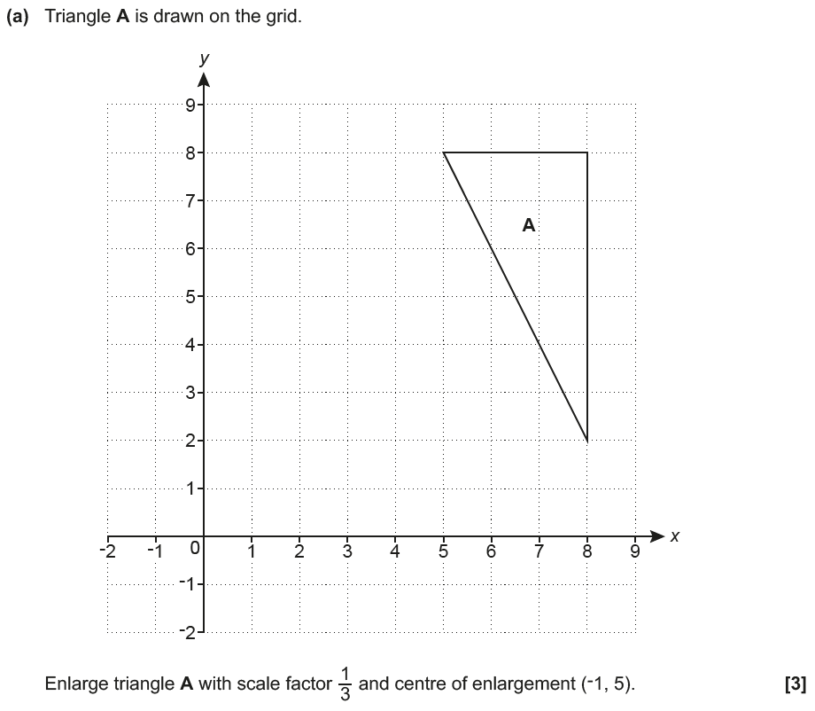
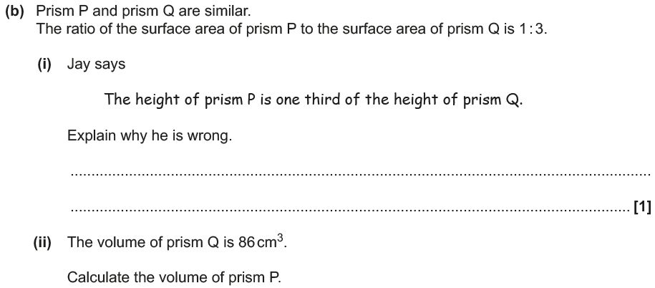
Similar Shapes
June 2017 3H Q9
A₁
Reveal Shape A₁ (a)
Hide A₁

Slide 17
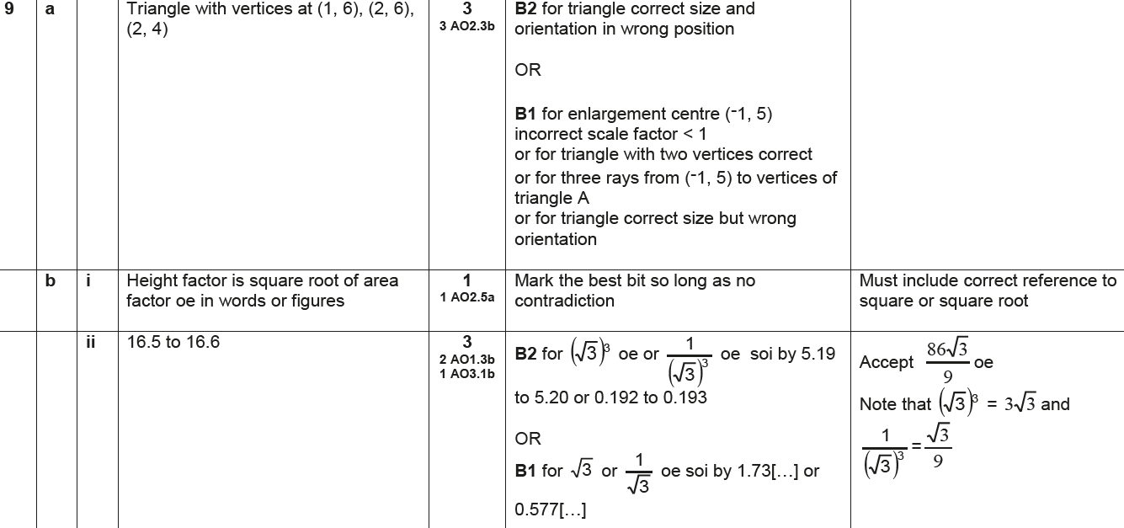
Similar Shapes
June 2017 3H Q9
A
B (i)
B (ii)

Slide 18
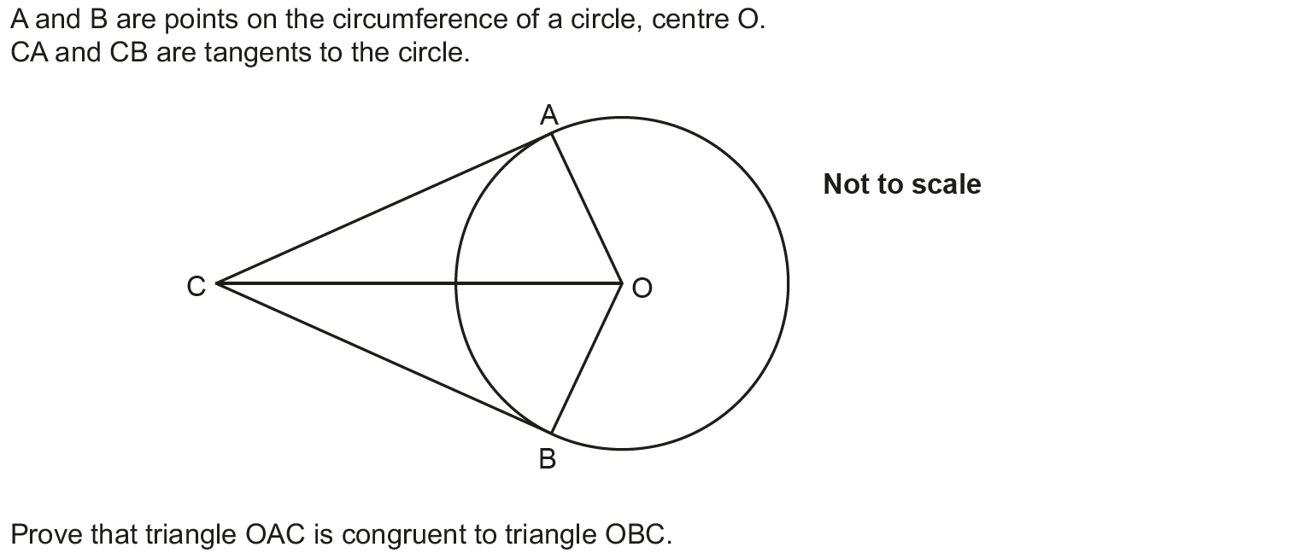
Similar Shapes
June 2017 3H Q13

Slide 19
Similar Shapes
June 2017 3H Q13
A

Slide 20
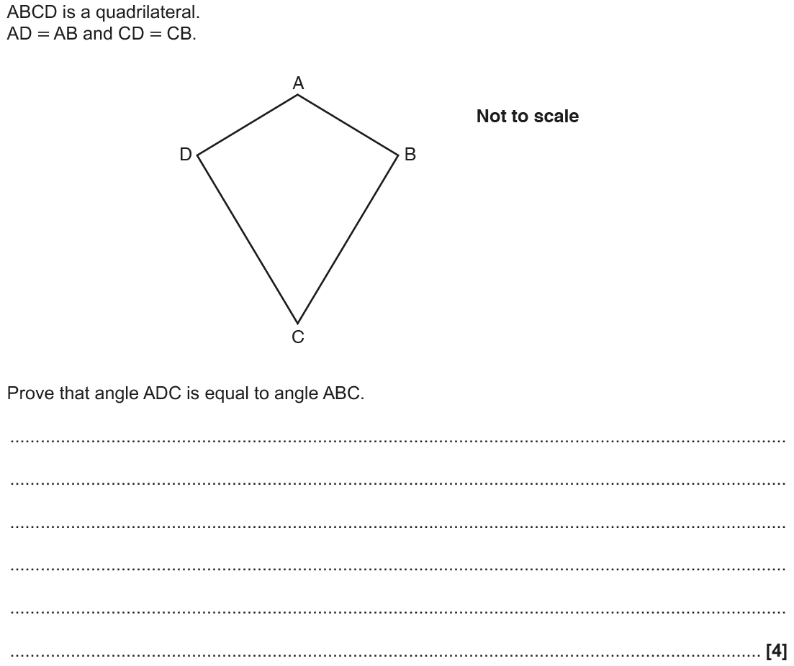
Similar Shapes
Nov 2017 2H Q10

Slide 21
Similar Shapes
Nov 2017 2H Q10
A

Slide 22
Similar Shapes
Nov 2017 3H Q13

Slide 23
Similar Shapes
Nov 2017 3H Q13
A
B

Slide 24
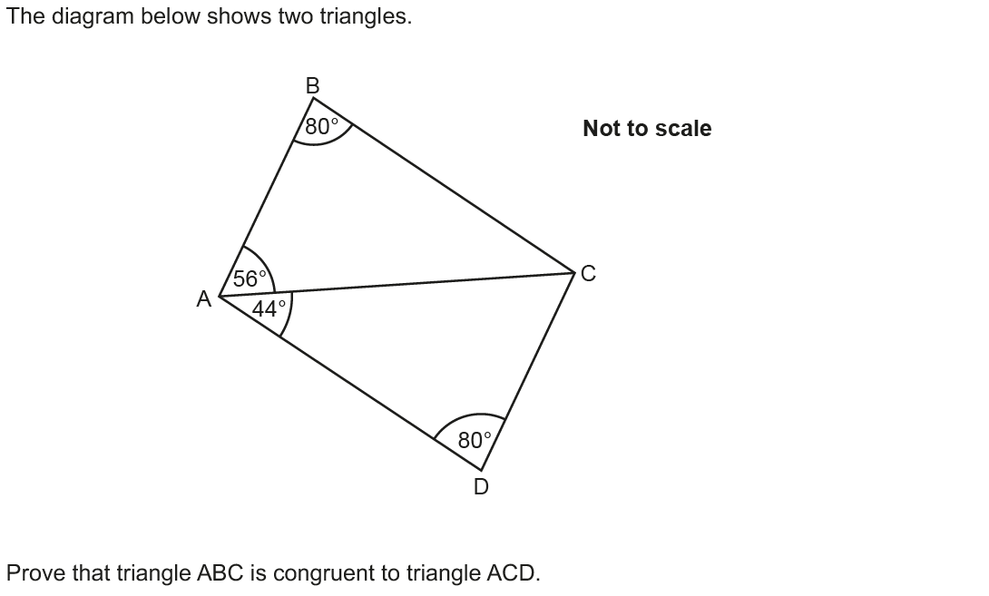
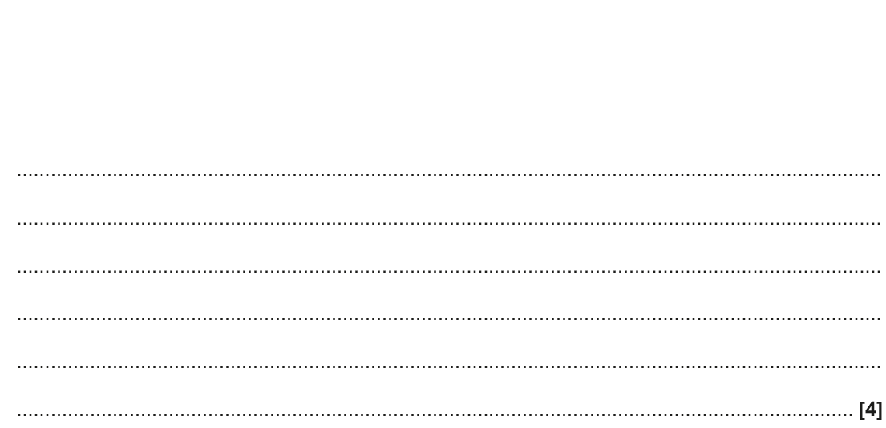
Similar Shapes
June 2018 3H Q11

Slide 25
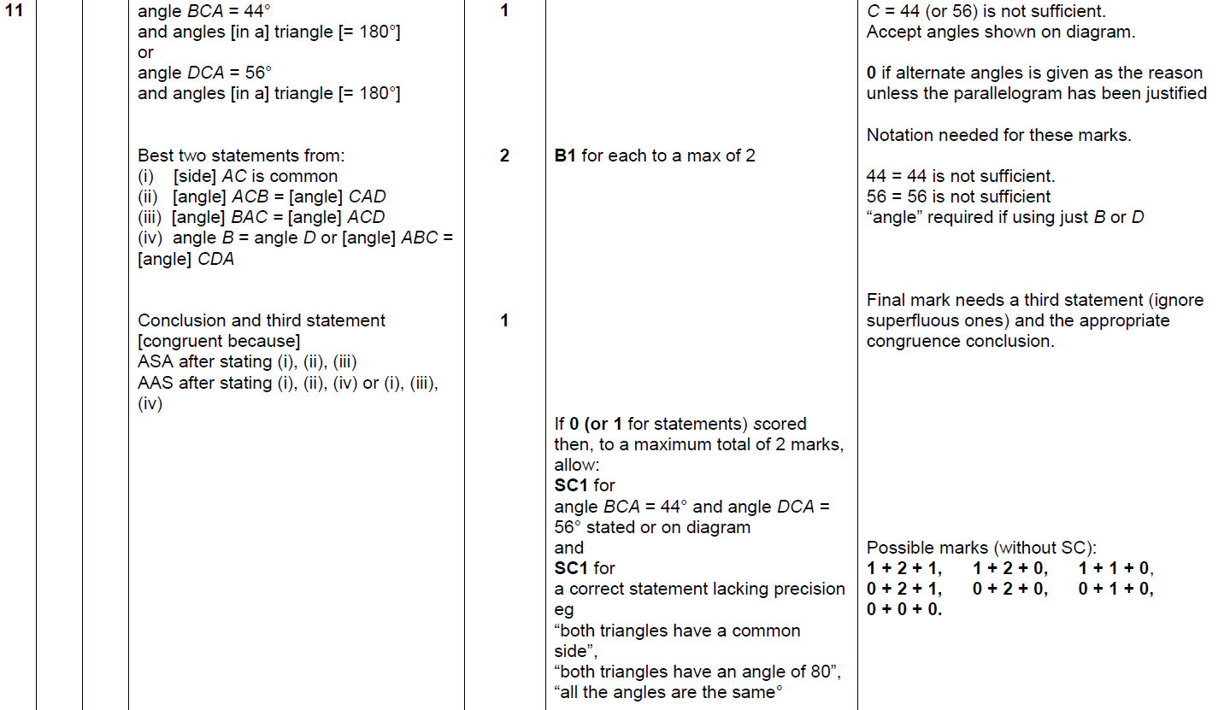
Similar Shapes
June 2018 3H Q11
A

Slide 26
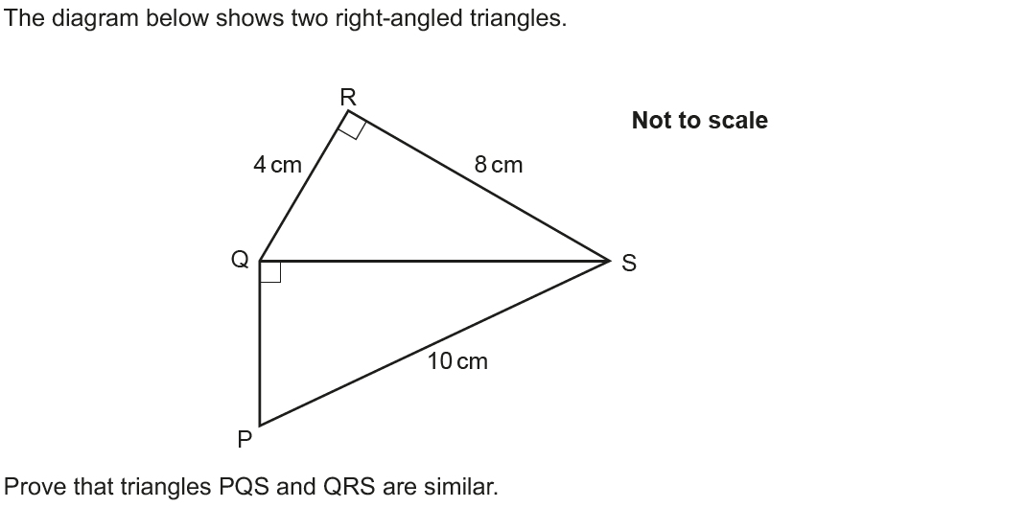
Similar Shapes
June 2018 3H Q12

Slide 27
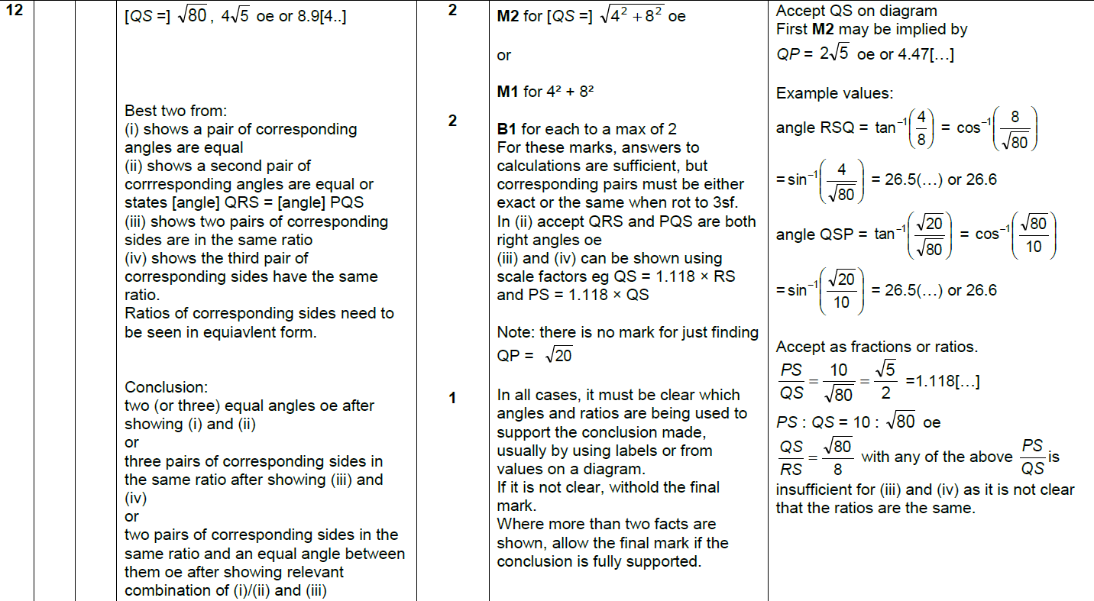
Similar Shapes
June 2018 3H Q12
A

Slide 28
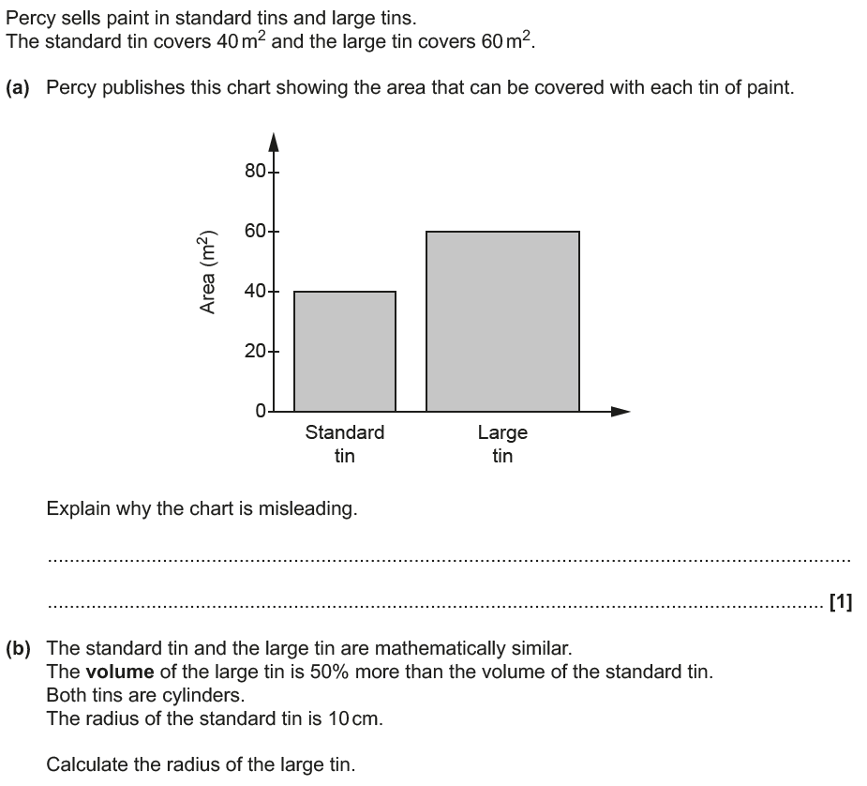
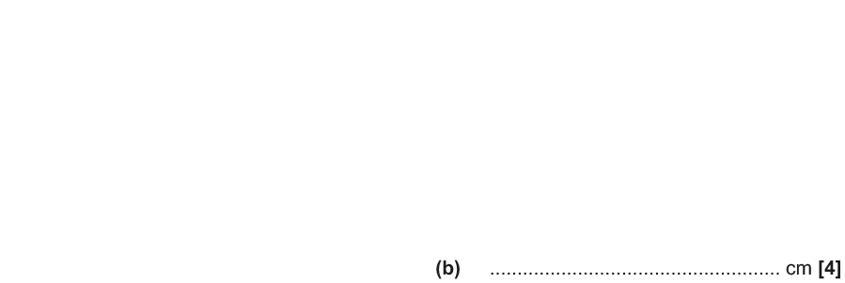
Similar Shapes
June 2018 3H Q18

Slide 29
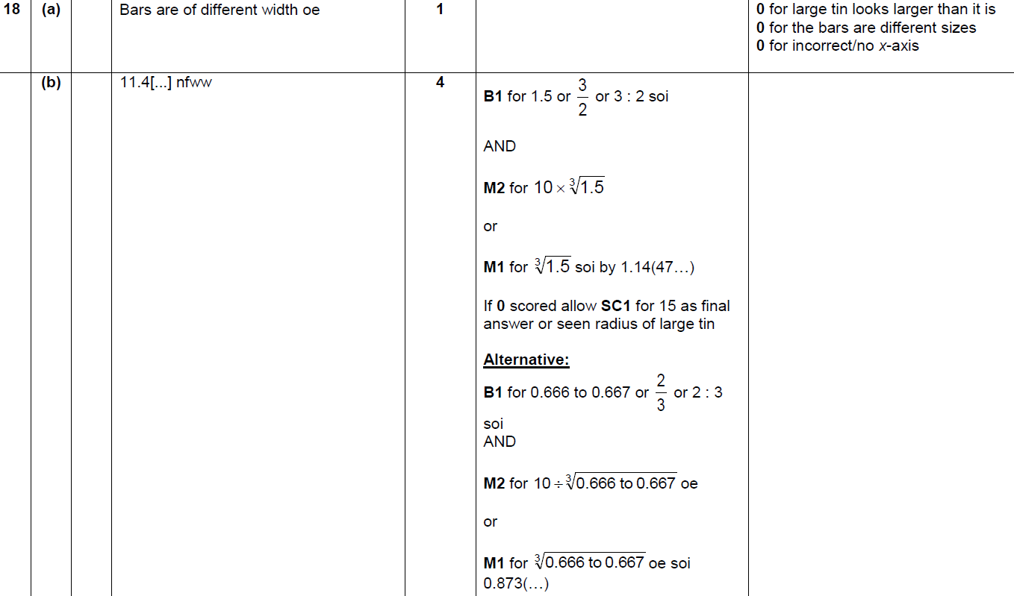
Similar Shapes
June 2018 3H Q18
A
B

Slide 30
Similar Shapes
Nov 2018 1H Q19

Slide 31
Similar Shapes
Nov 2018 1H Q19
A

Slide 32
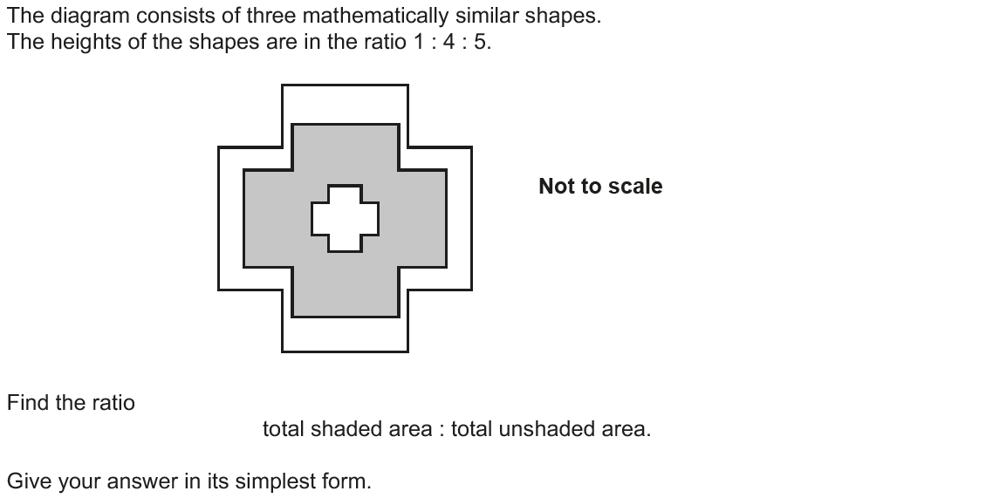
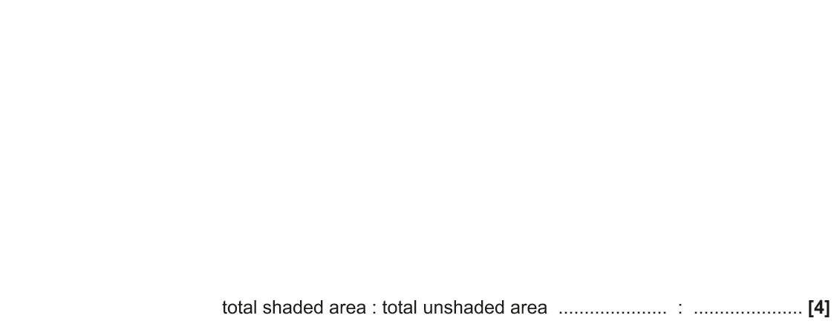
Similar Shapes
Nov 2018 2H Q17

Slide 33
Similar Shapes
Nov 2018 2H Q17
A

