Slide 1
Similar Shapes
Similar Shapes
SAM
1H Q13
SAM
1H Q18
May 2017
1H Q21
June 2018
3H Q19
SAM
3H Q13
June 2017
2H Q5
June 2018
3H Q21
Spec 1
1H Q17
Nov 2017
1H Q22
Nov 2018
1H Q15
Spec 1
2H Q14
Nov 2017
3H Q14
June 2019
2H Q9
Spec 1
3H Q20
June 2018
3H Q13
Spec 2
1H Q12
SF in area and volume
Congruent triangles (proof)

Slide 2
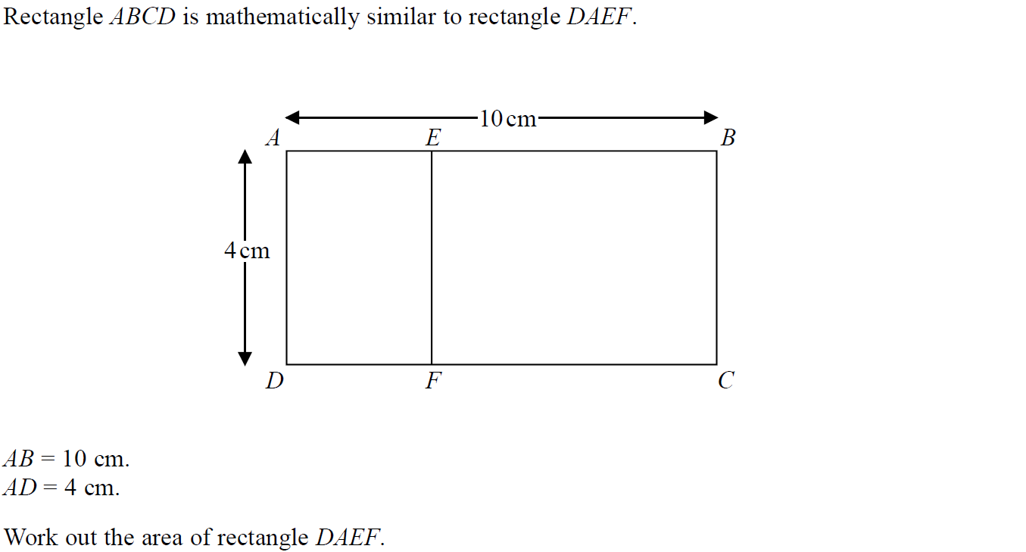
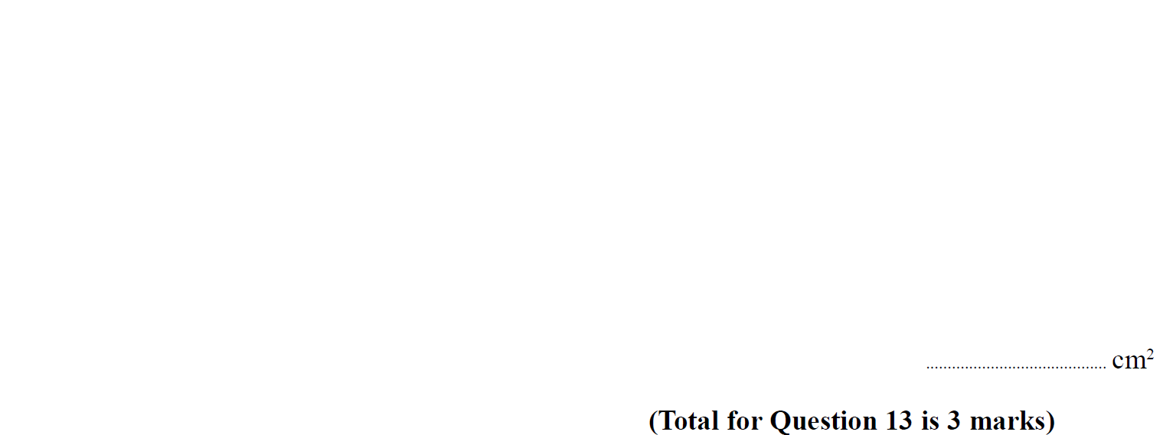
Similar Shapes
SAM 1H Q13

Slide 3
Similar Shapes
SAM 1H Q13
A

Slide 4
Similar Shapes
SAM 1H Q18

Slide 5
Similar Shapes
SAM 1H Q18
A

Slide 6
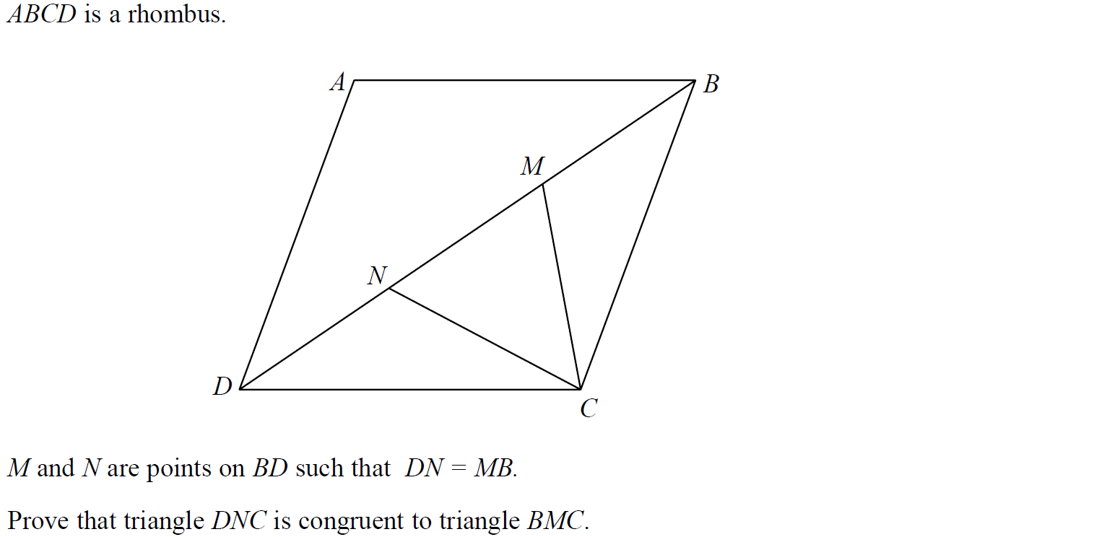
Similar Shapes
SAM 3H Q13

Slide 7
Similar Shapes
SAM 3H Q13
A

Slide 8
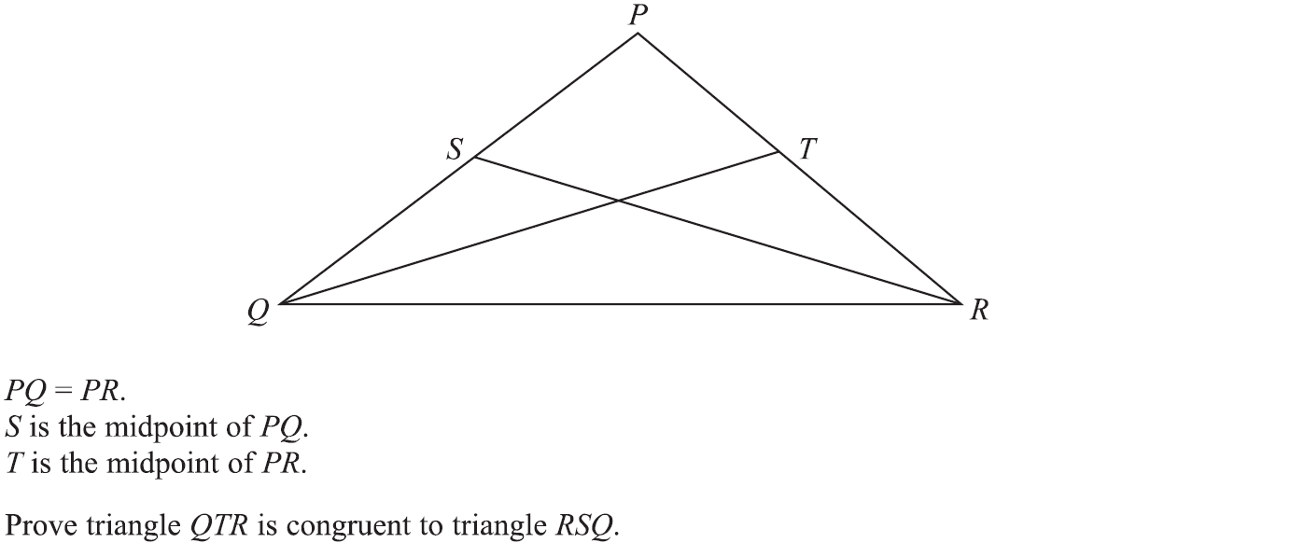
Similar Shapes
Specimen Set 1 1H Q17

Slide 9
Similar Shapes
Specimen Set 1 1H Q17
A

Slide 10
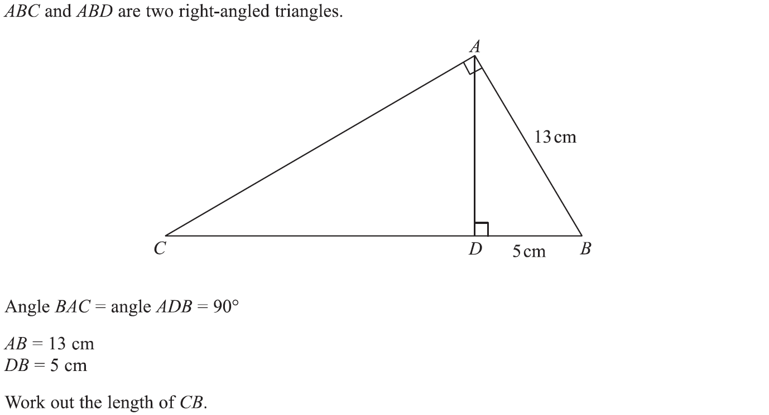
Similar Shapes
Specimen Set 1 2H Q14

Slide 11
Similar Shapes
Specimen Set 1 2H Q14
A

Slide 12
Similar Shapes
Specimen Set 1 3H Q20

Slide 13
Similar Shapes
Specimen Set 1 3H Q20
A

Slide 14
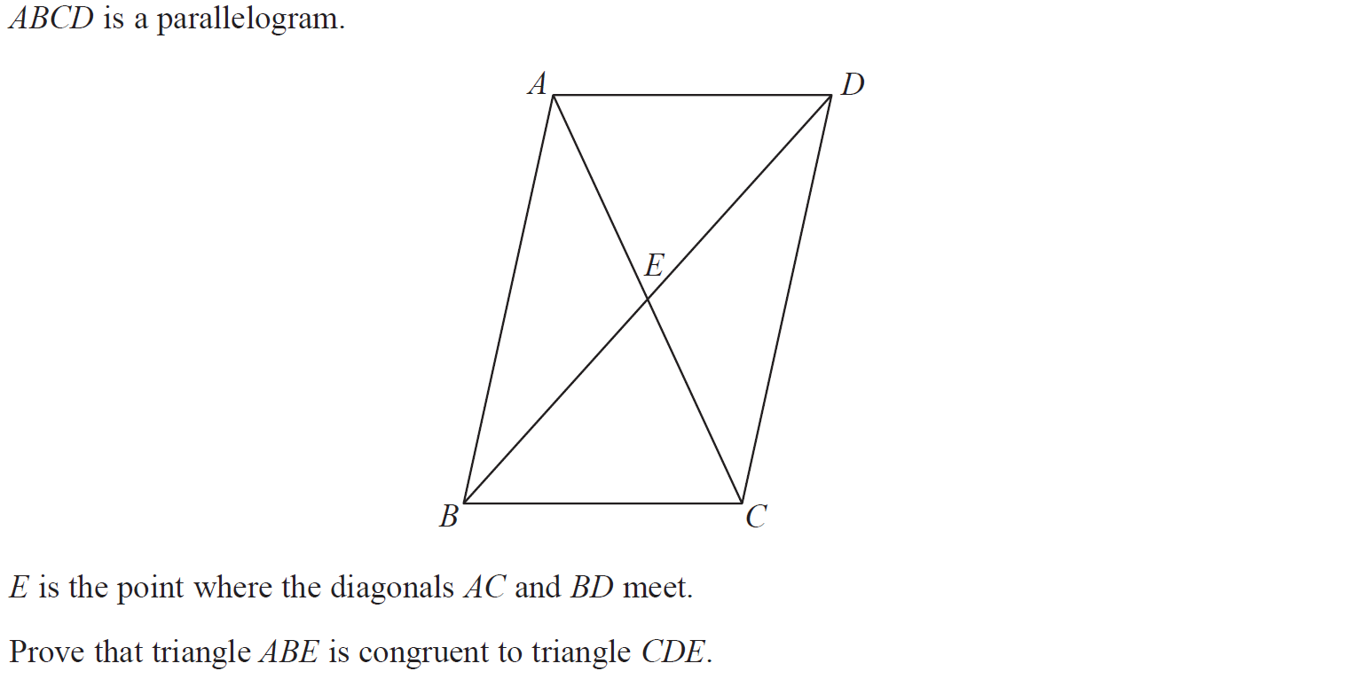
Similar Shapes
Specimen Set 2 1H Q12

Slide 15
Similar Shapes
Specimen Set 2 1H Q12
A

Slide 16
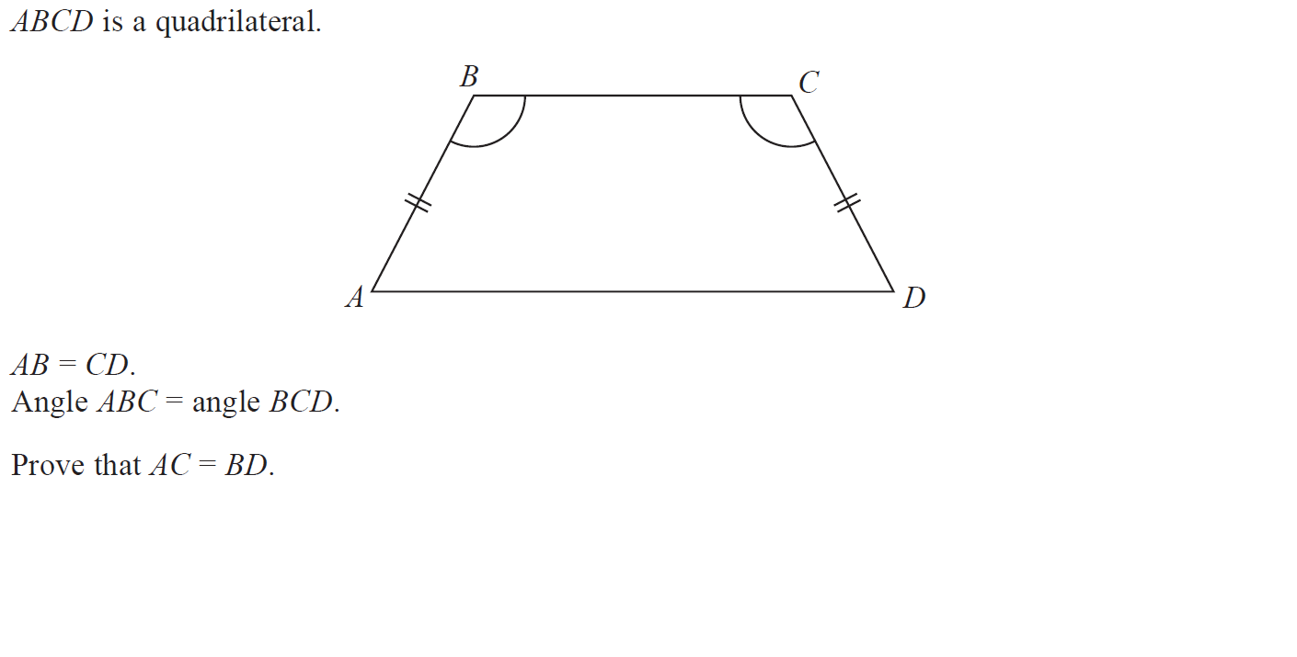
Similar Shapes
May 2017 1H Q21

Slide 17
Similar Shapes
May 2017 1H Q21
A

Slide 18
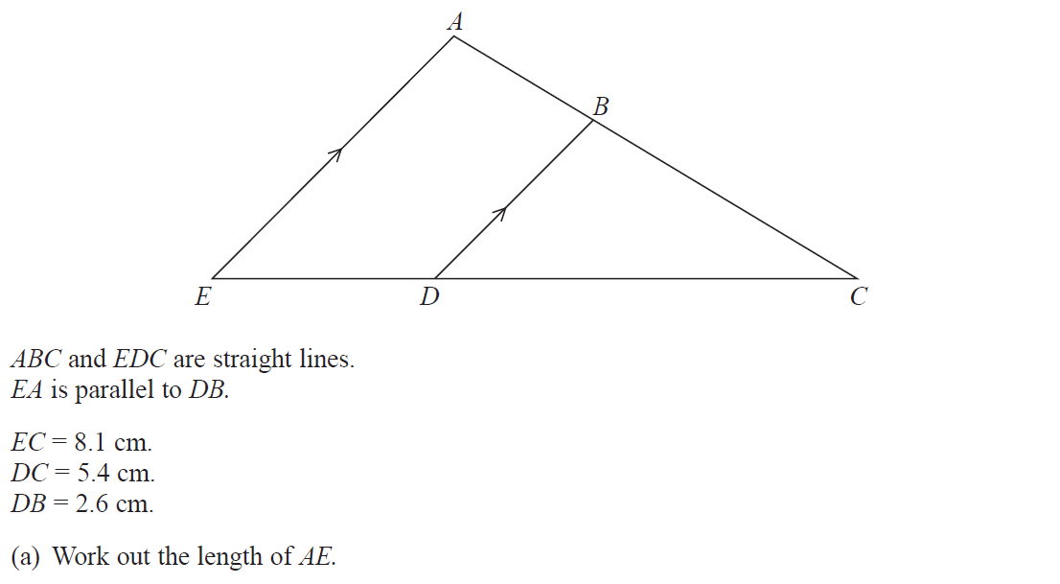
Similar Shapes
June 2017 2H Q5

Slide 19
Similar Shapes
June 2017 2H Q5
A
B

Slide 20
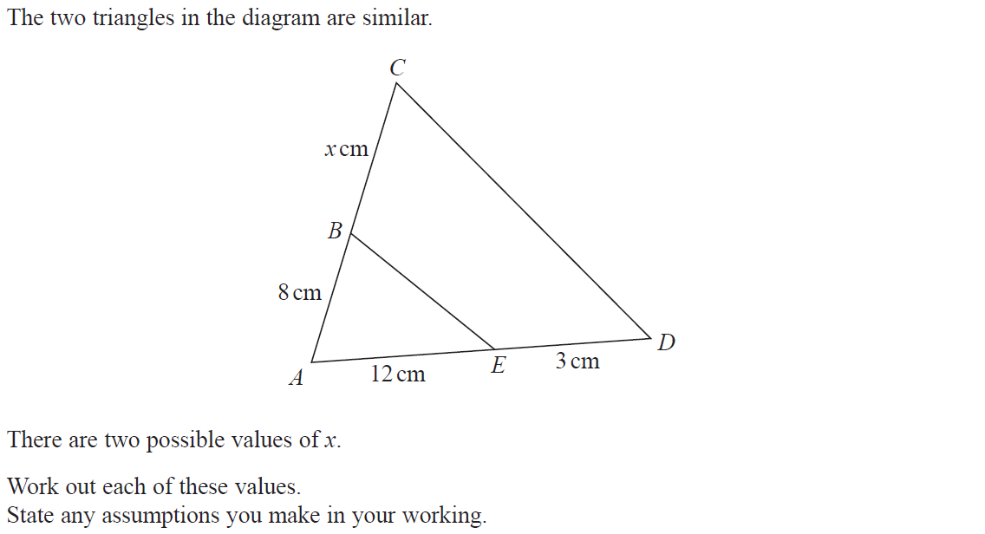
Similar Shapes
Nov 2017 1H Q22

Slide 21
Similar Shapes
Nov 2017 1H Q22
A

Slide 22
Similar Shapes
Nov 2017 3H Q14

Slide 23
Similar Shapes
Nov 2017 3H Q14
A

Slide 24
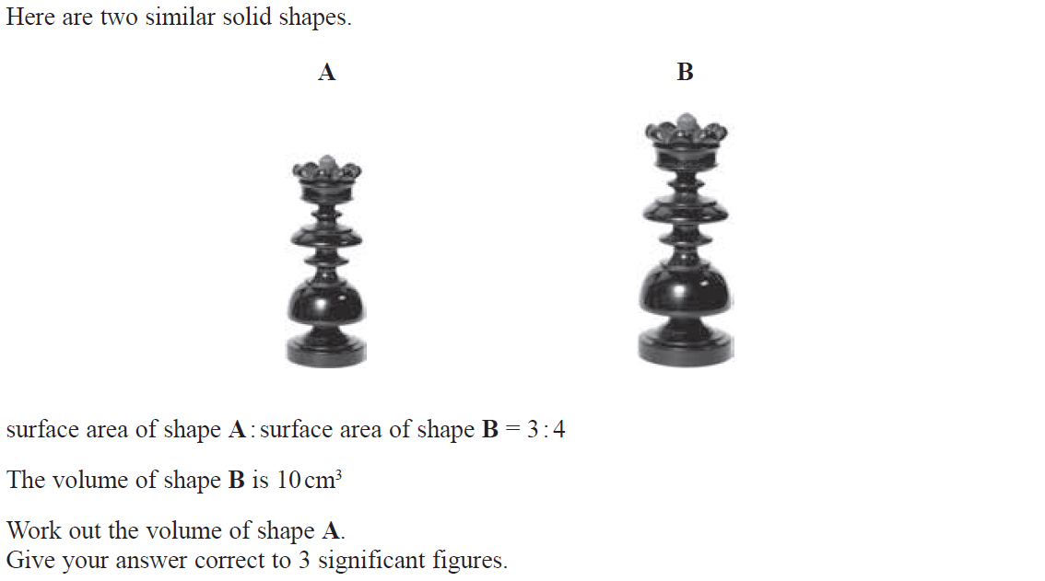
Similar Shapes
June 2018 3H Q13

Slide 25
Similar Shapes
June 2018 3H Q13
A

Slide 26
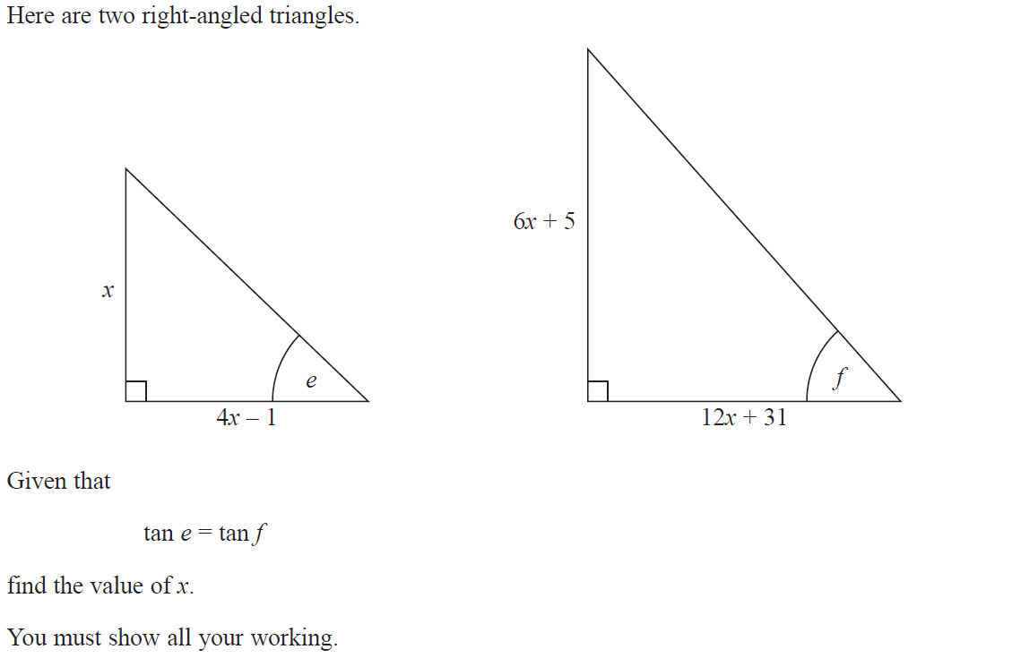
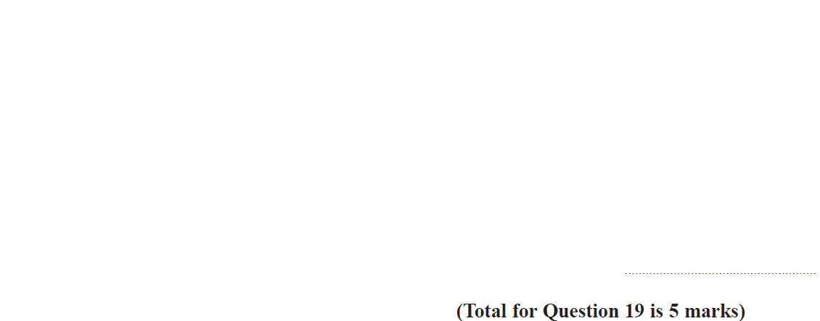
Similar Shapes
June 2018 3H Q19

Slide 27
Similar Shapes
June 2018 3H Q19
A

Slide 28
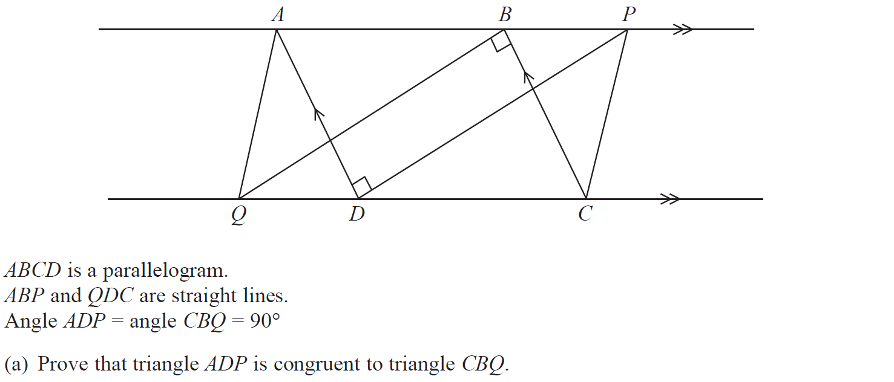
Similar Shapes
June 2018 3H Q21

Slide 29
Similar Shapes
June 2018 3H Q21
A
B

Slide 30
Similar Shapes
Nov 2018 1H Q15

Slide 31
Similar Shapes
Nov 2018 1H Q15
A

Slide 32
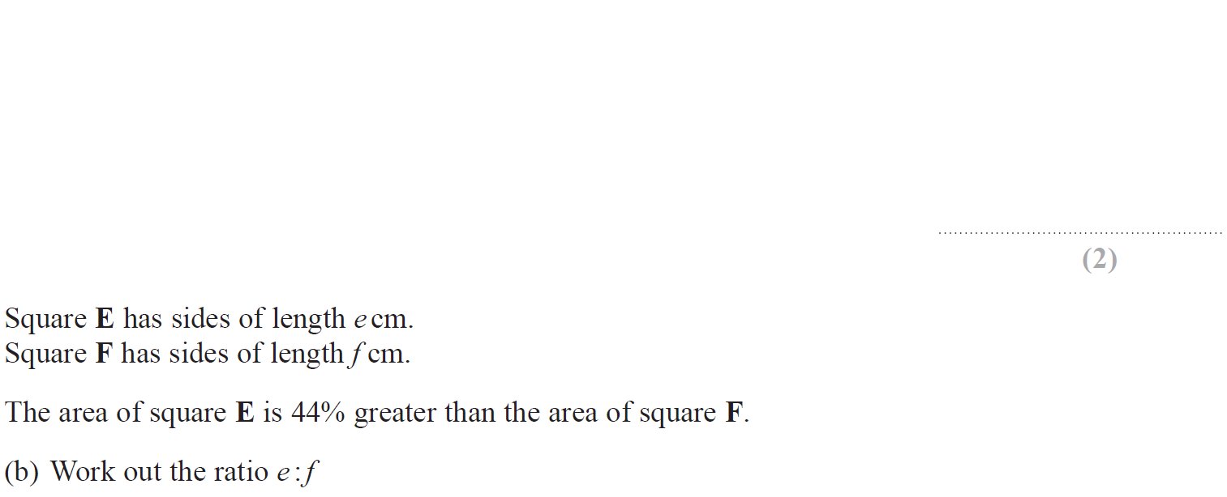
Similar Shapes
June 2019 2H Q9

Slide 33
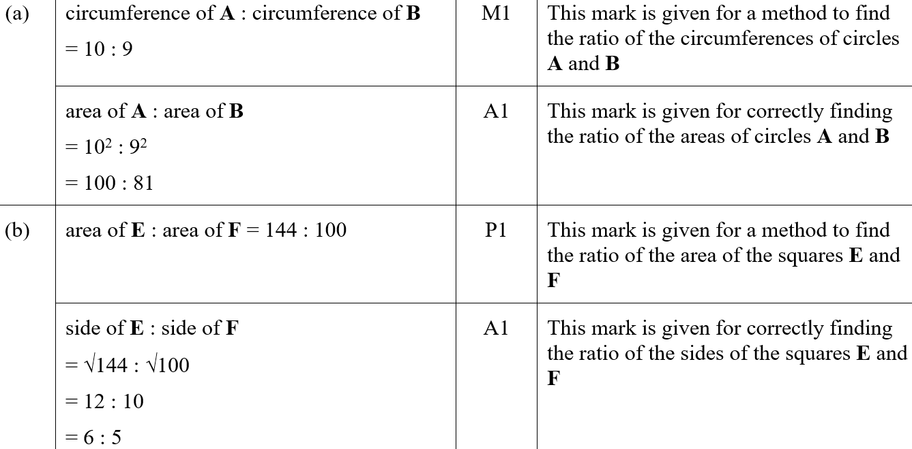
Similar Shapes
June 2019 2H Q9
A
B
A SF
B SF

