Slide 1
Simultaneous Equations
Simultaneous Equations
May 2017
1H Q20
Nov 2018
1H Q17
Edexcel
SAM
2H Q20
June 2017
3H Q2
Nov 2018
2H Q18
AQA
Spec 1
1H Q4
Nov 2017
1H Q11
Nov 2018
2H Q19
OCR
Spec 2
3H Q11
Nov 2017
3H Q19
May 2019
1H Q10
Nov 2018
1H Q6
June 2019
3H Q20
Quadratic
Graphical

Slide 2
Simultaneous Equations
Simultaneous Equations
Edexcel
May 2017
1H Q10
June 2018
3H Q16
AQA
SAM
2H Q8
Nov 2017
2H Q13
Nov 2018
1H Q19
1 Marker
OCR
June 2018
2H Q26
Nov 2018
3H Q27
Quadratic
Graphical

Slide 3
Simultaneous Equations
Simultaneous Equations
SAM
1H Q8
May 2017
1H Q9
SAM
2H Q6*
Edexcel
Nov 2017
2H Q19
SAM
2H Q19
AQA
May 2018
1H Q9
SAM
3H Q2
OCR
June 2018
2H Q18
Practice
1H Q8
*not really designed to be sim eq, but can be answered in this way
Nov 2018
3H Q17
Practice
1H Q16
Quadratic
Graphical

Slide 4
Simultaneous Equations
SAM 2H Q20

Slide 5
Simultaneous Equations
SAM 2H Q20
A

Slide 6
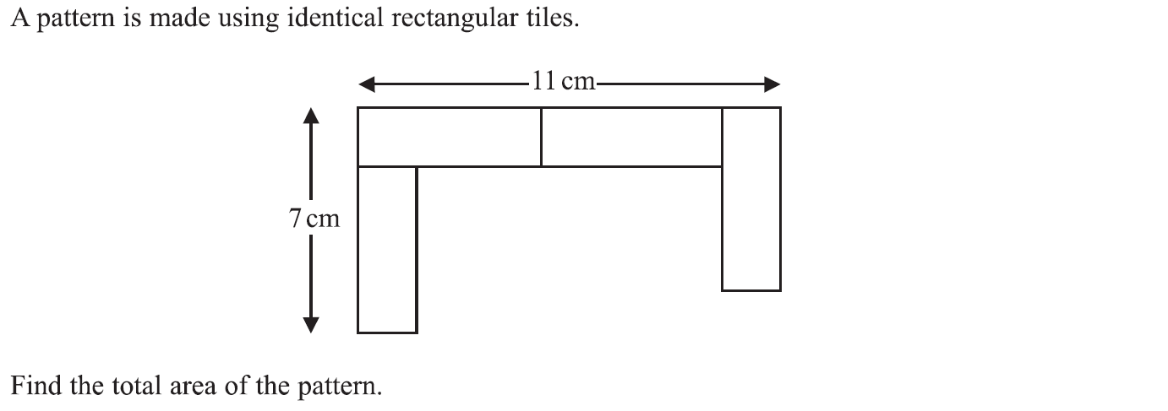
Simultaneous Equations
Specimen Set 1 1H Q4

Slide 7
Simultaneous Equations
Specimen Set 1 1H Q4
A

Slide 8
Simultaneous Equations
Specimen Set 2 3H Q11

Slide 9
Simultaneous Equations
Specimen Set 2 3H Q11
A

Slide 10
Simultaneous Equations
May 2017 1H Q20

Slide 11
Simultaneous Equations
May 2017 1H Q20
A

Slide 12
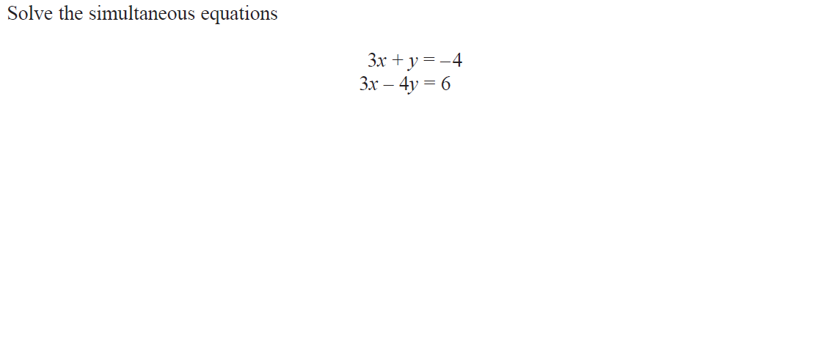
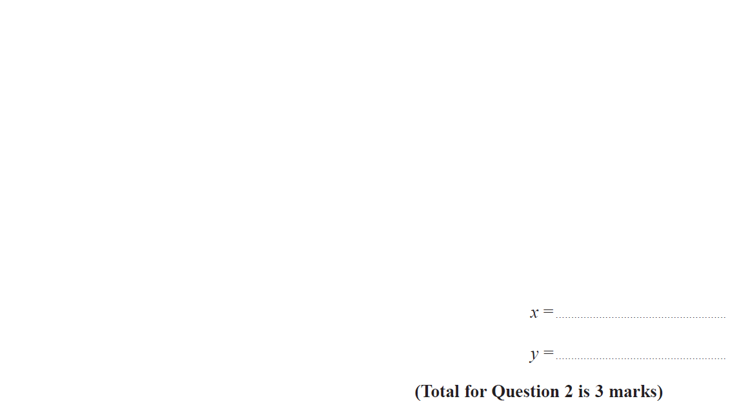
Simultaneous Equations
June 2017 3H Q2

Slide 13
Simultaneous Equations
June 2017 3H Q2
A

Slide 14
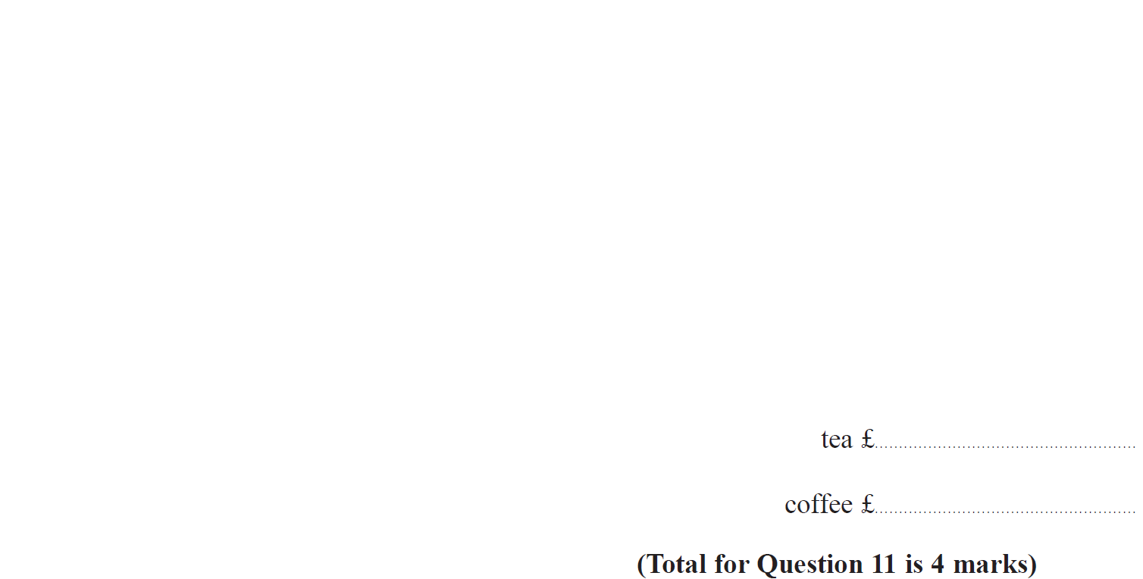
Simultaneous Equations
Nov 2017 1H Q11

Slide 15
Simultaneous Equations
Nov 2017 1H Q11
A

Slide 16
Simultaneous Equations
Nov 2017 3H Q19

Slide 17
Simultaneous Equations
Nov 2017 3H Q19
A

Slide 18
Simultaneous Equations
Nov 2018 1H Q6

Slide 19
Simultaneous Equations
Nov 2018 1H Q6
A

Slide 20
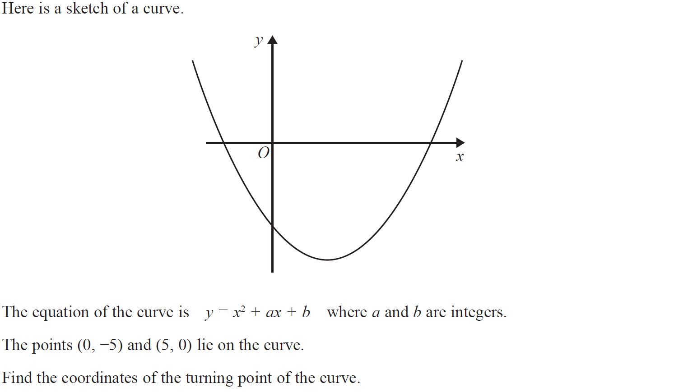
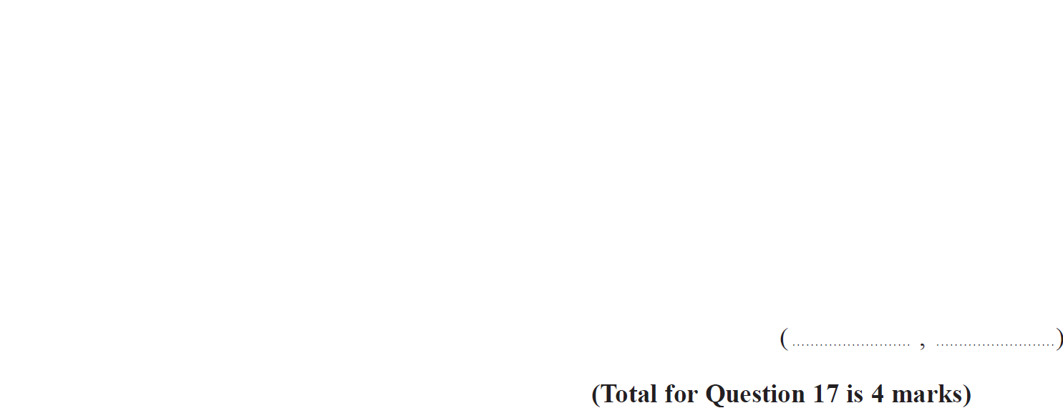
Simultaneous Equations
Nov 2018 1H Q17

Slide 21
Simultaneous Equations
Nov 2018 1H Q17
A

Slide 22
Simultaneous Equations
Nov 2018 2H Q18

Slide 23
Simultaneous Equations
Nov 2018 2H Q18
A

Slide 24
Simultaneous Equations
Nov 2018 3H Q19

Slide 25
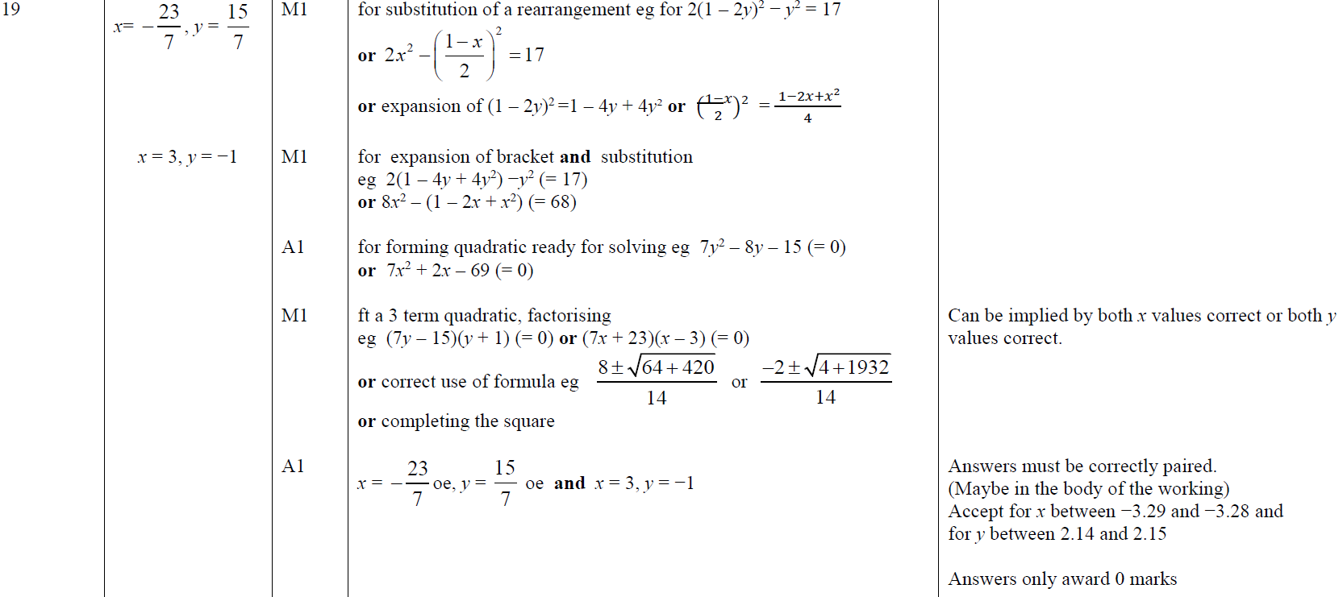
Simultaneous Equations
Nov 2018 3H Q19
A

Slide 26
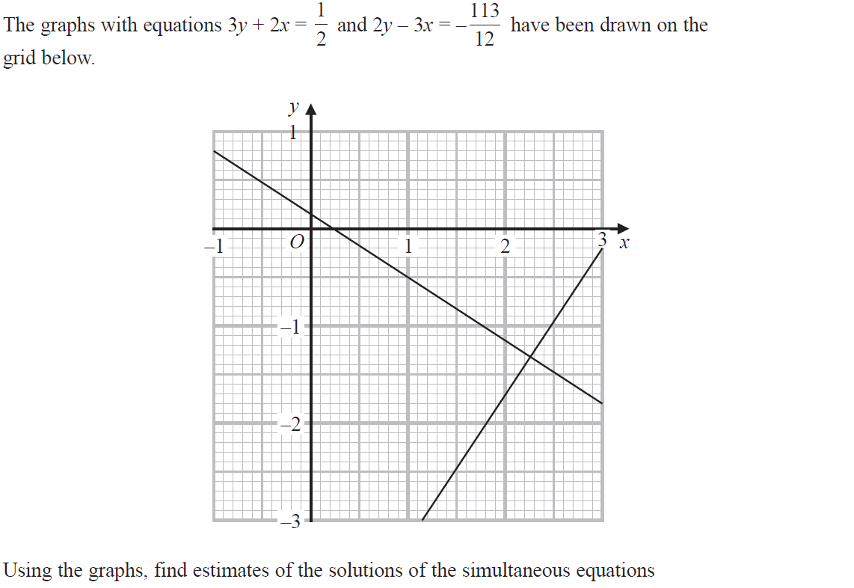
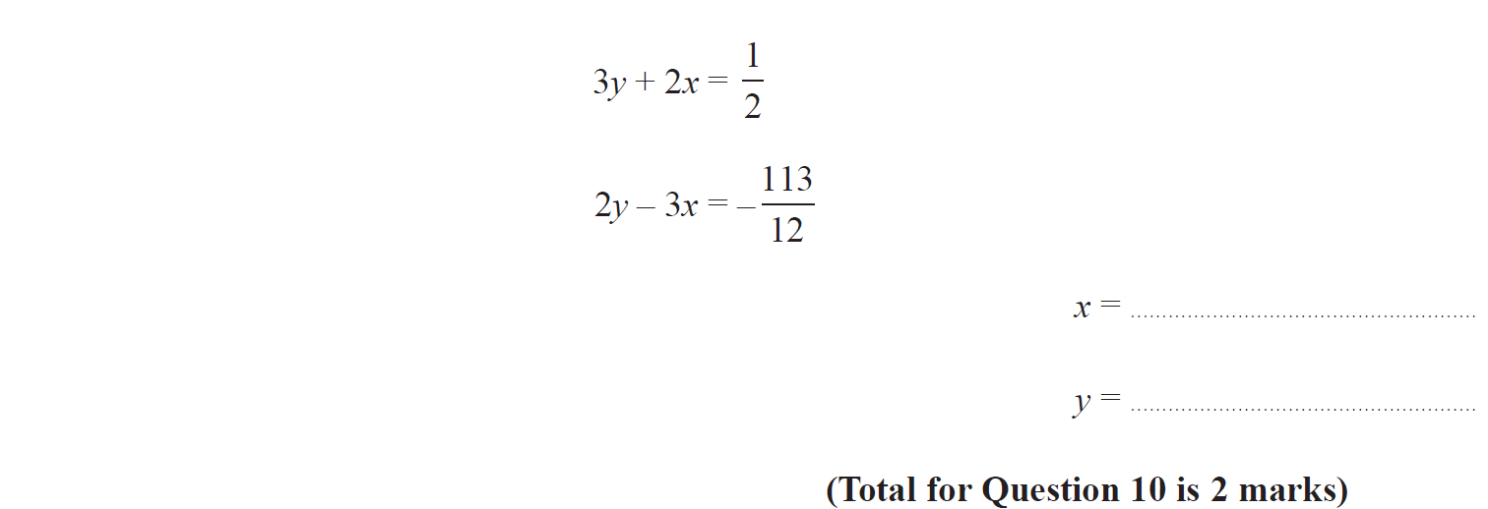
Simultaneous Equations
May 2019 1H Q10

Slide 27
Simultaneous Equations
May 2019 1H Q10
A
A SF

Slide 28
Simultaneous Equations
June 2019 3H Q20

Slide 29
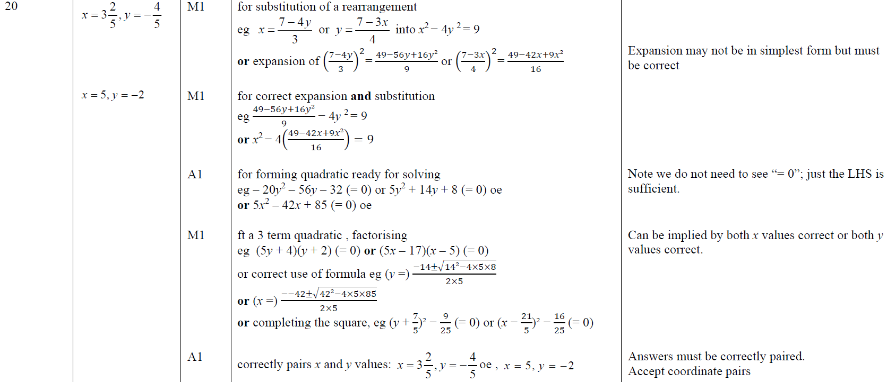
Simultaneous Equations
June 2019 3H Q20
A

Slide 30
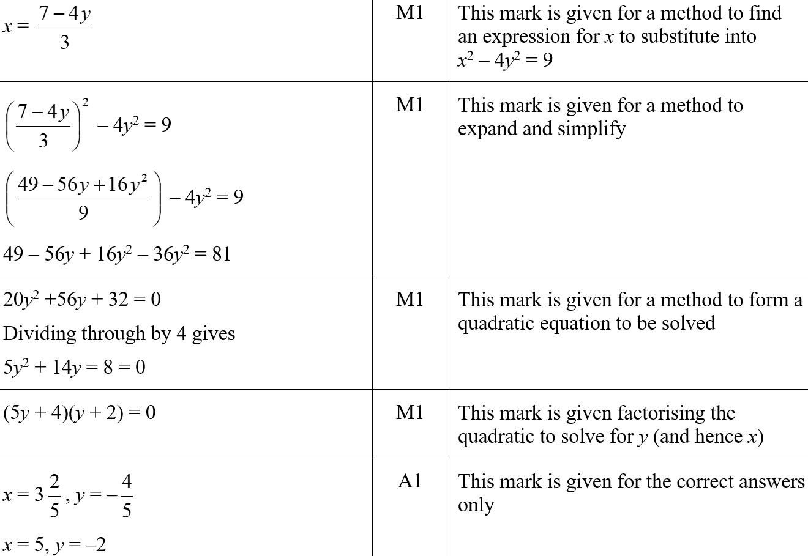
Simultaneous Equations
June 2019 3H Q20
A SF

Slide 31
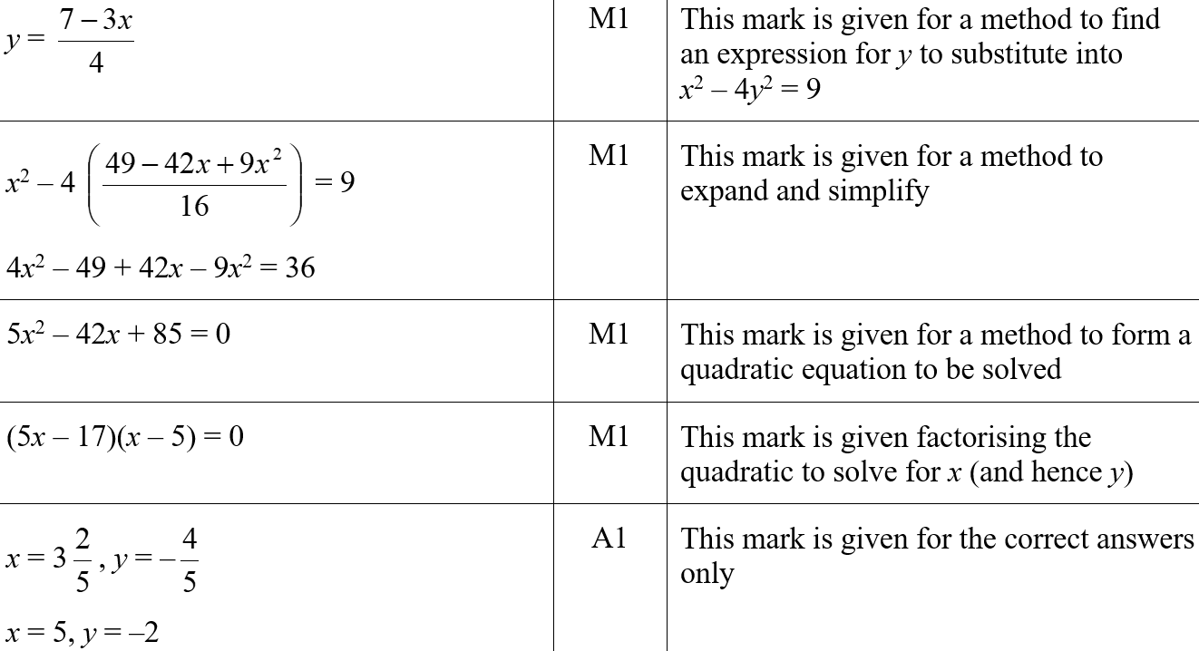
Simultaneous Equations
June 2019 3H Q20
A SF

Slide 32
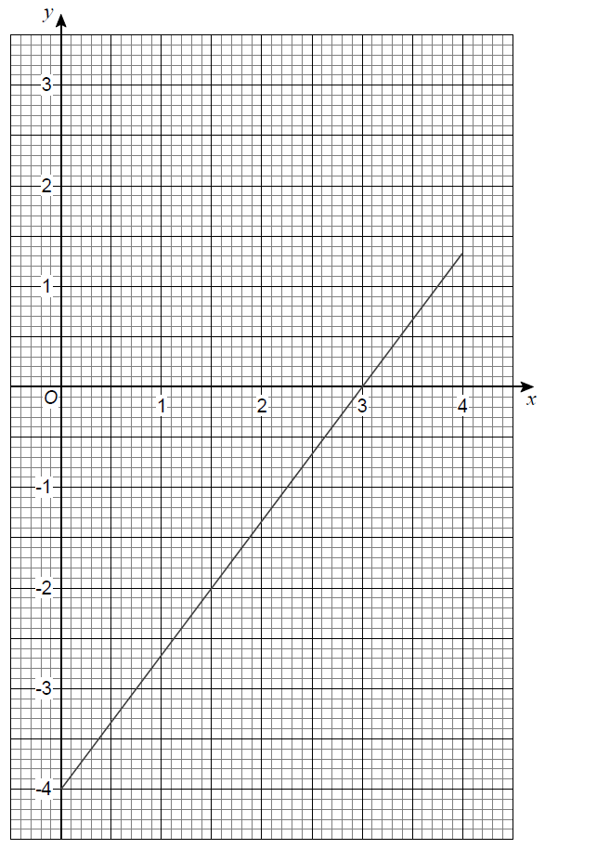
Simultaneous Equations
SAM 2H Q8

Slide 33
Simultaneous Equations
SAM 2H Q8
A

Slide 34
Simultaneous Equations
May 2017 1H Q10

Slide 35
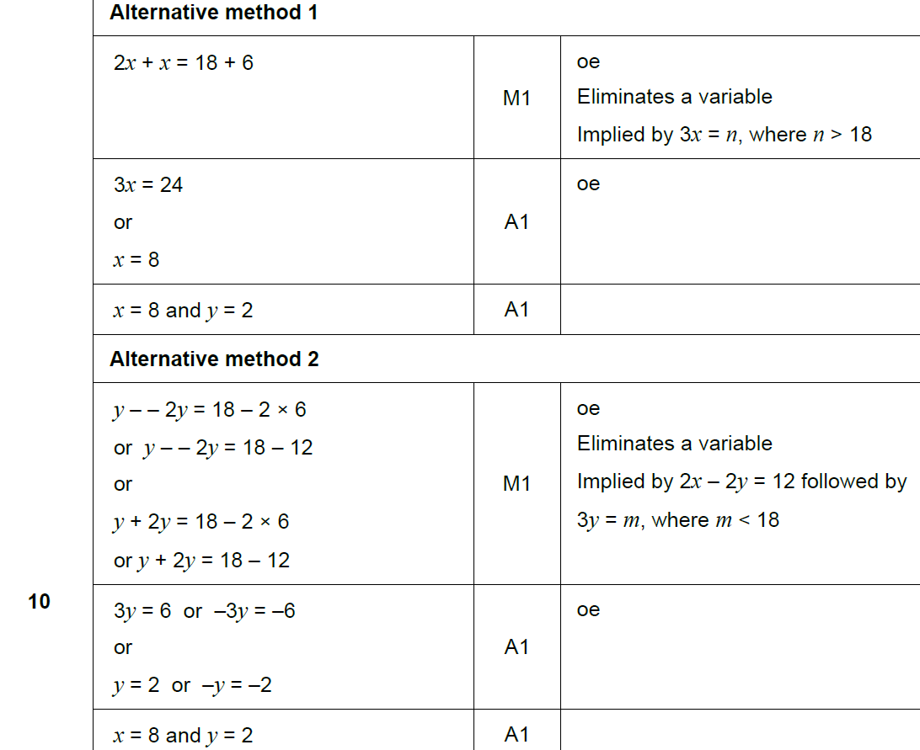
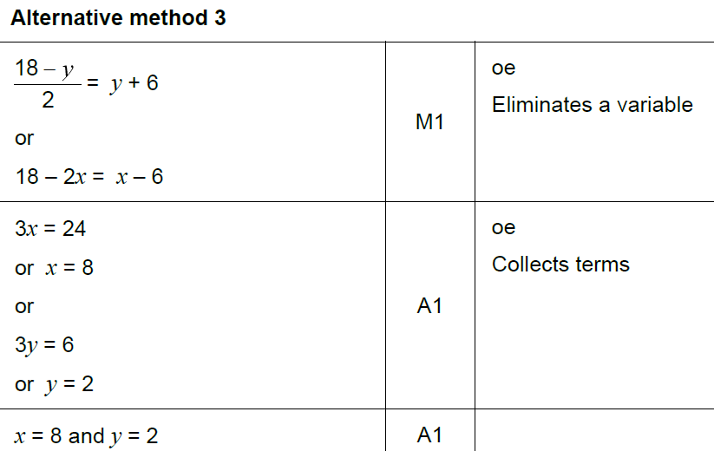
Simultaneous Equations
May 2017 1H Q10
A

Slide 36
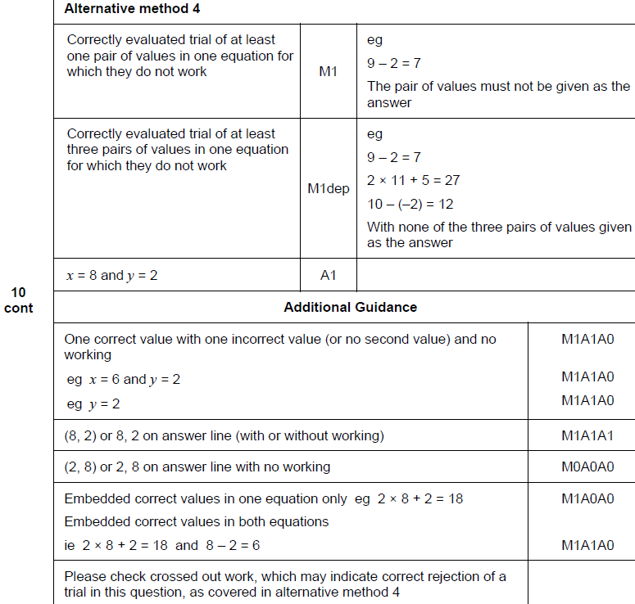
Simultaneous Equations
May 2017 1H Q10
A

Slide 37
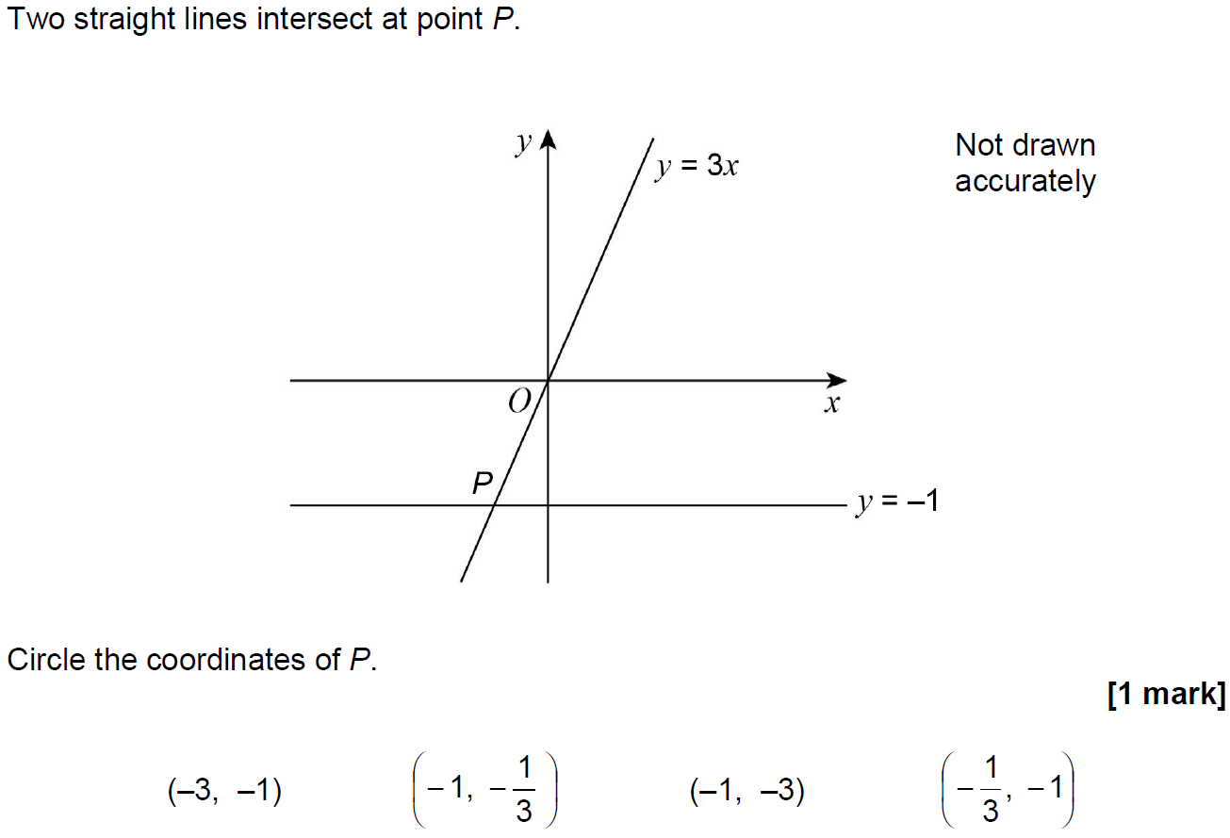
Simultaneous Equations
Nov 2017 2H Q13

Slide 38
Simultaneous Equations
Nov 2017 2H Q13
A

Slide 39
Simultaneous Equations
June 2018 2H Q26

Slide 40
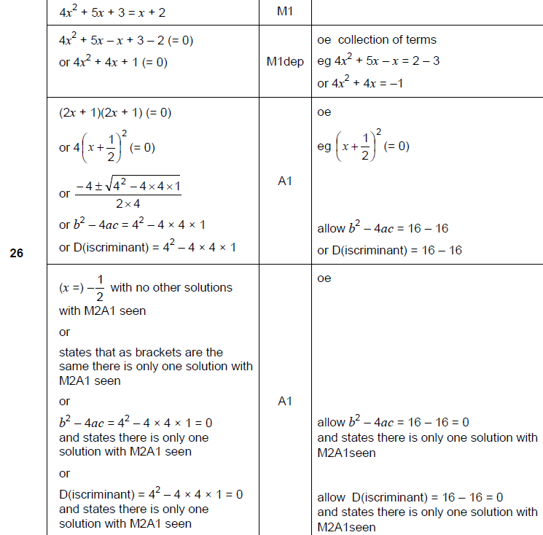
Simultaneous Equations
June 2018 2H Q26
A

Slide 41
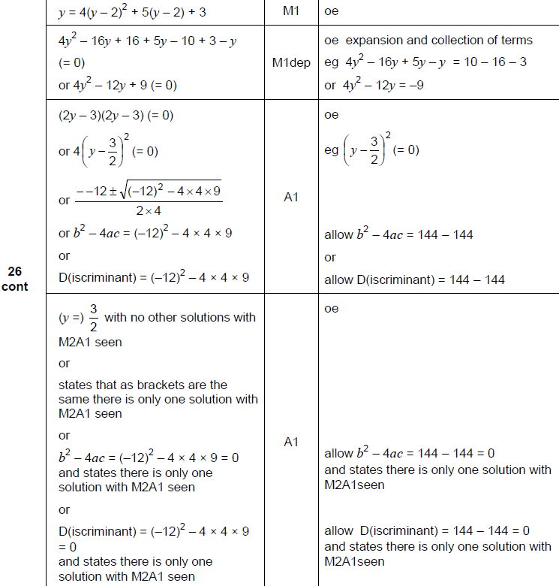
Simultaneous Equations
June 2018 2H Q26
A Alternative

Slide 42
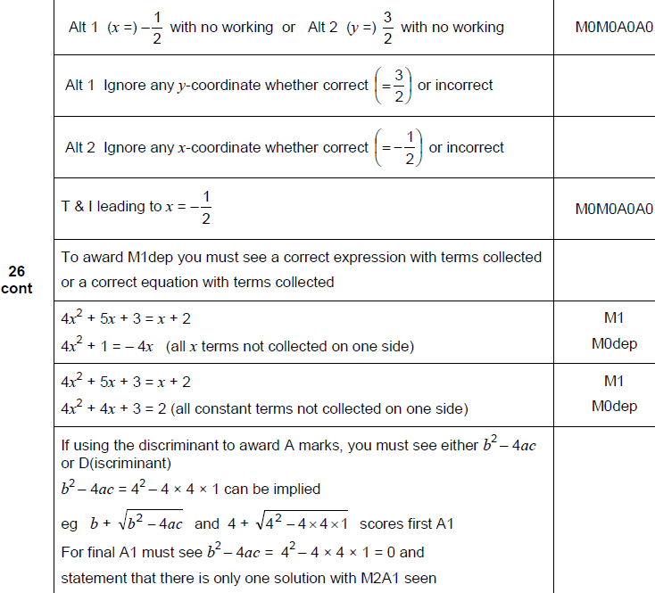
Simultaneous Equations
June 2018 2H Q26
A notes

Slide 43
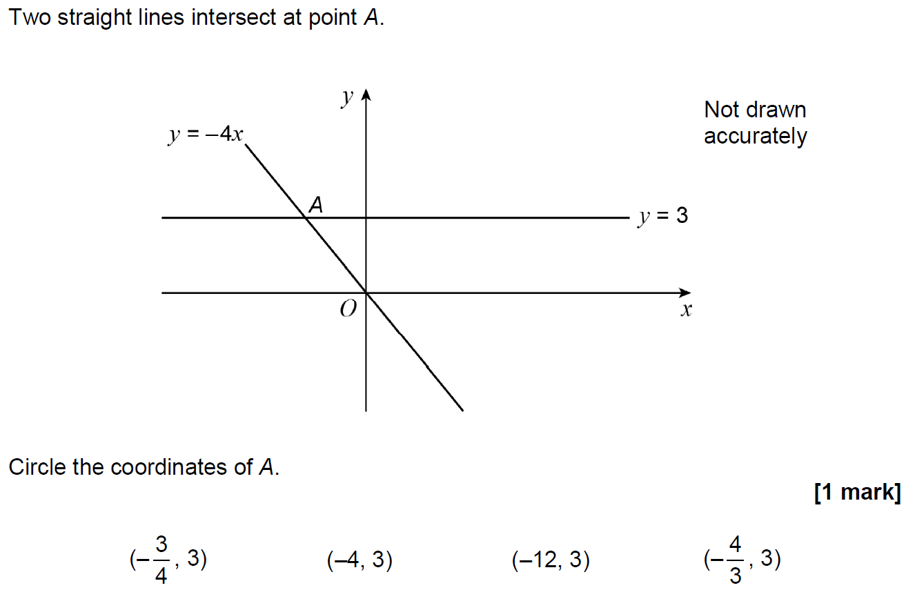
Simultaneous Equations
June 2018 3H Q16

Slide 44
Simultaneous Equations
June 2018 3H Q16
A

Slide 45
Simultaneous Equations
Nov 2018 1H Q19
In a chess club, there are x boys and y girls.
(a) If 5 more boys and 8 more girls join, there would be half as many boys as girls.
Show that y = 2x + 2
[2 marks]
(b) If instead,
10 more boys and 1 more girl join, there would be the same number of boys and girls.
Work out x and y.
[3 marks]

Slide 46
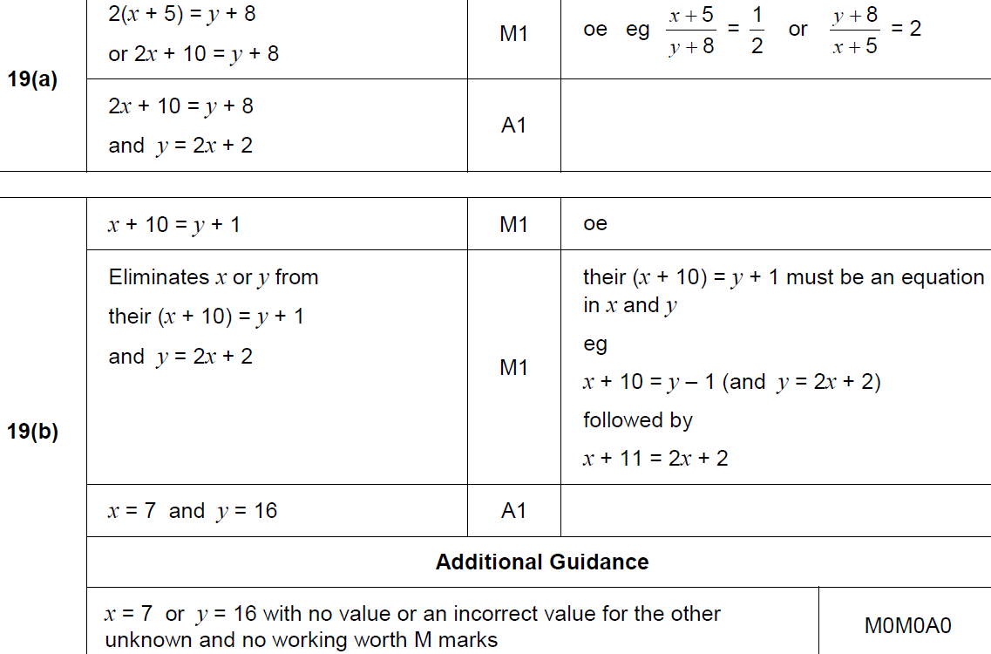
Simultaneous Equations
Nov 2018 1H Q19
A
B

Slide 47
Simultaneous Equations
Nov 2018 3H Q27

Slide 48
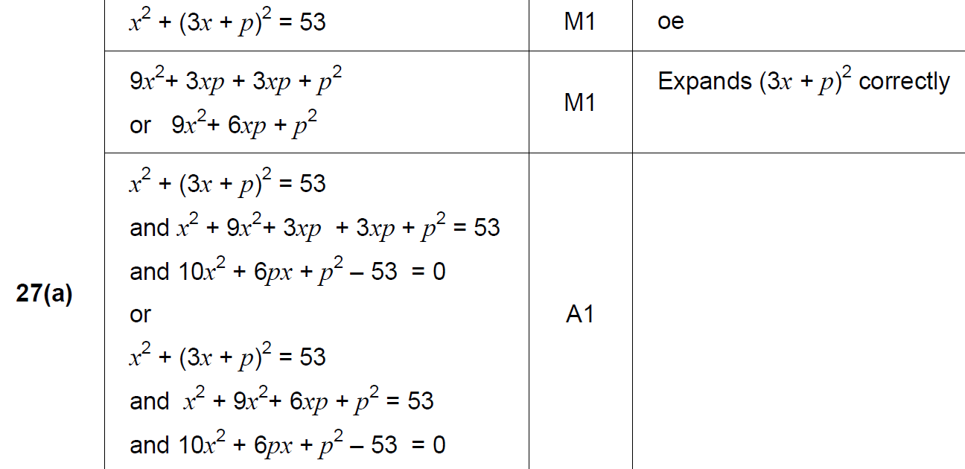
Simultaneous Equations
Nov 2018 3H Q27
A

Slide 49
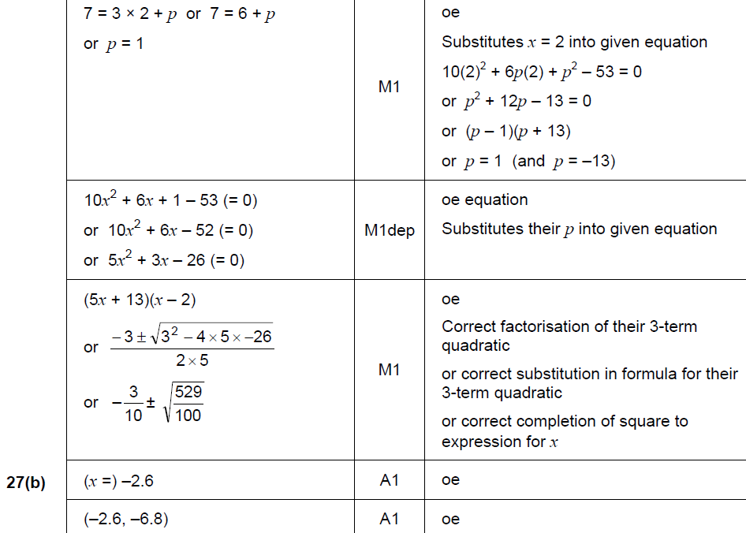
Simultaneous Equations
Nov 2018 3H Q27
B

Slide 50
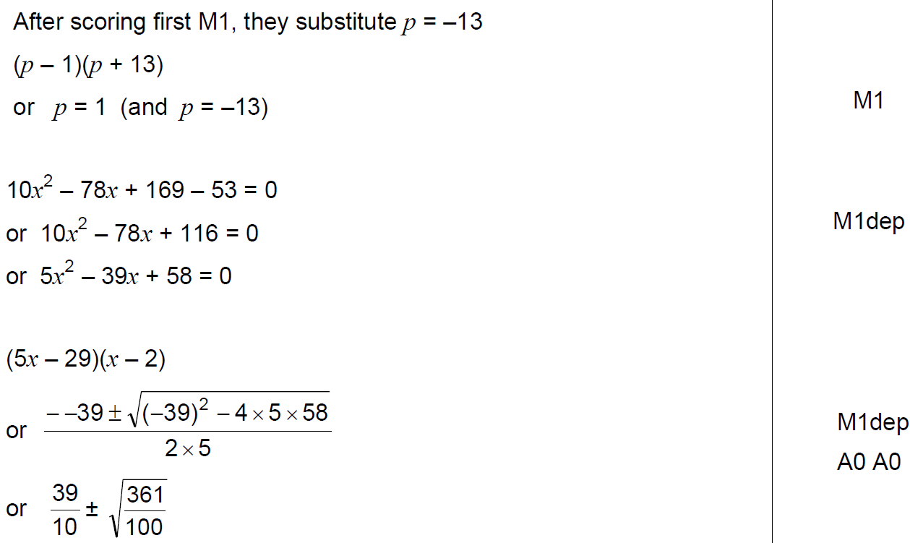
Simultaneous Equations
Nov 2018 3H Q27
B notes

Slide 51
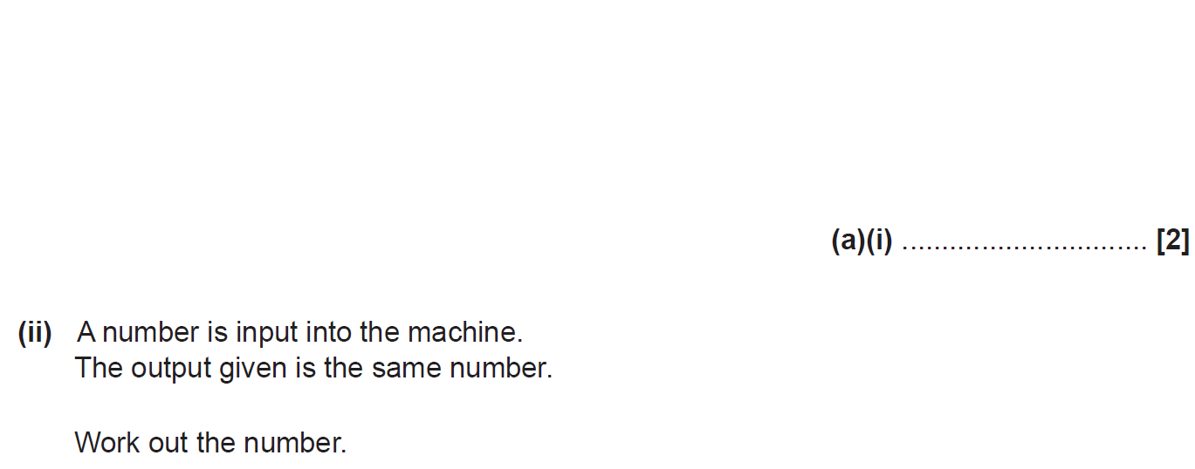
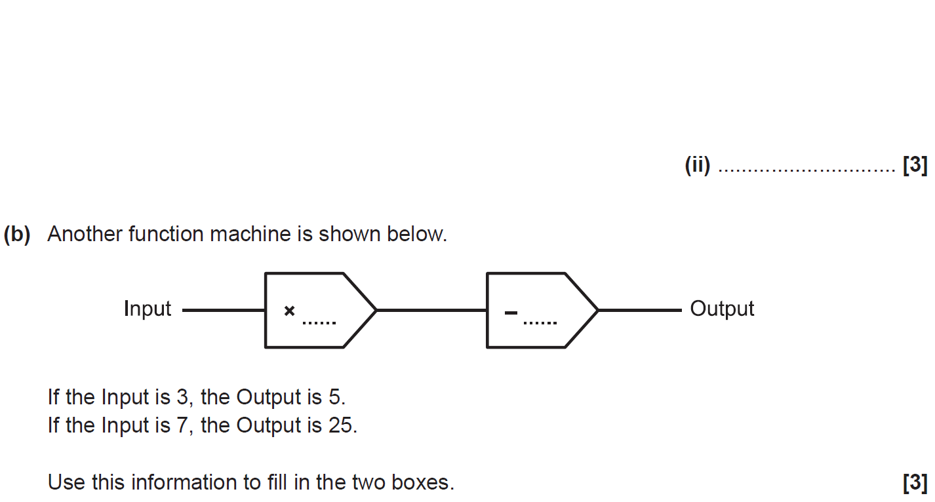
Simultaneous Equations
SAM 1H Q8

Slide 52
Simultaneous Equations
SAM 1H Q8
A (i)
A (ii)
B

Slide 53
Simultaneous Equations
SAM 2H Q6

Slide 54
Simultaneous Equations
SAM 2H Q6
A

Slide 55
Simultaneous Equations
SAM 2H Q19

Slide 56
Simultaneous Equations
SAM 2H Q19
A

Slide 57
Simultaneous Equations
SAM 3H Q2

Slide 58
Simultaneous Equations
SAM 3H Q2
A (i)
A (ii)
B
C

Slide 59
Simultaneous Equations
Practice 1H Q8

Slide 60
Simultaneous Equations
Practice 1H Q8
A

Slide 61
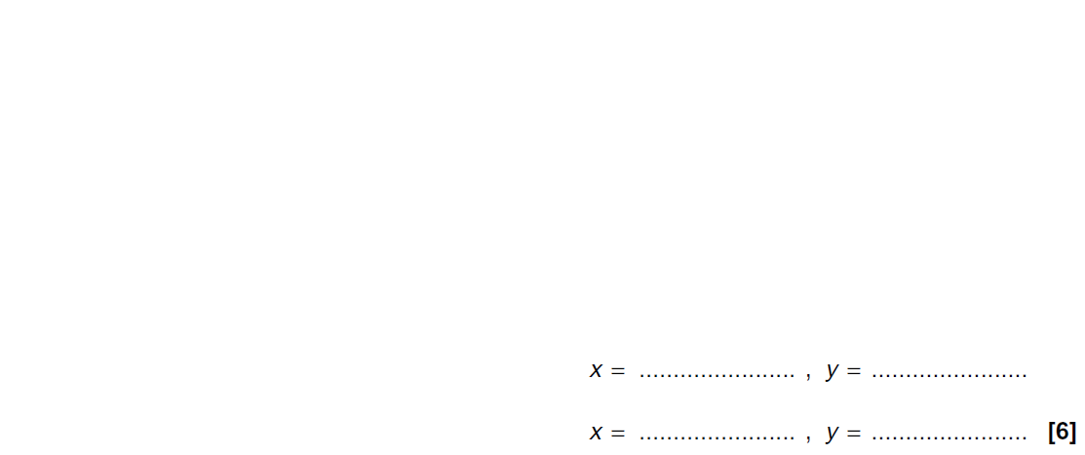
Simultaneous Equations
Practice 1H Q16

Slide 62
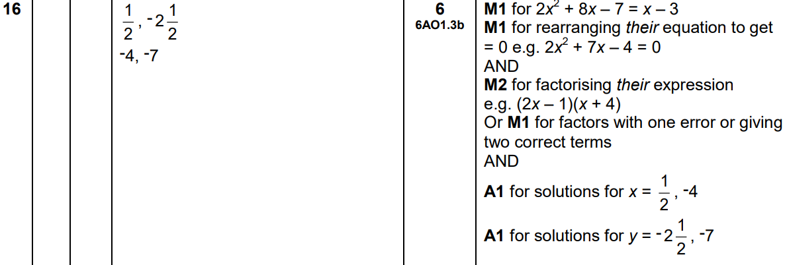
Simultaneous Equations
Practice 1H Q16
A

Slide 63
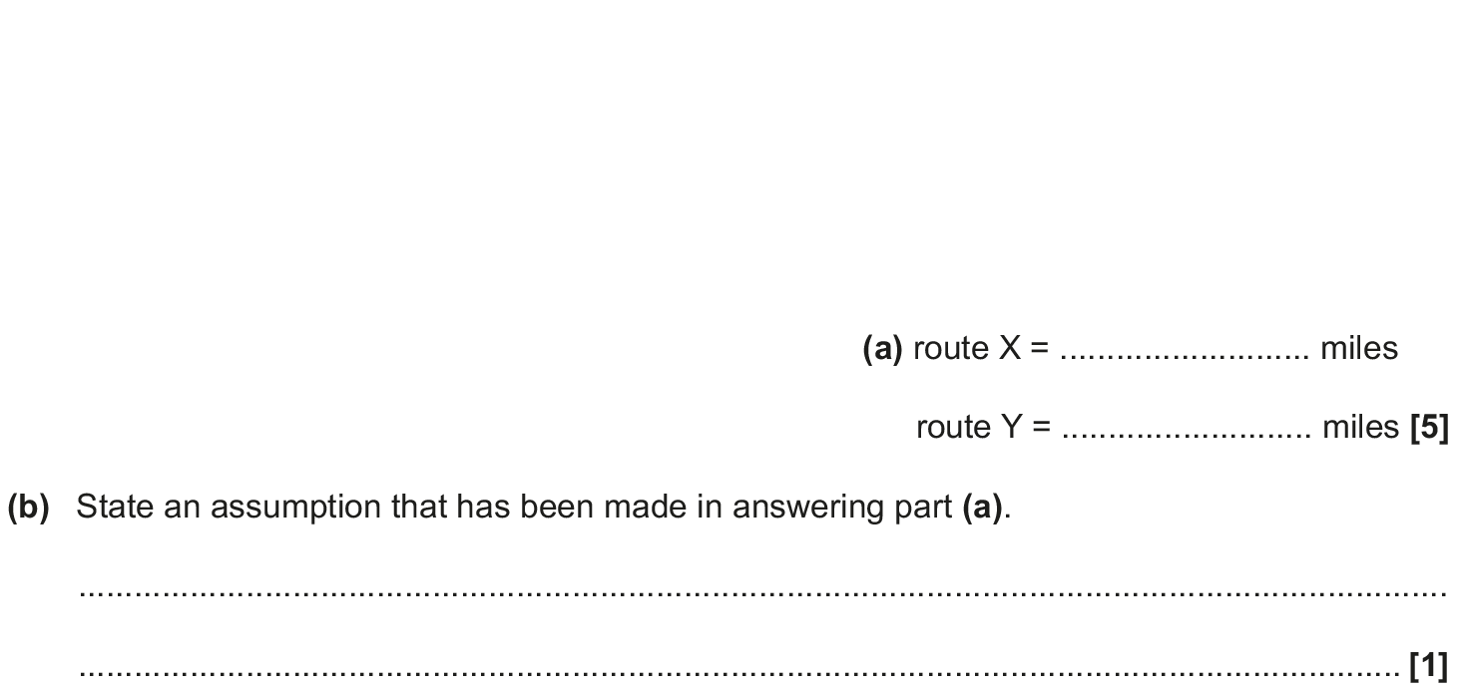
Simultaneous Equations
May 2017 1H Q9

Slide 64
Simultaneous Equations
May 2017 1H Q9
A
B

Slide 65
Simultaneous Equations
Nov 2017 2H Q19

Slide 66
Simultaneous Equations
Nov 2017 2H Q19
A

Slide 67
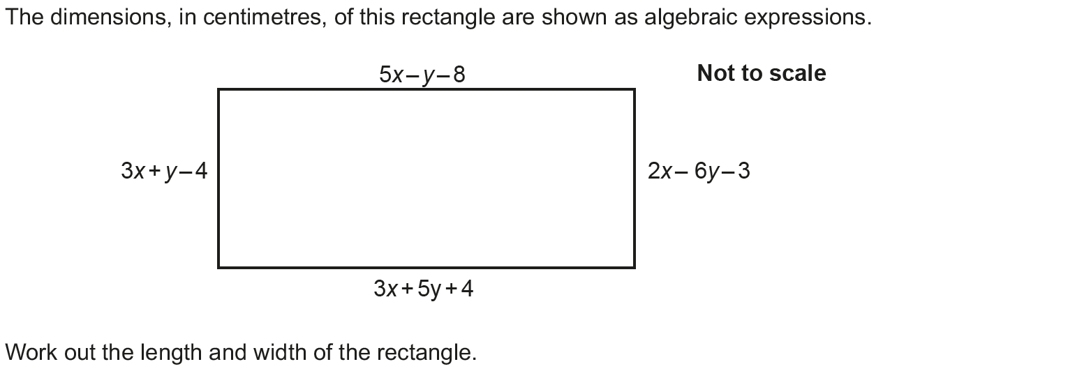
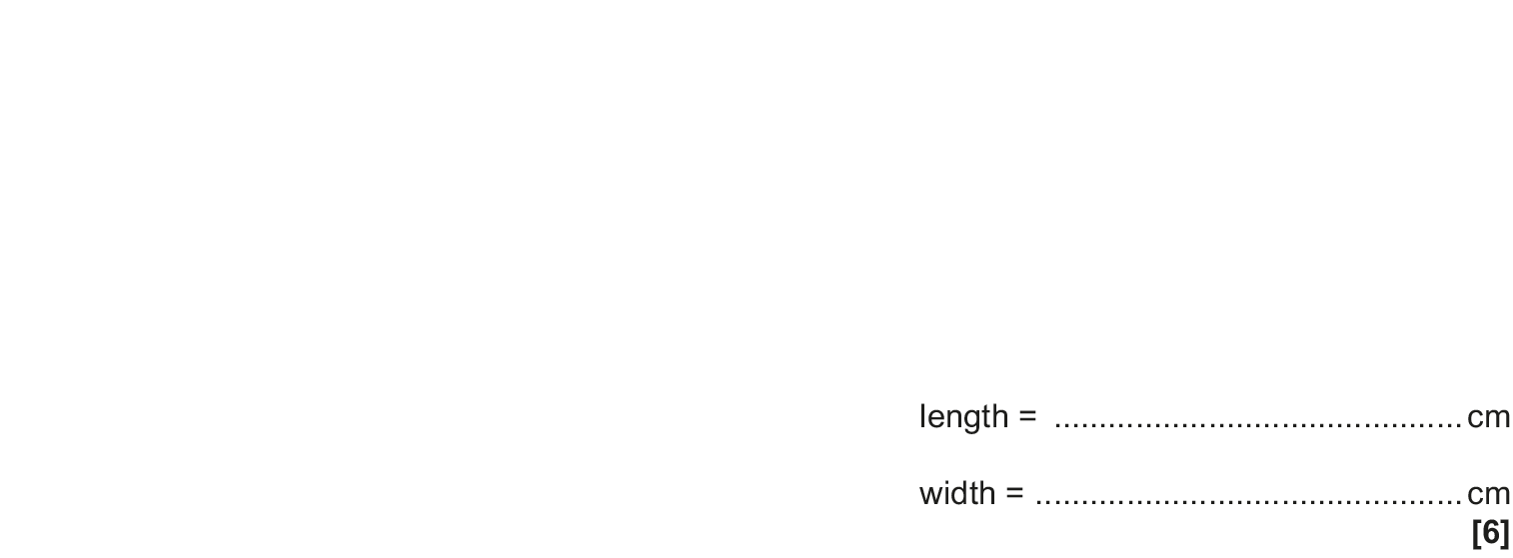
Simultaneous Equations
May 2018 1H Q9

Slide 68
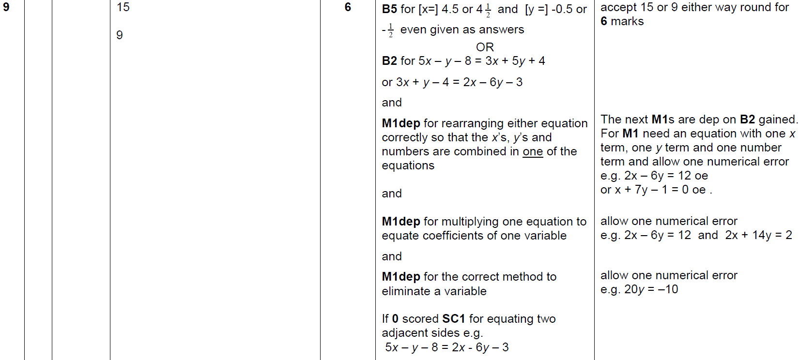
Simultaneous Equations
May 2018 1H Q9
A

Slide 69
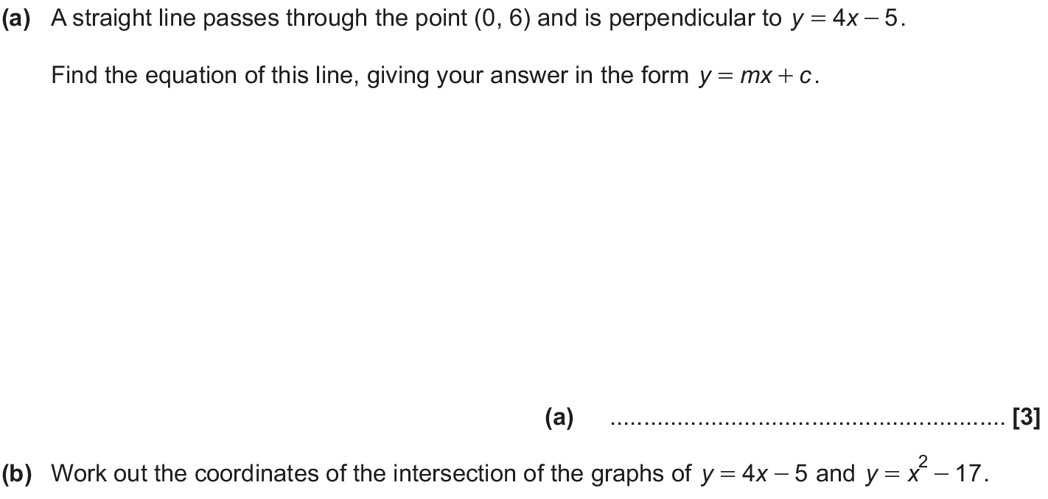
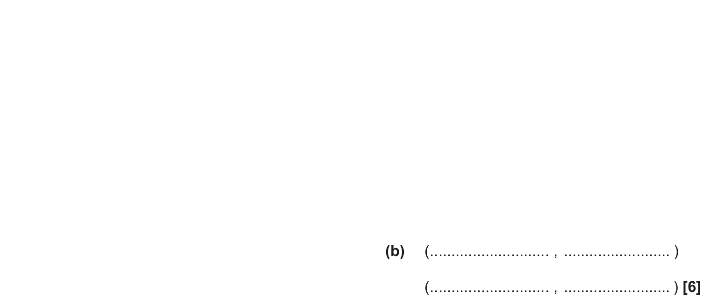
Simultaneous Equations
June 2018 2H Q18

Slide 70
Simultaneous Equations
June 2018 2H Q18
A
B

Slide 71
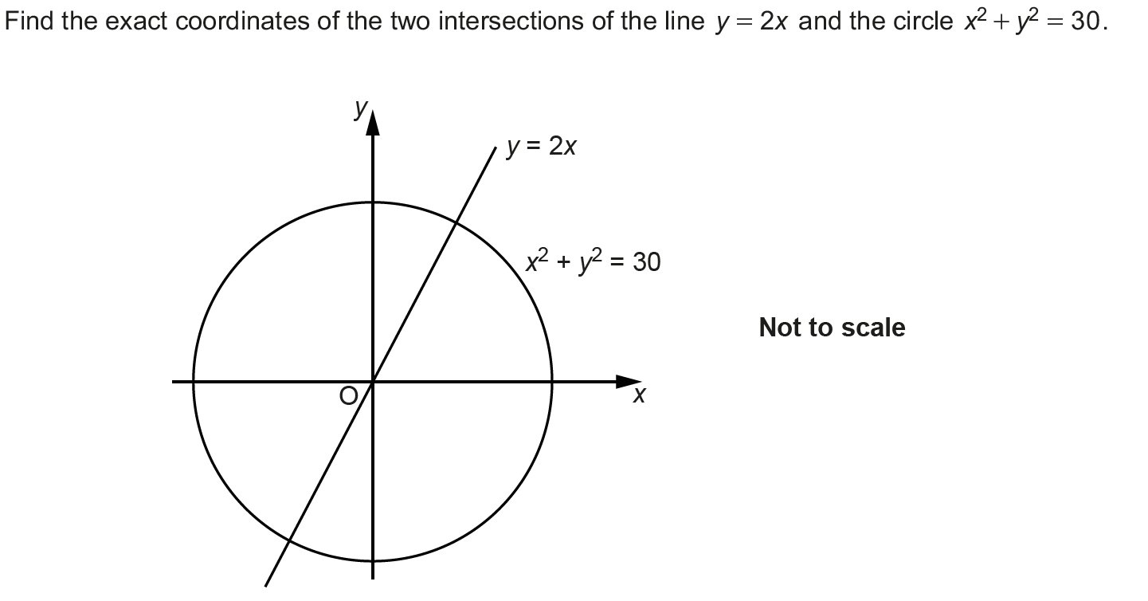
Simultaneous Equations
Nov 2018 3H Q17

Slide 72
Simultaneous Equations
Nov 2018 3H Q17
A

