Slide 1
Show that…/ Proof
Show that…/ Proof
(algebraic)
May 2017
1H Q17
Nov 2017
1H Q6
Nov 2018
1H Q19
SAM
1H Q12
June 2017
2H Q25
May 2018
1H Q30
Nov 2018
2H Q20
SAM
1H Q16
June 2017
3H Q17
June 2018
2H Q13
Nov 2018
3H Q7
SAM
2H Q16
June 2017
3H Q25
June 2018
2H Q26
Nov 2018
3H Q16
SAM
2H Q24
June 2017
3H Q27
June 2018
3H Q8
Nov 2018
3H Q27
Nov 2017
1H Q19
June 2018
3H Q18
Proof of algebraic properties
Proof

Slide 2
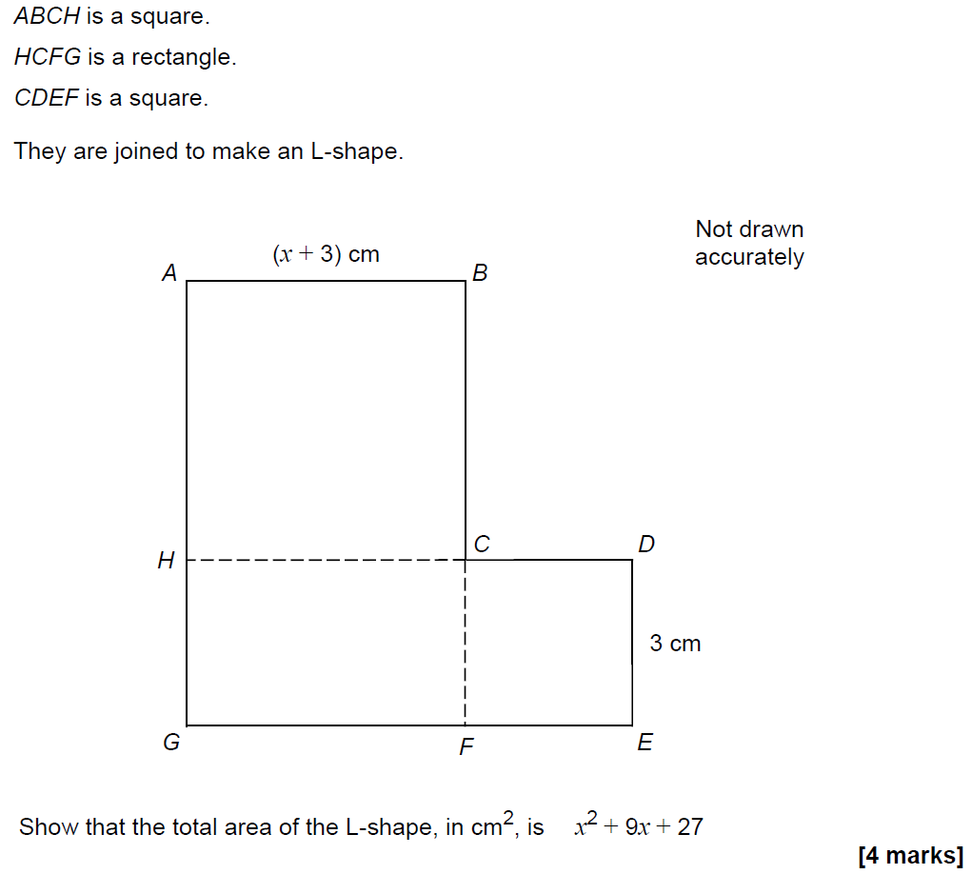
Show that…
SAM 1H Q12

Slide 3
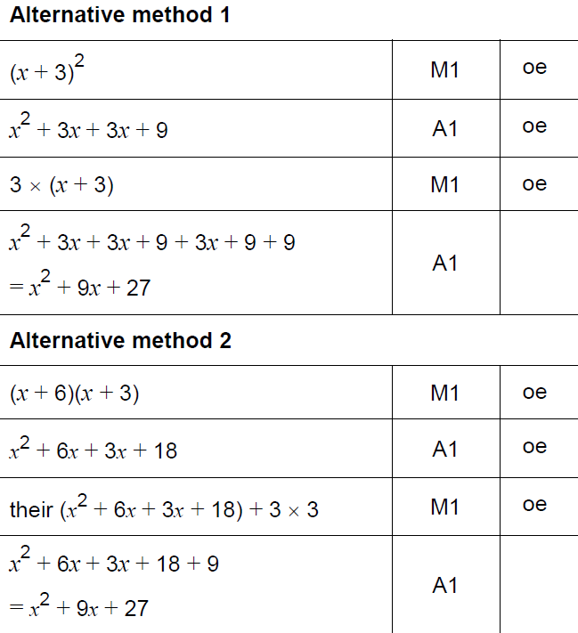
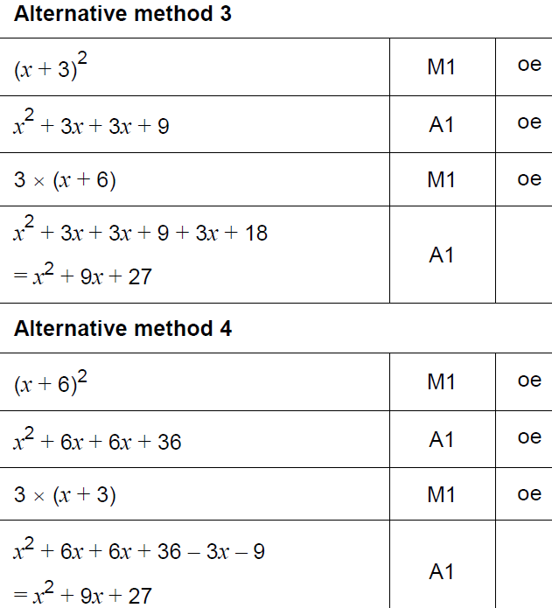
Show that…
SAM 1H Q12
A

Slide 4
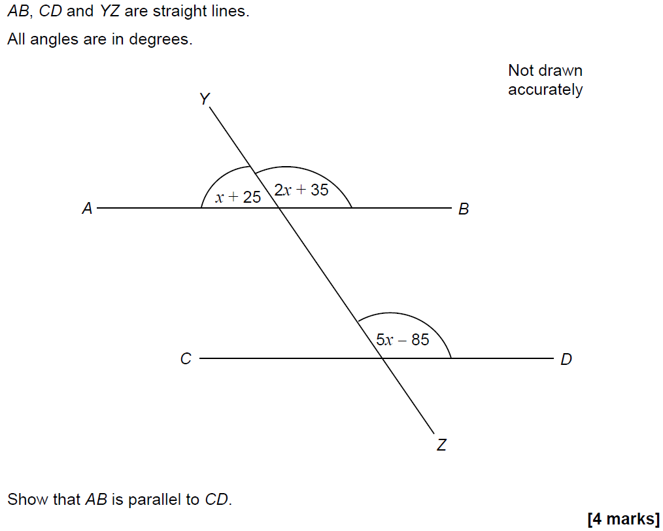
Show that…
SAM 1H Q16

Slide 5
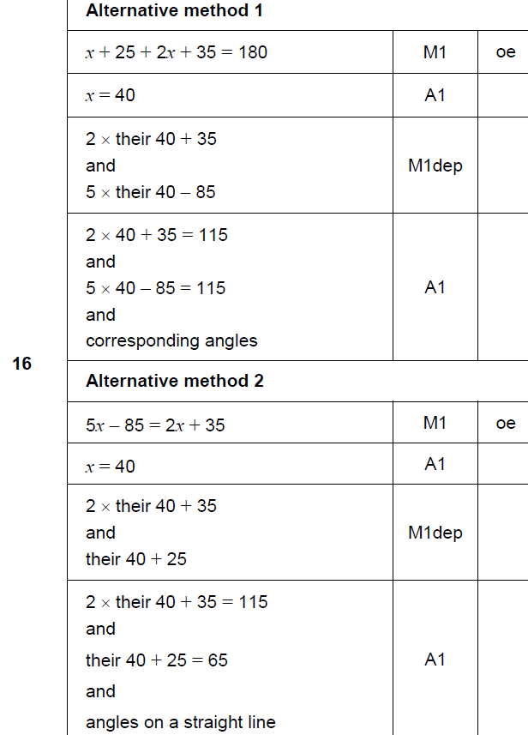
Show that…
SAM 1H Q16
A

Slide 6
Show that…
SAM 2H Q16

Slide 7
Show that…
SAM 2H Q16
A

Slide 8
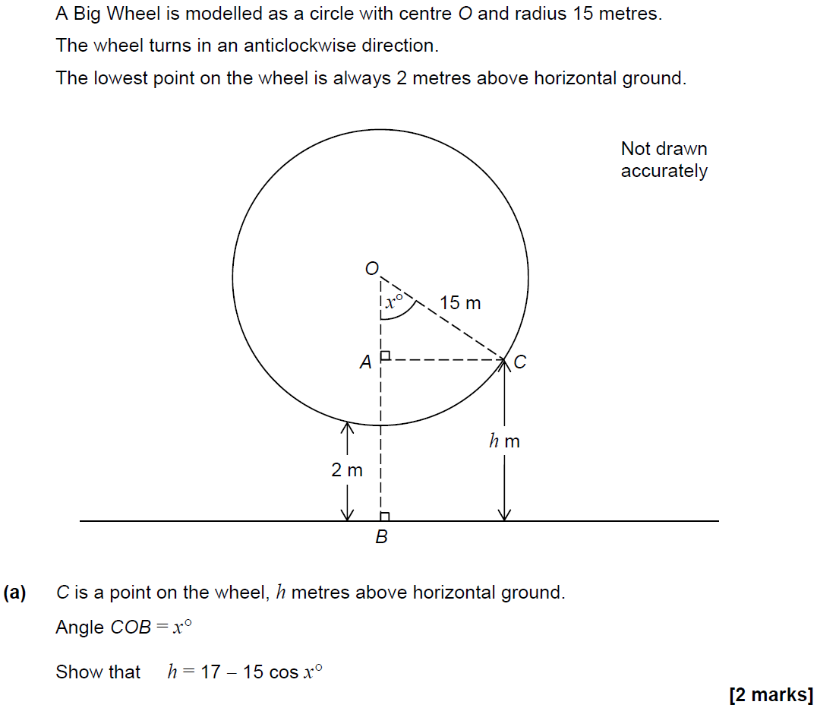
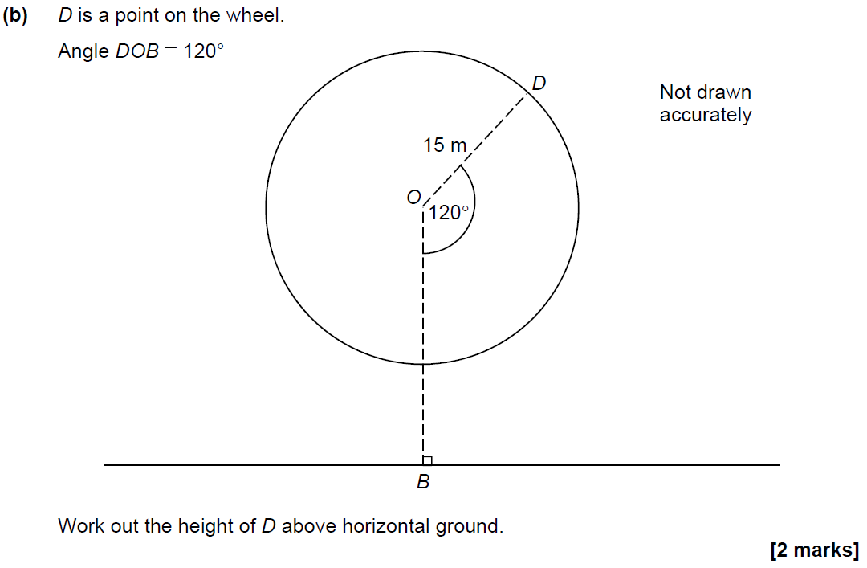
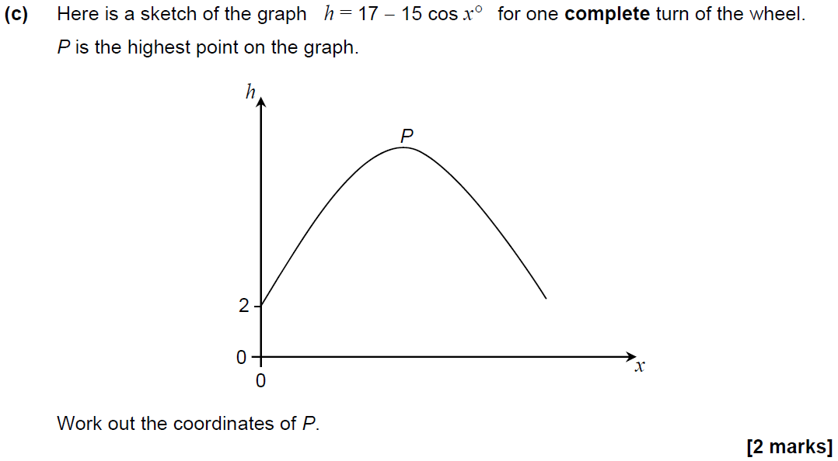
Show that…
SAM 2H Q24

Slide 9
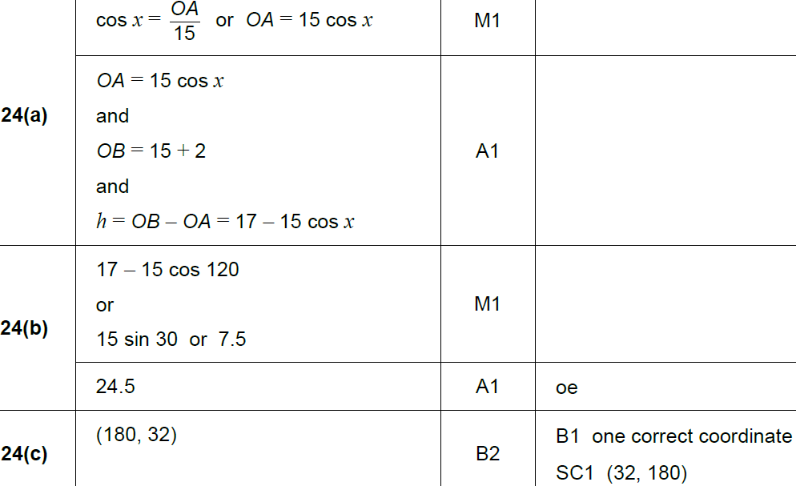
Show that…
SAM 2H Q24
A
B
C

Slide 10
Show that…
May 2017 1H Q17

Slide 11
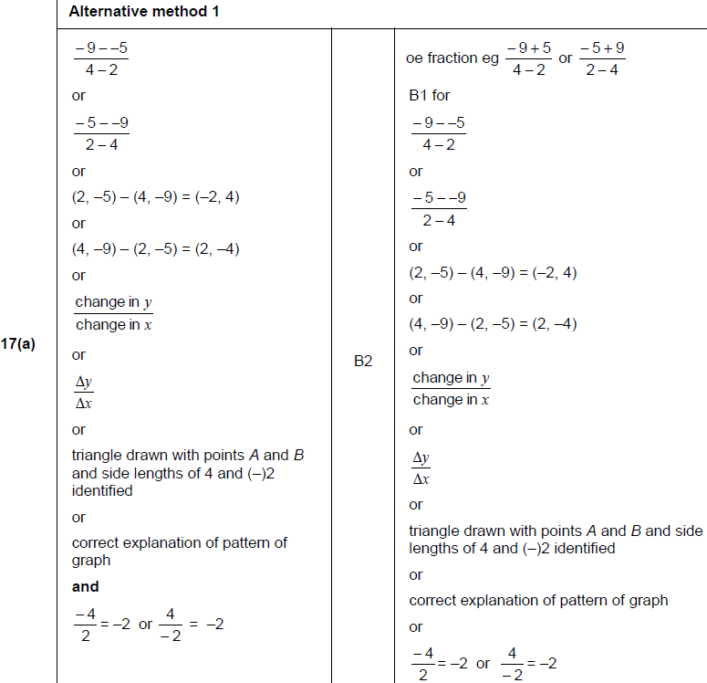
Show that…
May 2017 1H Q17
A

Slide 12
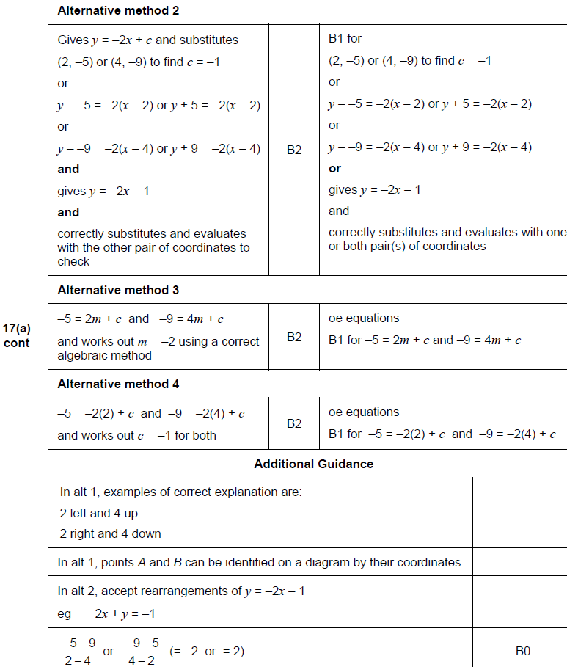
Show that…
May 2017 1H Q17
A Alternatives

Slide 13
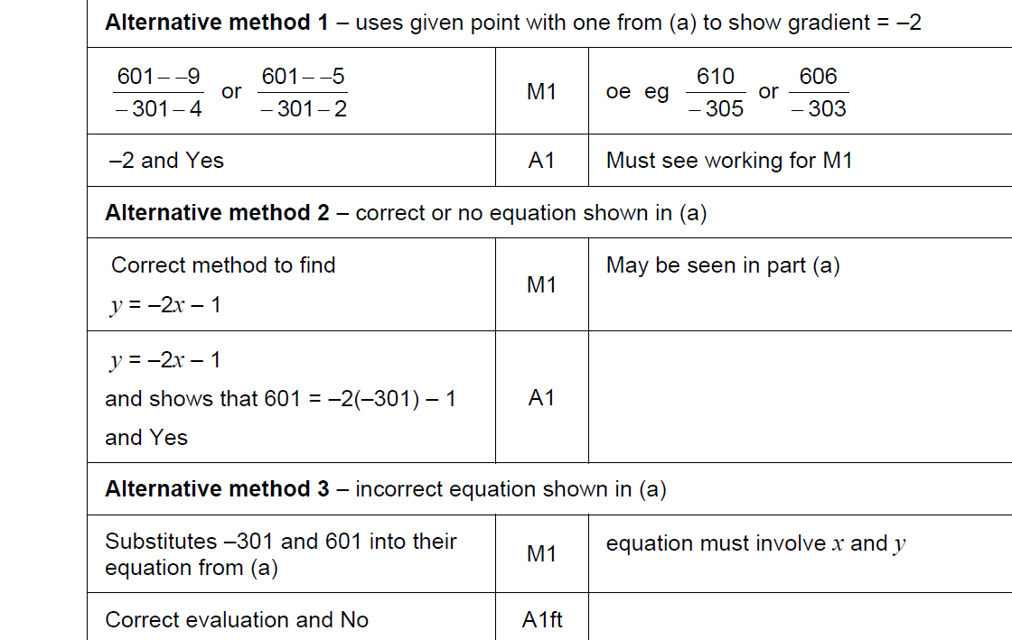
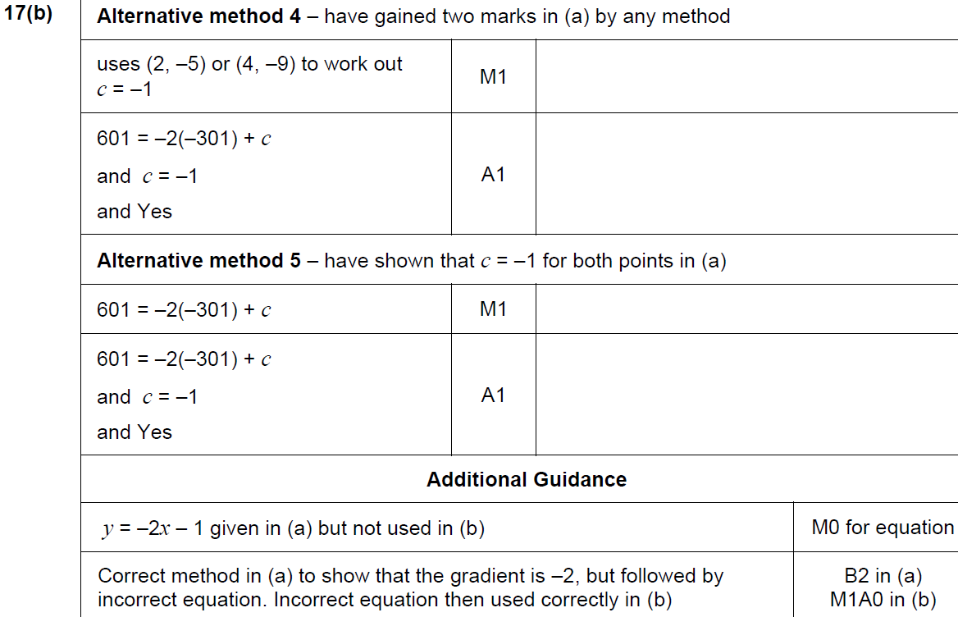
Show that…
May 2017 1H Q17
B

Slide 14
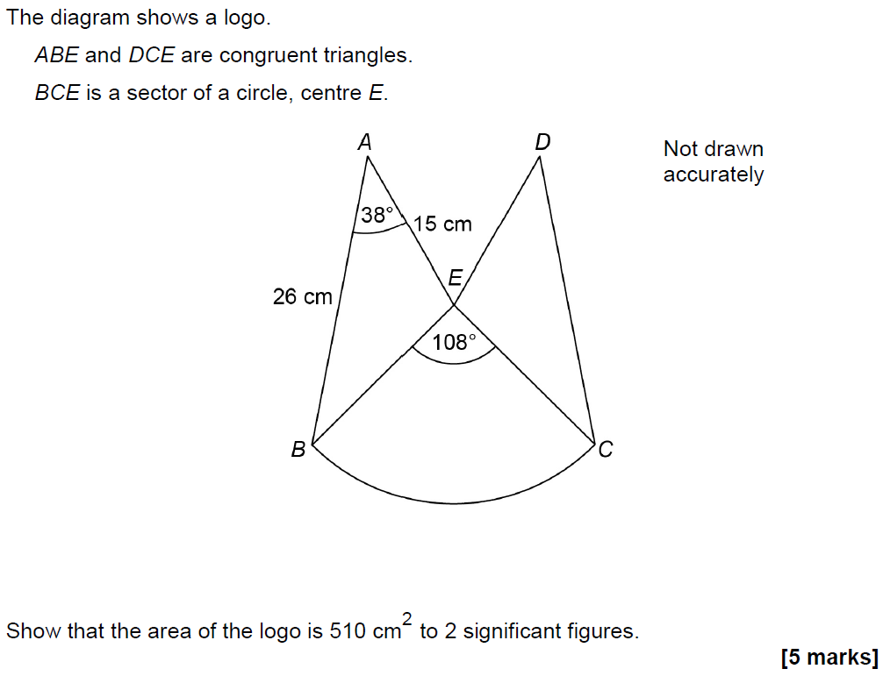
Show that…
June 2017 2H Q25

Slide 15
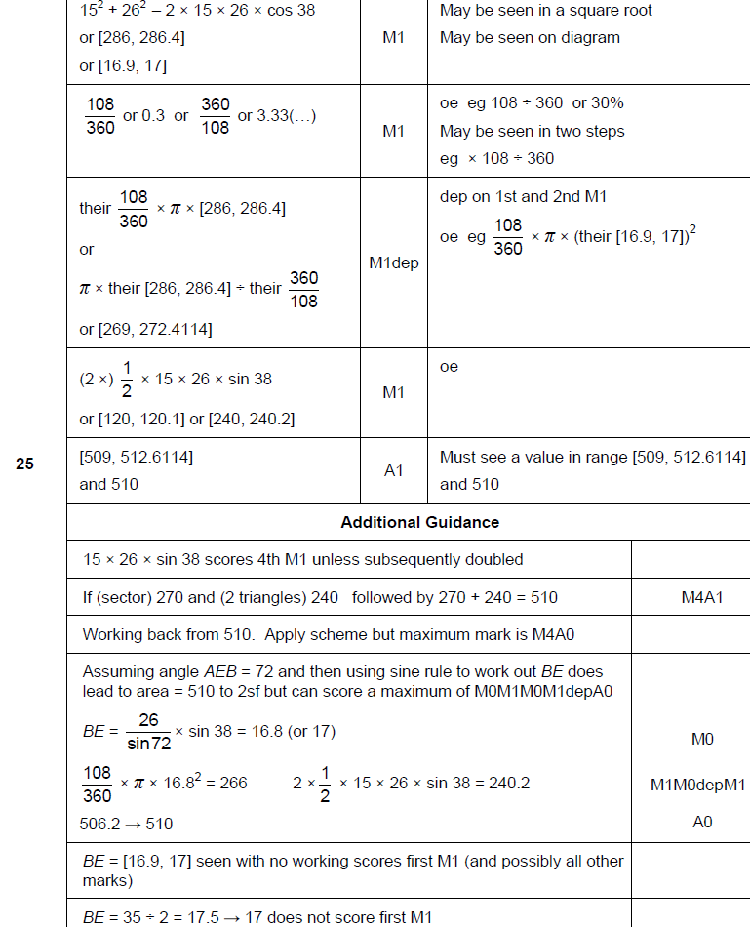
Show that…
June 2017 2H Q25
A

Slide 16
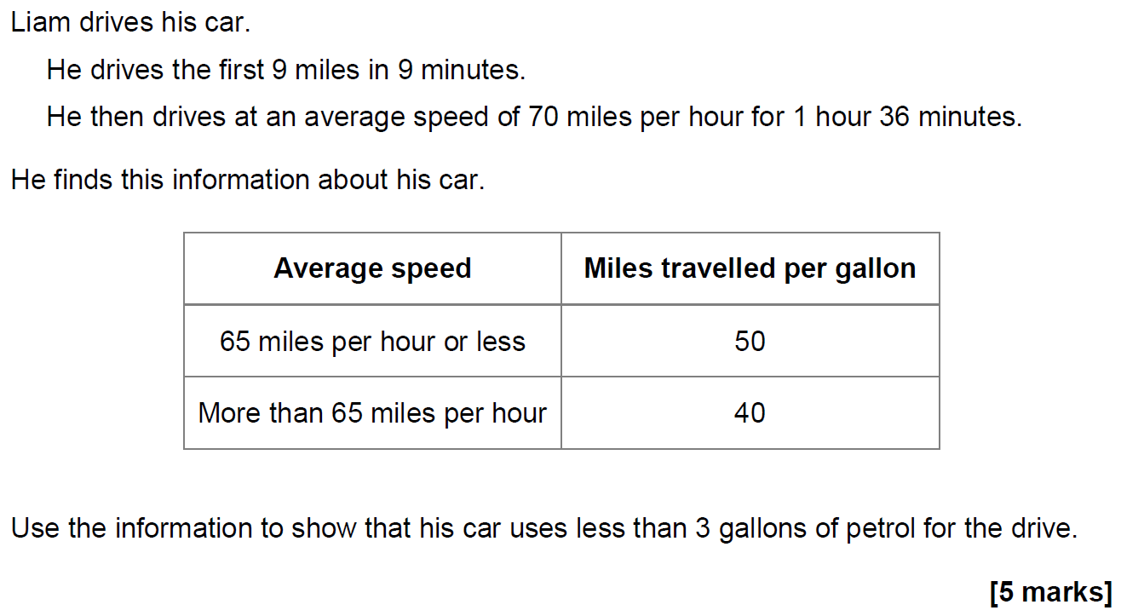
Show that…
June 2017 3H Q17

Slide 17
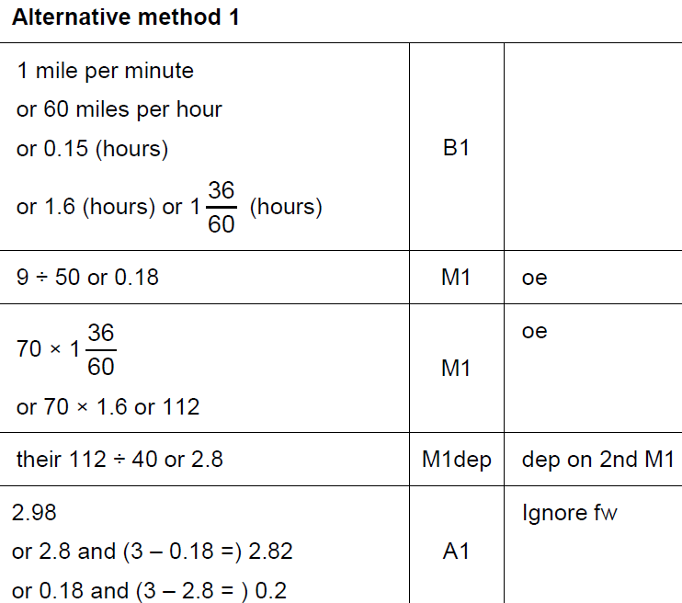
Show that…
June 2017 3H Q17
A

Slide 18
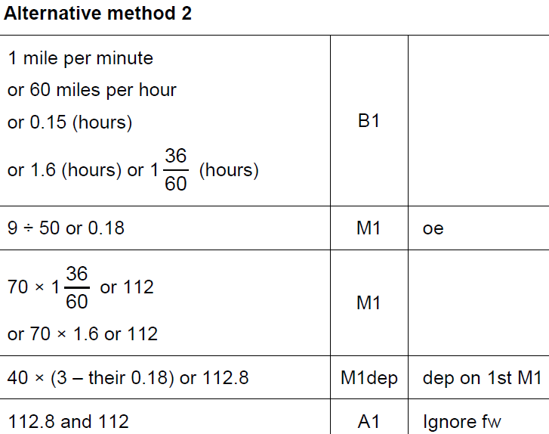
Show that…
June 2017 3H Q17
A Alternative 1

Slide 19
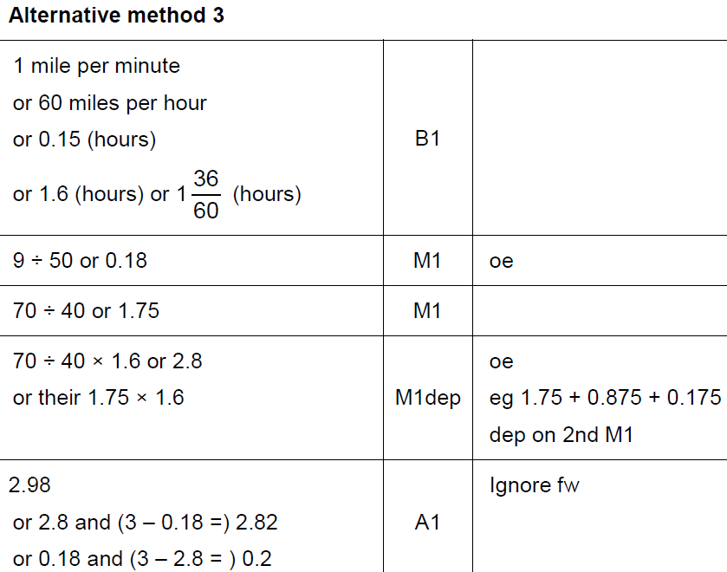
Show that…
June 2017 3H Q17
A Alternative 2

Slide 20
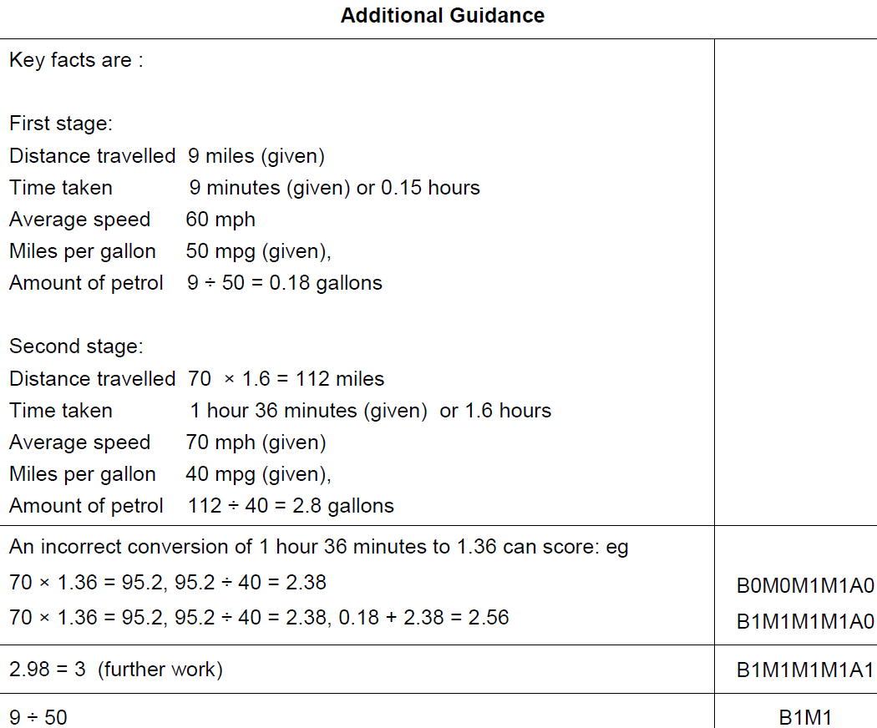
Show that…
June 2017 3H Q17
A notes

Slide 21
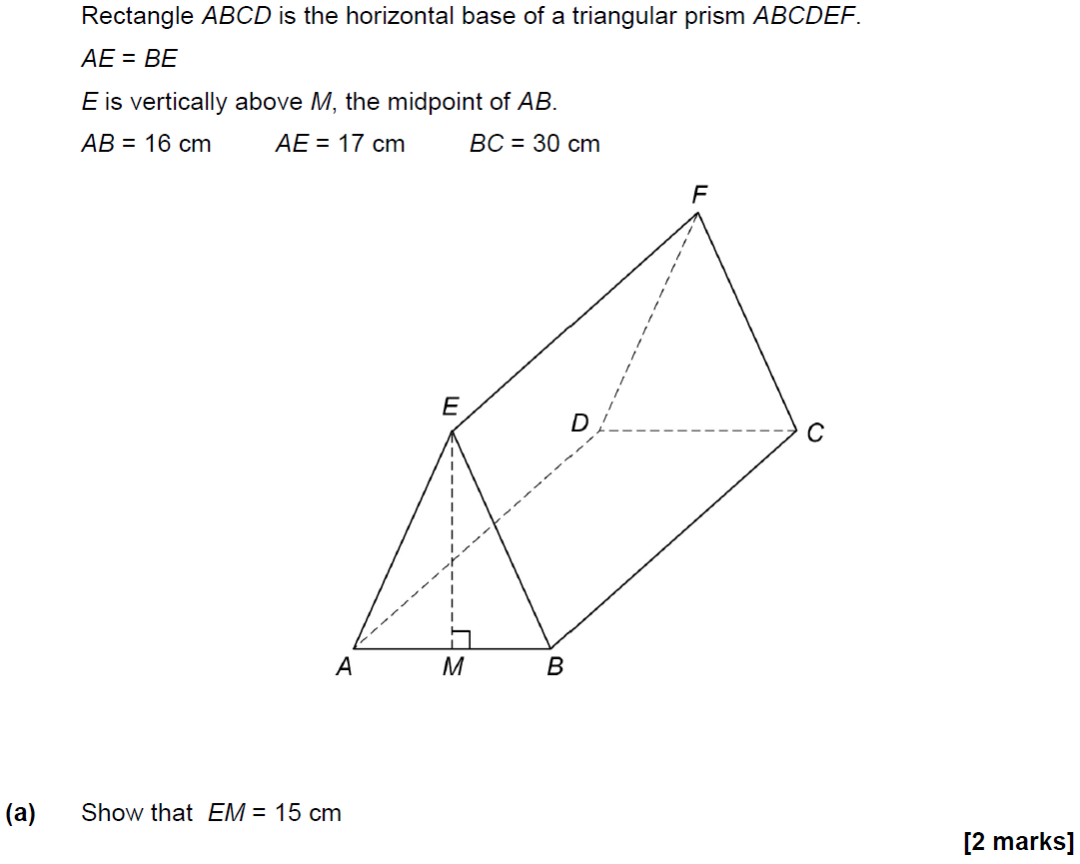
Show that…
June 2017 3H Q25

Slide 22
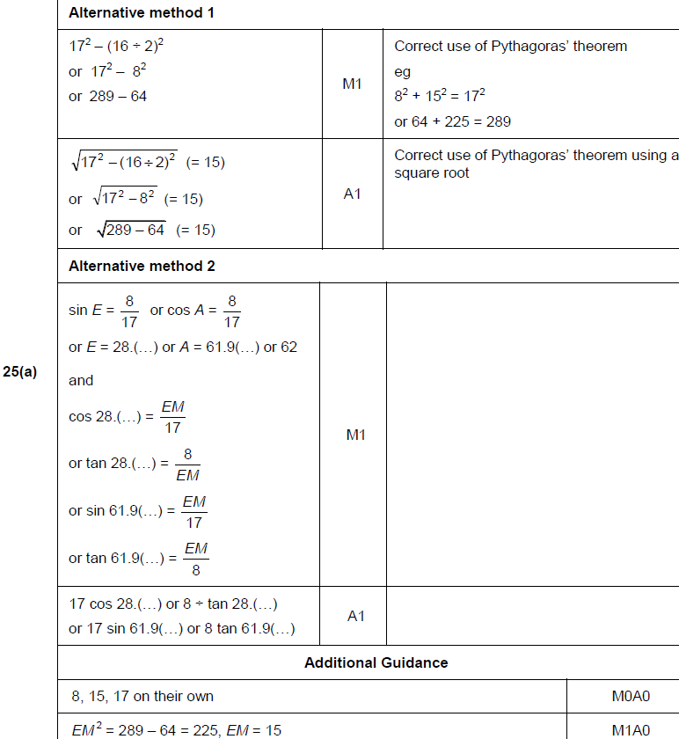
Show that…
June 2017 3H Q25
A

Slide 23
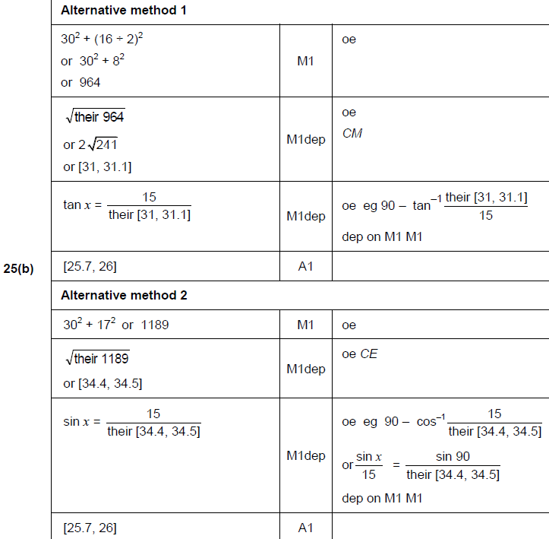
Show that…
June 2017 3H Q25
B

Slide 24
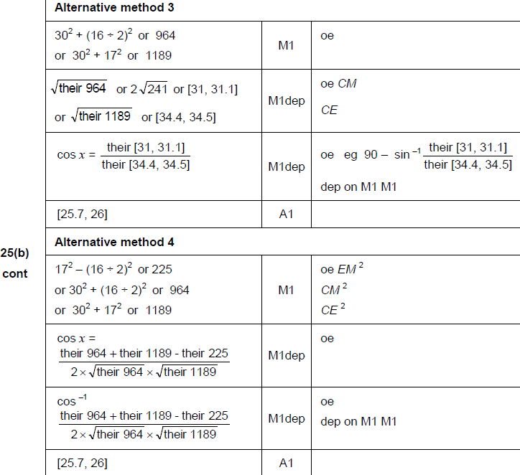
Show that…
June 2017 3H Q25
B Alternatives

Slide 25
Show that…
June 2017 3H Q27

Slide 26
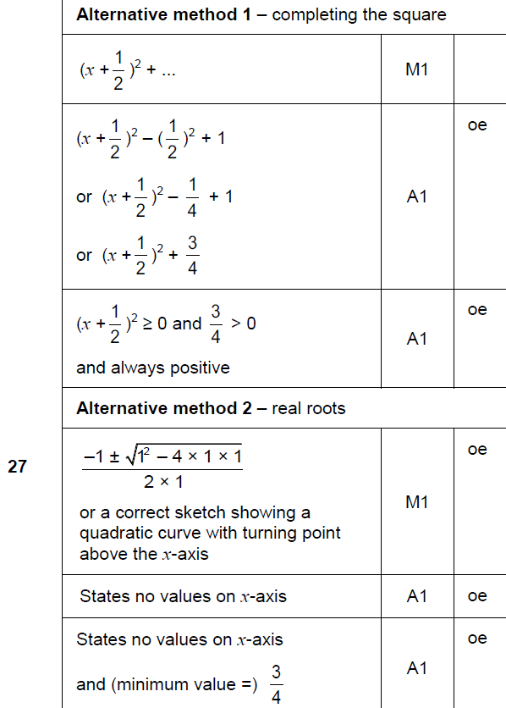
Show that…
June 2017 3H Q27
A

Slide 27
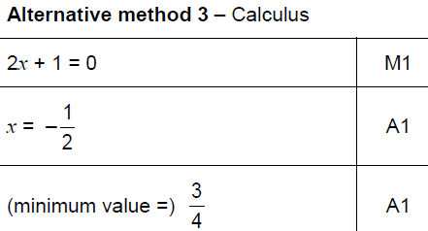
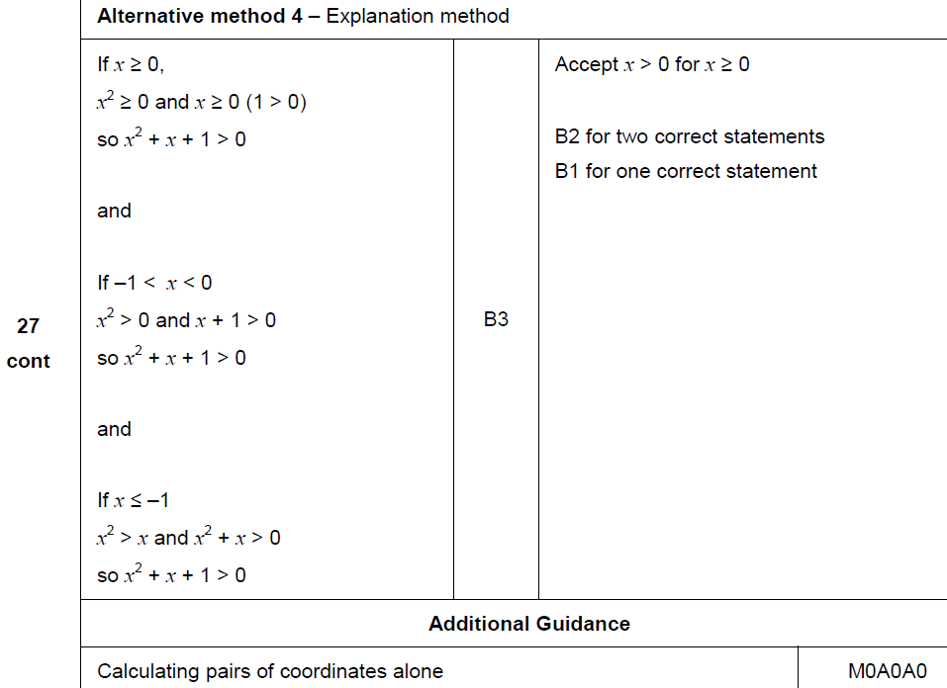
Show that…
June 2017 3H Q27
A Alternatives & notes

Slide 28
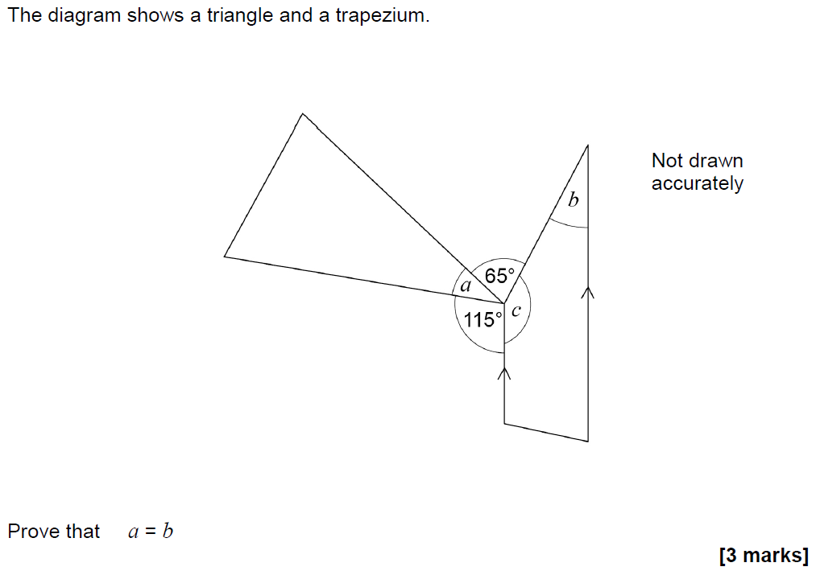
Show that…
Nov 2017 1H Q19

Slide 29
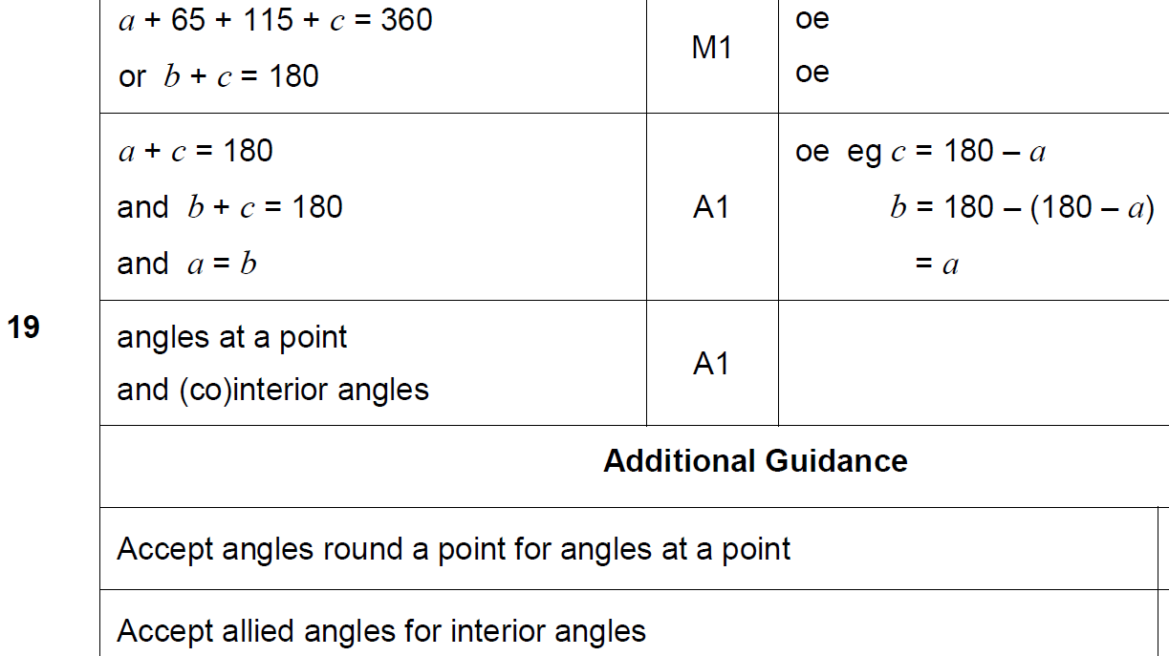
Show that…
Nov 2017 1H Q19
A

Slide 30
Show that…
Nov 2017 3H Q6

Slide 31
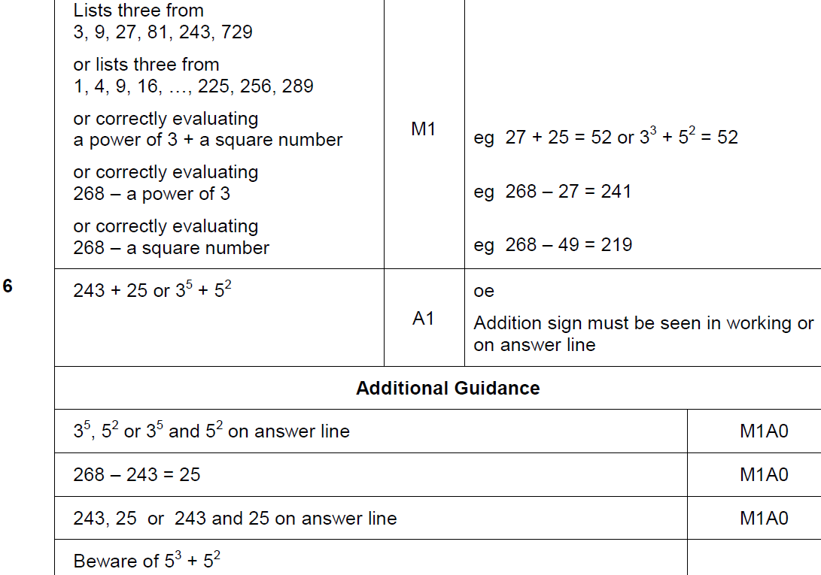
Show that…
Nov 2017 3H Q6
A

Slide 32
Show that…
May 2018 1H Q30
Show that the value of cos 30° × tan 60° + sin 30° is an integer.
[3 marks]

Slide 33
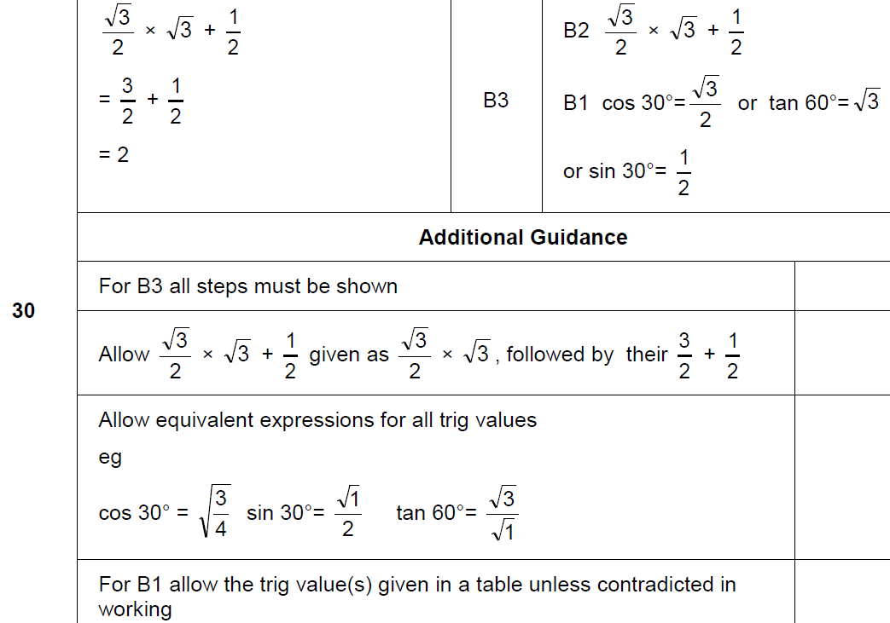
Show that…
May 2018 1H Q30
A

Slide 34
Show that…
June 2018 2H Q13

Slide 35
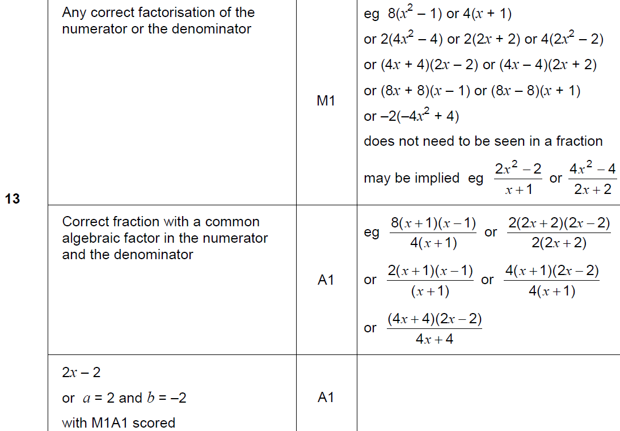
Show that…
June 2018 2H Q13
A

Slide 36
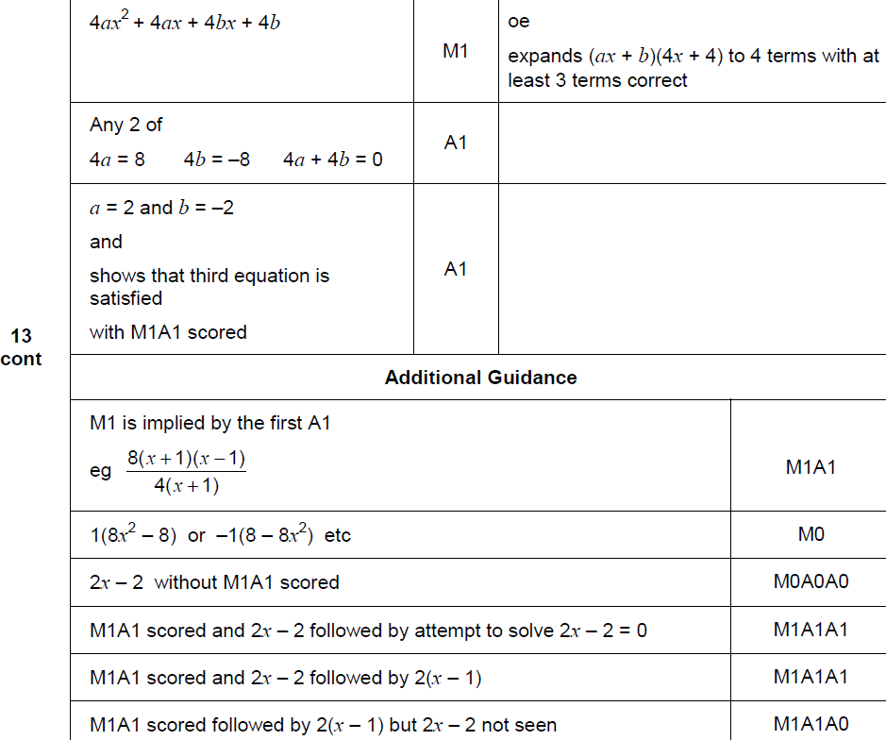
Show that…
June 2018 2H Q13
A Alternative & notes

Slide 37
Show that…
June 2018 2H Q26

Slide 38
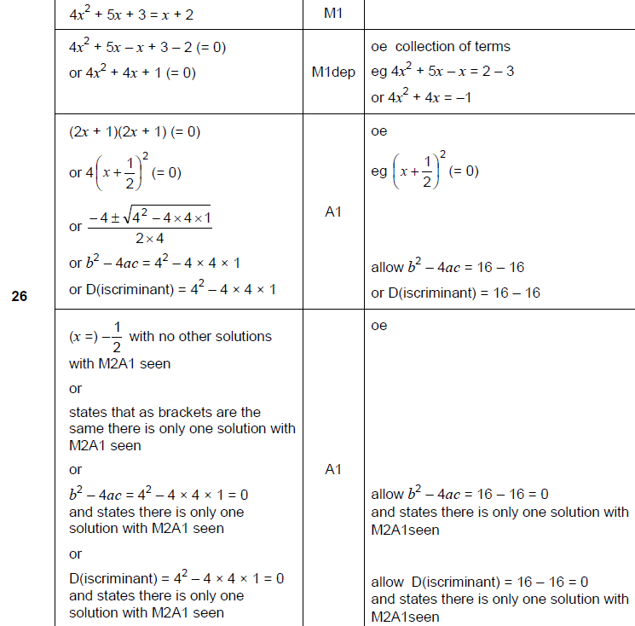
Show that…
June 2018 2H Q26
A

Slide 39
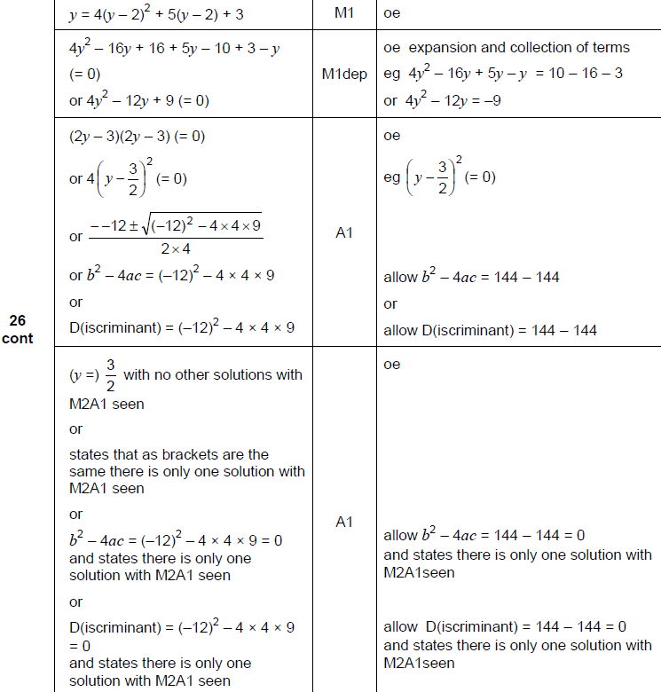
Show that…
June 2018 2H Q26
A Alternative

Slide 40
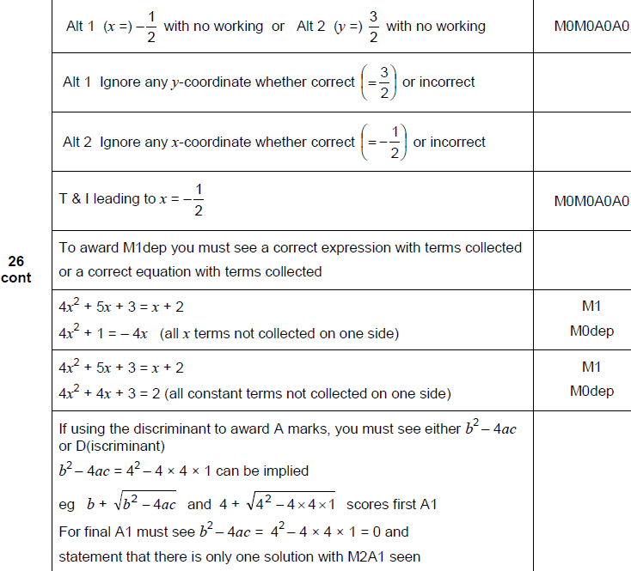
Show that…
June 2018 2H Q26
A notes

Slide 41
Show that…
June 2018 3H Q8

Slide 42
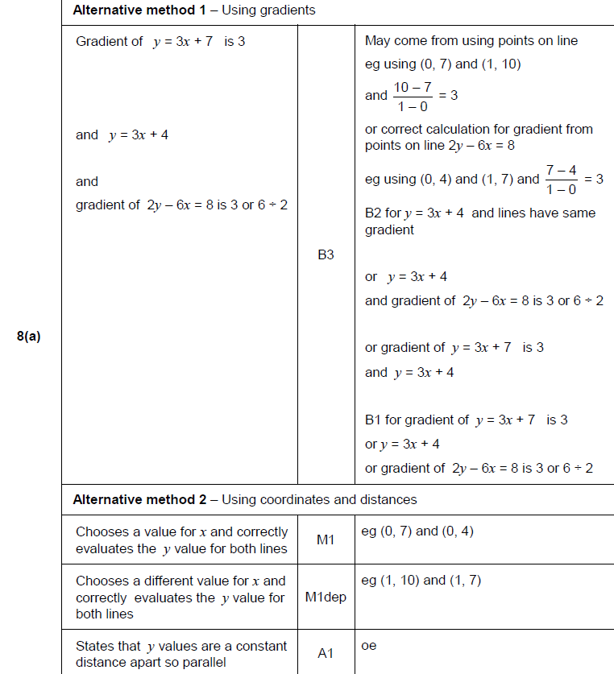
Show that…
June 2018 3H Q8
A

Slide 43
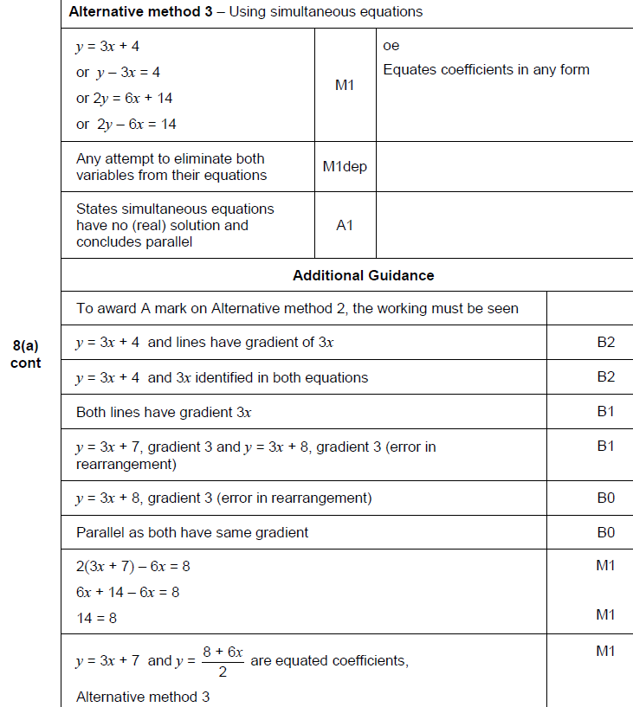
Show that…
June 2018 3H Q8
A Alternative & notes

Slide 44
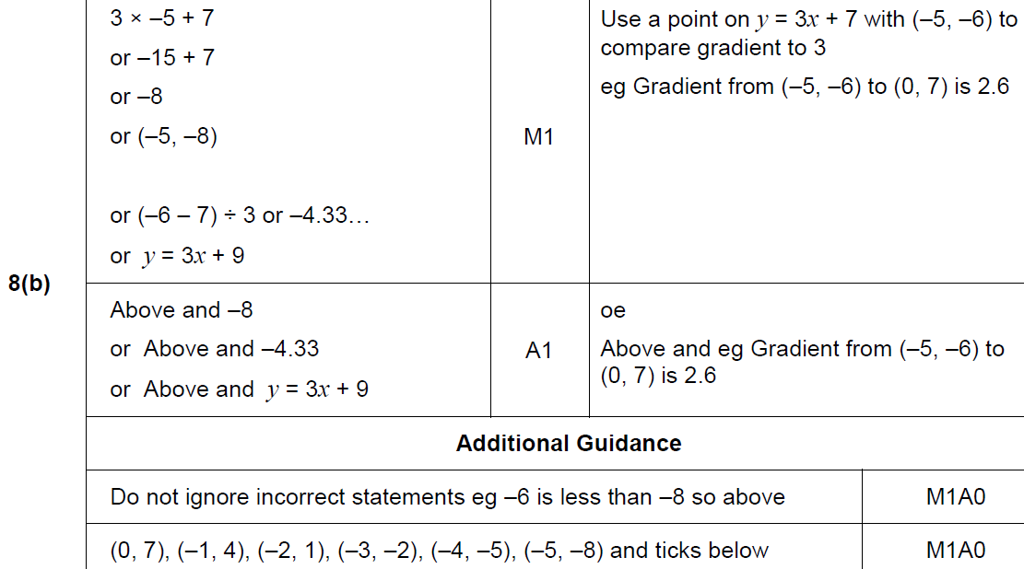
Show that…
June 2018 3H Q8
B

Slide 45
Show that…
June 2018 3H Q18

Slide 46
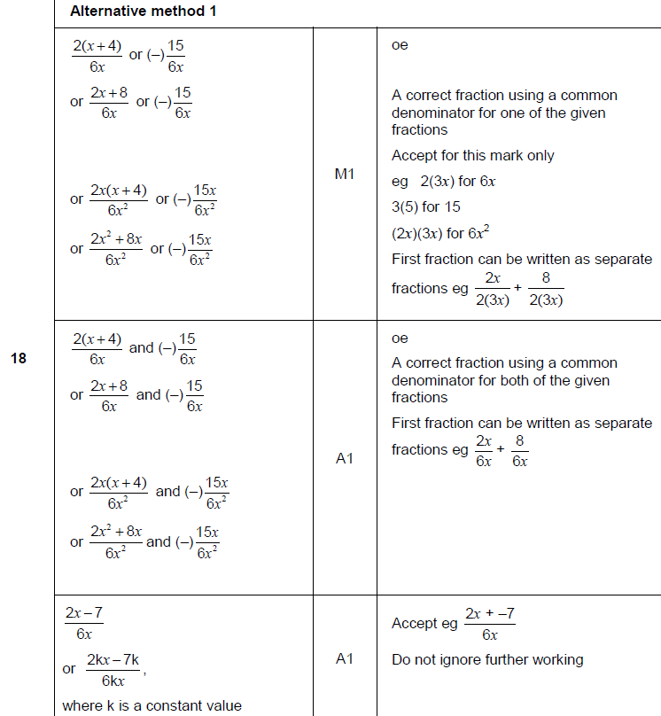
Show that…
June 2018 3H Q18
A

Slide 47
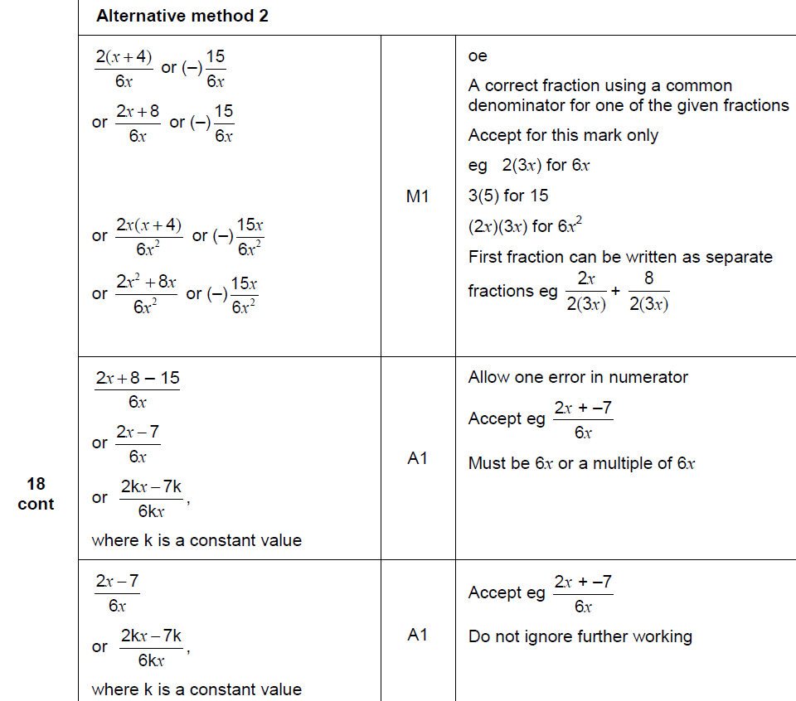
Show that…
June 2018 3H Q18
A Alternative

Slide 48
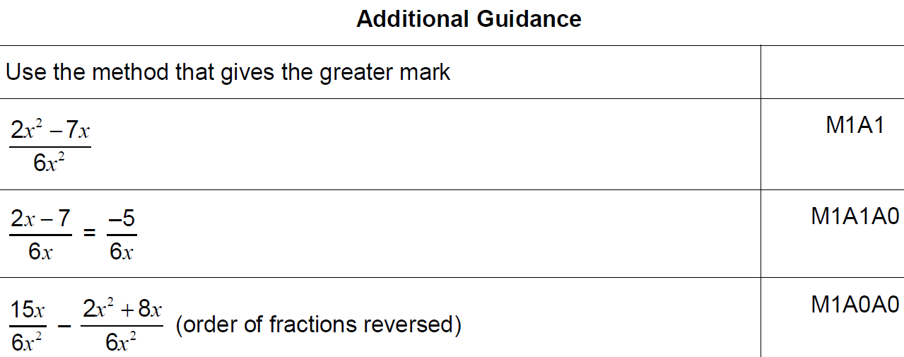
Show that…
June 2018 3H Q18
A notes

Slide 49
Show that…
Nov 2018 1H Q19
In a chess club, there are x boys and y girls.
(a) If 5 more boys and 8 more girls join, there would be half as many boys as girls.
Show that y = 2x + 2
[2 marks]
(b) If instead,
10 more boys and 1 more girl join, there would be the same number of boys and girls.
Work out x and y.
[3 marks]

Slide 50
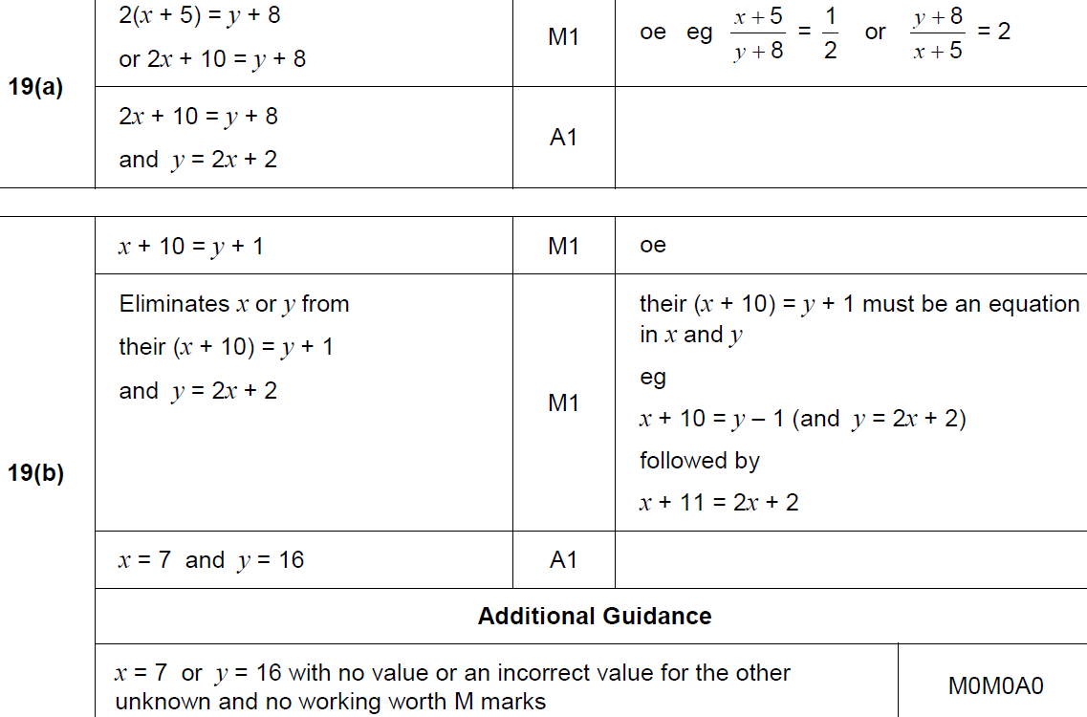
Show that…
Nov 2018 1H Q19
A
B

Slide 51
Show that…
Nov 2018 2H Q20

Slide 52
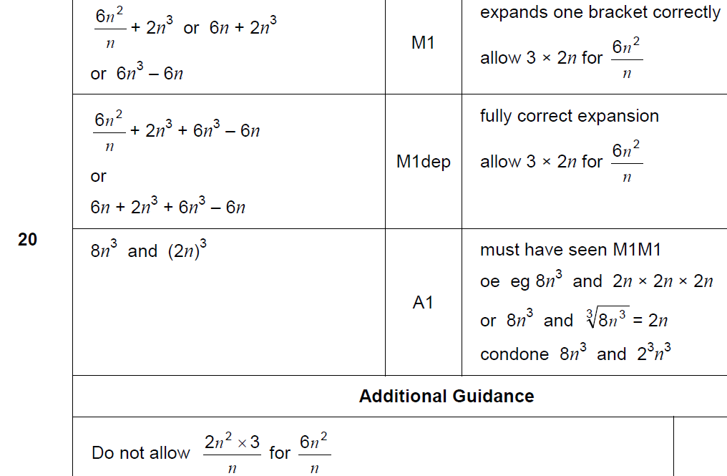
Show that…
Nov 2018 2H Q20
A

Slide 53
Show that…
Nov 2018 3H Q7

Slide 54
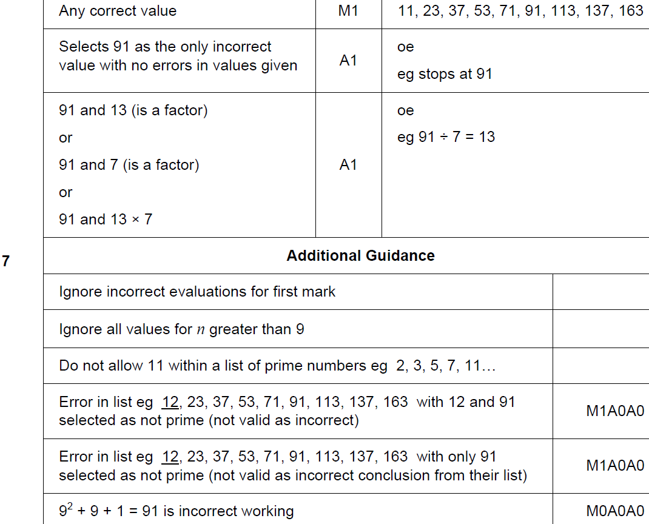
Show that…
Nov 2018 3H Q7
A

Slide 55
Show that…
Nov 2018 3H Q16
In a running club there are 50 females and 80 males.
If a female is chosen at random, the probability she has blue eyes is 0.38
If a male is chosen at random, the probability he has blue eyes is 0.6
One person is chosen at random.
Show that the probability the person has blue eyes is more than 0.5
[4 marks]

Slide 56
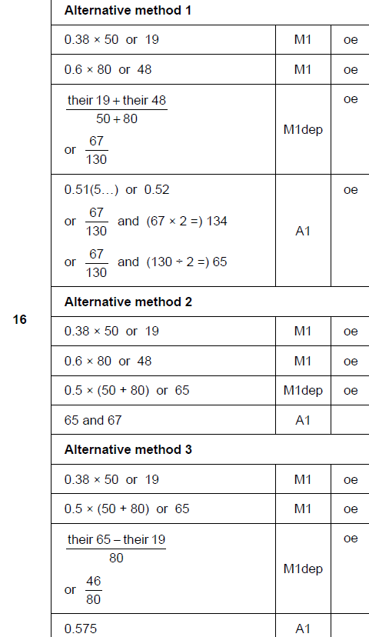
Show that…
Nov 2018 3H Q16
A

Slide 57
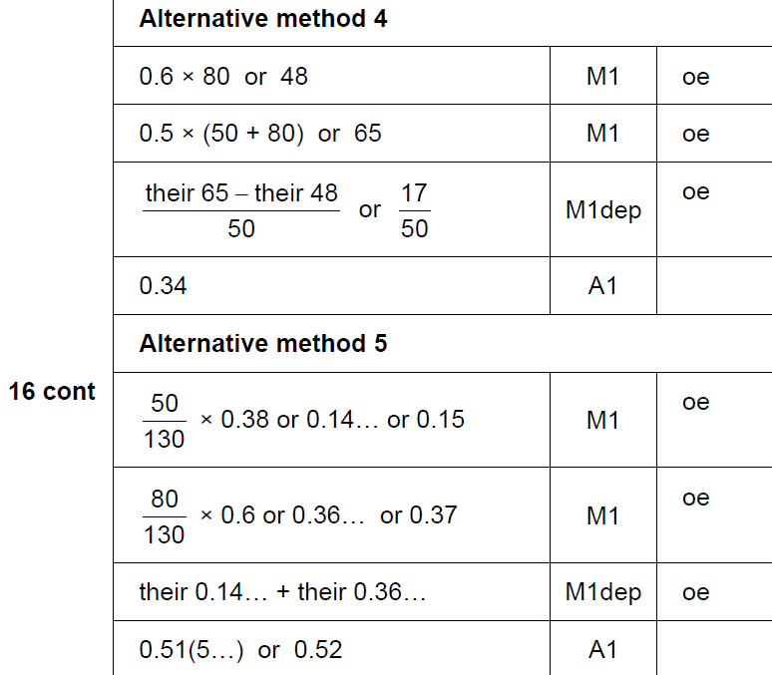
Show that…
Nov 2018 3H Q16
A Alternative 3 & 4

Slide 58
Show that…
Nov 2018 3H Q27

Slide 59
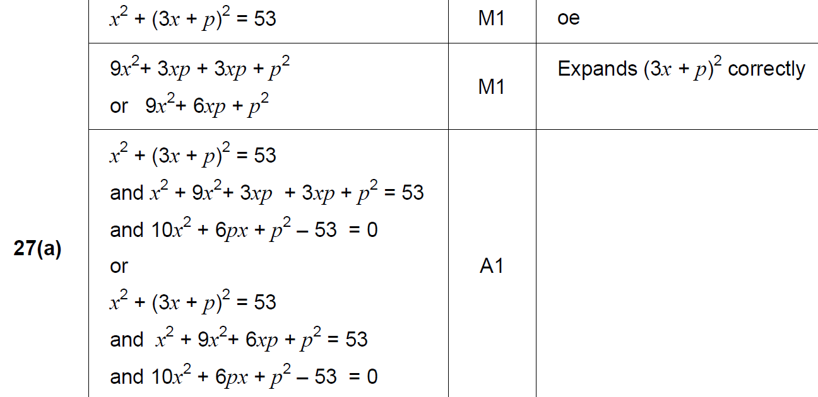
Show that…
Nov 2018 3H Q27
A

Slide 60
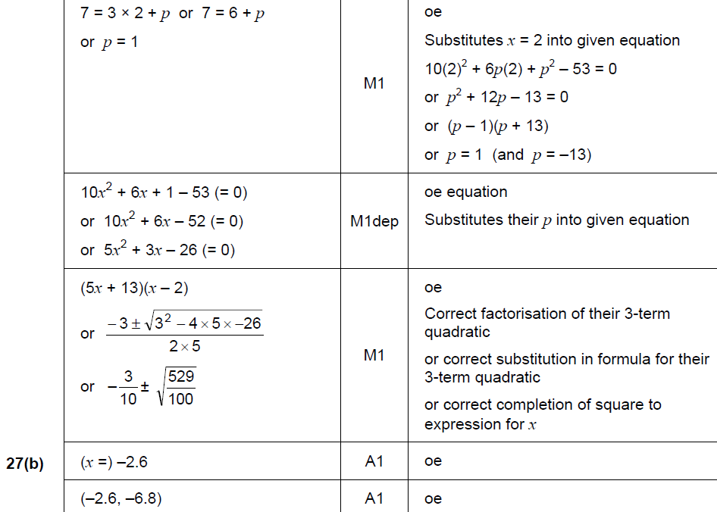
Show that…
Nov 2018 3H Q27
B

Slide 61
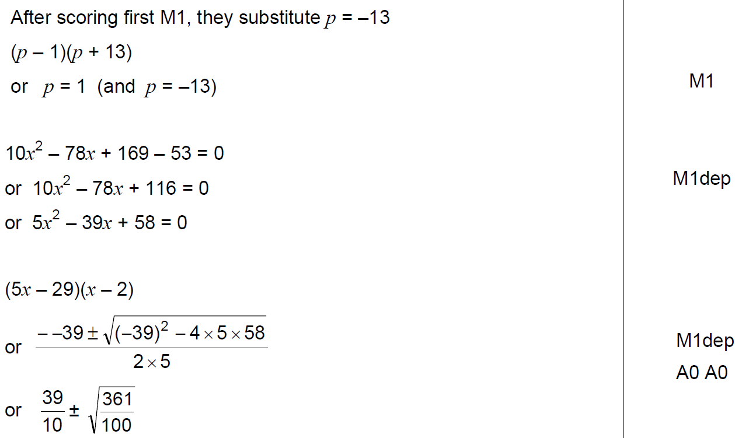
Show that…
Nov 2018 3H Q27
B notes

