Slide 1
Show that…/ Proof
Show that…/ Proof
(algebraic)
SAM
1H Q11
Practice
1H Q12
May 2017
1H Q10
Nov 2017
2H Q11
June 2018
2H Q15
SAM
1H Q17
Practice
1H Q13
June 2017
2H Q8
Nov 2017
2H Q18
June 2018
3H Q4
Nov 2018
2H Q13
SAM
1H Q20
Practice
2H Q15
June 2017
2H Q14
Nov 2017
3H Q14
June 2018
3H Q9
Nov 2018
2H Q20
SAM
2H Q14
Practice
2H Q17
June 2017
2H Q21
Nov 2017
3H Q17
June 2018
3H Q14
Nov 2018
3H Q5
SAM
2H Q16*
Practice
3H Q11
June 2017
3H Q17
May 2018
1H Q12
June 2018
3H Q19
Nov 2018
3H Q16
*By counter-example
SAM
3H Q7
Practice
3H Q15
Nov 2017
1H Q17
May 2018
1H Q13
Nov 2018
1H Q2
Nov 2018
3H Q21
Proof of algebraic properties
SAM
3H Q8
Practice
3H Q17
Nov 2017
2H Q8
June 2018
2H Q8
Nov 2018
1H Q22
Proof

Slide 2
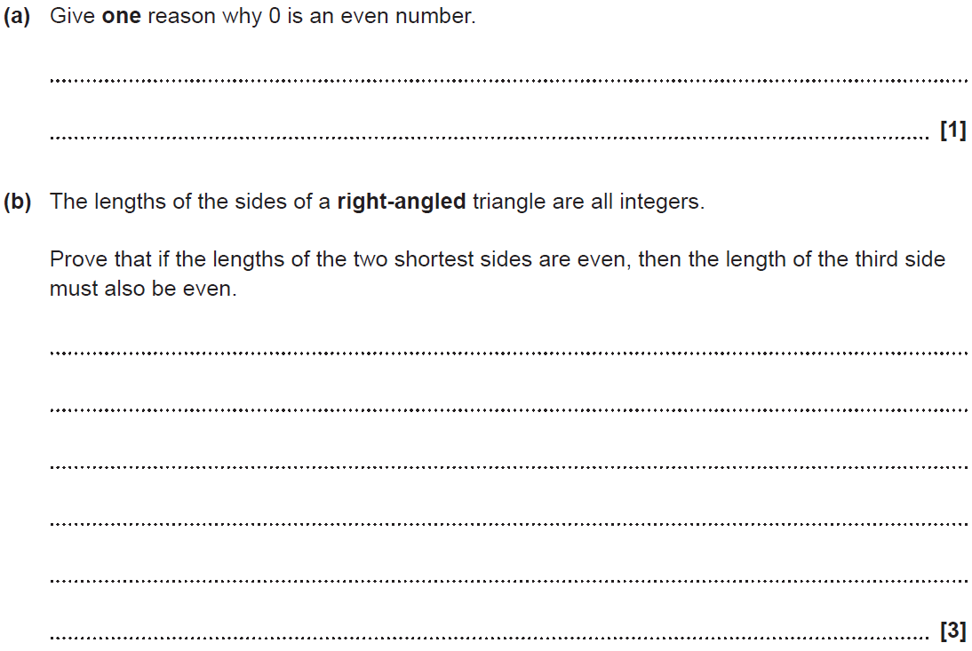
Show that…
SAM 1H Q11

Slide 3
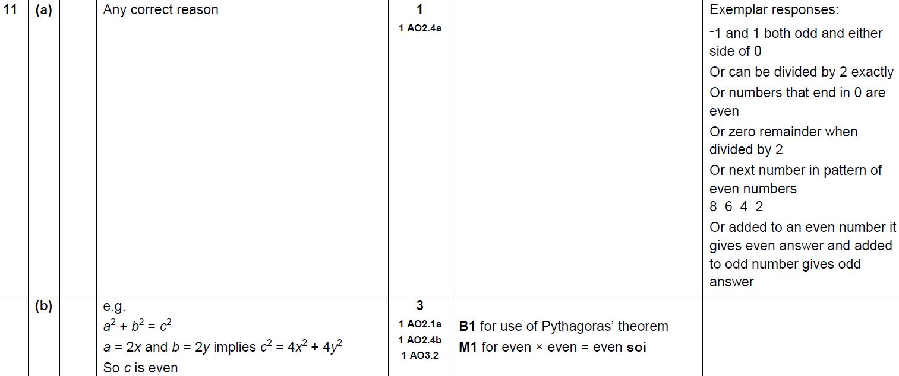
Show that…
SAM 1H Q11
A
B

Slide 4
Show that…
SAM 1H Q17

Slide 5
Show that…
SAM 1H Q17
A

Slide 6
Show that…
SAM 1H Q17

Slide 7
Show that…
SAM 1H Q17
A

Slide 8
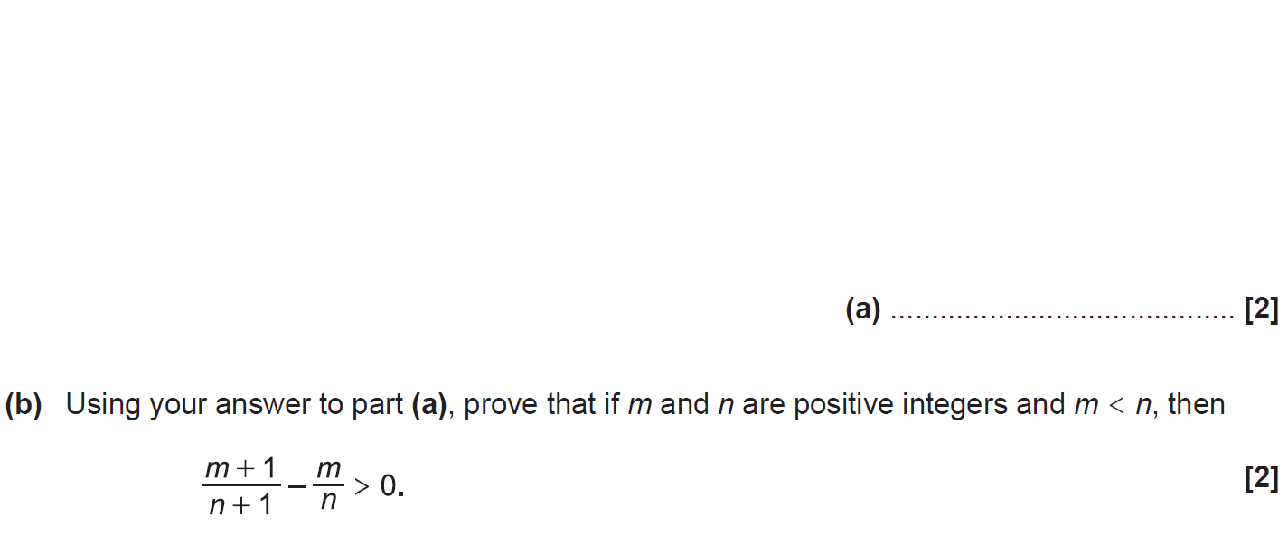
Show that…
SAM 1H Q20

Slide 9
Show that…
SAM 1H Q20
A
B

Slide 10
Show that…
SAM 2H Q14

Slide 11
Show that…
SAM 2H Q14
A

Slide 12
Show that…
SAM 2H Q16

Slide 13
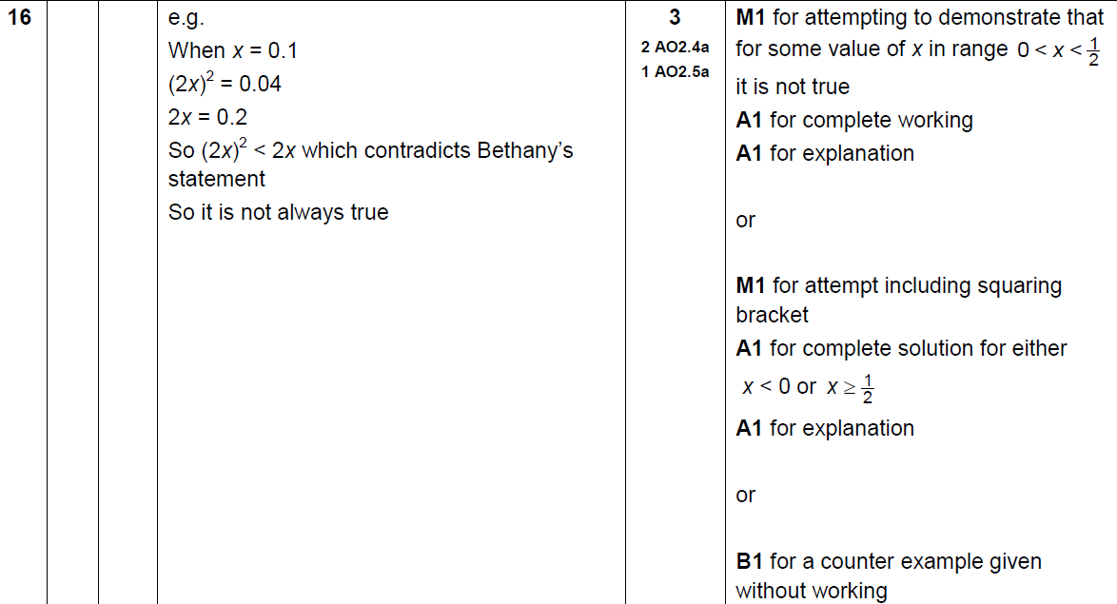
Show that…
SAM 2H Q16
A

Slide 14
Show that…
SAM 3H Q7

Slide 15
Show that…
SAM 3H Q7
A

Slide 16
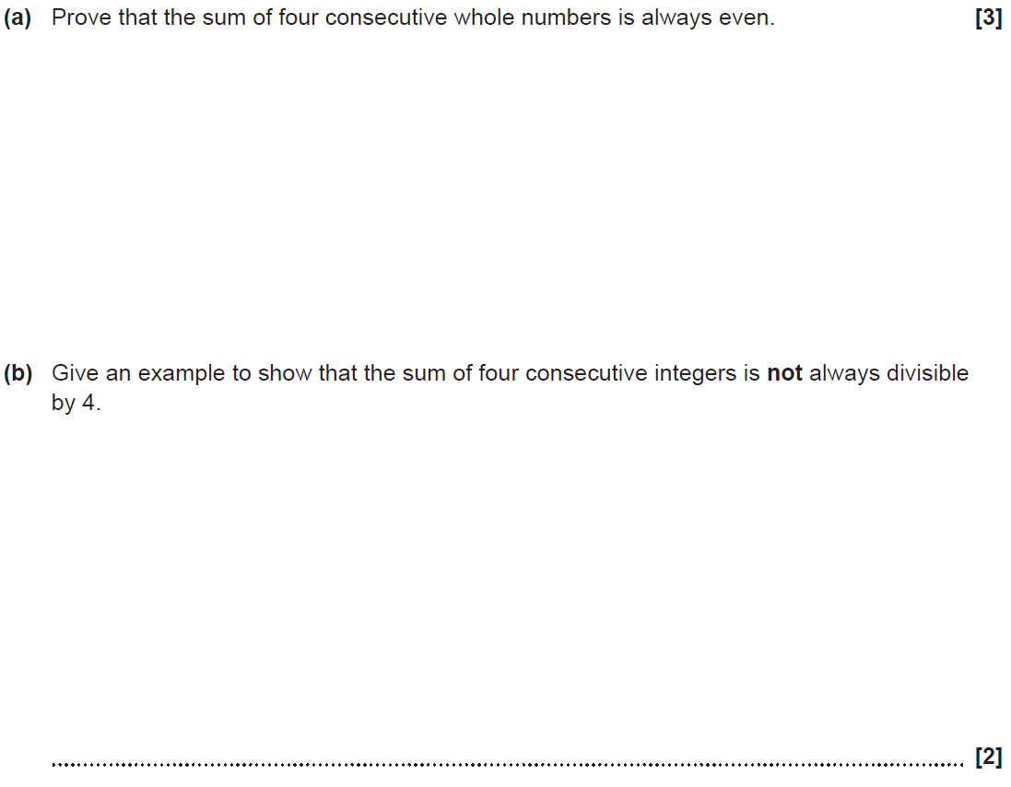
Show that…
SAM 3H Q8

Slide 17
Show that…
SAM 3H Q8
A
B

Slide 18
Show that…
Practice 1H Q12

Slide 19
Show that…
Practice 1H Q12
A

Slide 20
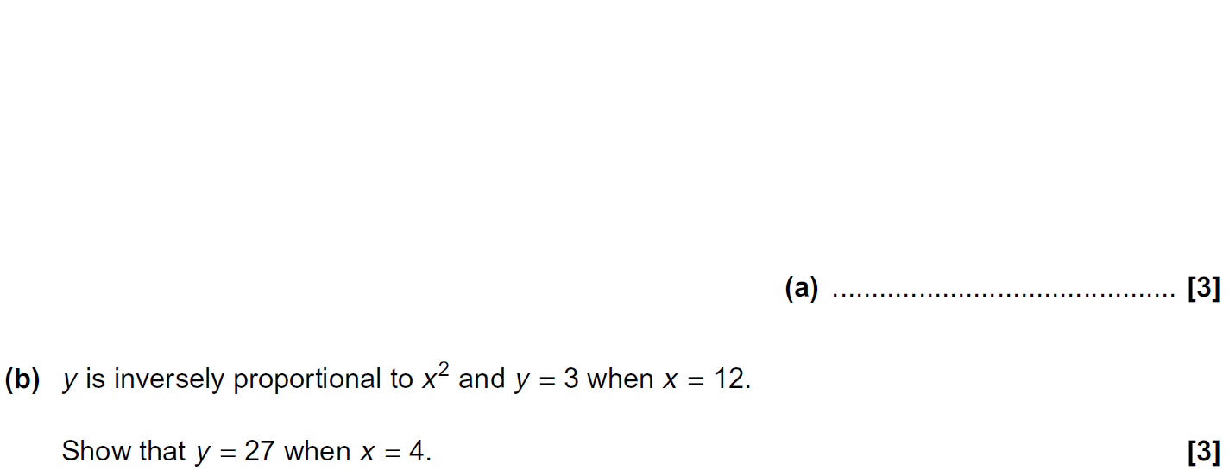
Show that…
Practice 1H Q13

Slide 21
Show that…
Practice 1H Q13
A
B

Slide 22
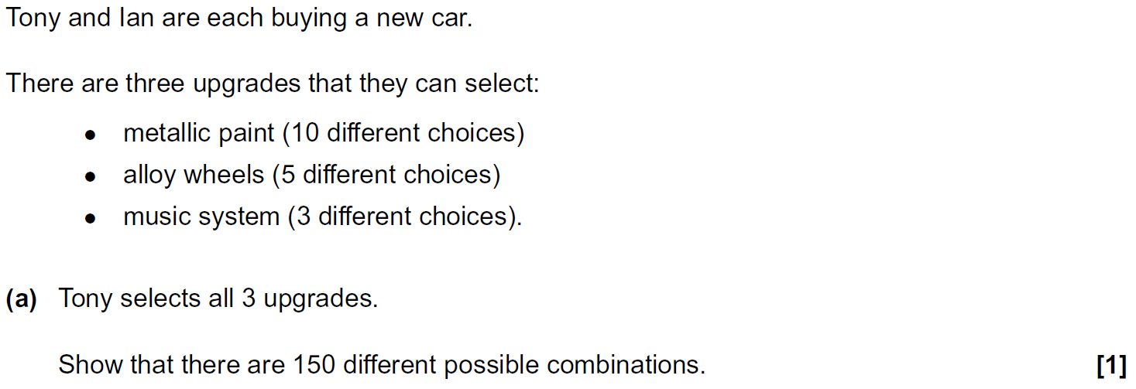
Show that…
Practice 2H Q15

Slide 23
Show that…
Practice 2H Q15
A
B

Slide 24
Show that…
Practice 2H Q15

Slide 25
Show that…
Practice 2H Q15
A
B

Slide 26
Show that…
Practice 2H Q17

Slide 27
Show that…
Practice 2H Q17
A

Slide 28
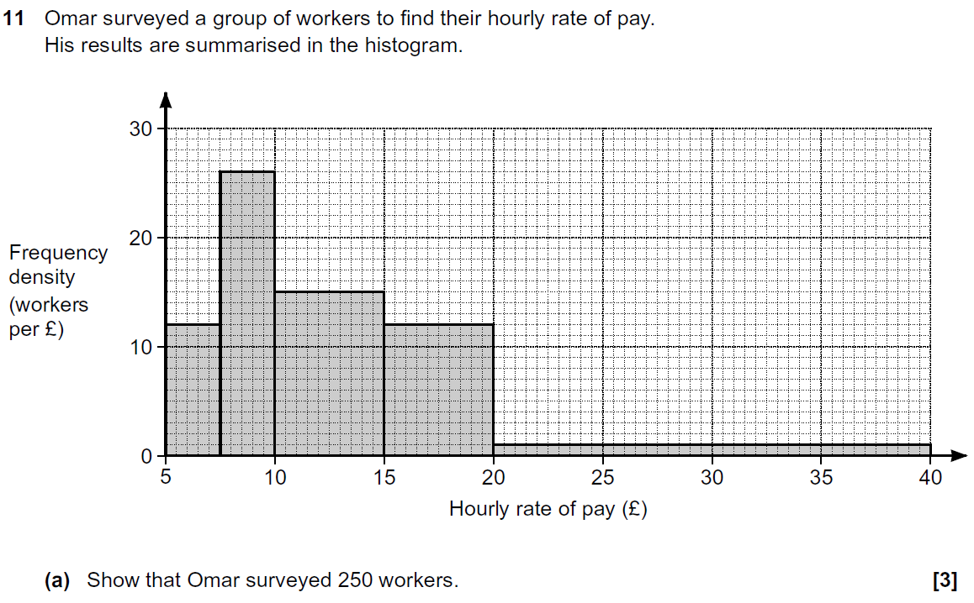
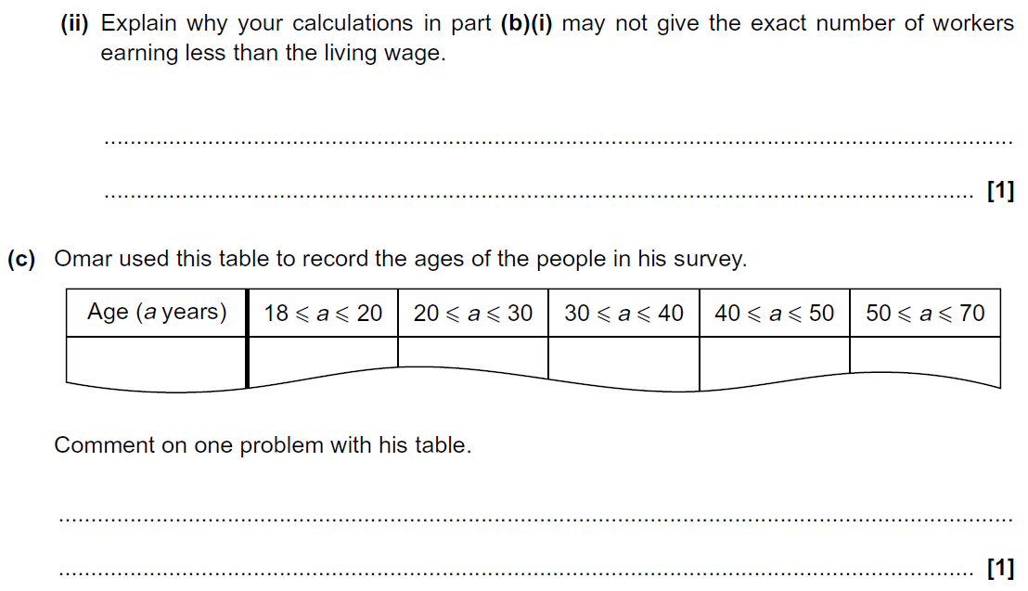
Show that…
Practice 3H Q11

Slide 29
Show that…
Practice 3H Q11
A
B (i)
B (ii)
C

Slide 30
Show that…
Practice 3H Q15

Slide 31
Show that…
Practice 3H Q15
A

Slide 32
Show that…
Practice 3H Q17

Slide 33
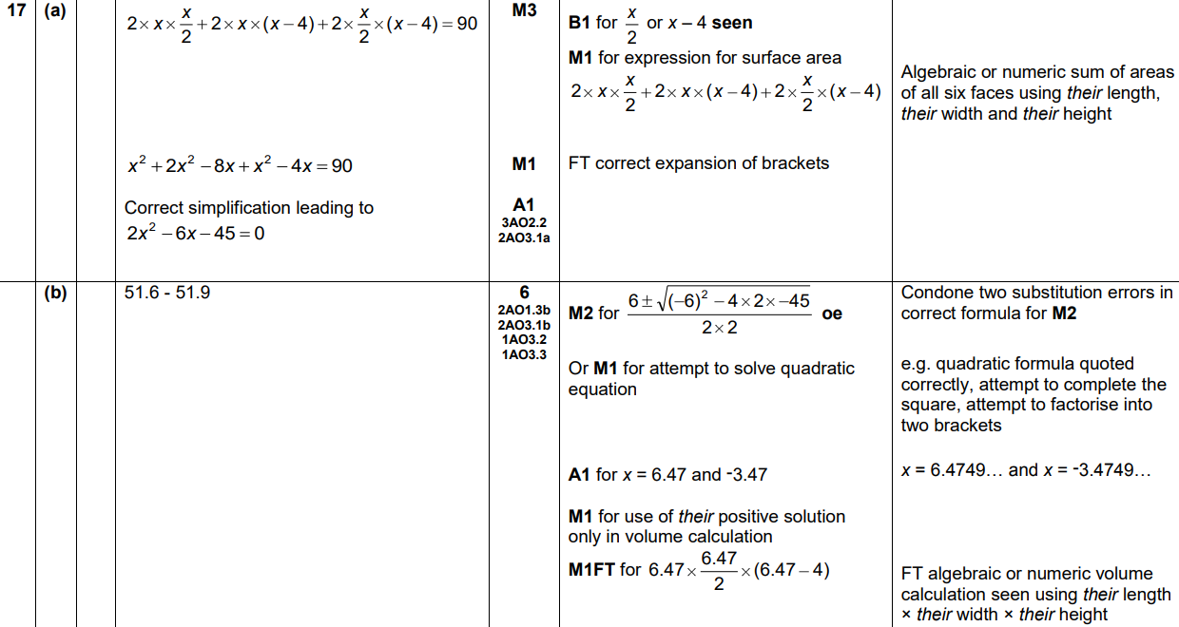
Show that…
Practice 3H Q17
A
B

Slide 34
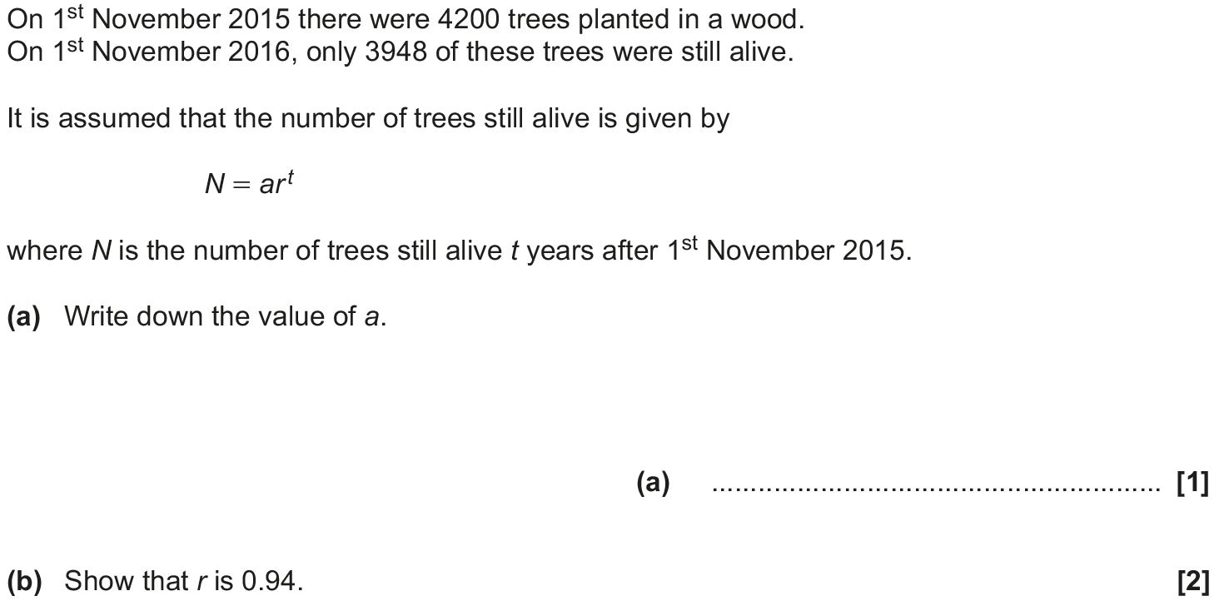
Show that…
May 2017 1H Q10

Slide 35
Show that…
May 2017 1H Q10
A
B
C

Slide 36
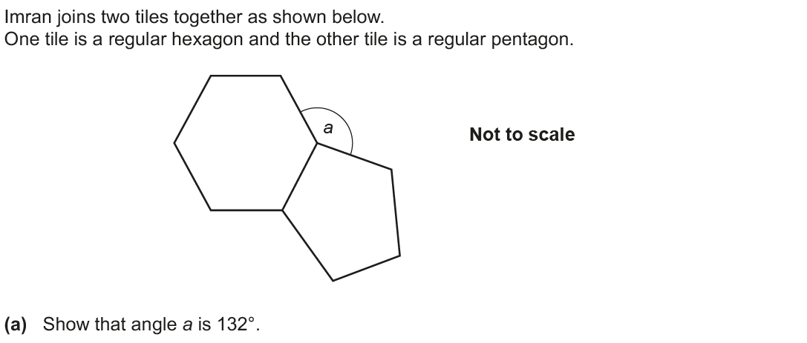
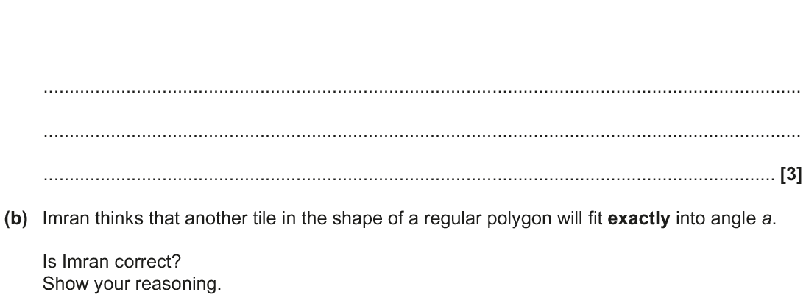
Show that…
June 2017 2H Q8

Slide 37
Show that…
June 2017 2H Q8
A
B

Slide 38
Show that…
June 2017 2H Q14

Slide 39
Show that…
June 2017 2H Q14
A
B

Slide 40
Show that…
June 2017 2H Q21

Slide 41
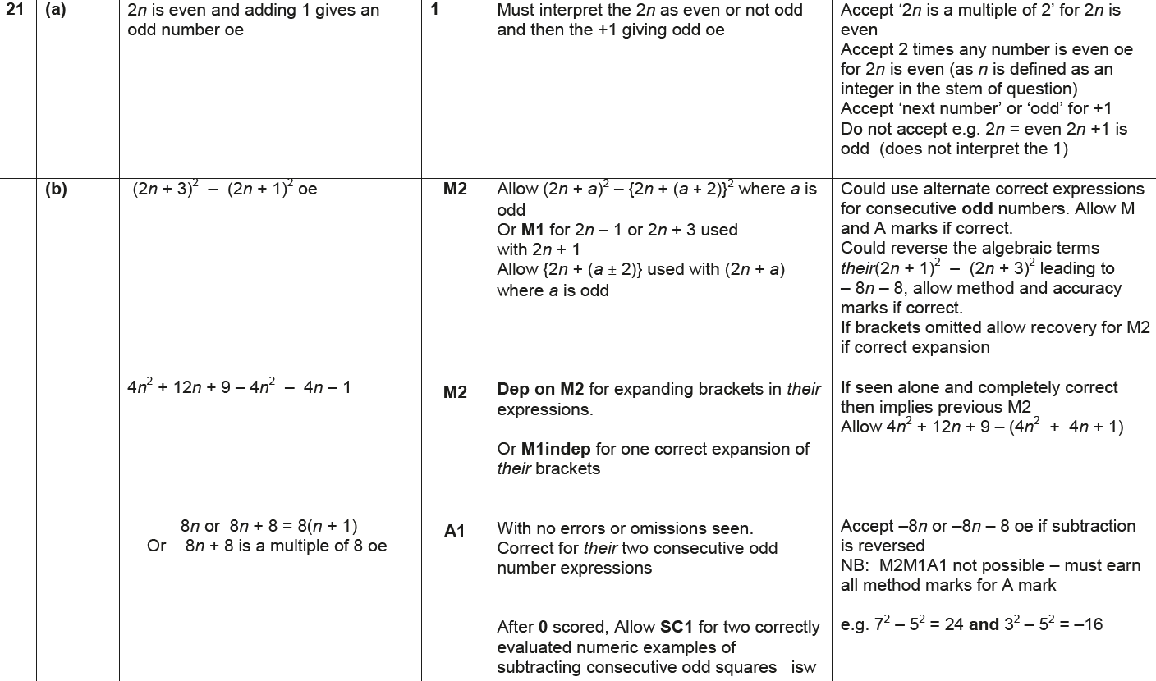
Show that…
June 2017 2H Q21
A
B

Slide 42
Show that…
June 2017 3H Q17

Slide 43
Show that…
June 2017 3H Q17
A

Slide 44
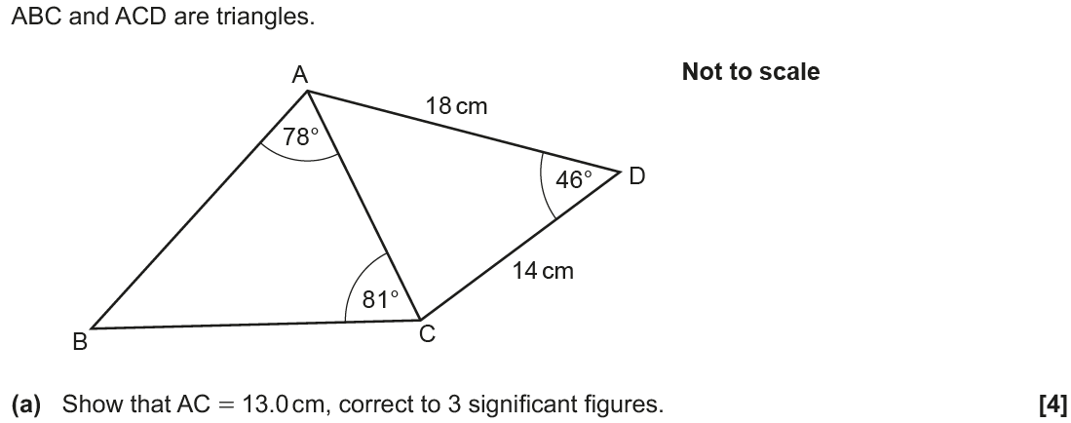
Show that…
Nov 2017 1H Q17

Slide 45
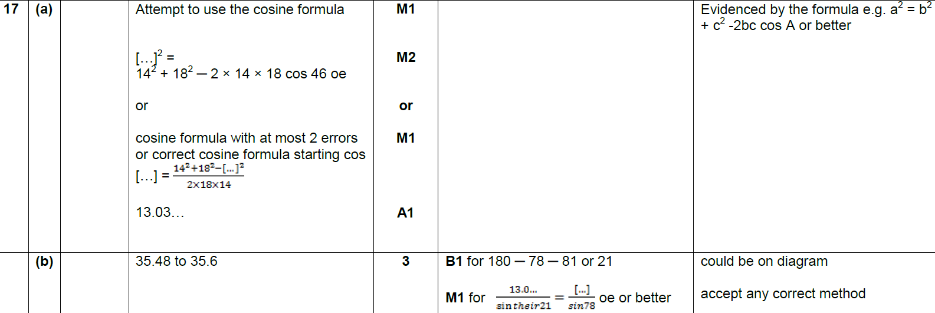
Show that…
Nov 2017 1H Q17
A
B

Slide 46
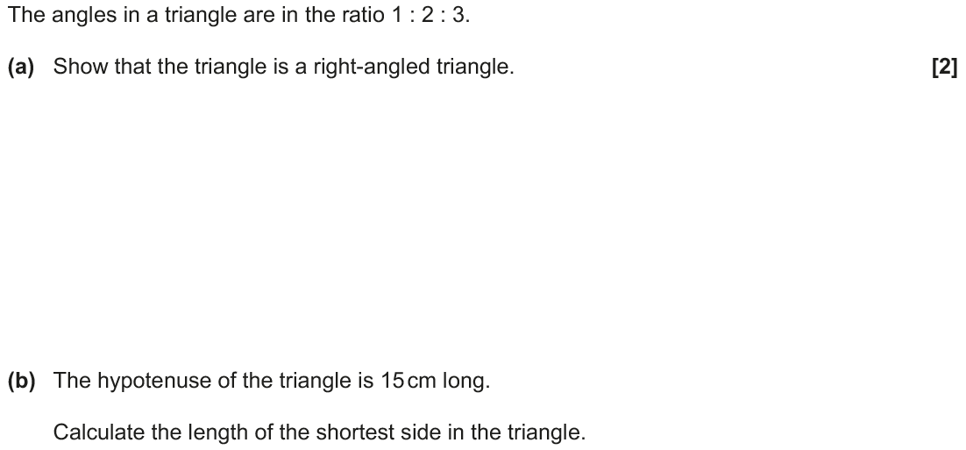
Show that…
Nov 2017 2H Q8

Slide 47
Show that…
Nov 2017 2H Q8
A
B

Slide 48
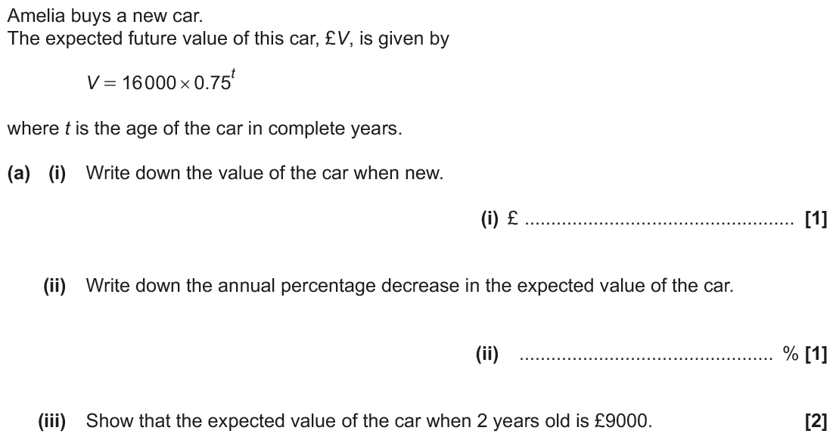
Show that…
Nov 2017 2H Q11

Slide 49
Show that…
Nov 2017 2H Q11
A (i)
A (ii)
A (iii)
B

Slide 50
Show that…
Nov 2017 2H Q18

Slide 51
Show that…
Nov 2017 2H Q18
A

Slide 52
Show that…
Nov 2017 3H Q14

Slide 53
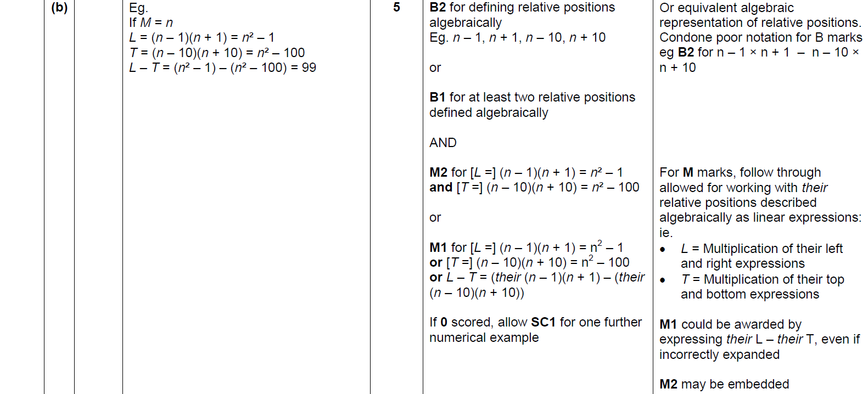
Show that…
Nov 2017 3H Q14
A
B

Slide 54
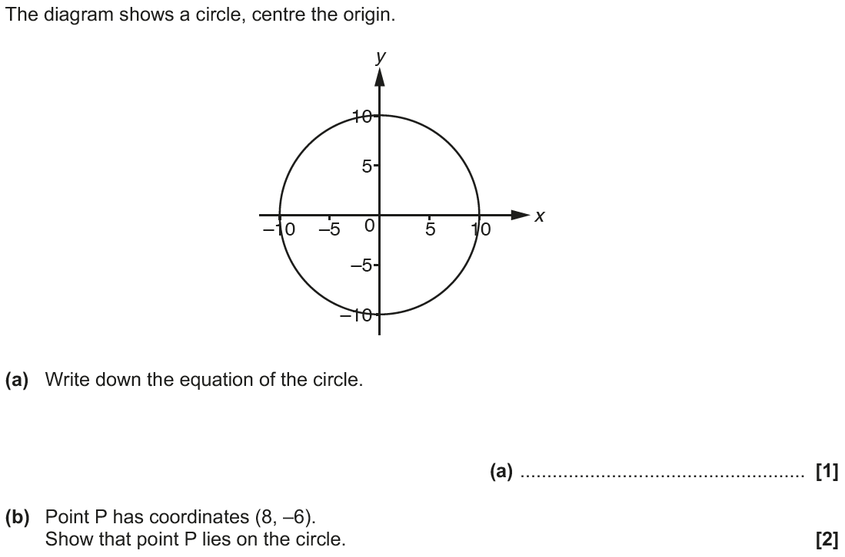
Show that…
Nov 2017 3H Q17

Slide 55
Show that…
Nov 2017 3H Q17
A
B
C

Slide 56
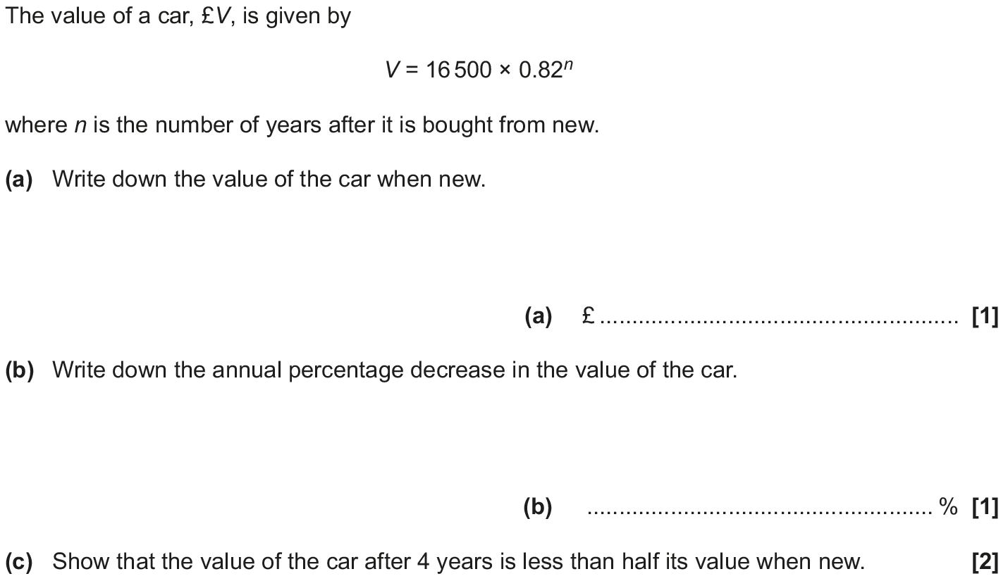
Show that…
May 2018 1H Q12

Slide 57
Show that…
May 2018 1H Q12
A
B
C

Slide 58
Show that…
May 2018 1H Q13

Slide 59
Show that…
May 2018 1H Q13
A
B

Slide 60
Show that…
June 2018 2H Q8

Slide 61
Show that…
June 2018 2H Q8
A
B (i)
B (ii)

Slide 62
Show that…
June 2018 2H Q15

Slide 63
Show that…
June 2018 2H Q15
A

Slide 64
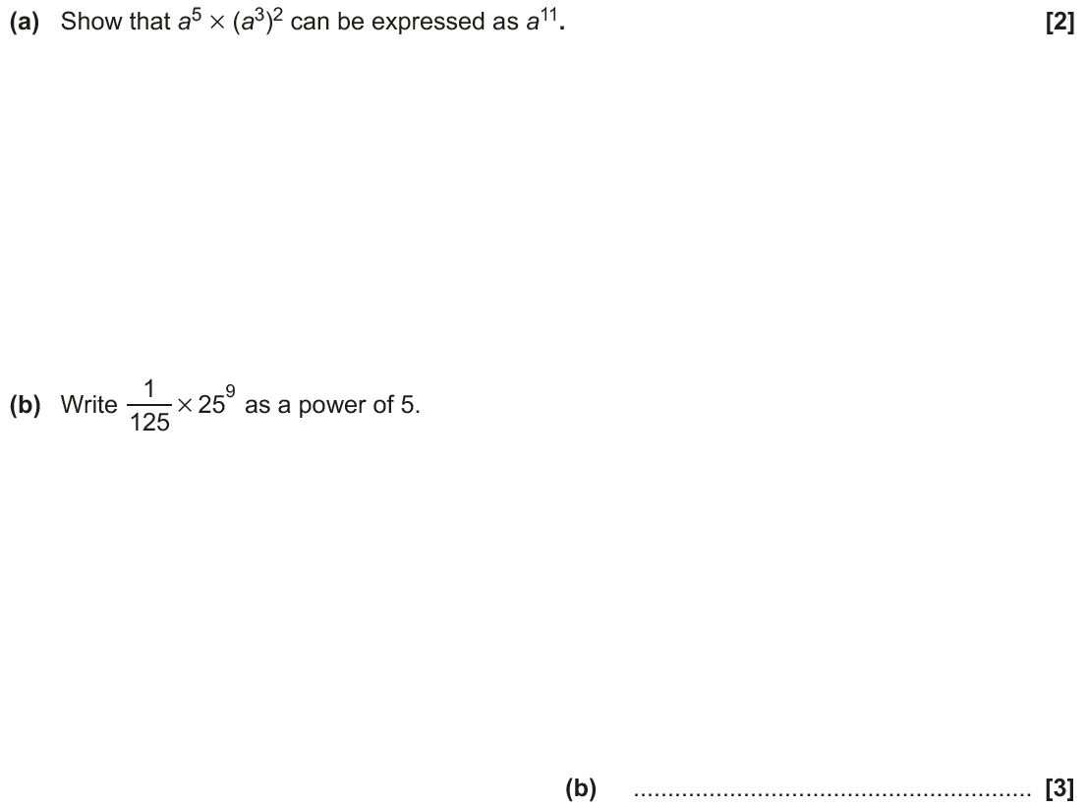
Show that…
June 2018 3H Q4

Slide 65
Show that…
June 2018 3H Q4
A
B

Slide 66
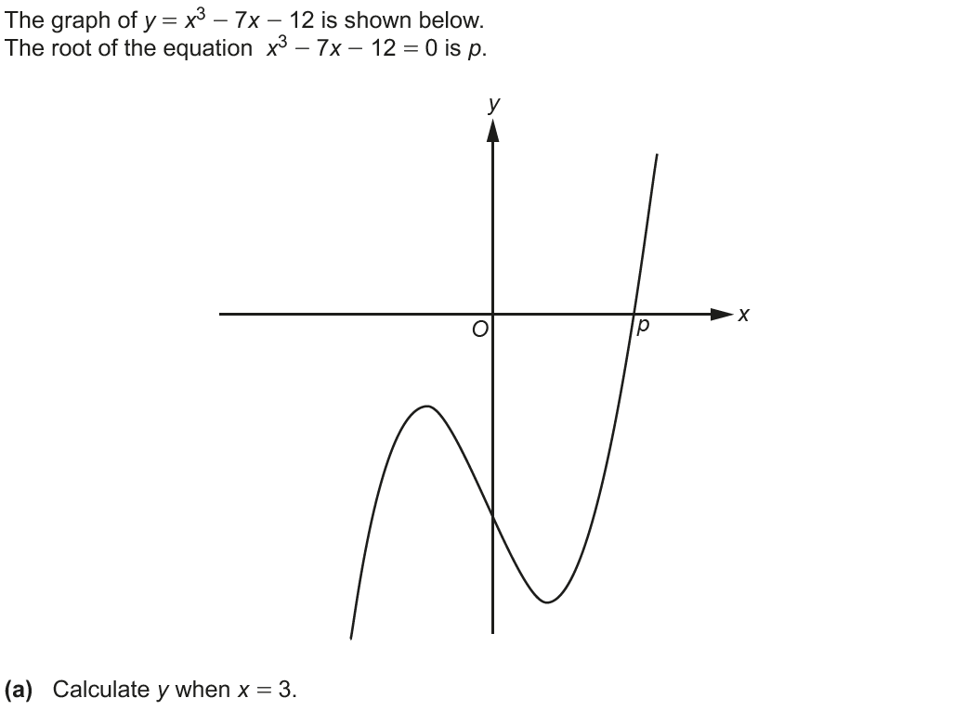
Show that…
June 2018 3H Q9

Slide 67
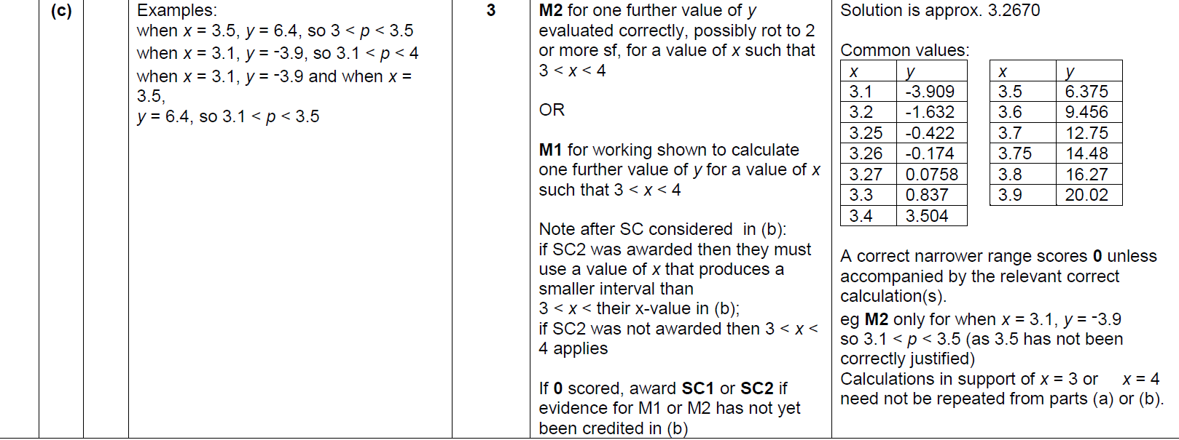
Show that…
June 2018 3H Q9
A
B
C

Slide 68
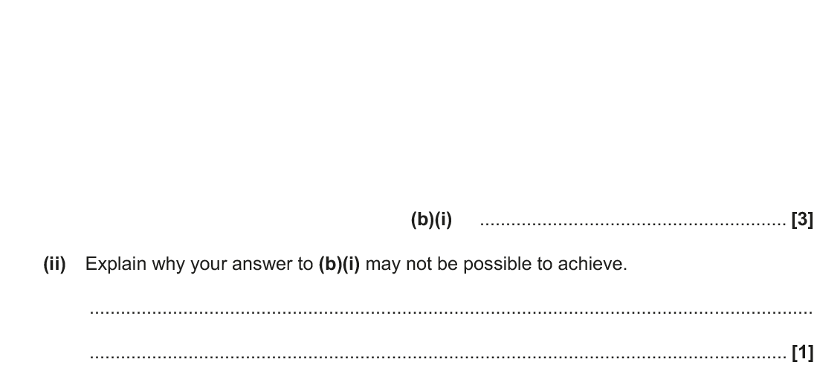
Show that…
June 2018 3H Q14

Slide 69
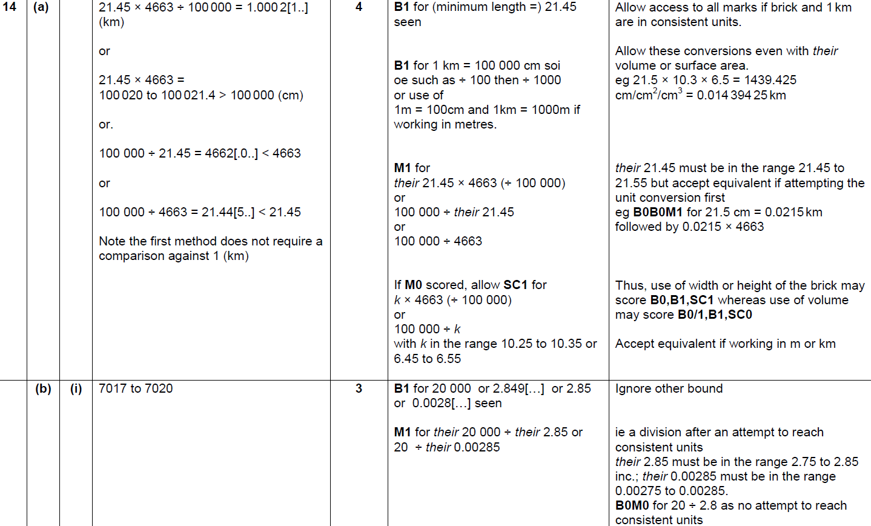
Show that…
June 2018 3H Q14
A
B (i)
B (ii)

Slide 70
Show that…
June 2018 3H Q19

Slide 71
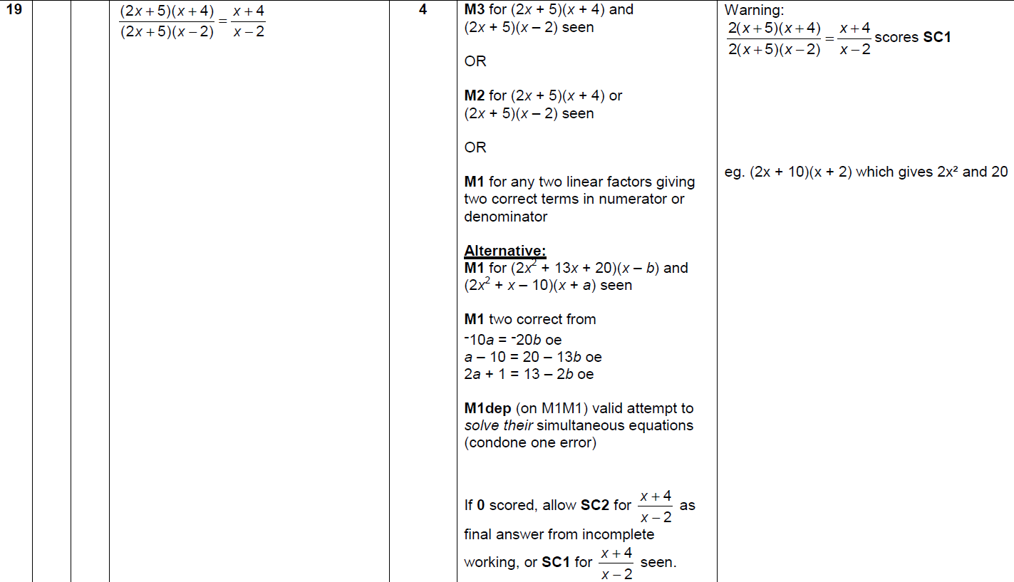
Show that…
June 2018 3H Q19
A

Slide 72
Show that…
Nov 2018 1H Q2

Slide 73
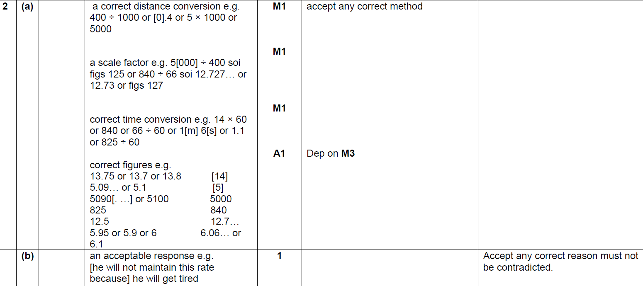
Show that…
Nov 2018 1H Q2
A
B

Slide 74
Show that…
Nov 2018 1H Q22

Slide 75
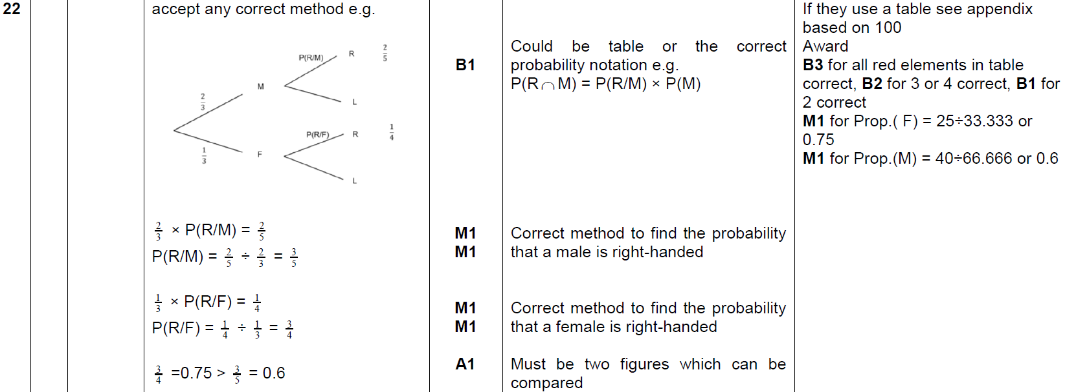
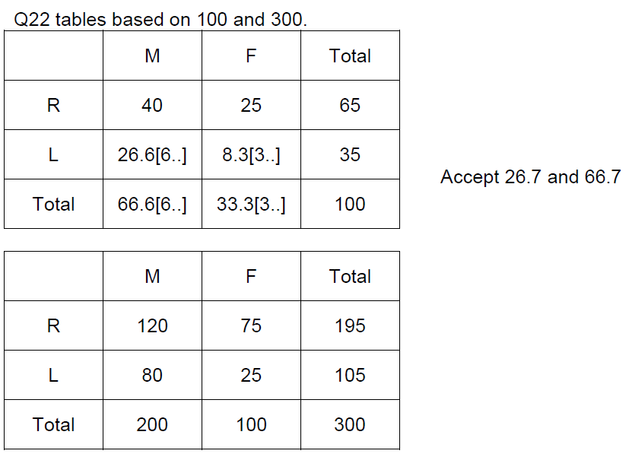
Show that…
Nov 2018 1H Q22
A

Slide 76
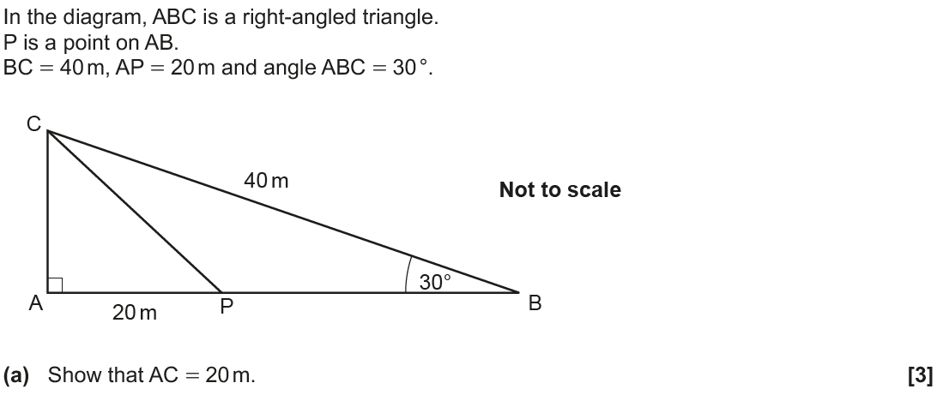
Show that…
Nov 2018 2H Q13

Slide 77
Show that…
Nov 2018 2H Q13
A
B

Slide 78
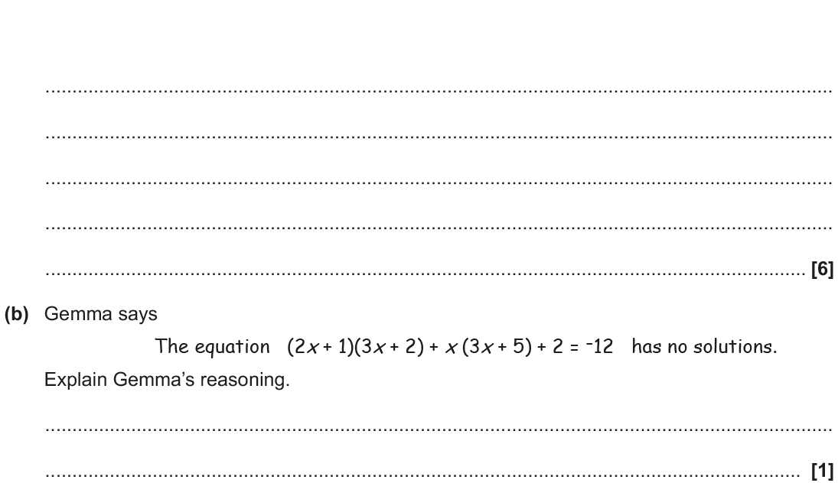
Show that…
Nov 2018 2H Q20

Slide 79
Show that…
Nov 2018 2H Q20
A
B

Slide 80
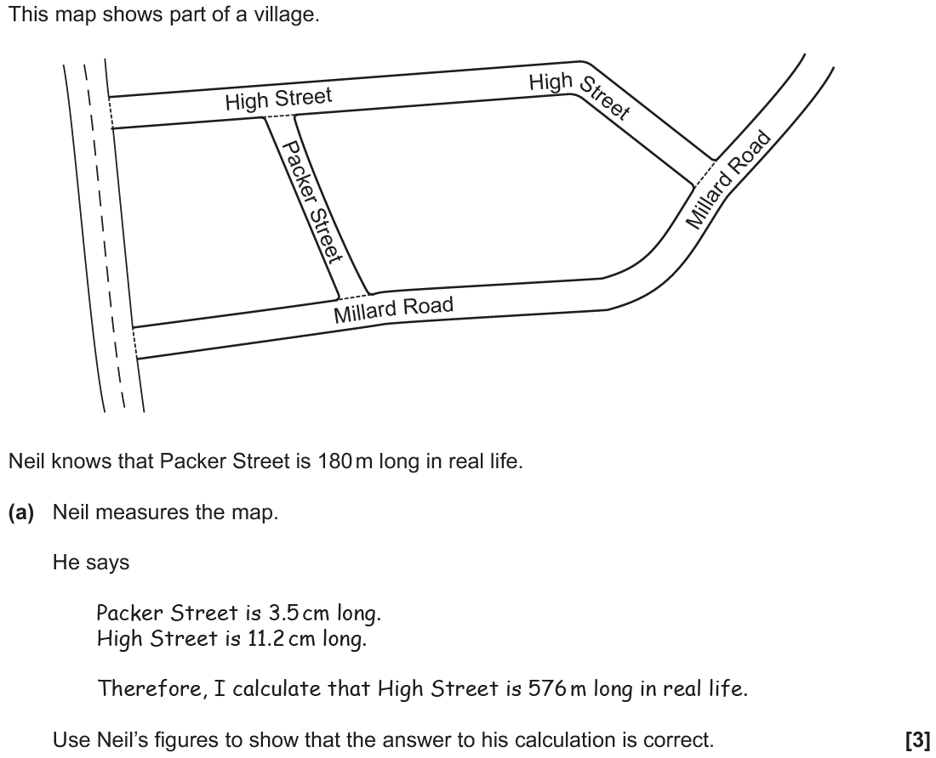
Show that…
Nov 2018 3H Q5

Slide 81
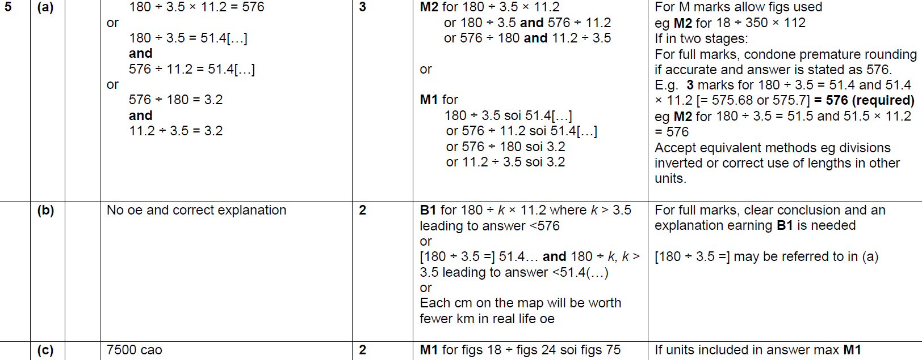
Show that…
Nov 2018 3H Q5
A
B
C

Slide 82
Show that…
Nov 2018 3H Q16

Slide 83
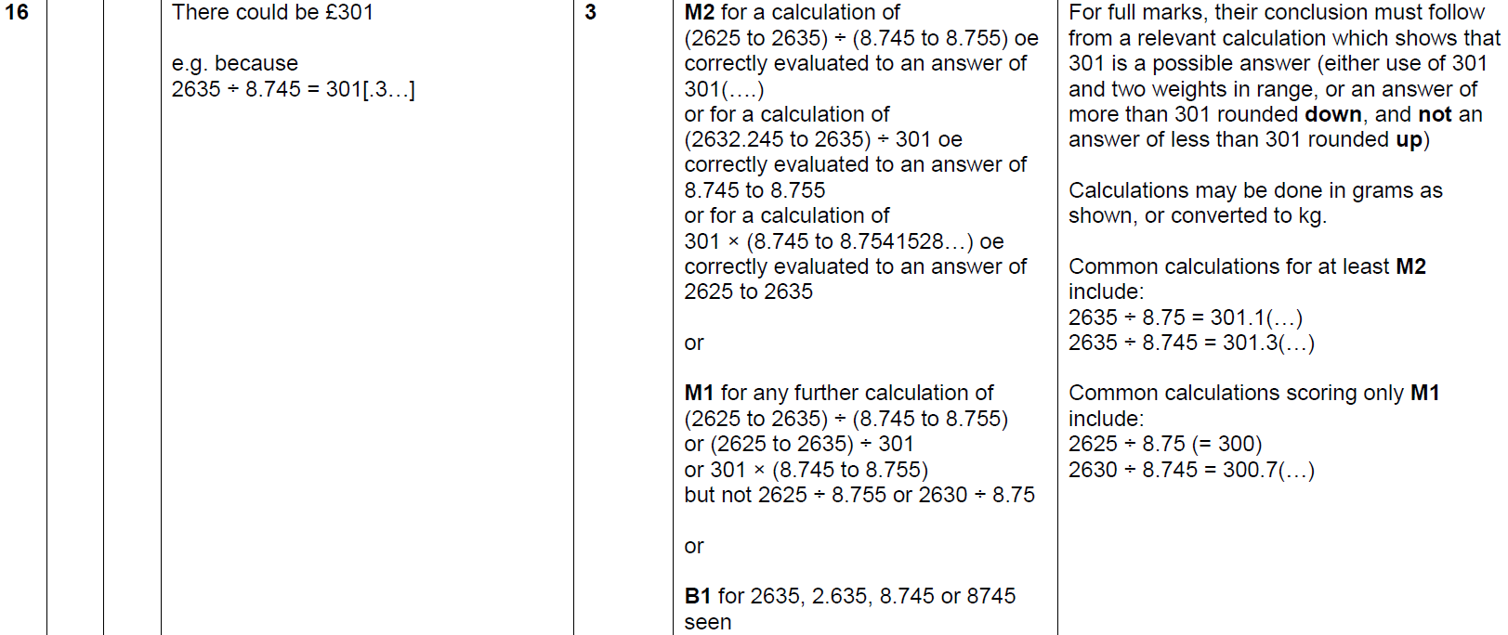
Show that…
Nov 2018 3H Q16
A

Slide 84
Show that…
Nov 2018 3H Q21

Slide 85
Show that…
Nov 2018 3H Q21
A

