Slide 1
Show that…/ Proof
Show that…/ Proof
(algebraic)
SAM
1H Q18
Spec 1
2H Q13
May 2017
1H Q4
Nov 2017
1H Q3
Nov 2017
3H Q19
Nov 2018
3H Q14
SAM
2H Q14
Spec 1
3H Q22
May 2017
1H Q6
Nov 2017
1H Q6
May 2018
1H Q12
Nov 2018
3H Q15
SAM
2H Q16
Spec 2
1H Q9
May 2017
1H Q10
Nov 2017
1H Q14
June 2018
2H Q13
May 2019
1H Q13
SAM
3H Q3
Spec 2
1H Q20
May 2017
1H Q16
Nov 2017
1H Q17
Nov 2018
1H Q7
May 2019
1H Q21
Spec 1
1H Q15
Spec 2
3H Q7
May 2017
1H Q22
Nov 2017
3H Q11
Nov 2018
2H Q11
June 2019
3H Q18
Spec 1
1H Q20
Spec 2
3H Q17
June 2017
3H Q5
Nov 2017
3H Q14
Nov 2018
3H Q4
Proof of algebraic properties
Proof

Slide 2
Show that…/ Proof
SAM 1H Q18

Slide 3
Show that…/ Proof
SAM 1H Q18
A

Slide 4
Show that…/ Proof
SAM 2H Q14

Slide 5
Show that…/ Proof
SAM 2H Q14
A

Slide 6
Show that…/ Proof
SAM 2H Q16

Slide 7
Show that…/ Proof
SAM 2H Q16
A

Slide 8
Show that…/ Proof
SAM 3H Q3

Slide 9
Show that…/ Proof
SAM 3H Q3
A
B
c

Slide 10
Show that…/ Proof
Specimen Set 1 1H Q15

Slide 11
Show that…/ Proof
Specimen Set 1 1H Q15
A

Slide 12
Show that…/ Proof
Specimen Set 1 1H Q20

Slide 13
Show that…/ Proof
Specimen Set 1 1H Q20
A

Slide 14
Show that…/ Proof
Specimen Set 1 2H Q13

Slide 15
Show that…/ Proof
Specimen Set 1 2H Q13
A

Slide 16
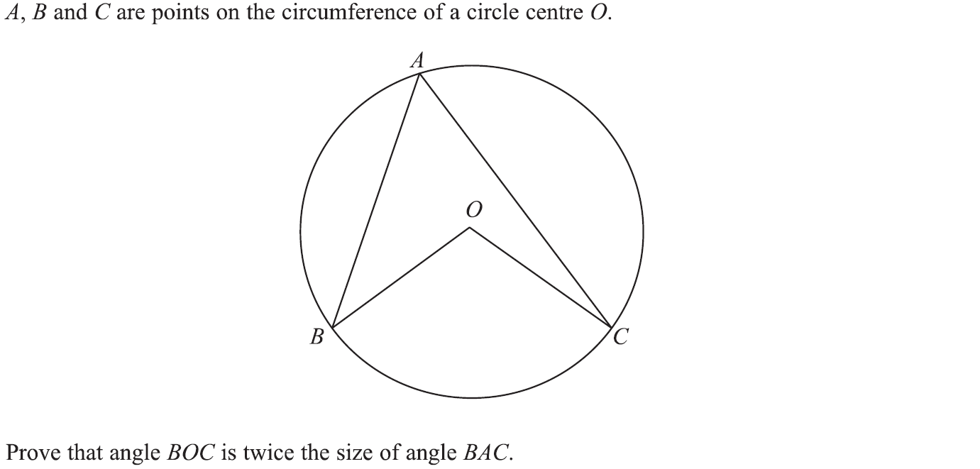
Show that…/ Proof
Specimen Set 1 2H Q24

Slide 17
Show that…/ Proof
Specimen Set 1 2H Q24
A

Slide 18
Show that…/ Proof
Specimen Set 1 3H Q22

Slide 19
Show that…/ Proof
Specimen Set 1 3H Q22
A

Slide 20
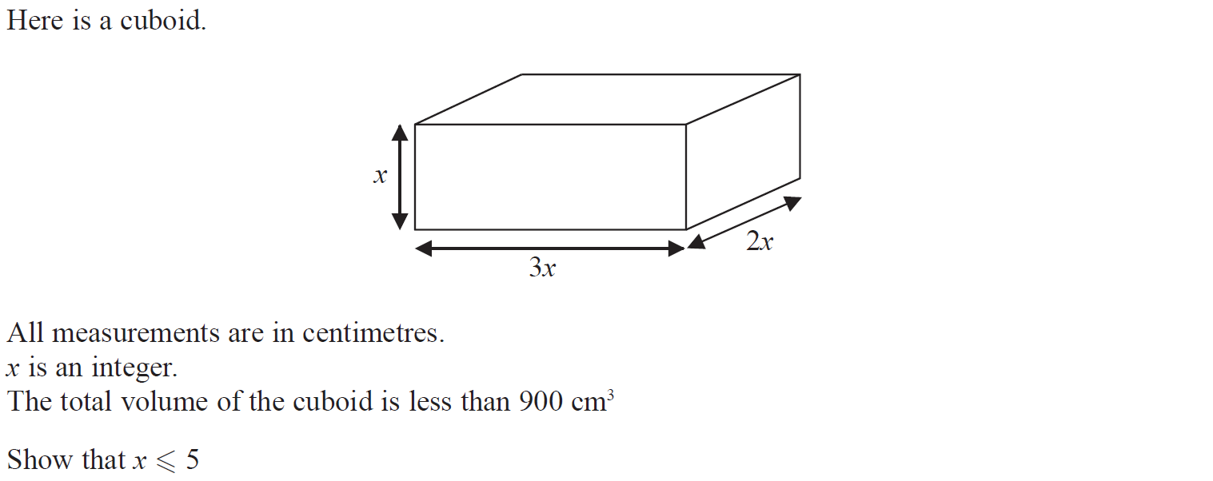
Show that…/ Proof
Specimen Set 2 1H Q9

Slide 21
Show that…/ Proof
Specimen Set 2 1H Q9
A

Slide 22
Show that…/ Proof
Specimen Set 2 1H Q20

Slide 23
Show that…/ Proof
Specimen Set 2 1H Q20
A

Slide 24
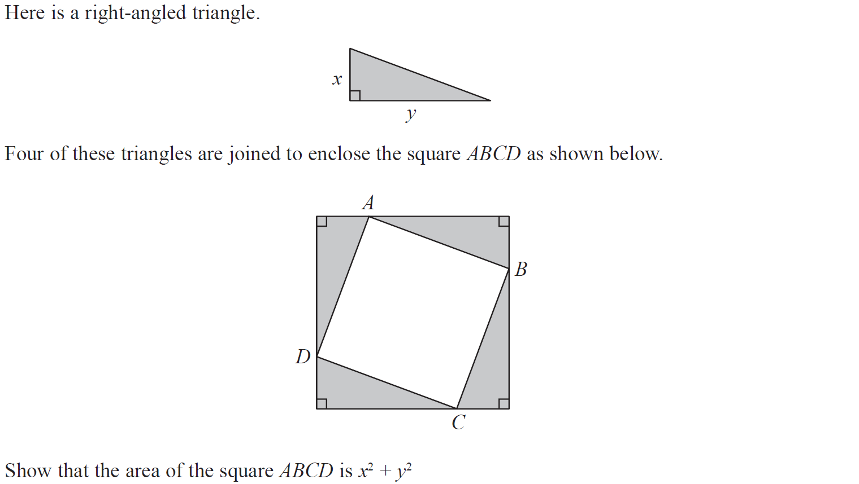
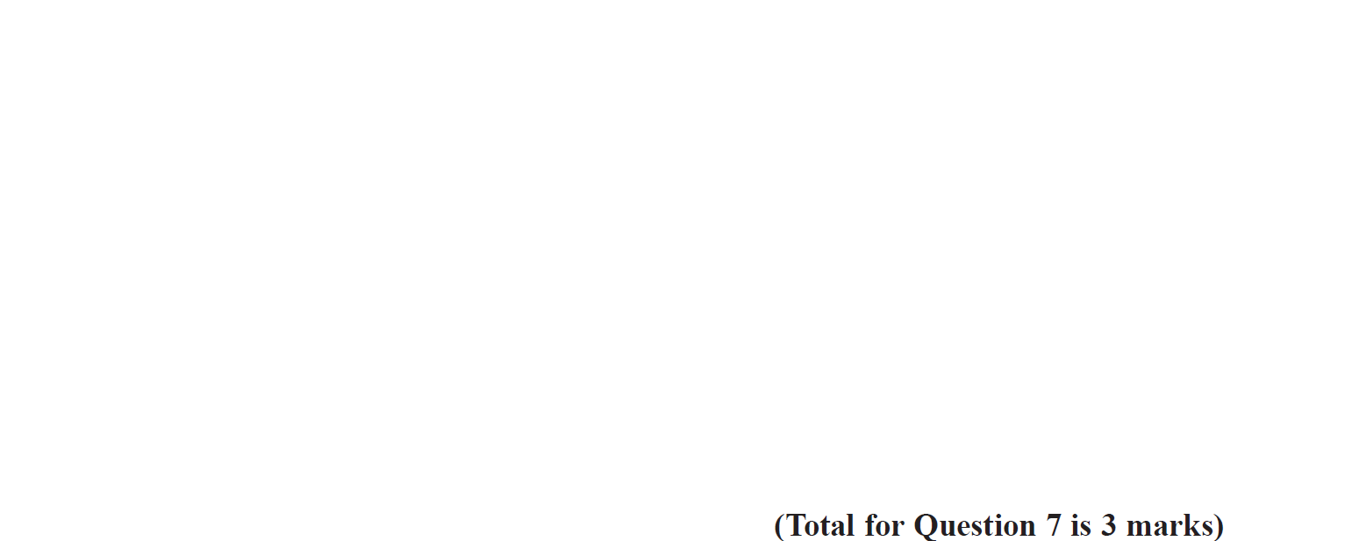
Show that…/ Proof
Specimen Set 2 3H Q7

Slide 25
Show that…/ Proof
Specimen Set 2 3H Q7
A

Slide 26
Show that…/ Proof
Specimen Set 2 3H Q17

Slide 27
Show that…/ Proof
Specimen Set 2 3H Q17
A

Slide 28
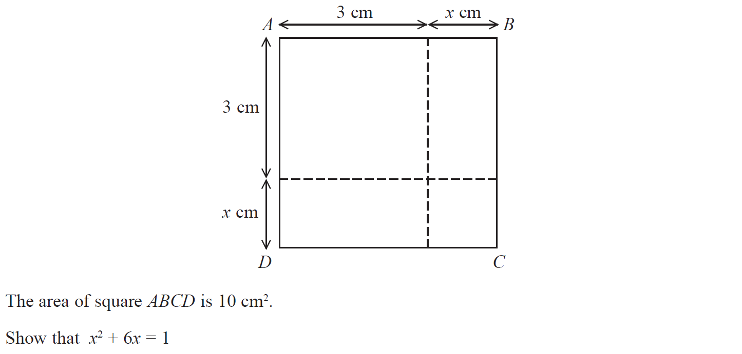
Show that…/ Proof
May 2017 1H Q4

Slide 29
Show that…/ Proof
May 2017 1H Q4
A

Slide 30
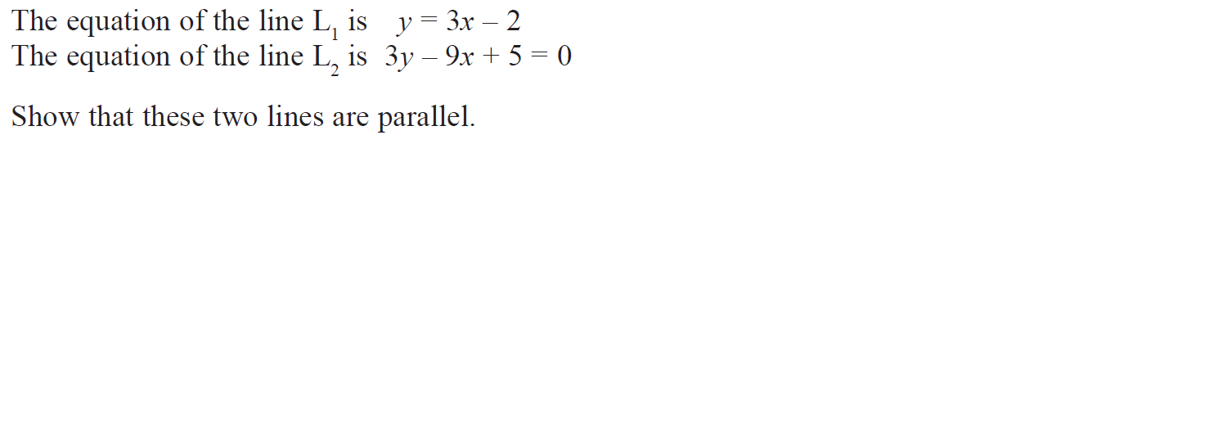
Show that…/ Proof
May 2017 1H Q6

Slide 31
Show that…/ Proof
May 2017 1H Q6
A

Slide 32
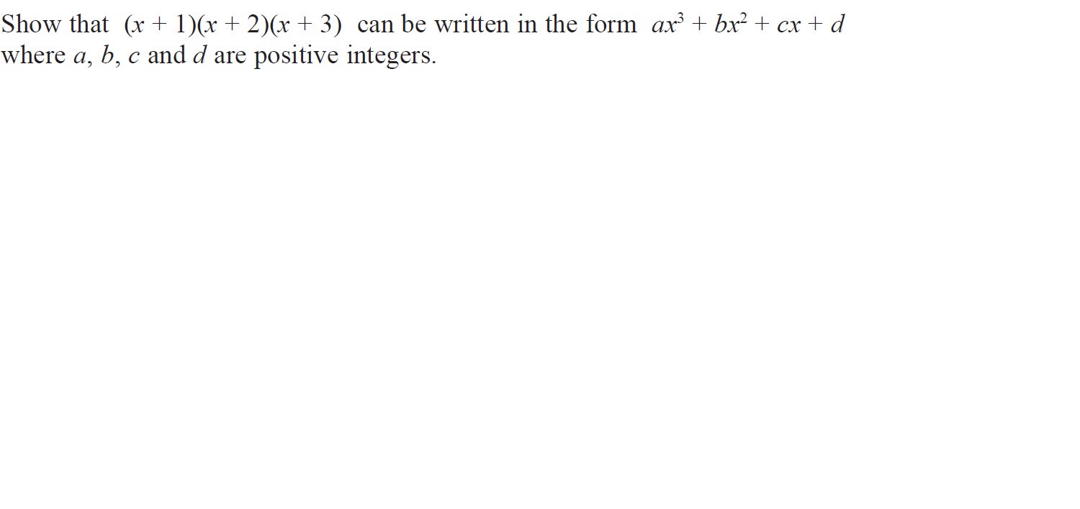
Show that…/ Proof
May 2017 1H Q10

Slide 33
Show that…/ Proof
May 2017 1H Q10
A

Slide 34
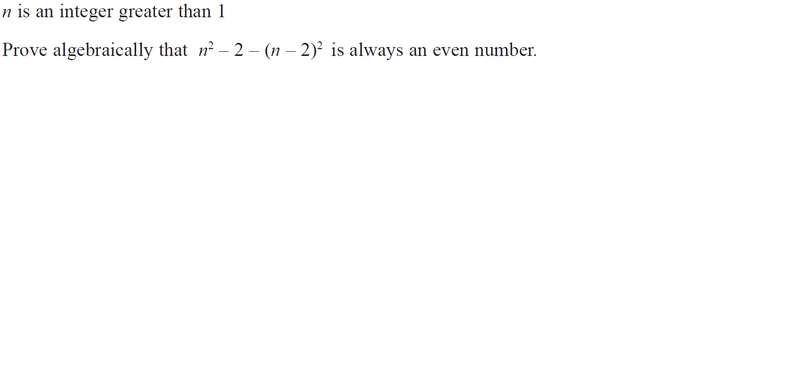
Show that…/ Proof
May 2017 1H Q16

Slide 35
Show that…/ Proof
May 2017 1H Q16
A

Slide 36
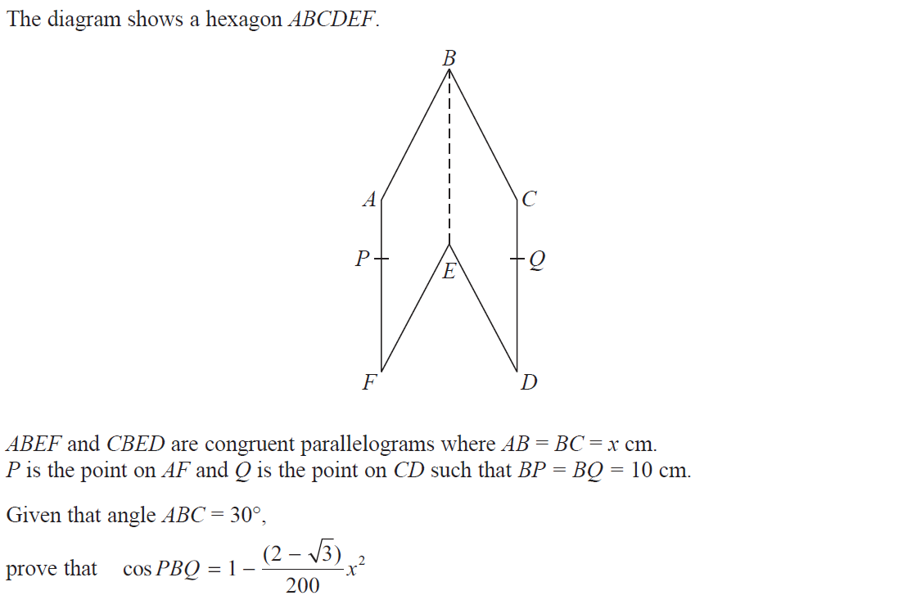
Show that…/ Proof
May 2017 1H Q22

Slide 37
Show that…/ Proof
May 2017 1H Q22
A

Slide 38
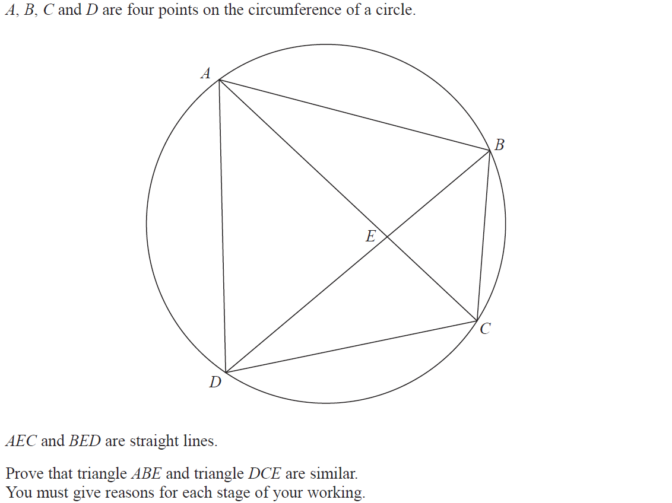
Show that…/ Proof
June 2017 2H Q15

Slide 39
Show that…/ Proof
June 2017 2H Q15
A

Slide 40
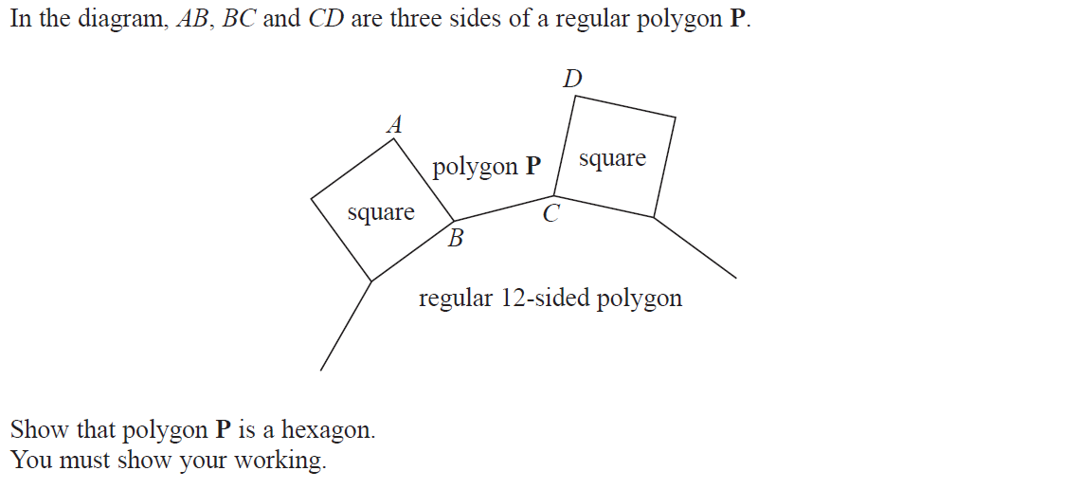
Show that…/ Proof
June 2017 3H Q5

Slide 41
Show that…/ Proof
June 2017 3H Q5
A

Slide 42
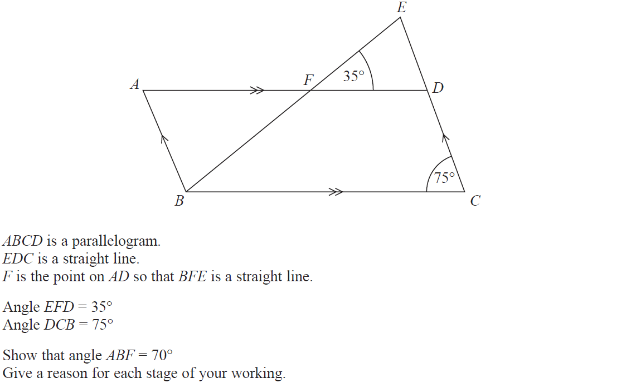
Show that…/ Proof
Nov 2017 1H Q3

Slide 43
Show that…/ Proof
Nov 2017 1H Q3
A

Slide 44
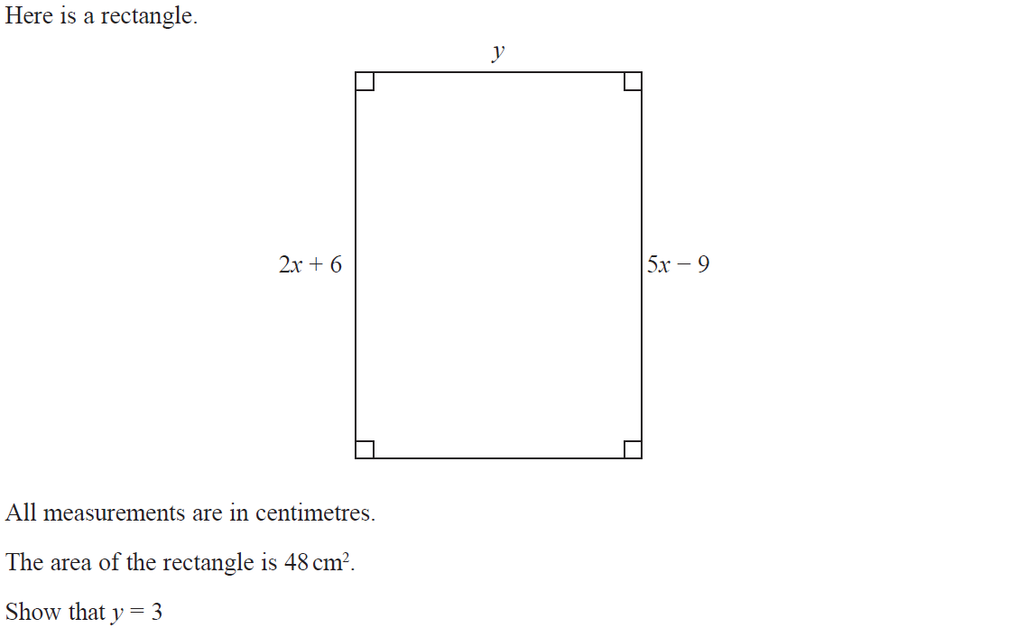
Show that…/ Proof
Nov 2017 1H Q6

Slide 45
Show that…/ Proof
Nov 2017 1H Q6
A

Slide 46
Show that…/ Proof
Nov 2017 1H Q14

Slide 47
Show that…/ Proof
Nov 2017 1H Q14
A

Slide 48
Show that…/ Proof
Nov 2017 1H Q17

Slide 49
Show that…/ Proof
Nov 2017 1H Q17
A

Slide 50
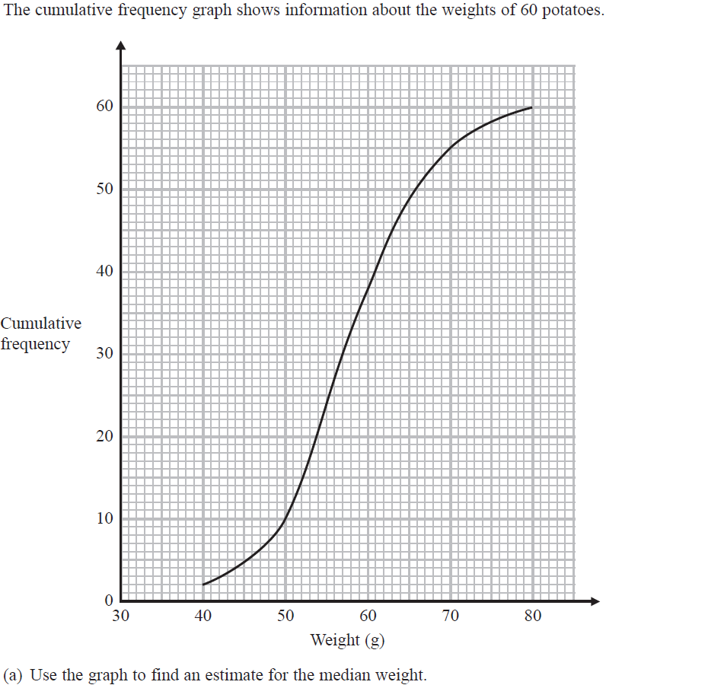
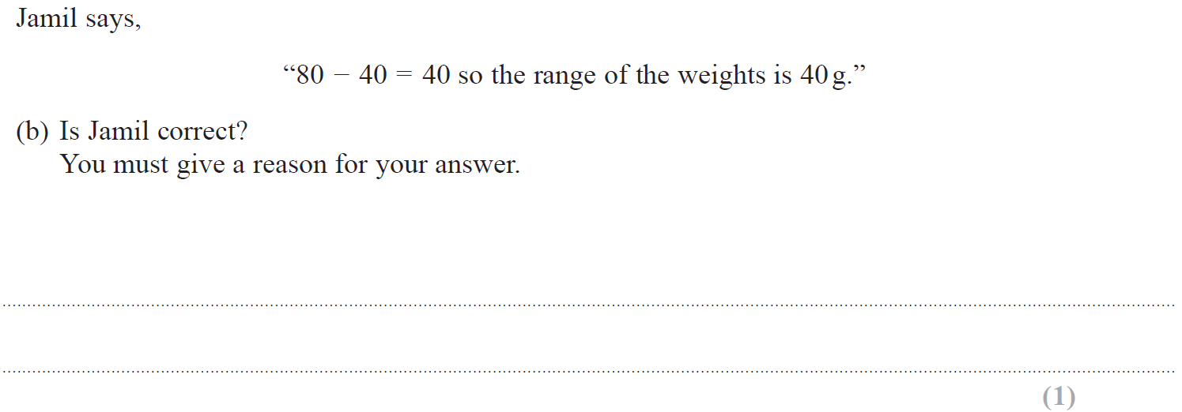
Show that…/ Proof
Nov 2017 3H Q11

Slide 51
Show that…/ Proof
Nov 2017 3H Q11
A
B
C

Slide 52
Show that…/ Proof
Nov 2017 3H Q14

Slide 53
Show that…/ Proof
Nov 2017 3H Q14
A

Slide 54
Show that…/ Proof
Nov 2017 3H Q19

Slide 55
Show that…/ Proof
Nov 2017 3H Q19
A

Slide 56
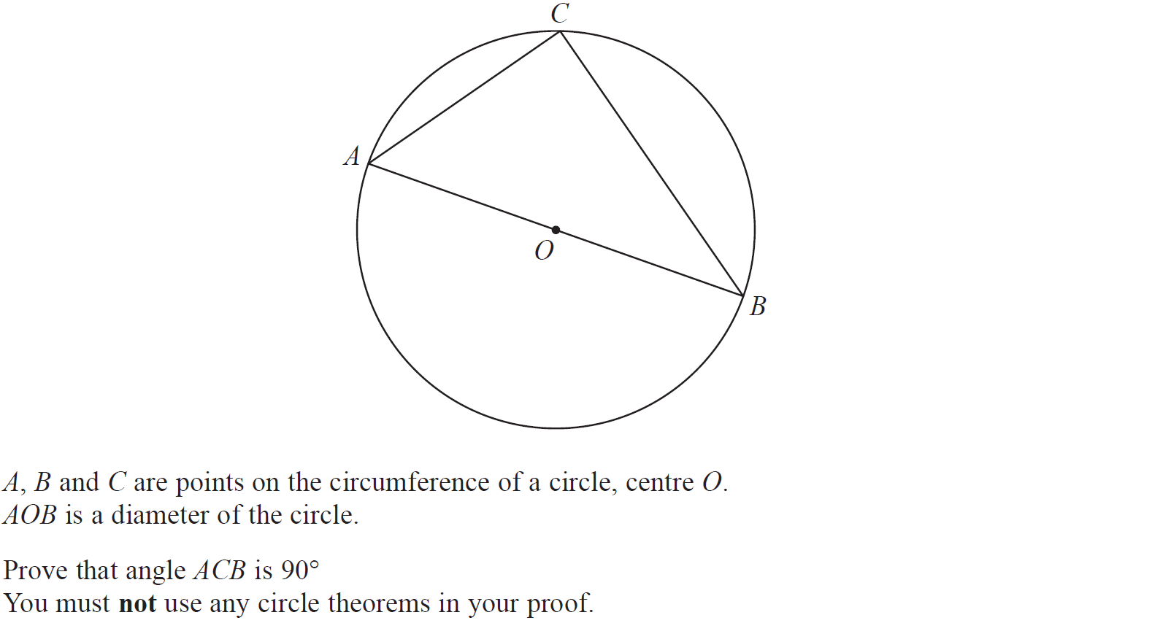
Show that…/ Proof
Nov 2017 3H Q20

Slide 57
Show that…/ Proof
Nov 2017 3H Q20
A

Slide 58
Show that…/ Proof
May 2018 1H Q12

Slide 59
Show that…/ Proof
May 2018 1H Q12
A

Slide 60
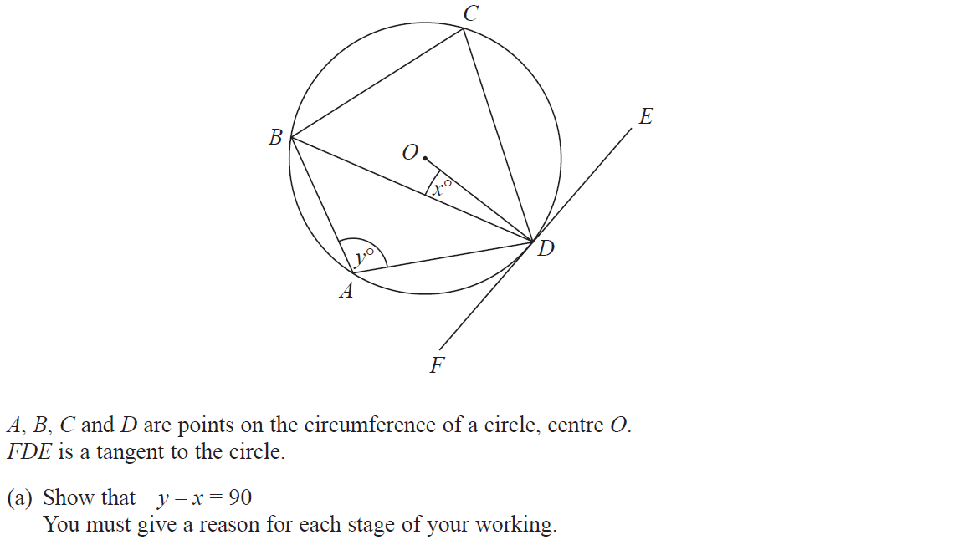
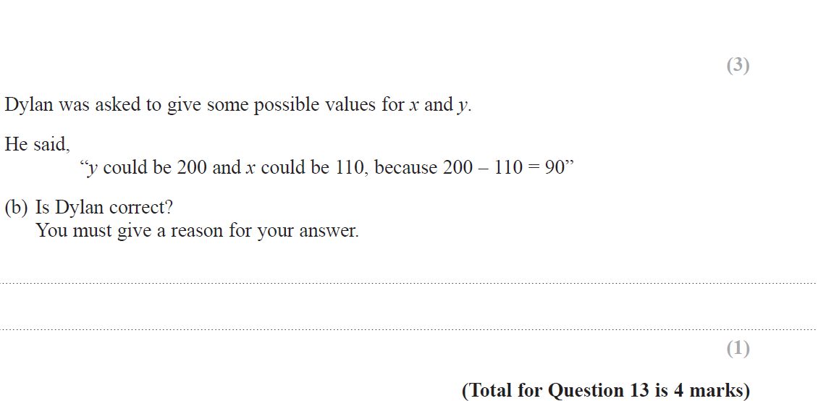
Show that…/ Proof
June 2018 2H Q13

Slide 61
Show that…/ Proof
June 2018 2H Q13
A
B

Slide 62
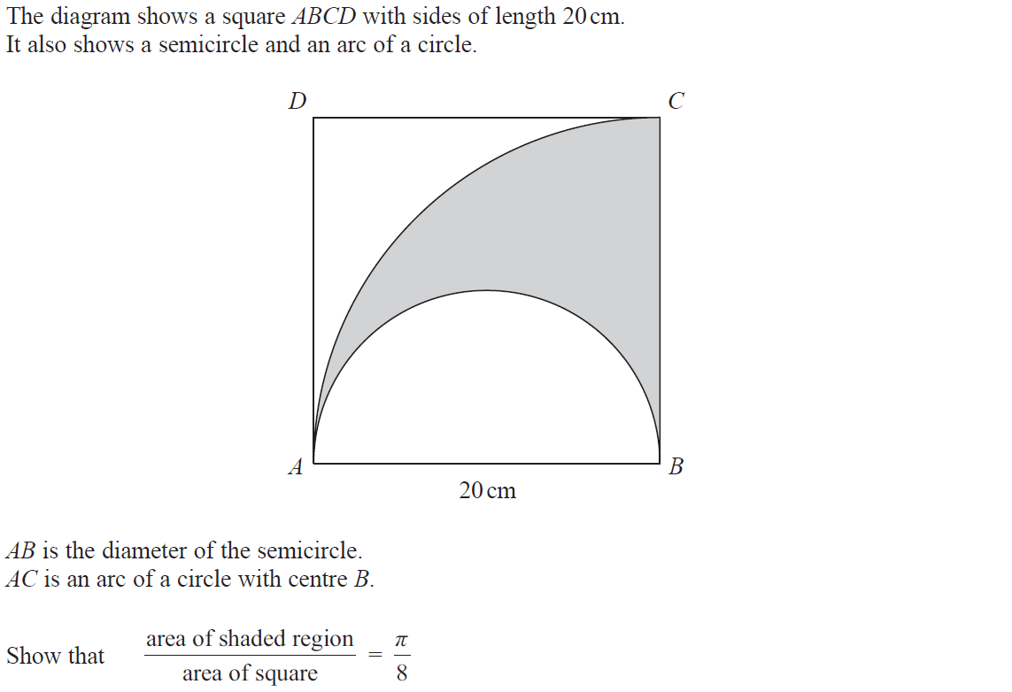
Show that…/ Proof
Nov 2018 1H Q7

Slide 63
Show that…/ Proof
Nov 2018 1H Q7
A

Slide 64
Show that…/ Proof
Nov 2018 2H Q11

Slide 65
Show that…/ Proof
Nov 2018 2H Q11
A

Slide 66
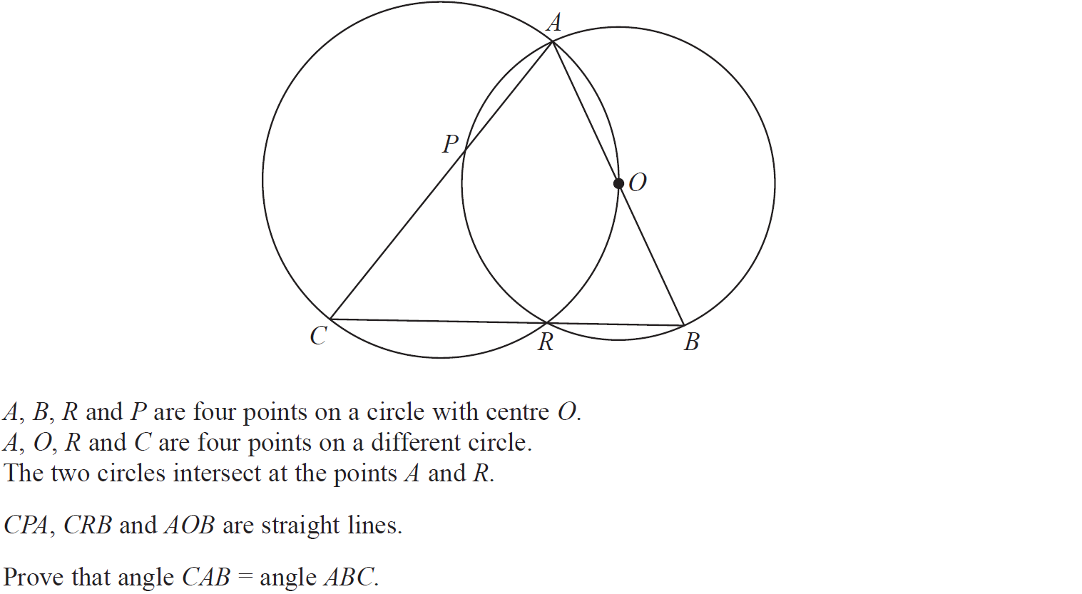
Show that…/ Proof
Nov 2018 2H Q21

Slide 67
Show that…/ Proof
Nov 2018 2H Q21
A

Slide 68
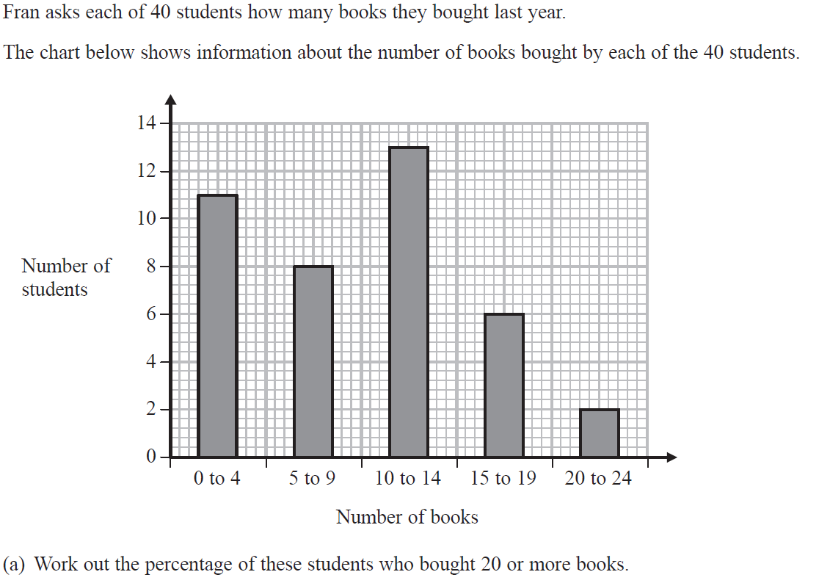
Show that…/ Proof
Nov 2018 3H Q4

Slide 69
Show that…/ Proof
Nov 2018 3H Q4
A
B

Slide 70
Show that…/ Proof
Nov 2018 3H Q14

Slide 71
Show that…/ Proof
Nov 2018 3H Q14
A

Slide 72
Show that…/ Proof
Nov 2018 3H Q15

Slide 73
Show that…/ Proof
Nov 2018 3H Q15
A

Slide 74
Show that…/ Proof
May 2019 1H Q13

Slide 75
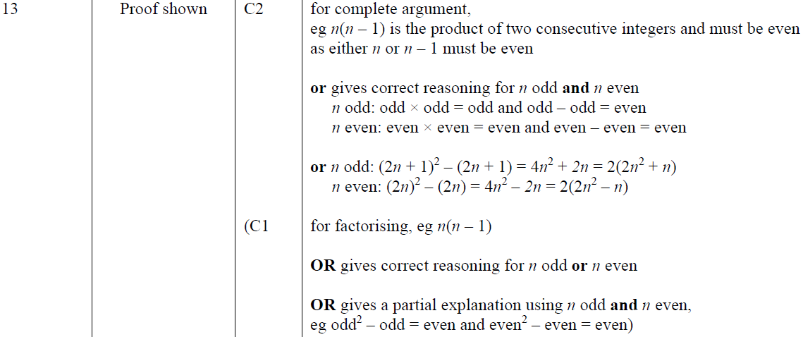
Show that…/ Proof
Nov 2018 3H Q15
A
A SF

Slide 76
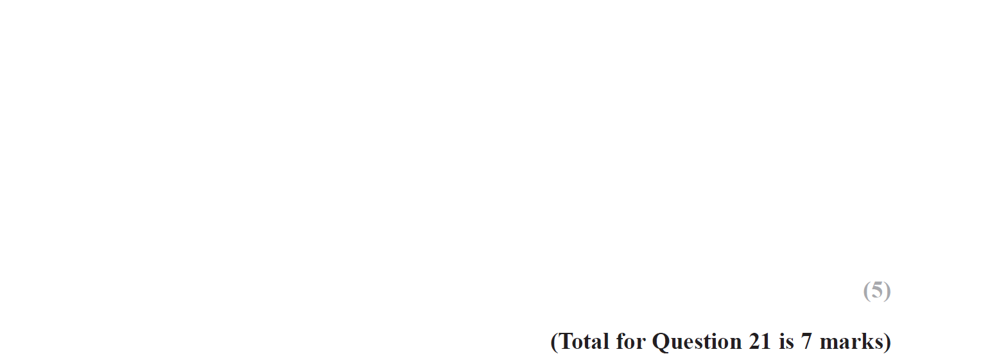
Show that…/ Proof
May 2019 1H Q21

Slide 77
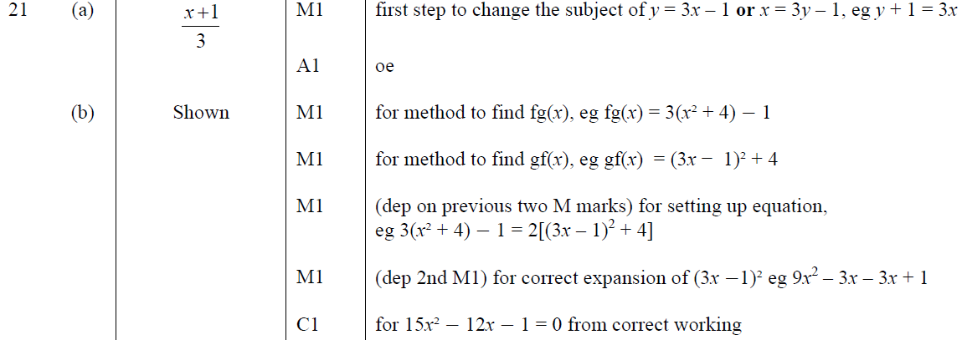
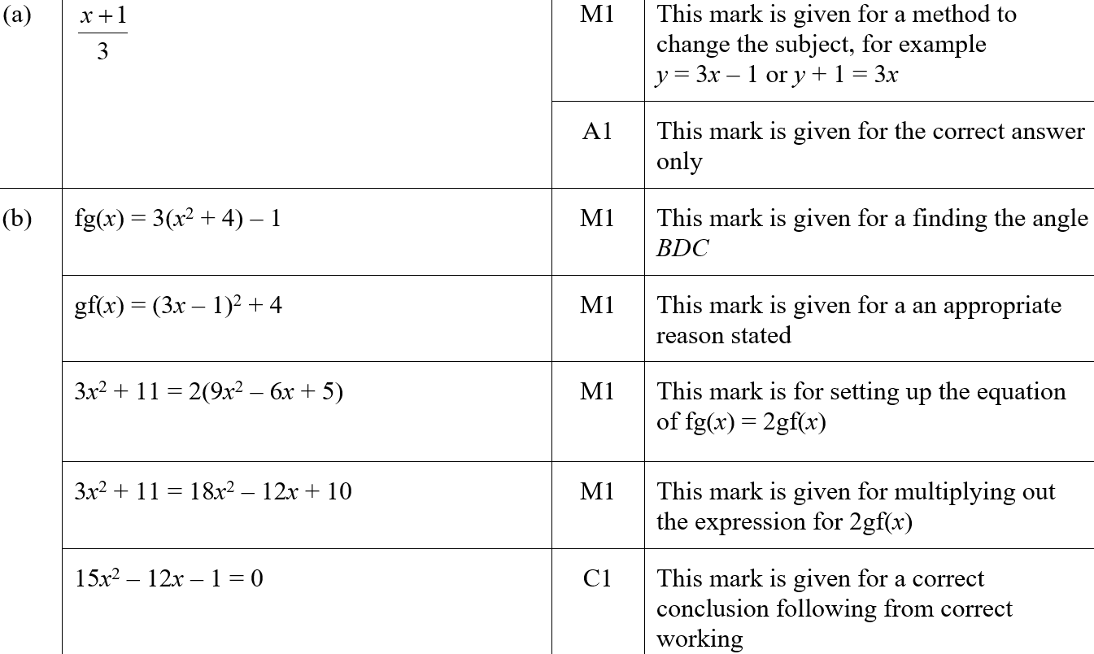
Show that…/ Proof
May 2019 1H Q21
A
B
A SF
B SF

Slide 78
Show that…/ Proof
June 2019 3H Q18

Slide 79
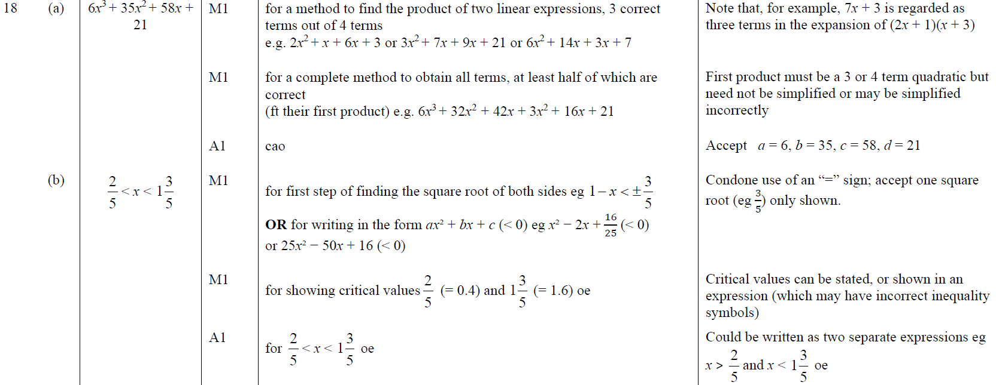
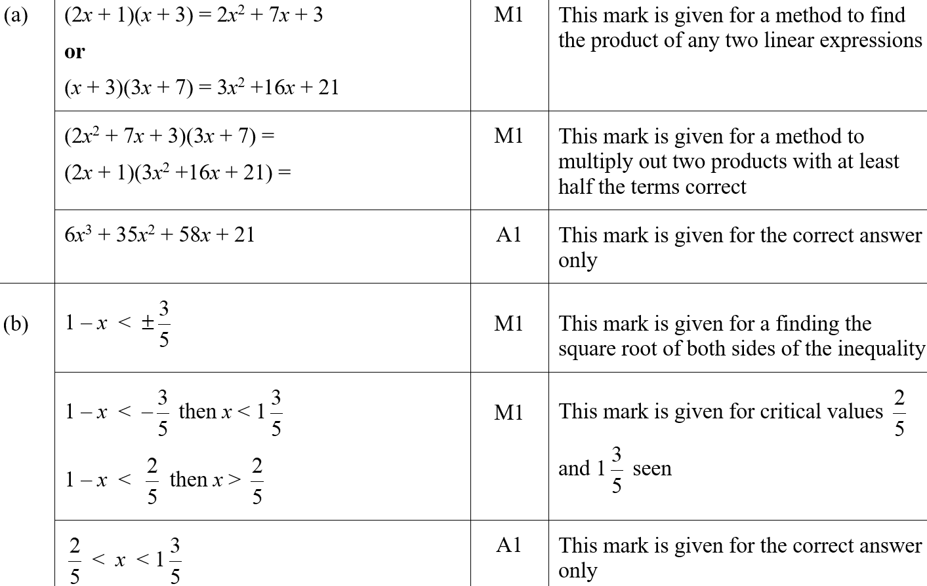
Show that…/ Proof
June 2019 3H Q18
A
B
A SF
B SF

