Slide 1
Show that…/ Proof
Show that…/ Proof
Old Spec Q’s
(algebraic)
NTSQ
Q6 (CM)
NTSQ
Q10(EB&P)
May 2018
1HR Q5
NTSQ
Q1 (EB&P)
NTSQ
Q11(EB&P)
May 2018
1HR Q16
NTSQ
Q4 (EB&P)
NTSQ
Q12(EB&P)
May 2018
1HR Q21
NTSQ
Q5 (EB&P)
NTSQ
Q13(EB&P)
Jan 2019
1H Q5
NTSQ
Q6 (EB&P)
NTSQ
Q14(EB&P)
Jan 2019
1H Q21
NTSQ
Q7 (EB&P)
SAM
1H Q13
Jan 2019
2H Q15
NTSQ
Q8 (EB&P)
SAM
1H Q15
Jan 2019
1HR Q12
NTSQ
Q9 (EB&P)
June 2018
2H Q16
Algebraic Proof

Slide 2
Show that…/ Proof
NTSQ Q6 (CM)

Slide 3
Show that…/ Proof
NTSQ Q6 (CM)
A

Slide 4
Show that…/ Proof
NTSQ Q1 (EB&P)

Slide 5
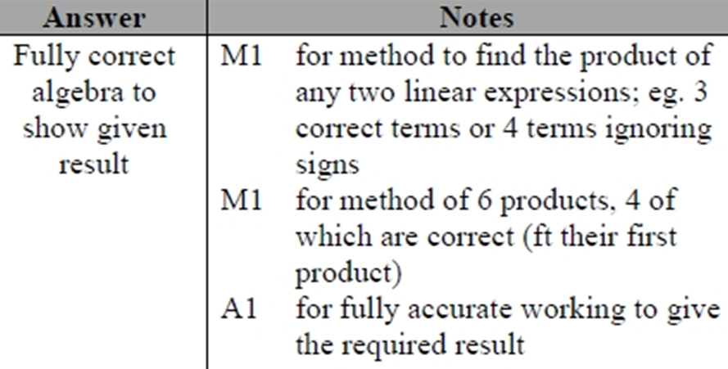
Show that…/ Proof
NTSQ Q1 (EB&P)
A

Slide 6
Show that…/ Proof
NTSQ Q4 (EB&P)

Slide 7
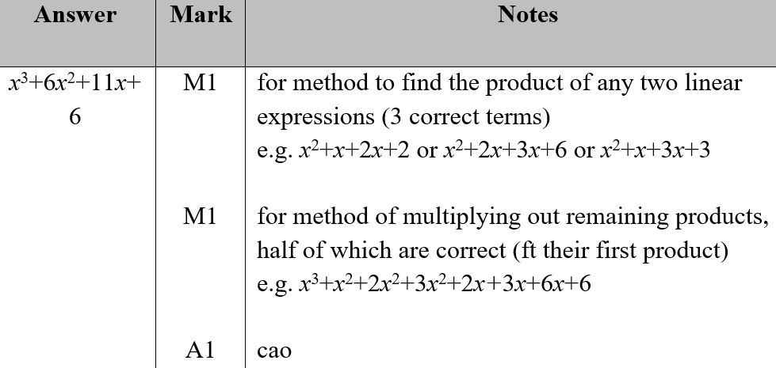
Show that…/ Proof
NTSQ Q4 (EB&P)
A

Slide 8
Show that…/ Proof
NTSQ Q5 (EB&P)

Slide 9
Show that…/ Proof
NTSQ Q5 (EB&P)
A

Slide 10
Show that…/ Proof
NTSQ Q6 (EB&P)

Slide 11
Show that…/ Proof
NTSQ Q6 (EB&P)
B

Slide 12
Show that…/ Proof
NTSQ Q7 (EB&P)

Slide 13
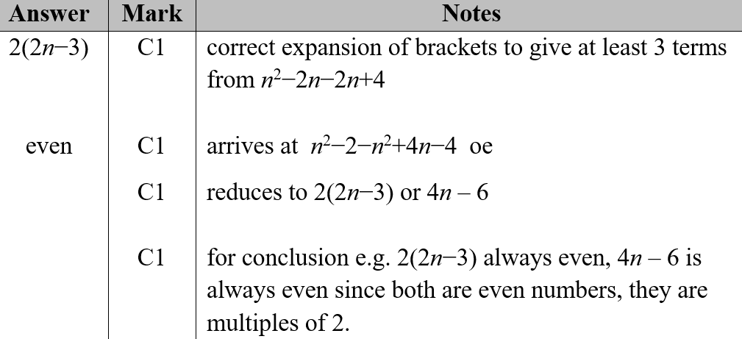
Show that…/ Proof
NTSQ Q7 (EB&P)
A

Slide 14
Show that…/ Proof
NTSQ Q8 (EB&P)

Slide 15
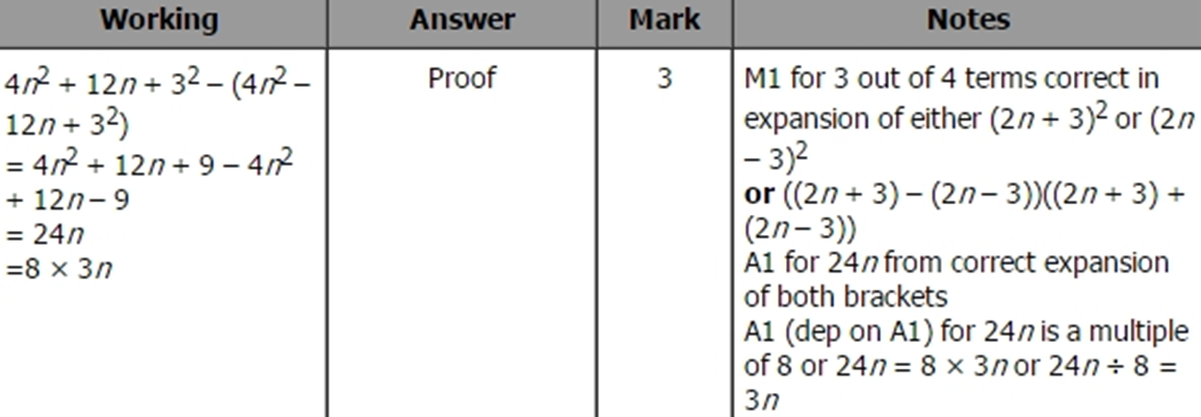
Show that…/ Proof
NTSQ Q8 (EB&P)
A

Slide 16
Show that…/ Proof
NTSQ Q9 (EB&P)

Slide 17
Show that…/ Proof
NTSQ Q9 (EB&P)
A

Slide 18
Show that…/ Proof
NTSQ Q10 (EB&P)

Slide 19
Show that…/ Proof
NTSQ Q10 (EB&P)
A

Slide 20
Show that…/ Proof
NTSQ Q11 (EB&P)

Slide 21
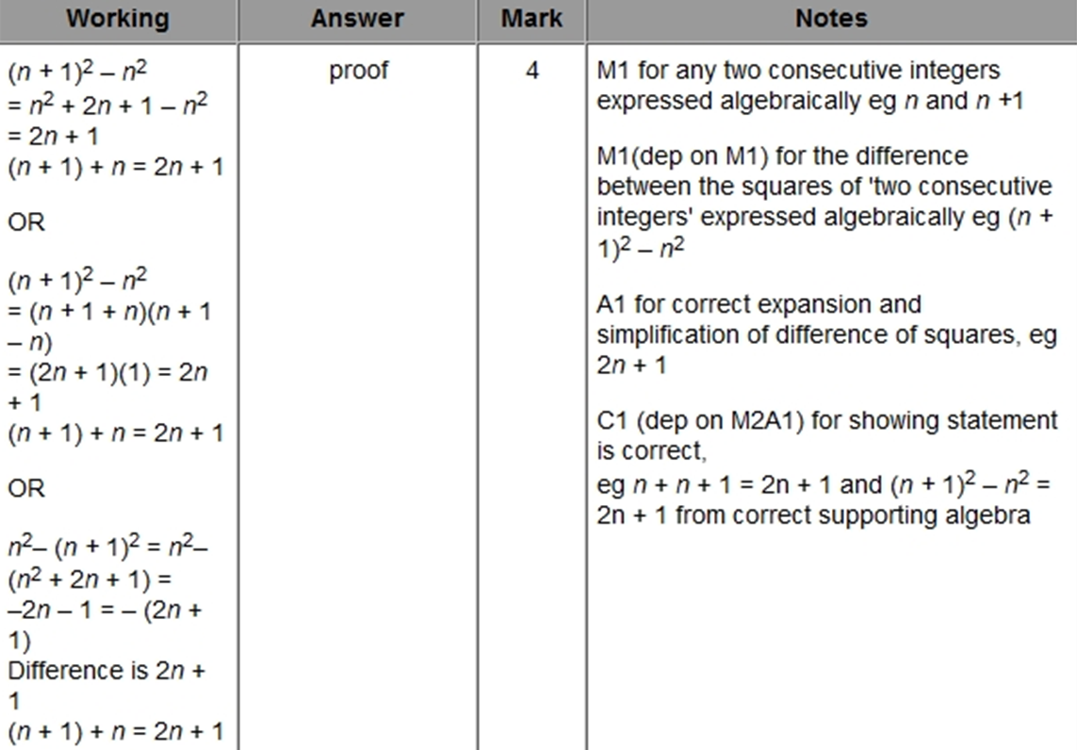
Show that…/ Proof
NTSQ Q11 (EB&P)
A

Slide 22
Show that…/ Proof
NTSQ Q12 (EB&P)

Slide 23
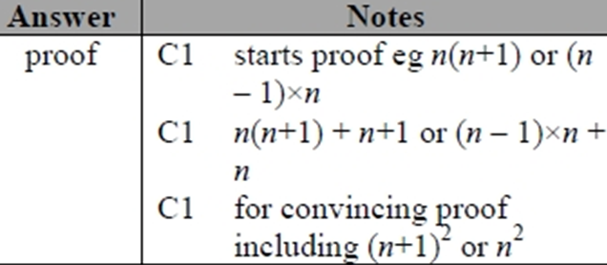
Show that…/ Proof
NTSQ Q12 (EB&P)
A

Slide 24
Show that…/ Proof
NTSQ Q13 (EB&P)

Slide 25
Show that…/ Proof
NTSQ Q13 (EB&P)
A

Slide 26
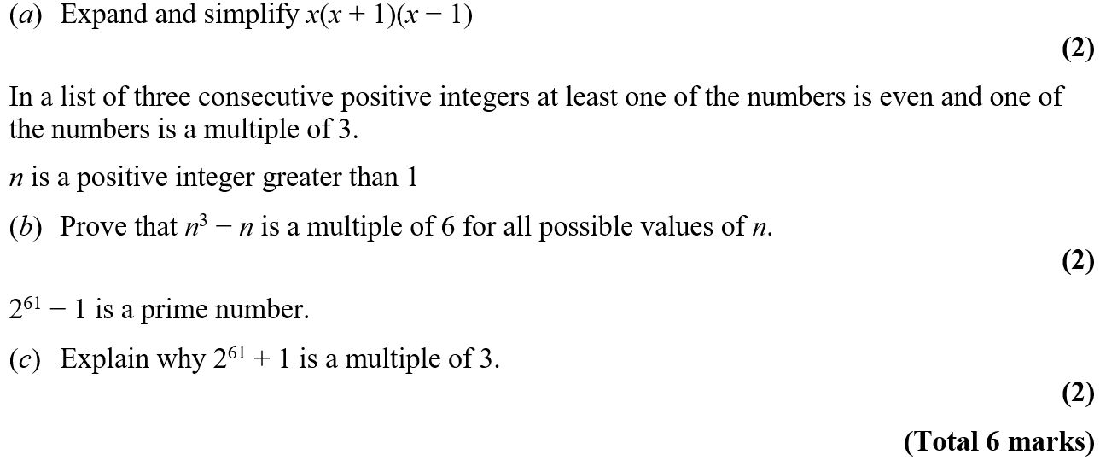
Show that…/ Proof
NTSQ Q14 (EB&P)

Slide 27
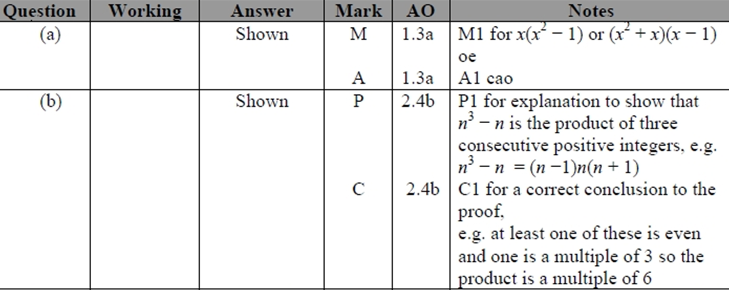
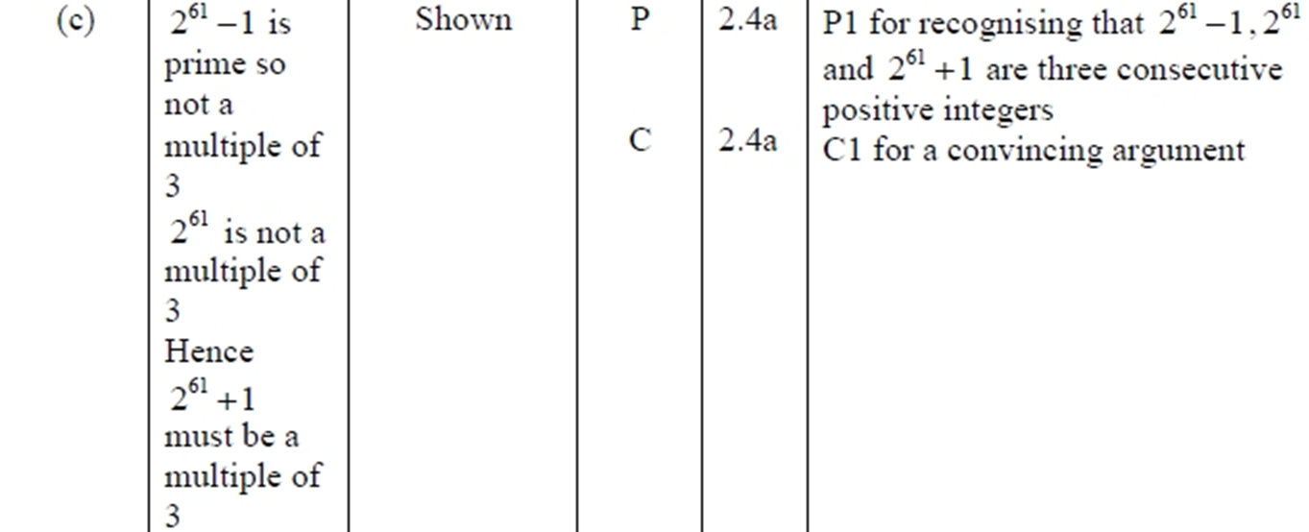
Show that…/ Proof
NTSQ Q14 (EB&P)
A
B
C

Slide 28
Show that…/ Proof
SAM 1H Q13

Slide 29
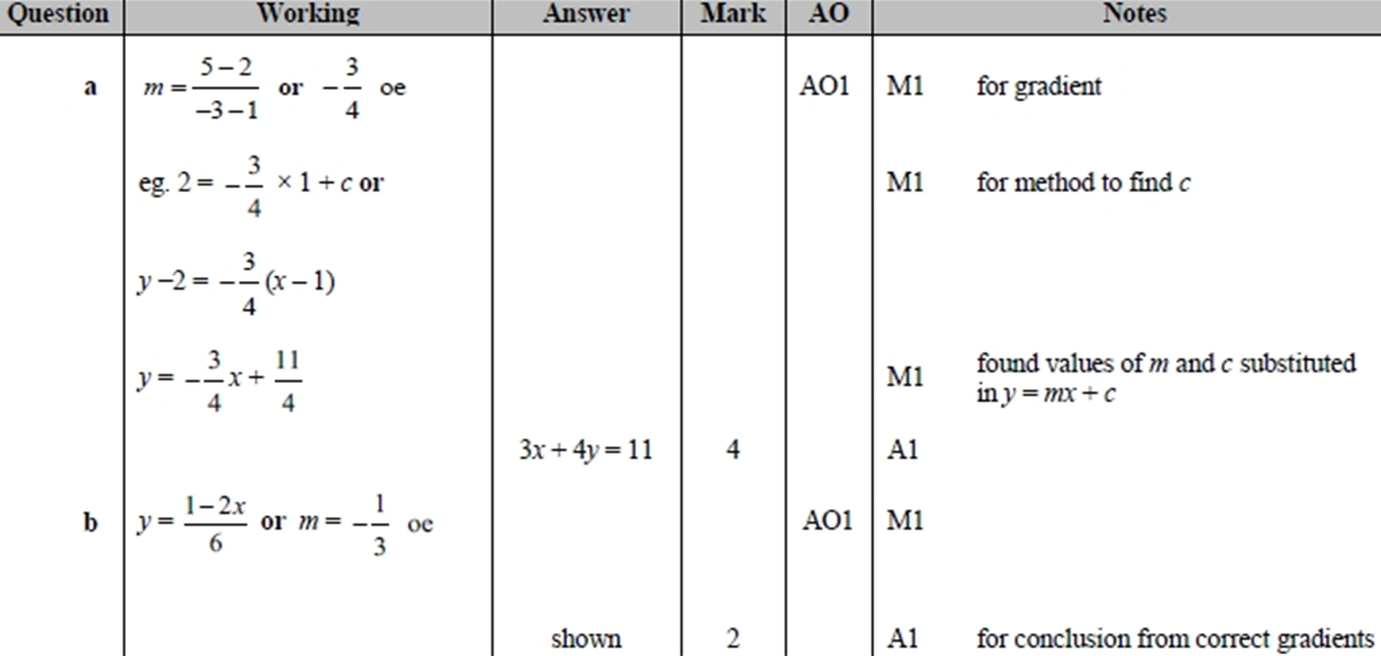
Show that…/ Proof
SAM 1H Q13
A
B

Slide 30
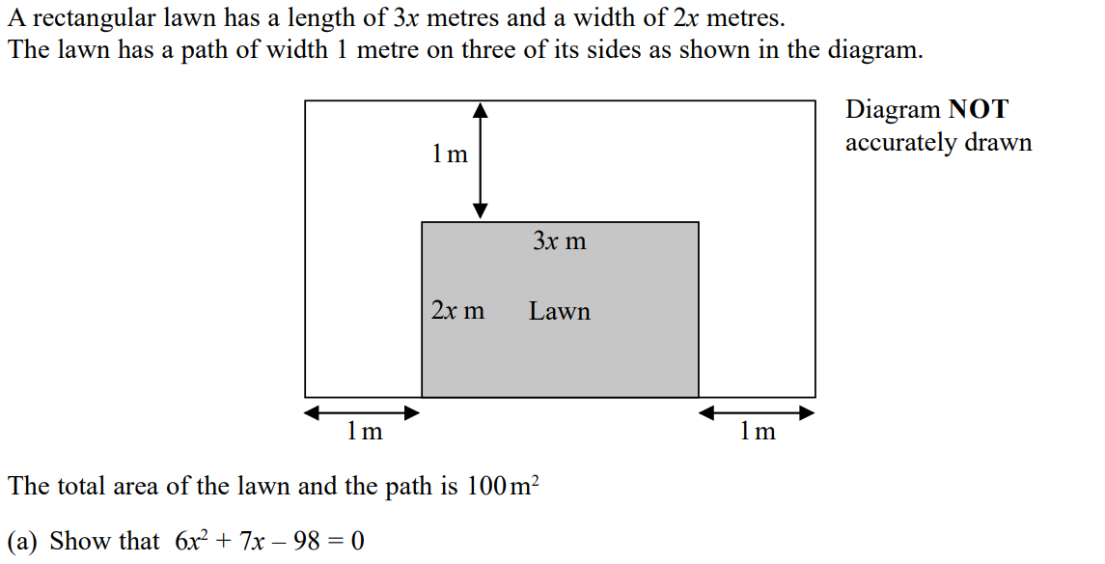
Show that…/ Proof
SAM 1H Q15

Slide 31
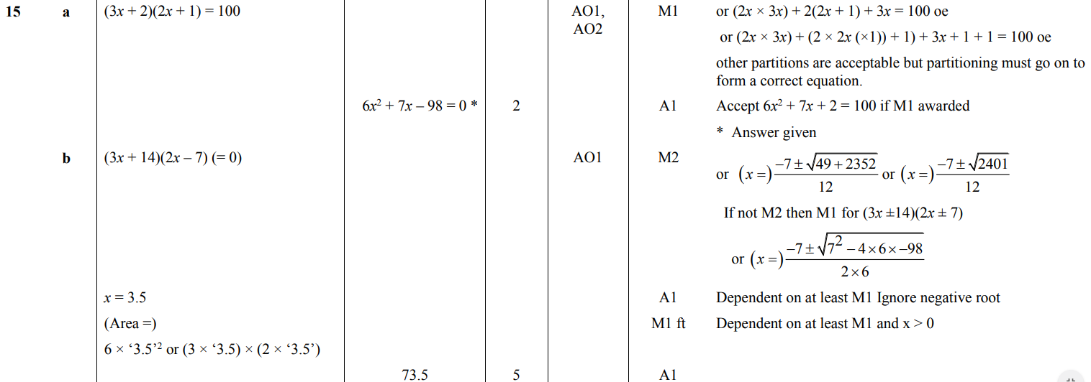
Show that…/ Proof
SAM 1H Q15
A
B

Slide 32
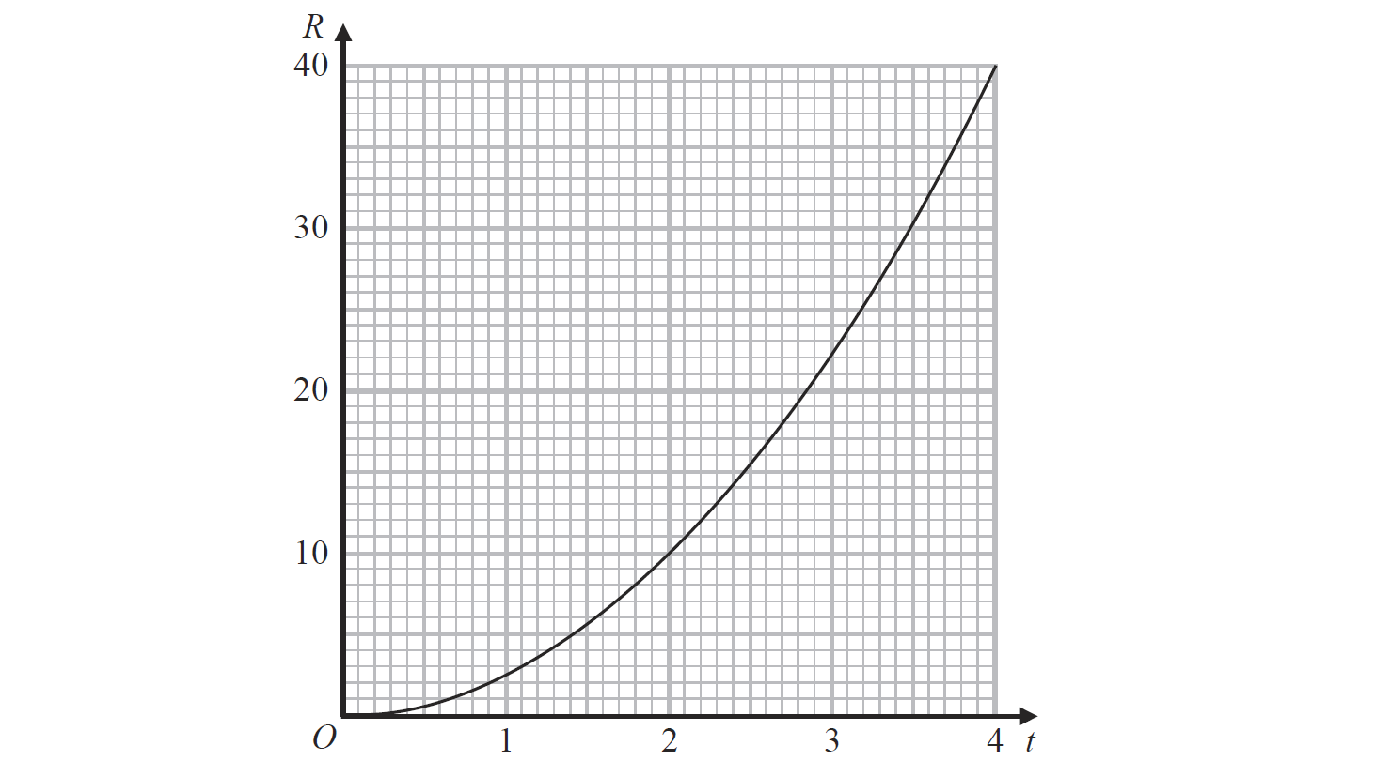
Show that…/ Proof
June 2018 2H Q16

Slide 33
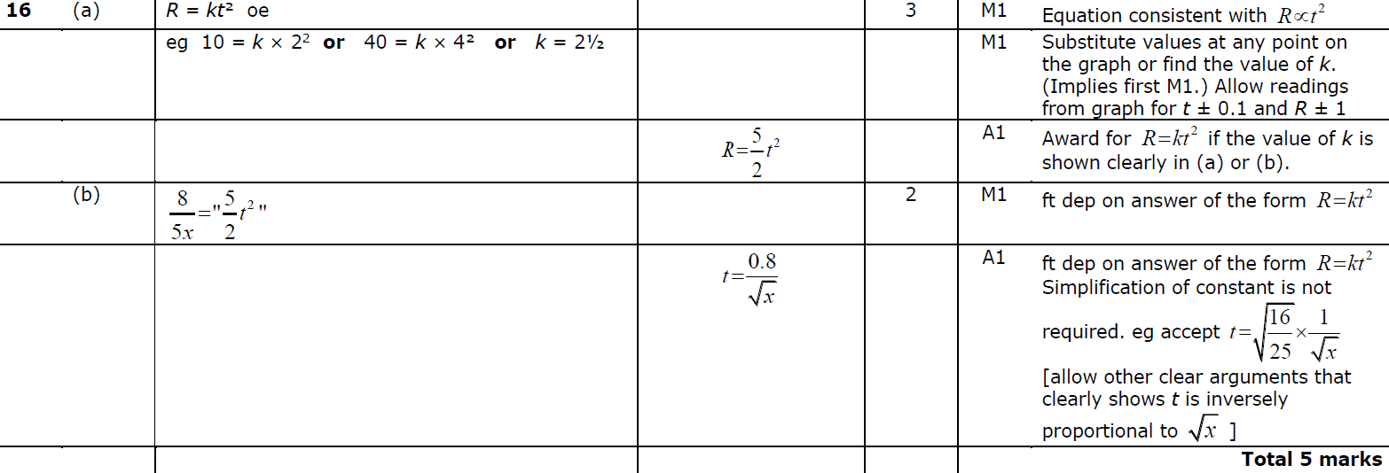
Show that…/ Proof
June 2018 2H Q16
A
B

Slide 34
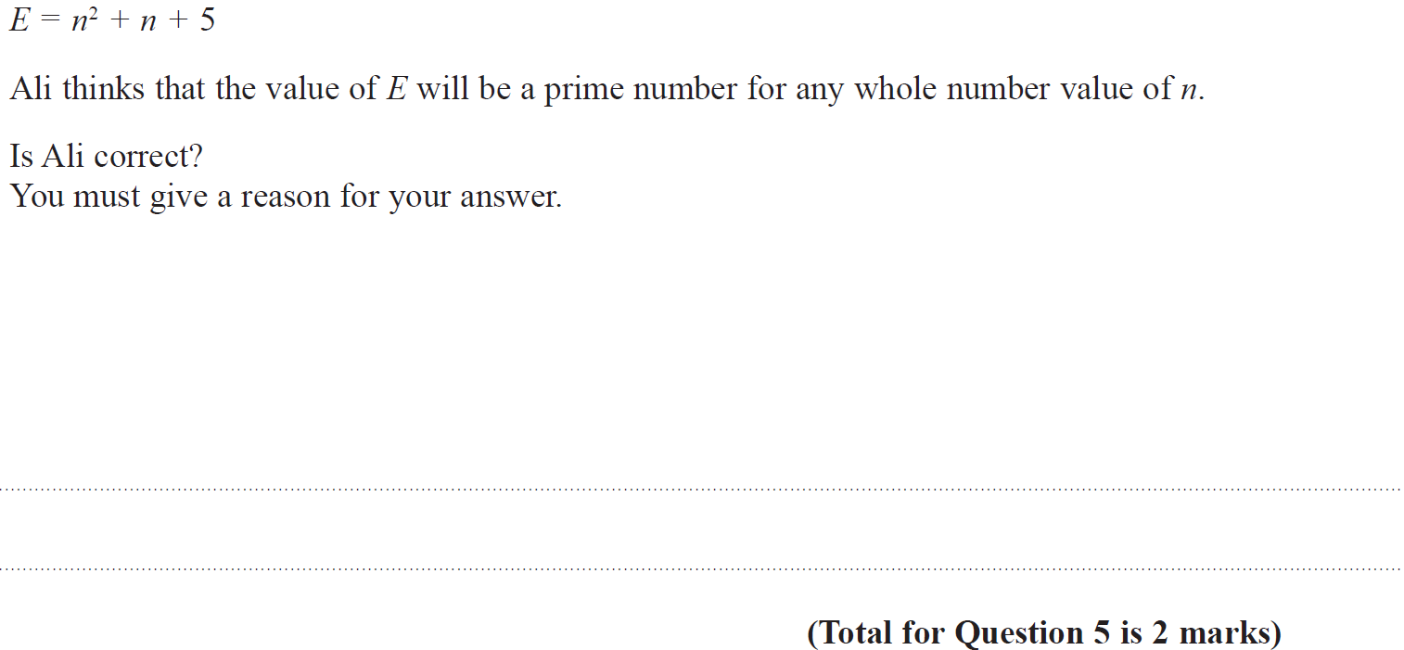
Show that…/ Proof
May 2018 1HR Q5

Slide 35
Show that…/ Proof
May 2018 1HR Q5
A

Slide 36
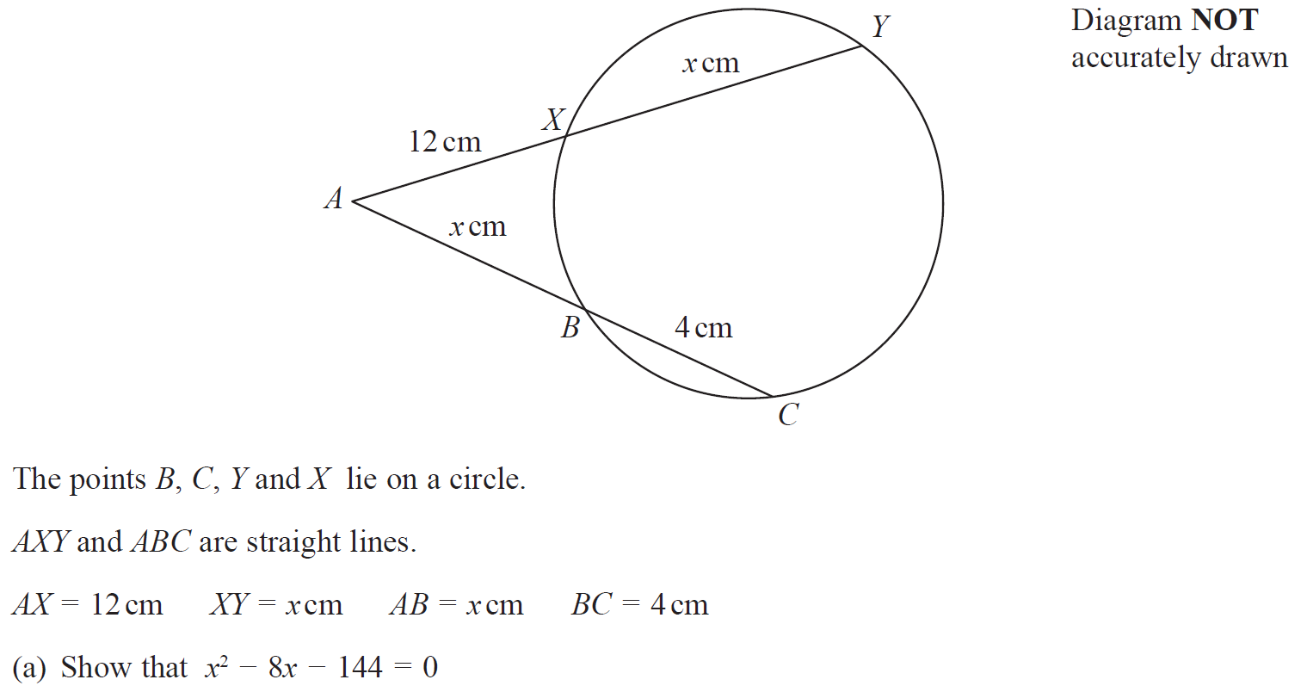
Show that…/ Proof
May 2018 1HR Q16

Slide 37
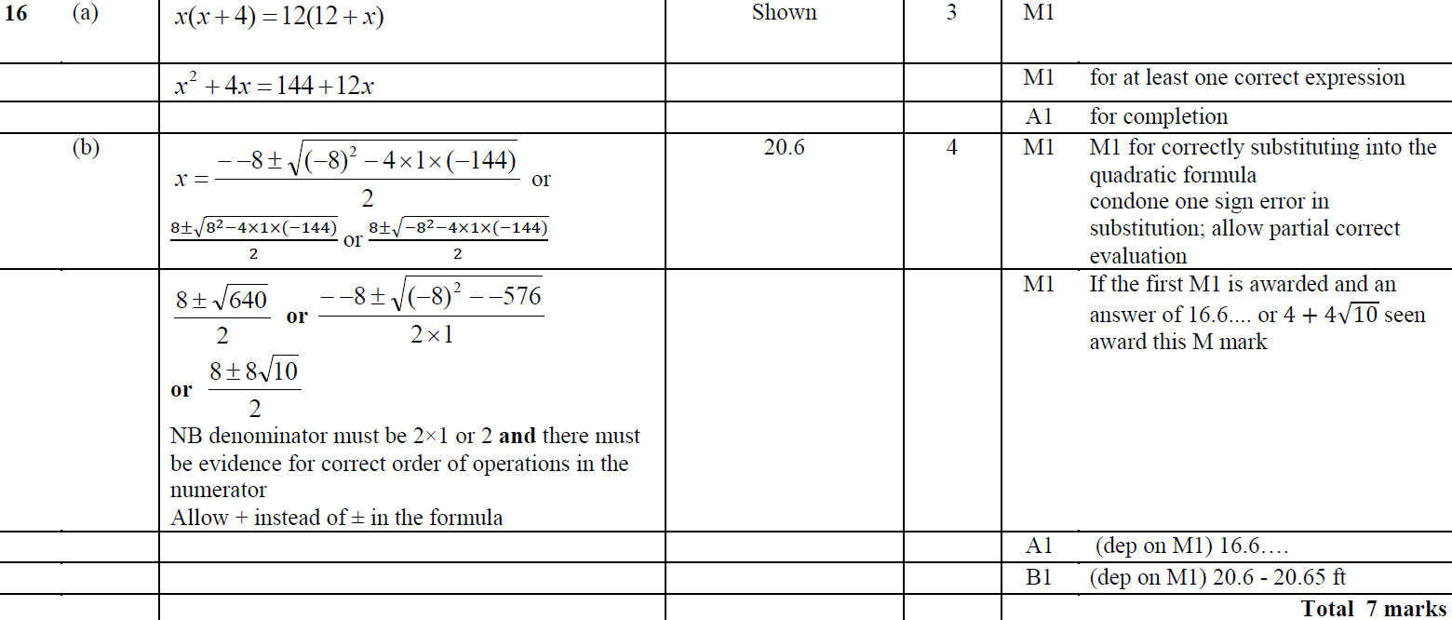
Show that…/ Proof
May 2018 1HR Q16
A
B

Slide 38
Show that…/ Proof
May 2018 1HR Q21

Slide 39
Show that…/ Proof
May 2018 1HR Q21
A
B

Slide 40
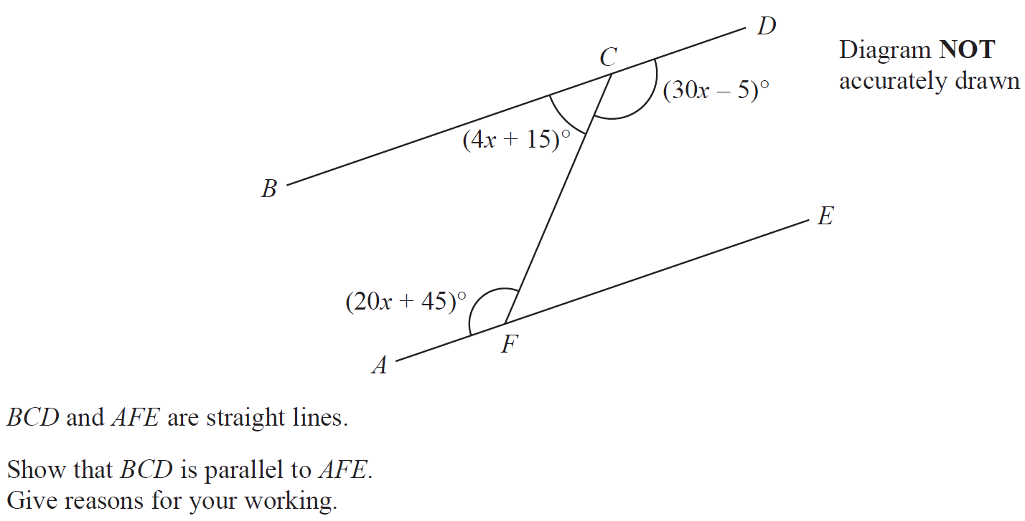
Show that…/ Proof
Jan 2019 1H Q5

Slide 41
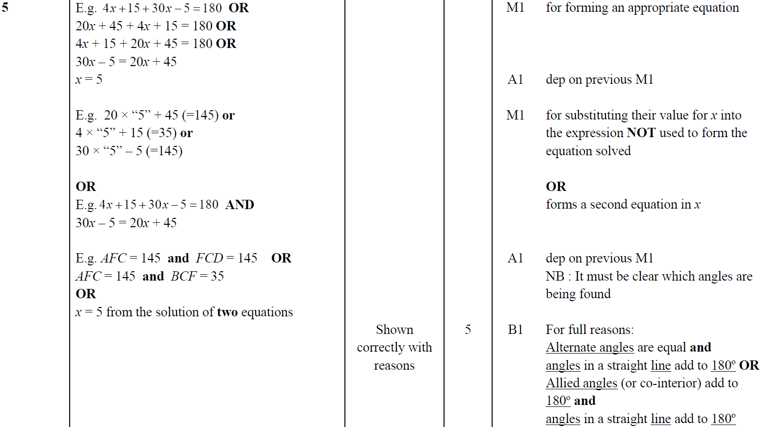
Show that…/ Proof
Jan 2019 1H Q5
A

Slide 42
Show that…/ Proof
Jan 2019 1H Q21

Slide 43
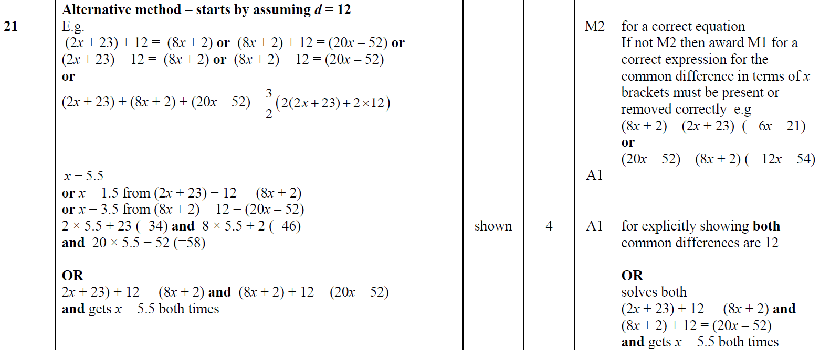
Show that…/ Proof
Jan 2019 1H Q21
A
A Alternative

Slide 44
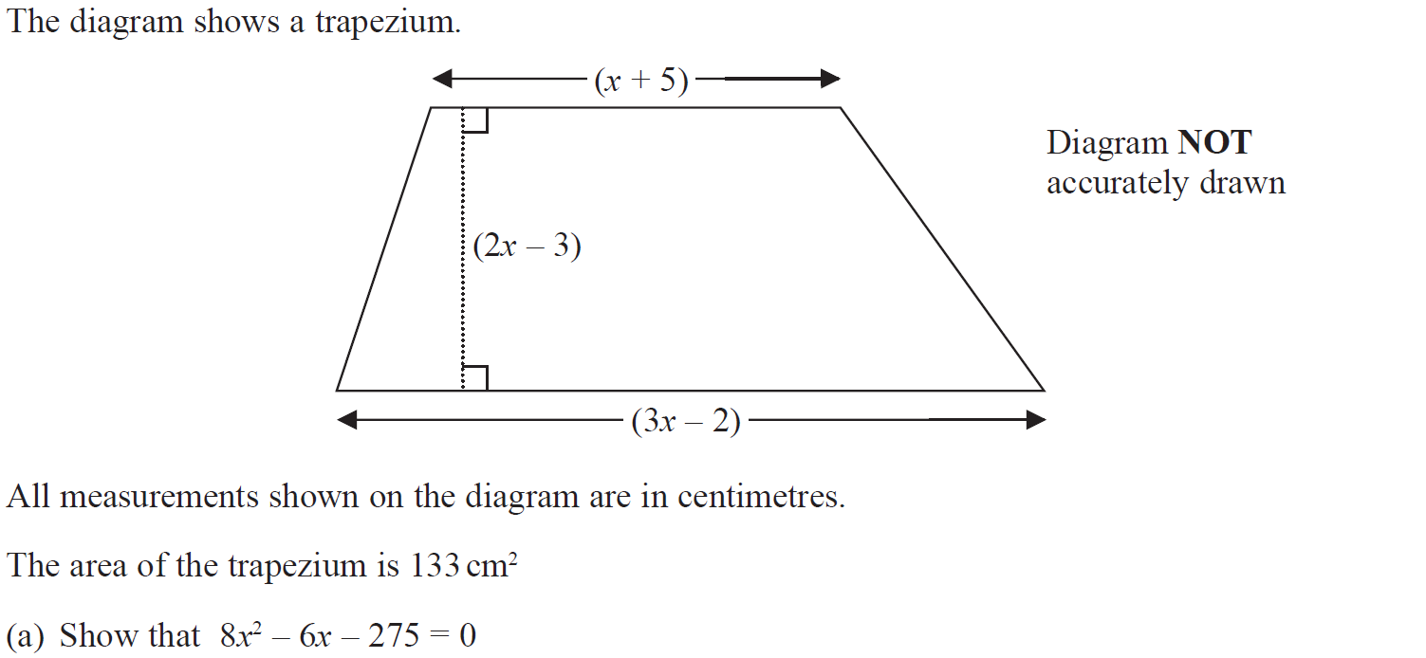
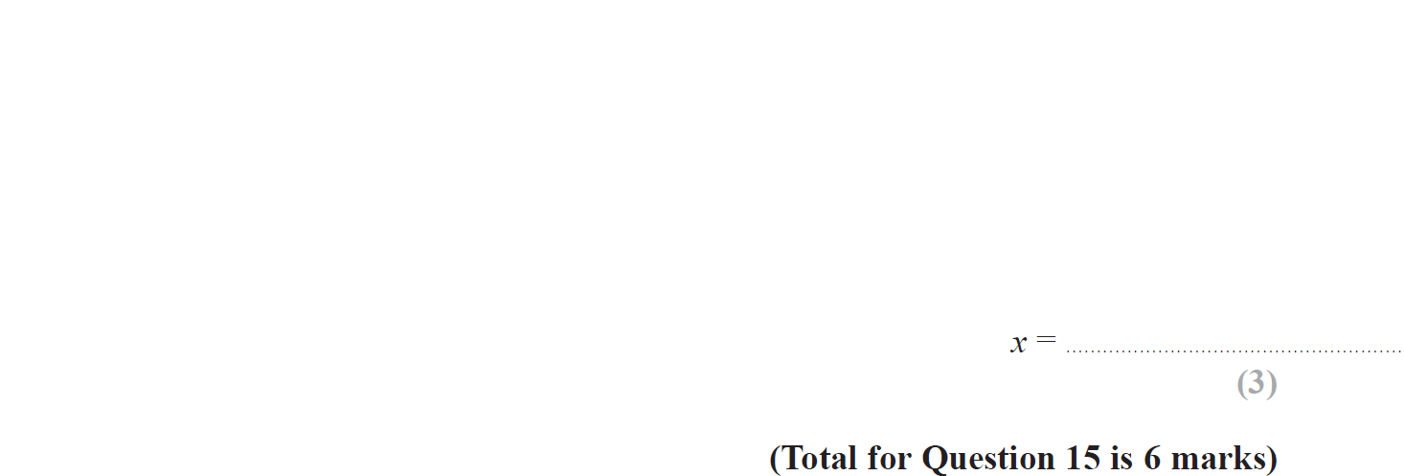
Show that…/ Proof
Jan 2019 2H Q15

Slide 45
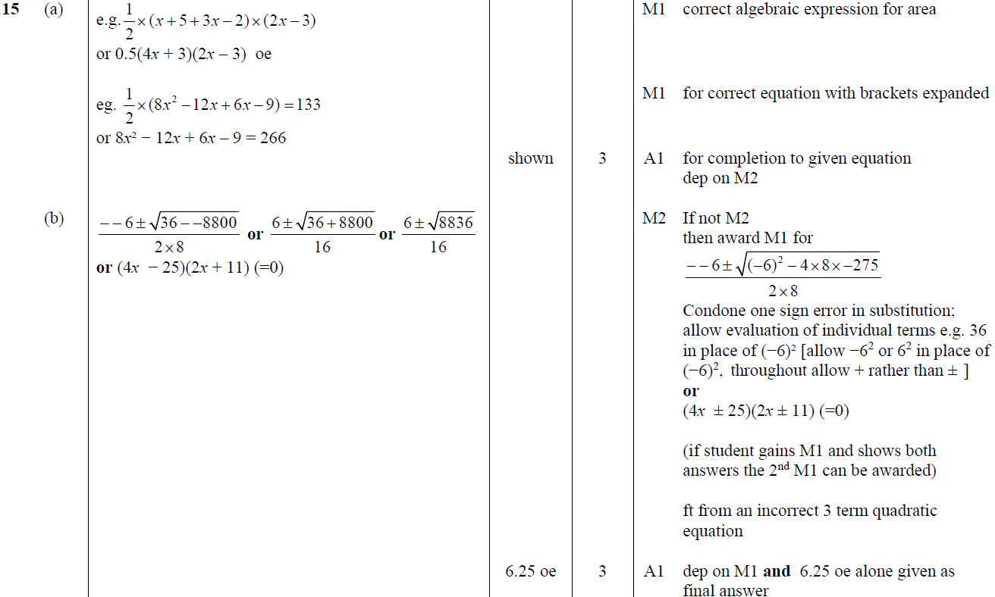
Show that…/ Proof
Jan 2019 2H Q15
A
B

Slide 46
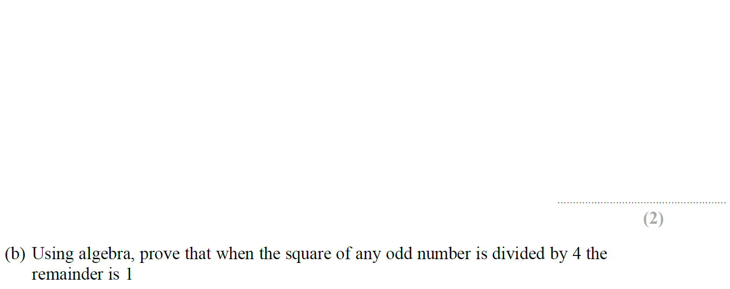
Show that…/ Proof
Jan 2019 1HR Q12

Slide 47
Show that…/ Proof
Jan 2019 1HR Q12
A
B

Slide 48
Show that…
Show that…
New Spec Q’s
(algebraic)
Nov 2004
4H Q23
Nov 2007
4H Q26
May 2013
3H Q20
Jan 2015
3HR Q17
May 2017
3HR Q20
May 2005
3H Q17
June 2009
4H Q20
May 2013
3HR Q21
June 2015
4H Q20
May 2017
3HR Q21
May 2005
4H Q14
June 2011
3H Q21
Jan 2014
4H Q15
May 2015
3HR Q19
Jan 2018
3HR Q17
May 2005
4H Q15
June 2011
4H Q21
Jan 2014
4H Q18
Jan 2016
3HR Q15
Jan 2018
4HR Q19
Nov 2005
4H Q11
Jan 2012
3H Q8
May 2014
3H Q14
May 2016
3H Q17
June 2018
4H Q13
Nov 2006
4H Q25
Jan 2012
3H Q14
May 2014
4HR Q16
June 2016
4H Q20
June 2018
4HR Q19
Nov 2007
3H Q21
Jan 2012
3H Q21
May 2014
4HR Q21
Jan 2017
4HR Q21
Nov 2007
4H Q25
Jan 2013
3H Q19
Jan 2015
4H Q17
June 2017
4H Q15
Trig

Slide 49
Show that…
Nov 2004 4H Q23

Slide 50
Show that…
Nov 2004 4H Q23
A

Slide 51
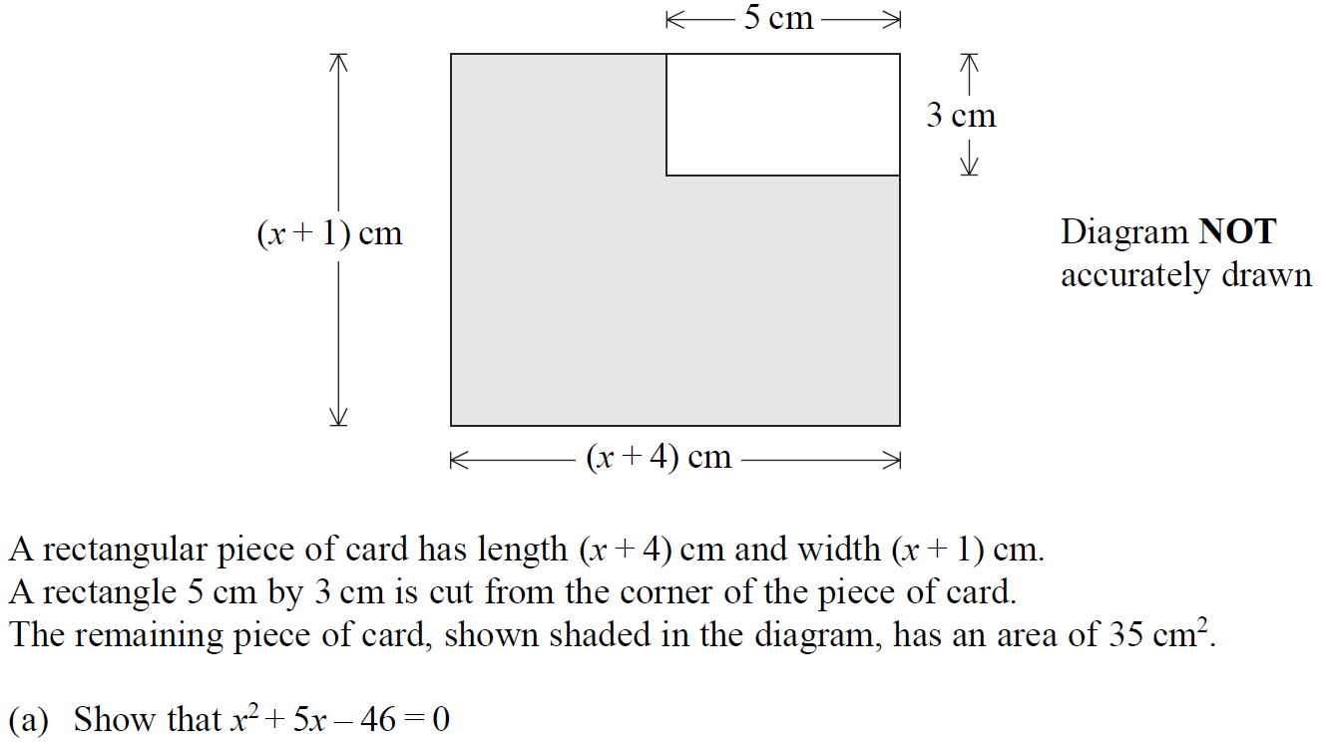
Show that…
May 2005 3H Q17

Slide 52
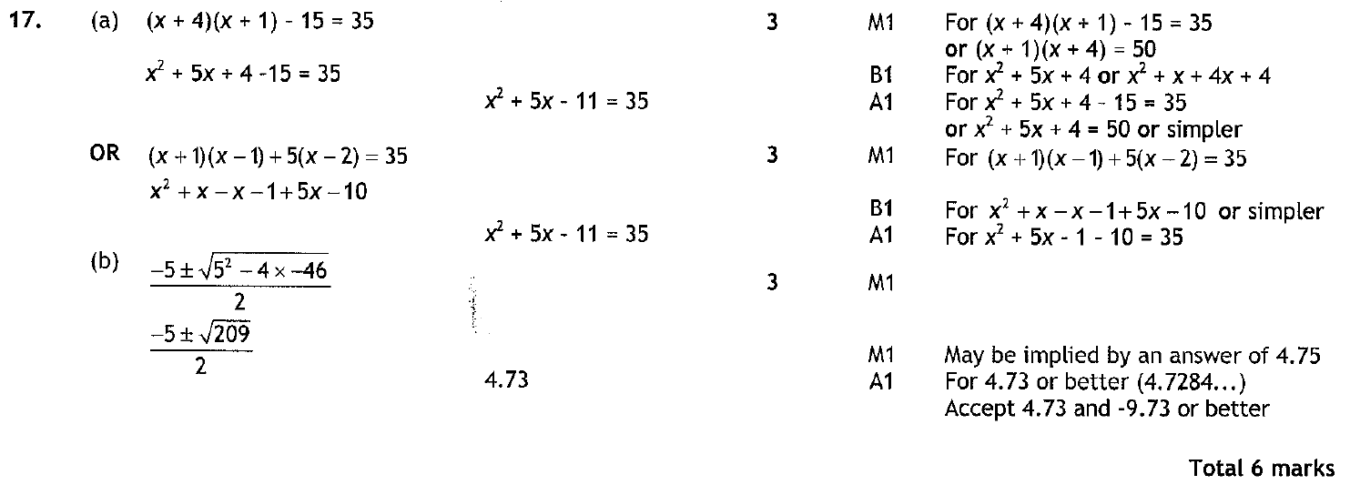
Show that…
May 2005 3H Q17
A
B

Slide 53
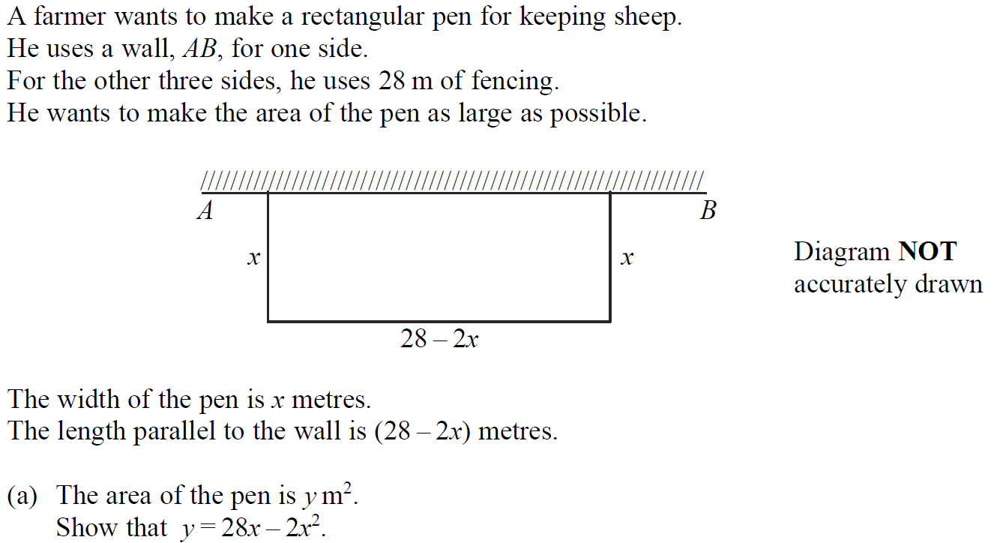
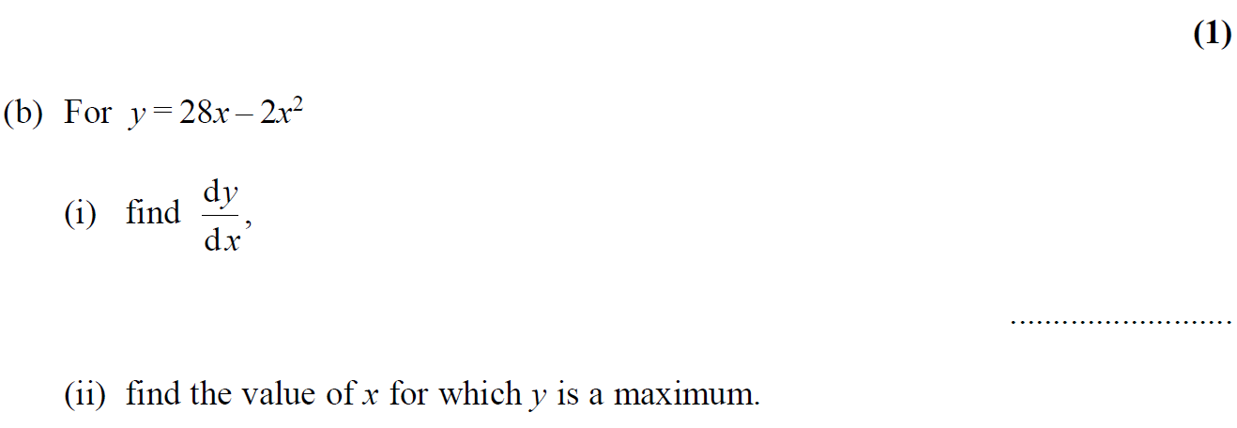
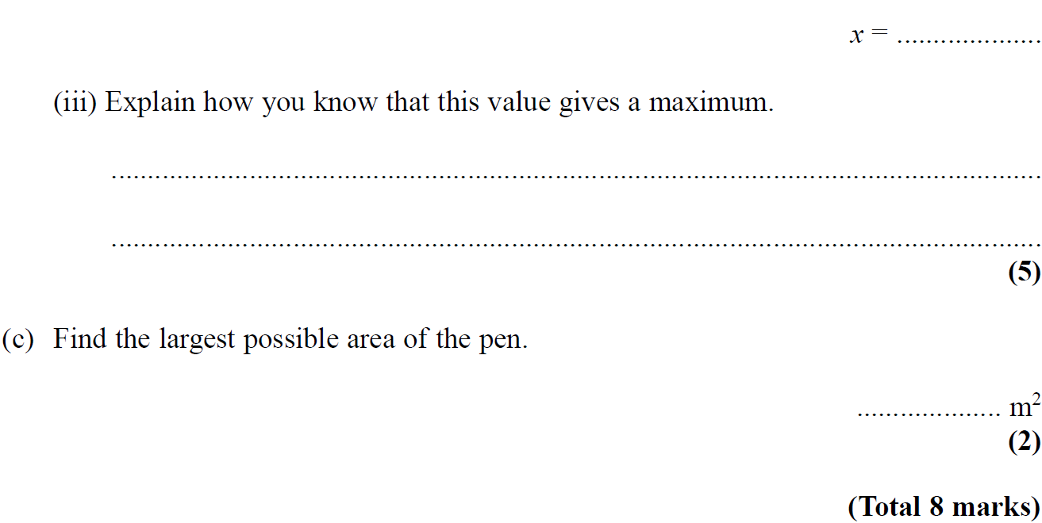
Show that…
May 2005 4H Q14

Slide 54
Show that…
May 2005 4H Q14
A
B (i)
B (ii)
B (iii)
C

Slide 55
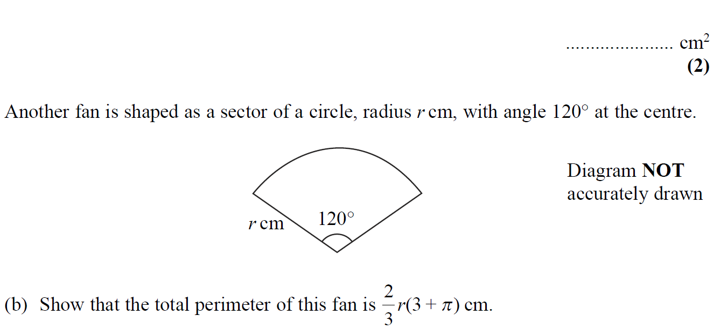
Show that…
May 2005 4H Q15

Slide 56
Show that…
May 2005 4H Q15
A
B

Slide 57
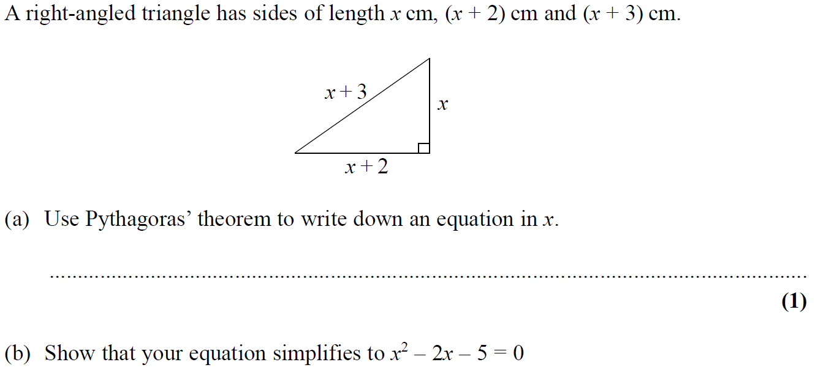
Show that…
Nov 2005 4H Q11

Slide 58
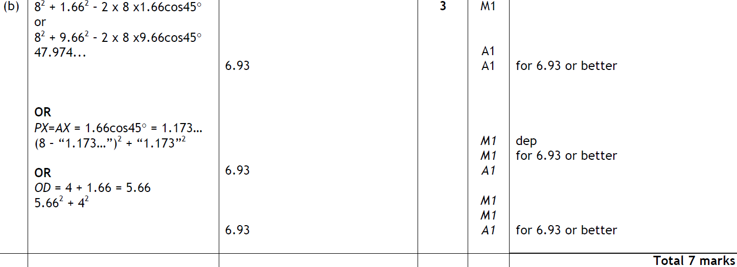
Show that…
Nov 2005 4H Q11
A
B

Slide 59
Show that…
Nov 2006 4H Q25

Slide 60
Show that…
Nov 2006 4H Q25
A
B

Slide 61
Show that…
Nov 2007 3H Q21

Slide 62
Show that…
Nov 2007 3H Q21
A

Slide 63
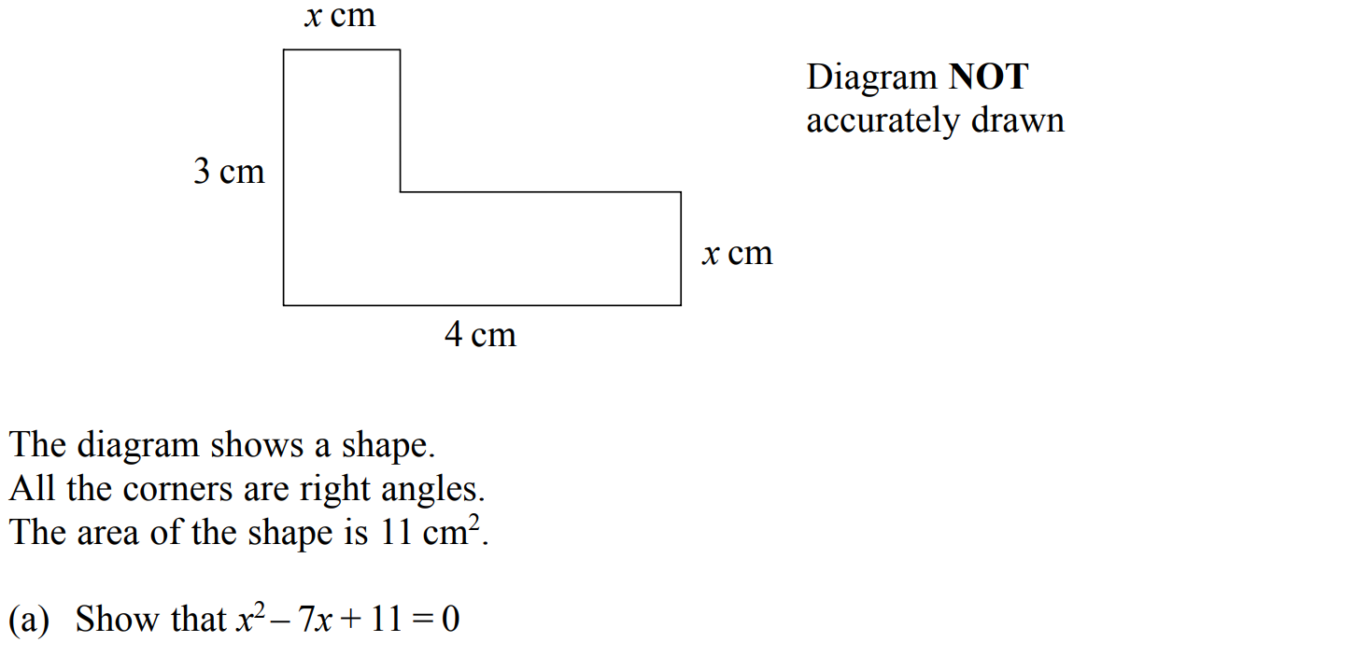
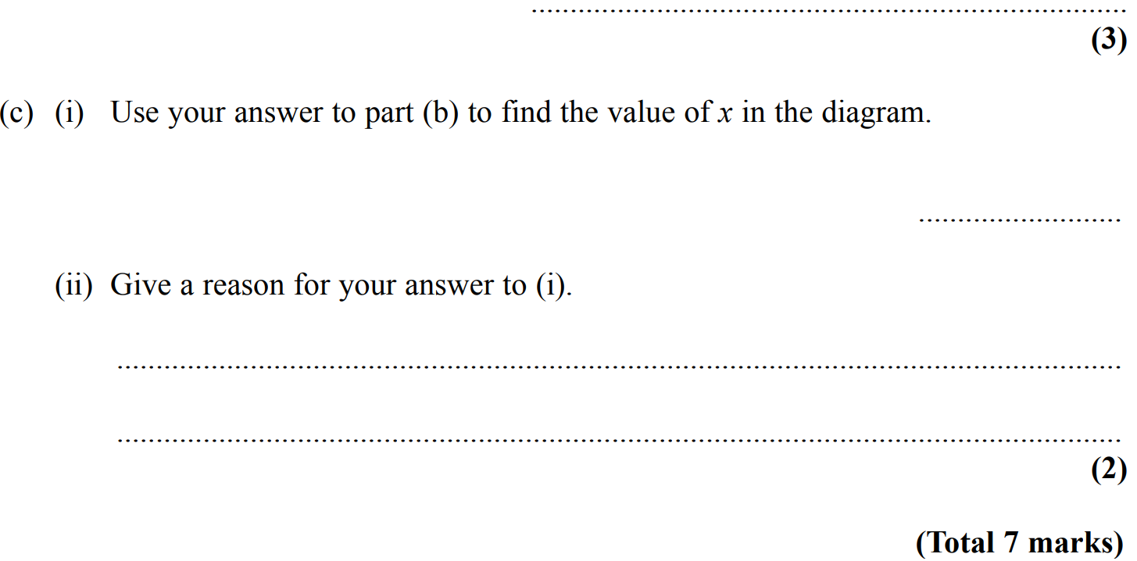
Show that…
Nov 2007 4H Q25

Slide 64
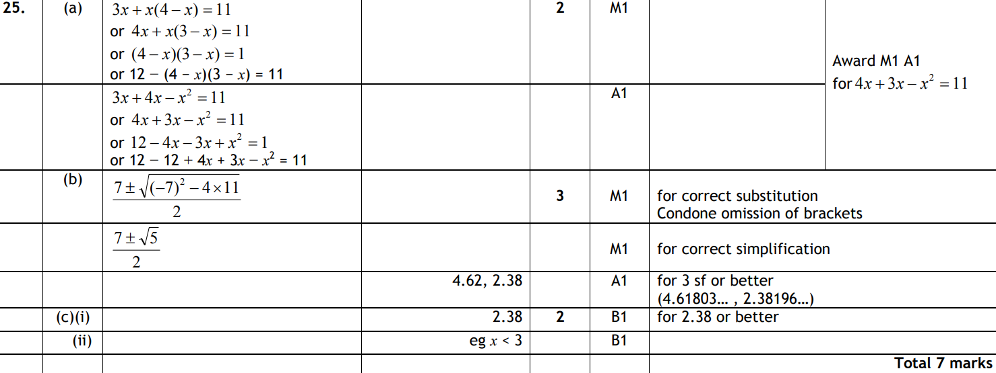
Show that…
Nov 2007 4H Q25
A
B
C (i)
C (ii)

Slide 65
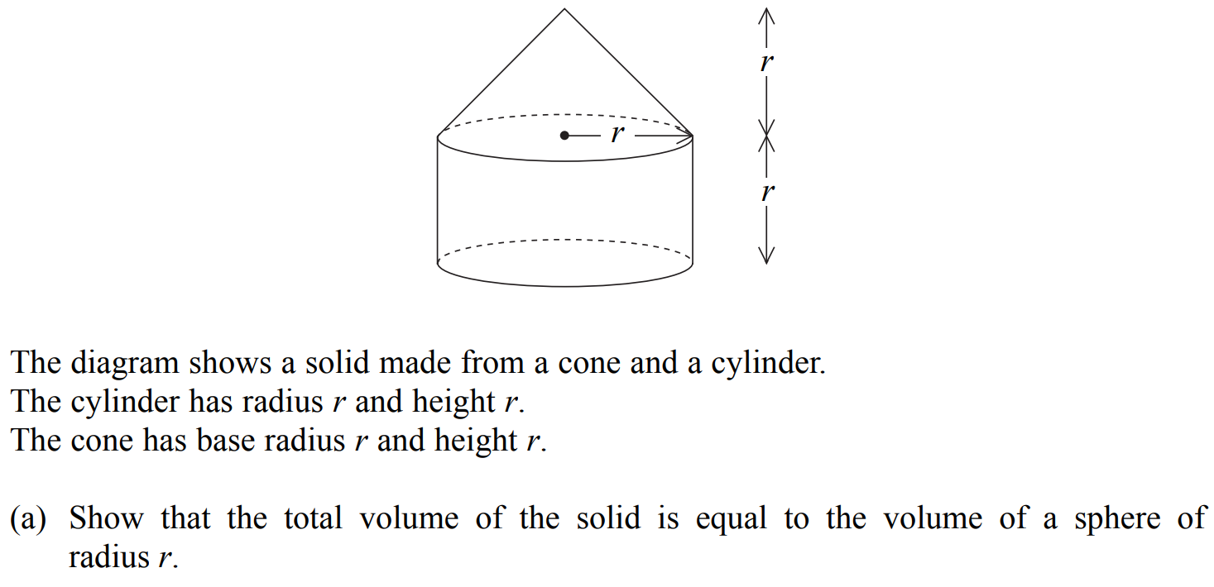
Show that…
Nov 2007 4H Q26

Slide 66
Show that…
Nov 2007 4H Q26
A
B

Slide 67
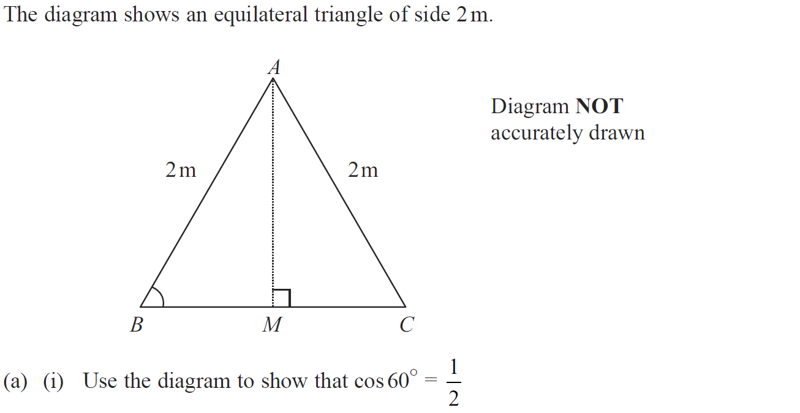
Show that…
June 2009 4H Q20

Slide 68
Show that…
June 2009 4H Q20
A (i)
A (ii)
B

Slide 69
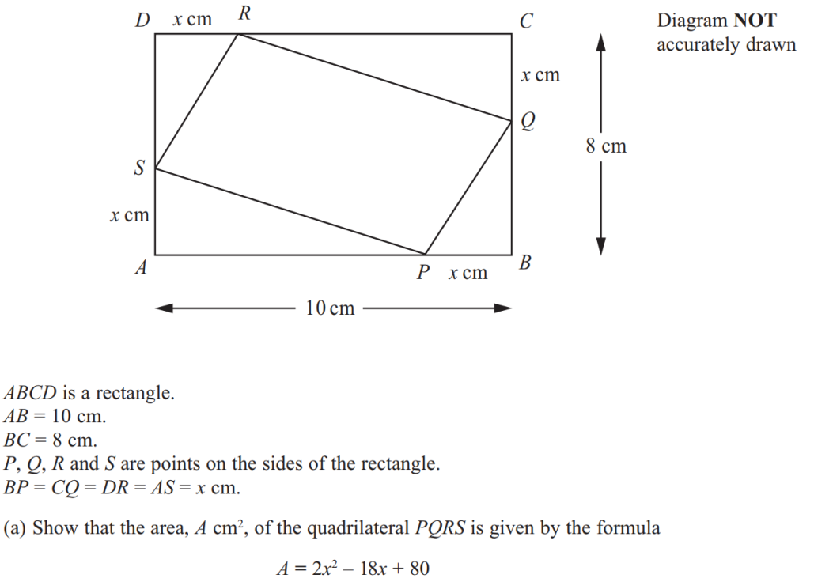
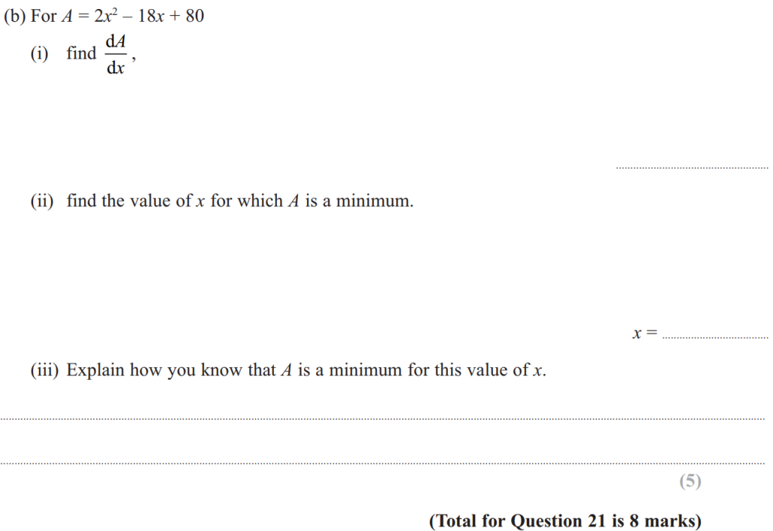
Show that…
June 2011 3H Q21

Slide 70
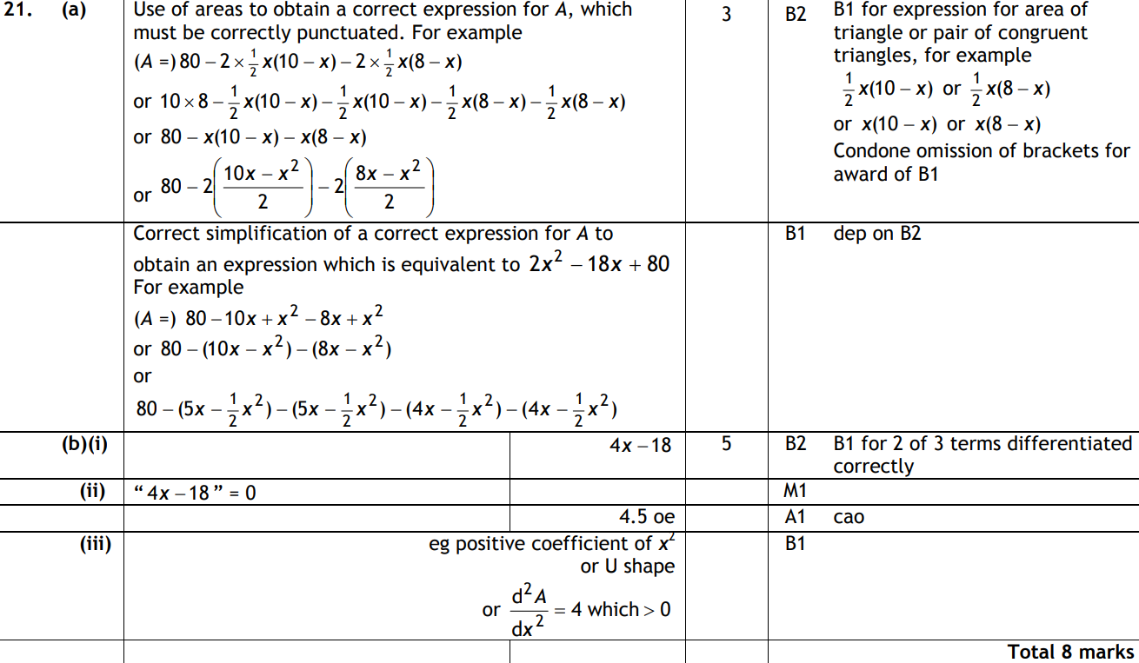
Show that…
June 2011 3H Q21
A
B (i)
B (ii)
B (iii)

Slide 71
Show that…
June 2011 4H Q21

Slide 72
Show that…
June 2011 4H Q21
A
B

Slide 73
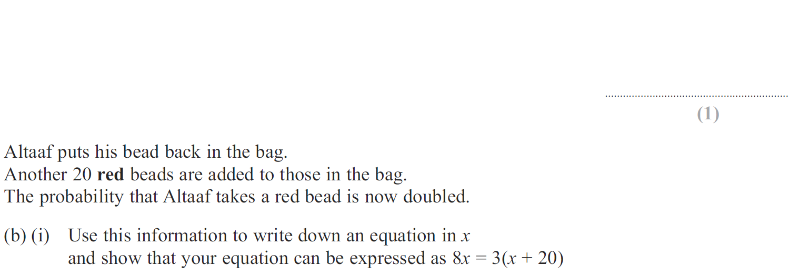
Show that…
Jan 2012 3H Q8

Slide 74
Show that…
Jan 2012 3H Q8
A
B (i)
B (ii)

Slide 75
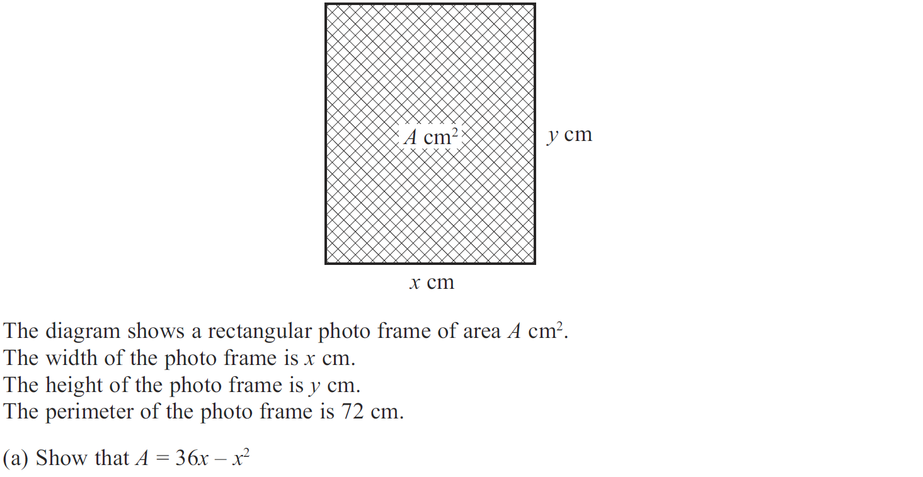
Show that…
Jan 2012 3H Q14

Slide 76
Show that…
Jan 2012 3H Q14
A
B
C

Slide 77
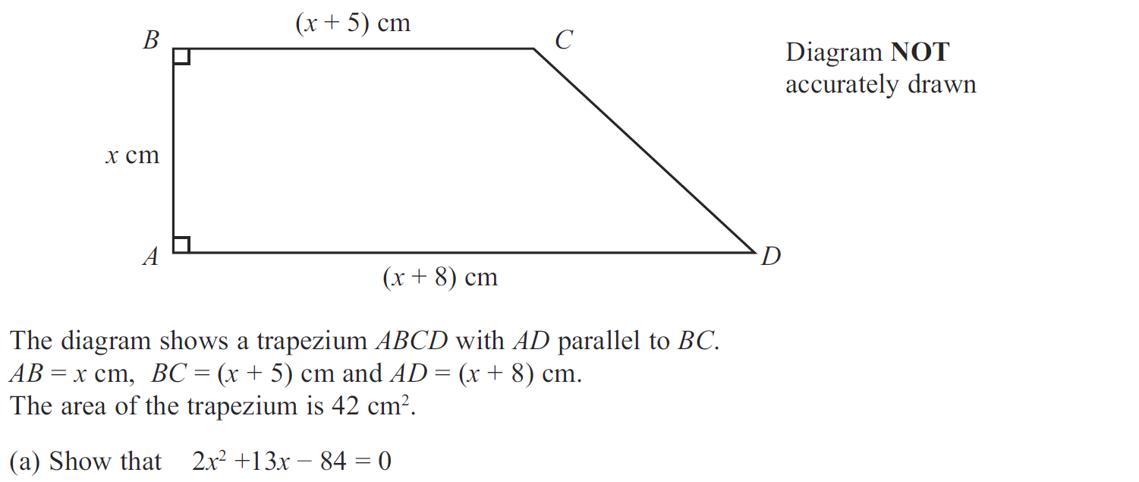
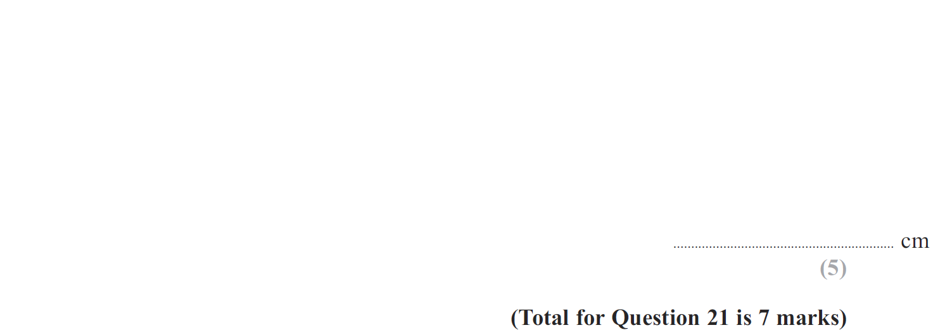
Show that…
Jan 2012 3H Q21

Slide 78
Show that…
Jan 2012 3H Q21
A
B

Slide 79
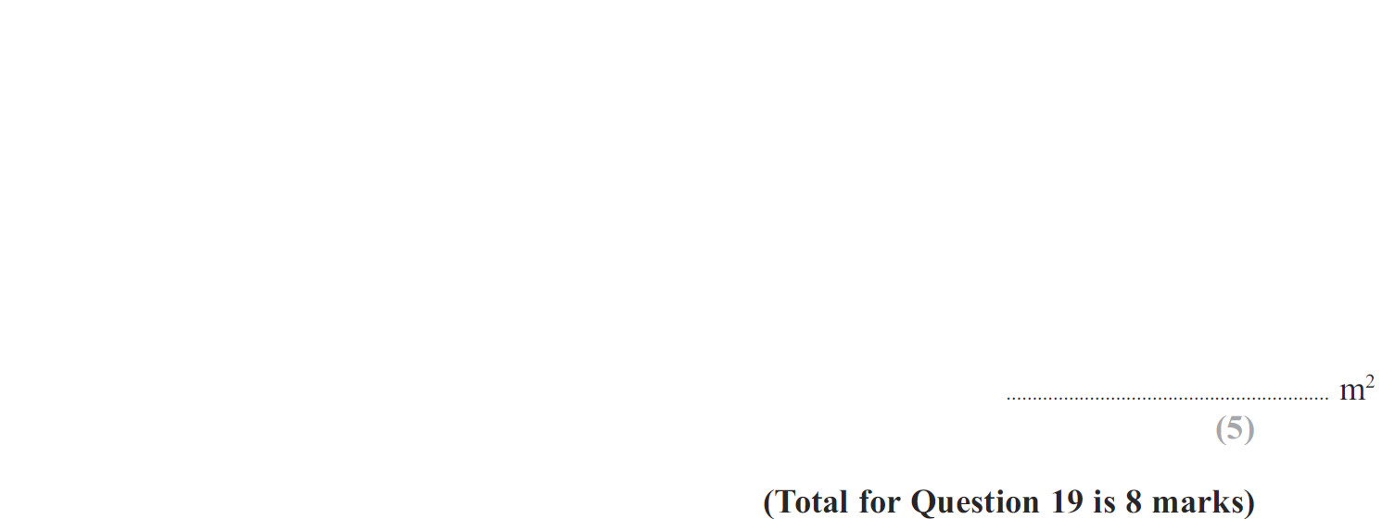
Show that…
Jan 2013 3H Q19

Slide 80
Show that…
Jan 2013 3H Q19
A
B

Slide 81
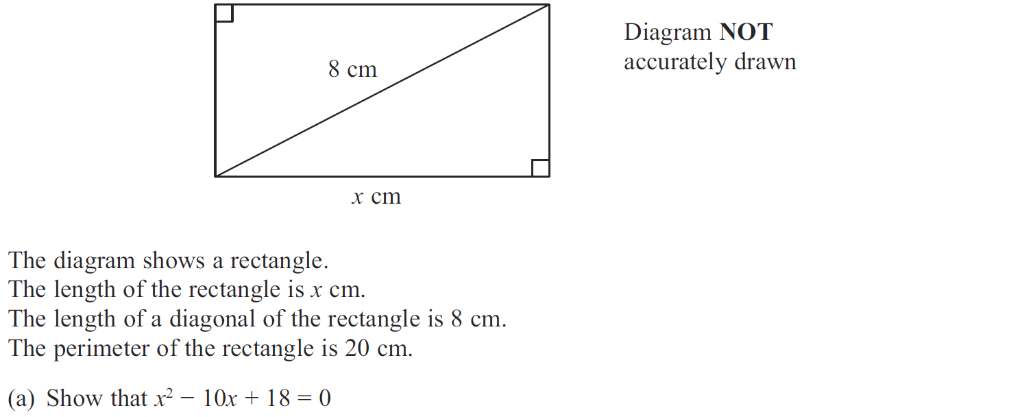
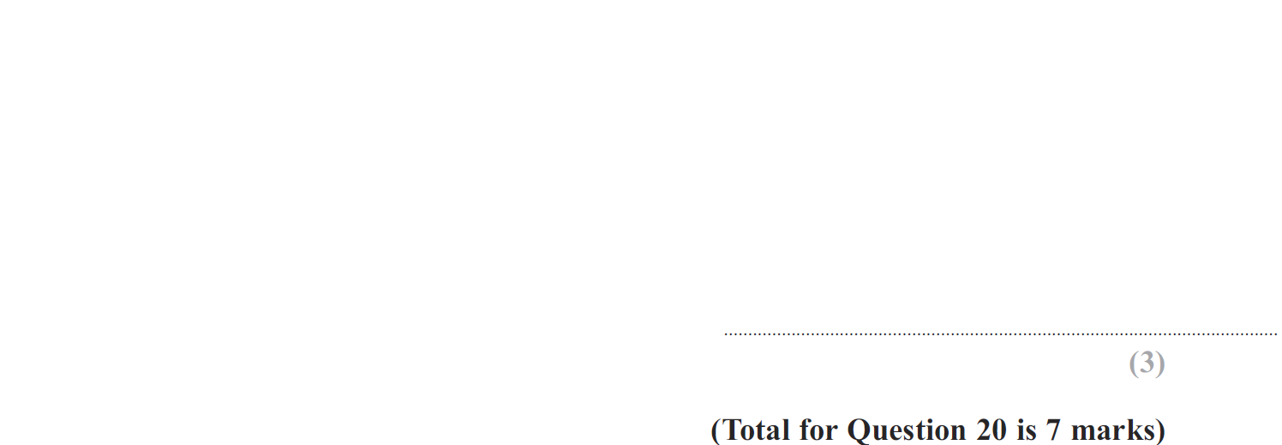
Show that…
May 2013 3H Q20

Slide 82
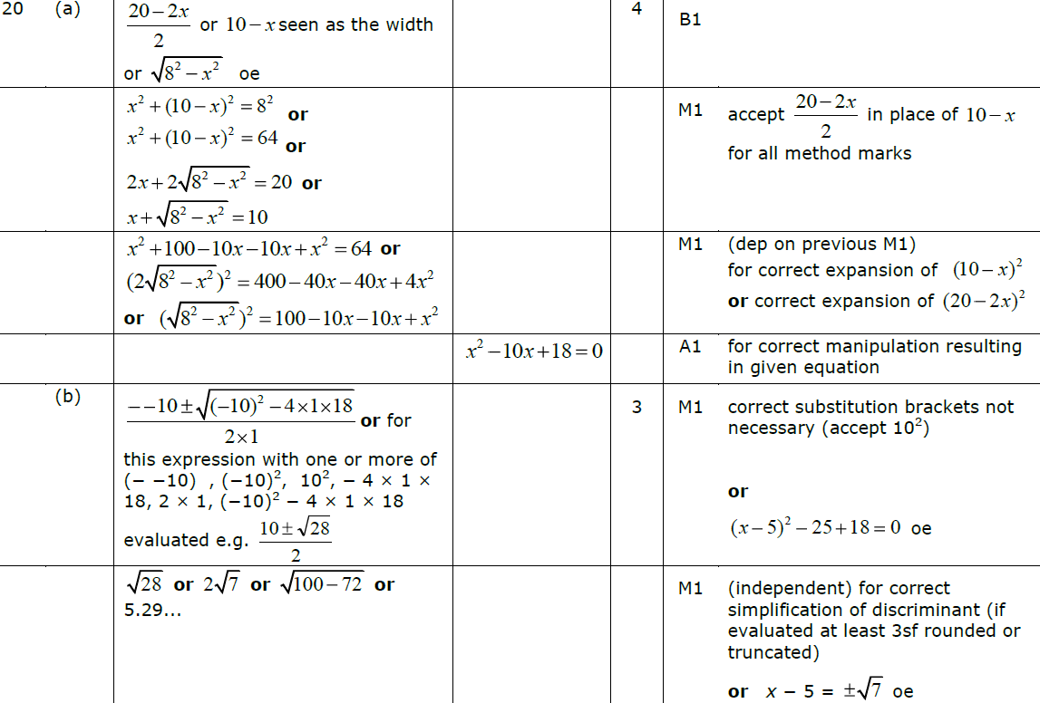
Show that…
May 2013 3H Q20
A
B

Slide 83
Show that…
May 2013 3HR Q21

Slide 84
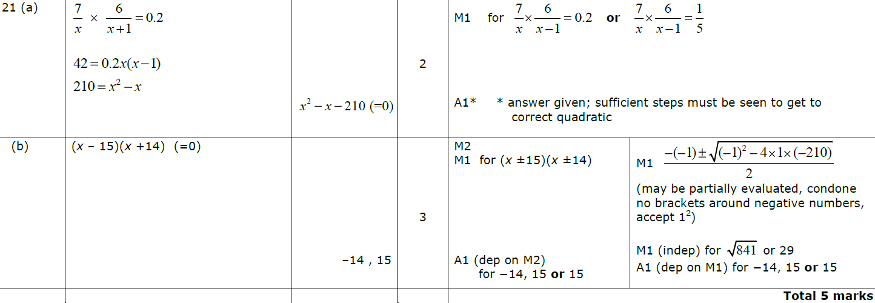
Show that…
May 2013 3HR Q21
A
B

Slide 85
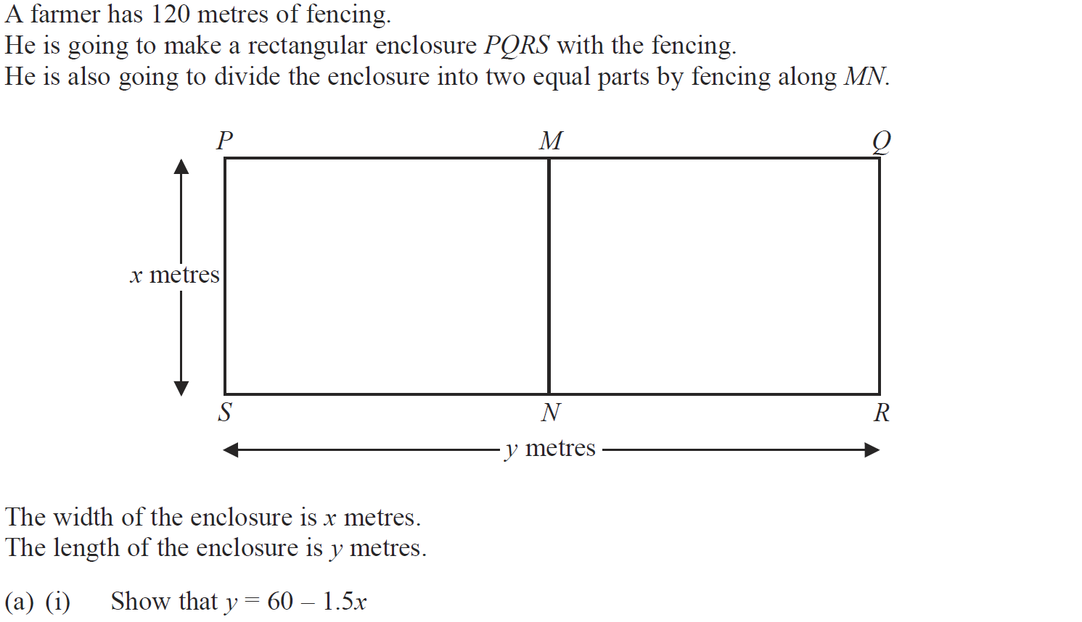
Show that…
Jan 2014 4H Q15

Slide 86
Show that…
Jan 2014 4H Q15
A (i)
A (ii)
B
C

Slide 87
Show that…
Jan 2014 4H Q18

Slide 88
Show that…
Jan 2014 4H Q18
A
B

Slide 89
Show that…
May 2014 3H Q14

Slide 90
Show that…
May 2014 3H Q14
A (i)
A (ii)
B
C

Slide 91
Show that…
May 2014 4HR Q16

Slide 92
Show that…
May 2014 4HR Q16
A
B
C
B Alternative

Slide 93
Show that…
May 2014 4HR Q21

Slide 94
Show that…
May 2014 4HR Q21
A
B

Slide 95
Show that…
Jan 2015 4H Q17

Slide 96
Show that…
Jan 2015 4H Q17
A
B

Slide 97
Show that…
Jan 2015 3HR Q17

Slide 98
Show that…
Jan 2015 3HR Q17
A
B
C

Slide 99
Show that…
June 2015 4H Q20

Slide 100
Show that…
June 2015 4H Q20
A
B

Slide 101
Show that…
May 2015 3HR Q19

Slide 102
Show that…
May 2015 3HR Q19
A
B

Slide 103
Show that…
Jan 2016 3HR Q15

Slide 104
Show that…
Jan 2016 3HR Q15
A
B
C

Slide 105
Show that…
May 2016 3H Q17

Slide 106
Show that…
May 2016 3H Q17
(i)
(ii)

Slide 107
Show that…
June 2016 4H Q20

Slide 108
Show that…
June 2016 4H Q20
A

Slide 109
Show that…
Jan 2017 4HR Q21

Slide 110
Show that…
Jan 2017 4HR Q21
A
B

Slide 111
Show that…
June 2017 4H Q15

Slide 112
Show that…
June 2017 4H Q15
A

Slide 113
Show that…
May 2017 3HR Q20

Slide 114
Show that…
May 2017 3HR Q20
A

Slide 115
Show that…
May 2017 3HR Q21

Slide 116
Show that…
May 2017 3HR Q21
A

Slide 117
Show that…
Jan 2018 3HR Q17

Slide 118
Show that…
Jan 2018 3HR Q17
A
B

Slide 119
Show that…
Jan 2018 4HR Q19

Slide 120
Show that…
Jan 2018 4HR Q19
A

Slide 121
Show that…
June 2018 4H Q13

Slide 122
Show that…
June 2018 4H Q13
A

Slide 123
Show that…
June 2018 4HR Q19

Slide 124
Show that…
June 2018 4HR Q19
A
B

