Slide 1
Sets
Sets
June 2017 3H Q1
SAM
3H Q12
June 2018 3H Q20
Spec 2
2H Q5
Nov 2018 2H Q1
June 2019 2H Q1

Slide 2
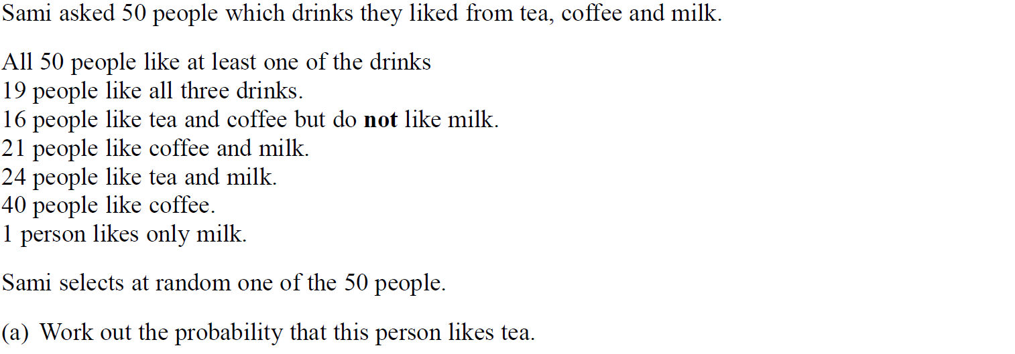
Sets
SAM 3H Q12

Slide 3
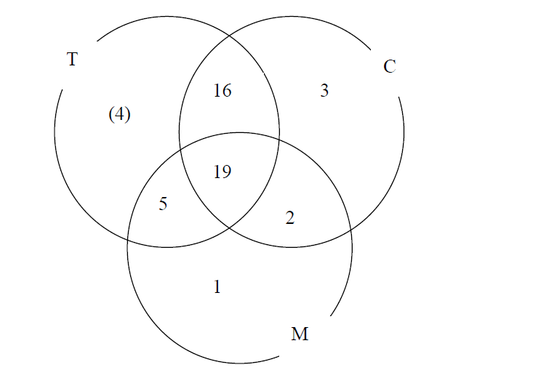
Sets
SAM 3H Q12
A
B

Slide 4
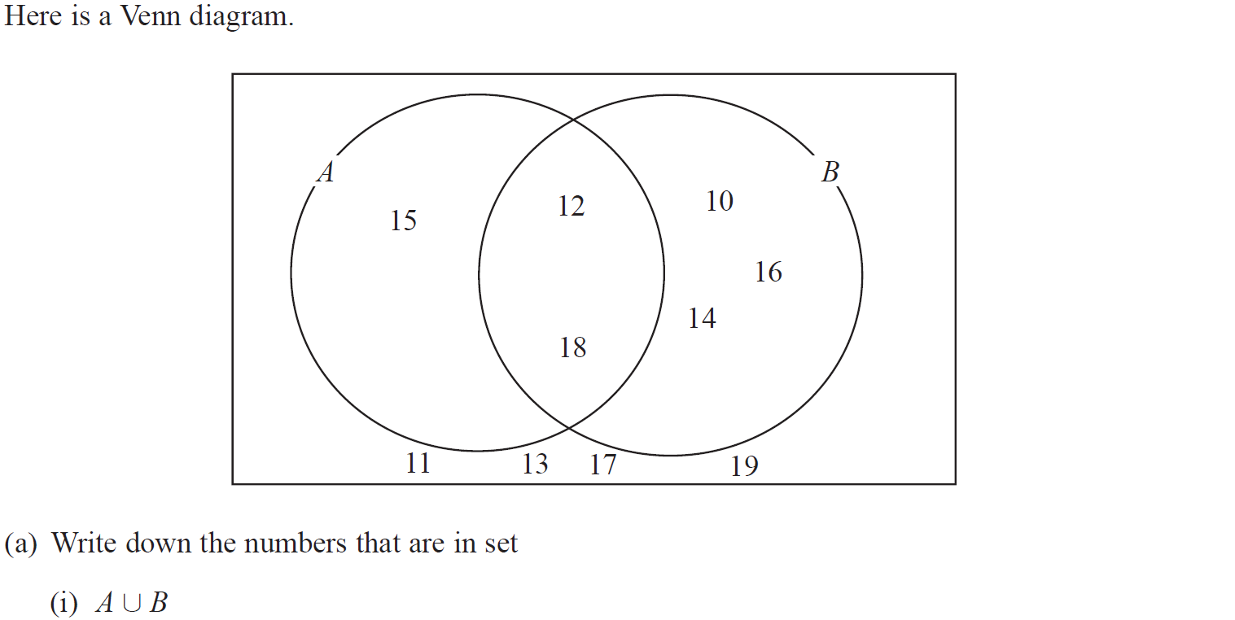
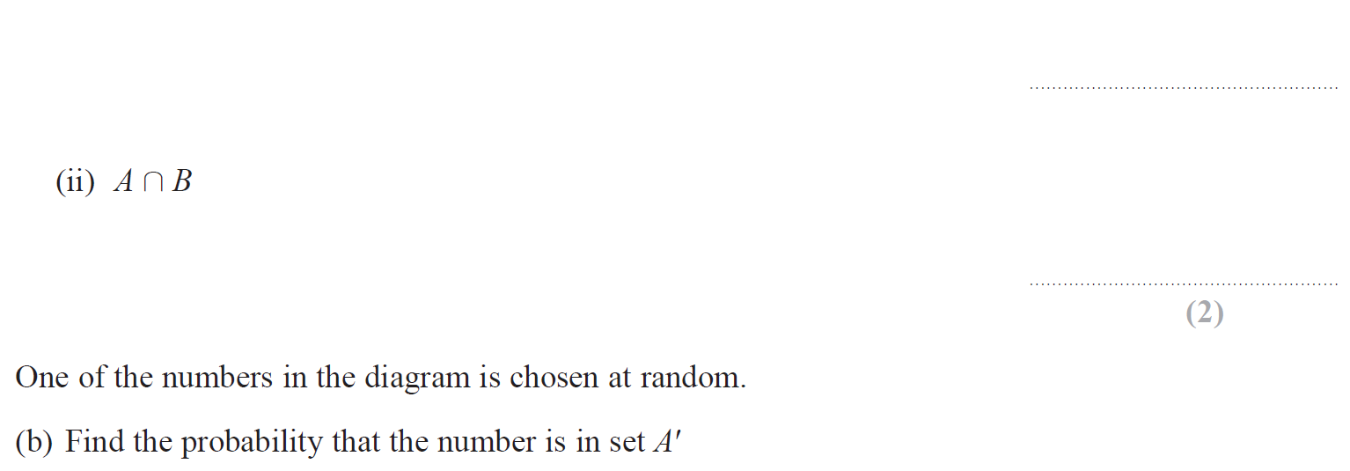
Sets
Specimen Set 2 2H Q5

Slide 5
Sets
Specimen Set 2 2H Q5
A (i)
A (ii)
B

Slide 6
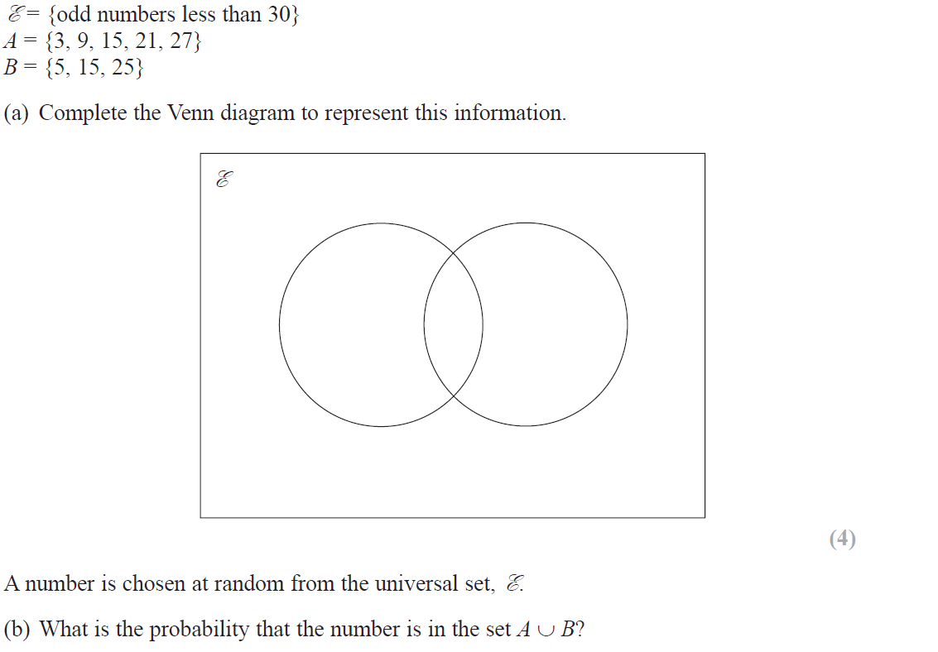
Sets
June 2017 3H Q1

Slide 7
Sets
June 2017 3H Q1
A
B

Slide 8
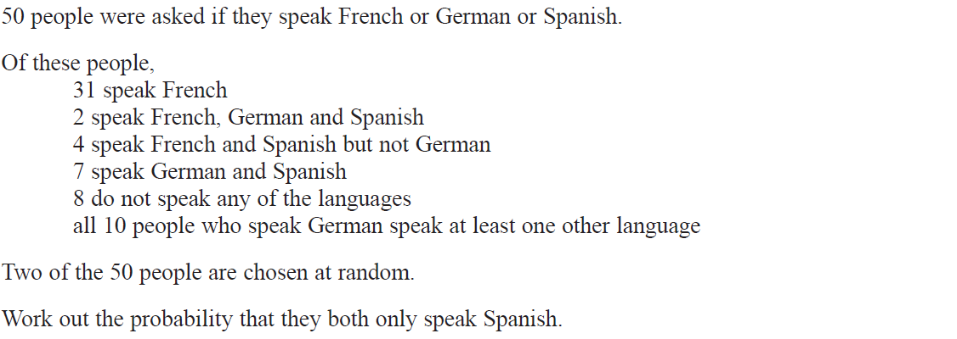
Sets
June 2018 3H Q20

Slide 9
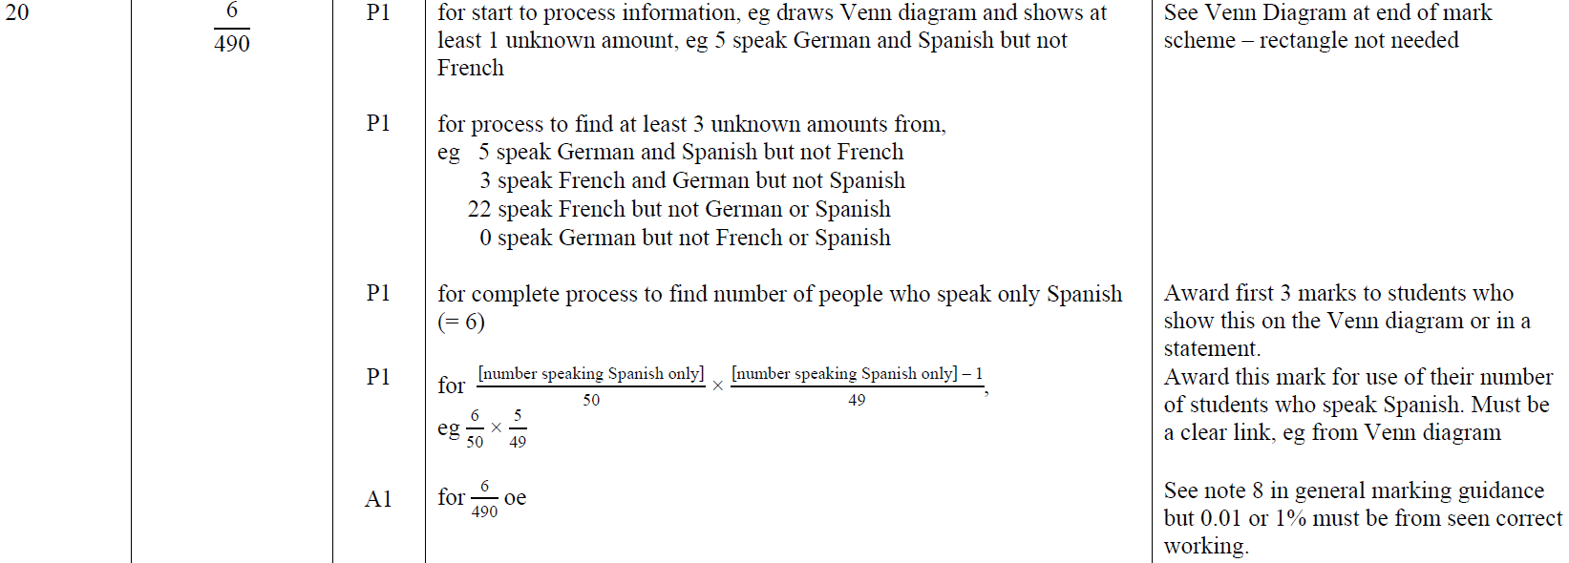
Sets
June 2018 3H Q20
A

Slide 10
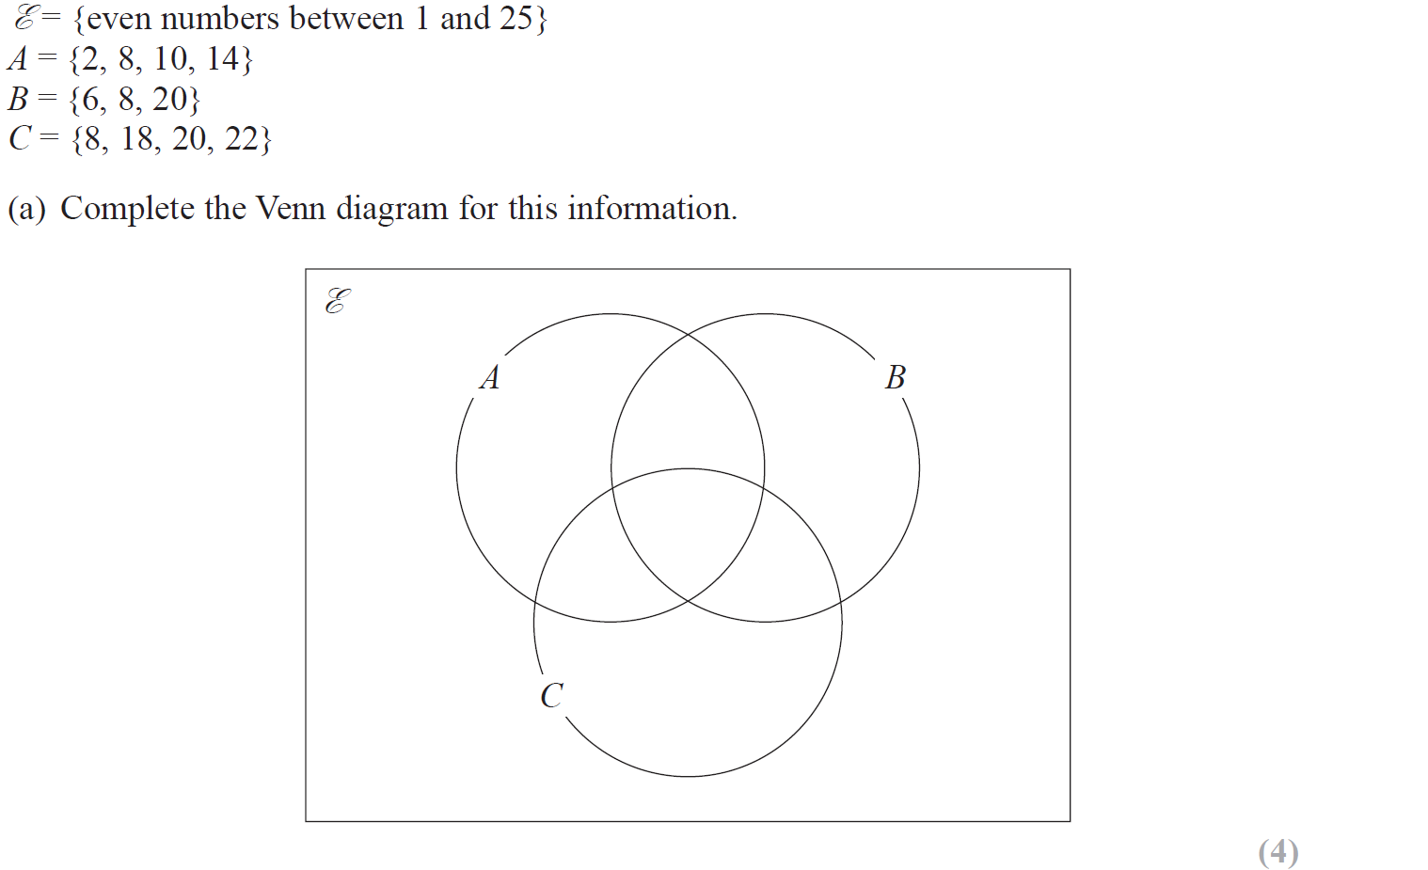
Sets
Nov 2018 2H Q1

Slide 11
Sets
Nov 2018 2H Q1
A
B

Slide 12
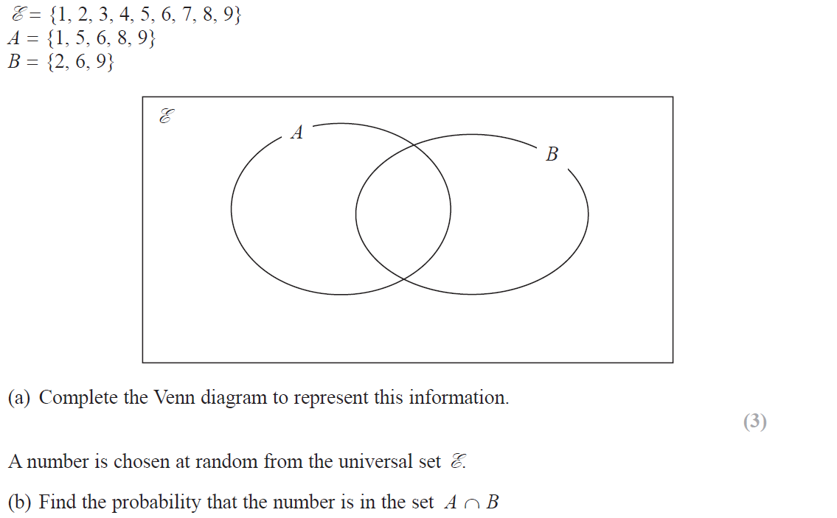
Sets
June 2019 3H Q1

Slide 13
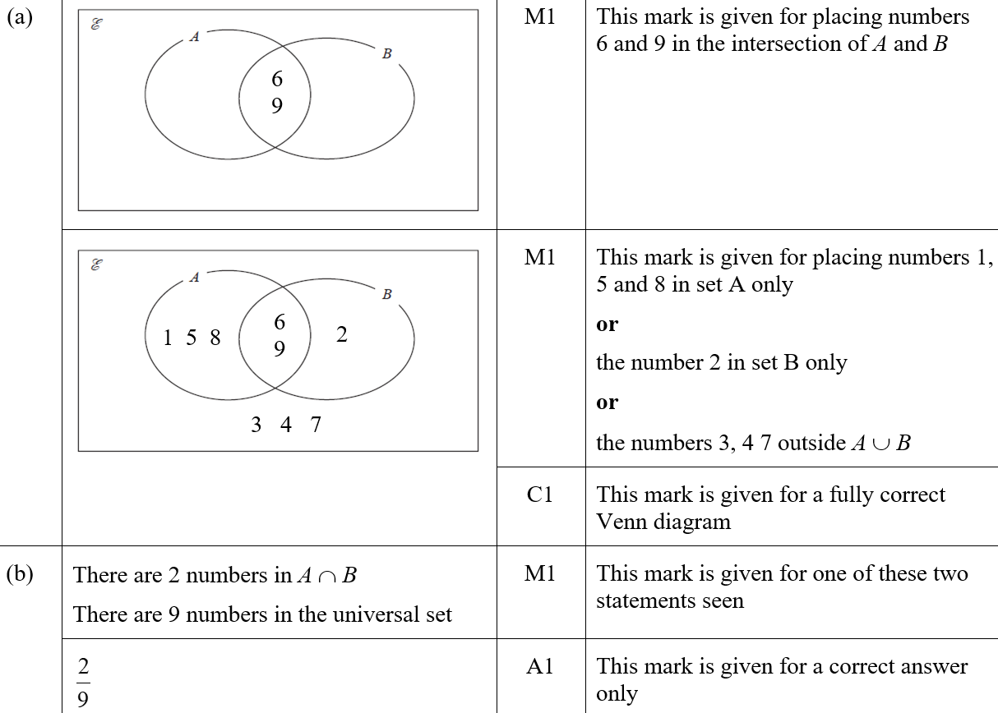
Sets
June 2019 3H Q1
A
B
A SF
B SF

