Slide 1
Sequences
Sequences
Old Spec Q’s
NTSQ
Q1
NTSQ
Q9
Jan 2019
1HR Q12
NTSQ
Q2
SAM
1H Q23
Jan 2019
2HR Q3
NTSQ
Q3
SAM
2H Q2
Jan 2019
2HR Q23
NTSQ
Q4
June 2018
2H Q23
May 2019
1H Q16
NTSQ
Q5
May 2018
1HR Q7
NTSQ
Q6
May 2018
1HR Q23
NTSQ
Q7
Jan 2019
1H Q21
NTSQ
Q8
Jan 2019
2H Q2

Slide 2
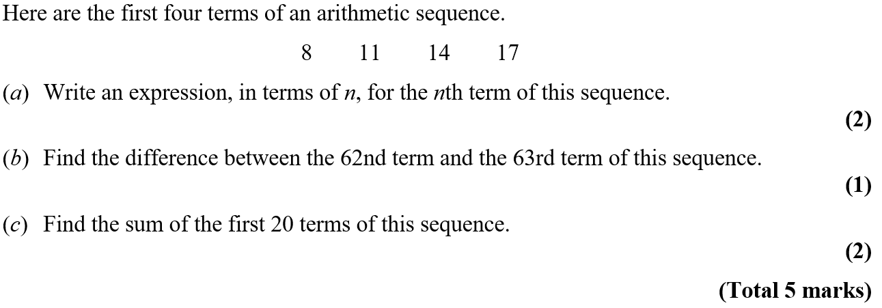
Sequences
NTSQ Q1

Slide 3
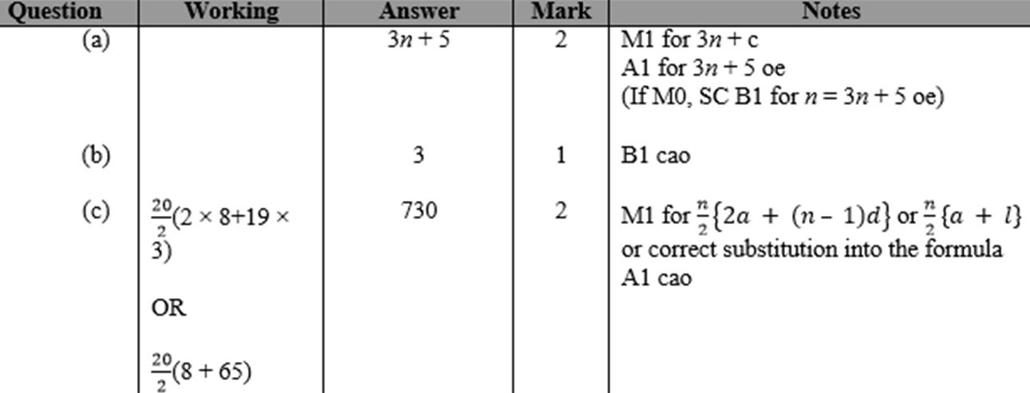
Sequences
NTSQ Q1
A
B
C

Slide 4
Sequences
NTSQ Q2

Slide 5
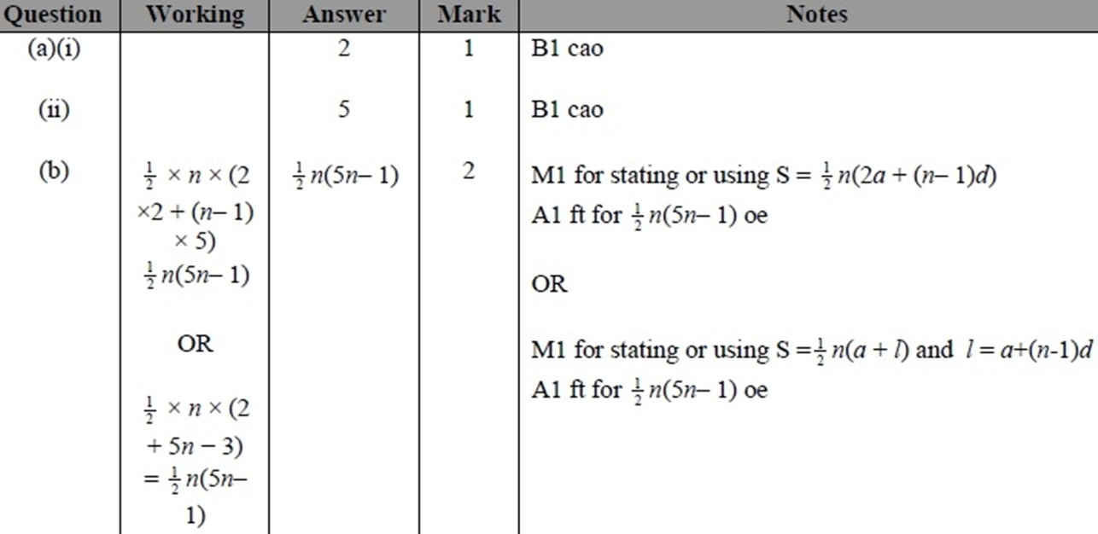
Sequences
NTSQ Q2
A (i)
A (ii)
B

Slide 6
Sequences
NTSQ Q3

Slide 7
Sequences
NTSQ Q3
A
B

Slide 8
Sequences
NTSQ Q4

Slide 9
Sequences
NTSQ Q4
A

Slide 10
Sequences
NTSQ Q5

Slide 11
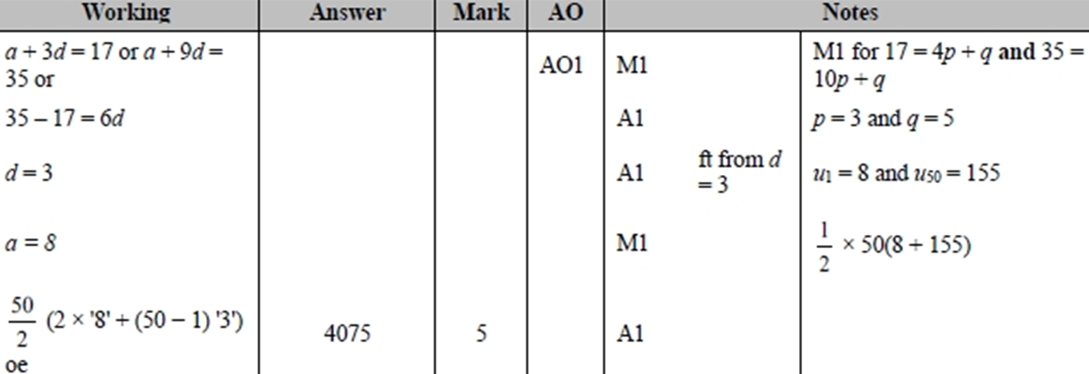
Sequences
NTSQ Q5
A

Slide 12
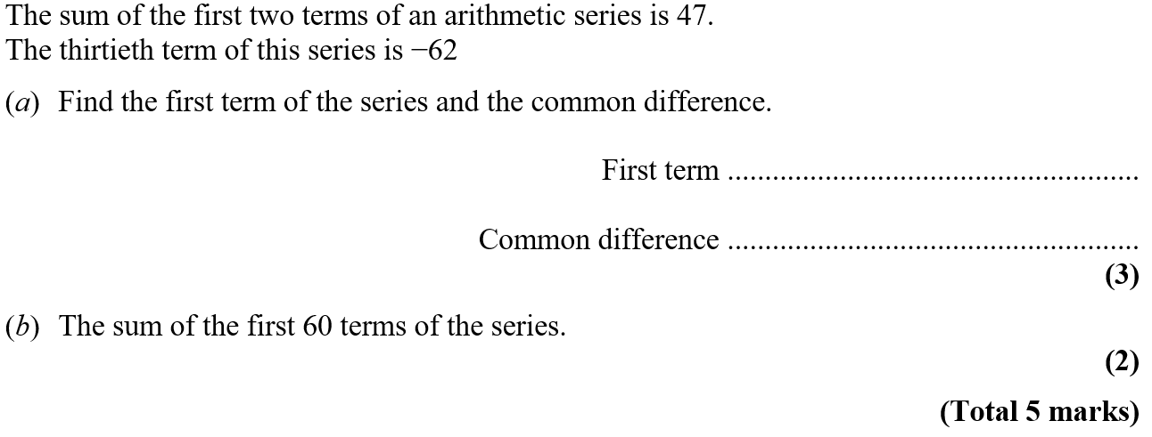
Sequences
NTSQ Q6

Slide 13
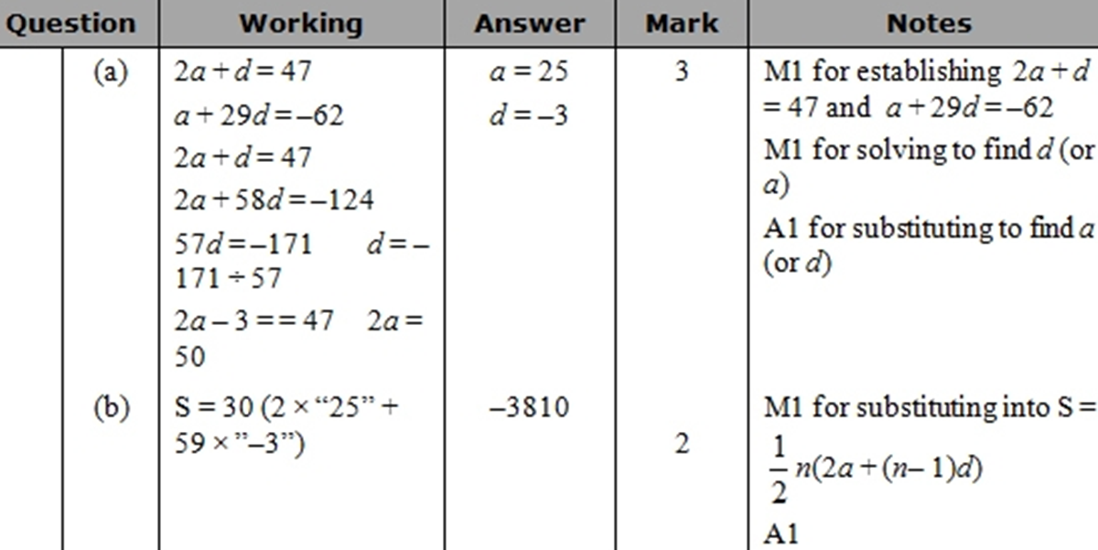
Sequences
NTSQ Q6
A
B

Slide 14
Sequences
NTSQ Q7

Slide 15
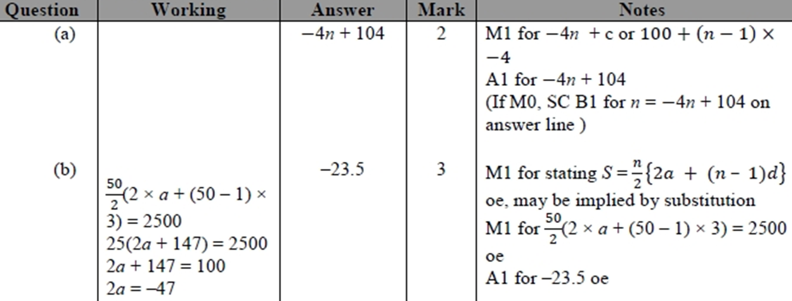
Sequences
NTSQ Q7
A
B

Slide 16
Sequences
NTSQ Q8

Slide 17
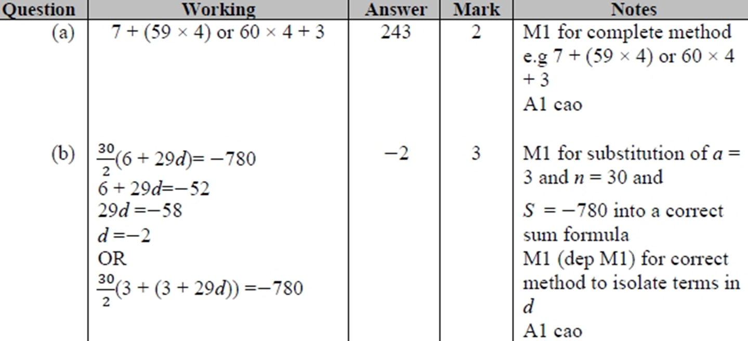
Sequences
NTSQ Q8
A
B

Slide 18
Sequences
NTSQ Q9

Slide 19
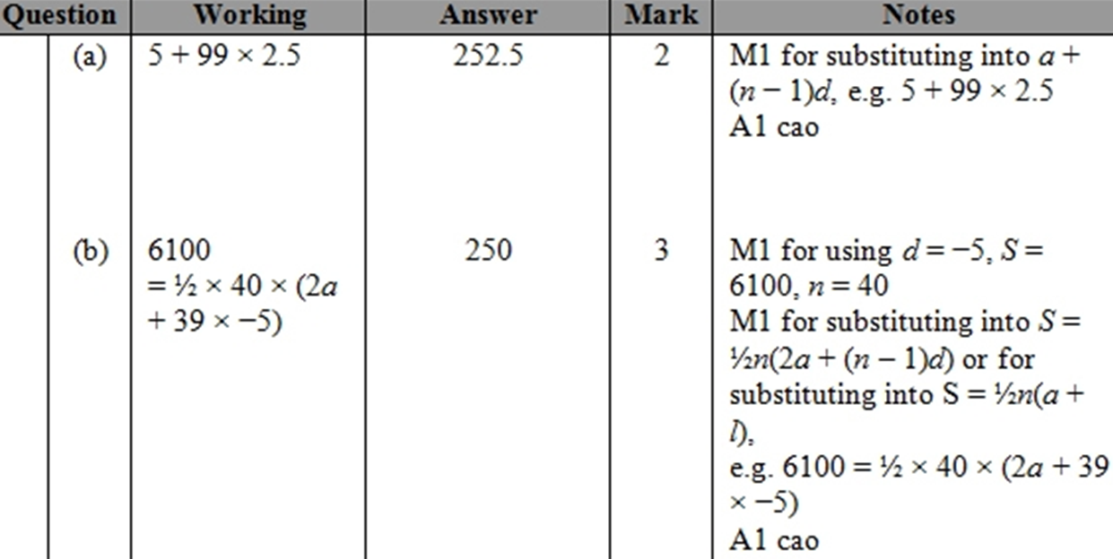
Sequences
NTSQ Q9
A
B

Slide 20
Sequences
SAM 1H Q23

Slide 21
Sequences
SAM 1H Q23
A

Slide 22
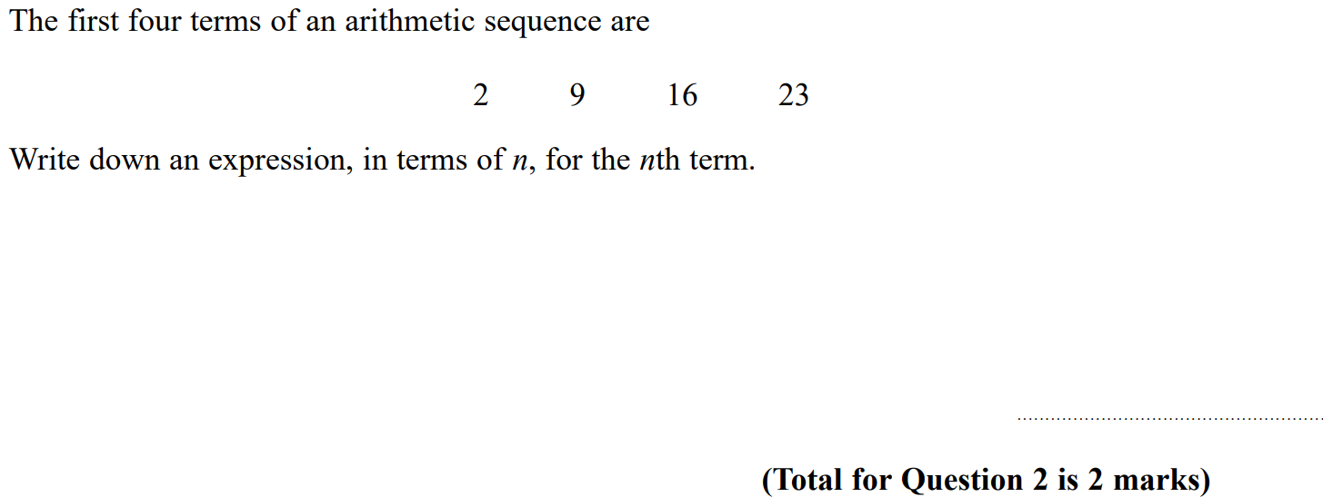
Sequences
SAM 2H Q2

Slide 23
Sequences
SAM 2H Q2
A

Slide 24
Sequences
June 2018 2H Q23

Slide 25
Sequences
June 2018 2H Q23
A

Slide 26
Sequences
May 2018 1HR Q7

Slide 27
Sequences
May 2018 1HR Q7
A
B

Slide 28
Sequences
May 2018 1HR Q23

Slide 29
Sequences
May 2018 1HR Q23
A

Slide 30
Sequences
Jan 2019 1H Q21

Slide 31
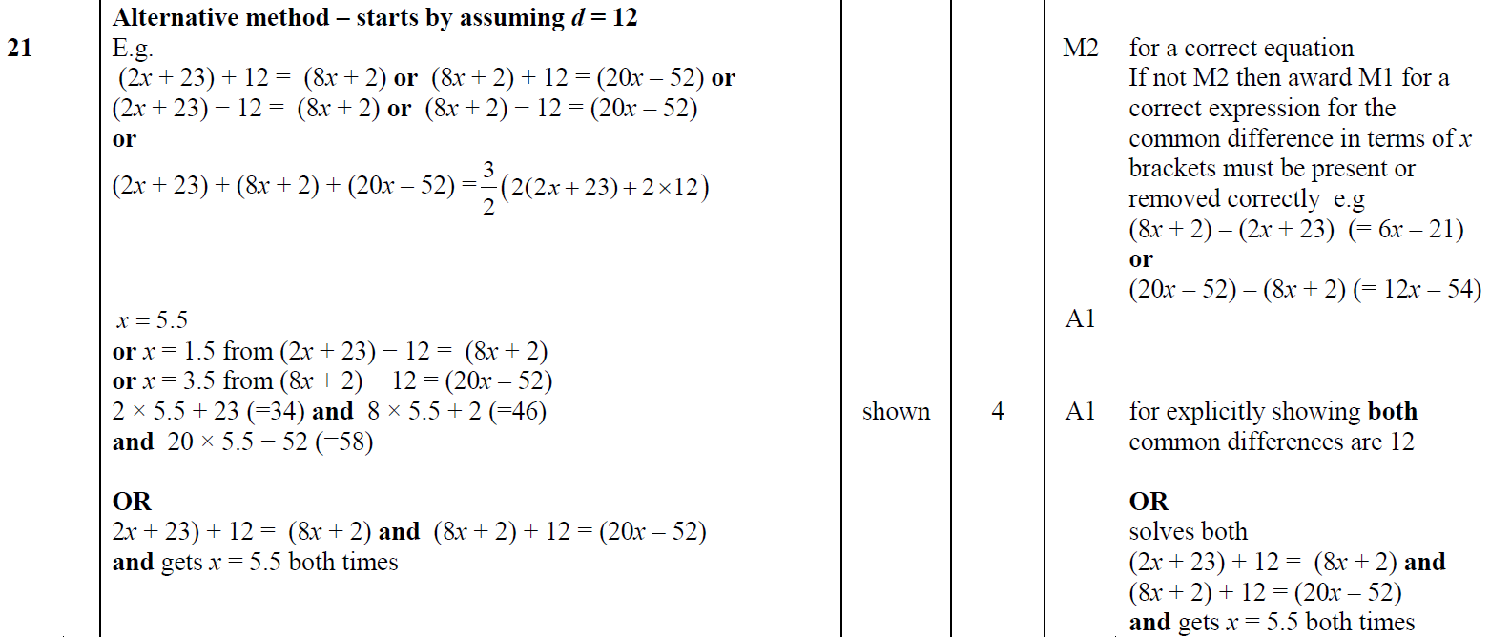
Sequences
Jan 2019 1H Q21
A
A Alternative

Slide 32
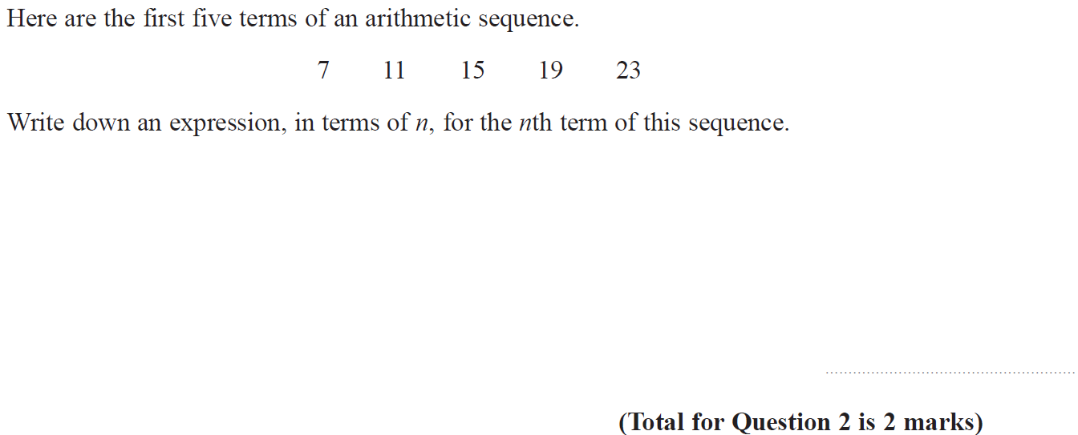
Sequences
Jan 2019 2H Q2

Slide 33
Sequences
Jan 2019 2H Q2
A

Slide 34
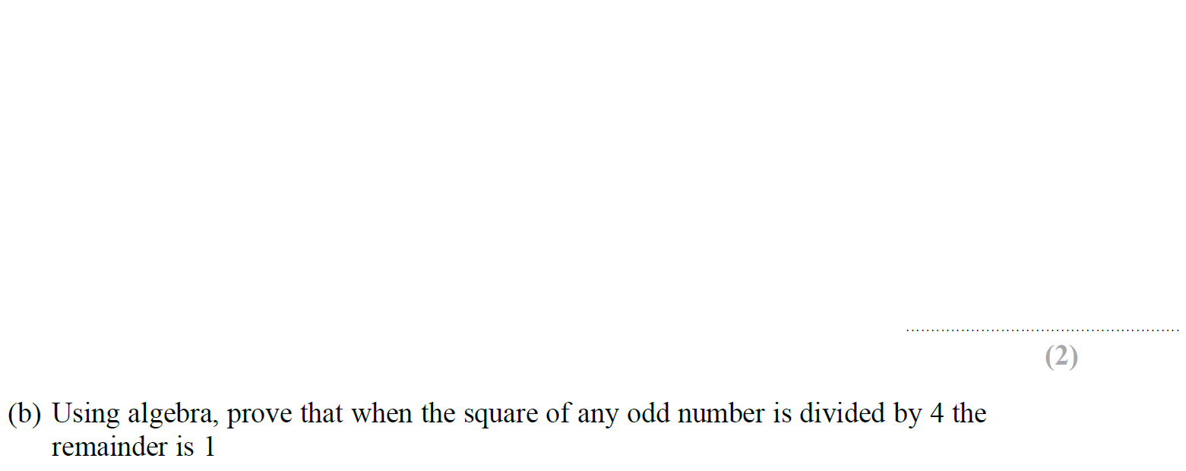
Sequences
Jan 2019 1HR Q12

Slide 35
Sequences
Jan 2019 1HR Q12
A
B

Slide 36
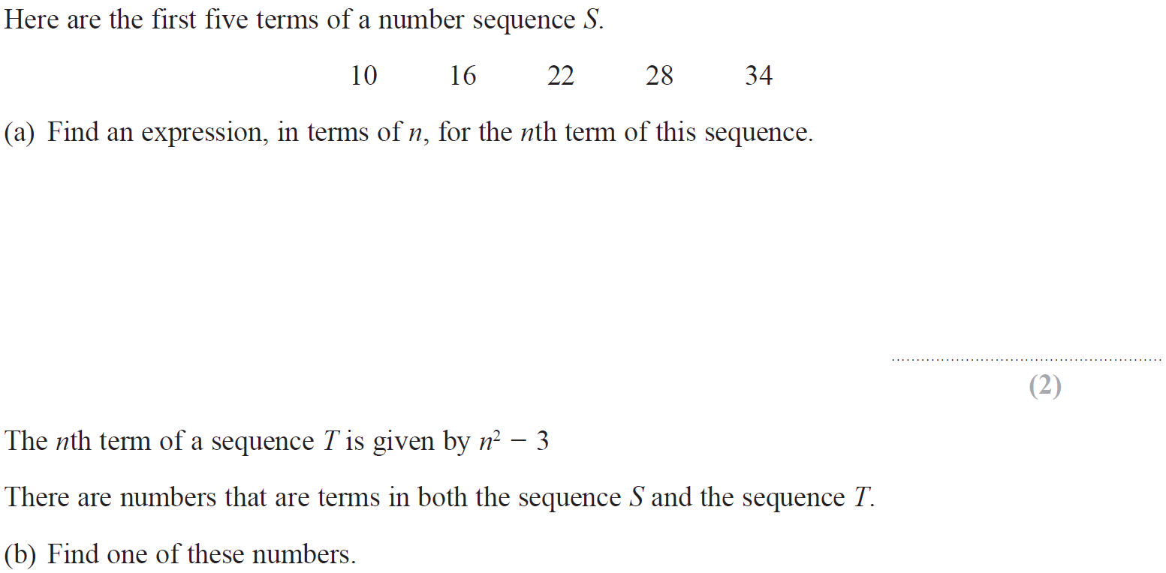
Sequences
Jan 2019 2HR Q3

Slide 37
Sequences
Jan 2019 2HR Q3
A
B

Slide 38
Sequences
Jan 2019 2HR Q23

Slide 39
Sequences
Jan 2019 2HR Q23
A

Slide 40
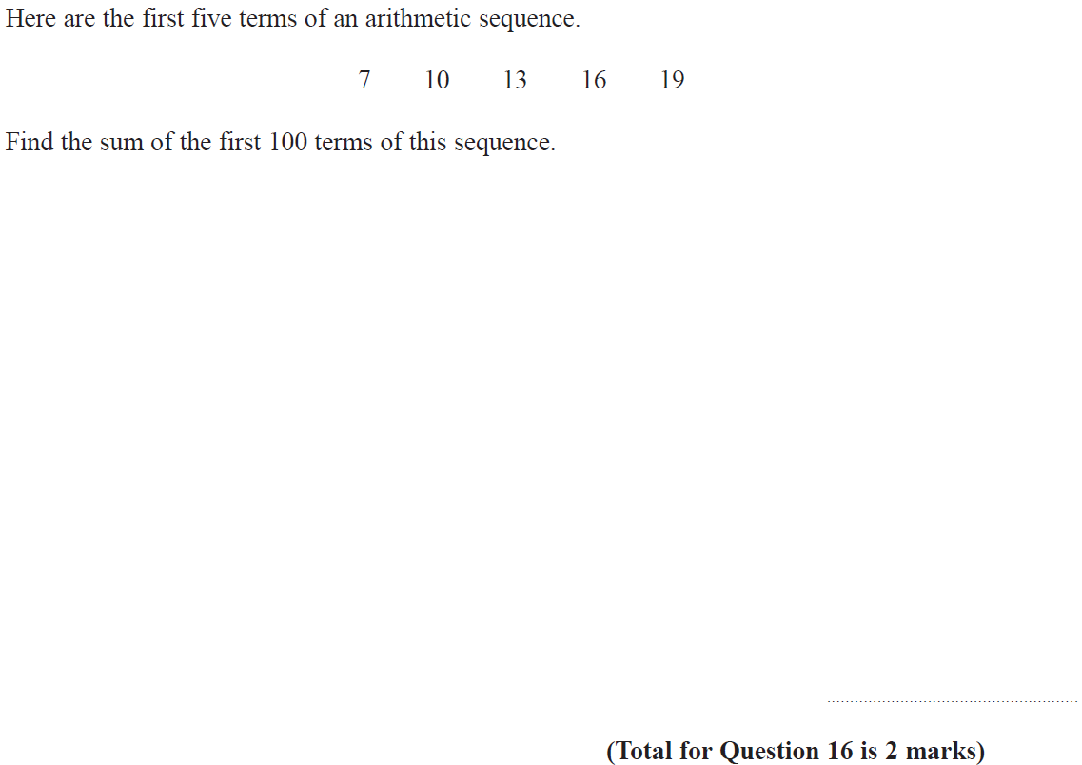
Sequences
May 2019 1H Q16

Slide 41
Sequences
May 2019 1H Q16
A

Slide 42
Sequences
Sequences
New Spec Q’s
Nov 2004
3H Q2
June 2016
4H Q1
Nov 2004
4H Q8
Nov 2006
4H Q4
May 2008
3H Q8
May 2014
4HR Q3
Jan 2015
4HR Q5
May 2015
3H Q3

Slide 43
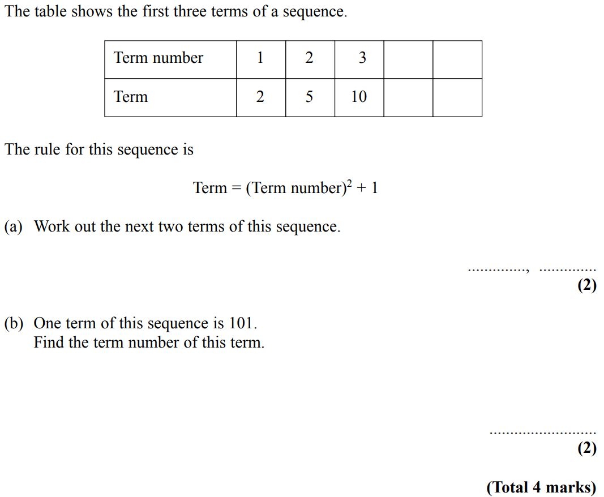
Sequences
Nov 2004 3H Q2

Slide 44
Sequences
Nov 2004 3H Q2
A
B

Slide 45
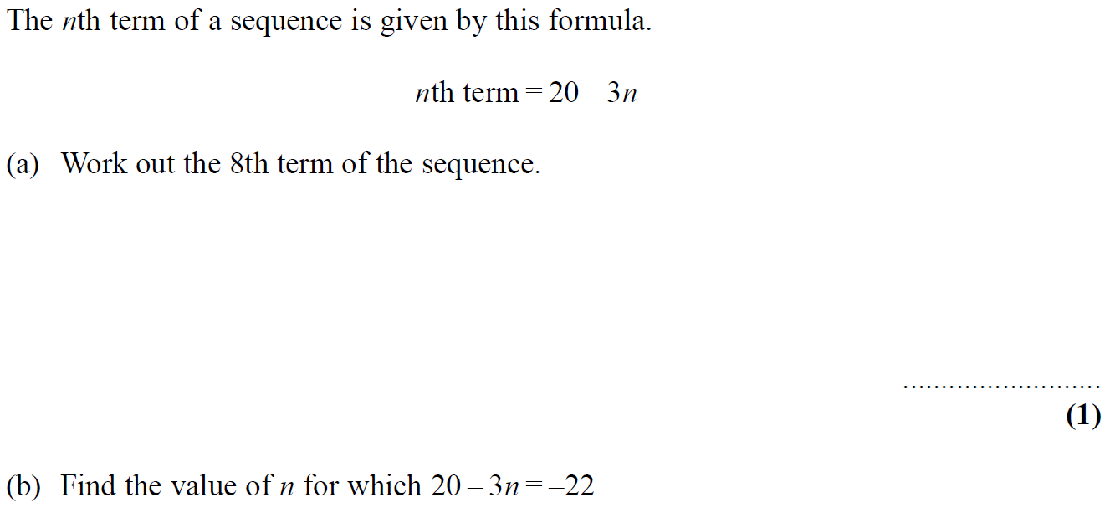
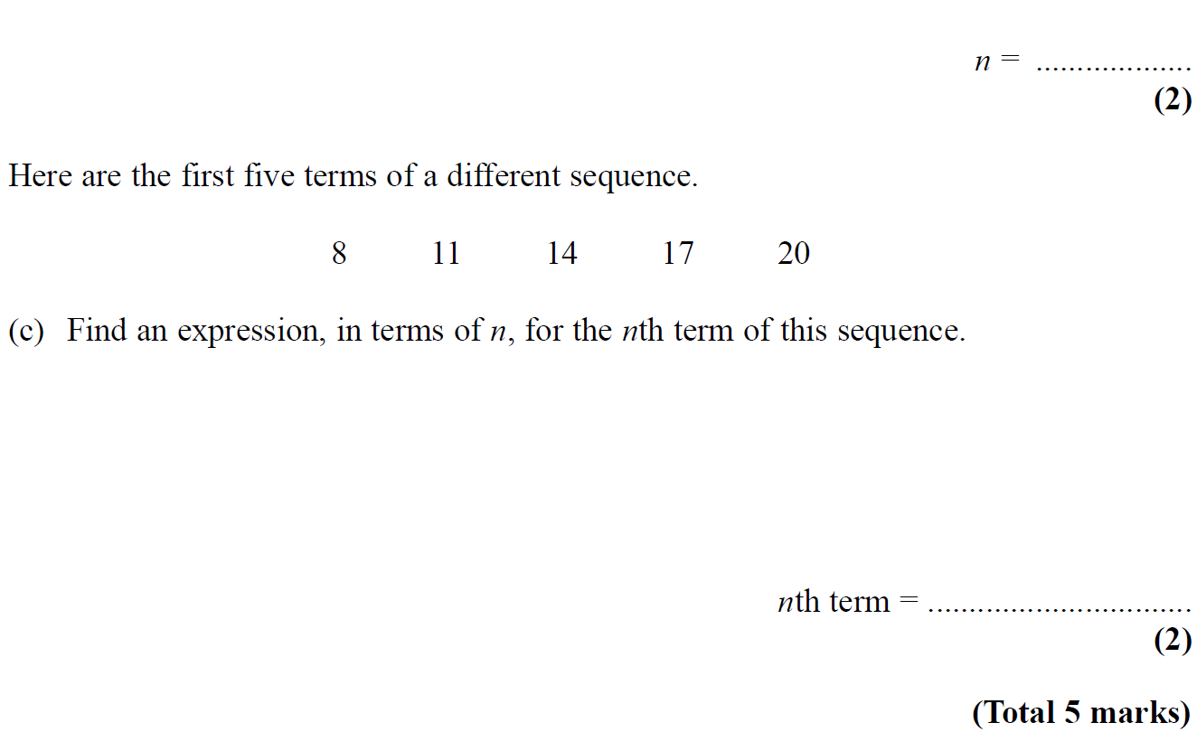
Sequences
Nov 2004 4H Q8

Slide 46
Sequences
Nov 2004 4H Q8
A
B
C

Slide 47
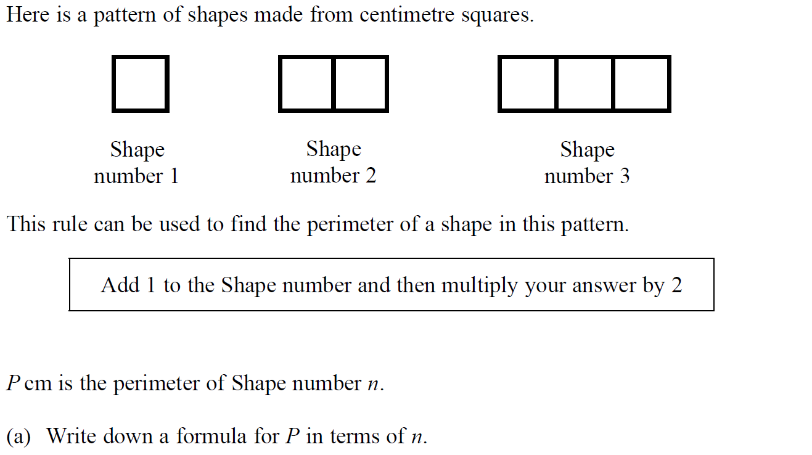
Sequences
Nov 2006 4H Q4

Slide 48
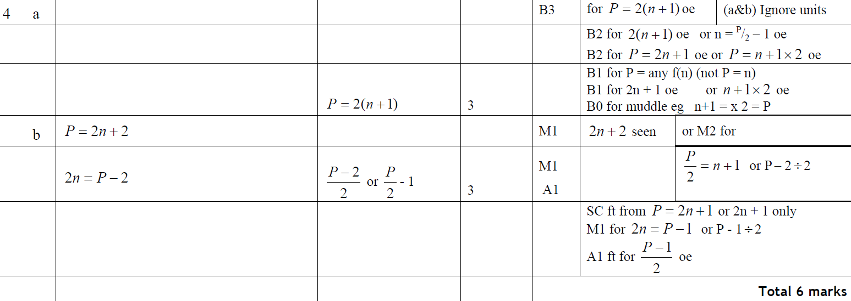
Sequences
Nov 2006 4H Q4
A
B

Slide 49
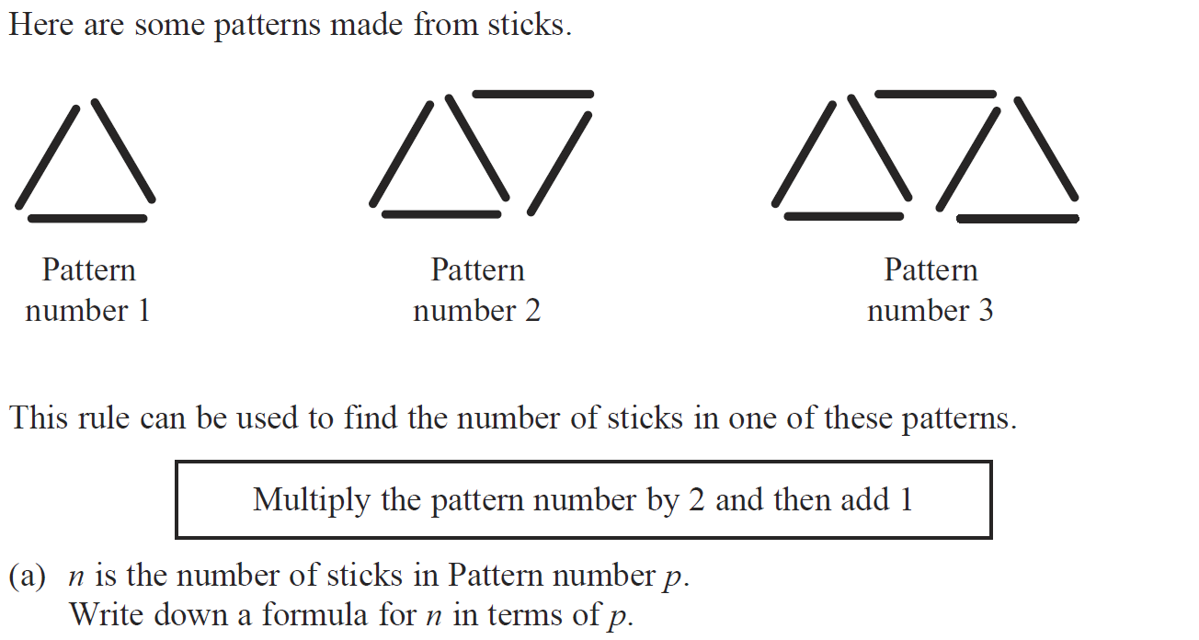
Sequences
May 2008 3H Q8

Slide 50
Sequences
May 2008 3H Q8
A
B

Slide 51
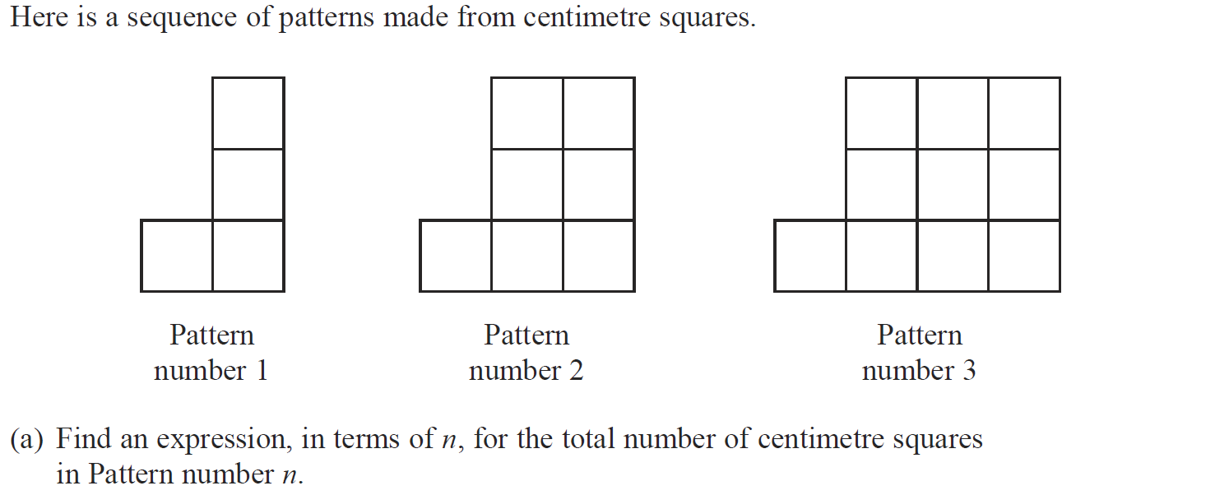
Sequences
May 2014 4HR Q3

Slide 52
Sequences
May 2014 4HR Q3
A
B

Slide 53
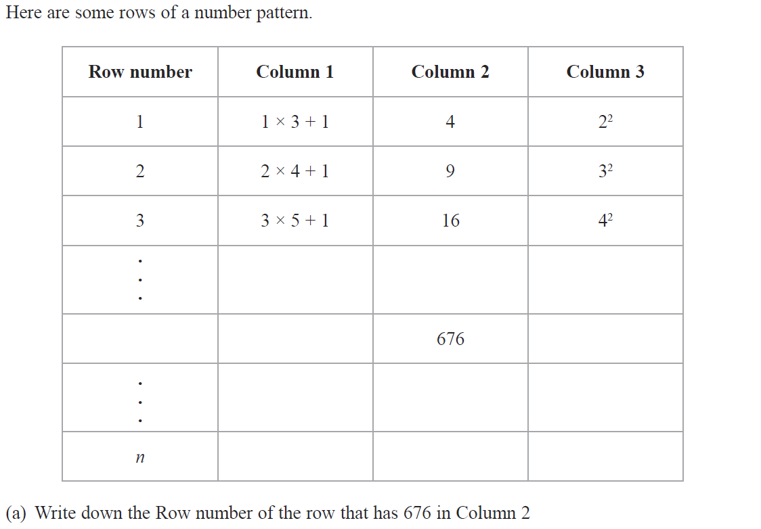
Sequences
Jan 2015 4HR Q5

Slide 54
Sequences
Jan 2015 4HR Q5
A
B (i)
B (ii)

Slide 55
Sequences
May 2015 3H Q3

Slide 56
Sequences
May 2015 3H Q3
A
B

Slide 57
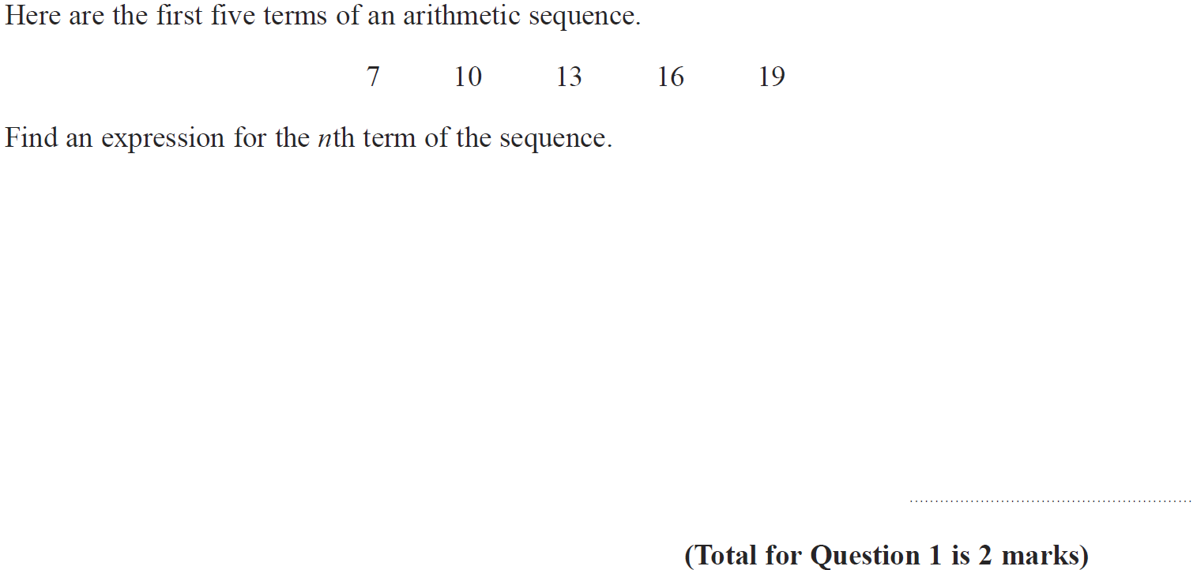
Sequences
June 2016 4H Q1

Slide 58
Sequences
June 2016 4H Q1
A

