Slide 1
Sequences
Sequences
SAM
2H Q3
June 2017 2H Q22
Edexcel
SAM
3H Q3
Nov 2017 2H Q23
AQA
SAM
3H Q17
June 2018 3H Q16
OCR
Spec 1
2H Q17
June 2019 3H Q16
Spec 1
3H Q22
Quadratic
Geometric

Slide 2
Sequences
Sequences
May 2017
1H Q3
May 2018
1H Q20
June 2017
2H Q4
June 2018
2H Q5
Edexcel
SAM
1H Q9
June 2017
3H Q22
June 2018
3H Q10
AQA
SAM
2H Q1
Nov 2017
2H Q10
1 Marker
Nov 2018
1H Q21
OCR
SAM
3H Q14
Nov 2017
2H Q14
Nov 2018
2H Q3
Nov 2017
3H Q3
Nov 2018
3H Q3
May 2018
1H Q14
Quadratic
Geometric

Slide 3
Sequences
Sequences
May 2017
1H Q19
SAM
2H Q10
Edexcel
Nov 2017
2H Q2
SAM
3H Q3
AQA
May 2018
1H Q19
Practice
1H Q5
OCR
Nov 2018
1H Q17
Practice
2H Q14
Nov 2018
2H Q16
Quadratic
Geometric

Slide 4
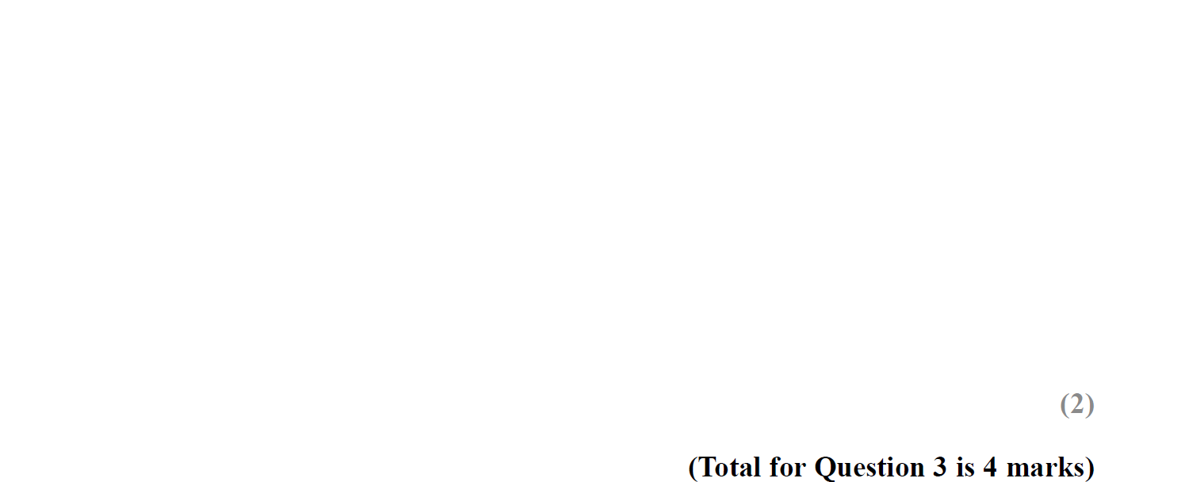
Sequences
SAM 2H Q3

Slide 5
Sequences
SAM 2H Q3
A
B

Slide 6
Sequences
SAM 3H Q3

Slide 7
Sequences
SAM 3H Q3
A
B
C

Slide 8
Sequences
SAM 3H Q17

Slide 9
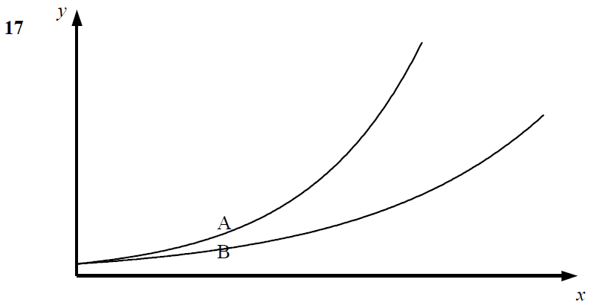
Sequences
SAM 3H Q17
A
B
C

Slide 10
Sequences
Specimen Set 1 2H Q17

Slide 11
Sequences
Specimen Set 1 2H Q17
A

Slide 12
Sequences
Specimen Set 1 3H Q22

Slide 13
Sequences
Specimen Set 1 3H Q22
A

Slide 14
Sequences
June 2017 2H Q22

Slide 15
Sequences
June 2017 2H Q22
A

Slide 16
Sequences
Nov 2017 2H Q23

Slide 17
Sequences
Nov 2017 2H Q23
A
B

Slide 18
Sequences
June 2018 3H Q16

Slide 19
Sequences
June 2018 3H Q16
A
B

Slide 20
Sequences
June 2019 3H Q16

Slide 21
Sequences
June 2019 3H Q16
A
A SF

Slide 22
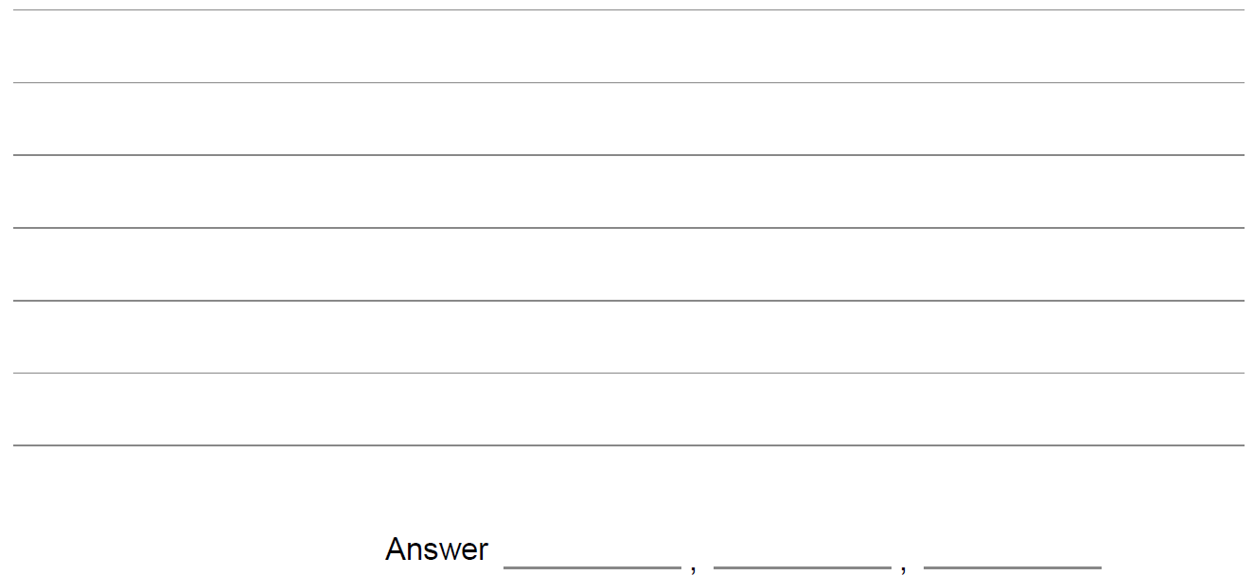
Sequences
SAM 1H Q9

Slide 23
Sequences
SAM 1H Q9
A

Slide 24
Sequences
SAM 2H Q1

Slide 25
Sequences
SAM 2H Q1
A

Slide 26
Sequences
SAM 3H Q14

Slide 27
Sequences
SAM 3H Q14
A
B

Slide 28
Sequences
May 2017 1H Q3

Slide 29
Sequences
May 2017 1H Q3
A

Slide 30
Sequences
June 2017 2H Q4

Slide 31
Sequences
June 2017 2H Q4
A

Slide 32
Sequences
June 2017 3H Q22

Slide 33
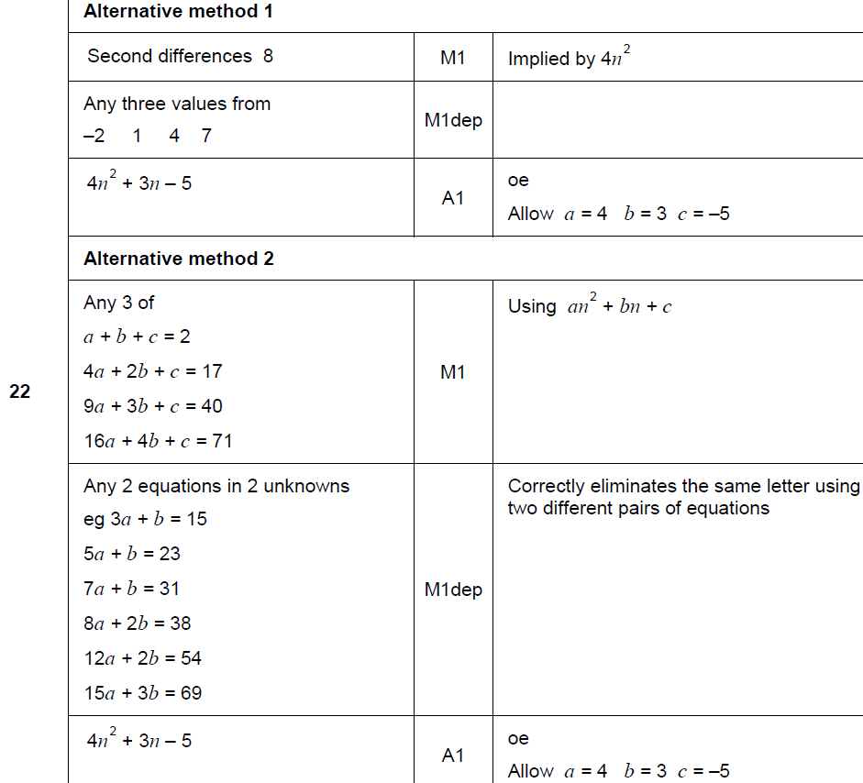
Sequences
June 2017 3H Q22
A

Slide 34
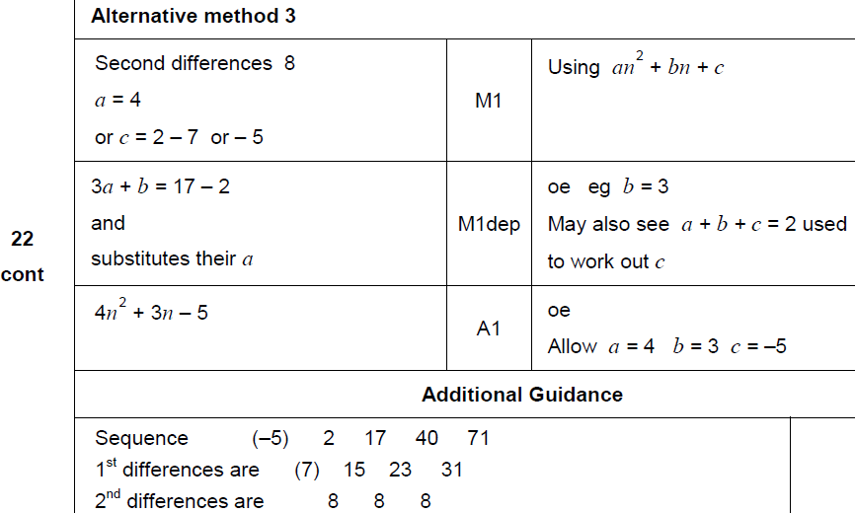
Sequences
June 2017 3H Q22
A Alternative & notes

Slide 35
Sequences
Nov 2017 2H Q10

Slide 36
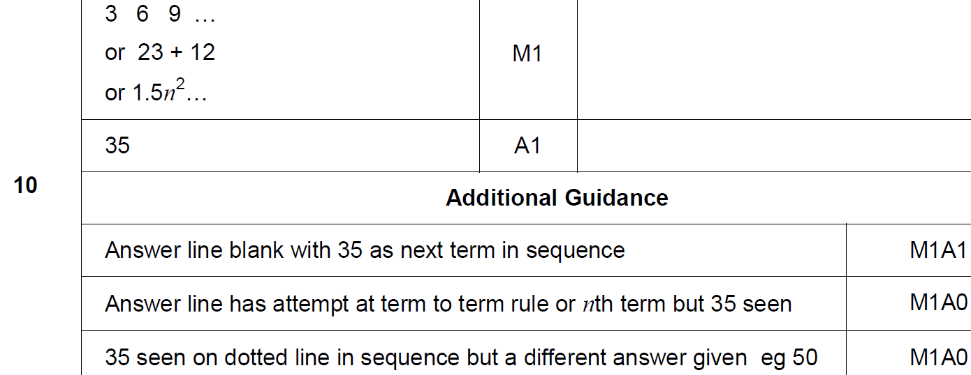
Sequences
Nov 2017 2H Q10
A

Slide 37
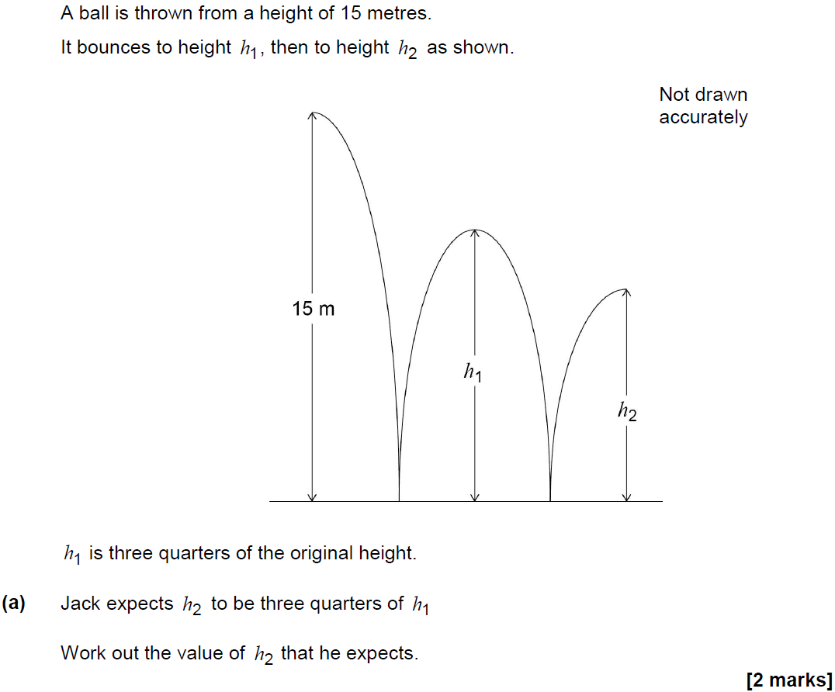
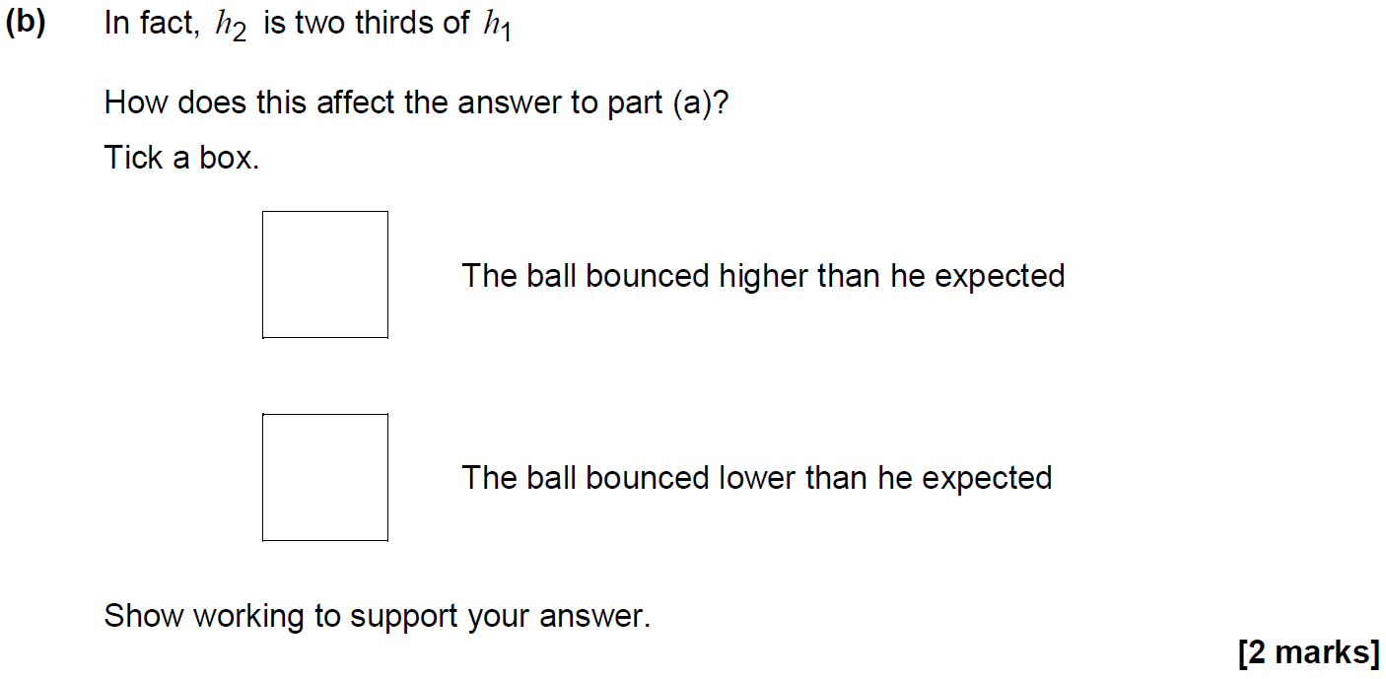
Sequences
Nov 2017 2H Q14

Slide 38
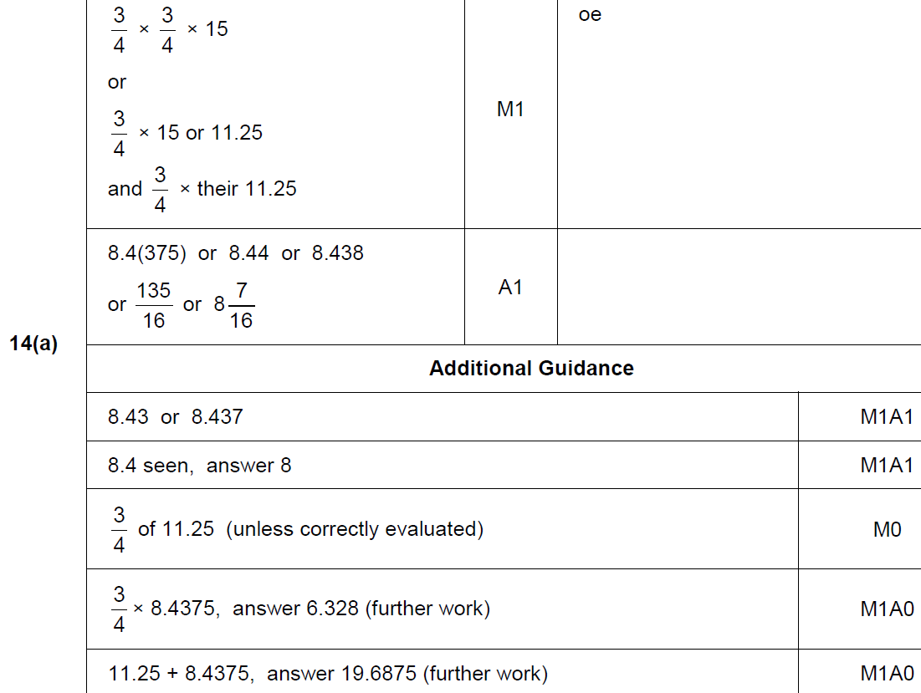
Sequences
Nov 2017 2H Q14
A

Slide 39
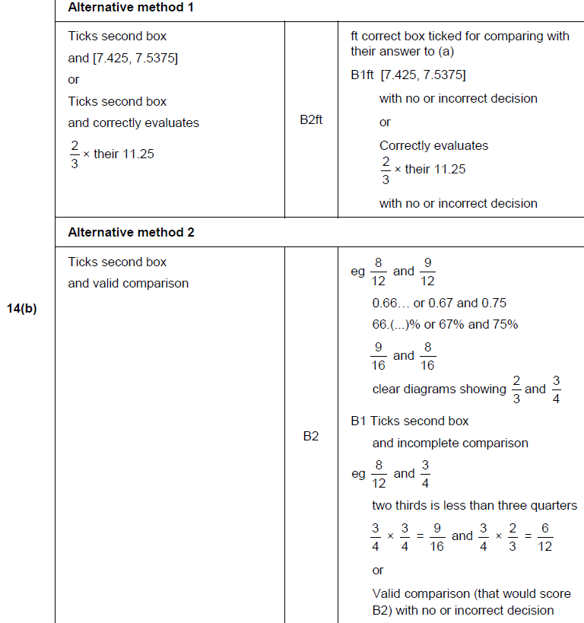
Sequences
Nov 2017 2H Q14
B

Slide 40
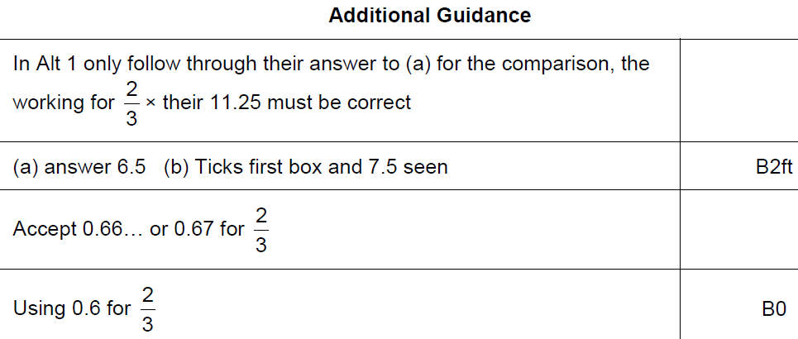
Sequences
Nov 2017 2H Q14
B notes

Slide 41
Sequences
Nov 2017 3H Q3

Slide 42
Sequences
Nov 2017 3H Q3
A

Slide 43
Sequences
May 2018 1H Q14

Slide 44
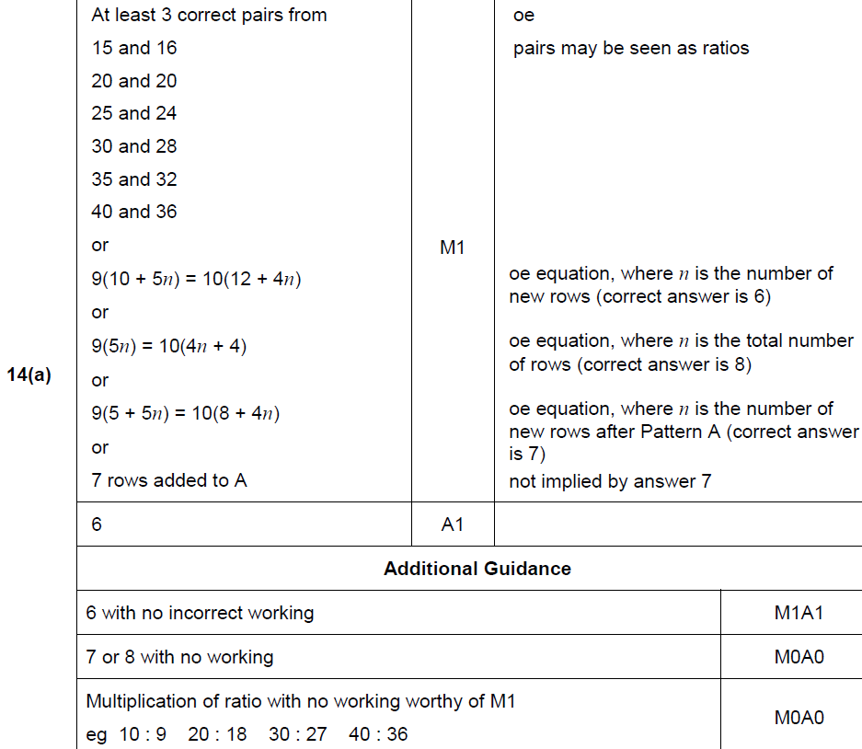
Sequences
May 2018 1H Q14
A

Slide 45
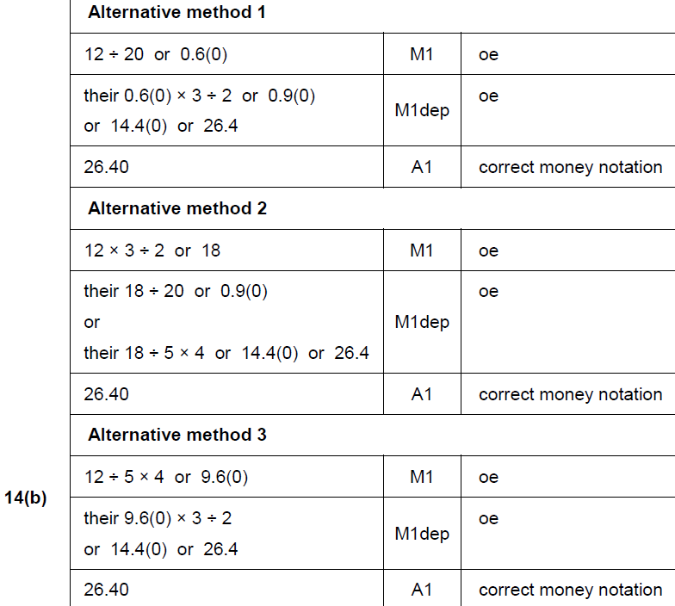
Sequences
May 2018 1H Q14
B

Slide 46
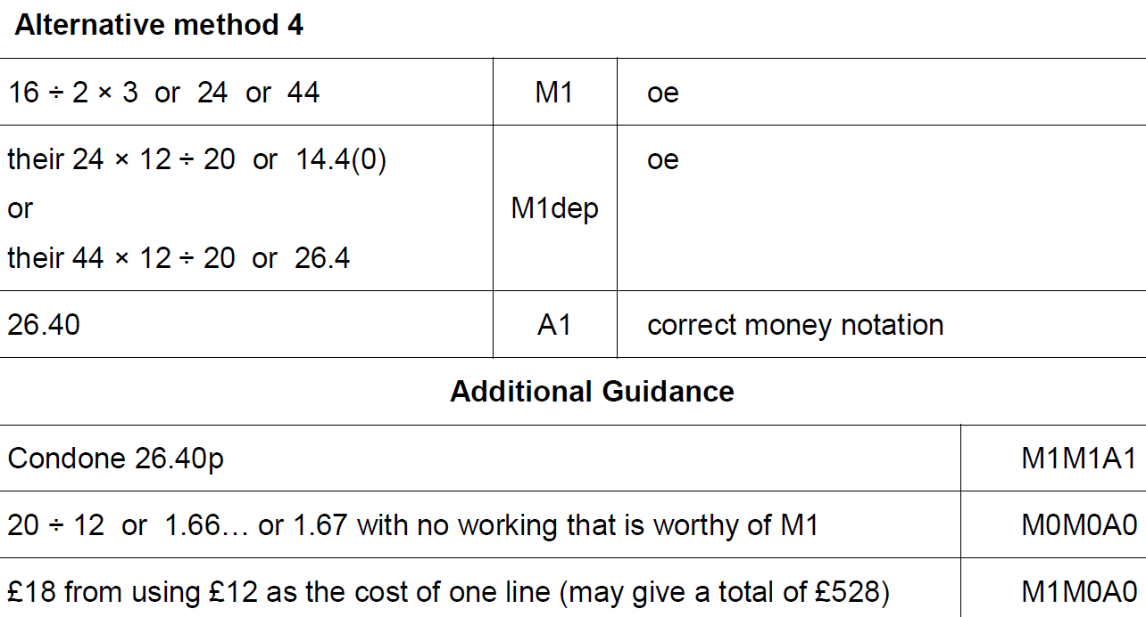
Sequences
May 2018 1H Q14
B Alternative 3 & notes

Slide 47
Sequences
May 2018 1H Q20

Slide 48
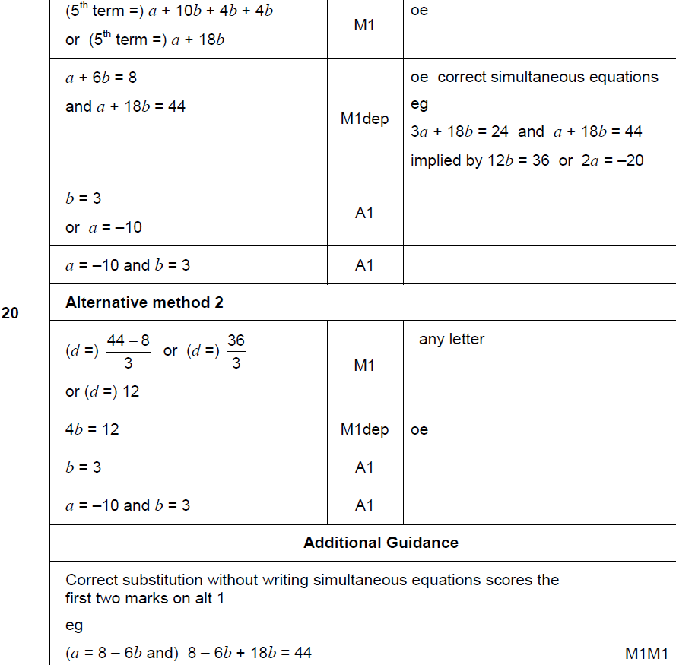
Sequences
May 2018 1H Q20
A

Slide 49
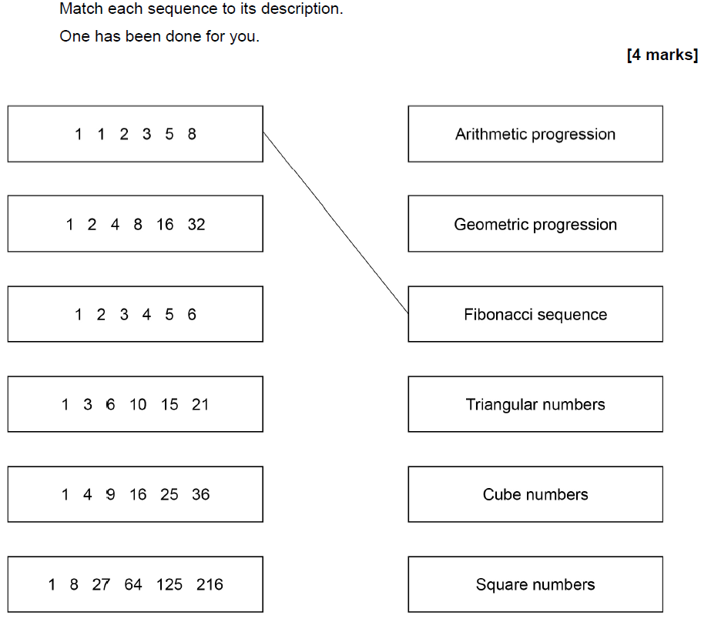
Sequences
June 2018 2H Q5

Slide 50
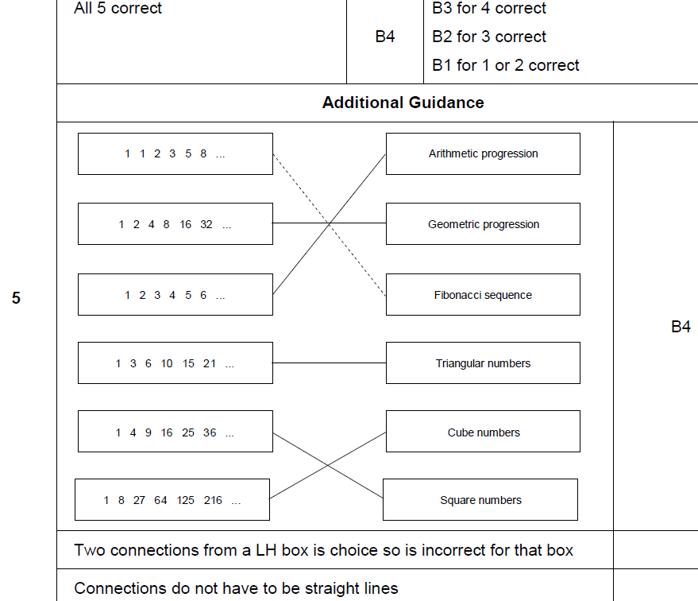
Sequences
June 2018 2H Q5
A

Slide 51
Sequences
June 2018 3H Q10
The nth term of a sequence is 12n – 5
Work out the numbers in the sequence that
have two digits
and
are not prime.
[3 marks]

Slide 52
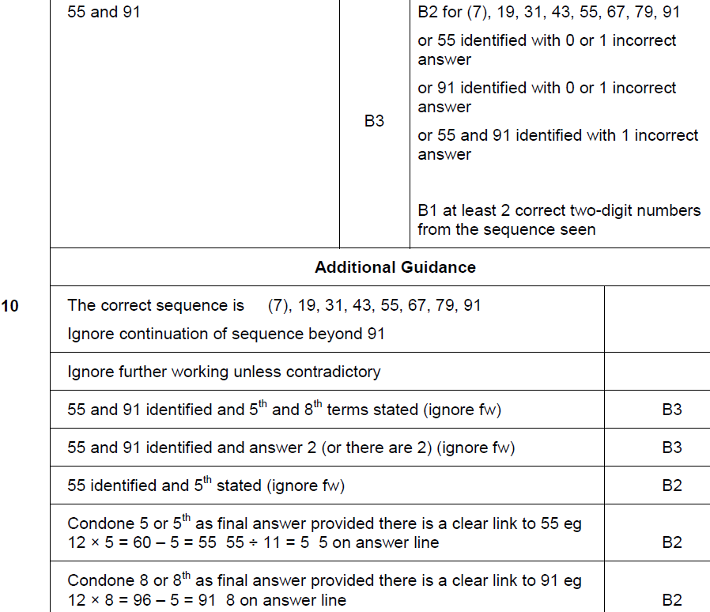
Sequences
June 2018 3H Q10
A

Slide 53
Sequences
Nov 2018 1H Q21

Slide 54
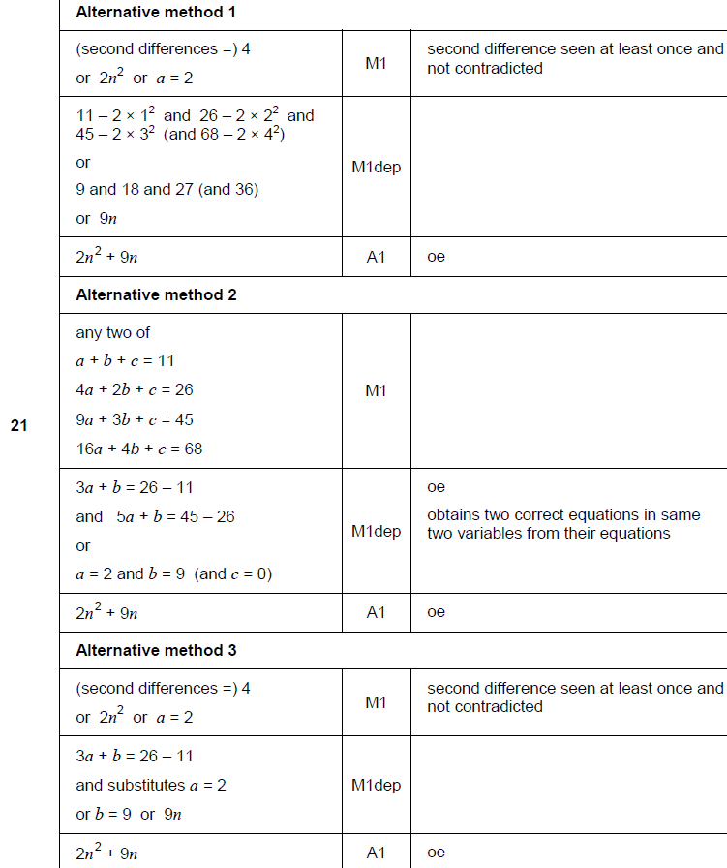
Sequences
Nov 2018 1H Q21
A

Slide 55
Sequences
Nov 2018 2H Q3

Slide 56
Sequences
Nov 2018 2H Q3
A

Slide 57
Sequences
Nov 2018 3H Q3

Slide 58
Sequences
Nov 2018 3H Q3
A

Slide 59
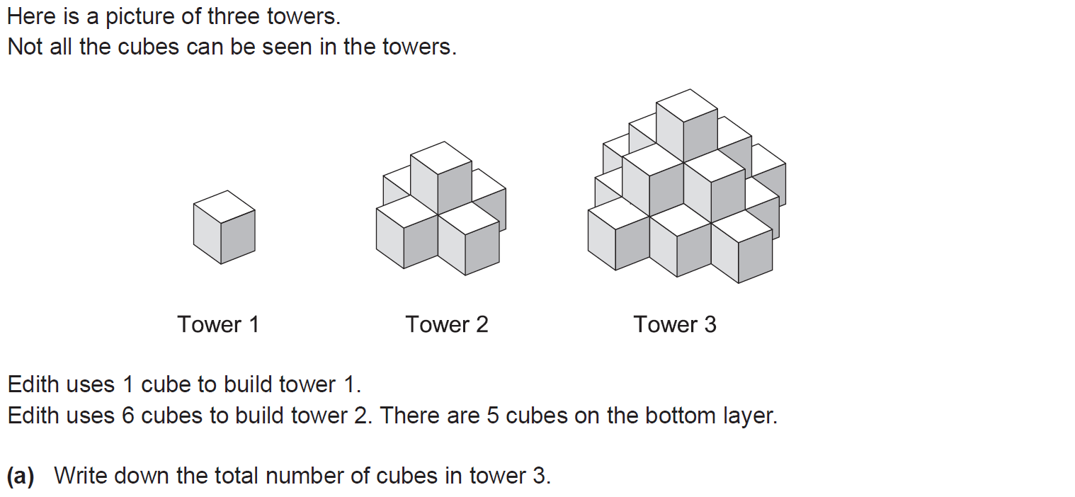
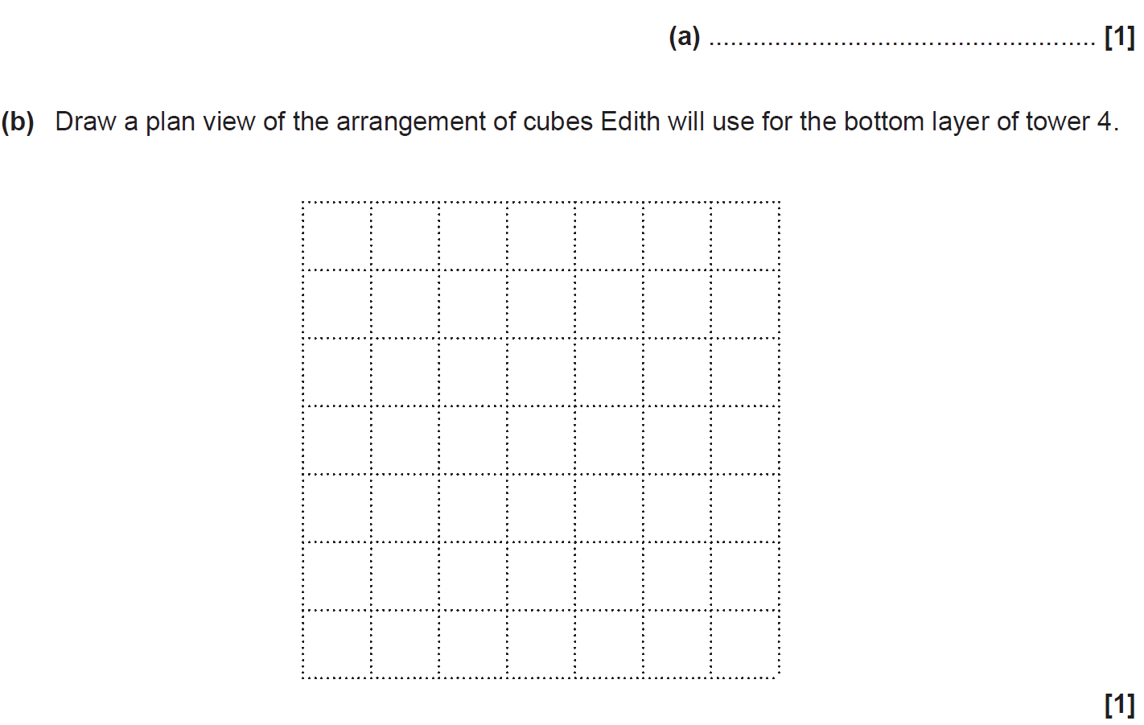
Sequences
SAM 2H Q10

Slide 60
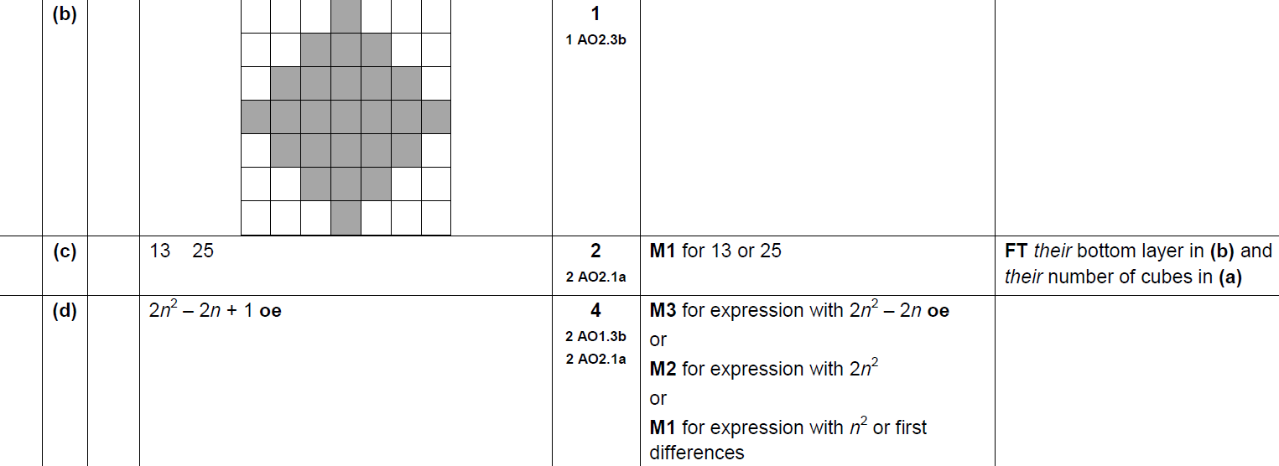
Sequences
SAM 2H Q10
A
B
C
D

Slide 61
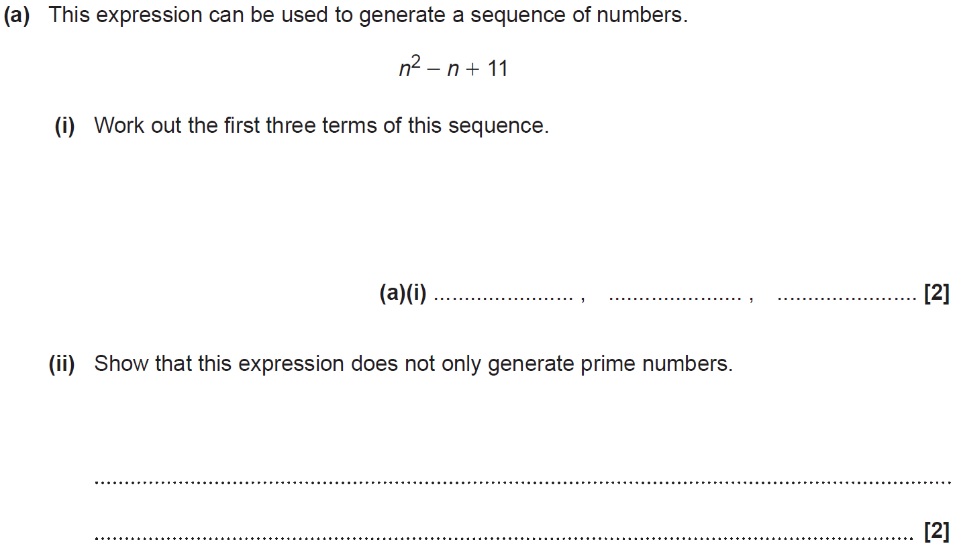
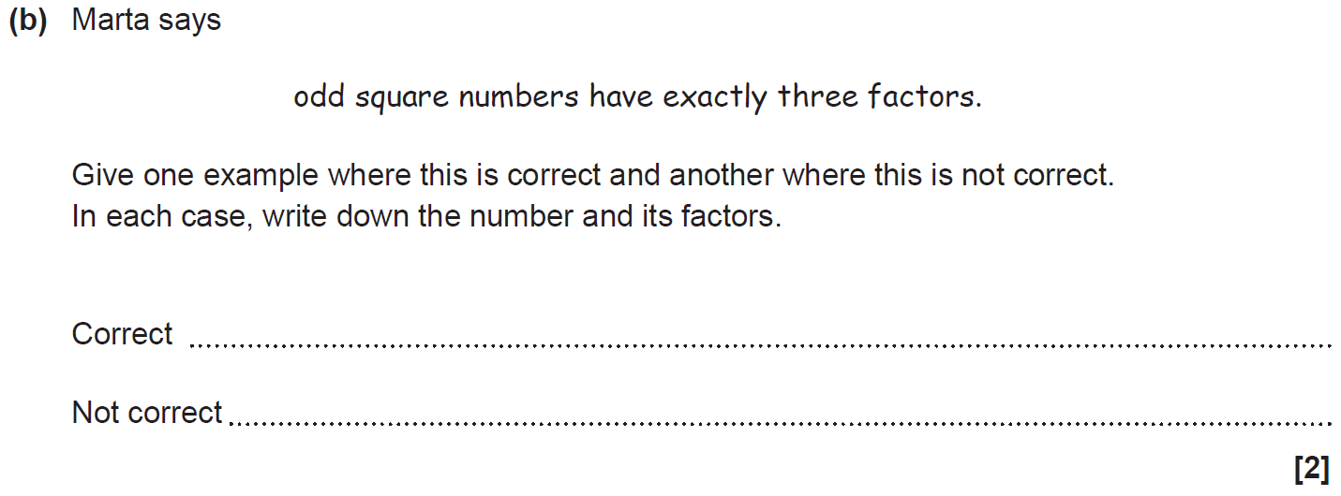
Sequences
SAM 3H Q3

Slide 62
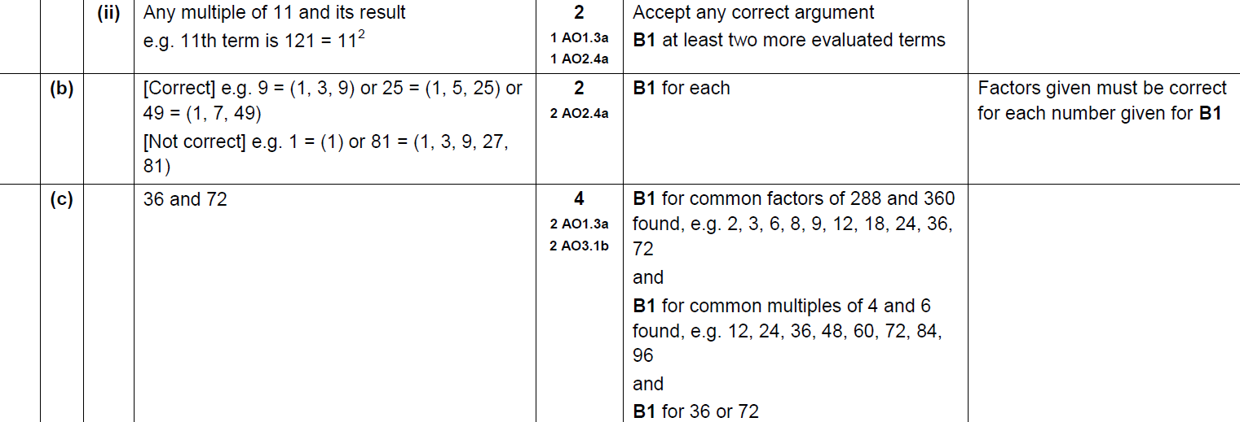
Sequences
SAM 3H Q3
A (i)
A (ii)
B
C

Slide 63
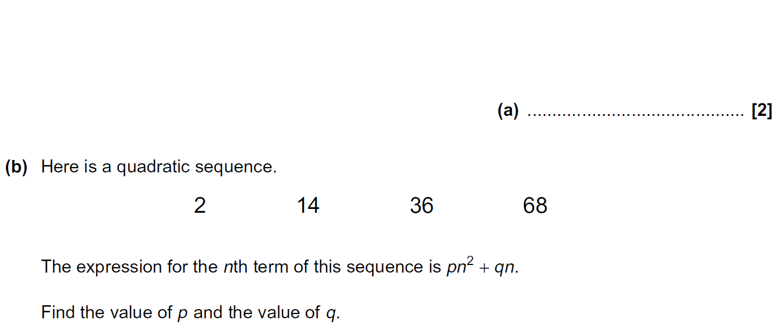
Sequences
Practice 1H Q5

Slide 64
Sequences
Practice 1H Q5
A
B

Slide 65
Sequences
Practice 2H Q14

Slide 66
Sequences
Practice 2H Q14
A
B
C

Slide 67
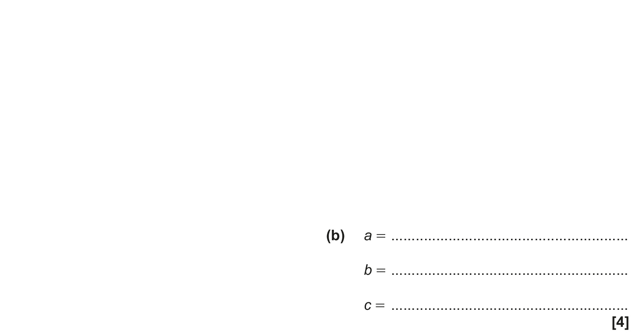
Sequences
May 2017 1H Q19

Slide 68
Sequences
May 2017 1H Q19
A
B

Slide 69
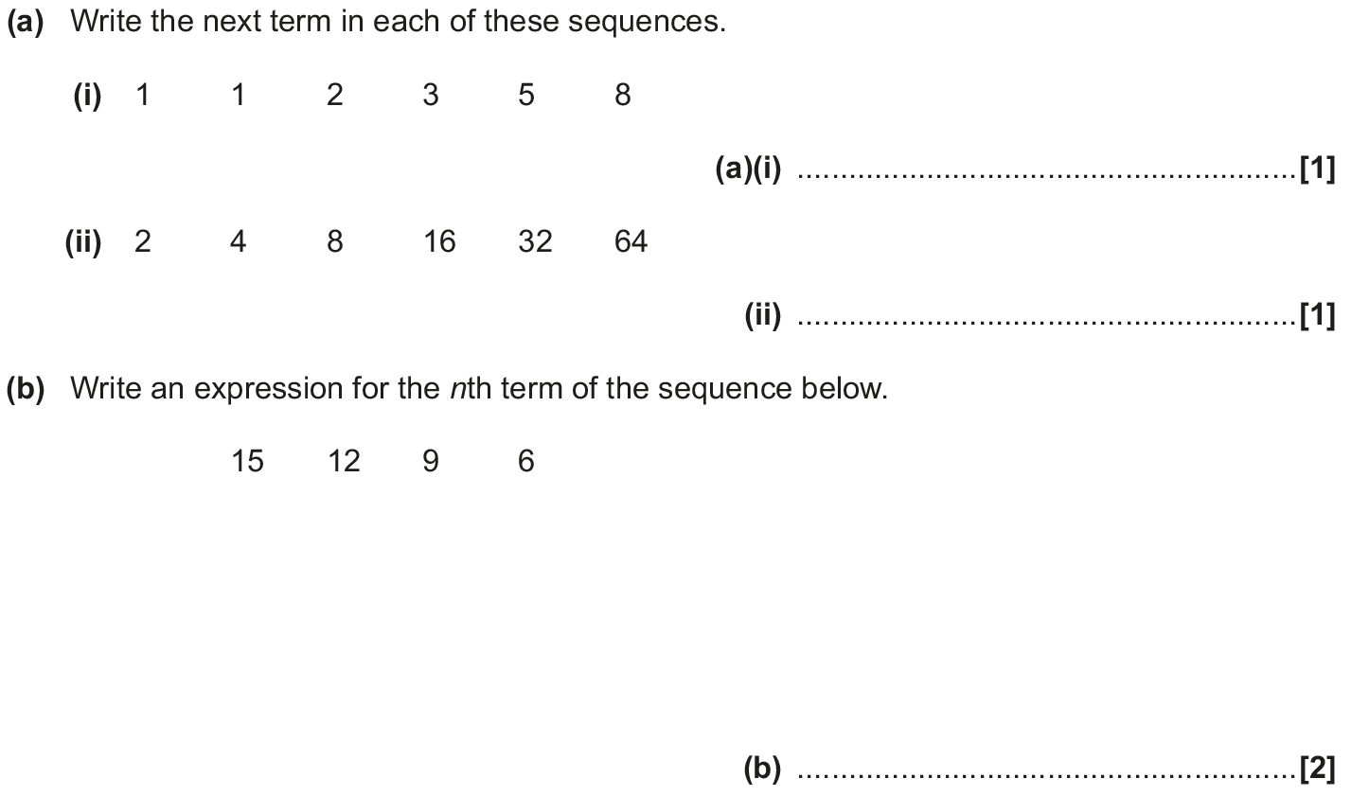
Sequences
Nov 2017 2H Q2

Slide 70
Sequences
Nov 2017 2H Q2
A (i)
A (ii)
B

Slide 71
Sequences
May 2018 1H Q19

Slide 72
Sequences
May 2018 1H Q19
A

Slide 73
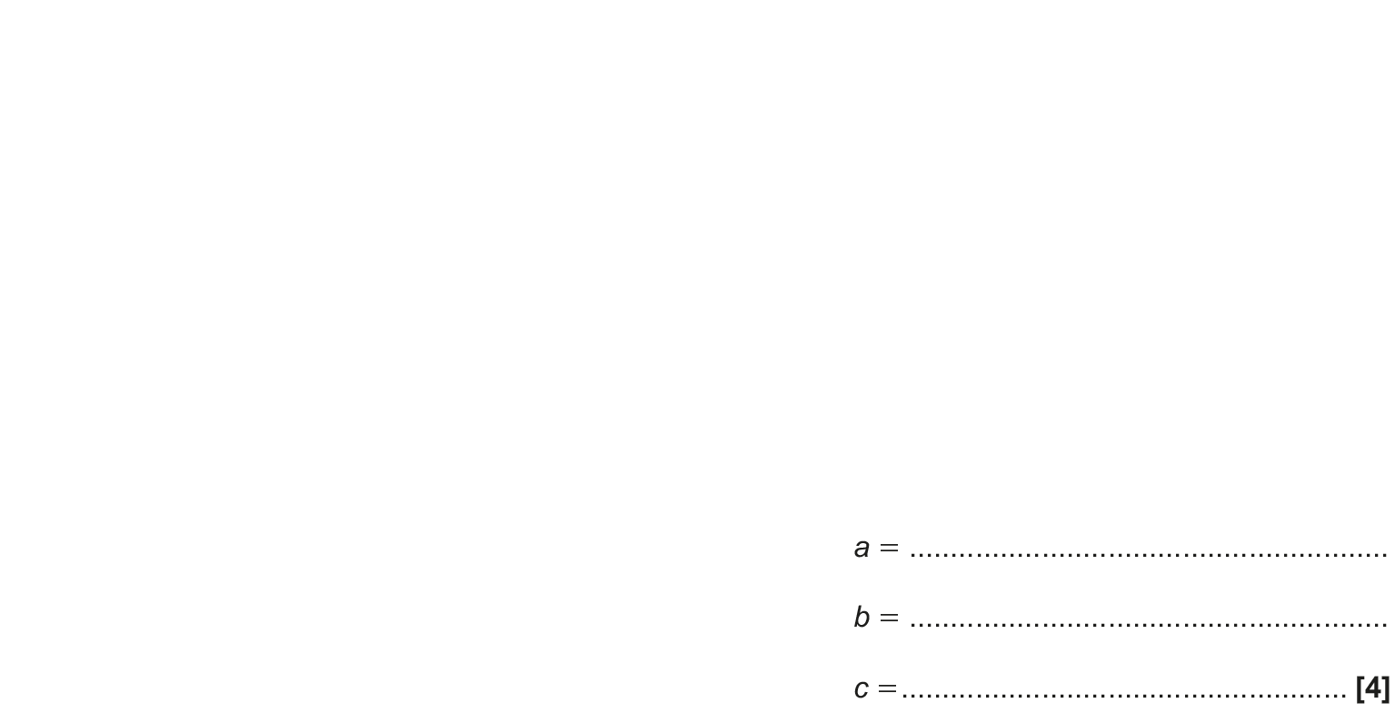
Sequences
Nov 2018 1H Q17

Slide 74
Sequences
Nov 2018 1H Q17
A

Slide 75
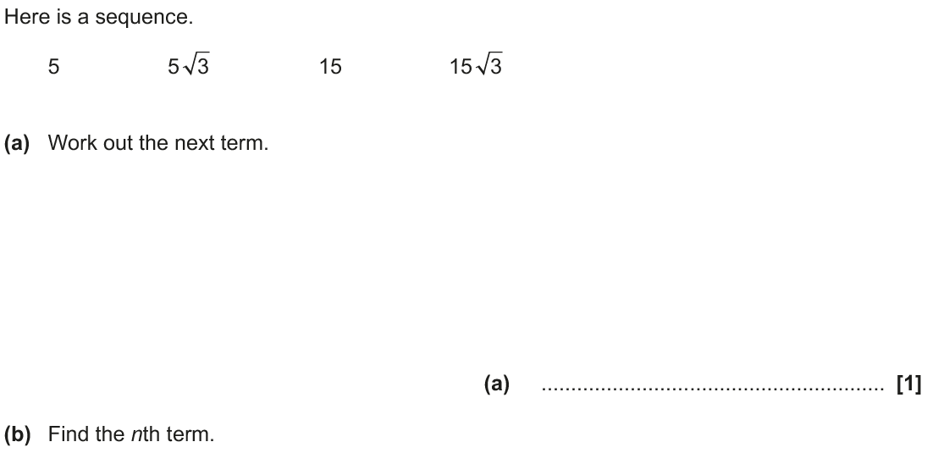
Sequences
Nov 2018 1H Q16

Slide 76
Sequences
Nov 2018 1H Q16
A
B

