Slide 1
Sequences
Sequences
SAM
2H Q3
June 2017 2H Q22
SAM
3H Q3
Nov 2017 2H Q23
SAM
3H Q17
June 2018 3H Q16
Spec 1
2H Q17
June 2019 3H Q16
Spec 1
3H Q22
Quadratic
Geometric

Slide 2
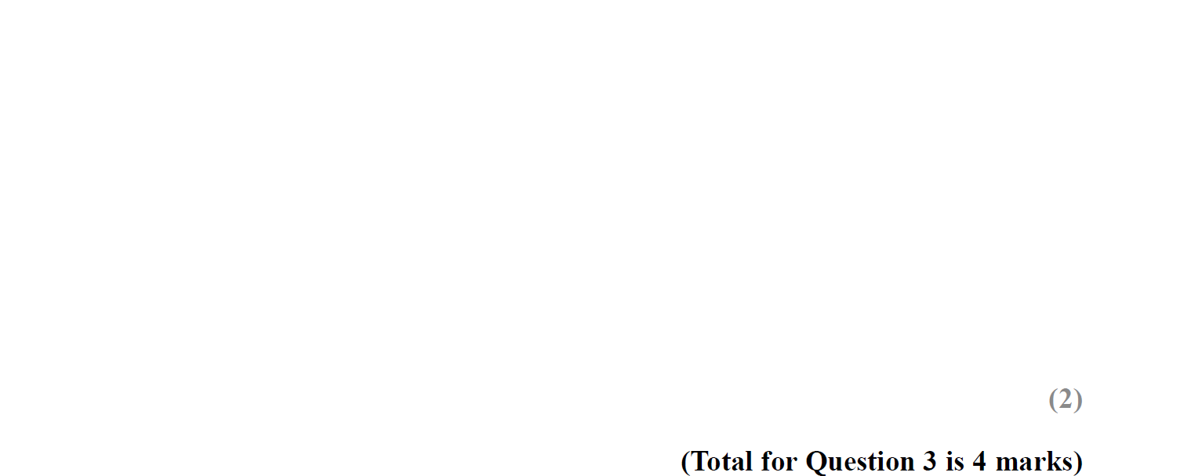
Sequences
SAM 2H Q3

Slide 3
Sequences
SAM 2H Q3
A
B

Slide 4
Sequences
SAM 3H Q3

Slide 5
Sequences
SAM 3H Q3
A
B
C

Slide 6
Sequences
SAM 3H Q17

Slide 7
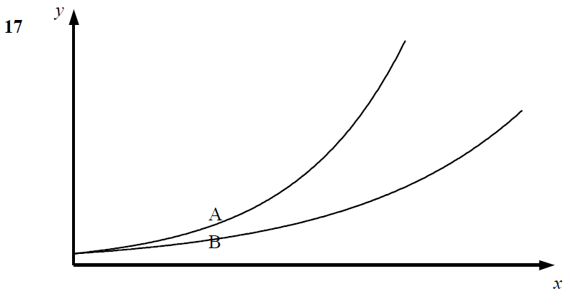
Sequences
SAM 3H Q17
A
B
C

Slide 8
Sequences
Specimen Set 1 2H Q17

Slide 9
Sequences
Specimen Set 1 2H Q17
A

Slide 10
Sequences
Specimen Set 1 3H Q22

Slide 11
Sequences
Specimen Set 1 3H Q22
A

Slide 12
Sequences
June 2017 2H Q22

Slide 13
Sequences
June 2017 2H Q22
A

Slide 14
Sequences
Nov 2017 2H Q23

Slide 15
Sequences
Nov 2017 2H Q23
A
B

Slide 16
Sequences
June 2018 3H Q16

Slide 17
Sequences
June 2018 3H Q16
A
B

Slide 18
Sequences
June 2019 3H Q16

Slide 19
Sequences
June 2019 3H Q16
A
A SF

