Slide 1
Scatter Diagrams & Correlation
Scatter Diagrams & Correlation
Edexcel
SAM
3H Q4
May 2017 1H Q1
AQA
Spec 1
3H Q1
June 2018 3H Q1
OCR
Spec 2
3H Q5
Nov 2018 2H Q2

Slide 2
Scatter Diagrams & Correlation
Scatter Diagrams & Correlation
Edexcel
AQA
SAM
1H Q5
1 Marker
OCR

Slide 3
Scatter Diagrams & Correlation
Scatter Diagrams & Correlation
June 2017
3H Q3
Edexcel
SAM
3H Q6
Nov 2017
1H Q4
AQA
Practice
2H Q7
May 2017
1H Q4
OCR
Nov 2017
3H Q1

Slide 4
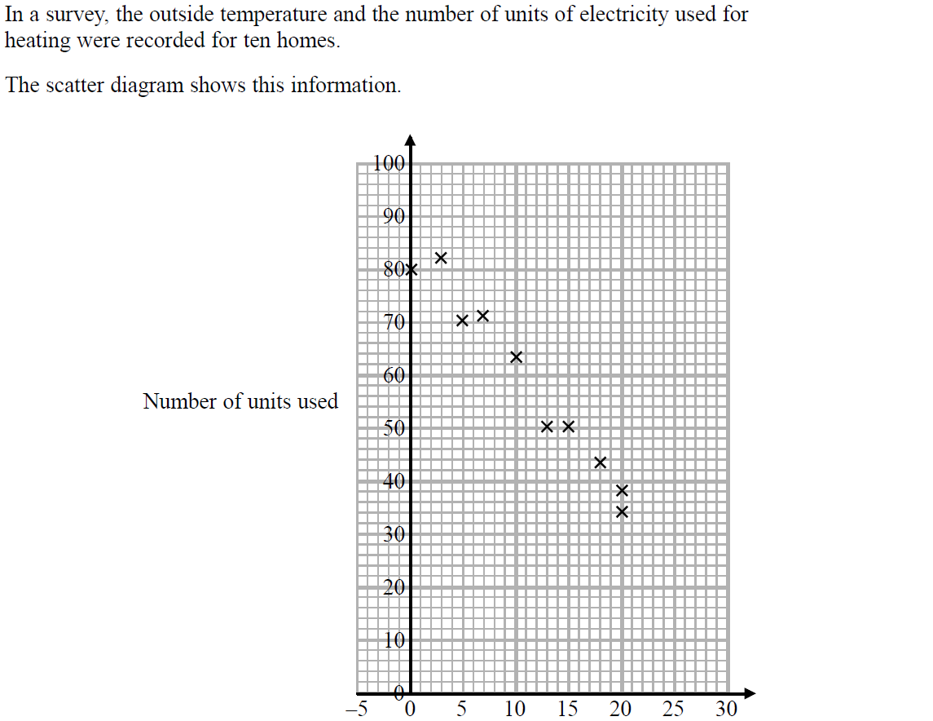
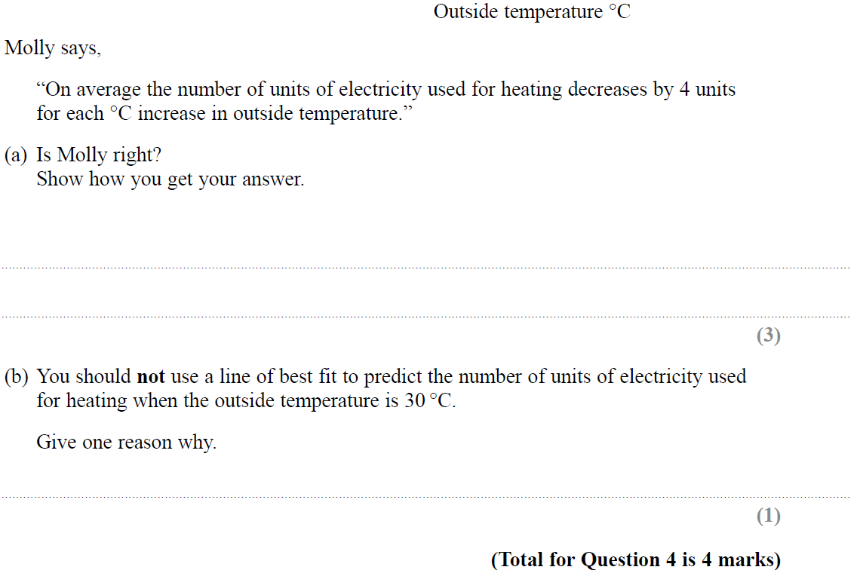
Scatter Diagrams & Correlation
SAM 3H Q4

Slide 5
Scatter Diagrams & Correlation
SAM 3H Q4
A
B

Slide 6
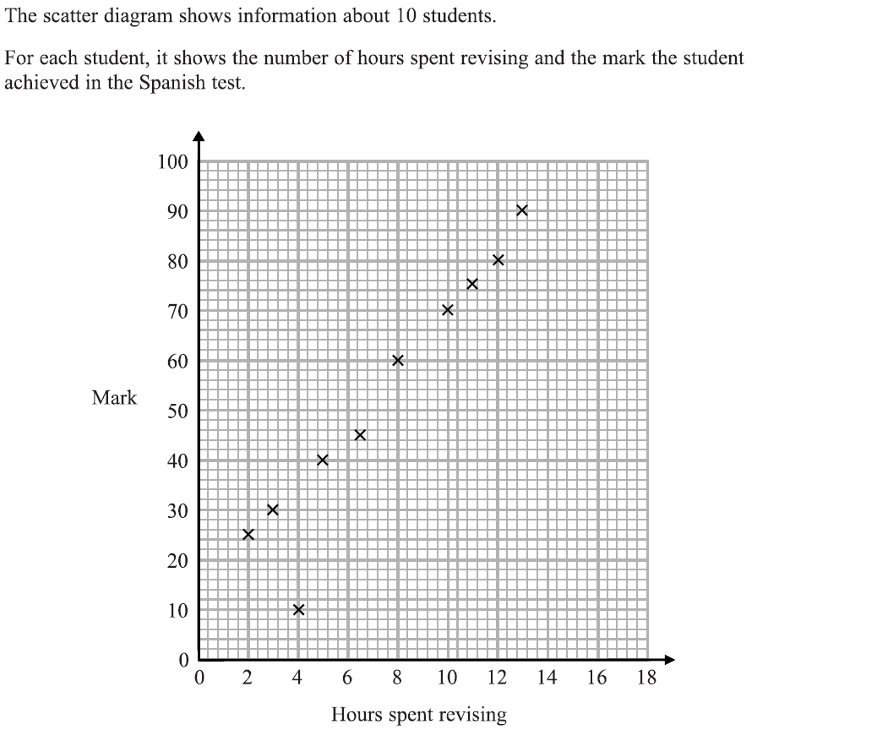
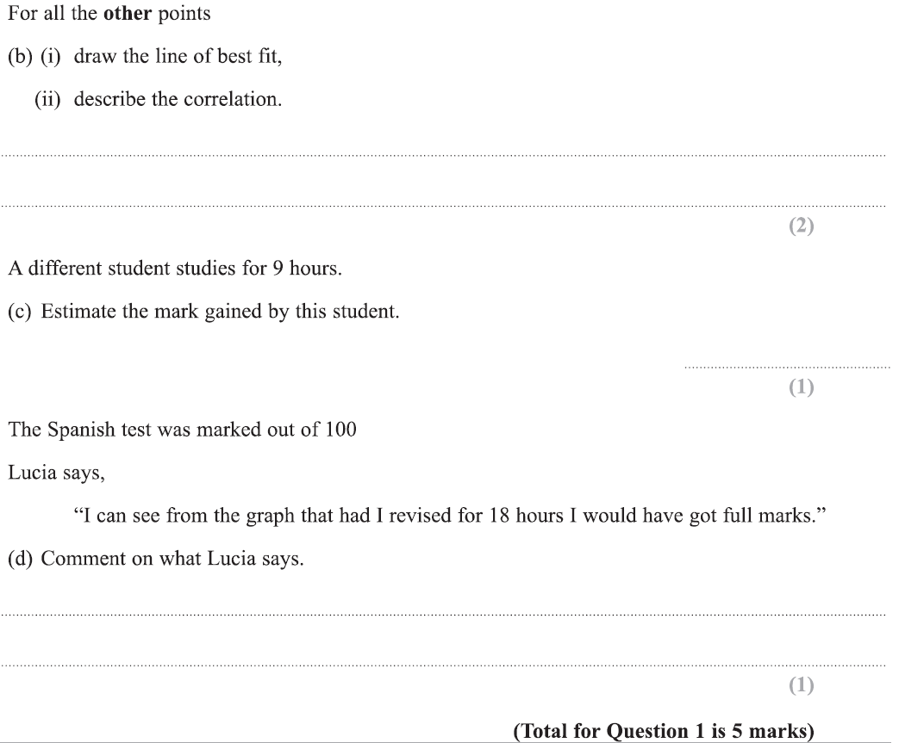
Scatter Diagrams & Correlation
Specimen Set 1 3H Q1

Slide 7
Scatter Diagrams & Correlation
Specimen Set 1 3H Q1
A
B (i)
B (ii)
C
D

Slide 8
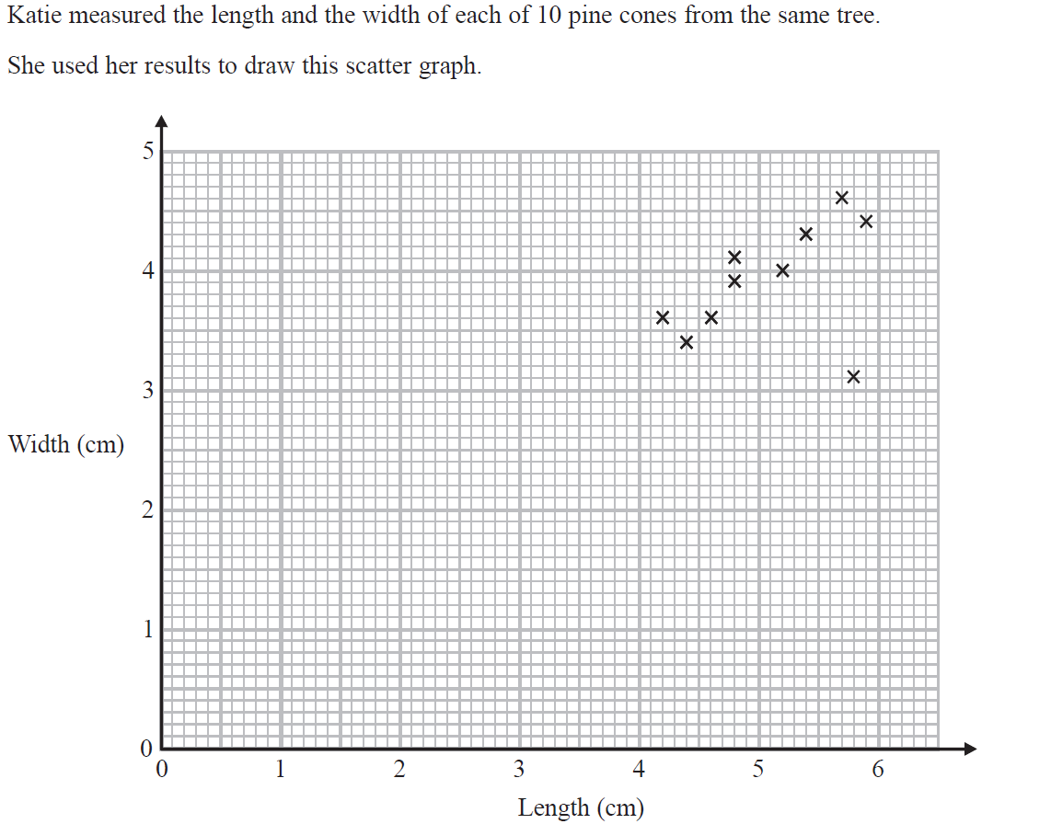
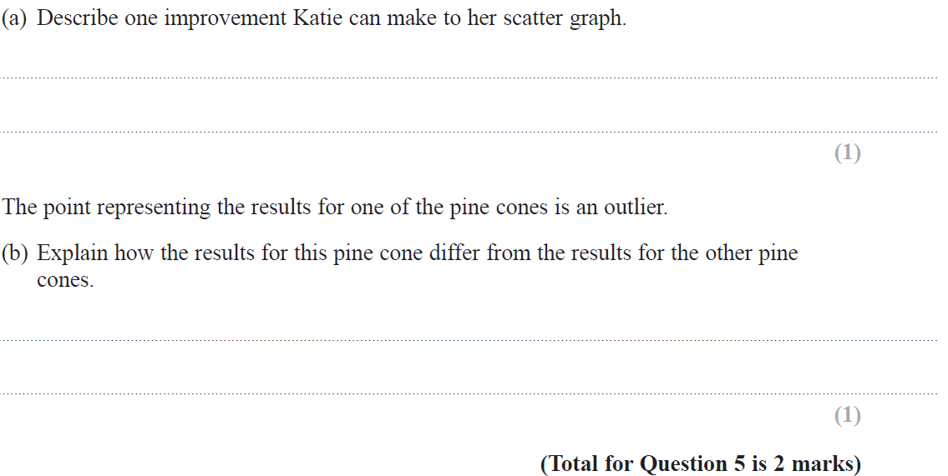
Scatter Diagrams & Correlation
Specimen Set 2 3H Q5

Slide 9
Scatter Diagrams & Correlation
Specimen Set 2 3H Q5
A
B

Slide 10
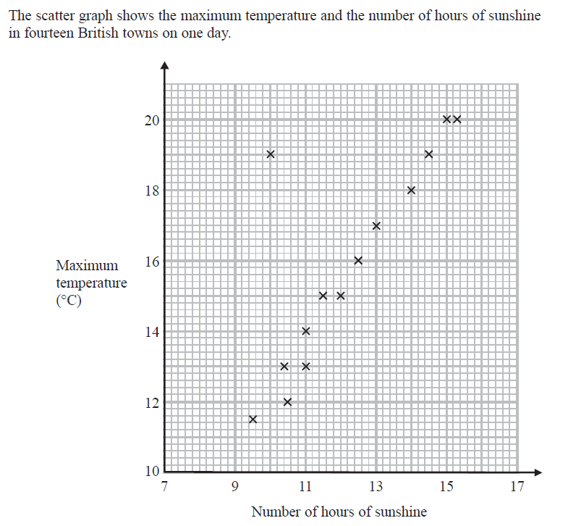
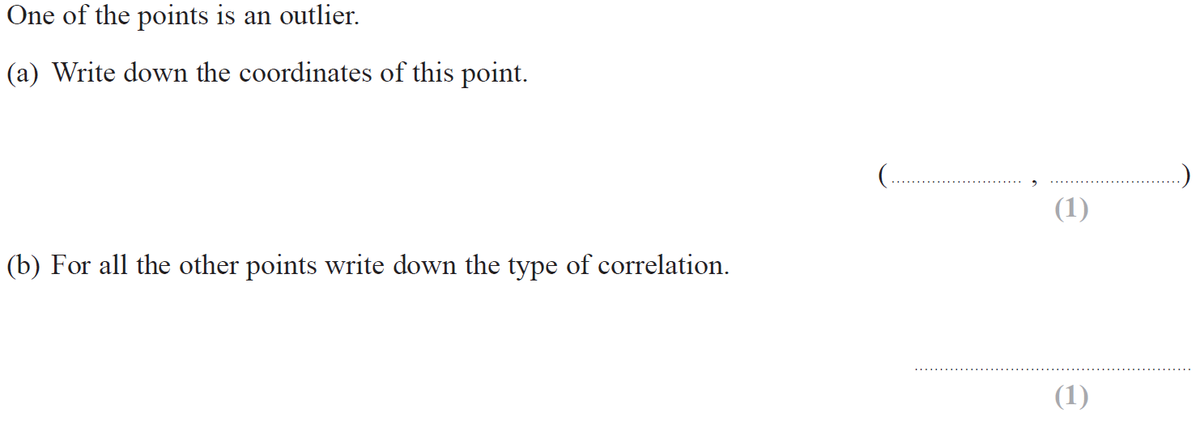
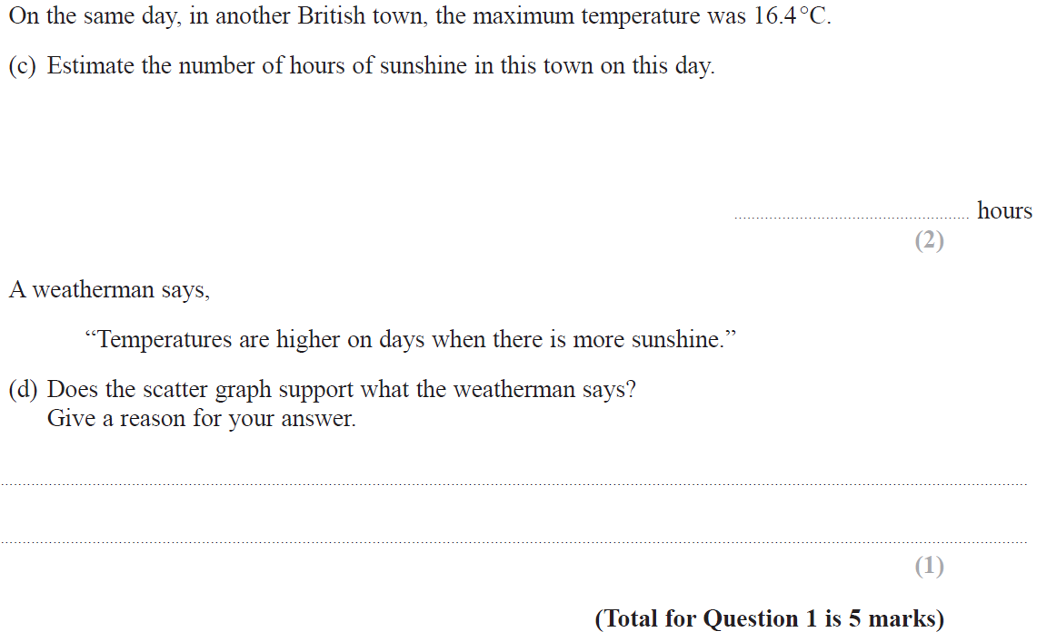
Scatter Diagrams & Correlation
May 2017 1H Q1

Slide 11
Scatter Diagrams & Correlation
May 2017 1H Q1
A
B
C
D

Slide 12
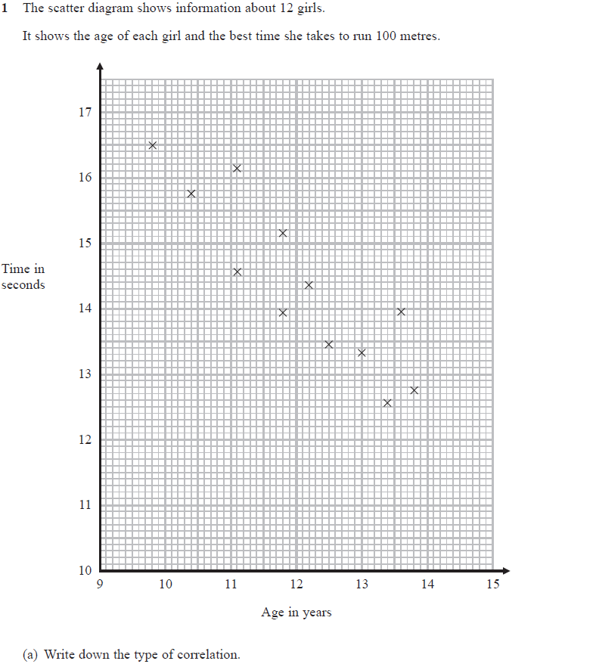
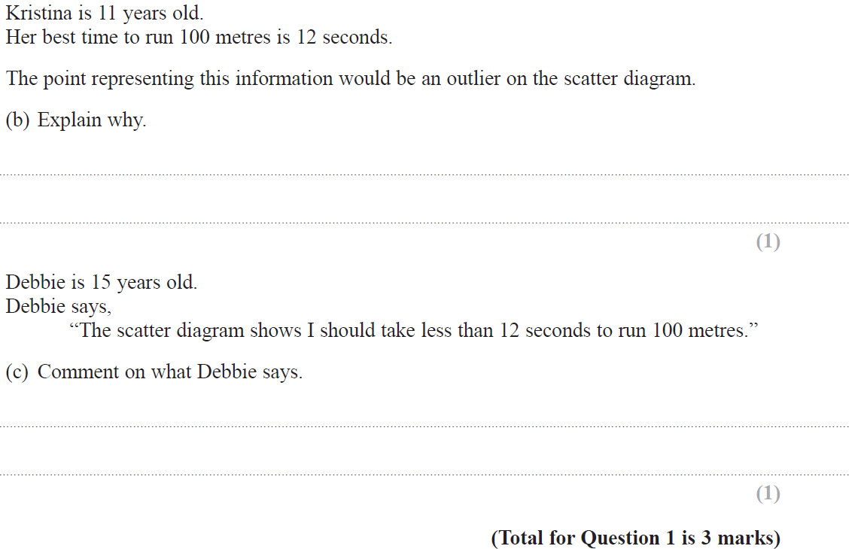
Scatter Diagrams & Correlation
June 2018 3H Q1

Slide 13
Scatter Diagrams & Correlation
June 2018 3H Q1
A
B
C

Slide 14
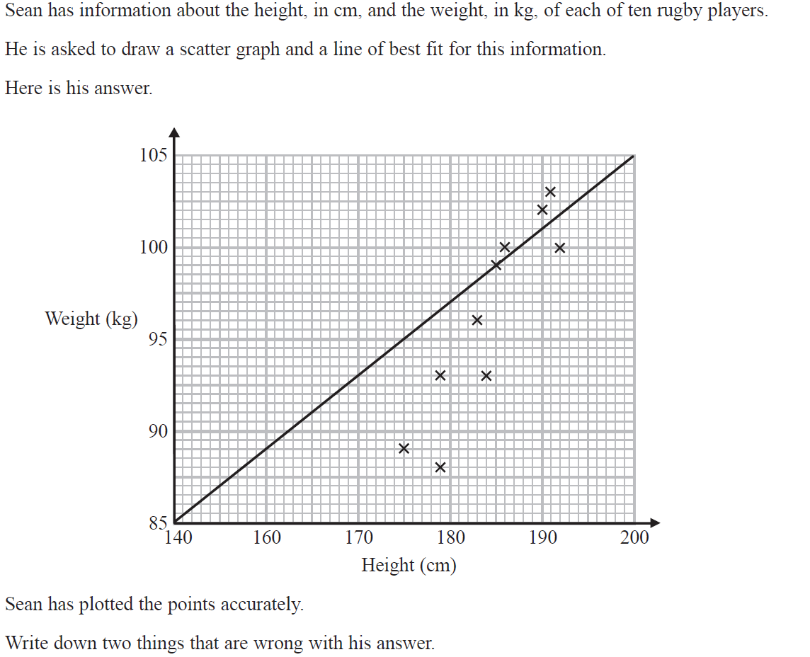
Scatter Diagrams & Correlation
Nov 2018 2H Q2

Slide 15
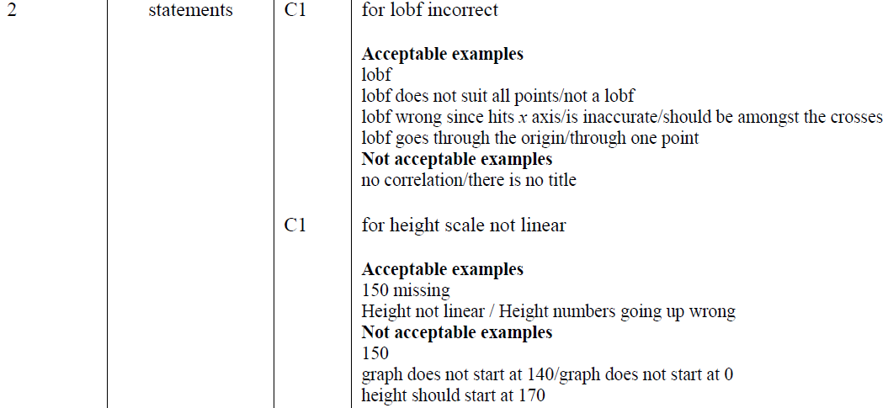
Scatter Diagrams & Correlation
Nov 2018 2H Q2
A

Slide 16
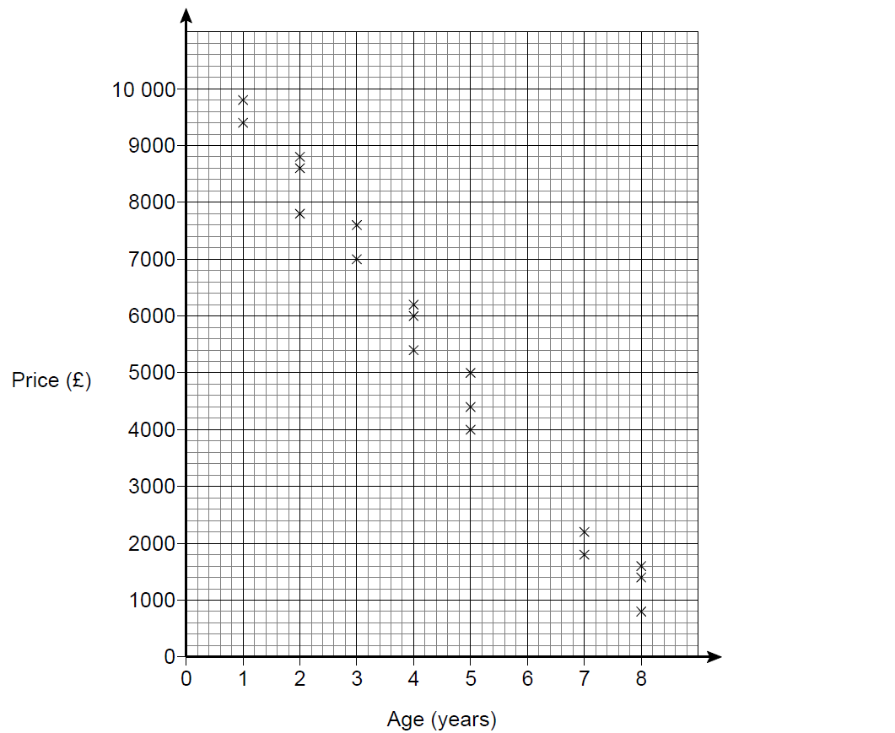
Scatter Diagrams & Correlation
SAM 1H Q5

Slide 17
Scatter Diagrams & Correlation
SAM 1H Q5
A

Slide 18
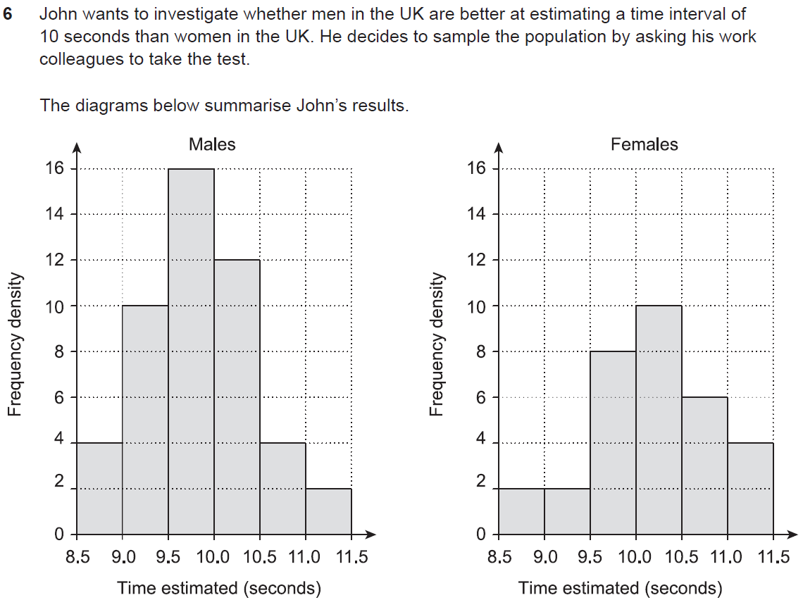
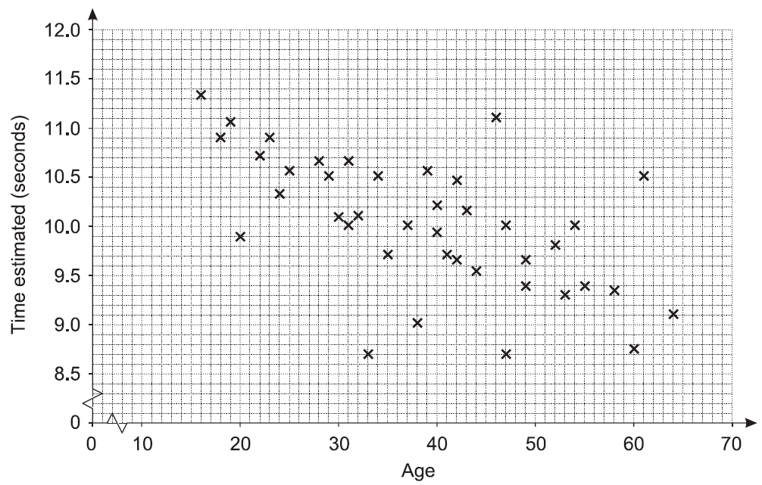
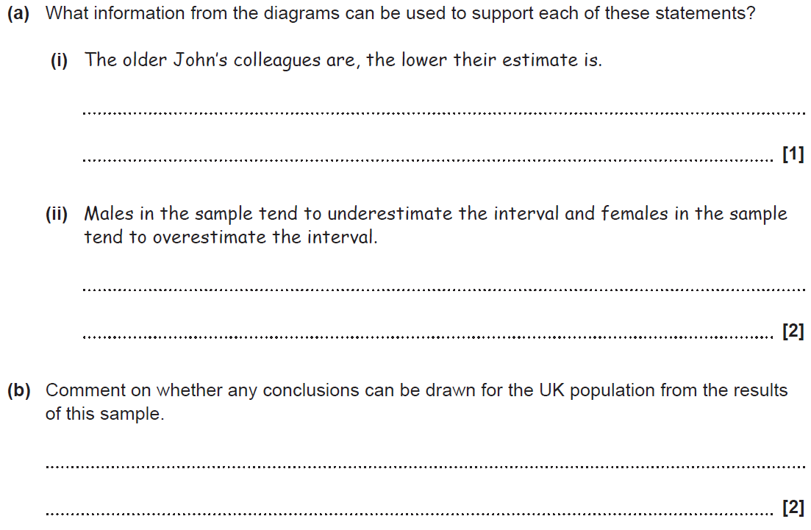
Scatter Diagrams & Correlation
SAM 3H Q6

Slide 19
Scatter Diagrams & Correlation
SAM 3H Q6
A (i)
A (ii)
B

Slide 20
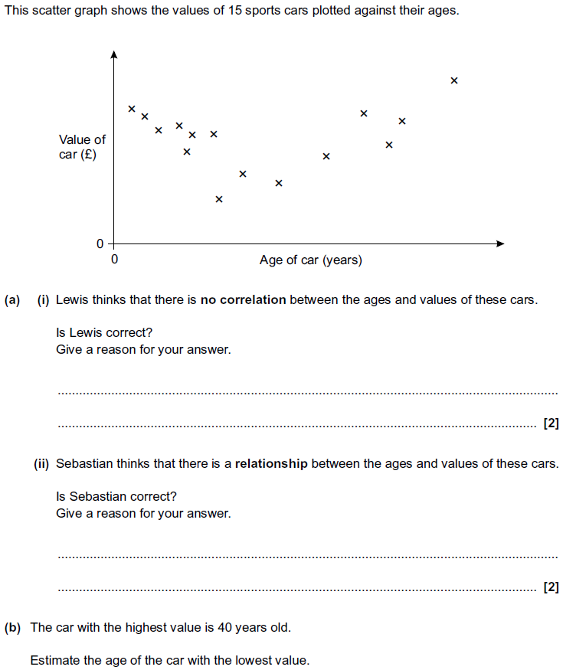
Scatter Diagrams & Correlation
Practice 2H Q7

Slide 21
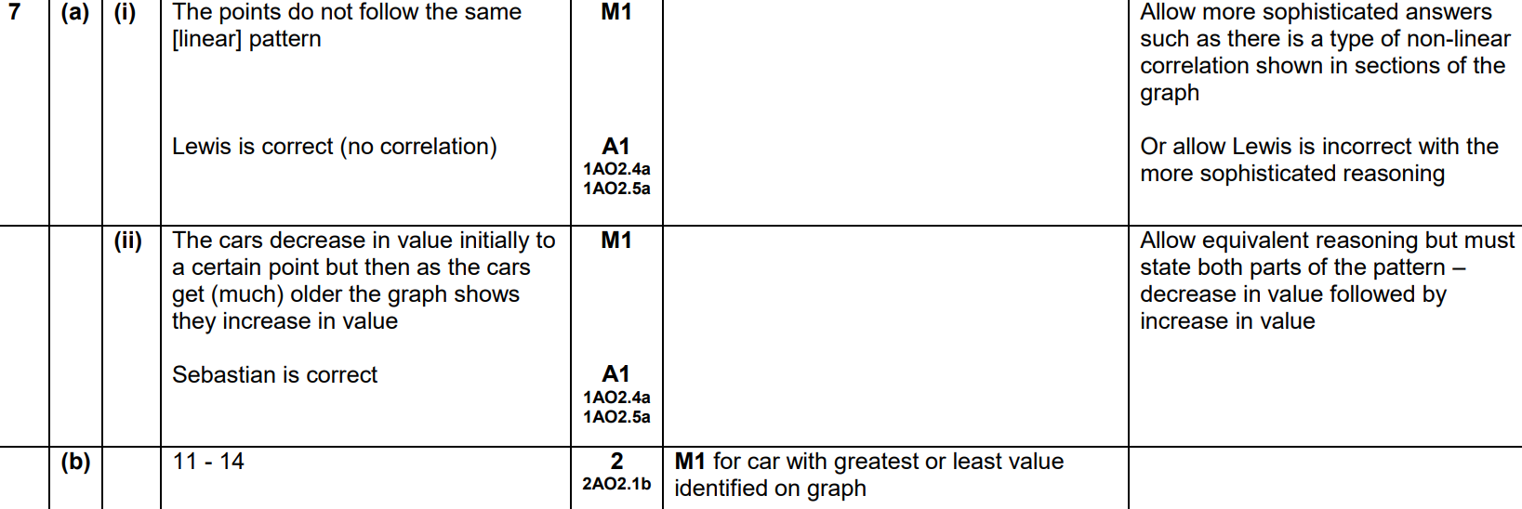
Scatter Diagrams & Correlation
Practice 2H Q7
A (i)
A (ii)
B

Slide 22
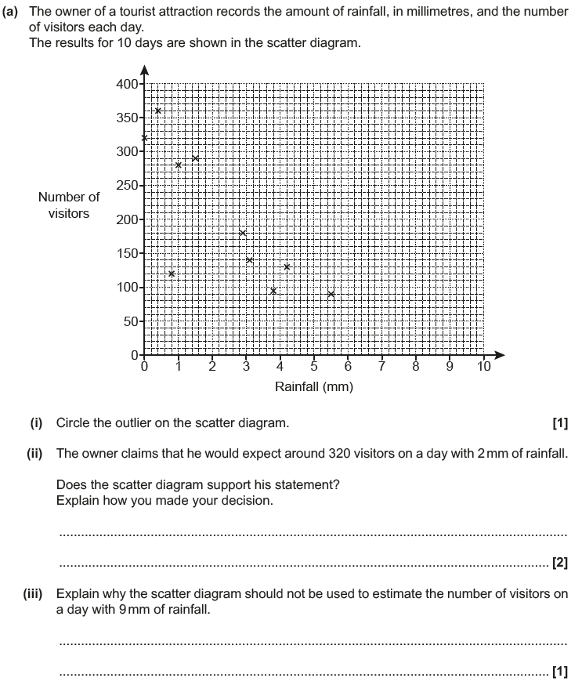
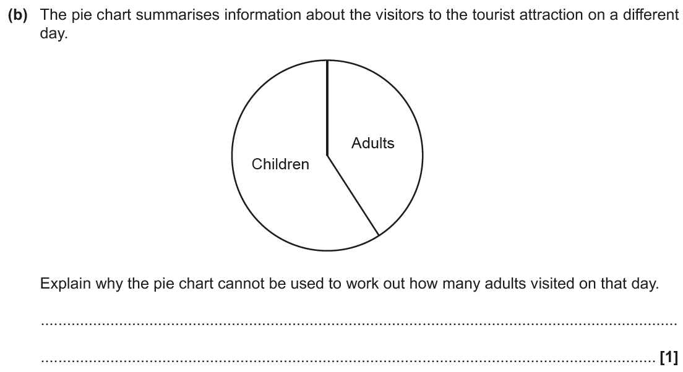
Scatter Diagrams & Correlation
June 2017 3H Q3

Slide 23
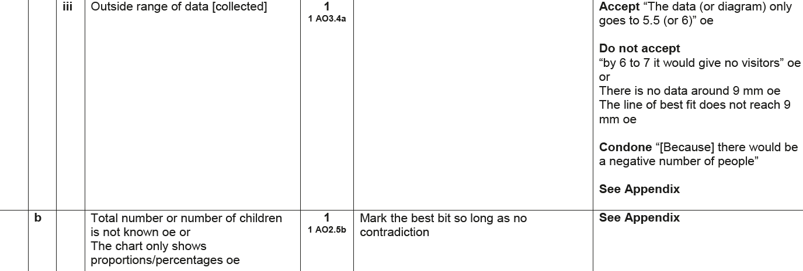
Scatter Diagrams & Correlation
June 2017 3H Q3
A (i)
A (ii)
A (iii)
B

Slide 24
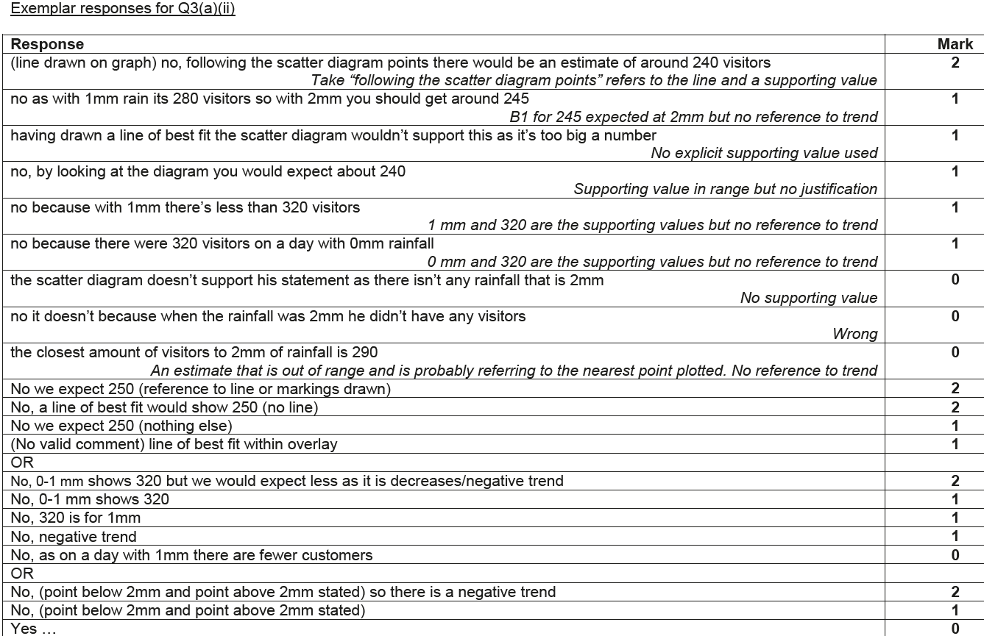
Scatter Diagrams & Correlation
June 2017 3H Q3
A (ii) Exemplar responses

Slide 25
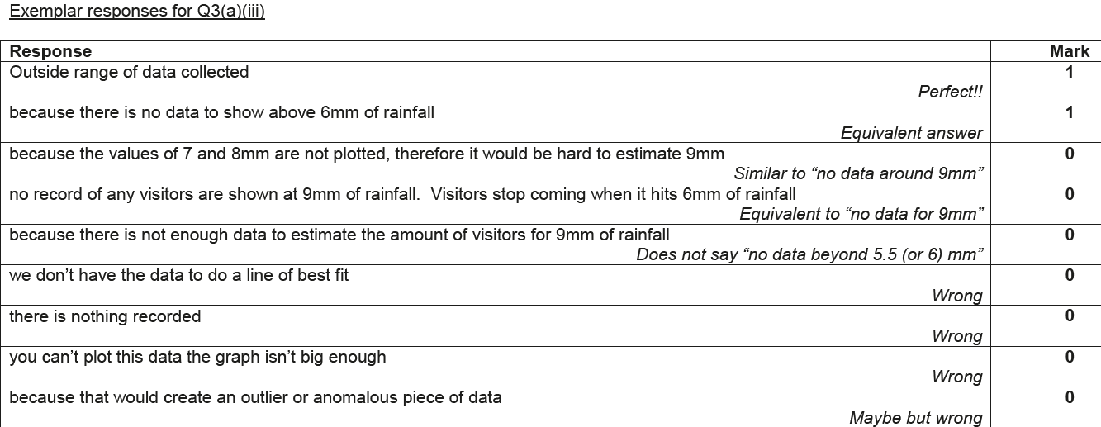
Scatter Diagrams & Correlation
June 2017 3H Q3
A (iii) Exemplar responses

Slide 26
Scatter Diagrams & Correlation
June 2017 3H Q3
B Exemplar responses

Slide 27
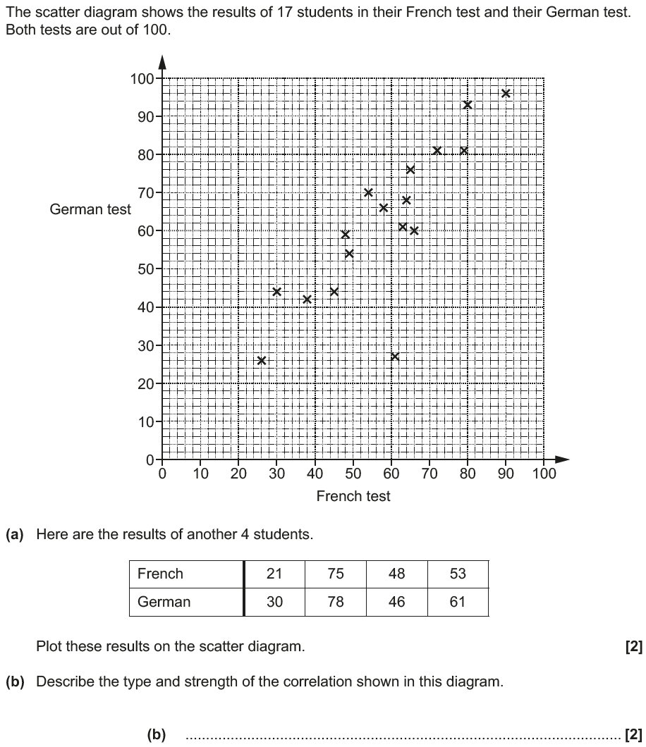
Scatter Diagrams & Correlation
Nov 2017 1H Q4

Slide 28
Scatter Diagrams & Correlation
Nov 2017 1H Q4
A
B
C

Slide 29
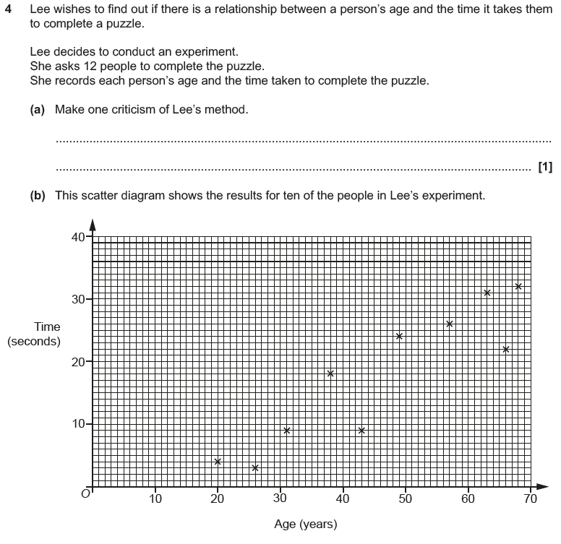
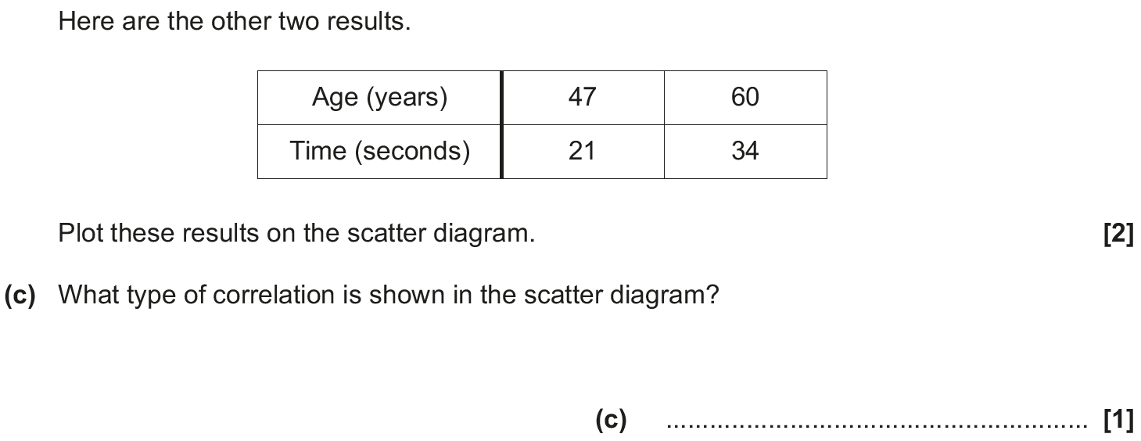
Scatter Diagrams & Correlation
May 2018 1H Q4

Slide 30
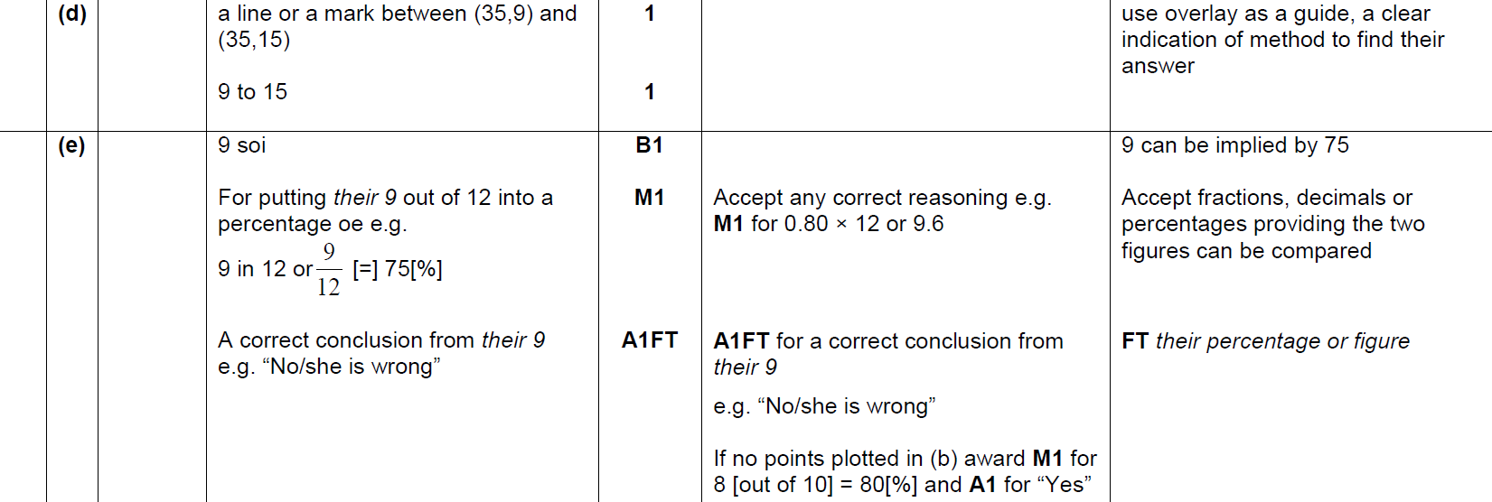
Scatter Diagrams & Correlation
May 2018 1H Q4
A
B
C
D
E

Slide 31
Scatter Diagrams & Correlation
May 2018 1H Q4
A Exemplar responses

Slide 32
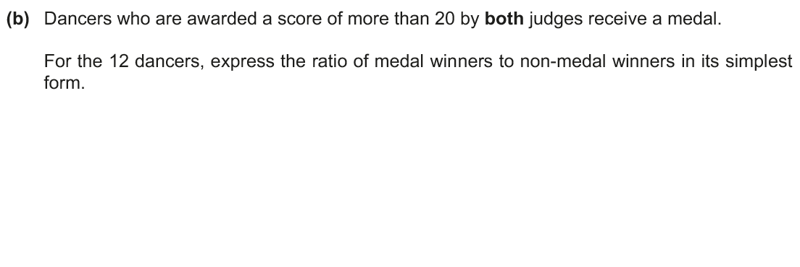
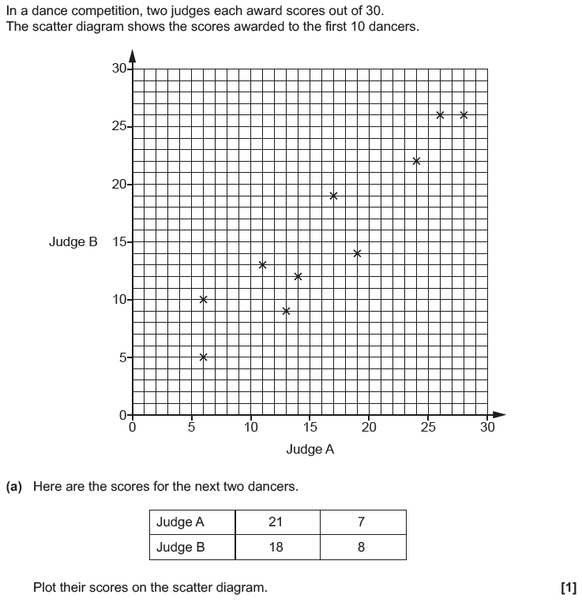
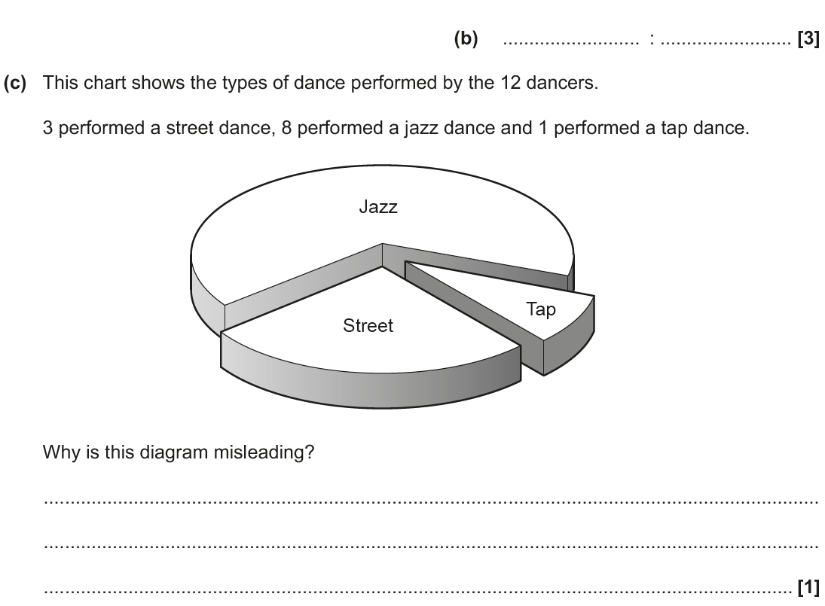
Scatter Diagrams & Correlation
Nov 2018 3H Q1

Slide 33
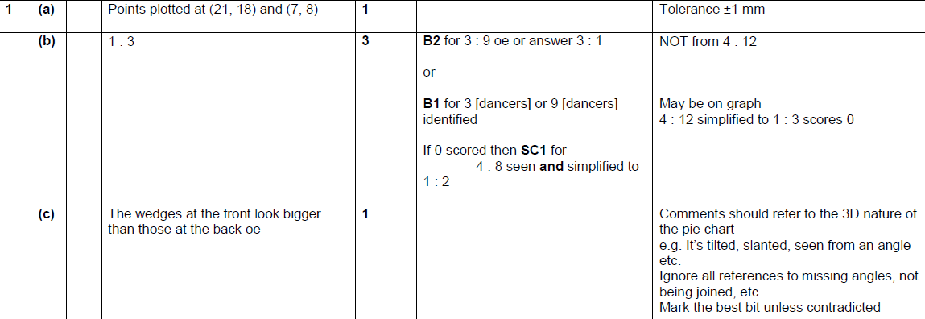
Scatter Diagrams & Correlation
Nov 2018 3H Q1
A
B
C

