Slide 1
Rounding & Estimation
Rounding
SAM
1H Q11
May 2017 1H Q15
Spec 1
1H Q8
Nov 2017 2H Q8
Spec 2
1H Q8
Nov 2018 3H Q1
Spec 2
2H Q16
May 2019 1H Q8

Slide 2
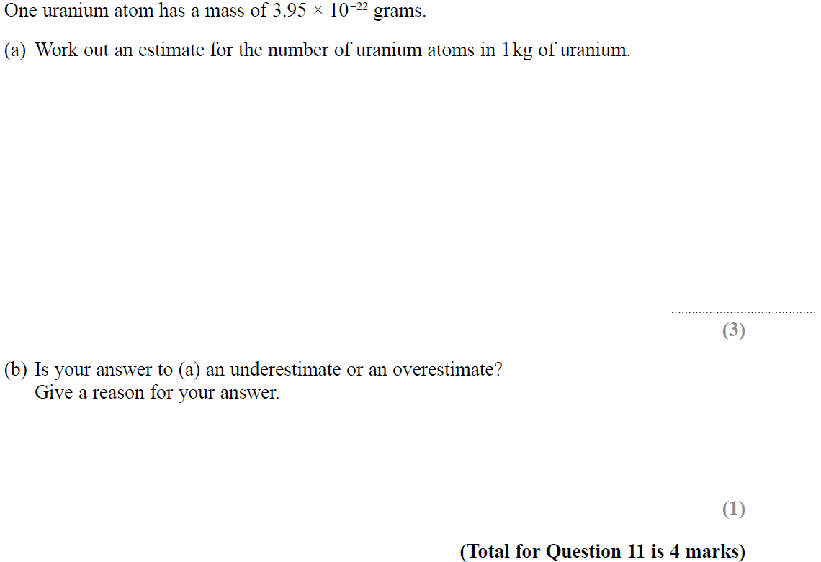
Rounding
SAM 1H Q11

Slide 3
Rounding
SAM 1H Q11
A
B

Slide 4
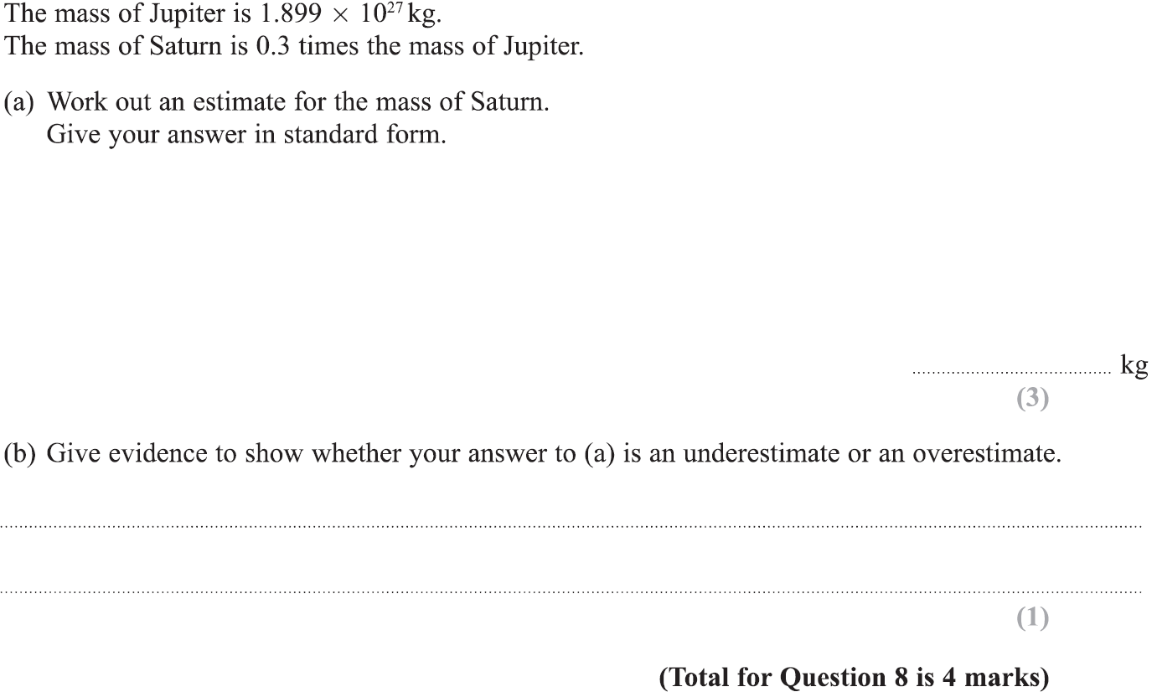
Rounding
Specimen Set 1 1H Q8

Slide 5
Rounding
Specimen Set 1 1H Q8
A
B

Slide 6
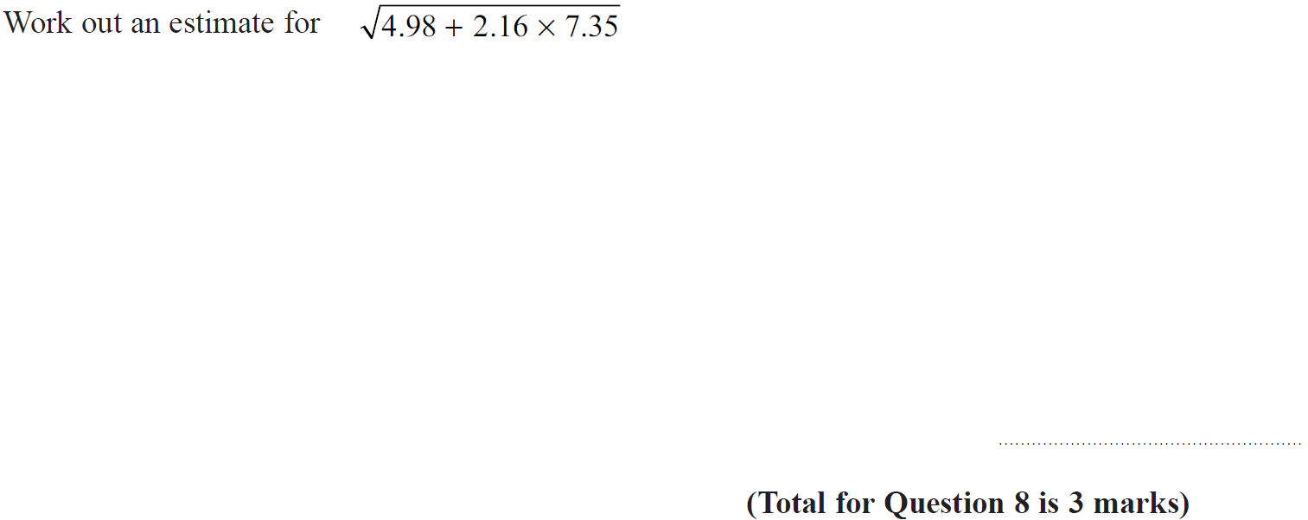
Rounding
Specimen Set 2 1H Q8

Slide 7
Rounding
Specimen Set 2 1H Q8
A

Slide 8
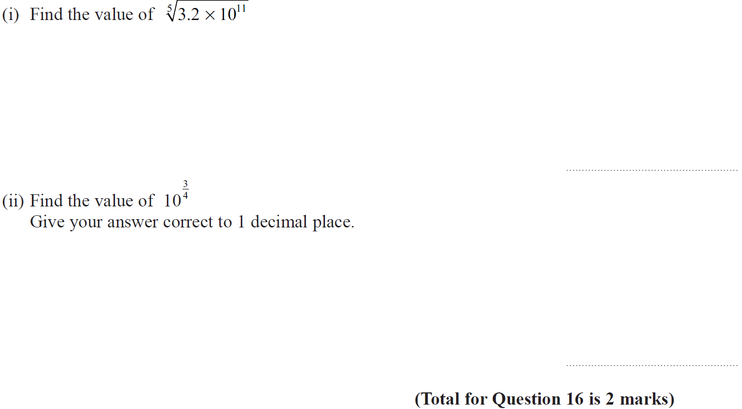
Rounding
Specimen Set 2 2H Q16

Slide 9
Rounding
Specimen Set 2 2H Q16
(i)
(ii)

Slide 10
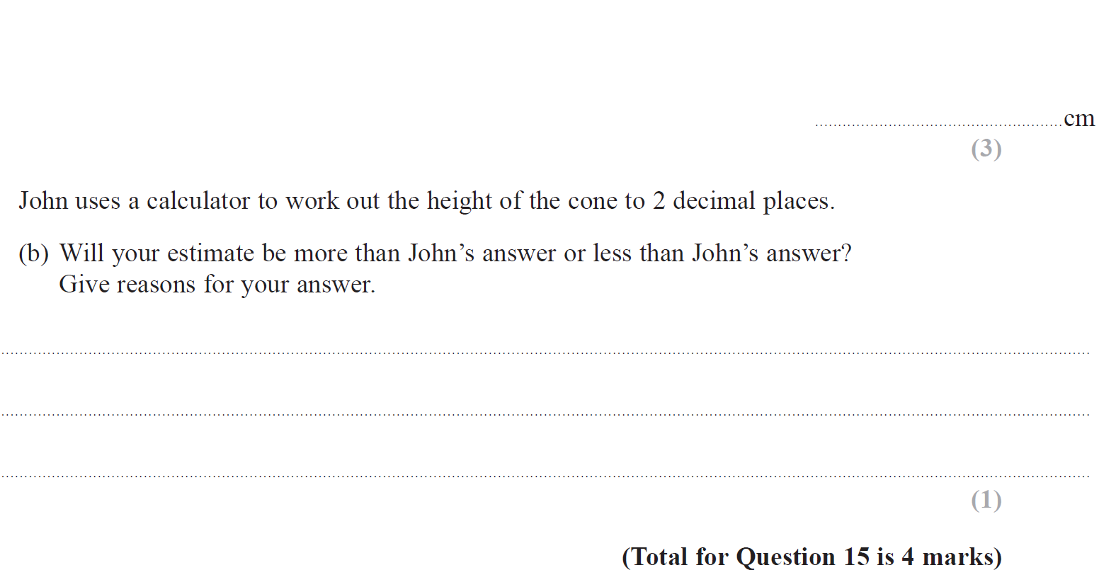
Rounding
May 2017 1H Q15

Slide 11
Rounding
May 2017 1H Q15
A
B

Slide 12
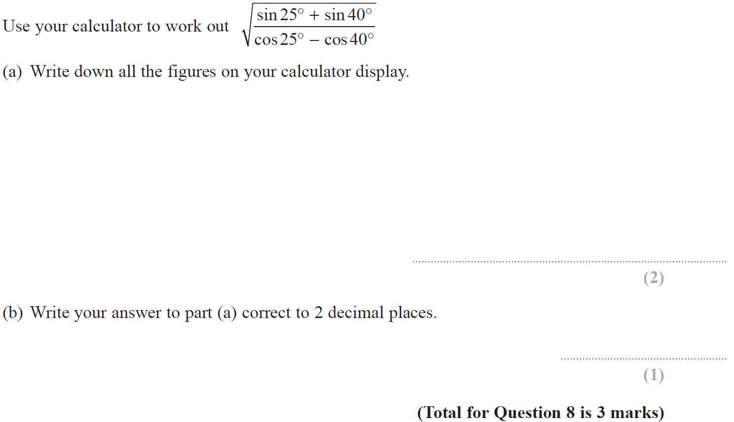
Rounding
Nov 2017 2H Q8

Slide 13
Rounding
Nov 2017 2H Q8
A
B

Slide 14
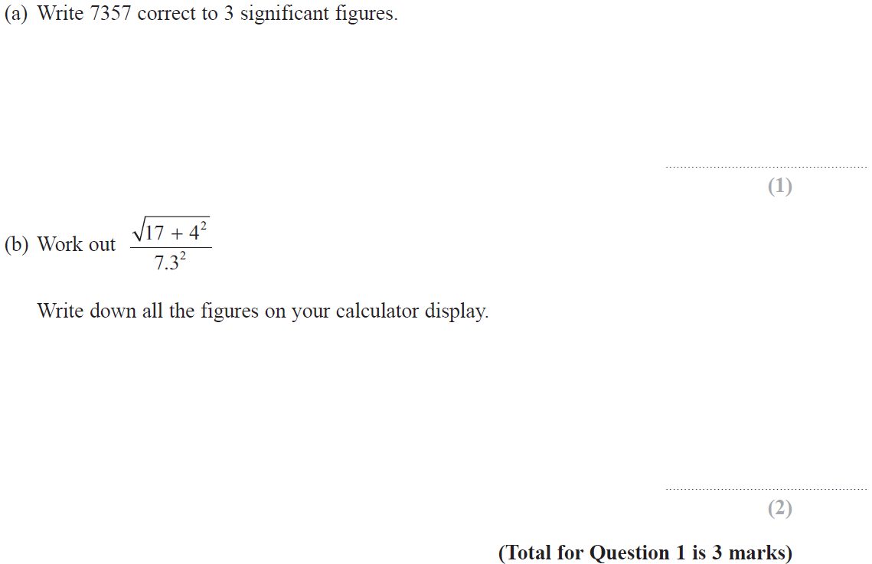
Rounding
Nov 2018 3H Q1

Slide 15
Rounding
Nov 2018 3H Q1
A
B

Slide 16
Rounding
May 2019 1H Q8

Slide 17
Rounding
May 2019 1H Q8
A
B
C
A SF
B SF
C SF

