Slide 1
Rounding & Estimation
Rounding
Nov 2017
1H Q8
Nov 2017
1H Q12
SAM
3H Q8
1 Marker
Nov 2017
1H Q4
Nov 2018
1H Q16

Slide 2
Rounding
SAM 3H Q8

Slide 3
Rounding
SAM 3H Q8
A
B

Slide 4
Rounding
Nov 2017 1H Q8

Slide 5
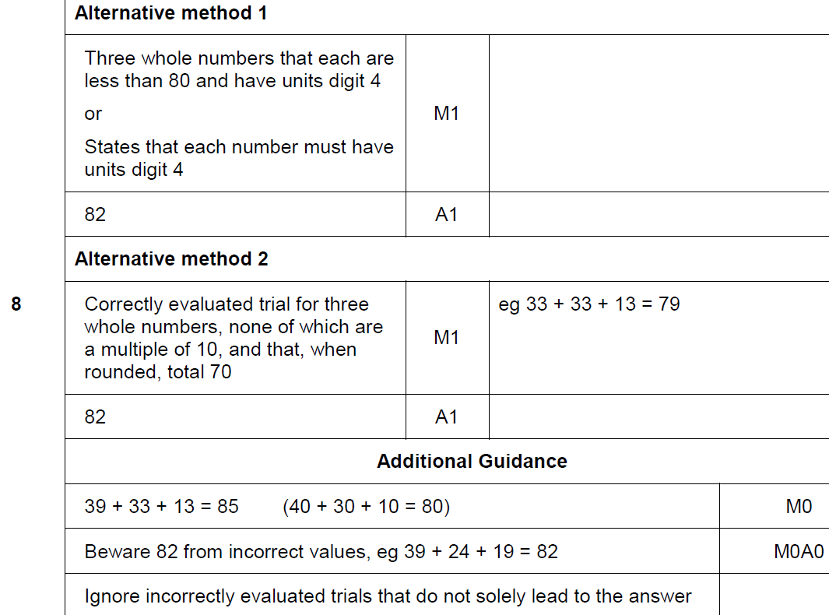
Rounding
Nov 2017 1H Q8
A

Slide 6
Rounding
Nov 2017 1H Q12

Slide 7
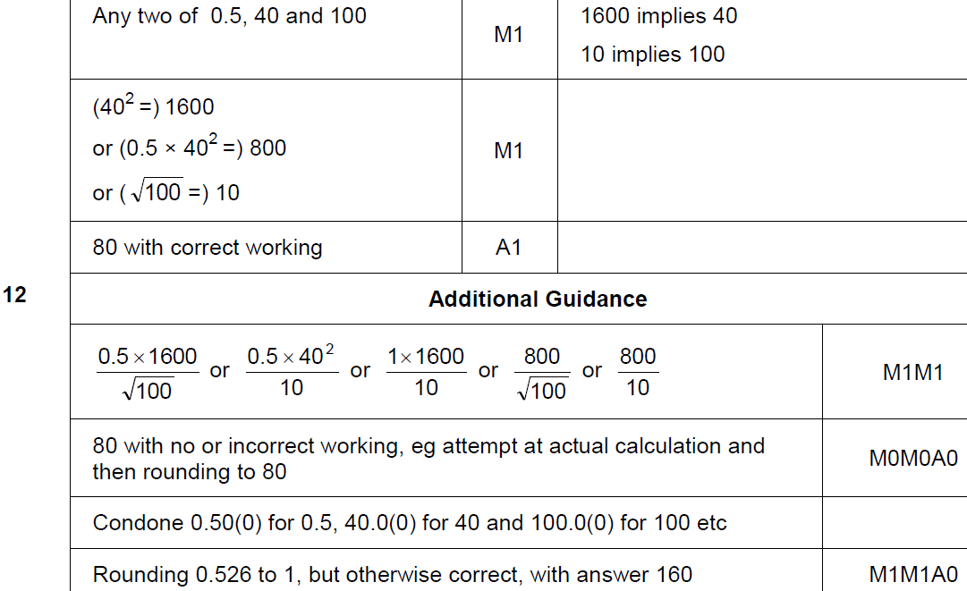
Rounding
Nov 2017 1H Q12
A

Slide 8
Rounding
May 2018 1H Q4

Slide 9
Rounding
May 2018 1H Q4
A

Slide 10
Rounding
Nov 2018 1H Q16

Slide 11
Rounding
Nov 2018 1H Q16
A

